Slide 1
CALICE calorimeters status
I.Laktineh

Slide 2
CALICE
CALICE is a collaboration with 59 institutes and 360 people from 4 continents.
Born in 2005 to provide the needed environment to develop a new generation of calorimeters for the new linear e⁺ e⁻ experiments for which new techniques are proposed: the Particle Flow Algorithms (PFA)
The PFA techniques try to separate the contribution of each of the produced particles in a collision and then use the right sub-detector for the right energy/momentum measurement. This leads to an optimal Jet Energy Resolution(JER)
and an optimal reconstruction of the event.

Slide 3
A view of a simulated event in a high granularity detector

Slide 4
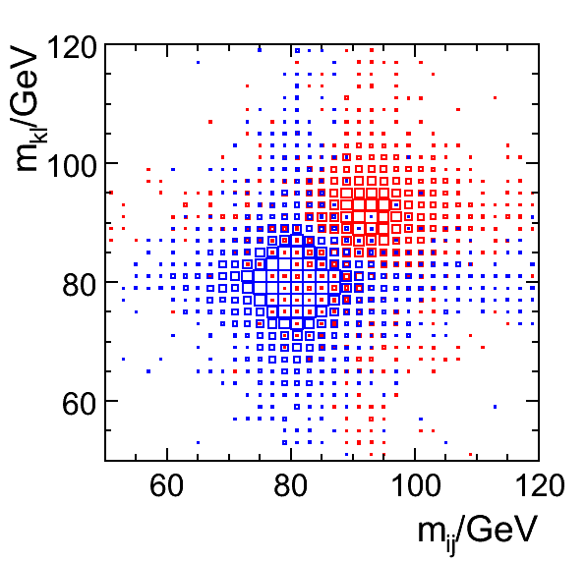
A view of a simulated event in a high granularity detector
30%/√E

Slide 5
Going granular
For PFA the finer the better but:
ECAL: X0, ρM (length scale &Moliere Radius)
in W: X0 ~ 3.5 mm, ρM ~ 9 mm
in Fe: X0 ~ 18 mm, ρM ~ 17 mm
W is better in the ECAL to separate close-by photons and also
longitudinal EM/had contributions.
  HCAL: length scale ~ λI, but EM sub-showers impose requirements not too much different than in ECAL.
in W: λI ~ 11 cm
in Fe λI ~ 17 cm
However, robust mechanical structure and abundant neutrons production favors Iron.

Slide 6
CALICE technologies
Highly granular calorimeters require enormous number of electronic channels
→ Cost and power consumption issues
PFA calorimeters require full active zones
→ Embedded electronics and integration issues
These challenges are addressed by the CALICE groups for the different proposed technologies. Common issues are addressed in the collaboration

Slide 7
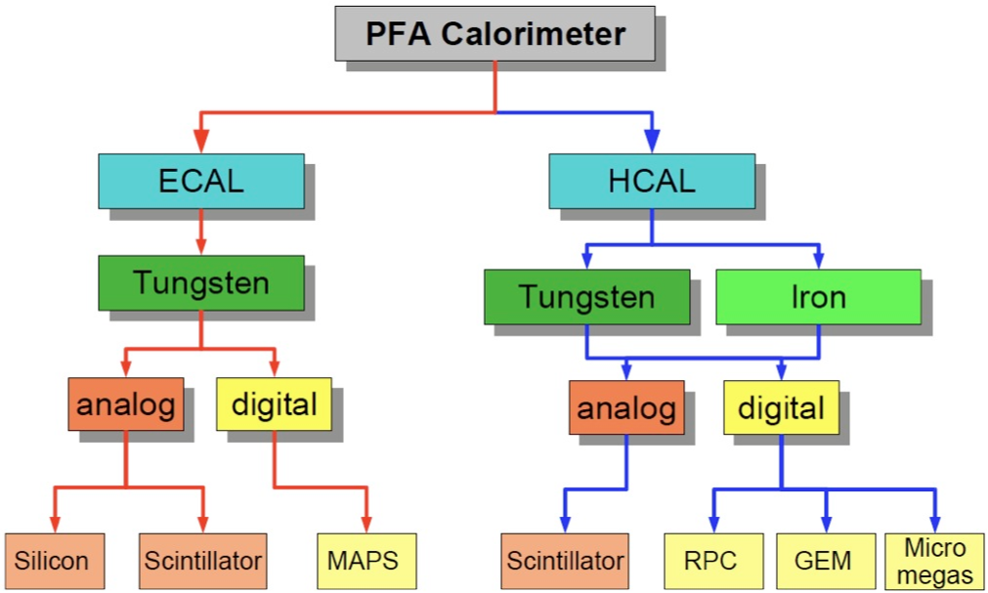
Common readout electronics, common DAQ

Slide 8
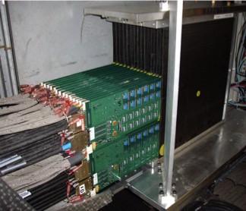
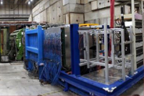
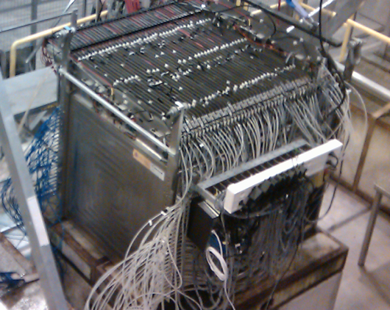
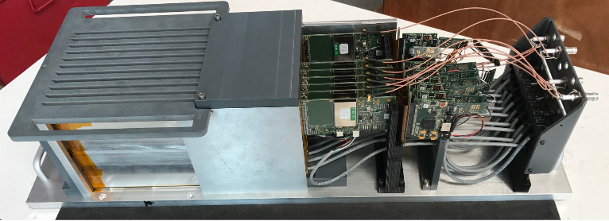
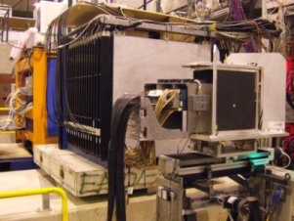
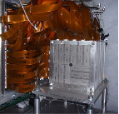
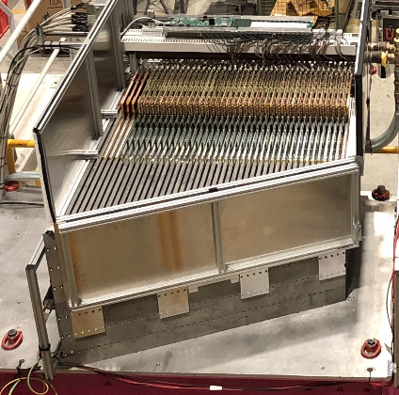
Prototypes
Power-pulsed
Embedded electronics
compactness
Granularity
Proof of principal
Physics
Technological
Si-W
DHCAL
SDHCAL
Si-W →
2005
2007
2010
2011
2012
2018
Scint-W
AHCAL
AHCAL
-SDHCAL was operated also by adding 4 Micromegas layers in 2012
-DHCAL and AHCAL were operated with tungsten absorber in 2012
-Devices to measure timing were added to AHCAL, SDHCAL to study shower time evolution
-FOCAL (MAPS technology) was tested in 2016

Slide 9
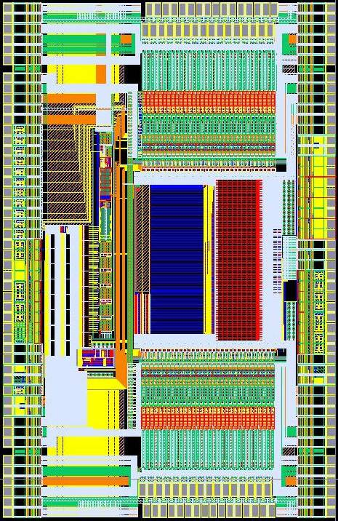
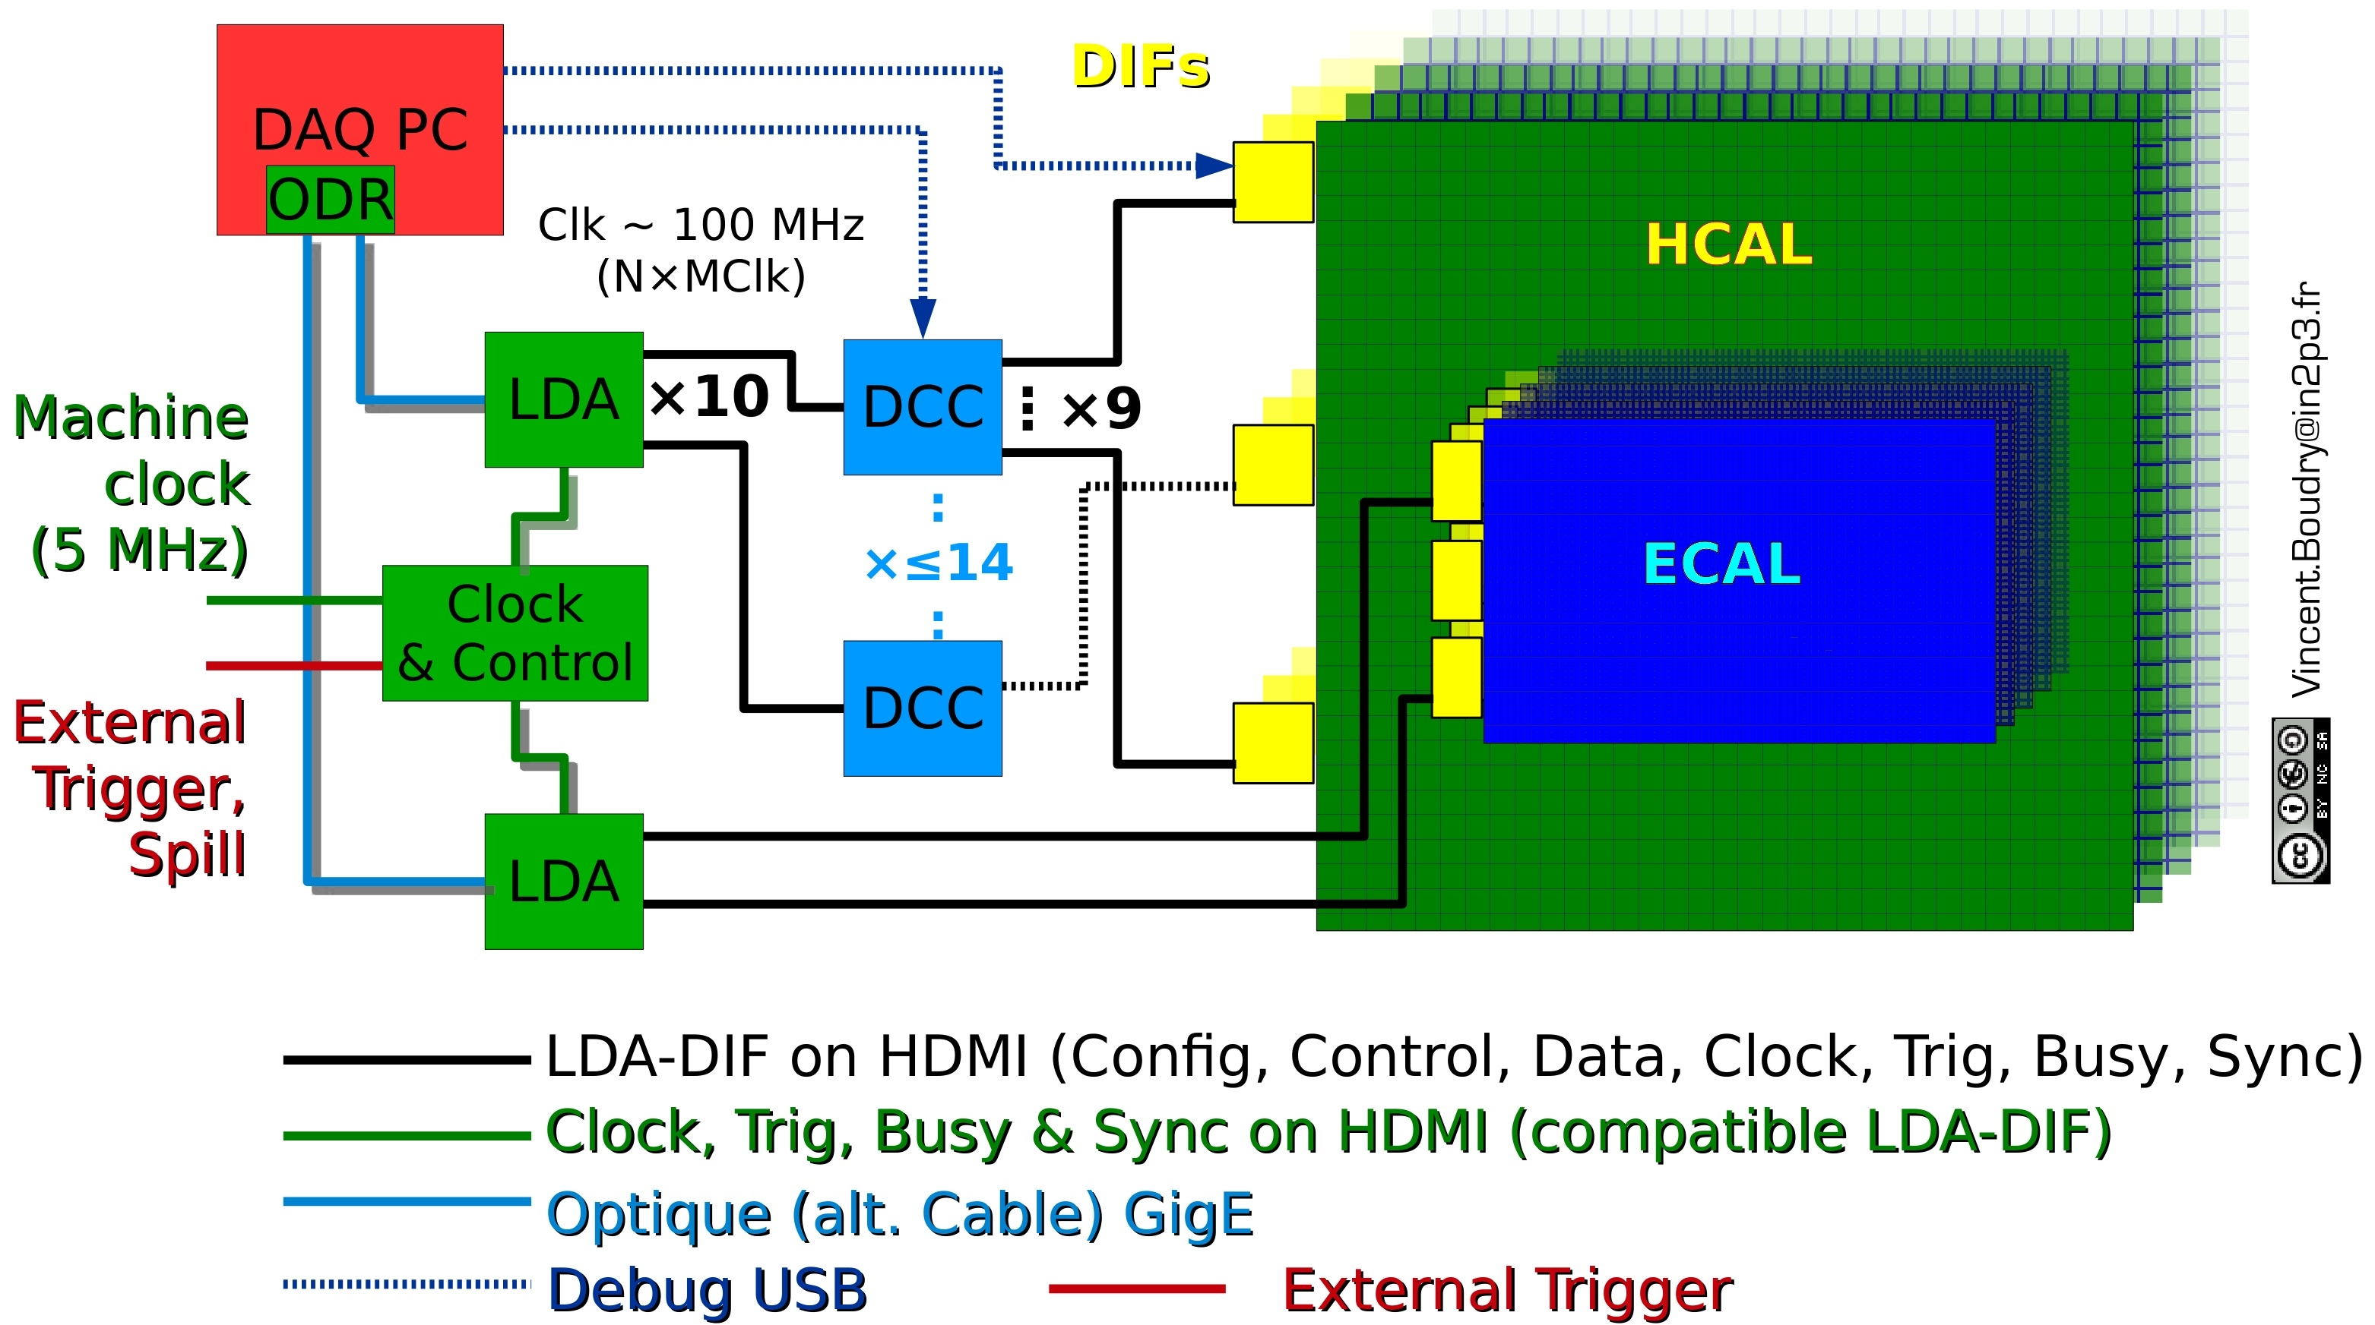
Most of the readout electronics and the DAQ system were developed in common within CALICE: first, second and third ROC generations.
SKIROC
(SiW)
SPIROC
(AHCAL-Scint-W)
DCAL
HARDROC

Slide 10
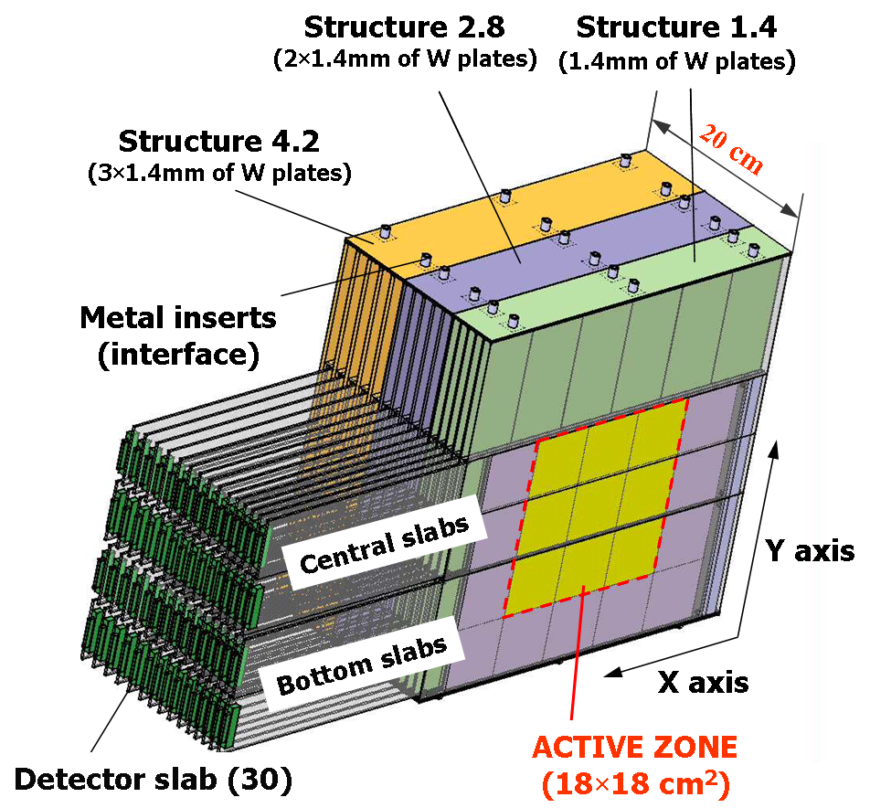
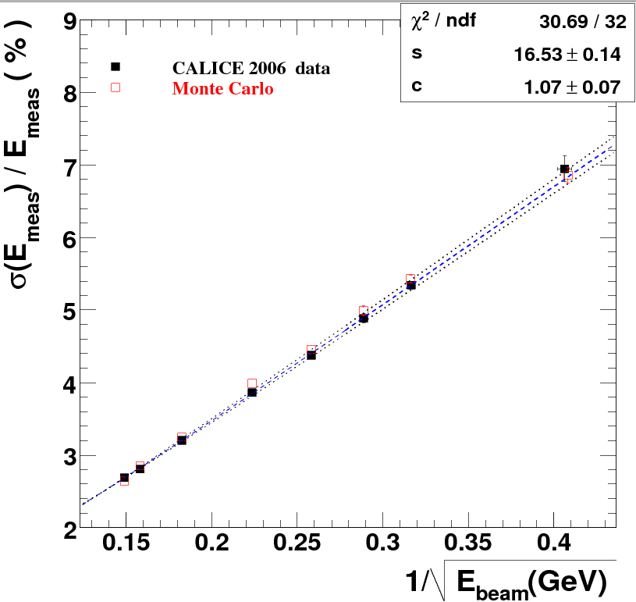
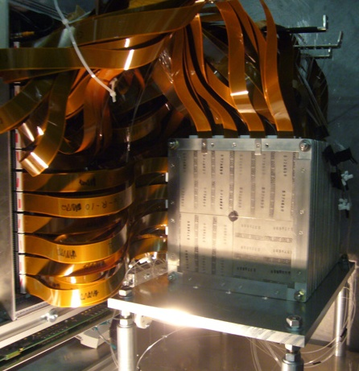
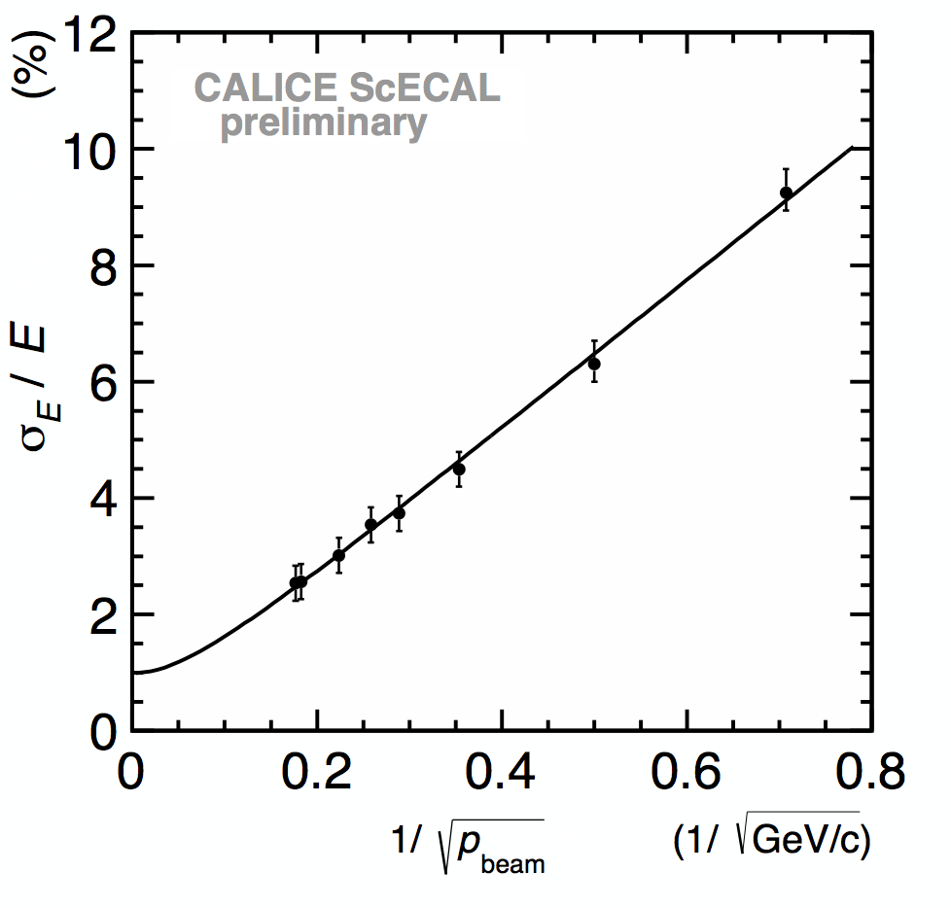
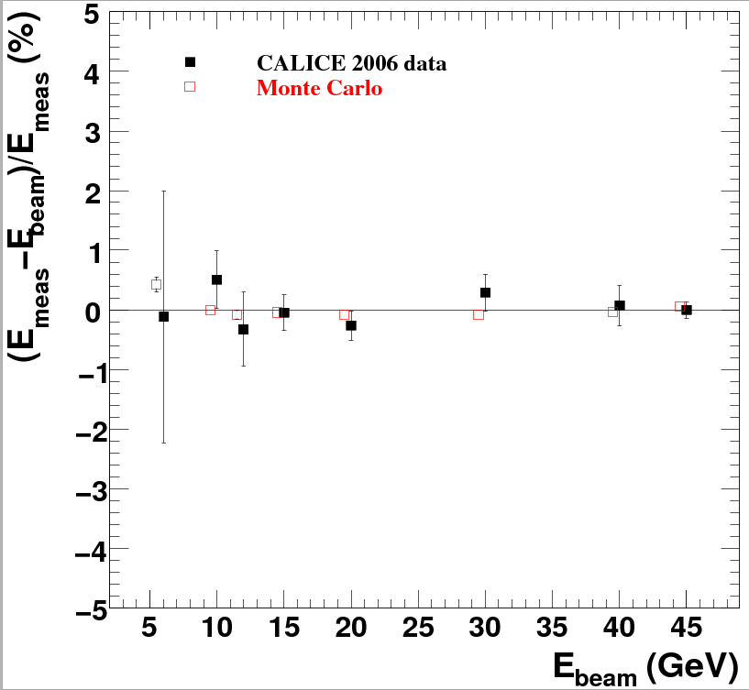
SiW ECAL
30 layer (24X₀) silicon-tungsten physics prototype
(1x1 cm² cell size) with a deported electronics
was built and successfully tested.
Energy resolution =
16.5/sqrt(E)+1.1%
Linearity <1%
Scint-W ECAL
30 layers of tungsten (24X₀) interleaved with
of 5x45 mm² scintillator strip with alternating
Direction layers (X&Y) → equivalent of 5x5 mm²
(SSA) read out by SiPM. A physics prototype with
a deported electronics was built and successfully
tested
Energy resolution
12.8%/√E ⊕ 1.0%
Linearity <1.5%
electron data (2006)
MOKKA (geant4) simulation
electron data (2006)
MOKKA (geant4) simulation
non-linearity<1%
non-linearity<1%
Ebeam
Ebeam

Slide 11
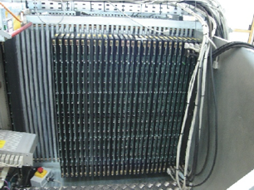
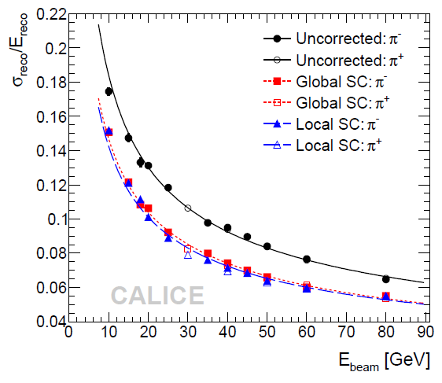
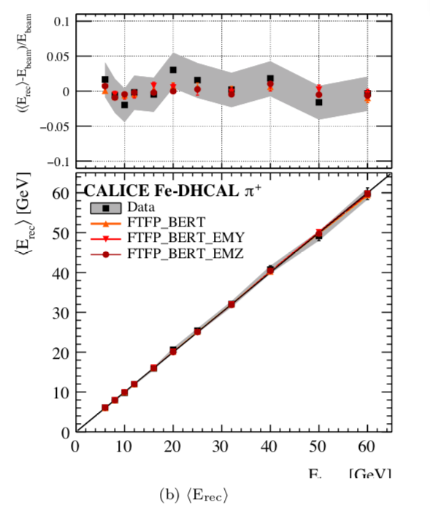
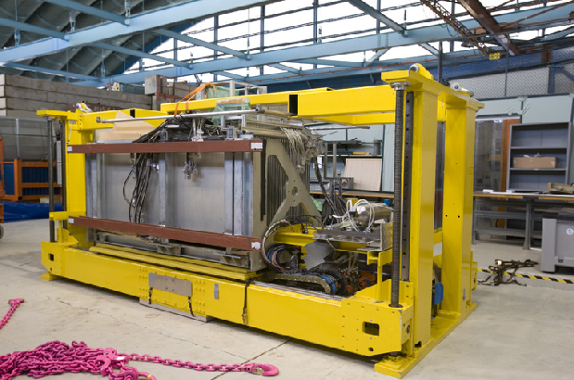
AHCAL
48 layers of 2 cm stainless steel interleaved with
planes made of 3x3 cm² tiles, read out directly
by SiPM and embedded electronics.
A physical prototype of 38 layers of 1 m²,
totalizing (5.3 λ_{I}) accompanied by a tail catcher
(6 λ_{I}) with deported electronics was built and
Successfully tested.
SC –based energy reconstruction improves on the resolution
DHCAL
A prototype of 50 layers each made of 3 RPC
covering 1 m² and read out by 1 cm² pads
With embedded electronics was successfully
tested.
electron data (2006)
MOKKA (geant4) simulation
electron data (2006)
MOKKA (geant4) simulation
non-linearity<1%
non-linearity<1%
Ebeam
Ebeam

Slide 12
Technological prototypes

Slide 13
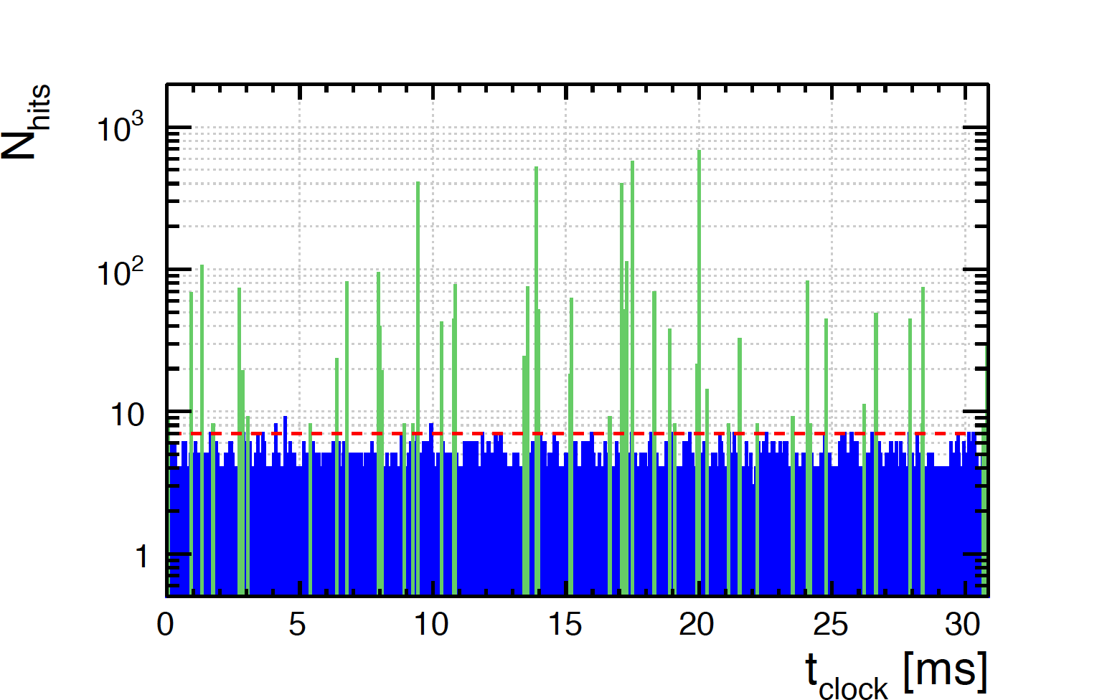
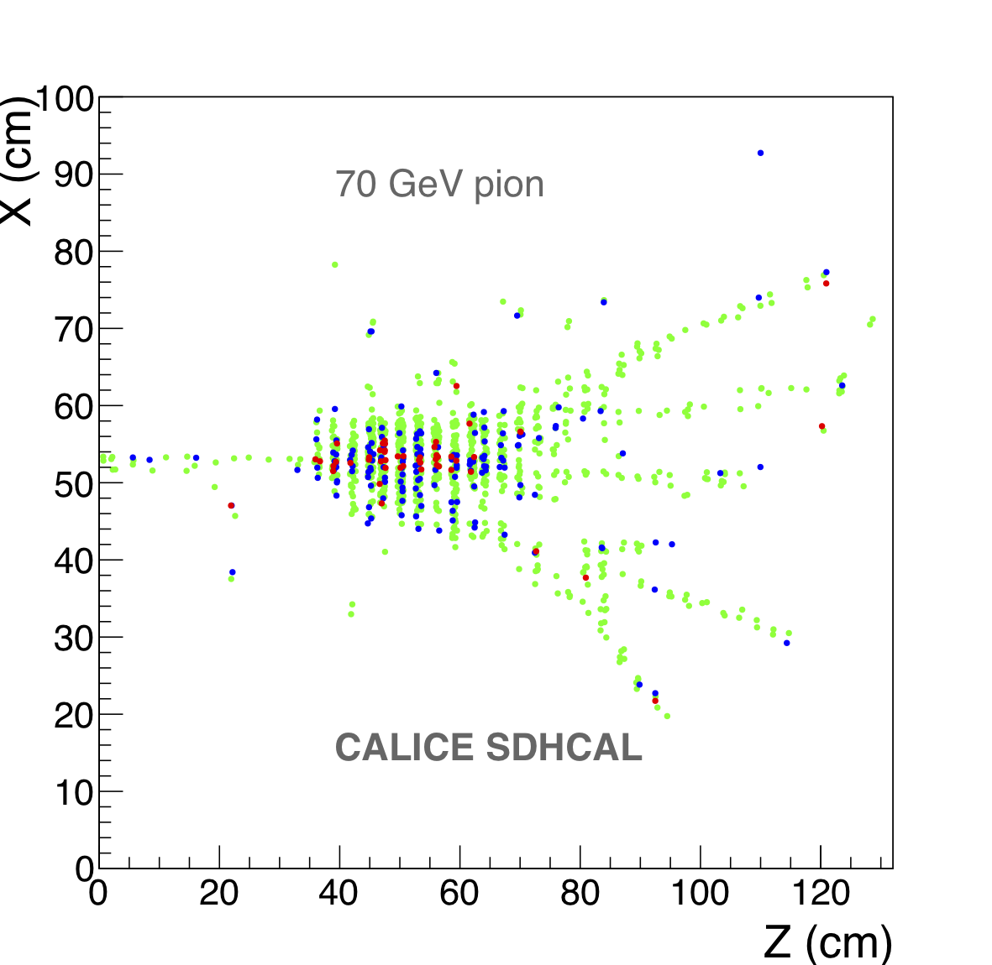
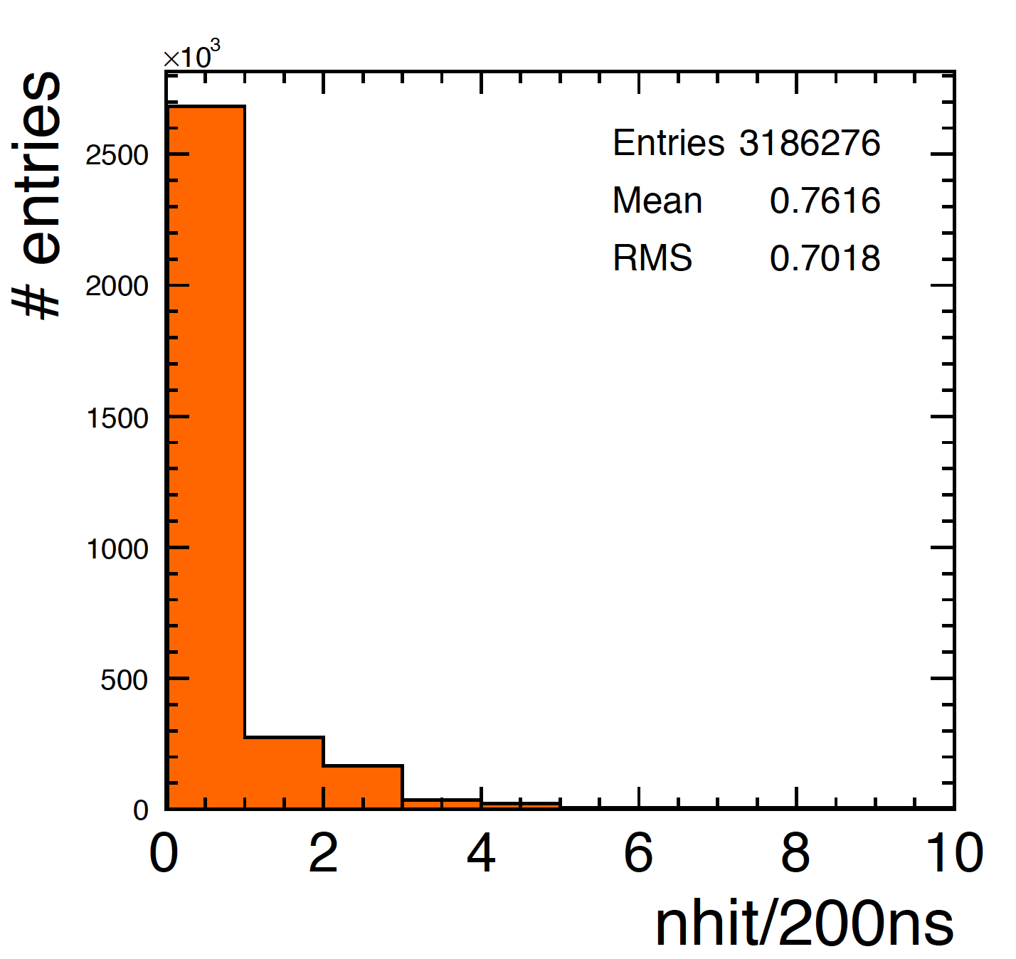
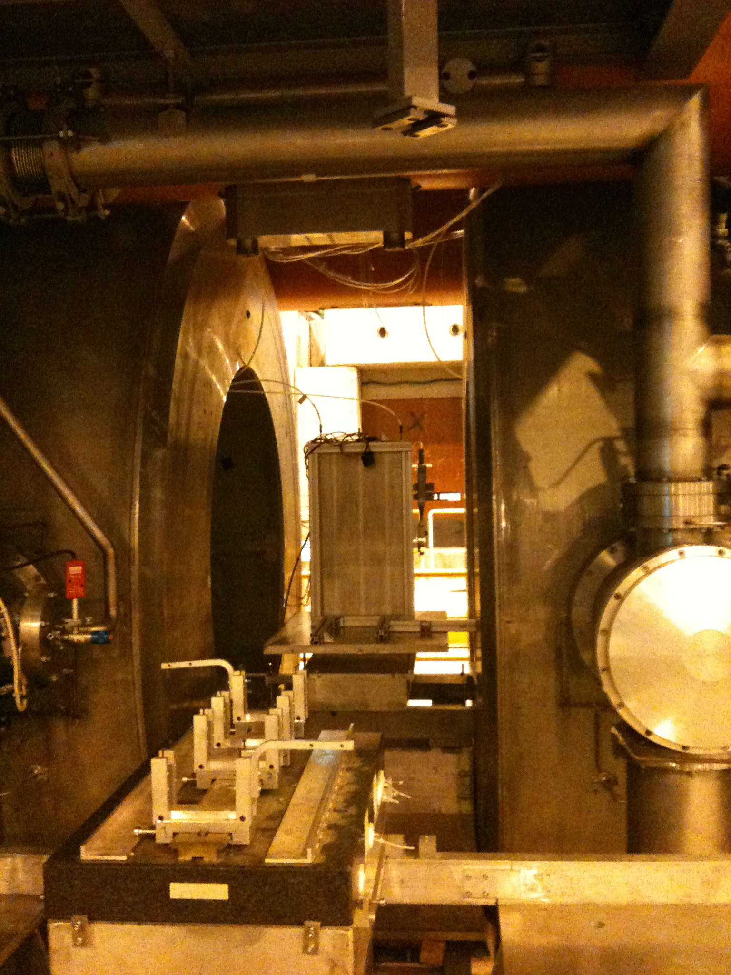
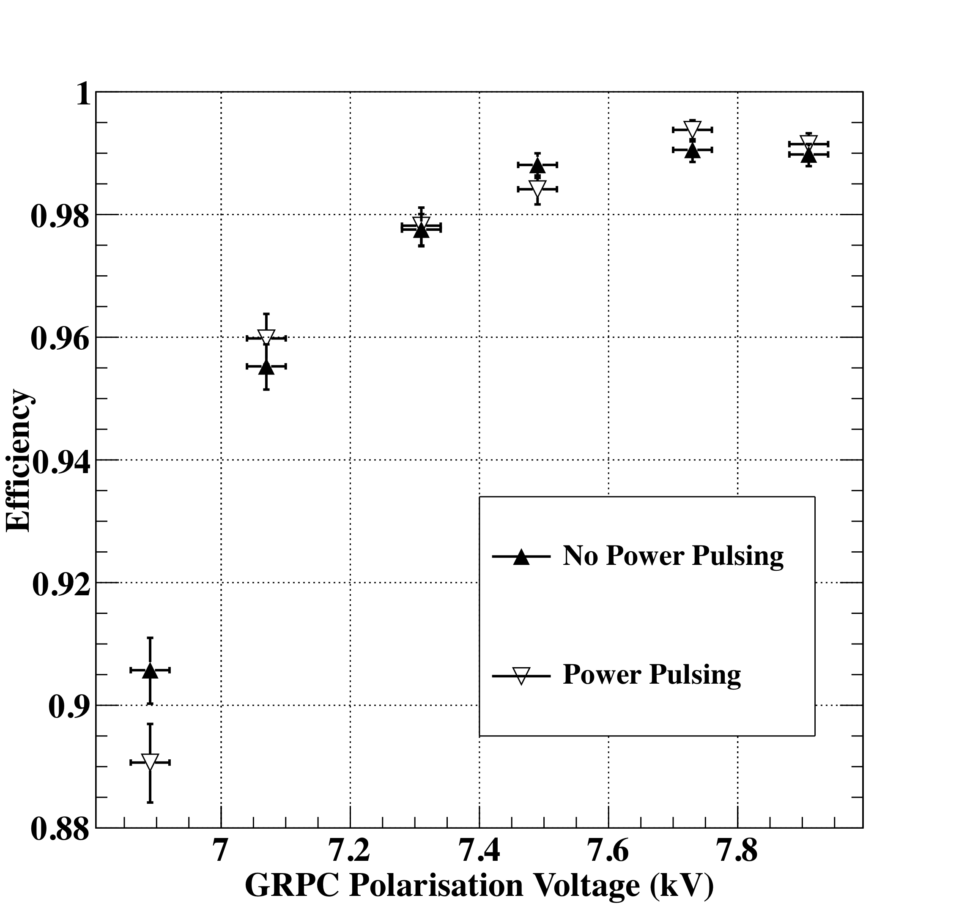
SDHCAL technological prototype
First technological prototype (2011->)
48 layers of 2 cm stainless steel interleaved with
planes made of Glass RPC and their embedded readout 2-bit electronics allowing a lateral segmentation of 1 cm²
A technological prototype of 48 fulfilling almost all
the ILD requirements of compactness and power consumption was built with a self-supporting mechanical structure. It ws successfully tested with
Triggerless mode
Power-pulsing mode
Self-supporting mechanics
No-dead zone
The GRPC was also successfully tested in a magnetic field of 3 T using the power-pulsing mode
electron data (2006)
MOKKA (geant4) simulation
electron data (2006)
MOKKA (geant4) simulation
non-linearity<1%
non-linearity<1%
Ebeam
Ebeam

Slide 14
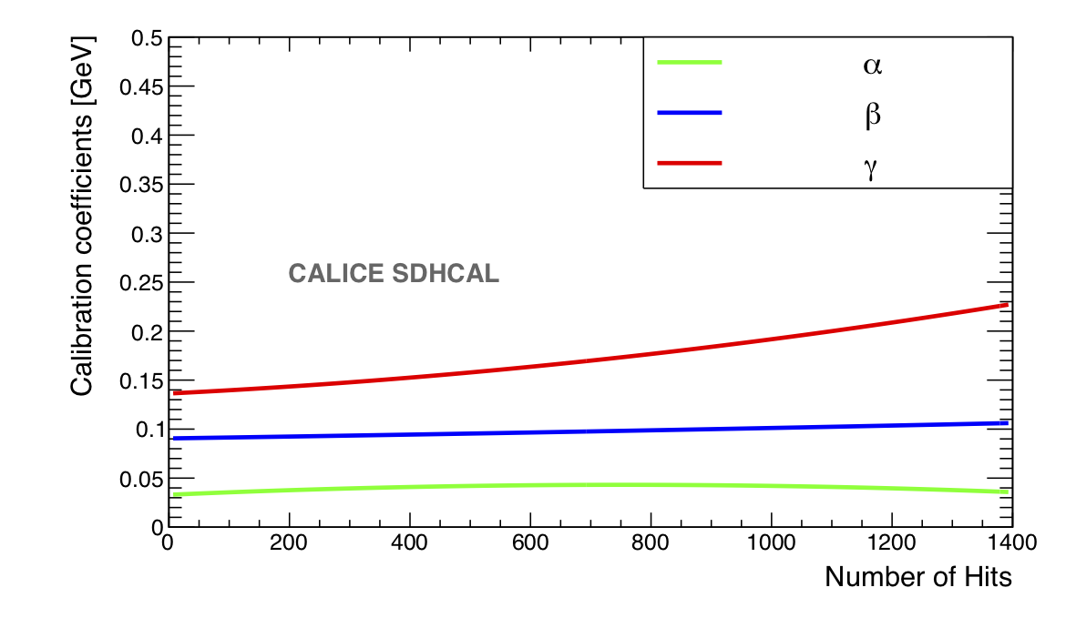
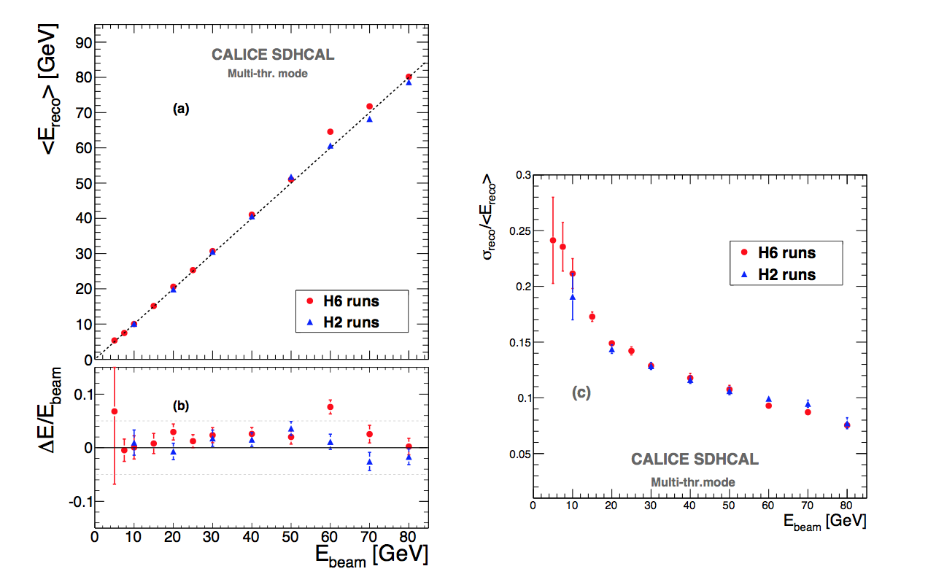
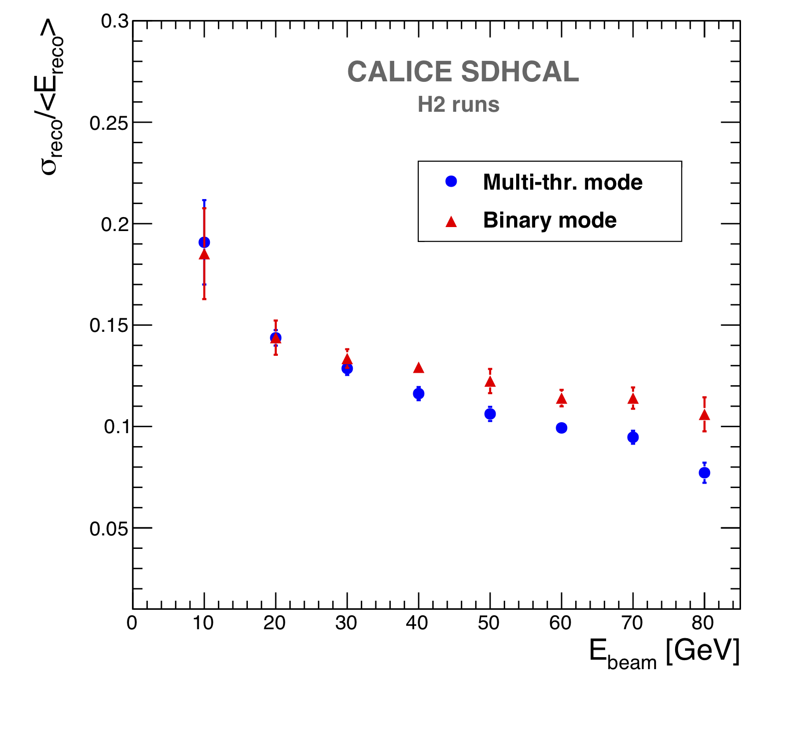
Energy reconstruction
The thresholds weight evolution with the total number
of hits obtained by minimizing a χ2:
χ2 = (E_{beam}-E_{rec})²/E_{beam}
E_{rec} = α (N_{tot}) N₁ + β(N_{tot}) N₂ + γ(N_{tot}) N₃
N₁,N₂ and N₃ : exclusive number of hits associated to first, second and third threshold.
α, β, γ are quadratic functions of the total number of hits (N_{tot})
Third threshold hits are related essentially to the EM part. Their weight increases with energy to compensate for the saturation effect.

Slide 15
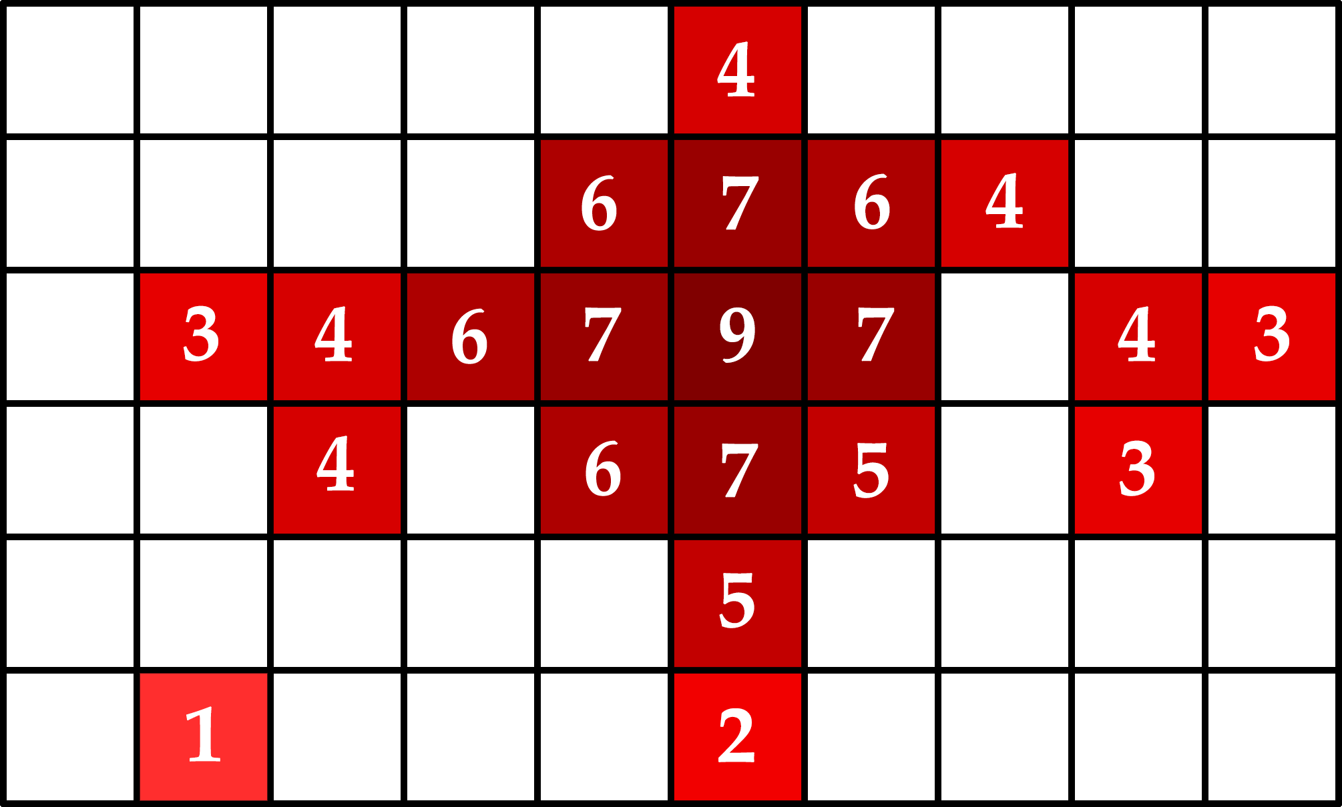
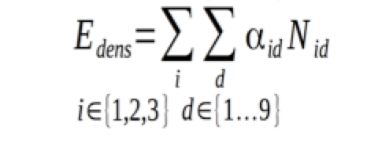
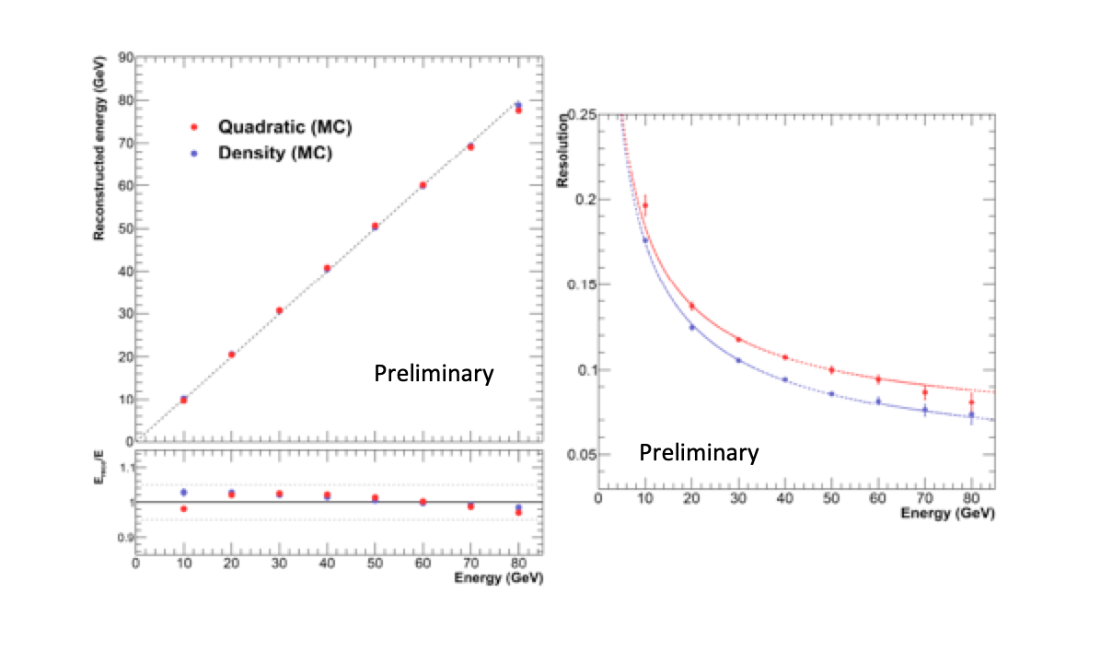
New SDHCAL energy Reconstruction
→ In addition to the three thresholds information density information could be very useful

Slide 16
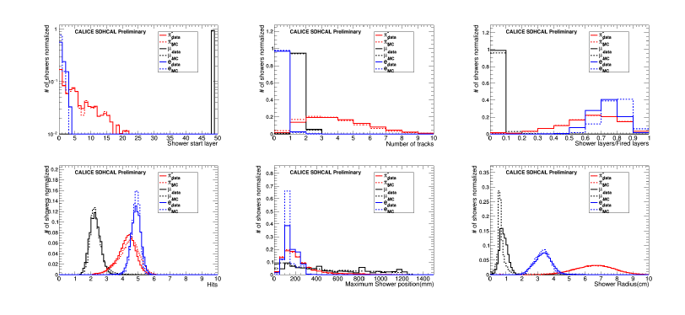
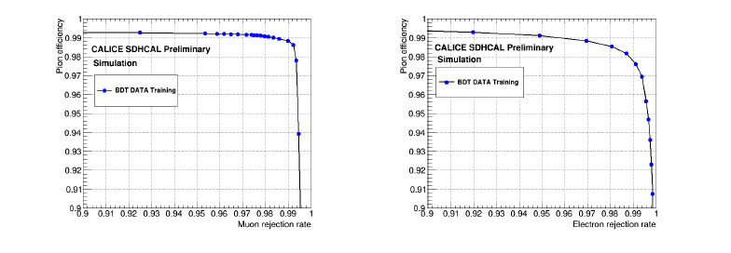
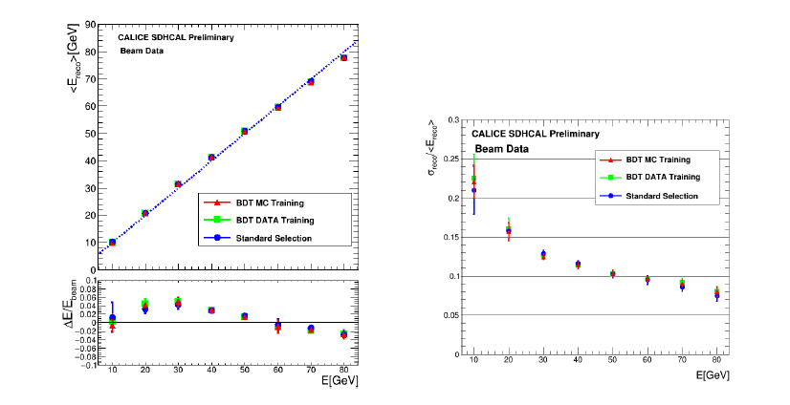
SDHCAL Particle Identification
6 variables discriminating the
Different species of particles :
hadrons, electrons and muons
were used to train a BDT on
both MC and data and then the
BDT was used to keep hadrons
(absence of Cernkov detector
in front of SDHCAL).
CALICE-CAN-2019-001

Slide 17
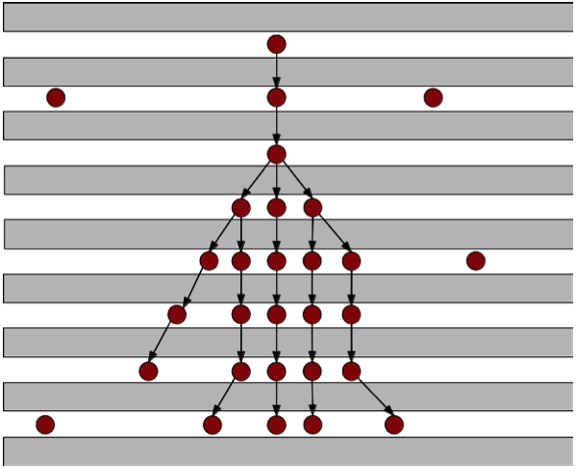
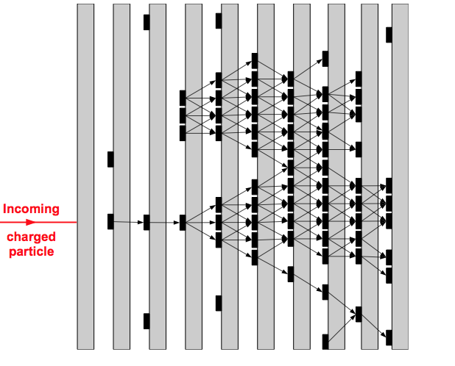
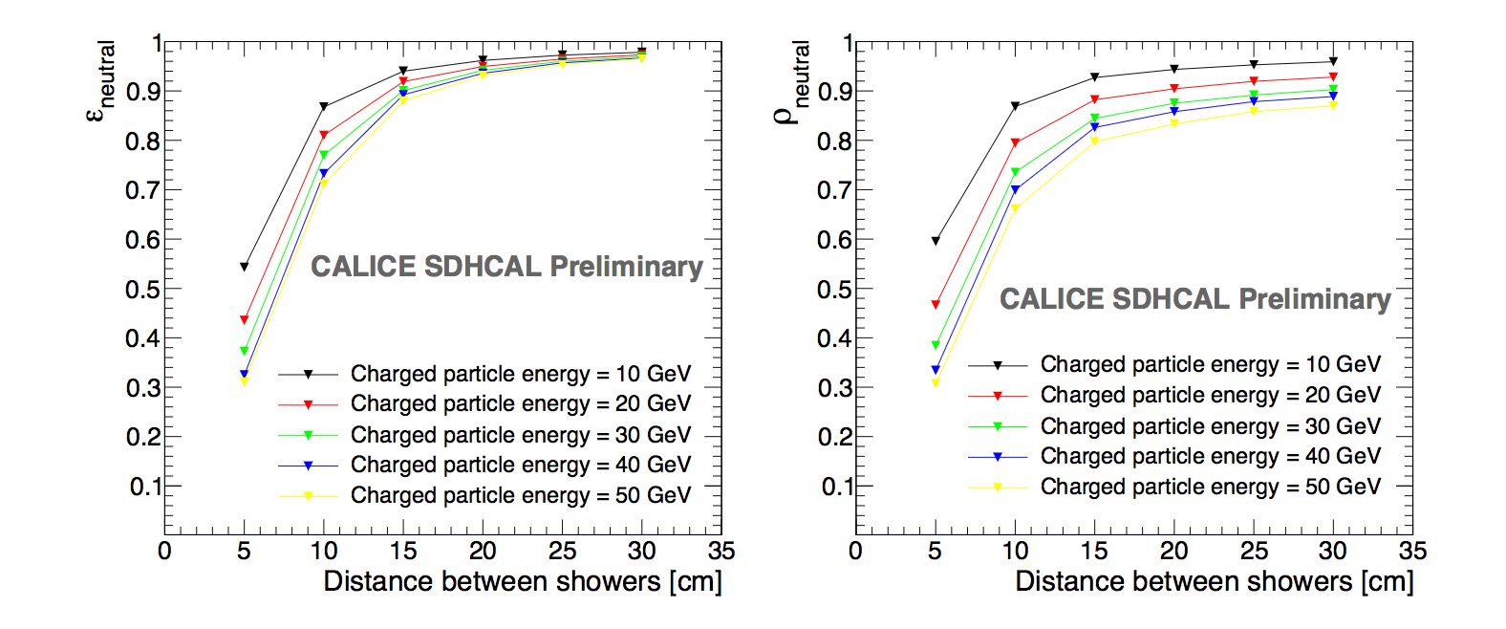
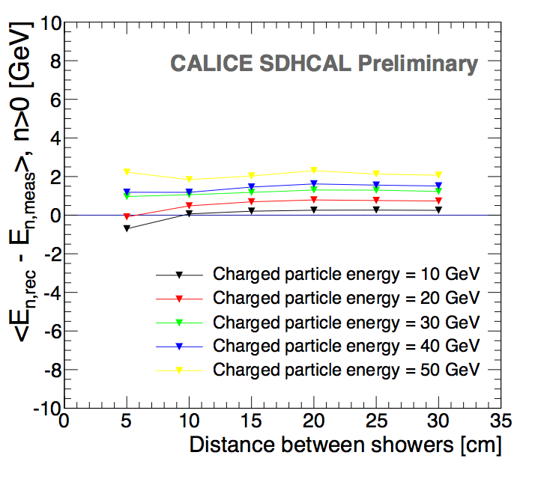
Arbor-Lyon@SDHCAL
Granularity helps to optimize the connection of hits belonging to the same shower by using first the topology and then the energy information
ArborPFA algorithm:
It connect first the hits and then the clusters using distance and orientation information then correct using tracker information (momentum)
Efficiency
ΔE
Purity
CALICE note CAN054

Slide 18
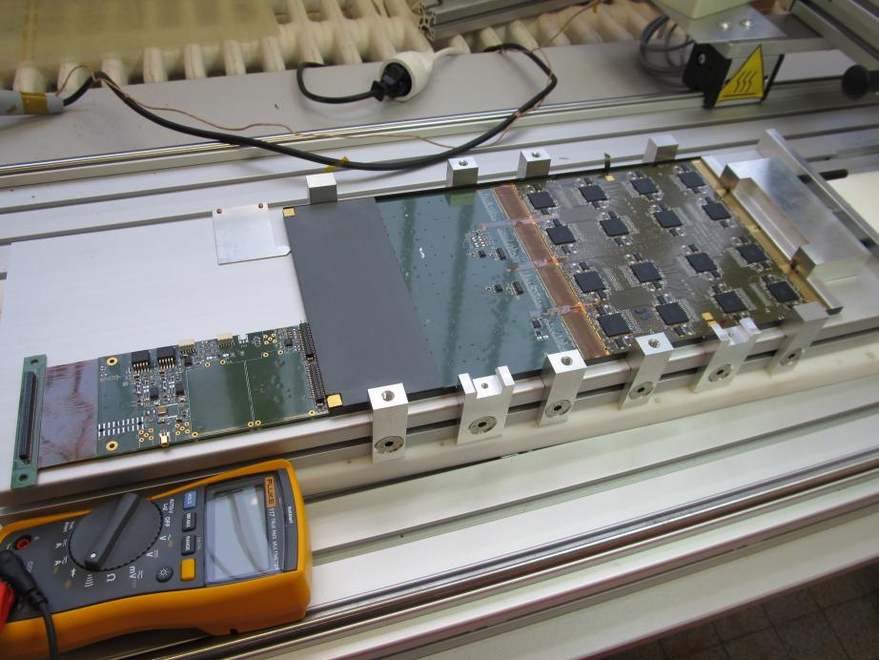
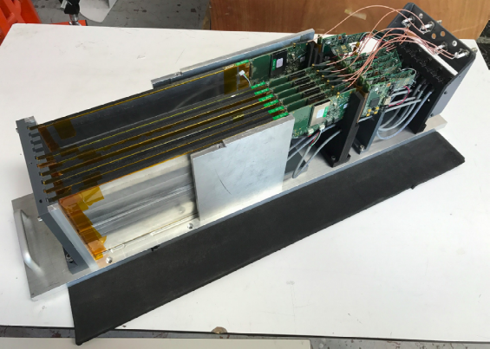
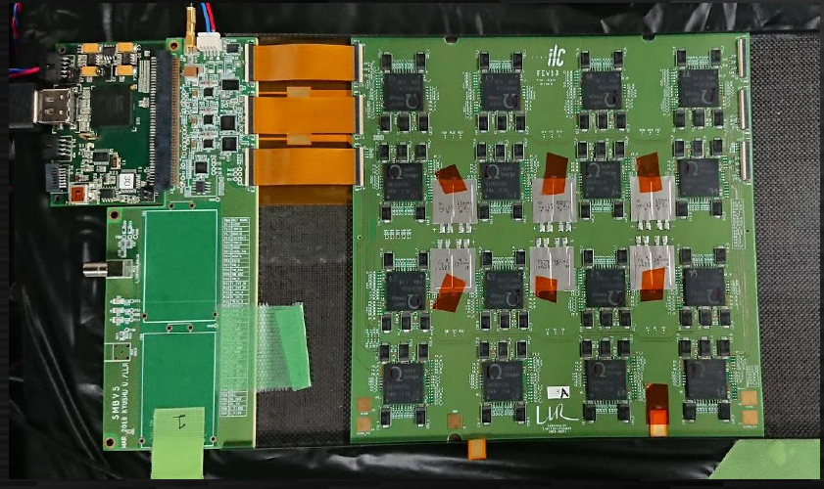
SiW Ecal technological stack for beam tests
PCB FEV12
with long adapter card
Wafer thickness
325 µm
PCB FEV13
with small adapter card
Wafer thickness
650 µm
Total ~15 layers constructed
1024 channels per layer
Assembly chains in France and Japan
Beam tests at DESY and CERN since 2016

Slide 19
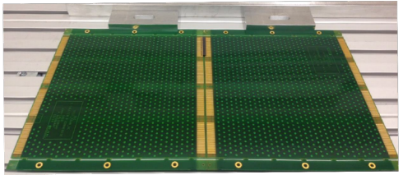

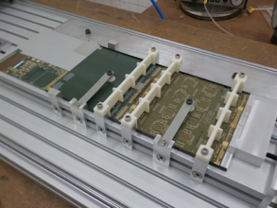

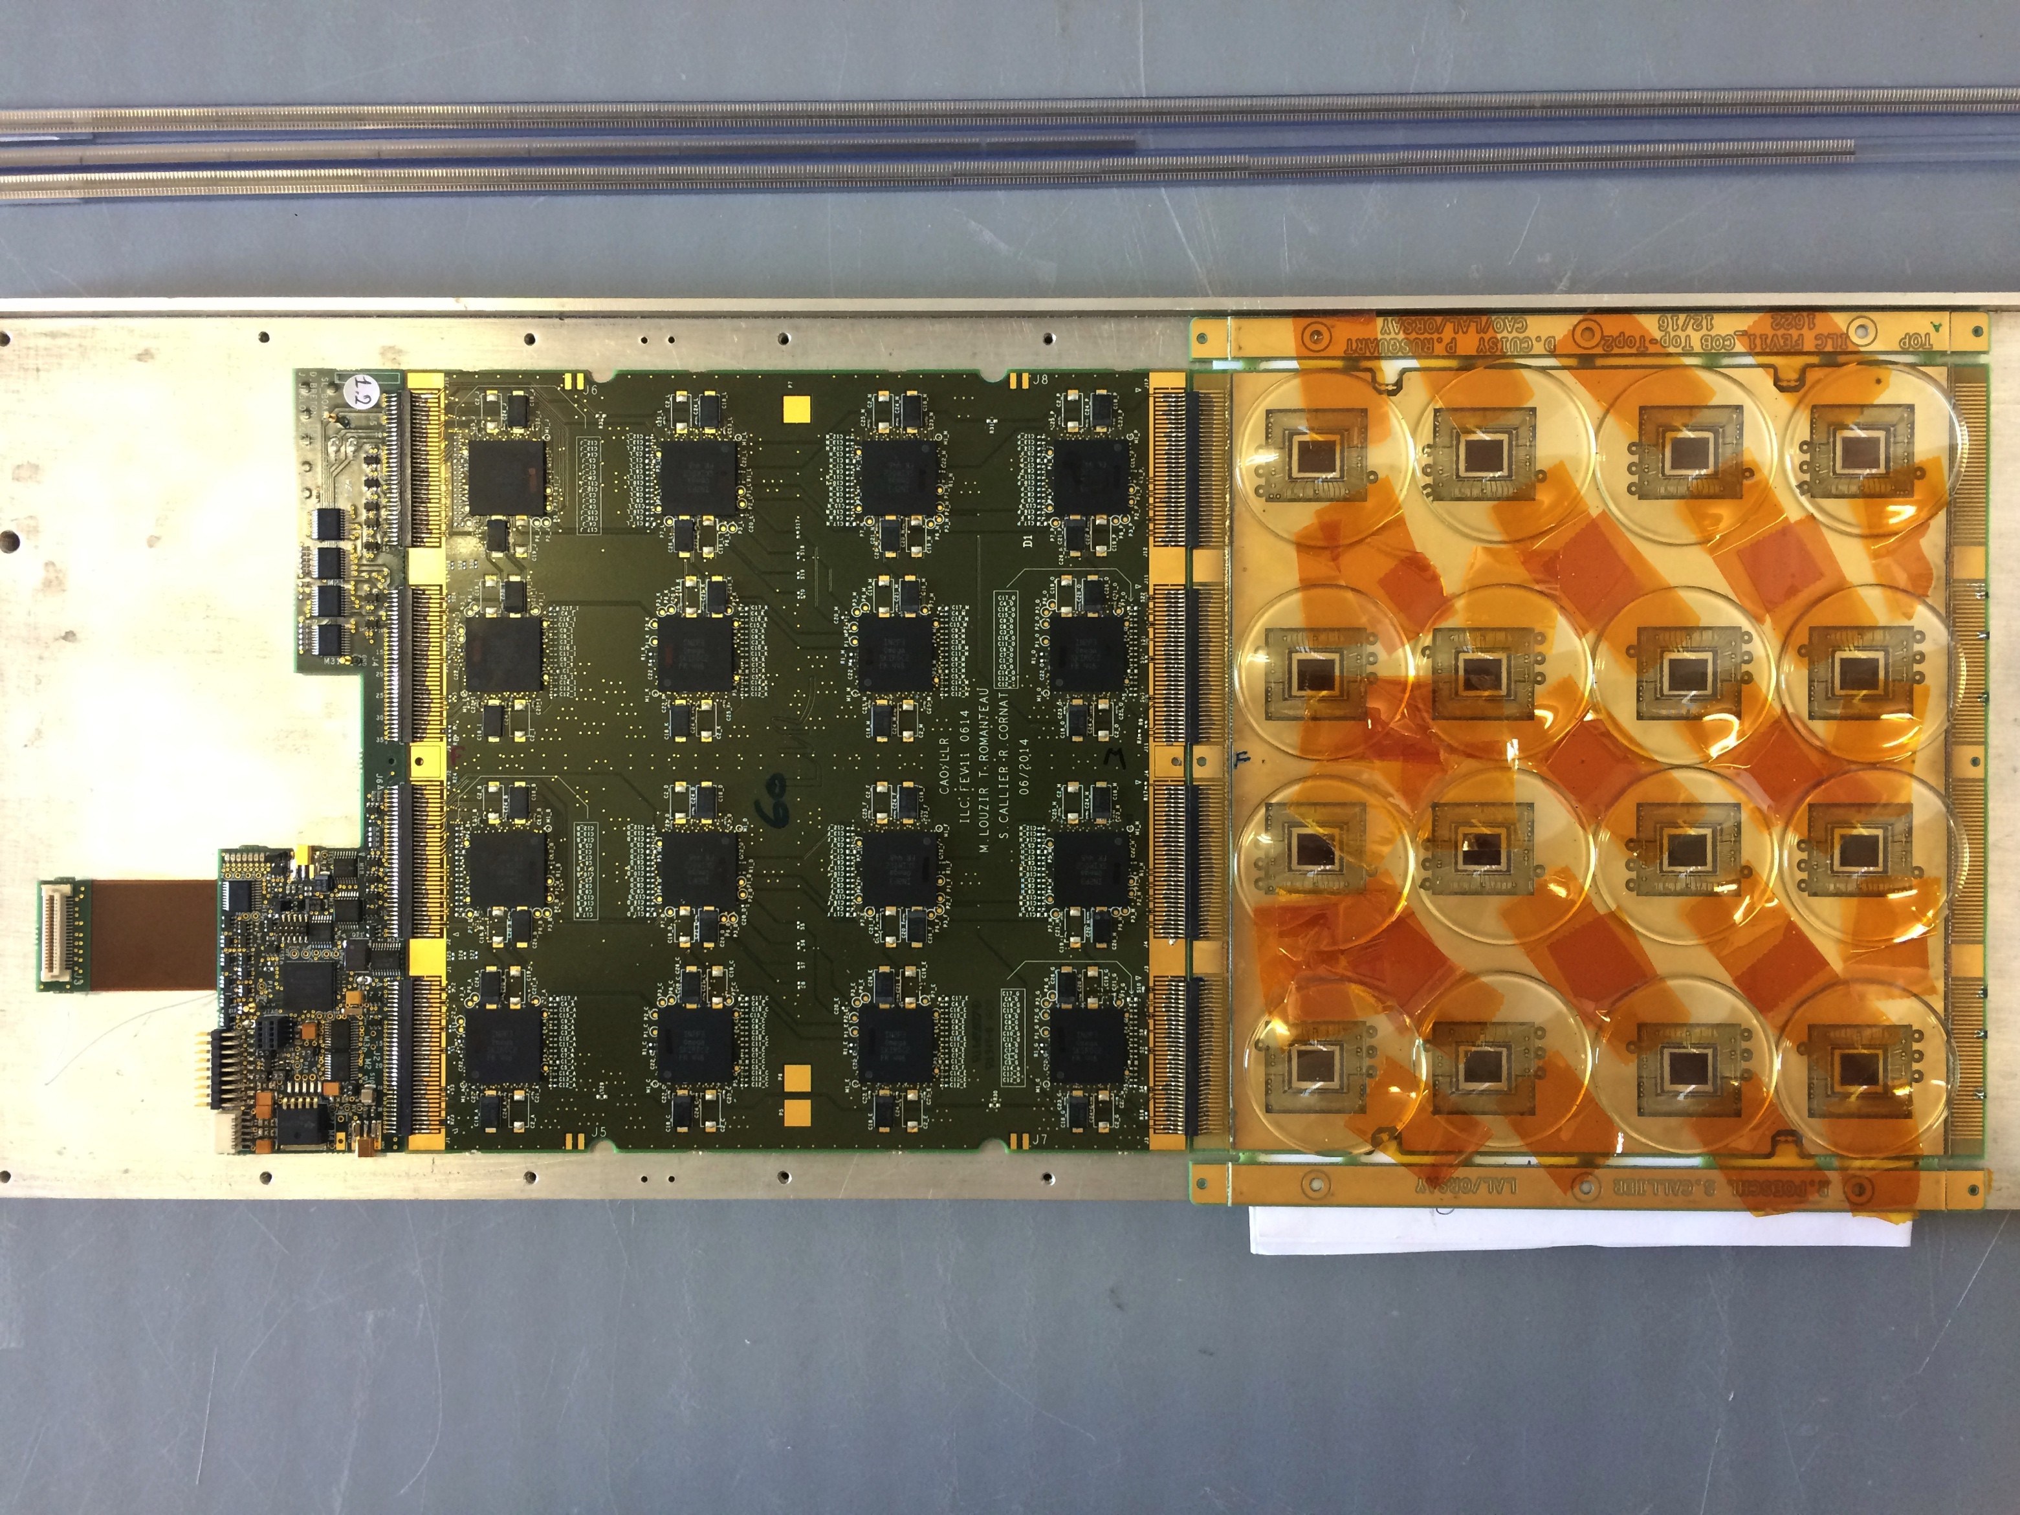
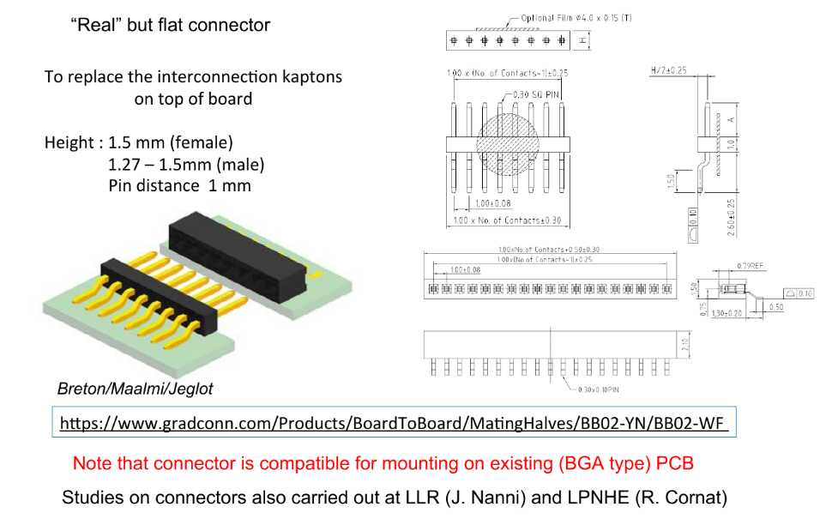
Assembly bench for:
  Fragile Wafer
  Precision of PCB’s ~ 50μm
  ⇒ precision of 100μm on SLAB
  Interconnection
Connections to be handled by industry
  Dedicated Kaptons ✘
  Connectors
End of Slab and DAQ R&D
SL-board

Slide 20
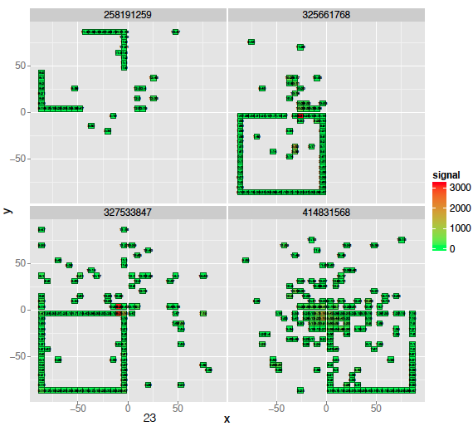
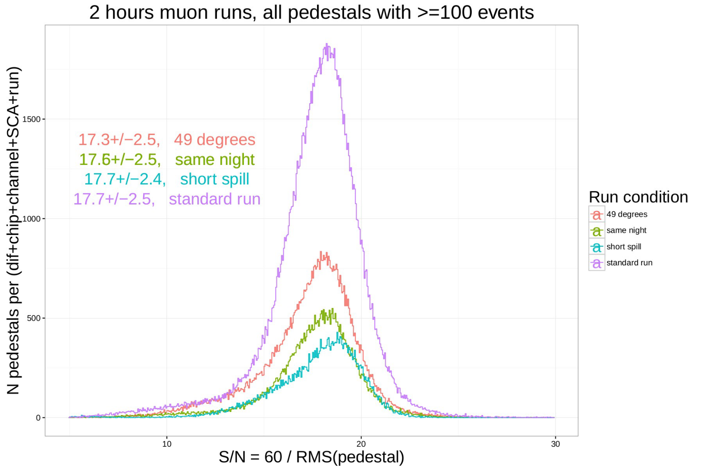
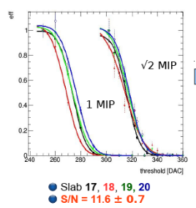
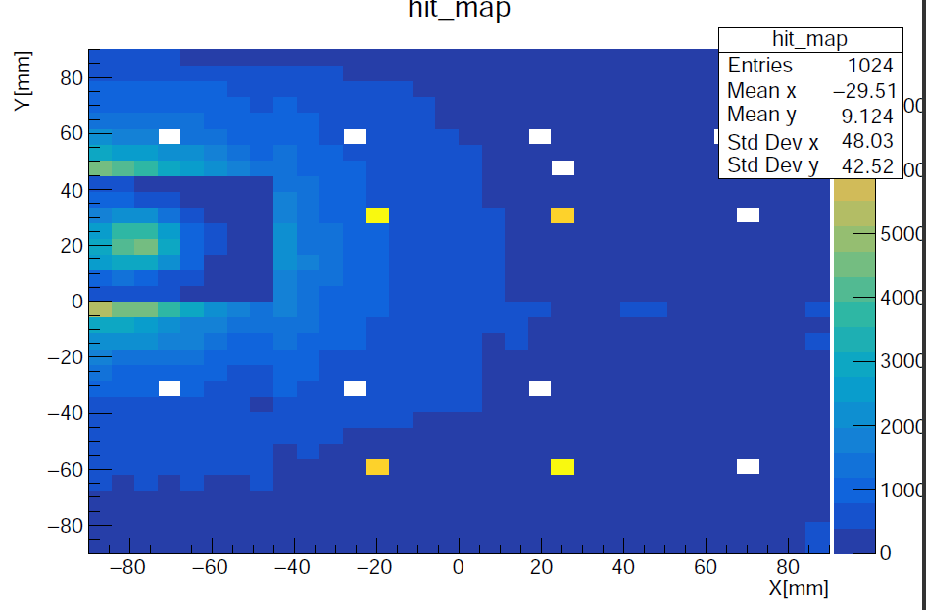
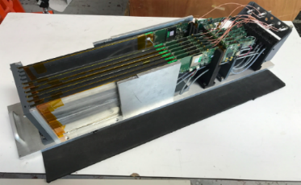





Beam-test 2015–2018
S/N_{ADC} = 16–17
(MIP – ped ) / σ_{ped}
Defaults cataract :
• Negative signals
• re-triggers
• ~ high thr.
• sq events / 10
CERN 2015
DESY 2018
S/N_{Trig} ~ 11.6.±0.7
Trigger → ~1/3 mip (est.)
First comm. of FEV13
S/N_{ADC} ~ 30-40
“Naked FEV11”
7 FEV11 + 1 FEV13(650μm)
DESY 2017
7 FEV11
Masked ch (FEV11) ~ 4 %
CERN 2018
Layer #6, pedestal postion (ADC) map for SCA = 0
6 FEV11 + 4 FEV13(320 & 650μm) + 24X₀ W
N_{hits}
S/N_{ADC} = 20.3,
σ_{S/N} = 1.5 (7.4 %)
masked ch. ~ 8 %
Hit eff. ~ 99.95 %
0°, 45° ✔
1T operation ✔
e⁻
μ
⟨z⟩

Slide 21



SiW Ecal – Performance at MIP Level I
Objectif: Trigger and readout of small signals, design criterion: S/N ~ 10:1
Arxiv:1810.05133
Trigger curves
Charge measurement
Test signals
Cosmics
S/N ~ 20
S/N ratio from relative position and width of threshold curves
Result here S/N ~12.9±3.4
Dedicated runs in 2018 TB, Analysis ongoing
Ability to trigger on small signals and to read them out for analysis

Slide 22


SiW Ecal – Performance at MIP Level II
Arxiv:1810.05133
CALICE SiW-ECAL
Trigger thresholds uniform at around 1/2 MIP
MIP Detection efficiency ~100%
PFA requires:
a) Access to small signals -> Low trigger thresholds ✔
b) Tracking in calorimeters -> High MIP detection efficiency ✔

Slide 23




AHCAL Technolgical Prototype
ILD barrel
HBU
highly granular scintillator SiPM-on-tile hadron calorimeter, 3*3 cm² scintillator tiles
fully integrated design
  front-end electronics, readout
  voltage supply, LED system for monitoring
  no cooling within active layers
scalable to full detector (~8 million channels)
HCAL Base Unit: 36*36 cm², 144 tiles, 4 ASICs
  slabs of 6 HBUs
  up to 3 slabs per layer

Slide 24


AHCAL Technolgical Prototype
Since 2018
38 active layers of 72*72 cm²
4 HBUs per module
  16 SPIROC 2E readout ASICs,
  576 channels of 3*3 cm² tiles
  in total: 608 ASICs, ~22000 channels
all modules with surface-mount MPPCs
  S13360-1325PE
  2668 pixels (3x physics prototype (PP))
  operated at 5V overvoltage
    50% less temperature sensitivity w.r.t. PP
  nominal operation voltage within 200mV in a module -> use same voltage
    Simplified set-up
    Layer-wise regulation
  About 3 orders of magnitude less noise
steel absorber stack corresponding to ~1% of ILD barrel

Slide 25

Testbeam Setup 27. June – 4. July 2018 in H2 at SPS
tailcatcher
AHCAL
main stack
as in May, plus:
  added one module with 6*6 cm2 tiles (prototype for rear layers)
  added CMS HGCAL “thick stack” (12 layers of 1 HBU, 7.4 cm steel absorber) as tailcatcher
  added single HBU in front of absorber as “pre-shower” detector

Slide 26




Event Displays and Online Monitoring
electron
hadron
muons
muon

Slide 27


Online Monitoring: Energy Sums
Electron Beam
CALICE
work in progress
10
20
30
40
50 GeV

Slide 28


Combined Testbeam: CMS HGCAL + CALICE AHCAL
2 weeks of combined testbeam at CERN SPS in October 2018
28 layers HGCAL EE (silicon/lead), 12 layers HGCAL FH (silicon/steel), 39 layers AHCAL (scintillator/steel); common DAQ: EUDAQ2
important test of concept, important information for simulation of showers

Slide 29

Combined Testbeam: CMS Silicon HGCAL + CALICE AHCAL
2 weeks of combined testbeam at CERN SPS in October 2018
28 layers HGCAL EE (silicon/lead), 12 layers HGCAL FH (silicon/steel), 39 layers AHCAL (scintillator/steel)
important test of concept, important information for simulation of showers

Slide 30

Towards SDHCAL Module0
Detectors as large as 3m X 1m need to be built
Electronic readout should be the most robust with
minimal intervention during operation.
DAQ system should be robust and efficient
Mechanical structure to be similar to the final one
Envisage new features such timing, etc..
GRPC
Glass Resistive Plate Chambers
SDHCAL
ILD Module

Slide 31





Large detector with new gas distribution scheme
Prototype circulation system
New circulation system
inlet
outlet
1 m
2 m
New readout electronics (HARDROC3)
Independent channels Zero suppress
Extended dynamic range (up to 50 pC) I2C link with triple voting for slow control parameters
packaging in QFP208, die size ~30 mm²
6,3 mm
4,7 mm

Slide 32





New electronics
Electronics readout for the 1m³ prototipo
1m² board ➔ 6 ASUs hosting 24 ASICs
3072 ch
DIF #1
144 ASICs= 9216 channels/1m²
USB
ASU1
ASU2
33 cm
DIF #2
HDMI
DIF
100 cm
DIF #3
1 DIF (detector InterFace) for 2 ASU (Active Sensor Unit.- PCB+ASICs) ➔ 3 DIFs for ONE 1m2
Electronics readout for the final detector
Uo to 9
ASU2
ASU2
Data transmission to/from DAQ by Ethernet
• Clock and synchronization by TTC (already used in LHC)

Slide 33




New Mechanical Structure
Goal: To fix the steel plate replace bolts with EWB to reduce the dead zone and the deformation
EBW@CERN
Deformation< 1mm

Slide 34
Conclusion
- A lot of activities within CALICE
- Technological prototypes have been built or being completed.
- A big progress on Scint-W ECAL and MAPS ECAL

Slide 35



S/N_{ADC} ~ 30
⁵⁷Co response

