Slide 1
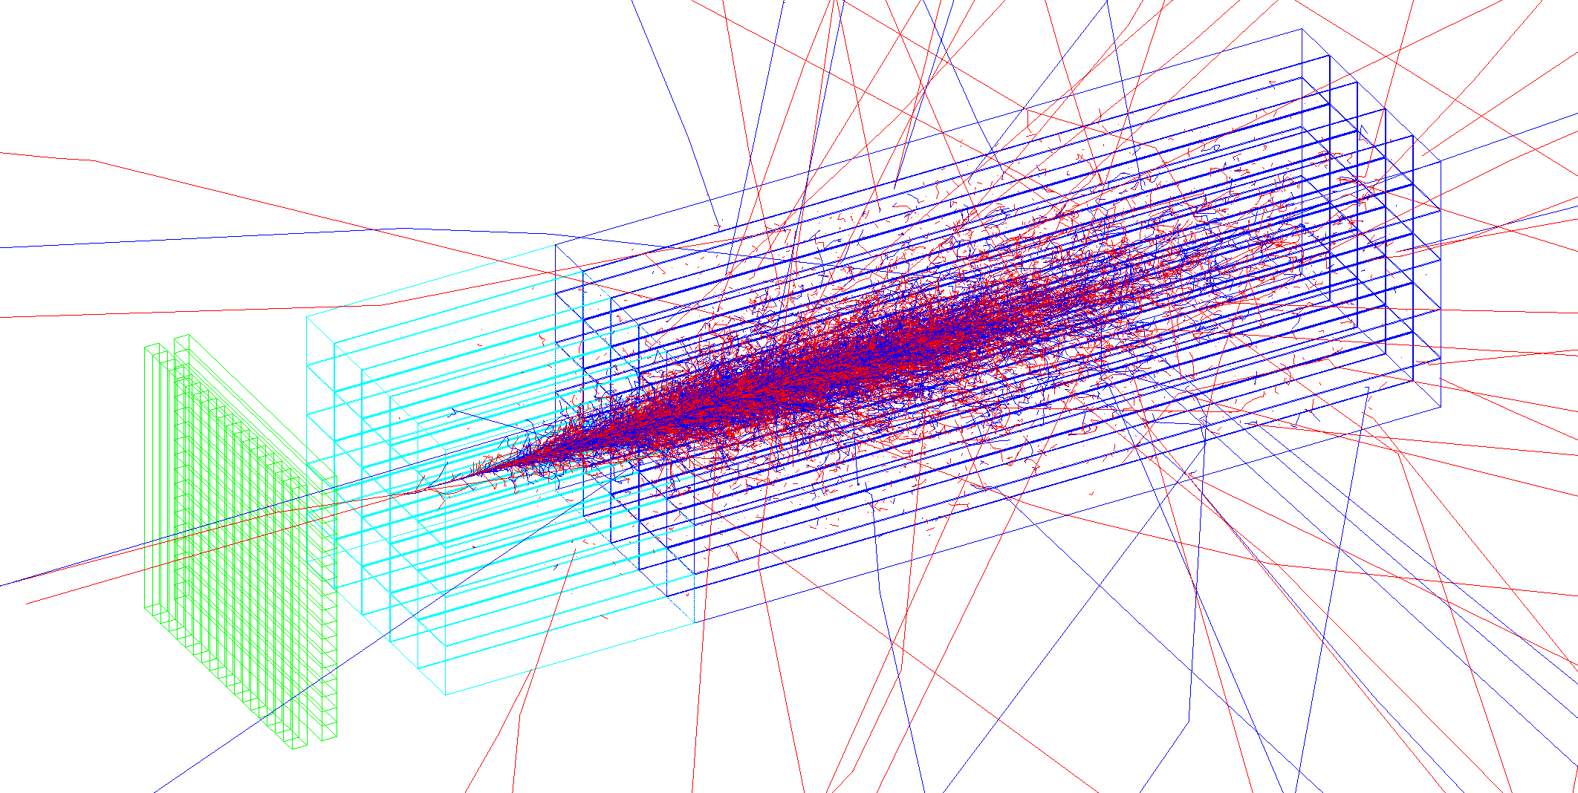
Segmented-Crystal Electromagnetic
Precision Calorimeter (S-CEPCal)
15 April 2019
CEPC Workshop, Oxford, England
Sarah Eno (Maryland), Marco Lucchini (Princeton),
Junguang Lyu (IHEP), Chris Tully (Princeton),
Zhigang Wang (IHEP)

Slide 2
Segmented Crystal Calorimeters for CEPC
Silicon Photomultiplier (SiPM) Readout
  Detectors with sq. meters of SiPMs (>300k devices)
Fine Segmentation to Image EM Shower
  Transverse ~1cm²
  Front (~6X₀) & Rear (~18X₀) compartments
  (+ Option of Fine-Pitch Precision Timing Detector)
High Sampling Fraction (~100%)
  equiv. to x100 statistics of standard imaging calorimeter
Exceptional Energy Resolution
  x3-5 higher than best sampling calorimeters
Precision Timing (~30ps above 20 GeV EM showers)
Cost-Effective
  Crystal cost well-understood (grown in China)

Slide 3
Simulated Detector Geometry
Tracker
Timing
Crystal grid
S-CEPCal
Segmented Crystal ECAL
HCAL
Solenoid
0.3 λ₀
2.7 X₀
Fe
84 mm
0.5λ₀
4.8X₀
Fe
84 mm
0.5λ₀
4.8X₀
Fe
84 mm
0.5λ₀
4.8X₀
Fe
84 mm
0.5λ₀
4.8X₀
Fe
84 mm
0.5λ₀
4.8X₀
Fe
84 mm
0.5λ₀
4.8X₀
Fe
84 mm
0.5λ₀
4.8X₀
1.8 m, ~0.3 X₀, Si
E1+E2 = 24X₀
T1+T2
0.8X₀
E1
6X₀
E2
18X₀
5 mm Al [0.056X₀] / layer
for cooling, services
1λ₀
~7λ₀
2 layers
2 layers
14 layers

Slide 4
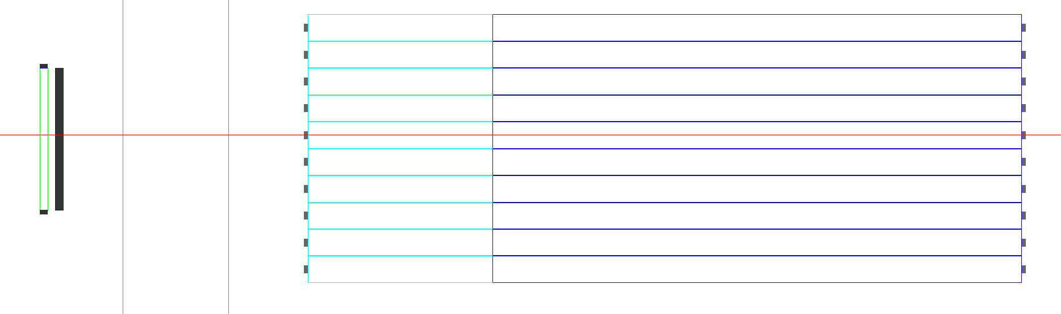
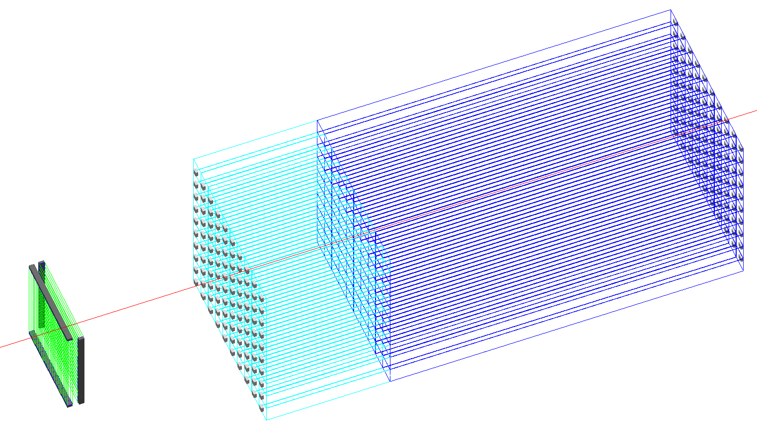
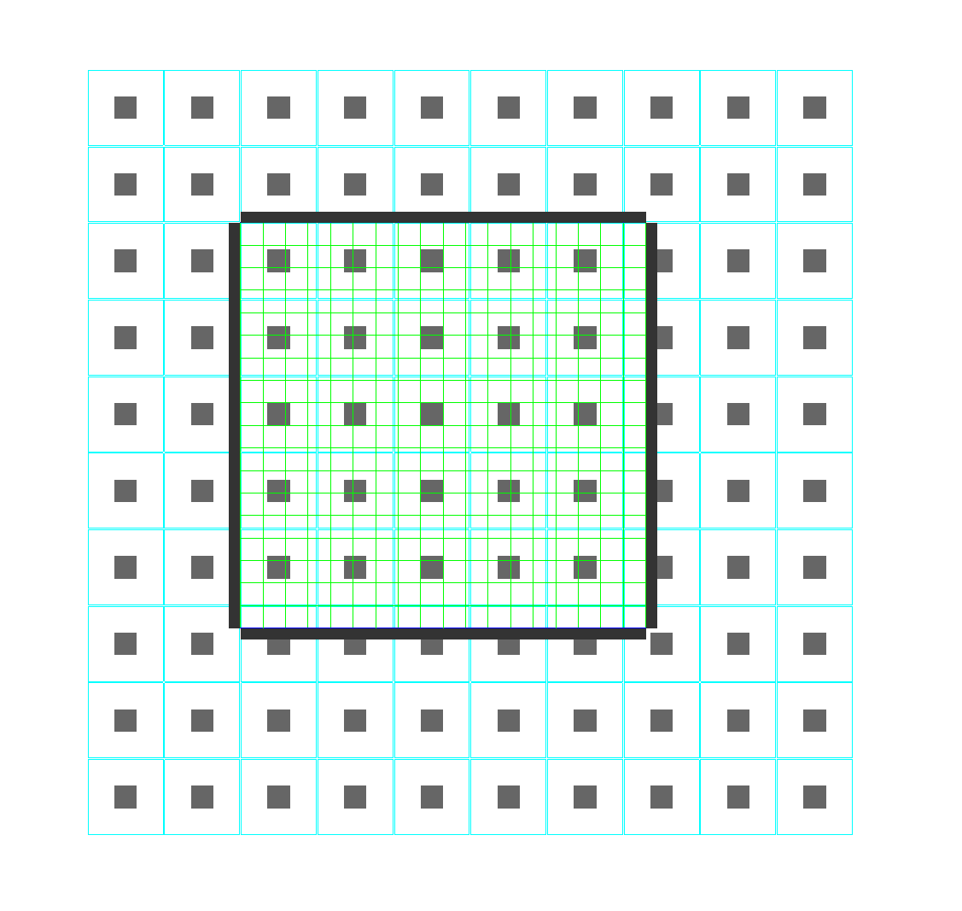
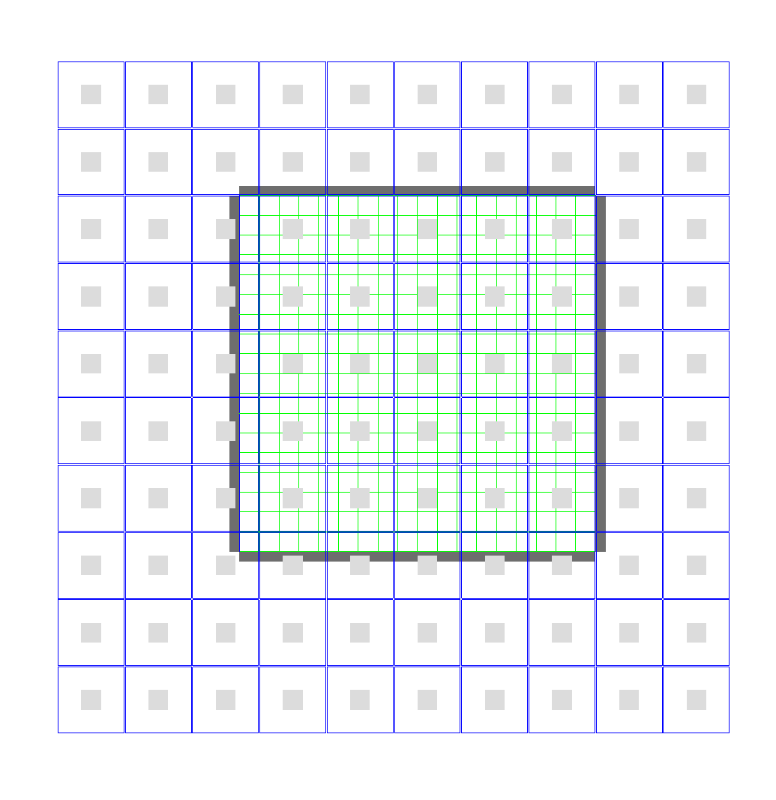
GEANT4 Views
4

Slide 5
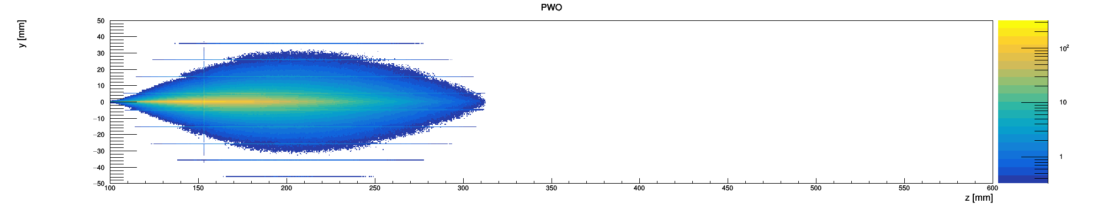
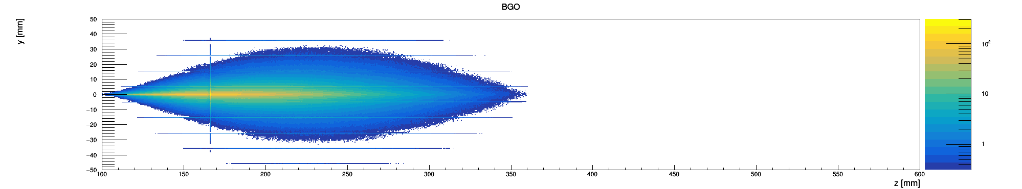
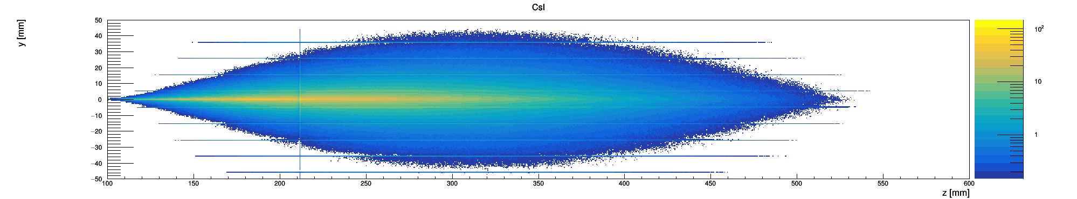
Optimization of Crystal Segmentation
Smaller Moliere radius in front segment
→ better shower separation
R_{M} = 2.00 cm
X₀ = 0.89 cm
PWO
45 GeV electrons
X₀^{TRK} = 0.3
ECAL length: 24 X₀
Module width: 10 cm
R_{M} = 2.23 cm
X₀ = 1.12 cm
BGO
R_{M} = 3.57 cm
X₀ = 1.86 cm
CsI

Slide 6
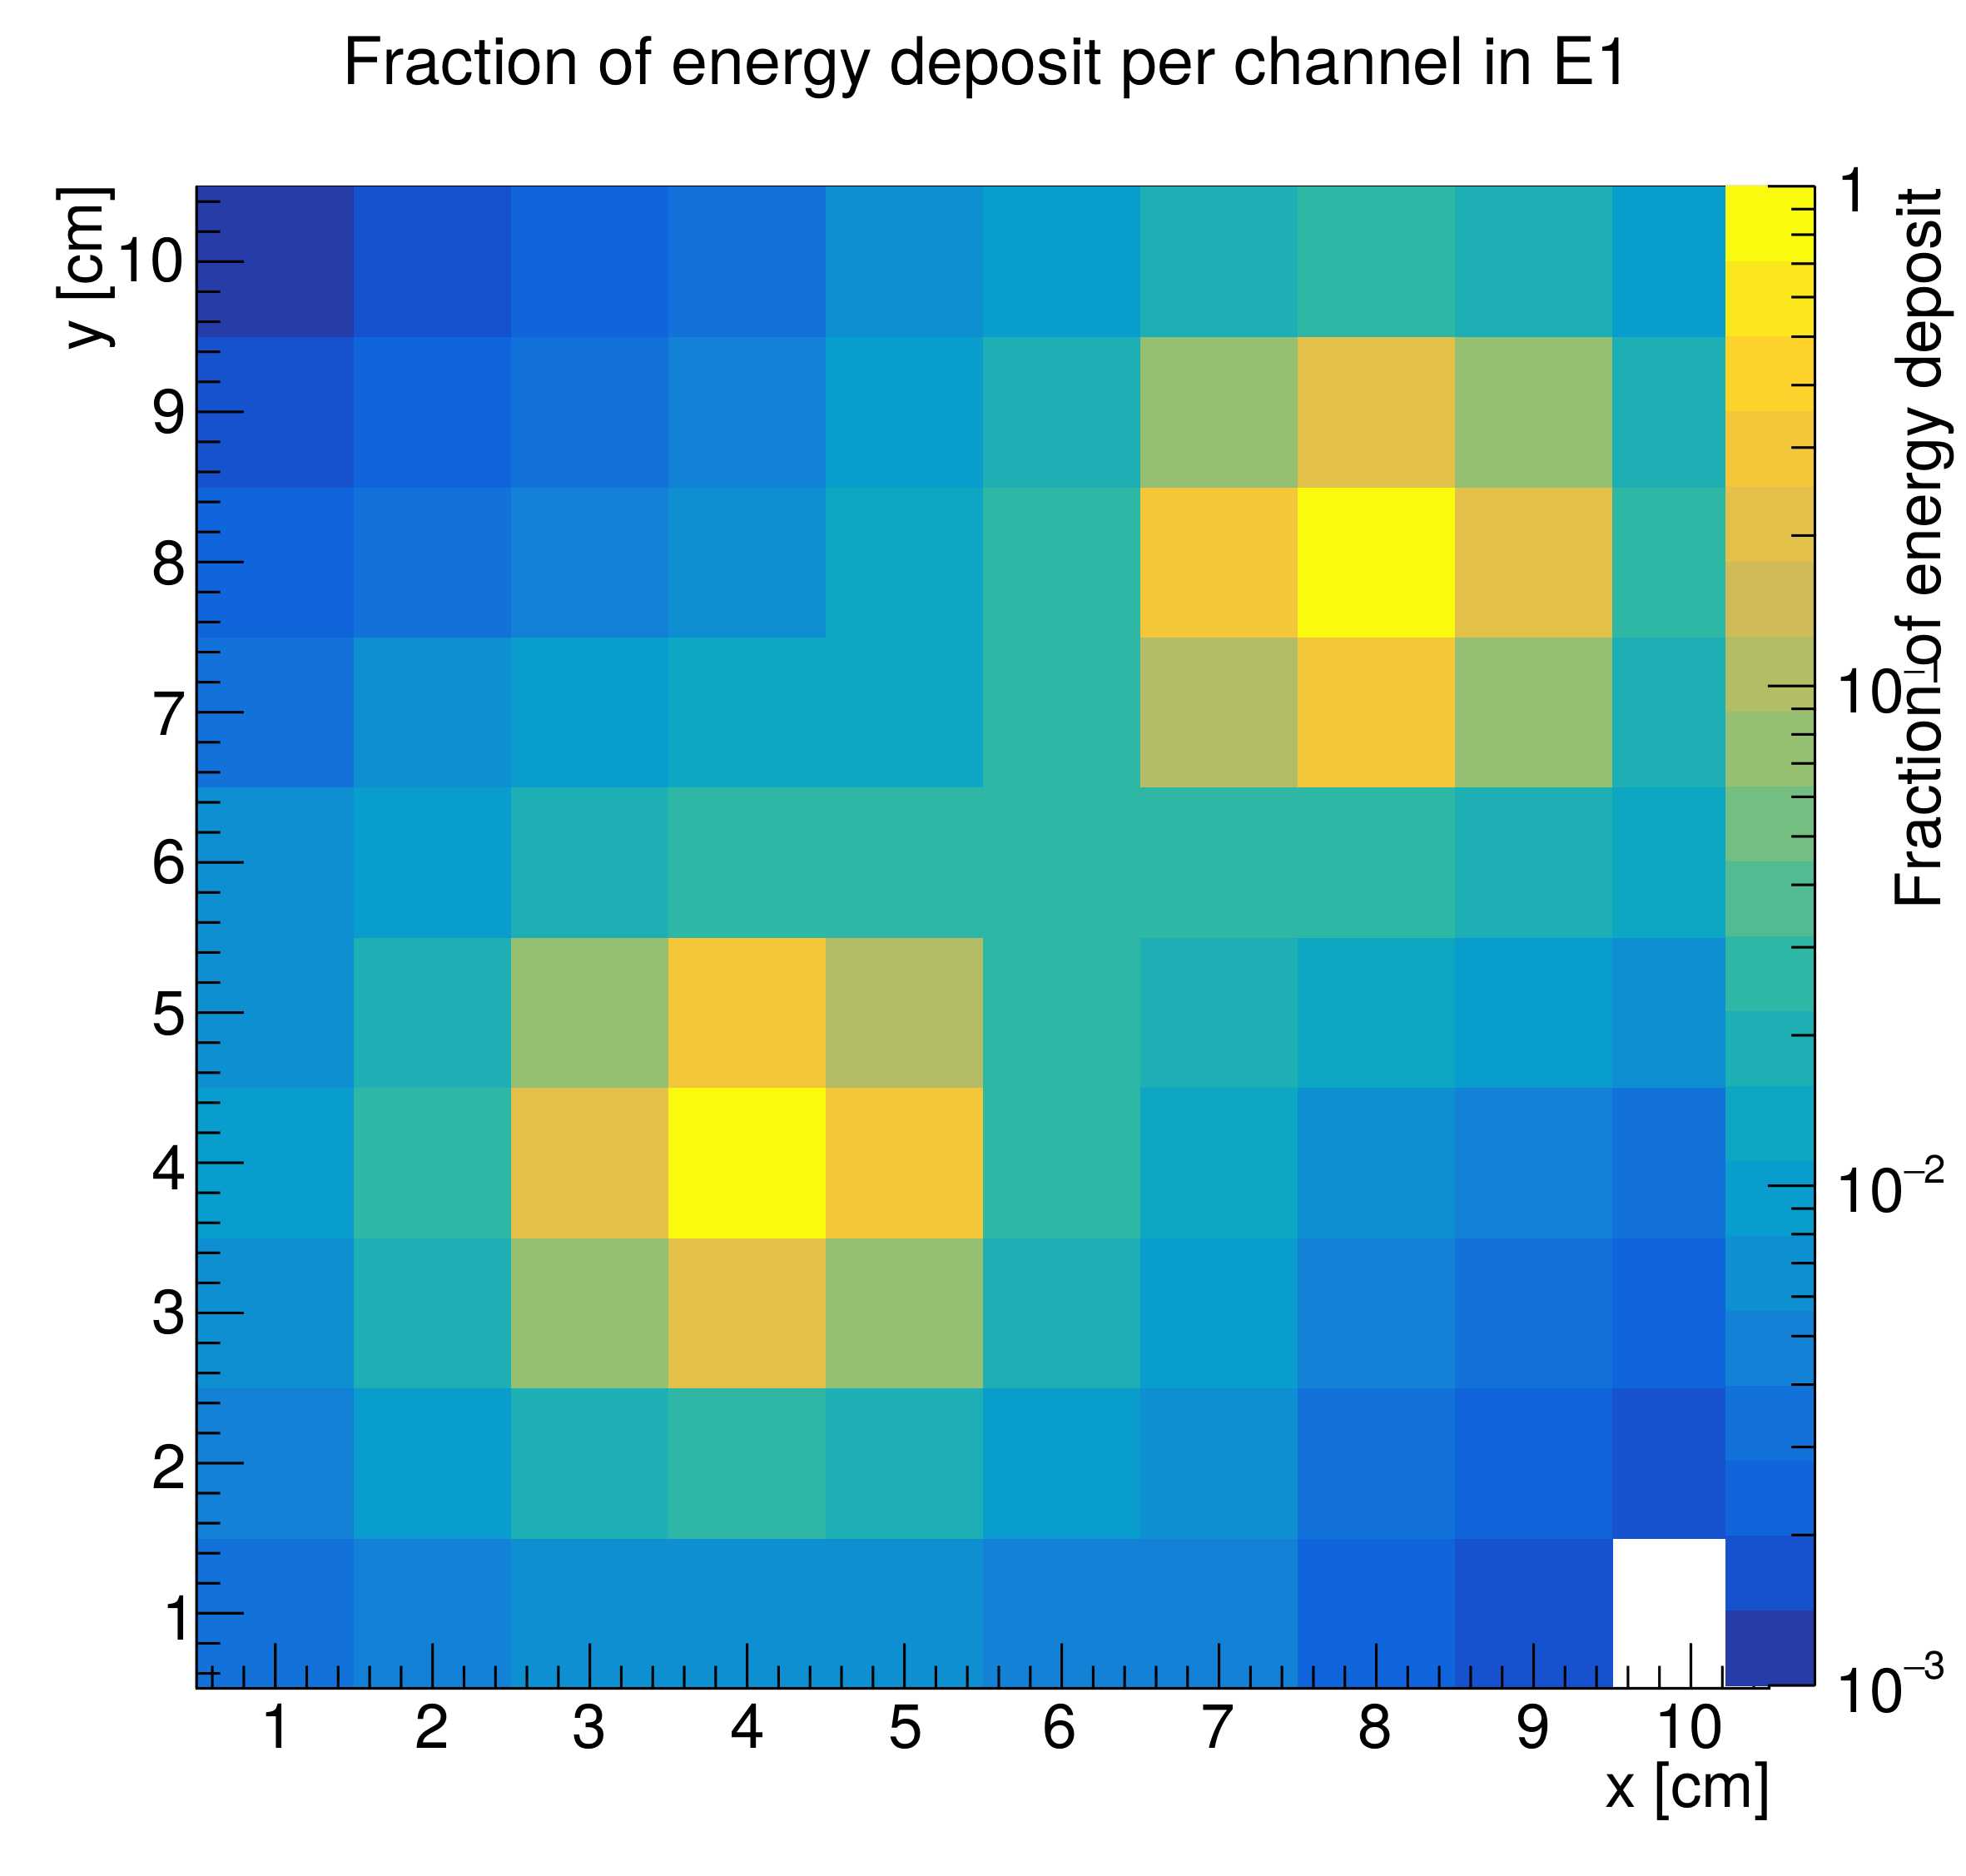
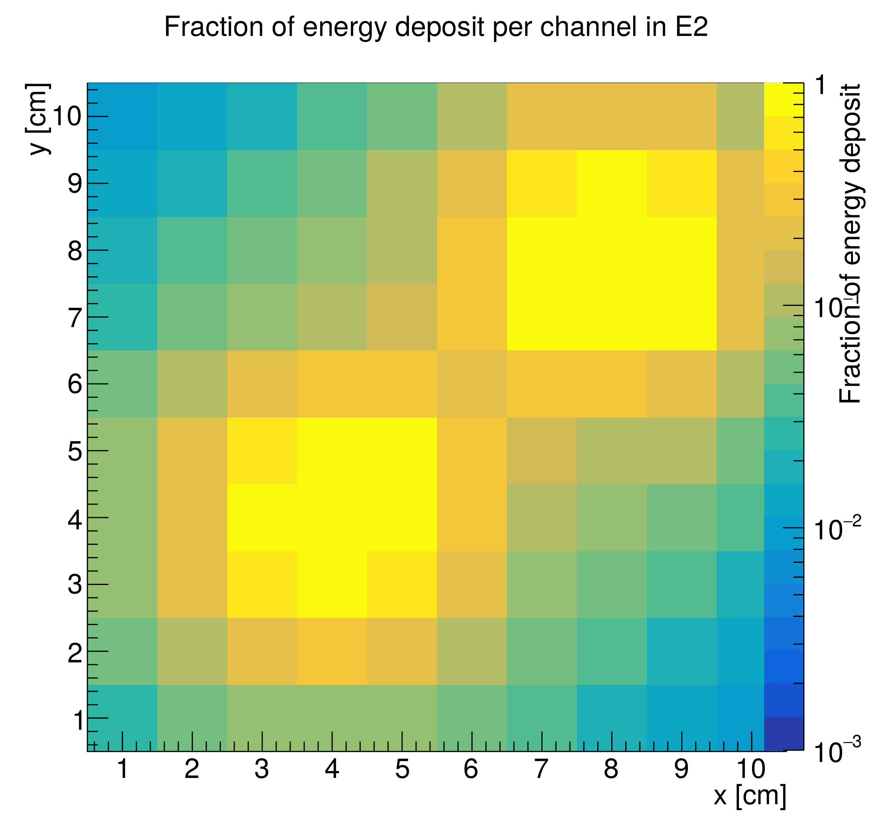
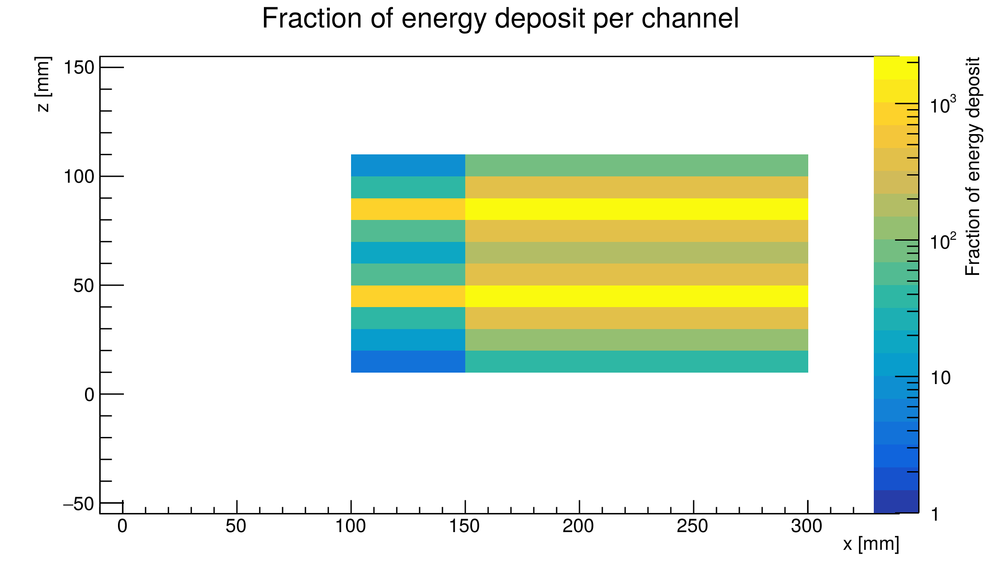
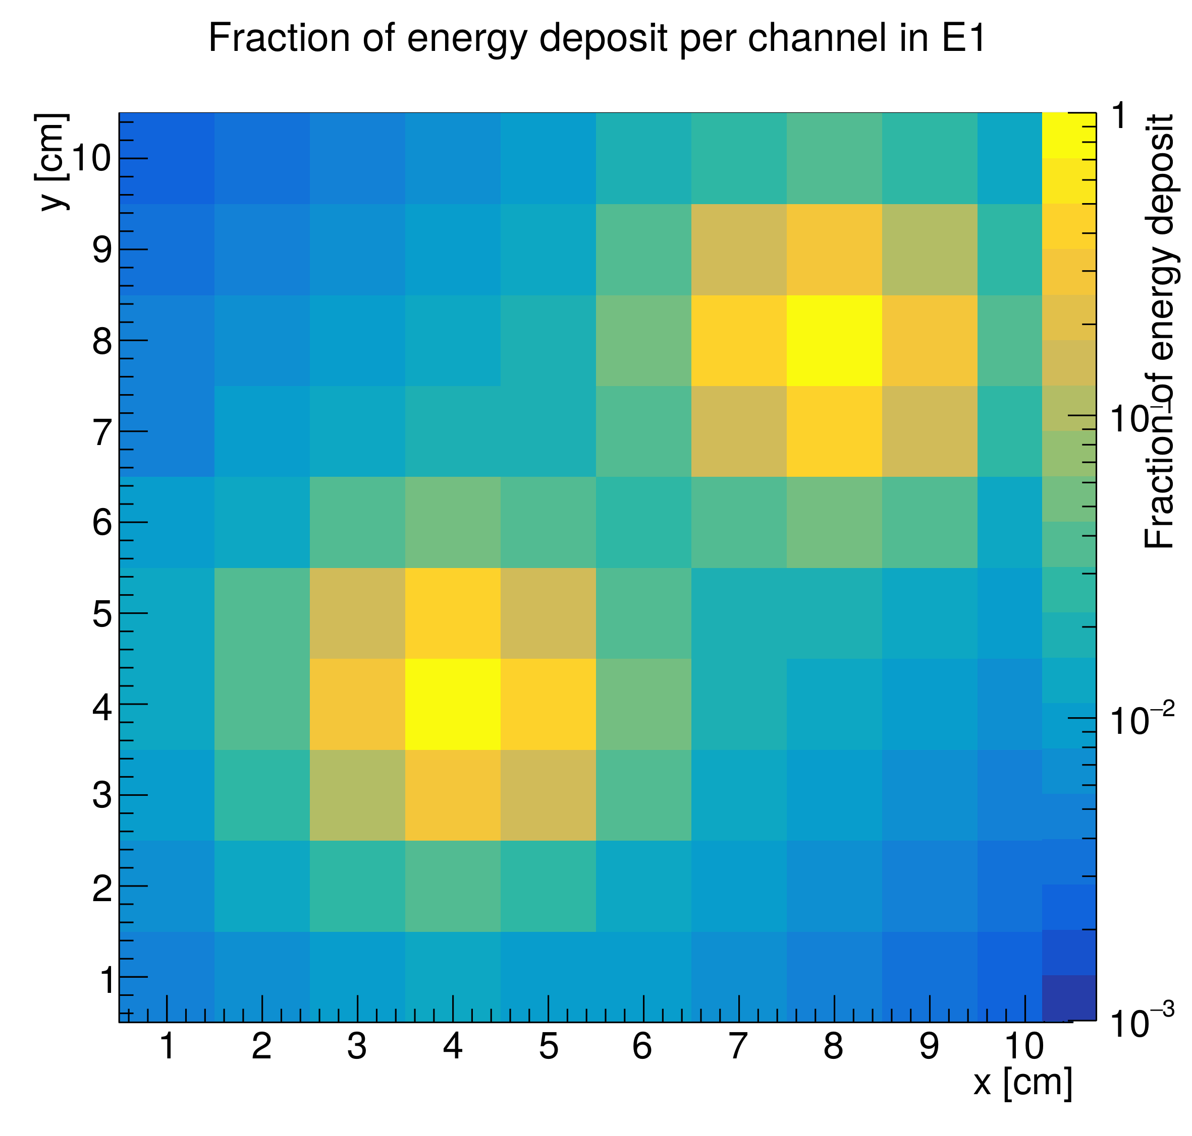
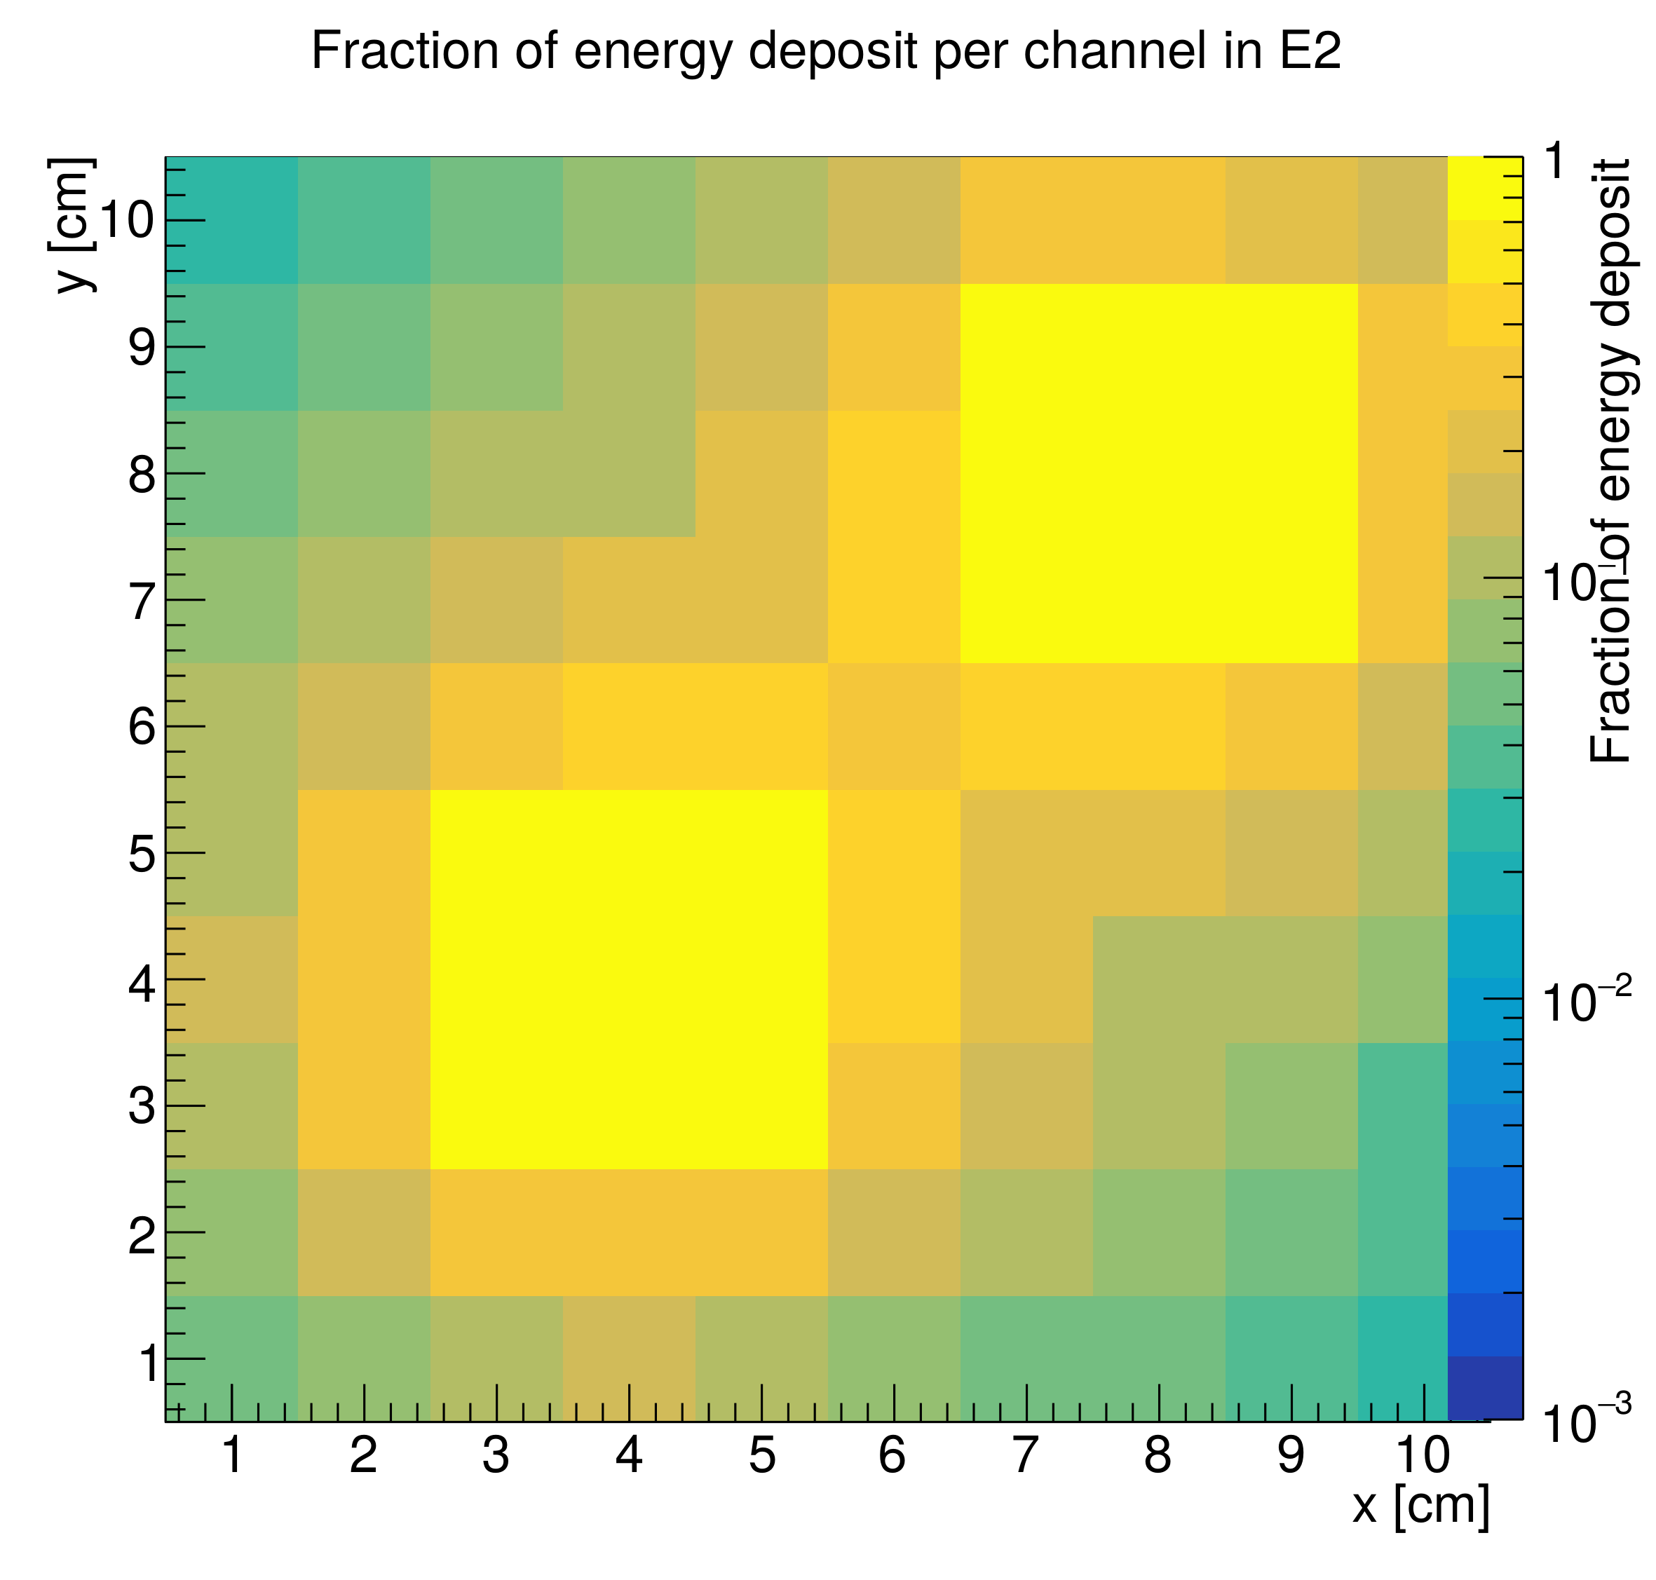
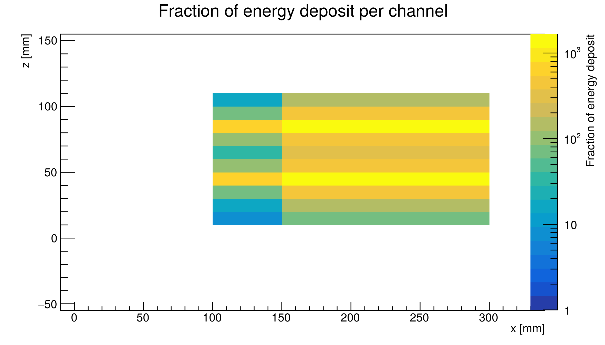
Pair of 45 GeV Electron Showers
PWO
R_{M} = 2.0 cm
PWO
R_{M} = 2.0 cm
PWO
R_{M} = 2.0 cm
CsI
R_{M} = 3.6 cm
CsI
R_{M} = 3.6 cm
CsI
R_{M} = 3.6 cm

Slide 7
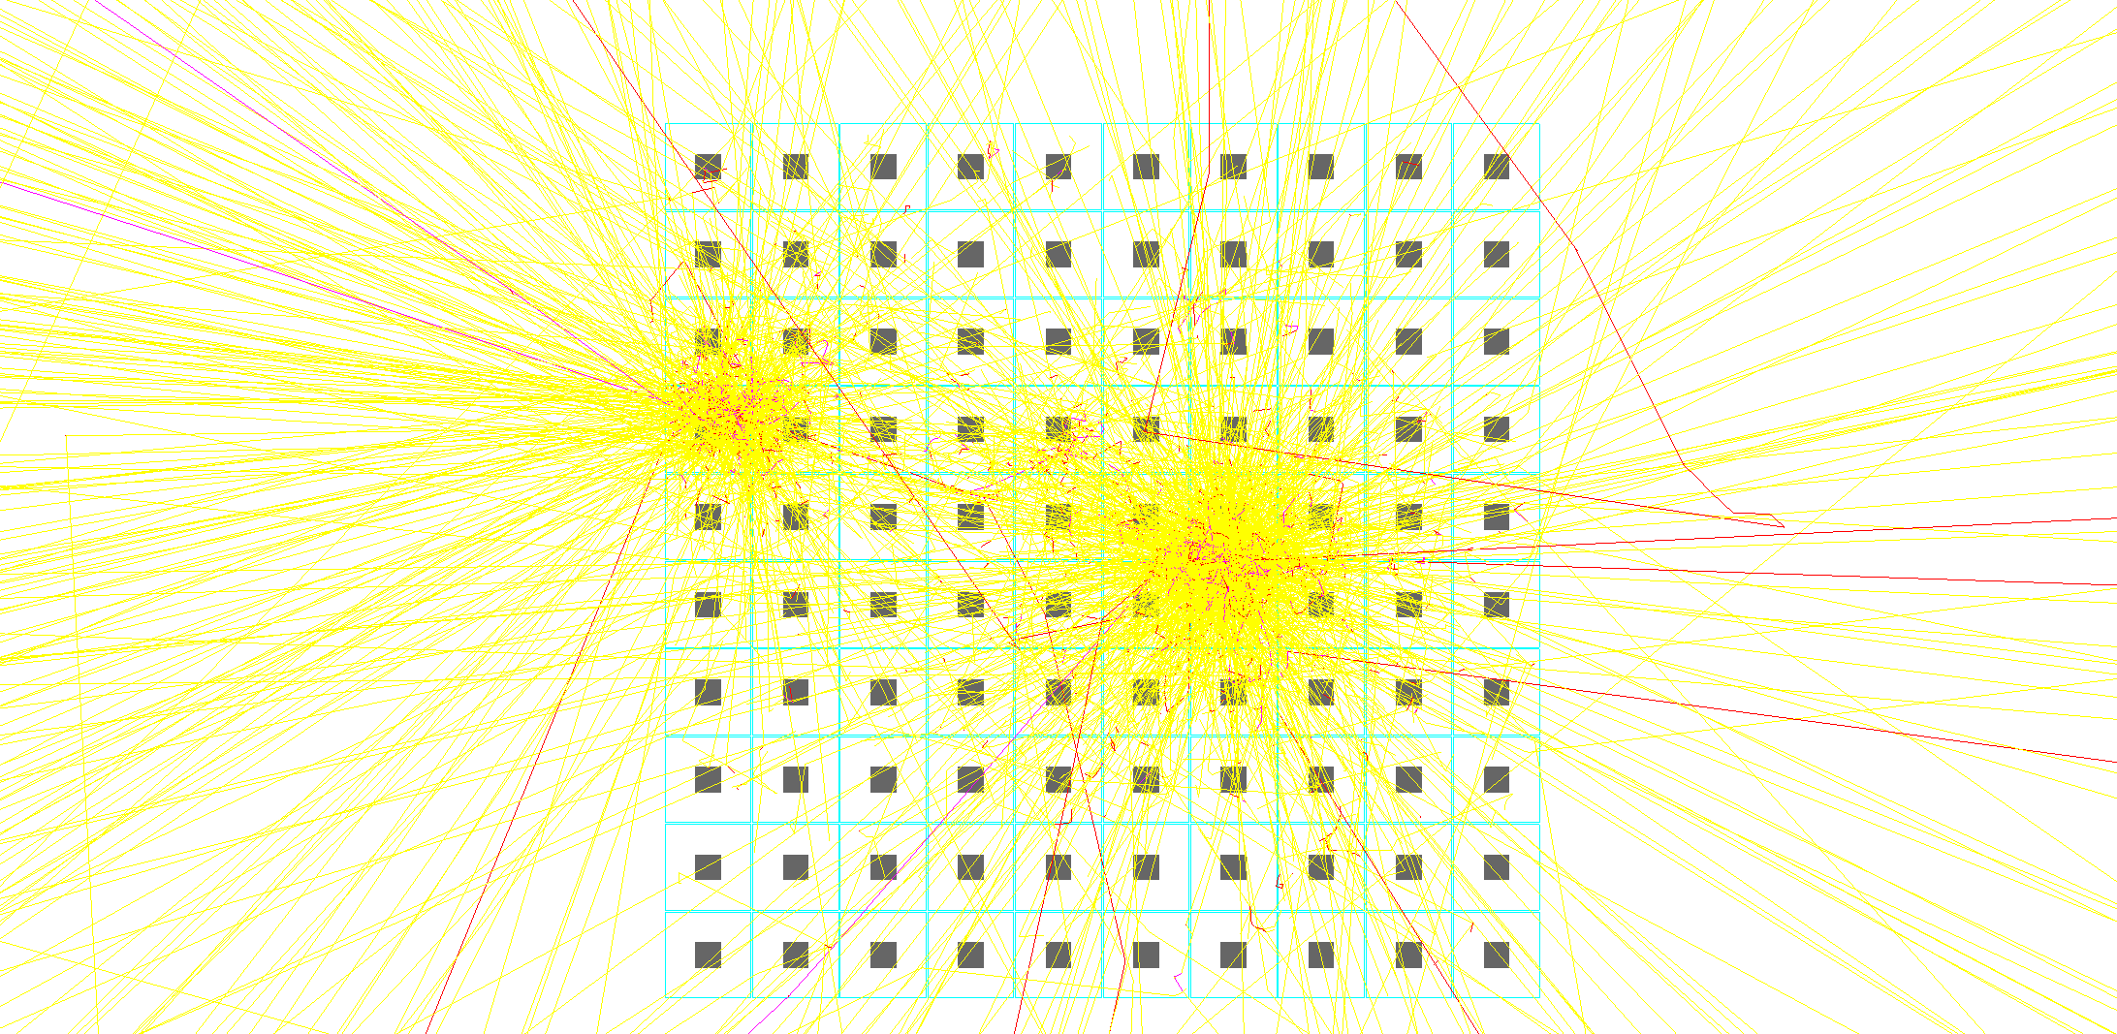
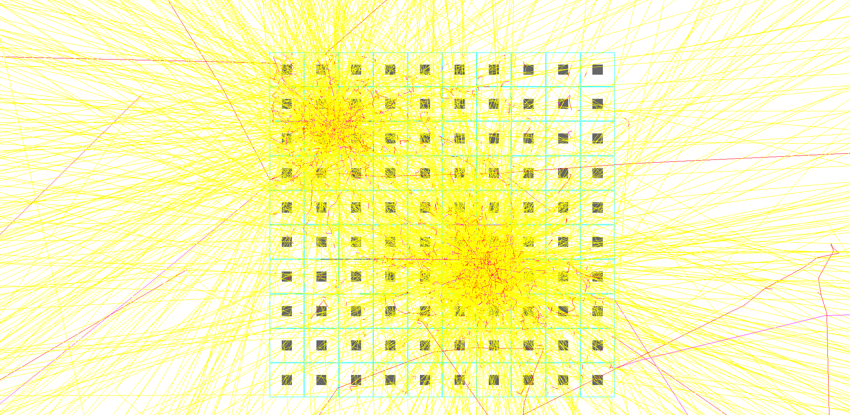
10 GeV π⁰ Photon Separation
More practical example (front & rear compartments):
PWO
R_{M} = 2.0 cm
CsI
R_{M} = 3.6 cm
10 cm

Slide 8
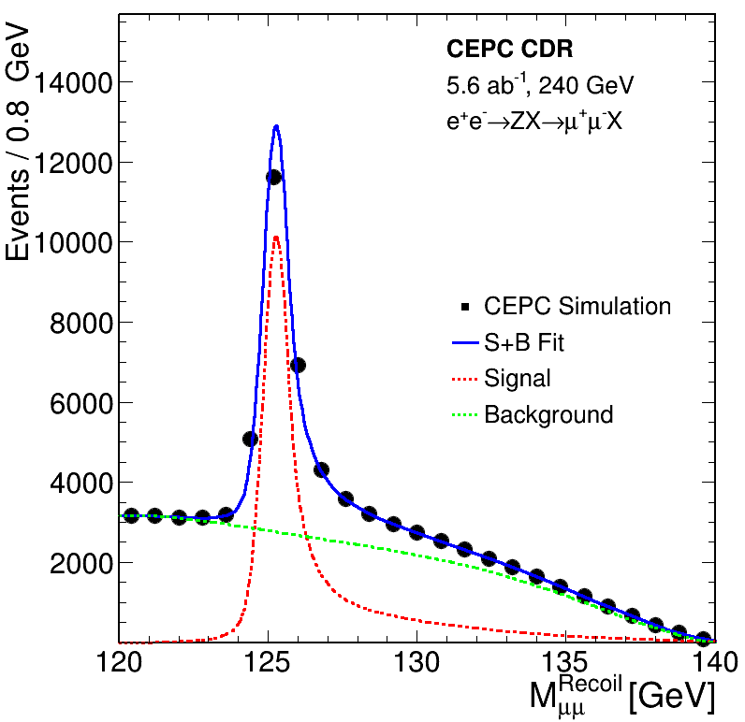
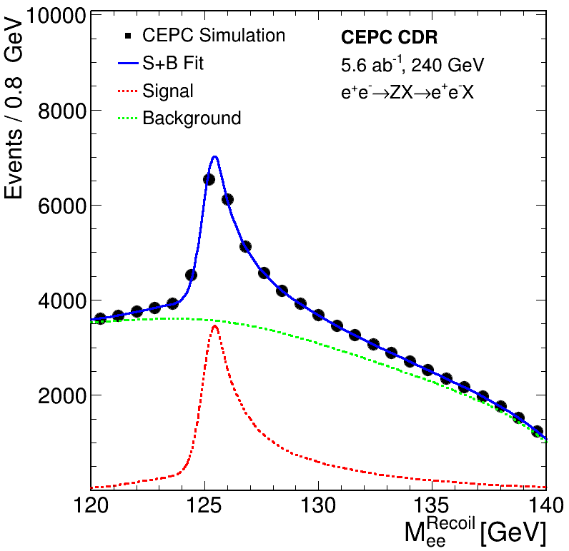
Measurement of Z→e⁺e⁻ Recoil Mass
Muons
Electrons
Muon Track
Δp/p ~0.3%
Electron Track
Δp/p tail ~1-2%
(two tracks)
CDR reference design
(electron tracks with no Brem. recovery)
Notes:
The 2-4% is the estimate additional broadening of the electron peak relative to the muon peak. I then multiply that percentage by the energy resolution of a 15%/sqrt(E) calorimeter to show that this
contribution is still significant compared to the track resolution ~0.1-0.3%.

Slide 9
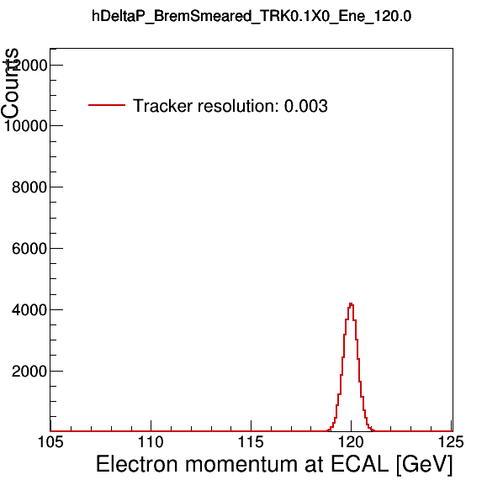

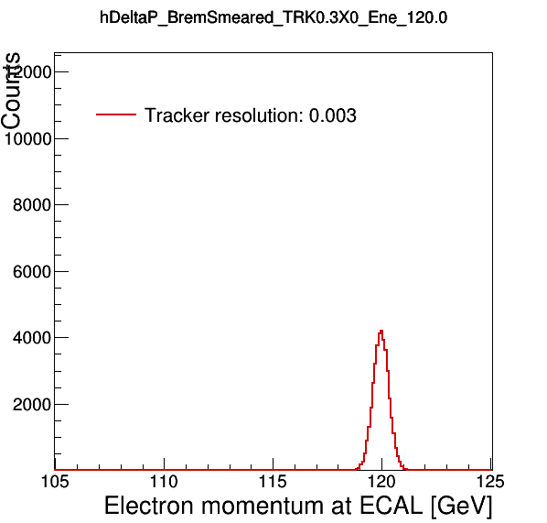

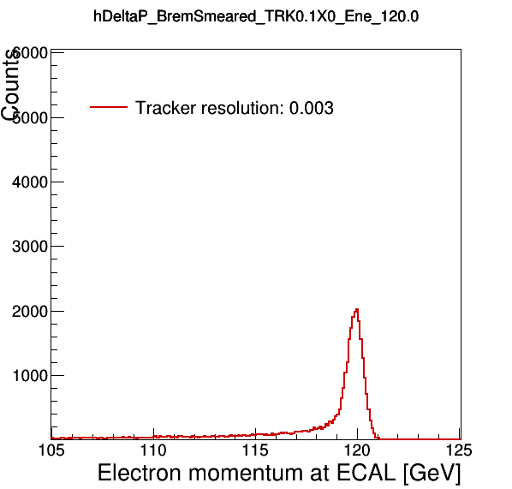
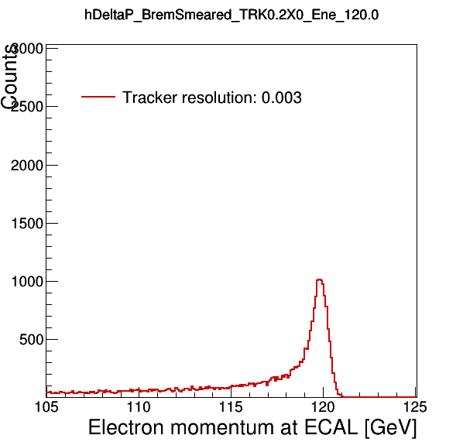
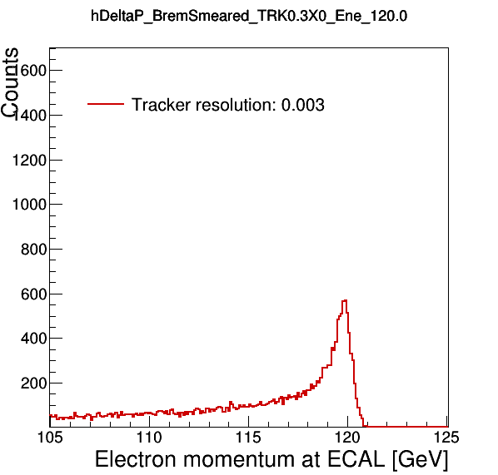
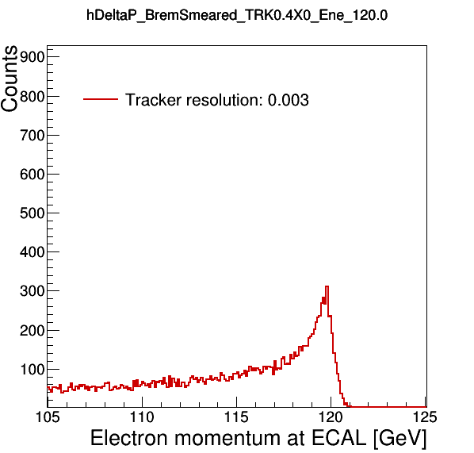
Muons vs. Electron w/ Tracker Material
Muons:
0.1 X₀
0.2 X₀
0.3 X₀
0.4 X₀
Electrons:
0.1 X₀
0.2 X₀
0.3 X₀
0.4 X₀

Slide 10
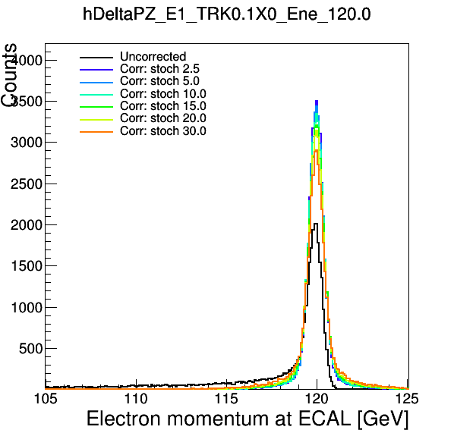
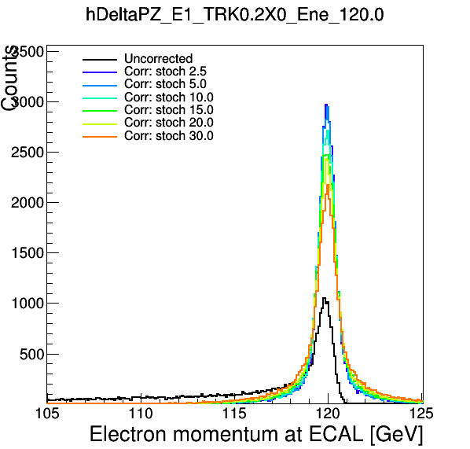
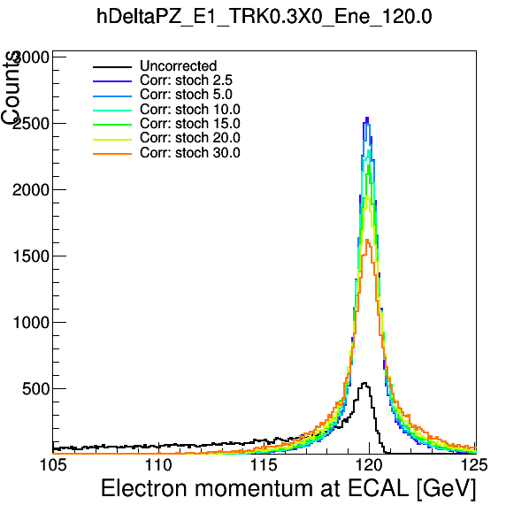
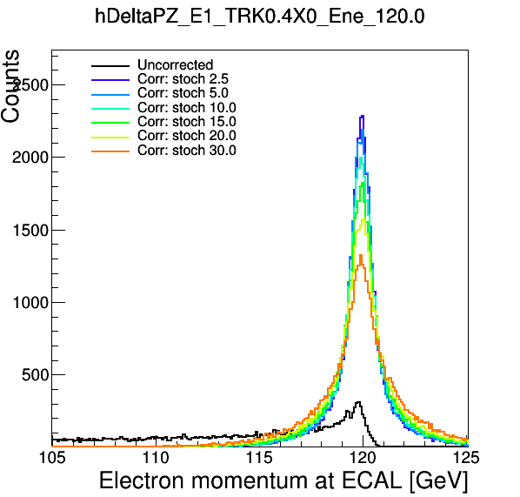
Z→e⁺e⁻ Sensitivity Recovery
Highest Recovery for ~3%/√E ECAL Energy Resolution
→ Improvement largest for ~0.3-0.4 X₀
0.1 X₀
0.2 X₀
0.3 X₀
0.4 X₀

Slide 11
Energy Resolution Target:
<3%/√E Stochastic Term
Requires:
  Shower fluctuations <2%
    Material budget in front of ECAL < 0.3X₀
  Photostatistic fluctuations < 2%
    Signal in photoelectrons >3500 phe/GeV
    Assuming 20% PDE for 10 um cell SiPMs → LY*LCE > 18 ph/MeV
      5 um cells with high PDE in development
    Need to tune SiPM active area accordingly to crystal LY
      PWO: LY=100 ph/MeV → LCE>18% → SiPM area > 64 mm²
        SiPM number of cells: 360k
      BGO: LY=7000 ph/MeV → LCE>0.3% → SiPM area > 1 mm²
        SiPM number of cells: 10k → dynamic range effectively x30-40 larger due to the fast time response of the pixel compared to the BGO decay time

Slide 12
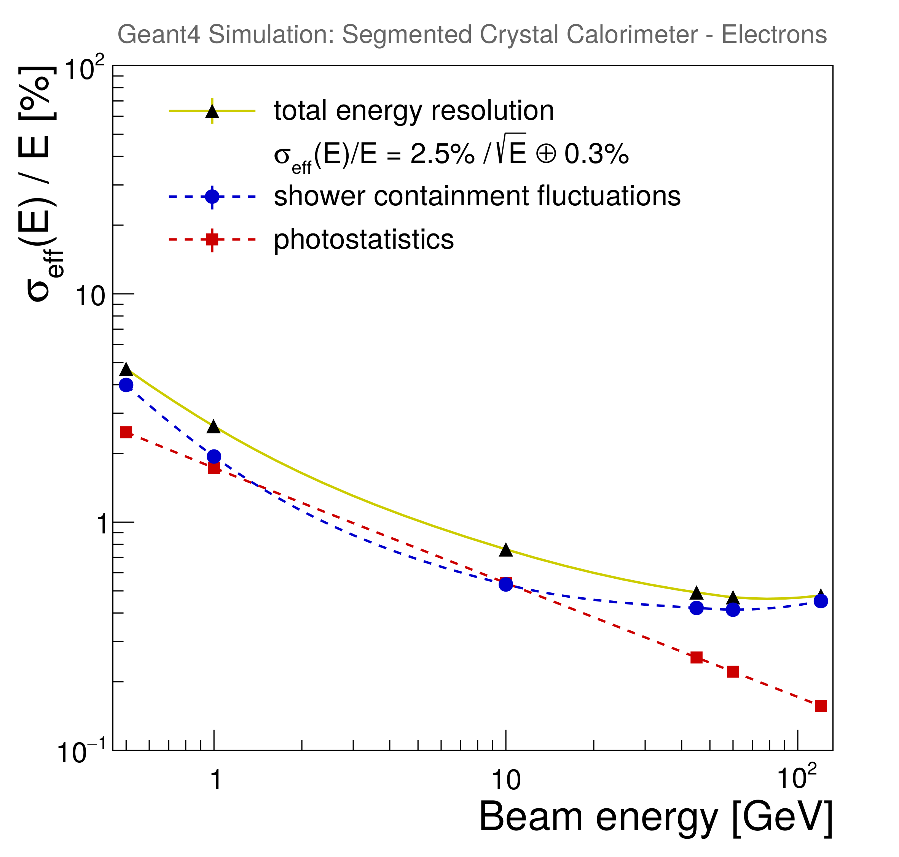
S-CEPCal Energy Resolution
Contributions :
  Shower containment fluctuations
    Longitudinal leakage
    Tracker material budget
    Services for front layer readout
  Photostatistics
    Tunable parameter depending on:
      SiPM choice
      Scintillator choice
      Connected to dynamic range
  Noise
    Negligible (low dark counts, high gain)

Slide 13
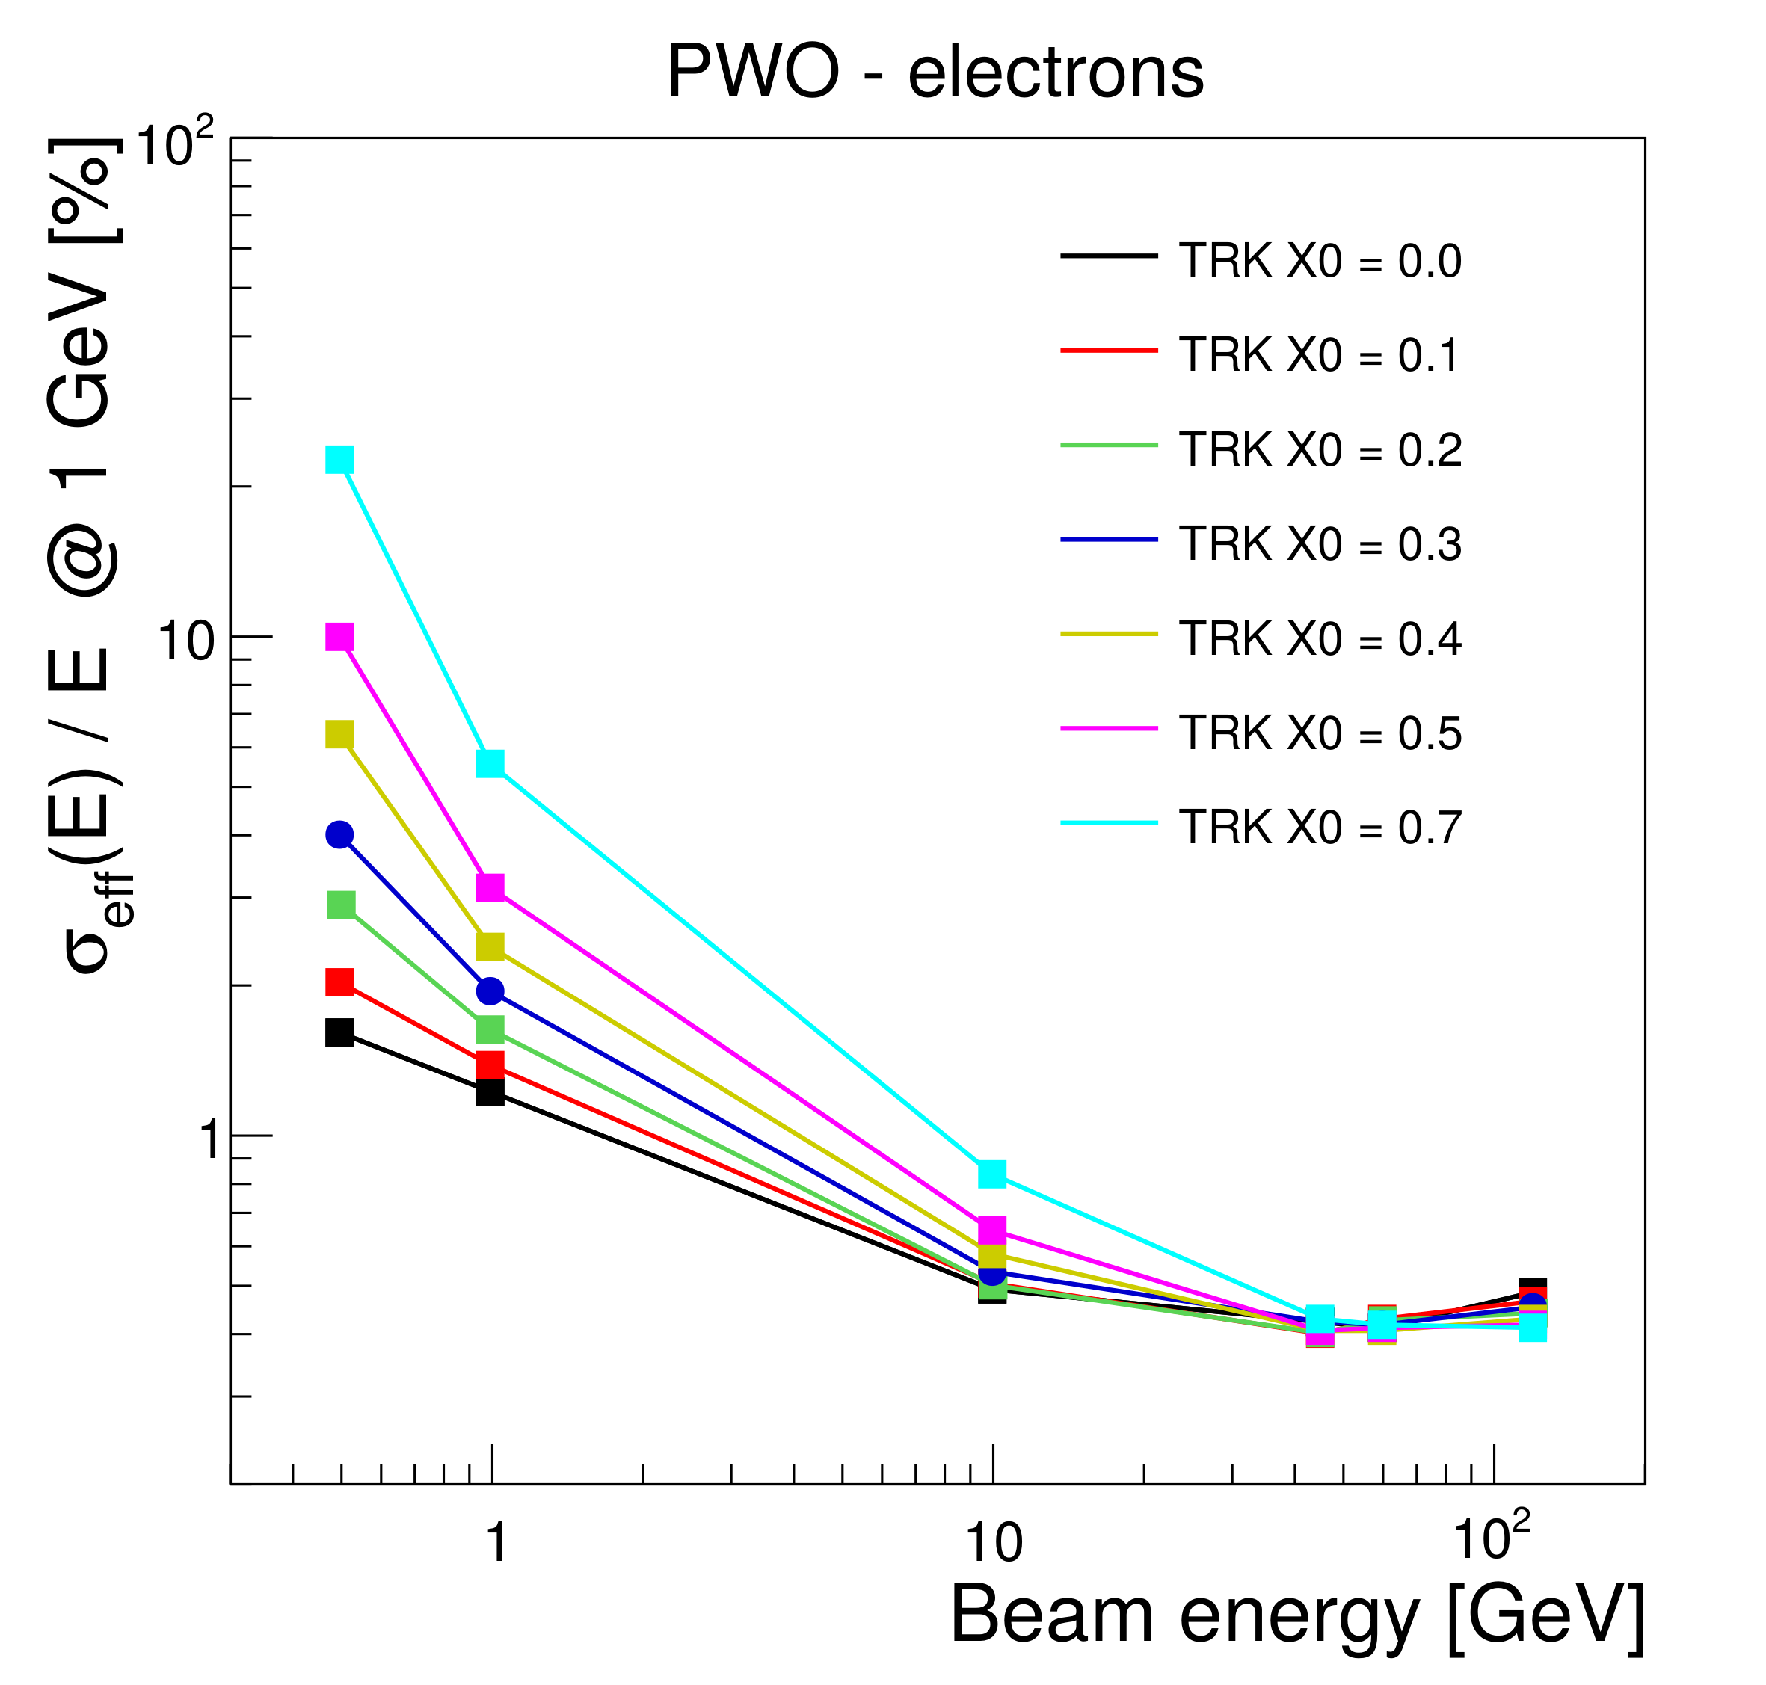
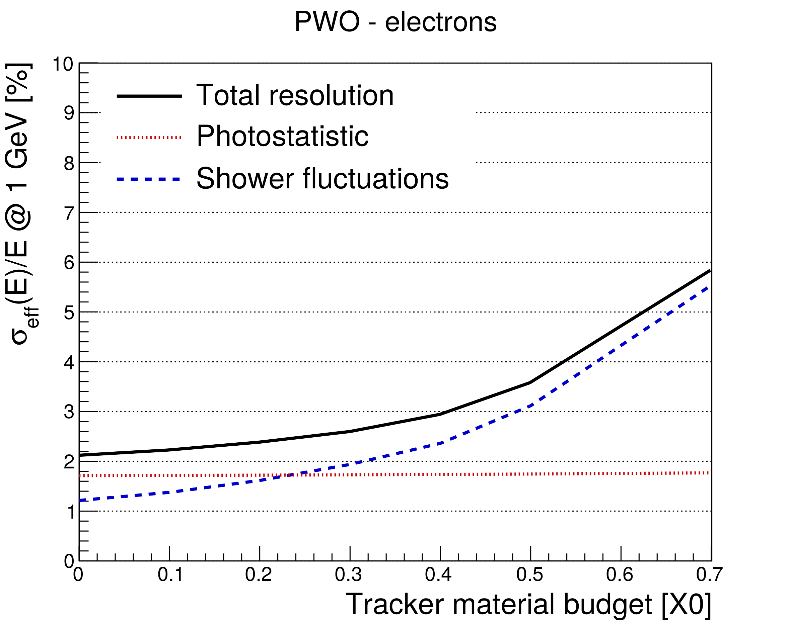
Impact of Tracker Material Budget

Slide 14
Crystal Options
better for PFA
PWO:
  the most compact, the fastest, the cheapest
BGO:
  close to PWO in compactness, slower, brighter
CsI:
  the least compact, the slowest, the brightest
better stochastic term
Crystal | Density g/cm³ | λ_{I} cm | X₀ cm | R_{M} cm | Relative LY @ RT | Decay time ns | Photon density (LY / τ_{D}) ph/ns | dLY/dT (% / °C) | Cost (10 m³) $/cm³ | Cost*X₀ $/cm²
PWO | 8.3 | 20.9 | 0.89 | 2.00 | 1 | 10 | 0.10 | -2.5 | 8 | 7.1
BGO | 7.1 | 22.7 | 1.12 | 2.23 | 70 | 300 | 0.23 | -0.9 | 7 | 7.8
CsI | 4.5 | 39.3 | 1.86 | 3.57 | 550 | 1220 | 0.45 | +0.4 | 4.3 | 8.0
Values from: Journal of Physics: Conference Series 293 (2011) 012004

Slide 15
Cost Estimate (and Power)
ECAL INPUTs
Number of crystals per m² (front E1) | 8100
Number of crystals per m² (rear E2) | 8100
Number of SiPM per crystal (front E1) | 1
Number of SiPM per crystal (rear E2) | 1
Cost/crystal (front+rear) (1x1x20 cm³) - SIC | 152.0832
Cost per SiPM (€) | 3
Electronics cost per channel (€) | 2
Power cost per channel (€) | 1
Calibration-monitoring cost / channel (€) | 0.5
Barrel ECAL
Total SiPM power (kW) | 1.7172
Total electronics (kW) | 23.1822
Total barrel ECAL power (kW) | 24.8994
2 Endcaps ECAL
Total SiPM power (kW) | 0.696
Total electronics (kW) | 9.396
Total endcap | 10.092
(35kW)
Grand total ECAL (barrel+endcap) [kW] | 35
Barrel ECAL
Radius | 1.8
Length | 4.7
Area (m²) | 53
Number of crystals (front E1) | 429300
Number of crystals (rear E2) | 429300
Number of SiPMs (front E1) | 429300
Number of SiPMs (rear E2) | 429300
Endcaps ECAL
Inner radius | 0.35
Outer radius | 1.7
Area (m²) for two endcaps | 17.4
Number of crystals (front E1) | 174000
Number of crystals (rear E2) | 174000
Number of SiPMs (front E1) | 174000
Number of SiPMs (rear E2) | 174000
Total barrel crystal cost (k€) | 65289
Total barrel SiPM cost (k€) | 3005
Total electronics cost (k€) | 1717
Power system | 859
Services (CO2 cooling) | 1318
Mechanics and assembly | 300
Total barrel ECAL cost (k€) | 72488
Total endcap crystal cost (k€) | 26462
Total endcap SiPM cost (k€) | 1218
Total electronics cost (k€) | 696
Power system | 348
Services (CO2 cooling) | 174
Mechanics and assembly | 300
Total endcap ECAL cost (k€) | 29198
Total ECAL crystal volume [m³] | 12
Grand total ECAL (barrel+endcap) [# channels] | 1206600
Grand total ECAL (barrel+endcap) [k€] | 101686
~100 Meuros

Slide 16
Summary
Puts Z→ee on equal footing with Z→μμ recoil
  x3 improvement on electron Brem. energy measurement
Improve PFA EM shower imaging and separation
  x100 increase on EM shower sampling fraction (1/300 → ~1)
Option to Incorporate Precision Time-of-Flight System
  ~20ps MIP/photon timing with high granularity (~3mm)
Option to Include Dual-Readout capabilities for hadrons
  Dual wavelength filters (320-400nm) for Cherenkov/Scint discr.
Extend Physics Program w/ EM Res. and Timing
  Neutrino counting (Ζ◊ννγ/Ζ◊μμγ), Long-lived Particles, Cosmics/Out-of-time background reduction for missing energy
Cost-effective solution
  Segmented crystals with SiPM readout

Slide 17
Additional slides

Slide 18
Electron Bremsstrahlung in Tracker
Tracker Material
Increasing
Count Tracks
(e+,e-, photons)
Crossing Here
6-Layer Silicon Tracker
S-CEPCal

Slide 19
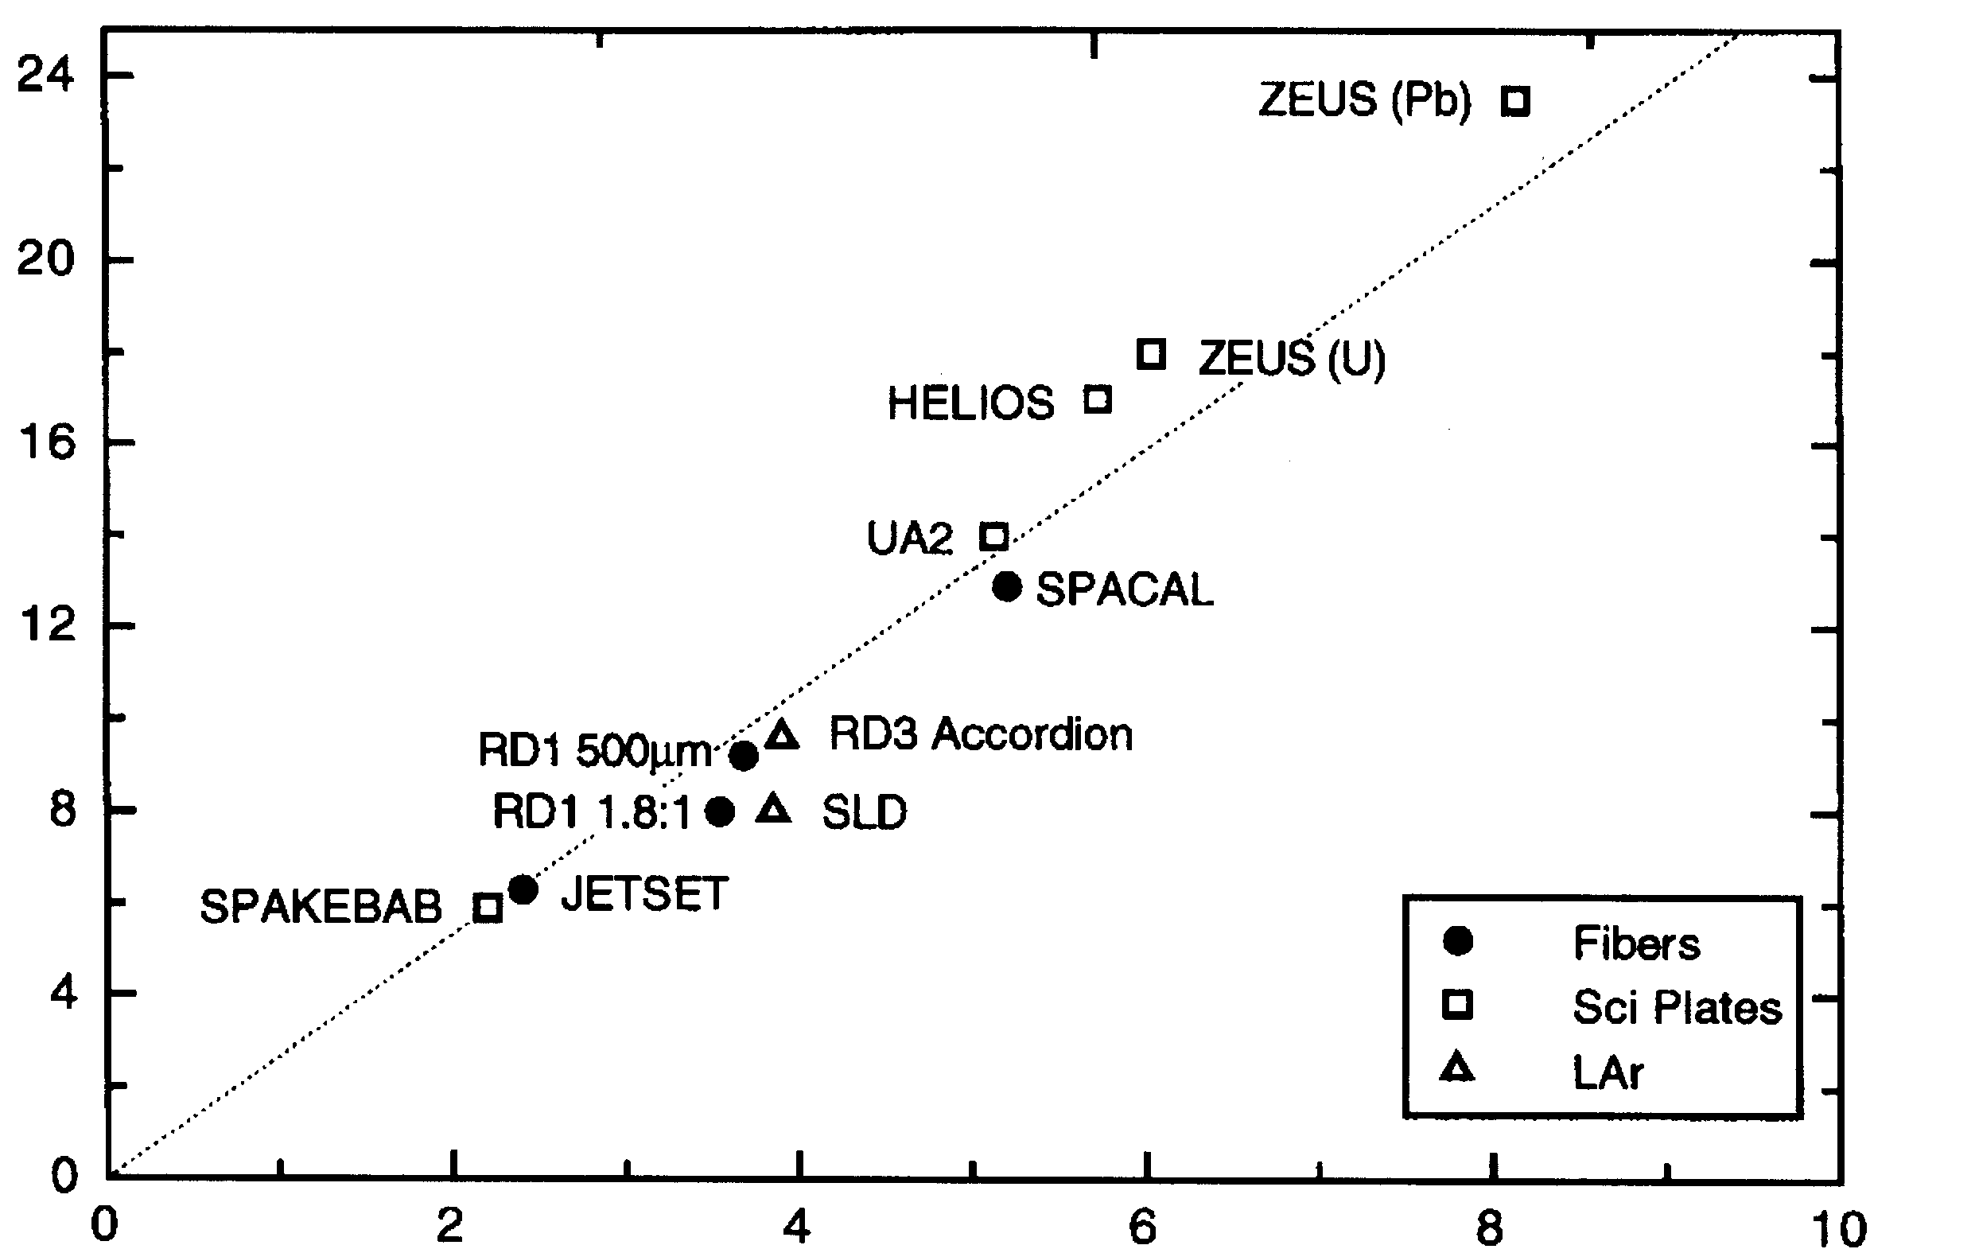
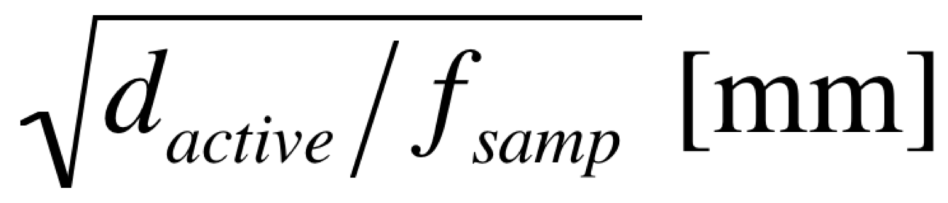
Three Regimes of EM Resolution
For EM showers in a sampling calorimeter, the energy resolution is dominated by the sampling fluctuations:
Silicon
* Si-W (100μm - HGC)
* Si-W (300μm - HGC)
X₀(Si)/X₀(W)=27
Segmented
Crystal?
(σ_{Ε} /E)_{EM} *√E [%]
Plastic/Quartz
Fiber
(Courtesy of R. Wigmans)
Homogeneous crystals
Notes:
The vertical axis is a demonstration by Wigmans of how to estimate the X%/sqrt(E) term for an electromagnetic calorimeter.
The current PFA concepts favor silicon (>20%/sqrt(E)) – which have a sampling fraction of ~1/270 from the ratio of the radiation lengths of Si and W (27) and the relative thicknesses ~0.3mm of Silicon divided by 3mm of W (1/10). The DREAM/fiber calorimeter hope to get 1-15%/sqrt(E).
We demonstrate in the next pages < 5%/sqrt(E) for segmented crystals.

Slide 20
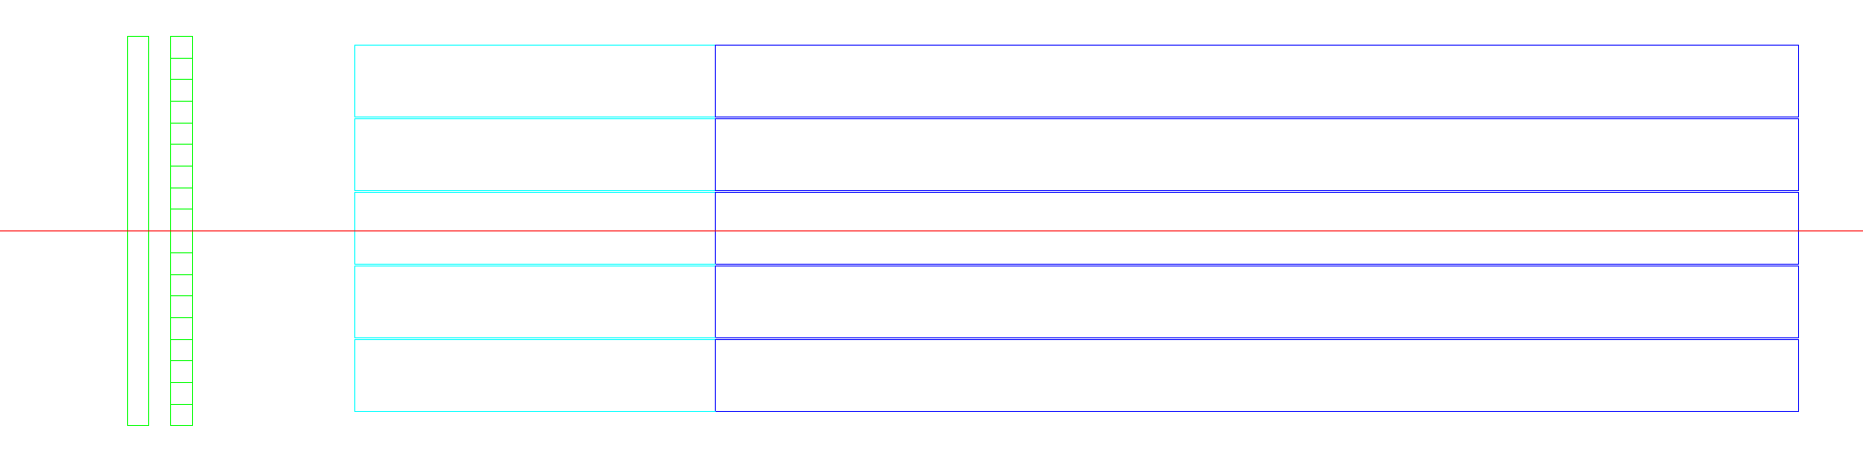
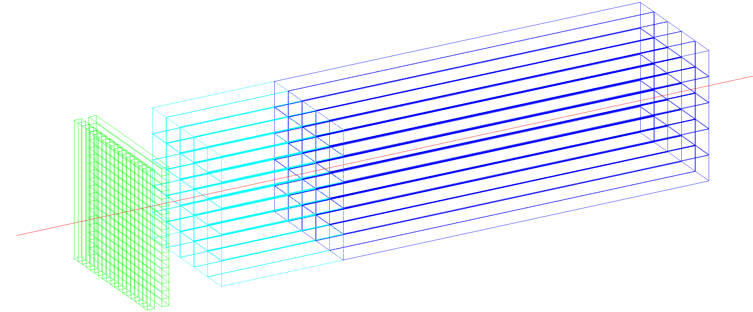
Segmented Crystal Calorimeter Module
Timing layer:
  LYSO:Ce crystals
  SiPMs
  3x3x54 mm³ active cell
  3x3 mm² SiPMs
  (15-25 um)
1 layer: 30 ps
2 layers: 20 ps + tracking
< 5%/sqrt(E) (+) 1%
~30 ps timing achieved for p_{T}>40GeV
ECAL layer:
  PbWO crystals
  front segment 5 cm (~5.4X₀)
  rear segment for core shower
  (15 cm ~16.3X₀)
  10x10x200 mm³ of crystal
  5x5 mm² SiPMs (10-15 um)
Front segment with SiPM in front and rear segment with SiPM on back
→ Avoids dead material at shower max
20
Notes:
We hope to get some GEANT4 EM shower in this.
The idea is for the first two layers to be timing layers (about 0.5 X0 each) that have very high MIP S/N like the CMS MTD for high resolution impact point and timing
resolution for charged particles and a fairly high photon conversion timing rate (in 1 X0 + tracker material before).
The two segments that follows are 1cm^2 transverse size with a 5cm front crystal and a 15cm back crystal butted together in the middle. The SiPM readout is on the
front of the front crystal and on the back of the back crystal so that the interface near shower max has little dead material.

Slide 21
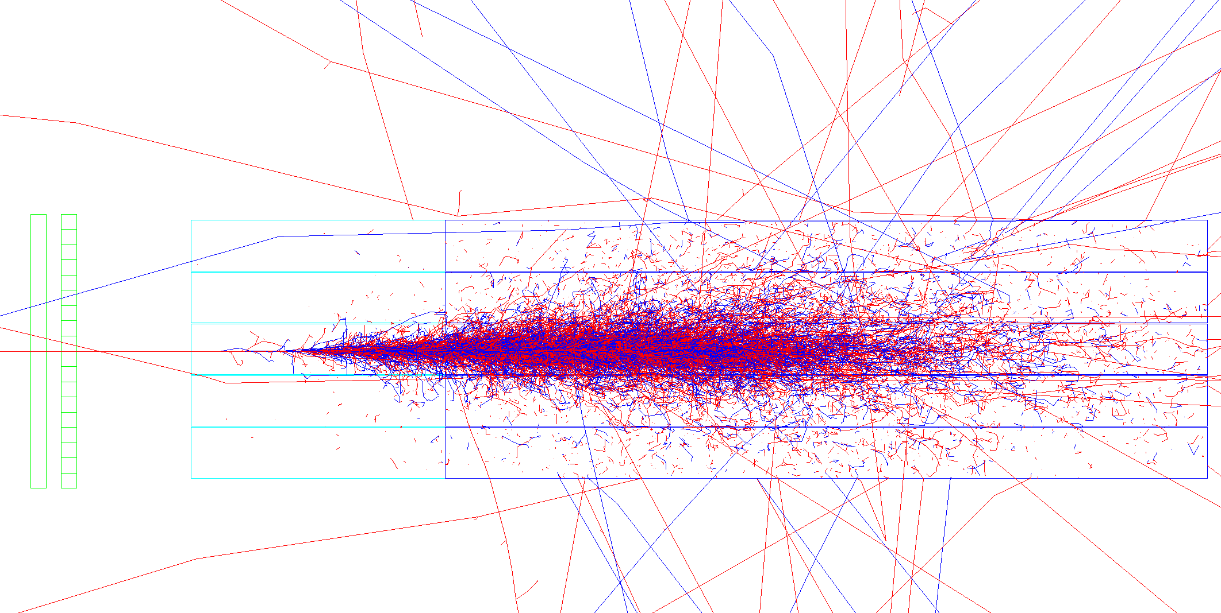
Electron Energy Resolution (no Dead Material)

Slide 22
Dead Material between Layers
rear

Slide 23
Impact of Dead Material between Layers

Slide 24
Impact of Tracker Material

Slide 25
Imaging Capabilities of Silicon (~1/300)
CO₂ (-35 C)
Fluctuations driven by
Low Sampling Fraction(~1/300)
High SF → one shower looks like many
Notes:
The left structure is the CMS HGCal and one has to look at the blue to see the 0.3mm of Silicon (goes down to 0.12mm at high eta). The rest is absorber. The top event
Shows that two adjacent EM showers look like from one event. It’s splotchy, but one can see what is going one. If one makes an average over many events, the separation is crystal clear.
The idea to convey is that a couple hundred times higher sampling fraction is equivalent to averaging over a couple hundred events. Hence, segmented crystals will be good for PFA.
The CEPC silicon proposals are for 1cm^2 transverse segmentation – we will match that with the segmented crystals. It’s not clear one needs a lot of longitudinal segmentation.
We make a proposal in what follows.

Slide 26
S-CEPCal Single EM Shower (High Stat)

Slide 27
S-CEPCal Single EM Shower (High Stat- Log)

Slide 28
S-CEPCal Pair of EM Showers (High Stat)

Slide 29
S-CEPCal Pair of EM Showers (High Stat - Log)

Slide 30
S-CEPCal Pair of EM Showers (Single Event)

Slide 31
S-CEPCal Pair of EM Showers (Single Event - Log)

Slide 32
Electron/π± Discrimination
1st
2nd
1st
1+2
2nd
Timing Layers
electron
Timing Layers
π±
1+2
Total
Front
Rear
Front
Rear
Total
Calo Layers
π±
Calo Layers
electron
Notes:
5x5 matrix of 1 cm^2 crystal of 200mm length contains 90% of a 120 GeV shower. This produces a constant term of 0.6%

Slide 33
Electron/π± Discrimination
Notes:
5x5 matrix of 1 cm^2 crystal of 200mm length contains 90% of a 120 GeV shower. This produces a constant term of 0.6%

Slide 34
Energy Resolution and Dynamic Range
5%/sqrt(E) → LO>400 phe/GeV → LO>0.4 phe/MeV
  at LCE~2.5%, PDE ~ 20% → LY>80 ph/MeV
  Ok for PWO (~100 ph/MeV)
Maximum energy deposit in single crystal for 120 GeV e.m. shower ~60%
  ~ 35000-70000 phe for ~72 GeV (at PDE~20-40% resp.)
SiPM 5x5 mm² on a 10x10 mm² crystal is sufficient
  LCE~2.5%
  if cell size: 15 um → cells / SiPM ~110,000 and PDE up to 40%
  if cell size: 10 um → cells / SiPM ~250,000 and PDE up to 25%
Sensitivity for 0.1 GeV particles
  40 phe signal
  Noise from SiPM within 30 ns integration gate negligible (DCR<10MHz → noise<1 phe)
Notes:
This is a dynamic range estimation showing PWO is a good option for them with SiPM readout.

Slide 35
Photostatistics

Slide 36
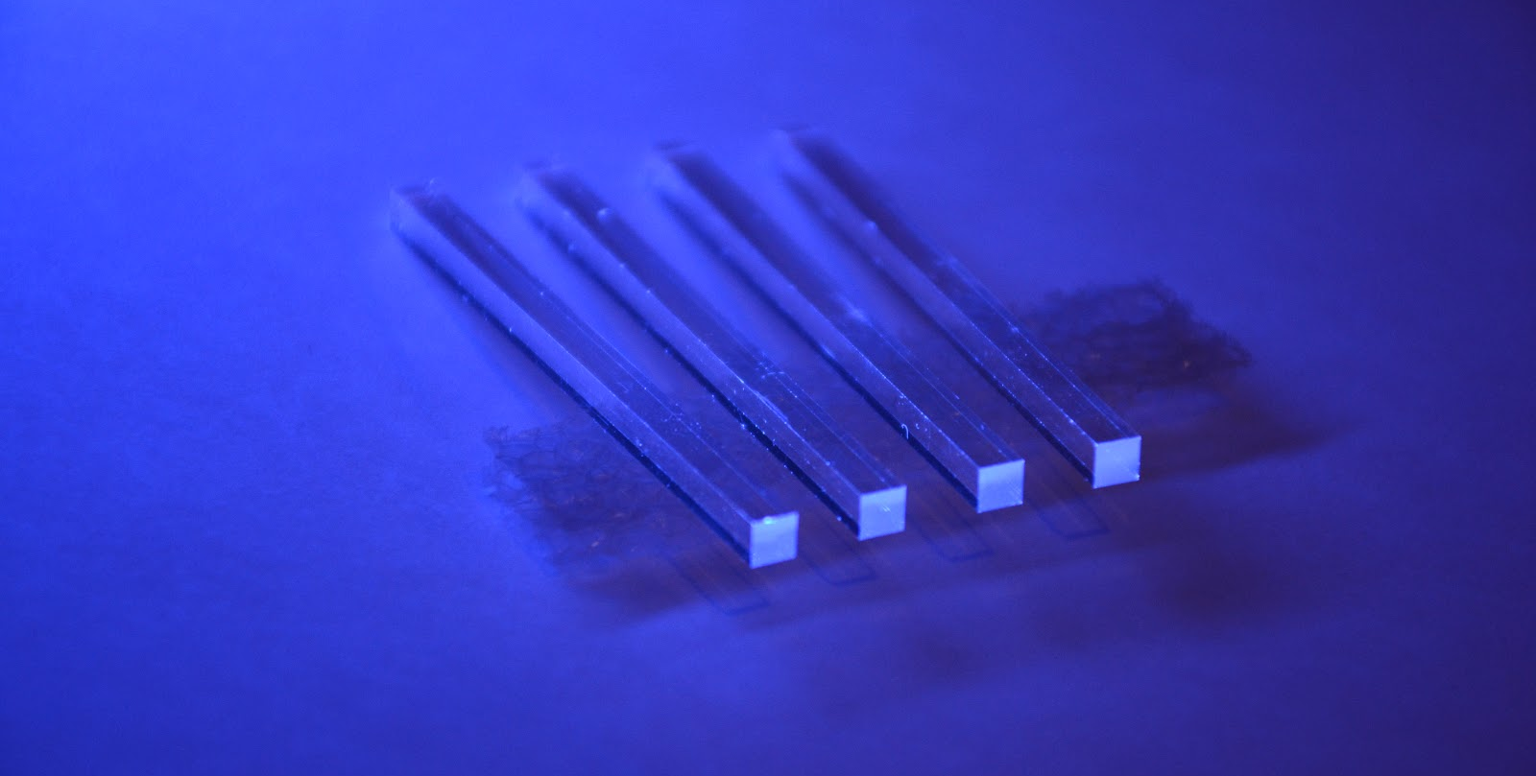
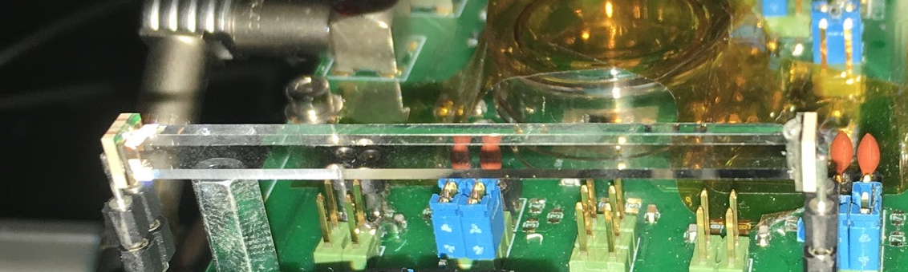
Small Crystal Geometries for Timing Detectors
Tiles and Bars (few mm thick w/ area of ~1cm²)
  CMS MTD: Single layer ~330,000 channels
  Stereo readout for bars (L/R) ~25ps timing resolution
SiPM
Non-wrapped crystal bar with 2 SiPMs attached at each end
3x3x50mm³
crystal
Option A for CMS MIP Timing Detector TDR
incoming particles
Low occupancy timing layer timing for ~1 X0
Transverse orientation w/ stereo readout
Similar study at IHEP
by Yuexin Wang
Notes:
This is some views of the CMS MTD technology showing the crystal bar sensors.
Back in November 2018 at IHEP, one of the students at IHEP presented a poster on a similar study (in blue box).

Slide 37
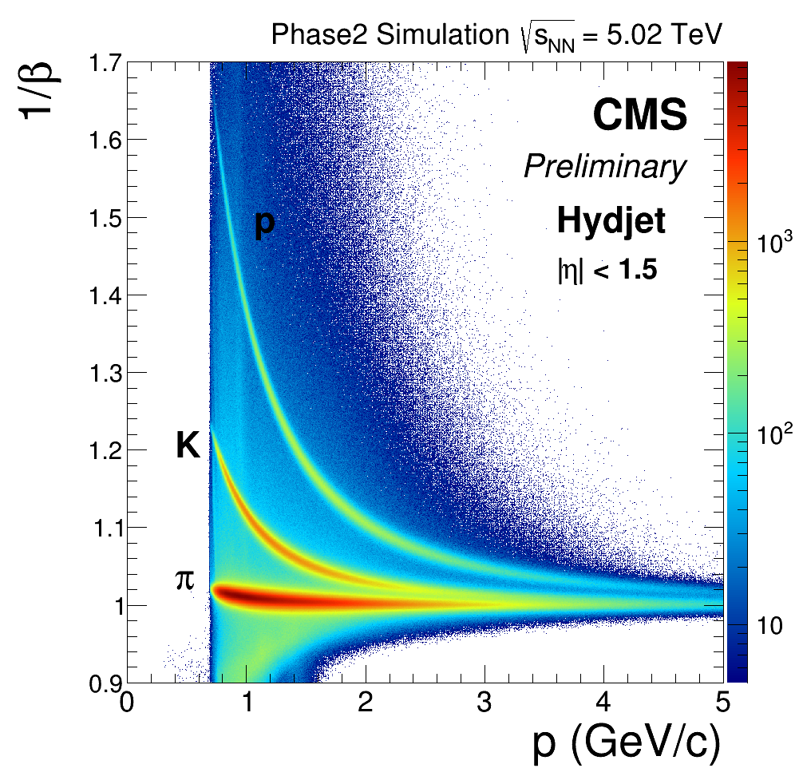
Time-of-Flight Particle ID (R=1.2m)
Single Layer
(30 ps)
Improves by 1/√2
w/Dble Layer

Slide 38
Dual-Readout Capability

Slide 39
Dual-Readout ECAL+HCAL Compatibility
Projective or Planar Sc/C
Tiles/Fiber
Bundles?
Muon
System
Plastic or Gas?
Projective Sc/C Fiber Bundles?
Scint.fibers
SiPM
Solenoid Inner Radius
Outside ECAL and ECAL/HCAL
Interface?
Sc/C filters
2x SiPM
Sc/C filters
2x SiPM
Ch.fibers
SiPM

Slide 40
EM Resolution and Photon Counting
EM Resolution also improves angular measurements and resolves N𝛄 counting
Recoil photons (~8% of full √s collision rate)
    New Physics Searches and Neutrino Counting
Improved Syst.
(A. Blondel)
E. Bartos et al., “2γ and 3γ annihilation as calibration processes for high energy e+e− colliders,”
https://arxiv.org/abs/0801.1592
Notes:
This is the physics argument that the normalization of the integrated luminosity with Bhabha scattering will not be precise enough to improve neutrino counting.
Similarly, single photon and multiple photon radiative return need to be able to count photons well in angle and energy to exclude additional radiation or mismeasurement.
If one normalizes the invisible Z radiative return to the Z->dilepton radiative return, then the ratio is well known in theory and the limitations from Bhabha scattering are eliminated
in ratio.
There are also papers on using QED diphoton instead of Bhabhas for more precise integrated luminosity – important for 10^11 Z boson factory.

Slide 41
Conclusions
Physics case at e⁺e⁻ colliders calls for high resolution ECAL
  Z→e⁺e⁻ recoil resolution w/ Brem. recovery methods
  Highly resolved PFA clustering from high sampling fraction
  20ps Resolution Time-of-Flight Particle ID for π/K/p
  Photon counting with high fidelity/angular resolution
Homogenous and segmented crystal calorimeters can provide outstanding energy resolution in the energy range 0.1-120 GeV
Calorimeter design can capitalize on the expertise from previous HEP crystal calorimeters
Recent progress in the fields of crystals and SiPMs enables a flexible, compact and lower cost solution for a high resolution ECAL
A highly segmented calorimeter in transverse and longitudinal direction combined with 20 ps timing capabilities extends the physics program for particle ID, long-lived particles and improves out-of-time background rejection

Slide 42
Balancing Jets and EM particle resolutions
For HZ production, all Z recoils matter
  ~70% of Z decay are hadronic
Particle Flow Principle
  Optimal use of measurement information applied to each reconstructed particle
    Charged hadrons (~65%)
      Replaced by track (~0.1%)
    Neutral hadron (~10%)
      HCAL (~45%/√E)
    Photons/EM (~25%)
      ECAL (~15%/√E)
~4.5%/√E
~3.8%/√E
Z Jets ~ 3.5 - 5.5% (Limited by HCAL & EM)
Notes:
The blue numbers multiply the calorimeter resolutions by their fractions to estimate the impact on the jet resolutions.
The blue terms add in quadrature. The tracker term is negligible.

Slide 43
Comparisons with CMS and PANDA ECALs
LY (PWO) ~ 100 ph/MeV
CMS EE:
  QE_{VPT} ~22%,
  LCE ~ 9% (1 VPT: size~ 11 mm radius - area: 380 mm²)
  PbWO, crystal end face size: ~30x30 mm²
CMS EB:
  QE_{APD}~75%,
  LCE~9% (2xAPDs, size: 5x5 mm²)
  PbWO crystal size: ~22x22 mm²
Resolution measured in test beam: ~3-6% stochastic + 0.3-0.6% constant
http://iopscience.iop.org/article/10.1088/1748-0221/2/04/P04004/pdf
https://arxiv.org/pdf/1306.2016.pdf
PANDA ECAL
PWO-II development:
→ factor 4 higher LO at -25°C wrt to +25°C
→ ~20 phe/MeV @PDE=20%
→ <2% stochastic term
https://arxiv.org/pdf/0810.1216.pdf

Slide 44
Silicon Photomultiplier (SiPM) Cells
Typical dynamic range customization for SiPM
  More (small) SPADS to count more photons (50→15μm)
  Bright crystal (LYSO, GAGG) and high photodetection efficiency (PDE) and light collection efficiency (LCE)
Currently:
Large device ~6x6mm²
CMS MTD ~4.5 m² of SiPMs
(of 3x3mm²)
Segmented Crystal ECAL:
~200 m² of crystal surface
(3-4 layers)
Which SiPM device?
Notes:
This is some added material I put in on SiPM customization which we studied extensively for the HCAL Phase-I and the MTD detectors.
The CEPC segmented crystal calorimeter would be significantly more total area of SiPMs. One might worry, for instance, that the timing
Detector SiPMs will not have enough dynamic range for early showers. Next slides on some ideas for further customization.

Slide 45
Further Possibilities for SiPMs with
High Dynamic Range and Packing Density
Large pixel count w/ large gain leads to current output limitations for large area devices
  Multiple analog outputs per device
    Regional lumped analog sums - split output currents per region and sum (1/128, 1/32,1/8,1/2)
    Multi-gain SPADs (5, 15, 50μm) for different cell sizes and fill factors – dynamic range built into SPAD layout
  On-chip ADC with regional serializers
  Commercial market for LIDAR advances is growing rapidly – many new developments expected
Notes:
These are some ideas about how SiPMs could have multiple analog outputs to handle dynamic range.
Technological development – when involving timing impacts
LIDAR and TOFPET medical imaging

