Slide 1
Timing and
Front End Control
David Cussans,
CEPC Workshop,
Oxford, 15th April 2019

Slide 2
Introduction
Need to synchronize data from detector
  → Need to distribute a timing signal to front-end components
  Can’t measure any time more precisely than the timing reference
  Precision required depends on detector and accelerator time structure
Need to configure front end
  → Thresholds and other configuration

Slide 3
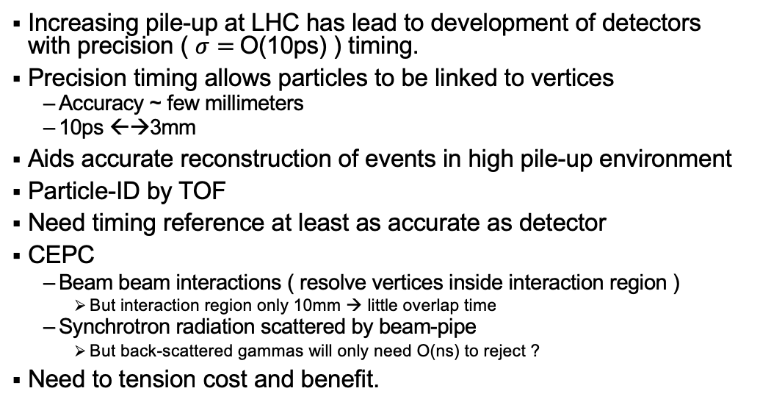
Why Precision Timing?
Increasing pile-up at LHC has lead to development of detectors with precision ( $σ=$O(10ps) ) timing.
Precision timing allows particles to be linked to vertices
  Accuracy ~ few millimeters
  10ps ←→3mm
Aids accurate reconstruction of events in high pile-up environment
Particle-ID by TOF
Need timing reference at least as accurate as detector
CEPC
  Beam beam interactions ( resolve vertices inside interaction region )
    But interaction region only 10mm → little overlap time
  Synchrotron radiation scattered by beam-pipe
    But back-scattered gammas will only need O(ns) to reject ?
Need to tension cost and benefit.

Slide 4
Why Precision Timing – pile-up rejection
Particles produced at same position can have different production times
Consider two beam bunches crossing at the interaction point:
t = -300 ps
z
t = 0
z
t = +300 ps
z
Interactions (marked with ) at same z but separated by 300 ps

Slide 5
Timing/Control Technology
Likely to end up as
  Fibre optic signal transport from timing master to detector
  Clock and data encoded on same serial link
  PLL based Clock and Data Recovery (CDR)
Considerations
  What precision is required
    Can’t measure time with higher precision than timing reference
  Is triggering (low latency signal to detector front end) required?
    Not required for data driven system
  Is fast feedback (of front-end busy) needed?
    Even in data-driven system feedback useful to avoid “Swiss Cheese” data:
    Different parts of detector busy at different times →Less data when all active.

Slide 6
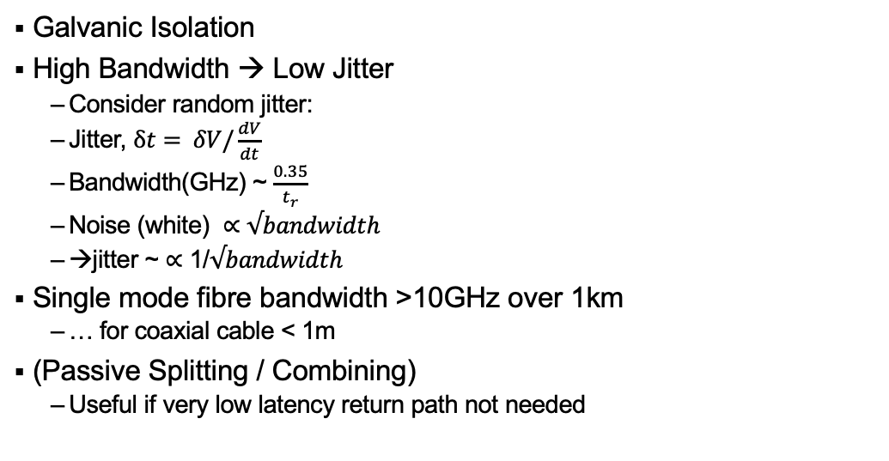
Why Fibre?
Galvanic Isolation
High Bandwidth → Low Jitter
  Consider random jitter:
  Jitter, $δt= δV/\frac{dV}{dt}$
  Bandwidth(GHz) ~ $\frac{0.35}{t_{r}}$
  Noise (white) $∝$ $√bandwidth$
  →jitter ~ $∝$ 1/$√bandwidth$
Single mode fibre bandwidth >10GHz over 1km
  … for coaxial cable < 1m
(Passive Splitting / Combining)
  Useful if very low latency return path not needed

Slide 7
Technology to the Rescue
High precision timing
LHC TTC developed ~ 1990-2000
Same period saw shift from parallel to serial links:
High bit-rates in commodity electronics → Cost/performance better than possible at start of LHC
Technology | From | To | Date
Networking |  | 1000Base-X (1GBit/s) | 1998
Backplanes | PCI VME | PCIe ATCA | 2003 2009
Peripherals | Centronics | USB | 1996
Disks | PATA SCSI | SATA | 2003

Slide 8
Data Format – LHC TTC
Need ”DC balanced” protocol.
LHC used Time Multiplexing
  Bi-phase mark encoding ( differential Manchester )
    High transition density→ Good for PLL
  Radiation hard A
  “A channel” prompt commands
  “B channel”
  OC-3 ( 155.52 MBit/s components )
From TTCrx manual

Slide 9
Data Format – DUNE Timing System
8b/10b encoding
  IP blocks readily available.
  Adequate transitions for good PLL performance
Protocol simple enough to be implemented in ASIC
  For DUNE, FPGA implementation sufficient
Designed to use passive optical splitting with endpoint → master feedback
Includes messages for adjusting clock skew and calibrating latency
  Precision dependent on “physical layer”. Current implementation granularity of 75ps
Takes advantage of higher bandwidth components now available (1GBit/s “commodity”)

Slide 10
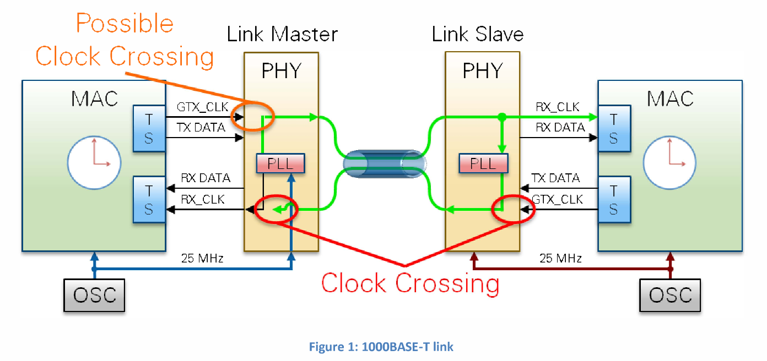
Data Format – White Rabbit?
White Rabbit is an Open Source/Open Hardware implementation of IEEE-1588
Precision ( better than 1ns ) timing using an Ethernet Link
No triggering (fixed, low, latency)
  But can be added
Would be difficult to implement in ASIC

Slide 11
Components – LHC TTC
TTC –
  OC-3 optical components
  Passive optical splitting ( downstream only )
  Higher bandwidth components now available (1GBit/s “commodity” )
Fast feedback – 10G-EPON proposed for LHC upgrade (DOI: 10.1088/1748-0221/12/02/C02041 )

Slide 12
Components – DUNE Timing System
Slower feedback, latency calibration – DUNE Timing system ( see poster at VCI2019 )
  Uses 1000Base-BX standard
    Bidirectional (different wavelength for each direction, e.g. 1490nm / 1310nm )
    Single mode fibre
    Low cost, multi-vendor
  Latency calibration accuracy O(100ps) ( TBC )

Slide 13
Components – DUNE Timing System
Slower feedback, latency calibration – DUNE Timing system ( see poster at VCI2019 )
  Uses 1000Base-BX standard
    Bidirectional (different wavelength for each direction, e.g. 1490nm / 1310nm )
    Single mode fibre
    Low cost, multi-vendor
  Latency calibration accuracy O(100ps) ( TBC )
Main Clock Path

Slide 14
Components – DUNE Timing System
Slower feedback, latency calibration – DUNE Timing system ( see poster at VCI2019 )
  Uses 1000Base-BX standard
    Bidirectional (different wavelength for each direction, e.g. 1490nm / 1310nm )
    Single mode fibre
    Low cost, multi-vendor
  Latency calibration accuracy O(100ps) ( TBC )
Latency Measurement

Slide 15
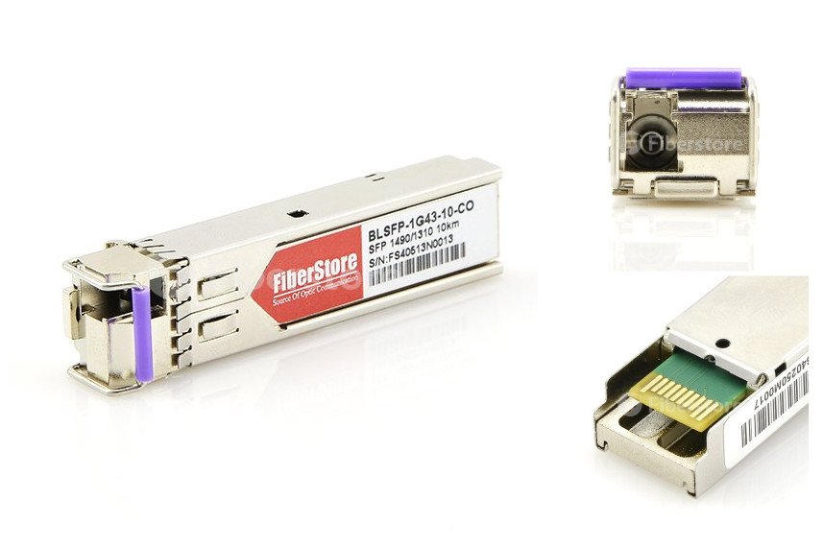
Components – DUNE Timing System
Slower feedback, latency calibration – DUNE Timing system ( see poster at VCI2019 )
  Uses 1000Base-BX standard
    Bidirectional (different wavelength for each direction, e.g. 1490nm / 1310nm )
    Single mode fibre
    Low cost, multi-vendor

Slide 16
On Detector Timing/Control Links
Small number compared to data links
Potential for single failure disabling large part of detector
  →Redundancy where possible
Considerations:
  Power: fibres generally use more power than low voltage differential signaling
  Radiation length
Simple to implement protocol (Radiation hard ASICs)

Slide 17
Control Links:
Example from CMS Tracker
See Optical readout and control systems for the CMS tracker doi:10.1109/NSSMIC.2002.1239306
Distributes clock, trigger, I2C control
Redundant links off detector
Redundant token ring

Slide 18
Conclusion
Requirements for timing should be driven by need for use of “4th-Dimension”
  Improve reconstruction in presence of high pile-up
  “Form follows function” (Sullivan)
Move from parallel to serial at the end of last millennium has developed technologies not available in time of LHC
Calibration of timing end-points can be done O(100ps) with bidirectional link
Final link into detector
  Combine timing and control
  Redundancy important

