Slide 1
Beam-Beam Interaction with Longitudinal Impedance, local RF Cavity
Y. Zhang, N. Wang
Workshop on the Circular Electron-Positron Collider,
EU Edition 2019
Oxford, UK, April 15 - 17, 2019

Slide 2
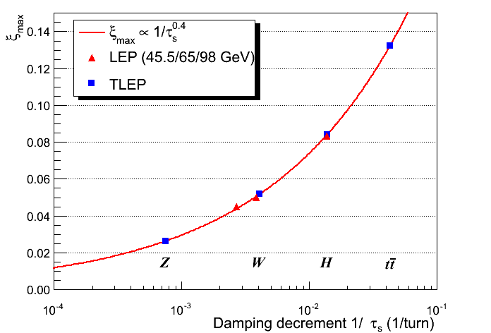
Beam-Beam Parameter at CEPC & LEP2
CDR
http://tlep.web.cern.ch/content/accelerator-challenges
CEPC-W
CEPC-H
CEPC-Z
R. Assmann
the damping rate per beam-beam interaction

Slide 3
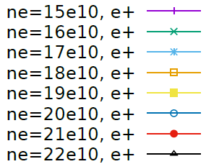
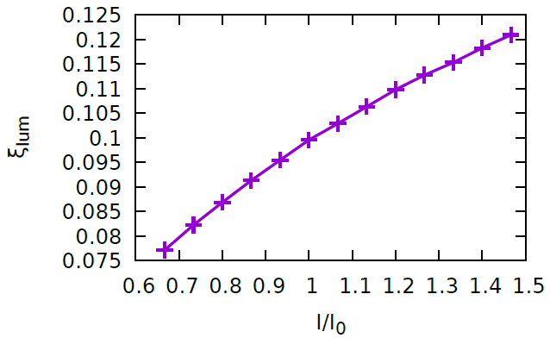
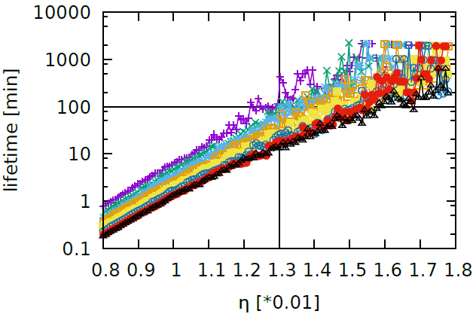

Bunch Current Limit @ Higgs
CDR
$$ξ_{y}=\frac{2r_{e}β_{y}^{0}}{Nγ}\frac{L}{f_{0}}$$
Maximum limit ~ 0.12
Bunch lengthening is considered instead of longitudinal wake force

Slide 4
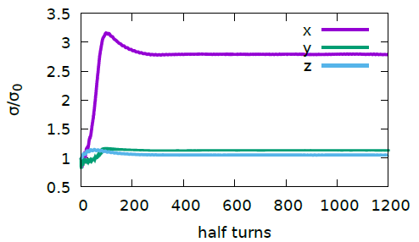
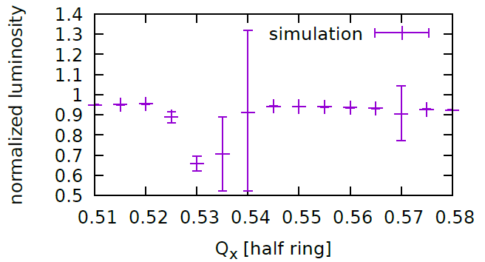
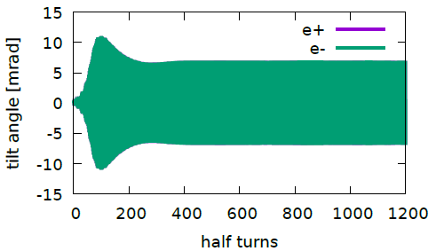


Tune Scan
Higgs
CDR
K. Ohmi and etal., DOI:10.1103/PhysRevLett.119.134801
$$Q_{x}+2{nQ}_{s}=N$$
X-Z instability @(0.535,0.61)
$Q_{y}=$0.61, $Q_{s}=0.035$
The error bar shows the turn-by-turn luminosity difference.

Slide 5
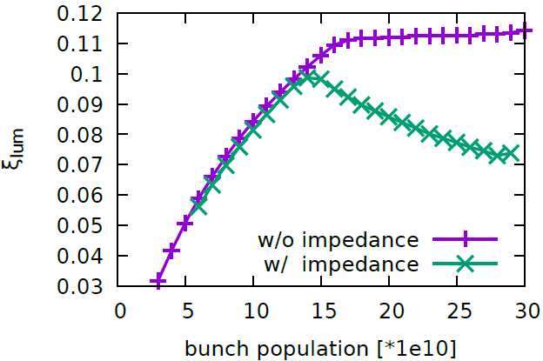

Higgs: Higher Luminosity (1904)
Maximum Beam-Beam Parameter: ~0.11
Lower $β_{y}^{∗}$: 1.5mm->1mm
Lower $ε_{x}$: 1.21nm -> 1.89nm
Ne: 15e10 -> 17e10
Qx=0.555
Qy=0.610
Luminosity = 5e34
SR Beam Power = 30MW
Ne=17e10

Slide 6


Crosstalk between Beam-Beam Interaction & Collective Effect
Bunch lengthening caused by impedance => Gaussian Approximation
In the conventional case, it is fine since the longitudinal dynamics is not sensitive to the beam-beam interaction
In CEPC/FCC, the beamstrahlung effect will also lengthen the bunch
It is self-consistent to consider the longitudinal wake field and beamstrahlung

Slide 7
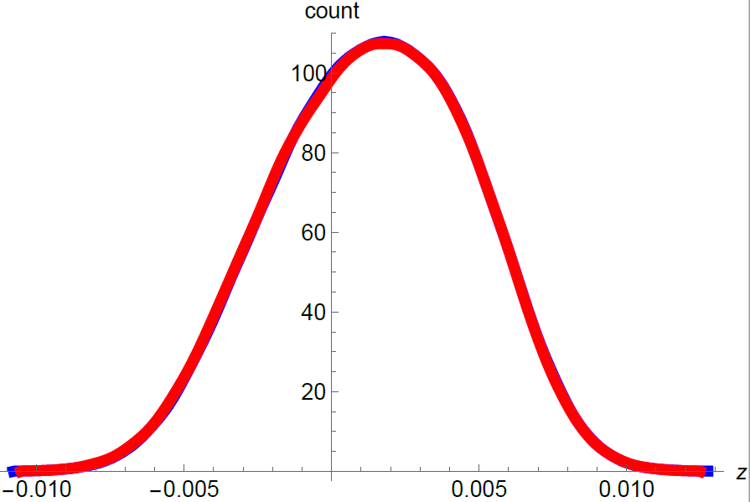
Crosscheck of Longitudinal Impedance
(W/O Beam-Beam)
Elegant vs IBB
Ne=20e10,
Higgs-CDR,
With CDR impedance budget

Slide 8
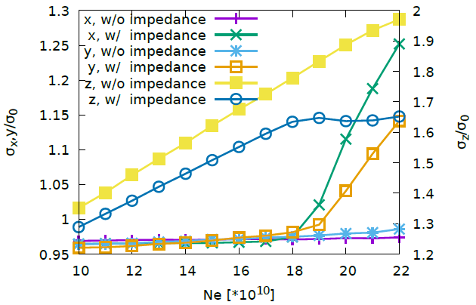
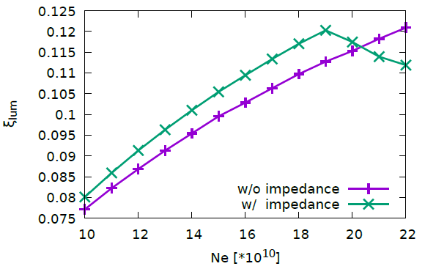
Collision with Longitudinal Impedance: the 1st sight (Higgs, CDR)

Slide 9
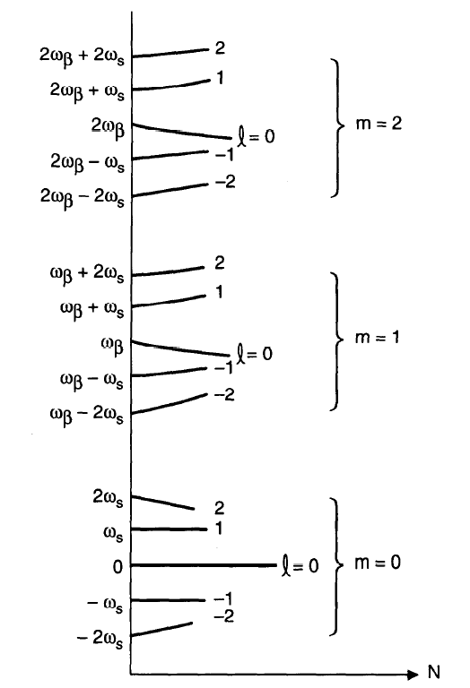
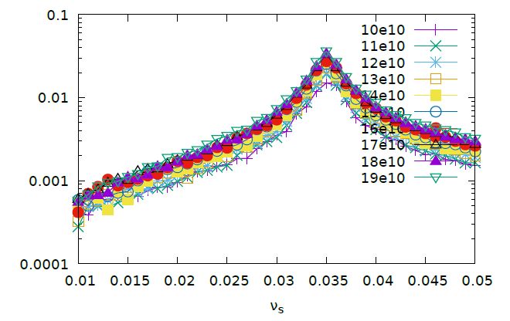


Check of $ν_{s}$ with impedance
A. Chao, “Physics of Collective Beam Instabilites in High Energy Accelerators”

Slide 10
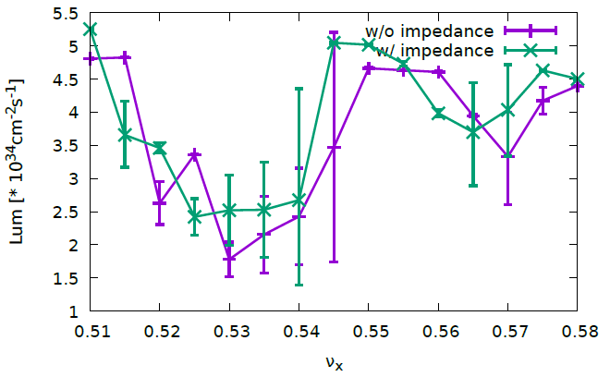
Dependence on Horizontal Tune
CDR, Ne=20e10
The optimized working point with impedance is shifted closer to half integer.

Slide 11
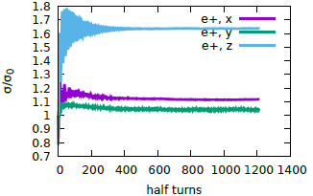
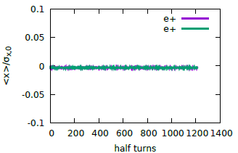
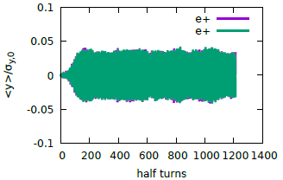
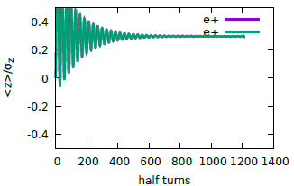
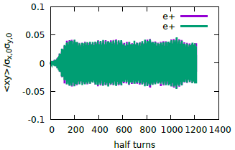
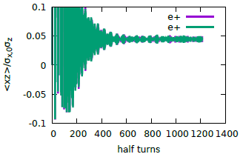
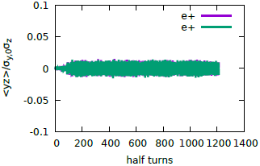

Moment Evolution w/ impedance
$$ν_{x}=0.555$$
Ne=20e10
Coherent vertical oscillation and transverse blowup

Slide 12
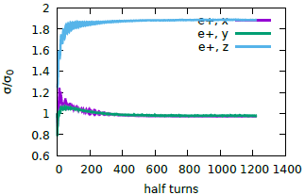
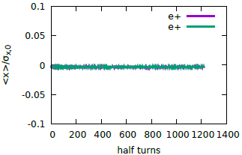
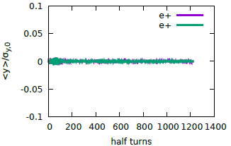
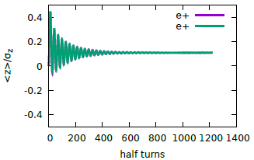
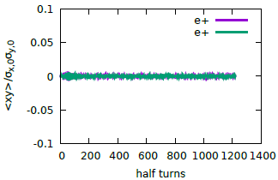
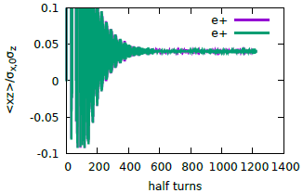
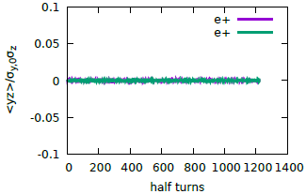
Moment Evolution w/o impedance
$$ν_{x}=0.555$$
Ne=20e10
No coherent vertical oscillation and No transverse blowup

Slide 13
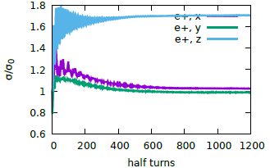
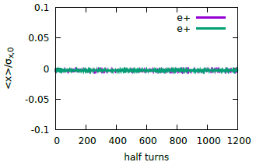
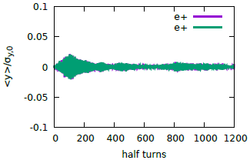
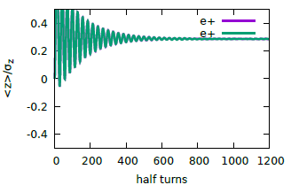
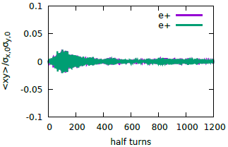
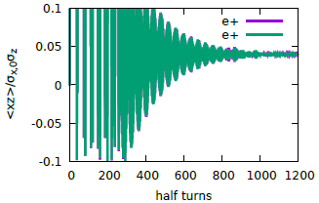
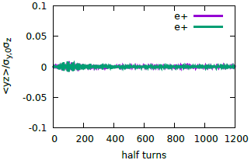

Moment Evolution w/ impedance
$$ν_{x}=0.550$$
Ne=20e10
Optimized working point could suppress the coherent oscillation and transverse blowup.

Slide 14
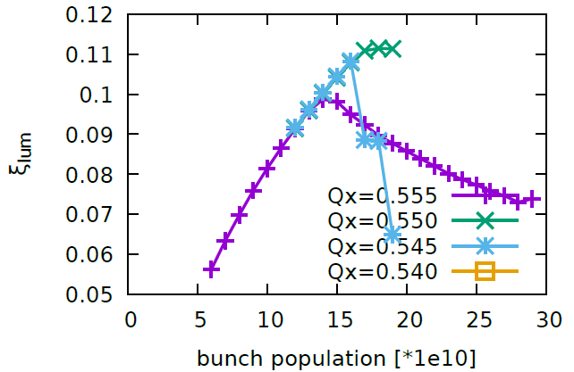
Horizontal Tune Scan (w/ impedance, 1904)
Qy=0.610
Ne=17e10

Slide 15
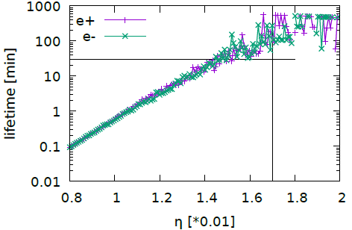
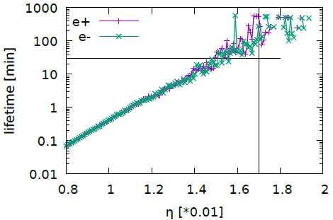
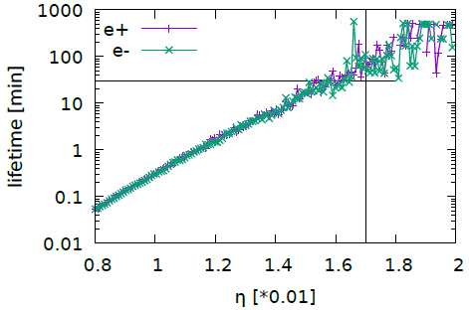
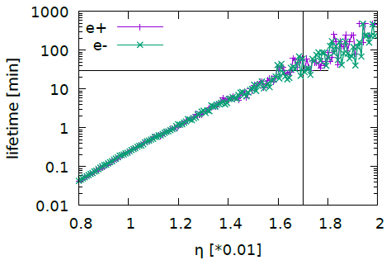
Beamstrahlung lifetime (Qx=0.550)
w/ impedance, 1904
14e10
15e10
16e10
17e10

Slide 16
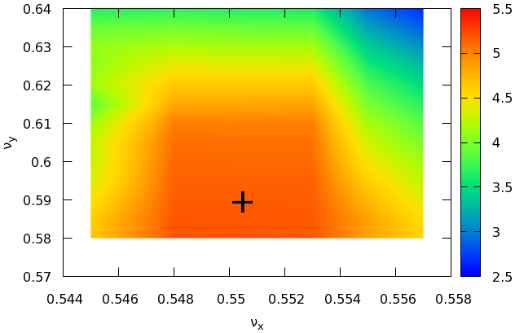
2D Tune Scan with Impedance
(Ne=17e10, 1904)
Optimized Working Point: (0.550, 0.590)
0.005

Slide 17
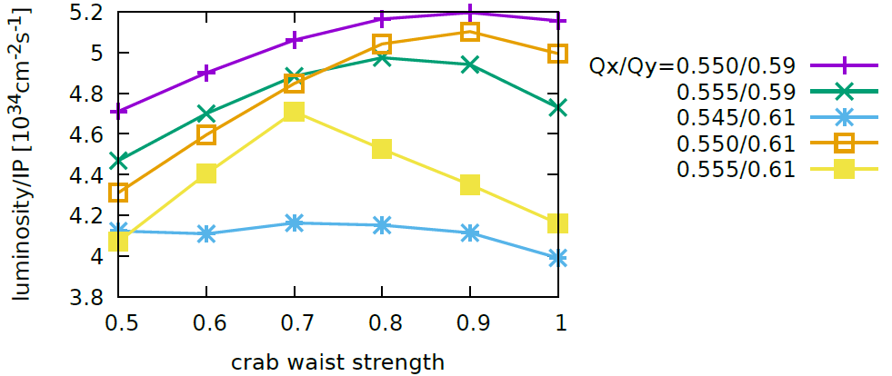
Crab-Waist Strength with Impedance (Ne=17e10, 1904)
Optimized CW strength ~0.85
Notes:
Cw = 0.85

Slide 18
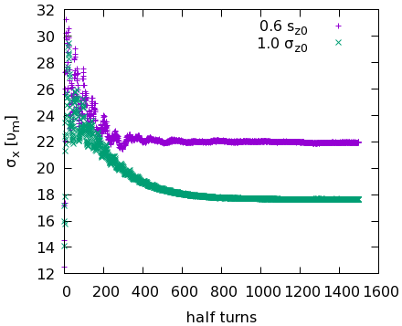
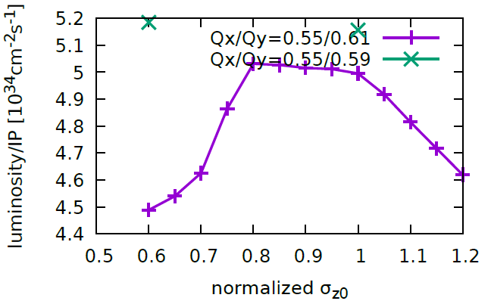
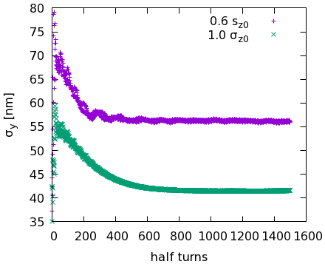
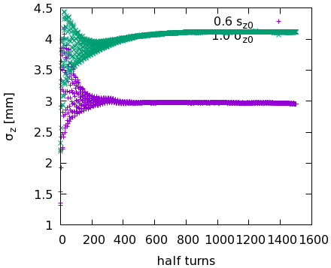
Performance vs zero bunch current length
Higher RF Voltage:
It is no use for luminosity performance after beam-beam limit is reached
It is expected we could collide with lower bunch current and achieve similar beam-beam parameter.
It could help us increase the RF bucket height and the width of stable working point space.

Slide 19
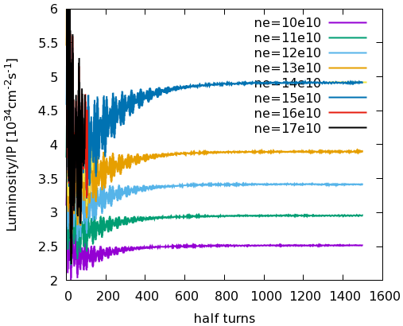
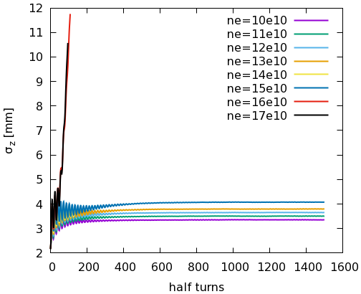
Different Bunch Population with
Local RF Cavity (Sin-Wave)
RF Voltage = 1.176GV * 2
Longitudinal direction is unstable when $N_{e}\sim 15e10$

Slide 20




Horizontal Tune: Local RF Cavity
RF Voltage = 1.176GV * 2
NE=17e10
LINEARIZED Cavity
Sin-Wave Cavity
0.545-0.549 is stable in linearized approximation
From 0.543-0.553 is always unstable in non-linearized case, due to serious bunch lengthening
Is it real physics or some bug of code
If it depends on the initial bunch distribution? Bootstraping(By D. Shatilov) is a must?

Slide 21


Higher RF Voltage
Local RF Cavity (nonlinear): Qx
RF Voltage = 1.294GV * 2
With higher RF Voltage, there exist one stable working point @0.552

Slide 22




Different initial bunch distribution
Local RF Cavity (nonlinear)
NE=17e10
Start with equilibrium distribution obtained without impedance and with smooth approximation in arc
RF Voltage = 1.176GV * 2
RF Voltage = 1.294GV * 2
Higher RF Voltage -> Wider Stable Working Point Space
Stable Collision: $ν_{x}∈(0.545,0.549)$
Width：0.004
Stable Collision: $ν_{x}∈(0.548,0.554)$
Width：0.006

Slide 23


More times simulation with same parameter
Local RF Cavity (nonlinear)
RF Voltage = 1.176GV * 2
Ne=17e10, Qx=0.547
Repeat the simulation 3 more times with same parameters
The longitudinal instability does not always occur in the simulation!
Notes:
Hrf1176-Qx547-ne17-zlongit, 90t, 稳定，ibb3-slice-190409,
Hrf1176-qx547-ne17-zlongit-190411, 再重复计算一遍 @190411，20：34
Hrf1176-qx547-ne17-zlongit-190411-1，再重复计算一遍 @190411，20：34
Hrf1176-qx547-ne17-zlongit-rf190411，再重复计算一遍 使用rf190406 @190411，20：39

Slide 24

Discussion on the Impedance Effect
Starting collision with “pure” zero-bunch current distribution(SR equilibrium, without bunch lengthening caused by impedance) means very strong beam-beam interaction($ξ_{y}\sim 0.2$) and may occasionally excite high energy photon(beamstrahlung) which lead the e+ or e- exceeding the RF bucket.
It is supposed that the particles exceeding the RF bucket are not reasonably treated (by interpolation) in the current beam-beam code. That’s why the “instability” is triggered in the longitudinal distribution.
It will be checked if the scenario is right in the following days.

Slide 25

Higgs: 80%, 100%, 120% impedance
The beam-beam performance is not sensitive to longitudinal impedance budget.

Slide 26

Higgs, Unequal Longitudinal impedance
The performance is not sensitive to the asymmetry of the longitudinal impedance

Slide 27




$β_{y}^{∗}$=1.5mm->1mm (Solenoid: 3T -> 2T)
Z, CDR
$$ξ_{y}=\frac{2r_{e}β_{y}^{0}}{Nγ}\frac{L}{f_{0}}$$
With same beam current,
smaller $β_{y}^{∗}$+weaker solenoid, luminosity increase by a factor of two.
bunch population increase from $8×{10}^{10}$ to $12×{10}^{10}$, luminosity increase about 20%.

Slide 28


Z with longitudinal impedance
CDR, Ne=12e10
Bunch Lengthening and Energy Spread w/o Collision

Slide 29





Direct Collision: Z with impedance
Vertical Coherent Oscillation
Transverse Blowup

Slide 30





Bootstrapping Collision: Z with impedance
Vertical Coherent Oscillation
Transverse Blowup

Slide 31
Discussion & Summary
The longitudinal impedance has been considered at CEPC
The performance of Higgs is not sensitive to the impedance
The stable working point has been shifted by the impedance. The cause need to be explained
The “bootstrapping” method is a good choice in the simulation considering local RF cavity, otherwise the very strong collision may lead particle exceeding RF bucket.
It seems the performance of Z would be sensitive to the longitudinal impedance. More parameter scan will be done in near future.

Slide 32
Backup Slides

Slide 33
CEPC CDR Parameters
 | Higgs | W | Z（3T） | Z（2T）
Number of IPs | 2
Beam energy (GeV) | 120 | 80 | 45.5
Circumference (km) | 100
Synchrotron radiation loss/turn (GeV) | 1.73 | 0.34 | 0.036
Crossing angle at IP (mrad) | 16.5×2
Piwinski angle | 3.48 | 7.0 | 23.8
Number of particles/bunch N_{e} (10¹⁰) | 15.0 | 12.0 | 8.0
Bunch number (bunch spacing) | 242 (0.68μs) | 1524 (0.21μs) | 12000 (25ns+10%gap)
Beam current (mA) | 17.4 | 87.9 | 461.0
Synchrotron radiation power /beam (MW) | 30 | 30 | 16.5
Bending radius (km) | 10.7
Momentum compact (10⁻⁵) | 1.11
β function at IP β_{x}* / β_{y}* (m) | 0.36/0.0015 | 0.36/0.0015 | 0.2/0.0015 | 0.2/0.001
Emittance ε_{x}/ε_{y} (nm) | 1.21/0.0024 | 0.54/0.0016 | 0.18/0.004 | 0.18/0.0016
Beam size at IP σ_{x} /σ_{y} (μm) | 20.9/0.06 | 13.9/0.049 | 6.0/0.078 | 6.0/0.04
Beam-beam parameters ξ_{x}/ξ_{y} | 0.018/0.109 | 0.013/0.123 | 0.004/0.06 | 0.004/0.079
RF voltage V_{RF} (GV) | 2.17 | 0.47 | 0.10
RF frequency f _{RF} (MHz) (harmonic) | 650 (216816)
Natural bunch length σ_{z} (mm) | 2.72 | 2.98 | 2.42
Bunch length σ_{z} (mm) | 4.4 | 5.9 | 8.5
HOM power/cavity (2 cell) (kw) | 0.46 | 0.75 | 1.94
Energy spread (%) | 0.134 | 0.098 | 0.080
Energy acceptance requirement (%) | 1.35 | 0.90 | 0.49
Energy acceptance by RF (%) | 2.06 | 1.47 | 1.7
Photon number due to beamstrahlung | 0.082 | 0.050 | 0.023
Beamstruhlung lifetime /quantum lifetime* (min) | 80/80 | >400
Lifetime (hour) | 0.43 | 1.4 | 4.6 | 2.5
F (hour glass) | 0.89 | 0.94 | 0.99
Luminosity/IP L (10³⁴cm⁻²s⁻¹) | 2.93 | 10.1 | 16.6 | 32.1
*include beam-beam simulation and real lattice

Slide 34
CEPC New Parameters
 | Higgs | W | Z（3T） | Z（2T）
Number of IPs | 2
Beam energy (GeV) | 120 | 80 | 45.5
Circumference (km) | 100
Synchrotron radiation loss/turn (GeV) | 1.68 | 0.33 | 0.035
Crossing angle at IP (mrad) | 16.5×2
Piwinski angle | 3.78 | 8.5 | 27.7
Number of particles/bunch N_{e} (10¹⁰) | 17.0 | 12.0 | 8.0
Bunch number (bunch spacing) | 218 (0.76μs) | 1568 (0.20μs) | 12000 (25ns+10%gap)
Beam current (mA) | 17.8 | 90.4 | 461.0
Synchrotron radiation power /beam (MW) | 30 | 30 | 16.5
Bending radius (km) | 10.7
Momentum compact (10⁻⁵) | 0.91
β function at IP β_{x}* / β_{y}* (m) | 0.33/0.001 | 0.33/0.001 | 0.2/0.001
Emittance ε_{x}/ε_{y} (nm) | 0.89/0.0018 | 0.395/0.0012 | 0.13/0.003 | 0.13/0.00115
Beam size at IP σ_{x} /σ_{y} (μm) | 17.1/0.042 | 11.4/0.035 | 5.1/0.054 | 5.1/0.034
Beam-beam parameters ξ_{x}/ξ_{y} | 0.024/0.113 | 0.012/0.1 | 0.004/0.053 | 0.004/0.085
RF voltage V_{RF} (GV) | 2.4 | 0.43 | 0.082
RF frequency f _{RF} (MHz) (harmonic) | 650 (216816)
Natural bunch length σ_{z} (mm) | 2.2 | 2.98 | 2.42
Bunch length σ_{z} (mm) | 3.93 | 5.9 | 8.5
HOM power/cavity (2 cell) (kw) | 0.58 | 0.77 | 1.94
Energy spread (%) | 0.19 | 0.098 | 0.080
Energy acceptance requirement (%) | 1.7 | 0.90 | 0.49
Energy acceptance by RF (%) | 3.0 | 1.27 | 1.55
Photon number due to beamstrahlung | 0.104 | 0.050 | 0.023
Beamstruhlung lifetime /quantum lifetime* (min) | 30/50 | >400
Lifetime (hour) | 0.22 | 1.2 | 3.2 | 2.0
F (hour glass) | 0.85 | 0.92 | 0.98
Luminosity/IP L (10³⁴cm⁻²s⁻¹) | 5.2 | 14.5 | 23.6 | 37.7
*include beam-beam simulation and real lattice

