Slide 1

CEPC Booster and Damping Ring
Dou Wang
on behalf of CEPC AP group
Many Thanks to: K. Oide, Y. Cai, M. Koratzinos
CEPC workshop-EU Edition, April 15-17, 2019. Oxford.

Slide 2
Outline
CEPC booster
Parameters
Geometry & optics
Error analysis & correction
Instability
Ramping dynamic simulation
Dipole/power supply error tolerance
Eddy current problem
CEPC damping ring system
Overall consideration for DR system
DR design
EC/BC design

Slide 3
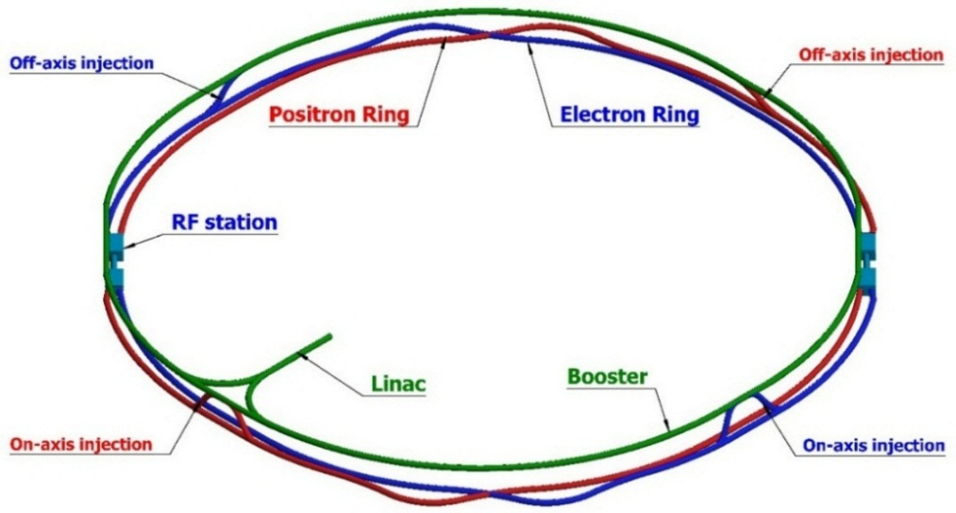
CEPC injector chain
100km
Injection energy: 10GeV
10 GeV linac provides electron and positron beams for booster.
Top up injection for collider ring ~ 3% current decay
Booster is in the same tunnel as collider ring, above the collider ring.
Booster has the same geometry as collider ring except for the two IRs.
Booster bypasses the collider ring from the outer side at two IPs.

Slide 4
Design requirements for CEPC booster
Parameters | Design goals
Beam current (mA) | <1.0 mA(Higgs), 4.0 mA (W), 10 mA(Z)
Emittance@ 120GeV (nm rad) | <3.6
Dynamic aperture @10GeV(σ, normalized by linac beam size) | >4σ+5mm
Dynamic aperture @120GeV | >6σx+3mm, 49σx+3mm
Energy acceptance | >1%
Coupling | <0.5%
Booster transfer efficiency | >92%
Total transfer efficiency (inc. inj. & ext.) | >90% (99%*92%*99%)
Timing | Meet the top-up injection requirements
Beam current threshold in booster is limited by RF power.
The diameter of the inner aperture is selected as 55mm for high current injection.
Assumption for total efficiency 90%: 92% for booster+ 99% for transport lines.
Emittance@120GeV <3.6nm, energy acceptance >1%
Coupling <0.5%: requirement of Higgs on-axis injection scheme
DA@10GeV: BSC region, DA@120GeV:on-axis injection (V) & quan. lifetime (H)

Slide 5
Booster parameters @ injection (10GeV)
 |  | H | W | Z
Beam energy | GeV | 10
Bunch number |  | 242 | 1524 | 6000
Threshold of single bunch current | μA | 25.7
Threshold of beam current (limited by coupled bunch instability) | mA | 100
Bunch charge | nC | 0.78 | 0.63 | 0.45
Single bunch current | μA | 2.3 | 1.8 | 1.3
Beam current | mA | 0.57 | 2.86 | 7.51
Natural Energy spread | % | 0.0078
Synchrotron radiation loss/turn | keV | 73.5
Momentum compaction factor | 10⁻⁵ | 2.44
Natural emittance | nm | 0.025
Natural chromaticity | H/V | -336/-333
RF voltage | MV | 62.7
Betatron tune ν_{x}/ν_{y}/ν_{s} |  | 263.2/261.2/0.1
RF energy acceptance | % | 1.9
Damping time | s | 90.7
Bunch length of linac beam | mm | 1.0
Energy spread of linac beam | % | 0.16
Emittance of linac beam | nm | 40~120

Slide 6
Booster parameters @ extraction
 |  | H |  |  | W | Z
 |  | Off axis injection | On axis injection |  | Off axis injection | Off axis injection
Beam energy | GeV | 120 |  |  | 80 | 45.5
Bunch number |  | 242 |  | 235+7 | 1524 | 6000
Maximum bunch charge | nC | 0.72 |  | 24.0 | 0.58 | 0.41
Maximum single bunch current | μA | 2.1 |  | 70 | 1.7 | 1.2
Threshold of single bunch current | μA | 300
Threshold of beam current (limited by RF power) | mA | 1.0 |  |  | 4.0 | 10.0
Beam current | mA | 0.52 |  | 1.0 | 2.63 | 6.91
Injection duration for top-up (Both beams) | s | 25.8 |  | 35.4 | 45.8 | 275.2
Injection interval for top-up | s | 47.0 |  |  | 153.0 | 504.0
Current decay during injection interval |  | 3%
Energy spread | % | 0.094 |  |  | 0.062 | 0.036
Synchrotron radiation loss/turn | GeV | 1.52 |  |  | 0.3 | 0.032
Momentum compaction factor | 10⁻⁵ | 2.44
Emittance | nm | 3.57 |  |  | 1.59 | 0.51
Natural chromaticity | H/V | -336/-333
Betatron tune ν_{x}/ν_{y} |  | 263.2/261.2
RF voltage | GV | 1.97 |  |  | 0.585 | 0.287
Longitudinal tune |  | 0.13 |  |  | 0.10 | 0.10
RF energy acceptance | % | 1.0 |  |  | 1.2 | 1.8
Damping time | ms | 52 |  |  | 177 | 963
Natural bunch length | mm | 2.8 |  |  | 2.4 | 1.3
Injection duration from empty ring | h | 0.17 |  |  | 0.25 | 2.2

Slide 7
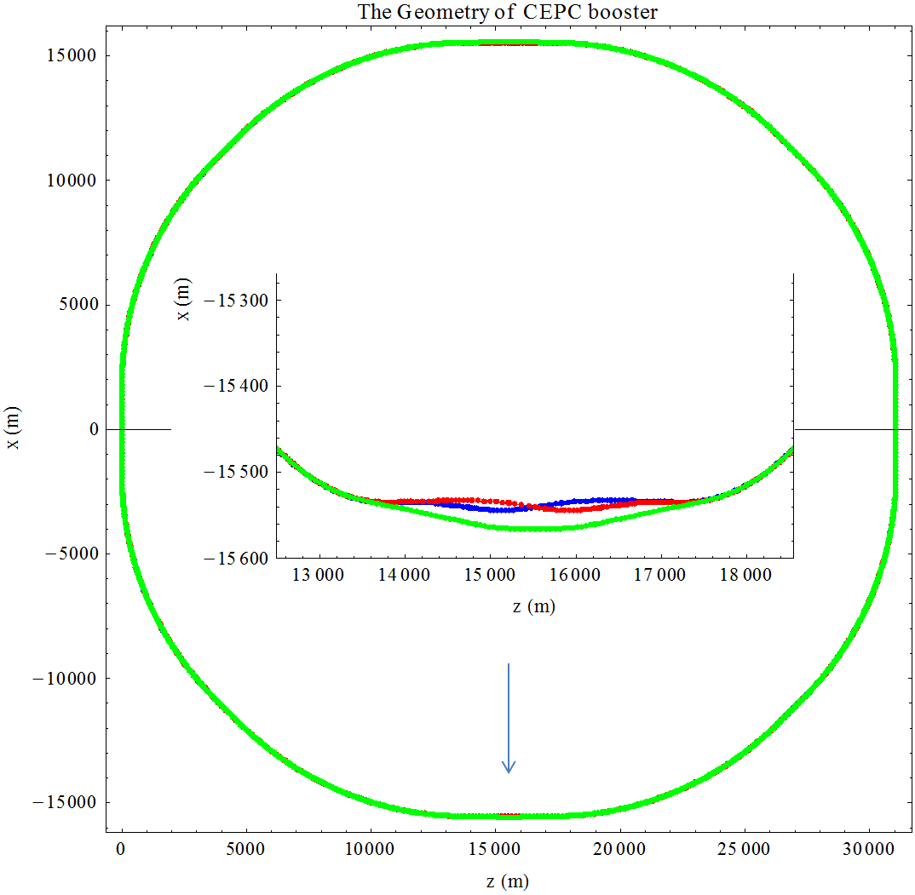
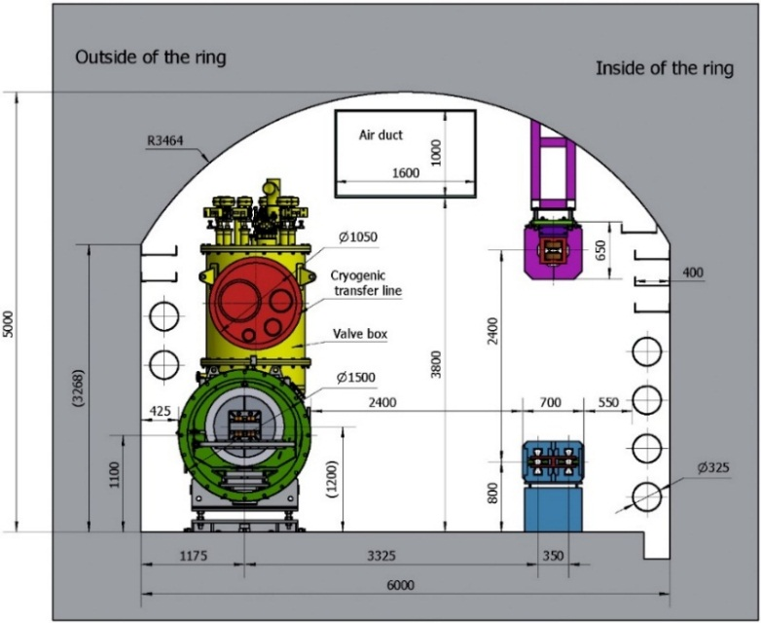
Booster geometry design
Booster has almost same geometry as collider ring except for the two IRs.
ARC: booster is in between the two beams of collider ring, error=±0.17m
-- precision of element length: ~10⁻⁵ m
-- precision of dipole angle: ~10⁻⁷ rad
IR: separation between detector center and booster: ~25 m
Same circumference for booster and collider

Slide 8
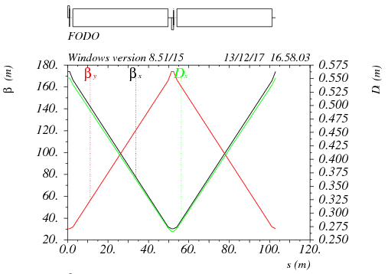
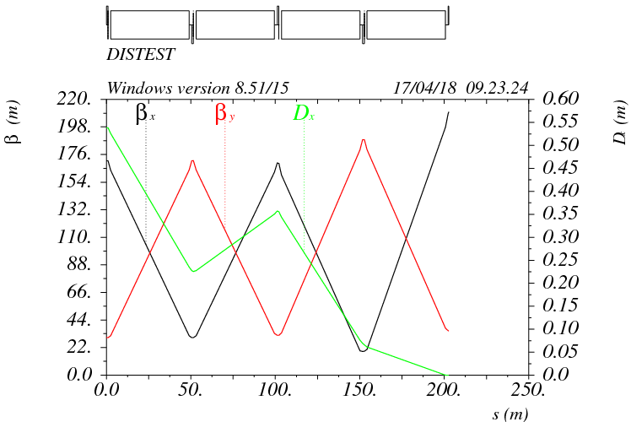
Booster optics - ARC
90°/ 90° FODO cell
2 cells @ booster = 3 cells @ collider
FODO length: 101m
Noninterleave sextupole scheme
Dispersion suppressor
- two standard FODO cell
- adjust bend strength- match the geometry of collider ring
FODO cell
Dispersion suppressor

Slide 9
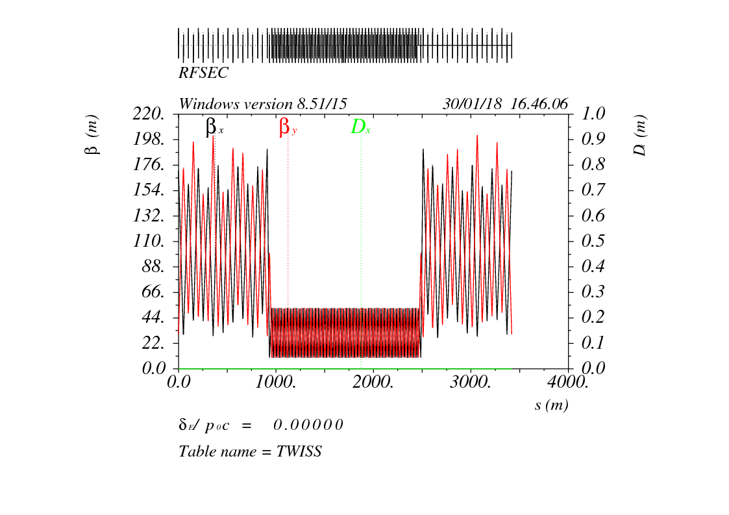
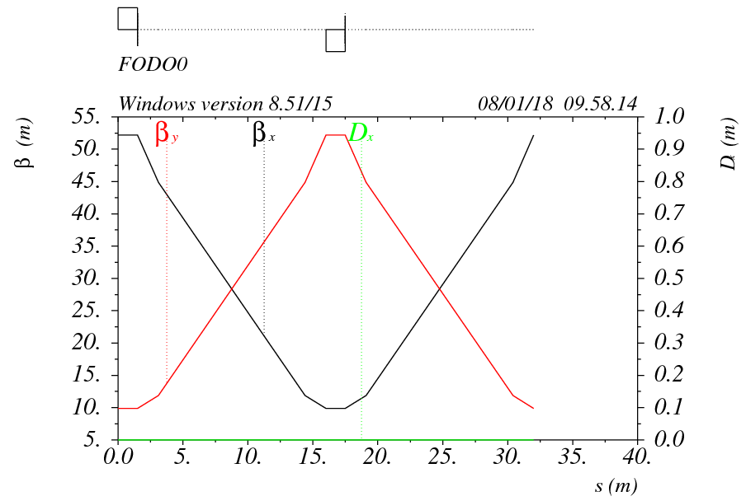
Booster optics - RF
Booster RF straight section at the same location as collider ring -3.4km
Low average beta to reduce the multi-bunch instability by RF cavities -1.6km
- 90°/ 90° FODO cell
- Average beta: 30 m
- Space between quadrupoles :14m
RF section

Slide 10
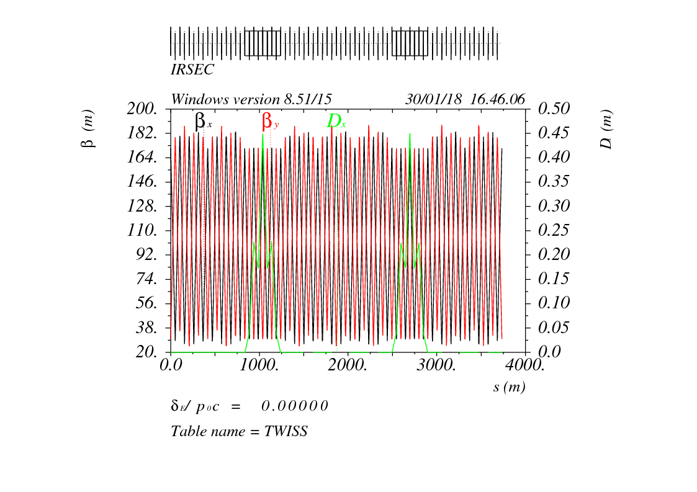
Booster optics – IR bypass
In CEPC detector region, booster bypasses the collider ring from the outer side.
25m separation: requirements of civil engineering and the radiation protection

Slide 11
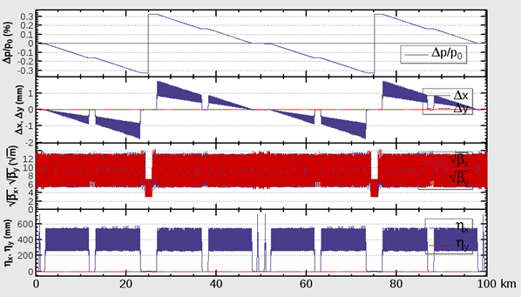
Sawtooth effect @120GeV
2 RF stations
Maximum sawtooth orbit: 1.7 mm
Maximum optics distortion: ~2%, Maximum dispersion distortion: ~50 mm
Emittance growth: ~0.3%
No DA reduction due to sawtooth effect
Magnets energy tapering is unnecessary

Slide 12
Booster error studies
D. Ji
Gaussian distribution and cut-off at 3σ
Errors Setting
Parameters | Dipole | Quadrupole | Sextupole
Transverse shift x/y (μm) | 50 | 70 | 70
Longitudinal shift z (μm) | 100 | 150 | 100
Tilt about x/y (mrad) | 0.2 | 0.2 | 0.2
Tilt about z (mrad) | 0.1 | 0.2 | 0.2
Nominal field | 3×10⁻⁴ | 2×10⁻⁴ | 3×10⁻⁴
 | Accuracy (m) | Tilt (mrad) | Gain | Offset after BBA(mm)
BPM | 1×10⁻⁷ | 10 | 5% | 30×10⁻³

Slide 13
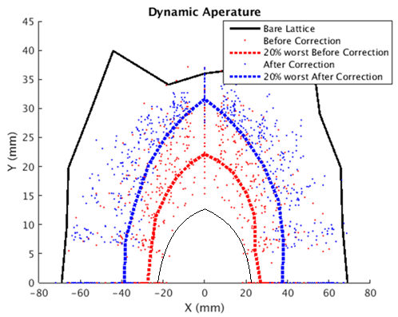
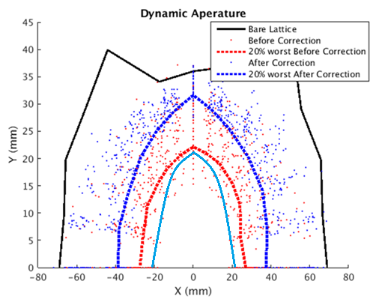
Dynamic aperture with errors
With only COD corrections, DA is nearly two thirds of bare lattice
At 120GeV, radiative damping and sawtooth was considered.
DA requirement @ 10GeV determined by the beam stay clear region
DA requirement @ 120GeV: 1) H- quantum lifetime, 2) V- re-injection process from the collider in the on-axis injection scheme
10GeV
120GeV
BSC
w damping
 | DA requirement |  | DA results
 | H | V | H | V
10GeV (ε_{x}= ε_{y} =120nm) | 4σ_{x} +5mm | 4σ_{y} +5mm | 7.7σ_{x} +5mm | 14.3σ_{y} +5mm
120GeV (ε_{x}=3.57nm, ε_{y}= ε_{x*}0.005) | 6σ_{x} +3mm | 49σ_{y} +3mm | 21.8σ_{x} +3mm | 779σ_{y} +3mm
Requirement for linac emittance: < 150nm, otherwise BSC > beam pipe

Slide 14
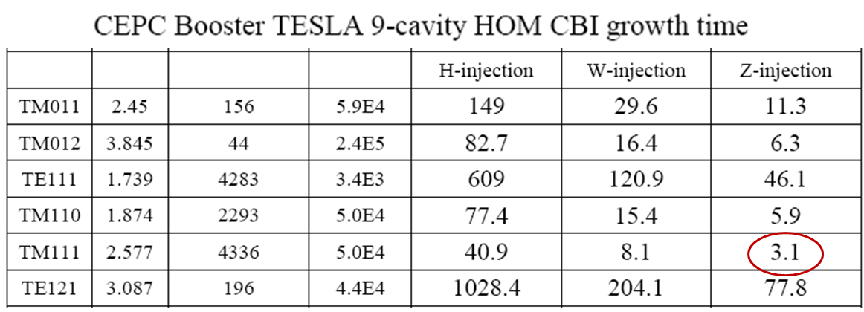
Beam instability
Impedance of kickers not included.
Aluminum pipe with radius 27.5 mm is chosen
Higher threshold of beam current for reasonable injection time during z operation
Higher single bunch current threshold@120GeV (on-axis injection)
Threshold of single bunch current (TMCI): 25.7uA (10GeV), 300 uA (120GeV)
Threshold of beam current (resistive wall) w. FB: 127.5mA (10GeV)
Damping time of transverse feedback system: 1.67ms (~5 turns)
Threshold of beam current (RF HOMs) w. FB: 100mA (10GeV)
Total beam current limited by RF power: 1mA(H), 4mA(W), 10mA(Z)
Feedback system is essential @10 GeV.
Damping time: 90ms
Growth time (RW): 20ms
Growth time (HOM): 3.1ms

Slide 15
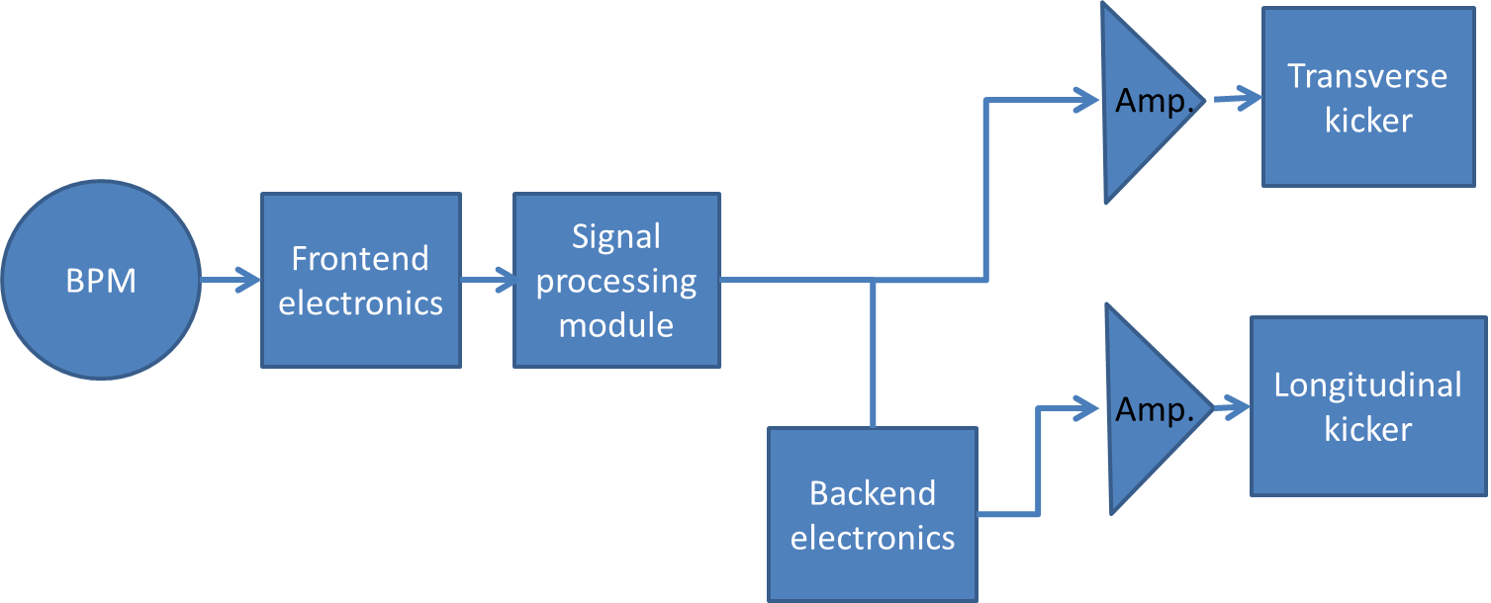
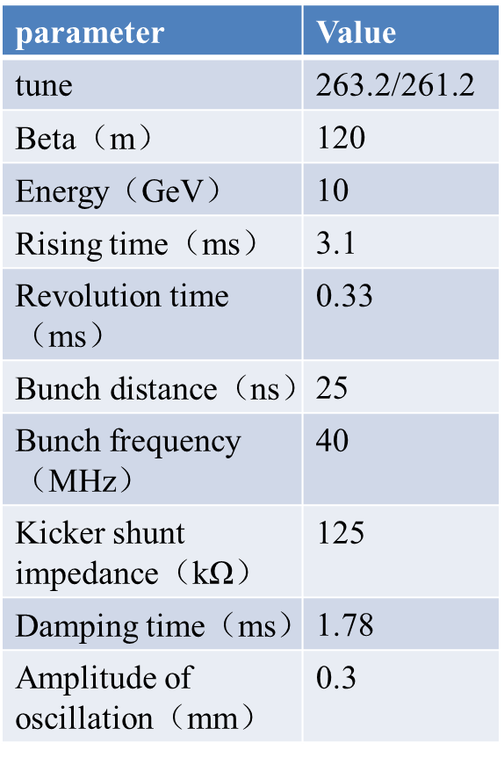
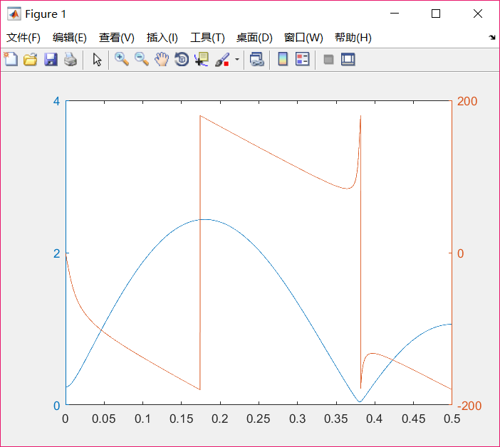
Parameter design for transverse feedback
J. Yue
E=10GeV，β_{m}=120m，β_{k}=120m，Δx=0.3mm, take τ_{FB} =1.45 ms，so ΔV_{FB⊥}＝9.27kV, P=344w.
4-tap filter was considered
One BPM and One kicker, 90 degree phase shift and DC rejection both are got in FPGA.
tap number always more than 2.

Slide 16
New requirement for ramping rate
CEPC CDR ramping rate: 62 G/s
CEPC Higher lumi. goal → shorter lifetime → faster injection
Higgs lumi. : 2.9 ×10³⁴cm⁻²s⁻¹ → 5.2 ×10³⁴cm⁻²s⁻¹
Higgs on-axis injection can not fulfilled
Z (2T) off-axis injection can not fulfilled
CEPC ramping rate requirement: 62 G/s → 120 G/s
Eddy current strength will be doubled.

Slide 17
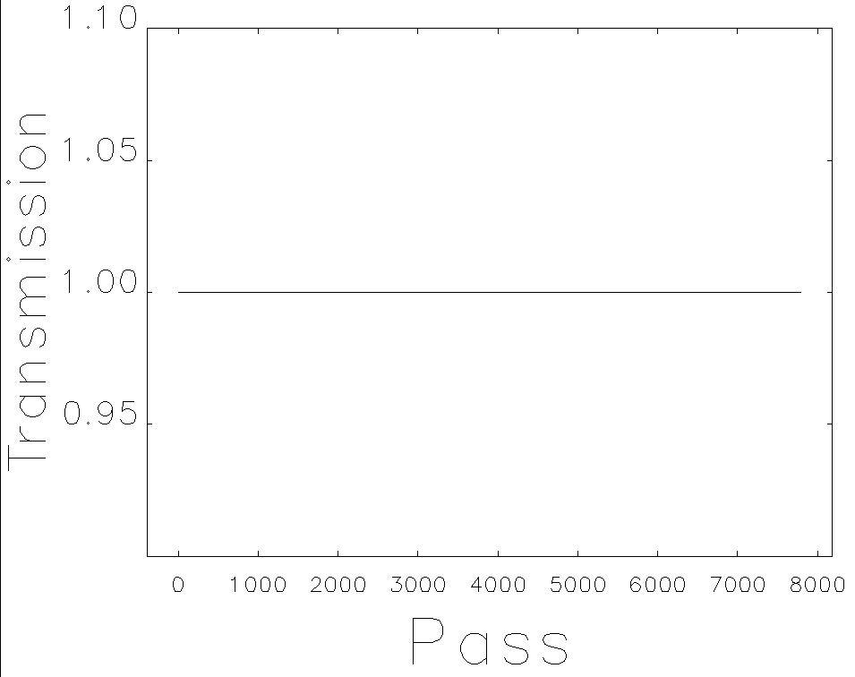
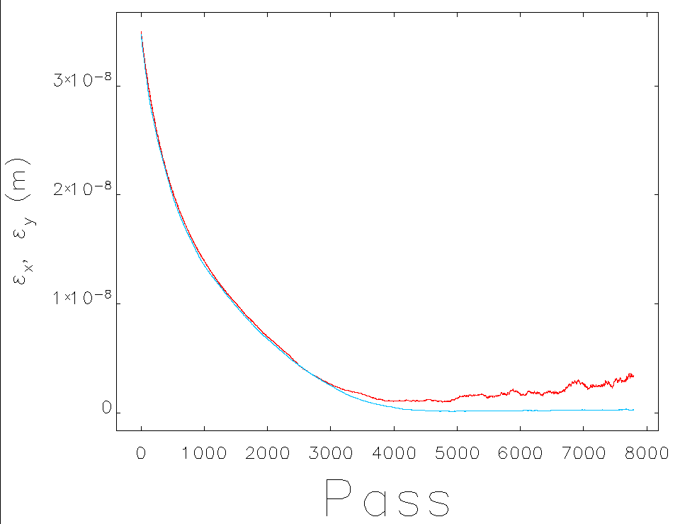
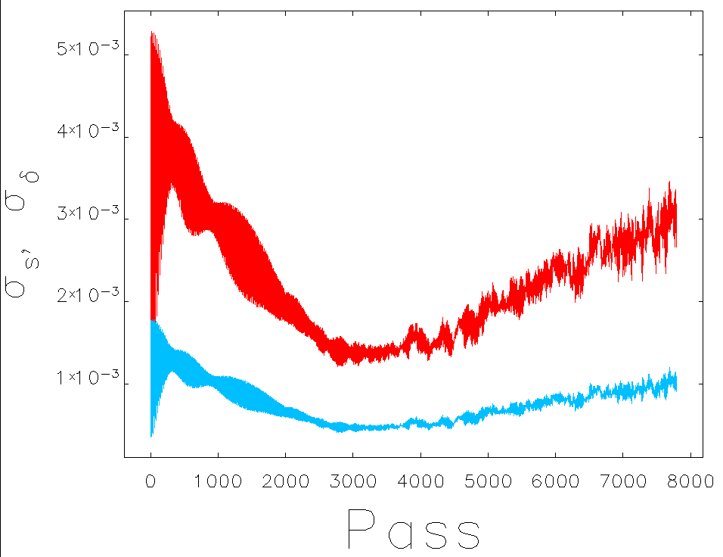
Ramping dynamic simulation
Energy: 10GeV ~ 120 GeV by 2.6s
Tracking by elegant, w/o error
360 particles
Linear ramping for magnets
RF ramping curve: νs=0.13
including SR damping & excitation

Slide 18
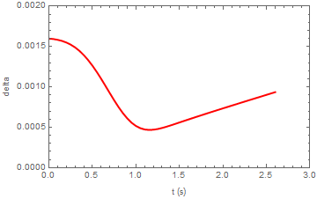
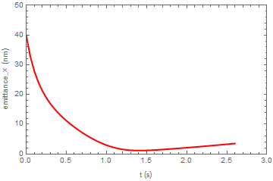
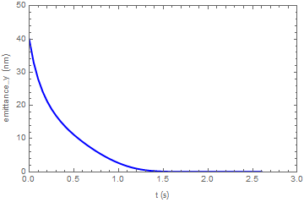
Analytical estimation for beam evolution
Positron emittance was reduced thanks to damping ring.
Emittance @injection = 40nm
Beam loss due to lifetime at low energy determined by the emittance of Linac and the DA.

Slide 19
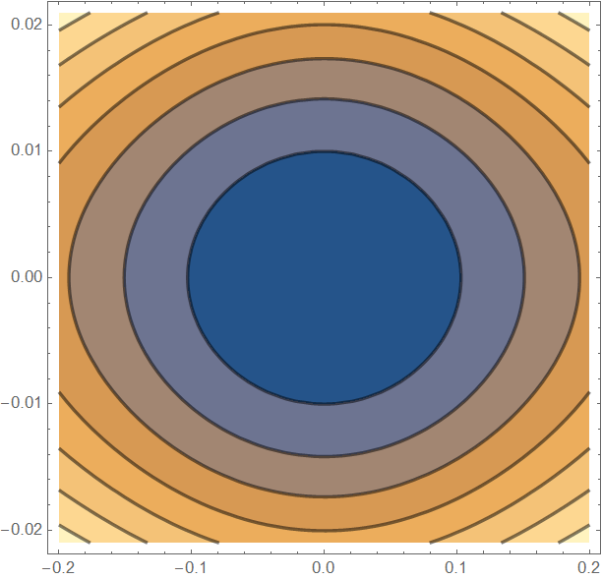
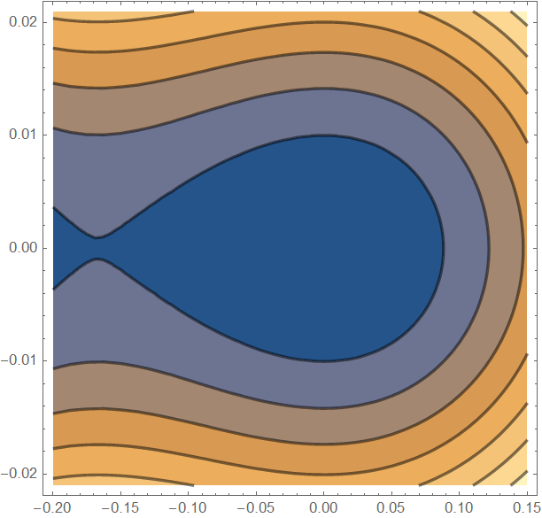
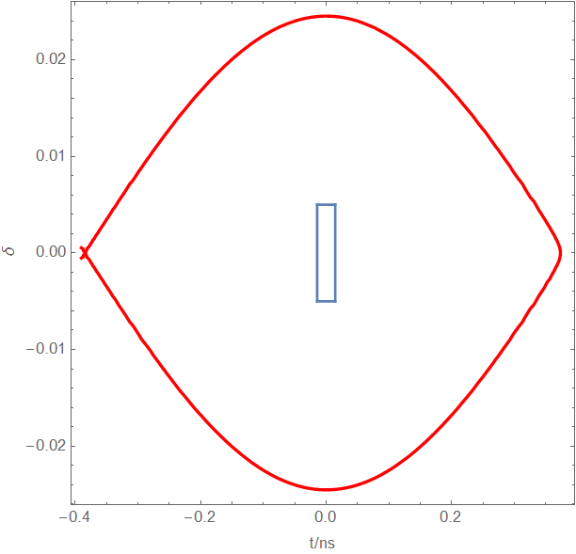
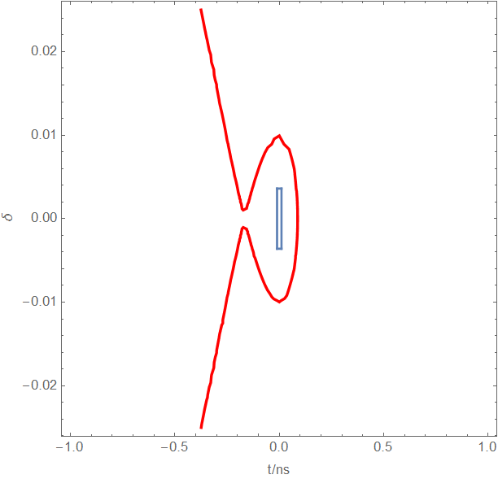
Longitudinal acceptance
10GeV
120GeV
φ_{s}: 180°
φ_{s}: 129°

Slide 20
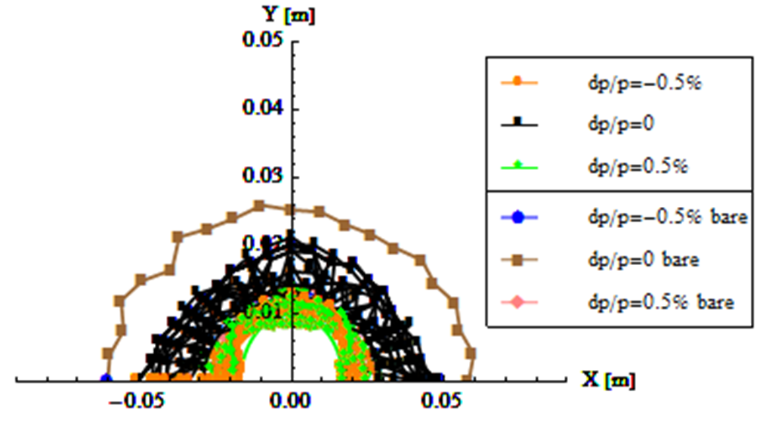
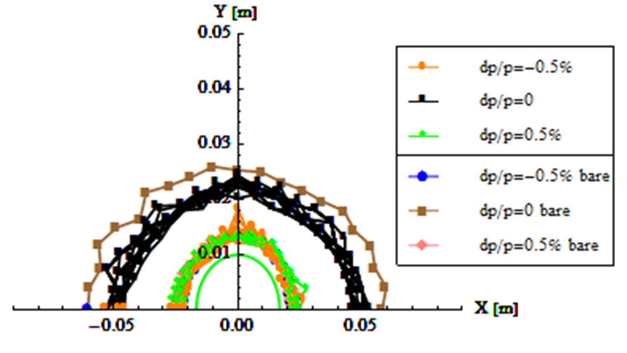
Dipole uniformity requirement@10Gev
Multipole errors’s influence to DA was considered.
sextupole error + octupole error, so far. (20 random seeds)
Reference radius: 17mm
DA should not smaller than BSC.
DA reduction due to other errors (correctable) is estimated: ~70%
Uniformity requirement: ~0.01% @27mm
Effort to enlarge DA is essential.
0.00005
0.00001

Slide 21
Dipole reproducibility requirement@10Gev
Increase/decrease the strength of all the dipoles by the same amount.
Decrease/increase the strength of quadrupoles & sextupoles → energy mismatch
Evaluate the influence: working point, closed orbit, DA, energy acceptance
Working point should not pass through the lower order resonance (<4)
No shrink for dynamic aperture
Reproducibility requirement: ~0.02%
 | original | +0.01% | -0.01% | +0.05% | -0.05%
nux | 263.20376 | 263.1367 | 263.271 | 262.868 | 263.5397
nuy | 261.21034 | 261.1437 | 261.277 | 260.877 | 261.5437
Δx (um) | 0 | -54 | 54 | -270 | 270
DA (%) | 100 | 100 | 100 | 90 | 90

Slide 22
Power supply stability@120Gev
Increase/decrease the strength of all the dipoles by the same amount.
Decrease/increase the strength of quadrupoles & sextupoles → energy mismatch
Evaluate the influence: working point, closed orbit, DA, energy acceptance
Working point should not pass through the lower order resonance (<4)
No shrink for dynamic aperture
Including SR damping, excitation and sawtooth effect
Stability requirement: ~0.01%
 | original | +0.01% | -0.01% | +0.02% | +0.02% | +0.05% | -0.05%
nux | 263.2038 | 263.1366 | 263.2710 | 263.3381 | 263.0695 | 262.8680 | 263.5397
nuy | 261.2103 | 261.1437 | 261.2770 | 261.3437 | 261.0770 | 260.8770 | 261.5437
Δx (um) | 0 | 0 | 0 | 0 | 0 | 0 | 0
DA (%) | 100 | 100 | 100 | 100 | 100 | 100 | 100

Slide 23
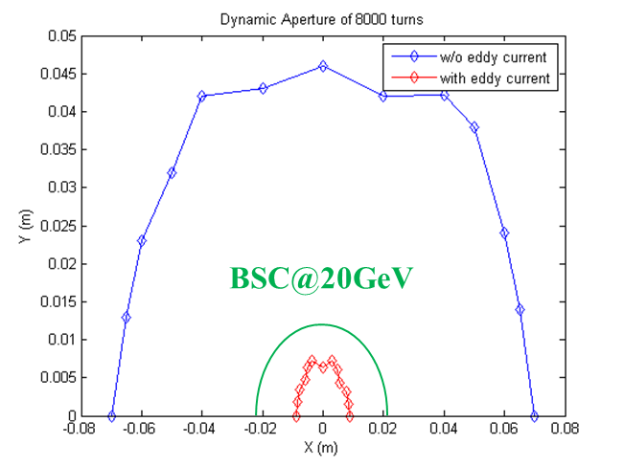
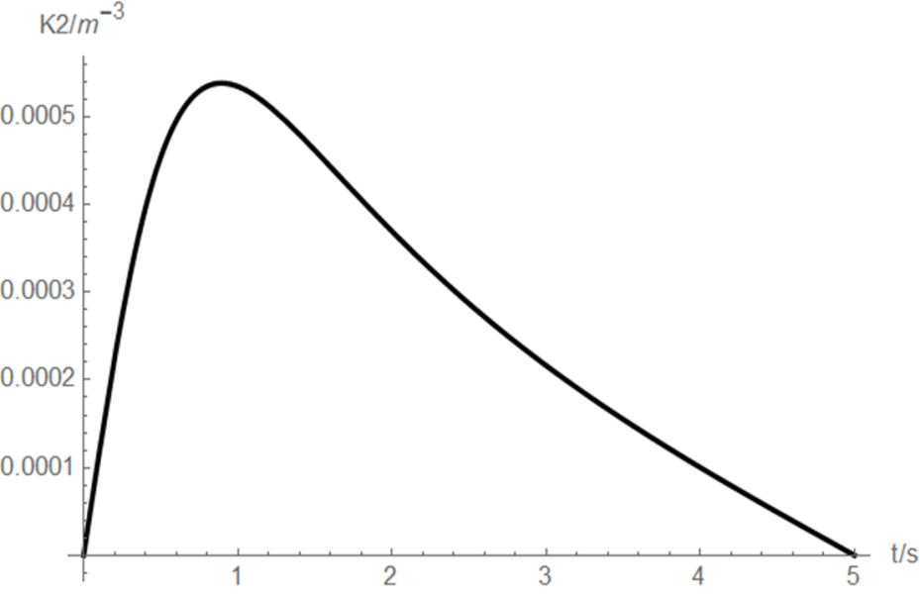
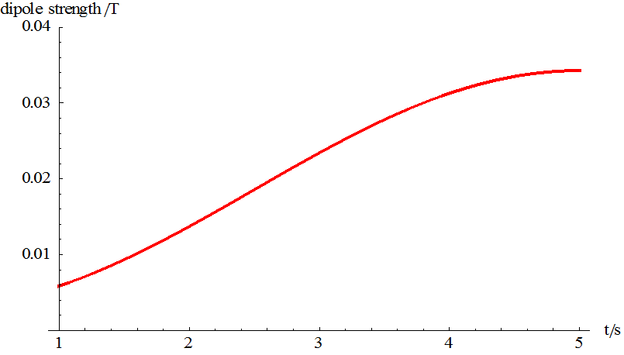
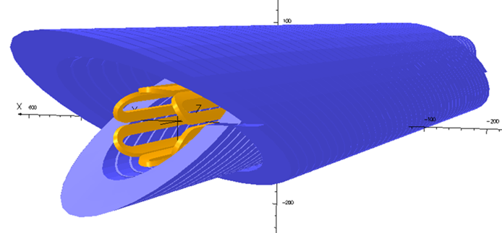
Eddy current effect & low field problem
Dedicated ramping curve to control the maximum K2.
Chromaticity distortion is corrected by independent sextupoles.
DA shrink significantly due to eddy current.
Sextupole coils attached to vacuum chamber are designed.
- Copper wire d=0.5mm
- Fix with glue (epoxy), air cooling
Iron dipole can not be used
- Yoke destroy the sex. field
CCT+S coils is baseline → eddy current & low field difficulties

Slide 24
Outline
CEPC booster
Parameters
Geometry & optics
Error analysis & correction
Instability
Ramping dynamic simulation
Dipole/power supply error tolerance
Eddy current problem
CEPC damping ring system
Overall consideration for DR system
DR design
EC/BC design

Slide 25
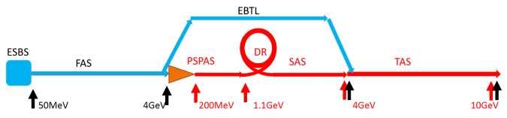
Principle of damping ring system
Energy compressor: match the RF acceptance of damping ring
Linac
Parameter exchange
Damping ring: reduce emittance of positron beam
Parameter exchange
Bunch compressor: reduce bunch length to control energy spread in Linac
Linac

Slide 26
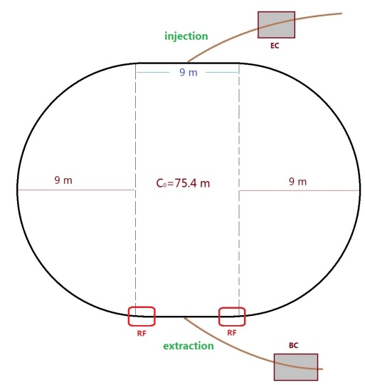
DR parameters
Linac repetition: 100Hz
two-bunch storage scheme
Storage time: 20 ms
Emittance (norm.): 2500→ 530 mm.mrad
Large trans. acceptance→ inj. efficiency

Slide 27
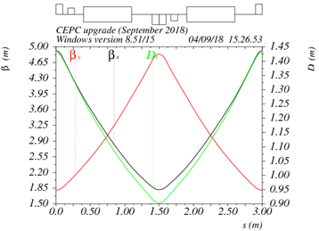
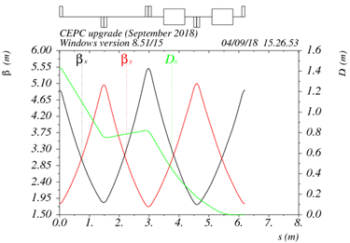
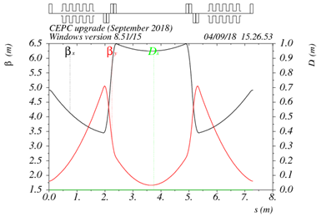
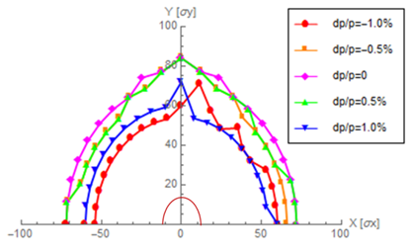
DR optics
60°/60° FODO
interleave sextupole scheme
2 sextupole families
DA > 5×injection beam size
Dis. suppressor
Arc FODO
RF & Inj./ext.

Slide 28
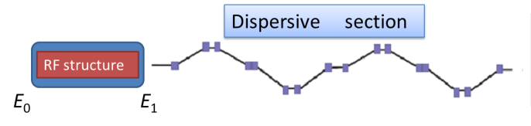
Parameter design for EC/BC
Same design principle for EC & BC.
EC: reduce energy spread under 0.2%
BC: reduce bunch length under 1mm
2 acc. structures (2860MHz)
Sketch of EC/BC
Long dispersive transport → large R₅₆

Slide 29
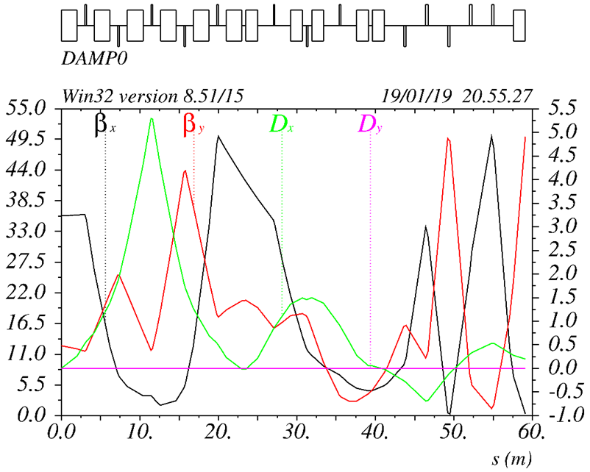
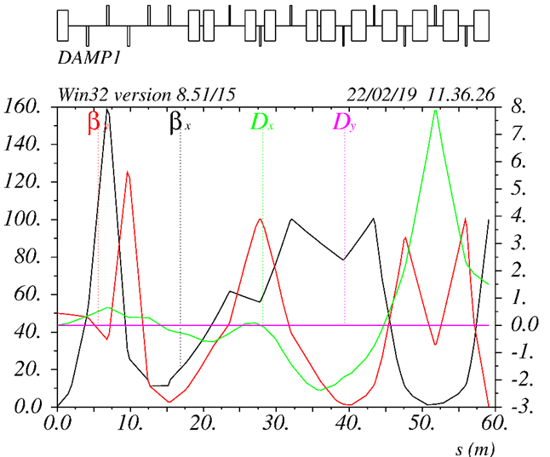
DR transport and inj./ext.
X. Cui
Linac → DR
DR → Linac
2 bunch scheme: rise/fall < bunch spacing (100 ns).
Component | Number | Septum width | Length (m) | Deflection angle (mrad) | Field (T) | BSC
 |  |  |  |  |  | H(mm) | V(mm)
Septum | 2 | 10mm | 2 | 100 | 0.18 | 60 | 60
Kicker | 2 |  | 0.5 | 1.5 | 0.01 | 60 | 60

Slide 30
Summary
The booster design can meet the injection requirements at three energy modes. Physics design satisfy the requirements of geometry, beam dynamics and key hardware.
Solution for eddy current and low field problem: CCT + sex. coil attached to vacuum chamber.
Dynamic simulation procedure established which is an important start for the study of beam dynamic property.
- Include error & eddy current soon…
Booster multipole error tolerance (0.01%) is very challenging. Effort to enlarge DA is a long-term task.
Feedback system is essential for booster. Design of transverse feedback has a good beginning.
DR is the key for easier booster (error tolerance, transmission efficiency, magnets aperture). Conceptual design finish. Need more detail study.

