Slide 1


  Lattice Design of the CEPC Collider Ring for A Higher Luminosity
Yiwei Wang
for the CEPC Accelerator Physics Group
The Institute of High Energy Physics, Chinese Academy of Sciences
CEPC Workshop-EU edition
15-17 April 2019, Oxford

Slide 2


Outline
Introduction
  Lattice design for a higher luminosity
  Preliminary result of dynamic aperture
  Performance with errors (based on CDR lattice)
Summary
Notes:
difficulties

Slide 3
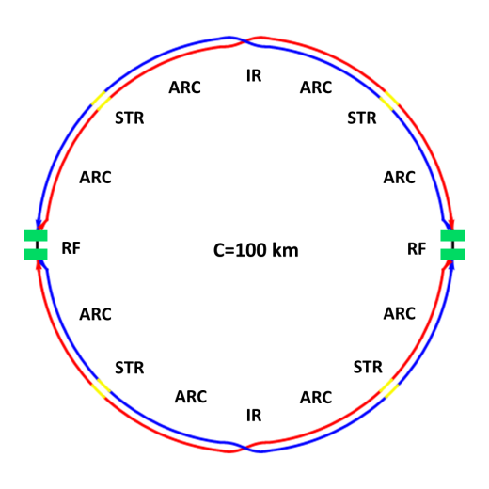
Introduction
The circumference of CEPC collider ring is 100 km.
In the RF region, the RF cavities are shared by two rings for H mode.
Twin-aperture of dipoles and quadrupoles is adopt in the arc region to reduce the their power. The distance between two beams is 0.35m.
Compatible optics for H, W and Z modes
  For the W and Z mode, the optics except RF region is got by scaling down the magnet strength with energy.
  For H mode, all the cavities will be used and bunches will be filled in half ring.
  For W & Z modes, bunches will only pass half number of cavities and can be filled in full ring.
Notes:
2 fold symmetry

Slide 4
CEPC CDR parameters
 | Higgs | W | Z（3T） | Z（2T）
Number of IPs | 2
Beam energy (GeV) | 120 | 80 | 45.5
Circumference (km) | 100
Synchrotron radiation loss/turn (GeV) | 1.73 | 0.34 | 0.036
Crossing angle at IP (mrad) | 16.5×2
Piwinski angle | 3.48 | 7.0 | 23.8
Number of particles/bunch N_{e} (10¹⁰) | 15.0 | 12.0 | 8.0
Bunch number (bunch spacing) | 242 (0.68μs) | 1524 (0.21μs) | 12000 (25ns+10%gap)
Beam current (mA) | 17.4 | 87.9 | 461.0
Synchrotron radiation power /beam (MW) | 30 | 30 | 16.5
Bending radius (km) | 10.7
Momentum compact (10⁻⁵) | 1.11
β function at IP β_{x}* / β_{y}* (m) | 0.36/0.0015 | 0.36/0.0015 | 0.2/0.0015 | 0.2/0.001
Emittance ε_{x}/ε_{y} (nm) | 1.21/0.0024 | 0.54/0.0016 | 0.18/0.004 | 0.18/0.0016
Beam size at IP σ_{x} /σ_{y} (μm) | 20.9/0.06 | 13.9/0.049 | 6.0/0.078 | 6.0/0.04
Beam-beam parameters ξ_{x}/ξ_{y} | 0.018/0.109 | 0.013/0.123 | 0.004/0.06 | 0.004/0.079
RF voltage V_{RF} (GV) | 2.17 | 0.47 | 0.10
RF frequency f _{RF} (MHz) (harmonic) | 650 (216816)
Natural bunch length σ_{z} (mm) | 2.72 | 2.98 | 2.42
Bunch length σ_{z} (mm) | 4.4 | 5.9 | 8.5
HOM power/cavity (2 cell) (kw) | 0.46 | 0.75 | 1.94
Energy spread (%) | 0.134 | 0.098 | 0.080
Energy acceptance requirement (%) | 1.35 | 0.90 | 0.49
Energy acceptance by RF (%) | 2.06 | 1.47 | 1.7
Photon number due to beamstrahlung | 0.082 | 0.050 | 0.023
Beamstruhlung lifetime /quantum lifetime* (min) | 80/80 | >400
Lifetime (hour) | 0.43 | 1.4 | 4.6 | 2.5
F (hour glass) | 0.89 | 0.94 | 0.99
Luminosity/IP L (10³⁴cm⁻²s⁻¹) | 2.93 | 10.1 | 16.6 | 32.1
D. Wang
et al

Slide 5
CEPC new parameters
 | Higgs | W | Z（3T） | Z（2T）
Number of IPs | 2
Beam energy (GeV) | 120 | 80 | 45.5
Circumference (km) | 100
Synchrotron radiation loss/turn (GeV) | 1.68 | 0.33 | 0.035
Crossing angle at IP (mrad) | 16.5×2
Piwinski angle | 3.78 | 8.5 | 27.7
Number of particles/bunch N_{e} (10¹⁰) | 17.0 | 12.0 | 8.0
Bunch number (bunch spacing) | 218 (0.76μs) | 1568 (0.20μs) | 12000 (25ns+10%gap)
Beam current (mA) | 17.8 | 90.4 | 461.0
Synchrotron radiation power /beam (MW) | 30 | 30 | 16.5
Bending radius (km) | 10.7
Momentum compact (10⁻⁵) | 0.91
β function at IP β_{x}* / β_{y}* (m) | 0.33/0.001 | 0.33/0.001 | 0.2/0.001
Emittance ε_{x}/ε_{y} (nm) | 0.89/0.0018 | 0.395/0.0012 | 0.13/0.003 | 0.13/0.00115
Beam size at IP σ_{x} /σ_{y} (μm) | 17.1/0.042 | 11.4/0.035 | 5.1/0.054 | 5.1/0.034
Beam-beam parameters ξ_{x}/ξ_{y} | 0.024/0.113 | 0.012/0.1 | 0.004/0.053 | 0.004/0.085
RF voltage V_{RF} (GV) | 2.4 | 0.43 | 0.082
RF frequency f _{RF} (MHz) (harmonic) | 650 (216816)
Natural bunch length σ_{z} (mm) | 2.2 | 2.98 | 2.42
Bunch length σ_{z} (mm) | 3.93 | 5.9 | 8.5
HOM power/cavity (2 cell) (kw) | 0.58 | 0.77 | 1.94
Energy spread (%) | 0.19 | 0.098 | 0.080
Energy acceptance requirement (%) | 1.7 | 0.90 | 0.49
Energy acceptance by RF (%) | 3.0 | 1.27 | 1.55
Photon number due to beamstrahlung | 0.104 | 0.050 | 0.023
Beamstruhlung lifetime /quantum lifetime* (min) | 30/50 | >400
Lifetime (hour) | 0.22 | 1.2 | 3.2 | 2.0
F (hour glass) | 0.85 | 0.92 | 0.98
Luminosity/IP L (10³⁴cm⁻²s⁻¹) | 5.2 | 14.5 | 23.6 | 37.7
D. Wang
et al
Notes:
RF cavity number

Slide 6

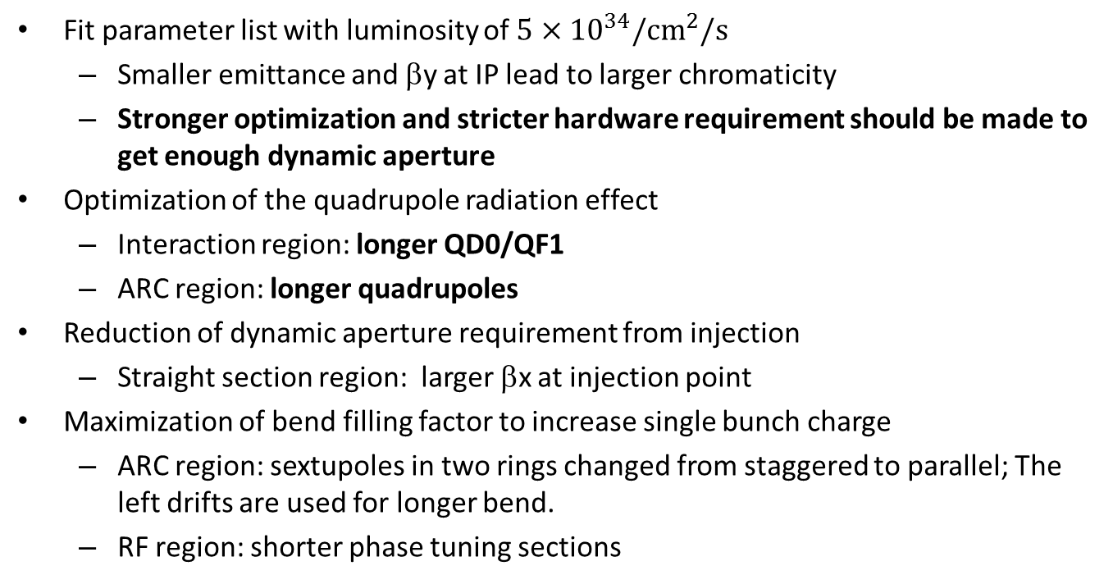
  Lattice design with luminosity of $5×{10}^{34}/{cm}^{2}/s$
  Fit parameter list with luminosity of $5×{10}^{34}/{cm}^{2}/s$
  Smaller emittance and βy at IP lead to larger chromaticity
  Stronger optimization and stricter hardware requirement should be made to get enough dynamic aperture
Optimization of the quadrupole radiation effect
  Interaction region: longer QD0/QF1
  ARC region: longer quadrupoles
  Reduction of dynamic aperture requirement from injection
  Straight section region: larger βx at injection point
Maximization of bend filling factor to increase single bunch charge
  ARC region: sextupoles in two rings changed from staggered to parallel; The left drifts are used for longer bend.
  RF region: shorter phase tuning sections

Slide 7
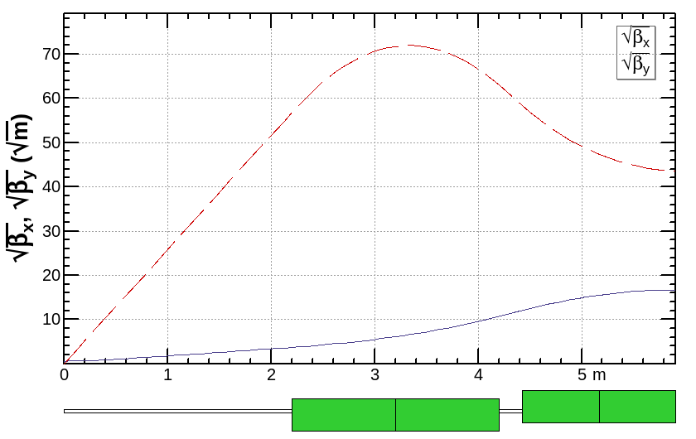
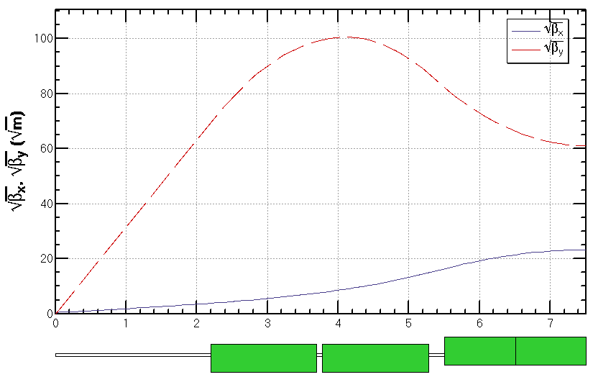
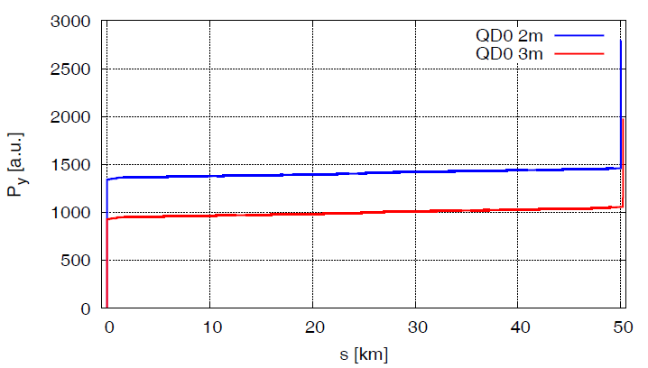
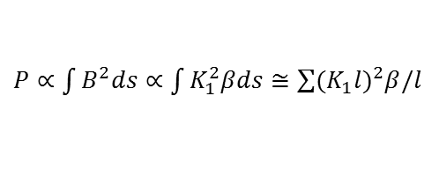
Optimization of the quadrupole radiation effect
The dynamic aperture reduction due to the damping and fluctuation is significant especially on the vertical plane.
Radiation power due to quadrupoles:
  contribution of QD0 dominant
  longer QD0 will significantly decreased the power on vertical plane and thus help to increase the dynamic aperture: QD0/QF1 2m/1.48m => 3m/2m
  longer ARC quadrupoles: 2m => 3m
$P∝\int{B^{2}ds}∝$ $\int{K_{1}^{2}βds≅\sum{{(K_{1}l)}^{2}β/l}}$
L*= 2.2 m
LQD0 = 2 m
D = 0.23 m
LQF1 = 1.48 m
L*= 2.2 m
LQD0 = 2×1.5 m+0.08m
D = 0.23 m
LQF1 = 2.0 m

Slide 8
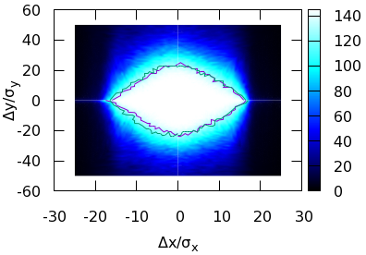
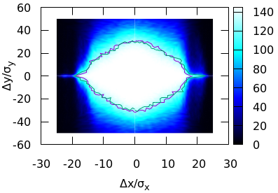
Optimization of the quadrupole radiation effect (cont.)
Checked with CDR lattice for time being
With longer QD0, the vertical dynamic aperture increased around 30%.
by Yuan Zhang, Jin Wu

Slide 9
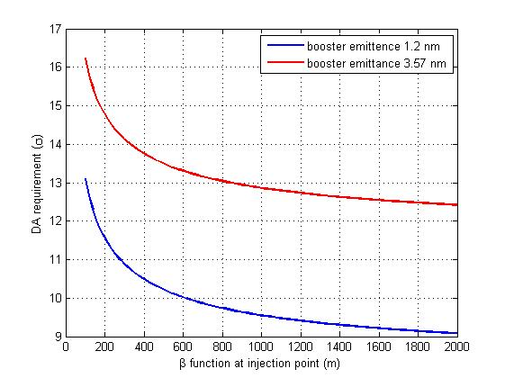
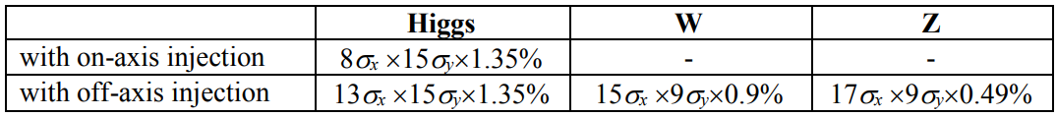
Reduction of dynamic aperture requirement from injection
Horizontal DA requirement with off-axis injection
Trying to relax the dynamic aperture requirement of the off-axis injection scheme
  Larger βx at injection point
  Smaller injected emittance
Ɛ_{booster}=3Ɛ_{collider}
DA requirement for the CDR parameters
Ɛ_{booster}=Ɛ_{collider}
by Xiaohao CUI

Slide 10
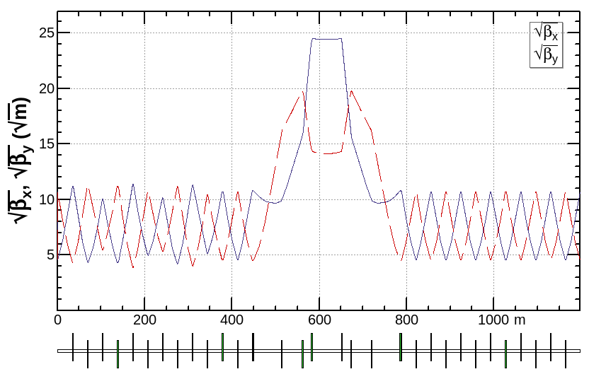
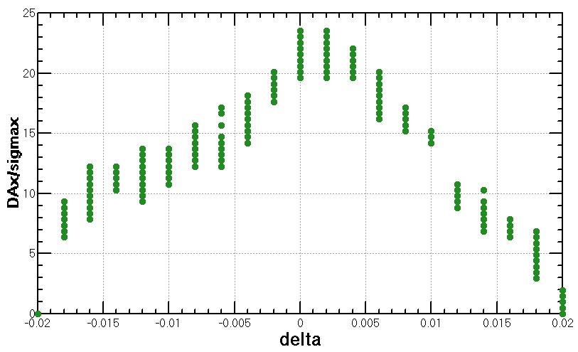
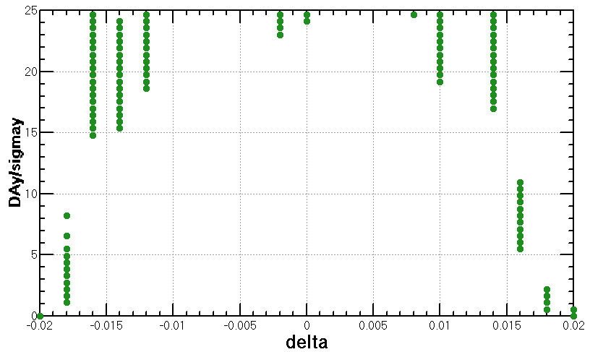
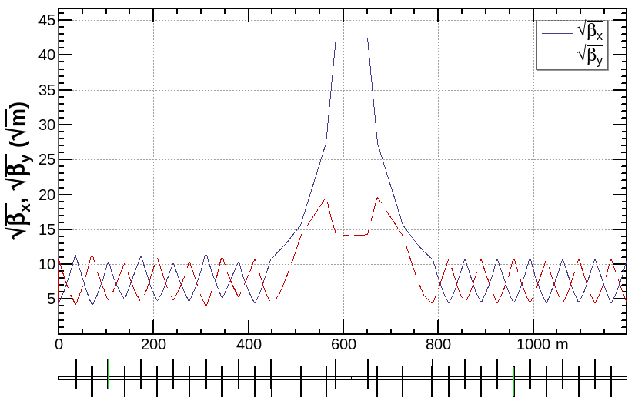
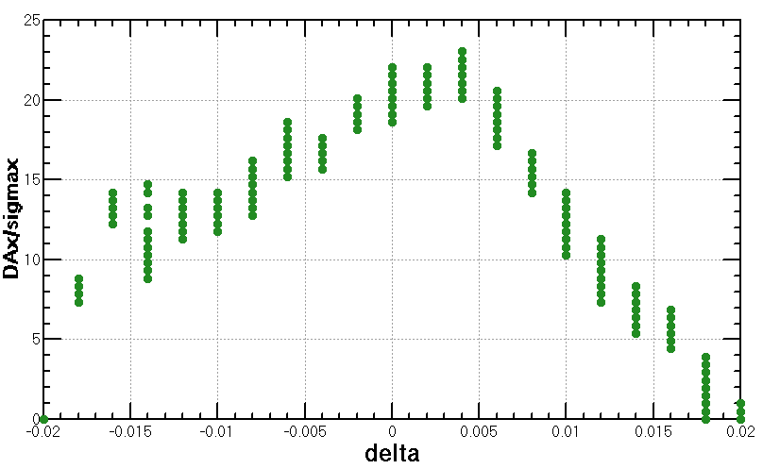
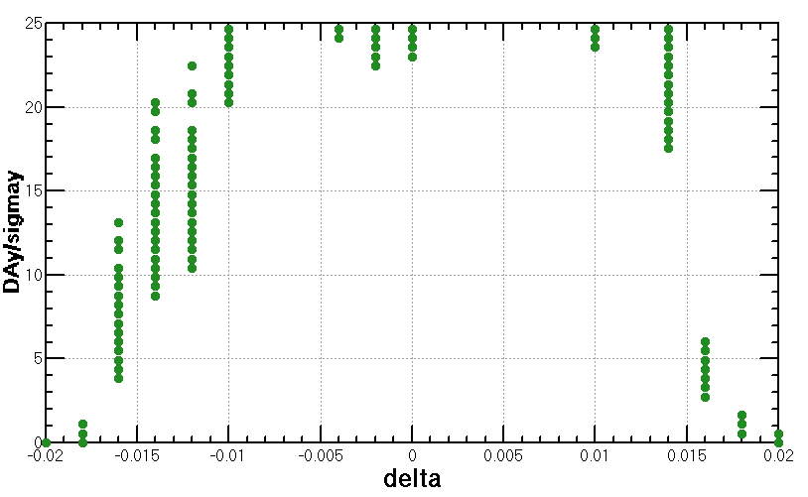
Reduction of dynamic aperture requirement
from injection (cont.)
Larger βx at injection point
  βx increased from 600m to 1800m
  Increased horizontal chromaticity is small and the results of DA are almost the same.
*based on CDR lattice

Slide 11
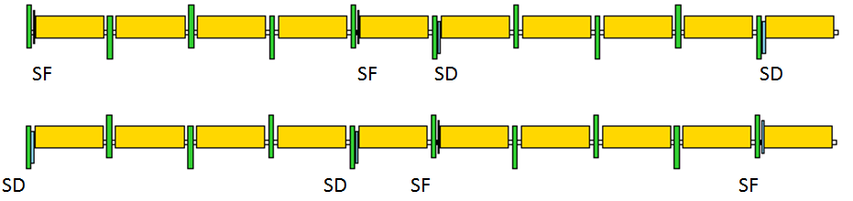
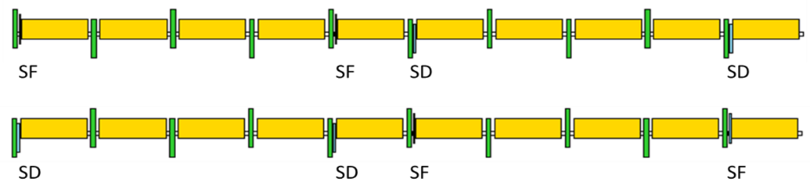
Maximization of the bend filling factor in the ARC
Corr
Corr
Corr
Corr
Corr
Corr
Corr
Corr
Corr
Corr
SF
SF
SD
SD
L+0.7m
1.1m+L+0.7m
1.1m+L+0.7m
1.1m+L+0.7m
L+0.7m
L+0.7m
1.1m+L+0.7m
1.1m+L+0.7m
1.1m+L+0.7m
L+0.7m
Corr
Bend: L -> L+0.7m, L+1.8m
Quad: 2m -> 3m
SF: 0.7m
SD: 1.4m
Corr: 0.3m (drift 0.15m)
Drift: 0.2m
Corr
Corr
Corr
1.1m+L+0.7m
1.1m+L+0.7m
1.1m+L+0.7m
1.1m+L+0.7m

Slide 12
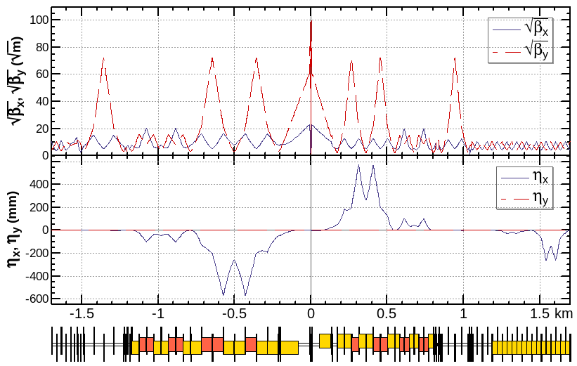
Optics design of Interaction region
local chromaticity correction of both plane, asymmetric layout 1), crab-waist collision 2)
L*=2.2m, θ_{C} =33mrad, G_{QD0} =77 T/m, G_{QF1} =63 T/m, L_{QD0} =3.0m, L_{QF1} =2.0m
IP upstream of IR: Ec < 120 keV within 400m, last bend Ec = 45 keV
IP downstream of IR: Ec < 300 keV within 250m, last bend Ec = 97 keV
1) K. Oide et al., ICHEP16.
2) M. Zobov et al., Phys. Rev. Lett. 104, 174801(2010).

Slide 13
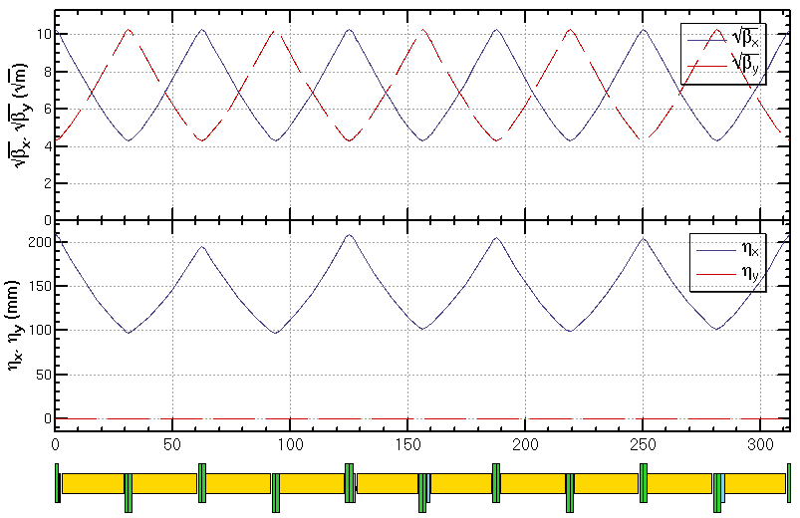
Optics design of ARC region
  FODO cell, 90°/90°, non-interleaved sextupole scheme, period =5cells
  Cell length reduced from 69m to 62m
Twin-aperture of dipoles and quadrupoles* is adopt in the arc region to reduce the their power. The distance between two beams is 0.35m.
*Ref: A. Milanese,
PRAB 19, 112401 (2016)

Slide 14
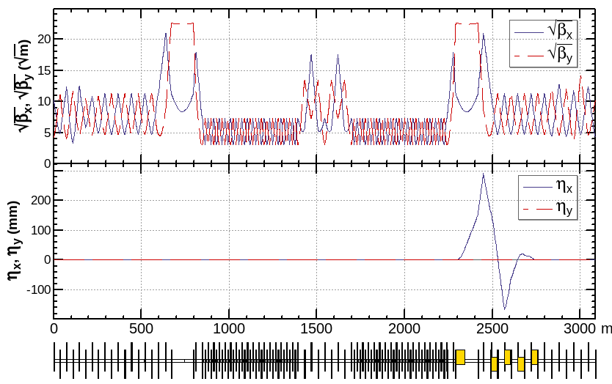
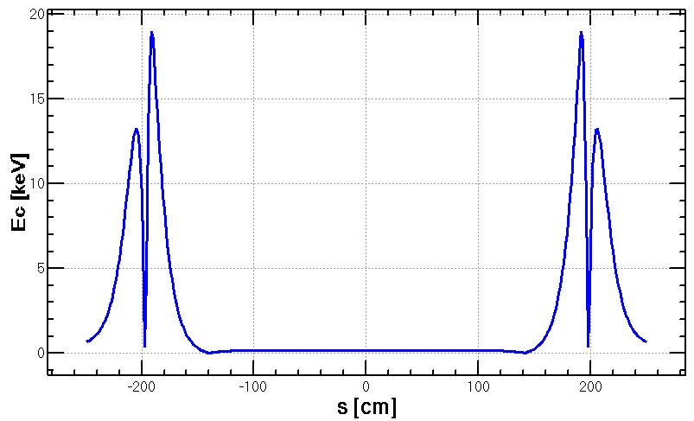
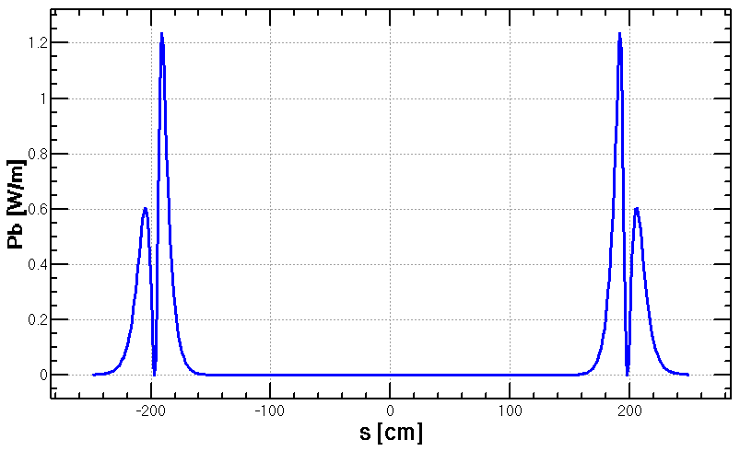
Optics design of RF region
Common RF cavities for e- and e+ ring (Higgs)
RF region divided into two sections for bypassing half numbers of cavities in W&Z mode
An electrostatic separator combined with a dipole magnet to avoid bending of incoming beam (ref: K. Oide, ICHEP16)
  The radiation due to imperfect cancelation from incoming beam is tolerable for SCRF cavities.
Shorter phase tuning sections to increase the length of ARC region
Ec maximum around 19 keV
3.4 W for 8 components
Power of 0.1W may hit when top-up injection
Esep= 2.0 MV/m
Bdip=66.7 G
L= (4+1)m×8
Δx= 11.1 cm at the entrance of quad
phase tuning
Separation
cavities
cavities
Separation
phase tuning

Slide 15
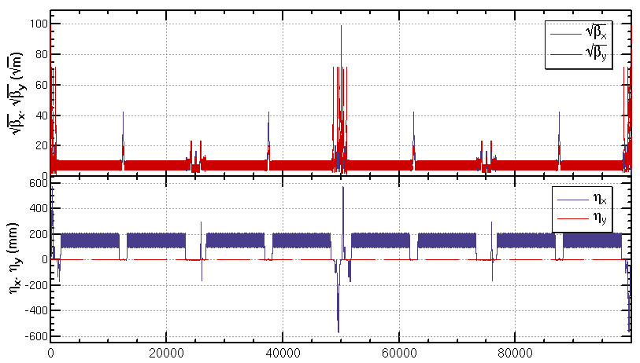
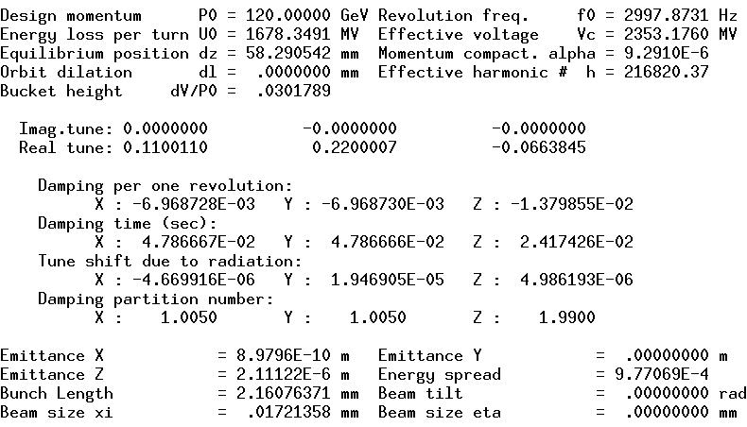
Optics of the collider ring
  An preliminary optics fulfilling requirements of the new parameters list, geometry, photon background and key hardware was got.
Circumference=100,001 m
Qx/Qy=391.11/393.22

Slide 16
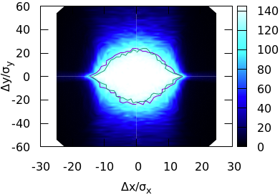
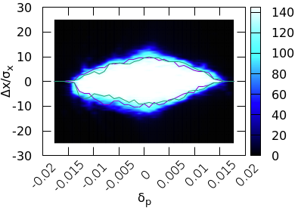

Preliminary result of dynamic aperture
Start point of the optimization
  Nonlinearity optimized term by term with 10 families of sextupoles in the IR and 4 families of sextupoles in the ARC.
1st result of dynamic aperture optimized with MODE
  Higgs dynamic aperture with 90% survival of 100 samples
  Including radiation damping, fluctuation, energy sawtooth and tapering, beam-beam effects
  145 turns (2 damping times), 4 initial phases
DA for on momentum
DA w/ designed coupling
Y. Zhang, J. Wu, et al
1$2σ_{x}×$ 21$σ_{y}×$ 1.5%

Slide 17
Performance with errors
(based on CDR lattice)
Relaxed requirement of alignments and filed errors compared with CDR
Stronger corrections made
Component | Δx (um) | Δy (um) | Δθ_{z} (urad)
Arc quadrupole | 100 | 100 | 100
IR Quadrupole (w/o FF) | 50 | 50 | 50
Sextupole | 100 | 100 | 100
Component | Field error
Dipole | 0.01%
Arc quadrupole | 0.02%
By Y. Wei
Notes:
Design coupling 0.26 % used

Slide 18
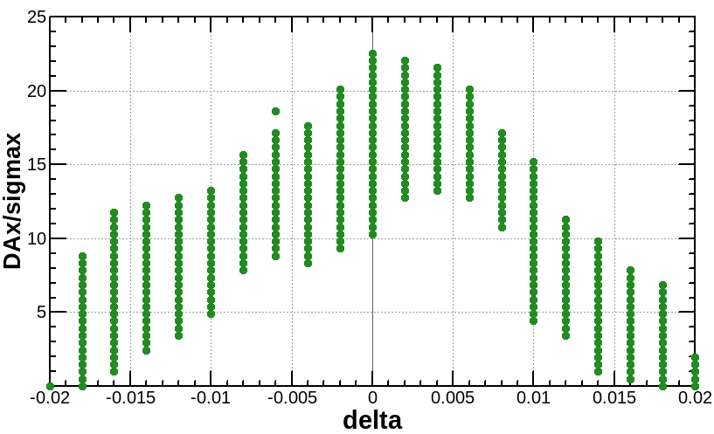
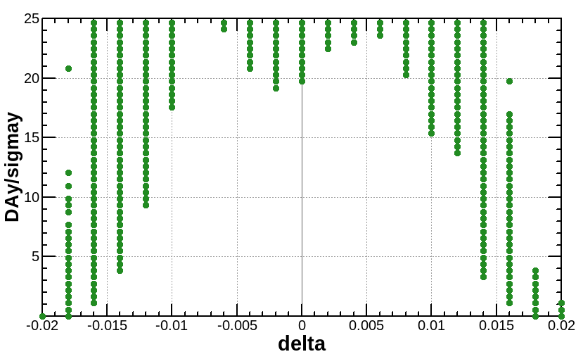
Performance with errors
(based on CDR lattice)
Dynamic aperture result for Higgs mode
  Tracking in SAD with radiation damping, fluctuation, energy sawtooth and tapering, 145 turns (2 damping times), initial phases=0
  Horizontal dynamic aperture decreased significantly with errors. But it still fulfils the dynamic aperture requirement of on-axis injection.
w/ error
requirement
Requirement with on-axis injeciotn $8σ_{x}×15σ_{y} \& 0.0135$
Notes:
Design coupling 0.26 % used

Slide 19
Summary
  An preliminary lattice for a higher luminosity has been got.
  Stronger optimization and stricter hardware requirement should be made to get enough dynamic aperture
  Optimization of the quadrupole radiation effect
  Reduction of dynamic aperture requirement from injection
  Maximization of bend filling factor to increase single bunch charge
Preliminary result of dynamic aperture
  Further optimization need to be made to increase the momentum acceptance
Relaxed requirement of alignments and filed errors compared with CDR and stronger corrections made.
  Work will be done with the new lattice

