Slide 1

Fast tracking simulation
F. Bedeschi,
CepC workshop
Oxford, April 2019
Outline
The need
Implementation
Examples
Conclusions

Slide 2
The need
CEPC/FCC tracking systems still evolving
Need fast turn around in evaluation of various options
  Easy implementation of modified geometry
  Easy change of detector performances
Werner’s formulas are useful but limited
  Equal spacing
  Uniform resolution
Need realistic input for fast simulation
  Full covariance matrix
  Dependence on pt and polar angle for generic configuration

Slide 3
Implementation (1)
Track fit χ² linearized in the fit parameters:
  d/d* = predicted/measured distance of track from wire or pixel
  p = track parameters
  S = covariance of all measurements: resolution & MS
    MS → worse resolution and non diagonal correlation terms
Parameter resolution depends only on S and derivatives:

Slide 4
Implementation (2)
Simple geometry description in ROOT:
  Layer types allowed:
    Cylinder shell (const R) or disk (constant z)
    Measurement or inert (for MS)
    Measurement is axial (Rφ), small angle stereo or 90 deg. (Rz)
  Features:
    Geometry can be stored in/recovered from text file
    Each sub-detector can be turned on or off
    Methods to draw geometry and material budget
Currently implemented:
  IDEA old, as in full simulation (conservative Si resolution)
  IDEA optimized (same Si resolution assumed by CLD - baseline)
  CLD (Thanks Emilia!)

Slide 5
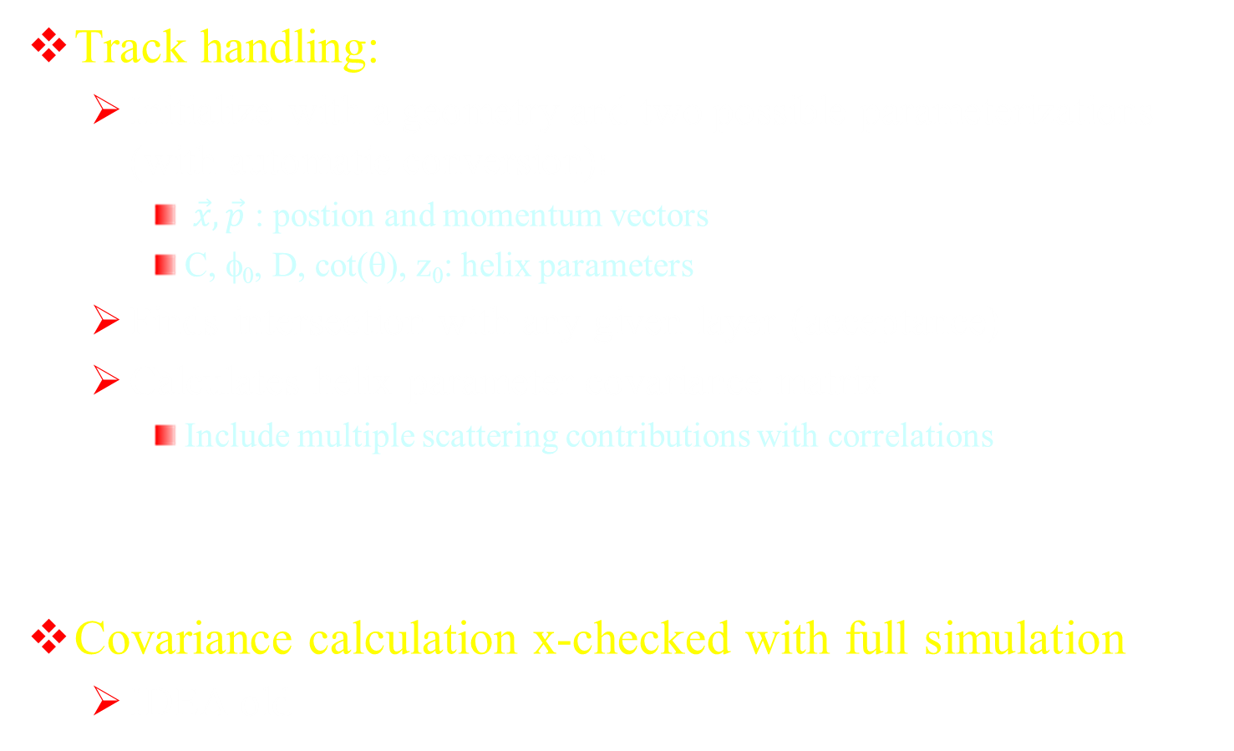
Implementation (3)
Track handling:
  Initialize with a geometry and two possible parameterizations (with automatic conversion):
    $\vec{x}, \vec{p}$ : postion and momentum vectors
    C, φ₀, D, cot(θ), z₀: helix parameters
  Finds intersection with any given layer (acceptance)
  Calculates helix parameter covariance matrix
    Include multiple scattering contributions with correlations
Covariance calculation x-checked with full simulation
  IDEA old

Slide 6
Examples (1)
Initialize geometry and draw it
→ material plot
CLD
IDEA

Slide 7
Examples (2)
IDEA (baseline)/ CLD comparison
→zoom pt resolution
45 degree
90 degree

Slide 8
Make it faster
Calculation of covariance matrix slow for IDEA
  Involves inversion of matrix ~ 120x120
Solution:
  Store pt-polar angle grid of matrices in .root file
  Get any matrix by bi-linear interpolation over 2D-grid
    C = C₁₁(1-t_{pt})(1-t_{th})+C₁₂(1-t_{pt})t_{th}
    +C₂₁t_{pt}(1-t_{th})+C₂₂ t_{pt} t_{th}
    t_{pt} = (pt-pt_{min})/(pt_{max}-pt_{min})
    t_{th} = (th-th_{min})/(th_{max}-th_{min})
    Protect positive definitness
C₁₂
C₂₂
t_{th}
C
C₁₁
t_{pt}
C₂₁

Slide 9
Application to simulation
Track handling:
  Perfect track → observed track
    Conversion to helix parameters
    Get covariance matrix from interpolation
    Smear helix parameters according to appropriate covariance matrix
      Use Choleski decomposition

Slide 10
Example (3)
Application in invariant mass calculation in Pythia generated events

Slide 11
Example (4)
Higgs recoil from HZ (Z→μ⁺μ⁻)

Slide 12
Example (5)
Full process simulation
Cuts:
Opposite sign muon pairs
θ_{μ} > 10 deg, pt_{μ} > 1 GeV
|M_{μμ}-M_{z}| < 20 GeV
L = 5 ab⁻¹
35<|p_{Z}|<60, cos α_{μμ}< − 0.4
WW background could be further reduced with MET

Slide 13
Conclusion
Simple ROOT based classes to simulate tracking system resolution
  Easy to change configuration
  Perfect to compare options
Validated on full simulation
Use demonstrated on specific physics process
Usable to feed fast simulation a realistic covariance
  Can/Should be included inside DELPHES

Slide 14
Additional Slides

Slide 15
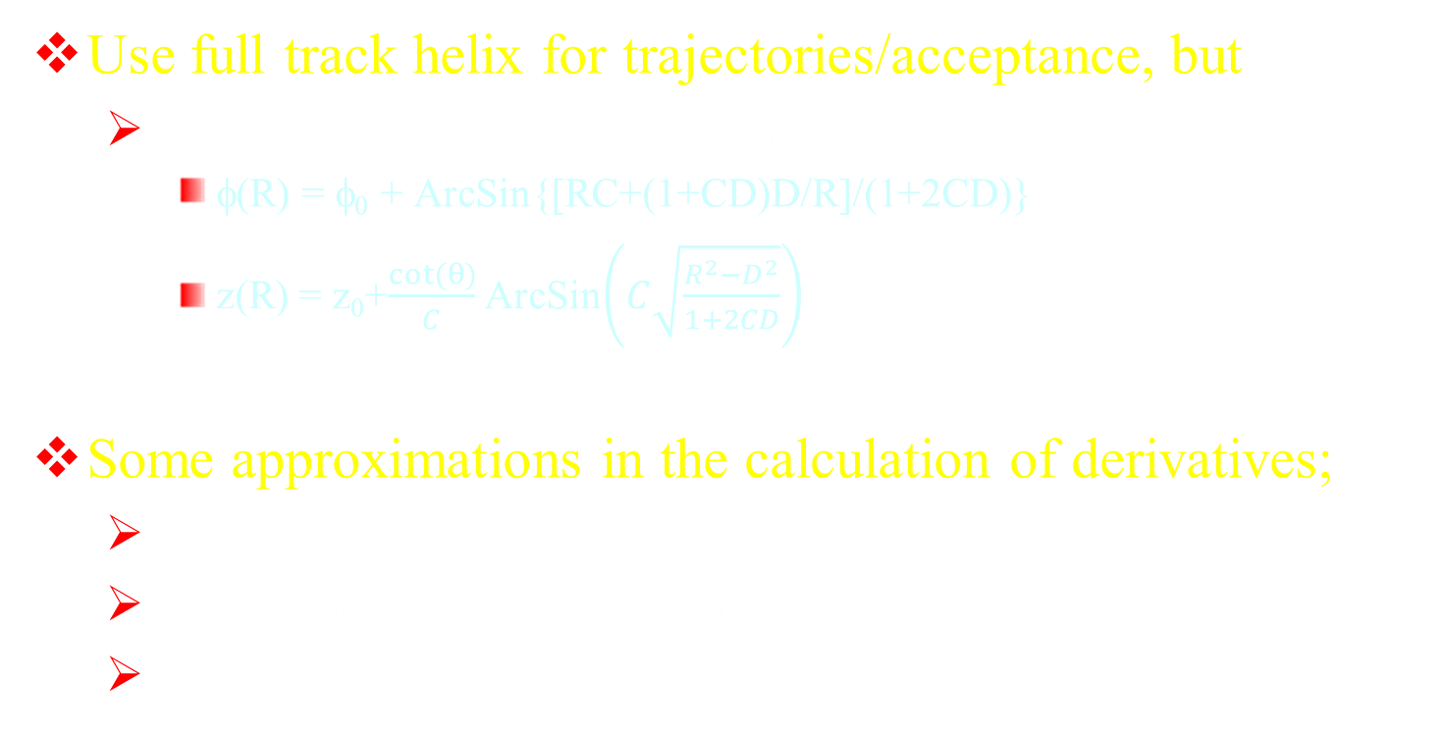
Implementation details
Use full track helix for trajectories/acceptance, but
  Keep only first outgoing branch
    φ(R) = φ₀ + ArcSin{[RC+(1+CD)D/R]/(1+2CD)}
    z(R) = z₀+$\frac{cot⁡(θ)}{C}$ ArcSin$\left(C\sqrt{\frac{R^{2}−D^{2}}{1+2CD}}\right)$
Some approximations in the calculation of derivatives;
  CD<<1, |D| <<R
  OK also for low momentum track
  Full derivatives much more complex, but could be added later

Slide 16
Implementation details
Typical geometry block

Slide 17


Beam energy spread
Courtesy of P. Janot (FCC week 2018 – Amsterdam)
σ_{beam} = 0.165%
σ$\sqrt{s}$ = σ_{beam}/$\sqrt{2}$
= 0.136%

Slide 18
HZ→Hμμ
Pt distributions of muons from Z decay

Slide 19
Z invariant mass in ZH events

Slide 20
X-sections

