Slide 1
HL-LHC Higgs physics
Workshop on the Circular Electron-Positron Collider
EU Edition 2019
Oxford, UK, April 15 - 17, 2019
Marianna Testa
LNF-INFN
Notes:
4/15/19
1
1

Slide 2
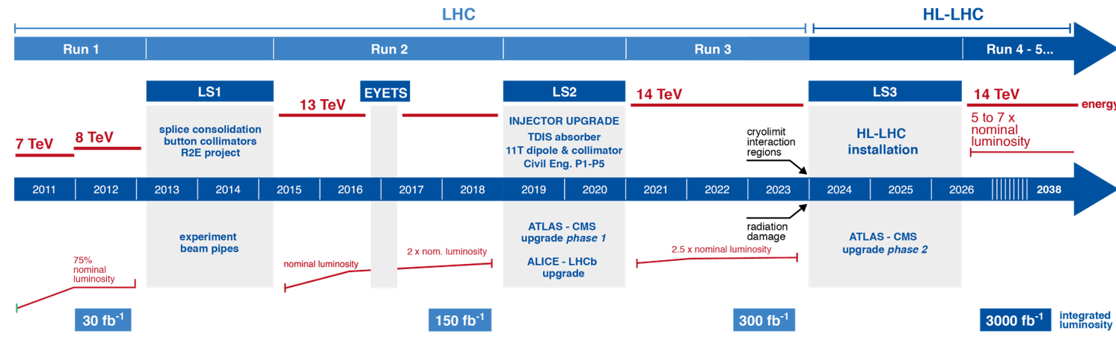
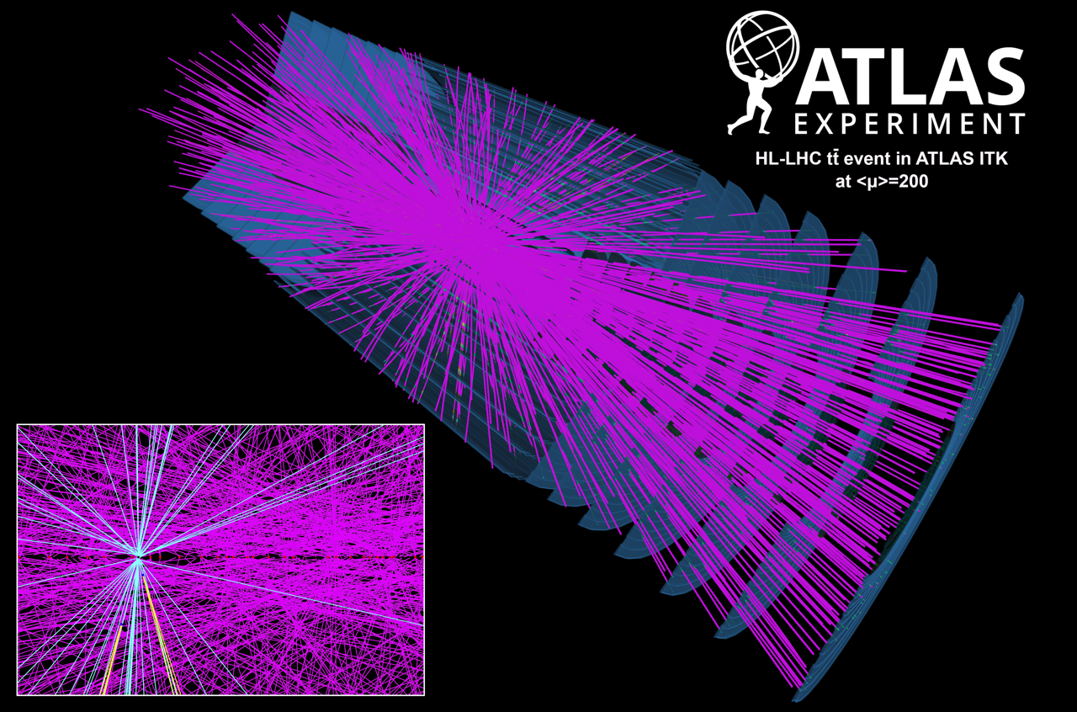
High Luminosity LHC
This talk
We are here
Operation at up to L=7.5·10³⁴Hz/cm² (LHC Run-2: 2·10³⁴) to collect up to L_{int} = 3000 fb⁻¹
Up to 200 (~ 37) pp collisions per bunch crossing at HL-LHC (LHC Run2)
  Very challenging experimental conditions
  Extensive detector upgrades to operate under HL-LHC conditions
tt̄ simulated event at average pile-up of 200
collisions per bunch crossing
Notes:
4/15/19
2
2

Slide 3
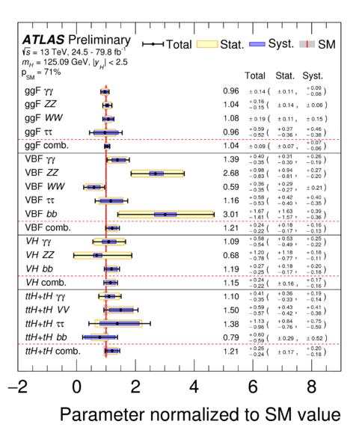
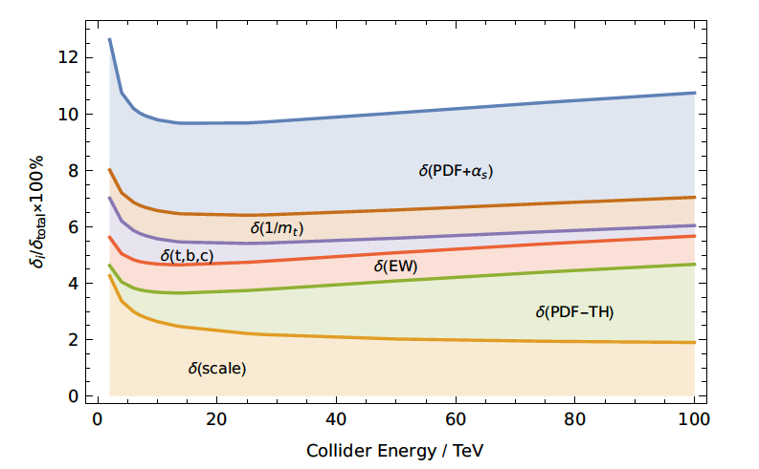
Higgs Physics at (HL-)LHC
ATLAS-CONF-2019-005
Wide range of Higgs boson couplings explored at LHC
  Recent observation: ttH production
  Still unobserved H→µµ, H→Zγ decays
  Many measurements still statistically limited
Precise characterization of the Higgs boson main priority of HL-LHC. With L=3 ab⁻¹ :
  Reduced statistical uncertainties
  Reduced experimental systematic uncertainties
  Reduced background uncertainties from high-statistics control regions
Crucial to also reduce theory uncertainties
  New precision PDF sets including HL-LHC data
    Exploit improved experimental precision and enhanced forward acceptance of upgraded detectors
  Increasing availability of higher order theory calculations
Crucial to also improve luminosity: aim to 1% precision
YR2018 1902.00134
Notes:
4/15/19
3
3
1.7 x 10⁸ Higgs bosons expected in ATLAS, produced by the HL-LHC. More than 1 x 10 6 Higgs bosons per main production mode.~100k Higgs to di-Higgs decays.

Slide 4
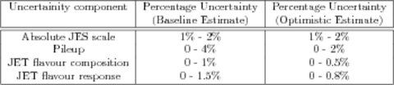
Higgs measurements@HL-LHC : methods
Recent new projections in the Yellow Report 1902.00134
Extrapolations from Run 2 data to 3 ab⁻¹
  Efficiencies, resolutions, fake rates assumed unchanged from the Run 2 values
    assumption is that upgraded detectors compensate pileup effects
Analysis of simulated samples with HL-LHC conditions
  Number of pileup interactions μ=200
  Upgraded detectors
  Performed for new analysis or significantly improved analysis wrt Run2 ones
Main scenario in YR for systematic uncertainties (S2):
  Most theoretical uncertainties scaled down by a factor ½
    from improvements in the PDFs and a more accurate account of correlations
  experimental uncertainties scaled down by √L until they reach a defined lower limit
Scenario for comparison: using Run 2 systematic uncertainties (S1)
  In all cases uncertainties due to the finite number of simulated events are neglected
Example:
Jet systematics uncertainties expected at HL-LHC
Notes:
4/15/19
4
4

Slide 5
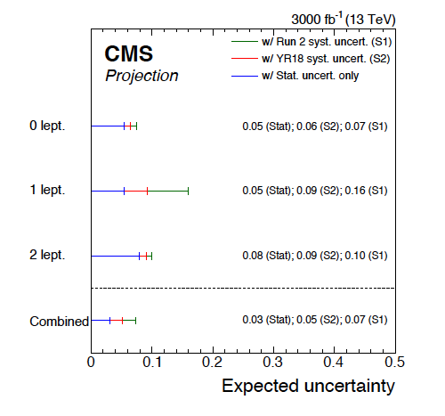
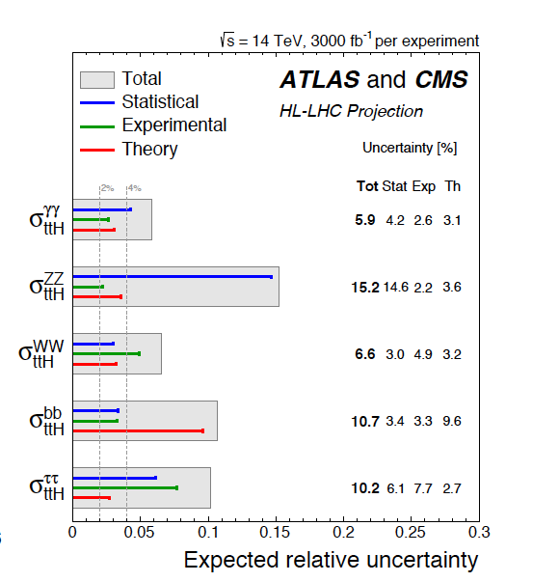
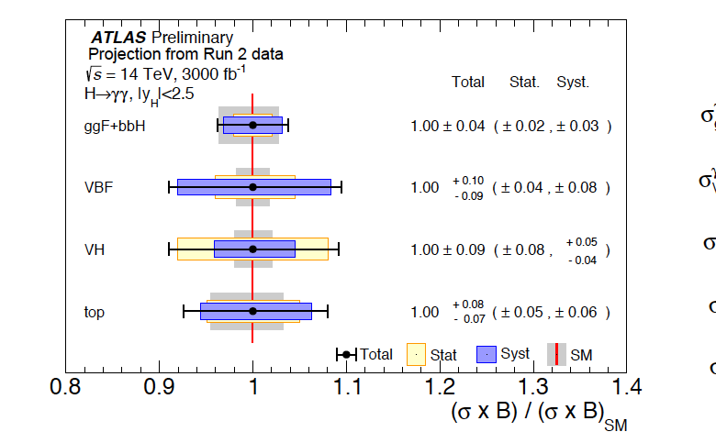
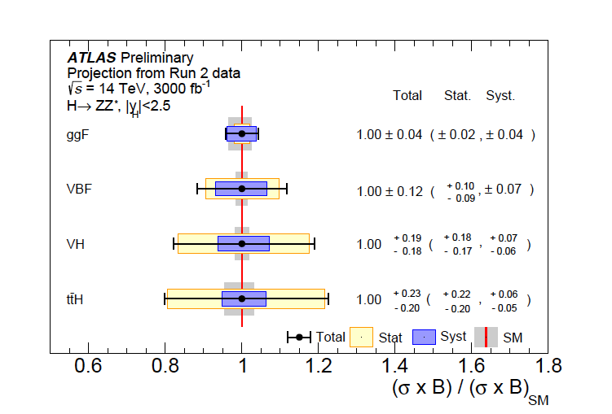
Higgs couplings: single channels
YR2018 1902.00134
Projection of combined measurements of Higgs boson couplings using data collected in Run2
  main production: ggF, VBF, VH, ttH
  decay modes: γγ, ZZ, WW, bb, ττ, µµ, Zγ
Most channels dominated by systematic uncertainties:
  exception: ttH, H→γγ, ZZ and VH, H→ZZ, γγ
Rare H→μμ decay mode expected to be observed
  and precisely measured!
Expected evidence for rare H→Zγ decay
VH,H→bb
H→γγ
H→ZZ
ttH
Notes:
4/15/19
5
5

Slide 6
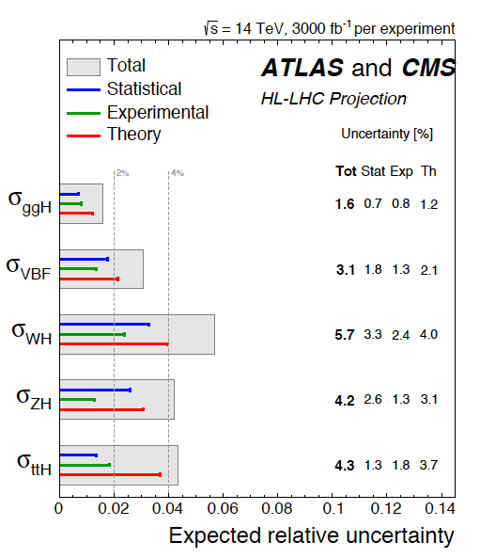
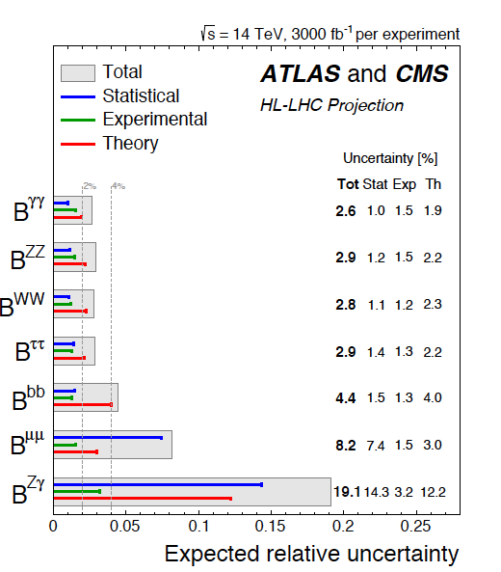
Combined Higgs cross section and BR measurements
YR2018 1902.00134
BR H→µµ and BR H→Zγ statistically limited
Other branching ratios and cross sections dominated by theoretical uncertainties
Notes:
4/15/19
6
6

Slide 7
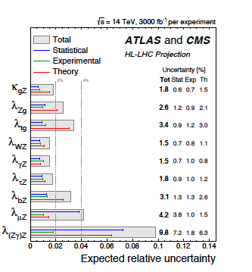
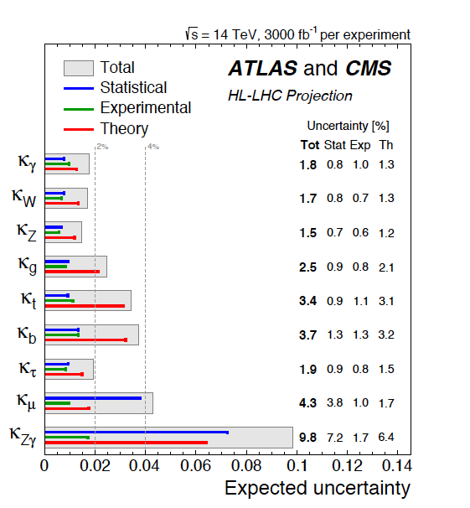
Combined Higgs coupling measurements
YR2018 1902.00134
Coupling modifiers for production process or decay mode j
Ratio of coupling modifiers
σ_{ggF} = κ ² _{g} σ_{ggF}(SM)
κ _{g}
κ _{W,Z}
Γ _{W,Z} = κ ² _{W,Z} Γ _{W,Z} (SM)
Uncertainties on the κ's 2-5%, apart from Zγ. Mostly limited by theoretical uncertainties
Uncertainties on λ_{ij} 1.5-4%, a part λ_{ZγΖ}
λ_{γΖ} best measured, allows to probe new particles in the H→γγ loop
Notes:
4/15/19
7
7

Slide 8
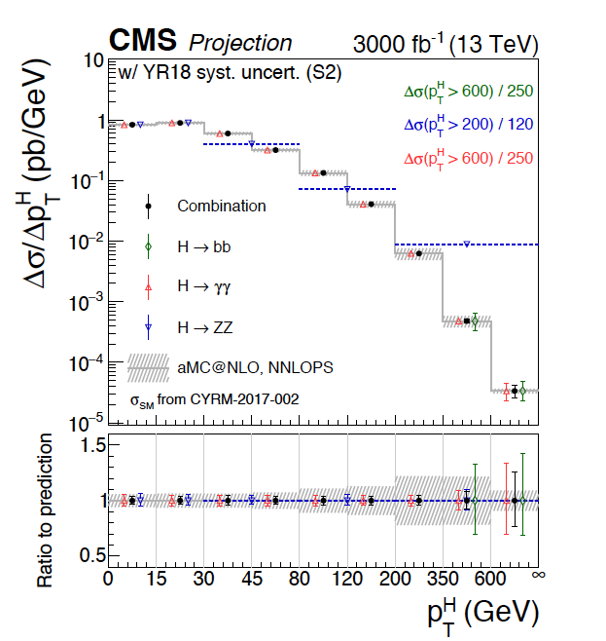
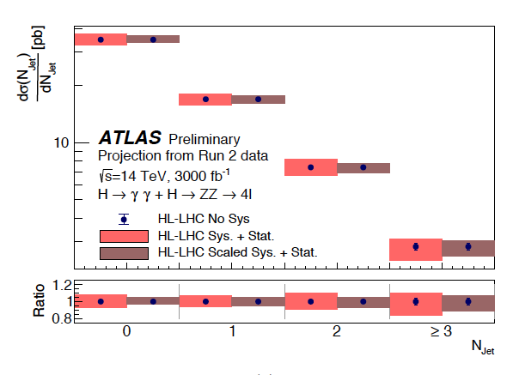
Differential cross sections
Projection of H➔γγ and H➔ZZ➔4l differential cross sections
Measurement of p_{T}^{H} distribution
probes perturbative QCD calculations
gives information about (new) particles contributing to the gluon fusion loop
high p_{T} ^{H} region sensitive to new physics effects
Precision ~10% for p _{T}^{H} > 350 GeV,
statistically limited
Precision 5-15% depending on N_{jet} bin
YR2018 1902.00134
Notes:
4/15/19
8
8

Slide 9
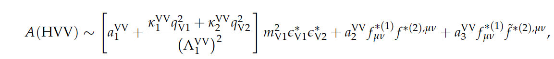
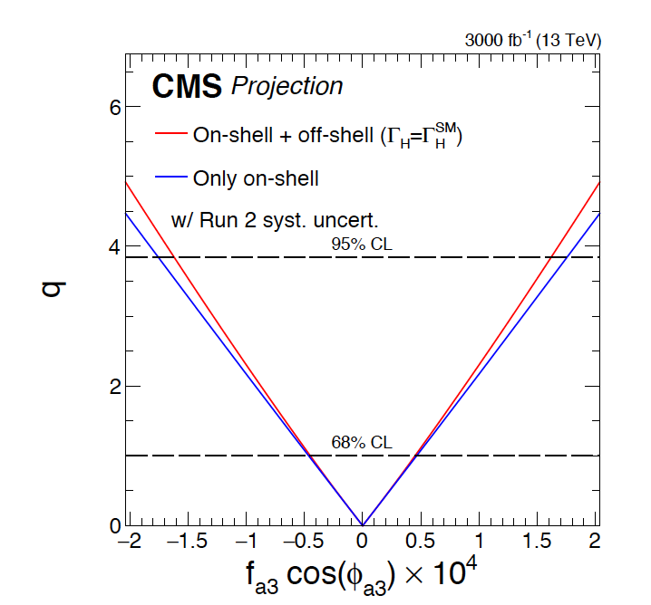
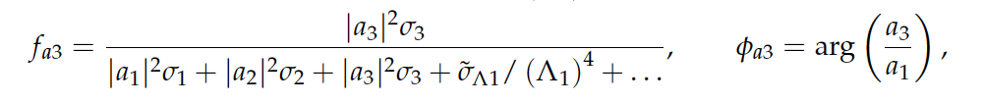
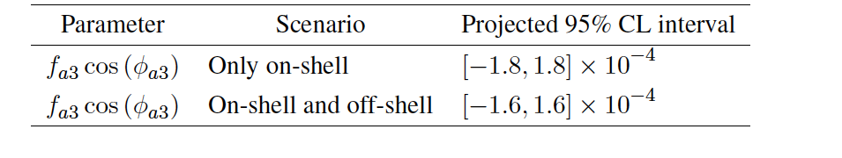
Anomalous HVV couplings
Amplitude describing the interaction of a spin-0 particle and and two spin-one gauge bosons
Coupling a1(a2) describe the tree-level( loop-induced) interaction of a CP even scalar
Coupling a3 describes the interactions of a CP odd scalar, SM a3 = 0
Λ is scale of NP
Fit fractional contribution to on-shell H → ZZ decays:
YR2018 1902.00134
off-shell production enhanced with anomalous HVV couplings
→Improved constraints
1901.00174.pdf
Large improvements
on limits at HL-LHC
Run1+Run2
Notes:
4/15/19
9
9

Slide 10
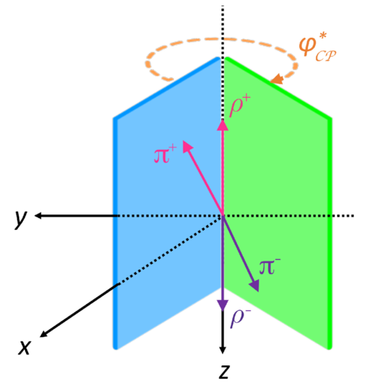

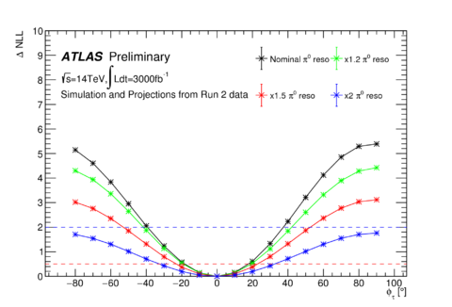
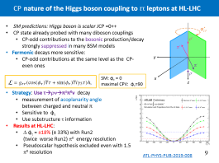

^{CP} nature of the Higgs boson couplings to ττ leptons at HL-LHC
SM predictions: Higgs boson is scalar JCP =0++
CP state already probed with many diboson couplings
  CP-odd contributions to the bosonic production/decay strongly suppressed in many BSM models
Fermonic decays more sensitive:
  CP-odd contributions at the same level as the CP-even ones
SM: φ_{τ} = 0
maximal CPV: φ_{τ}=90
Strategy: Use τ→ρν→π±π⁰ν decay
  measurement of acoplanarity angle
between charged and neutral π
  Sensitive to φ_{τ}
  Use substructure τ information
Results at HL-LHC:
  Δ φ_{τ} = ±18% (± 33%) with Run2 (twice worse Run2) π⁰ energy resolution
  Pseudoscalar hypothesis excluded even with 1.5 π⁰ resolution
ATL-PHYS-PUB-2019-008
Notes:
4/15/19
10
10

Slide 11
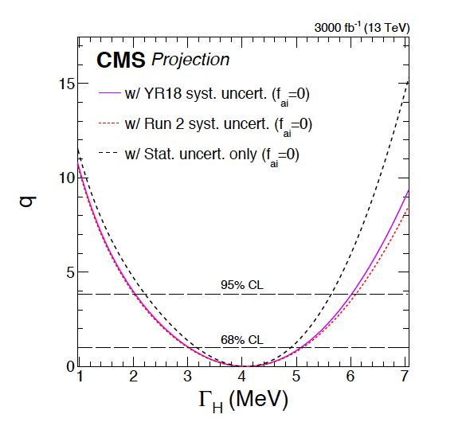
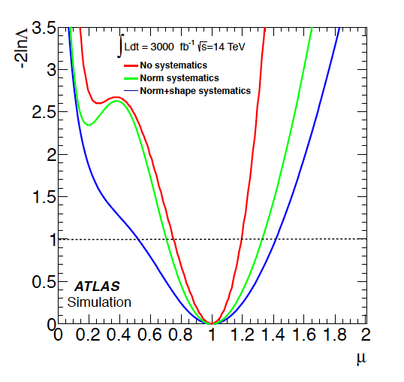
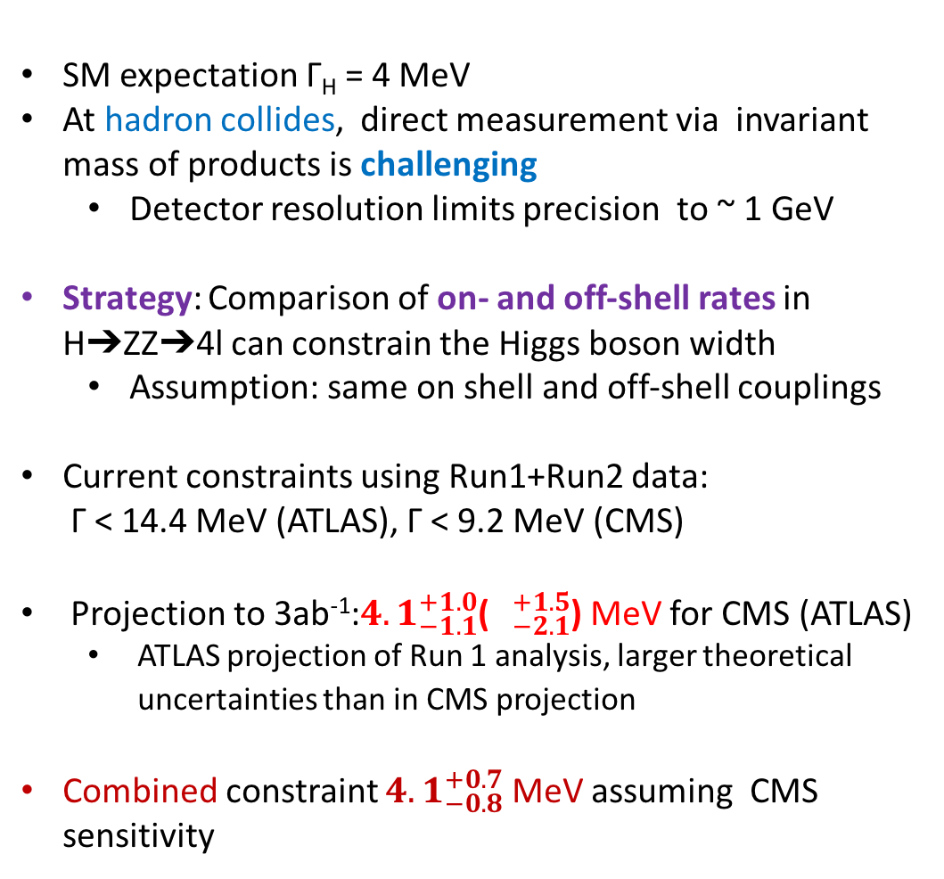
Higgs Boson width
SM expectation Γ_{H} = 4 MeV
At hadron collides, direct measurement via invariant mass of products is challenging
  Detector resolution limits precision to ~ 1 GeV
Strategy: Comparison of on- and off-shell rates in H➔ZZ➔4l can constrain the Higgs boson width
  Assumption: same on shell and off-shell couplings
Current constraints using Run1+Run2 data:
Γ < 14.4 MeV (ATLAS), Γ < 9.2 MeV (CMS)
Projection to 3ab⁻¹:${4.1}_{−1.1}^{+1.0}$($∆_{−2.1}^{+1.5}$) MeV for CMS (ATLAS)
  ATLAS projection of Run 1 analysis, larger theoretical uncertainties than in CMS projection
Combined constraint ${4.1}_{−0.8}^{+0.7}$ MeV assuming CMS sensitivity
YR2018 1902.00134
Notes:
4/15/19
11
11

Slide 12
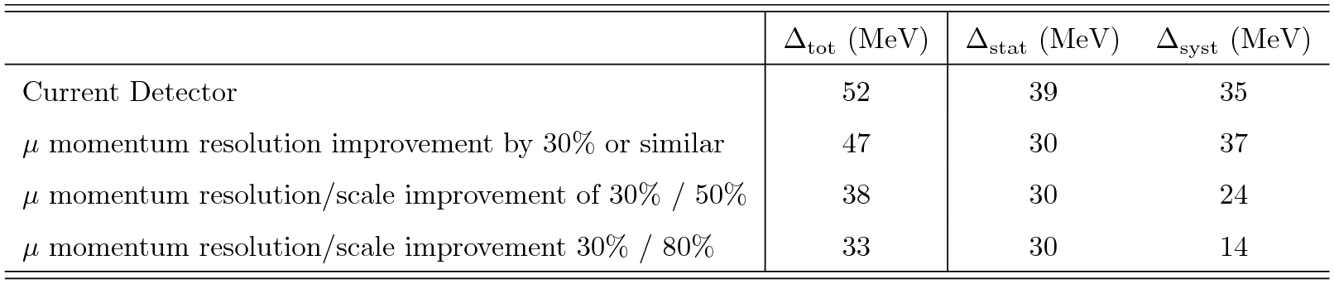
Higgs Boson mass
Current ATLAS+CMS: m_{H} = 125.18 ± 0.16 GeV pdg 2018
  Using H → ZZ* → 4l and H →γγ
  H→γγ limited by uncertainty on photon energy scale
Detailed studies for the muons, electrons and photons calibration at HL-HC not yet done
Precision of 10-20 MeV plausible
ATLAS extrapolation from Run2 m_{H} = 124.79 ± 0.36 (stat.) ± 0.05 (syst.) GeV, assuming:
  improvement in μ momentum resolution from the new inner tracker
  Improvement in uncertainty in μ momentum scale
YR2018 1902.00134
ATL-PHYS-PUB-2018-054
Notes:
4/15/19
12
12
Combined constraint 〖𝟒.𝟏〗_(−𝟎.𝟖)^(+𝟎.𝟕) MeV assuming CMS sensitivity

Slide 13
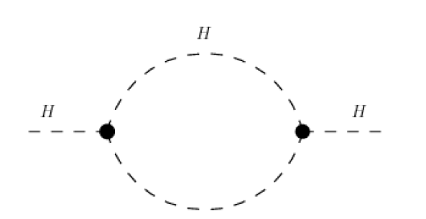
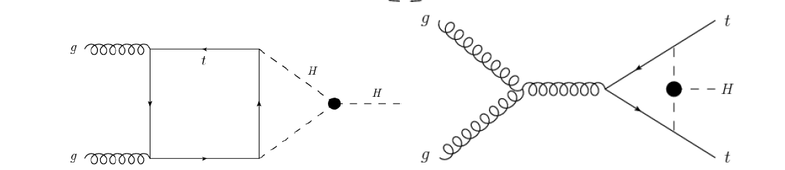
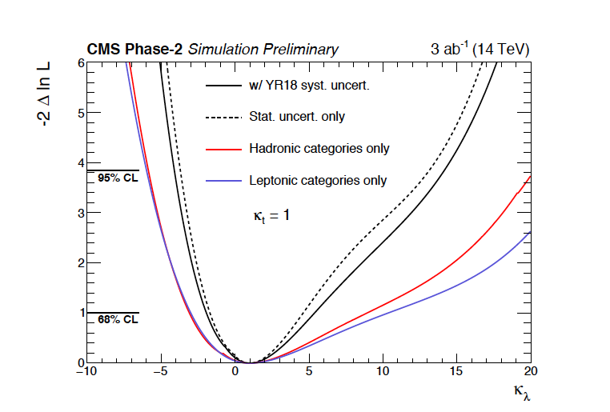
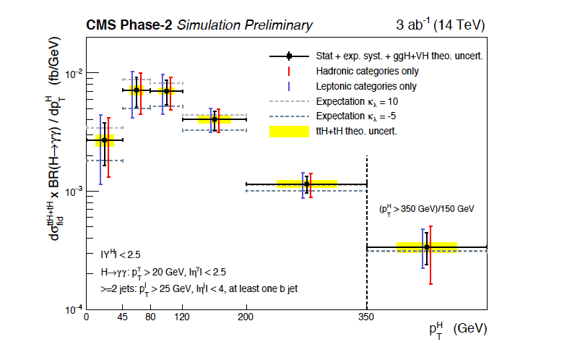
Differential cross sections: probing Higgs-self coupling
Single-Higgs production depends ○n self coupling via one-loop corrections
Corrections to the tree-level cross-sections depend on:
  production mode → mainly ttH, tH, VH
  kinematics properties of the event
Study on ttH(→γγ) differential cross-section measurement:
  At 95% CL: -4.1<κ _{λ} <14.1 if only κ_{λ} varied
All amplitudes
κλ
κλ
ggF
ttH
κt
κt
κλ
κλ
κt
κt
κt
YR2018 1902.00134
Notes:
4/15/19
13
13

Slide 14
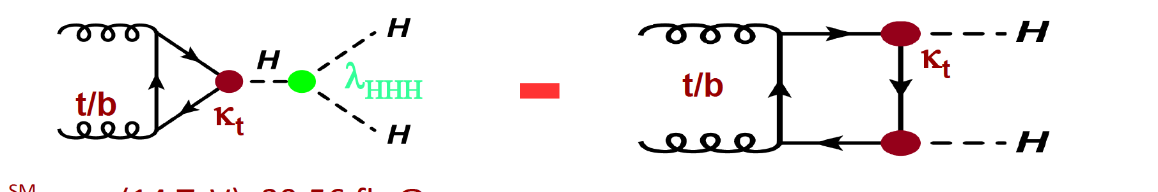
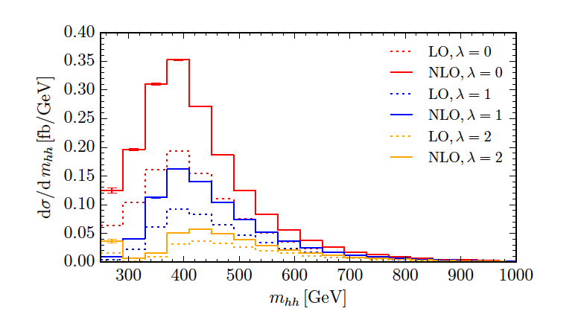
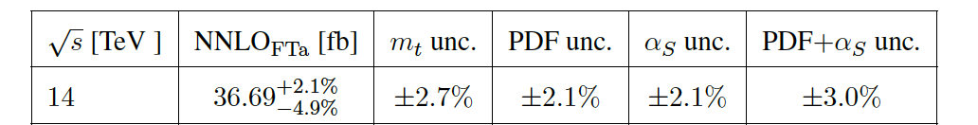
Higgs-self coupling
Motivation for Higgs-selfcoupling λ
  Shape of Higgs potential
  Probe EW Symmetry Breaking mechanism
  Probe new physics
Non-resonant HH production sensitive to λ:
  rare process of the SM: σ(gg→HH) ≈ 0.1%*σ(gg→H)
    destructive interference between box and triangle diagram
  Strong dependence of inclusive cross section
and m_{hh} shape on λ
Triangle diagram
Box diagram
SM prediction:
  ggF: NNLO calculation with finite m_{t} effects at NLO
  -8% wrt YR4, used in previous projections
YR2018 1902.00134
Notes:
4/15/19
14
14

Slide 15
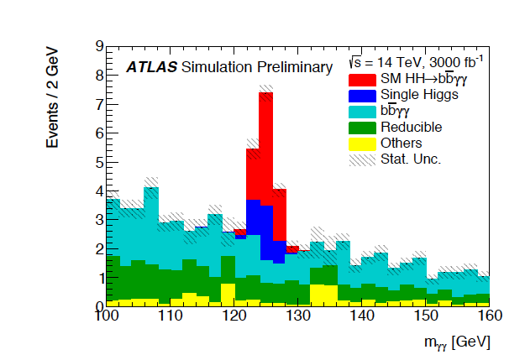
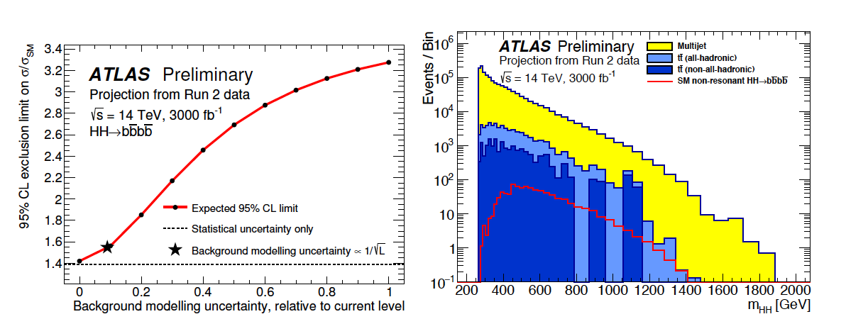
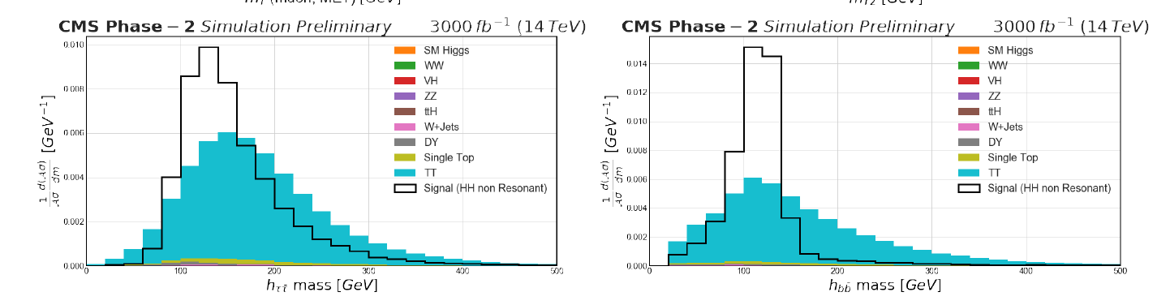
Higgs-self coupling: input channels
HH→bbγγ:
  Small BR: 291 events with 3ab ⁻¹
  Low bkg
  Photon resolution critical
HH→4b:
  Large BR: ~37k events with 3ab⁻¹
  Large QCD bkg
  Large dependence on background modelling uncertainty
HH→bbττ:
  Sizeable BR: ~8k events with 3ab ⁻¹
  Relatively low background
  Incomplete reconstruction of the event due to the presence of neutrinos
    → Challenging separation from tt and Drell-Yan bkg
HH→bbVV (llνν), HH→bbZZ(ll) projections by CMS only
YR2018 1902.00134
Notes:
4/15/19
15
15

Slide 16
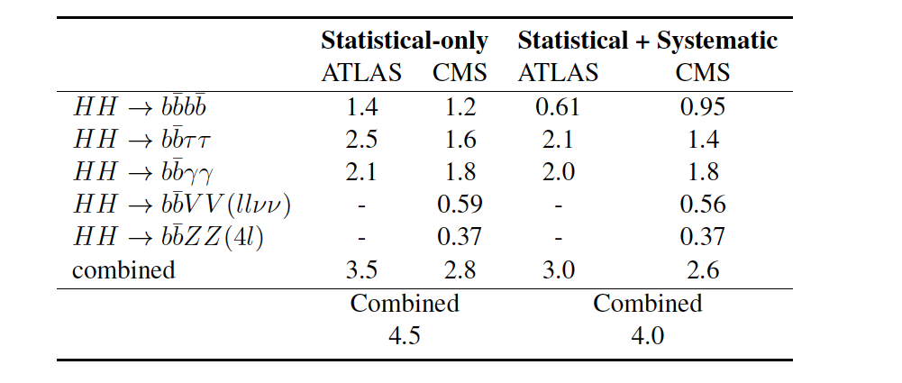
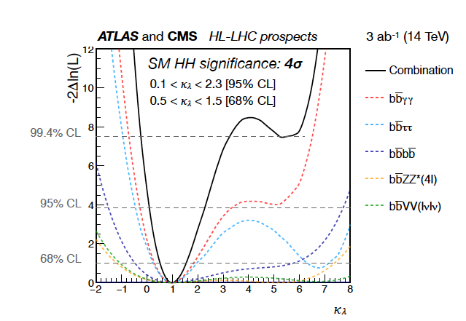
HH production and Higgs-self coupling
Expected significance of HH production with(without) systematics at HL-LHC
  4σ (4.5σ) expected with ATLAS+CMS !
Measurement of μ (SM signal injected):
  ~30% (25%) with (without) systematics
YR2018 1902.00134
Measurement of κ _{λ :}
  0.52(0.57) < κ _{λ} < 1.5 without/with systematics
  2nd minimum is excluded at 99% thanks to m_{HH} shape information
Not all channels optimized to measure κ _{λ}
Notes:
4/15/19
16
16

Slide 17
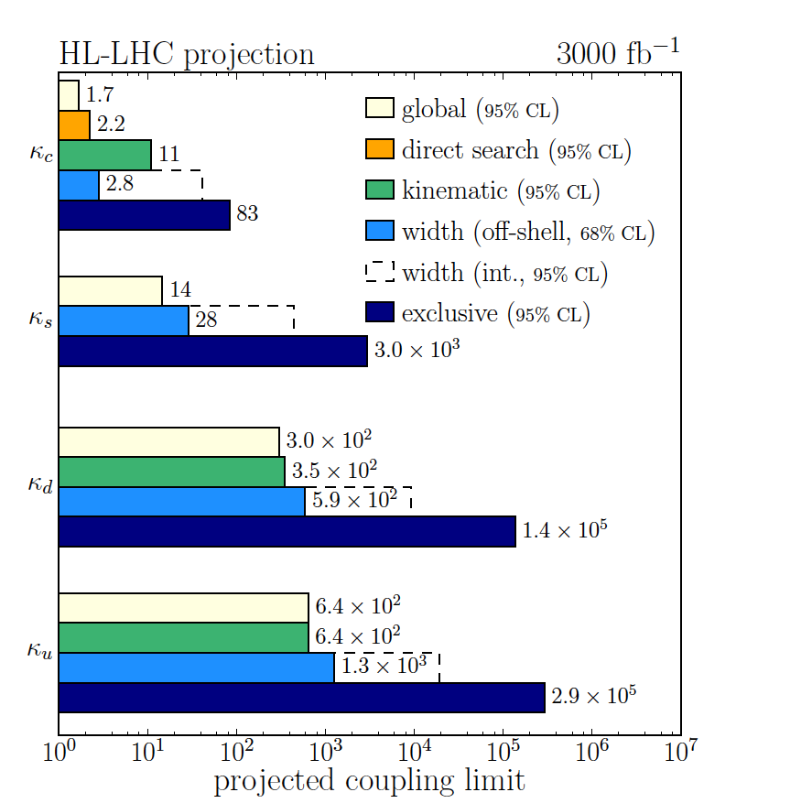
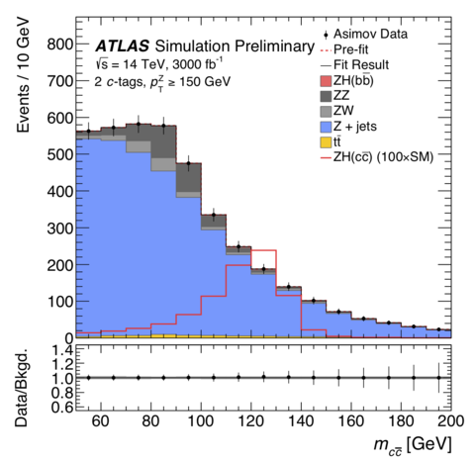
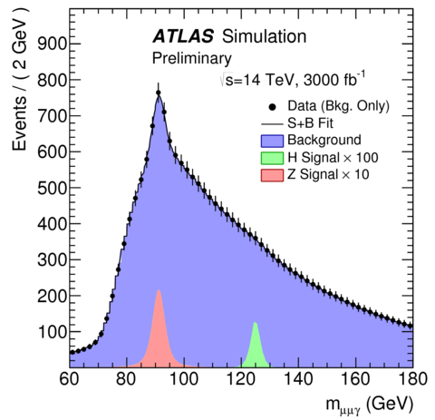
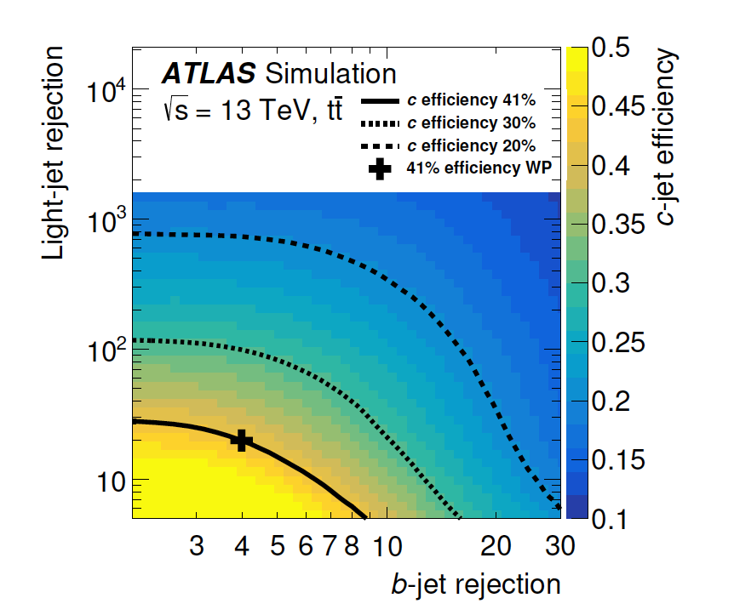
Higgs coupling to light quarks
YR2018 1902.00134
Yukawa couplings of the Higgs boson to the first and second generation quarks
  Run2: only upper limits
  Challenging: Small BR, large hadronic bkg, c-jet tagging
Indirect measurements:
  direct global fits, diff. cross section, width
Inclusive searches: VH, H→cc. SM BR H→cc = 2.9 %
  HL-LHC projection: σ(pp → ZH) × B(H → cc) < 6.3 SM
  Exclusive searches: H → J/ψγ, H → ργ for s and u/d quarks
  SM prediction: BR(H→J/ψ γ) ~3 ⨉ 10⁻⁶
  HL-LHC projection: σ(pp → H) × B(H → J/ψ γ) < 14 SM
ATL-PHYS-PUB-2018-016
ATL-PHYS-PUB-2015-043/
PhysRevLett.120.211802
ZH, H→cc
H→J/ψ γ
Notes:
4/15/19
17
17

Slide 18
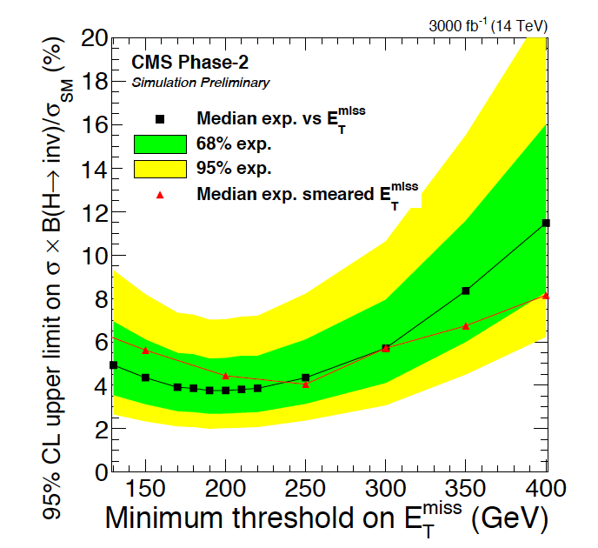
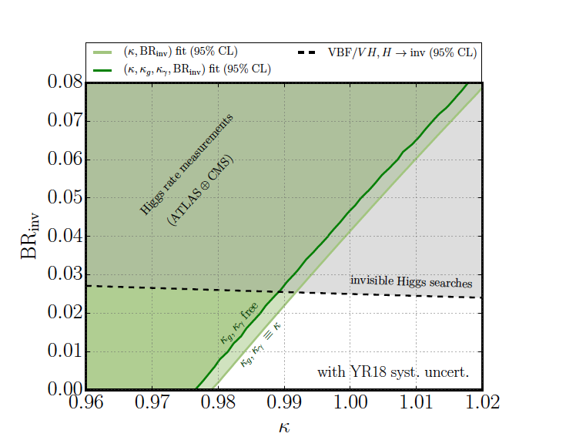
Higgs to invisible decays
SM BR H→invisible = 0.1 %
Run2: BR_{inv} < 26 ( 22%) obs., exp 17(17)% for ATLAS(CMS)
Experimentally challenging: pile-up effects degradation in E_{T} ^{miss} , tagging of VBF jets
VBF channel most sensitive
At HL-LHC (CMS) B _{inv} < 3.8% at 95% CL
  Limited by syst. exp. uncertainties
  Degradation of E_{T} ^{miss} resolution does not impact the sensitivity significantly
Assuming same sensitivity of experiments for VH and VBF, and using ATLAS projection with VH:
  B _{inv} < 2.5% at 95% CL
Using Higgs rate measurements, and assuming universal Higgs couplings modifiers:
  BR_{inv} (κ==1) < 4.2%
YR2018 1902.00134
Notes:
4/15/19
18
18

Slide 19
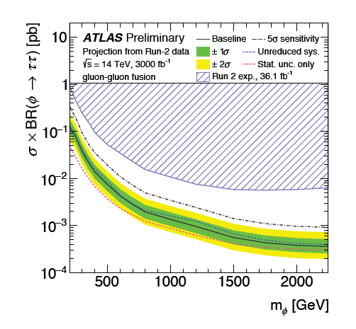
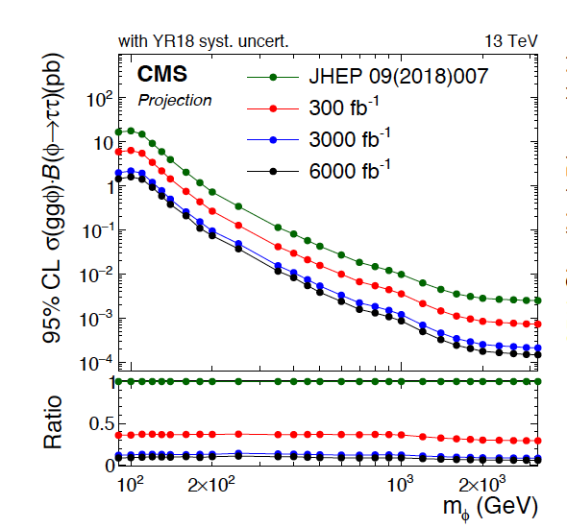
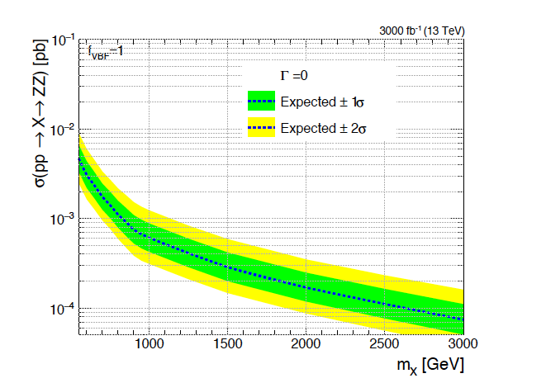
Searches for additional heavy Higgs states
Search for φ◊ττ decay
MSSM benchmark mode
  Coupling to down-type fermions enhanced
With 3 ab⁻¹ large limit improvement wrt to Run2
  Especially at high mass
Significant impact of systematics:
  Dominated by fake τ and high p_{T} τ reco+ID
Intermediate tanβ still to be explored in more details
Search for X◊ZZ decay
With 3 ab⁻¹ X 10 limit improvement wrt Run2
for m_{X} > 1TeV
At HL-LHC still statistically limited
YR2018 1902.00134
Notes:
4/15/19
19
19

Slide 20
Conclusions
The precise determination of Higgs boson properties, and their connection to electroweak symmetry breaking is a primary target of the HL-LHC physics program
What we expect:
main Higgs boson couplings at the percent level
HH production: sensitivity of 4σ
Rare H→µµ, H→Zγ decays visible
…
To reach this goal, need to
reach the expected reduction of experimental and theoretical uncertainties
face challenging experimental conditions with unprecedented pileup levels
build new detectors
→ Hard and exciting work for the next ~15 years !
Big change wrt
to last projections
Notes:
4/15/19
20
20

Slide 21
Backup
Notes:
4/15/19
21
21

Slide 22
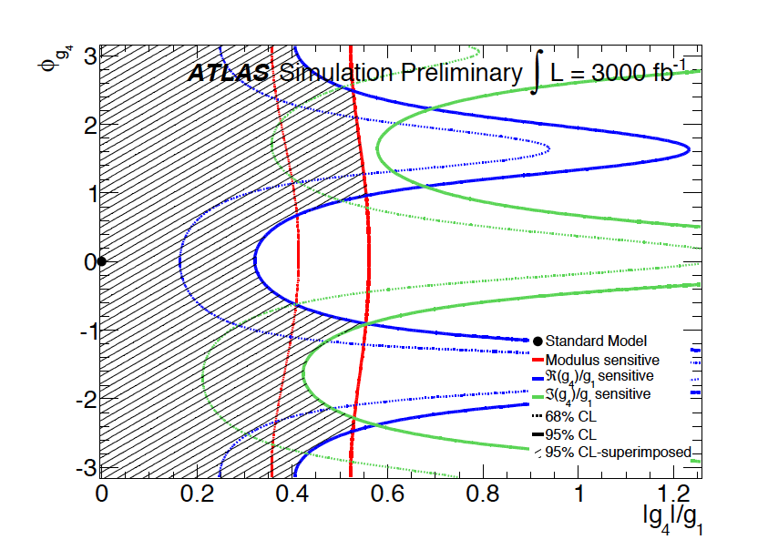

Spin and parity
Amplitude describing the interaction of a spin-0 particle and and two spin-one gauge bosons
Coupling g1(g2) describe the tree-level( loop-induced) interaction of a CP even scalar
Coupling g4 describes the interactions of a CP odd scalar
Coupling g3 can be absorbed into g2
SM prediction, CP-conserving tree-level interaction:g1 >0 and g_{2,3,4} =0.
ATL-PHYS-PUB-2013-013
Parametrization:
f_{g4} < 0.037 and f_{g2} < 0.12
at 95% CL for 3000 fb⁻¹
Sensitive test of the tensor structure of the H →ZZ* couplings a the high luminosity LHC.
Notes:
An uncertainty of 3% on the knowledge of the integrated luminosity is added in a correlated way to both signal and background yields.
A 5% uncertainty for the signal and background yields, due the lepton reconstruction e ciency .
A combined uncertainty on the ZZ⇤ production cross section and the reducible background yield
is estimated as 9.4% for 300 fb 1 and 7.4% for 3000 fb 1 respectively.

