Slide 1
The International Workshop on the
Circular Electron Positron Collider
EU EDITION 2019
Daniela Bortoletto

Slide 2
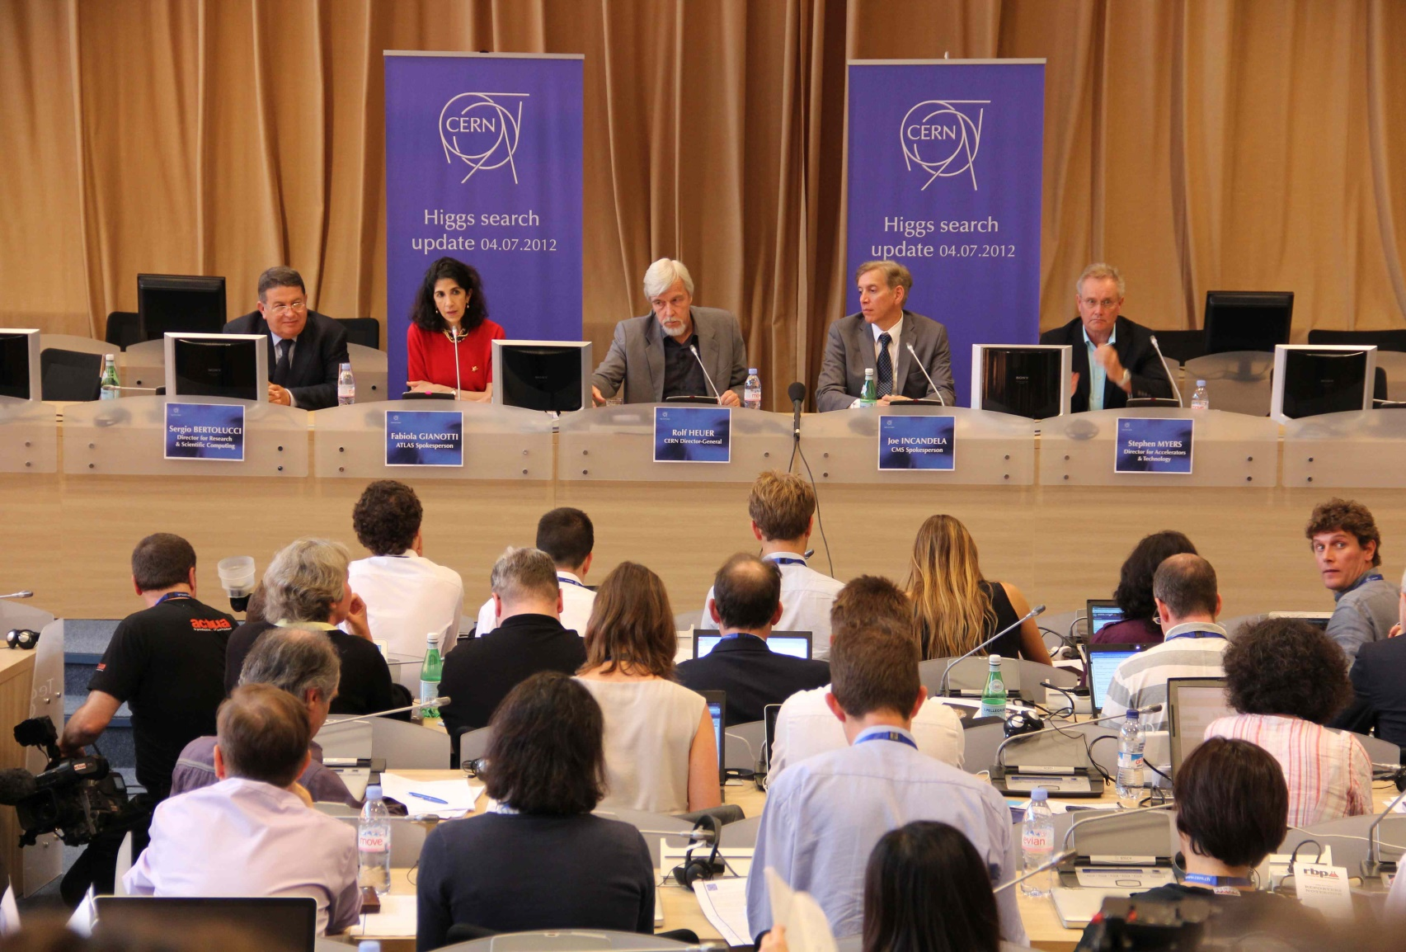
The completion of the Standard Model
July 4th, 2012
The discovery of the Higgs boson does not close the book but opens a whole new chapter of exploration in Particle Physics

Slide 3

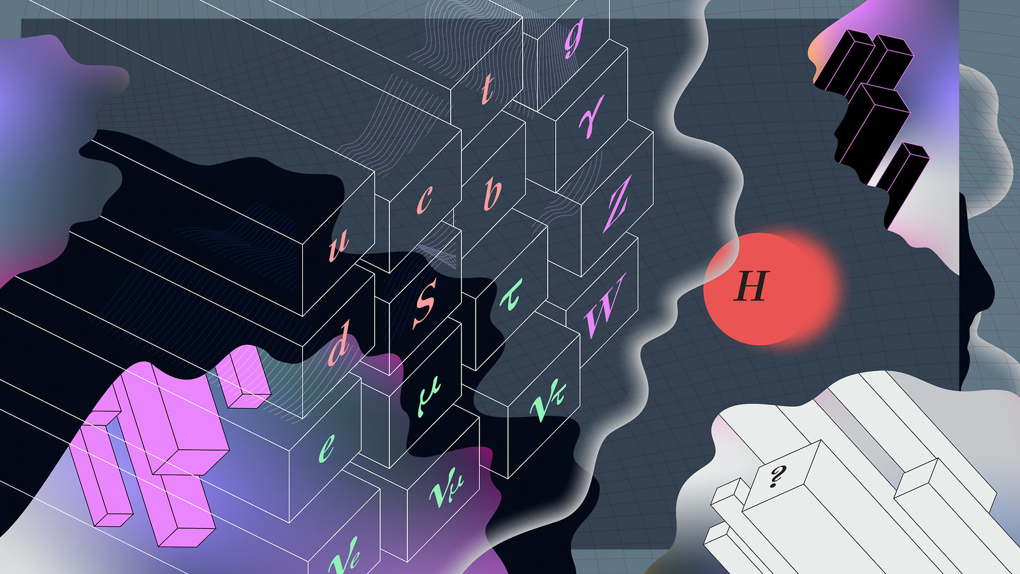
Many Open Questions Remain
Pursue the physics associated with neutrino mass
Understand the matter antimatter asymmetry of the Universe
Explore the unknown: new particles, interactions,
and physical principles
Identify the new physics of dark matter
Use the Higgs boson as a new tool for discovery

Slide 4
The answers require different experiments
The surprising neutrinos:
  Mass hierarchy
  CP violation
  Majorana or Dirac nature
  Neutrino masses could originate anywhere between the EW and the GUT scale
DM could be anything:
  O(TeV) WIMPs
  multi-M⦿primordial BHs
  Fuzzy 10^{–22} eV scalars
  Axion
Is M_{H} natural or fine tuned ? The Higgs dynamics is sensitive to scale larger than the Higgs mass
Is Higgs is a composite object or elementary?
Is there a TeV-scale solution to the hierarchy problem?
Is it alone or are there other Higgs boson
What is the origin of the coupling to fermions?
Does the Higgs couple to DM and neutrinos ?

Slide 5
IMPACT of 125 GeV on Energy Frontier
The low mass of the Higgs makes e⁺e⁻ Higgs factories both linear and circular possible
Circular accelerator can reach high luminosity at lower energies
  Can store and re-collide the beams
  Experience
  Synchrotron radiation limits the energy and beam quality
Linear accelerator can reach high energies ~ multi-TeV with high luminosity
  Can avoid synchrotron radiation
  High accelerating field to achieve high energy
  High beam current and quality to achieve the luminosity

Slide 6
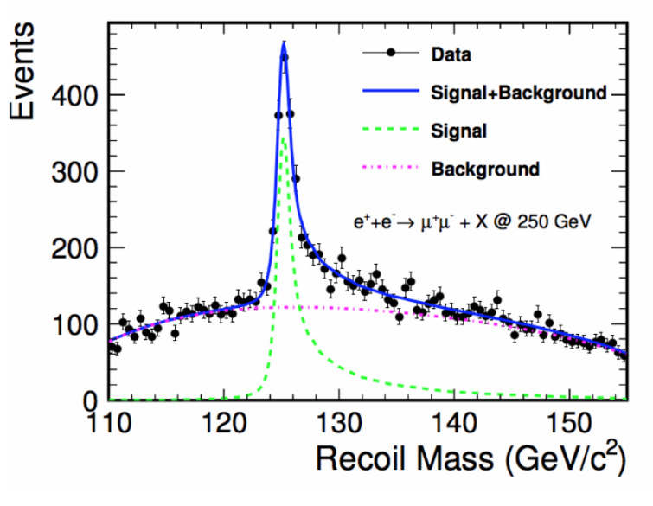
Advantages of e⁺e⁻
Higgs events are readily isolated from background
All standard Higgs decay modes are visible
Measurement accuracies O(1%) are feasible
The absolute cross section for e⁺e⁻→ZH can be measured and therefore there is no model dependence in BR measurements
At 250 GeV any Z boson with E_{lab}=110 GeV is recoiling against a H boson

Slide 7
The options
ILC 250: 2032
CLIC 350: 2035
FCC-ee: 2039
CepC-ee: 2030

Slide 8
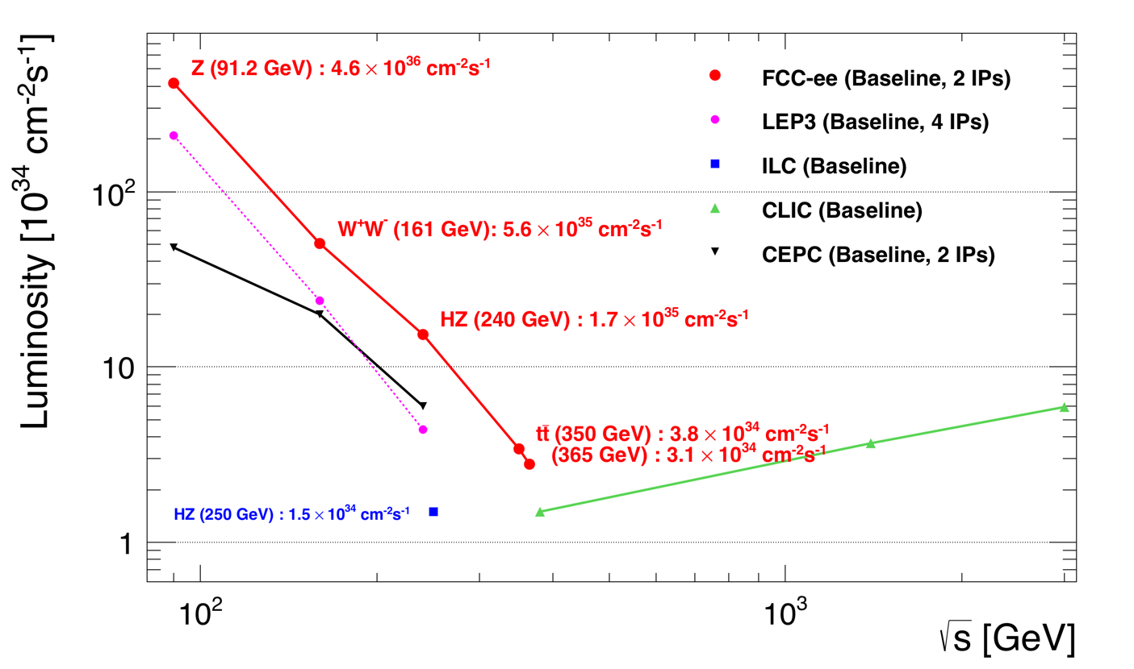
Luminosity Comparison
FCC
CepC
CLIC
100X LEP
ILC

Slide 9
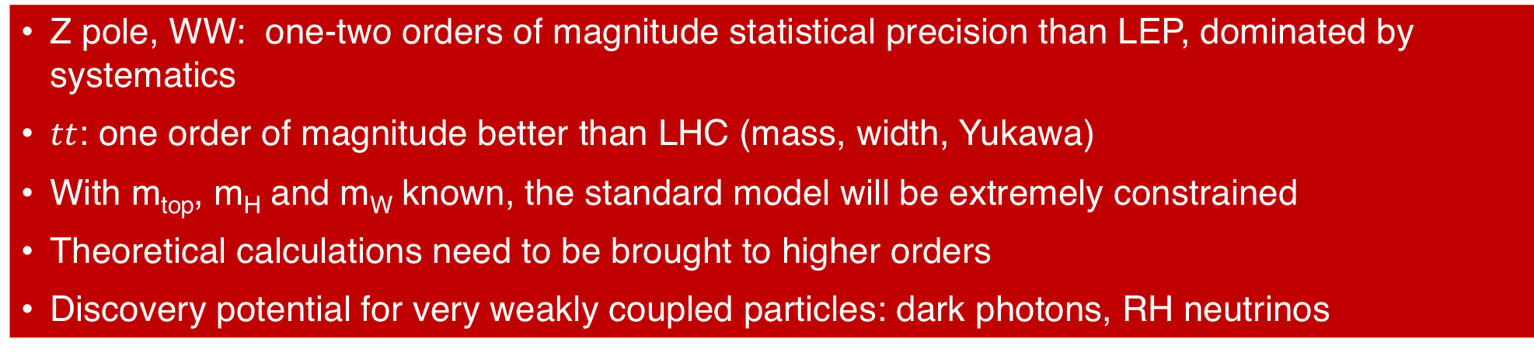
e⁺e⁻ collider potential
FCC
Z pole, WW: one-two orders of magnitude statistical precision than LEP, dominated by systematics
$tt$: one order of magnitude better than LHC (mass, width, Yukawa)
With m_{top}, m_{H} and m_{W} known, the standard model will be extremely constrained
Theoretical calculations need to be brought to higher orders
Discovery potential for very weakly coupled particles: dark photons, RH neutrinos

Slide 10
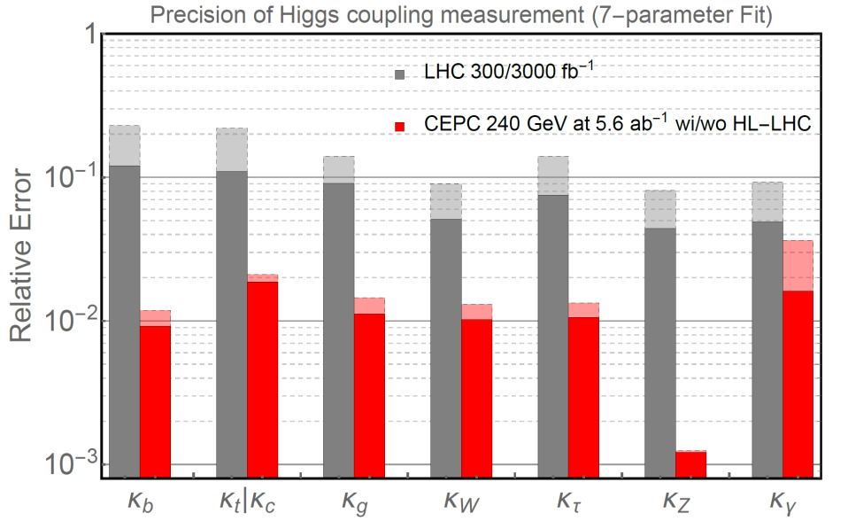
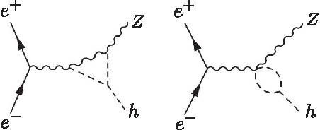
e⁺e⁻ collider potential
CepC
Coupling measurements at the % level
Model independent Higgs width
3 𝜎, possibly 5, discovery of Higgs boson self coupling from vertex corrections

Slide 11
FCC CRD
15/01/2019 (press release)
The FCC Conceptual Design Reports
have been released with an updated time
schedule and approx. cost estimate
Tunnel: 5000 MCHF
e⁺e⁻machine in tunnel: 4000 MCHF
hh machine in tunnel: 15000 MCHF
Possible e⁺e⁻ starting date ~ 2040
Possible hh starting date ~ late 2050’s

Slide 12
FCC-ee Schedule

Slide 13
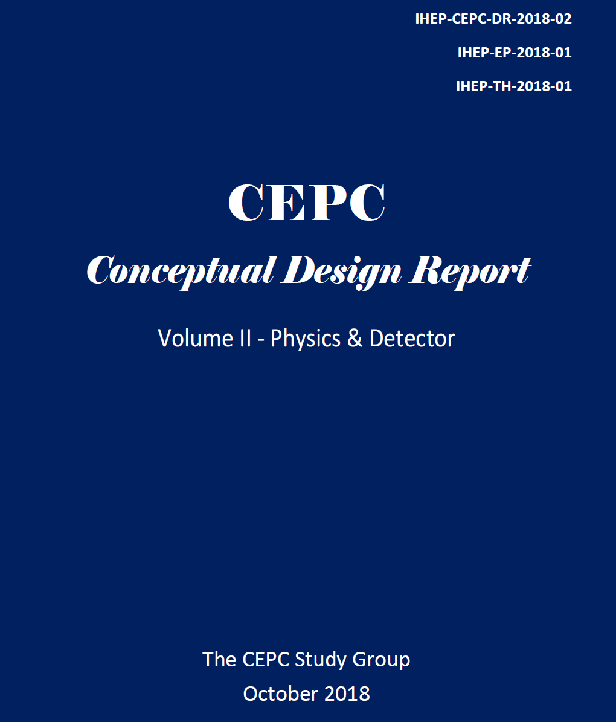
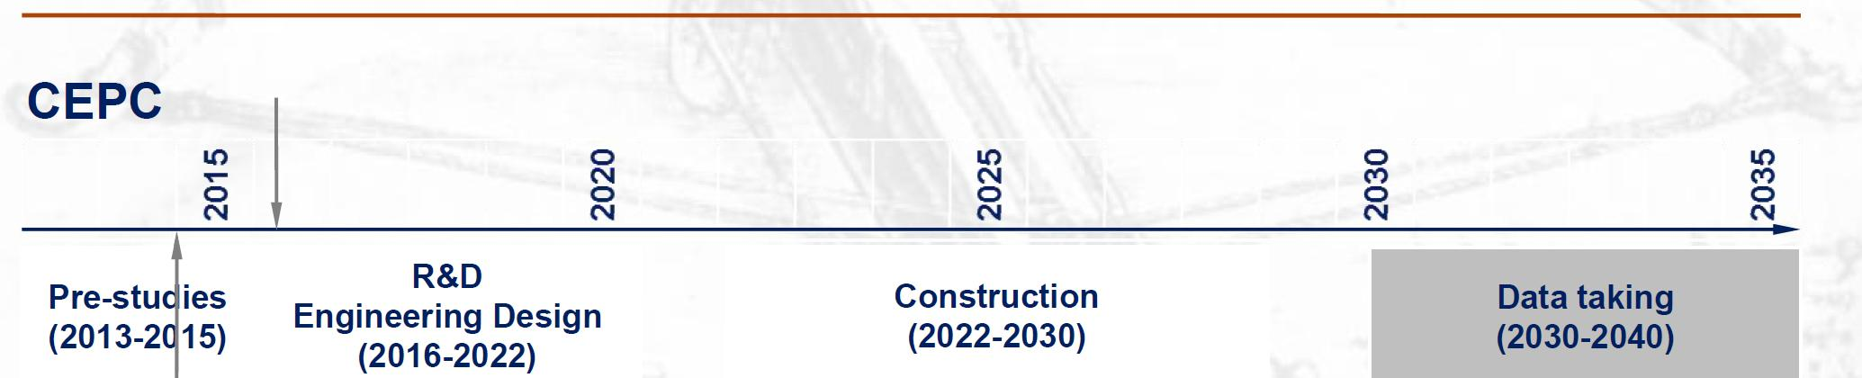
CepC CDR

Slide 14
European Strategy

Slide 15
Workshop agenda & goals
Day 1: Status of all e⁺e⁻ options for the post-LHC era & Physics
Day 1 & 2: Parallel session on Physics (Room8), Detector R&D (LT), Accelerator R&D (Room 11), Tools & Performance (Room 10)
  Looking at the plans for the CepC TDR
  Examining the potential for joint developments between FCC and CepC (including joint EW TH efforts)
  Understanding synergies with solutions designed for ILC/CLIC
  Bringing together communities interested in similar physics and detector technologies
Day 3:
  Summaries of the Parallel sessions
  Panel with representatives from many regions to discuss the path to the realization of at least one of these projects
  Final motivational talk

Slide 16
R&D for the CepC and the FCC-ee
Benefits from a decade of Linear Collider R&D
But also from:
  ATLAS
  ALICE
  BELLE II
  Mu3e
  ……
How we perceive R&D
FCCee

Slide 17
R&D for the CepC and the FCC-ee
In reality there are many interconnections
Benefits from a decade of Linear Collider R&D
But also from:
  ATLAS
  ALICE
  BELLE II
  Mu3e
  …..
FCCee
Marcel Stanitzki
FCCee

Slide 18
Final Comments
We are in the excellence position of having different regions of the world interested in fundamental physics and considering that the outstanding questions in particle physics are worth building the next generation particle collider.
The LHC has shown us that while competition can be energizing, global cooperation is often critical to realize at least one machine.
Let us find the optimal level of coopetion and let us have a great workshop!

