Slide 1
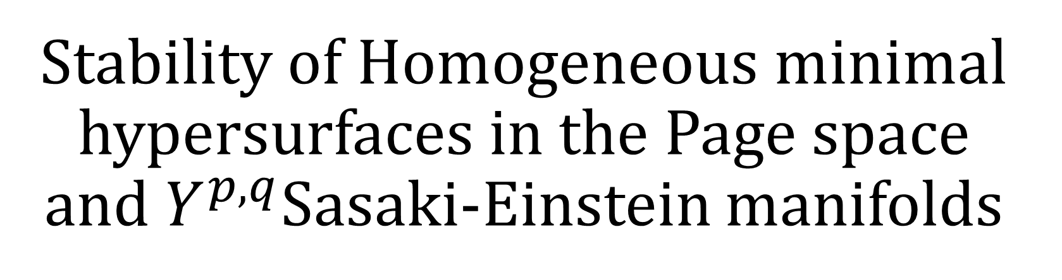
Stability of Homogeneous minimal hypersurfaces in the Page space and $Y^{p,q}$Sasaki-Einstein manifolds
Natalia Gherghel MSc. Student
McMaster University
1

Slide 2
Overview:
What is a minimal surface?
  Describes how ambient spaces curvature distorts submanifolds.
What is the stability operator?
Minimal Surfaces in Einstein Manifold
  Page Metric
  Sasaki-Einstein Metric
Calculating stability eigenvalues
2

Slide 3
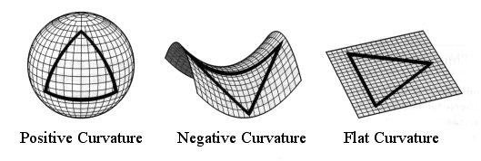
Section 1: Curvature
ASA / WMAP Science Team. (2003). Three possible geometries of the universe: Positive, negative, and flat curvature [Digital image]. Retrieved from NASA Wilkinson Microwave Anisotropy Probe educational resources.
3

Slide 4
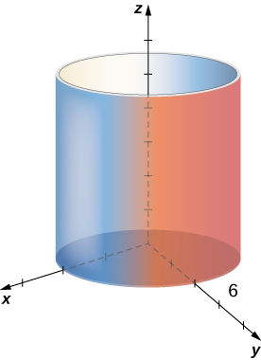

Section 1: Intrinsic vs Extrinsic
Intrinsically flat
Extrinsically curved
Intrinsically curved
Extrinsically curved
Strang, G., & Herman, E. (2016). Calculus Volume 3. OpenStax.
Geek3. (2009). Sphere wireframe
4

Slide 5
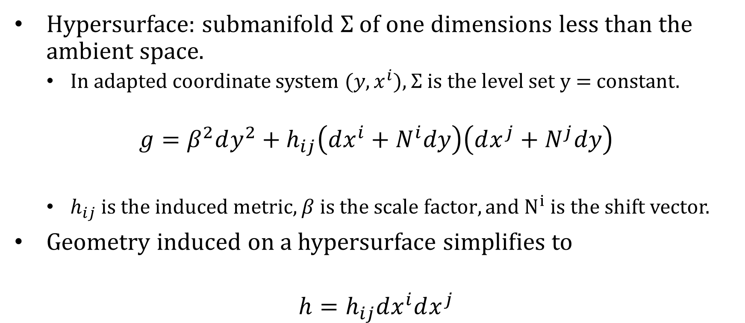
Section 1: Hypersurfaces
Hypersurface: submanifold $Σ$ of one dimensions less than the ambient space.
  In adapted coordinate system ($y,x^{i}$), $Σ$ is the level set y = constant.
$$g=β^{2}dy^{2}+h_{ij}\left(dx^{i}+N^{i}dy\right)\left(dx^{j}+N^{j}dy\right)$$
  $h_{ij}$ is the induced metric, $β is the scale factor, and N^{i}$ is the shift vector.
Geometry induced on a hypersurface simplifies to
$$h=h_{ij}dx^{i}dx^{j}$$
5

Slide 6
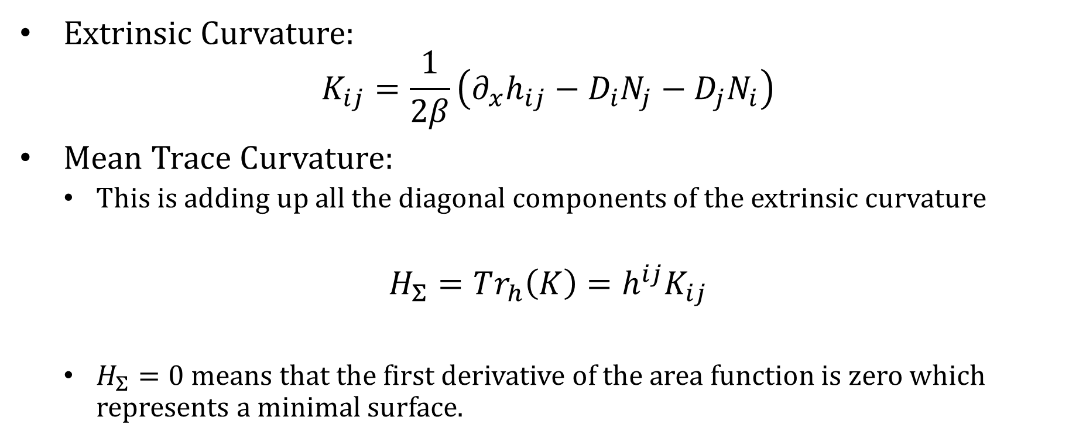
Section 1: Mean Curvature
Extrinsic Curvature:
$$K_{ij}=\frac{1}{2β}\left(∂_{x}h_{ij}−D_{i}N_{j}−D_{j}N_{i}\right)$$
Mean Trace Curvature:
  This is adding up all the diagonal components of the extrinsic curvature
$$H_{Σ}=Tr_{h}\left(K\right)=h^{ij}K_{ij}$$
  $H_{Σ}=0$ means that the first derivative of the area function is zero which represents a minimal surface.
6

Slide 7
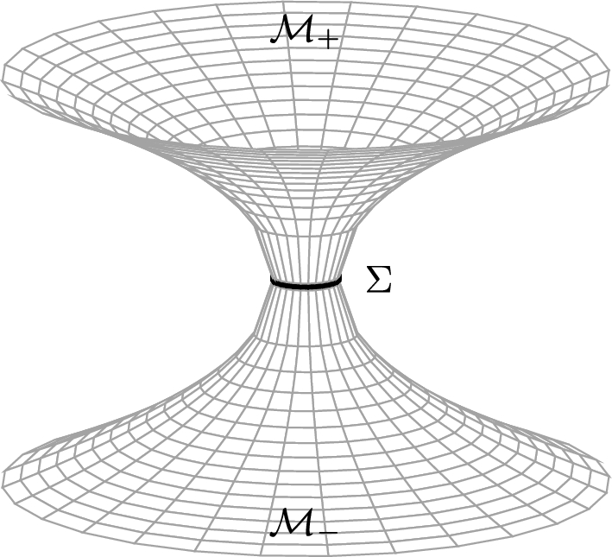

Section 1: Minimal Surface
Minimal surfaces are critical points of the area function:
$$Area_{Σ}=\int_{Σ}{\sqrt{det h}}dx$$
Liempi, L., Orellana, F., & Cataldo, M. (2024). Stability of the thin shell from traversable Schwarzschild-like wormholes. The European Physical Journal C, 84(12), Article 1302. doi.org
7

Slide 8

Section 1: Stability Operator
Tracks how the entire surface area changes if the surface is infinitesimally deformed outwards.
$$Lψ≔−Δ_{Σ }ψ−\left(\text{Ric}\left(n,n\right)+\text{Tr}\left(K^{2}\right)\right)ψ$$
  n is the unit normal pointing outwards, and the deformation is $X^{a}=ψn^{a}$
Morse Index: Total number of independent ways a minimal surface can be deformed to decrease the total surface area.
  Index 0: Stable
  Index 1: One unstable direction
  Index larger than 1: Multiple unstable directions
8

Slide 9

Section 2: Page Metric
Einstein space meaning the Ricci Tensor is proportional to the metric
$$R_{ij}=Λg_{ij}$$
$$g=S\left[\frac{dx^{2}}{A\left(x\right)}+4α^{2}A\left(x\right){\left(dψ+\frac{\cos{θ}}{2}dφ\right)}^{2}+B\left(x\right)\left(dθ^{2}+\sin^{2}{θ}dφ^{2}\right)\right]$$
Coordinate Ranges and Identifications:
$$x∈\left(−1,1\right),θ∈\left(0,π\right)$$
$$\left(ψ,φ\right)\sim \left(ψ+π,φ+2π\right), \left(ψ,φ\right)\sim \left(ψ+2π,φ\right)$$
First inhomogeneous, compact Einstein space in 4D.
9

Slide 10

Section 3: Sasaki-Einstein Metric
Einstein manifold with $R_{ij}=4g_{ij}$for any pair of coprime positive integers given that p >q.
$$g=a(x)\left(dθ^{2}+\sin^{2}{θ}dφ^{2}\right)+\frac{dy^{2}}{w\left(y\right)q\left(y\right)}+\frac{q\left(y\right)}{9}{\left(dψ−\cos{θ}dφ\right)}^{2}$$
$$+ w\left(y\right){\left[dα+f\left(y\right)\left(dψ−\cos{θ}dφ\right)\right]}^{2}$$
Coordinate Symmetries:
$$\left(ψ,φ,α\right)∼\left(ψ+2π,φ,α\right),$$
$$\left(ψ,φ,α\right)∼\left(ψ+2π,φ+2π,α\right), \left(ψ,φ,α\right)∼\left(ψ,φ,α+2πℓ\right)$$
Inhomogeneous, compact 5-dimensional Einstein space.
10

Slide 11

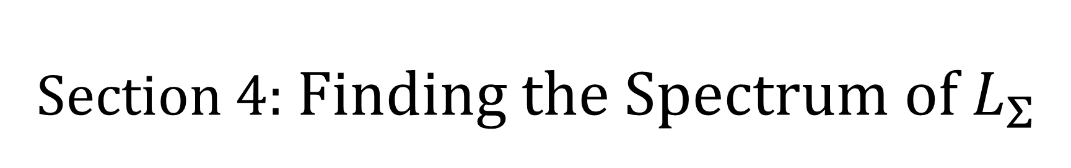
Section 4: Finding the Spectrum of $L_{Σ}$
Generally, solving the full eigenvalue spectrum on a multi-dimension surface is extremely difficult except for spheres.
$L_{Σ}f=−λf$
  Can use symmetry to separate variables.
  Reduces eigenvalue problem to 1 variable Sturm-Liouville.
The sign of the eigenvalue determines the stability:
  $λ> 0:$ stable
  $λ< 0:$ unstable
11

Slide 12

Section 4: Page Metric
Minimal Surface at x =0
  Stability operator $L=−Δ_{Σ}−3$
Continuous symmetries allows the usage of scalar harmonics.
$$f\left(θ, φ,ψ\right)= Y\left(θ, φ\right)e^{\left\{in ψ\right\}} with n ε ℤ$$
From here the eigenvalues are:
$$λ=\frac{μ}{4SB\left(0\right)}+\frac{n^{2}}{4Sα^{2}A\left(0\right)} with$$
$$μ_{n,k}=\left(4k+2\right)\left|n\right|+4k\left(k+1\right), n∈ℤ, k∈ℕ∪\{0\}$$
12

Slide 13

Section 4: Page Metric
From here the eigenvalues are:
$$λ_{\left\{1,0\right\}}= 4.61536 , λ_{\left\{2,0\right\}}= 15.2467, { λ}_{\left\{0,1\right\}}= 6.42956$$
Since the stability operator’s eigenvalues are:
$$λ_{n,k}^{L}=λ_{n,k}−3$$
All of the eigenvalues are positive with the exception of $λ_{0,0}^{L}=−3$ which is negative, thus proving index 1.
13

Slide 14

Section 4: Sasaki-Einstein
The minimal surface is located at $y=\hat{y}$.
  $\tilde{y}$ is a unique negative root.
  Minimal surface equation: $H_{Σ}=ay^{3}+by^{2}+cy+d=0$
The stability operator is:
$$L=−Δ_{Σ}−\frac{6\left(1+4\hat{y}\right)}{1−\hat{y}}$$
Finding the spectrum is much more difficult since the hypersurface is not totally geodesic.
14

Slide 15

Section 4: Sasaki-Einstein
To get the eigenvalue spectrum we use,
$$u=U\left(θ\right)e^{iN_{ψ}ψ}e^{iN_{φ}φ}e^{iN_{α}α/ℓ}$$
The resulting stability eigenvalues are given by,
$$λ=\frac{N_{α}^{2}}{ℓ^{2}w\left(\overline{y}\right)}+\frac{9f{\left(\overline{y}\right)}^{2}}{q\left(\overline{y}\right)}{\left(\frac{N_{α}}{ℓ}−\frac{N_{ψ}}{f\left(\overline{y}\right)}\right)}^{2}+\frac{6\left(E−N_{ψ}^{2}\right)}{1−\overline{y}}$$
15

Slide 16

Section 4: Sasaki-Einstein
The main result is that there is one negative eigenvalue that occurs when $γ=\left(0,0,0,0\right)$.
The rest of the eigenvalues are all proved to be positive through analytic calculations.
We conclude this to be index 1.
16

Slide 17
Section 5: Conclusion
Challenge: Classifying minimal hypersurfaces and determining their stability is typically very difficult.
Symmetry allowed us to reduce a multi-dimensional problem to a 1-variable algebraic one.
We derived the eigenvalue formulas, which allowed us to determine their stability.
We found exactly one negative eigen value for both the Page Metric and Sasaki-Einstein metric.
  They have index 1, meaning they’re as stable as they can be in spaces with positive curvature.
17

