Slide 1
From Pixels to Parameters
Part 1: Galaxy Surveys
  Galaxies beyond the point-particle picture
Part 2: From Pixels to Power Spectra
  Systematics, systematics, systematics (& estimators)
Part 3: From Power Spectra to Parameters
  Covariances, inference & error bars you can trust
Part 4: Weak Lensing + Multi-Probe Cosmology
  Galaxies beyond the spin-2 field picture
Powerful surveys → excellent statistical power → systematic effects (astrophysics, observational) more significant. Correct cosmological interpretation of observations will require more and more astrophysics.

Slide 2
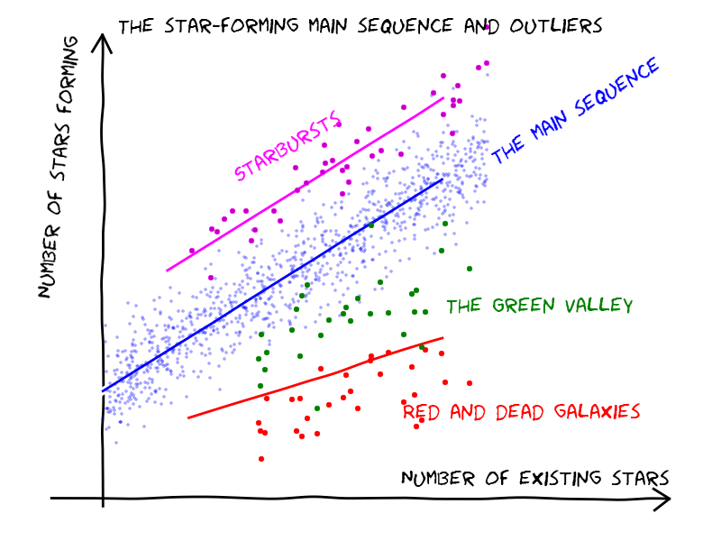
Galaxies 101 (astronomer’s version)
credit: Candels collaboration

Slide 3
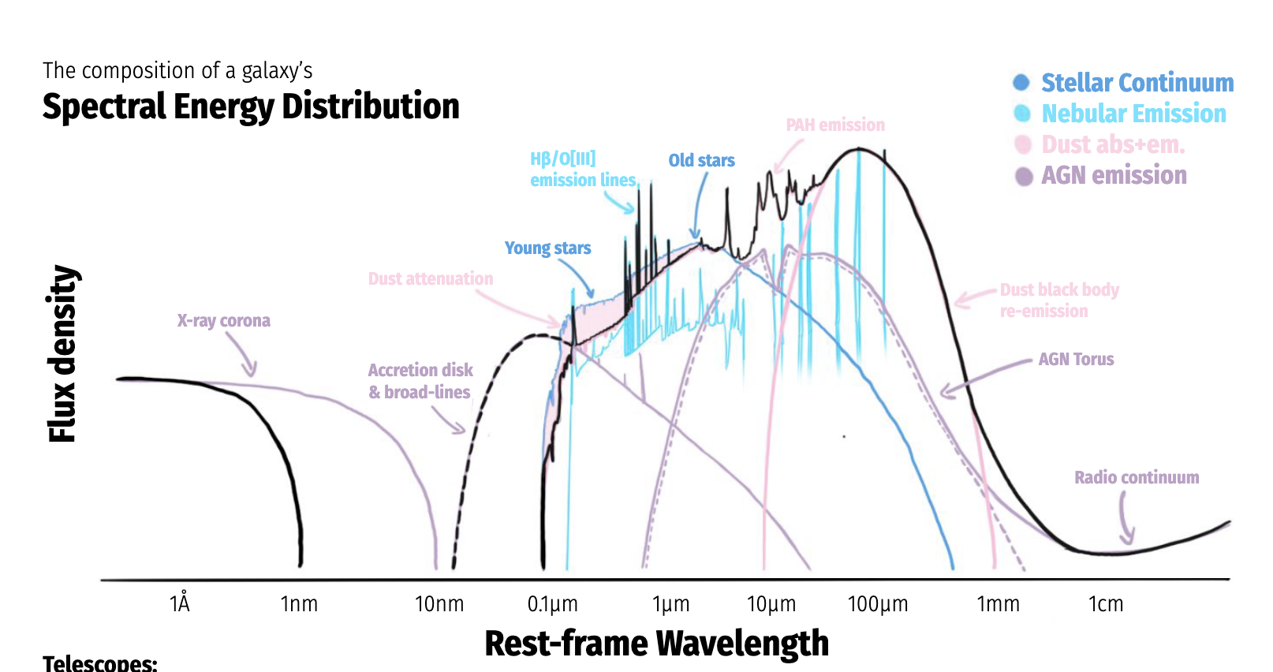
How to Bake a Galaxy Spectrum
Iyer+ 2025

Slide 4
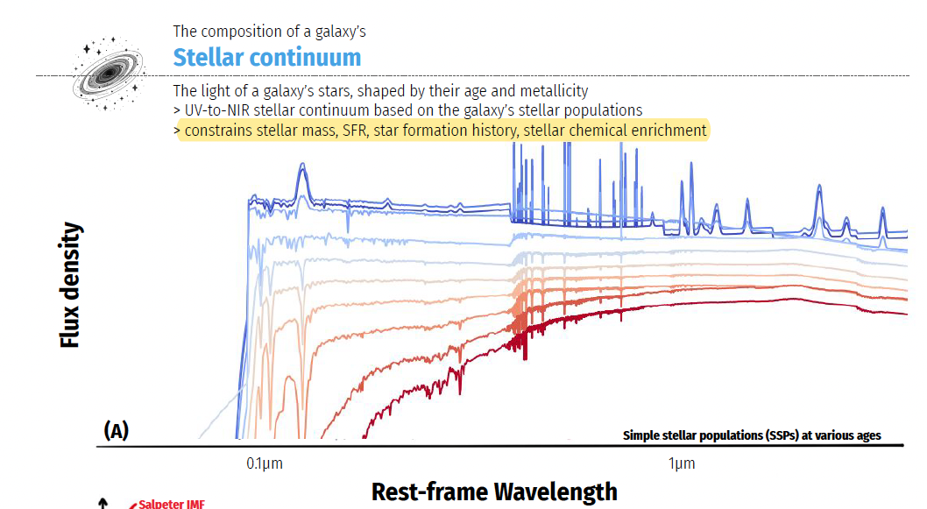
Iyer+ 2025

Slide 5
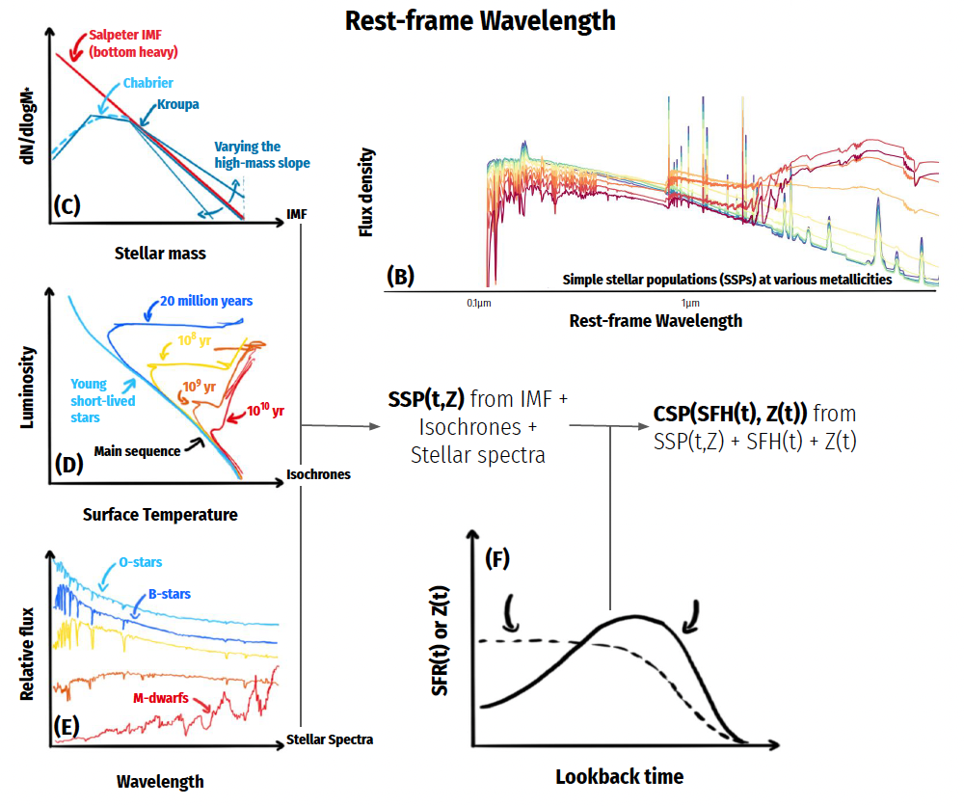
Iyer+ 2025

Slide 6
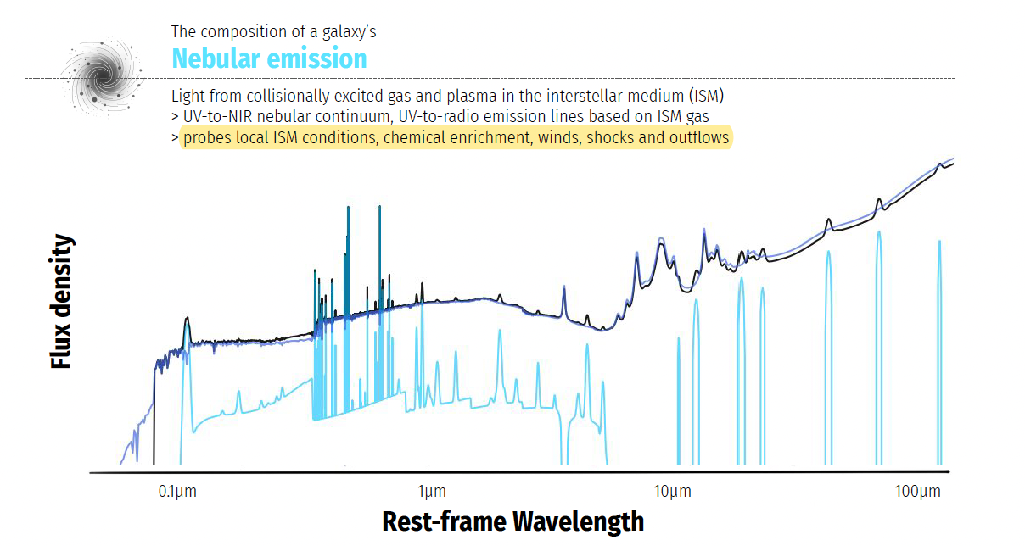
Iyer+ 2025

Slide 7
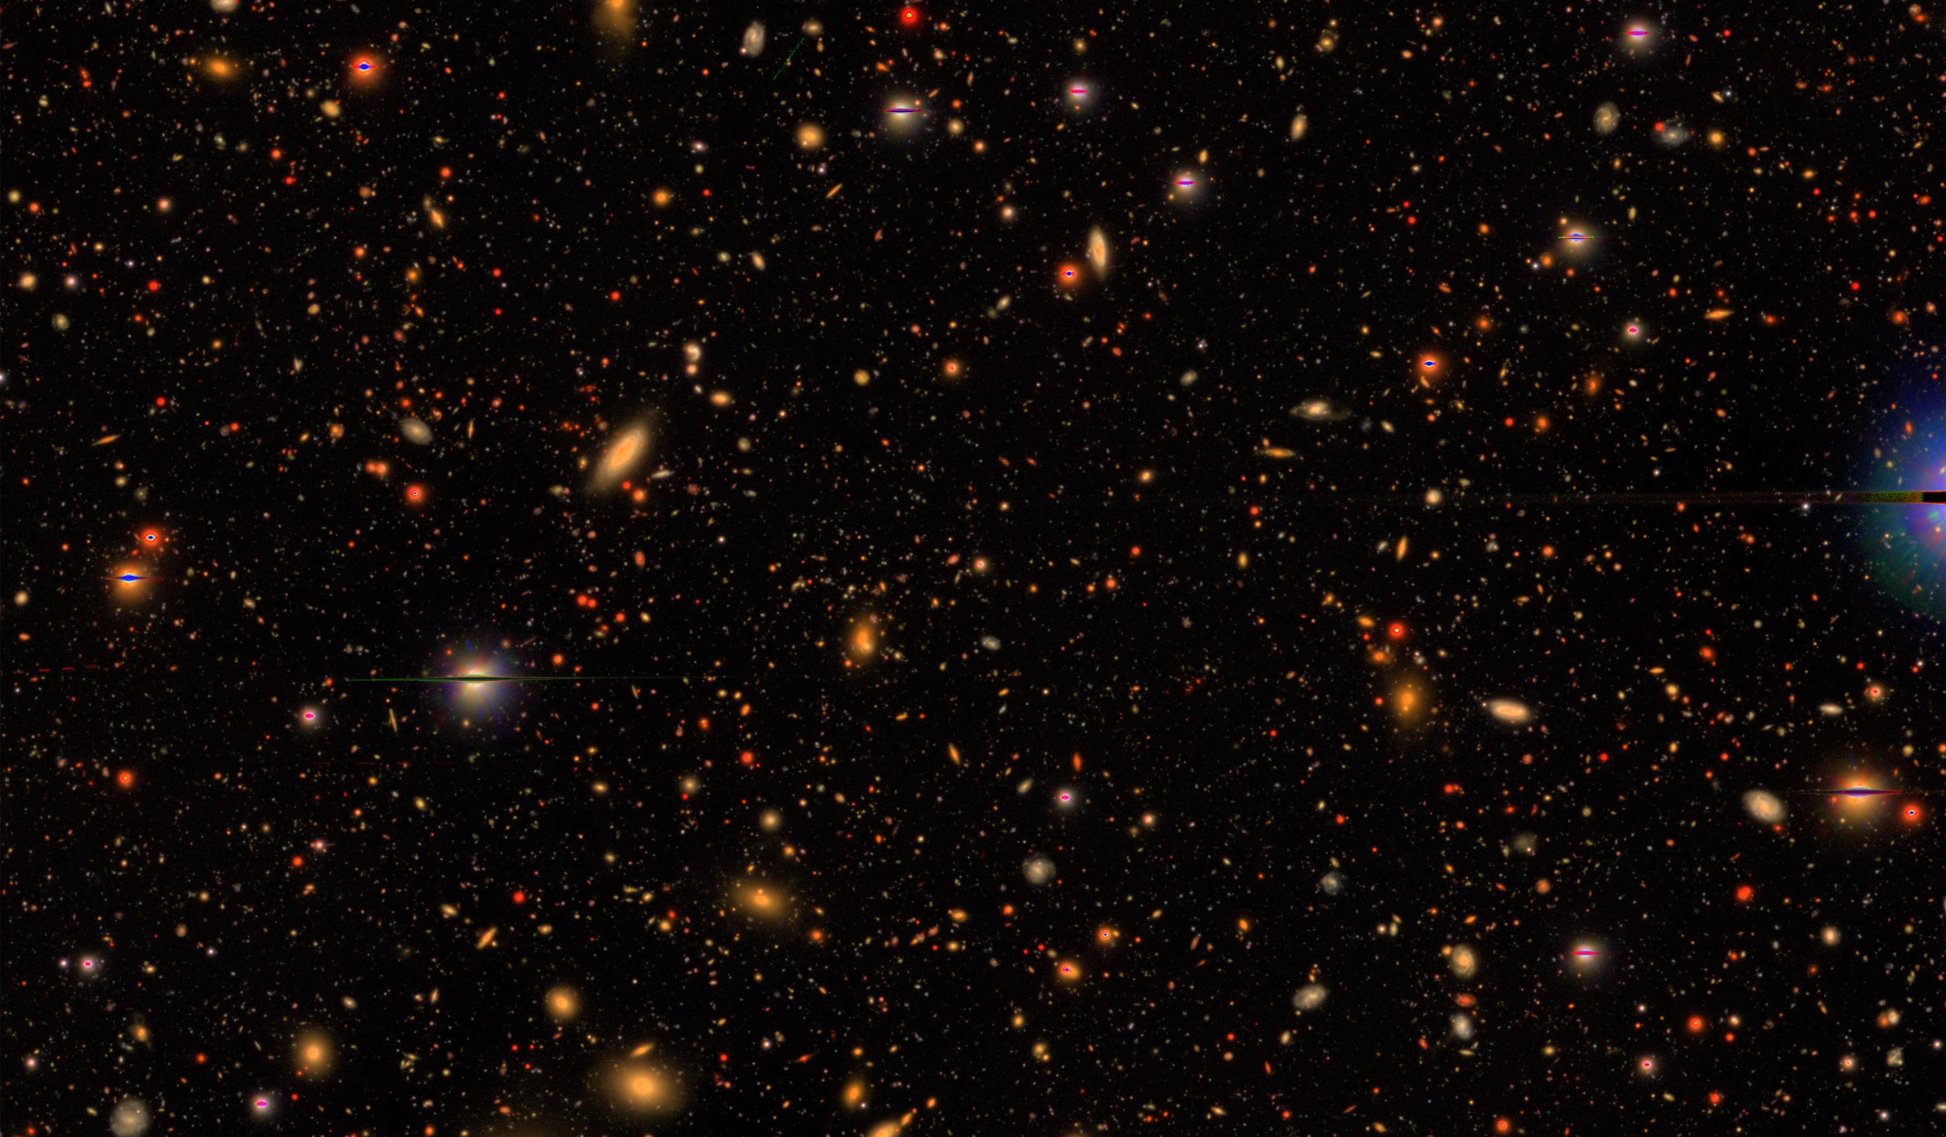
Galaxy Surveys
credit: Subaru HSC, limiting magnitude ~27

Slide 8
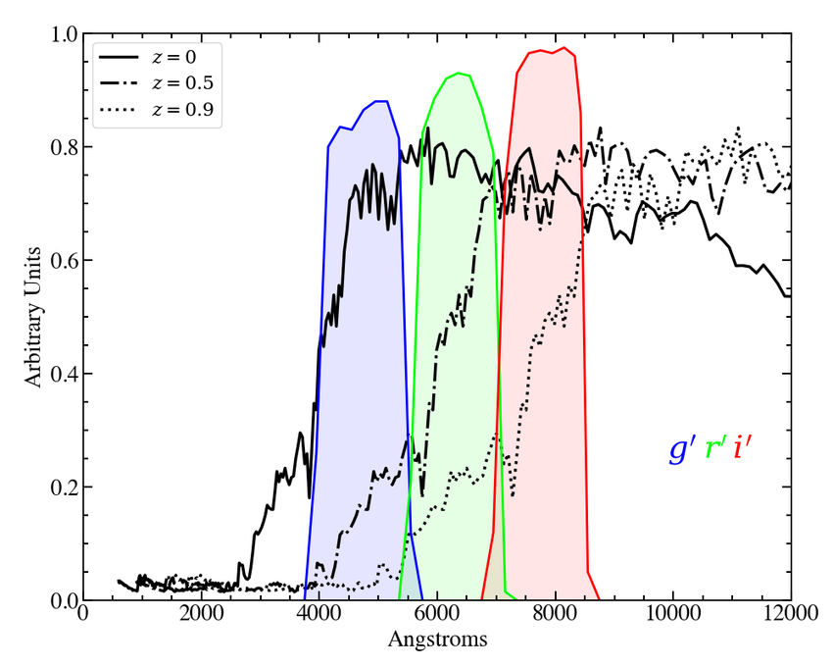
Galaxy Surveys: Imaging
Images → angular coordinates of objects
  In practice, astrometric calibration + object detection are major research areas!
Need to identify galaxies, and estimate their redshifts
  Stars are point sources, galaxies extended; occupy specific regions in color space
redshifted spectra of an elliptical galaxy
4000A break, indicates old stellar population
most common filters in optical imaging
(‘green’, ‘red’, ‘infrared’)

Slide 9
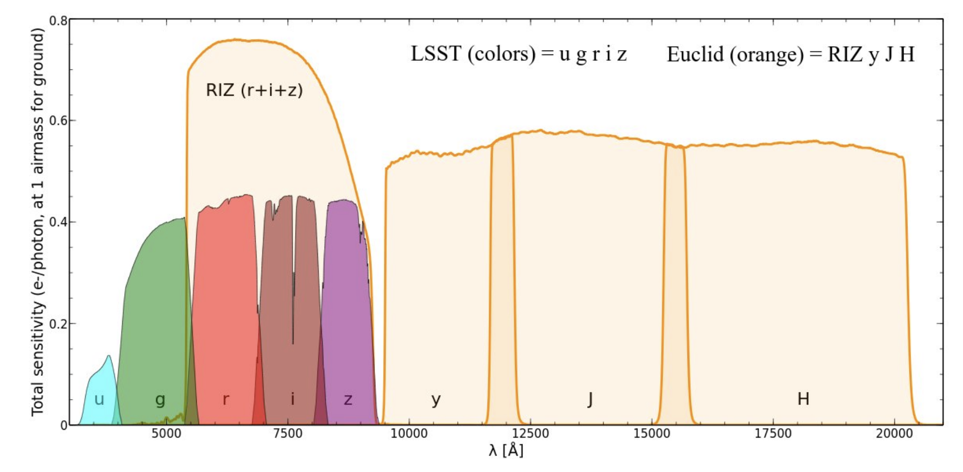
Galaxy Surveys: Imaging
Images → angular coordinates of objects
  In practice, astrometric calibration + object detection are major research areas!
Need to identify galaxies, and estimate their redshifts
  Stars are point sources, galaxies extended; occupy specific regions in color space
more filters →better redshift estimates
infrared coverage critical for high-z galaxies

Slide 10
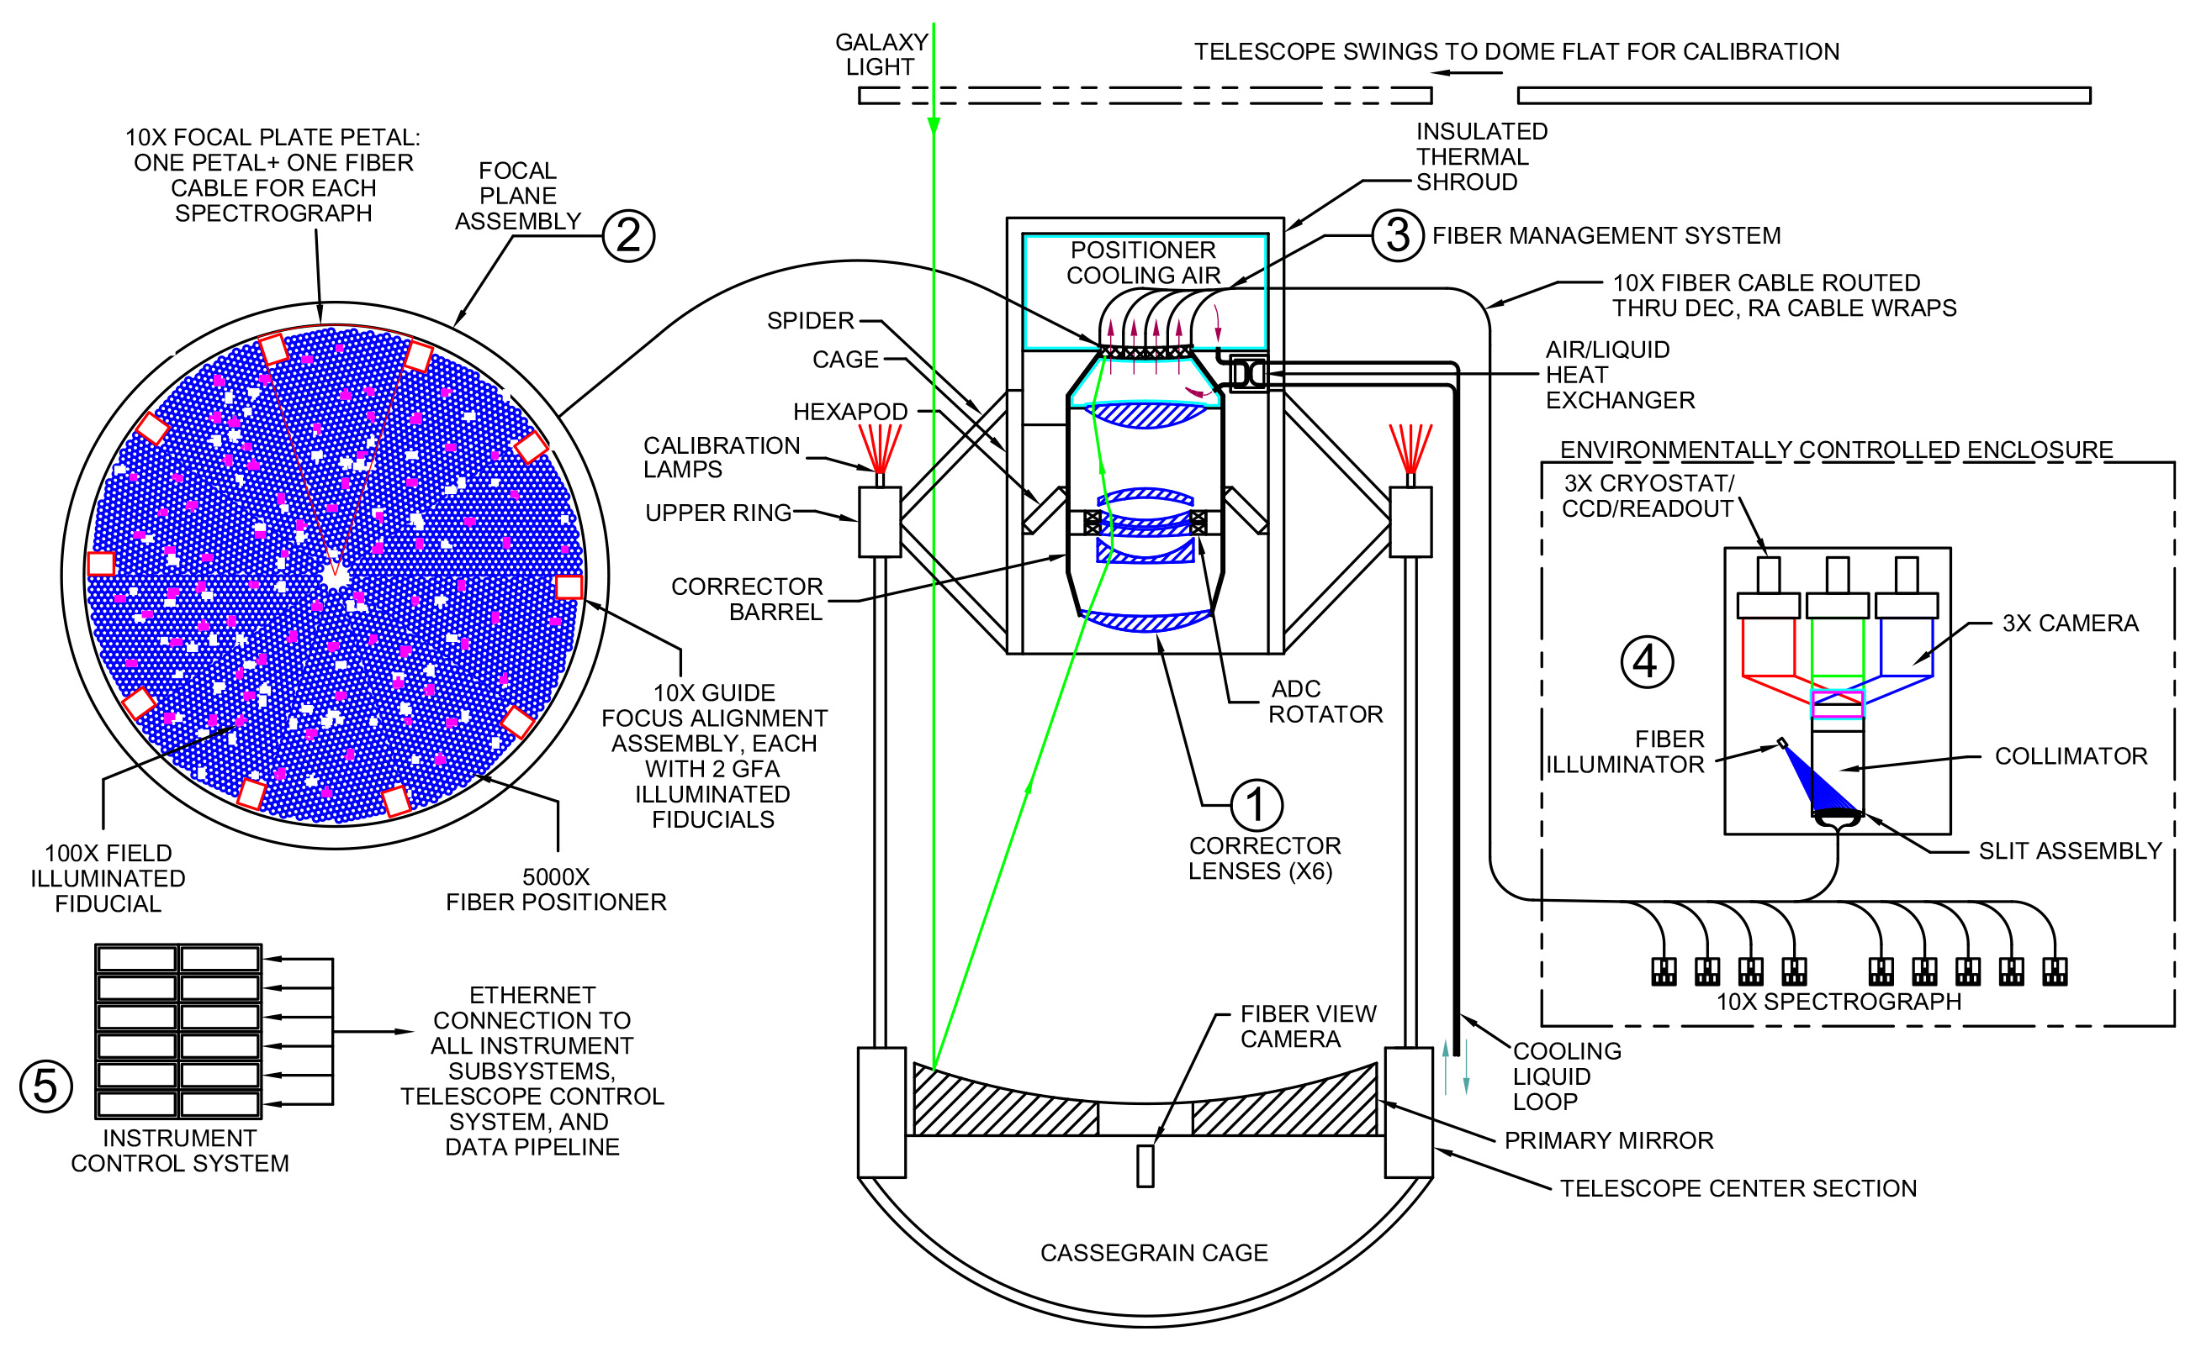
Galaxy Surveys: Spectroscopy
Classic: point spectrograph to individual galaxies
  Wide-field surveys use multi-object spectrographs, e.g., BOSS (1000 fibers), DESI (5000 fibers)
  Requires advance target selection (from imaging data)
credit: desi.lbl.gov

Slide 11
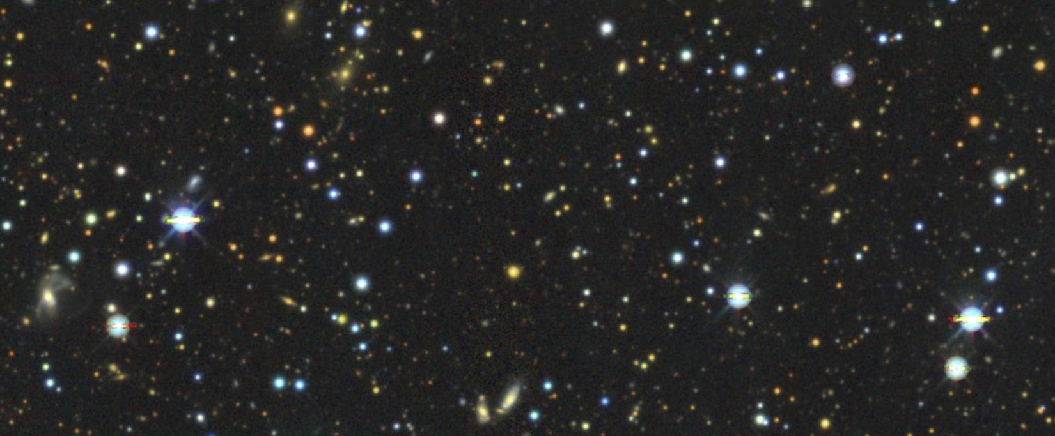
Galaxy Surveys: Spectroscopy
Classic: point spectrograph to individual galaxies
  Wide-field surveys use multi-object spectrographs, e.g., BOSS (1000 fibers), DESI (5000 fibers)
  Requires advance target selection (from imaging data)
DESI Legacy Imaging Survey
6+ years of imaging with multiple telescopes, covering 1/3 sky
1.5 billion galaxies detected!
credit: legacysurvey.org, limiting magnitude ~25

Slide 12
Galaxy Surveys: Spectroscopy
Classic: point spectrograph to individual galaxies
  Wide-field surveys use multi-object spectrographs, e.g., BOSS (1000 fibers), DESI (5000 fibers)
  Requires advance target selection (from imaging data)
DESI Legacy Imaging Survey
6+ years of imaging with multiple telescopes, covering 1/3 sky
1.5 billion galaxies detected!
DESI can take 5000 spectra at a time
5000 x 8 hrs x 2 (per hour) = 64,000 spectra per night
64,000 x 365 days x 5 years x 0.5 (efficiency) ~ 58 million galaxies
→ can target only 4% of galaxies from imaging survey!
credit: legacysurvey.org, limiting magnitude ~25

Slide 13
Galaxy Surveys: Spectroscopy
Classic: point spectrograph to individual galaxies
  Wide-field surveys use multi-object spectrographs, e.g., BOSS (1000 fibers), DESI (5000 fibers)
  Requires advance target selection (from imaging data)
    Goal 1: shot noise subdominant at BAO scales
      → n > 1/P(k~0.1) ~ 10^{-3..-4} (h/Mpc)³
    Goal 2: maximize chances for getting reliable redshift during exposure time
      → magnitude cut

Slide 14
Galaxy Surveys: Spectroscopy
Classic: point spectrograph to individual galaxies
  Wide-field surveys use multi-object spectrographs, e.g., BOSS (1000 fibers), DESI (5000 fibers)
  Requires advance target selection (from imaging data)
    Goal 1: shot noise subdominant at BAO scales
      → n > 1/P(k~0.1) ~ 10^{-3..-4} (h/Mpc)³
    Goal 2: maximize chances for getting reliable redshift during exposure time
      → magnitude cut
    Goal 3: select galaxy populations with well-understood selection function
      → different galaxy types (LRG, ELG, QSO) at different z, identified by color cuts

Slide 15
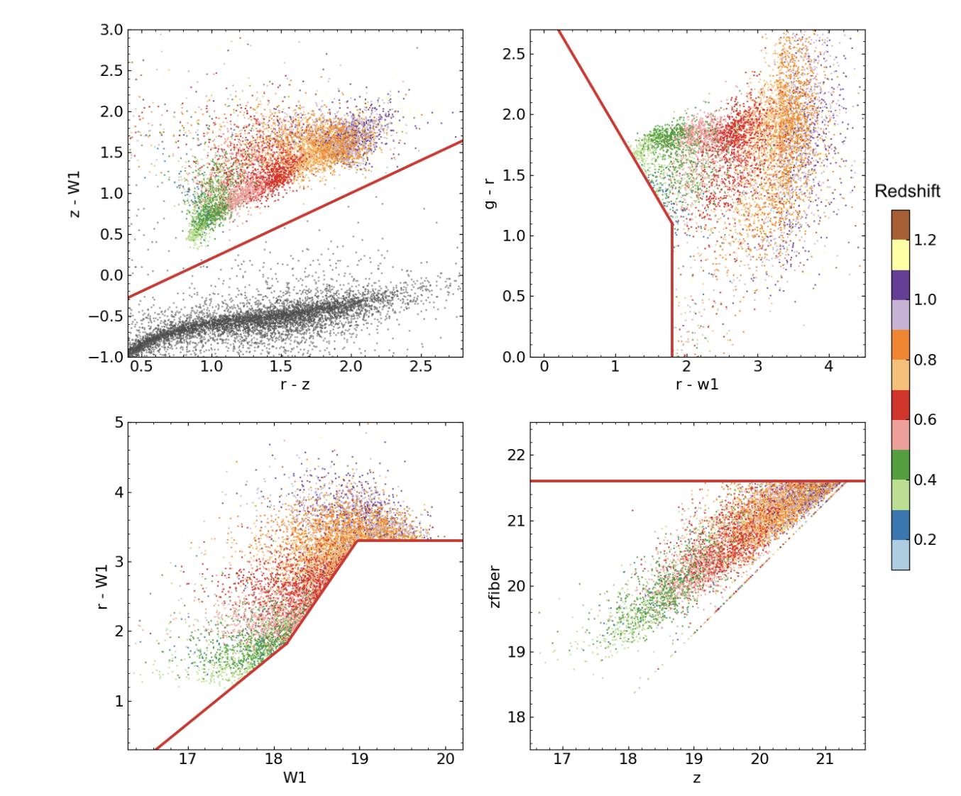
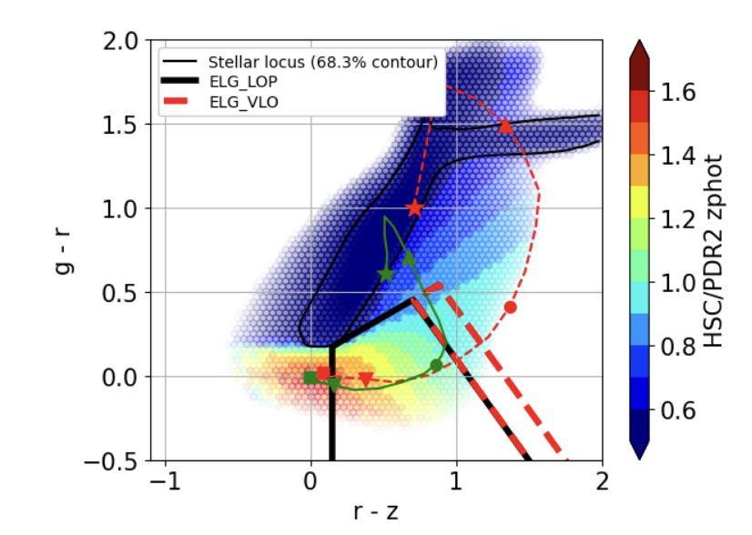
DESI Target Selection
Large Red Galaxies (LRG)
0.4 < z <~ 1.0
Emission Line Galaxies (ELG)
0.6 < z < 1.6
reject z<0.6 ELGs
minimize stellar contamination
stars
luminosity cut
evolutionary tracks of ELGs
reject z>1.6 ELGs
[0II] outside DESI spectrograph
Zhou+ 2023
Raichoor+ 2023

Slide 16
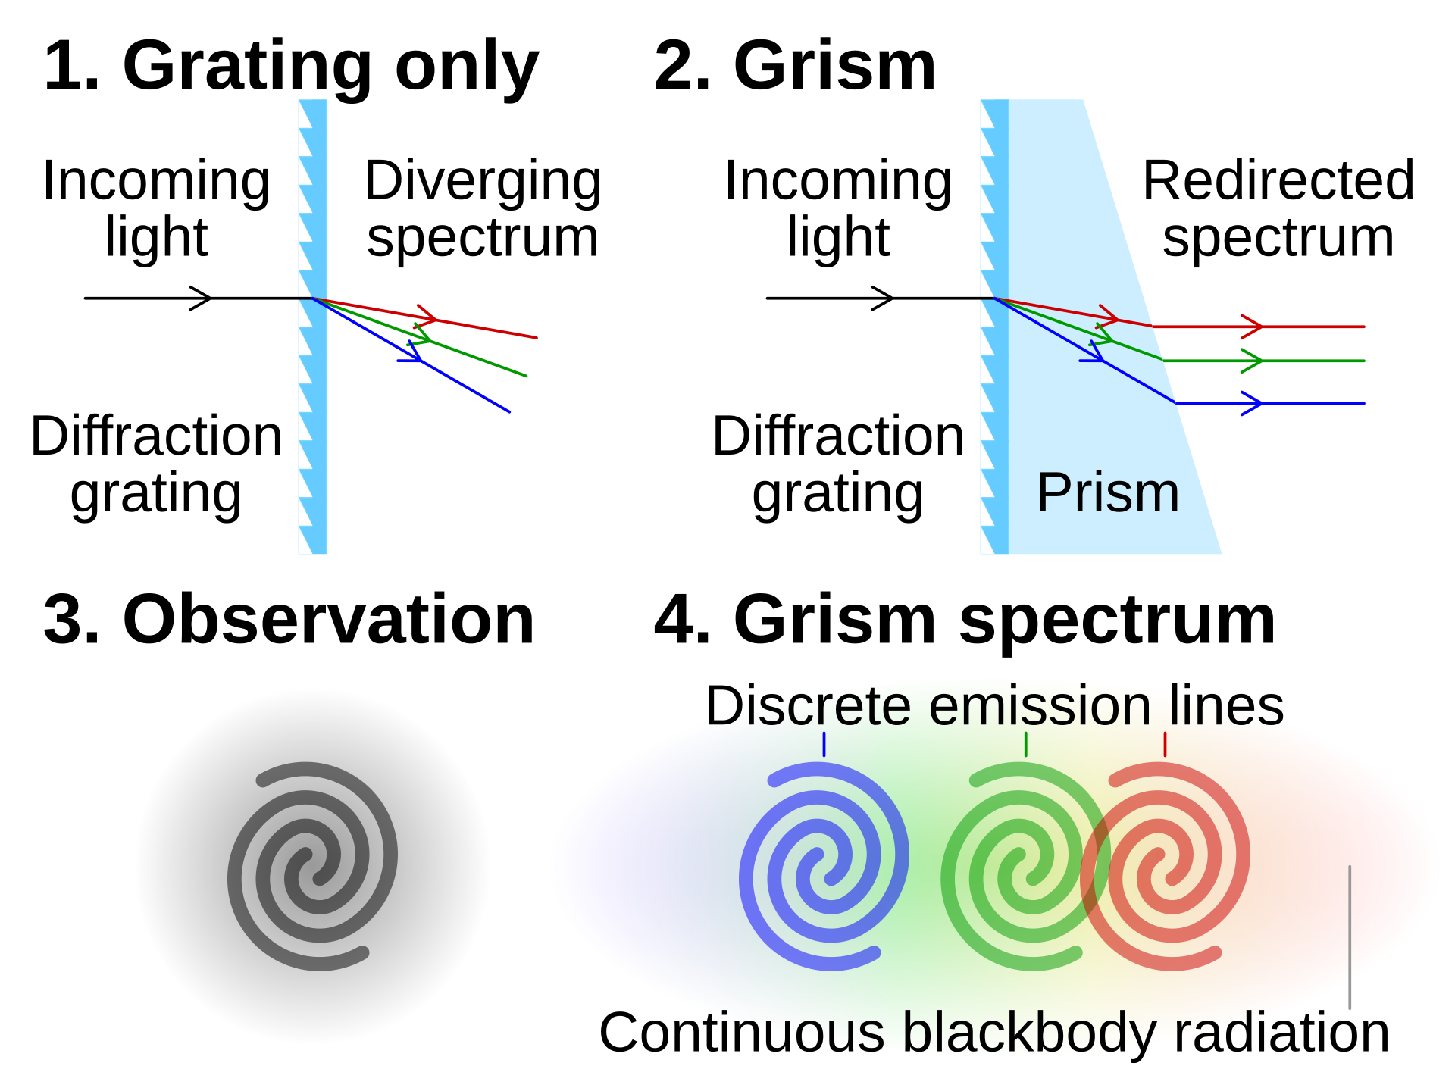
Galaxy Surveys: Spectroscopy
Classic: point (slit/fiber) spectrograph to individual galaxies
  Wide-field surveys use multi-object spectrographs, e.g., BOSS (1000 fibers), DESI (5000 fibers)
  Requires advance target selection (from imaging data)
Slit-less/grism spectroscopy: disperse all (sufficiently bright) galaxies within field of view
Source: wikipedia

Slide 17
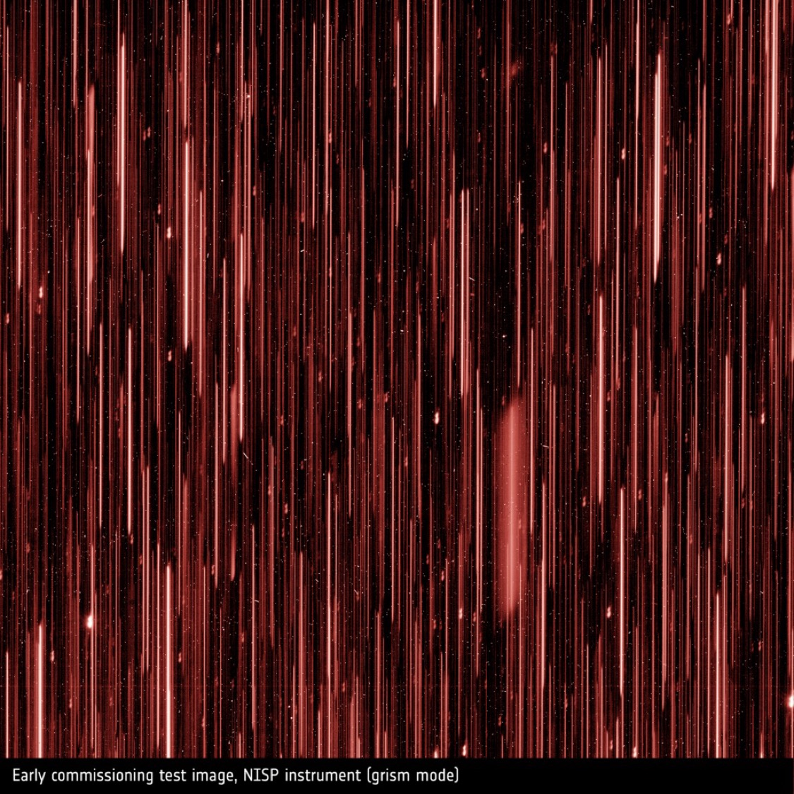
Galaxy Surveys: Spectroscopy
Classic: point (slit/fiber) spectrograph to individual galaxies
  Wide-field surveys use multi-object spectrographs, e.g., BOSS (1000 fibers), DESI (5000 fibers)
  Requires advance target selection (from imaging data)
Slit-less/grism spectroscopy: disperse all (sufficiently bright) galaxies within field of view
Source: wikipedia

Slide 18
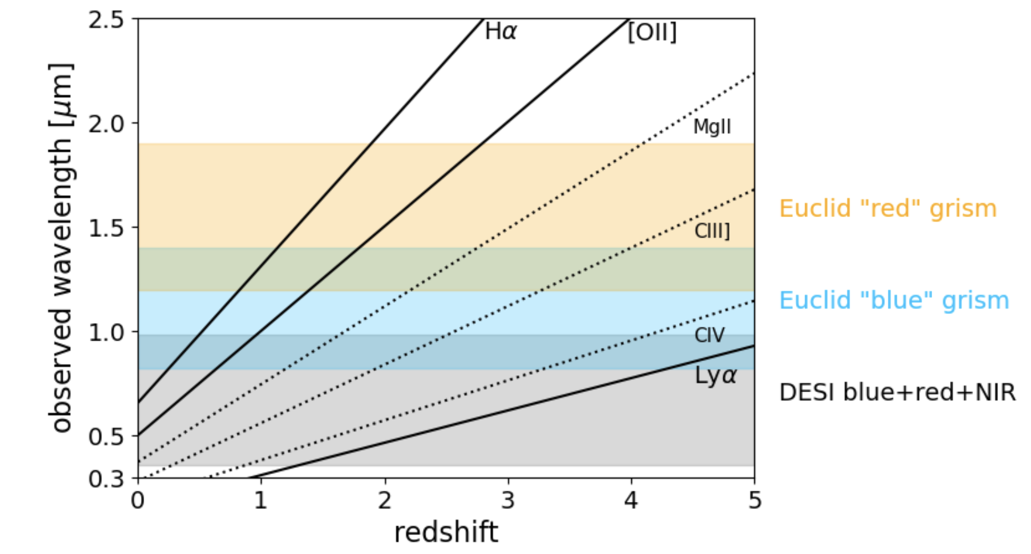
Galaxy Surveys: Spectroscopy
Classic: point (slit/fiber) spectrograph to individual galaxies
  Wide-field surveys use multi-object spectrographs, e.g., BOSS (1000 fibers), DESI (5000 fibers)
  Requires advance target selection (from imaging data)
Slit-less/grism spectroscopy: disperse all (sufficiently bright) galaxies within field of view

Slide 19
Modeling Galaxy Formation
Perturbation theory enables us to calculate the evolution of small density perturbations with (linear + higher-order).
Today: oversimplified, but insightful, (semi-)analytic models for the highly non-linear regime
Halo formation through gravitational collapse.
Halo biasing in the peak-background split.
Assuming that all matter is distributed in halos, approximate the non-linear matter power spectrum with the halo model.
Include ”gastrophysics” to describe galaxy formation.

Slide 20

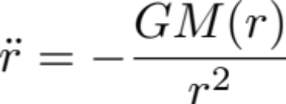
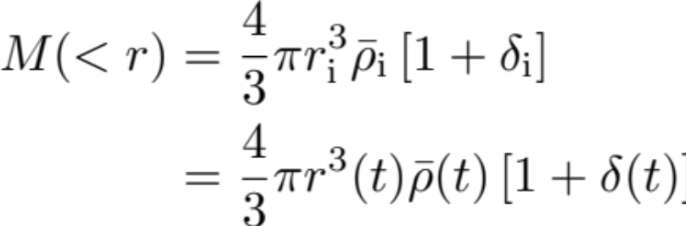
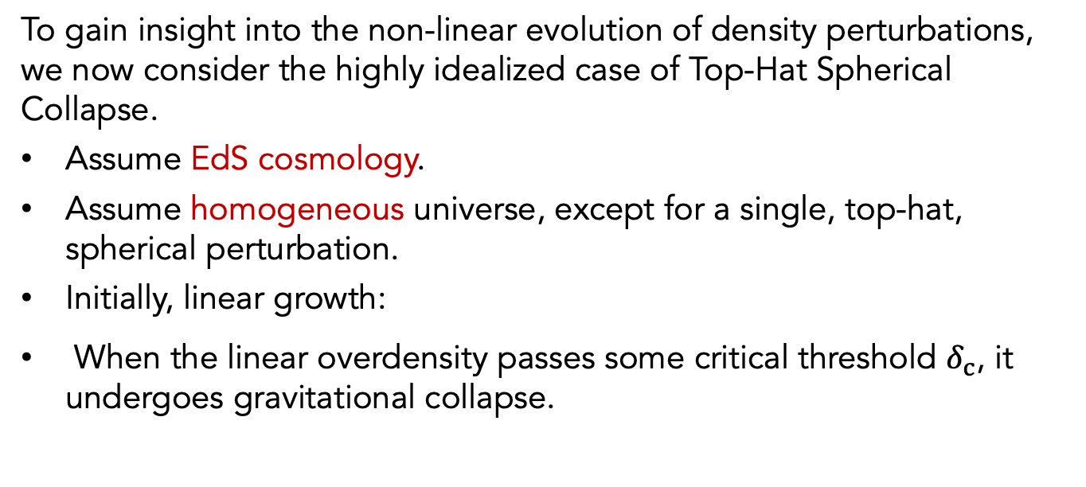
Spherical Collapse
To gain insight into the non-linear evolution of density perturbations, we now consider the highly idealized case of Top-Hat Spherical Collapse.
Assume EdS cosmology.
Assume homogeneous universe, except for a single, top-hat, spherical perturbation.
Initially, linear growth:
When the linear overdensity passes some critical threshold $δ_{c}$, it undergoes gravitational collapse.
Equation of motion
for shell radius(EdS)
Λ would add to rhs,
requiring numerical solution
Mass inside a shell r(t) is conserved
until shell crossing.

Slide 21


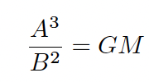

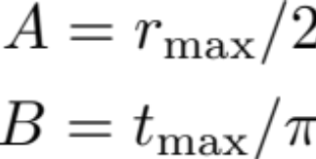
Spherical Collapse
In EdS, equation of motion has parametric solution:
(easily verified by evaluating )
This solution implies the following evolution:
shell expands from r=0 at 𝜃=0 (t=0),
shell reaches a maximum radius r_{max} at at 𝜃=π (t=t_{max}),
shell collapses back to r=0 at 𝜃=2π (t=t_{coll}= 2t_{max}).

Slide 22
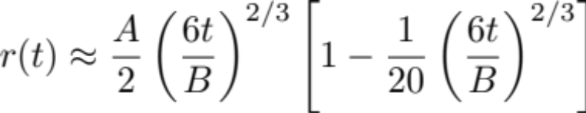

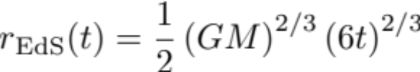
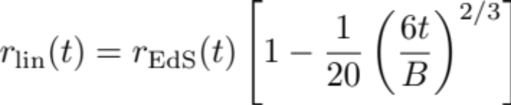
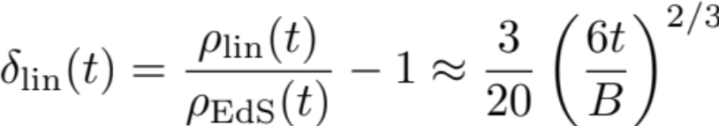
Spherical Collapse
Limiting behavior of the parametric solution:
Taylor expand t(𝜃), r(𝜃):
Recover EdS background solution ( )
and linear evolution
recover linear growth ∝ D(t)

Slide 23
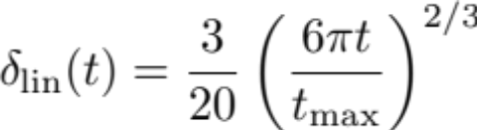
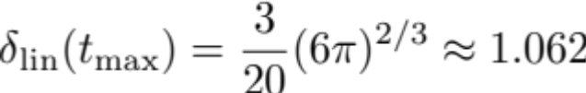
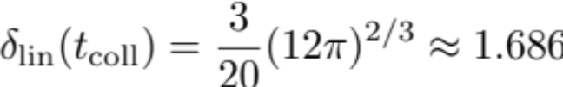
Spherical Collapse
Linear solution
turn around
t=t_{max}, 𝜃=π
collapse
t=2t_{max}, 𝜃=2π
If initial density contrast evolved forward to time t in linear theory 𝛿_{c}> 1.686, then a region has collapsed by time t.
Only weak cosmology dependence.

Slide 24
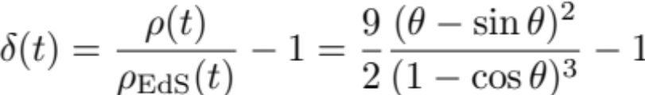
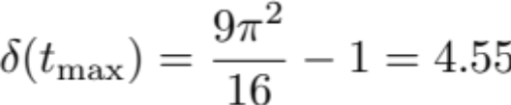

Spherical Collapse
Linear solution
Spherical collapse
turn around
t=t_{max}, 𝜃=π
collapse
t=2t_{max}, 𝜃=2π
Spherical collapse model singular at collapse; proceed by considering virialization after turn around.

Slide 25

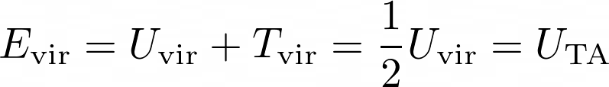
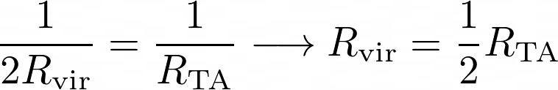
Virialization
What does it mean when I say that the collapsed region will be virialized?
Kinetic and potential energy satisfy the virial theorem:
Assuming virialization, we can use conservation of energy to figure out the final radius of the overdensity.
Assumes virialized region is uniform!

Slide 26
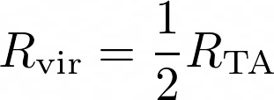
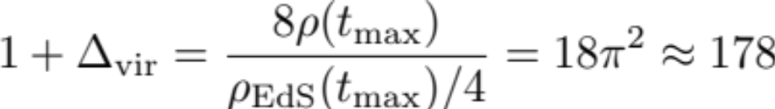
Virialization
Final virial radius:
𝜌_{EdS} decreases by factor 4 during virialization (t_{max}→ 2t_{max})
This is why halos are often defined using a ~200 overdensity criterion.
Unlike the linear density contrast for collapse, 𝛿_{c}=1.686, Δ_{vir} depends notably on cosmology!

Slide 27
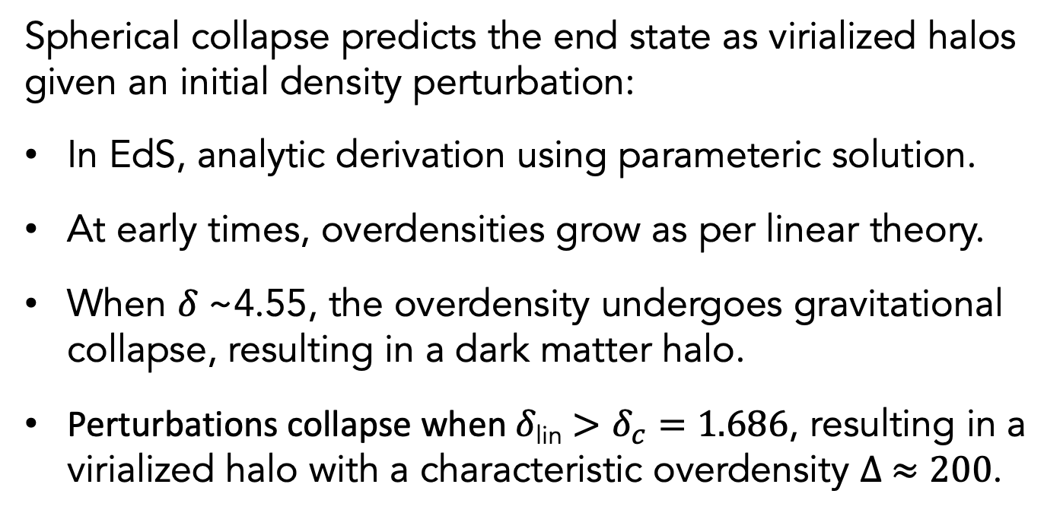
Spherical Collapse Model for Halo Formation
Spherical collapse predicts the end state as virialized halos given an initial density perturbation:
In EdS, analytic derivation using parameteric solution.
At early times, overdensities grow as per linear theory.
When 𝛿 ~4.55, the overdensity undergoes gravitational collapse, resulting in a dark matter halo.
Perturbations collapse when 𝛿_{lin} $>δ_{c}=1.686$, resulting in a virialized halo with a characteristic overdensity $∆ ≈200$.

Slide 28
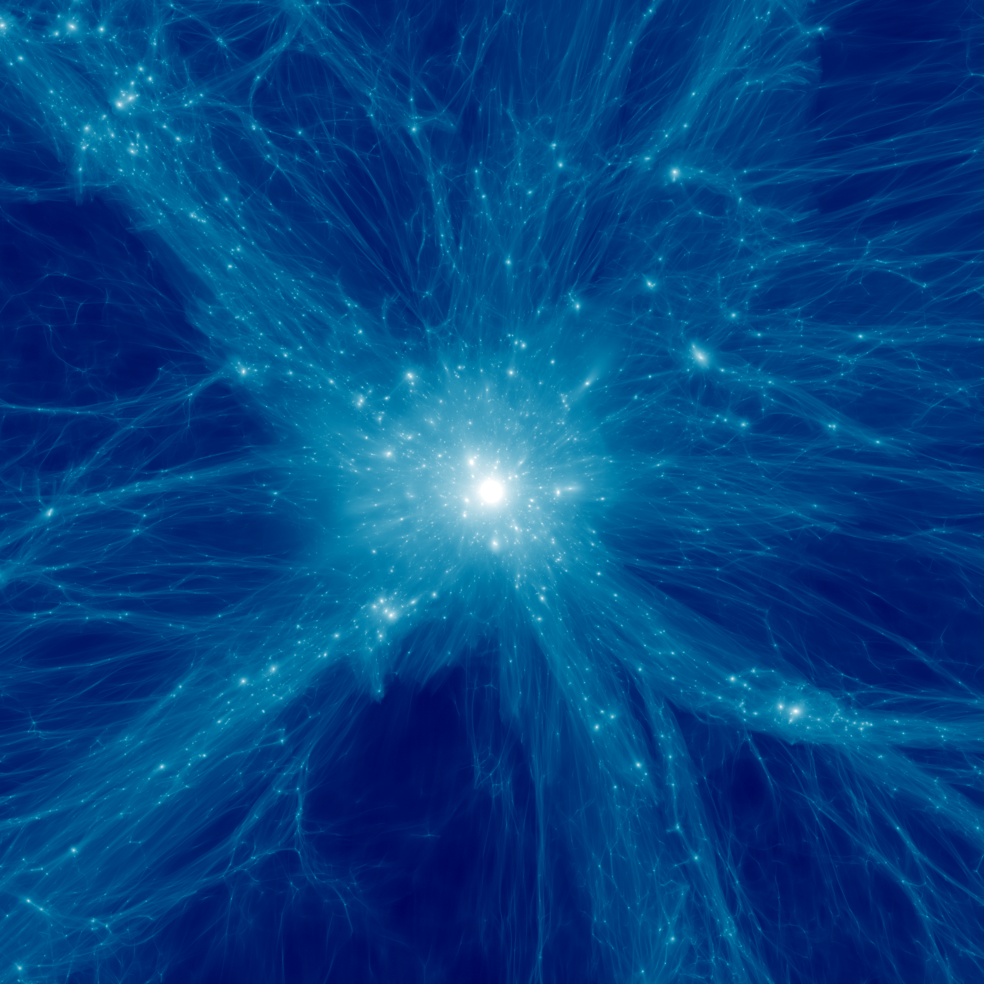
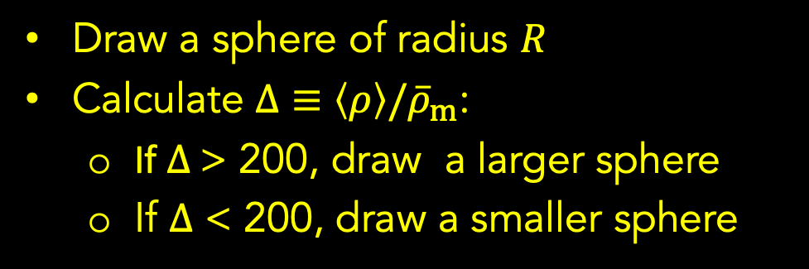
Halo Definition
Draw a sphere of radius $R$
Calculate $Δ≡\left\langle ρ\right\rangle /{\overline{ρ}}_{m}$:
  If $Δ$> 200, draw a larger sphere
  If $Δ$ < 200, draw a smaller sphere

Slide 29
Words of Warning
Mass definition is non-unique:
Other overdensity criteria and/or reference densities can be used, e.g. M_{500c} vs M_{200m}.
Spherical collapse calculation can be repeated for an LCDM cosmology:
  results in a cosmology dependent overdensity.

Slide 30
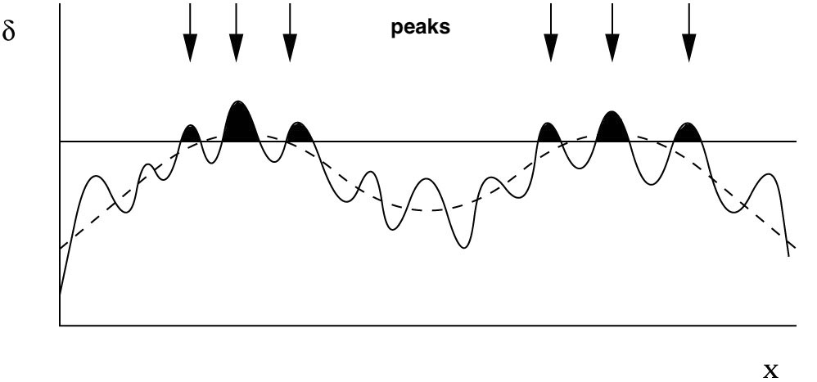
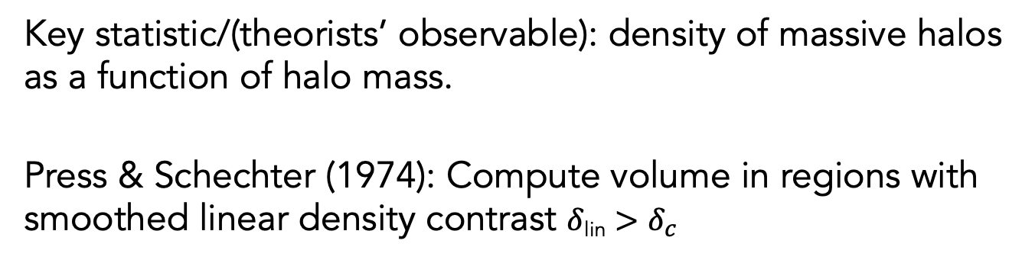
The Halo Mass Function
Key statistic/(theorists’ observable): density of massive halos as a function of halo mass.
Press & Schechter (1974): Compute volume in regions with smoothed linear density contrast 𝛿_{lin} $>δ_{c}$
Credit: John Peacock

Slide 31

The Halo Mass Function
Key statistic/(theorists’ observable): density of massive halos as a function of halo mass.
Press & Schechter (1974) calculation of halo mass function:
Lin. density contrast smoothed on scale is a Gaussian random field with mean zero, variance

Slide 32
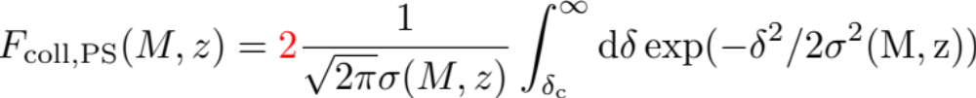
The Halo Mass Function
Key statistic/(theorists’ observable): density of massive halos as a function of halo mass.
Press & Schechter (1974) calculation of halo mass function:
Lin. density contrast smoothed on scale is a Gaussian random field with mean zero, variance
Fraction of space collapsed into halos above mass M at redshift z can be calculated as
Fudge factor so that all matter is in collapsed halos as M→0
Rigorous derivation in Extended Press Schechter (Bond 1991)

Slide 33
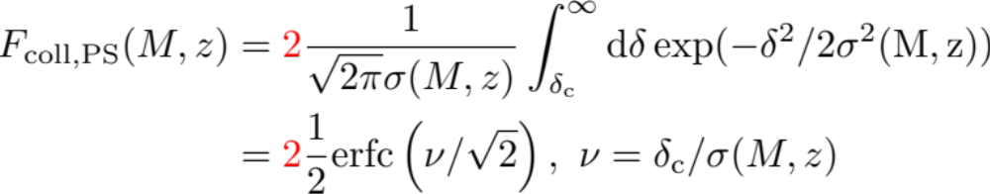

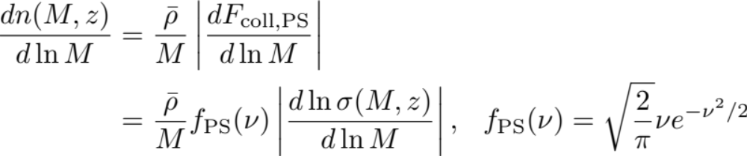
The Halo Mass Function
Fraction of space collapsed into halos above mass M at redshift z can be calculated as
Differentiate in M to find fraction in range dM and multiply by the number density of halos if all of the mass were composed of such halos → differential number density of halos

Slide 34
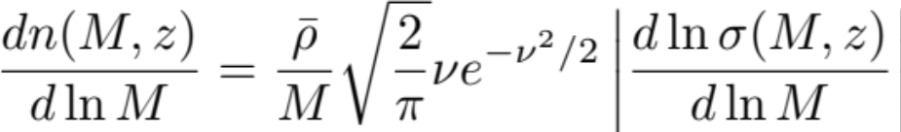


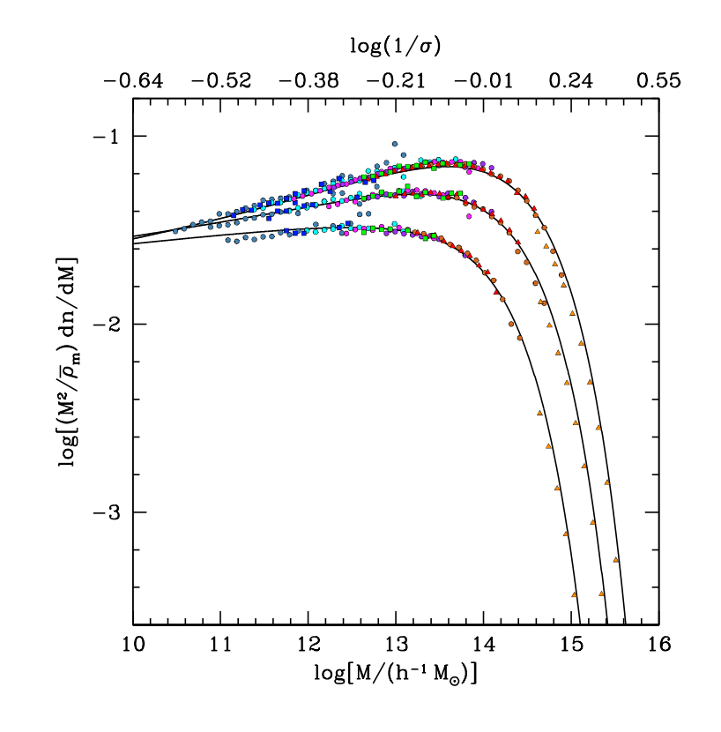
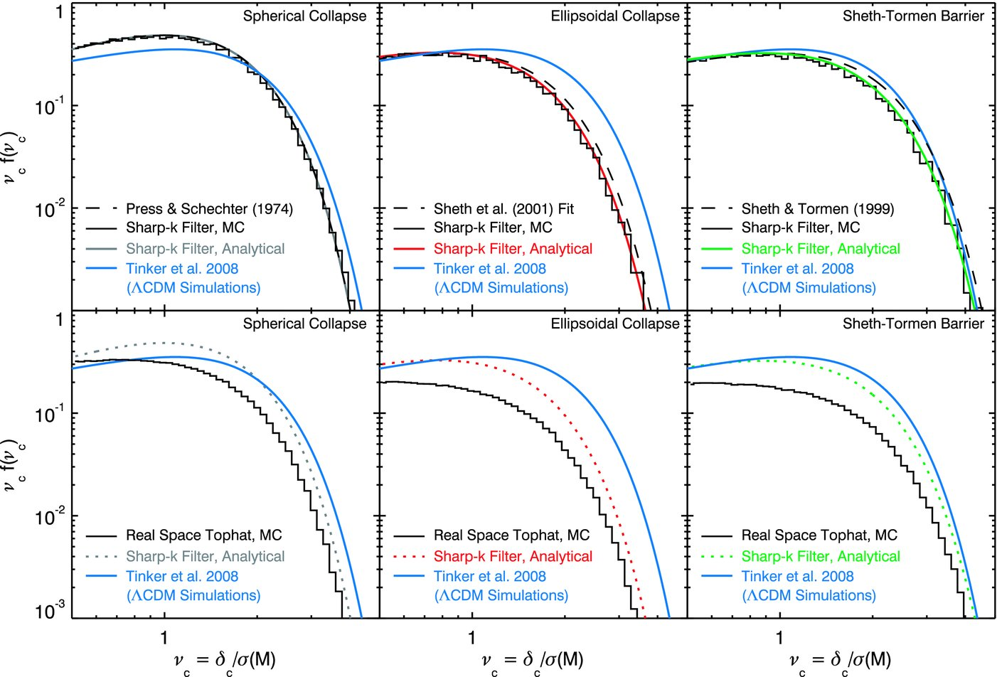
The Halo Mass Function
The Press-Schechter model builds intuition for the halo mass function and its cosmology + redshift dependence:
High mass: exponential cut off above M∗ where
For higher precision, measure f(v) in simulations:
Tinker et al. 2008
Robertson et al. 2009

Slide 35
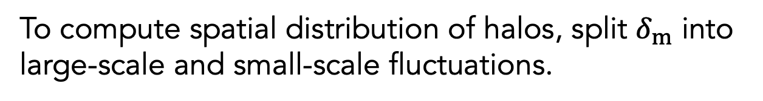
The Peak-Background Split
To compute spatial distribution of halos, split $δ_{m}$ into large-scale and small-scale fluctuations.
Credit: John Peacock

Slide 36



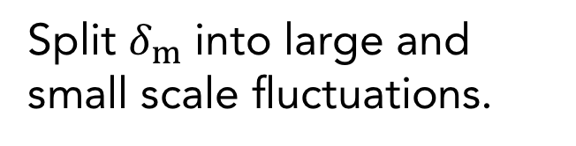
Halo Clustering
Modify spherical collapse to incorporate for large-scale matter fluctuations, compute linear halo bias
Key idea:
Split $δ_{m}$ into large and small scale fluctuations.
Halo bias is relative to large scale overdensities.
Effective barrier is lower in high density regions.

Slide 37
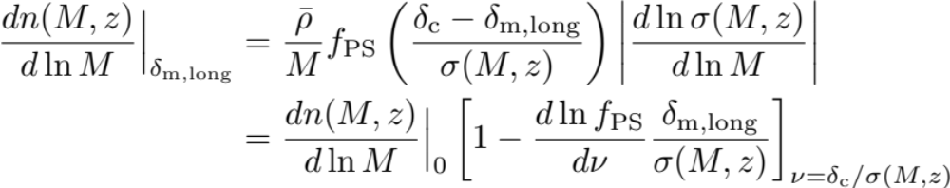
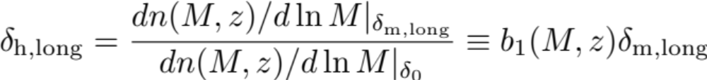
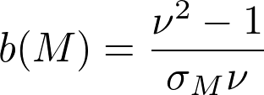
(Linear) Halo Bias
Number of halos in an overdensity $δ_{m,long}$ is:
Press-Schechter:

Slide 38
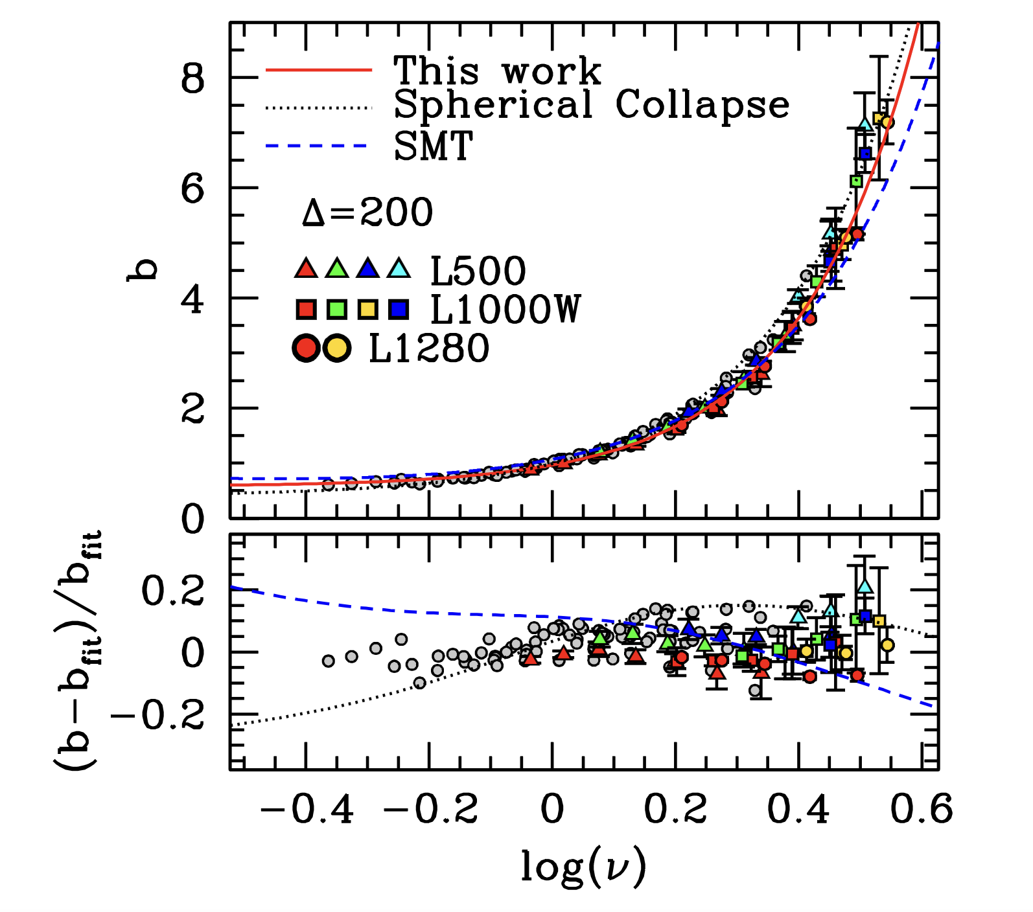
(Linear) Halo Bias
Tinker et al. 2010

Slide 39

Hierarchical Merging
Illustration of a merger tree, depicting the growth of dark matter halos as the results of a series of mergers. A horizontal slice through the tree gives the mass distribution of progenitor halos at a given time.
(Lacey & Cole 1993)

Slide 40
Galaxy Formation: a Classic Recipe
1. Structure formation is driven by gravitational instability.
2. Dark-matter proto haloes get a spin due to tidal torques.
3. Galaxies form inside dark-matter haloes, via a two-stage collapse:
a. Dissipationless collapse of the dark-matter haloes,
b. dissipative collapse of gas: baryons collapse into the halo potential well and get shock heated.
4. Gas cools mainly by radiative transitions: typical mass of a galaxy is set by cooling arguments .
5. The formation of disk galaxies can be understood by the cooling of gas to the DM-halo centres via conservation of the angular momentum of the DM halo.
6. (Elliptical galaxies form via the merger of disk galaxies)
Hoyle 1949
Rees & Ostriker 1977, White & Rees 1978
Hoyle 1953, Silk 1977, Binney 1977, Rees & Ostriker 1977
Fall & Efstathiou 1980

Slide 41

From Halos to Galaxies
Simple prediction for the LF of galactic compared with the group luminosity function measured from the 2dFGRS (Eke+06).
Obvious discrepancy between the shape of the observed luminosity function and the one expected if all halos had the same M/L ratio.
Halos of different mass must have different efficiency with which baryons are converted into stars.

Slide 42

From Halos to Galaxies
t1: Baryons fall into the potential well of a dark matter halo
t2: Baryons are shock-heated to the halo temperature.
t3: The hot halo gas cools, and cool gas falls towards the halo center where it forms stars.
t4: The radius within which gas had sufficient time to cool increases with time.
(From Baugh 2007)

Slide 43


From Halos to Galaxies
t2: Baryons are shock-heated to the halo temperature.
Consider a gas cloud of mass M_{gas} falling into a halo of mass M_{h} with v_{in}.
If the gas falls in from large distances (where Φ(r) ~0), and has negligible initial velocity, then v_{in}² ~ 2| Φ(r_{halo})|.
Assuming hydrostatic equilibrium (+ideal gas, spherical halo) and virial theorem, and ignoring external pressure, magnetic fields, etc., one can define the virial temperature

Slide 44

From Halos to Galaxies
In order to compute the cooling function Λ(T) for a certain gas, one first
needs to determine the densities of the various ionic species. In the case of a pure H/He mixture (the simplest, relevant case), these are
n_{e} , n_{H0} , n_{H+} , n_{He0} , n_{He+} , n_{He++}.
In ionization equilibrium, the ionic abundances are determined by simple algebraic equations.
If there is no photo-ionization, then, under CIE, the relative abundances of ionic species depend only on temperature.
From Katz+ 1996.

Slide 45

From Halos to Galaxies
t3: The hot halo gas cools, and cool gas falls towards the halo center where it forms stars.
Molecular cooling: Collisions excite vibrational and rotational energy levels in H2. The subsequent decay of the excited states removes energy from the gas. Most important in halos with virial temperature below T ∼ 10⁴ K.
Atomic cooling: Partly ionized atoms cool through the excitation and radiative decay of higher energy levels. Contributes while gas is partly, but not fully ionized (10⁴ K < T < 10⁶ K for primordial gas). Metal enrichment enhances the cooling efficiency at higher temperatures where gas of primordial composition is almost completely ionized.
Bremsstrahlung: As electrons are accelerated in an ionized plasma they loose energy due to the emission of Bremsstrahlung. Dominant cooling process in cluster halos with T > 10⁷ K.

Slide 46

From Halos to Galaxies
t3: The hot halo gas cools, and cool gas falls towards the halo center where it forms stars.
Cooling rate as a function of halo temperature and gas metallicity. Bremsstrahlung becomes the dominant process at T > 10⁷ K. Atomic line cooling is most efficient at lower temperatures and causes the peaks at 15000 K (H) and 10⁵ K (He+).
Sutherland & Dopita 1993

Slide 47

From Halos to Galaxies
t4: The radius within which gas had sufficient time to cool increases with time.
We can implicitly define the as the radius at which the cooling time is equal to the dynamical time (or free-fall time) of the halo
If t_{cool} > t_{H}: Cooling is not important. Gas is in hydrostatic equilibrium, unless it was recently disturbed.
If t_{dyn} < t_{cool} < t_{H}: System is in quasi-hydrostatic equilibrium. It evolves on cooling time scale. Gas contracts slowly as it cools, but system has sufficient time to continue to re-establish hydrostatic equilibrium.
If t_{cool} < t_{dyn}: Gas cannot respond fast enough to loss of pressure. Since cooling time decreases with increasing density, cooling proceeds faster and faster. Gas falls to center of dynamic system on free-fall time.

Slide 48

From Halos to Galaxies
t4: The radius within which gas had sufficient time to cool increases with time.

Slide 49
From Halos to Galaxies
t4: The radius within which gas had sufficient time to cool increases with time.
We can implicitly define the as the radius at which the cooling time is equal to the dynamical time (or free-fall time) of the halo
At late times and in massive systems, the cooling radius typically is smaller than the virial radius. The gas outside r_{cool} forms a quasi-static hot halo, while gas from the central regions (r < r_{cool}) cools and is accreted onto the center. The accretion rate can be estimated from a continuity equation
At z = 0 the transition between halos that are rapidly cooling and those forming a static hot halo occurs at M_{vir} ∼ 2 − 3 × 10¹¹M⊙.

Slide 50


Star Formation & Feedback
Feedback from supernova-driven winds. Hot halo gas cools and builds up a reservoir of cold gas in the galactic disk (solid arrows). The cold gas is turned into stars. Supernova explosions reheat a fraction of the cold gas and returns it to the hot phase (dashed arrows) or eject material from the halo (dotted arrows).
(Illustration from Baugh 2007)

Slide 51

Galaxy Transformations

Slide 52

Simulating Galaxy Evolution
By now, AGN feedback is a crucial ingredient in hydro simulations of cosmological structure formation and galaxy evolution.
First introduced by Springel, Di Matteo & Hernquist 2005, and continuously refined since.
Simulation set up:
dark matter ”particles” (representing dark matter density), interacting only via gravity
gas “particles” (representing gas density), interacting via gravity and hydrodynamics - effective parameterizations tracking heating and cooling. Gas below certain temperature converted to stars. Sophisticated simulations also track metallicity.
star “particles” representing density of single stellar population – formed from cold gas, inject feedback energy to surrounding gas
black hole/sink particles – accrete matter, inject AGN feedback energy into surrounding gas

Slide 53

Simulating Star Formation
Different Simulation – Different Recipe
Pillepich+2018
Without ‘a’ form of feedback acting at all masses, i.e., a mechanism regulating conversion of gas into star, halos would host way too massive and compact galaxies.

Slide 54



AGN Feedback
Supermassive black holes, residing in all galactic spheroids, play an important role in the formation of massive galaxies. Black holes deplete a galaxy’s gas supply by accretion of gas, and injecting heat into the ISM. At times where a galaxy is not undergoing a major merger, the black hole quiescently accretes gas which is assumed to come from the hot halo.
A simple phenomenological model for the accretion rate is
This accretion rate can be motivated by noting that f_{hot}v_{vir}³/H(z)/(10G) is the total mass of hot gas, so that in case of unit accretion efficiency the black hole will accrete all hot gas within a Hubble time. We then assume that a fixed fraction η of the accreted energy is released radiatively
and injected into the ISM where it compensates in part for cooling, giving rise to a modified infall rate

Slide 55

AGN Feedback in Simulations
Di Matteo, Springel & Hernquist 2005:
Simulations of galaxy mergers with and without AGN feedback

Slide 56

AGN Feedback in Simulations
Di Matteo, Springel & Hernquist 2005:
Simulations of galaxy mergers with and without AGN feedback
Merger leads to inflow of gas, burst of star formation.
Merger also leads to strong inflows that feed gas to the supermassive black hole and thereby power the quasar.
The energy released by the quasar expels enough gas to quench both star formation and further black hole growth.
Simulated merger remnants with AGN feedback follow observed early-type galaxy scaling relations!

Slide 57

Galaxy Evolution
Hopkins et al. 2008

Slide 58

Simulating AGN Feedback
Different Simulation – Different Recipe
All simulations also require prescription for forming initial SMBHs & BH accretion rate…

Slide 59

Impact of Feedback on the Matter Distribution

Slide 60
The Halo Model
The concept of halos is a useful way of modeling clustering in the highly non-linear regime.
Assume that all mass is in dark matter halos.
If we know:
How halos cluster.
The mass distribution around each halo.
Then we can calculate how all matter is clustered.
This formalism can be extended to model the clustering of galaxies (and other tracers).

Slide 61






We can use the idea of halos to model the non-linear bump!
$$\sim k$$
$$k_{nl}$$
Non-linear bump.
$$k_{eq}$$
$$\sim k^{−3}$$
$$k$$

Slide 62

The Halo Model
Computation of matter clustering splits into
1-halo term: clustering of matter within one halo
2-halo term: large-scale clustering of halos
Dodelson/Schmidt: Modern Cosmoloy

Slide 63



The Halo Model: 1h Term
Write mass profile as
$U(r|M)$ is normalized to unity over halo volume (e.g., R₂₀₀).
On small scales, the two particles will always be in the same halo → single mass integral
Note that mass function must obey
(all mass is contained in halos)

Slide 64



The Halo Model: 2h Term
For two halo term, halos may have different masses
→ double mass integral
Note that bias function must obey
(mass is on average unbiased)
non-linear corrections,
→ Asgari+(2023) review

Slide 65
Halo Profile
Empirically, the Navarro-Frenk-White profile describes density profile of simulated halos across remarkable mass and redshift range.
Free parameter: halo concentration c(M)
requires fitting function

Slide 66

Halo Profile
Empirically, the Navarro-Frenk-White profile describes density profile of simulated halos across remarkable mass and redshift range.
Free parameter: halo concentration c(M)
requires fitting function
Non-exhaustive list of
c(M) fitting functions.
Note different definitions!
Asgari+2023

Slide 67

Halo Profile
Empirically, the Navarro-Frenk-White profile describes density profile of simulated halos across remarkable mass and redshift range.
Free parameter: halo concentration c(M)
requires fitting function
Asgari+2023

Slide 68
The Halo Model
Typically agrees with simulations at 10s of % level.

Slide 69
The Halo Model
tweak profile/c(M)
to improve fit
Higher-order PT+biasing
1h-2h transition
Complicated…
Typically agrees with simulations at 10s of % level.

Slide 70


Halo Occupation Distribution
Despite the rich astrophysics of feedback, the empirical halo occupation distribution (HOD) has been successful to model 2pt clustering of many different galaxy samples (so far…):
Split galaxies into central galaxies (c) and satellites (s)
Introduce empirical forms for halo occupation N_{c/s}(M) and radial galaxy distribution.
Compute galaxy power spectrum
Halo + HOD model fits to luminosity bin galaxy samples in SDSS (w_{p} measurements offset for clarity).
To match precision of recent data, many extensions needed already…
Zehavi+ 2010

Slide 71


HODs for (DESI) ELGs
Fitting DESI ELG 2pt clustering already requires
Flexible parameterization of N_{s}(M)
Parameterized satellite conformity (N_{c}(M) depends on whether central galaxy is ELG)
Radial satellite distributions extending beyond R_{vir}
Beyond-2pt statistics will likely require (many) morel parameters.
Rocher+ 2024

