Slide 1
From Pixels to Parameters
Part 1: Galaxy Surveys
  Galaxies beyond the point-particle picture
Part 2: From Pixels to Power Spectra
  Systematics, estimators & covariances
Part 3: From Power Spectra to Parameters
  Inference & error bars you can trust
Part 4: Weak Lensing
  Galaxies beyond the spin-2 field picture

Slide 2

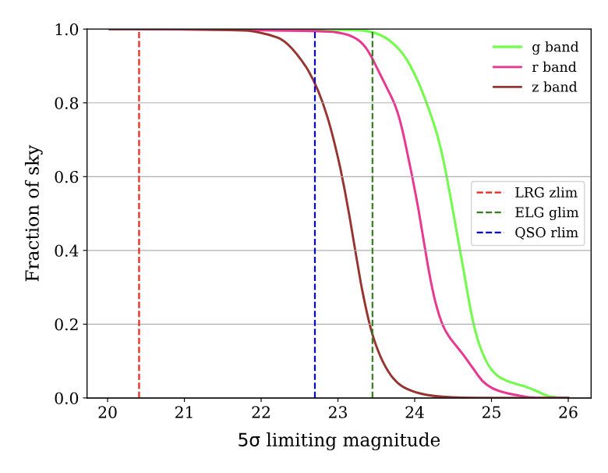
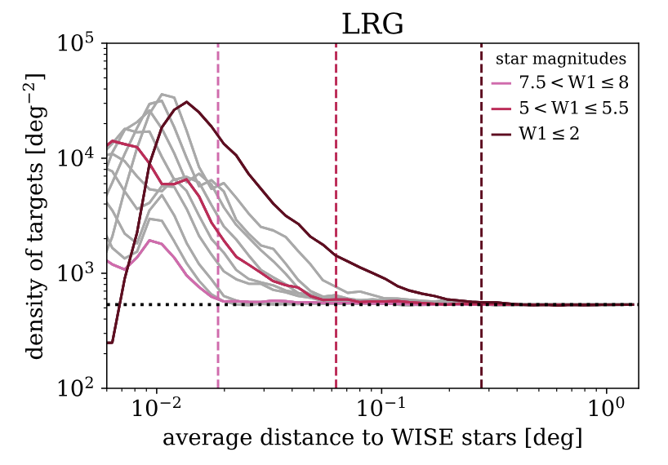
Catalog Systematics: Foregrounds
Target selection from imaging data (color+magnitude cuts)
→ selection probability of spectroscopic sample modulated by systematics of the imaging survey(s)
Kitanidis+2020

Slide 3
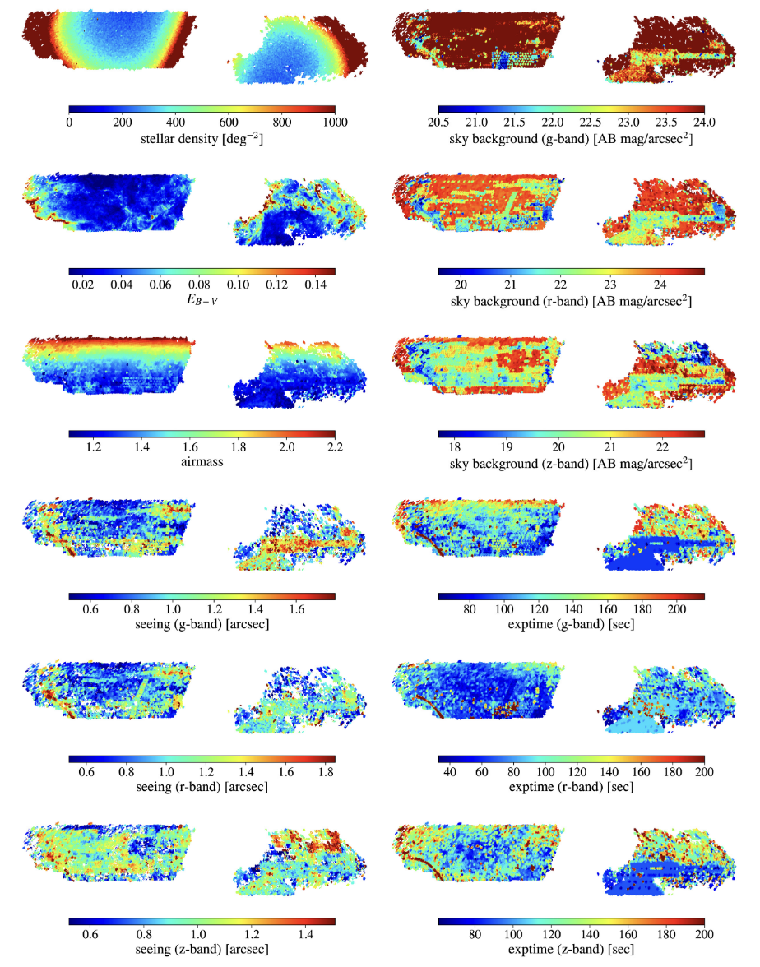
Catalog Systematics: Foregrounds
Target selection from imaging data (color+magnitude cuts)
→ selection probability of spectroscopic sample modulated by systematics of the imaging survey(s)
potential foreground systematics affecting DESI target selecting (Kitanidis+2020)

Slide 4
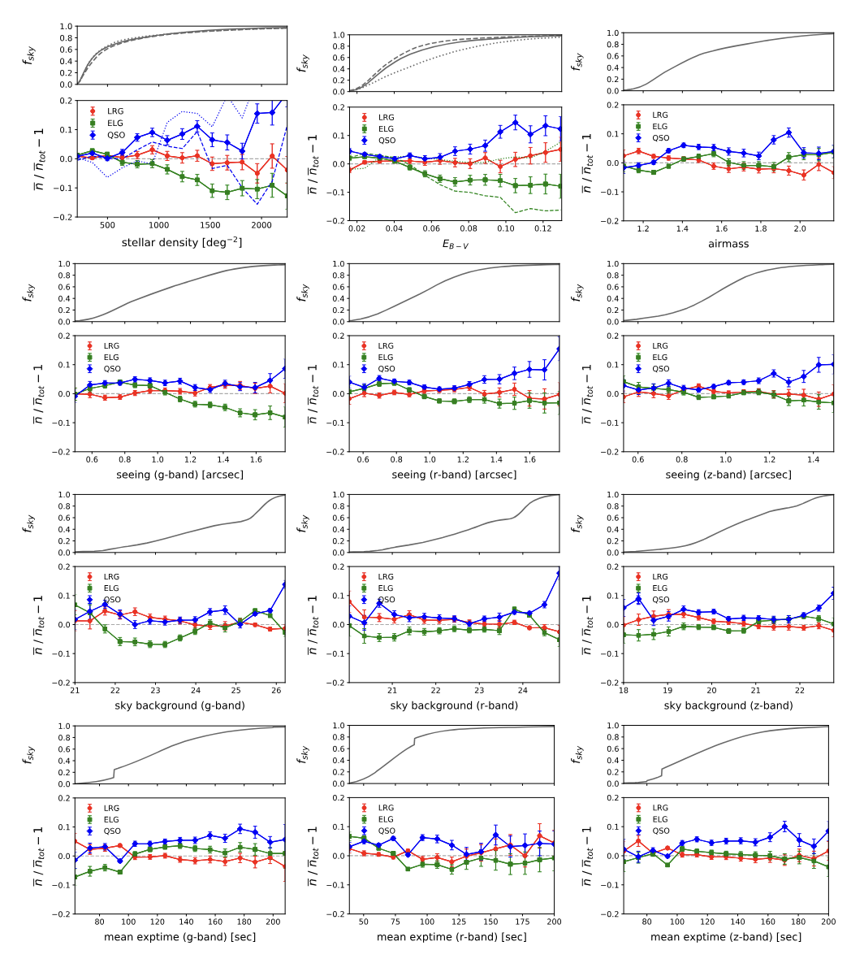
Catalog Systematics: Foregrounds
Kitanidis+2020

Slide 5
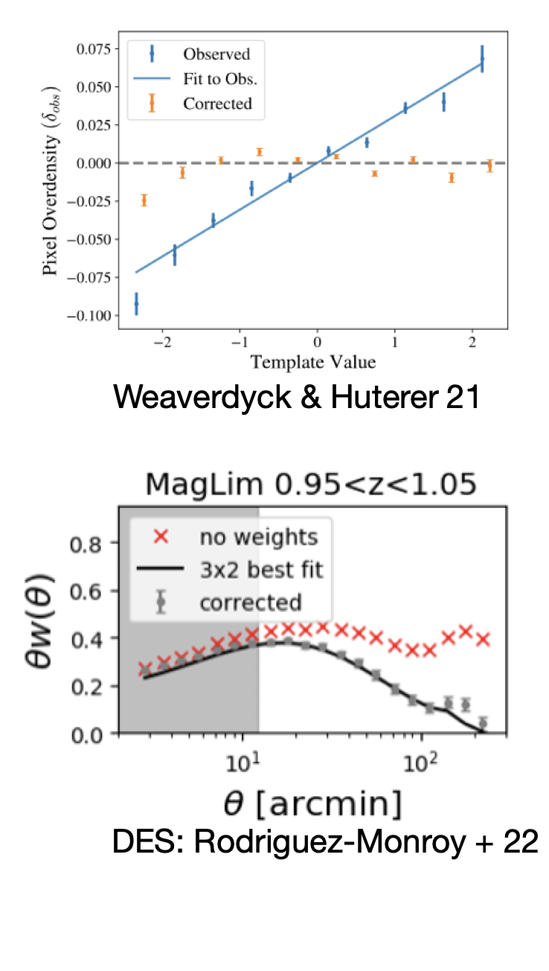
Catalog Systematics: Foregrounds
List of systematics depends on ground/space, imaging-based target selection or slit-less survey
Mitigation generally template based
  multi-linear regression at field level (Ross+2016, ff)
  template subtraction (Ho+12, ff), mode projection (Leistedt+2013, ff) at summary statistics level
  methods are equivalent for certain prior choices (Weaverdyck & Huterer 2021)
beware of overfitting!

Slide 6
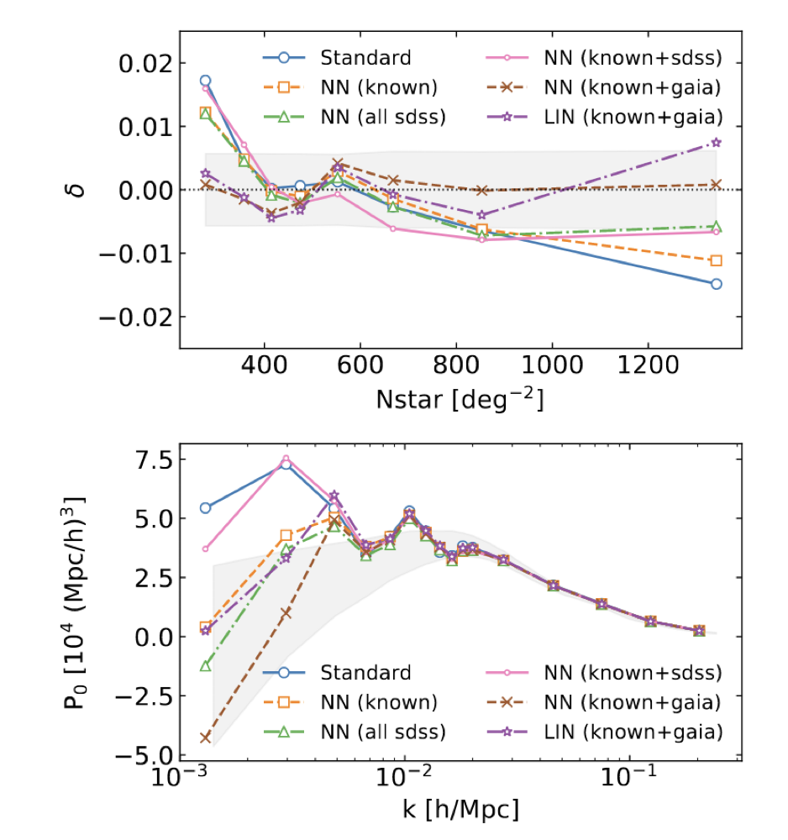
Catalog Systematics: Foregrounds
Rezaie+2020,2021 validated FCNN for non-linear weights of imaging sys on eBOSS ELGs/quasars.
Example: mean density as a function of stellar density against expected variance from EZmocks without systematics.
Notable effect of lin/NN and choice of stellar density template on low-k power spectrum monopole.

Slide 7
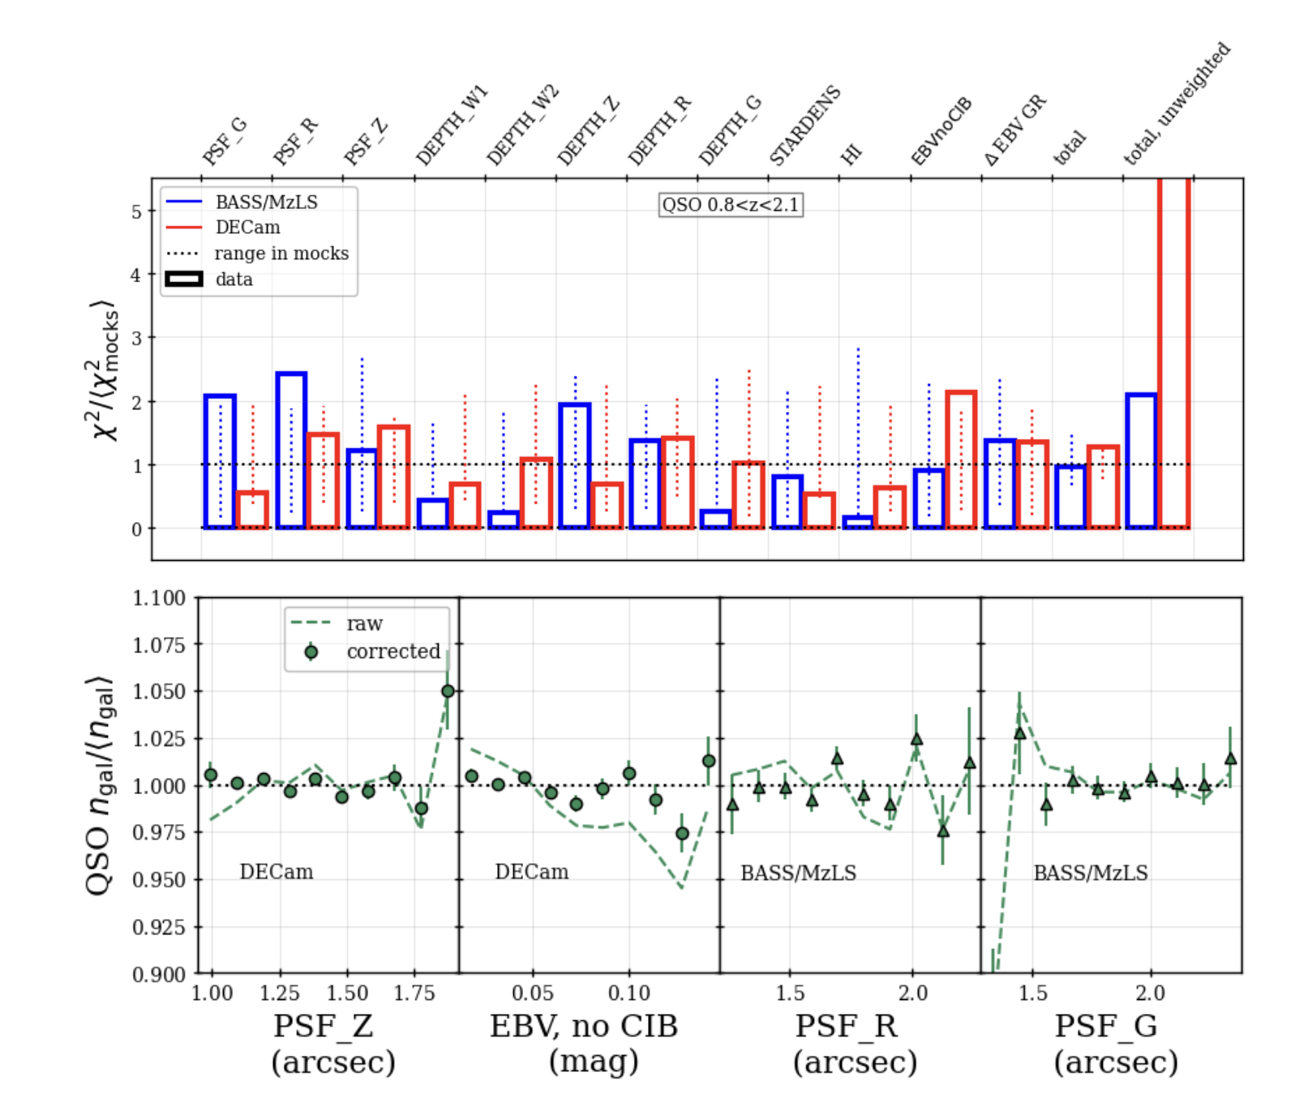
Catalog Systematics: Foregrounds
Identify most significant foregrounds for each sample (ELG, LRG, QSO)
Sample density after multi-dimensional foreground regression: assign weight w_{imsys} to each galaxy
DESI 2025 (2411.12020)

Slide 8
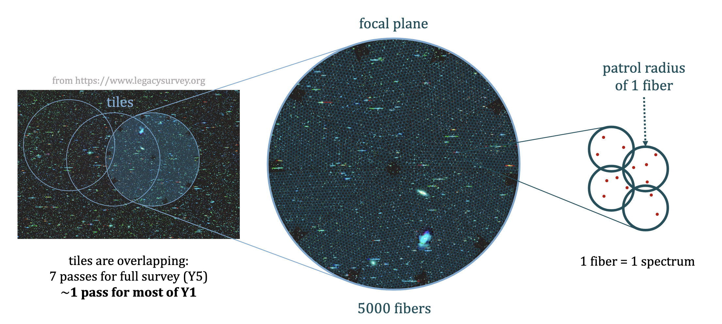
Catalog Systematics: Fiber Collisions
Credit: Mathilde Pinon

Slide 9
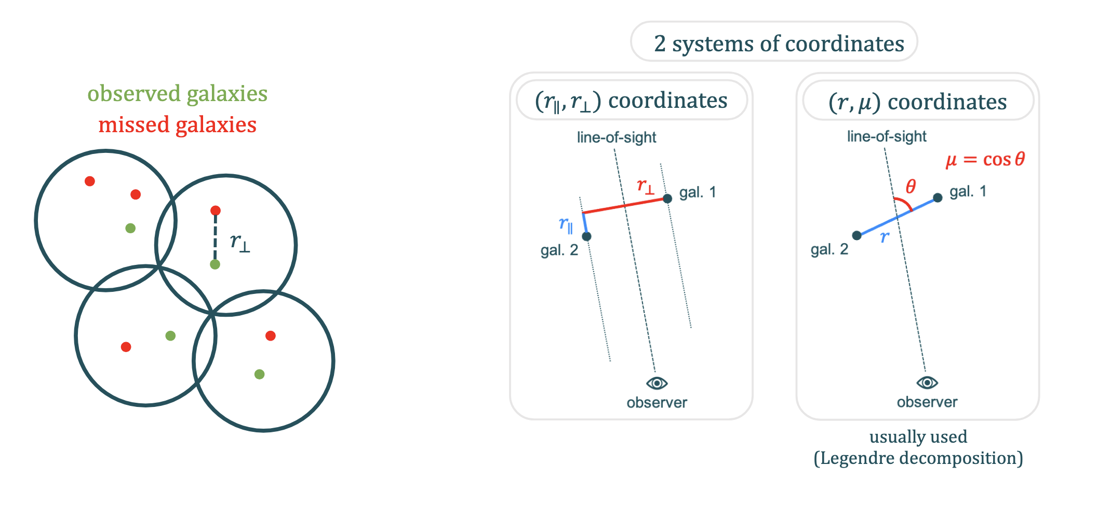
Catalog Systematics: Fiber Collisions
Credit: Mathilde Pinon

Slide 10
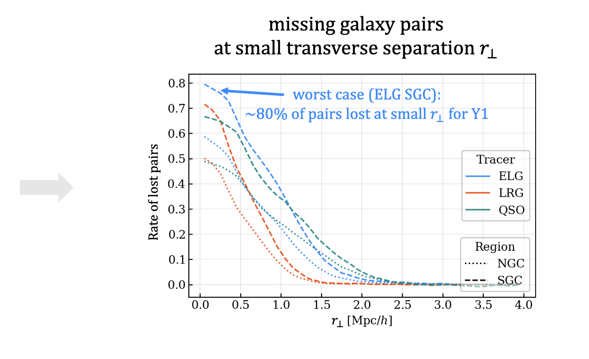
Catalog Systematics: Fiber Collisions
Credit: Mathilde Pinon

Slide 11
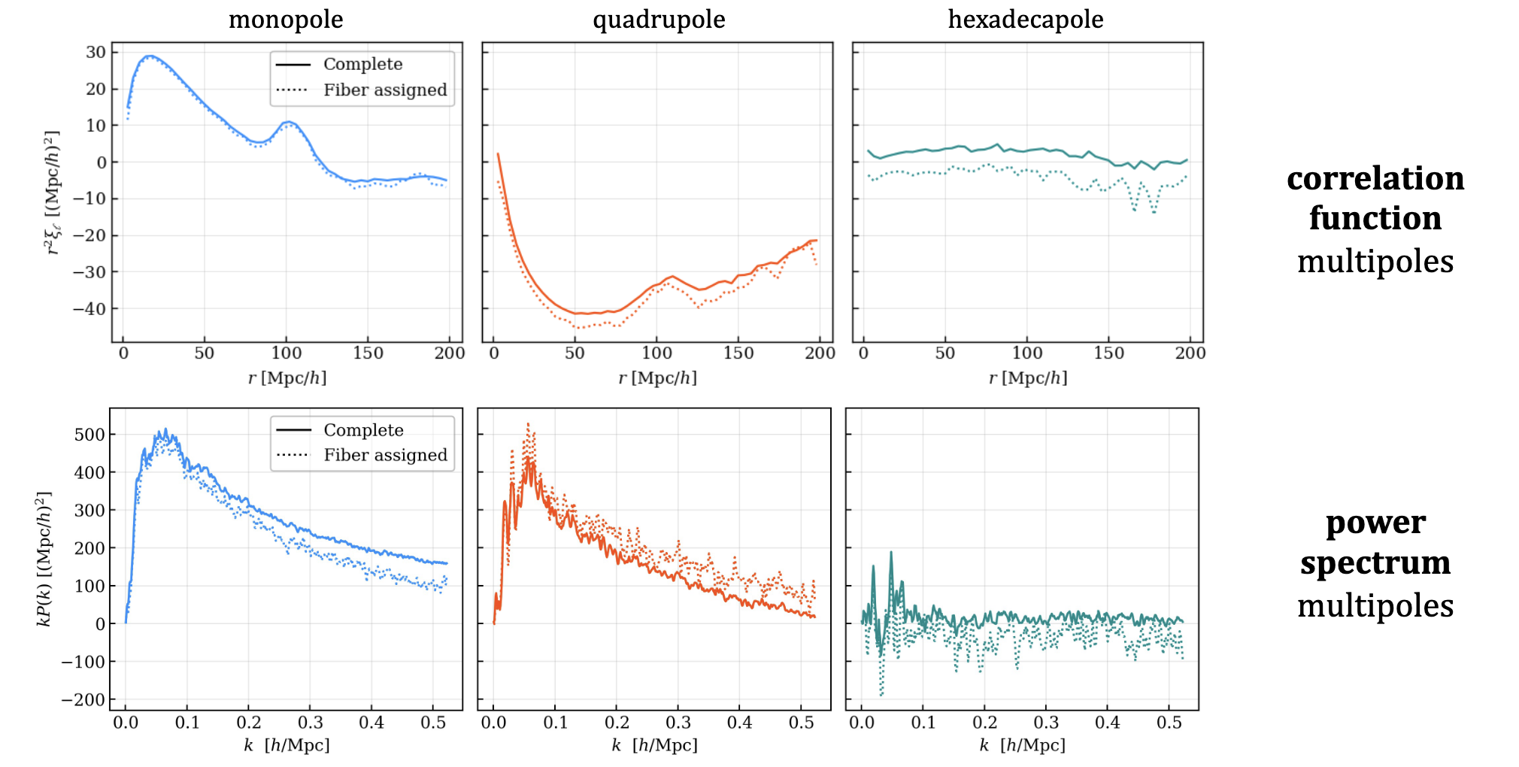
Catalog Systematics: Fiber Collisions
Pinon+2025

Slide 12
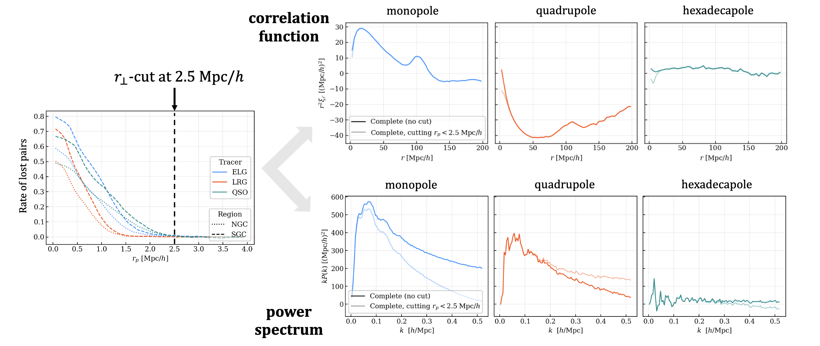
Catalog Systematics: Fiber Collisions
DESI2025: modify 2-pt estimators by removing all galaxy pairs at small transverse separation
→ must also be accounted for in theoretical modeling
Note: does not generalize to beyond-2pt summary statistics
Pinon+2025

Slide 13
Catalog Systematics
Imaging systematics and fiber collisions are just two prominent examples for catalog systematics – there are many more, known unknowns and unknown unknowns!
Quantifying the significance of a systematic effect and mitigating its impact may each amount to many person years of effort.
Increasing statistical precision of data sets puts more and more stringent requirements on systematic mitigation algorithms.
Note that requirements on systematics may differ for different summary statistics, and different science cases!

Slide 14
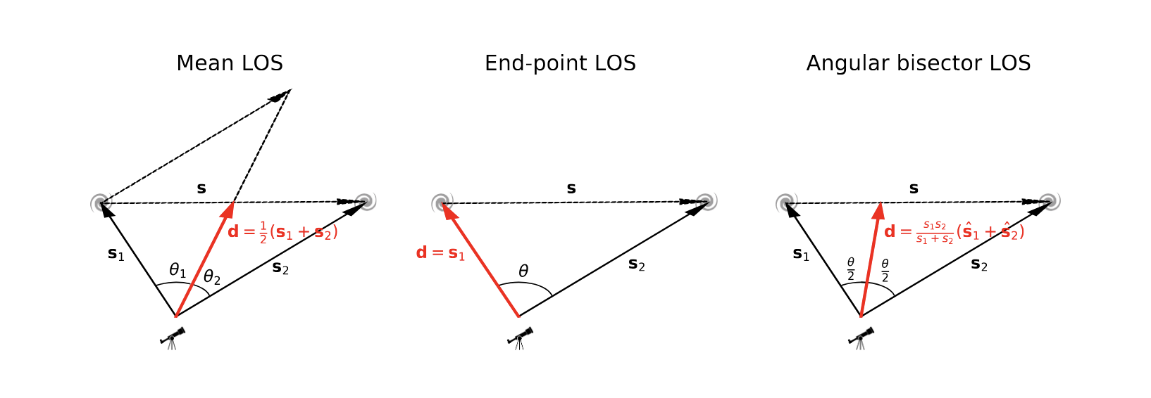
Power Spectrum Estimators
Power spectrum estimation in redshift space (Yamamoto+06)
On large scales, need to pay close attention to geometry + wide angle effects…
Alternatives to FKP & related estimators:
window-less quadratic estimators (Philcox 20ff)
spherical Fourier-Bessel decomposition (Binney&Quinn 91; Leistedt+13,…)

Slide 15
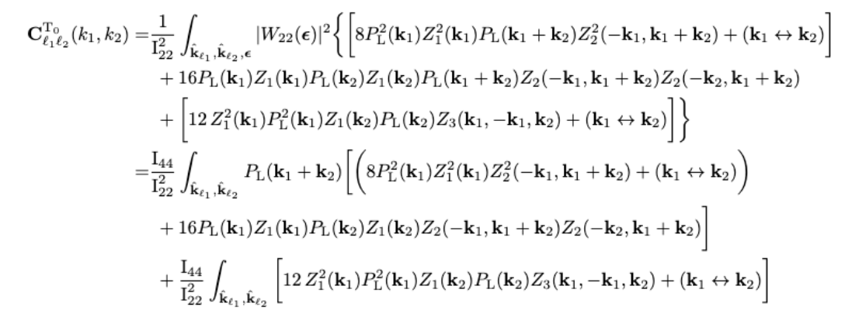
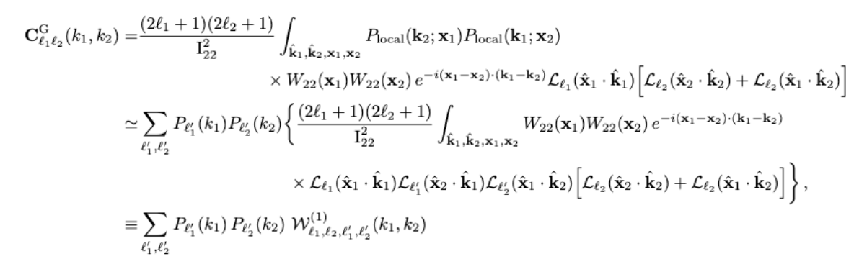
Covariance Details
Redshift-space galaxy power spectrum
Wadekar & Scoccimarro 2020
Projected 2pt statistics + clusters
Krause & Eifler 2017

