Slide 1
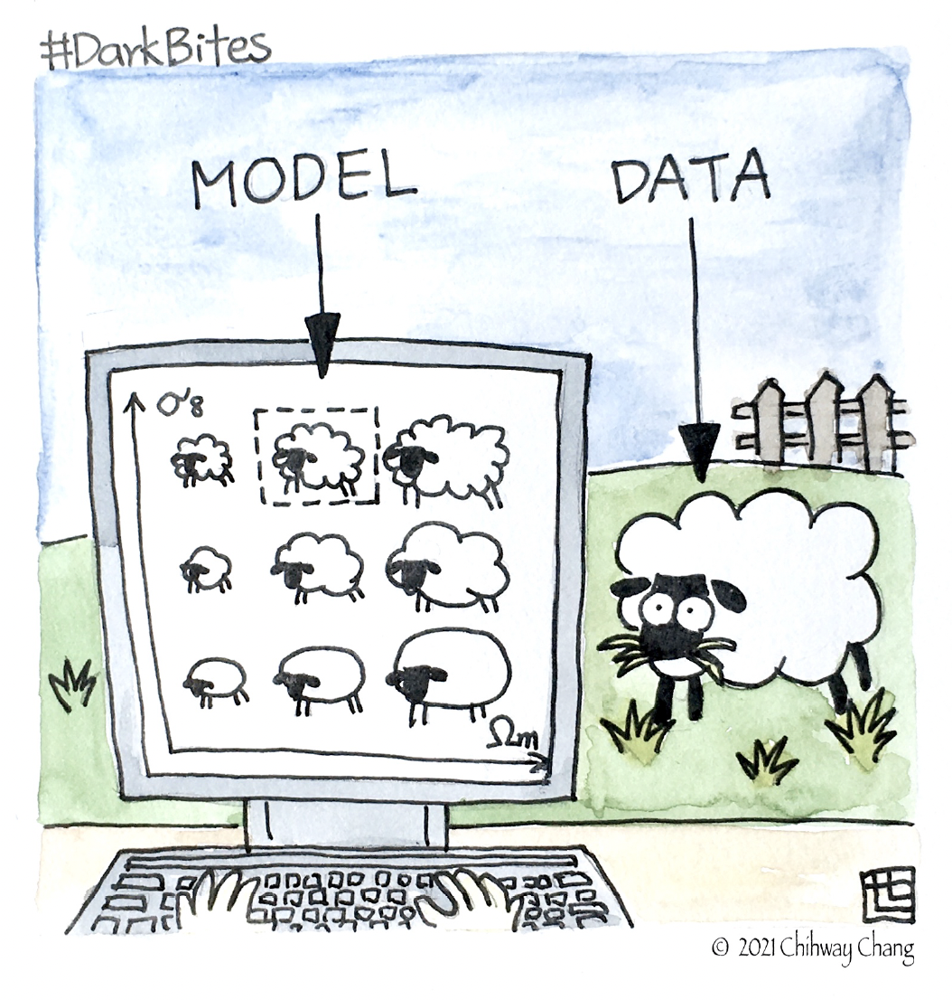
From Summary Statistics to Parameters

Slide 2
What is Probability?
Classical: Probability as frequency.
Probability of an event := the number of times the event occurs over the total number of trials, in the limit of an infinite series of equiprobable repetitions.
model is fixed, data are repeatable
Bayesian: Probability as degree of belief.
Probability is a measure of the degree of belief about a proposition.
data are fixed, model is repeatable
Trotta: Bayes in the sky, 0803.4089

Slide 3
Bayesian and Frequentist statistics
Frequentist: model is fixed, data are repeatable
Bayesian: data are fixed, model is repeatable
Say H0 = (72 ± 2) km/s/Mpc. Then:
Frequentist: Performing the same procedure with independent data will cover the real value of H0 within the limits 68% of the time.
(Limited practicability in cosmology…)
Bayesian: the posterior distribution for H0 has 68% if its integral between
70 and 74 km/s/Mpc. The posterior can be used as a prior for future analyses of independent data.

Slide 4
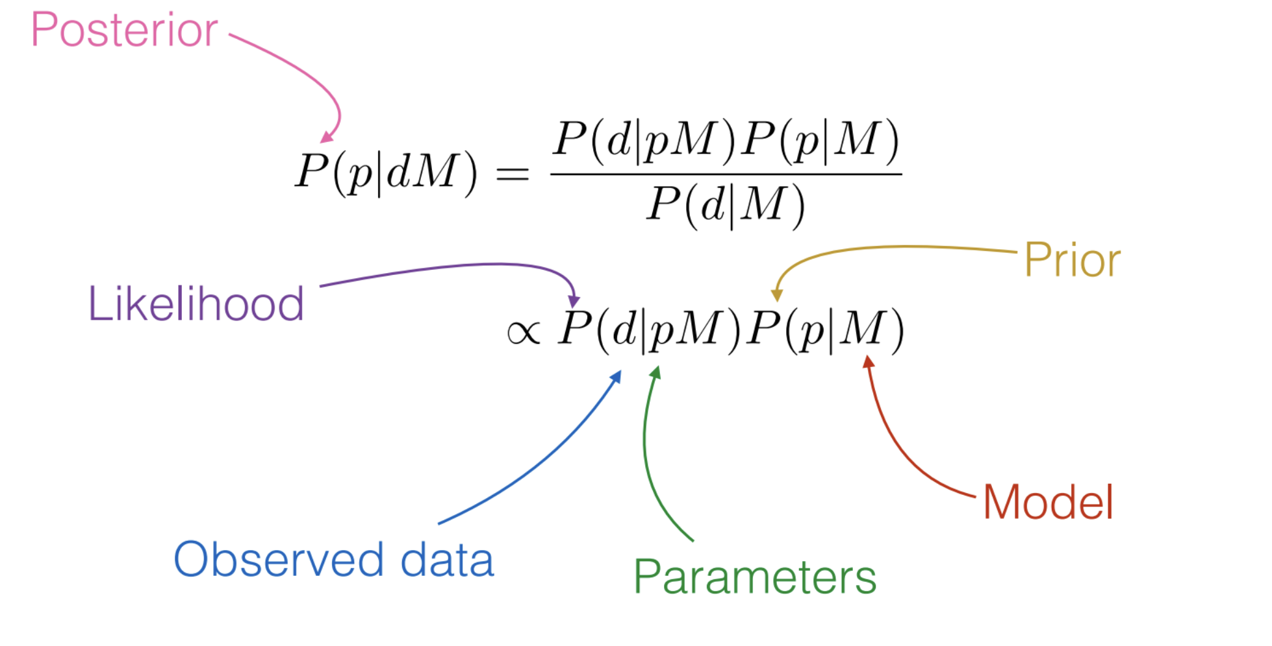
Bayesian Parameter Inference
Bayes Law:
What you know after the experiment (posterior)
= what you knew before (prior)+ what you learn (likelihood)

Slide 5
Priors
• Priors quantify what you knew about the parameters before the experiment
Theoretical limits, preferences, things that must be true (e.g., from previous experiments)
• In regions where the likelihood is zero your prior doesn’t matter for parameter estimation, but can for more advanced model selection
• It is common practice in cosmology to use uniform priors for most parameters
easy to write down, hard to justify
→Sensitivity analysis: change priors, check how your conclusions change!

Slide 6
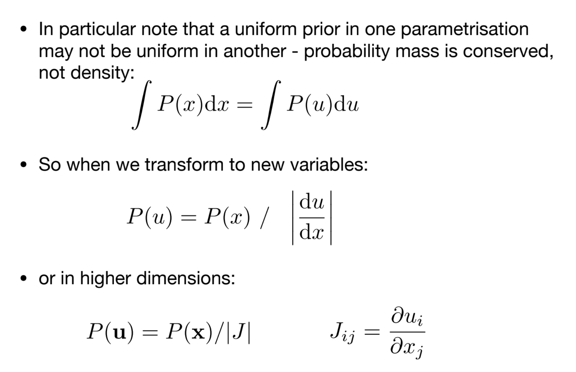
Transformed Priors

Slide 7
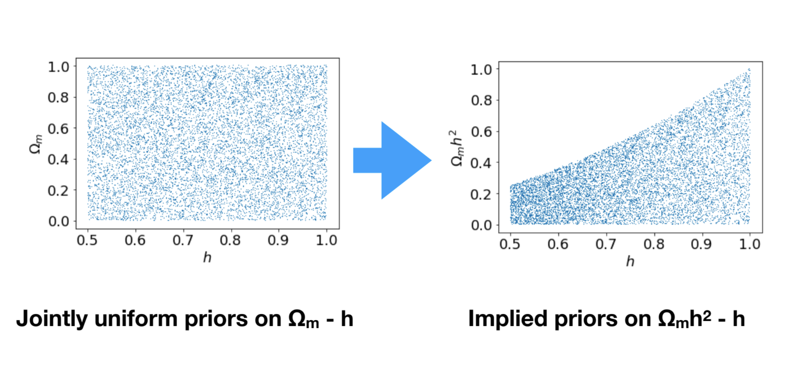
Transformed Priors

Slide 8
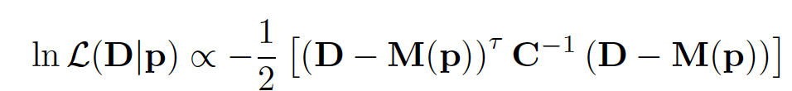
Likelihoods
Most existing cosmological analyses assume Gaussian likelihood
Assumes data points are Gaussian-distributed around the truth – reasonableness depends on type of measurement and sources of noise.
Alternatives:
• non-Gaussian likelihood (explored in e.g. Lin et al. 2019, Hall & Taylor 2022) – low on the priority list for 2pt statistics.
• Likelihood-free Inference (LFI), Simulation-base Inference (SBI)

Slide 9
Sampling the Likelihood
For most data sets, likelihoods cannot be written in a simple closed form equation.
We cannot just evaluate/plot posteriors directly, but instead musts indirect methods.
Most obvious solution is to evaluate at every point in the space, on a grid. Impossible for high-dimensional parameter spaces!
→ sampling methods like Monte-Carlo Markov Chains.
each element of Markov Chain depends only on the previous one
basic algorithm: Metropolis–Hastings
improved in widely used packages Emcee, Zeus
limitations: lack of definitiveness that the chain has converged

Slide 10
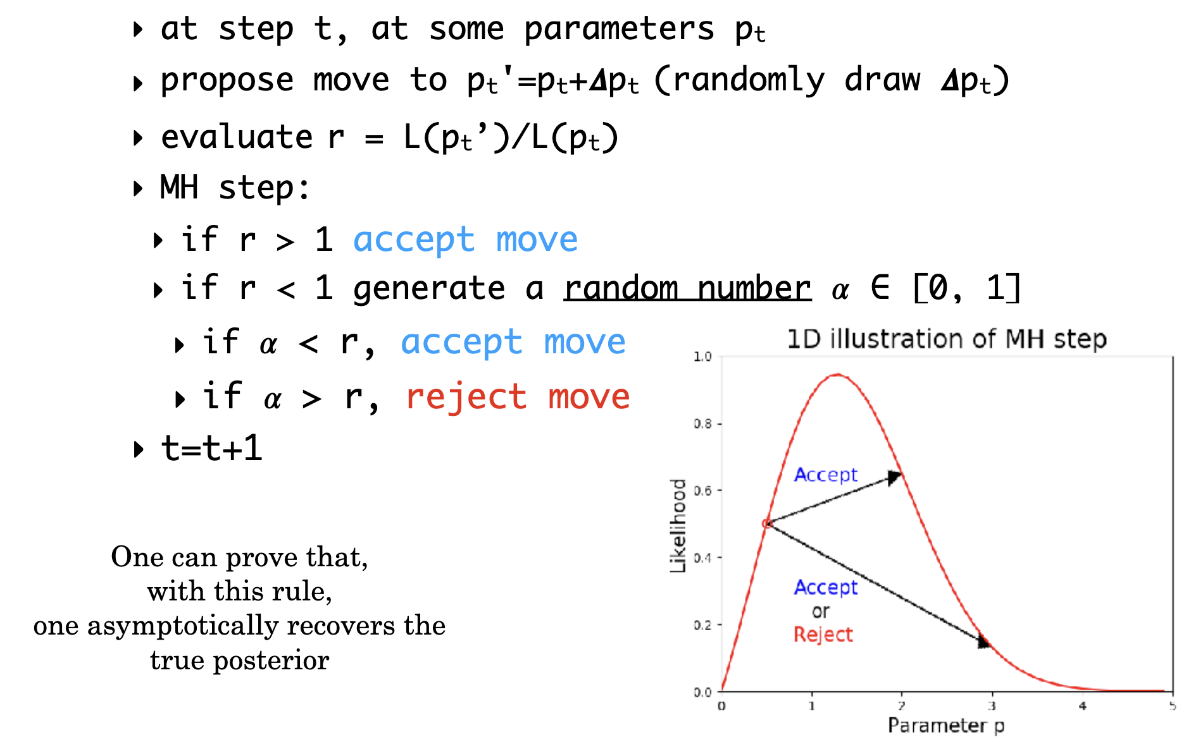
The Metropolis-Hastings algorithm
One can prove that this algorithm asymptotically recovers the true posterior

Slide 11
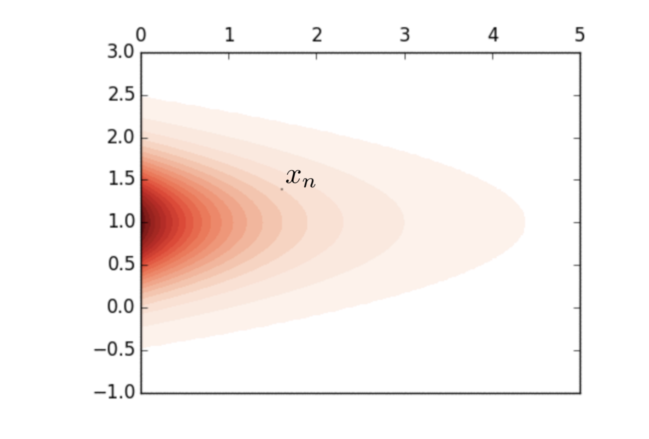
The Metropolis-Hastings algorithm

Slide 12
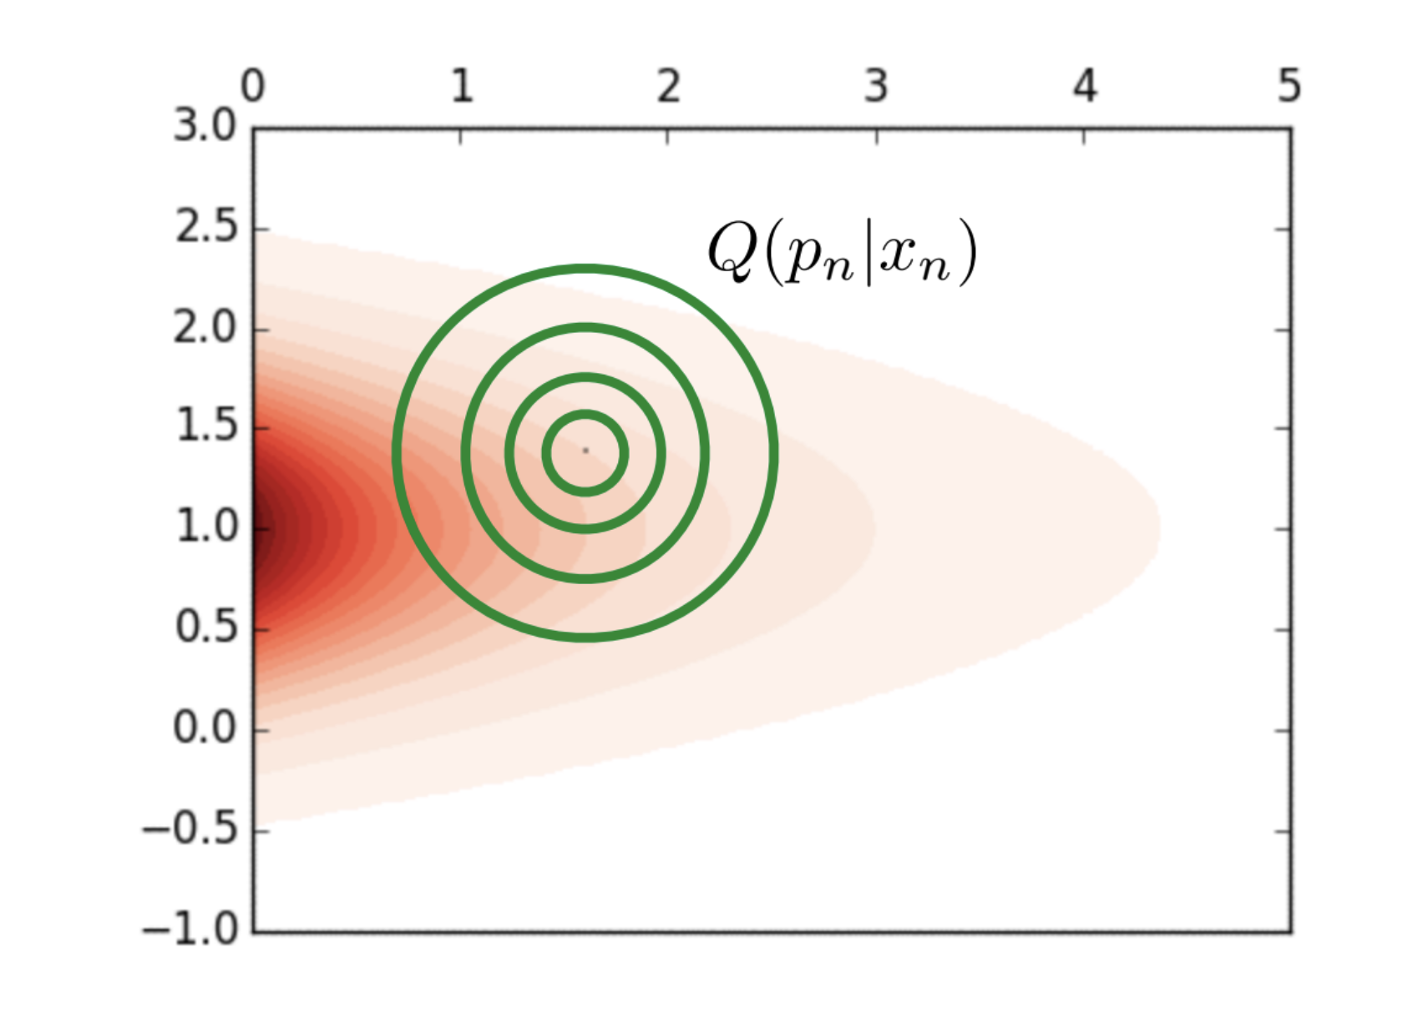
The Metropolis-Hastings algorithm

Slide 13
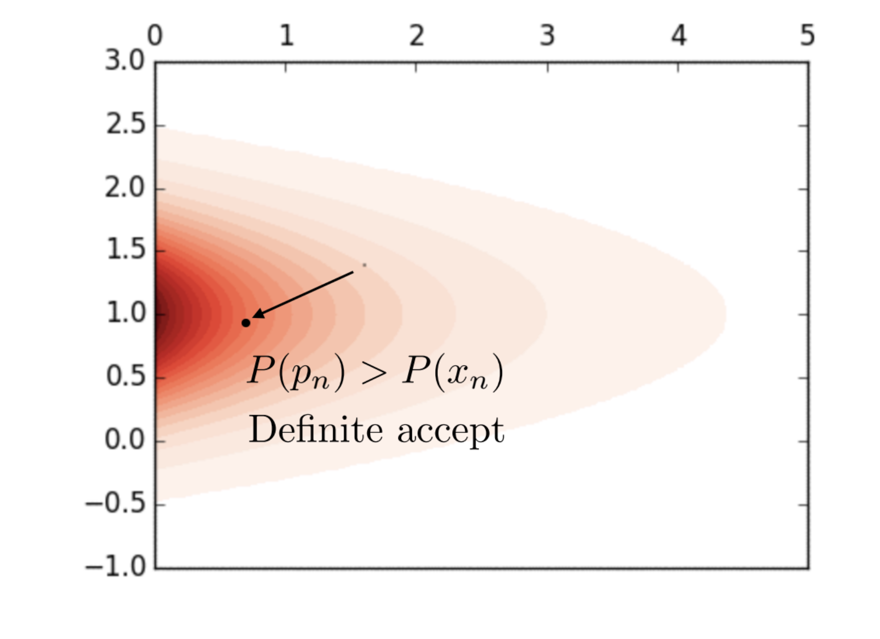
The Metropolis-Hastings algorithm

Slide 14
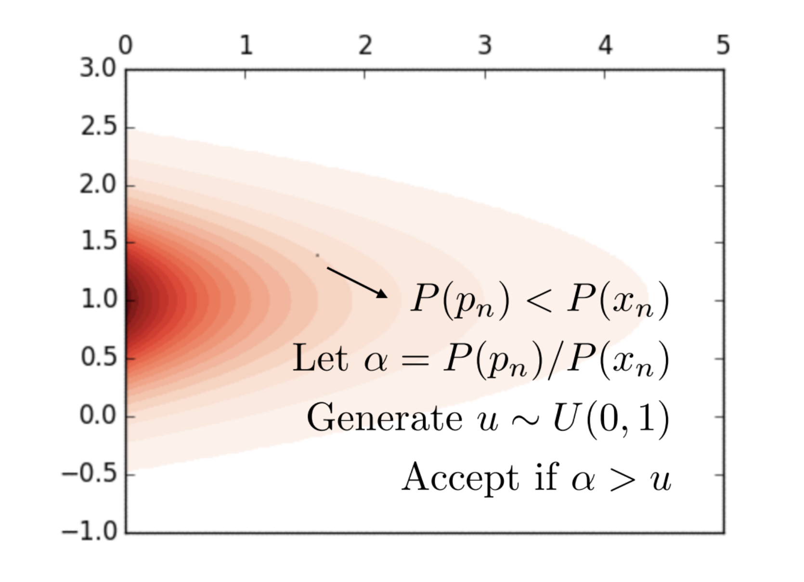
The Metropolis-Hastings algorithm

Slide 15
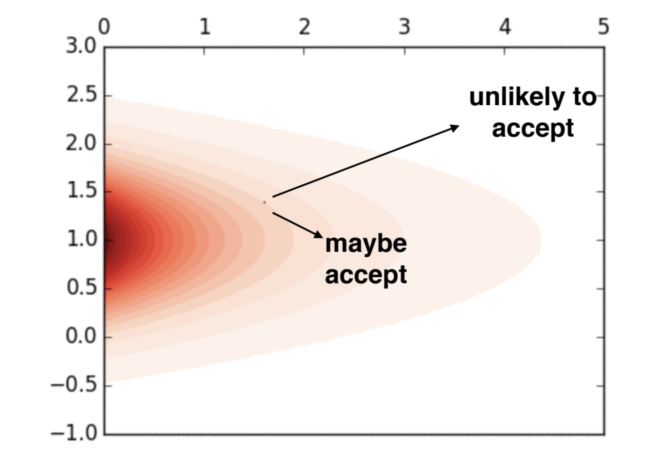
The Metropolis-Hastings algorithm

Slide 16
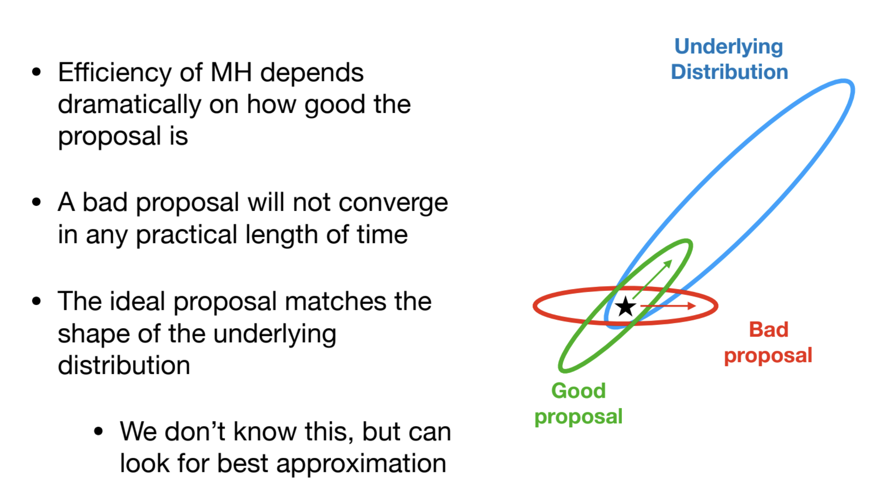
MCMC: Proposal Distribution

Slide 17
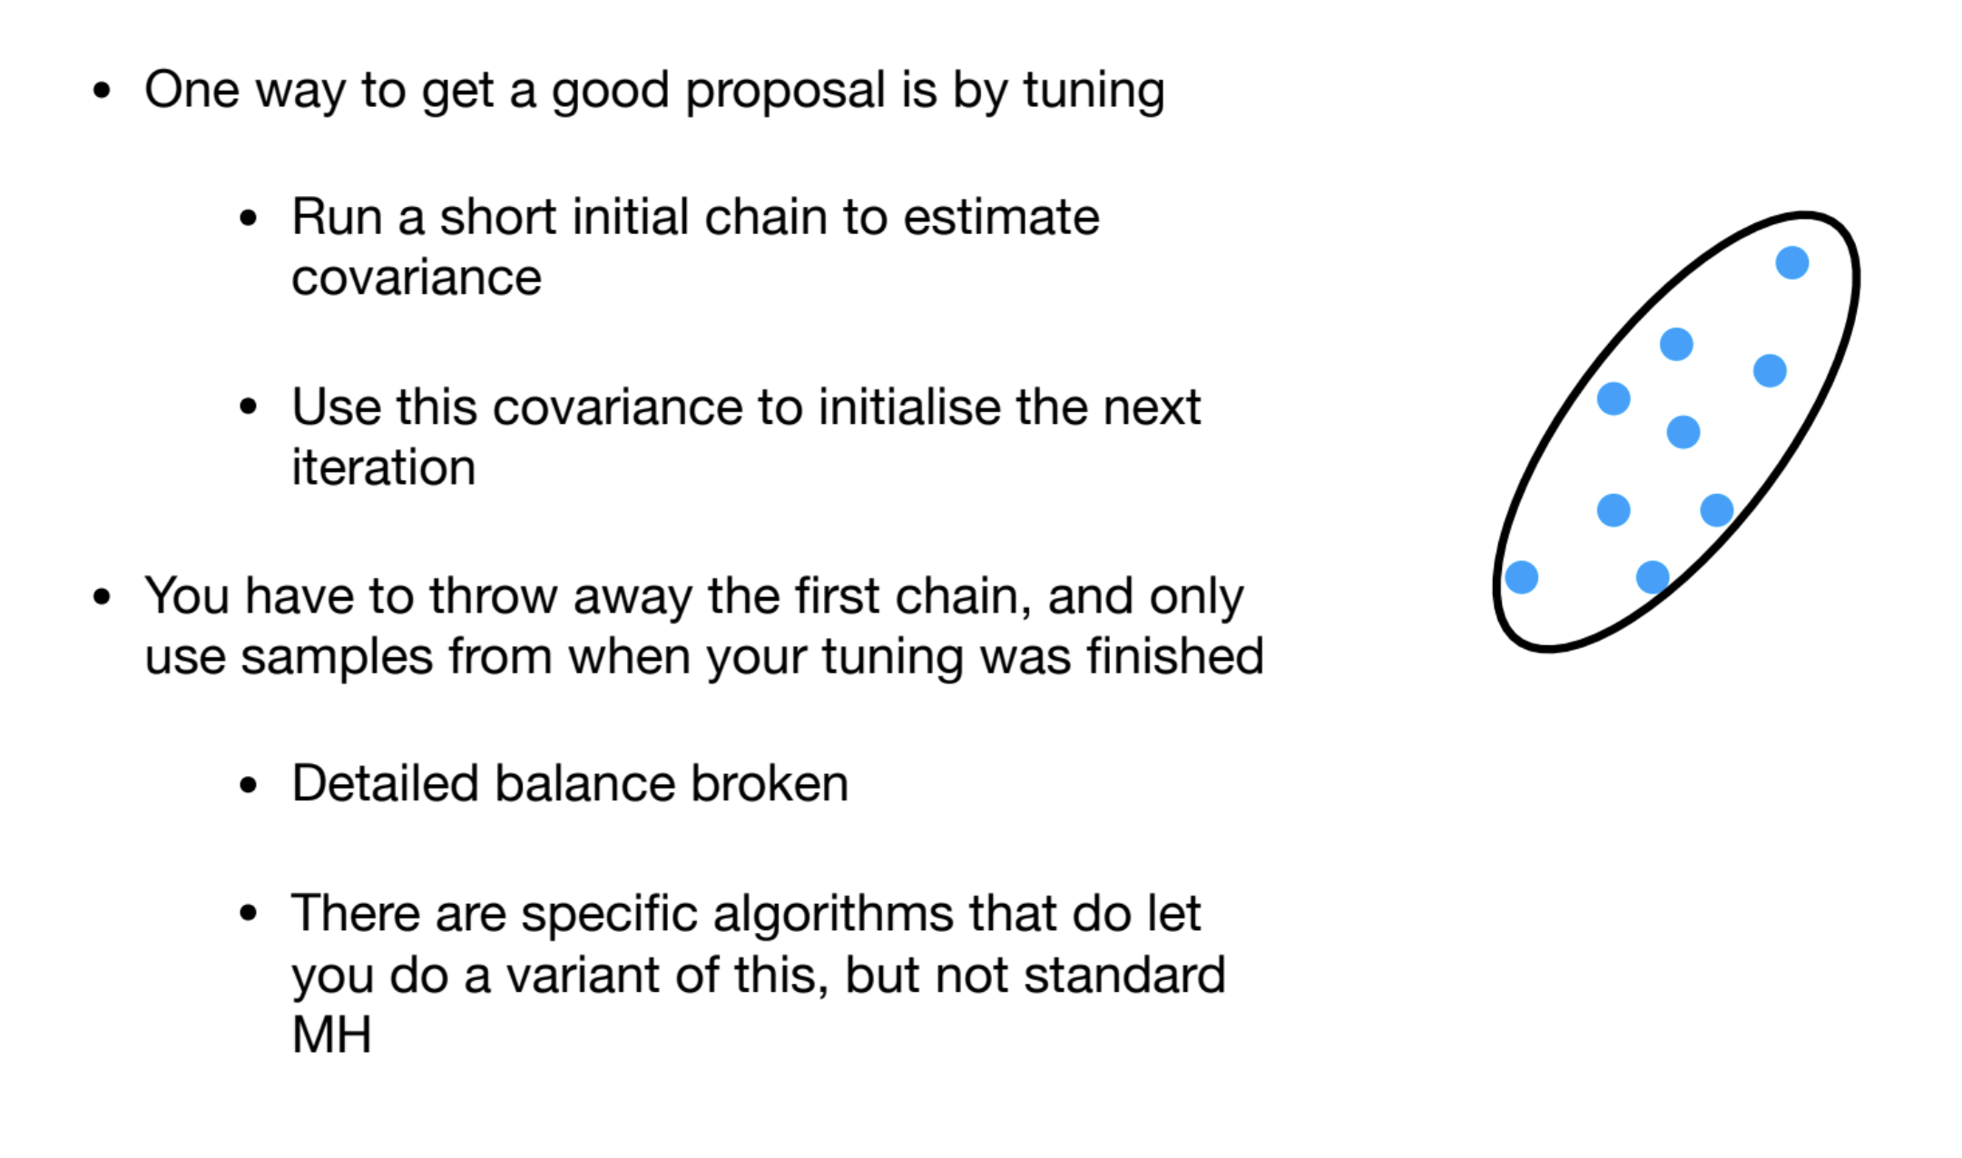
MCMC: Proposal Distribution

Slide 18
Intricacies of High-Dimensional Sampling
Nested sampling: starts with a large number of points, and repeatedly eliminates and find new replacement points
• e.g. Multinest, PolyChord
• calculate Bayesian evidence simultaneously
Choosing the right sampler to accurate sample your parameter space is an art - and hard validation work.

Slide 19
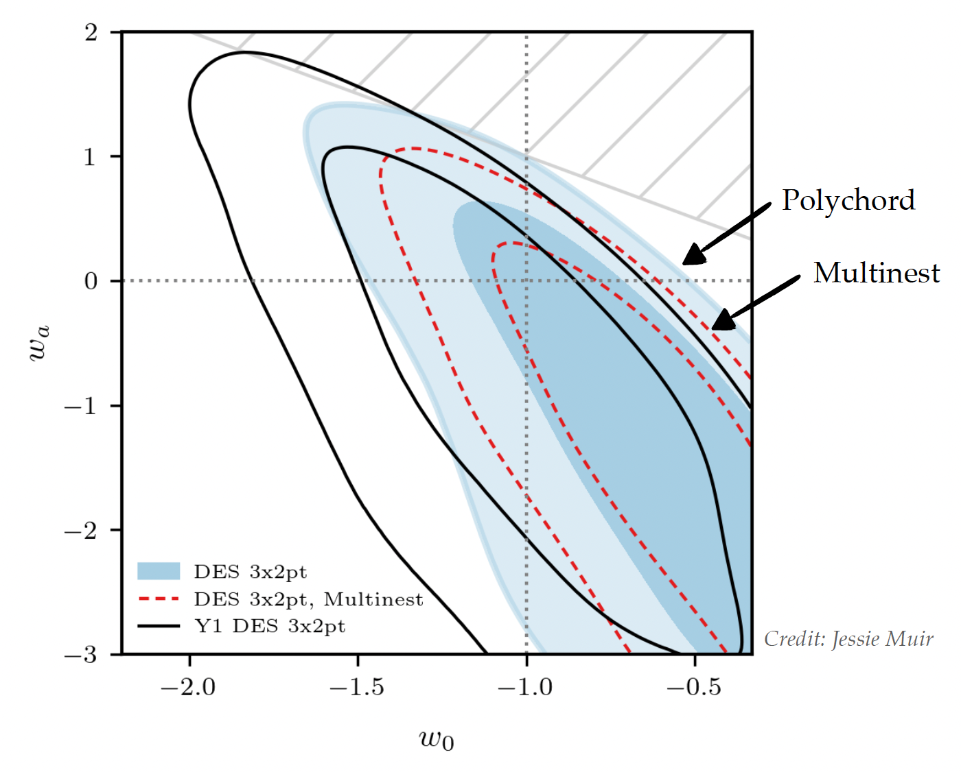
Intricacies of High-Dimensional Sampling

Slide 20
Interpreting chains
• Check to see if we actually found a good fit
• Quote the cosmological constraints, check to see if we’ve broken ΛCDM yet
• Compare with other similar measurements
• Compare with other independent measurements

Slide 21
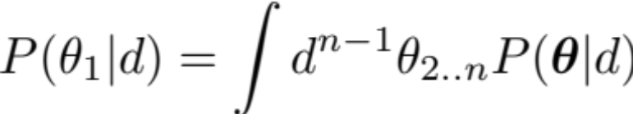
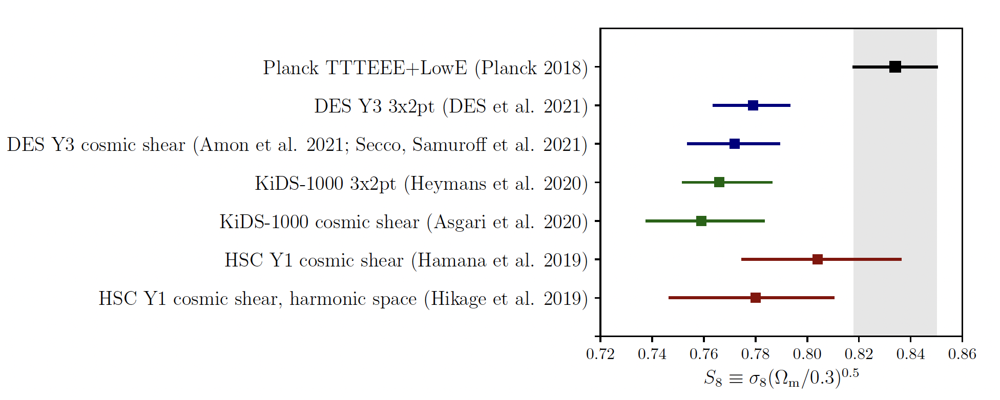
Interpreting chains
Can only plot 1D/2D results - report marginalized constraints.

Slide 22
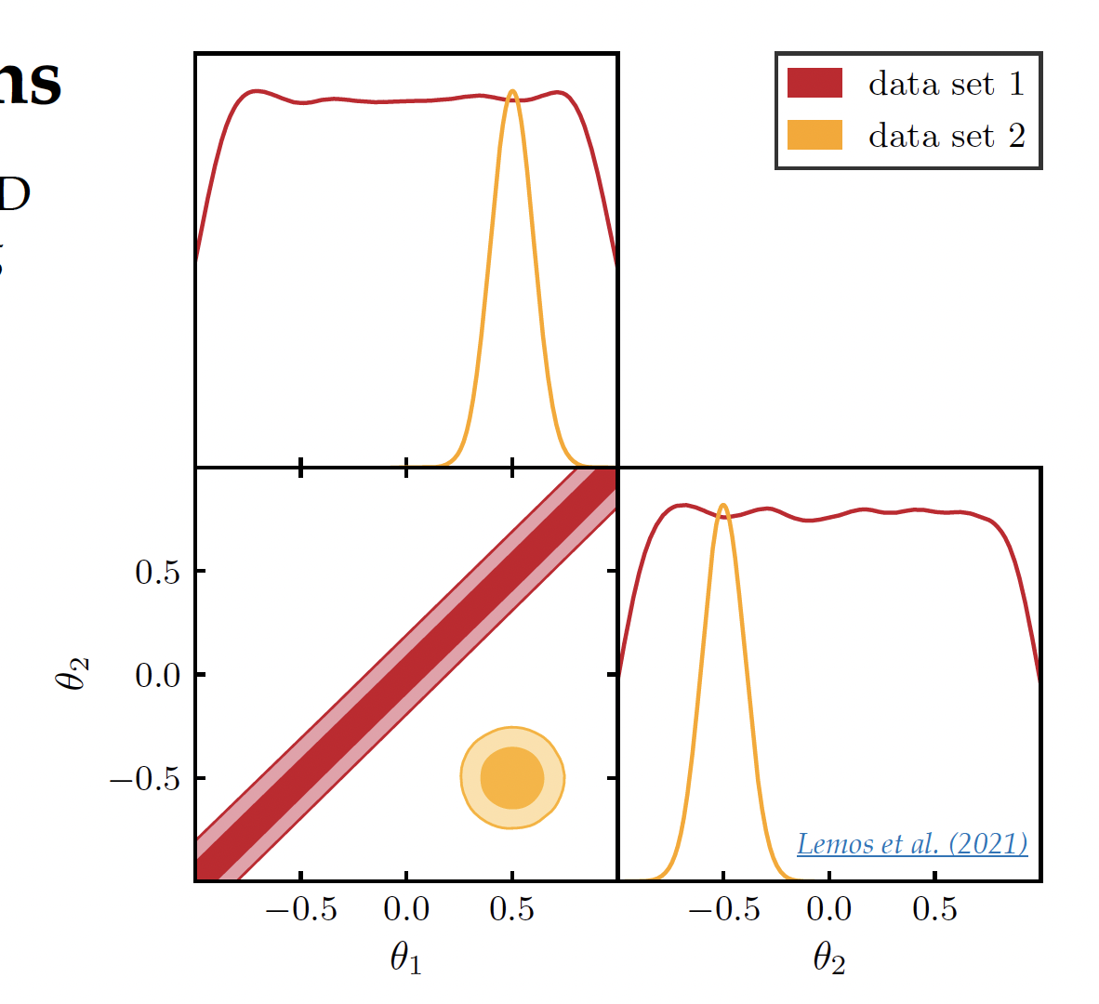
Marginalized Parameters

Slide 23
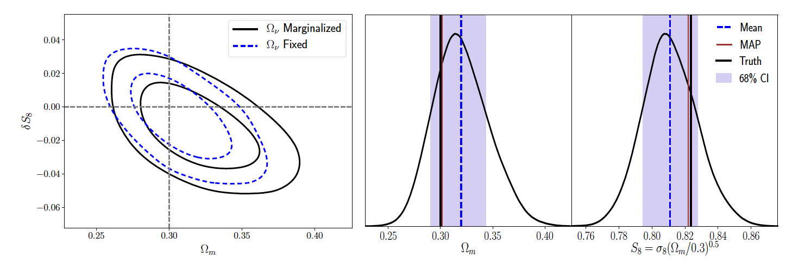
Beware of Projection/Prior Volume Effects!
Parameters of interest may be correlated with poorly constrained “nuisance parameters”.
Marginalization may introduce projection effects, skew marginalized posteriors away from best fit.
This effect can be characterized on synthetic data!

Slide 24
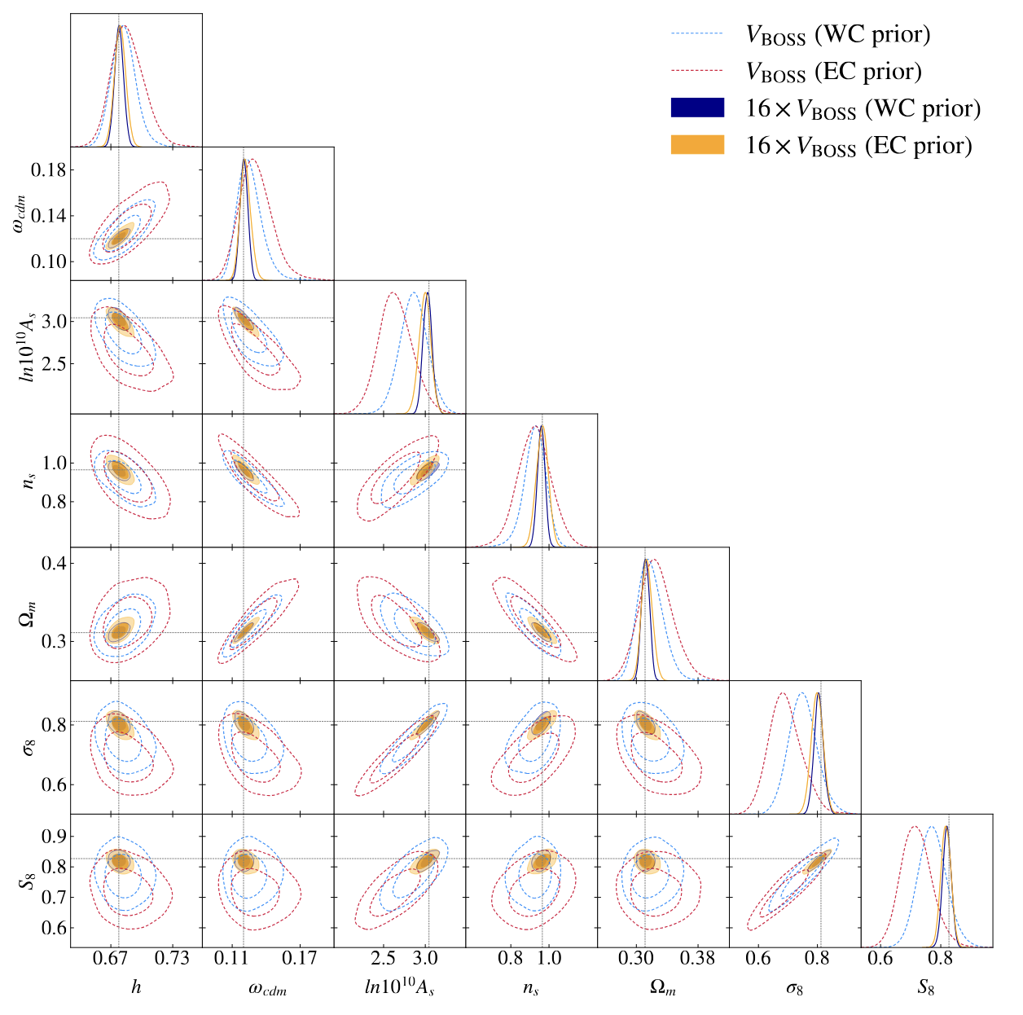
Beware of Projection/Prior Volume Effects!
Simon et al. 2023: EFTofLSS analyses of BOSS data with different nuisance parameter priors.

Slide 25

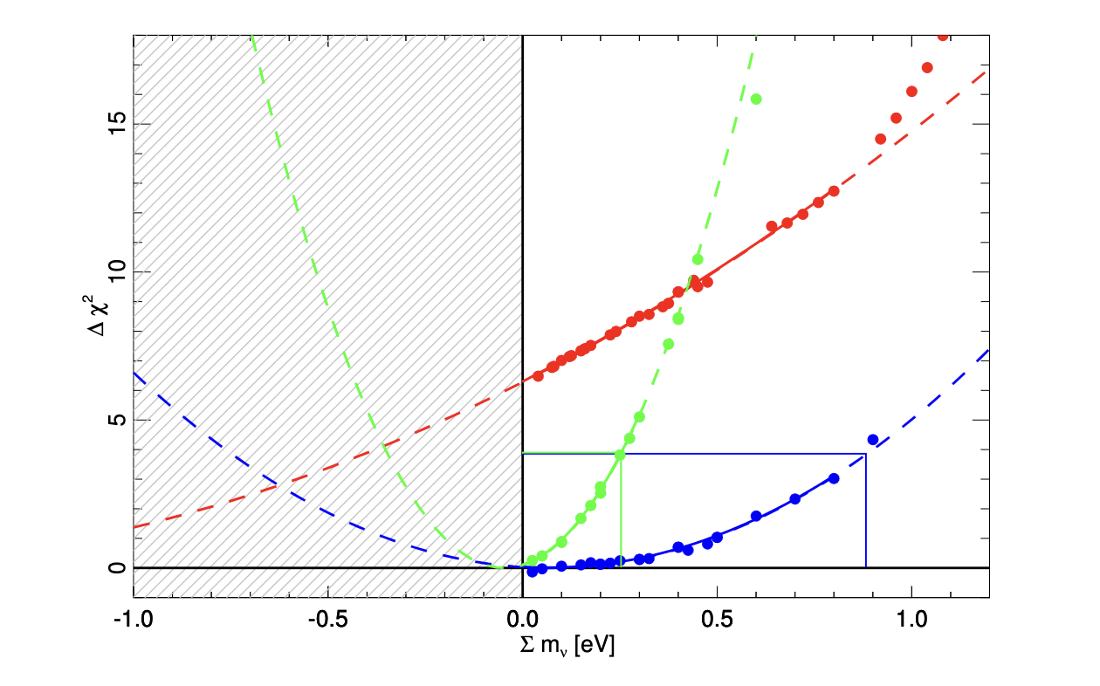
Profile Likelihoods
Frequentists’ way to treat nuisance parameters ν
CMB
CMB+lensing
CMB+lensing+BAO
Planck Profile Likelihood (37 parameters!) 1311.1657

Slide 26
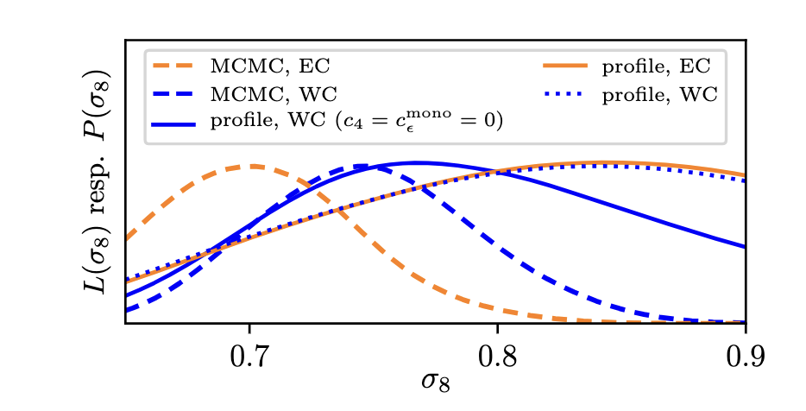
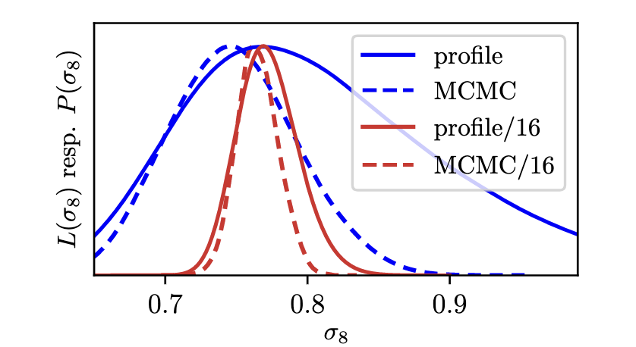
Profile Likelihoods
Holm+ 2023
Comparison of MCMC, profile likelihoods for EFTofLSS BOSS analyses
Improved constraining power will reduce difference between frequentist and Bayesian statistics.

Slide 27
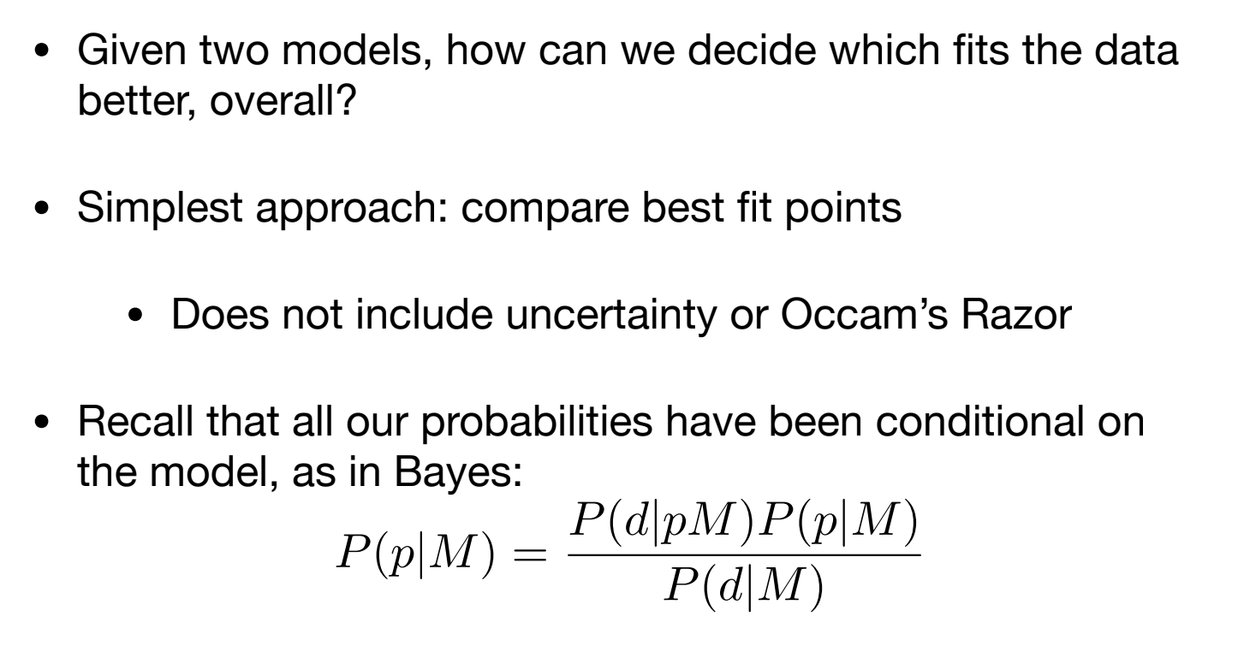
Model Comparison/Selection

Slide 28
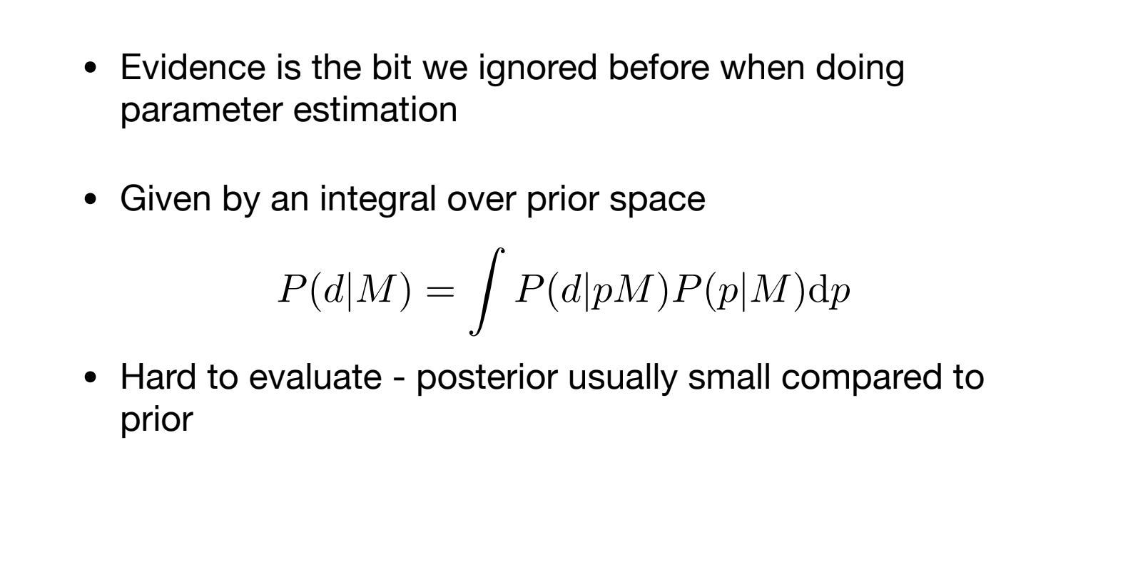
Model Comparison/Selection

Slide 29
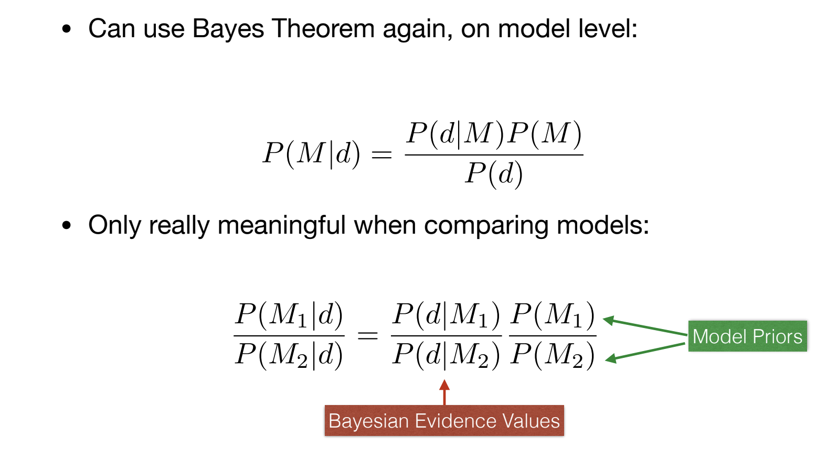
Model Comparison/Selection
Bayesian
Evidence Ratio
R=

Slide 30
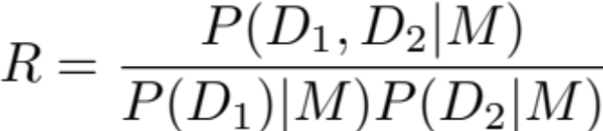
Bayesian Model Selection
Nominally, M₁ is favored with R:1 odds over H₂ .
Jeffreys scale R > 3.2 substantial evidence, R > 10 strong evidence
But: need to recalibrate for prior volume (→ numerous analyses of simulated noisy realizations)
For combining data sets:
M₁ = ‘data sets described by same model parameters’
M₂ = ‘data sets described by different model parameters
combine if R>[threshold for inconsistency]*
*agree on this before the analysis to avoid confirmation biases

Slide 31
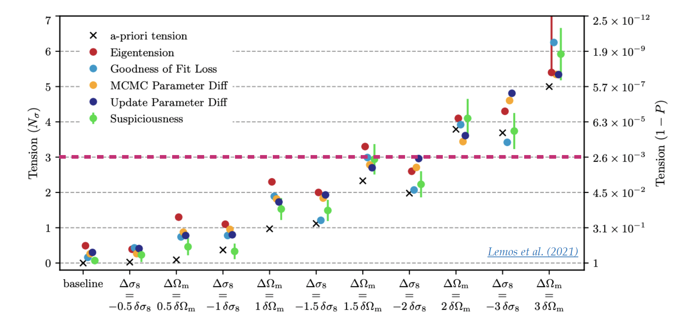
Comparing Experiments
We like to quantify to what extend our results are consistent with other experiments.
Complicated since we are comparing two chains in very high dimension, and the effect of priors are non-trivial.
In the past few years, many have devised certain statistics (“tension metrics”) to quantify how likely the two experiments are realizations drawn from the same underlying universe.

Slide 32
Model Incompleteness
a systematics free survey....
bias free parameter estimates with statistical uncertainty
So far, we haven’t discussed the model itself yet…
While details depend on the cosmological probe and survey, we can say that no model will perfect.

Slide 33
Model Incompleteness
a systematics free survey....
bias free parameter estimates with statistical uncertainty

Slide 34
Model Incompleteness
ignored systematic effect in analysis:
parameter bias
It’s research time!

Slide 35
Model Incompleteness
marginalize systematic effect, correct parameterization
remove parameter bias, increase uncertainty
It’s research time!

Slide 36
Model Incompleteness
marginalize systematic effect, correct parameterization
remove parameter bias, increase uncertainty
improve priors on
nuisance parameters

Slide 37

Model Incompleteness + Misspecification
marginalize systematic effect, imperfect parameterization
residual parameter bias, increased uncertainty
It’s research time!
We need more research…
And in the end, we may throw out some data points

Slide 38
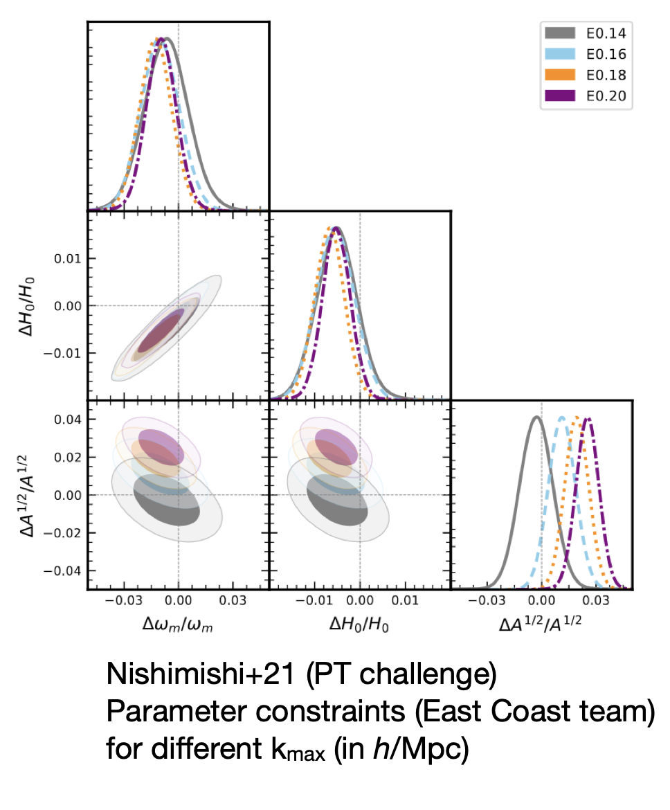
Scale Cuts
k_{max} largely determined by non-linear (bias, RSD) modeling accuracy
often determined by parameter drift tests (on mocks, if sufficiently accurate; on data, if allowed by blinding)

Slide 39
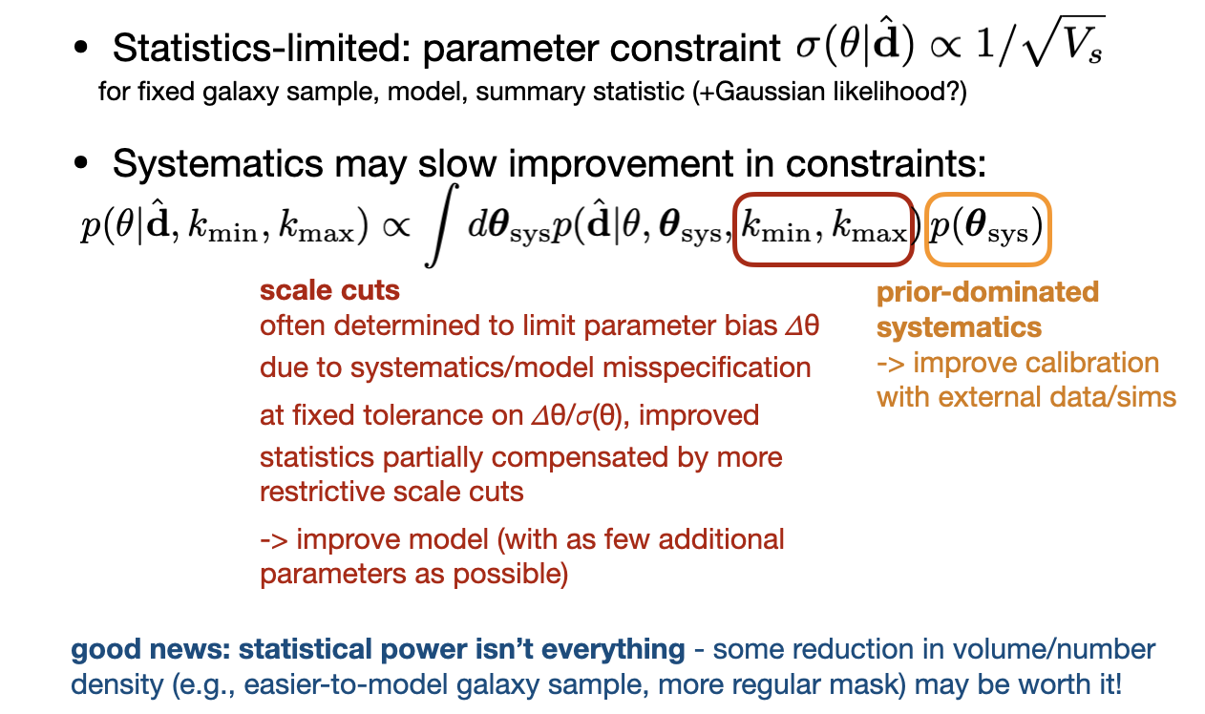
On Systematics-limited Constraints

