Slide 1



Studies towards a sub-100 ps time-resolved
LHCb RICH detector and a novel method for the primary vertex time estimation during LHC Run 4
Lorenzo Malentacca
Tutor: Gianluigi Pessina
Supervisor: Marta Calvi
CERN Supervisor: Floris Keizer
Coordinator: Stefano Ragazzi
Università degli Studi Milano-Bicocca, 16/02/2026

Slide 2
Outline
Introduction to the LHCb RICH detector and its upgrades.
Analogue and digital measurements on Multi-anode Photomultiplier Tubes (MAPMT).
Primary-vertex time reconstruction with the LHC Run 4 RICH detectors.
Flex-PCB prototype for operating SiPM arrays at cryogenic temperatures.
This work has been carried out within the CERN RICH group and the LHCb RICH collaboration.
Notes:
All three related to the upgrades of the RICH detectors with particular focus on the integration of picosecond timing information

Slide 3
LHCb experiment
Forward spectrometer at LHC.
Optimised for heavy-flavour production (b, c hadrons).
Physics goal:
Precision measurements of CP violation and
rare decays.
Sensitivity to physics beyond the Standard Model.
LHCb Upgrade II to cope with the increased luminosity in LHC Run 5 (2036 – ).
Higher particle multiplicity and fluence.
Many sub-detectors will improve their granularity and introduce picosecond timing information.
The current LHCb Upgrade I detector

Slide 4
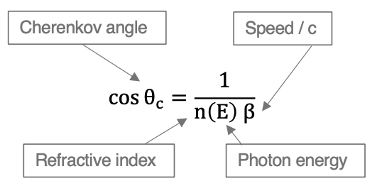
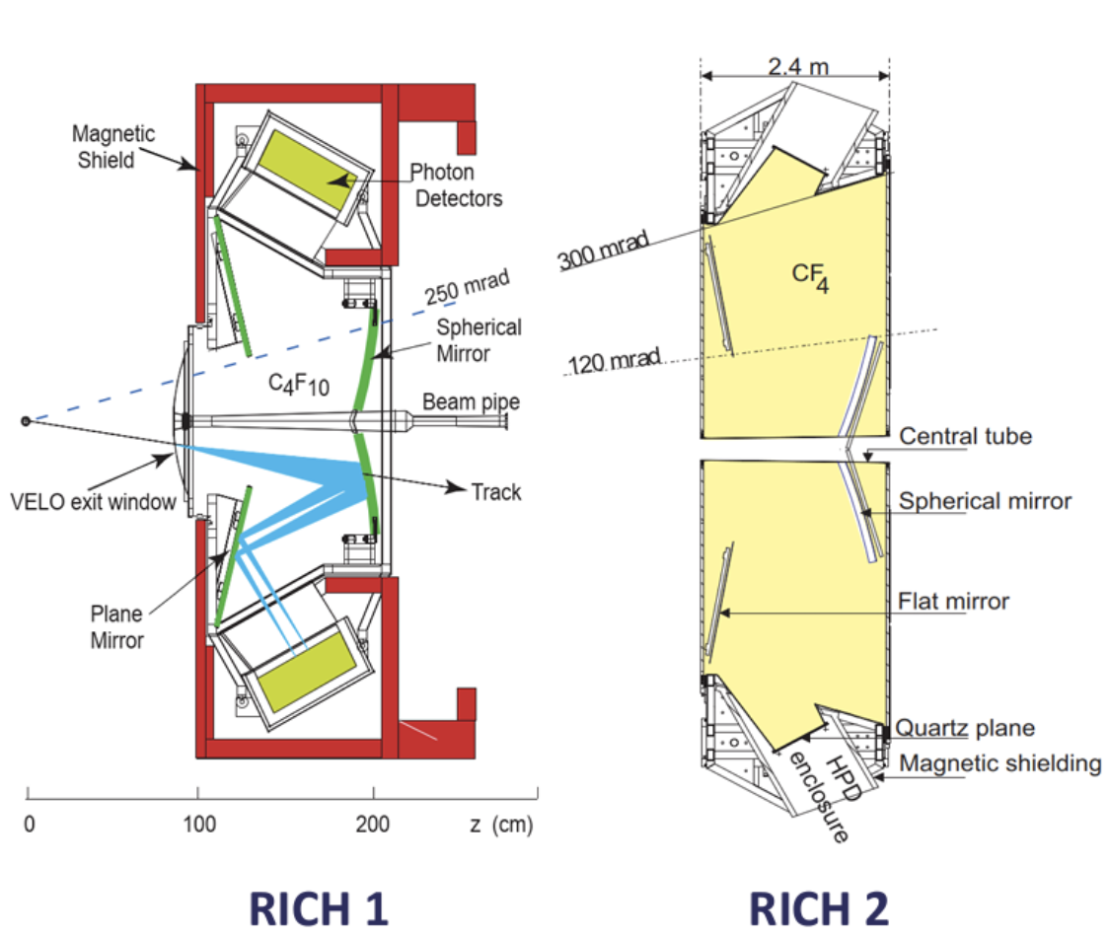
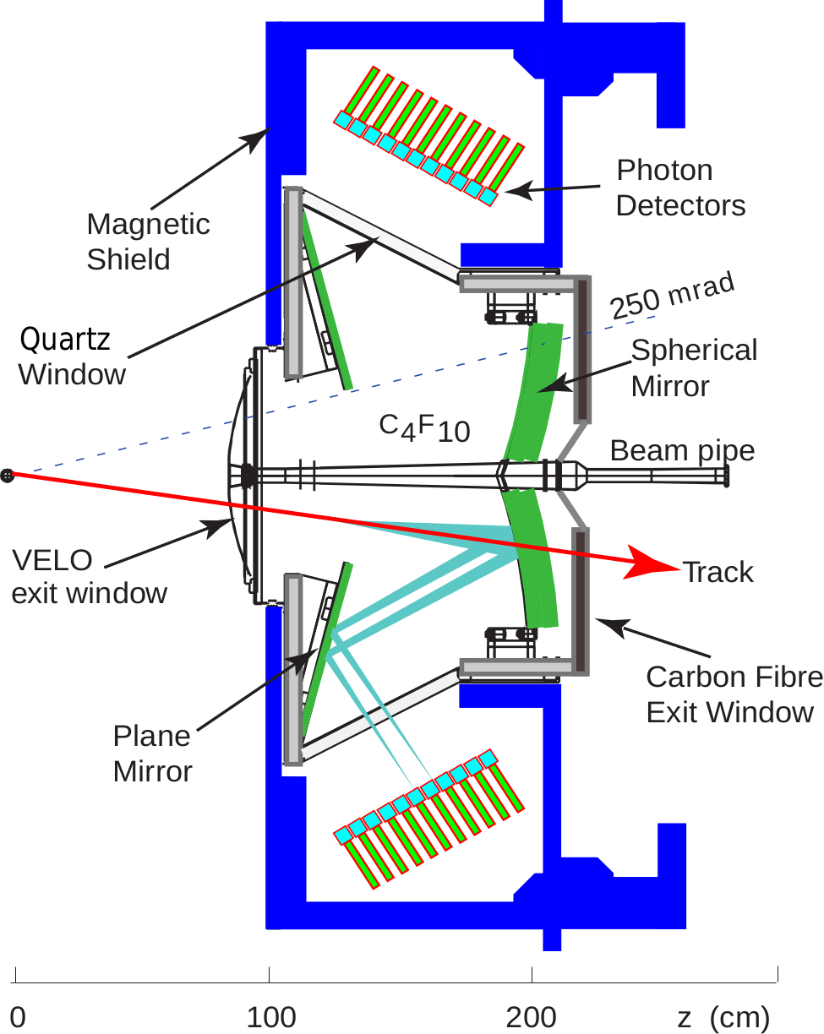
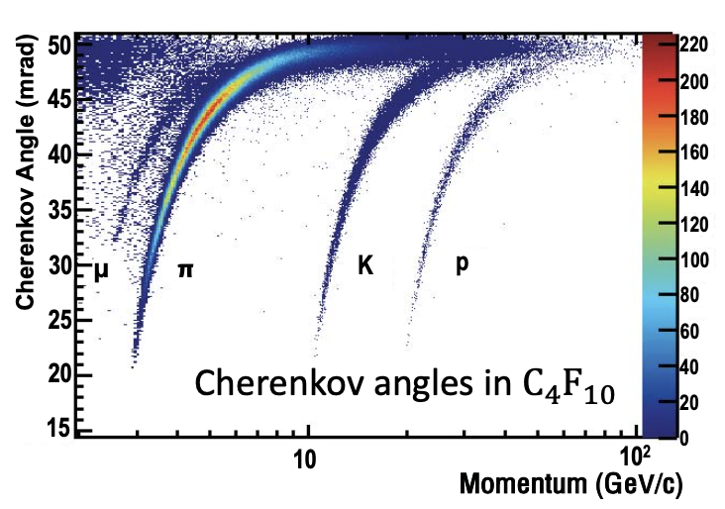
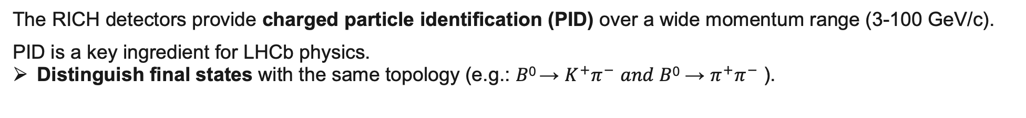
LHCb RICH detectors
m = p / 𝛾βc
From tracking
The RICH detectors provide charged particle identification (PID) over a wide momentum range (3-100 GeV/c).
PID is a key ingredient for LHCb physics.
Distinguish final states with the same topology (e.g.: 𝐵⁰ → $K^{+}{\text{π}}^{−}$ 𝑎𝑛𝑑 𝐵⁰ → ${\text{π}}^{+}{\text{π}}^{−}$ ).
Notes:
The Cherenkov light emitted by the particles in the radiators is directed by an optical system toward the photodetector planes.
The reconstructed angle, with the momentum from the tracking, is used to identify the particle mass.
PID key ingredient in LHCb to distinguish final states with same topology.

Slide 5
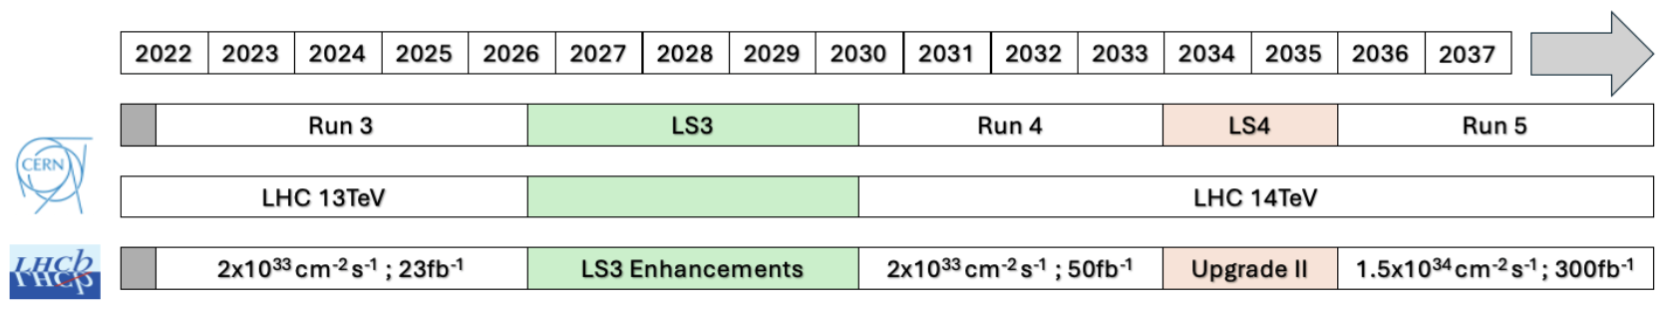
The luminosity challenge in the RICH detectors
Run 1 and Run 2
Run 3 and Run 4
Run 5
Higher signal pile-up is good for statistics but challenging for the RICH reconstruction.
Fast-timing information is key to reduce combinatorial background.
Notes:
We will discuss about how timing can be used in the rich detector to ‘clean’ the events from the combinatorial background and improve the PID performance

Slide 6
RICH detector upgrades
Back-end
LS3 enhancements
Back-end
Upgrade II
Back-end
LS3 Enhancements to introduce picosecond timing to the RICH detectors.
Novel FastRICH electronics with photon hit timestamp precision of ~25 ps. [DOI:10.1016/j.nima.2024.169664]
Timing into reconstruction with improved PID → novel PV t₀ estimation algorithm.
Leave untouched the photon sensor (MAPMT), optics and mechanics.
For Upgrade II RICH needs a new photon detector with better time resolution and improved granularity.
Strict requirements – no ‘perfect’ sensor off the shelf.
SiPM technology as a promising candidate.
Notes:
The upgrade is divided into 2 phases.

Slide 7
Multi-anode Photomultiplier Tube (MAPMT)
2-in.
1-in.
doi:10.1088/1748-0221/19/05/P05065
Super-bialkali photocathode with peak QE > 30 % at 350 nm.
Metal-dynode chain for amplification: gain in the order of 10⁶,
Broad single-photon amplitude spectrum (time-walk, no photon counting).
Pros: Low noise, radiation-hard, robustness.
Cons (specifically for Upgrade II):
Limited time resolution by their Transit-Time Spread (TTS).
Granularity lower limit at the moment ~2.88 mm.
Limited anodic current.

Slide 8
Analogue and digital studies on MAPMT single-photon response

Slide 9
Motivations for the MAPMT characterisation
MAPMTs are used in the current RICH detector and will be used in Run 4.
Well-established technology for RICH, providing stable and reliable operation.
Their single-photon response and timing performance is key for Run 4.
Pulse shape studies needed as input for the FastRICH ASIC design.
Time resolution will be the limiting factor for the RICH timing performance.
RICH2 photodetector plane with 1-in. and 2-in. MAPMTs
Notes:
From ls3 to upgrade II

Slide 10
Setup for analogue measurements
Fanout board
Pulsed laser with 50 ps time width (FWHM) → Single-photon regime.
Single-channel response recorded with a differential probe across a termination.
MAPMT Hamamatsu R13472 (1-in.) and R13473 (2-in.) tested.

Slide 11
Waveform fitting and amplitude analysis
1-in. MAPMT at –900V
Waveform fitted with Crystal Ball function after correction.
Amplitude, rise time and charge extracted from the fit.
Amplitude spectrum fitted with first-order approx. distribution to select photon events.

Slide 12

Rise time (10-90%) and gain
Rise time of ~640 ps for the 1-in. MAPMT and ~300 ps for the 2-in.
Gain defined as the mean of single-photon charge distribution.
Good agreement with Hamamatsu and QA values.
1-in. MAPMT at –900V
Gain
$$Charge = \frac{fit integral}{R_{t} ∗e}$$

Slide 13
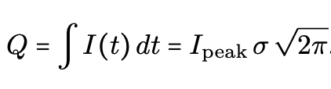
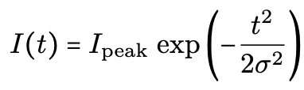
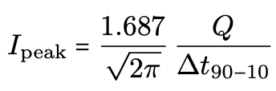
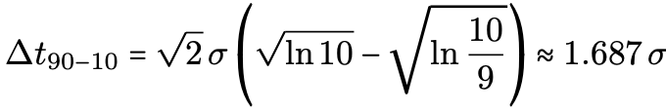
First-order approximation of anode current
Approximating the MAPMT pulse coupled to current readout electronics (Z_{in}~50Ω) as a Gaussian,
the expected peak current can be estimated:
(Gain)
Estimation was used as input for the design of the FastRICH analogue FE.
Targeted gain of 1.2 ± 0.3 Me in the RICH.
Considering a 3σ variation, the lower bound of the FastRICH input-current dynamic range was designed to be 50µA.

Slide 14
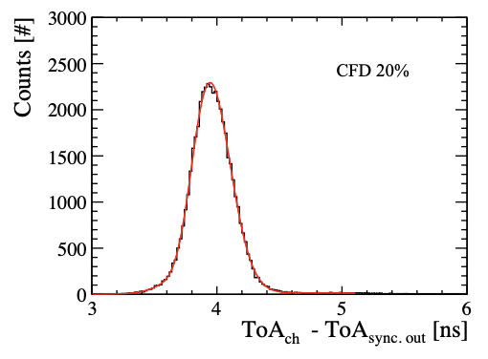
Transit-time spread (TTS) measurements analysis
1-in. MAPMT at –900V
In-software Constant Fraction Discrimination (CFD) to correct for time-walk.
Photon time-of-arrival (ToA) at a fixed % of the pulse amplitude.
TTS extracted as the FWHM of a double-Gaussian fit of
the ToA distribution.
Notes:
Single-photon time resolution of MAPMT dominated by transit time spread

Slide 15
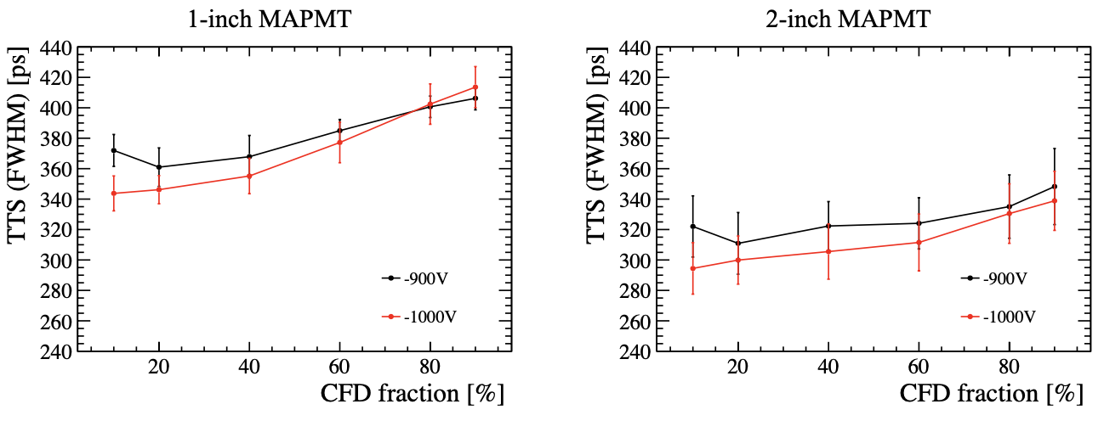
Transit-time spread (TTS) results
Higher gain results in better timing performance.
Best performance at -1000V and 10% CFD:
145 ± 5 ps for the 1-in. MAPMT and 125 ± 5 ps for the 2-in. (𝛔 = FWHM/2.355).
This sets the lower limit on the single-photon time resolution of the two devices.

Slide 16
Setup for digital measurements on the 1-in. MAPMT
Same laser illumination as per the analogue measurements.
Readout with FastIC coupled with TDC-in-FPGA with ~150 ps bins.
FastIC is the predecessor of the FastRICH.
Measurements used as reference for the RICH 2022 beam test campaign. [DOI:10.1088/1748-0221/20/03/P03034 ]

Slide 17
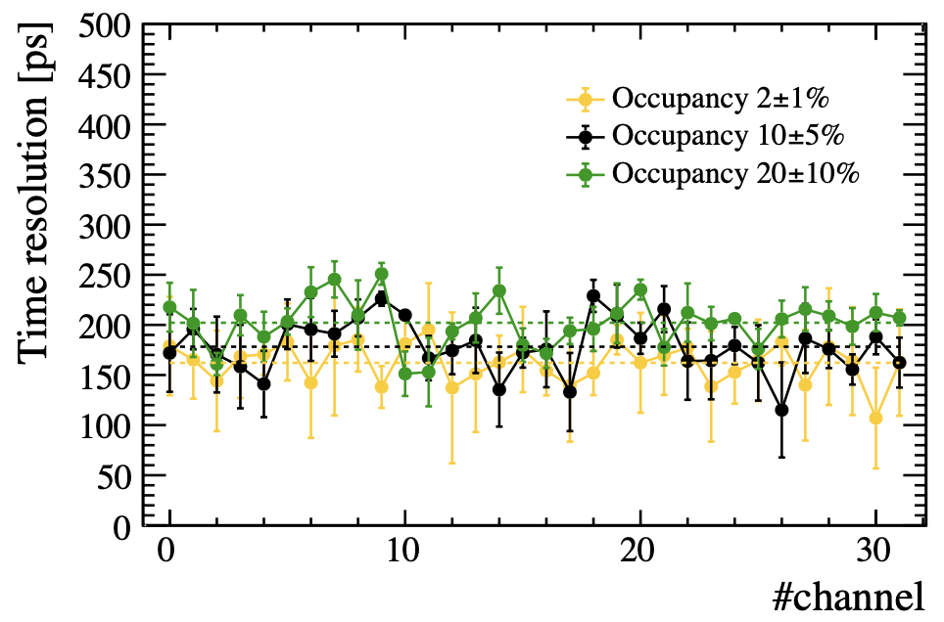
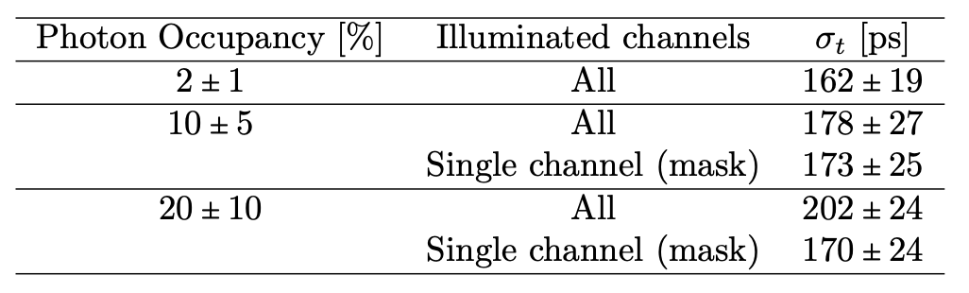
Single-photon time resolution (SPTR) results
DOI:10.1088/1748-0221/20/03/P03034 &
https://inspirehep.net/literature/2898078
SPTR consistent within uncertainty with the analogue results.
SPTR in good agreement with SPS beam test results 182 ± 24 ps (~20% occ.).
The worsening of the SPTR at higher occupancies can be explained by the increased hit rate.
Mask to illuminate one channel mitigates.
Notes:
Difference between this dataset and beam test is focalised ring vs wide laser spot.
Increase hit rate that enhances electronic switching noise in the FastICs and by higher cross-talk.

Slide 18
Conclusions on MAPMT studies
Analogue and digital analysis on MAPMT single-photon response.
Pulse shape characterisation for coupling with current readout electronics (FastRICH).
Timing performance to define the achievable resolution in the RICH Run 4 detector.
These results were also used in the integration of timing in the RICH Run 4 reconstruction.

Slide 19
Primary-vertex time reconstruction with the LHC Run 4 RICH detectors
… a key ingredient for a time-resolved RICH detector.
Notes:
The results of this studies have been used in the next section of this presentation, which describe a novel method I implemented for the primary vertex time estimation with the run 4 rich detector. Which is a key ingredient for a time-resolved RICH.
First let me introduce how the time information can be used to improve the detector performance.

Slide 20
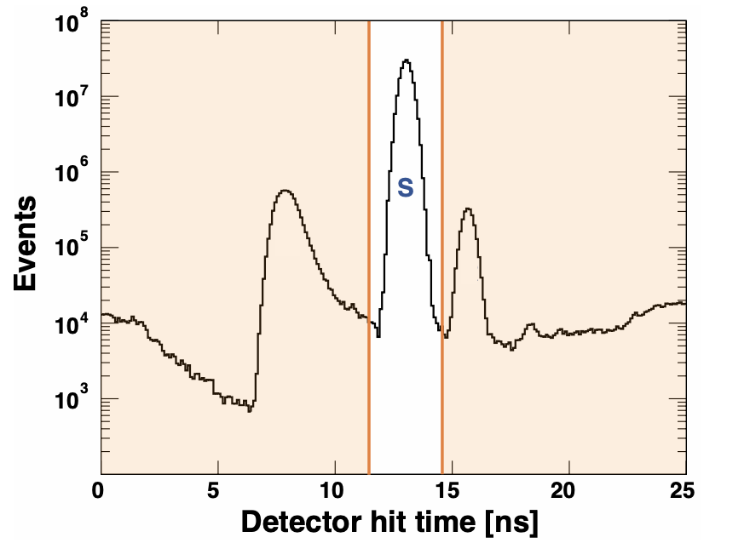
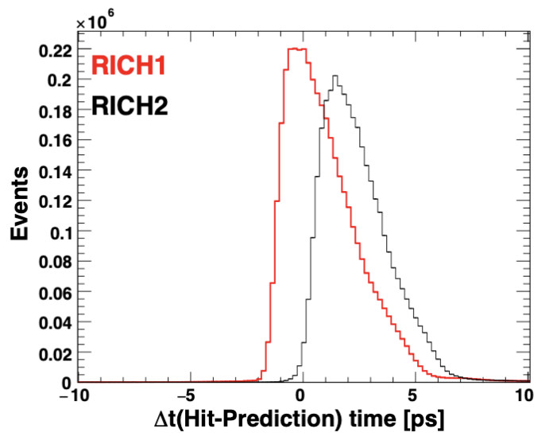
Time information in the RICH detectors
https://cds.cern.ch/record/2866493
Cherenkov signal peak (“S”) within a 25 ns bunch crossing.
Given prompt Cherenkov emission and detector geometry,
the ToA of the photons can be predicted with ~10 ps precision.
$$t_{PRED}=t_{PV}+t_{track TOF}+t_{photon TOP} (+ RICH 2 corr.)$$
DOI:10.17863/CAM.45822

Slide 21
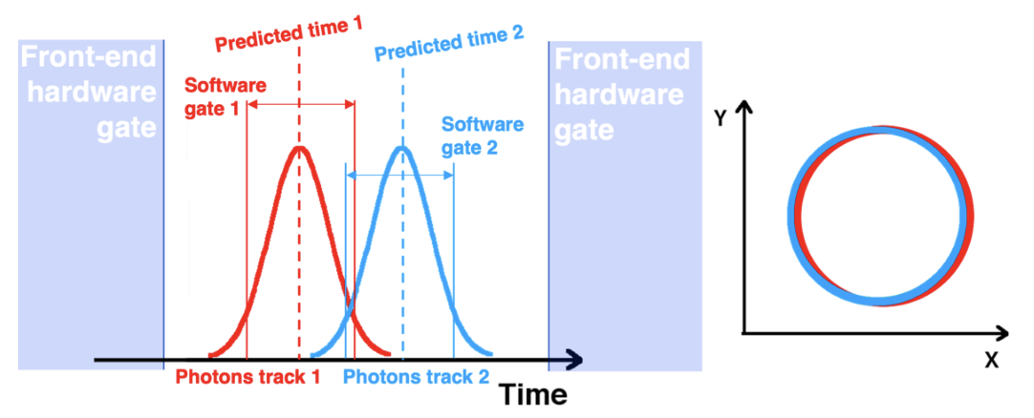
The use of timing for better detector performance
DOI:10.1088/1742-6596/2374/1/012074
Front-end gate at the ns level to reduce data throughput.
Software time gate around the predicted photon ToA to reduce combinatorial background and improve PID.
This gate width depend on:
Sensor time spread (optimal gate width = ±2𝜎sensor ). MAPMT spread ~ 150ps.
PV t₀ → Novel method to estimate PV t₀ with RICH standalone in Run 4.

Slide 22
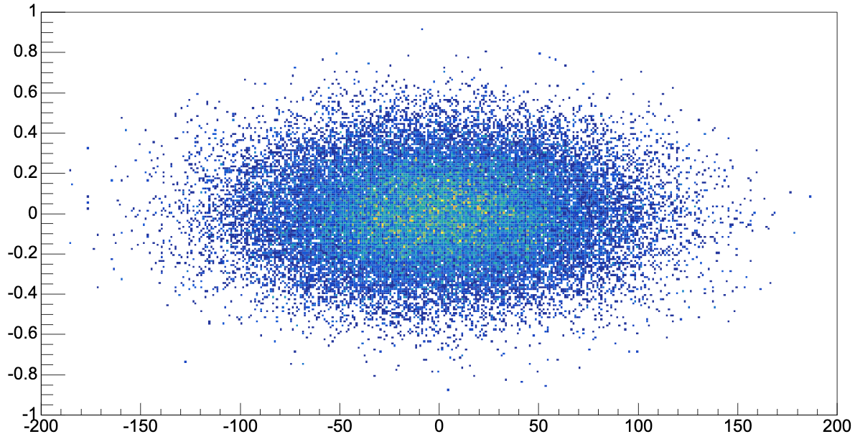
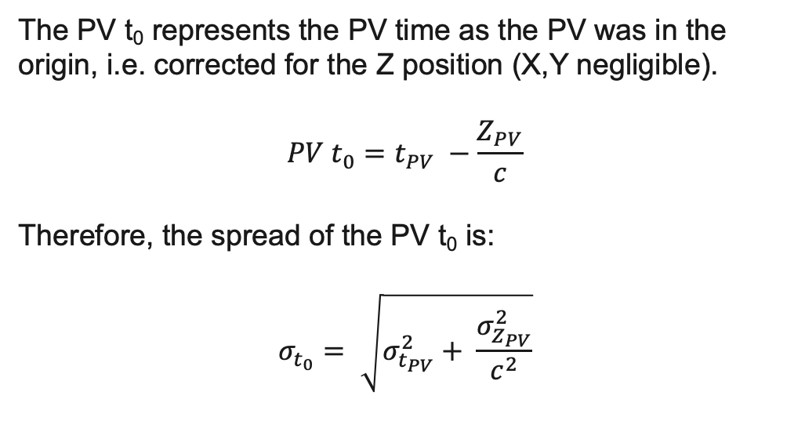

The PV t₀
10k bunch-crossing events
The PV t₀ represents the PV time as the PV was in the origin, i.e. corrected for the Z position (X,Y negligible).
$${PV t}_{0}=t_{PV} −\frac{Z_{PV}}{c}$$
Therefore, the spread of the PV t₀ is:
$$σ_{t_{0}}= \sqrt{σ_{t_{PV}}^{2}+ \frac{σ_{Z_{PV}}^{2}}{c^{2}}}$$
t_{PV} [ns]
Z_{PV} [mm]
In Run 4, $σ_{t_{PV }}\sim 200 ps$and $σ_{Z_{PV }}\sim 50 mm$ resulting in a $σ_{t_{0 }}\sim 260 ps$.
→ RICH-standalone method to estimate the PV t₀ to reduce this uncertainty.

Slide 23
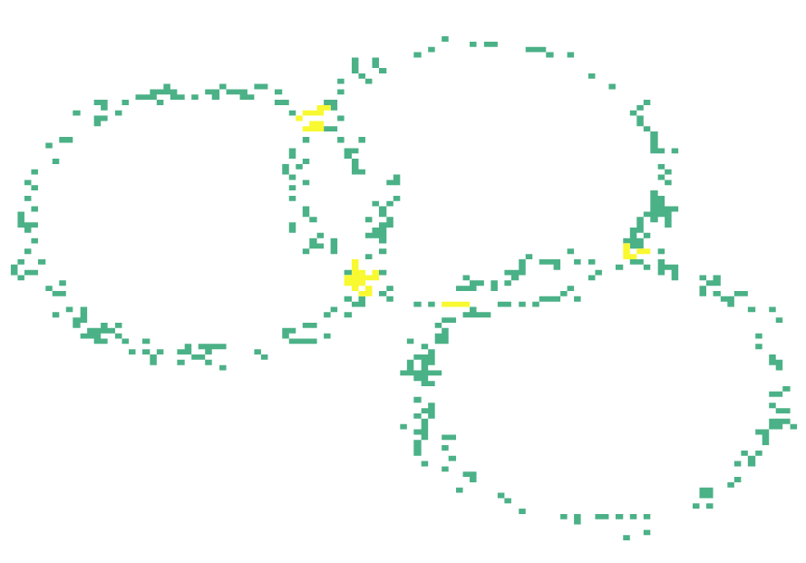
RICH reconstruction: photon objects
Detector hits
(X,Y)
+
Hit time
Tracking information
1 PO
2 POs
A photon object (PO) is created for each combination of a track and a detector hit.
Track1
Track2
Track3
PV1
PV2
In the high-occupancy regions, a photon hit can be associated with >10 POs.
→ Combinatorial background.
PID log-likelihood maximisation.
Notes:
Before entering the details of the method it’s important to introduce briefily the rich reconstruction

Slide 24
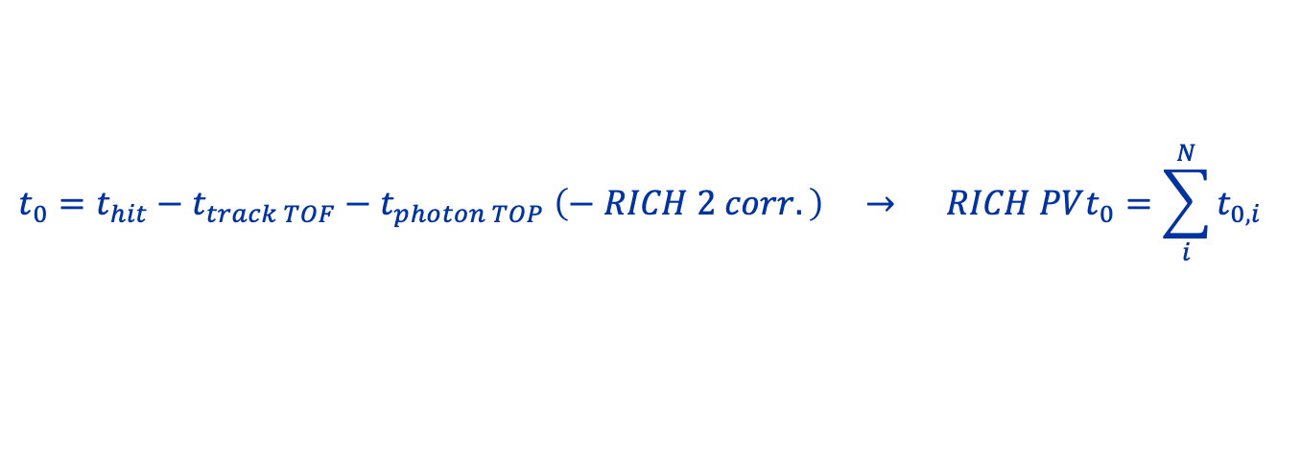
RICH PV t₀
RICH PV t₀ obtained by averaging the PV t₀ calculated for all the POs associated with the PV.
$$t_{0}=t_{hit}−t_{track TOF}−t_{photon TOP} \left(− RICH 2 corr.\right) → RICH PVt_{0}=\sum_{i}^{N}{t_{0,i}}$$
The correct association between PV and POs is crucial for a precise PV t₀ estimation.
In Run 4, on average, >1k POs per PV but only ~20% of POs are correct associations, the remaining POs form combinatorial background.
→ The abundance of POs per PV allows for selection.

Slide 25
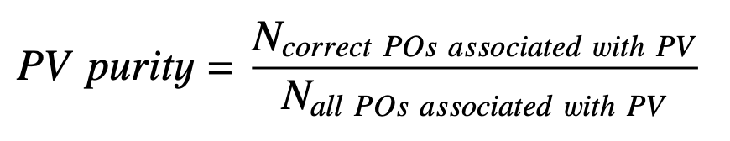
Effect of the PO selection on the PV t₀ resolution
No PO selection (avg. purity 20%)
Correct POs using MC (purity 100%)
Filtering the POs is key to improve the PV t₀ resolution.
Two selection criteria have shown great improvements on PV t₀ resolution.

Slide 26
PO selection based on Signal Amplitude (SA)
Signal amplitude (SA) is a parameter defined in the Likelihood for each photon object as the
probability that the track has produced a hit in the pixel.
It is calculated for all the mass hypotheses of the track (pion mass here because before likelihood max.).
Avg. PV

Slide 27
POs uniquely associated with a pixel hit
Only ~10% of the POs pass this selection. High-occupancy regions are strongly affected.
PV purity increases to 53% in RICH 1 and 55% in RICH 2, maintaining >100 POs per PV on average.
Event with 5 PVs

Slide 28
PV t₀ resolution
The two selections are complementary and can be applied simultaneously.
RICH 1, SA > 0.05 → 88 ± 2 ps FWHM
(70 ps RMS) for 85% of the PVs
(>5 POs per PV).
RICH 2, SA > 0.05 → 93 ± 2 ps FWHM
(69 ps RMS) for 81% of the PVs
(>5 POs per PV).
Statistically limited by number of POs:
Balance between PV t₀ resolution and number of PVs reconstructed.
Combining POs from both detectors can help the trade-off.

Slide 29
PV t₀ resolution using POs from both RICH detector
With SA > 0.05 for both detectors → 85 ± 2 ps FWHM (64 ps RMS)
for 94% of the PVs (> 5 POs per PV).
For SA > 0.10 and > 100 POs per PV a resolution of 54 ± 3 ps FWHM (34 ps RMS) can be reached for 25% of the PVs.
Comparable spread with using only correct POs.

Slide 30
Considerations and outlook
The PV t₀ as input for the software time gate in the RICH reconstruction → other sub-detectors can benefit too.
Many interesting studies can follow for Run 4.
The method was implemented before the likelihood maximisation.
It can benefit from an initial likelihood maximisation that provides the best mass for each track.
In LHC Run 5, the PV t₀ will be provided by the tracking system.
However, the MAPMT time resolution will not be sufficient to maintain the PID performance of the RICH.

Slide 31
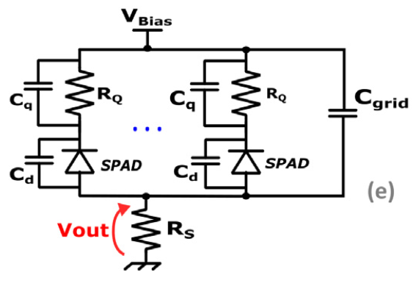
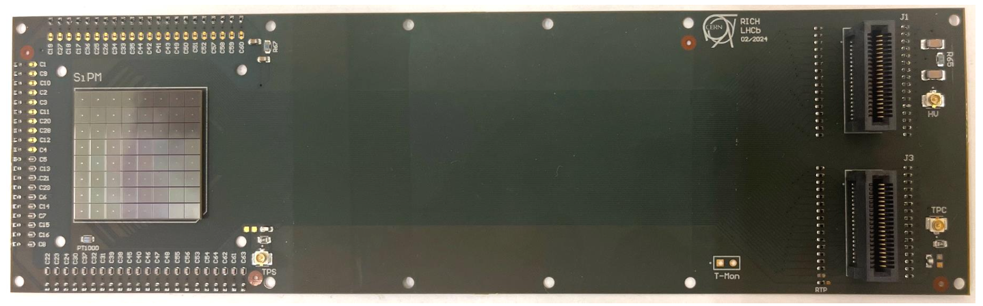
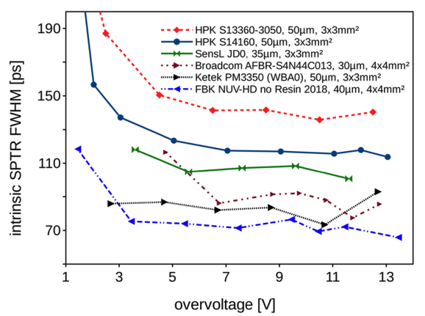
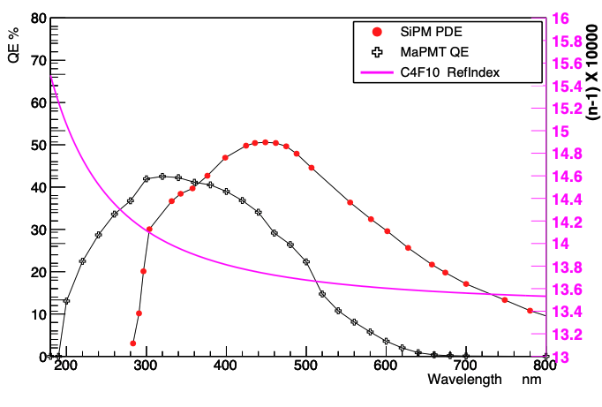
Silicon Photomultipliers (SiPM) technology
SiPM
An SiPM is a matrix of Single-Photon Avalanche Diodes (SPAD) connected in parallel.
Promising candidate as RICH Upgrade II photodetector:
Good single-photon time resolution.
High photon detection efficiency in the green wavelength region reduces 4D chromatic error.
Pixel size down to ~ 1x1 mm².
B-field robustness.
Multiple-photon counting capability.
Hamamatsu S13361-3050NE-08
DOI:10.1016/j.nima.2018.11.118
doi:10.1088/1361-6560/ab63b4

Slide 32
SiPM: DCR and radiation hardness
Dark count rate (DCR) and radiation damage are the main challenges with the SiPMs.
RICH upgrades require single-photon detection at fluences up to ~6x10¹³ n_{eq}/cm⁻².
Mitigation:
Cryogenic cooling.
Annealing during annual stops.
Neutron shielding.
Micro-lenses.
RICH 2025 conf. poster

Slide 33
Flex-PCB prototype for operating
SiPM arrays at cryogenic temperatures

Slide 34
Multi-channel readout of SiPM arrays at cryogenic temperatures
Extensive studies in literature for SiPM at cryogenic temperature.
Often on single devices with custom readout electronics.
Not aiming for large-area detector applications.
Scaling to multi-channel readout (with large-area detector integration in mind) introduces additional challenges, including the analogue signal transmission.
SiPM at cryogenic temperatures and readout electronics at room temperature.
Maintaining signal integrity for sub-100 ps timing.
Optimising the thermal contact between SiPM array and cooling surface.
High-density of connections.
Flex-PCB technology enables compact, cryo-compatible multi-channel integration.

Slide 35
Flex-PCB for SiPM array readout
3-layer flex-PCB for the readout of a 64-channel SiPM array surface mounted (Ham. S13361-3050NE-08).
Designed to study the impact of high-density cm-long traces between SiPM and FE on the signal integrity.
Integration into a cryostat test bench.
SiPM array
HSEC8 connectors
~15 cm analogue traces
Test-pulse circuits

Slide 36
Design choices
TOP LAYER – signal mainly
High-density signal routing to emulate close packing arrangement of arrays.
GND plane as middle layer to isolate bias and signal.
Precaution for assembly.
Copper balance to minimise warping.
Components on one side only.
Stack-up optimisation:
Flexibility and SiPM cooling required low dielectric thickness.
Signal traces impedance ~50Ω.
BOTTOM LAYER – bias mainly

Slide 37
A cryostat demonstrator for SiPM studies at cryogenic temperatures
Flexible test bench for studies on SiPMs and cooling integration.
Flex-PCB integrated in the cryostat demonstrator.
Mounting holes for clamping to the cold-block.
Flexibility for limited space inside enclosure.
Low thickness for better thermal exchange between SiPMs and cold clock.
LN2
Flex-PCB
Cold block

Slide 38
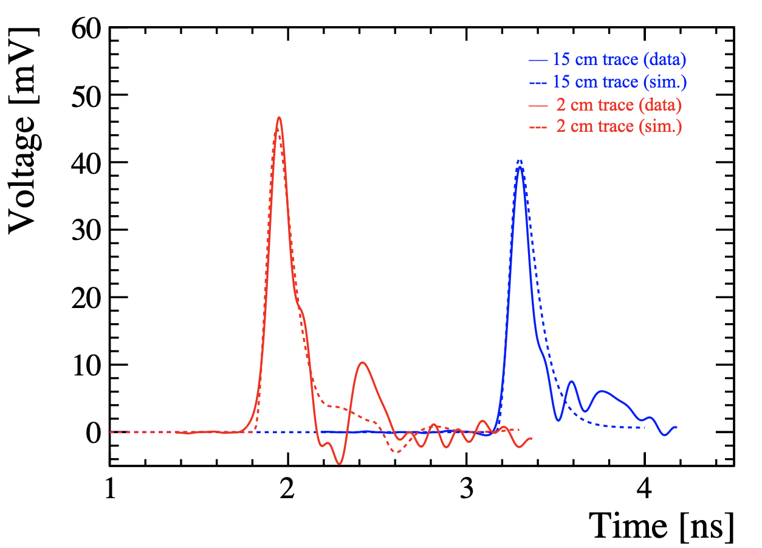
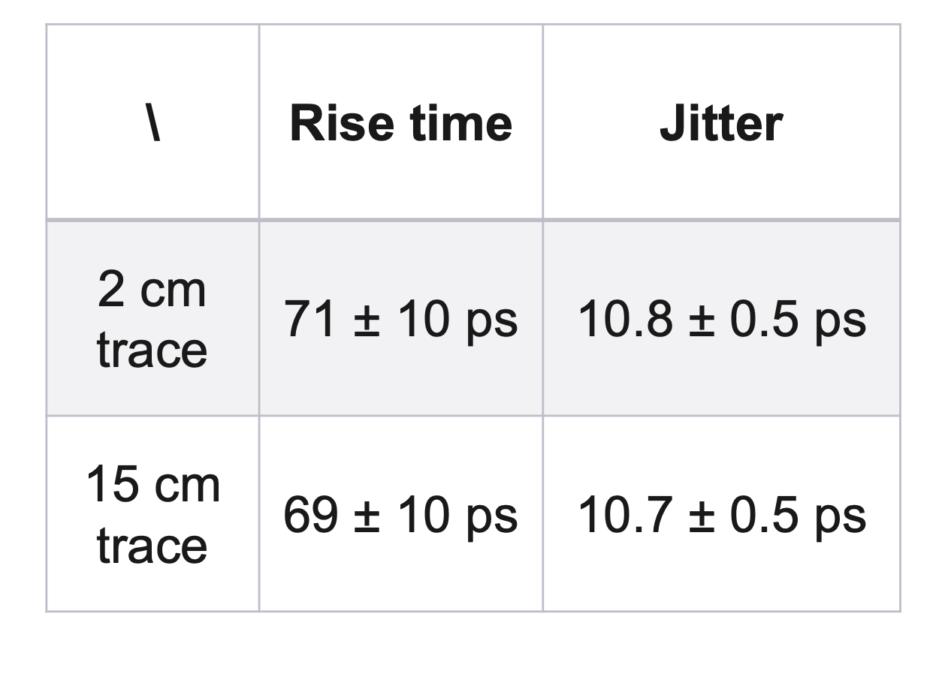
Flex-PCB signal integrity test
Same voltage step injected into the 2 flex-PCB test-pulse circuits to emulate single-photon pulse:
Rise time <ns, 1 Me, amplitude o(10 mV).
Recorded waveforms with oscilloscope and circuit simulation with LTSpice.
No difference between the two circuits in rise time and jitter.

Slide 39
SiPM array single-photon characterisation
2.5 V
4.5 V
7.5 V
Flex-PCB coupled with FastIC + picoTDC readout chain.
FastIC comparator threshold scan at different voltages:
Discrete response of the SiPM.
Linear behaviour of single-photon gain and DCR with the applied bias voltage, as expected.

Slide 40
SiPM array single-photon time resolution with pulsed-laser illumination
Same laser illumination as per MAPMT studies → single photon regime.
SPTR as FWHM of a double-Gaussian fit to the ToA distribution.
Average SPTR at 7.5 V is 103 ± 5 ps (σ = FWHM / 2.355), best channel: 88 ± 4 ps.
Average from all channels
Best channel at 7.5 V
500
SPTR (FWHM) [ps]
400
300
2.5
3.5
4.5
5.5
6.5
7.5
Overvoltage [V]

Slide 41
SiPM array single-photon time resolution with charged-particle beam – setup
Flex-PCB has been integrated and successfully tested in the May 2025 LHCb RICH beam test at SPS.
Several dataset at different threshold and bias voltage.

Slide 42
SiPM array single-photon time resolution with charged-particle beam – results
Average SPTR for 7.5 V of 134 ± 15 ps (σ = FWHM / 2.355).
SPTR degradation of ~70 ps (FWHM) observed during the beam test period.
Average DCR per channel increased by a factor ~5, likely due to beam induce effects.
2.5 V
4.5 V
7.5 V
2.5
3.5
4.5
5.5
6.5
7.5
8.5
Overvoltage [V]

Slide 43
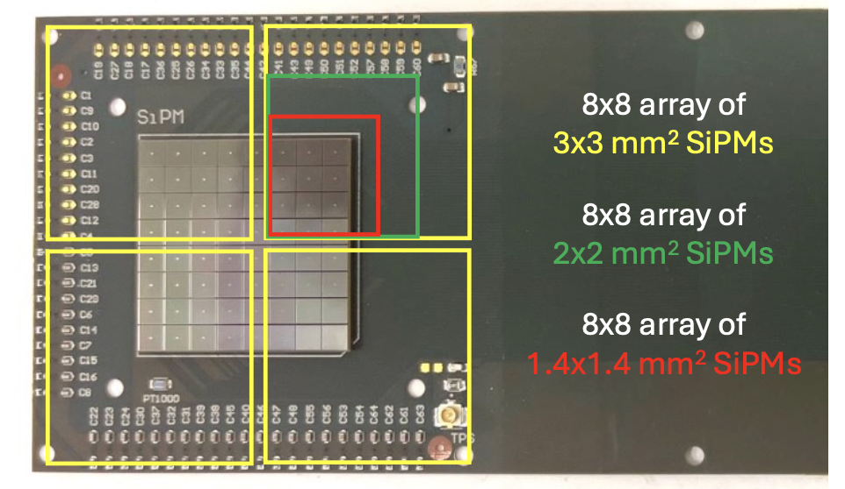
A second flex-PCB prototype
Close packing of SiPM arrays towards real-detector applications with smaller size SiPM arrays.
Challenge in terms of signal routing and bias.
Redesign of clamping mechanics to optimise photo-sensitive area.
Improved flexibility with reduced dielectric layers.

Slide 44
Conclusions
Analogue and digital analysis on MAPMT single-photon response.
Pulse shape characterisation for coupling with current readout electronics (FastRICH).
Timing performance to define the achievable resolution in the RICH Run 4 detector.
Novel method to estimate the PV t₀ using the RICH standalone in Run 4.
Multiple selection criteria explored and optimised.
Achieved an 85 ps (FWHM) precision for 94% of the PV in the simulated sample.
Flex-PCB prototype for operating SiPM arrays at cryogenic temperatures.
Design of the board for cm-long transmission of analogue signals.
Signal integrity measurements.
Single-photon characterisation of the SiPM array with laser and in beam test.

Slide 46
BACKUP SLIDES

Slide 47
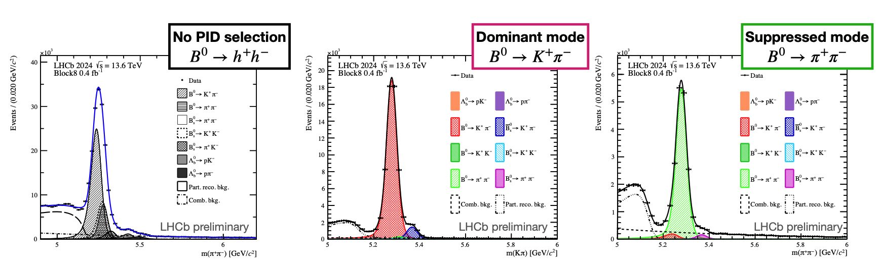
Particle identification in LHCb

Slide 48
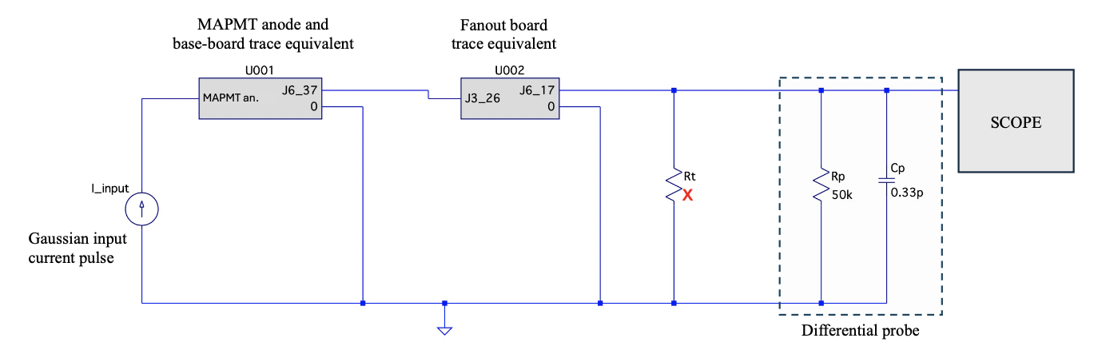
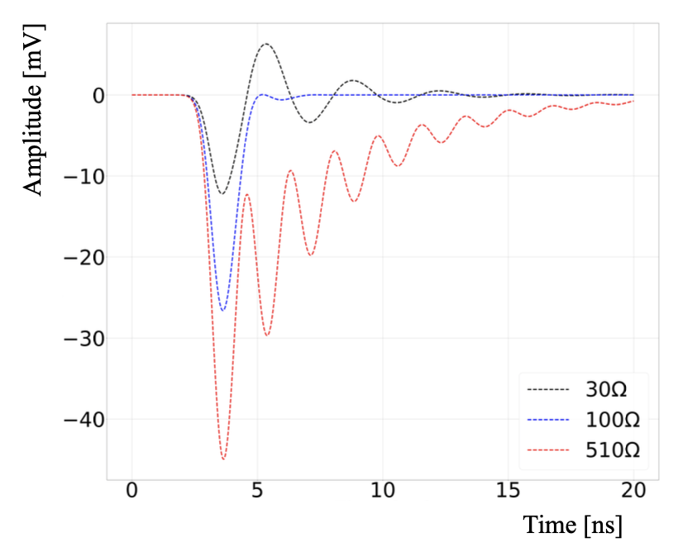
LTSpice simulation of the readout system
Injected Gaussian current pulse corresponding to 2 Me gain.
The termination value (R_{t}) affects only the decay time.
Same rise time of ~735 ps and charge of 2 Me measured for the 3 resistive values.
510 Ω selected for a better signal-to-noise ratio.

Slide 49
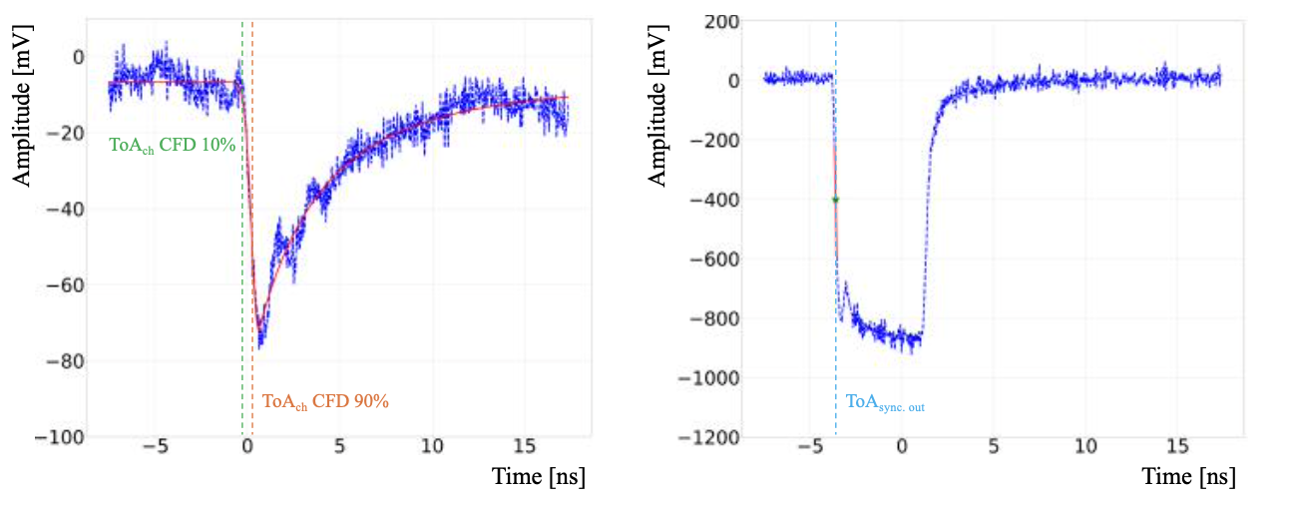
Transit-time spread (TTS) measurements analysis
1-in. MAPMT at –900V
In-software Constant Fraction Discrimination (CFD).
ToA from the crystal ball fit at a fixed % of the pulse amplitude.
TTS extracted as the FWHM of a double-gaussian fit of the ToA distribution.

Slide 50
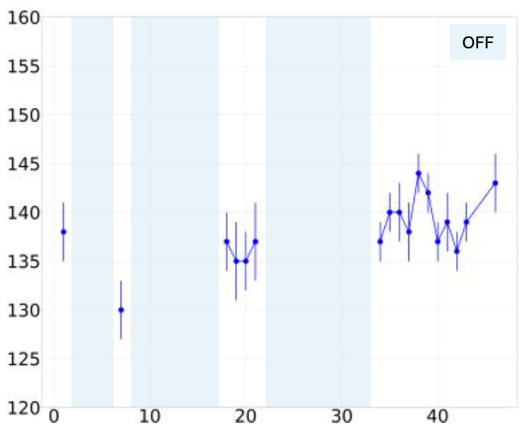
Transit-time spread (TTS) stability
2-in. MAPMT at –1000V
TTS (σ_{meas}) [ps]
TTS measured over >1month period
with a final 12-days period of both
laser and MAPMT always on.
TTS is stable around 140ps.
Important results for LHC Run 4 operation.
Days

Slide 51
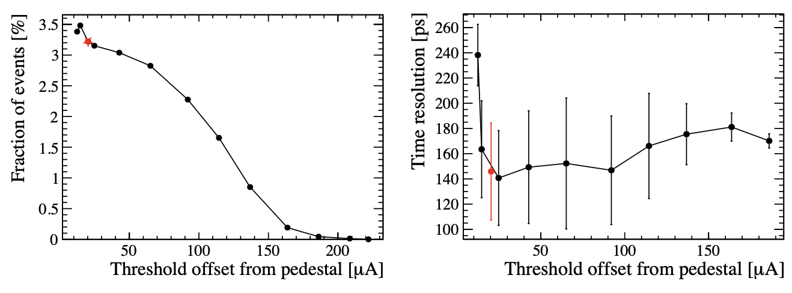
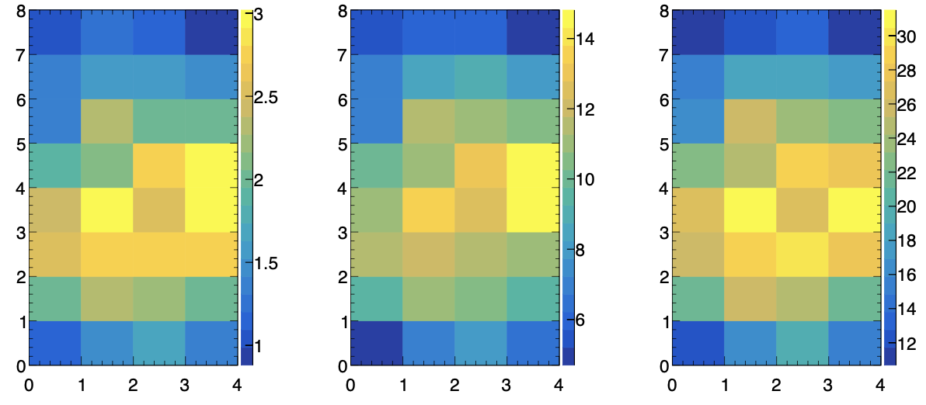

Working point analysis
Occupancy [%]
Measurements used as reference for the RICH 2022 beam test campaign.
[DOI:10.1088/1748-0221/20/03/P03034 ]
Datasets at different photon occupancy.
Occupancy [%]
Notes:
These dataset were used to convalidate the results observed during the RICH 2022 beam test campaign on the 1-inch MAPMT. A first focus to convalidate the working point used in the beam test. Which means setting the FastIC comparator threshold at the right level to optimise photon collection and time resolution. Then, the photon occupancy was varied to investigate some effects observed during the testbeam.

Slide 52
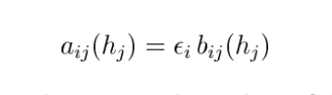
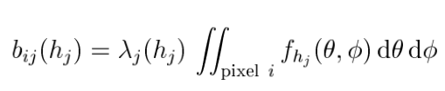
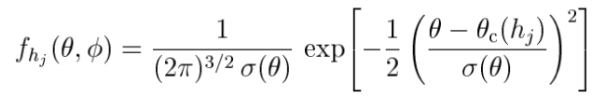
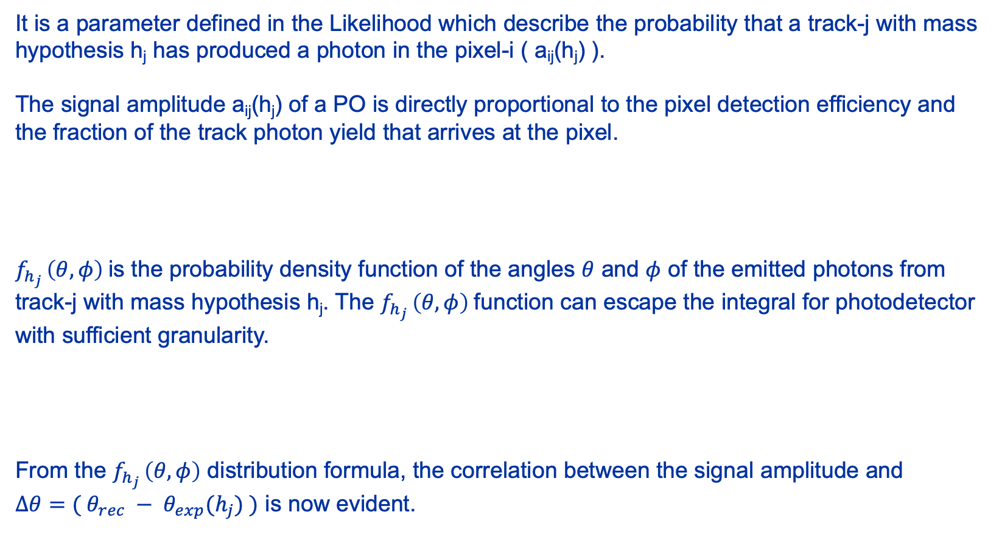

Signal amplitude
It is a parameter defined in the Likelihood which describe the probability that a track-j with mass hypothesis h_{j} has produced a photon in the pixel-i ( a_{ij}(h_{j}) ).
The signal amplitude a_{ij}(h_{j}) of a PO is directly proportional to the pixel detection efficiency and the fraction of the track photon yield that arrives at the pixel.
$f_{h_{j} }\left(θ,φ\right)$is the probability density function of the angles $θ$ and $φ$ of the emitted photons from track-j with mass hypothesis h_{j}. The $f_{h_{j} }\left(θ,φ\right)$function can escape the integral for photodetector with sufficient granularity.
From the $f_{h_{j} }\left(θ,φ\right)$ distribution formula, the correlation between the signal amplitude and
$Δθ=( θ_{rec} − θ_{exp}(h_{j}) )$ is now evident.
$$Δθ$$

Slide 53
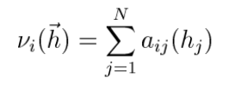
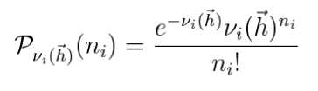
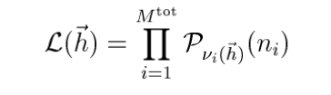
Log-likelihood maximisation
The sum over the total number of tracks in the event of the signal amplitude probabilities for the pixel-i gives the expected number of photons in the pixel for the hypothesis h.
The probability of observing n_{i} photons in the pixel-i is given by a Poisson distribution around the expected value v_{i}(h). The Likelihood is defined as the product of the Poisson distributions of all the pixels.
At the start of the maximisation process all the tracks are pions. The mass hypothesis are changed one at a time and a mass hypothesis is updated if the Likelihood (L(h)) improves more than a certain threshold, i.e. if the Delta-Log-Likelihood (DLL) is greater than a fixed DLL threshold.
The DLL threshold can tune sensitivity to pions or kaons.

Slide 54
Run 4 RICH reconstruction

Slide 55

RICH PV t₀
RICH PV t₀ obtained by averaging the PV t₀ calculated for all the POs associated with the PV.
$$RICH PV t_{0}={\left\langle t_{hit}−\frac{\left|r_{A}\right|}{c}\sqrt{1+{\left(\frac{mc}{p}\right)}^{2}}−\frac{d_{A,E}}{c} n\cos{θ_{c}}−\left[d_{E,M1}+d_{M1,M2}+d_{M2,hit} \right]\frac{n}{c}+t_{spread} \right\rangle }_{N}$$
N POs → PVs
Track path
to entry point
Track path inside
the radiator
Photon path
inside the RICH
Sensor and
FE spread
PV
Track
Hit form track
PO
Hit from another track
PO
Hit from another track
PO
…
…

Slide 56
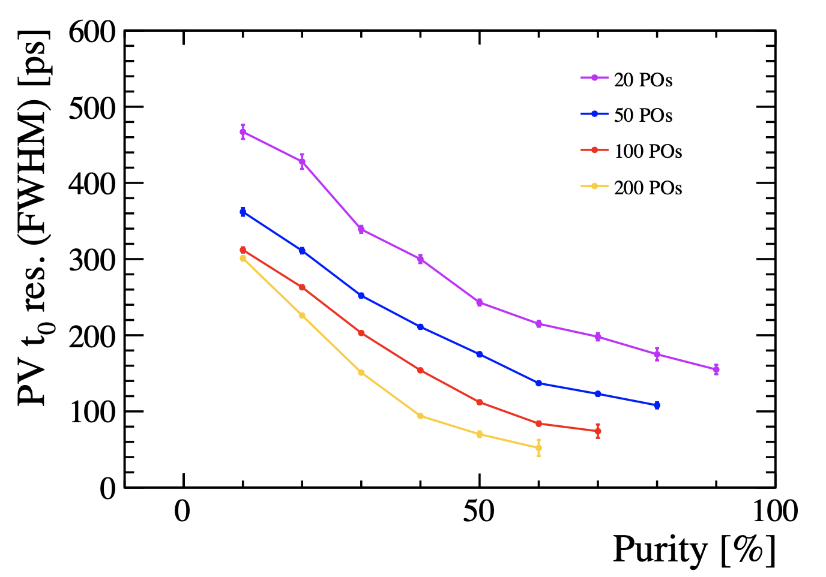
PV t₀ resolution as a function of the PV purity and PO statistics
PV t₀ resolution improves significantly as the PV purity increases.
Increasing the number of POs per PV improves RICH PV t0 resolution by reducing statistical fluctuations.
High-quality PO selections required to improve the PV purity without reducing the number of POs too strongly.
Notes:
PV t₀ resolution improves significantly as the PV purity increase.
Increasing the number of POs per PV improves RICH PV t₀ resolution by reducing statistical fluctuations.

Slide 57
PV t₀ resolution with SA cut
Statistically limited only for strong cuts on RICH 2.
No need for using POs from both RICH detectors.
RICH 2 performs better than RICH 1
Different geometry, lower hit occupancy and background level.
2-in. MAPMT have better time spread
than 1-in. ones.
A SA cut of 0.05 on RICH 2 only can be used to estimate the PV t₀.
On the remaining PVs a SA cut of 0.1 on RICH 1 can be applied.

Slide 58
PV t₀ resolution with both selections
Overall resolution further improved.
RICH 1, SA > 0.05 → 88 ± 2 ps FWHM
(70 ps RMS) for 85% of the PVs
(>5 POs per PV).
RICH 2, SA > 0.05 → 93 ± 2 ps FWHM
(69 ps RMS) for 81% of the PVs
(>5 POs per PV).
Statistically limited by number of POs:
Balance between increasing purity with stronger cuts and number of POs per PV.
Using POs from both detectors can further improve the resolution and the % of PVs reconstructed.

Slide 59
PV t₀ resolution and event pile-up
PV reconstruction efficiency and resolution degrade with PV multiplicity.
Resolution gain driven by improved PO purity, not by selecting intrinsically clean PVs.
~50% of PVs reconstructed with RMS < 150 ps at Run 5 luminosity.

Slide 60
Multi-channel readout of SiPM arrays at cryogenic temperatures
Cryogenic cooling effectively mitigates DCR in SiPMs after irradiation.
Main challenges for a detector application:
Large photodetector areas at cryogenic temp.
Vacuum for thermal insulation.
Analogue signals over cm-long distances.
Stable gas (/radiator) temperature.
Block IR radiation.
Cooling system infrastructure.

Slide 61
A cryostat demonstrator for SiPM arrays studies at cryogenic temperature

Slide 62
SiPM array single-photon time resolution with pulsed-laser illumination – setup
Laser pulses at 405 nm and width of 50 ps (FWHM),
triggered at 20 kHz.
Peak photon occupancy of ~12%, average occupancy of ~6%:
Single-photon regime.

Slide 63
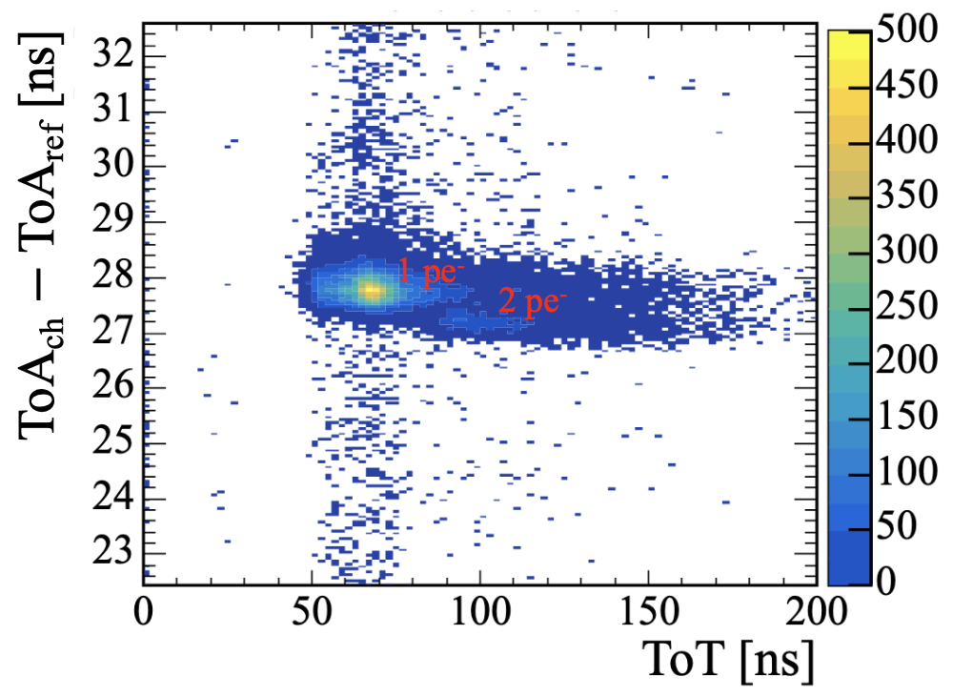
SiPM array single-photon time resolution with pulsed-laser illumination
Same laser illumination as per MAPMT studies → single photon regime.
ToT selection to isolate 1pe⁻ events.
SPTR as FWHM of a double gaussian fit to the ToA distribution.
Average SPTR at 59 V is 103 ± 5 ps (σ = FWHM / 2.355), best channel: 88 ± 4 ps.
ToT cut
Average from all channels
Best channel at 59 V

Slide 64
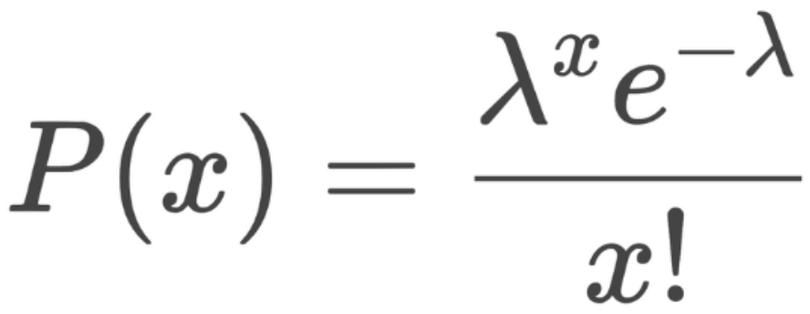
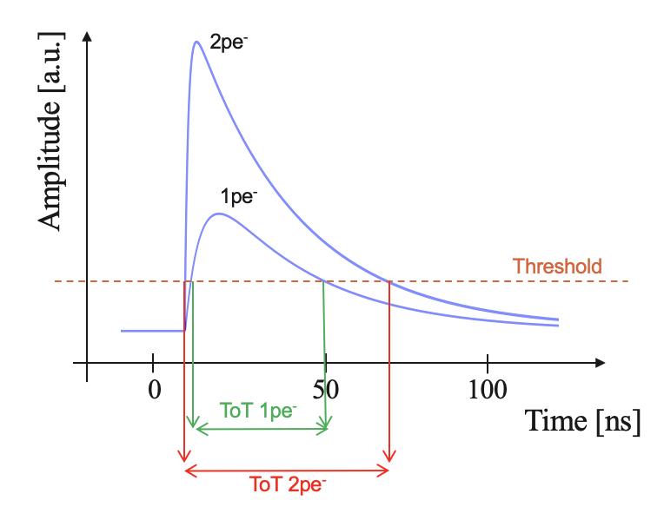
Poisson distribution of the hits
54 V th: 2.45 µA – channel 42
Assuming the number of pe in a single hit follows a Poisson distribution.
With a channel occupancy of 64% (corrected for DCR),
P(0) = 0.36 and 𝜆 ~ 1.021.
Measured P(X) can vary with the selected area of the 2D plot, but the observed ratio between P(2) and P(1) agrees with expected and simulated values.
1 pe⁻
2 pe⁻
+3 pe⁻
--- | Expected P(X) | Measured P(X) | Simulated* P(X) (65.4%)
P(1) | 0.368 | ~ 0.325 | 0.390
P(2) | 0.188 | ~ 0.164 | 0.175
P(3+) | 0.084 | ~ 0.113 | 0.089
*Simulation results from Ankhbayar, Summer Students.

Slide 65
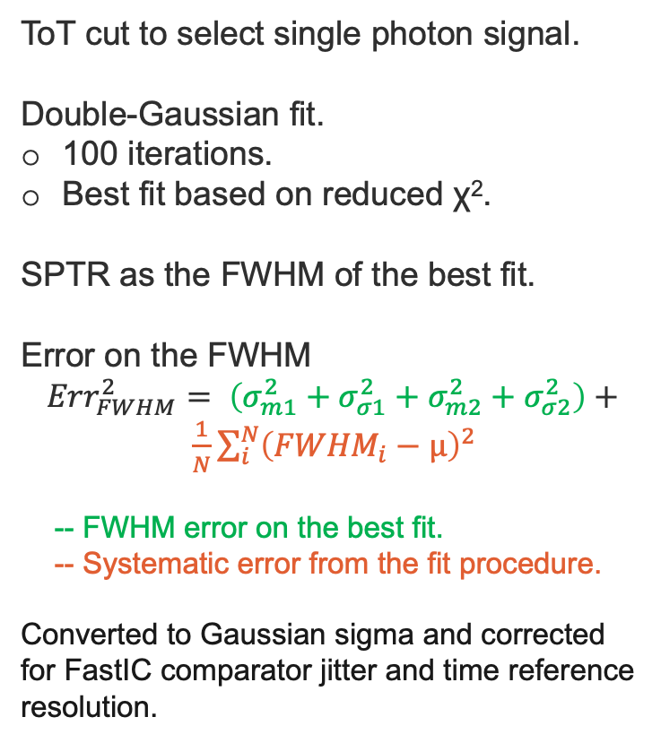
Single-photon time resolution analysis method
2 pe⁻
ToT cut to select single photon signal.
Double-Gaussian fit.
100 iterations.
Best fit based on reduced χ².
SPTR as the FWHM of the best fit.
Error on the FWHM
$${Err}_{FWHM}^{2}= \left(σ_{m1}^{2}+σ_{σ1}^{2}+σ_{m2}^{2}+σ_{σ2}^{2}\right)+$$
$\frac{1}{N}\sum_{i}^{N}{{\left({FWHM}_{i}−µ\right)}^{2}}$
-- FWHM error on the best fit.
-- Systematic error from the fit procedure.
Converted to Gaussian sigma and corrected for FastIC comparator jitter and time reference resolution.
+3 pe⁻
1 pe⁻
1 pe⁻
2 pe⁻
+3 pe⁻
ToT cut
1 pe⁻
FWHM:
572 ± 37 ps

