Slide 1


Slide 2





with generous support of our sponsors:

Slide 3
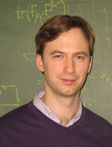
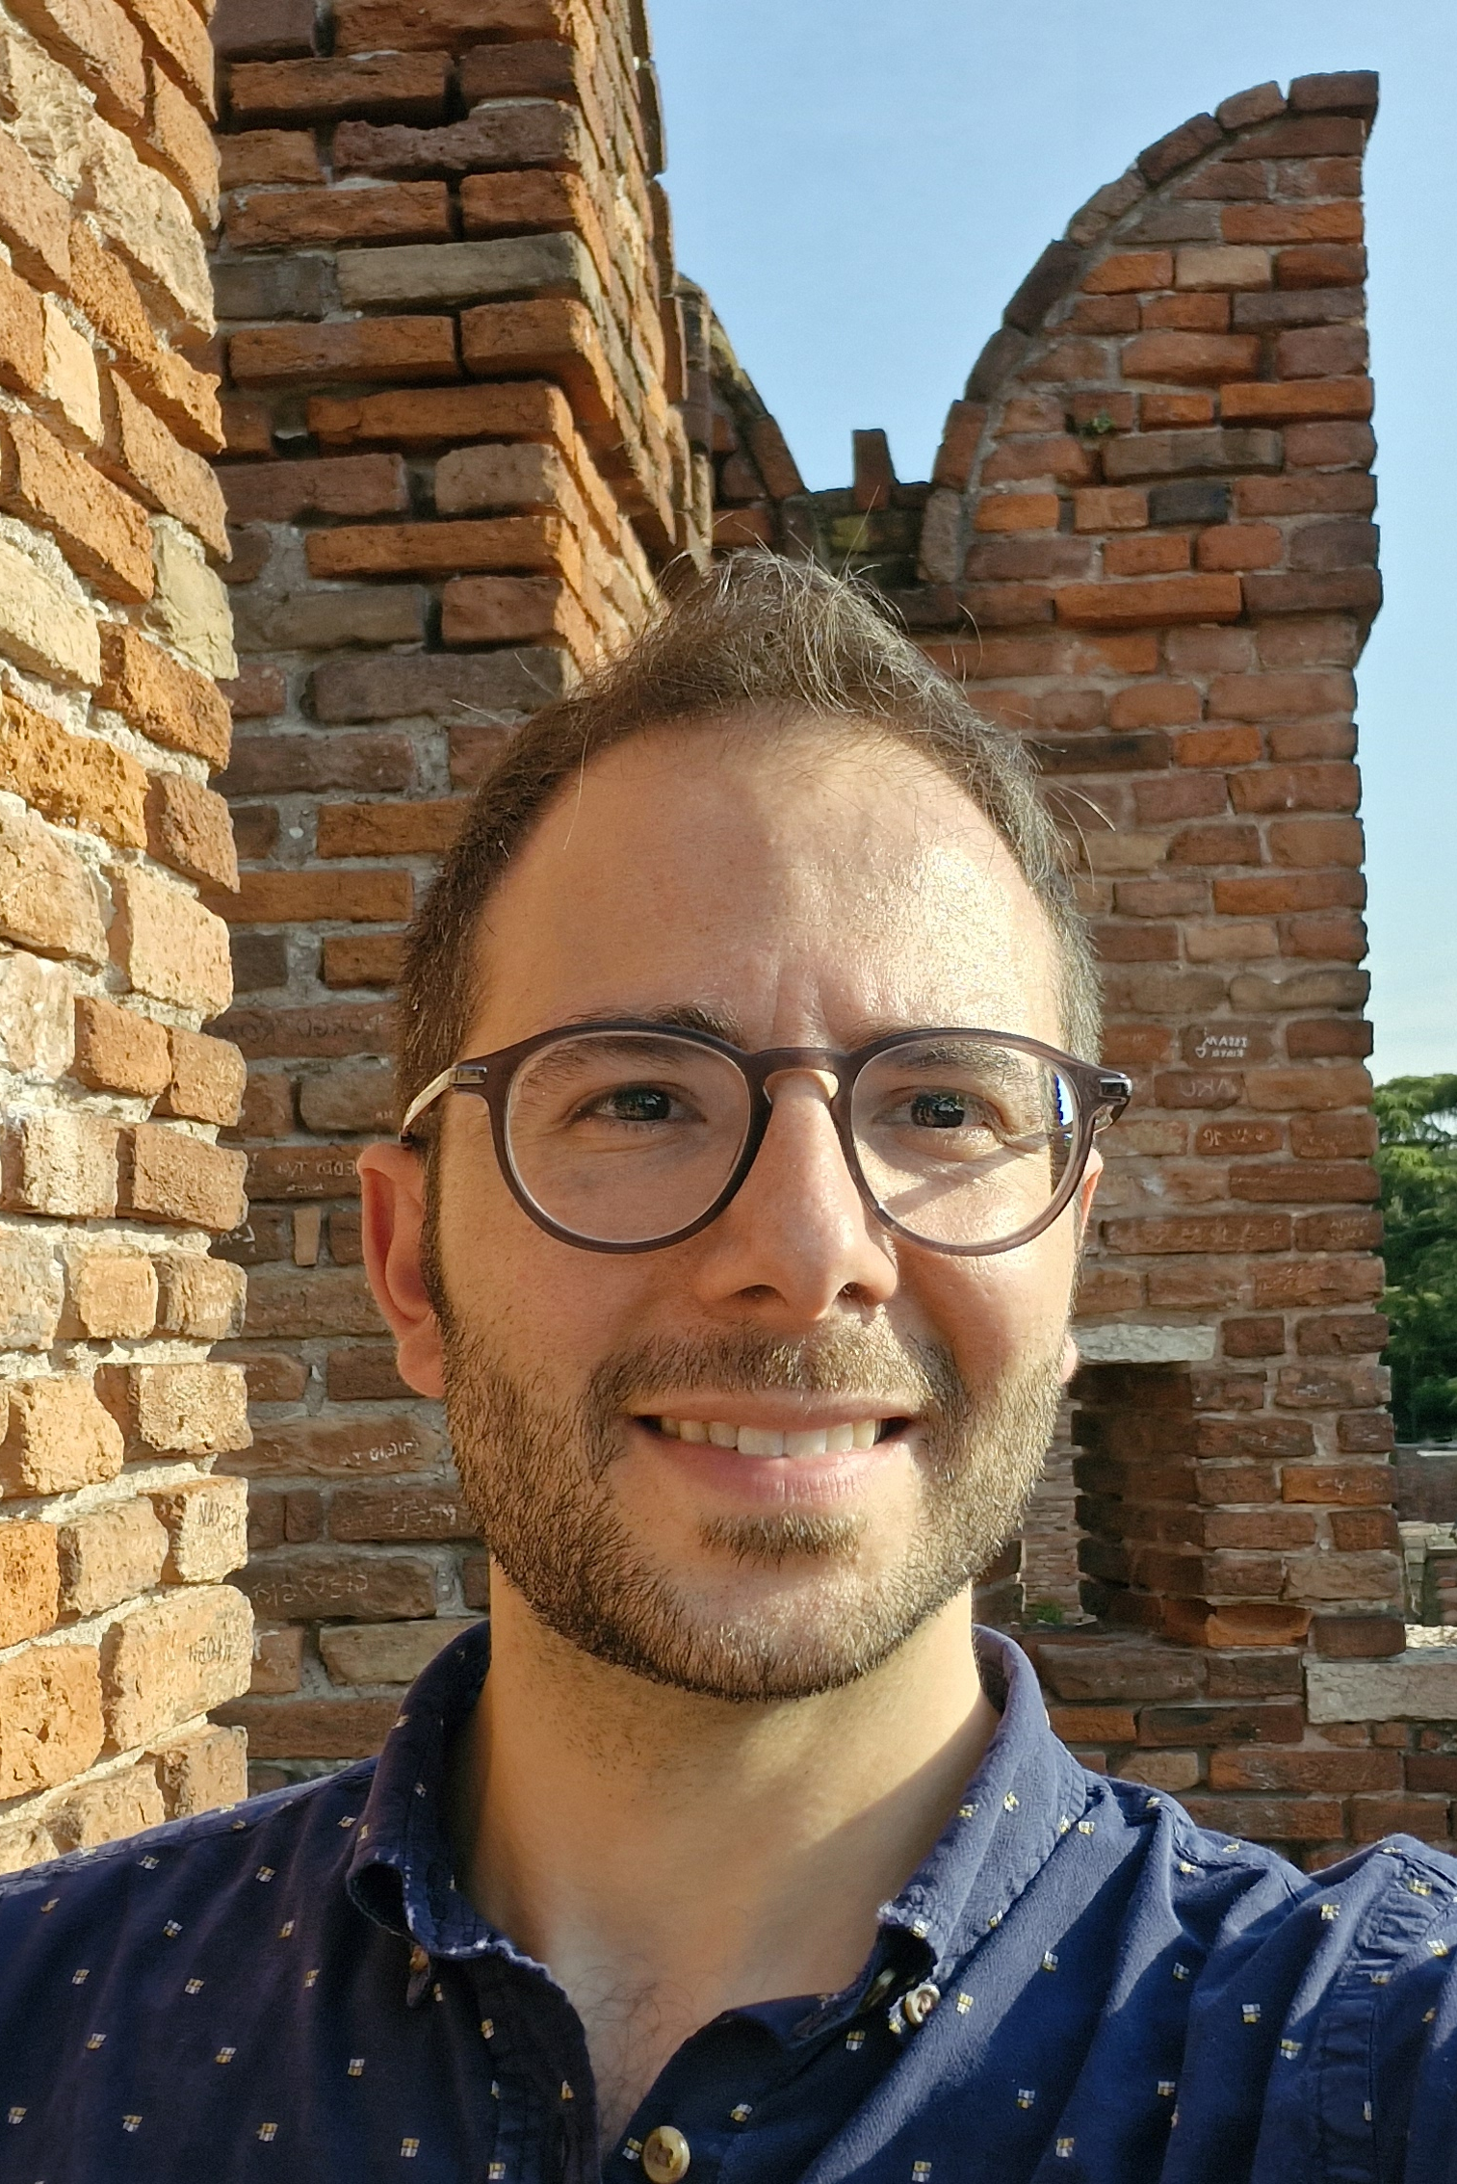
organizers:
Debasish Banerjee
University of Southampton
Masanori Hanada
Queen Mary
University of London
Georg Bergner
Univeristy of Jena
Emanuele Mendicelli
University of Liverpool
Jinzhao Sun
Queen Mary
University of London

Slide 4
in numbers:
27 Invited talks
15 Contributed talks
20 Posters
2 Quantum computing companies
Main topics:
Quantum simulation of lattice gauge theories; Quantum Algorithms for High-Energy Physics; NISQ quantum hardware demonstrations;
Real-Time Dynamics and Thermalization; Quantum computing for Quantum Gravity; Quantum computing for neutrinos; Quantum Many-Body Physics, Quantum Computing for Feynman Integrals and more

Slide 5
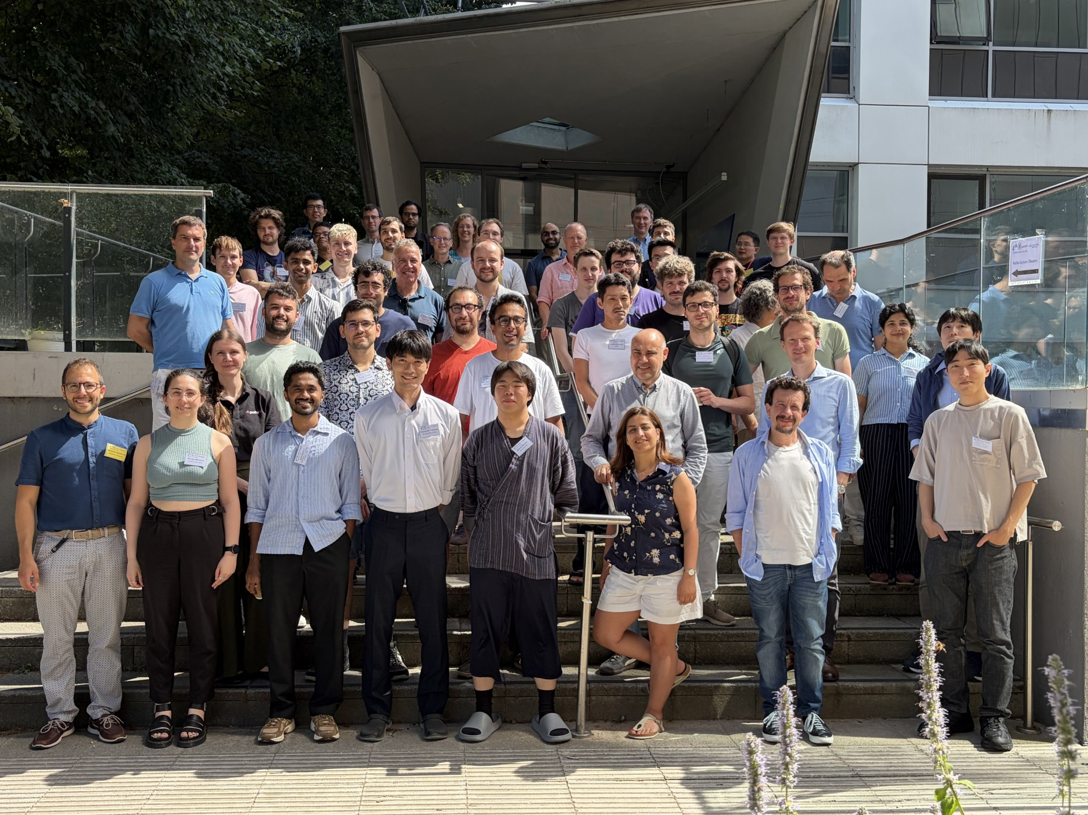

Slide 6
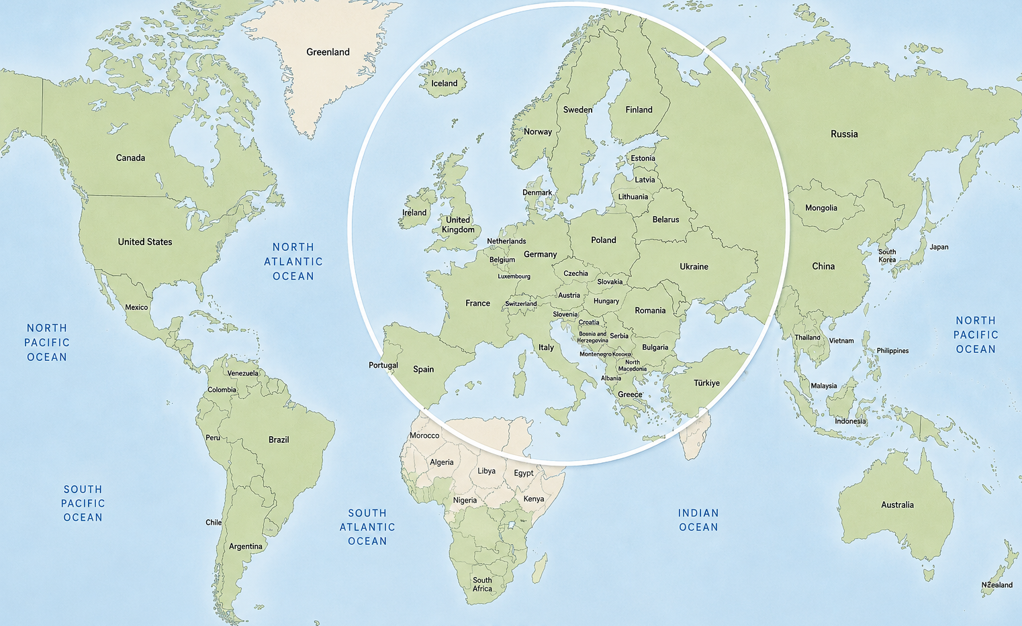

Thank you so much for coming!

Slide 7



mission:
High-Energy Physics
Challenges
Quantum Algorithms
Quantum Technologies
Quantum Information Science

Slide 8
legacy:
Conference series started in 2023 as part of the QuantHEP & QuantERA project
1th edition Bari, Italy, 25-27 September 2023
2th edition LMU Munich, Germany, 2-5 September 2024
3th edition Berkeley, USA, 29 September-2 October 2025
4th edition London, UK, 13-16 July 2026 (Done! Thank you!)
5th edition US Summer 2027
Applications for the 6th edition are now open at: quanthep.org

Slide 9
special issue in
A special issue of Quantum Report will be dedicated to the conference
The 4th QuantHEP organizers will serve as Guest Editors for this special issue
Partecipants are strongly encuraged to submit articles to the special issue
We aim to prepare a summary of the conference content
20% discount per participant
With our help, authors can negotiate, additional discounts or a full cost waiver!
Further information and submission details will be shared
The deadline to express interest to contribute is August 31st

Slide 10
your talk photos:
To receive the photos taken during your talk, please send an email to: quanthep2026@gmail.com
(If we do not receive your request, all photos will be permanently deleted after July 31st.)

Slide 11
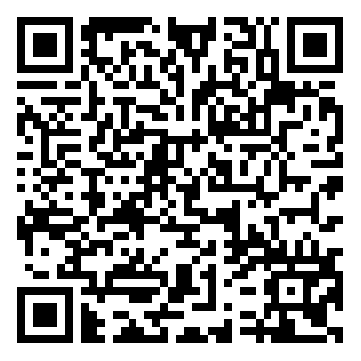
social activities
Conference WhatsApp group for social activities:
Link: WhatsApp group

Slide 12
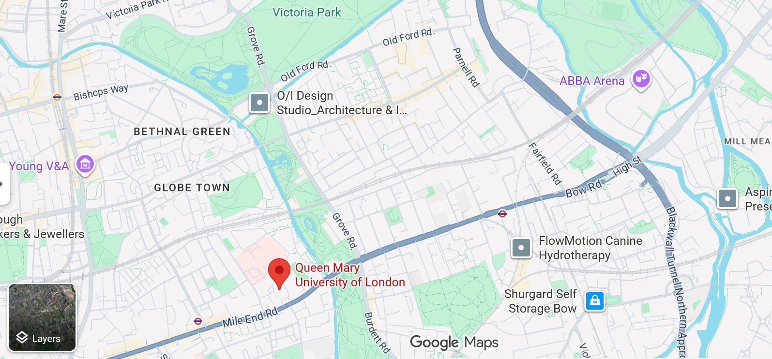
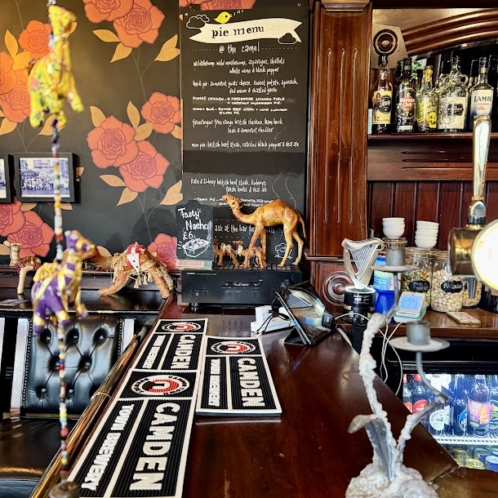
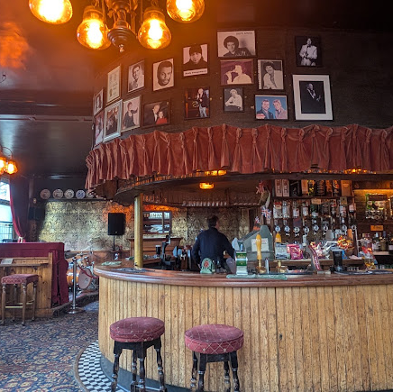
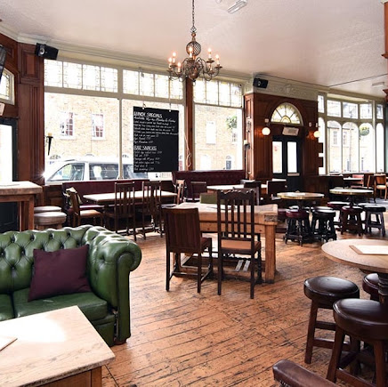
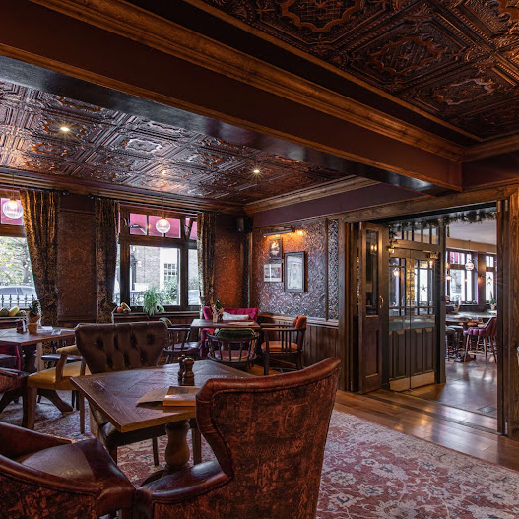
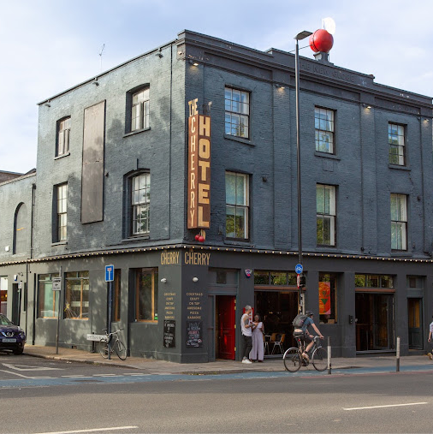
some local pubs
The Camel
The Pam Tree
Morgan Arms
The Coborn
The Cherry

Slide 13
Have a safe trip home!

Slide 14
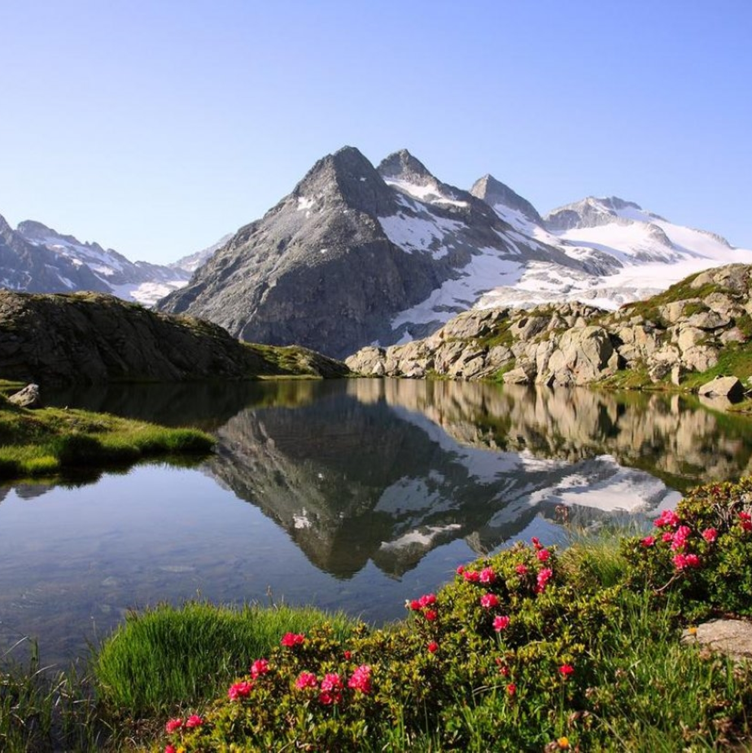
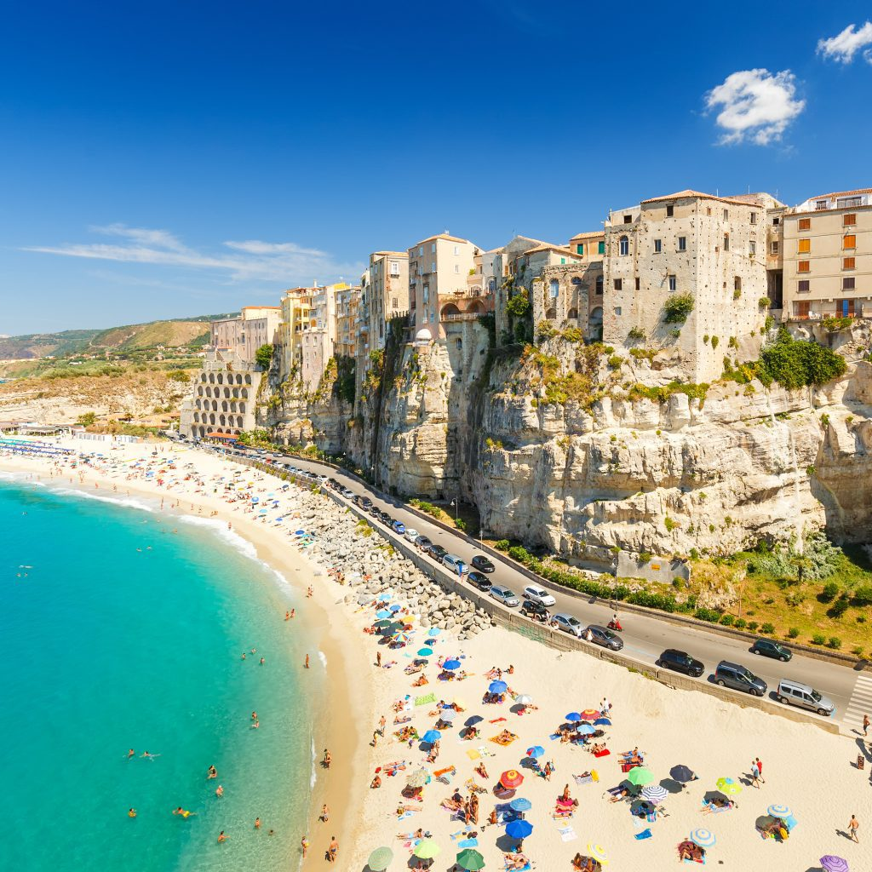
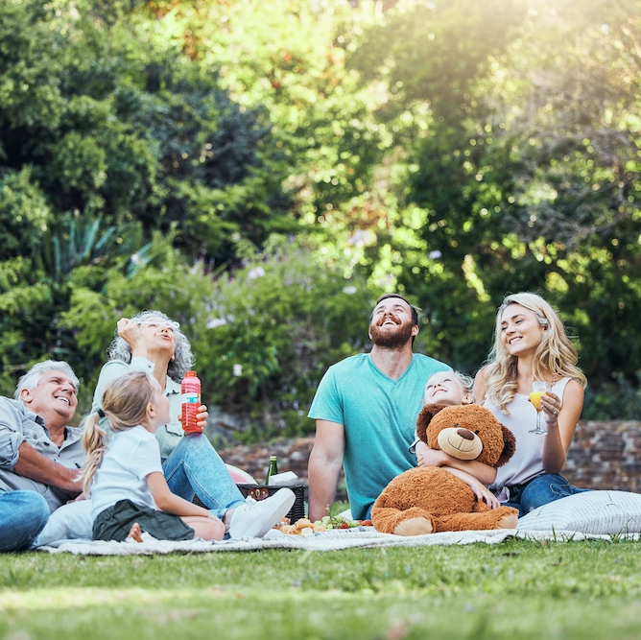

advice:
Remember to take your holidays!

Slide 15
Goodbye!

