Slide 1

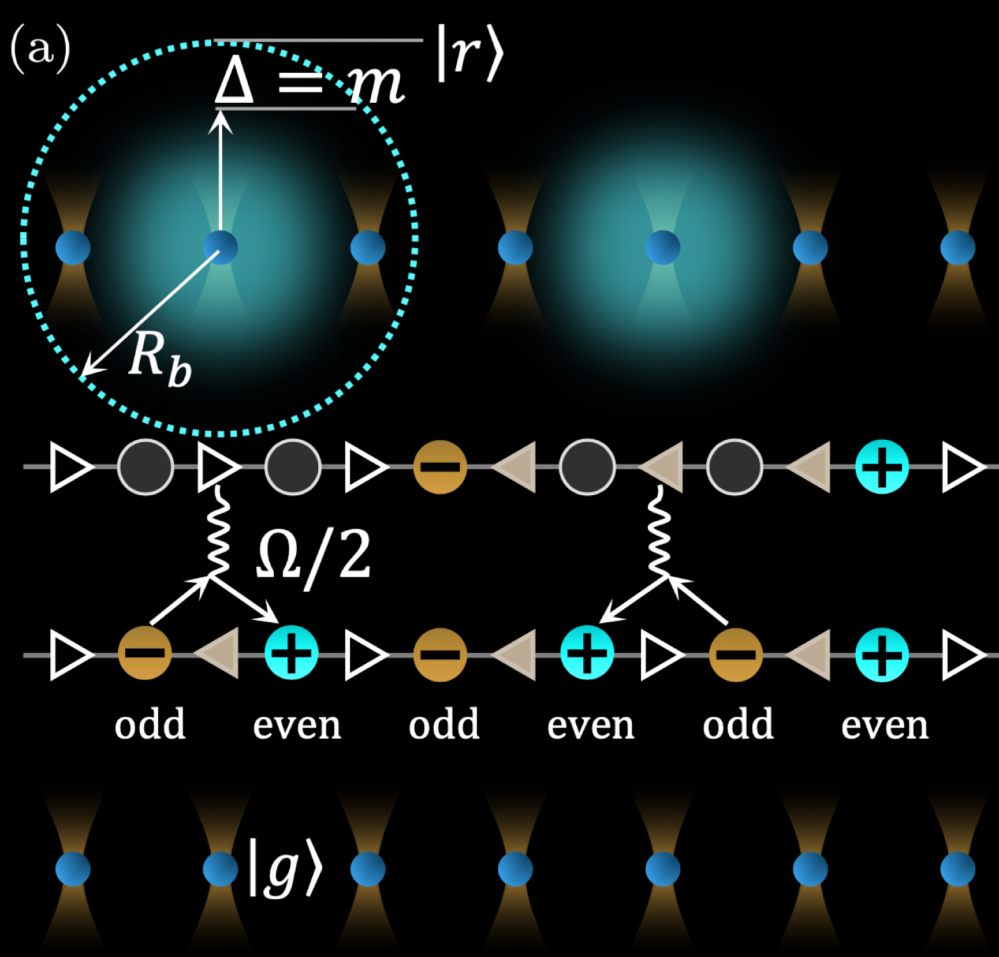
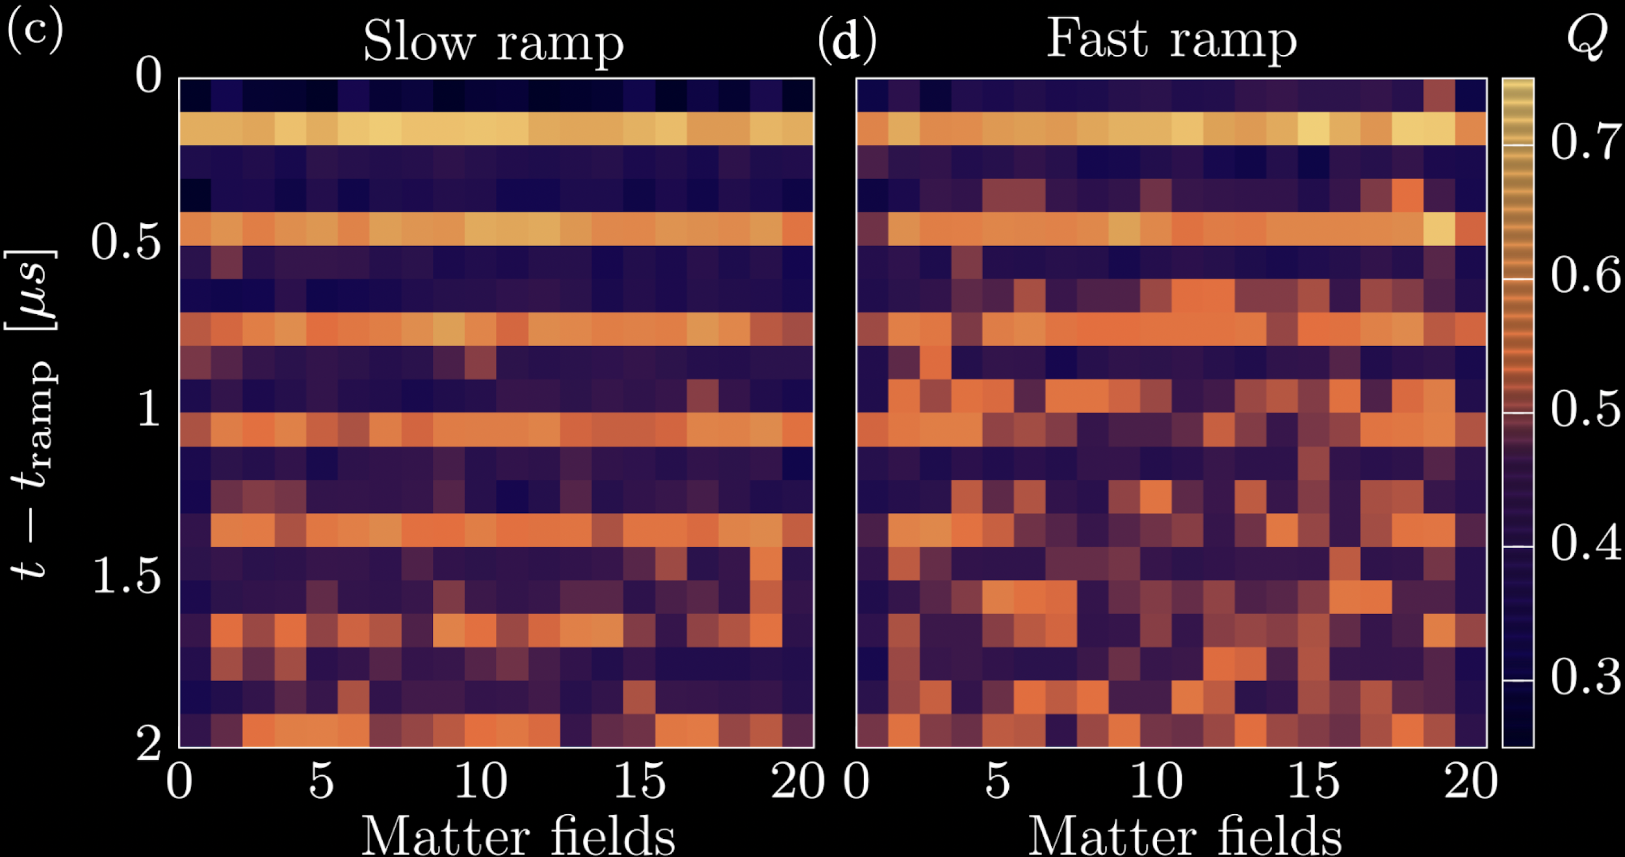







Ergodicity breaking meets criticality in a gauge-theory quantum simulator
Ana Hudomal, Aiden Daniel, Tiago Santiago, Milan Kornjaca,
Tommaso Macri, Jad Halimeh, Guoxian Su, Antun Balaz, Zlatko Papic
arXiv:2512.23794
QuantHEP, 13 July 2026
Notes:
Station Q, 11/1/2012
1

Slide 2
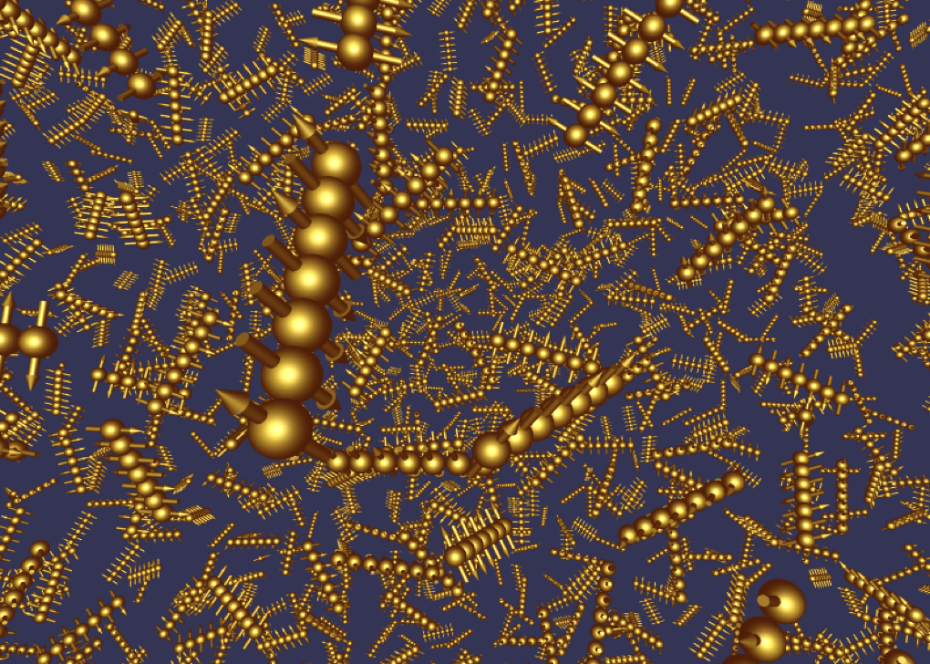
How do isolated quantum systems thermalize?
Ergodic = explores all configurations allowed by conservation laws
Described by statistical mechanics
Repulsion of energy levels & quantum chaos
Subsystems maximally mixed (eigenstates are highly-entangled)
Is this true for gauge theories?

Slide 3
Outline
Outline
Thermalization and its breakdown in gauge theories
Quantum simulation using QuEra’s Rydberg atom array
Interplay of criticality & defects with ergodicity breaking
Conclusions
Milan Kornjaca
Tommaso Macri
[A. Daniel et al., PRB 107, 235108 (2023); A. Hudomal et al, to appear]
Ana Hudomal
Aiden Daniel
Notes:
Station Q, 11/1/2012
3

Slide 4

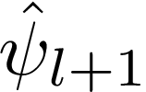


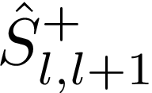
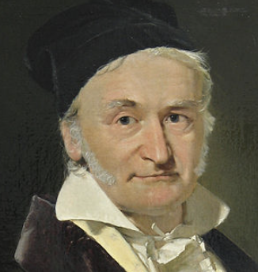
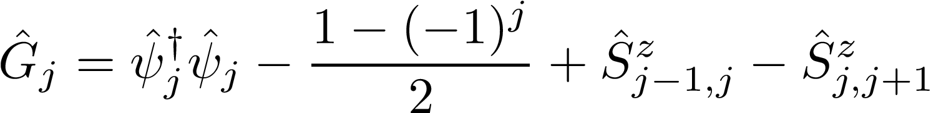
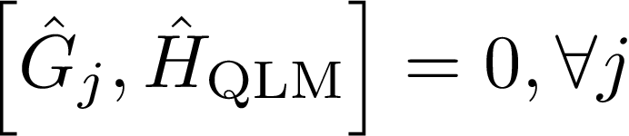
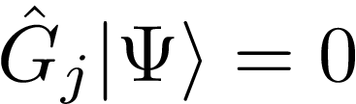
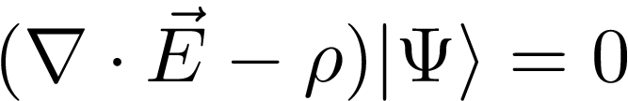
U(1) gauge theory in (1+1)D: quantum link model
[Kogut & Susskind ‘75, Wiese ‘13]
Kinetic
Mass
Electric field
trivial constant for S=1/2
discretized
The configurations of matter and gauge field are constrained.

Slide 5

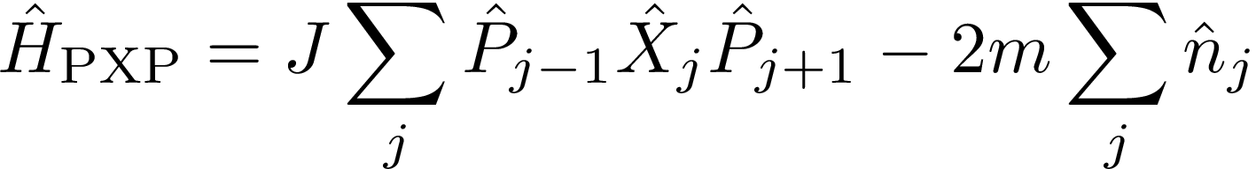
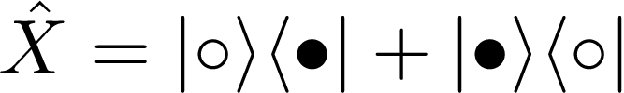
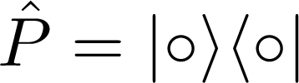

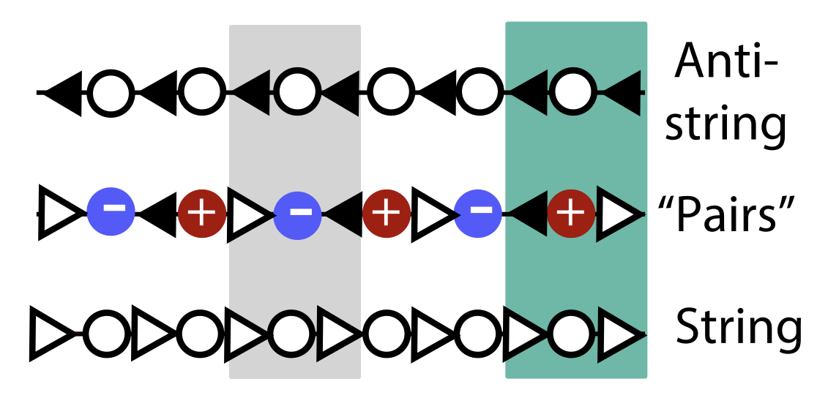
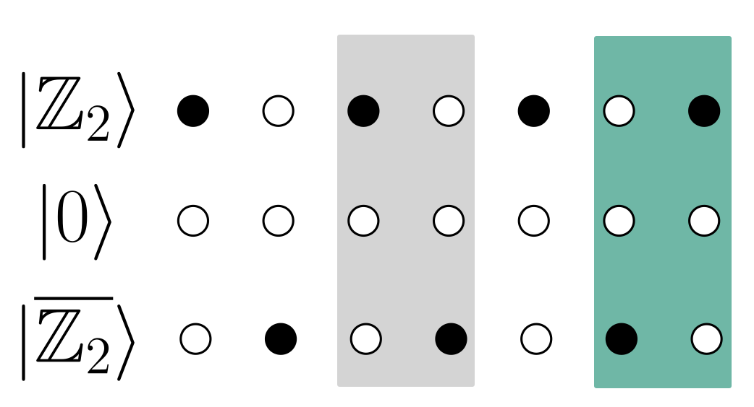
Mapping of S=½ QLM to PXP model
Gauge theory
PXP spin model:
each flux link is a spin
Particle on even site = electron
Gauss law = spin constraint
Hole on odd site = positron
Electric field =
or
Kinetic move:
allowed
forbidden
QLM kinetic move: a link arrow flips when a particle-hole pair is created or removed
Matter can be integrated out: physical states = flux strings
Empty site:
flux continues
Does the PXP model thermalize?
Matter:
flux reverses
[Surace et al., PRX 10, 021041 (2020)]

Slide 6
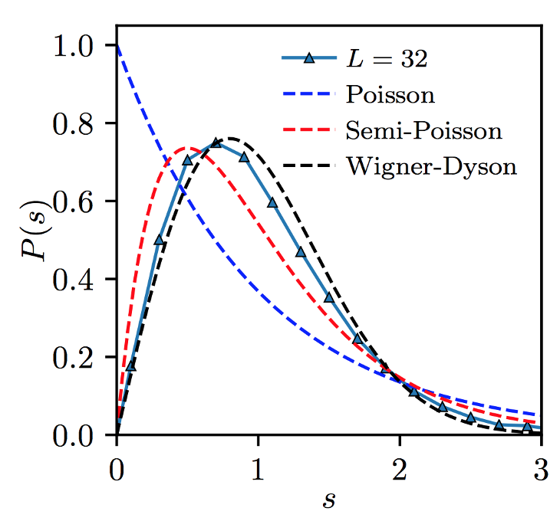
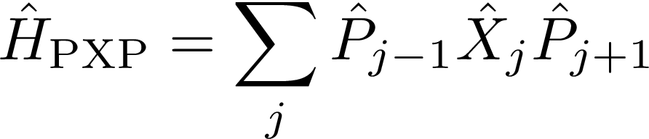

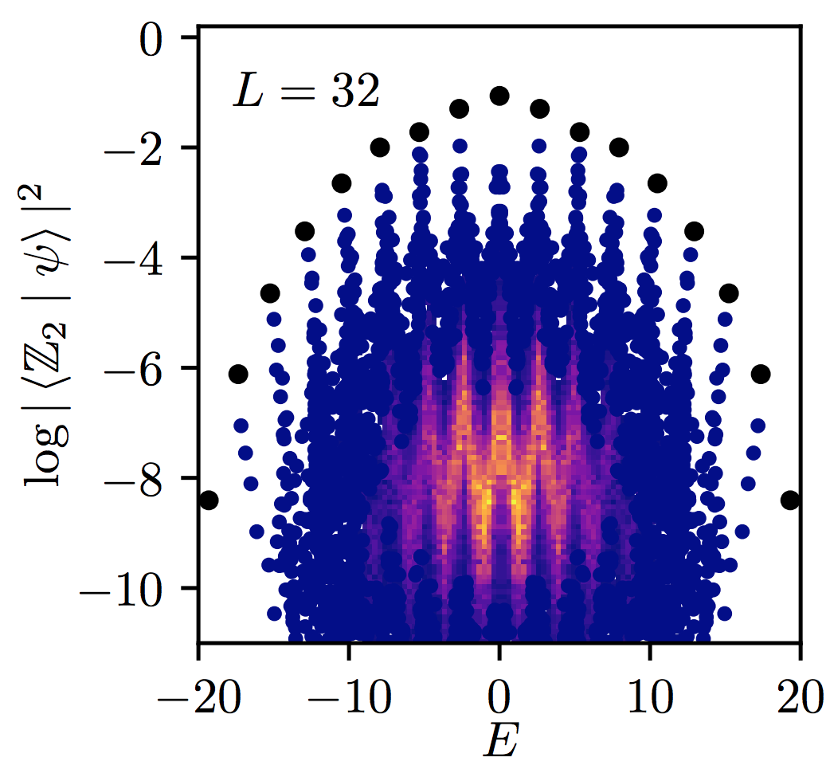
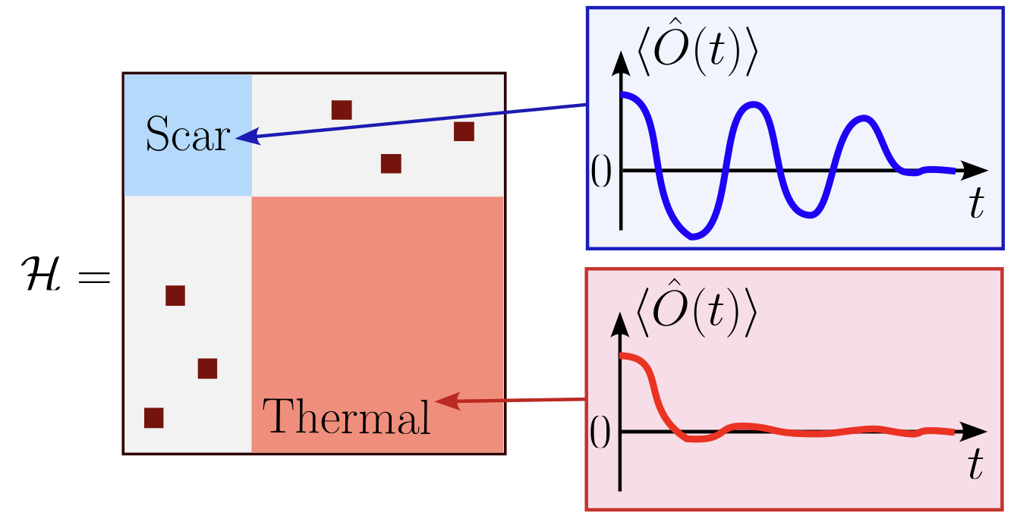
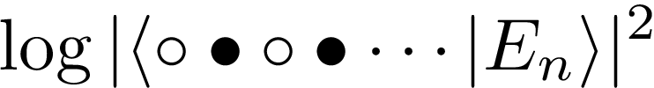

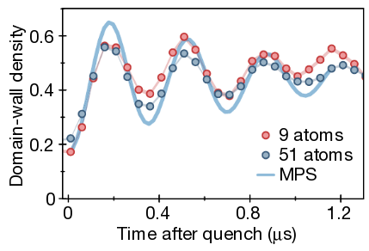

Quantum many-body scars in the PXP model
Level statistics converges to Wigner-Dyson (chaos)
Hilbert space fragmentation
1 neighboring excitation
no neighboring excitations
Physical sector (Gauss law)
Weak breakdown of ergodicity
(not due to symmetry or integrability).
What is left to understand?
Non-ergodic eigenstates throughout the spectrum – “quantum many-body scars”
Most initial state thermalize fast, but special states can have persistent revivals
Global quench from
[Turner, Michailidis, Abanin, Serbyn, Papic, Nature Physics 14, 745 (2018)]
persistent oscillations
[Bernien et al., Nature 551, 579 (2017)]
Notes:
Station Q, 11/1/2012
6

Slide 7

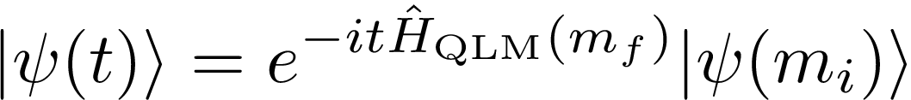
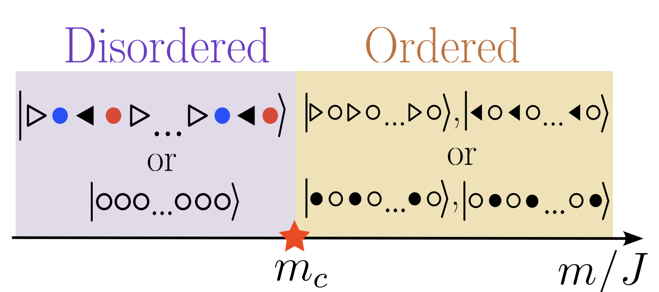


Open questions
In experiment, scar dynamics was observed in product states like
More general protocol where we ramp to some mass and evolve with a different one:
For what choices of masses is there ergodicity breaking?
[Bernien et al., ‘17]
Scarring beyond product states?
What is the role of defects due to Kibble-Zurek mechanism?
Ising critical point
[Coleman ‘76; Rico et al., ‘14]
Previous work predicted disappearance of scars at criticality
[Zhiyuan Yao et al., PRB 105, 125123 (2022); Han-Yi Wang et al., PRL 131, 050401 (2023)]

Slide 8
Outline
Outline
Thermalization and its breakdown in gauge theories
Quantum simulation using QuEra’s Rydberg atom array
Interplay of criticality & defects with ergodicity breaking
Conclusions
Milan Kornjaca
Tommaso Macri
[A. Daniel et al., PRB 107, 235108 (2023); A. Hudomal et al, to appear]
Ana Hudomal
Aiden Daniel
Notes:
Station Q, 11/1/2012
8

Slide 9
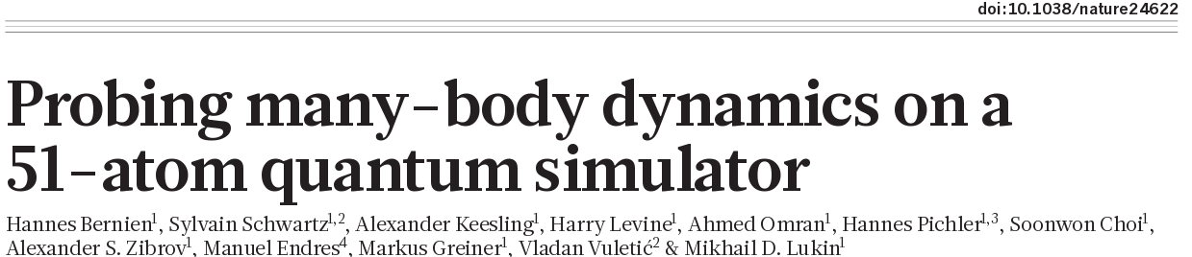

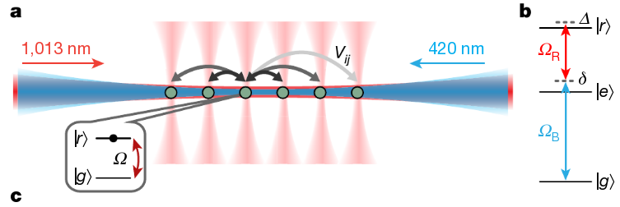


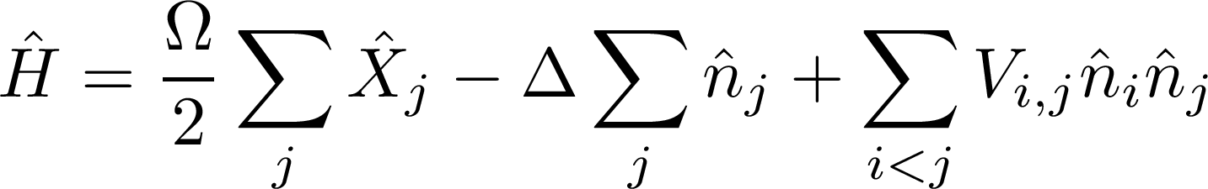
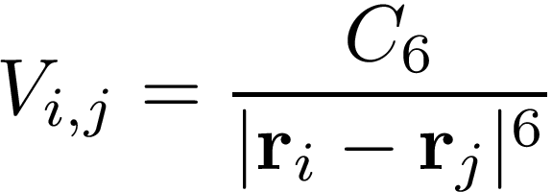
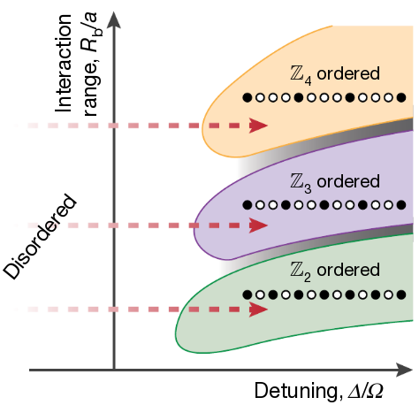


QuEra’s programmable Rydberg atom platform
These can be time-dependent!
Rabi
Detuning
van der Waals
Effective model is PXP when

Slide 10
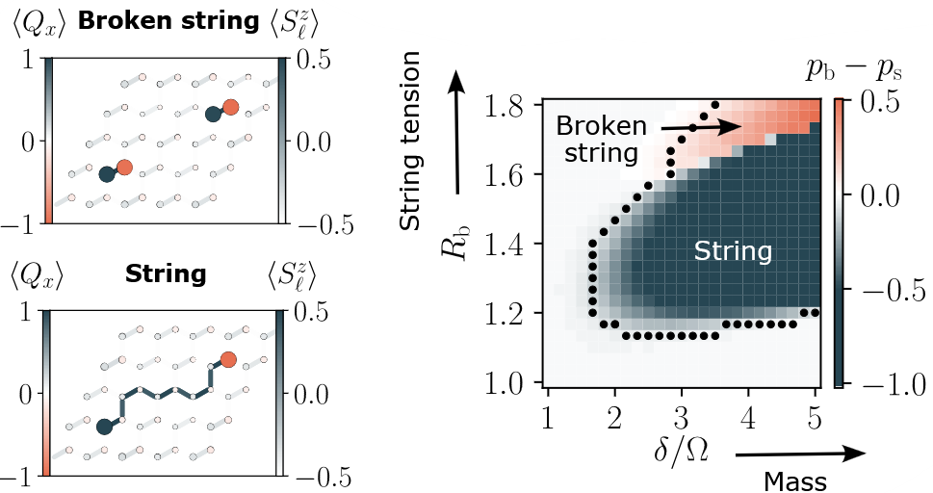
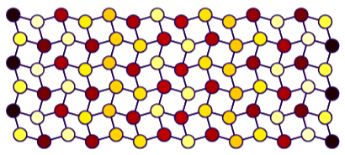
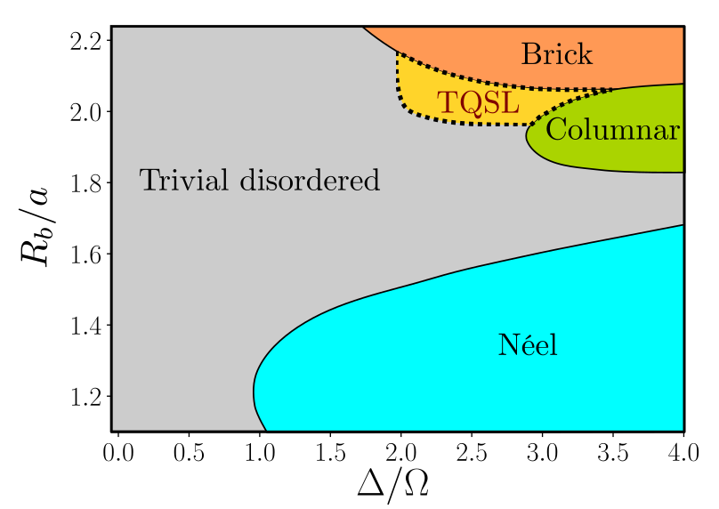
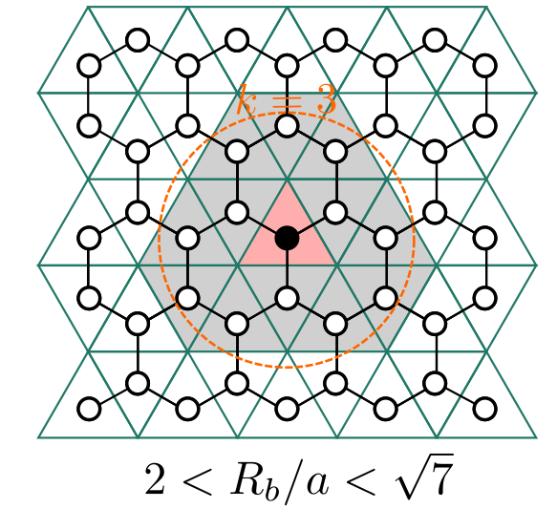
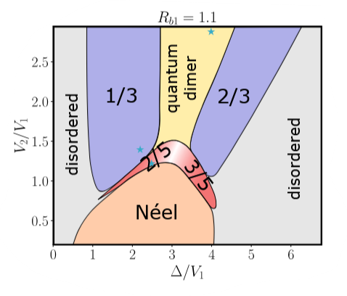
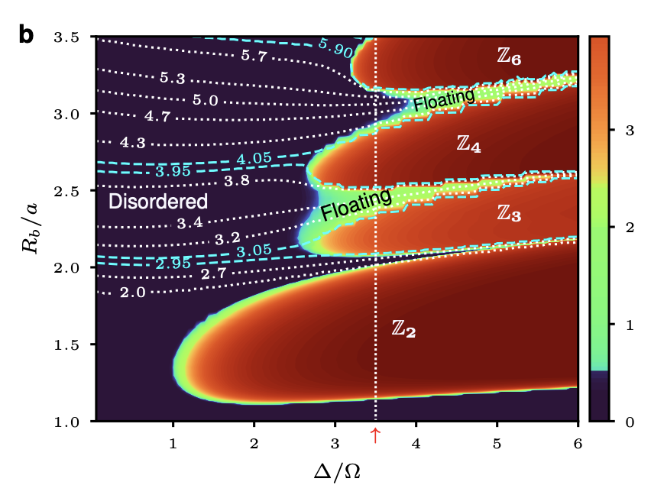
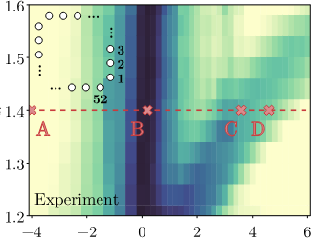

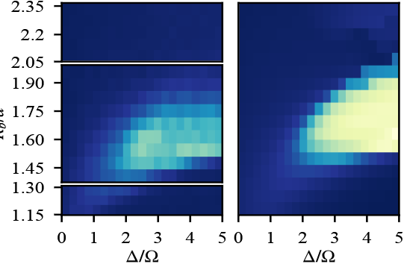
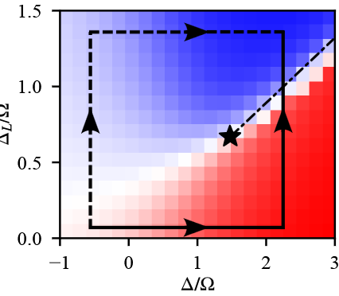
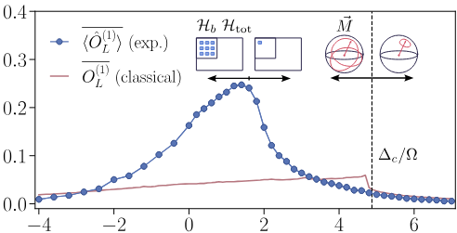
Analog quantum simulations with QuEra
Confinement and string breaking
Frustrated magnetism
Trimer spin liquid
Nature 642, 321 (2025)
M. Kornjaca et al., Commun. Phys. 6: 358 (2024)
Today: Ergodicity breaking & criticality in a gauge theory
Collab. With Shalaev, Boltasseva, Banerjee groups (Purdue & QSC) and AWS Braket
Quantum floating phases
Multicriticality & metastability
Prethermalization and dynamical phases
Zhang et al., Nat. Commun. 16: 712 (2025)
Collab. with NERSC, arXiv:2508.05737
Collab. with NERSC, arXiv:2510.11706

Slide 11
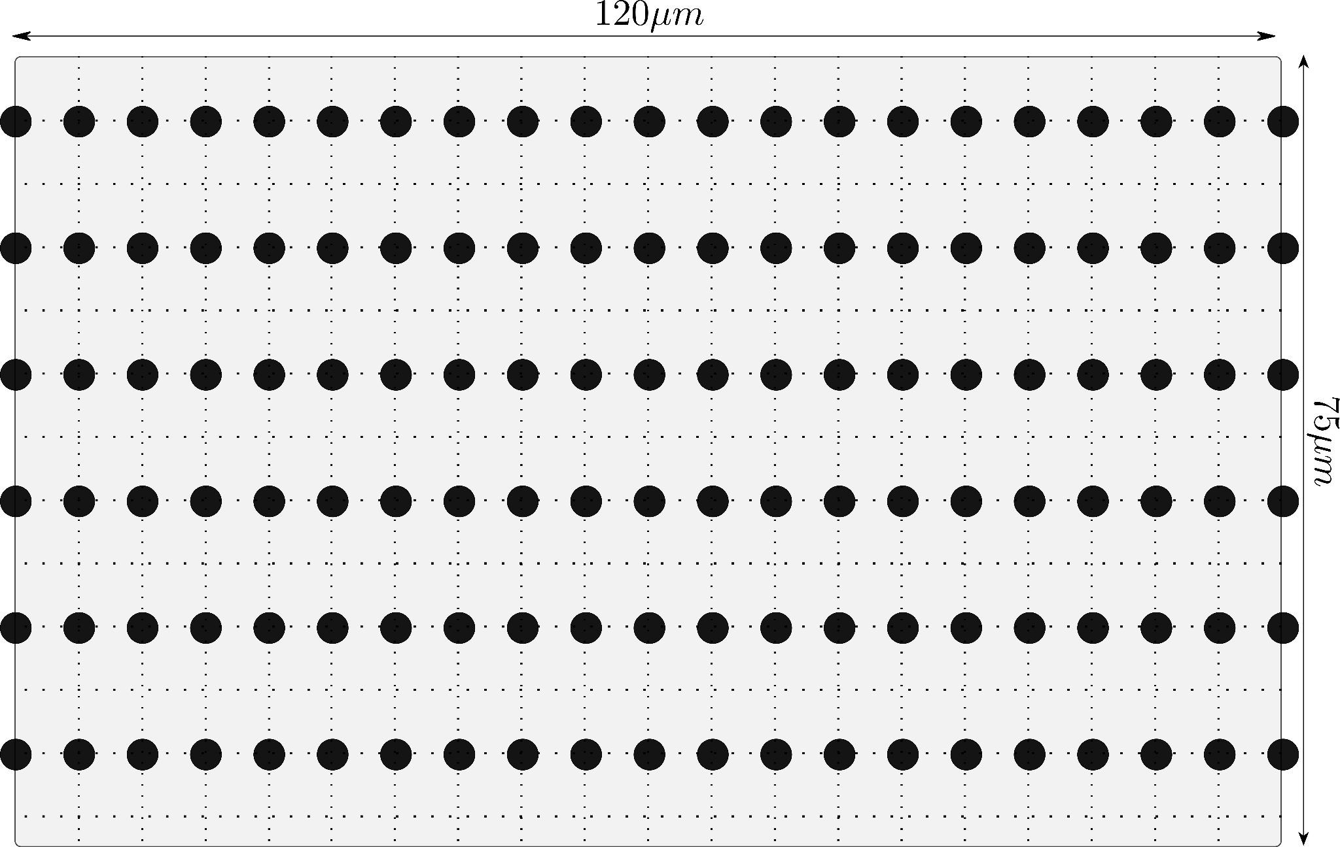
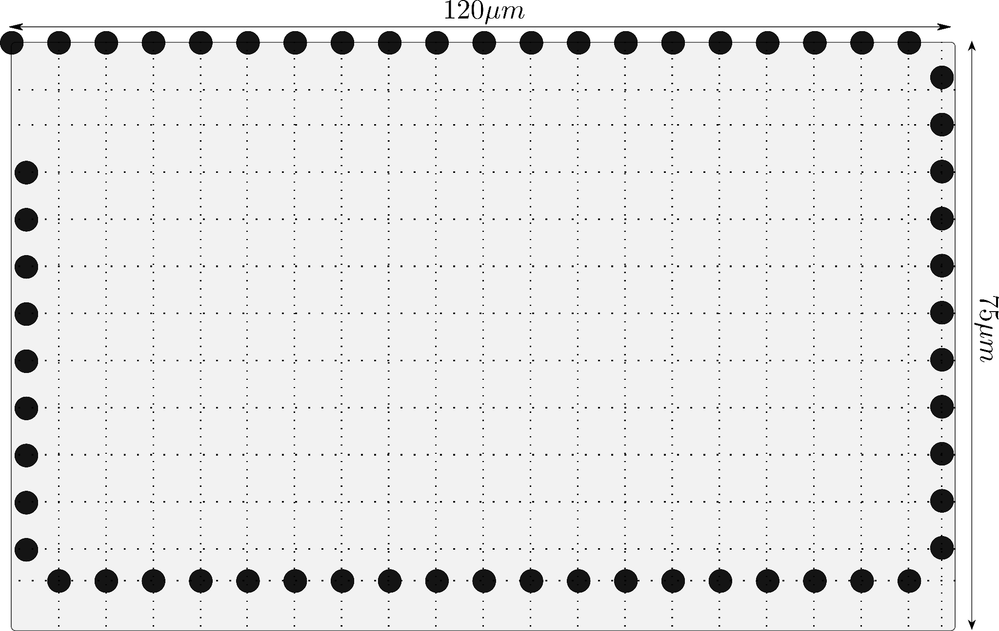
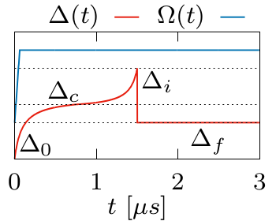

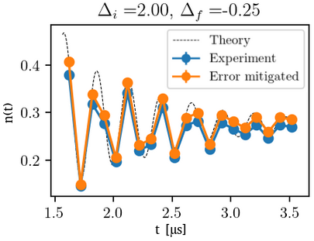

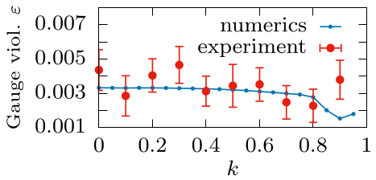
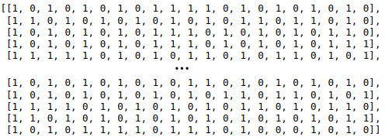
Experimental setup
Spatial arrangement
  six parallel short chains
  (21 atoms)
  one long chain (61 atoms)
  interatomic distance
→
State preparation
  all atoms initially in the
  ground state
  adiabatic sigmoid-type
  ramp to
H. Bernien et al., Nature 551, 579 (2017).
Quench to
  measurements
  error-mitigation

Slide 12
Outline
Outline
Thermalization and its breakdown in gauge theories
Quantum simulation using QuEra’s Rydberg atom array
Interplay of criticality & defects with ergodicity breaking
Conclusions
Milan Kornjaca
Tommaso Macri
[A. Daniel et al., PRB 107, 235108 (2023); A. Hudomal et al, to appear]
Ana Hudomal
Aiden Daniel
Notes:
Station Q, 11/1/2012
12

Slide 13
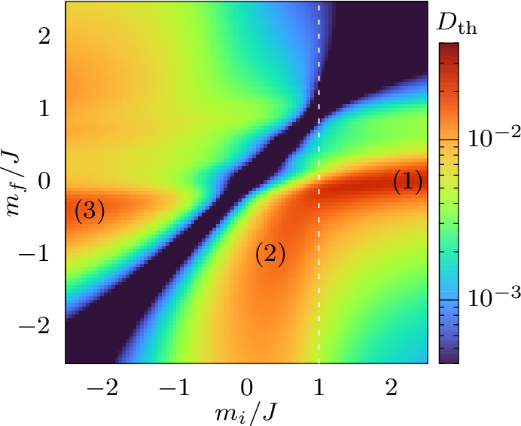
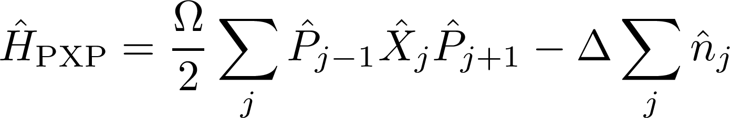




Dynamical phase diagram
PXP model with chemical potential
Z2 Ising
phase transition
fermionic mass in QLM
Ramp to some mass and evolve with a different one:
For what choices of masses is there ergodicity breaking?
Measure density of matter fields
and compute its deviation from thermal value:

Slide 14





Dynamical phase diagram
PXP model with chemical potential
fermionic mass in QLM
Ramp to some mass and evolve with a different one:
How to experimentally measure?
For what choices of masses is there ergodicity breaking?
Ergodicity breaking regions
Measure density of matter fields
(1) Néel/vacuum
(2) continuous QMBS family
(3) polarized/charge-proliferated
H. Bernien et al., Nature 551, 579 (2017).
and compute its deviation from thermal value:
A. Daniel et al., PRB 107, 235108 (2023).
G.-X. Su et al., PRResearch 5, 023010 (2023).

Slide 15
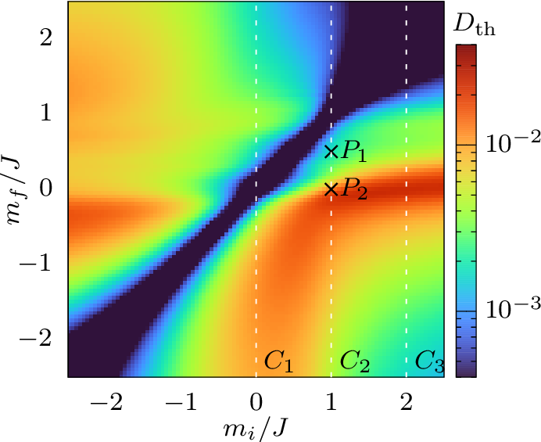
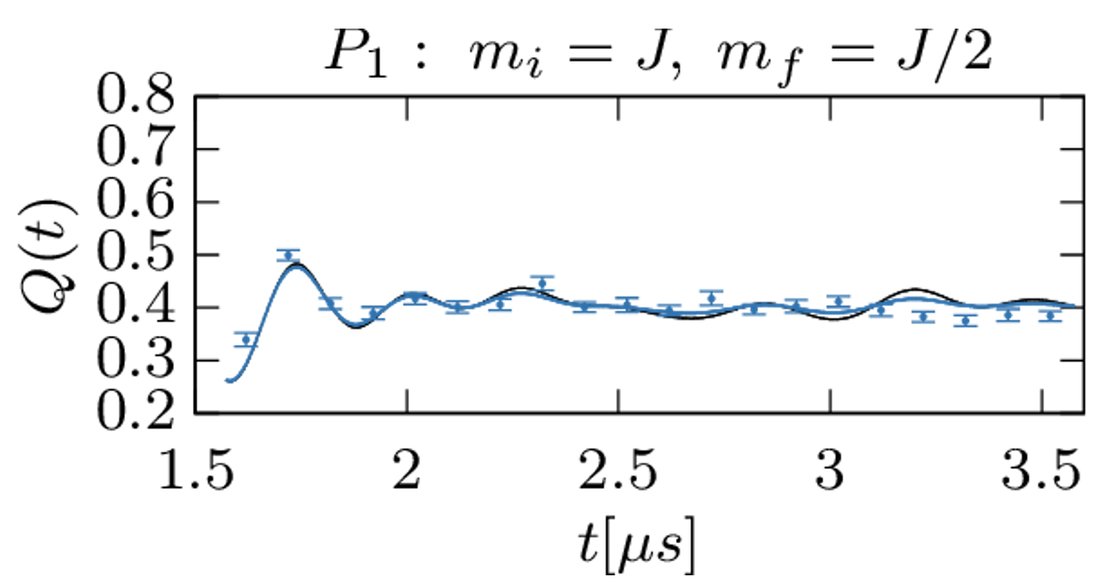
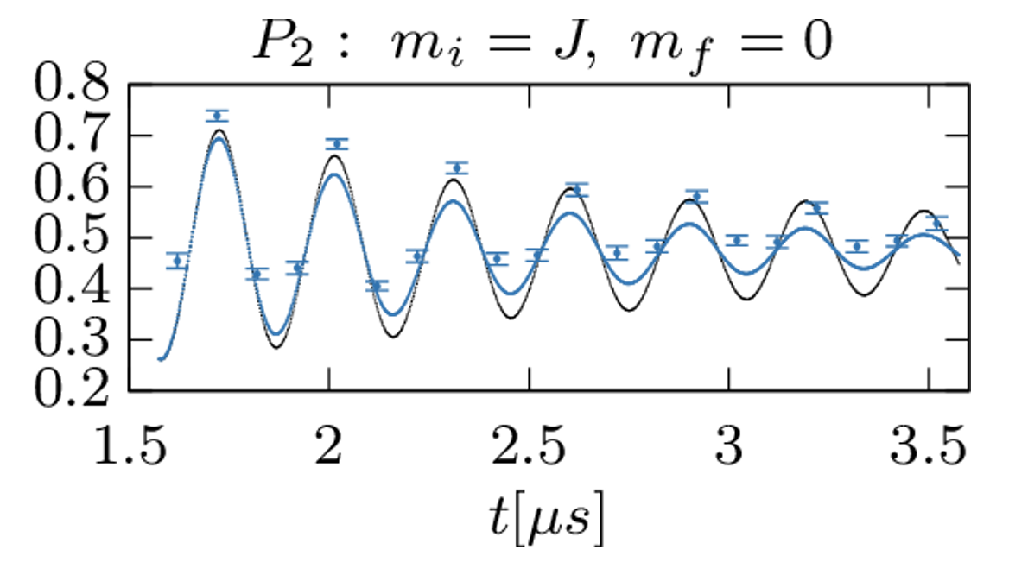
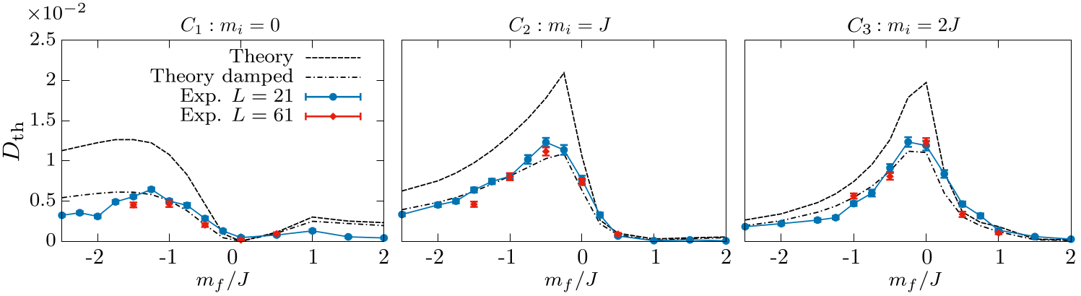

Experimental probe of dynamical phase diagram
damped theory
Persistent revivals from a critical (highly entangled) ground state

Slide 16







Why is the critical state so scarred?
Entanglement growth from the critical initial state is very slow and oscillating:
Entanglement in the initial state diverges as
Mechanism not yet fully understood!
A large part of the spectrum can be approximated by condensing magnons:
For this special value magnons are most weakly interacting
[A. Daniel et al., PRB 107, 235108 (2023)]

Slide 17





Scar dynamics & Kibble-Zurek mechanism
Crossing the quantum phase transition
relaxation time diverges
  formation of separate domains
  domain walls – topological defects
We use a sigmoid-type ramp
Regime with strong oscillations
  Rydberg: Néel state with defects
  QLM: vacuum state with particles
curvature parameter
A. Keesling et al., Nature 568, 207 (2019).
Prepared state is close to one of the flux states
(no matter)
Prepared state contains defects (electron-positron pairs)

Slide 18







Dynamics depends on density and type of defects
Clear correlation between total matter density and the height of first Fourier peak in the dynamics:
KZ-type theory describing this?
Type of defect is also important:
  “paired” defects
  “unpaired” defects
The dynamics of paired and unpaired defects is very different!

Slide 19
Outline
Outline
Thermalization and its breakdown in gauge theories
Quantum simulation using QuEra’s Rydberg atom array
Interplay of criticality & defects with ergodicity breaking
Conclusions
Milan Kornjaca
Tommaso Macri
[A. Daniel et al., PRB 107, 235108 (2023); A. Hudomal et al, to appear]
Ana Hudomal
Aiden Daniel
Notes:
Station Q, 11/1/2012
19

Slide 20
Conclusions
Rydberg atoms provide a versatile platform for probing ergodicity breaking in gauge theories
Quantum simulation of U(1) quantum link model demonstrated ergodicity breaking from a continuous family of initial conditions
Ergodicity breaking also found from a critical ground state with large entanglement, but mechanism not fully understood.
Crucial role of defects, refined Kibble-Zurek theory needed to explain the observations
Many open questions in 2D Rydberg arrays, other types of gauge theories, interplay with periodic driving, etc.

Slide 21
Thank you for attention!
Questions?

Slide 22




PCA entropy
What else can we measure?
Principal Component Analysis (PCA) entropy
  proxy for entanglement entropy
  Shannon entropy defined on a data matrix
  containing the experimental bitstrings
  normalized singular values
  of the bitstring matrix
Quench dynamics
  non-QMBS:
  saturates
  QMBS: persistent
  oscillations
  same frequency
  as local observables

Slide 23

Phase transition point

Slide 24

Scarred states with periodic defects

Slide 25

Bitstring statistics

