Slide 1





Hilbert space fragmentation and disorder-free localisation in the lattice Schwinger model
Jared Jeyaretnam
Nottingham
Tanmay Bhore
Leeds
Zlatko Papic
Leeds
Jad C. Halimeh
Munich
Jesse J. Osborne
Queensland
Jeyaretnam et al., Commun Phys 8, 172 (2025)
Notes:
Thanks <host>. Today I'd like to talk about some work I did on disorder free localisation when I was at Leeds, which is now published in Communications Physics.

Slide 2
Outline
Thermalisation and its breakdown in gauge theories
Disorder-free localisation in the Schwinger model
Conclusions & outlook
Notes:
To understand localisation and why it’s special, I first need to cover the usual scenario of thermalisation, and how it can break down in lattice gauge theories.

Slide 3

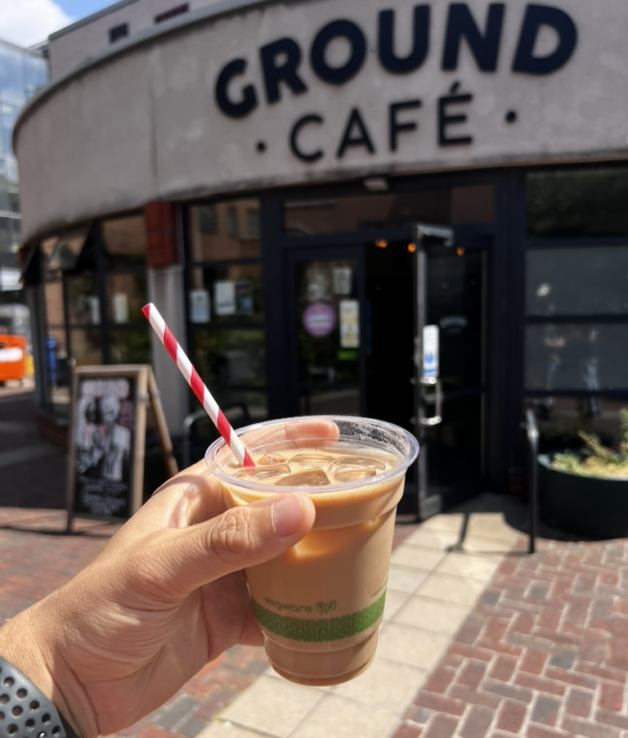

Thermalisation: classical and quantum
Room temperature
Unitary dynamics
$$\sim 1{fm}/c$$
Memory of initial conditions is lost!
Notes:
We all know that when we forget a hot cup of coffee on our desk and find it hours later, it’ll have gone cold. In the same way, an iced coffee (like this one from the campus coffee shop) will melt and heat up - reaching thermal equilibrium.
Likewise in the quantum setting, a heavy ion collision will rapidly become a locally thermal plasma through unitary time evolution, in an astonishingly short time.
What unifies both these scenarios is that memory of initial conditions is lost, with the final state controlled only by globally conserved quantities such as total energy. And this is not just a generic phenomenon but the default, across both classical and quantum settings.
But is there some way to avoid this fate?

Slide 4
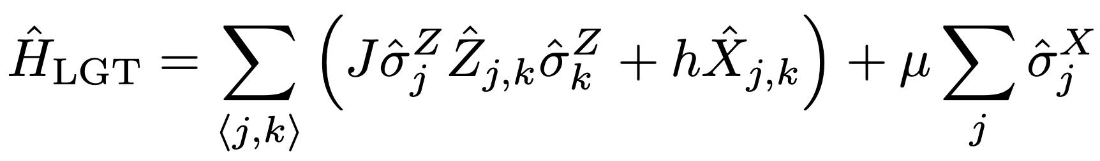
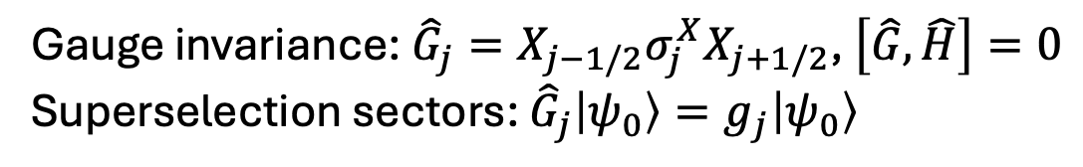

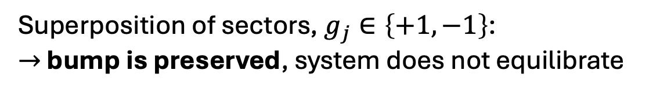
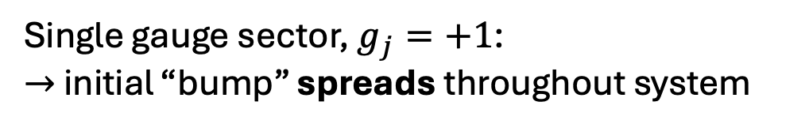
Arresting thermalisation in a gauge theory?
Recent Google experiment simulated a $ℤ_{2}$ LGT:
coupling
gauge field
matter
Gauge invariance: ${\hat{G}}_{j}=X_{j−1/2}σ_{j}^{X}X_{j+1/2}$, $\left[\hat{G}, \hat{H}\right]=0$
Superselection sectors: ${\hat{G}}_{j}\left|ψ_{0}\right\rangle =g_{j}\left|ψ_{0}\right\rangle$
How do we explain this?
Single gauge sector, $g_{j}=+1$:
$→$ initial “bump” spreads throughout system
Superposition of sectors, $g_{j}∈\left\{+1, −1\right\}$:
$→$ bump is preserved, system does not equilibrate
[1] Google Quantum AI et al., Science 393, 71-75 (2026)
Notes:
Some clues come from a recent Google experiment that simulated a Z2 lattice gauge theory.
[click]
In this model, gauge invariance gives us superselection sectors indexed by the generators of Gauss's law, giving us these binary conserved quantities g sub j.
The system was initialised with a flipped electric field in the middle of the chain, acting as a spatially-localised perturbation away from an equilibrium state.
[click]
When the initial matter configuration is chosen to satisfy the gauge constraint, g_j = +1 everywhere, the initial bump rapidly spreads out and so the system thermalises.
[click]
However, when we rotate the matter fields such that the initial state is spread over many superselection sectors, we see that initial bump is preserved and localised in space. How do we explain this?

Slide 5
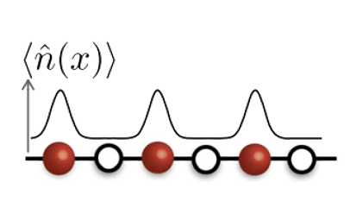

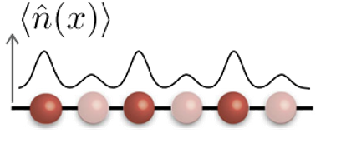
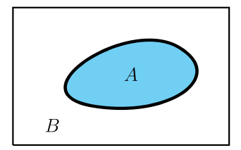
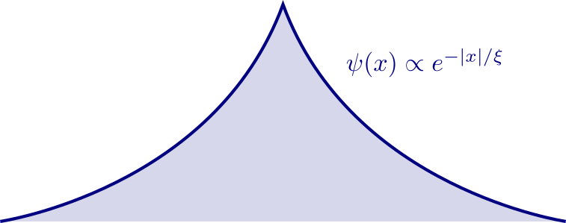
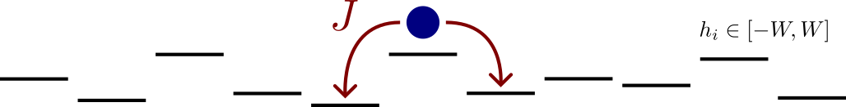
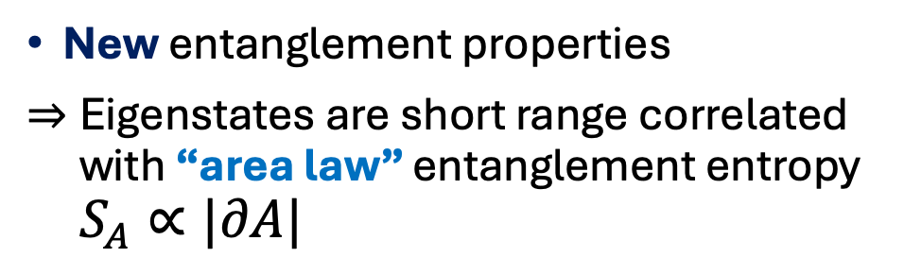
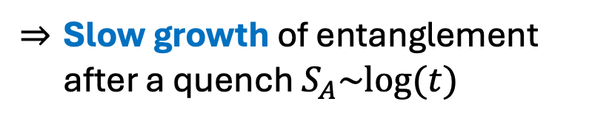

Many-Body Localisation (MBL)
Interacting system + strong disorder
Memory of initial conditions
Generic violation of thermalisation
D. A. Abanin, E. Altman, I. Bloch, and M. Serbyn, RMP 91, 021001 (2019)
Can this physics arise in LGTs without disorder?
New entanglement properties
Eigenstates are short range correlated with “area law” entanglement entropy $S_{A}∝|∂A|$
Interacting cousin of Anderson localisation [P.W. Anderson, 1958]
$$∂A$$
﻿Slow growth of entanglement after a quench $S_{A}\sim log{(t)}$
Notes:
To answer that, let me introduce many-body localisation. This is a broad phenomenon where adding strong disorder (such as a random local field) to an interacting system produces long-lived memory of initial conditions.
For example, if we initialise particles on odd sites, at late times the density will retain a strong imprint of that initial pattern. As a result, such a system never thermalises.
[click]
This is very closely related to Anderson localisation, which we've known about since the 50s, in which disorder causes single particles to become exponentially localised in space.
[click]
MBL results in certain entanglement properties which can be regarded as smoking guns of the phenomenon.
Firstly, the eigenstates of such a system are only locally entangled, such that the entanglement entropy across a cut proportional to the length of that cut, a so-called "area law".
Furthermore, following a quench from an unentangled product state, the entanglement grows logarithmically in time.
Having seen how localisation typically arises, the key question now is how does the same phenomenon arise in a disorder-free and translationally-invariant lattice gauge theory?

Slide 6
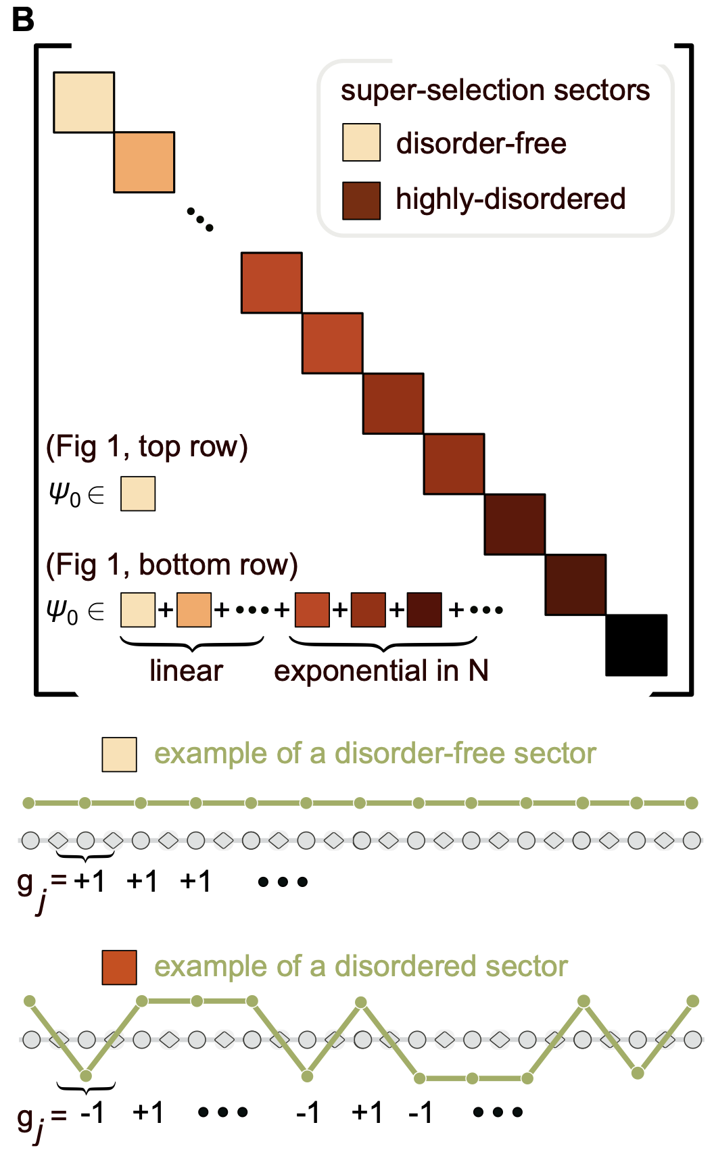
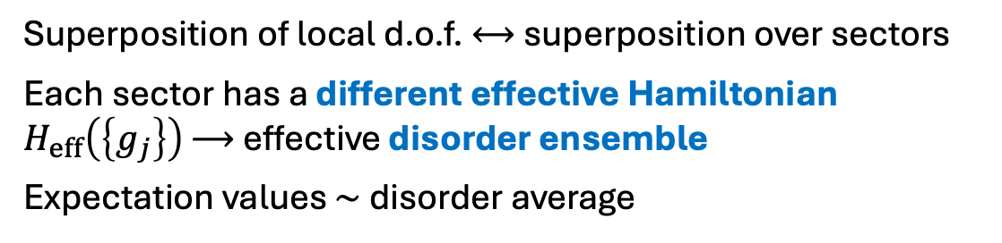
Gauge constraint induces effective disorder
Hamiltonian is block diagonal in superselection sectors $\left\{g_{j}\right\}$
Superposition of local d.o.f. $⟷$ superposition over sectors
Each sector has a different effective Hamiltonian $H_{eff}\left(\left\{g_{j}\right\}\right)$ $⟶$ effective disorder ensemble
Expectation values $∼$ disorder average
Quantum parallelism can efficiently perform disorder average!
Paredes, Verstraete, Cirac, PRL 95, 140501 (2005)
A. Smith et al., PRL 118, 266601 (2017)
Google Quantum AI et al., Science 393, 71-75 (2026)
What about in a U(1) LGT?
Figure: Google Quantum AI et al., Science 393, 71-75 (2026)
Notes:
The answer lies in gauge invariance.
In a lattice gauge theory, gauge invariance decomposes the Hamiltonian into blocks known as superselection sectors, indexed by local conserved charges g_j.
[click]
But with a simple superposition of our local degrees of freedom (i.e. either the matter or gauge fields) we can obtain a superposition over exponentially many sectors.
Each one of these sectors has a different effective Hamiltonian, almost all of which will be highly disordered, and as a result we obtain an effective disorder ensemble. Expectation values of observables at late times will be equivalent to averaging over many runs in single sectors.
[click]
This exactly explains the Google results I showed earlier: we are leveraging quantum parallelism to average over the whole ensemble in one run. This quantum advantage in experiments is one reason why disorder free localisation attracts so much interest.
[click]
But what about a more complex system, such as a U(1) LGT?

Slide 7
Outline
Thermalisation and its breakdown in gauge theories
Disorder-free localisation in the Schwinger model
Conclusions & outlook
Notes:
To answer this, let's look at the lattice Schwinger model in 1+1D

Slide 8
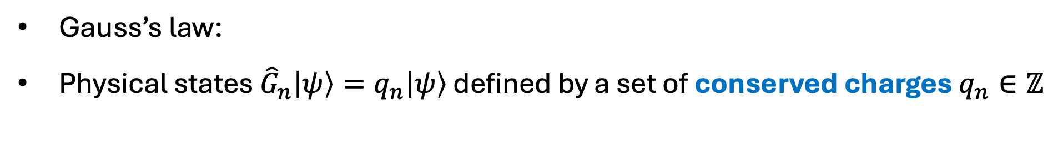
The Schwinger model: a U(1) LGT in 1+1D
J. Schwinger, Phys. Rev. 82, 914 (1951)
J. Kogut and L. Susskind, Phys. Rev. D 11, 395 (1975)
T. Banks, L. Susskind, and J. Kogut, Phys. Rev. D 13, 1043 (1976)
staggered fermions
electric field
Gauss’s law:
Physical states ${\hat{G}}_{n}\left|ψ\right\rangle =q_{n}\left|ψ\right\rangle$ defined by a set of conserved charges $q_{n}∈ℤ$
Effective model in superselection sectors?
Notes:
The lattice Schwinger model represents QED, with electrons and positrons on even and odd sites, and and a U(1) electric field.
[click]
Gauss's law then gives us a set of superselection sectors indexed by conserved integer charges q_n.
[click]
So what does the effective model look like within these sectors? Is it disordered, like in the Google experiment?

Slide 9
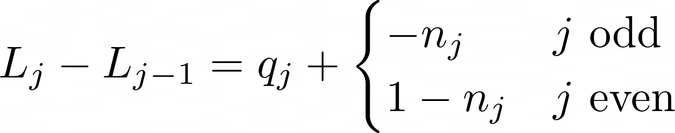
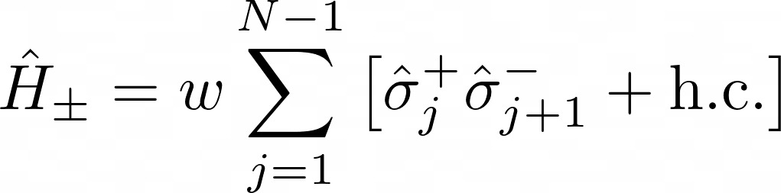
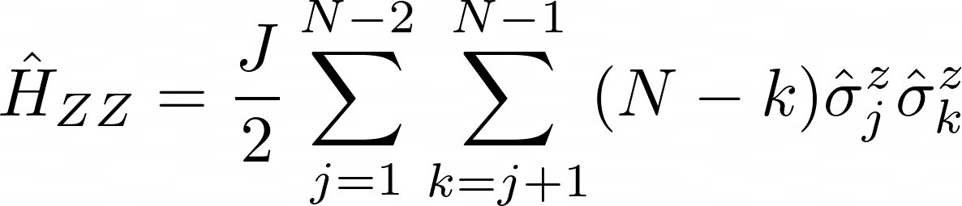
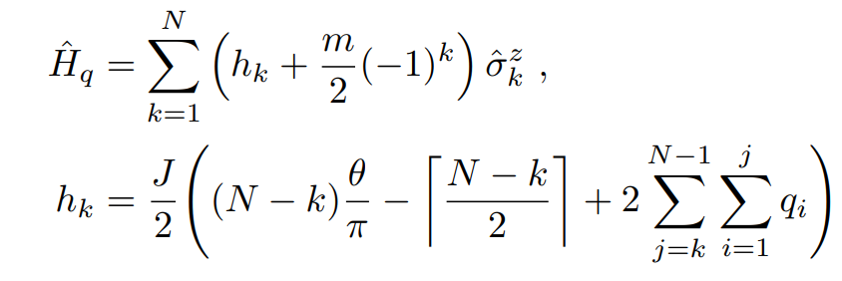
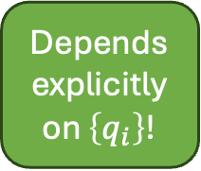
Mapping the Schwinger model to a spin chain
Background charges
Martinez et al., Nature 534, 516 (2016)
Coulomb force between fermions and background
Depends explicitly on $\left\{q_{i}\right\}$!
Encodes Coulomb force in 1D
Notes:
The conserved quantities q sub j in the model can be regarded as background charges which balance the gradient in the gauge field with the local matter density. If we use these to eliminate the fields and thebn convert the fermions to spins using Jordan-Wigner, we obtain a spin Hamiltonian. This has three terms.
[click]
The first is a simple XY-type spin hopping term with strength w, which is equivalent to pair creation/annihilation in the fermionic picture.
[click]
The second is a complicated all-to-all spin interaction with coupling strength J, which turns out to encode a linear coulomb potential between the fermions.
[click]
Finally, we have a local field in the z direction which encodes the same coulomb force between fermions and the background charges. It's complicated, but the key thing to note is that it depends explicitly on the background charge configuration. So our effective model has a disordered background charge.

Slide 10
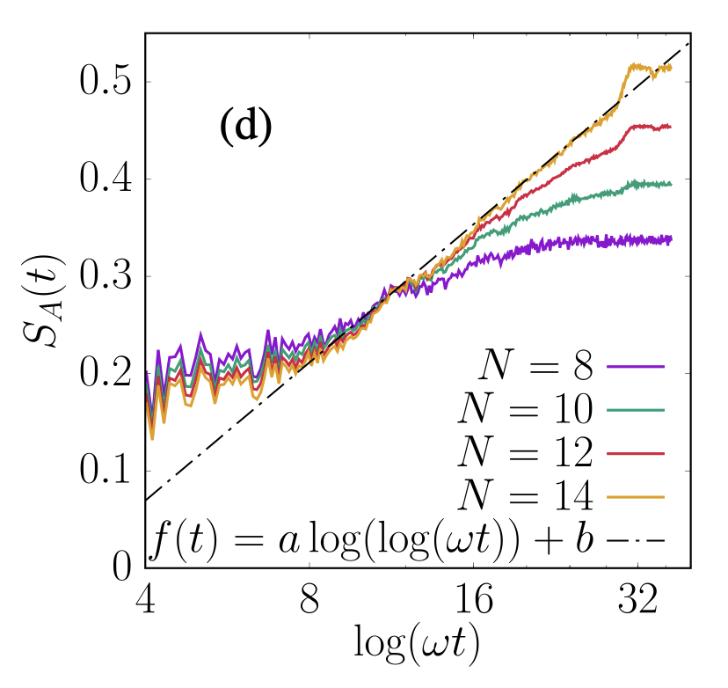
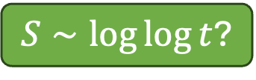
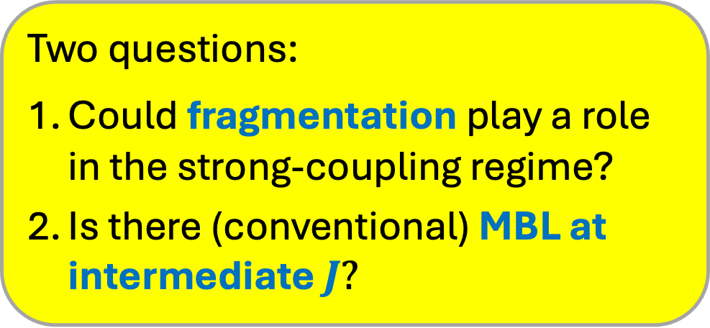

Previous studies claimed ultraslow dynamics
Initial state: $\left|vac\right\rangle =|101010...⟩$ , $q_{n}∈\{−1, 0, +1\}$
$$J=10$$
Entanglement growth appears even slower than MBL:
$S∼\log{\log{t}}$?
But its origin has not been identified and J is very large.
Two questions:
Could fragmentation play a role in the strong-coupling regime?
Is there (conventional) MBL at intermediate $J?$
M. Brenes, M. Dalmonte, M. Heyl, and A. Scardicchio
Phys. Rev. Lett. 120, 030601 (2018)
See also:
G. Giudici et al., PRR 2, 032034(R) (2020)
C. Muschik et al, New J. Phys. 19 103020 (2017)
Notes:
So do we get MBL in this theory?
Previous studies have looked dynamics following a quench from the vacuum state, which in the spin language is an alternating CDW.
[click]
We see what appears to be an ultraslow growth of entanglement entropy – possibly even double-logarithmic in time. But there’s no explanation for this, and it only appears at very strong coupling J.
[click]
We’re left with two key questions:
Could fragmentation play a role in the strong-coupling regime?
Is there (conventional) MBL at intermediate coupling$?$

Slide 11
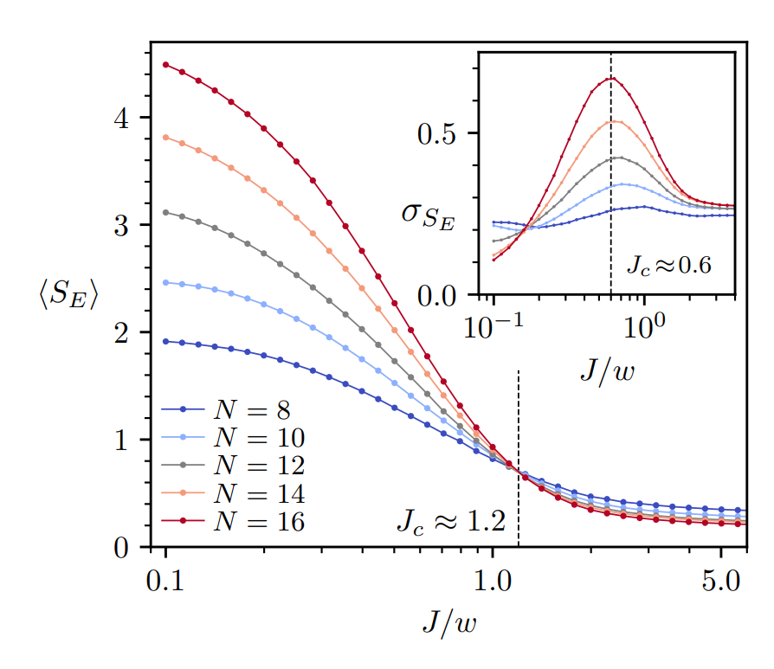

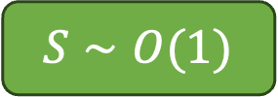
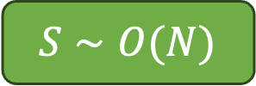

$J∼w$ regime: MBL eigenstates
$$H=wH_{±}+J[H_{ZZ}+H_{q}\left(\left\{q_{n}\right\}\right)]$$
Bipartite entanglement entropy of eigenstates:
$$S∼O(N)$$
Localisation!
$$ρ_{A}={Tr}_{B}\left(\left|ψ\right\rangle \left\langle ψ\right|\right)$$
$S_{A}=Tr\left(ρ_{A}\log{ρ_{A}}\right)$
$$S∼O(1)$$
Jeyaretnam et al., Commun Phys 8, 172 (2025)
Notes:
First, let's look at the intermediate coupling regime, where coupling strength J is similar to hopping strength w.
We study the bipartite entanglement entropy of mid-spectrum eigenstates entropy [DEFINE THIS WITH EQUATION!]. For chaotic systems, these have extensive entanglement, whereas for localised systems in 1D, this will be O(1)
[click]
Indeed we see a very clean crossover in the entanglement entropy, with a corresponding spike in the variance of this quantity - a smoking gun of a localisation transition.

Slide 12

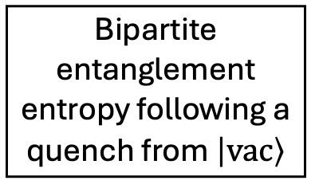



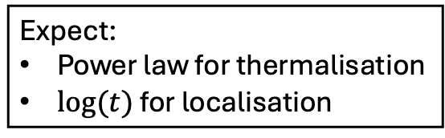
$J∼w$ regime: MBL dynamics
$$H=wH_{±}+J[H_{ZZ}+H_{q}\left(\left\{q_{n}\right\}\right)]$$
Bipartite entanglement entropy following a quench from $\left|vac\right\rangle$
MPS simulation, $N=50$
$$S∼\log{t}$$
Expect:
Power law for thermalisation
$log⁡(t)$ for localisation
$$J=3.0$$
Notes:
We can also look at the dynamics in this regime. Using a tensor network simulation over 50 sites, we calculate the growth in bipartite entanglement entropy following a quench from the unentangled vacuum state. For chaotic systems, we expect a power law, whereas for localised systems, we expect this to grow logarithmically in time.
We find that the entanglement growth is consistent with localisation - although on the numerically accessible timescales, we couldn't distinguish this from a power law with a small exponent.

Slide 13
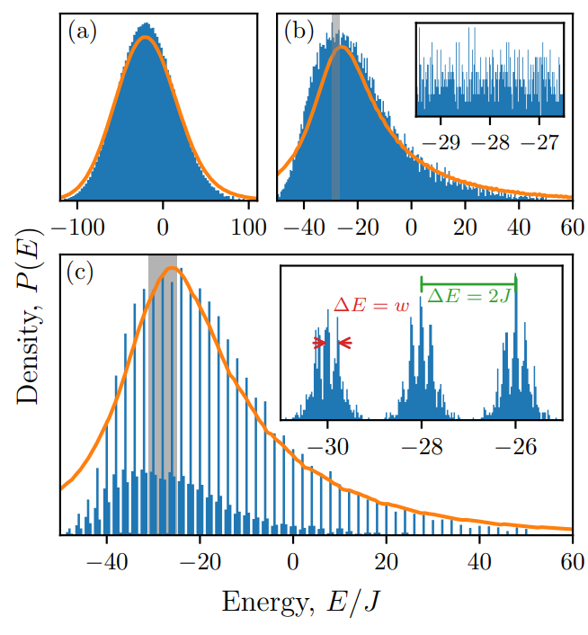
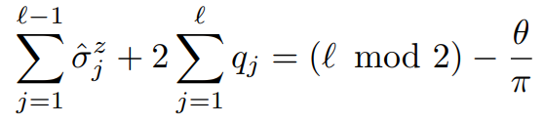

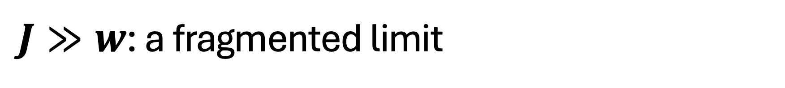

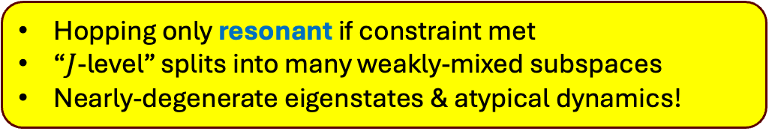

$J≫w$: a fragmented limit
$$\frac{J}{w}=0.1$$
?
$$\frac{J}{w}=1$$
$$\frac{J}{w}=5$$
Constraint: dynamical charges screen background charges
Hopping only resonant if constraint met
“$J$-level” splits into many weakly-mixed subspaces
Nearly-degenerate eigenstates & atypical dynamics!
Notes:
Smooth DOS for small coupling. Fragments into peaks with separation 2J at large coupling. But subpeaks with separation w. Why?
Consider exchanging two spins, equivalent to creating/destroying a particle-antiparticle pair. This normally incurs a large energy penalty proportional to J, due to coulomb forces.
However, if this equation is satisfied – that is, if dynamical charges screen the background charges – there is no energy cost!
Basis states split into energy levels in multiples of 2J. But even within an energy level, the states are not fully connected under the hopping term.

Slide 14
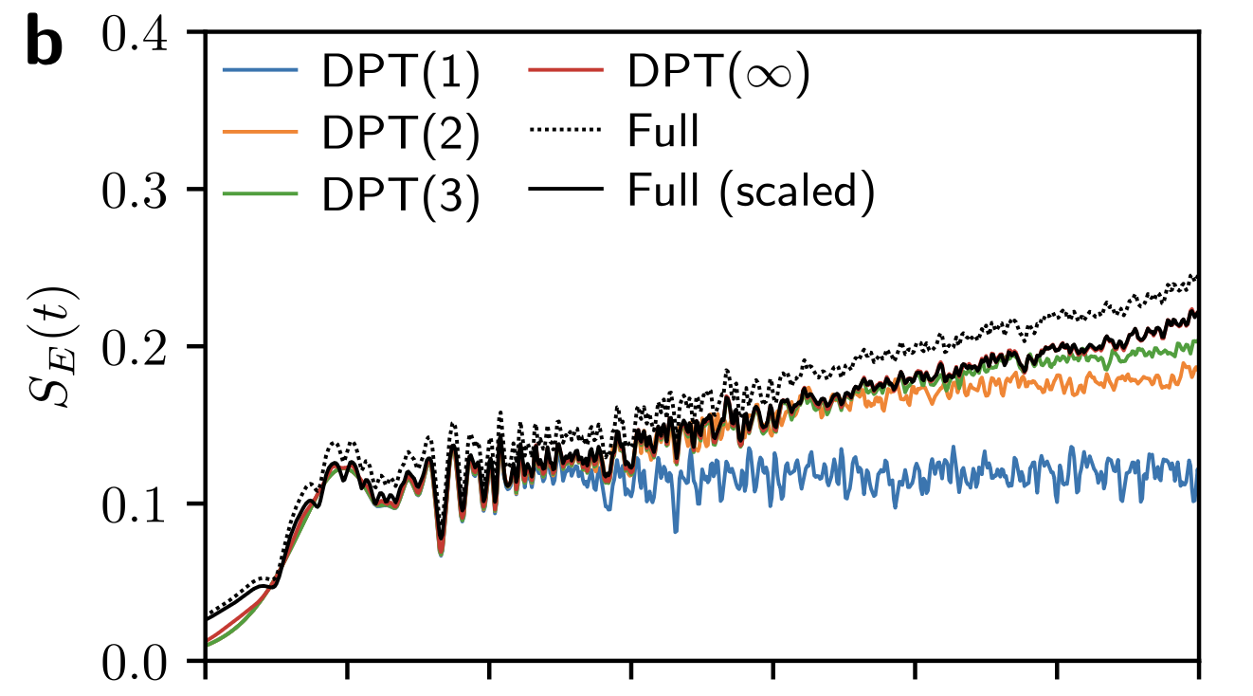
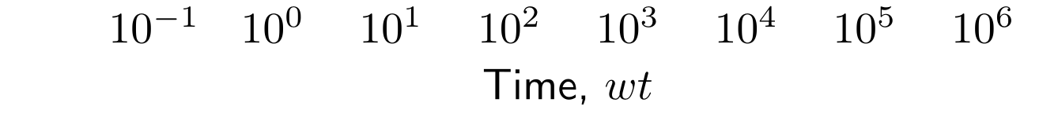
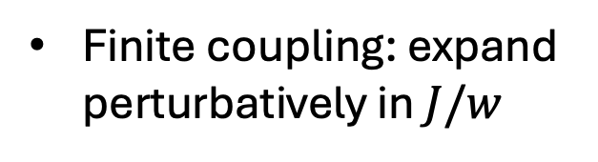
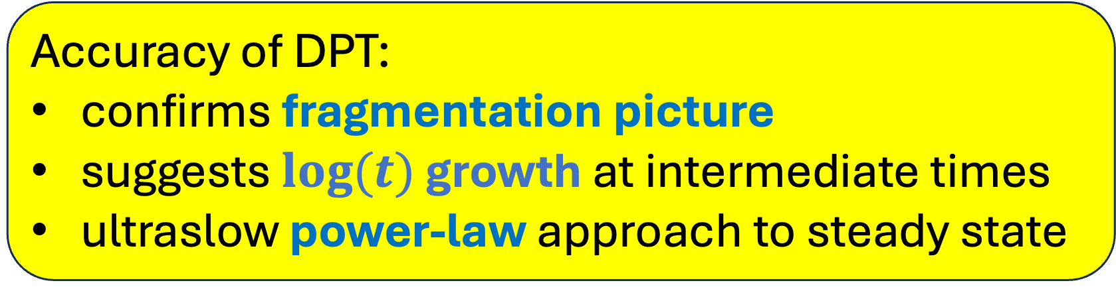
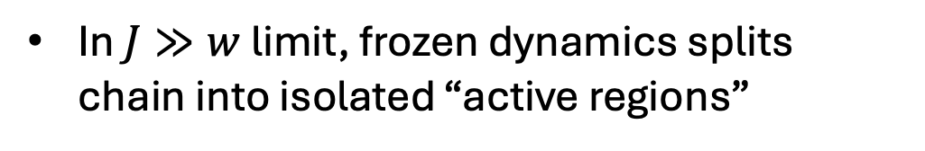
Degenerate Perturbation Theory (DPT)
Accuracy of DPT:
confirms fragmentation picture
suggests $log⁡(t)$ growth at intermediate times
ultraslow power-law approach to steady state
In $J≫w$ limit, frozen dynamics splits chain into isolated “active regions”
In limit, Hamiltonian is block diagonal: Hilbert space fragmentation
DPT reproduces late-time dynamics
Finite coupling: expand perturbatively in $J/w$
virtual hops via other energy levels
Notes:
In the infinite coupling limit, this restriction ensures that only certain parts of the chain permit resonant hopping and have active dynamics, while other spins are frozen.
[click]
As a result the effective Hamiltonian is block diagonal, and the Hilbert space fragments into disconnected subspaces.
[click]
However, at finite coupling, this fragmentation is only approximate, and we can perturbatively expand an effective Hamiltonian in powers of w/J, corresponding to dynamics from virtual hops via other energy levels.
[click]
This predicts observables following a quench with very high accuracy – including non-local and non-linear observables like entanglement entropy.
We can see as we go from first-order – exact fragmentation – to second and third-order, perturbation theory becomes accurate for longer times. In fact, we can numerically obtain the infinite-order dynamics and it agrees perfectly with the full dynamics, up to a simple rescaling.
[click]
This confirms this fragmentation picture is valid, and furthermore we were able to show in our paper that this implies at intermediate times we have the normal MBL behaviour of logarithmic growth of entanglement entropy. It’s only at late times this crosses over to a slow power-law approach to a steady state.

Slide 15
Outline
Thermalisation and its breakdown in gauge theories
Disorder-free localisation in the Schwinger model
Conclusions & outlook
Notes:
Finally some closing remarks.

Slide 16
Conclusions
Jeyaretnam et al., Commun Phys 8, 172 (2025)
U(1) LGTs can also exhibit disorder-free localisation
Conventional MBL at intermediate coupling
Strong coupling is controlled by proximity to a fragmented limit
Notes:
Studying tentative disorder free localisation in the lattice Schwinger model in 1+1D, we found a regime resembling conventional MBL at intermediate coupling.
However, at strong coupling, dynamics are controlled by proximity to a Hilbert space fragmented limit at infinite coupling, and so we get very slow unconventional dynamics.
This is

Slide 17
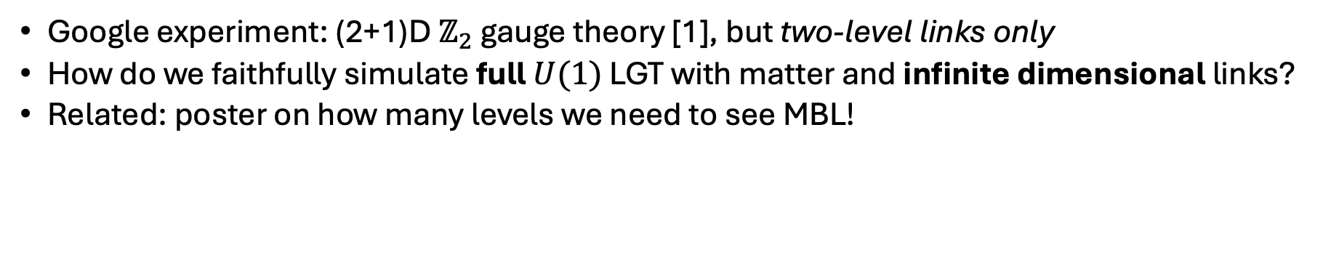
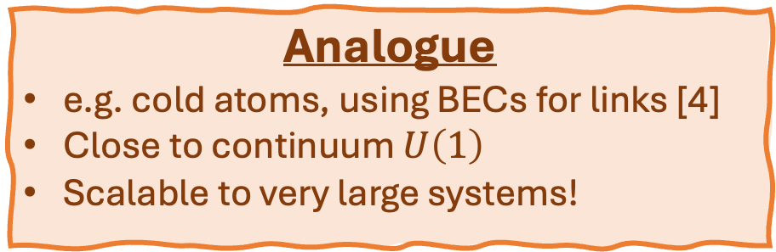
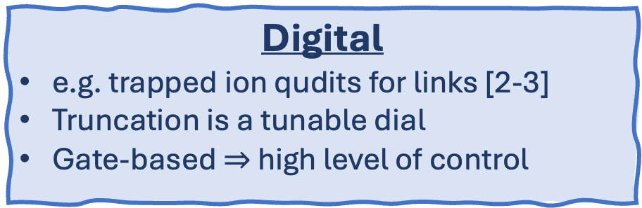
Quantum simulation?
[1] Google Quantum AI et al., Science 393, 71-75 (2026)
[2] M. Meth, L. Dellantonio et al., Nat. Phys. 21, 570–576 (2025).
[3] R. Joshi et al., arXiv:2507.12614 [quant-ph]
[4] A. Mil, P. Hauke et al., Science, 367, 1128-1130 (2020)
[5] V. Ale, T. Rainaldi, E. Rico et al., JHEP 2026, 122
[6] J. M. Alcaine-Cuervo, E. Rico et al., arXiv:2601.23150 [quant-ph]
[7] See Simon William’s talk, Monday
Google experiment: (2+1)D $ℤ_{2}$ gauge theory [1], but two-level links only
How do we faithfully simulate full $U(1)$ LGT with matter and infinite dimensional links?
Related: poster on how many levels we need to see MBL!
Digital
e.g. trapped ion qudits for links [2-3]
Truncation is a tunable dial
Gate-based $⇒$ high level of control
Analogue
e.g. cold atoms, using BECs for links [4]
Close to continuum $U\left(1\right)$
Scalable to very large systems!
Local control and readout
Faithful links
Large systems
Hybrid approaches with continuous variables? e.g. [5-7]
Notes:
Caveat that you’re not an expert on this…
This slide most of all needs callouts to other talks.
There were many talks which mentioned implementations of QLMs, e.g. Marina Krstic Marinkovic, Elisa Ercolessi.
Implementation of QED, Xiaojun Yao.
Luca Dellantonio on [2]
Phillip Hauke on [4]
Simon Willams talked extensively about qumodes.
Enrique Rico from [5] speaks, ask him too.
MUST CITE arXiv:2601.23150 [quant-ph]
FOR QUESTIONS: Gauge protection: https://journals.aps.org/prxquantum/pdf/10.1103/PRXQuantum.2.040311 - “can...be readily implemented in current ultracold-atom analog simulators as
well as digital noisy intermediate-scale quantum devices”

Slide 18
Thank you!

Slide 19
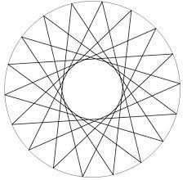
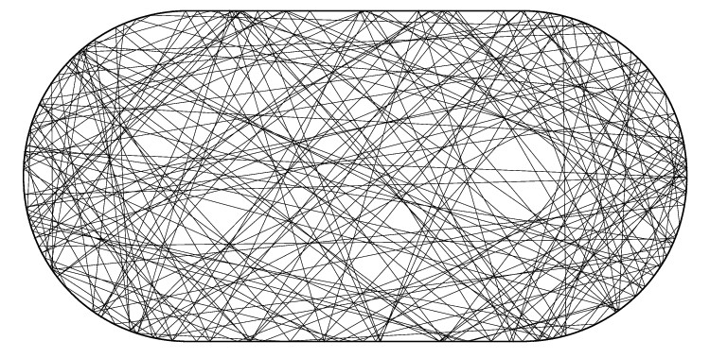
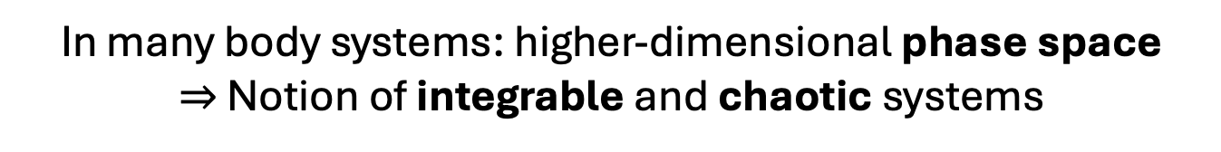
Does everything thermalise?
Non-ergodic
Ergodic
See Bunimovich (1974)
In many body systems: higher-dimensional phase space
$⇒$ Notion of integrable and chaotic systems
Notes:
Common sense: yes
But closed quantum systems? Maybe, depends on whether explore phase space
Maybe mention analogy to free and interacting field theories?

Slide 20
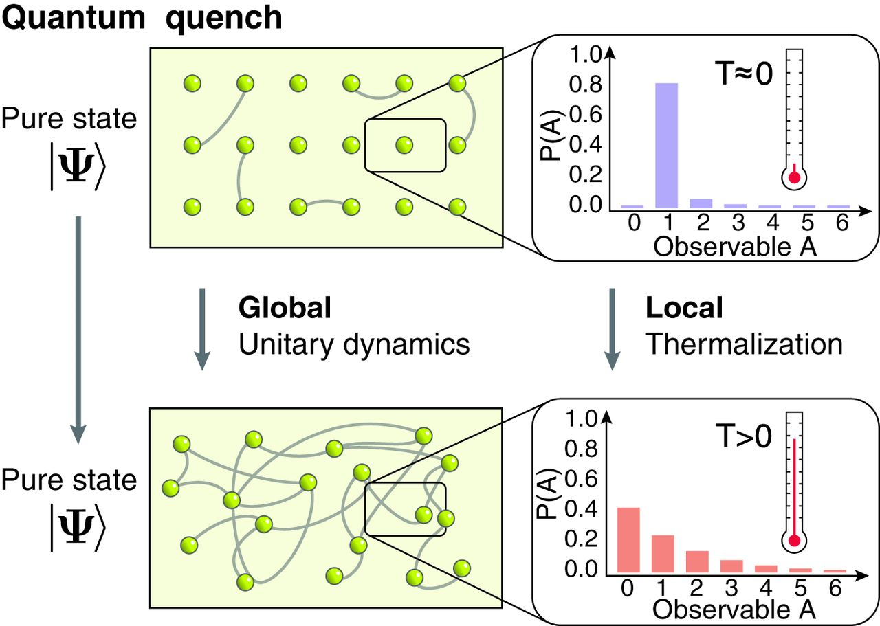
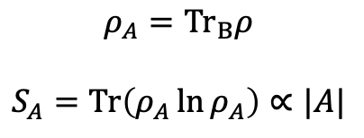
Quantum thermalisation
Unitary evolution conserves information! But…
Dynamics spreads information through entanglement
Information can’t be recovered by local measurements
Subsystems act as heat baths to each other
All-to-all entanglement → “Volume law” entanglement entropy for a subsystem
Adam M. Kaufman et al., Science 353, 794-800 (2016).
$$ρ_{A}={Tr}_{B}ρ$$
$$S_{A}=Tr\left(ρ_{A}\ln{ρ_{A}}\right)∝|A|$$
Notes:
Not that simple in QM
Quantum tech part seems superfluous

Slide 21
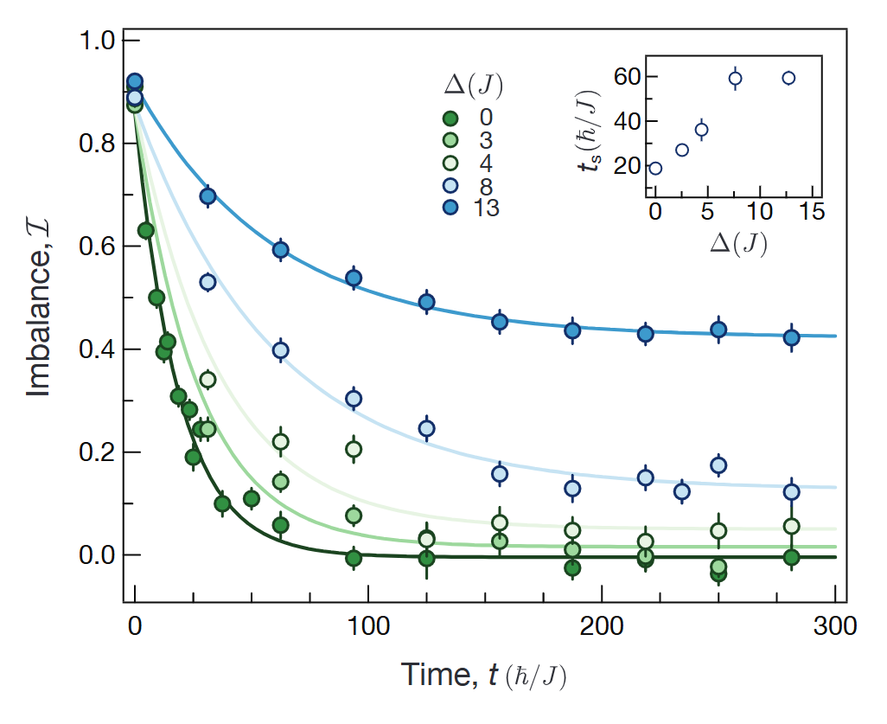

Many-body localisation (MBL)
$$Δ$$
Issue: interactions might destroy phase coherence and delocalise
2000s-2010s: theory and experiment shows MBL may be possible!
Memory of initial conditions!
Jae-yoon Choi et al., Science 352, 1547-1552 (2016)
Notes:
Shows MBL on practical timescales of experiment.
Quantify with imbalance – proportion of atoms initialised on the left of a harmonic trap.
Should decay to zero, but as disorder increases, clearly decays to non-zero value.

Slide 22



Lattice gauge theories
John Kogut, Leonard Susskind
Phys. Rev. D 11, 395 (1975)
Introduced to understand gauge field theories where perturbation theory fails
Typically take the continuum limit: lattice spacing $a→0$
This talk: non-equilibrium dynamics of the lattice model in its own right!
QED in (1+1)D:
$\left[{\hat{θ}}_{n},{\hat{L}}_{m}\right]=iδ_{nm}$
Notes:
Lattices are more just a different method that can help make progress != solution
Stress that I’m focusing on Schwinger – say again 1D electromagnetism. Talk about the physics more here so less needed to explain on next slide.
MASSIVELY SIMPLIFY: EVERYONE WILL KNOW WHAT AN LGT IS. START WITH LGT. CAN PROBABLY REMOVE THIS SLIDE.

Slide 23




“Disorder” without disorder
Image: M. Brenes, M. Dalmonte,
M. Heyl, and A. Scardicchio
Phys. Rev. Lett. 120, 030601 (2019)
See also:
A. Smith et al., PRL. 118, 266601 (2017)
G. Giudici et al., PRR 2, 032034(R) (2020)
C. Muschik et al, New J. Phys. 19 103020 (2017)
Each basis state $\left|Ψ_{0}\right\rangle =\left|ψ_{0}\right\rangle ⊗\left|L_{0}\right\rangle$ belongs to a charge sector $\left\{q_{n}\right\}$, giving a charge-dependent Hamiltonian $H(\left\{q_{n}\right\})$.
Choose our fields $\left|L_{0}\right\rangle$ to instead be in a superposition: we therefore have a superposition of charge sectors $q_{n}$!
Each element of this superposition evolves under an independent Hamiltonian – giving us an effective disorder ensemble
Notes:
Last slide: potential that depends on the charges. This is how we generate effective disorder without actual disorder.
This slide: how does this give us a disorder ensemble? Key point is superposition that evolves under different hamiltonians, typical one is disordered.
Explain picture carefully – yellow, white, red.
This is one of the most important slides.

Slide 24









Our results: $J∼O(1)$ regime seems conventionally localised
MPS simulation, $N=50$
$$S∼\log{t}$$
Dip below Poisson value!
Implies level attraction or near-degeneracies
$$J=3.0$$
$$S∼O(N)$$
Localisation!
We see multiple signatures of conventional MBL at intermediate $J$...
$$S∼O(1)$$
Notes:
SPLIT THIS UP AND REMOVE LEVEL SPACINGS RATIO!
See if this can be rearranged to have a title – making clear it’s my results. Here be very clear that we have 3 different signatures pointing to MBL. But still a mystery with the near-degeneracies.
Try and be clear where there are open questions. And clear where you do understand something. Can always say we give an explanation in the paper (or wait for a question) rather than give a vague half-explanation.
Replace text with arrows pointing to plot etc., minimise text.
Can we either remove <r> or explain it earlier?
r-stats – chaotic at small J, MBL at intermediate J
Entropy – clear transition. We also see fluctuations peak indicating phase transition (not shown).
Log growth MBL at J = 0.8
But…dip in r.
Point out too that small systems can be misleading! System sizes flow slowly. Believe it will hit poisson eventually.

Slide 25







Late-time entropy growth
R. Ghosh and M. Žnidarič
Phys. Rev. B 105, 144203
total entanglement
distribution of particle number
distribution within number sectors
$$J=5$$
Blue lines represent individual charge sectors
Notes:
Bipartite entanglement entropy in number conserving system can be split up: number entropy counts variance in particle number in subsystem, config entropy looks at rearrangements of those particles.
There were two pictures of how number entropy could behave in MBL: one where it saturates at short times, and one where it keeps growing slowly forever, even at late times. Recent investigations of paradigmatic XXZ model show the latter. But that’s not what we see in the Schwinger model: we see number entropy saturating, while configurational entropy rises. Additionally, you can see that individual charge sectors exhibit strange “jump” behaviour – only when you average do you get smooth line, and there is a big mean/median discrepancy.

Slide 26






Double log? Or slow saturation?
Integrate $P\left(τ_{J}\right)$ to obtain an ansatz…
$S_{config}≃S_{∞} −bt^{−α}$
$$τ_{J}$$
Notes:
We’d like to characterise these jumps. We can measure the time and height of these; plotting their distribution shows that they follow a power law during the claimed double log regime, with the exponent slightly greater than 1. The cumulative distribution then gives a functional form for entropy: a slow power law decay to a saturation value, and we find good agreement for this, with the growth exponent close to zero. We believe this behaviour has been misidentified as a double-log growth.
For N = 16, the fitted value is very small – this could mean a trend towards logarithmic growth, or simply that we aren’t able to access long enough times to capture saturation behaviour.

