Slide 1

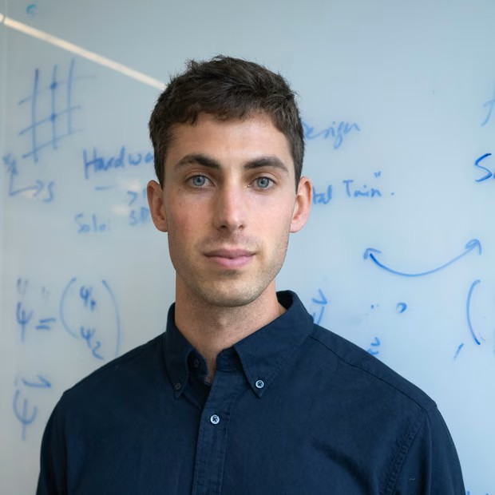
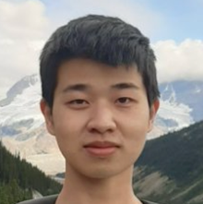
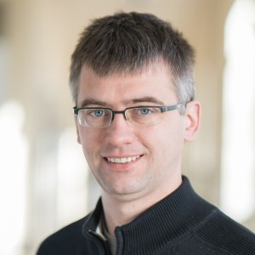
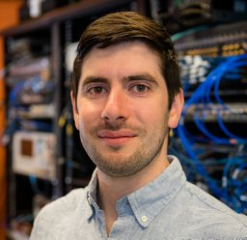
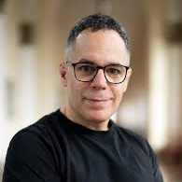





Dissipative preparation of thermal states on quantum computers
QuantHEP, Queen Mary University London, 15.07.2026
Roland Farrell
Yongtao
Zhan
Lode
Pollet
Ilan T. Rosen
Jad C.
Halimeh
Preparing thermal states of frustrated quantum spin systems using 139 qubits
ArXiv: 2605.26245
Speaker: Lucas Katschke

Slide 2
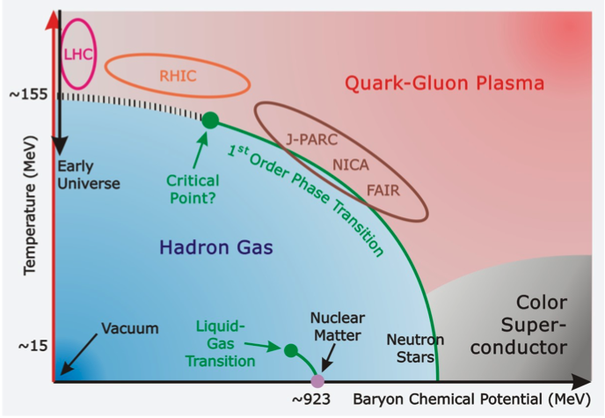
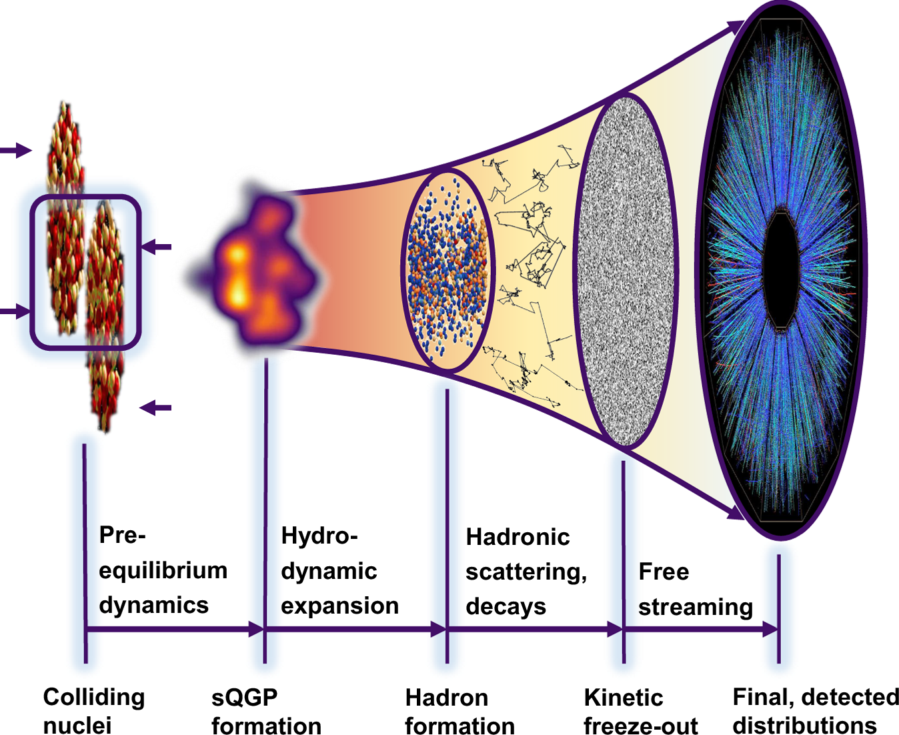
Applications of thermal state preparation
Equilibrium observables and phase structure
Real-time observables
viscosities
Transport coefficients
Sign problem
https://www.gsi.de/
D. Kincses, M. Nagy, and M. Csanád, Commun Phys 8, 55 (2025).
Beyond HEP: Condensed matter physics, quantum chemistry, …

Slide 3

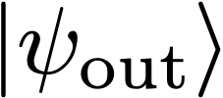

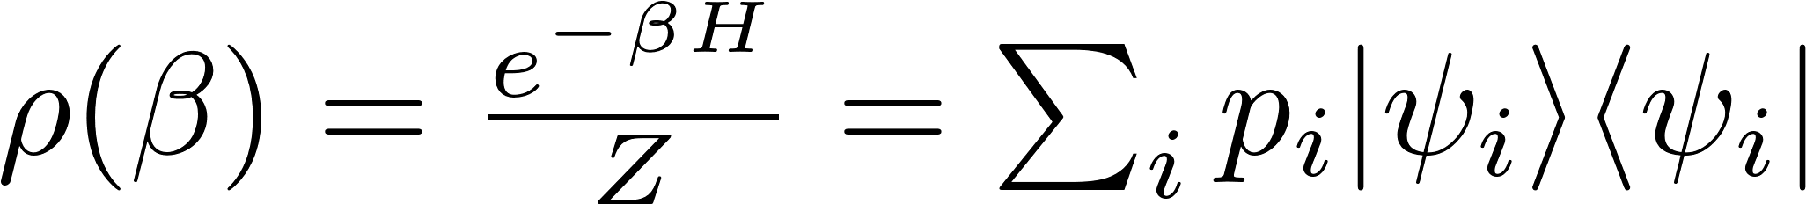




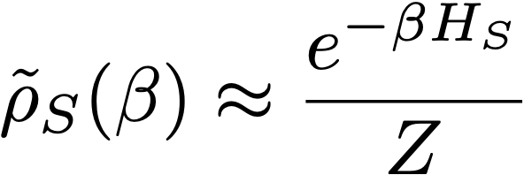


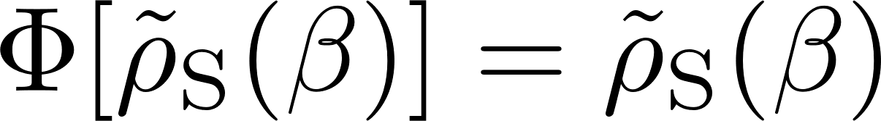
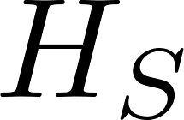
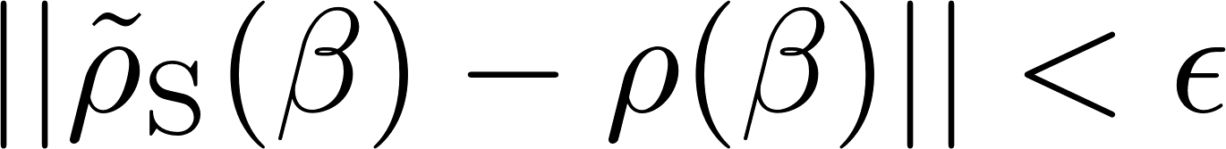
Dissipative Thermal State Preparation
Goal: Sample from Gibbs state
Idea: Engineered dissipation
Environment
Design quantum channel with approximately thermal steady state
System
Env.
F. Verstraete, M. M. Wolf, and J. Ignacio Cirac, Nature Phys 5, 633 (2009).
Z. Ding, C.-F. Chen, and L. Lin, Phys. Rev. Res. 6, 033147 (2024).
Env.

Slide 4
Towards an efficient algorithm for thermal state preparation
Previous results: Simple models (Analytic)^{[4][5][6]}
Here: Frustrated spin systems (Numerical)
Convergence to an approximate thermal state upon repeated application of
How many times do we need to apply ?
Previous results: Analytic guarantee^{[1][2][3]}
Here: Comparison to Quantum Monte Carlo
Here: Hardware runs on ibm_boston
Verification that steady state in the presence of noise is approximately thermal
Will have a steady state in the presence of device noise?
[1] D. Hahn, S. A. Parameswaran, and B. Placke, 2505.22816(2026).
[2] J. Lloyd and D. A. Abanin, 2506.21318 (2026).
[3] Z. Ding et al., 2508.05703 (2025).
[4] C. Rouzé, D. S. França, and Á. M. Alhambra, Nat. Phys.(2026).
[5] Š. Šmíd et al., Nat Commun 16, 10736 (2025).
[6] Á. Capel, C. Rouzé, and D. S. França, 2009.11817 (2021).

Slide 5
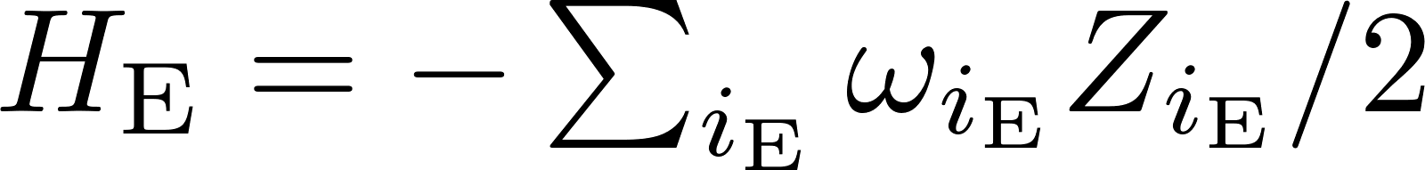

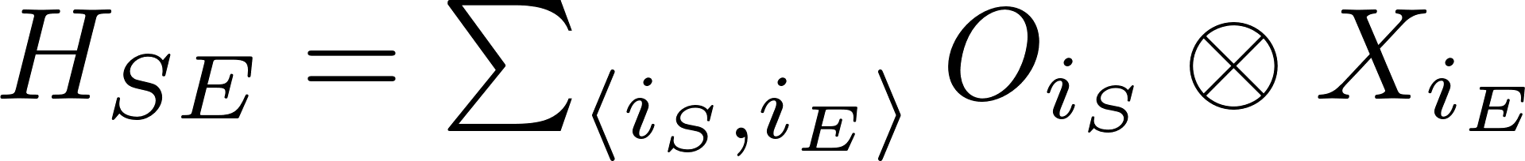



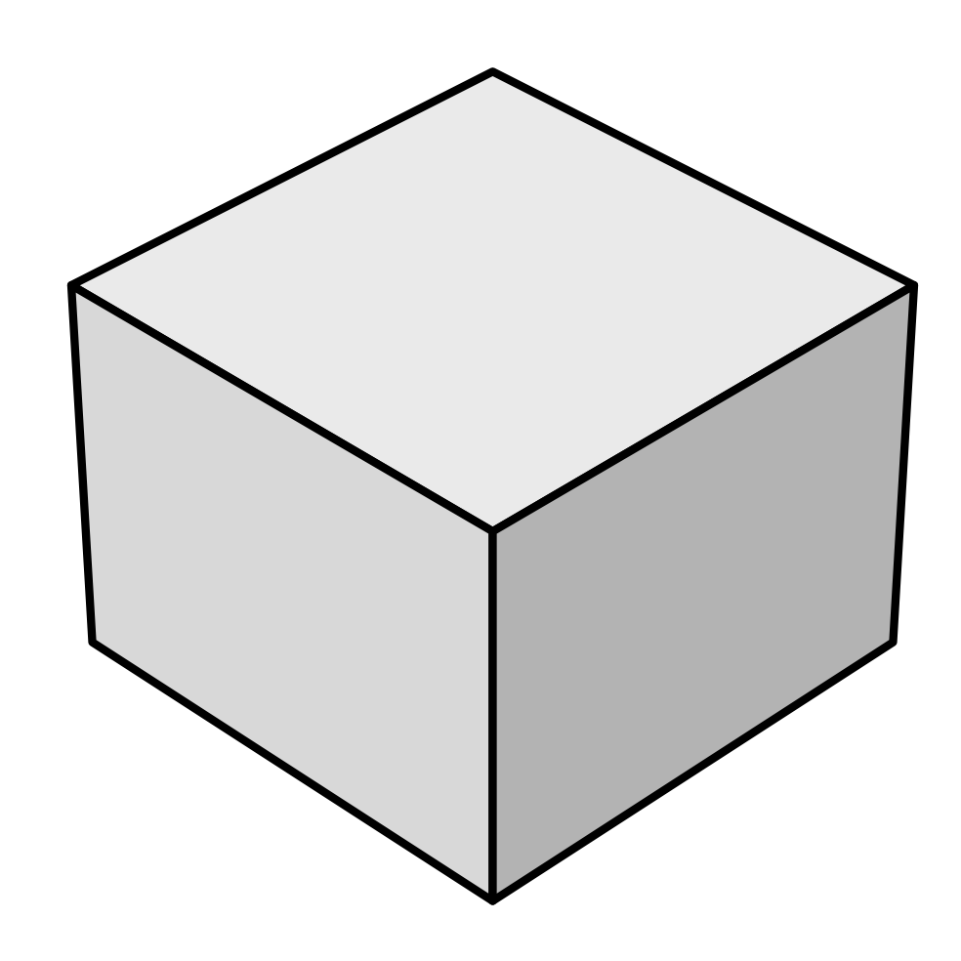












End-to-End Efficient Quantum Thermal and Ground State Preparation^{[1]}
Randomly sampled Bohr frequencies
Prepare environment in thermal state
Do joint time evolution for time :
Reset environment qubits
Environment:
System-Environment
Interaction:
Randomly sampled operators
Guaranteed to reach approximate thermal steady state. But How many applications of the channel are required to reach the steady state?
[1] Z. Ding et al., 2508.05703 (2025).
See also: D. Hahn, S. A. Parameswaran, and B. Placke, 2505.22816(2026). & J. Lloyd and D. A. Abanin, 2506.21318 (2026).

Slide 6

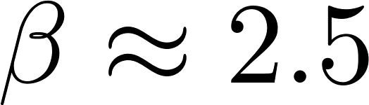
Frustrated spin systems – a testing ground
Kagome lattice
Antiferromagnetic mixed field Ising model
Exponentially many states clustered in energy
around the ground state energy. Spin ice
Challenging to simulate classically. Current frontier from QMC
^{[1],[2]}
Antiferromagnetic Heisenberg model
numerical sign problem
Current frontier from High temperature expansions with Padé resummation
^{[3]}
Low temperature properties still debated.
Geometric frustration
[1] Y. Wang, S. Humeniuk, and Y. Wan, Phys. Rev. B 101, 134414 (2020).
[2] P. Narasimhan et al., Phys. Rev. B 110, 054432 (2024).
[3] B. Bernu et al., Phys. Rev. B 101, 140403 (2020).

Slide 7
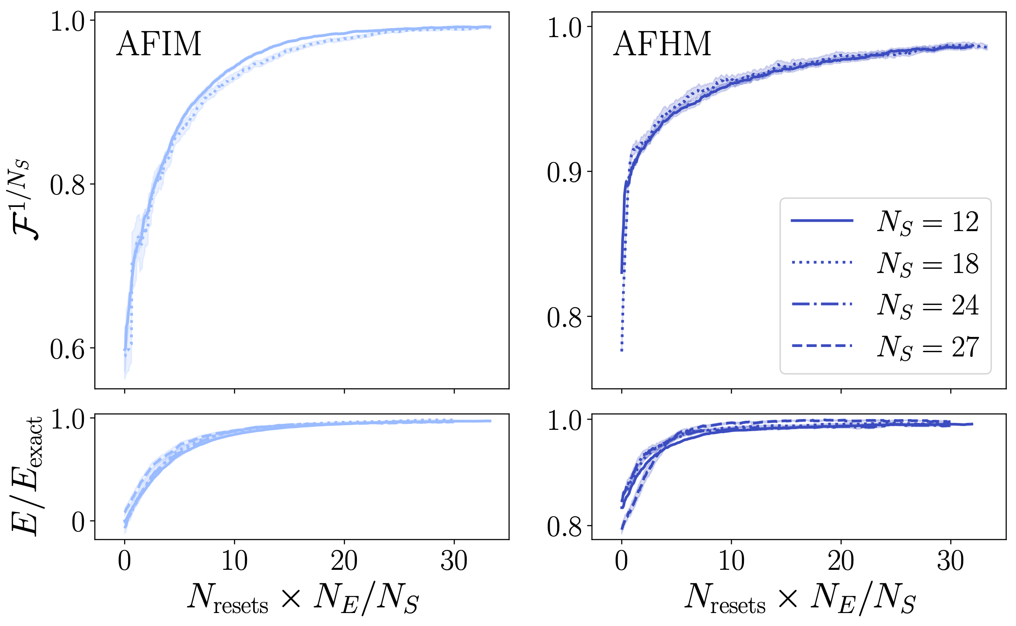

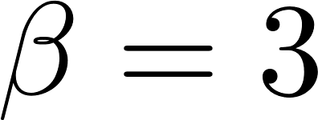
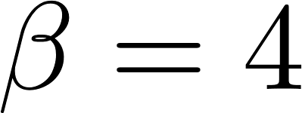

Classical state-vector simulations 1:
Scaling with system size
Ising model
Heisenberg model
Noiseless simulations with Trotterization and periodic boundary conditions
Few resets are enough to reach good fidelities and energy accuracies.
Reasonable to put on hardware.
Mixing time is independent of system size. Indicator for rapid mixing

Slide 8
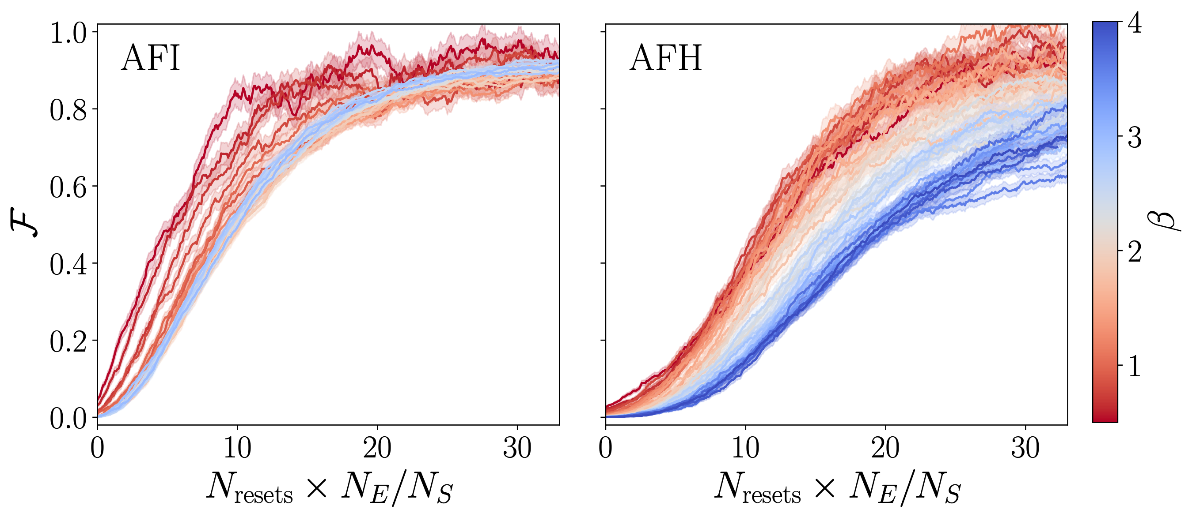
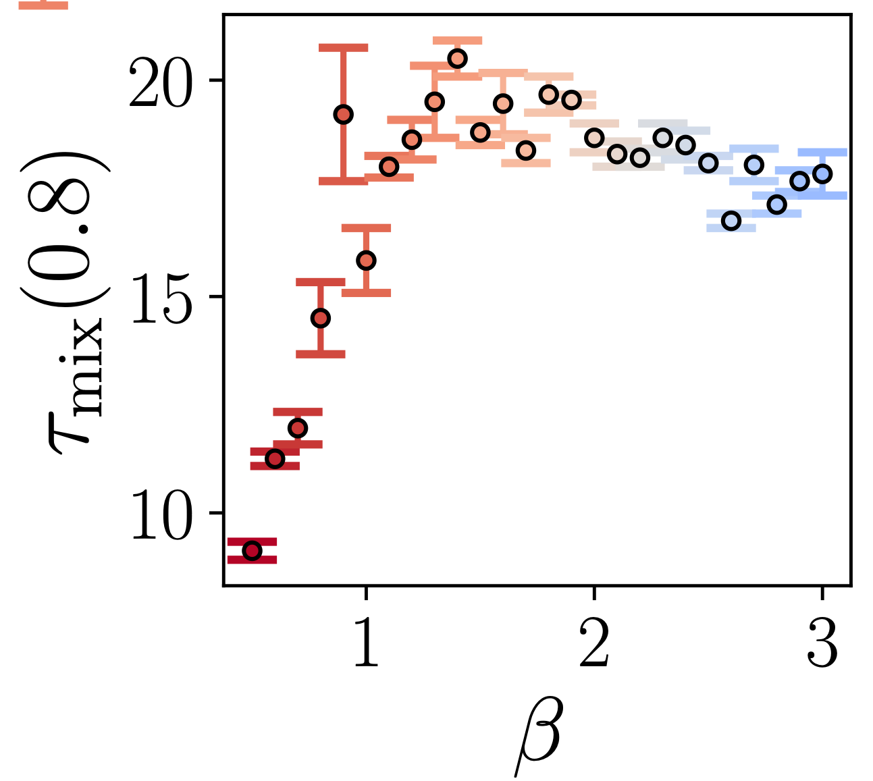




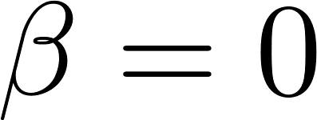
Classical state-vector simulations 2:
Scaling with temperature
Ising model
Heisenberg model
Cross-over to spin ice
Here: Mixing time = resets needed to reach threshold fidelity
Linear scaling with
Vs. need of exponentially many samples in QMC
Starting state faster mixing for high temperatures.
Peak in mixing time around cross-over.

Slide 9
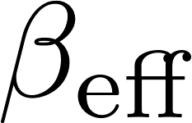
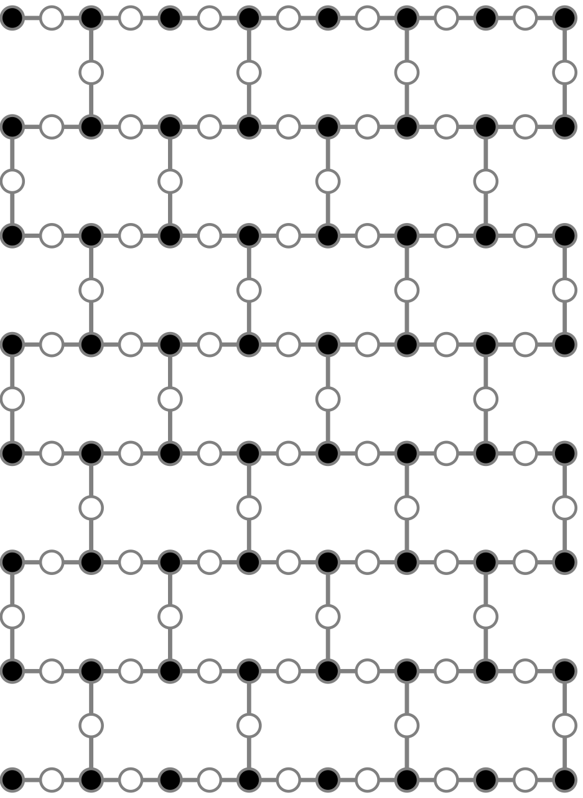
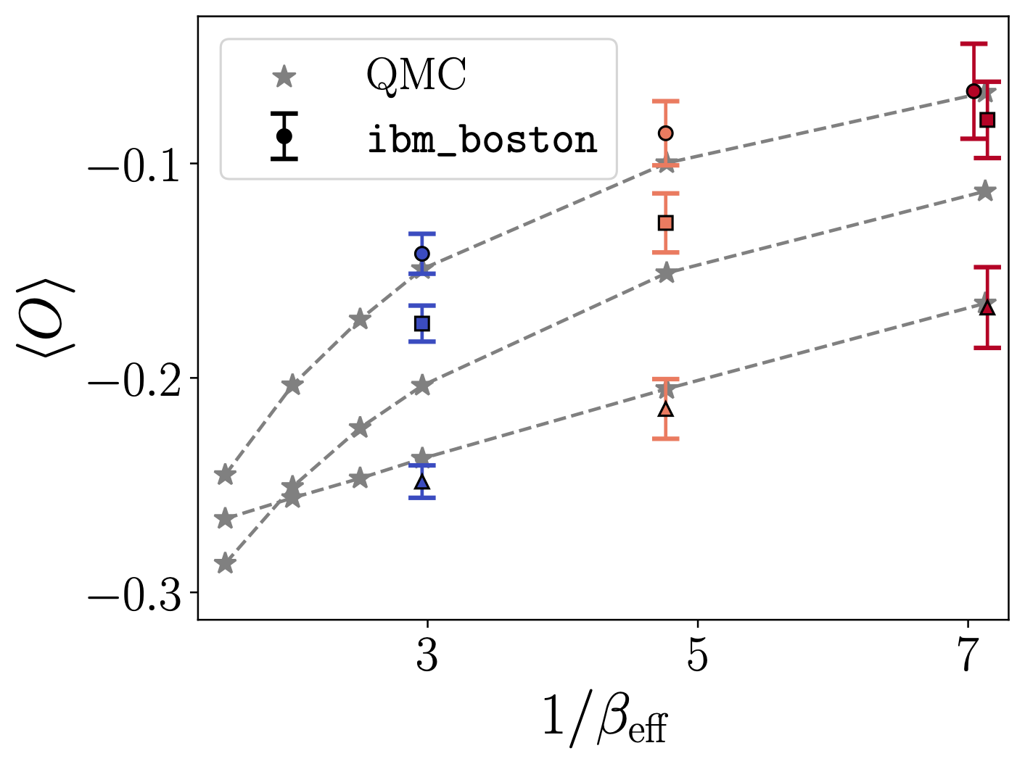
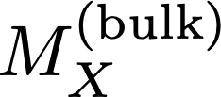
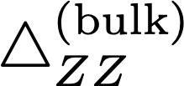
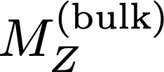
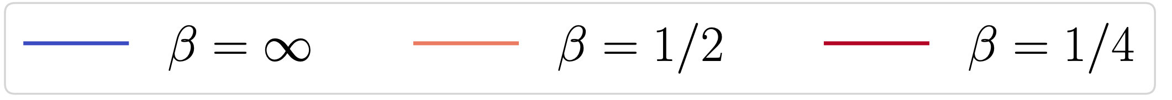
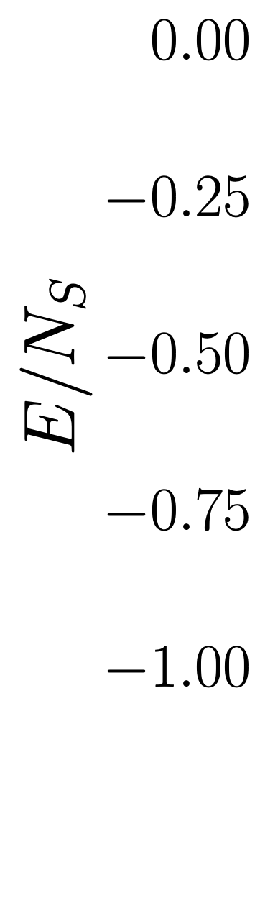
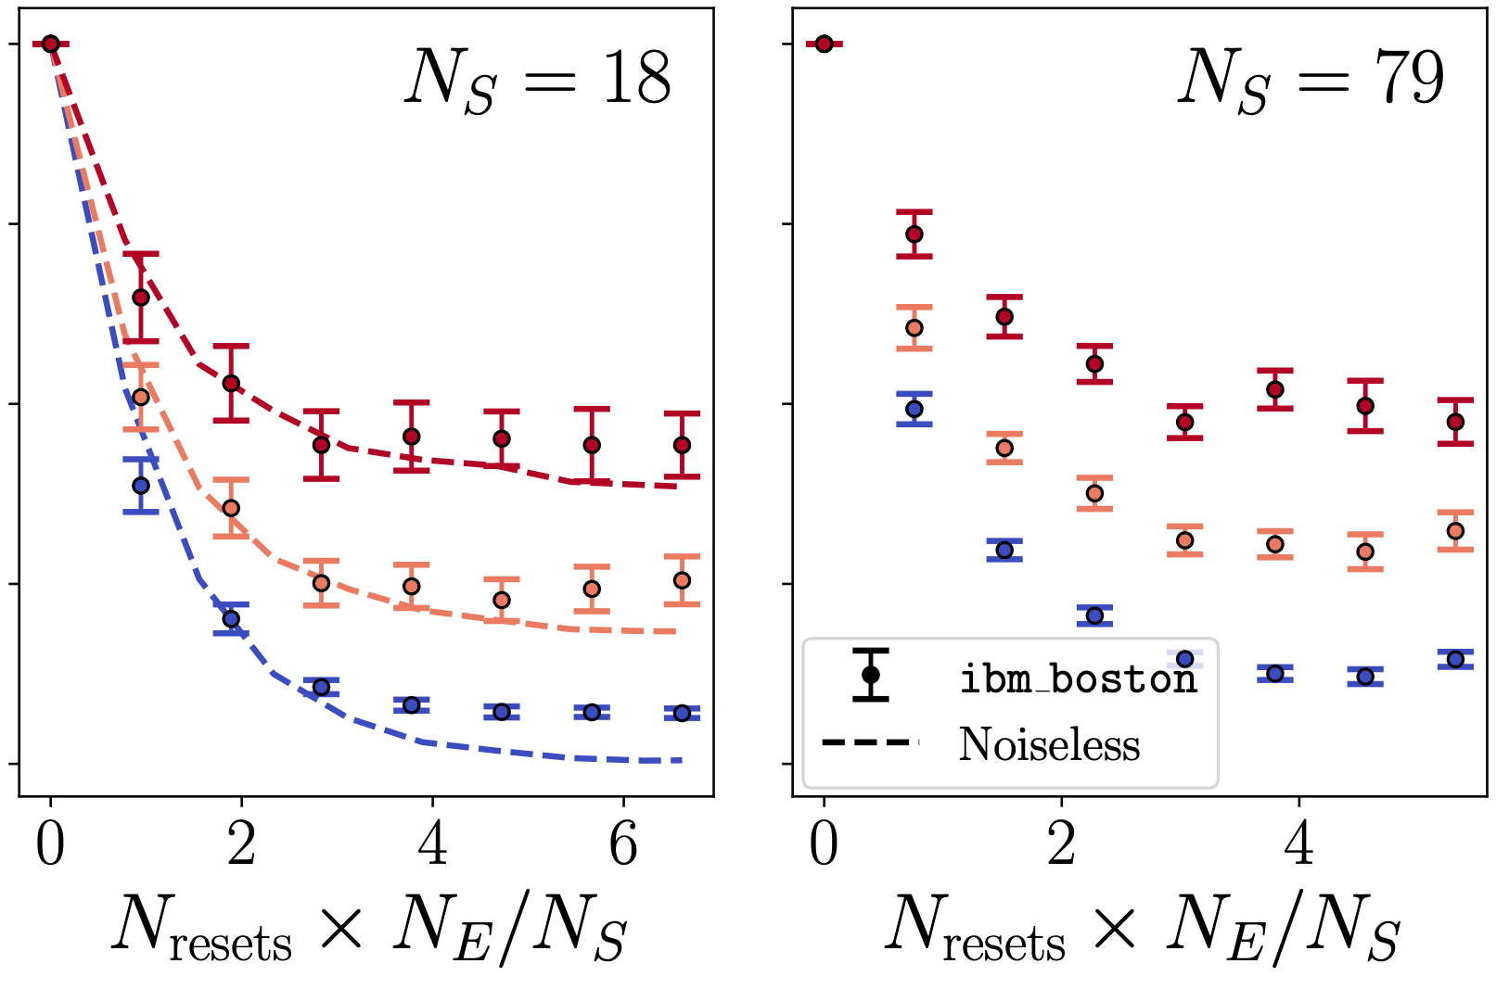


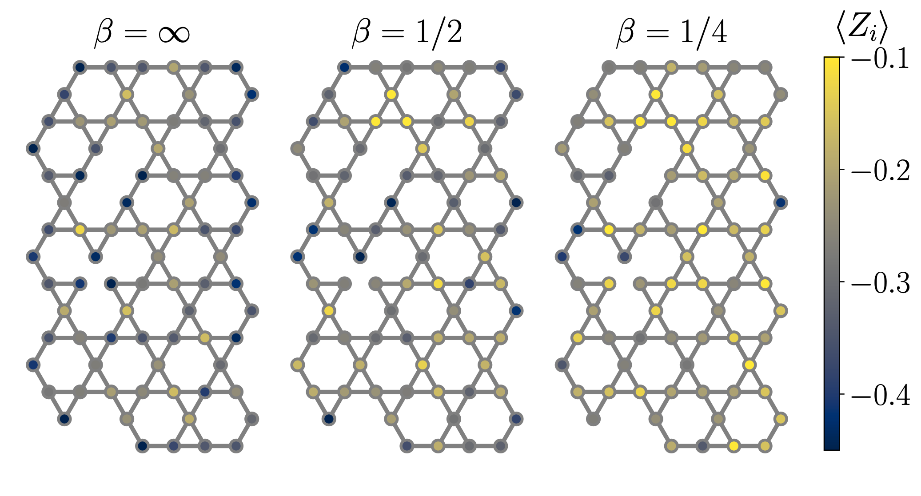
Hardware runs for the Ising model on ibm_boston
Use QMC to find such that the thermal energy matches the experiment
3 trotter steps per reset cycle.
Total of 55 2-qubit gate depth for one cycle
QPU
QMC
Kagome lattice fits on heavy hex with bath qubits spread throughout the system^{[1]}
Without rapid mixing this would not be possible
[1] K. Shinjo, K. Seki, and S. Yunoki, 2510.13577 (2026).
Notes:
250 samples at N_resets = 1 down to 50 at N_resets = 7. Per sample 200 shots after leakage post selection down to 22% survive of them. DD, PT, Meas. Twirling, post selection against leakage noise, ZNE

Slide 10
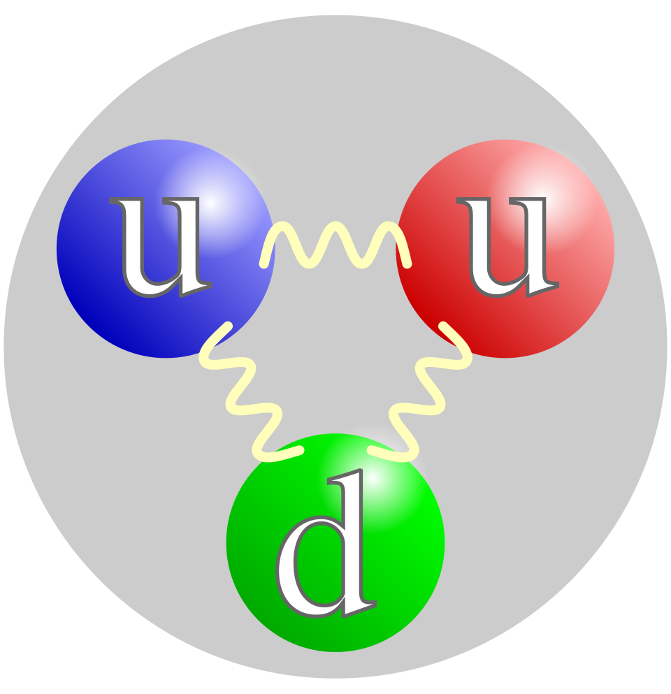
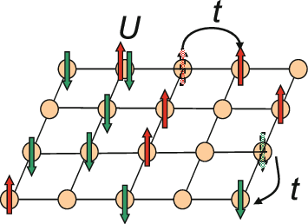
Conclusion
Summary
Using classical and quantum computers we found evidence for rapid mixing in frustrated spin systems.
Actual device noise drives the system to a new stable steady state with approximate thermal properties.
Outlook
^{[1]}
Put model with sign problem on quantum hardware
^{[1]}
Combine thermal state preparation with real time evolution
System
Verify equilibration/temperature beyond comparison to classical methods
[1] https://www.wikipedia.org/

Slide 11

Thank you for your attention!
Roland Farrell
Yongtao
Zhan
Lode
Pollet
Ilan T. Rosen
Jad C.
Halimeh
Check out our preprint:
2605.26245

Slide 12
Backup

Slide 13
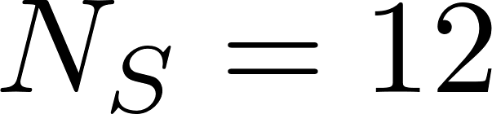
Scaling of resets with number of environment qubits
Ising model
Heisenberg model

Slide 14
Jump Operators
Ising model
Heisenberg model

Slide 15
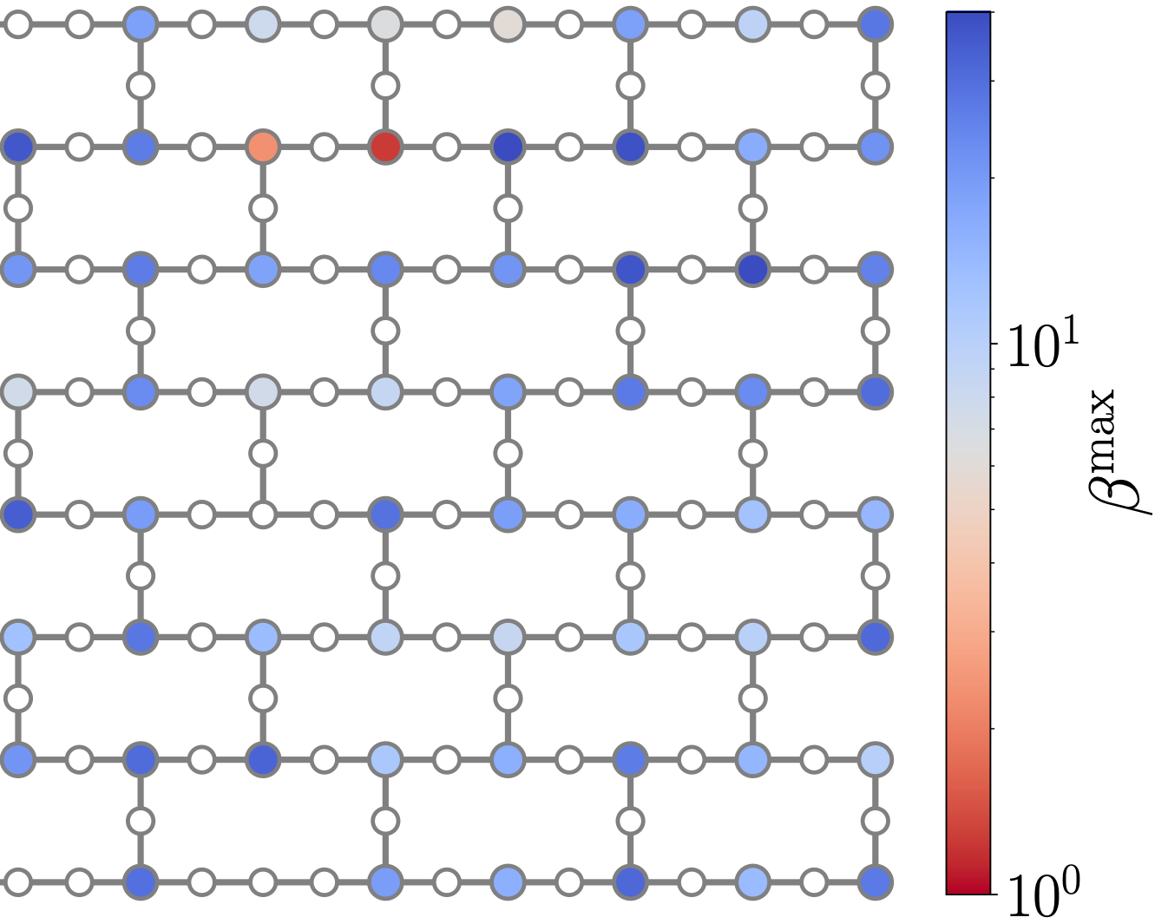
Qubit reset error
Reset errors:
V
V
V
V
V
V
V
Reset errors lead to „hot“ bath qubits

Slide 16
Scaling with noise classical simulations

Slide 17
Steady state scaling with environment qubits
Classical simulations
Actual device data

