Slide 1
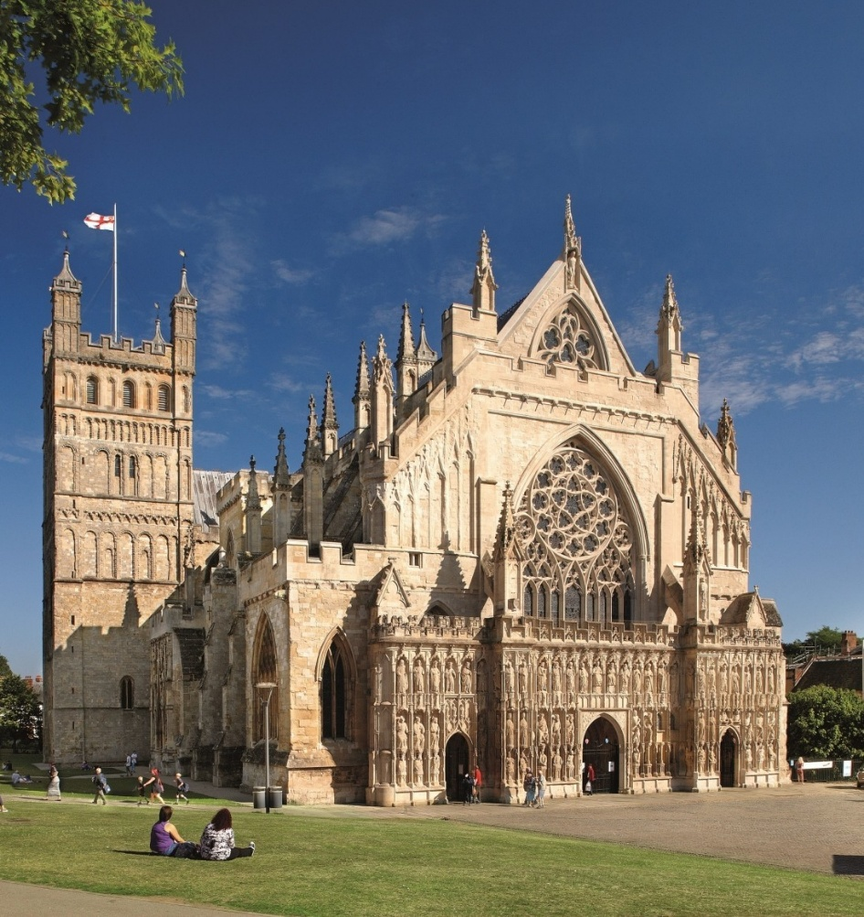
Simplifying quantum simulations
Many others and Luca Dellantonio
QuantHEP, London, 13/07/2026

Slide 2
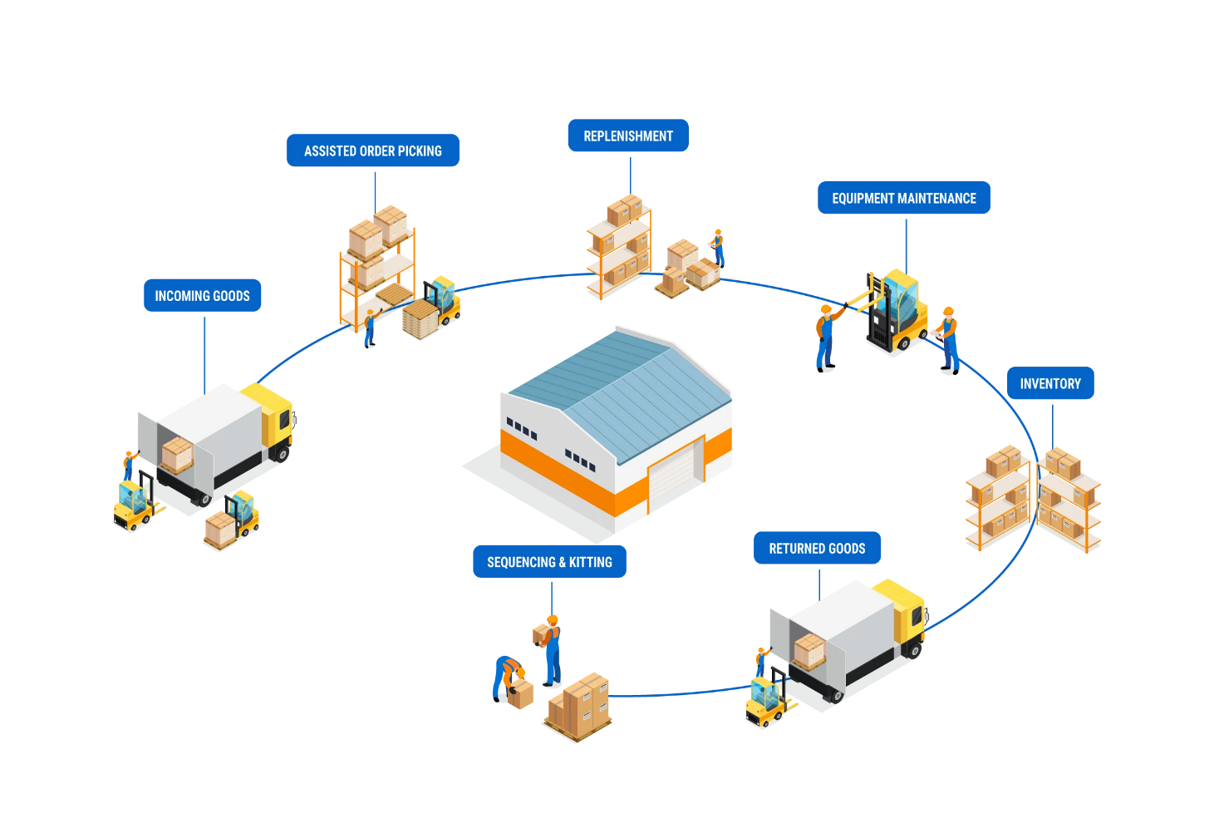
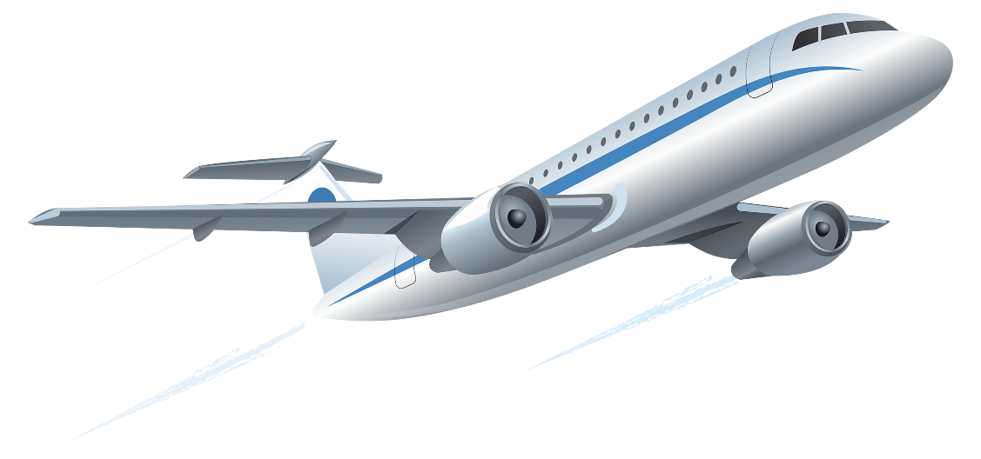
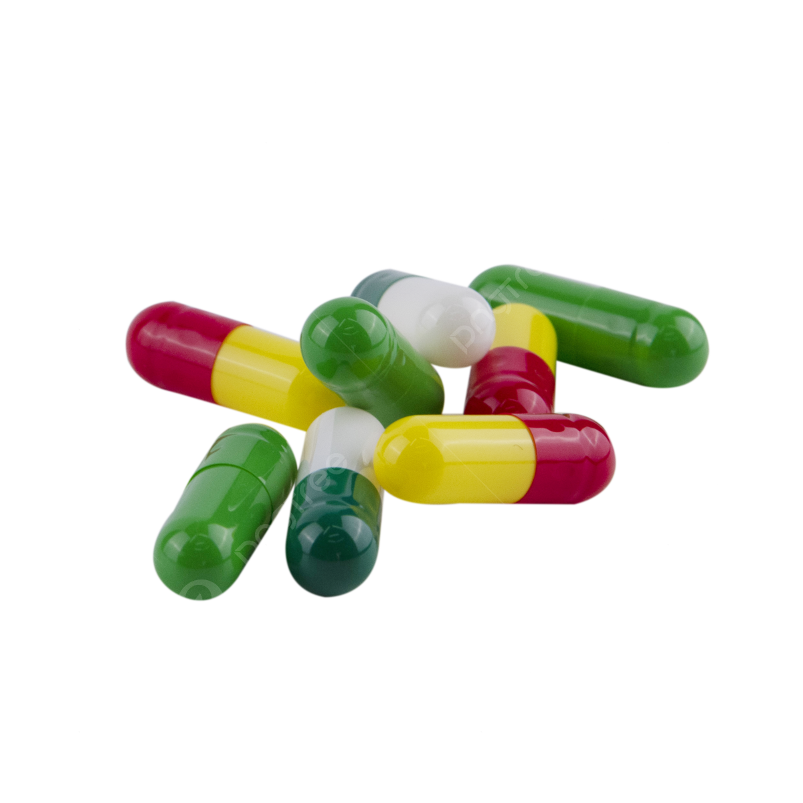

Why?

Slide 3
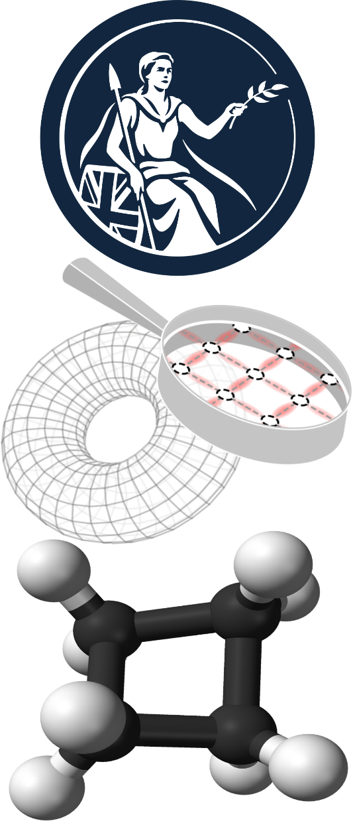
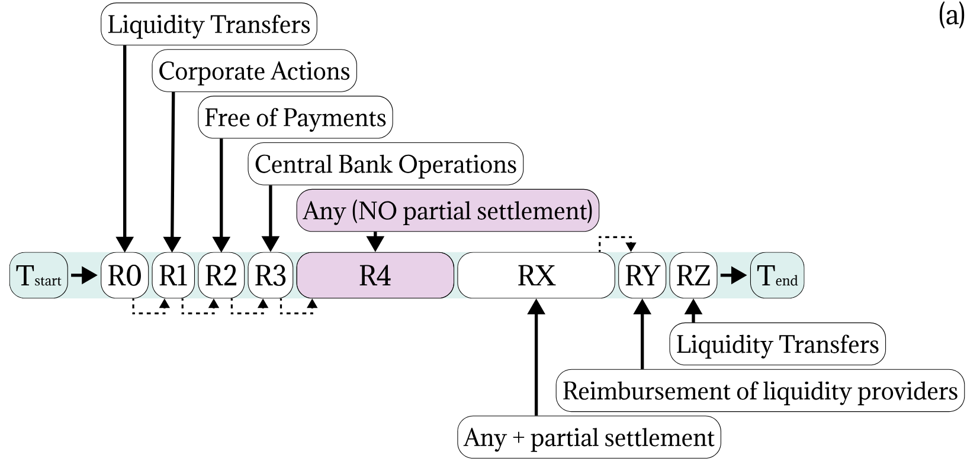
Why?
F. Martini et al., arXiv:2501.08794 (2025), featured WEF
Target2-Securities Specifications (2024)

Slide 4
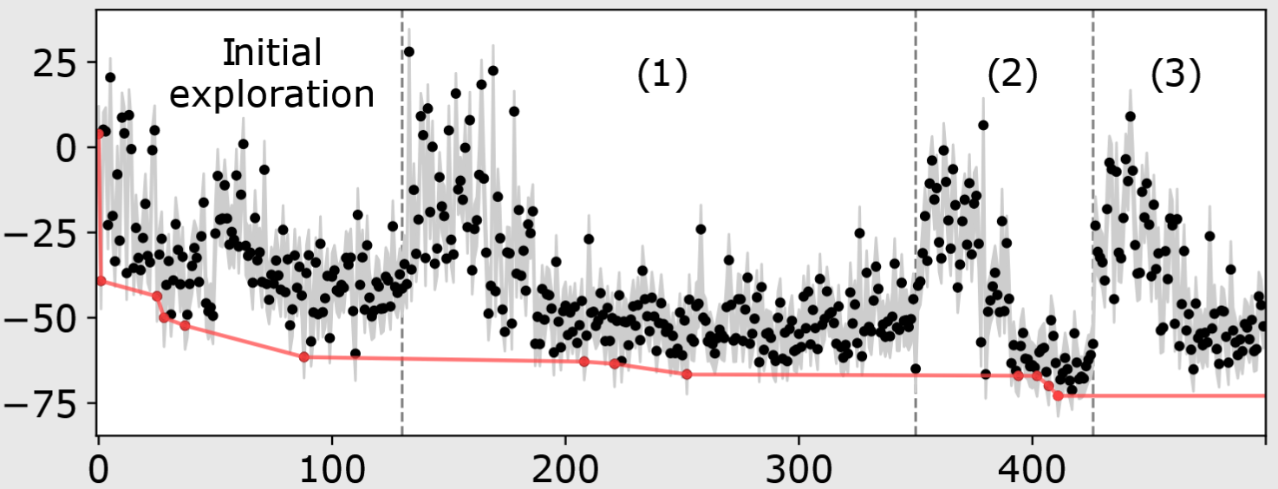
Why?
Approx. £1 trillion daily
Featured at WEF
Contributed to G7 statement
Martini & al, arXiv:2501.08794 (2025)
Energy (au)
Iteration
M. Meth et al., Nature Physics 21, 570-576 (2025)
J. Haase et al., Quantum 5, 393 (2021)

Slide 5
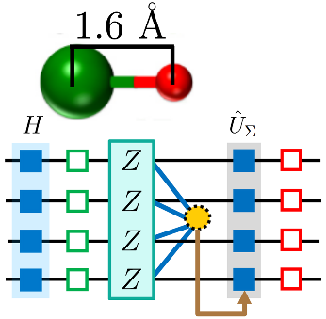
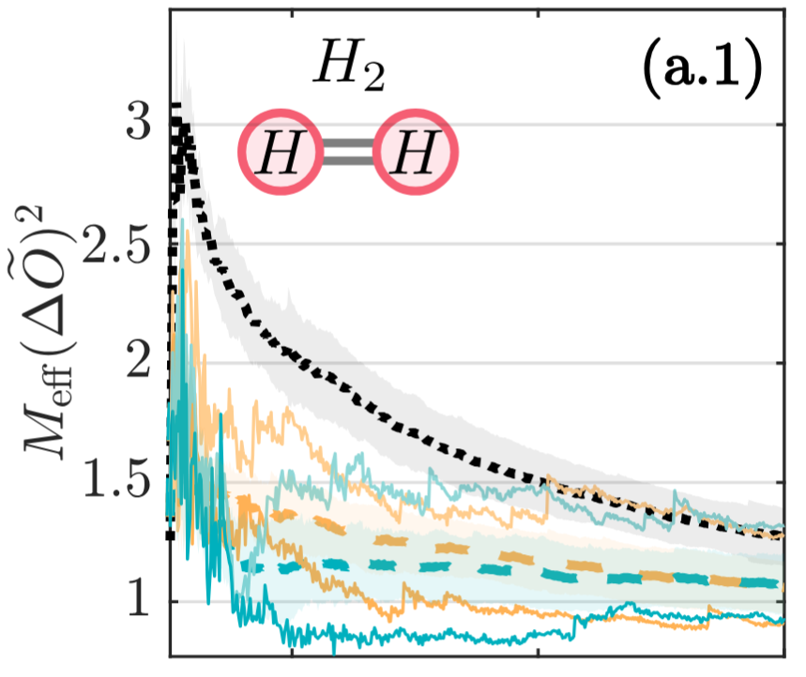
Why?
Approx. £1 trillion daily
Featured at WEF
Contributed to G7 statement
Martini & al, 2501.08794 (2025)
Q. advantage beyond HPC
quBits -> quDits
Hybrid Classical+Quantum
Meth & al, N. Phy 21, 570-576 (2025)
Energy (au)
Iteration
LiH
Drug discovery
Circuit+Msmnt Q. computing
Quantum software
Simon & al, 2509.01482 (2025)
Chan & al, PRL 132, 240601 (2024)

Slide 6
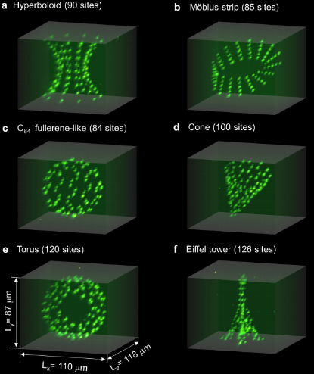
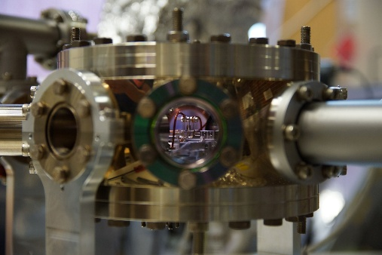
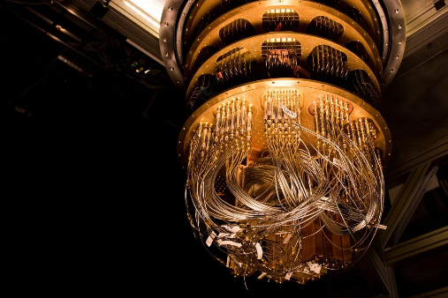
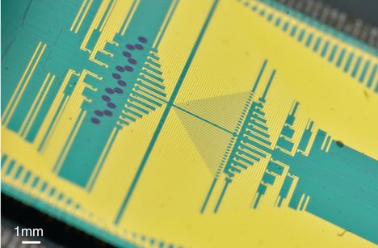
What?
Hardware
University of Innsbruck,
IonQ, Quantinuum...
IBM, Fujitsu,
NPL, Google, Righetti, Intel, Alibaba…
University of Bristol, PsiQuantum, Orca,
Niels Bohr Institute…
Pasqal, QuERA, ...

Slide 7
What?
Hardware
Software
Encoding a problem onto a q. comp [1, 2, 3, 4]
Develop better languages [5, 6]
Efficient measurement of q. observables [7, 8, 9]
[1] L. Gunderman, A. Jena, LD, Phys. Rev. A 109, 022618, (2024)
[2] C. Nation, R. Simon, S. Banerjee, F. Martini, A. Ricottone, F. Cerisola, LD, arXiv:2605.18966 (2026)
[3] C. Nation, R. Simon, S. Banerjee, F. Martini, A. Ricottone, F. Cerisola, LD, arXiv:2605.30428 (2026)
[4] S. Banerjee, V. Muthu, C. Nation, R. Simon, F. Martini, A. Ricottone, F. Cerisola, LD, arXiv:2605.30429 (2026)
[5] R. R. Ferguson, LD, A. A. Balushi, K. Jansen, W. Dür and C. Muschik, PRL, 126, 22, (2021)
[6] A. Chan, Z. Shi, L. Dellantonio, W. Duer, C. Muschik, PRL, 132, 240601, (2024)
[7] A. J. Jena, A., Schlosberg P. Mukhopadhyay, J. F. Haase, F. Leditzky and LD, Quantum 7, 903, (2023)
[8] R. Simon, Z. Shi, C. Nation, A. Jena, LD, arXiv:2509.01482 (2025)
[9] R. Simon, M. Meth, F. Martini, P. Tirler, A. Jena, M. Ringbauer, LD, arXiv:2605.00682 (2026)
Notes:
Mention Carsten’s presentation: not going to give “final solutions” to the problems he mentioned, but definitely help ☺

Slide 8
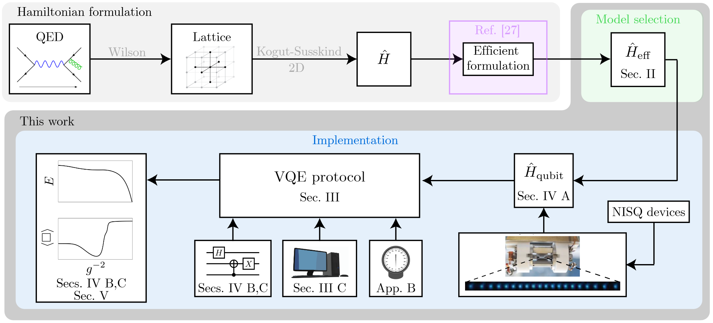
Software
Measurement
Efficient encoding
Image from D. Paulson*, LD*, J. F. Haase*, A. Celi*, A. Kan, A. Jena, C. Kokail, R. v. Bijnen, K. Jansen, P. Zoller and C. A. Muschik, PRX Quantum, 2, 030334, 2021

Slide 9
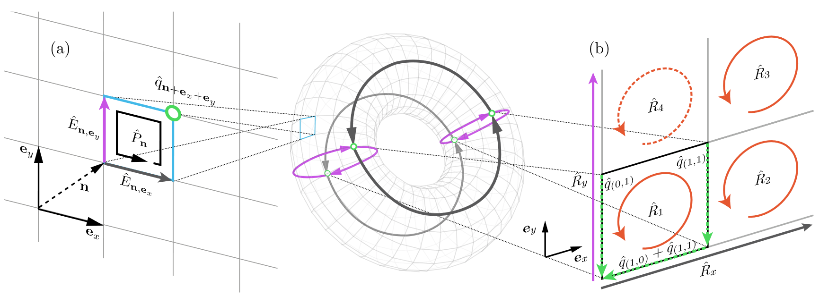
Encoding
Particles ${\hat{q}}_{n}→$ ‘easy’ for q. computer
Fields ${\hat{E}}_{n},{\hat{P}}_{n},{\hat{R}}_{n}→$ hard and expensive for q. computer...
Image from J. F. Haase*, LD*, A. Celi*, D. Paulson, A. Kan, K. Jansen and C. A. Muschik, Quantum, 5, 393, 2021

Slide 10
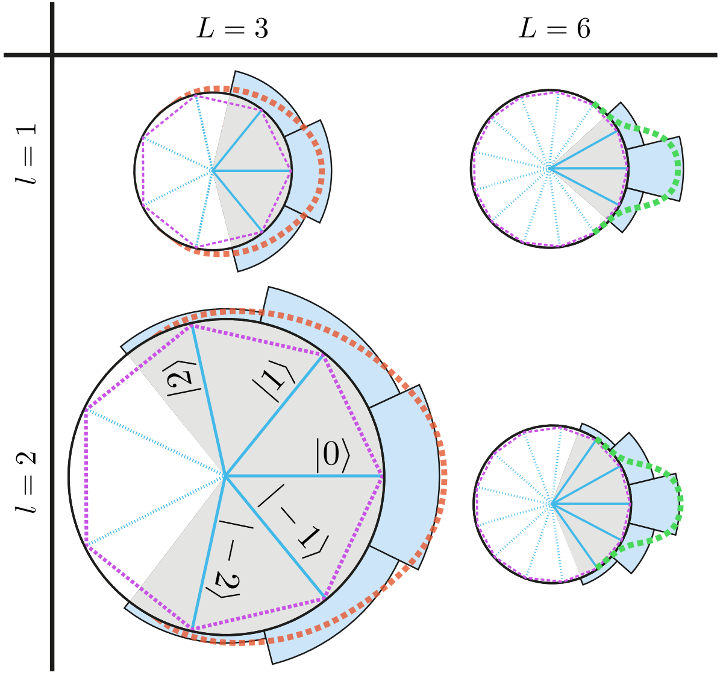
Encoding
Particles ${\hat{q}}_{n}→$ ‘easy’ for q. computer
Fields ${\hat{E}}_{n},{\hat{P}}_{n},{\hat{R}}_{n}→$ hard and expensive for q. computer...
Approximate a circle with a polygon
«Concentrate» the desired state
Truncate the Hilbert space
Convergence to untruncated model
Image from J. F. Haase*, LD*, A. Celi*, D. Paulson, A. Kan, K. Jansen and C. A. Muschik, Quantum, 5, 393, 2021

Slide 11
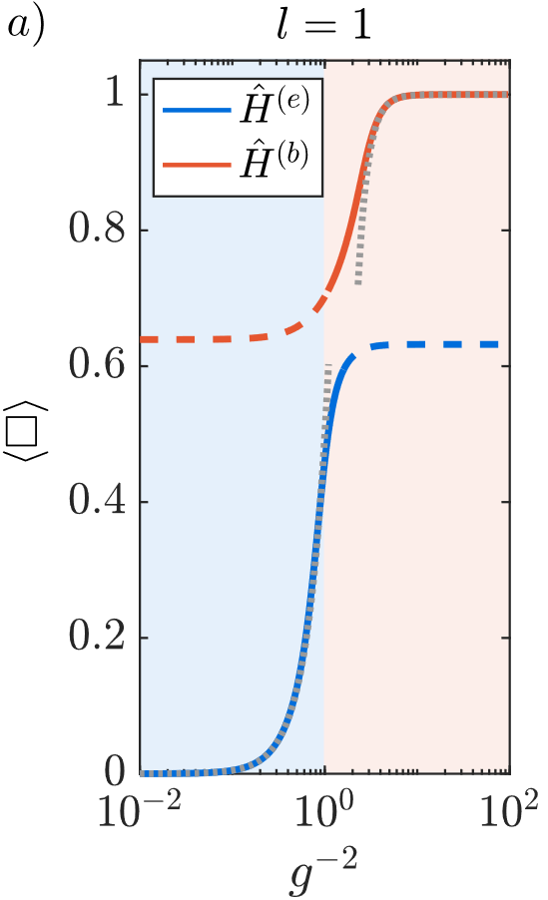
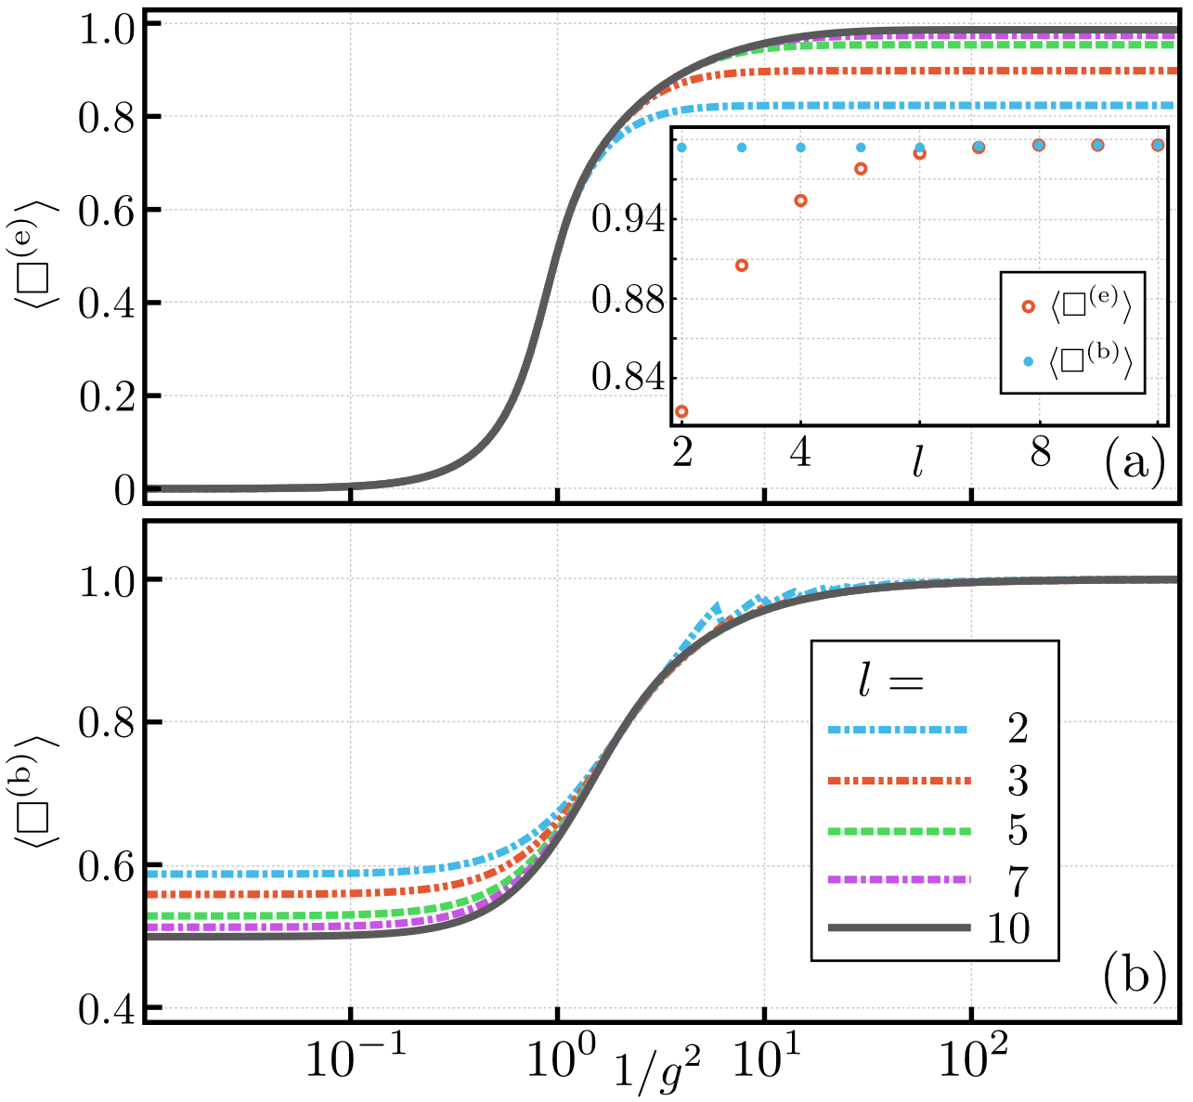
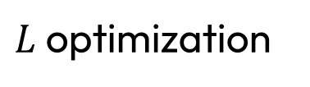
Encoding
Particles ${\hat{q}}_{n}→$ ‘easy’ for q. computer
Fields ${\hat{E}}_{n},{\hat{P}}_{n},{\hat{R}}_{n}→$ hard and expensive for q. computer...
Models convergence
$L$ optimization
J. F. Haase*, LD*, A. Celi*, D. Paulson, A. Kan, K. Jansen and C. A. Muschik, Quantum, 5, 393, 2021
D. Paulson*, LD*, J. F. Haase*, A. Celi*, A. Kan, A. Jena, C. Kokail, R. v. Bijnen, K. Jansen, P. Zoller and C. A. Muschik, PRX Quantum, 2, 030334, 2021

Slide 12
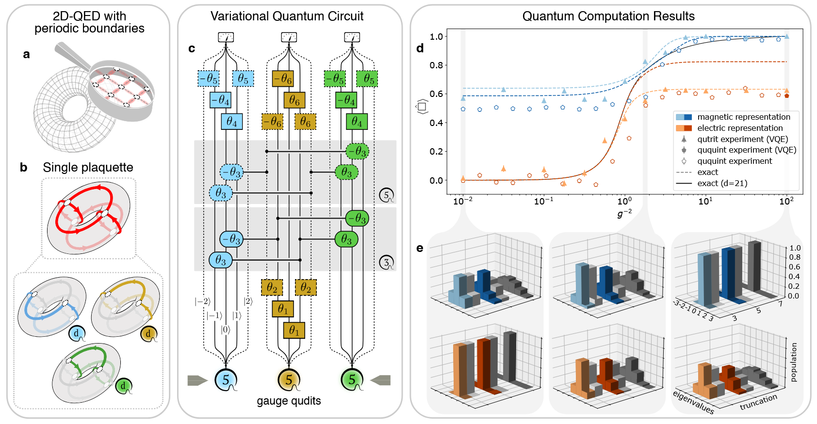
Encoding
Particles ${\hat{q}}_{n}→$ ‘easy’ for q. computer
Fields ${\hat{E}}_{n},{\hat{P}}_{n},{\hat{R}}_{n}→$ hard and expensive for q. computer... Unless it is qudit ready!
M. Meth et many al. (including LD), Nature Physics 21, 570-576 (2025)

Slide 13
Encoding – can we do better?
Zero charge subsector: many redundant DOFs
[1] S. Bravyi, J. M. Gambetta, A. Mezzacapo, and K. Temme, arXiv:1701.08213, 2017
[2] L. Gunderman, A. Jena, LD, and Phys. Rev. A 109, 022618, 2024
Notes:
Story about me (and Alessio) finding effective Hamiltonians
and next slide present occam

Slide 14
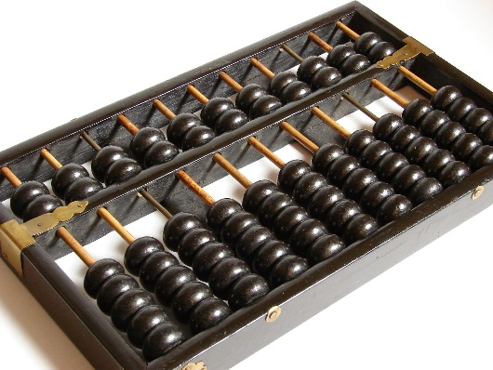
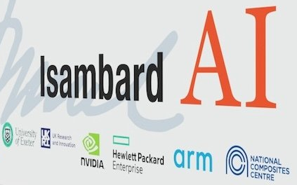
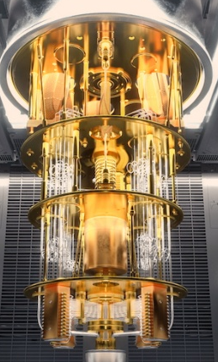
Efficient Encoding
More computational power
Too hard for HPC or Quantum
More symmetries needed
S. Bravyi et al., arXiv:1701.08213, (2017)
L. Gunderman et al., Phys. Rev. A 109, 022618, (2024)
C. Nation et al., arXiv:2605.18966 (2026)
C. Nation et al., arXiv:2605.30428 (2026)
S. Banerjee et al., arXiv:2605.30429 (2026)

Slide 15
Efficient Encoding
More computational power
Solved with HPC or Quantum
More symmetries exploited
S. Bravyi et al., arXiv:1701.08213, (2017)
L. Gunderman et al., Phys. Rev. A 109, 022618, (2024)
C. Nation et al., arXiv:2605.18966 (2026)
C. Nation et al., arXiv:2605.30428 (2026)
S. Banerjee et al., arXiv:2605.30429 (2026)

Slide 16
Efficient Encoding
More symmetries
exploited
Quantum Inspired, Classically Efficient
For Quantum and Classical Simulations
Solidifies Quantum Advantage
S. Bravyi et al., arXiv:1701.08213, (2017)
L. Gunderman et al., Phys. Rev. A 109, 022618, (2024)
C. Nation et al., arXiv:2605.18966 (2026)
C. Nation et al., arXiv:2605.30428 (2026)
S. Banerjee et al., arXiv:2605.30429 (2026)

Slide 17
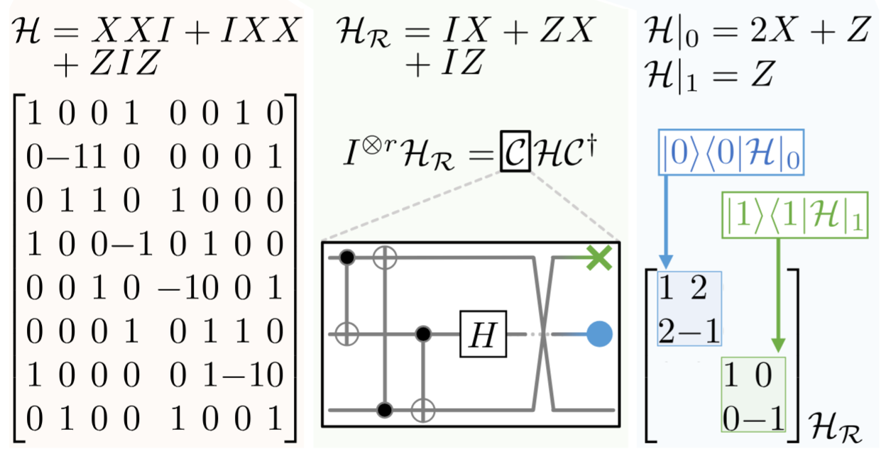
Efficient Encoding
Find all qudit Pauli symmetry and only work in the right subsector!
[1] S. Bravyi, J. M. Gambetta, A. Mezzacapo, and K. Temme, arXiv:1701.08213, 2017
[2] L. Gunderman, A. Jena, LD, and Phys. Rev. A 109, 022618, 2024
Notes:
We find all Pauli symmetries deterministically and efficiently
Consider the example; 3 qubit Hamiltonian. Do we need these 3?
We find a Clifford where one is redundant (eliminated)
And the other only has Z -> classically simulable
This can be done with spins and for large Hamiltonians

Slide 18
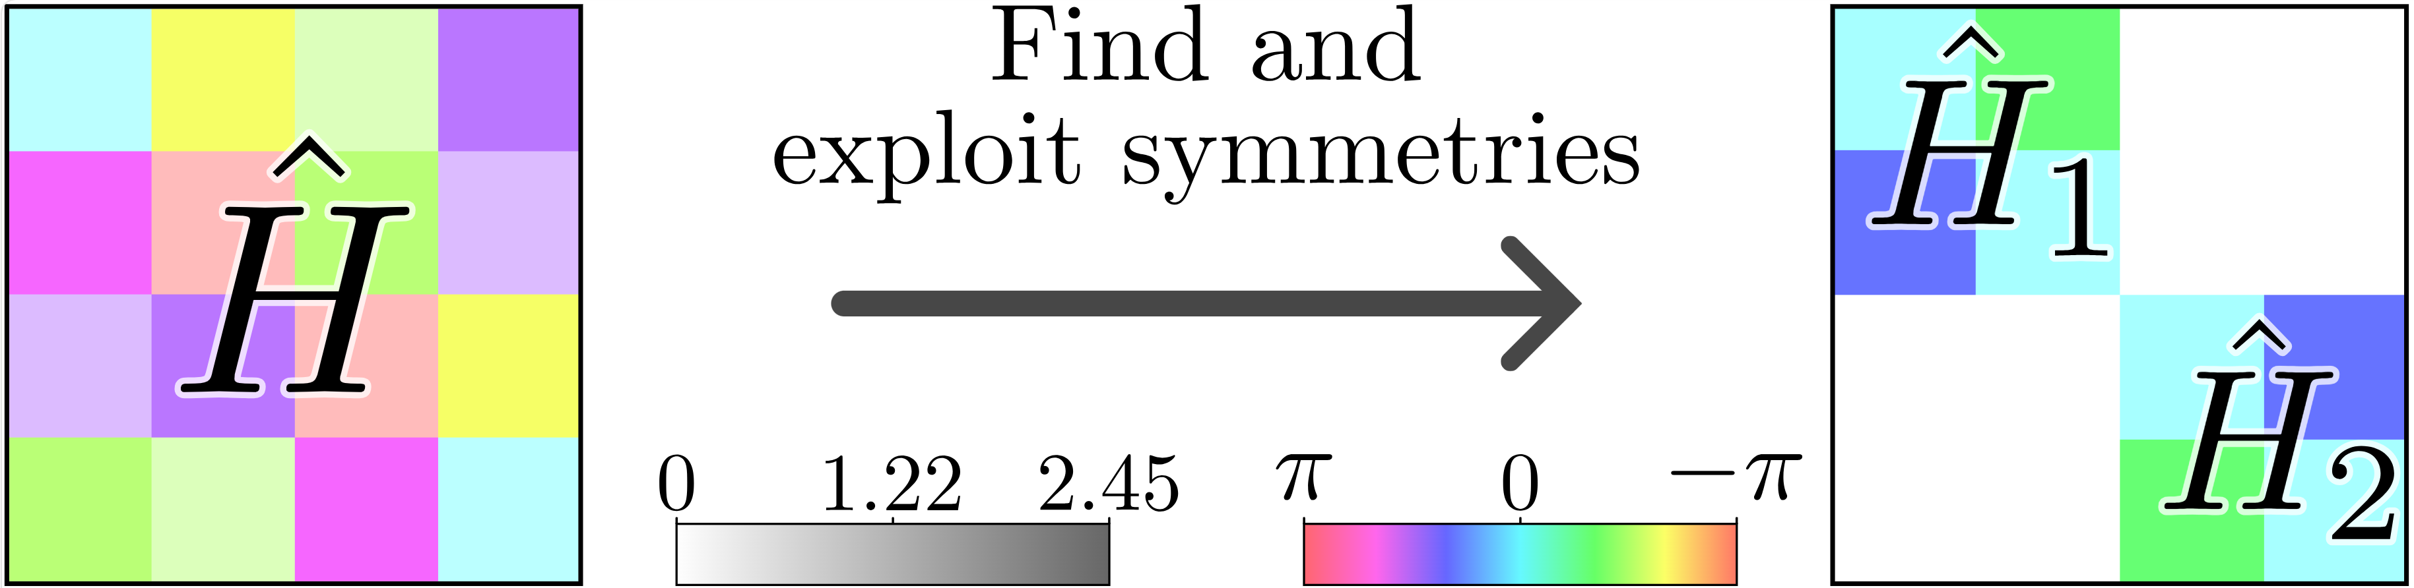
Efficient Encoding
[2] C. Nation, R. Simon, S. Banerjee, F. Martini, A. Ricottone, F. Cerisola, LD, arXiv:2605.18966 (2026)
[3] C. Nation, R. Simon, S. Banerjee, F. Martini, A. Ricottone, F. Cerisola, LD, arXiv:2605.30428 (2026)
[4] S. Banerjee, V. Muthu, C. Nation, R. Simon, F. Martini, A. Ricottone, F. Cerisola, LD, arXiv:2605.30429 (2026)

Slide 19
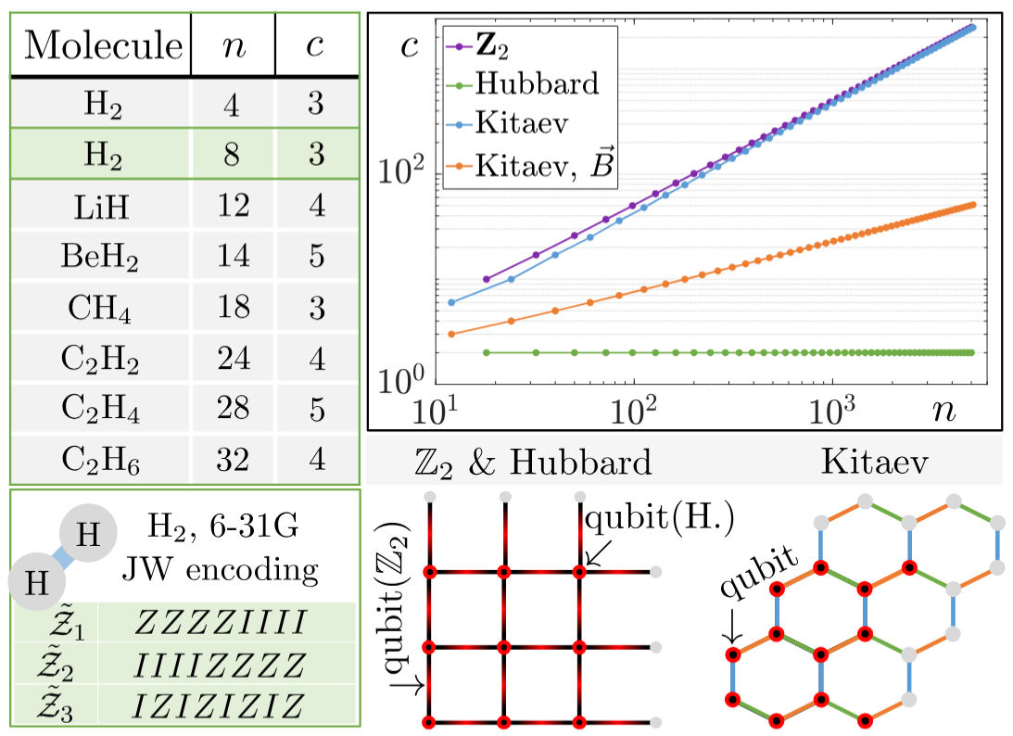
Efficient Encoding
Pauli symmetries
5000+ qubits
Generalised to quDits
Any input Hamiltonian
Exponential advantage
(still exponentially hard)
[1] S. Bravyi, J. M. Gambetta, A. Mezzacapo, and K. Temme, arXiv:1701.08213, 2017
[2] Image from L. Gunderman, A. Jena, LD, and Phys. Rev. A 109, 022618, 2024

Slide 20
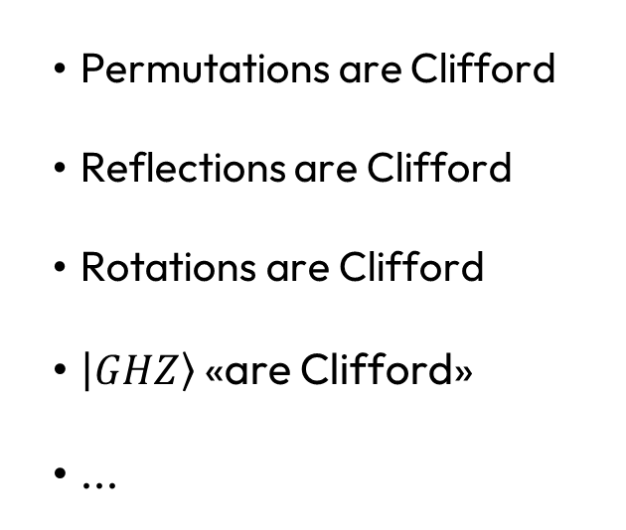
Efficient Encoding
Permutations are Clifford
Reflections are Clifford
Rotations are Clifford
$\left|\left.GHZ\right\rangle \right.$ «are Clifford»
...
Clifford Symmetries
Pauli Symmetries
[2] C. Nation, R. Simon, S. Banerjee, F. Martini, A. Ricottone, F. Cerisola, LD, arXiv:2605.18966 (2026)
[3] C. Nation, R. Simon, S. Banerjee, F. Martini, A. Ricottone, F. Cerisola, LD, arXiv:2605.30428 (2026)
[4] S. Banerjee, V. Muthu, C. Nation, R. Simon, F. Martini, A. Ricottone, F. Cerisola, LD, arXiv:2605.30429 (2026)

Slide 21
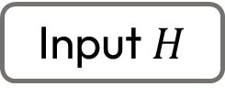
Efficient Encoding
Input $H$
Find Clifford symmetries
Find optimal Clifford decomposition
Diagonalize Clifford subsector
Find effective Hamiltonians
Solve the problem
[2] C. Nation et al., arXiv:2605.18966 (2026)
[3] C. Nation et al., arXiv:2605.30428 (2026)

Slide 22
Efficient Encoding
Input $H$
Find Clifford symmetries
Find optimal Clifford decomposition
Diagonalize Clifford subsector
Find effective Hamiltonians
Solve the problem
[2] C. Nation et al., arXiv:2605.18966 (2026)
[3] C. Nation et al., arXiv:2605.30428 (2026)

Slide 23

Efficient Encoding
$$H=XY+ZY$$
XY
XY
Hadamard
ZY
ZY
[2] C. Nation et al., arXiv:2605.18966 (2026)
[3] C. Nation et al., arXiv:2605.30428 (2026)

Slide 24
Efficient Encoding
Find a mapping that corresponds to a Clifford and preserves the input Hamiltonian… Is np-hard (in the worst case)!
[2] C. Nation et al., arXiv:2605.18966 (2026)
[3] C. Nation et al., arXiv:2605.30428 (2026)

Slide 25
Efficient Encoding
Find a mapping that corresponds to a Clifford and preserves the input Hamiltonian… Is np-hard (in the worst case)!
[2] C. Nation et al., arXiv:2605.18966 (2026)
[3] C. Nation et al., arXiv:2605.30428 (2026)

Slide 26
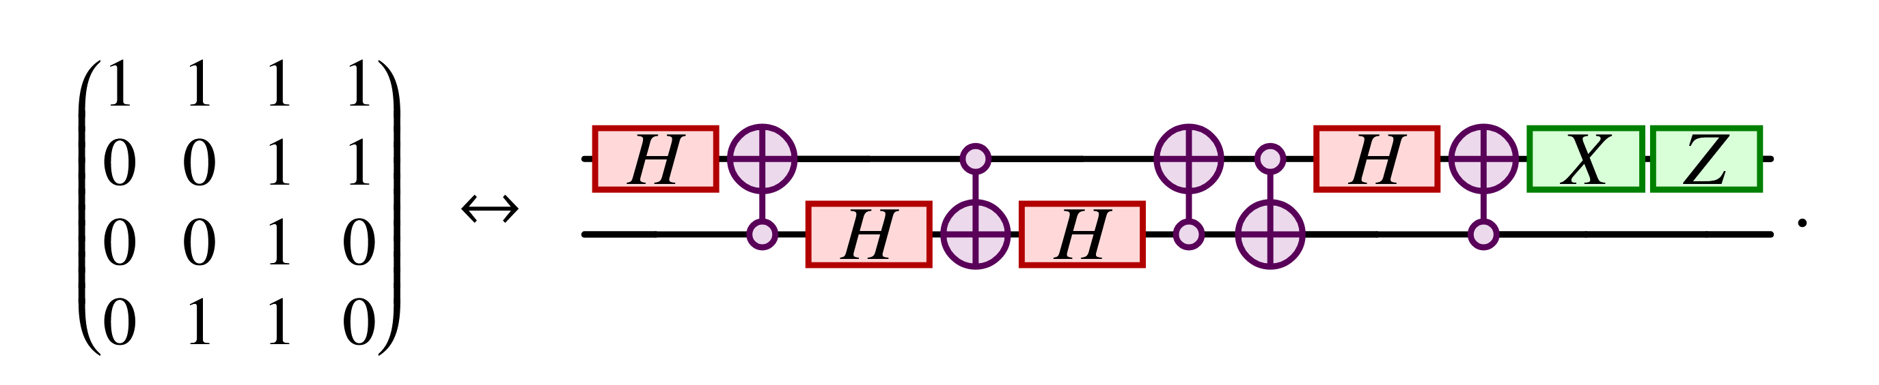
Efficient Encoding
Find a mapping that corresponds to a Clifford and preserves the input Hamiltonian… Is np-hard (in the worst case)!
[2] C. Nation et al., arXiv:2605.18966 (2026)
[3] C. Nation et al., arXiv:2605.30428 (2026)

Slide 27
Efficient Encoding
Find a mapping that corresponds to a Clifford and preserves the input Hamiltonian… Is np-hard (in the worst case)!
[2] C. Nation et al., arXiv:2605.18966 (2026)
[3] C. Nation et al., arXiv:2605.30428 (2026)

Slide 28
Efficient Encoding
Input $H$
Find Clifford symmetries
Find optimal Clifford decomposition
Diagonalize Clifford subsector
Find effective Hamiltonians
Solve the problem
[2] C. Nation et al., arXiv:2605.18966 (2026)
[3] C. Nation et al., arXiv:2605.30428 (2026)

Slide 29

Efficient Encoding
$$\hat{S}$$
Diagonalizing a Clifford… Is np-hard!
[2] C. Nation et al., arXiv:2605.18966 (2026)
[3] C. Nation et al., arXiv:2605.30428 (2026)

Slide 30
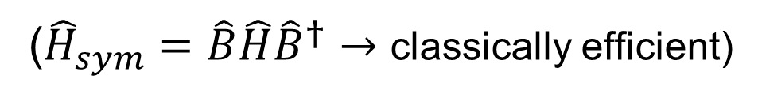

Efficient Encoding
$$\hat{S}=\hat{B}{\hat{S}}_{min}{\hat{B}}^{†}$$
(${\hat{H}}_{sym}=\hat{B}\hat{H}{\hat{B}}^{†}→$ classically efficient)
Efficiently find minimal block decomposition ${\hat{S}}_{min}$
[2] C. Nation et al., arXiv:2605.18966 (2026)
[3] C. Nation et al., arXiv:2605.30428 (2026)

Slide 31
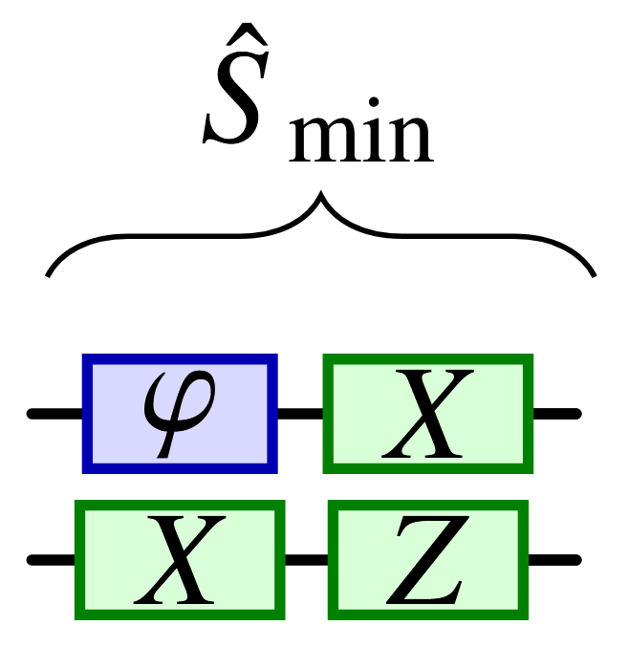
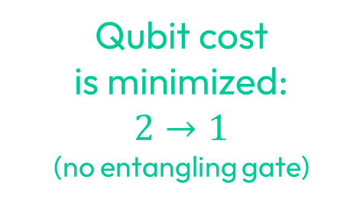
Efficient Encoding
Qubit cost
is minimized:
$$2→1$$
(no entangling gate)
Efficiently find minimal block decomposition ${\hat{S}}_{min}$
[2] C. Nation et al., arXiv:2605.18966 (2026)
[3] C. Nation et al., arXiv:2605.30428 (2026)

Slide 32
Efficient Encoding
Input $H$
Find Clifford symmetries
Find optimal Clifford decomposition
Diagonalize Clifford subsector
Find effective Hamiltonians
Solve the problem
[2] C. Nation et al., arXiv:2605.18966 (2026)
[3] C. Nation et al., arXiv:2605.30428 (2026)

Slide 33



Efficient Encoding
$${\hat{H}}_{1}=\sqrt{2}(\hat{1}+\hat{X})+2\hat{Y}$$
$$\hat{H}=\hat{Y}\hat{Z}+\hat{Z}\hat{Z}−\hat{1}\hat{X}−2\hat{X}\hat{Y}+2\hat{Y}\hat{1}$$
$${\hat{H}}_{2}=\sqrt{2}\left(\hat{1}+\hat{X}\right)−2\hat{Y}$$
[2] C. Nation et al., arXiv:2605.18966 (2026)
[3] C. Nation et al., arXiv:2605.30428 (2026)

Slide 34

Efficient Encoding
Cost?
Diagonalization of ${\hat{S}}_{min}$ (minimal with our method)
Degeneracy of the eigenvalues of ${\hat{S}}_{min}$
Finding all effective Hamiltonians… Is np-hard, but yields exponential advantage, and if know the right subsector you WIN!
[2] C. Nation et al., arXiv:2605.18966 (2026)
[3] C. Nation et al., arXiv:2605.30428 (2026)

Slide 35
Efficient Encoding
Input $H$
Find Clifford symmetries
Find optimal Clifford decomposition
Diagonalize Clifford subsector
Find effective Hamiltonians
Solve the problem – go ahead ☺
[2] C. Nation et al., arXiv:2605.18966 (2026)
[3] C. Nation et al., arXiv:2605.30428 (2026)

Slide 36
Efficient Encoding
Does it work?
[2] C. Nation et al., arXiv:2605.18966 (2026)
[3] C. Nation et al., arXiv:2605.30428 (2026)

Slide 37
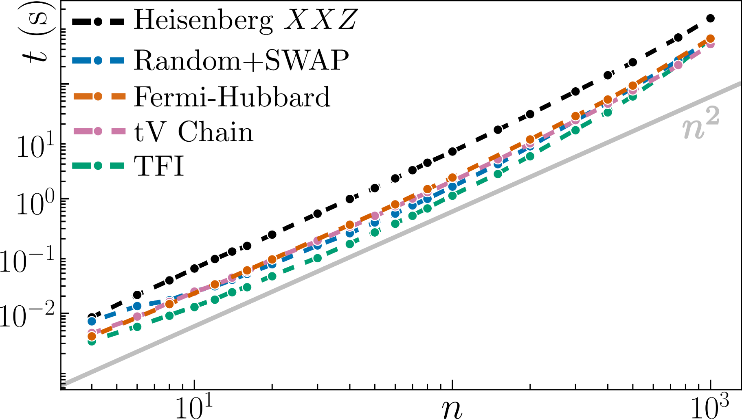
Efficient Encoding
Analytical understanding
Exploitability
256x larger instances

Slide 38
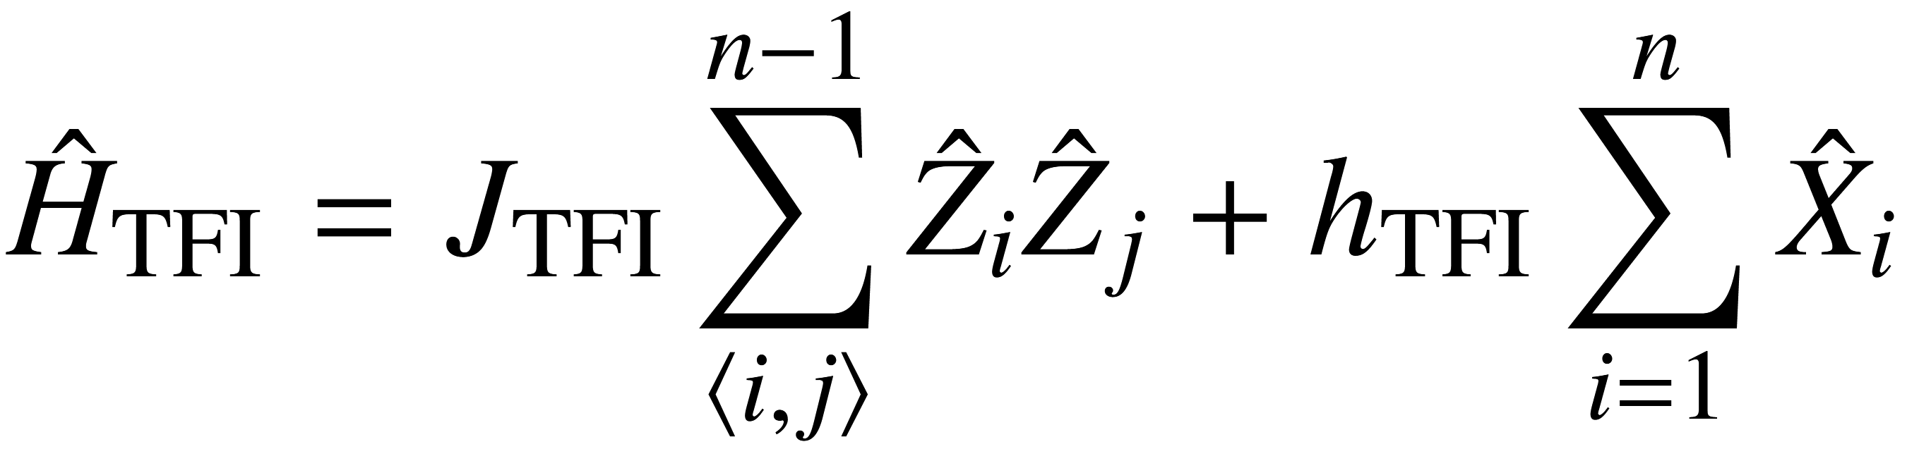
Efficient Encoding
TFI (Transverse-Field Ising model)

Slide 39
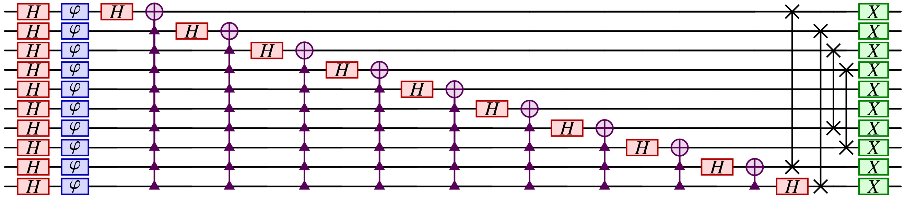
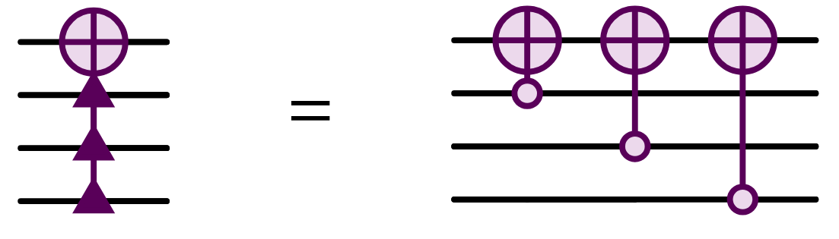

Efficient Encoding
TFI (Transverse-Field Ising model)
$$\hat{S}=$$

Slide 40

Efficient Encoding
TFI (Transverse-Field Ising model)
$$\hat{S}$$
Exploitability?

Slide 41
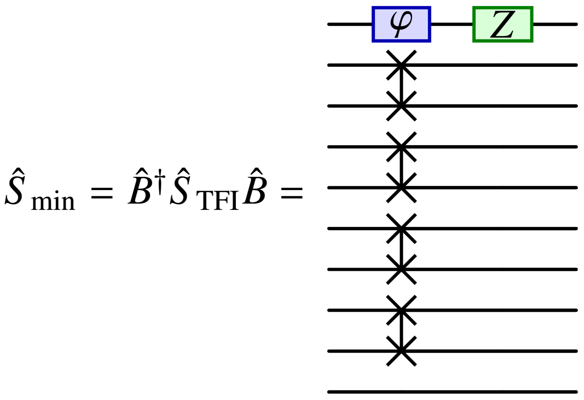
Efficient Encoding
TFI (Transverse-Field Ising model)
Symmetry found+diagonalized
“Qubit cost” is 2 for all sizes!
Best reference frame

Slide 42
Efficient Encoding
Analytical understanding
Exploitability
256x larger instances

Slide 43
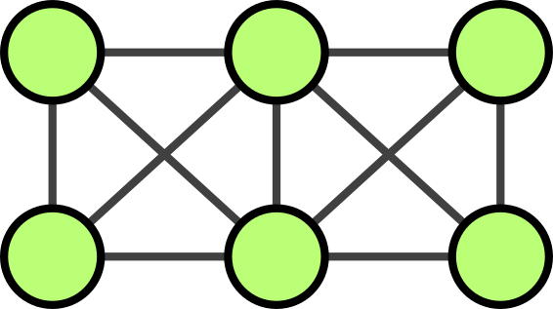
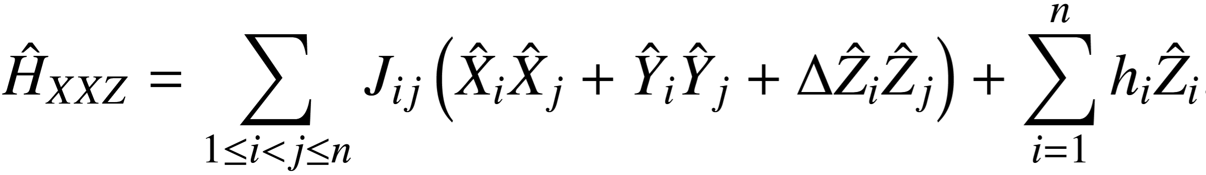
Efficient Encoding
Heisenberg XXZ

Slide 44
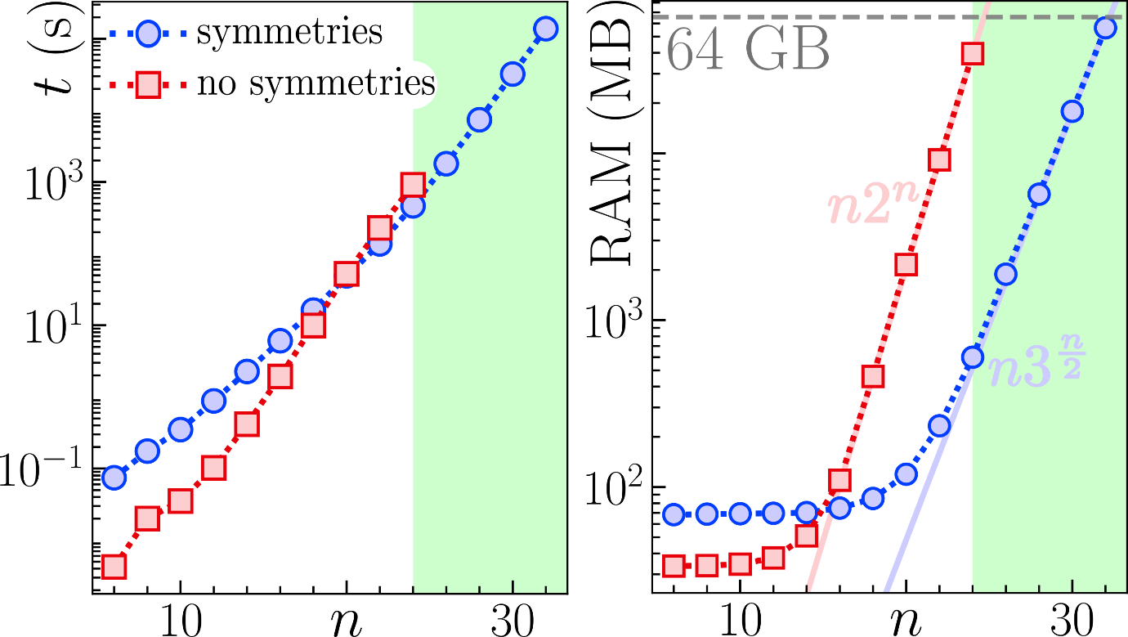
Efficient Encoding
Heisenberg XXZ

Slide 45
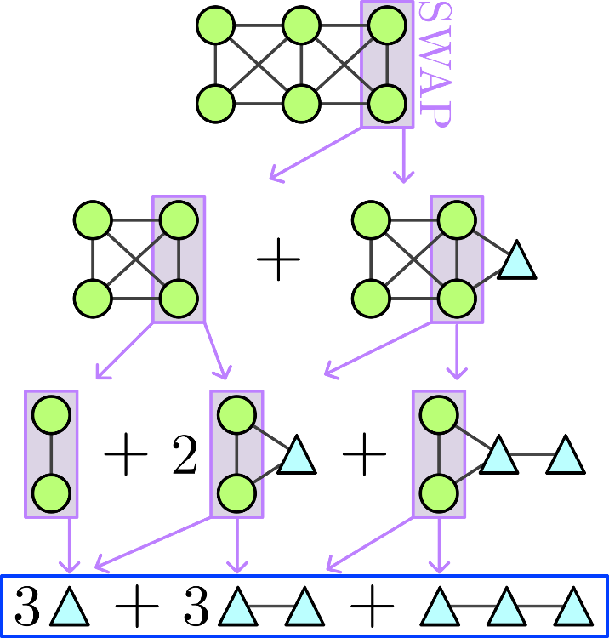
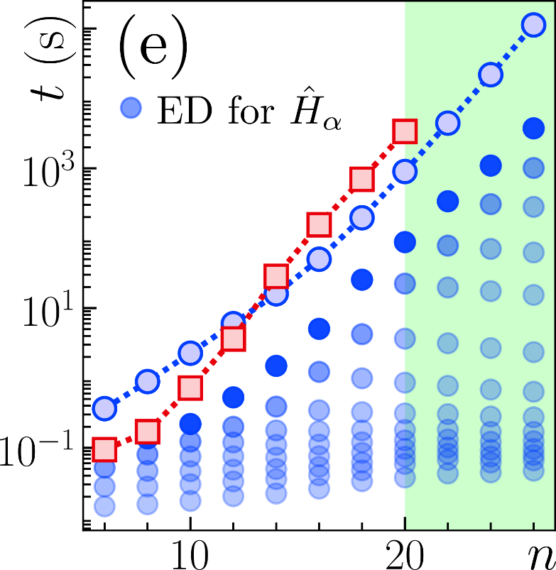
Efficient Encoding
Heisenberg XXZ
256x larger
4x faster (total)
40x faster
60.000x faster

Slide 46
Efficient Encoding
Does it work?
Efficiently finds all Clifford symmetries of any model
Diagonalizes the symmetry optimally by minimizing their qubit cost
Even if the symmetry is known, we exploit it finding effective Hamiltonians
Crucial to develop understanding the model
256x larger models solved up to 60.000 times faster for 20 qubits (ED)
[2] C. Nation et al., arXiv:2605.18966 (2026)
[3] C. Nation et al., arXiv:2605.30428 (2026)

Slide 47
Efficient Encoding
Can we bypass complexity with a quantum computer?
[2] C. Nation et al., arXiv:2605.18966 (2026)
[3] C. Nation et al., arXiv:2605.30428 (2026)

Slide 48
Efficient Encoding
Can we bypass complexity with a quantum computer?
[2] C. Nation et al., arXiv:2605.18966 (2026)
[3] C. Nation et al., arXiv:2605.30428 (2026)

Slide 49
Efficient Encoding
Can we bypass complexity with a quantum computer?
No need to find effective H
☹
gone
X
One X rotation
☺
Residual complexity
[2] C. Nation et al., arXiv:2605.18966 (2026)
[3] C. Nation et al., arXiv:2605.30428 (2026)

Slide 50
Efficient Encoding
Symmetries have huge untapped potential
They can push the limits of classical simulations
They can push the limits of quantum simulations
They will shed light on real quantum advantage
[2] C. Nation, R. Simon, S. Banerjee, F. Martini, A. Ricottone, F. Cerisola, LD, arXiv:2605.18966 (2026)
[3] C. Nation, R. Simon, S. Banerjee, F. Martini, A. Ricottone, F. Cerisola, LD, arXiv:2605.30428 (2026)
[4] S. Banerjee, V. Muthu, C. Nation, R. Simon, F. Martini, A. Ricottone, F. Cerisola, LD, arXiv:2605.30429 (2026)

Slide 51
Software
Measurement
Image from D. Paulson*, LD*, J. F. Haase*, A. Celi*, A. Kan, A. Jena, C. Kokail, R. v. Bijnen, K. Jansen, P. Zoller and C. A. Muschik, PRX Quantum, 2, 030334, 2021

Slide 52
Measurement
Protocol | Overlap | 1/M scaling | Non-bitwise | Single-shot error | Adaptive | Doubling | Noise | qudit
LDF [1] | NO | YES | YES | YES (trivial) | NO | NO | NO | NO
Classical shadow [2] | YES | NO (exp. worse) | NO | NO | NO | NO | NO | NO
APS [3] | YES | NO | NO | NO | NO | NO | NO | NO
Derand [4] | YES | YES | NO | NO | NO | NO | NO | NO
OGM [5] | YES | YES | NO | NO | NO | NO | NO | NO
AEQuO [1] | YES | YES | YES | YES | YES | NO | NO | NO
CBS [6] | YES | YES | YES | NO | NO | NO | NO | NO
AQuIRE [7,8] | YES | YES | YES | YES | YES | YES | YES | YES
[1]: A. J. Jena, A., Schlosberg P. Mukhopadhyay, J. F. Haase, F. Leditzky and LD, Quantum 7, 903, 2023
[2]: H. Y. Huang, R. Kueng, J. Preskill, Nat. Physics, 16, 1050-1057, 2020
[3]: C. Hadfield, S. Bravy, R. Raymond, A. Mezzacapo, arXiv:2006.15788, 2020
[4]: H. Y. Huang, R. Kueng, J. Preskill, PRL, 127, 030503, 2021
[5]: B. Wu, J. Sun, Q. Huang, X. Yuan, arXiv:2105.13091, 2021
[6]: M. Kohda, R. Imai, K. Kanno, K. Mitarai, W. Mizukami, Y. O. Nakagawa, arXiv:2112.07416, 2022
[7] R. Simon, Z. Shi, C. Nation, A. Jena, LD, arXiv:2509.01482 (2025)
[8] R. Simon, M. Meth, F. Martini, P. Tirler, A. Jena, M. Ringbauer, LD, arXiv:2605.00682 (2026)

Slide 53
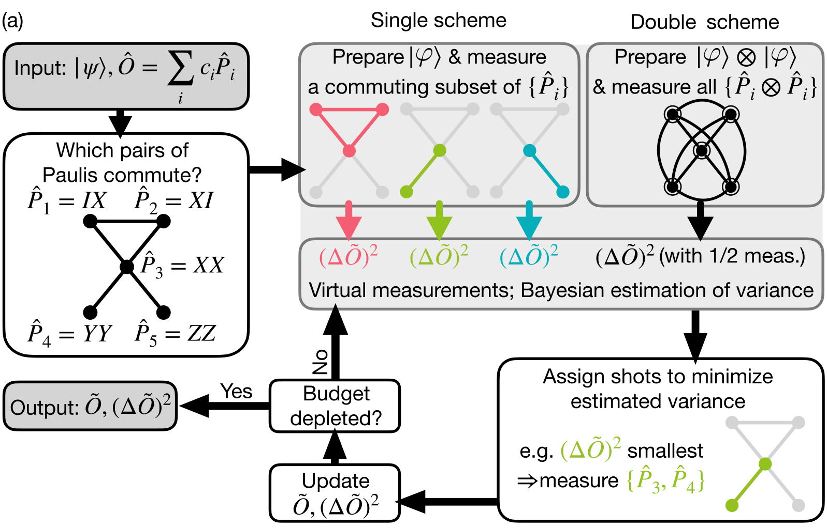
Measurement
Qudit ready
Hardware noise awareness
Not an
Error!
[7] R. Simon, Z. Shi, C. Nation, A. Jena, LD, arXiv:2509.01482 (2025)
[8] R. Simon, M. Meth, F. Martini, P. Tirler, A. Jena, M. Ringbauer, LD, arXiv:2605.00682 (2026)

Slide 54
Measurement – double scheme
[7] Image from R. Simon, Z. Shi, C. Nation, A. Jena, LD, arXiv:2509.01482 (2025)
[8] R. Simon, M. Meth, F. Martini, P. Tirler, A. Jena, M. Ringbauer, LD, arXiv:2605.00682 (2026)

Slide 55
Measurement – qudit observables
Particles $→$ ‘easy’ for q. computer
Gauge fields $→$ hard and expensive for q. computer... Much better if qudit ready!
M. Meth et many al., Nature Physics 21, 570-576 (2025)

Slide 56
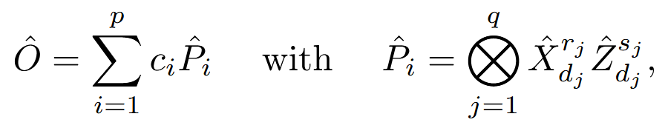
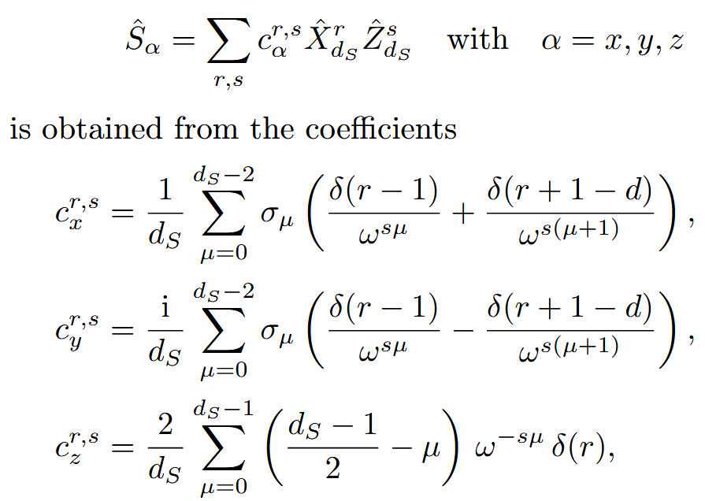

Measurement – qudit observables
Spin Hamiltonian
Classically efficient
Pauli Hamiltonian
[7] R. Simon, Z. Shi, C. Nation, A. Jena, LD, arXiv:2509.01482 (2025)
[8] R. Simon, M. Meth, F. Martini, P. Tirler, A. Jena, M. Ringbauer, LD, arXiv:2605.00682 (2026)

Slide 57
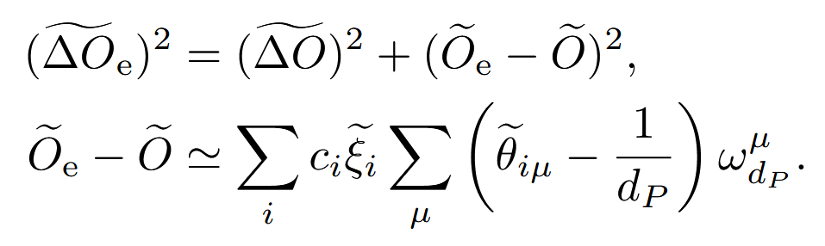
Measurement – error awareness
Cheap
Impact on the specific experiment
[7] R. Simon, Z. Shi, C. Nation, A. Jena, LD, arXiv:2509.01482 (2025)
[8] R. Simon, M. Meth, F. Martini, P. Tirler, A. Jena, M. Ringbauer, LD, arXiv:2605.00682 (2026)
Notes:
Error awareness (super simple, can get really complicated depended on how accurately you want to estimate error probabilities... )
Efficiency of error awareness
Will lead to error mitigation

Slide 58
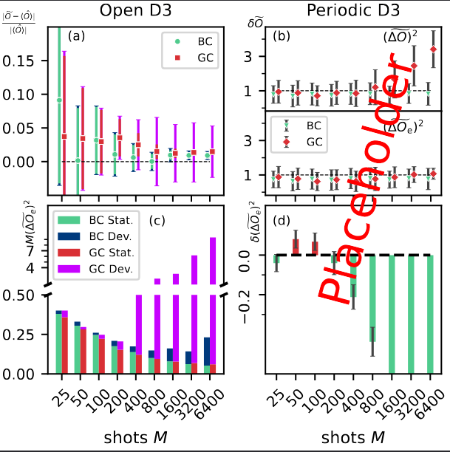
Measurement
# shots
# shots
[7] R. Simon, Z. Shi, C. Nation, A. Jena, LD, arXiv:2509.01482 (2025)
[8] Image from R. Simon, M. Meth, A. Jena, F. Martini, M. Ringbauer, LD, in preparation

Slide 59
Conclusions and Outlook
Classically efficient approach for symmetry finding
Measurement protocol that will not let you down
sympleq
Error mitigation within AQuIRE
Beyond Clifford symmetries and “almost” symmetries

Slide 60
Attempt for open questions
Readout mitigation. We have seen amazing results, that I cannot reproduce. While this is mostly my lack of capabilities, I believe that a shared framework would benefit the whole community.
What am I simulating? As an (ignorant) quantum simulation person, I would like a “revised Kogut-Susskind” paper, because I simply do not understand it!

Slide 61
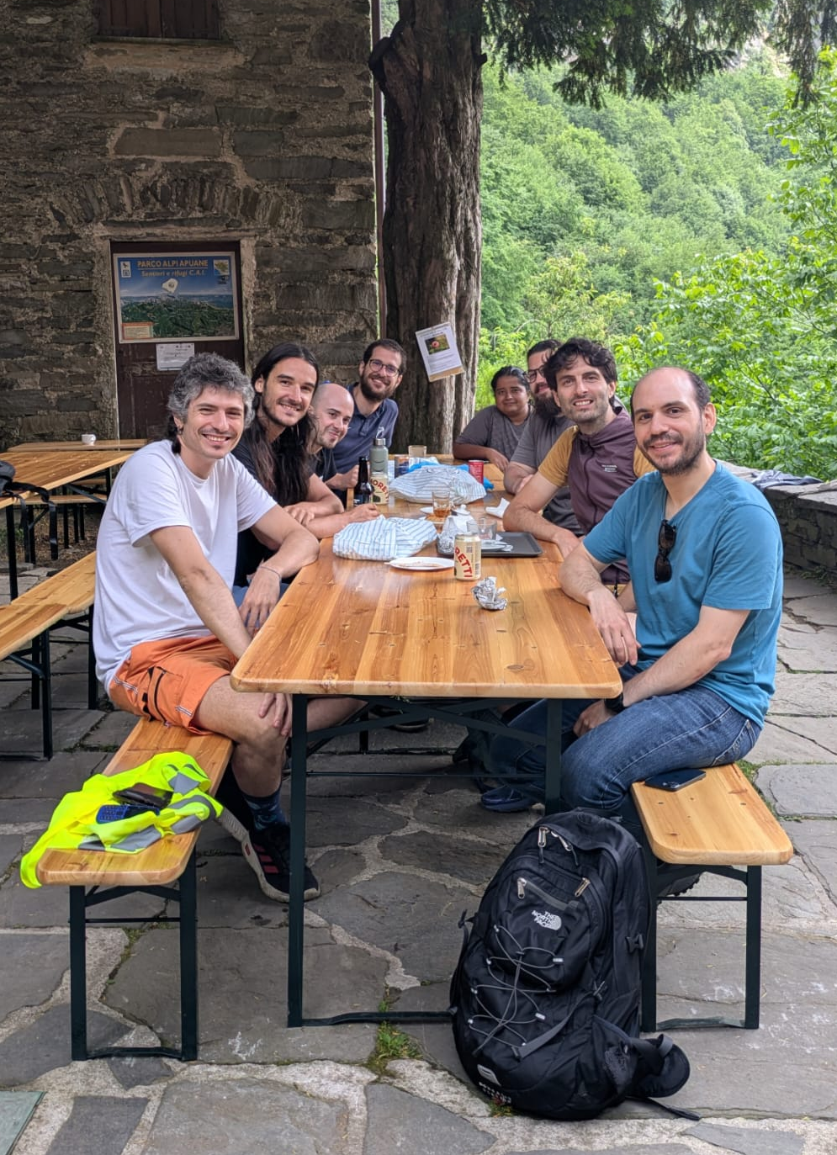
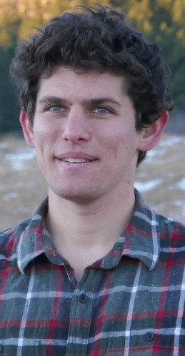



Acknowledgements

Slide 62
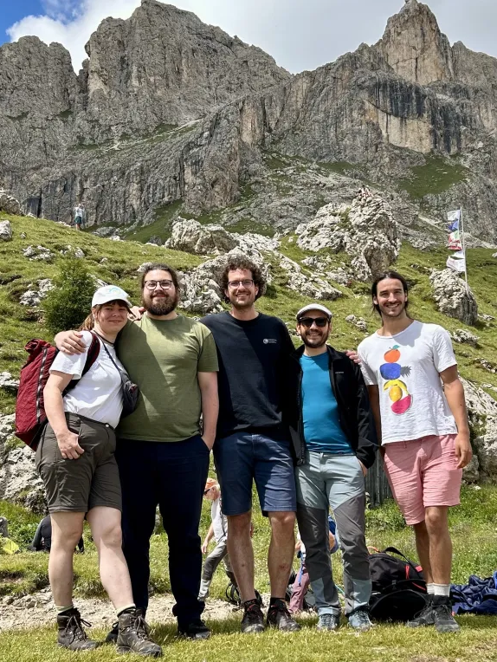



Acknowledgements

