Slide 1

TPCs: Past, Present, and Futures
Lior Arazi
Ben-Gurion University
SARAF TPC Day Workshop, Feb 19, 2026

Slide 2
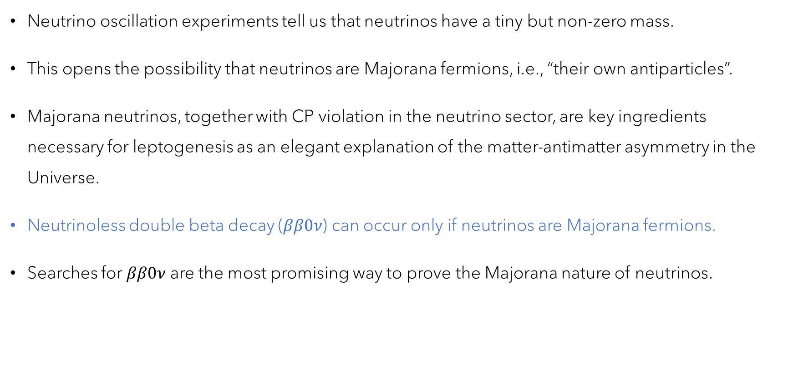
Majorana neutrinos?
Neutrino oscillation experiments tell us that neutrinos have a tiny but non-zero mass.
This opens the possibility that neutrinos are Majorana fermions, i.e., “their own antiparticles”.
Majorana neutrinos, together with CP violation in the neutrino sector, are key ingredients necessary for leptogenesis as an elegant explanation of the matter-antimatter asymmetry in the Universe.
Neutrinoless double beta decay ($ββ0ν$) can occur only if neutrinos are Majorana fermions.
Searches for $ββ0ν$ are the most promising way to prove the Majorana nature of neutrinos.

Slide 3
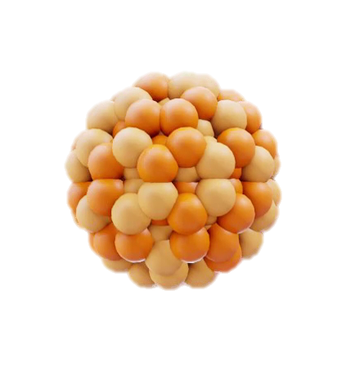
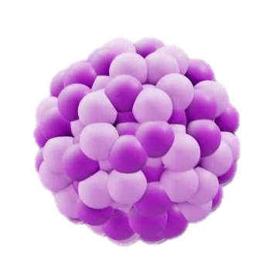
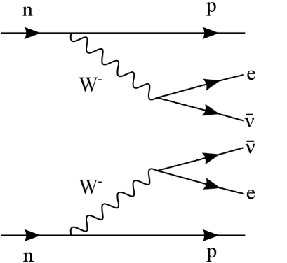

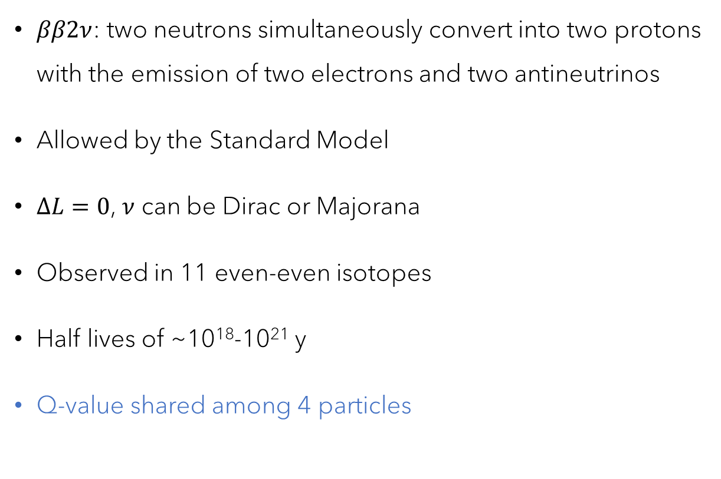

Normal double beta decay
$ββ2ν$: two neutrons simultaneously convert into two protons with the emission of two electrons and two antineutrinos
Allowed by the Standard Model
$ΔL=0$, $ν$ can be Dirac or Majorana
Observed in 11 even-even isotopes
Half lives of ~10¹⁸-10²¹ y
Q-value shared among 4 particles
_
_
e-
ν_{e}
ν_{e}
e-
$$ββ2ν$$
$${}_{Z}^{A}{X⟶}{}_{Z+2}^{A}{Y+2}e^{−}+2{\overline{ν}}_{e}$$

Slide 4
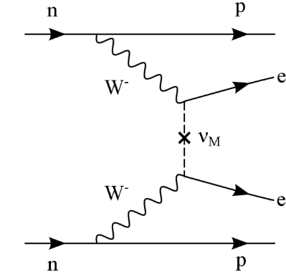

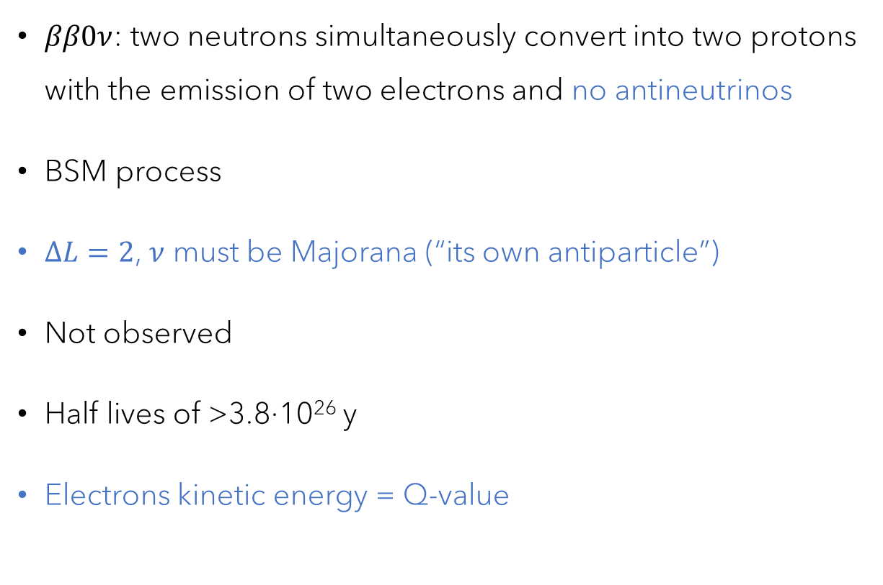

Neutrinoless double beta decay
$ββ0ν$: two neutrons simultaneously convert into two protons with the emission of two electrons and no antineutrinos
BSM process
$ΔL=2$, $ν$ must be Majorana (“its own antiparticle”)
Not observed
Half lives of >3.8·10²⁶ y
Electrons kinetic energy = Q-value
_
_
e-
ν_{e}
ν_{e}
e-
$$ββ0ν$$
$${}_{Z}^{A}{X⟶}{}_{Z+2}^{A}{Y+2}e^{−}$$

Slide 5



$ββ2ν$ vs. $ββ0ν$
counts
$$ββ2ν$$
Q-value shared among 4 particles
$$ββ0ν$$
Q-value shared among 2 e⁻
Total electron kinetic energy
$$Q_{ββ}$$
$ββ0ν$ can only occur in nuclei with $ββ2ν$, with $<{10}^{−5}$ relative rate

Slide 6
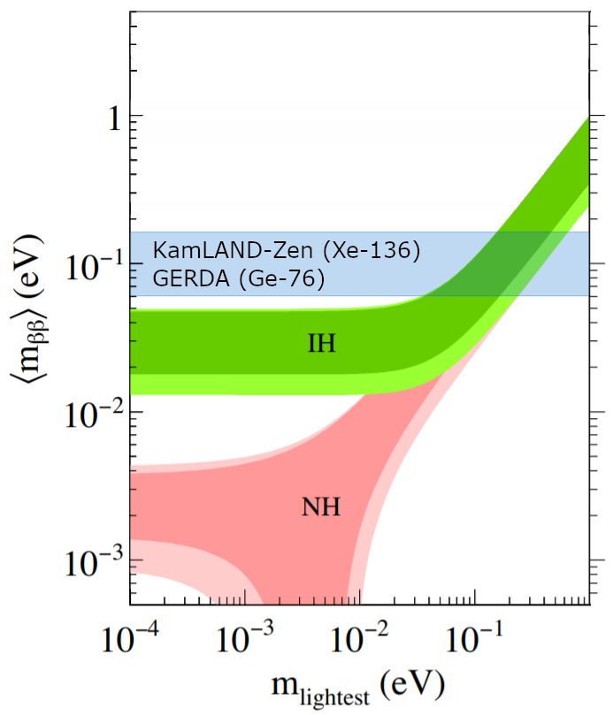
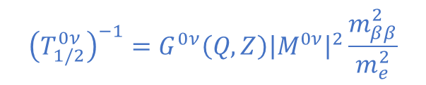
The challenge of next generation experiments
$${\left(T_{1/2}^{0ν}\right)}^{−1}=G^{0ν}\left(Q,Z\right){\left|M^{0ν}\right|}^{2}\frac{m_{ββ}^{2}}{m_{e}^{2}}$$
Next generation:
Lifetime ~10²⁷-10²⁸ years. For ¹³⁶Xe: 0.3-3 events/tonne/yr

Slide 7
It’s all about mass
and backgrounds

Slide 8
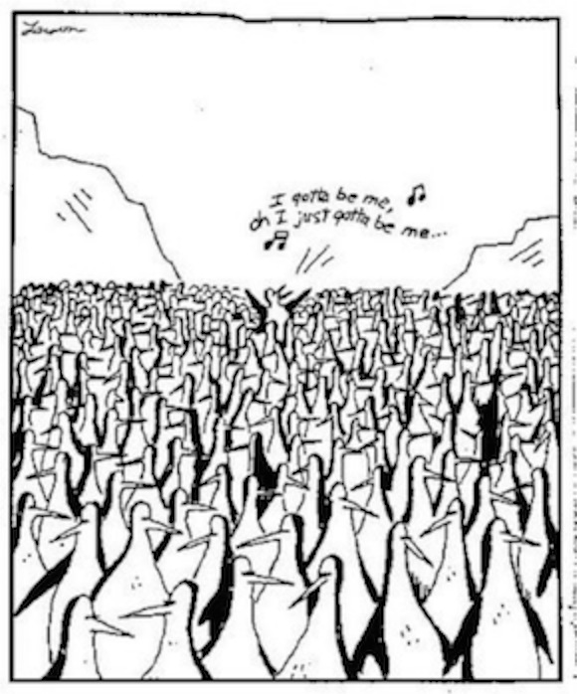
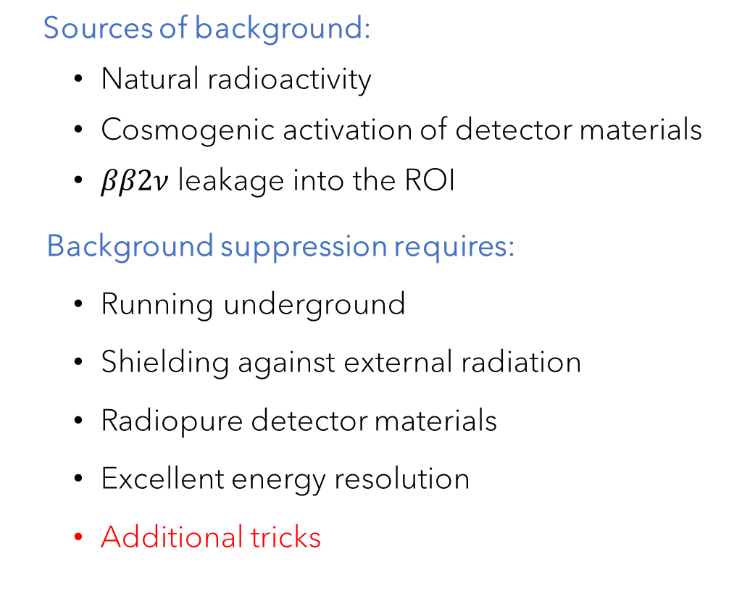
Backgrounds
Sources of background:
Natural radioactivity
Cosmogenic activation of detector materials
$ββ2ν$ leakage into the ROI
Background suppression requires:
Running underground
Shielding against external radiation
Radiopure detector materials
Excellent energy resolution
Additional tricks

Slide 9


Slide 10
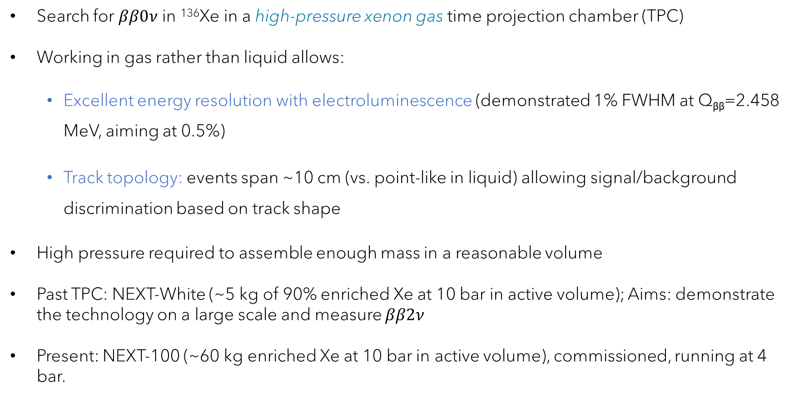
NEXT: Neutrino Experiment with a Xenon TPC
Search for $ββ0ν$ in ¹³⁶Xe in a high-pressure xenon gas time projection chamber (TPC)
Working in gas rather than liquid allows:
Excellent energy resolution with electroluminescence (demonstrated 1% FWHM at Q_{ββ}=2.458 MeV, aiming at 0.5%)
Track topology: events span ~10 cm (vs. point-like in liquid) allowing signal/background discrimination based on track shape
High pressure required to assemble enough mass in a reasonable volume
Past TPC: NEXT-White (~5 kg of 90% enriched Xe at 10 bar in active volume); Aims: demonstrate the technology on a large scale and measure $ββ2ν$
Present: NEXT-100 (~60 kg enriched Xe at 10 bar in active volume), commissioned, running at 4 bar.

Slide 11
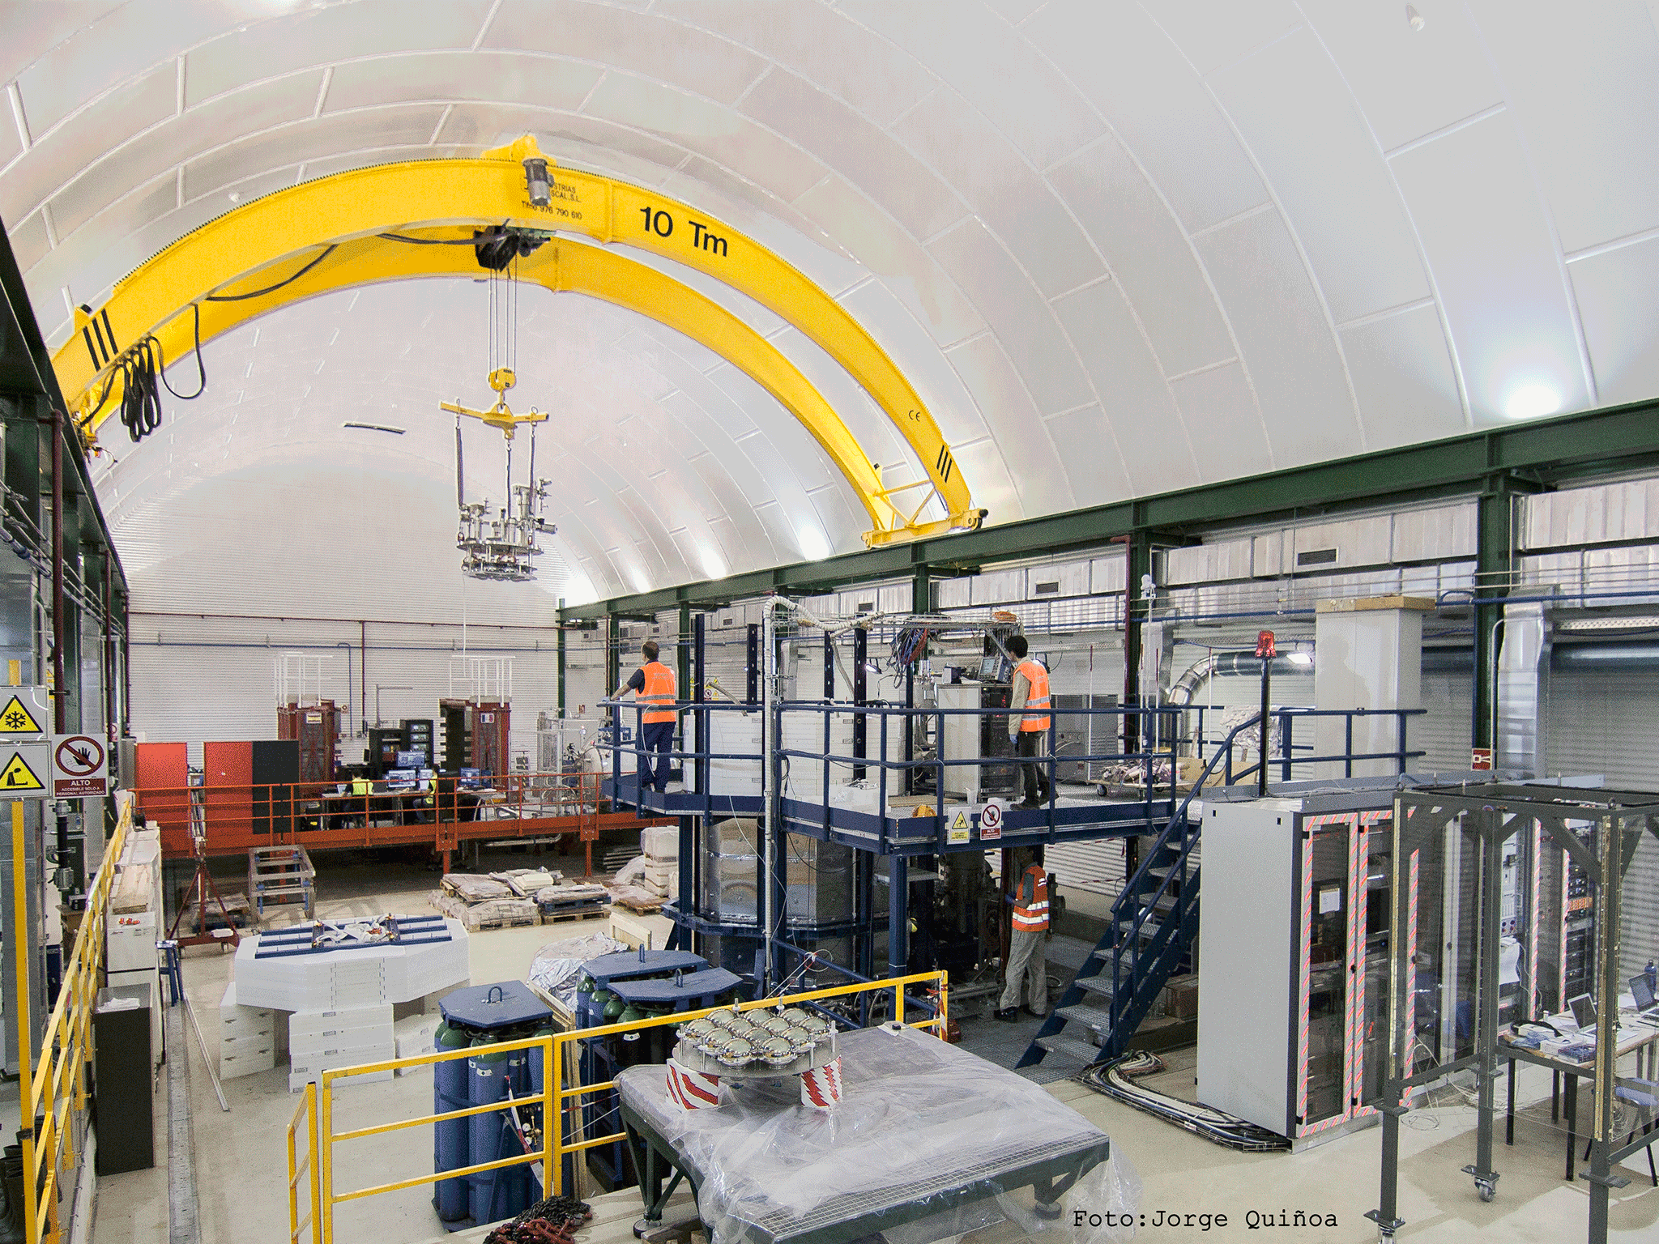
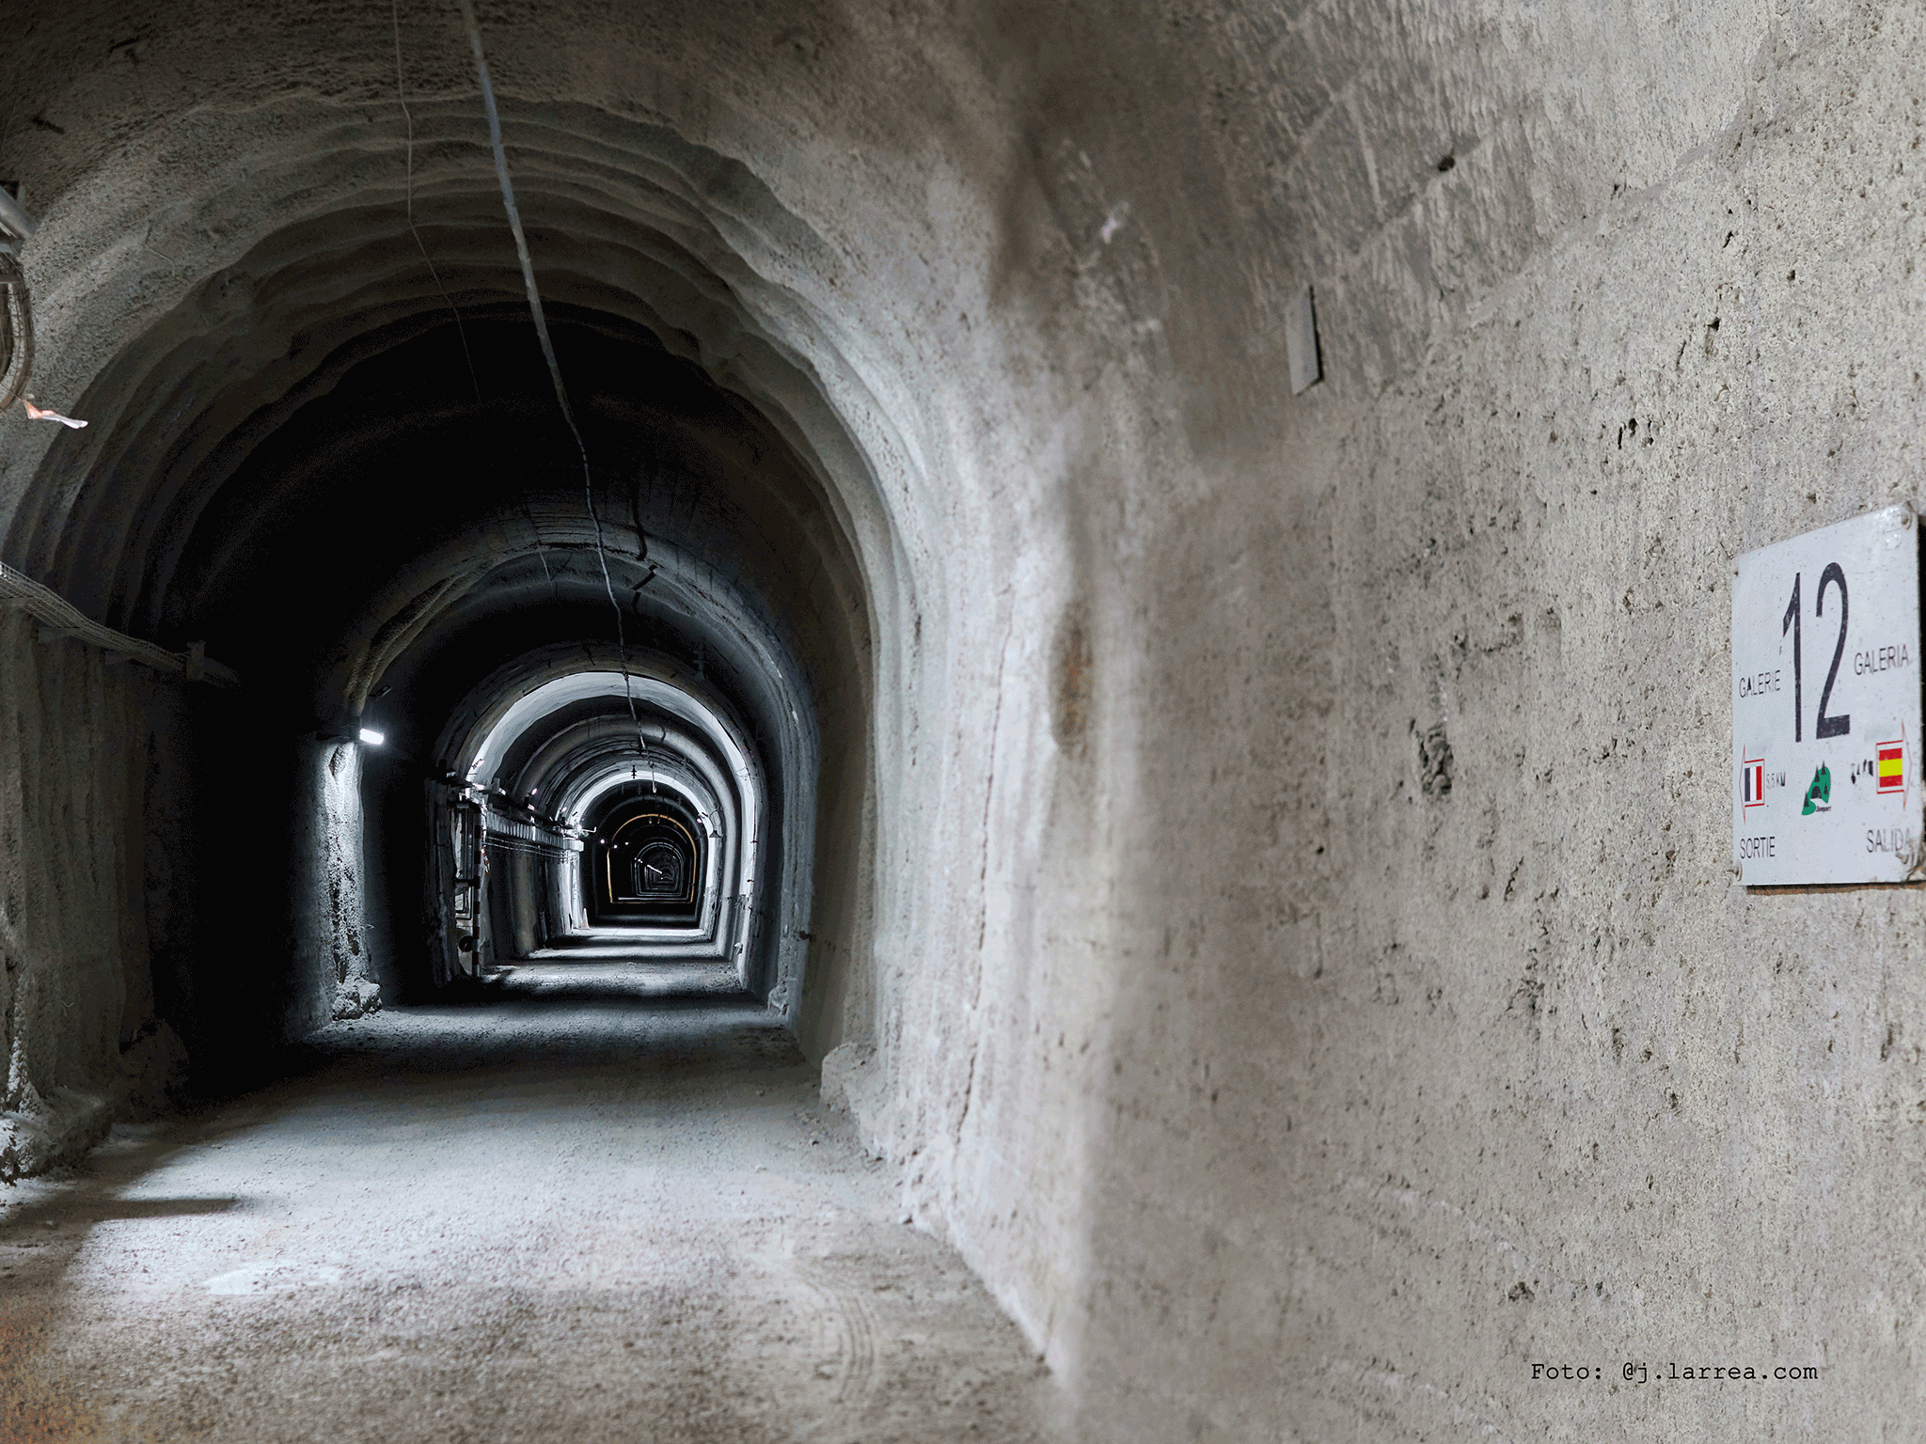
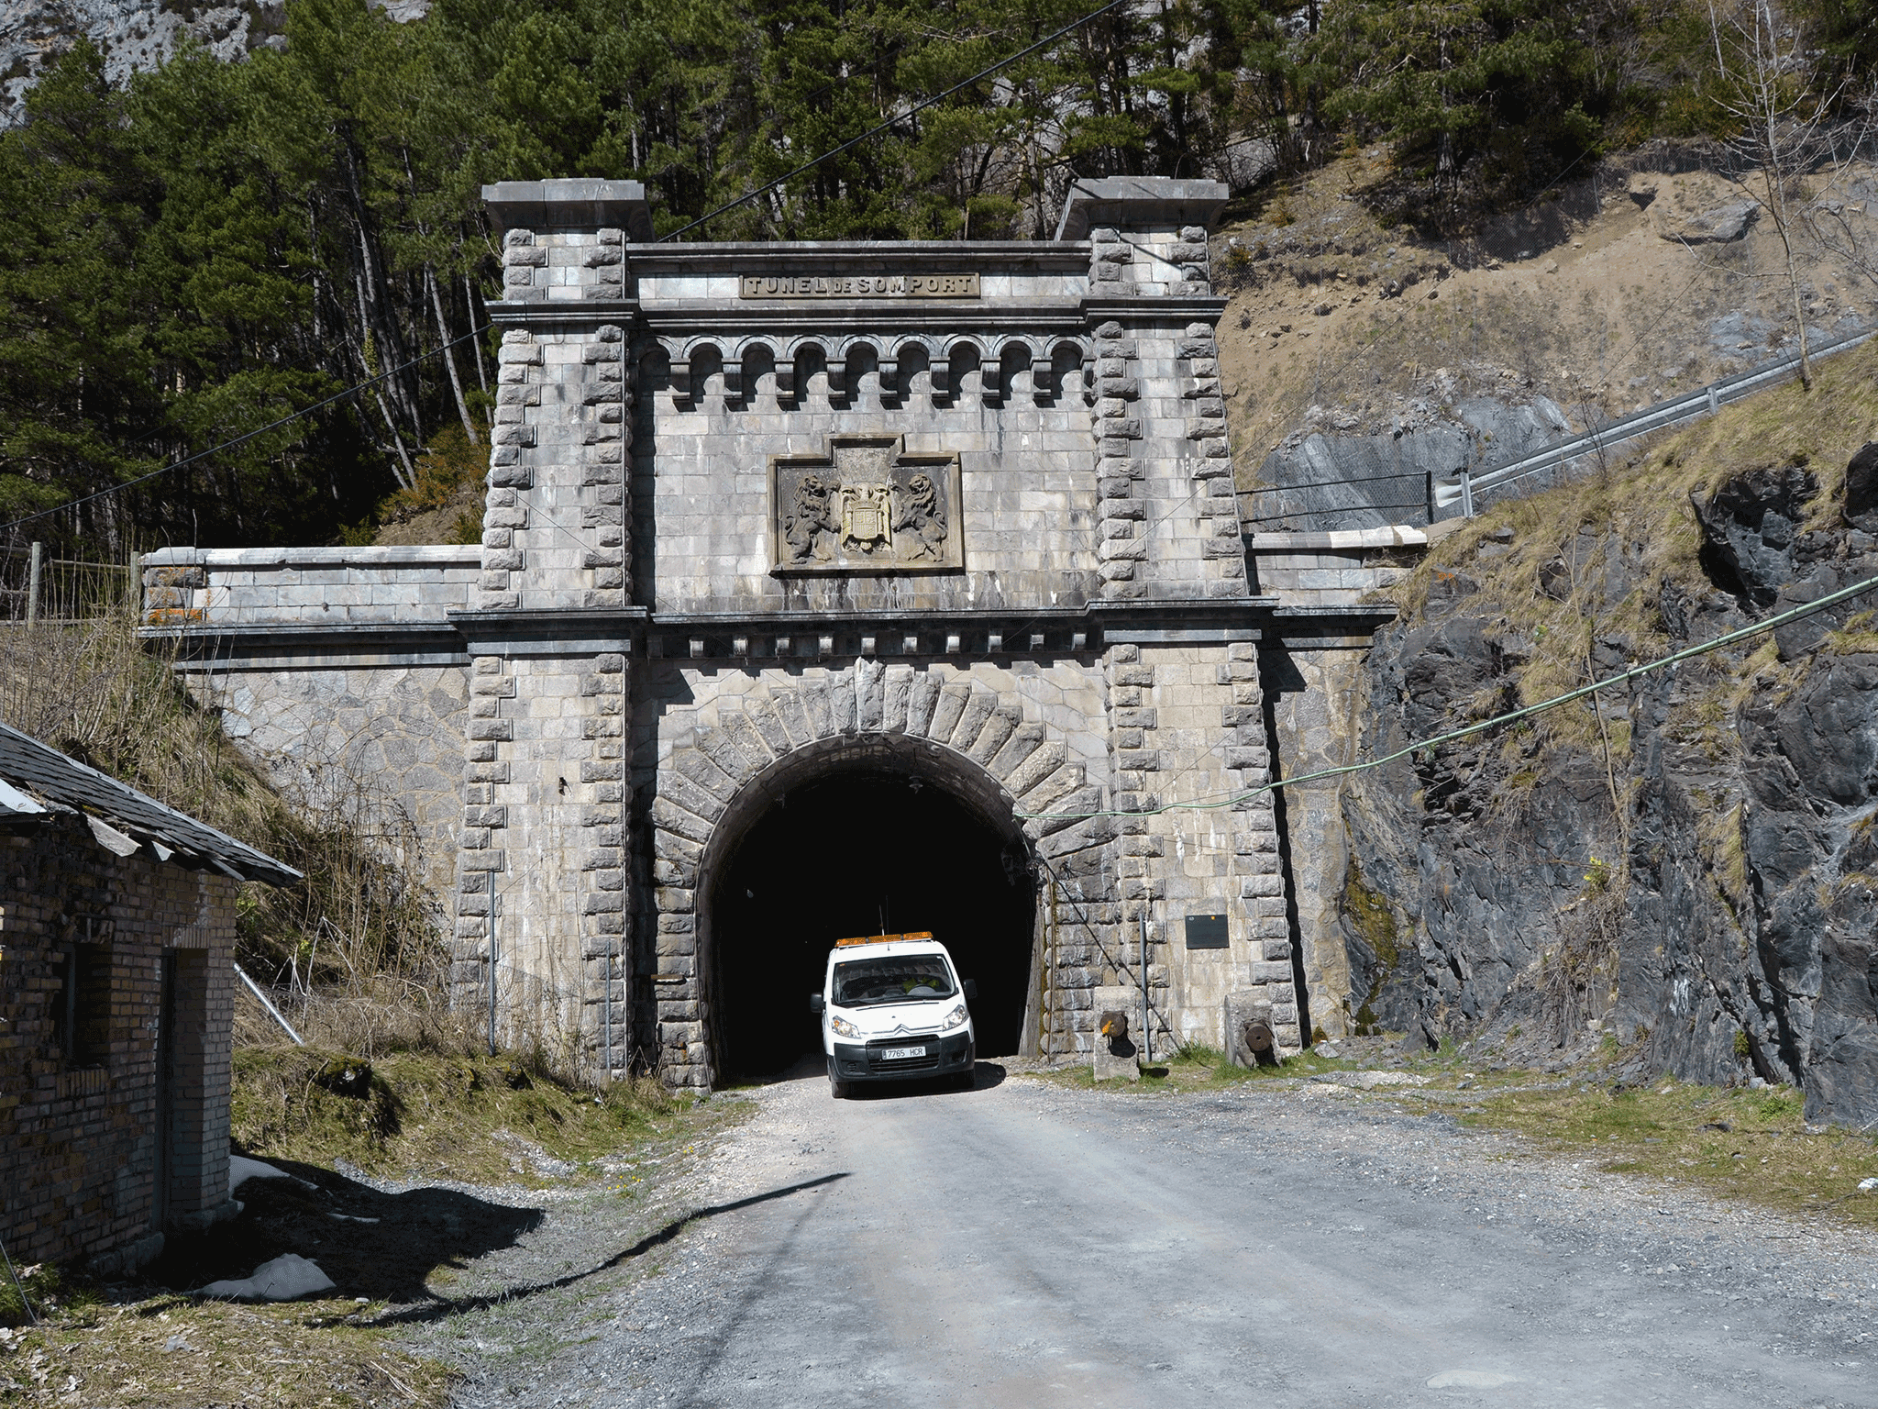
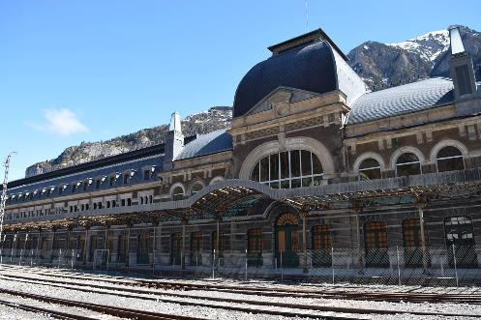
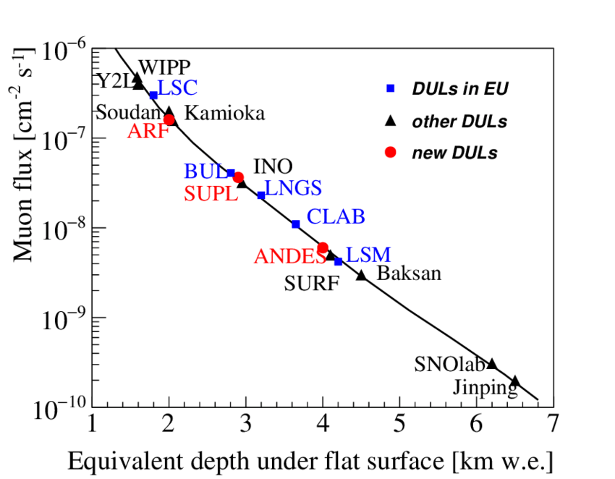
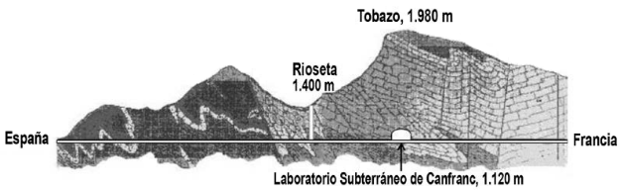
Canfranc underground laboratory (LSC)

Slide 12
NEXT-White outside view
Lead castle (shield)
Detector vessel
Data acquisition system
Gas system

Slide 13
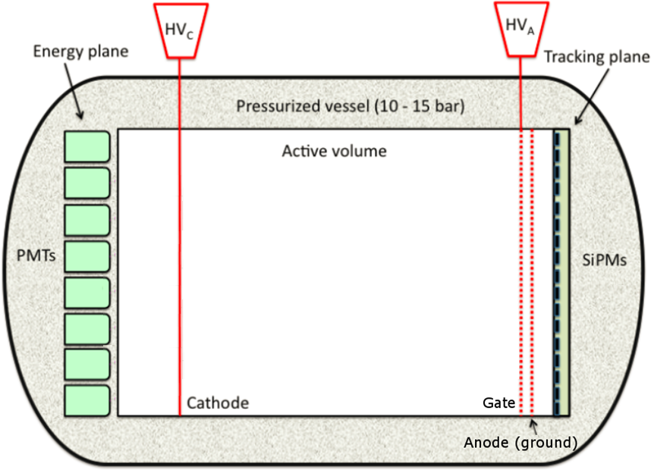


NEXT principle of operation (demonstrated in NEXT-White)
Horizontal asymmetric TPC
Full of high-purity xenon gas at 10 bar, contained in a high-pressure vessel
Three conductive grids + field cage define two uniform field regions:
The cathode and gate grids (1.3 m apart) define the drift field
The gate and anode grids (10 mm apart) define the electroluminescence (EL) field
TPC diameter: 1 m
60 PMTs behind the cathode form the “Energy Plane”.
3,584 SiPMs behind the anode define the “Tracking Plane”
-50kV
-15kV
G
Xe gas
Field cage
$$E_{drift}\sim 0.3 kV/cm$$
$$E_{EL}\sim 15 kV/cm$$

Slide 14
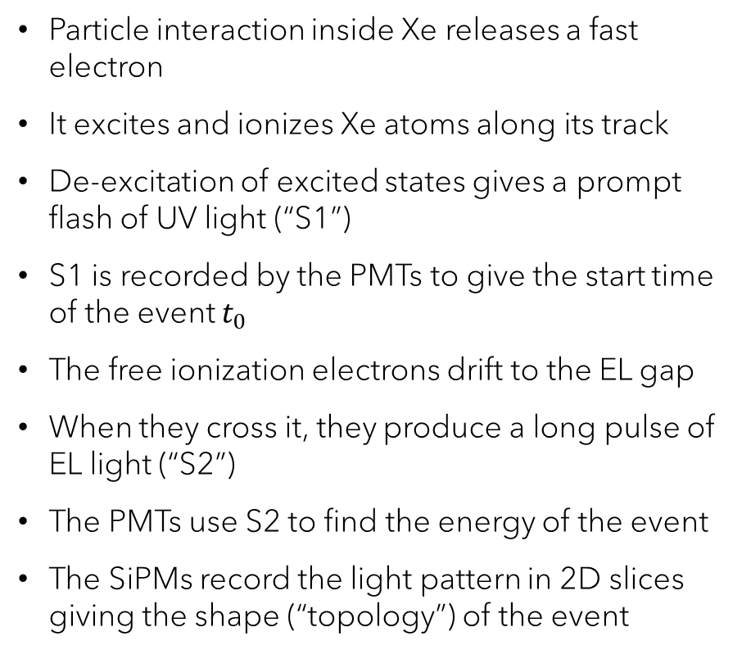
NEXT principle of operation (demonstrated in NEXT-White)
Particle interaction inside Xe releases a fast electron
It excites and ionizes Xe atoms along its track
De-excitation of excited states gives a prompt flash of UV light (“S1”)
S1 is recorded by the PMTs to give the start time of the event $t_{0}$
The free ionization electrons drift to the EL gap
When they cross it, they produce a long pulse of EL light (“S2”)
The PMTs use S2 to find the energy of the event
The SiPMs record the light pattern in 2D slices giving the shape (“topology”) of the event
-50kV
-15kV
G
Xe gas
EL (S2)
e⁻
Primary scintillation (S1)
Field cage
$$E_{drift}\sim 0.3 kV/cm$$
$$E_{EL}\sim 15 kV/cm$$

Slide 15
S1 and S2
The SiPMs are blind to VUV light (which is also strongly attenuated by the PMT protective windows)
Therefore, all inner surfaces of the TPC are coated with tetraphenyl butadiene (TPB) which absorbs UV light and re-emits it as blue light (centered at 430 nm)
S1 has a fast decay component of ~4 ns and a long one of ~100 ns (→ integrated over ~300 ns).
S2 lasts from a few µs to ~100 µs. It has a complicated shape, which reflects the time structure of the track

Slide 16
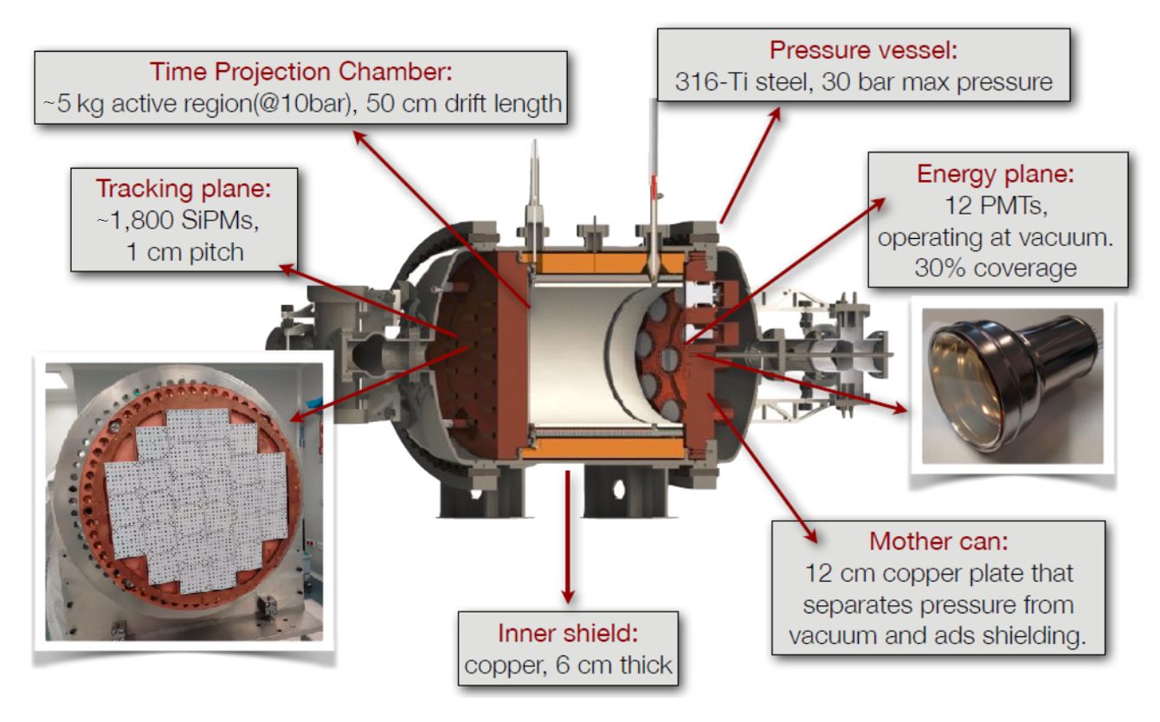
NEXT-White inner structure
2018 JINST 13 P12010

Slide 17
NEXT-White in the lab

Slide 18
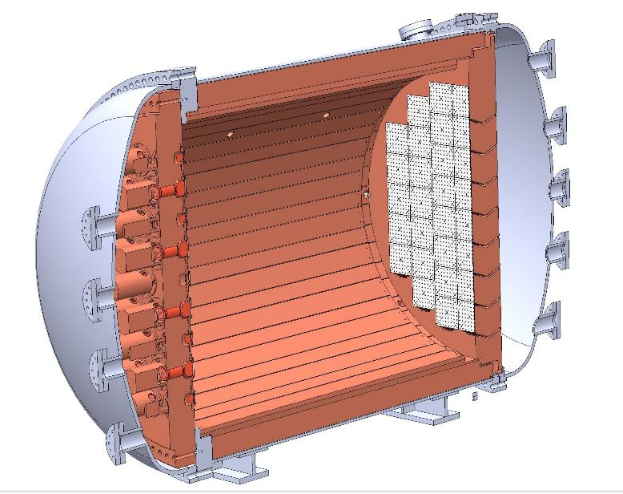
NEXT-100
Main goal: demonstrate the technology at the 100 kg scale, expected sensitivity ~10²⁶ y
Background rate: 1 count/ROI/yr. Commissioned, running for now at low pressure (4 bar)
TPC: 97 kg Xe in total, 130 cm drift length
Pressure vessel: St-St, rated for 15 bar
Tracking plane: 3584 SiPMs at 1.5 cm pitch
Energy plane: 60 radio-pure PMTs, 30% coverage
Inner shield: 12 cm Cu
Outer shield: lead castle with Rn-free air

Slide 19
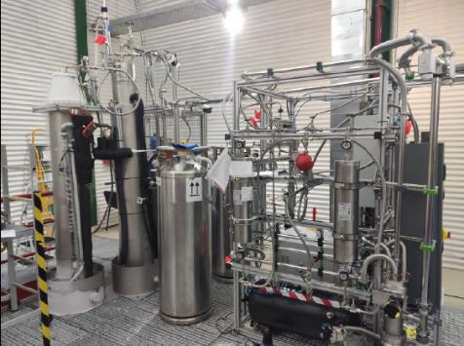
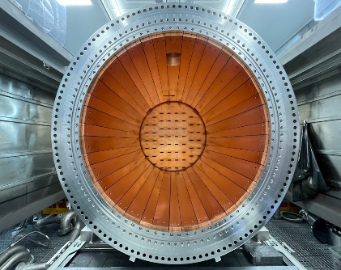
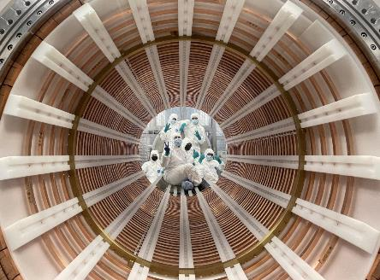
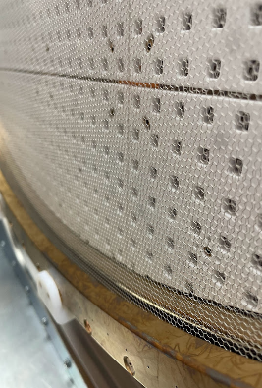
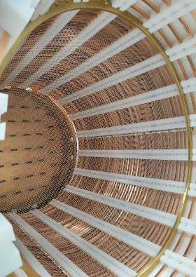
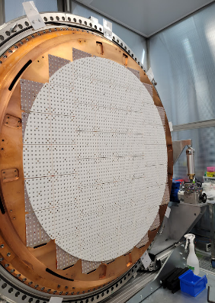
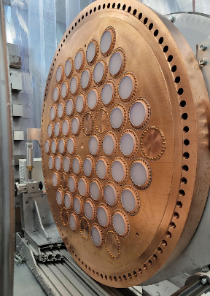
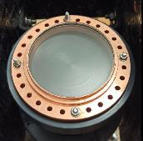
NEXT-100
Gas System
Field Cage
Inner Cu shielding
Tracking Plane
PMT Window
Cathode
EL Grid
Energy Plane
JINST 19 (2024) 02, P02007
Eur. Phys. J. C 86, 114 (2026)

Slide 20
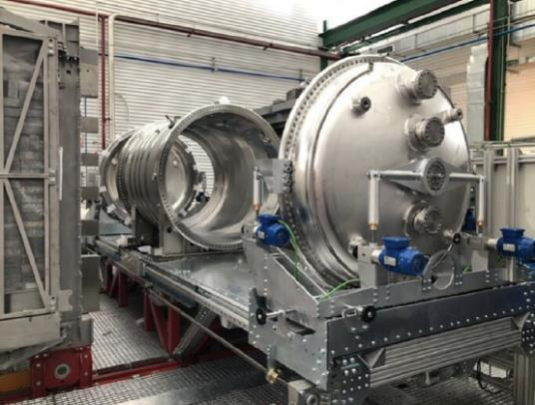
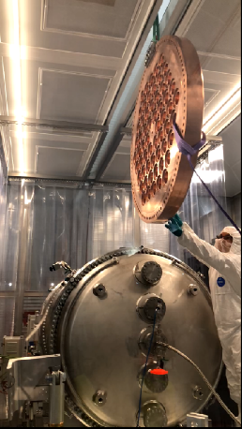
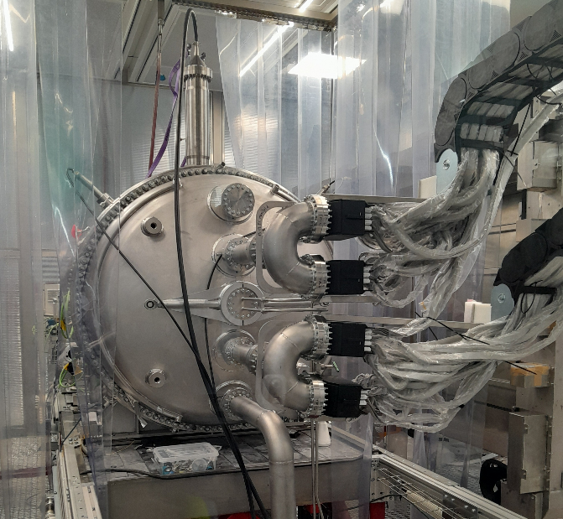
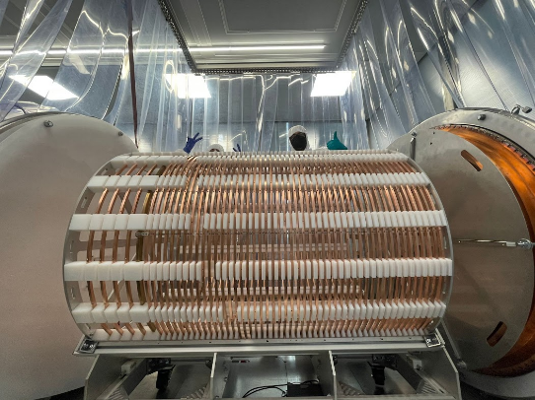
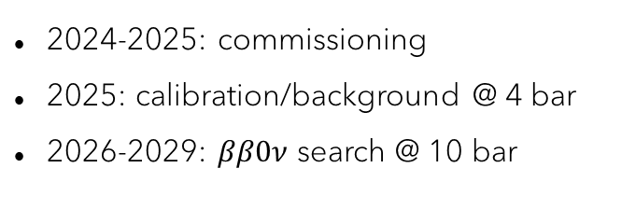
NEXT-100
Pressure Vessel
Assembly of energy plate
Field Cage installation
NEXT-100, HV, and cabling
2024-2025: commissioning
2025: calibration/background @ 4 bar
2026-2029: $ββ0ν$ search @ 10 bar

Slide 21
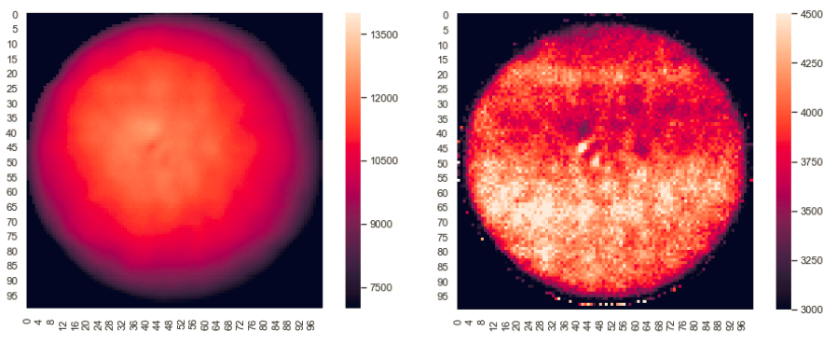
3D mapping of the detector response
Precise calibration of the detector requires mapping its S2 response in 3D to point-like events throughout its volume. This is done using ^{83m}Kr.
A ⁸³Rb source continuously emits ^{83m}Kr into the gas line (⁸³Rb decays to ^{83m}Kr by electron capture). ^{83m}Kr atoms mix with Xe and fill the TPC.
^{83m}Kr decays by isomeric transition to its ground state with a half-life of 1.8 h, emitting 41.6 keV by the emission of x-rays, gamma-rays and Auger electrons.
It allows mapping the xy S2 detector response and electron lifetime.
It also allows extracting the point-spread function (PSF) of the tracking plane.
S2 response
e⁻ lifetime

Slide 22
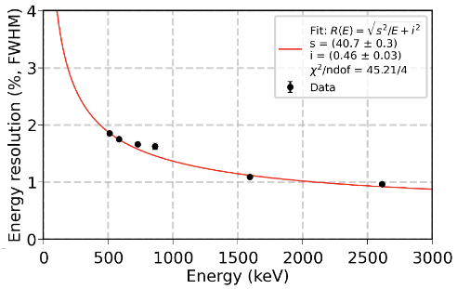
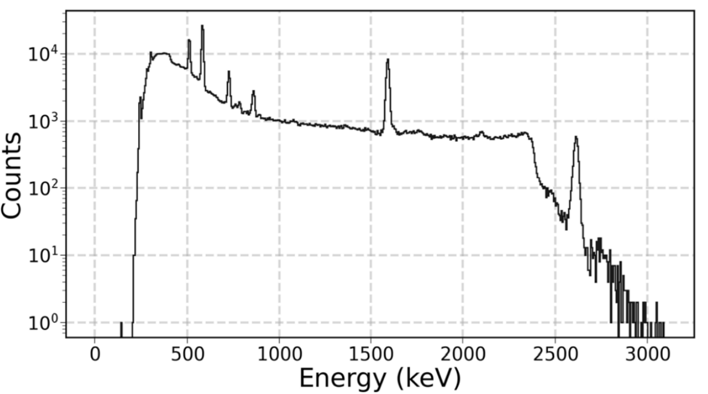
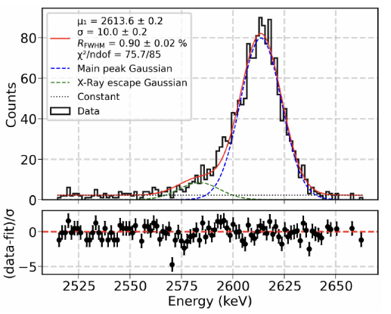

Determining the energy resolution by calibration sources
Energy resolution determined using gammas from an external ²²⁸Th calibration source
²⁰⁸Tl
²⁰⁸Tl
²⁰⁸Tl (DEP)
²¹²Bi
²⁰⁸Tl
²⁰⁸Tl (PP)
<1% FWHM @$Q_{ββ}$

Slide 23
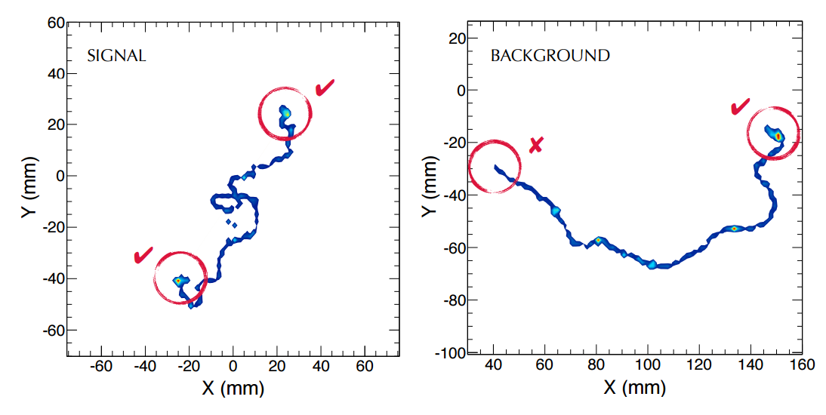
Topological background suppression
Background events more likely to have multiple tracks → require a single track
Remaining background events have a single electron, with one Bragg peak at the end
ββ events have two Bragg peaks
→ Signal/background discrimination by comparing the energy in spherical “blobs” at track ends

Slide 24
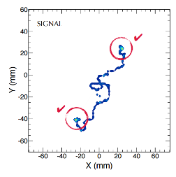
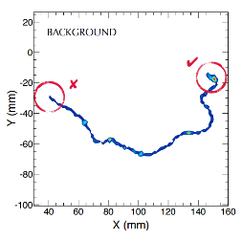
Topological background suppression (ideal MC)
Signal: both blobs have similar energy
Background: one blob has low energy
JHEP 1605 (2016) 159

Slide 25
Recent progress in track reconstruction
Image deblurring using Richardson-Lucy deconvolution with ^{83m}Kr PSF leads to refined 3D track images
Real e⁻e⁺ events recorded and processed by RL deconvolution in NEXT-White
JHEP 146 (2021)

Slide 26
Recent progress in track reconstruction
Real Compton electrons recorded and processed by RL deconvolution in NEXT-White

Slide 27
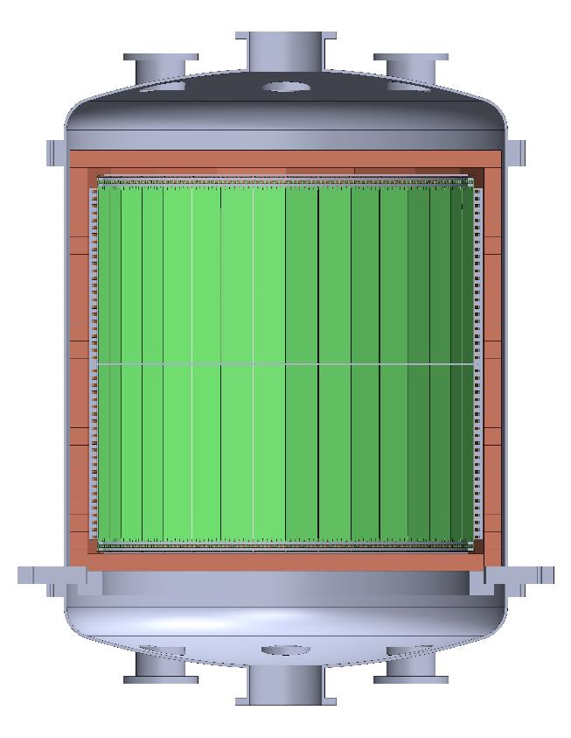
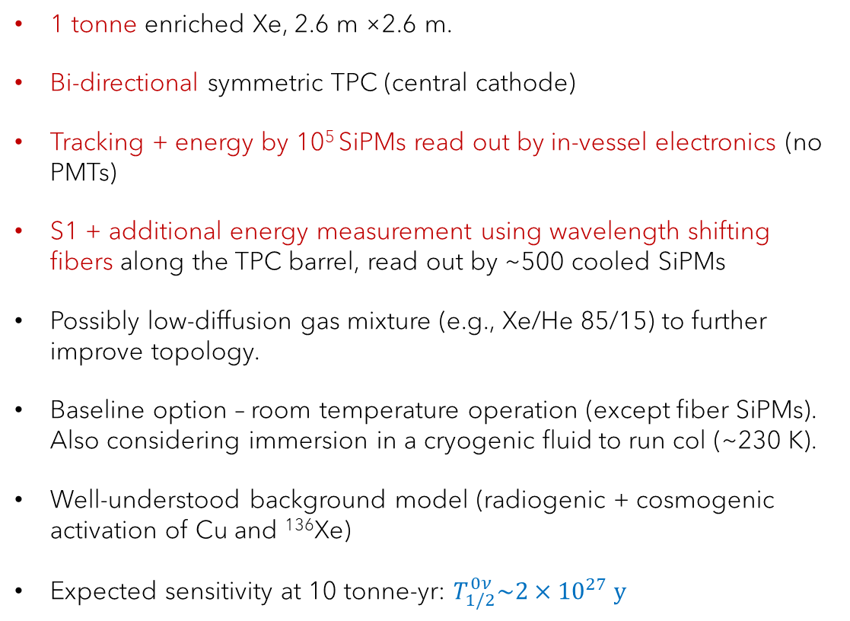
NEXT-HD (high definition/density) – baseline concept
1 tonne enriched Xe, 2.6 m ×2.6 m.
Bi-directional symmetric TPC (central cathode)
Tracking + energy by 10⁵ SiPMs read out by in-vessel electronics (no PMTs)
S1 + additional energy measurement using wavelength shifting fibers along the TPC barrel, read out by ~500 cooled SiPMs
Possibly low-diffusion gas mixture (e.g., Xe/He 85/15) to further improve topology.
Baseline option – room temperature operation (except fiber SiPMs). Also considering immersion in a cryogenic fluid to run col (~230 K).
Well-understood background model (radiogenic + cosmogenic activation of Cu and ¹³⁶Xe)
Expected sensitivity at 10 tonne-yr: $T_{1/2}^{0ν}\sim {2×10}^{27} y$
SiPMs
gate + anode
cathode
gate + anode
SiPMs
JHEP 2021 164 (2021)

Slide 28
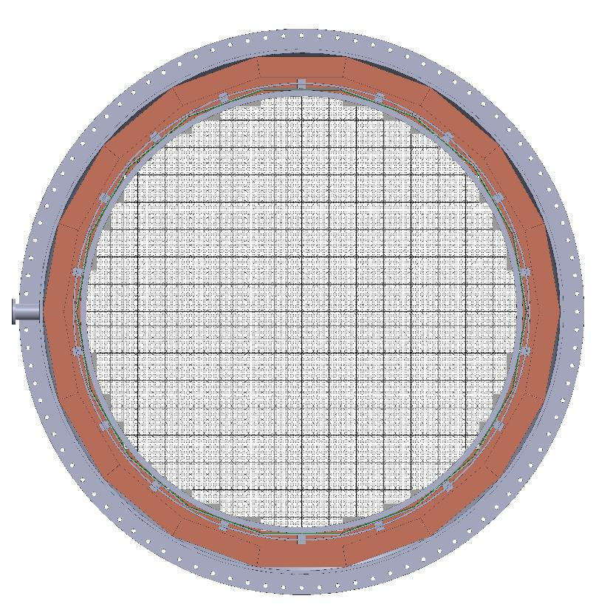
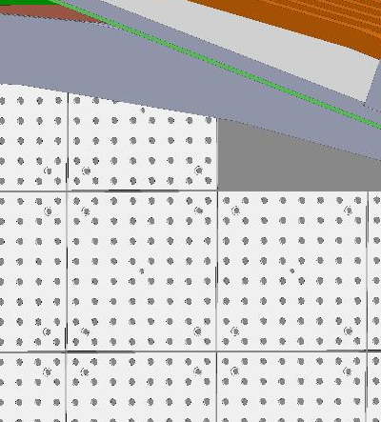
NEXT-HD
Baseline design:
Pitch: 10 mm
8x8 SiPM “dice boards”
788 DBs
50,432 SiPMs (each plane)
Readout electronics immediately behind SiPMs.
Integration time ~1 μs.
Data multiplexed and sent out on optical fibers.

Slide 29
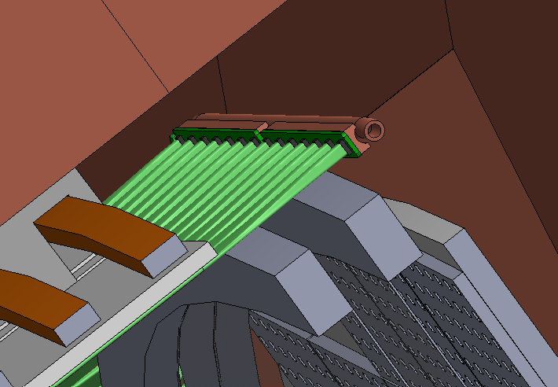
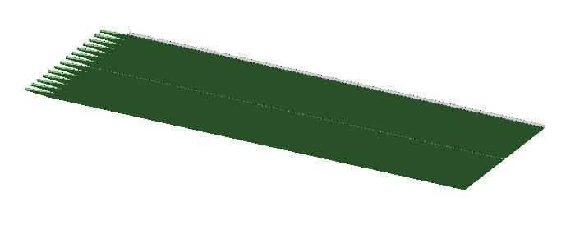
NEXT-HD
Base design: Fibers
Ø1mm TPB-coated WLS fibers (VUV → blue → trapped as green)
Fibers 1.3 m long, arranged on 36 panels.
Each panel: 14 groups of 30 fibers
Total num. of fibers: 15,120
Total fiber length: 19.4 km.
One 6x6 mm² SiPM for each 30-fiber group
504 SiPMs in total, mounted on a cooled Cu ring (to suppress dark counts).
Fast readout (integration time ~25 ns) for S1, realistic for 500 channels.

Slide 30

The aggressive approach: NEXT-BOLD
Tagging the barium daughter in a $ββ0ν$ candidate event can lead to a background-free experiment

Slide 31
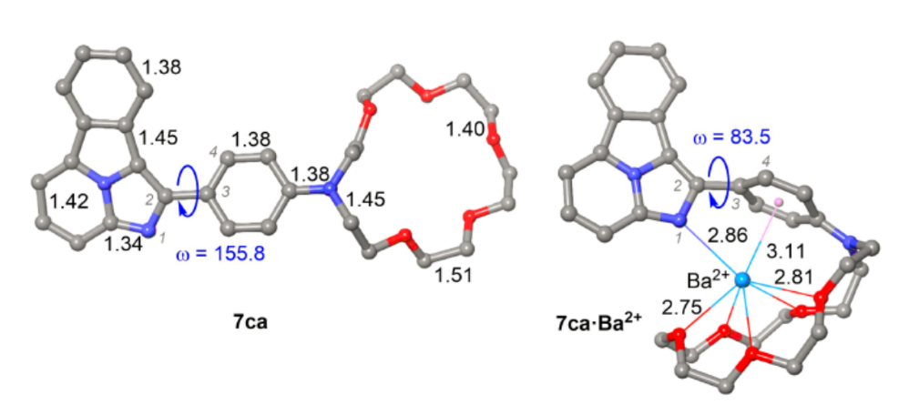
Barium tagging with molecular indicators in NEXT
Coat cathode plane with molecules that selectively catch barium ions (not Xe)
Once capturing barium, a molecule changes its fluorescent response to laser excitation
Following a trigger on the event energy, scan expected barium “landing site” on cathode with a laser. A single molecule holding Ba²⁺ appears as a bright spot`
Bicolor molecule developed at DIPC/EHU by the F. Cossio group
Nature 583 (2020) 48

Slide 32
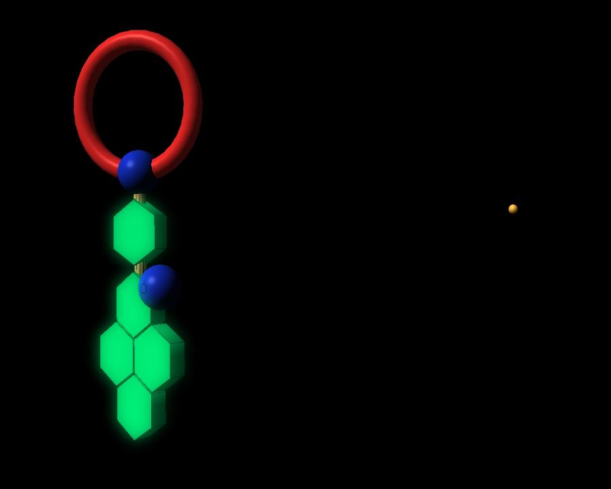
Fluorescent Bicolor Indicators (FBI)
Ba⁺⁺ receptor unit
Rotating unit
Additional recognition point
Signaling unit
Main signaling unit

Slide 33

Fluorescent Bicolor Indicators (FBI)
Ba⁺⁺ receptor unit
Rotating unit
Additional recognition point
Signaling unit
Main signaling unit

Slide 34


Fluorescent Bicolor Indicators (FBI)

Slide 35

NEXT-BOLD (Barium atOn Light Detector)
The cathode consists of transparent tiles coated with molecular barium sensors.
The anode side consists of an EL gap and tracking plane
Energy is read out with barrel fibers
The system triggers on the energy of a candidate event
The barycenter of the event (in xyz) is sent to the barium tagging detector
An electrostatic gate opens, allowing the ions to reach one or more ion sensor tiles
Candidate tiles are moved mechanically to the laser scanning system
Electrostatic gate

Slide 36
Projected sensitivities
NEXT sensitivity estimates for a tonne-scale detector
Background in ROI:
NEXT-HD: 1 counts/yr
BOLD: 0.1 counts/yr

Slide 37

Summary and outlook
NEXT concept demonstrated on a large scale, with <1% FWHM energy resolution at $Q_{ββ}$ and highly effective topological background suppression
NEXT-HD is a reasonable extrapolation from an established technology, would be sensitive to half-lives of 10²⁷ years. Funding for NEXT-HD is feasible (~10s M$).
Barium tagging is a central effort but very challenging.
Barium tagging on the tonne-scale (NEXT-BOLD) can enable reaching a sensitivity of 10²⁸ y

Slide 38

Thank you!
G. Larson, “The Far Side” (1983)

Slide 39
Backup slides

Slide 40


Double beta decay in even-even isotopes
$$β^{−}β^{−}$$

Slide 41

From $ββ0ν$ half-life to effective Majorana mass
General form of the $ββ0ν$ half-life:
$${\left(T_{1/2}^{0ν}\right)}^{−1}=G^{0ν}\left(Q,Z\right){\left|M^{0ν}\right|}^{2}{\left|f\left(m_{i},U_{ei}\right)\right|}^{2}$$
Two-body phase space factor (known at few %)
Particle physics:
Underlying BSM mechanism
Nuclear physics:
Nuclear Matrix Element (NME)
If the underlying particle physics mechanism is the exchange of light Majorana neutrino:
$${\left|f\left(m_{i},U_{ei}\right)\right|}^{2}=\frac{m_{ββ}^{2}}{m_{e}^{2}}$$

Slide 42




Phase space factor
$${\left(T_{1/2}^{0ν}\right)}^{−1}=G^{0ν}\left(Q,Z\right){\left|M^{0ν}\right|}^{2}{\left|f\left(m_{i},U_{ei}\right)\right|}^{2}$$
10⁻²⁴
$G^{0ν}\left(Q,Z\right)$ can be calculated with few % accuracy, scales with $Q^{5}$
only nuclei with $Q>2$ MeV are considered experimentally
$G^{0ν}$ (yr⁻¹ eV²)
10⁻²⁵
10⁻²⁶
⁴⁸Ca ⁷⁶Ge ⁸²Se ⁹⁶Zr ¹⁰⁰Mo ¹¹⁰Pd ¹¹⁶Cd ¹²⁴Sn ¹³⁰Te ¹³⁶Xe ¹⁵⁰Nd

Slide 43


Nuclear matrix elements
$${\left(T_{1/2}^{0ν}\right)}^{−1}=G^{0ν}\left(Q,Z\right){\left|M^{0ν}\right|}^{2}{\left|f\left(m_{i},U_{ei}\right)\right|}^{2}$$
The NMEs can be calculated by several models with considerable spread
The leading uncertainty is on the value of the axial coupling constant $g_{A}$ relevant for $0νββ$
Since ${\left|M^{0ν}\right|}^{2}\sim g_{A}^{4}$ this can have a major effect
Nightmare scenario - $g_{A}=0.5$ will reduce the sensitivity to $m_{ββ}$ by a factor of 5
Evaluated with $g_{A}=1.27$

Slide 44



Largest source of uncertainty: the size of axial coupling $g_{A}$
$g_{A}=1.269$ for weak interaction and decays of nucleons
Quenching effects inside the nucleus may considerably reduce $g_{A}$
Conservatively one should consider several options:
$$g_{A}=\left\{\begin{matrix}g_{nucleon} & = & 1.269 \\ g_{quark} & = & 1 \\ g_{phen.} & = & g_{nucleon}∙A^{−0.18}\end{matrix}\right.$$
The degree of $g_{A}$ quenching is unknown. The expression for $g_{phen.}$ is based on $2νββ$ half-lives and may be different for $0νββ$

Slide 45




Effect of uncertainty in $g_{A}$
$$g_{A}=g_{phen}= 0.52$$
$$g_{A}=1$$
$$g_{A}=1.269$$
KamLand-Zen + EXO-200 2015 data
For ¹³⁶Xe taking $g_{A}=g_{phen}$ pushes up the limit on $m_{ββ}$ by a factor of $≳5$

Slide 46

LEGEND
A merger of two collaborations: GERDA and MAJORANA
Technology: high-purity germanium diodes enriched to >85% ⁷⁶Ge
Key feature: best energy resolution in the market (0.13% FWHM at $Q_{ββ}$)
Detectors immersed in liquid argon serving as a coolant and active veto
GERDA and MAJORANA completed (~30 kg each), set a limit at $1.8∙{10}^{26}$ y
LEGEND-200: 200 kg ⁷⁶Ge, under commissioning at LNGS, sensitivity 10²⁷ y at ~10 y
LEGEND-1000: 1 ton ⁷⁶Ge, guaranteed for funding (>USD 400 M)

Slide 47
Background suppression in ⁷⁶Ge detectors
Event topology + anti-coincidence between HPGe detectors + pulse shape discrimination + liquid argon veto
Event topology
Detector
anti-coincidence
Pulse shape discrimination
Detector-LAr anti coincidence
Differentiate point-like ββ topology from:
multi-detector interactions
multi-site / surface interactions
interactions with coincident energy deposition in LAr

Slide 48
GERDA
Bare crystals

Slide 49
GERDA

Slide 50

LEGEND-200
200 kg HPGe in existing (upgraded) infrastructure at LNGS
Ge detectors from Majorana and GERDA + new inverted coaxial detectors (larger mass)
Background reduction: factor 5 compared to GERDA (reduce ⁴²K, ²¹⁴Bi, ²⁰⁸Tl)
Discovery sensitivity (10 y):
$$T_{1/2}^{0ν}\sim {1×10}^{27} y \left(34−90 meV\right)$$
(inside the IO band)
arXiv:1709.01980

Slide 51
LEGEND-1000
Discovery sensitivity (10 y):$T_{1/2}^{0ν}\sim {1×10}^{28} y \left(11−28 meV\right)$- cover IO band
4 LEGEND-200 payloads
LEGEND-1t baseline design
challenging

Slide 52


nEXO
Builds on experience gained in EXO-200 (110 kg LXe active mass, $T_{1/2}^{0ν}>1.8×{ 10}^{25} y$)
Single-phase LXe TPC: 1.16 m inner diameter, 1.25 m drift height (single drift direction)
5.1 t LXe (90% ¹³⁶Xe) in total (4.0 in the TPC)
Charge readout by induced current on charge collection tiles (top)
Light readout by SiPM tiles (4.5 m² total) on barrel behind the field cage
Cost > USD 400M
EXO-200 mounted in cryostat
e⁻ drift direction
arXiv:1710.05075, 1805.11142

Slide 53
nEXO: projected sensitivity

Slide 54

CUPID: CUORE Upgrade with Particle IDentification
Successor of CUORE, which used 988 ^{nat}TeO₂ (34% ¹³⁰Te) bolometer crystals @ 10-15 mK at LNGS
CUORE’s bolometers were sensitive only to heat signals and suffered from a high background of alpha events on their surface.
CUPID will reuse CUORE’s cryostat with a new generation of scintillating bolometers, sensitive to both heat and light.
CUORE: “The coldest cubic meter in the universe”

Slide 55



CUPID
CUPID will rely on Li₂¹⁰⁰MoO₄ scintillating bolometer crystals
¹⁰⁰Mo: $Q_{ββ}=3034 keV$ – above all natural gamma lines
The combined readout of light and heat allows eliminating surface alpha events
Excellent energy resolution: 0.17% FWHM at $Q_{ββ}$, high radiopurity
Preliminary
$$Q_{ββ}$$
β /γ
α ²¹⁰Po
α/γ(β) separation ~15σ

Slide 56


CUPID
First phase: 1534 Li₂¹⁰⁰MoO₄ crystals in the existing CUORE cryostat (250 kg ¹⁰⁰Mo, >95% enrichment)
Expected sensitivity after 10 years: $T_{1/2}^{0ν}=1.5×{10}^{27} y$ ($m_{ββ}=10−17 meV$– enough to cover the IO band)
Modest cost (first phase): few tens M USD
Future: “CUPID-1T”, $T_{1/2}^{0ν}=0.9×{10}^{28} y$after 10 years, requires a new cryostat and 20-fold improvement in background
arXiv:1907.09376

Slide 57
Barium tagging with molecular indicators in NEXT
Coat cathode plane with molecules that selectively catch barium ions (not Xe)
Once capturing barium, a molecule changes its fluorescent response to laser excitation
Following a trigger on the event energy, scan expected barium “landing site” on cathode with a laser. A single molecule holding Ba²⁺ appears as a bright spot`
Bicolor molecule developed at DIPC/EHU by the F. Cossio group
Nature 583 (2020) 48

Slide 58
Fluorescent Bicolor Indicators (FBI)
Ba⁺⁺ receptor unit
Rotating unit
Additional recognition point
Signaling unit
Main signaling unit

Slide 59
Fluorescent Bicolor Indicators (FBI)
Ba⁺⁺ receptor unit
Rotating unit
Additional recognition point
Signaling unit
Main signaling unit

Slide 60
Fluorescent Bicolor Indicators (FBI)

Slide 61


Bicolor enhance fluorescence
Development at DIPC based on Fluorescent Bicolor Indicators (FBI)
Enhanced fluorescence and spectral separation
Overall separation factor of $1.2∙{10}^{4}$between chelated and unchelated states
So far demonstrated on a macroscopic scale
Scaled by x300
Excitation laser at 250 nm
Readout band

Slide 62



FBI tests at BGU
BGU group builds a Ba²⁺ ion beam for testing and measuring the chelation efficiency of FBI molecules
The few-keV beam will be slowed down in low-pressure helium to “feed” the molecules with thermal Ba²⁺ ions
Chelated molecules will be interrogated by a tabletop optical system separating between the excitation and emission light

Slide 63
NEXT-BOLD (Barium atOn Light Detector)
The cathode consists of transparent tiles coated with FBI monolayers
The anode side consists of an EL gap and tracking plane
Energy is read out with barrel fibers
The system triggers on the energy of a candidate event
The barycenter of the event (in xyz) is sent to the barium tagging detector
An electrostatic gate opens, allowing the ions to reach one or more FBI tiles
Candidate tiles are moved mechanically to the laser scanning system
Electrostatic gate
9.3 M€ ERC grant awarded to build a BOLD demonstrator

Slide 64
Projected sensitivities
NEXT sensitivity estimates for a tonne-scale detector
Background in ROI:
NEXT-HD: 1 counts/yr
BOLD: 0.1 counts/yr

