Slide 1
Israel Research Reactor 1 – IRR-1
Joint SARAF-WIS TPC mini workshop 19/02/2026
Dr. El’ad N. Caspi
Head, Nuclear Physics Division, Soreq-NRC

Slide 2
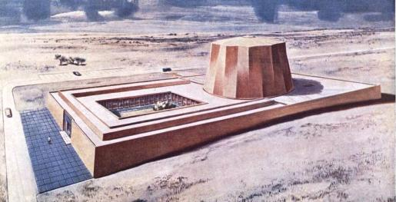
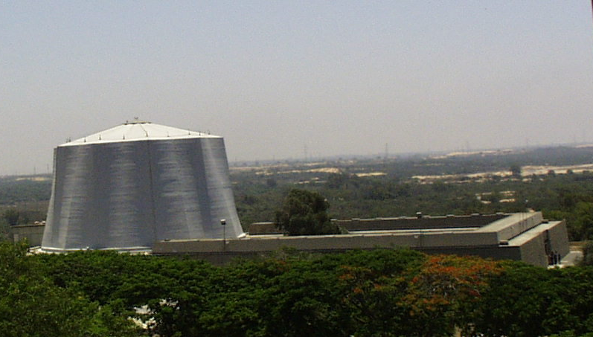
The first reactor in Israel

Slide 3
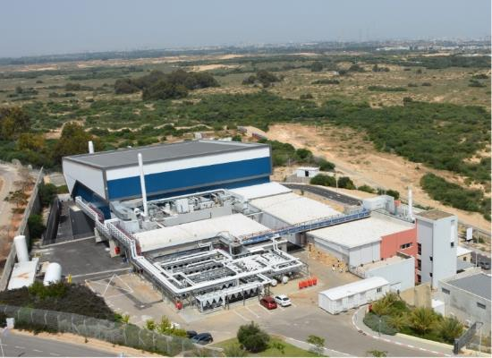
Nuclear physics division - SNRC

Slide 4
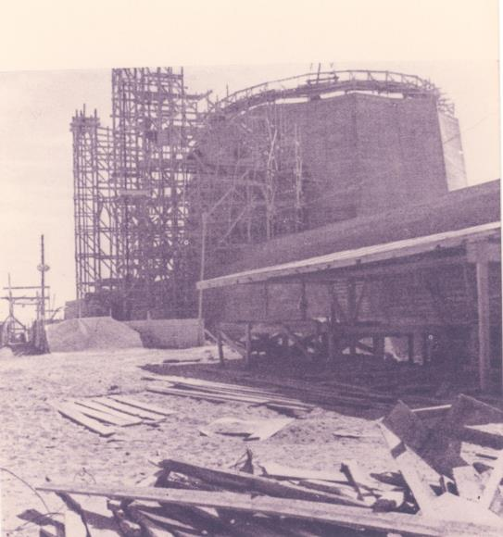
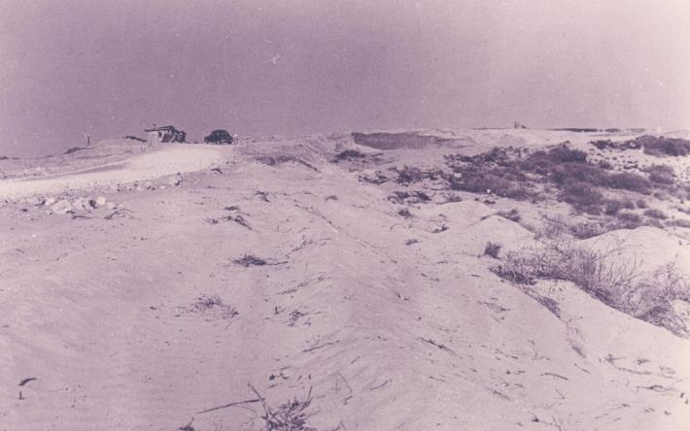
Some history of Soreq Nuclear Research Center
Founded in 1958 as a research center of the Israeli Atomic Energy Commission (IAEC) with the main goal to operate the first Israeli reactor.
1958 – This is where it all started
1959 – Building the reactor

Slide 5
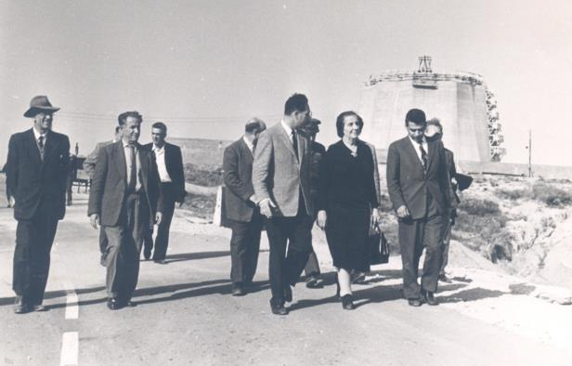
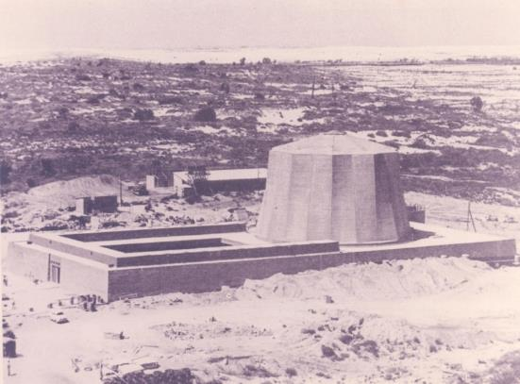
Some history of Soreq-NRC
Given to Israel by President Eisenhauer as part of Atoms for Peace program.
Went critical on June 1960.
Supervised by the IAEA.
1959

Slide 6
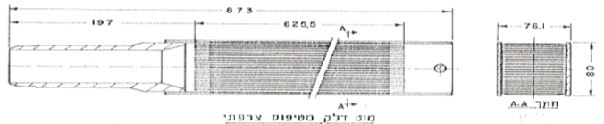
IRR-1 – Basic Characteristics
Open pool reactor
MTR (Materials Testing Reactor) type fuel
HEU – 93%
Fork type control rods – Ag, In, Cd
Light water moderator and coolant
Primary cooling cycle – Mineral less water 650 m³/h
Secondary cooling cycle – Soft water 1100 m³/h
Graphite reflector

Slide 7
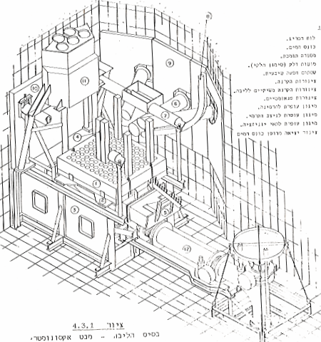
General schematics
Irradiation tubes
Ionization chambers
Fuel rods
Core lattice
Flapper

Slide 8
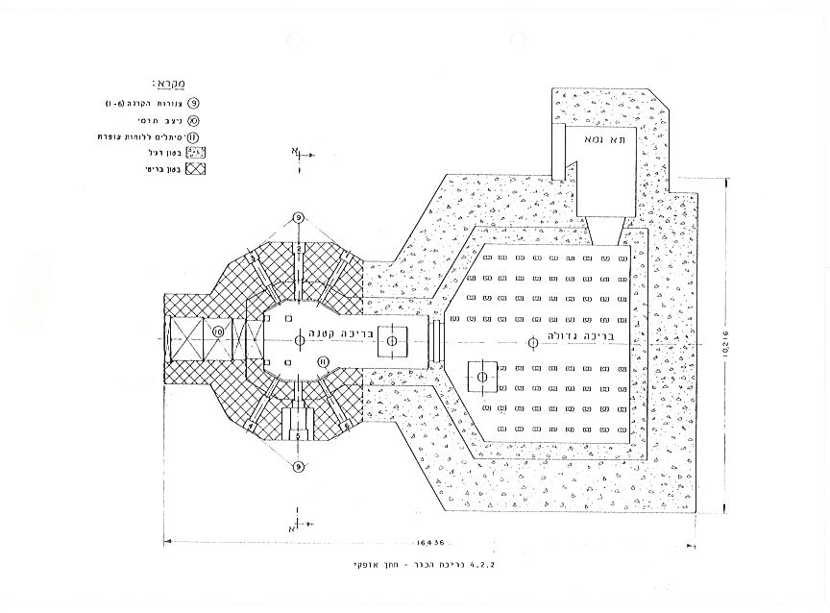
General schematics

Slide 9
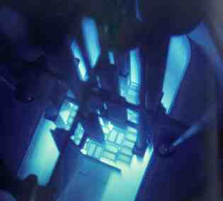
Research stations
Three operational tubes:
Thermal neutron camera (radial tube)
Thermal neutron diffractometer (radial tube)
Thermal neutron chamber (radial tube)
Pneumatic Rabbit Irradiation System
“Direct” access to the core from the pool

Slide 10
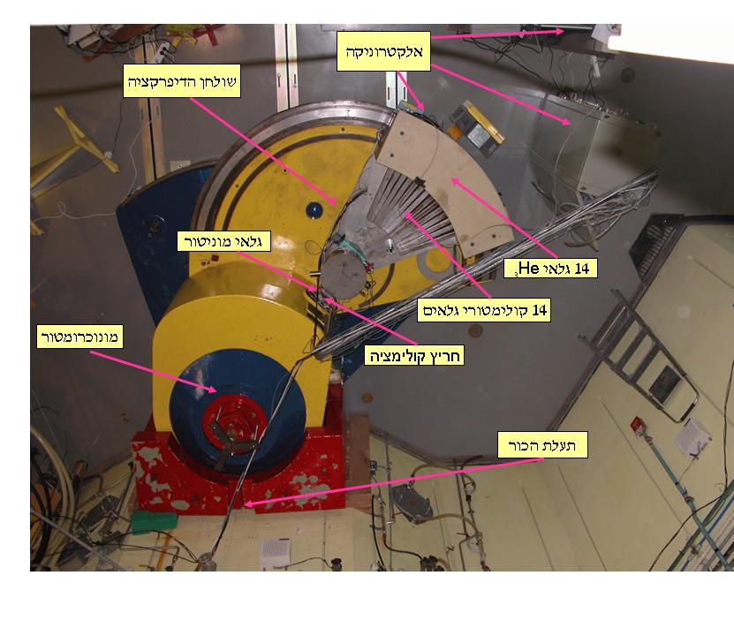
Thermal neutron diffractometer
PG monochromator λ = 2.421Å
∆d/d = 1.6% @ 3Å (medium resolution)
Cu monochromator λ ≈ 1Å
∆d/d = 1.4% @ 3Å (medium resolution)
14 ³He detector multi-detector (45.5º)
2θ = 5º – 130º
Q = 0.23 – 4.7Å⁻¹ @ λ = 2.421Å (Q ≈ 0.55 – 11.4Å⁻¹ @ λ = 1Å)
T = 10 – 300K
~10⁵ n/cm²/s

Slide 11
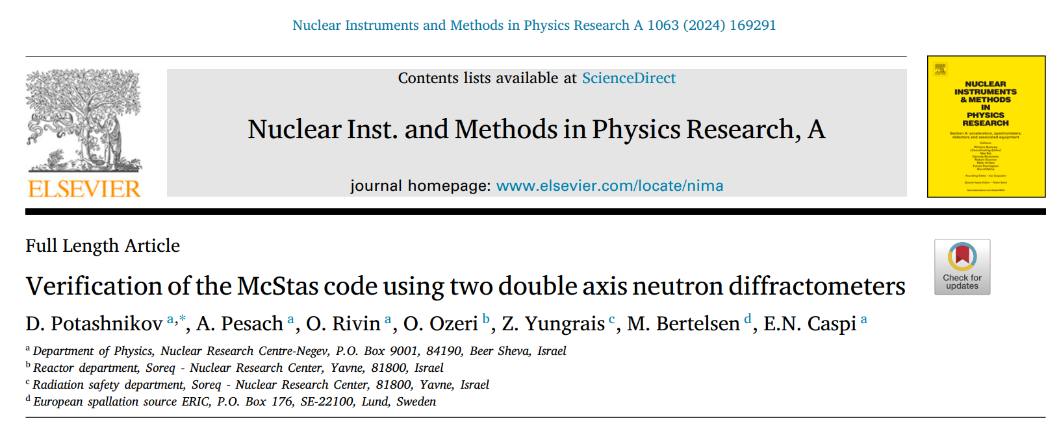
KARL – select papers

Slide 12
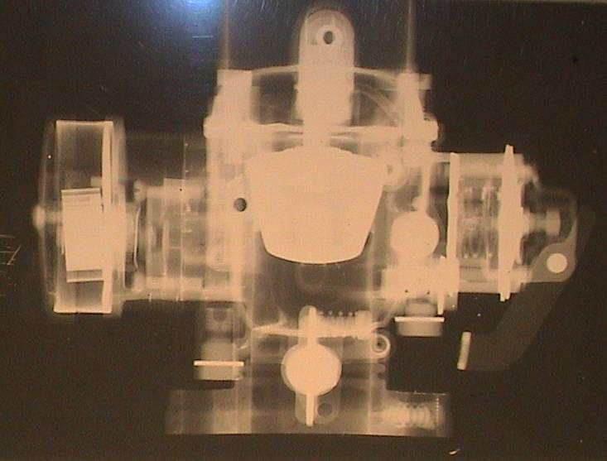
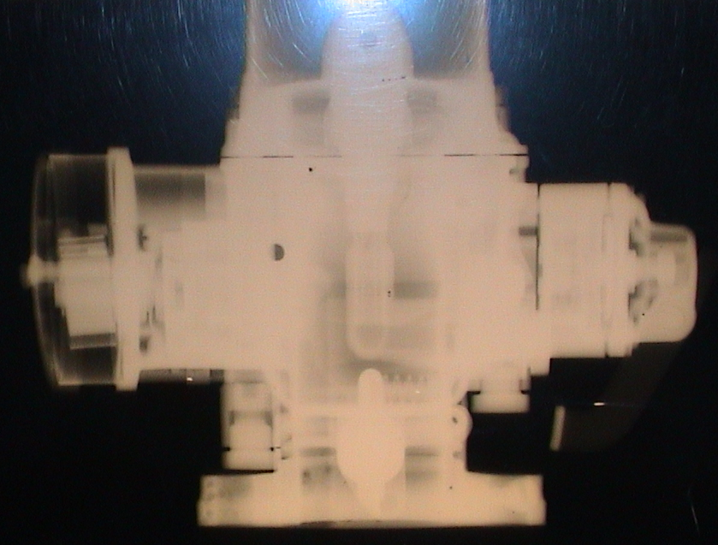
Thermal neutron camera
L/D = 250
Maximum object size 40 x 40 cm²
Average time of exposure ~ 30 min
~10⁶ n/cm²/s

Slide 13
IRR-1 “applications”
Materials science
NDT for industry and IAEC
Activation analysis
Neutron detectors calibration and QA
Radiation damage
Experimental reactor physics
Nuclear Safeguard
Education in reactor and nuclear physics

Slide 14
How to ask for a beam-time
Must collaborate with SNRC scientist
Nuclear Physics Division approval (both Reactor Manager or Division Head)
Safety approval
Final scheduling by reactor manager or Chief Operation Engineer

