Slide 1

Introduction: A bit on Optical TPCs

Slide 2

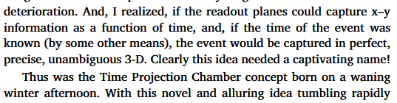
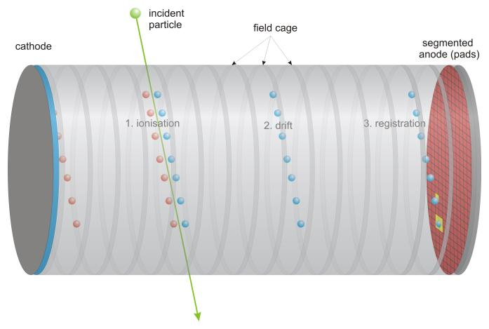
The basics: From TPC to OTPC
The Time Projection Chamber is a detector concept invented by Dave Nygren in the 70’s
Primary interactions leave a cloud of electrons drifted by a uniform field to a readout plane able to record x,y ionization charge as a function of time
Knowing the drift velocity knowledge, one can “project the time” and reconstruct the z coordinate ➔ 3D reconstruction
[1] D. R. Nygren, Origin and development of the TPC idea, NIM A, 2018
doi:10.1016/j.nima.2018.07.015
Optical/Electroluminescent TPCs:
Include light readouts: the drifting electrons are accelerated near the readout plane in order to yield electroluminescence (EL)
➔ track photo-imaging
Using an array of photosensors (PMTs, SiPMs)
Or use optical lenses and cameras outside of the main volume
Illustration taken from LCTPC website
Ryan Felkai, SARAF&WIS TPC mini-workshop, 19th February 2026

Slide 3
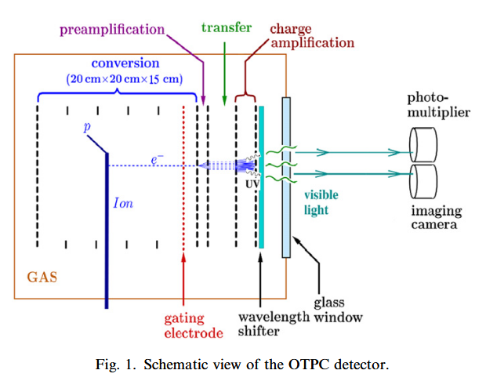
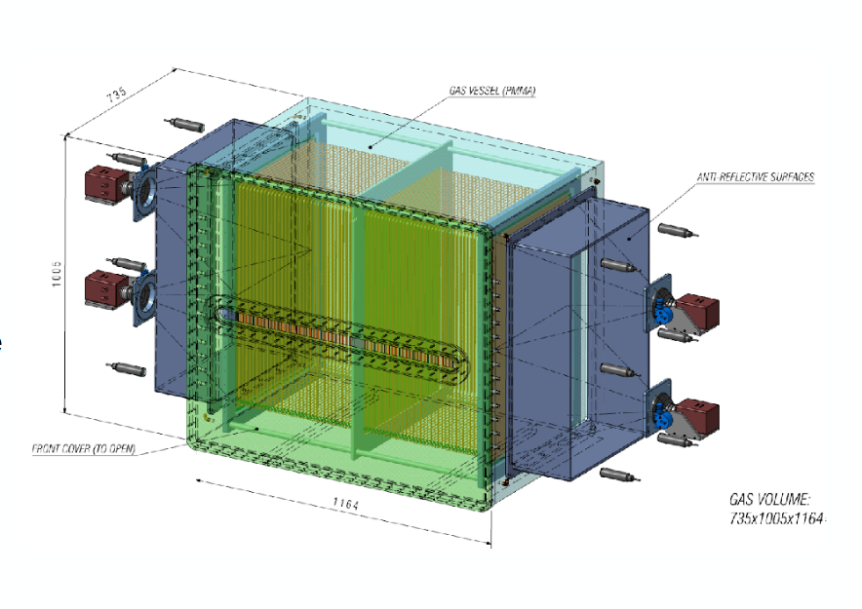
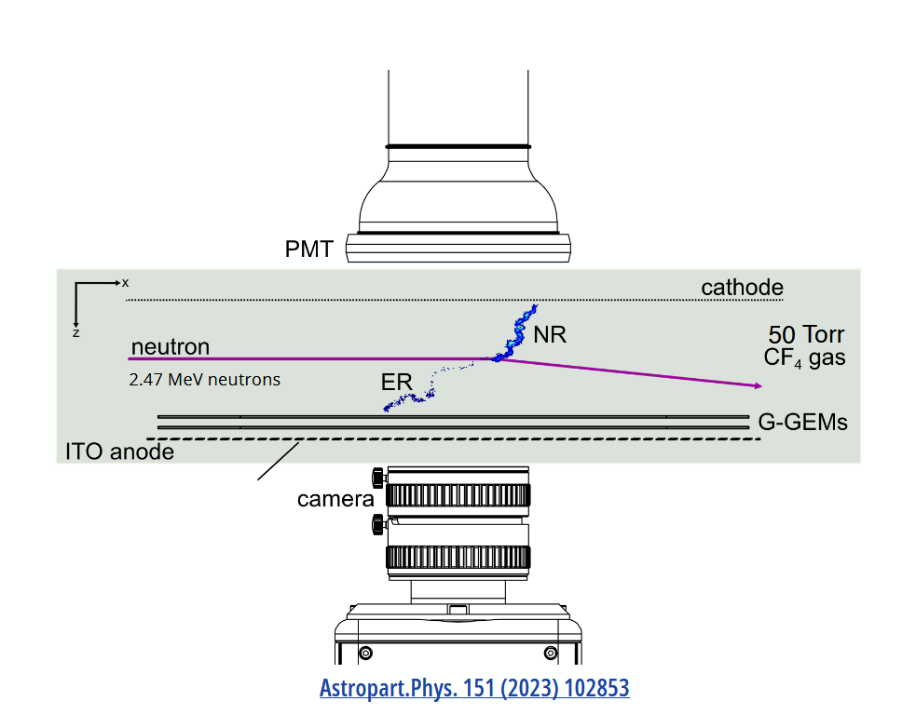
OTPCs with traditional cameras
(and some examples)
“Warsaw” OTPC (2007)
Advantages:
- Avoiding electronic-related challenges
- One single integrated imaging device commercially available
- Great spatial resolution
- Low cost (for million-scale pixels)
Limitations:
- Limited framerate (not an issue for rare event searches)
- Readout noise (massively improved over the last decade)
- No direct access to (x,y) time information (only 2D flattened view)
Nuclear decay imaging
CCD camera + PMT for timing
CYGNO
Migdal
Directional DM searches at LNGS
Orca Quest cameras + PMTs
Developing negative ion
Migdal effect: an electron and a nuclear recoil sharing common vertex
Ryan Felkai, SARAF&WIS TPC mini-workshop, 19th February 2026

Slide 4
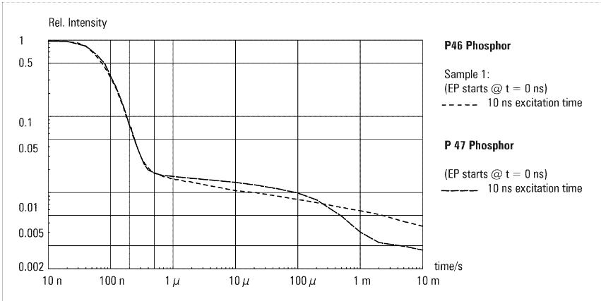
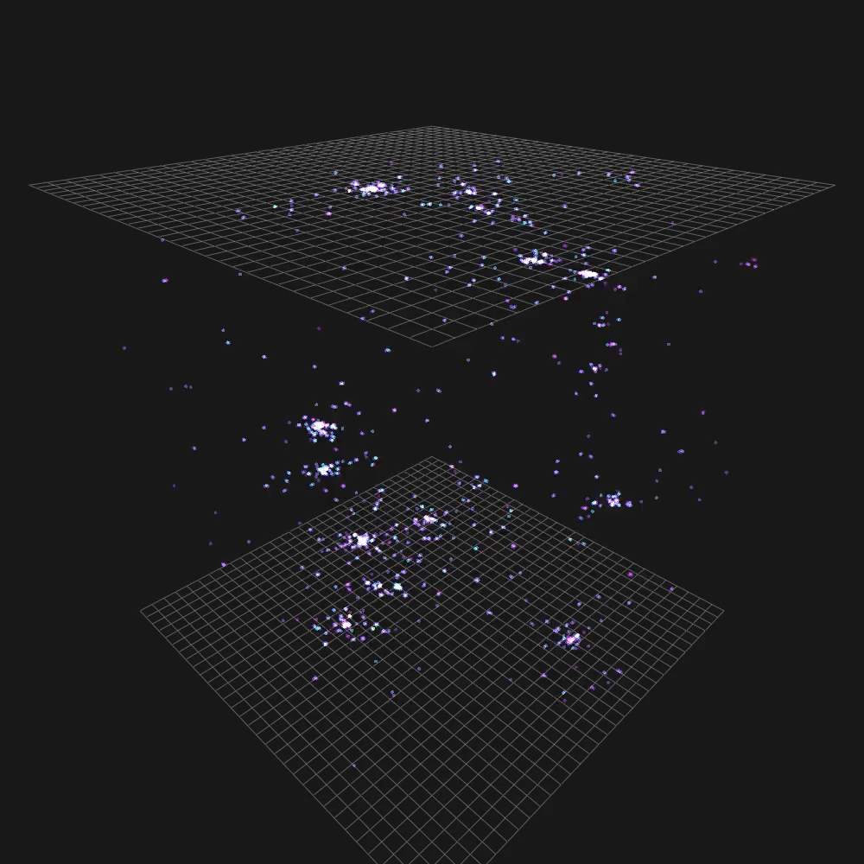
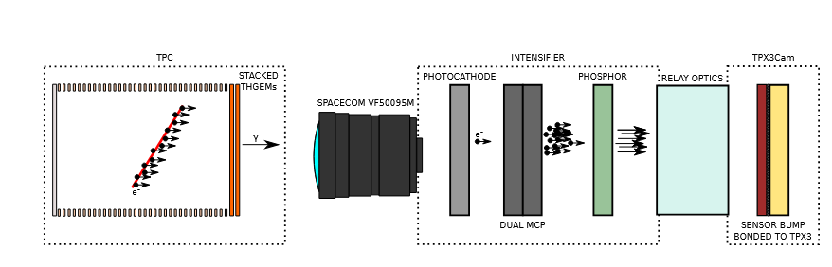
OTPC with TimePix-based camera
with Ariadne
Phosphor screen
TimePix3 chip bump-bonded with a light sensitive silicon sensor
Photons convert to electrons in the silicon, then accumulated on a pixel until a threshold is reached ➔ pixel registers a hit (x,y,t)
TimePix3 also gives the time-over-threshold which is a proxy for amount of light
TimePix-based camera offers 3D tracking and calorimetry with a single integrated device
Caveat: not single-photon sensitive ➔ requires intensifier with fast phosphor
Ryan Felkai, SARAF&WIS TPC mini-workshop, 19th February 2026

Slide 5



Results from a prototype Optical TPC at WIS: a milestone towards a detector at SARAF-II
R. Felkai, M. Borysova, L. Moleri, J. Pienaar,
D. Vartsky, A. Breskin, I. Mor, L. Weissman and S. Bressler
19th February
SARAF&WIS TPC
mini-workshop

Slide 6
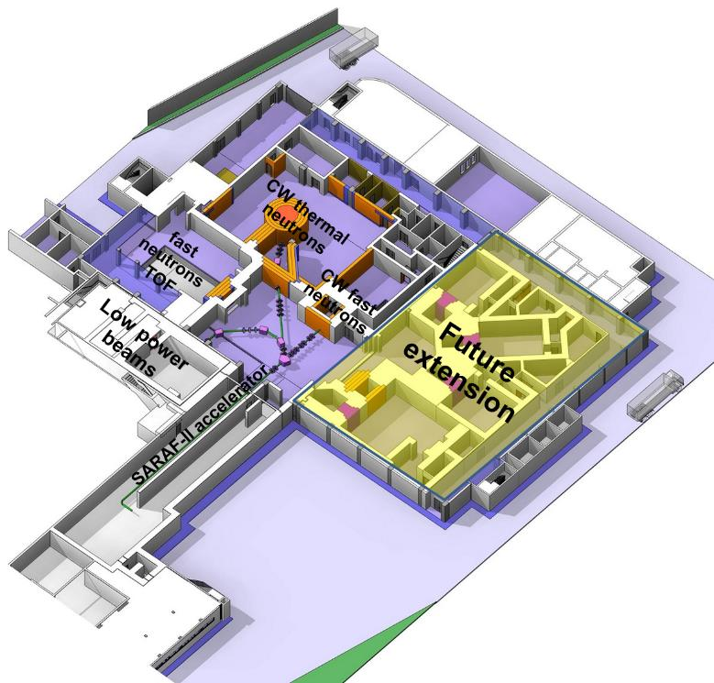
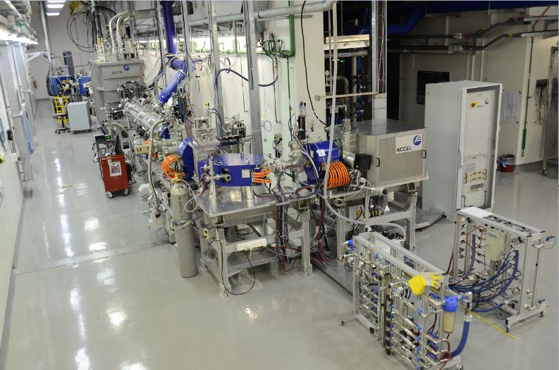
Motivation for an OTPC at SARAF-II
SARAF-II layout
Soreq Applied Research Accelerator Facility (SARAF) will upgrade its neutron beamline: higher beam energy (~30 MeV), higher current (5 mA)
Pulsed fast neutrons with a broad energy spectrum ➔ Time-of-Flight (ToF) energy tagging
Relevant to studying neutron-induced reactions in the fields of astrophysics, civil nuclear engineering...
Needs a versatile detector
Optical Time Projection Chambers (OTPCs) are gas detectors that provide nearly 4π acceptance and event-by-event tracking
Primary scintillation (S1) and electroluminescence (S2) enable 3D reconstruction of the final state
PID from range and dE/dx
Single versatile detector: tunable gas/pressure to optimize the performance to specific reactions
CF₄ is a molecular gas emitting light in the near-UV and in the visible: compatible with modern scientific cameras
Ryan Felkai, SARAF&WIS TPC mini-workshop, 19th February 2026

Slide 7
Project roadmap
Prototype at Weizmann
Electron transport,
charge amplification, electroluminescence and imaging
Test-bench for novel imaging techniques
This talk
Ryan Felkai, SARAF&WIS TPC mini-workshop, 19th February 2026

Slide 8
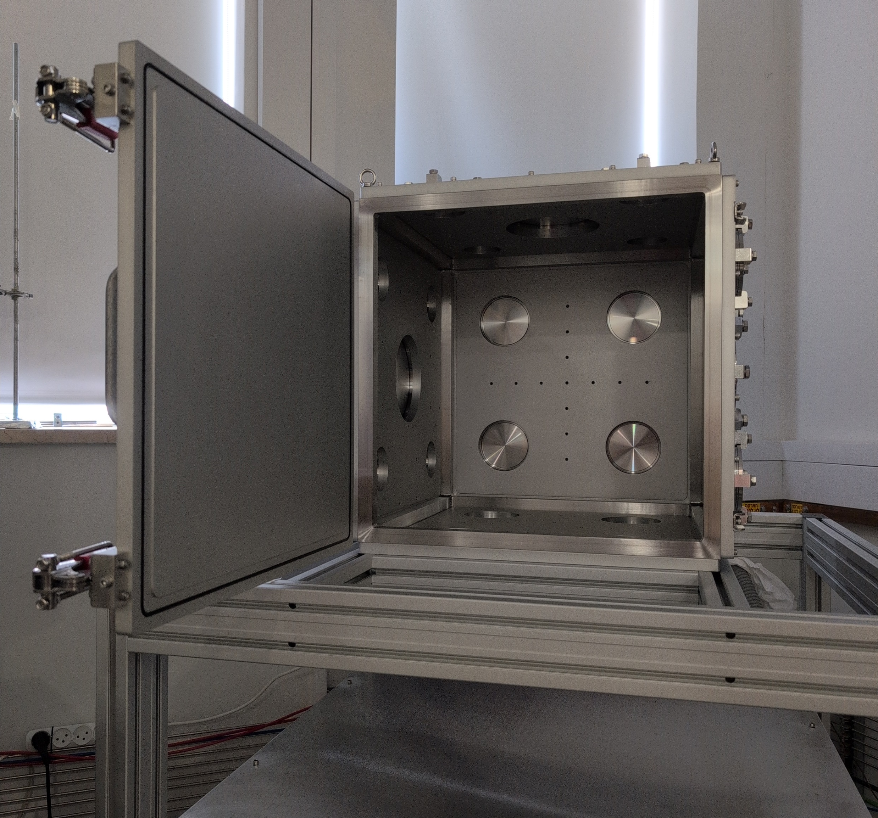
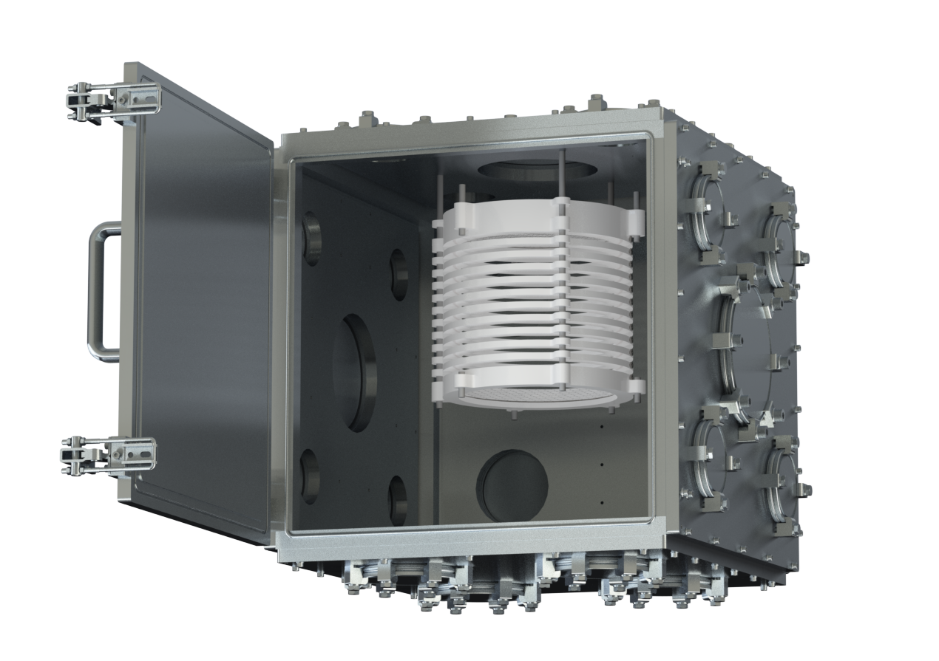
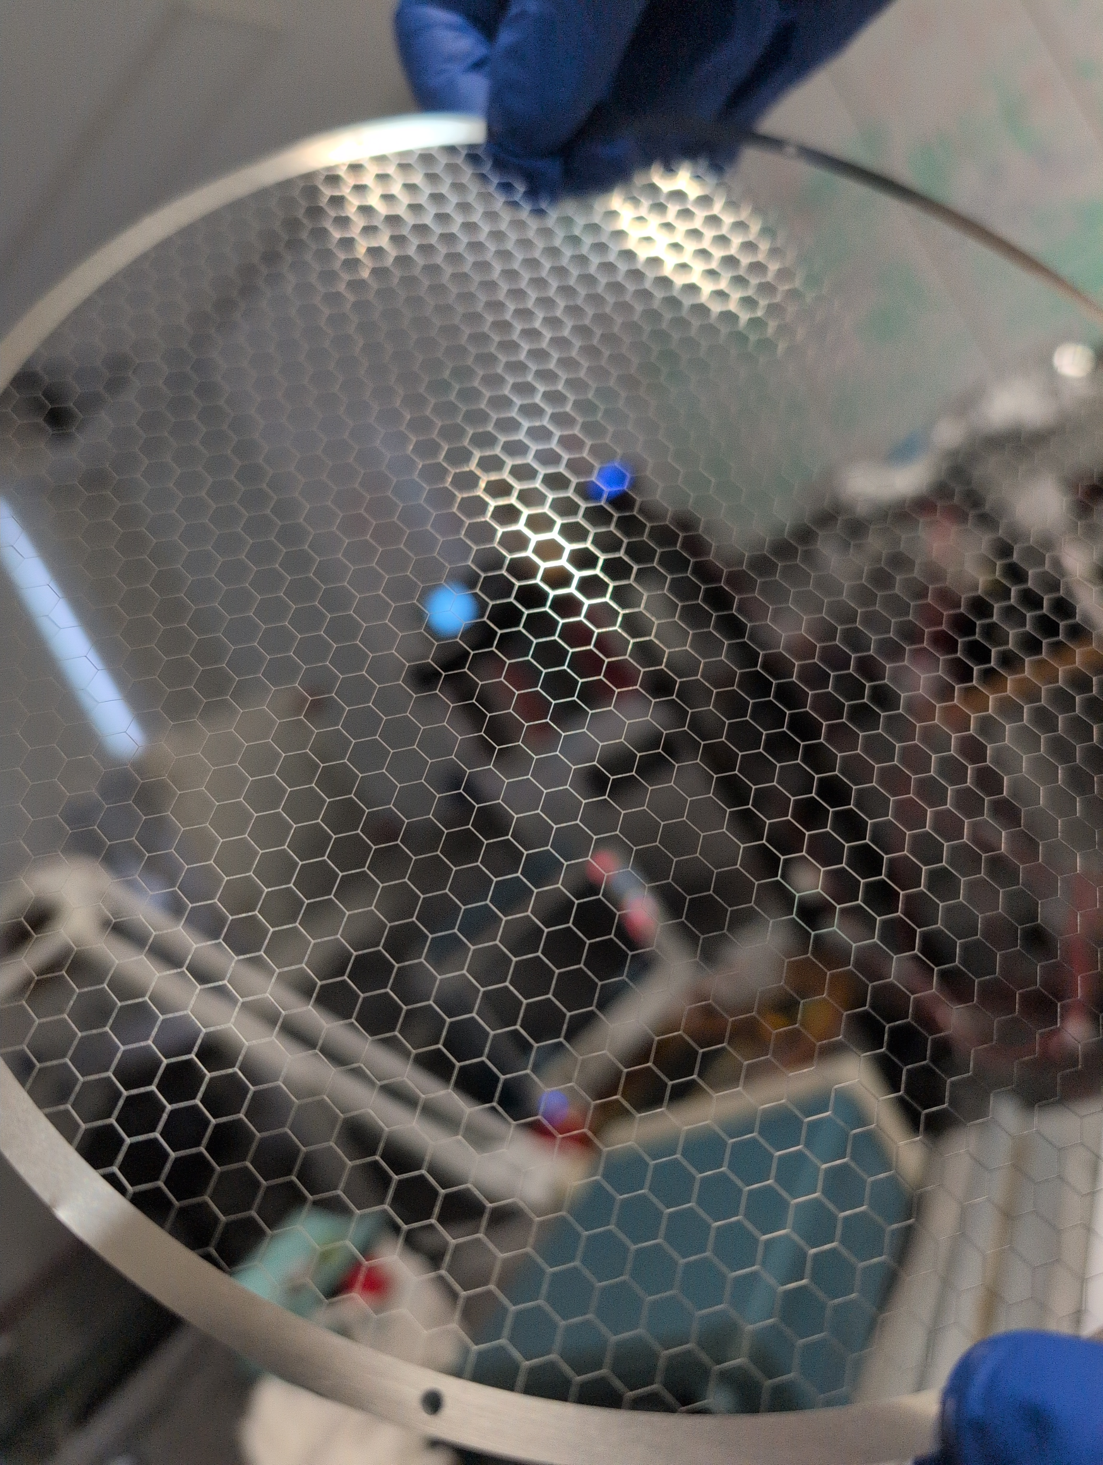
Project roadmap
Prototype at Weizmann
Multi-purpose detector
Electron transport,
charge amplification, electroluminescence and imaging
Test-bench for novel imaging techniques
Scaled up geometry
(20 cm drift length)
Tunable pressure
(10 mbar up to 1 bar)
Modular design
This talk
In progress
Ryan Felkai, SARAF&WIS TPC mini-workshop, 19th February 2026

Slide 9
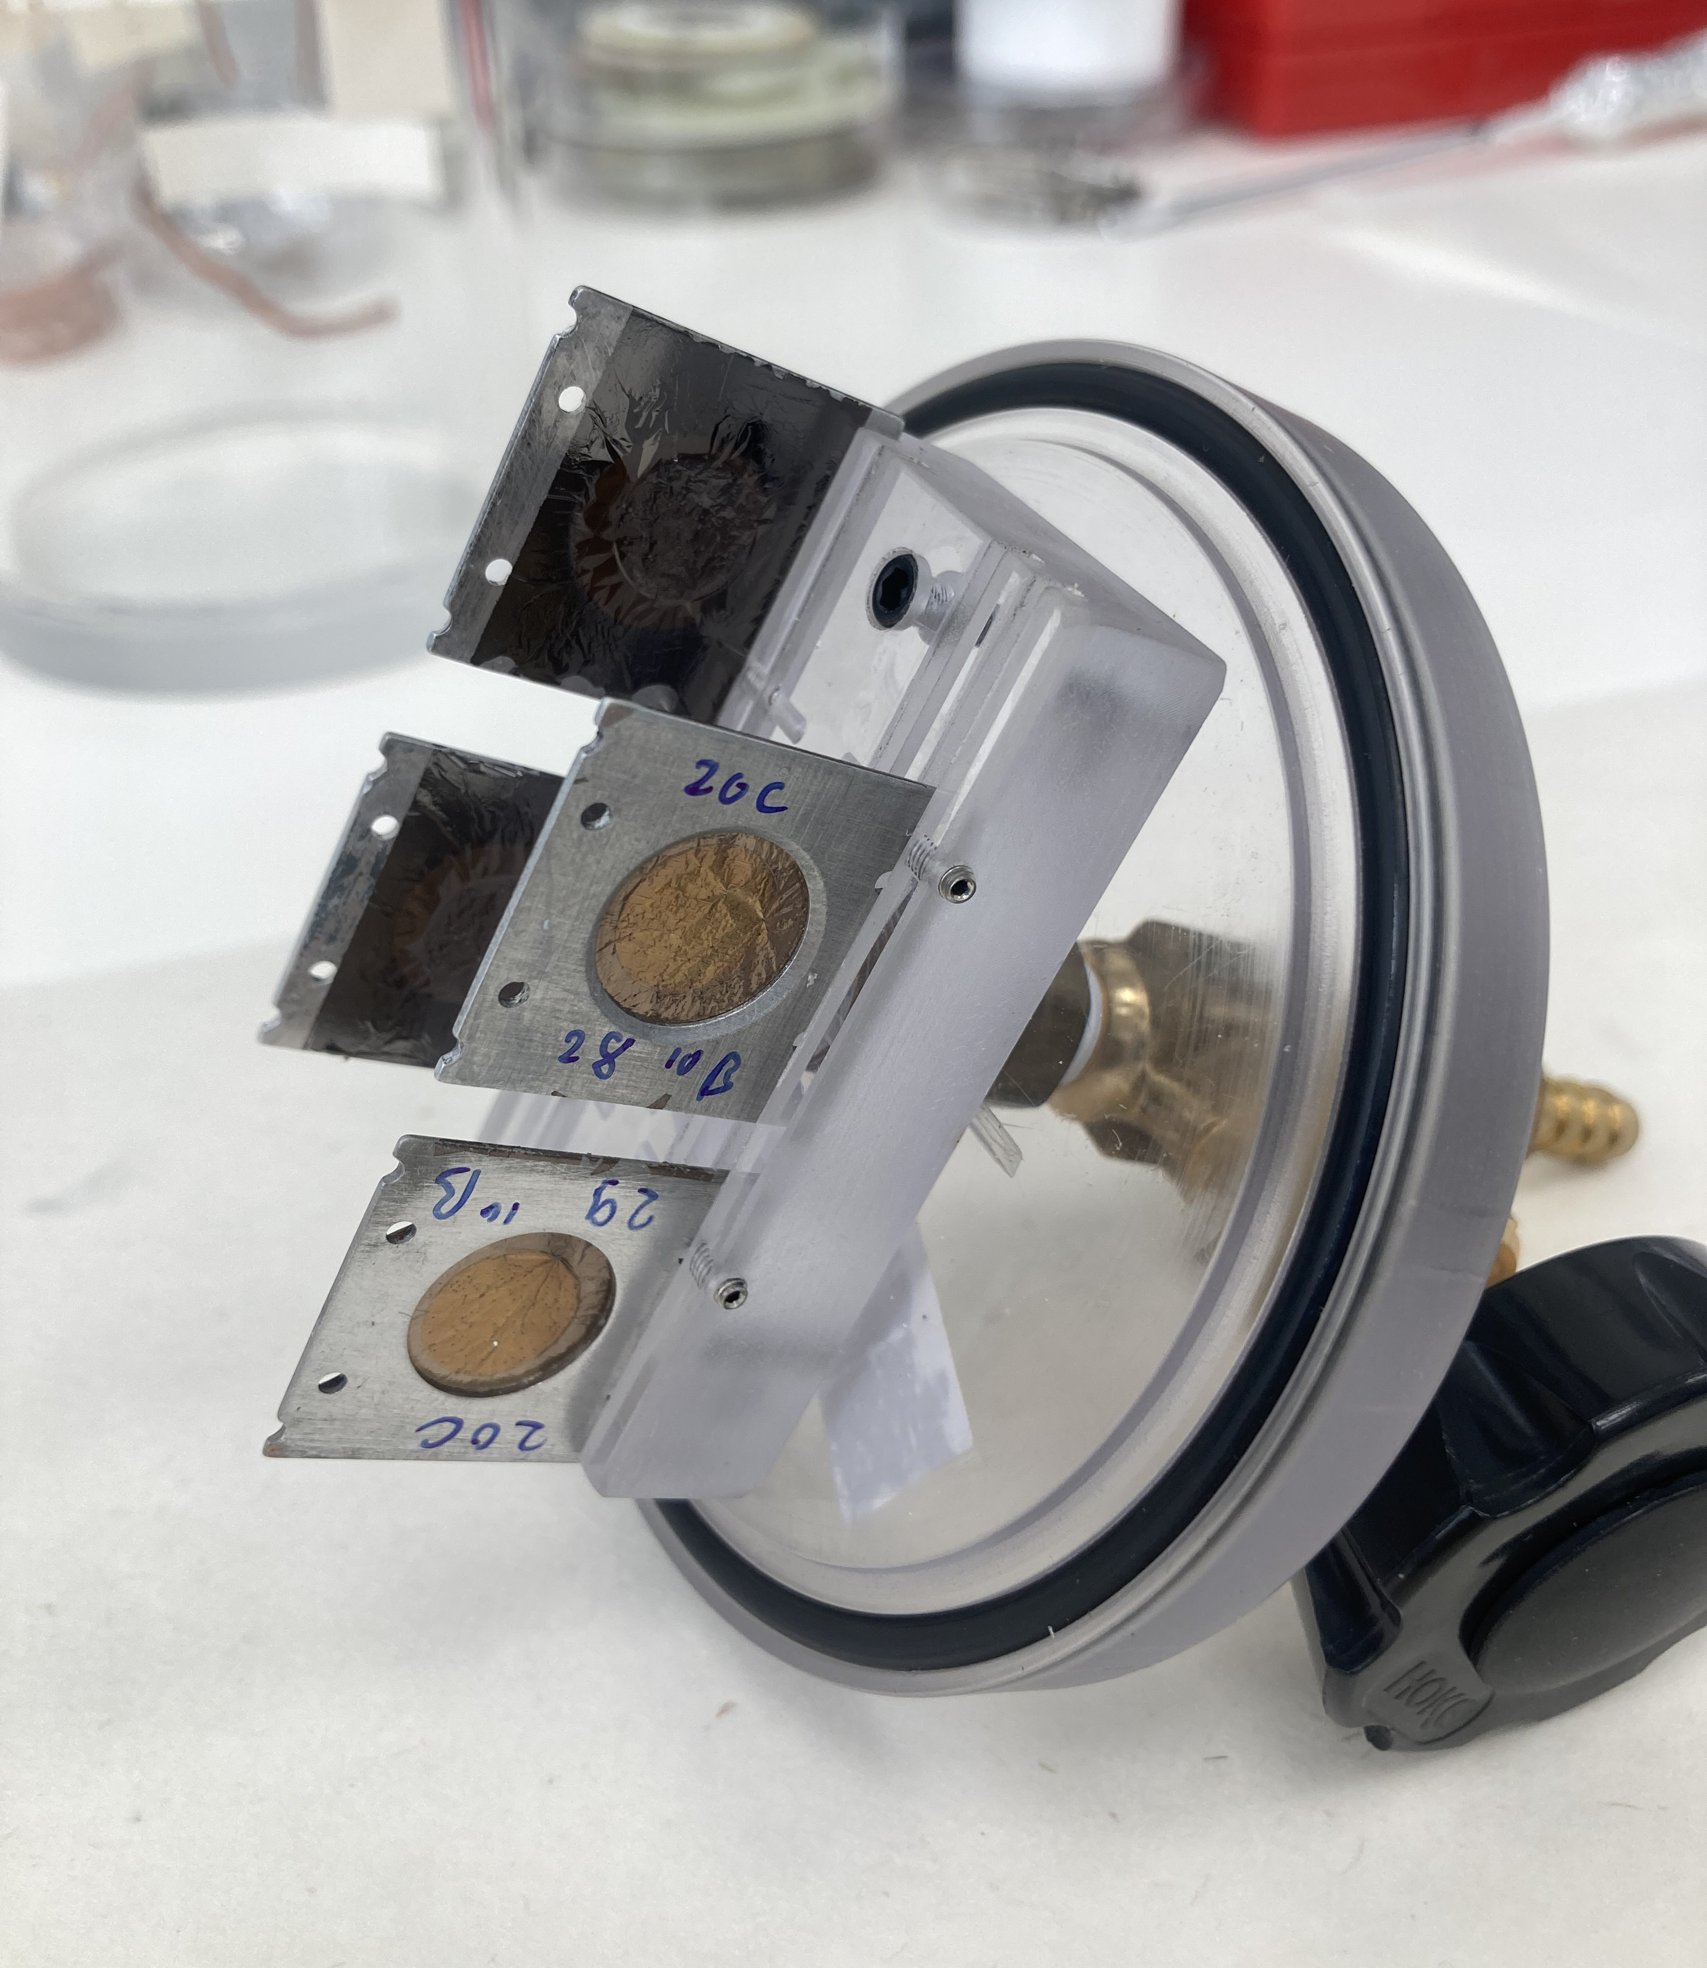
Project roadmap
Prototype at Weizmann
Multi-purpose detector
Commissioning + Physics
Electron transport,
charge amplification, electroluminescence and imaging
Test-bench for novel imaging techniques
Scaled up geometry
(20 cm drift length)
Tunable pressure
(10 mbar up to 1 bar)
Modular design
Simulations:
- Neutron background
- Reaction products
Early runs: Collimated nuclear reactor neutron flux on Boron-10 targets
This talk
In progress
In progress
Ryan Felkai, SARAF&WIS TPC mini-workshop, 19th February 2026

Slide 10
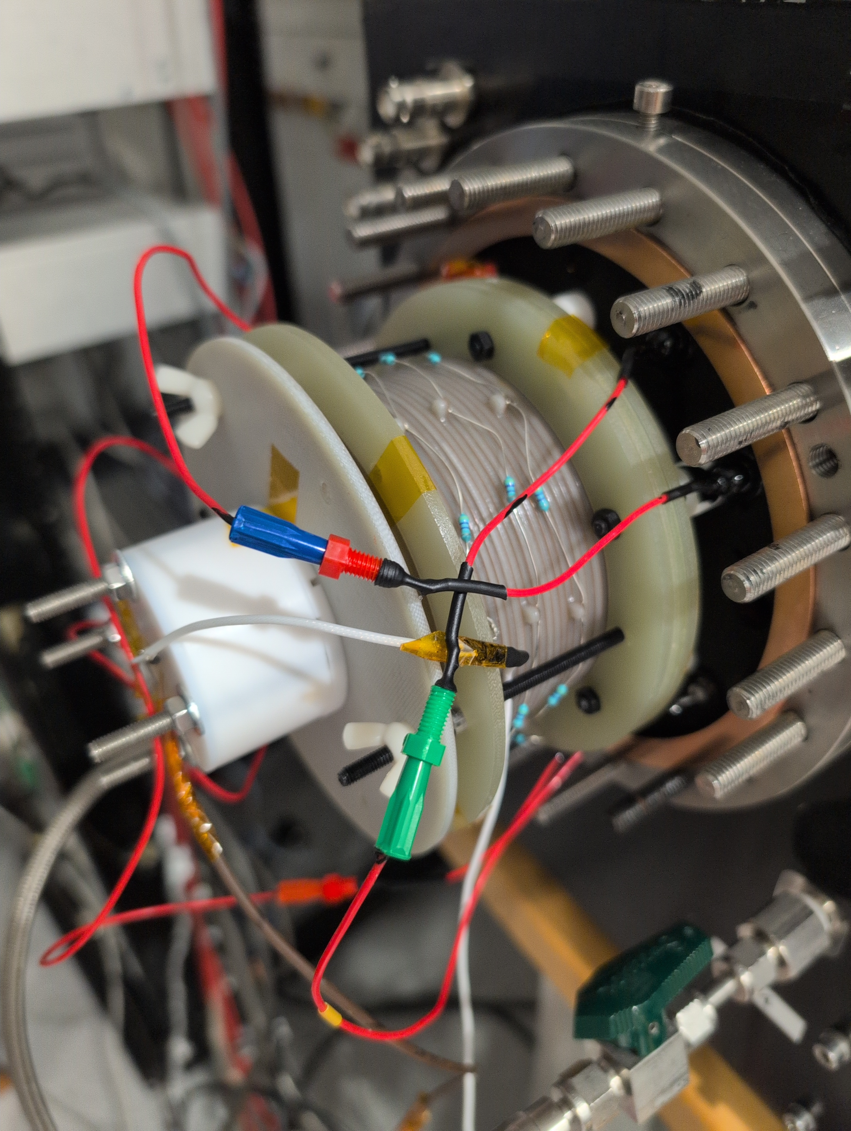
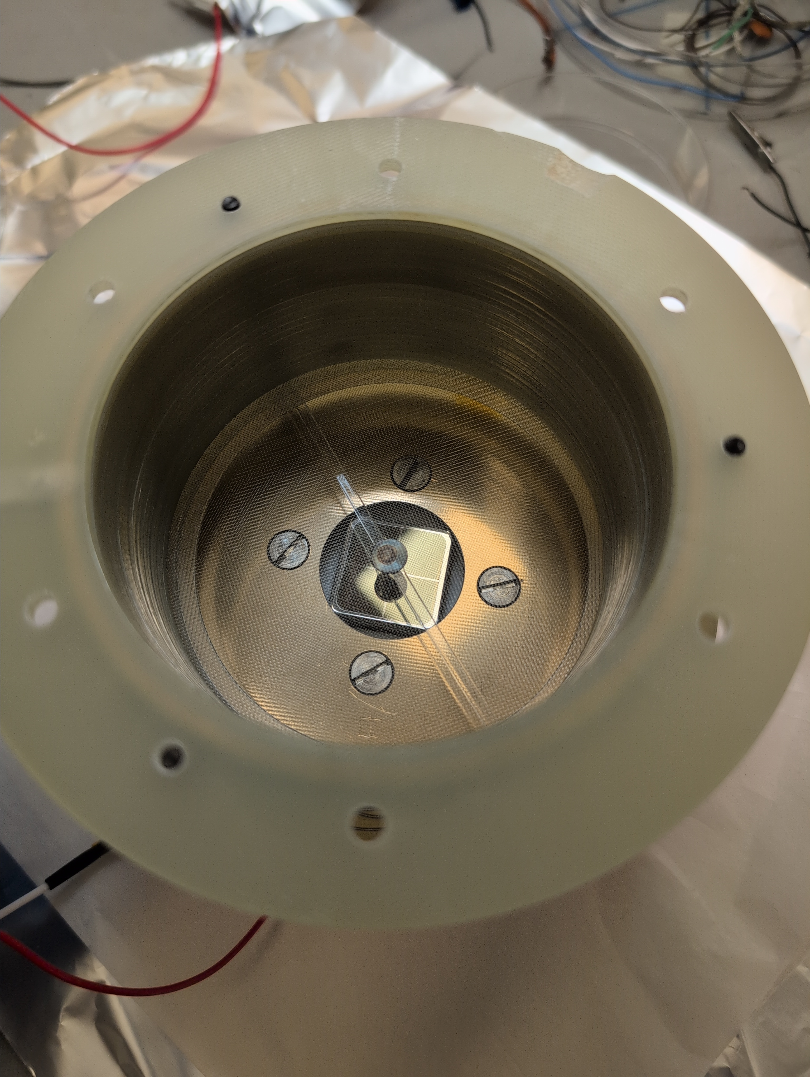
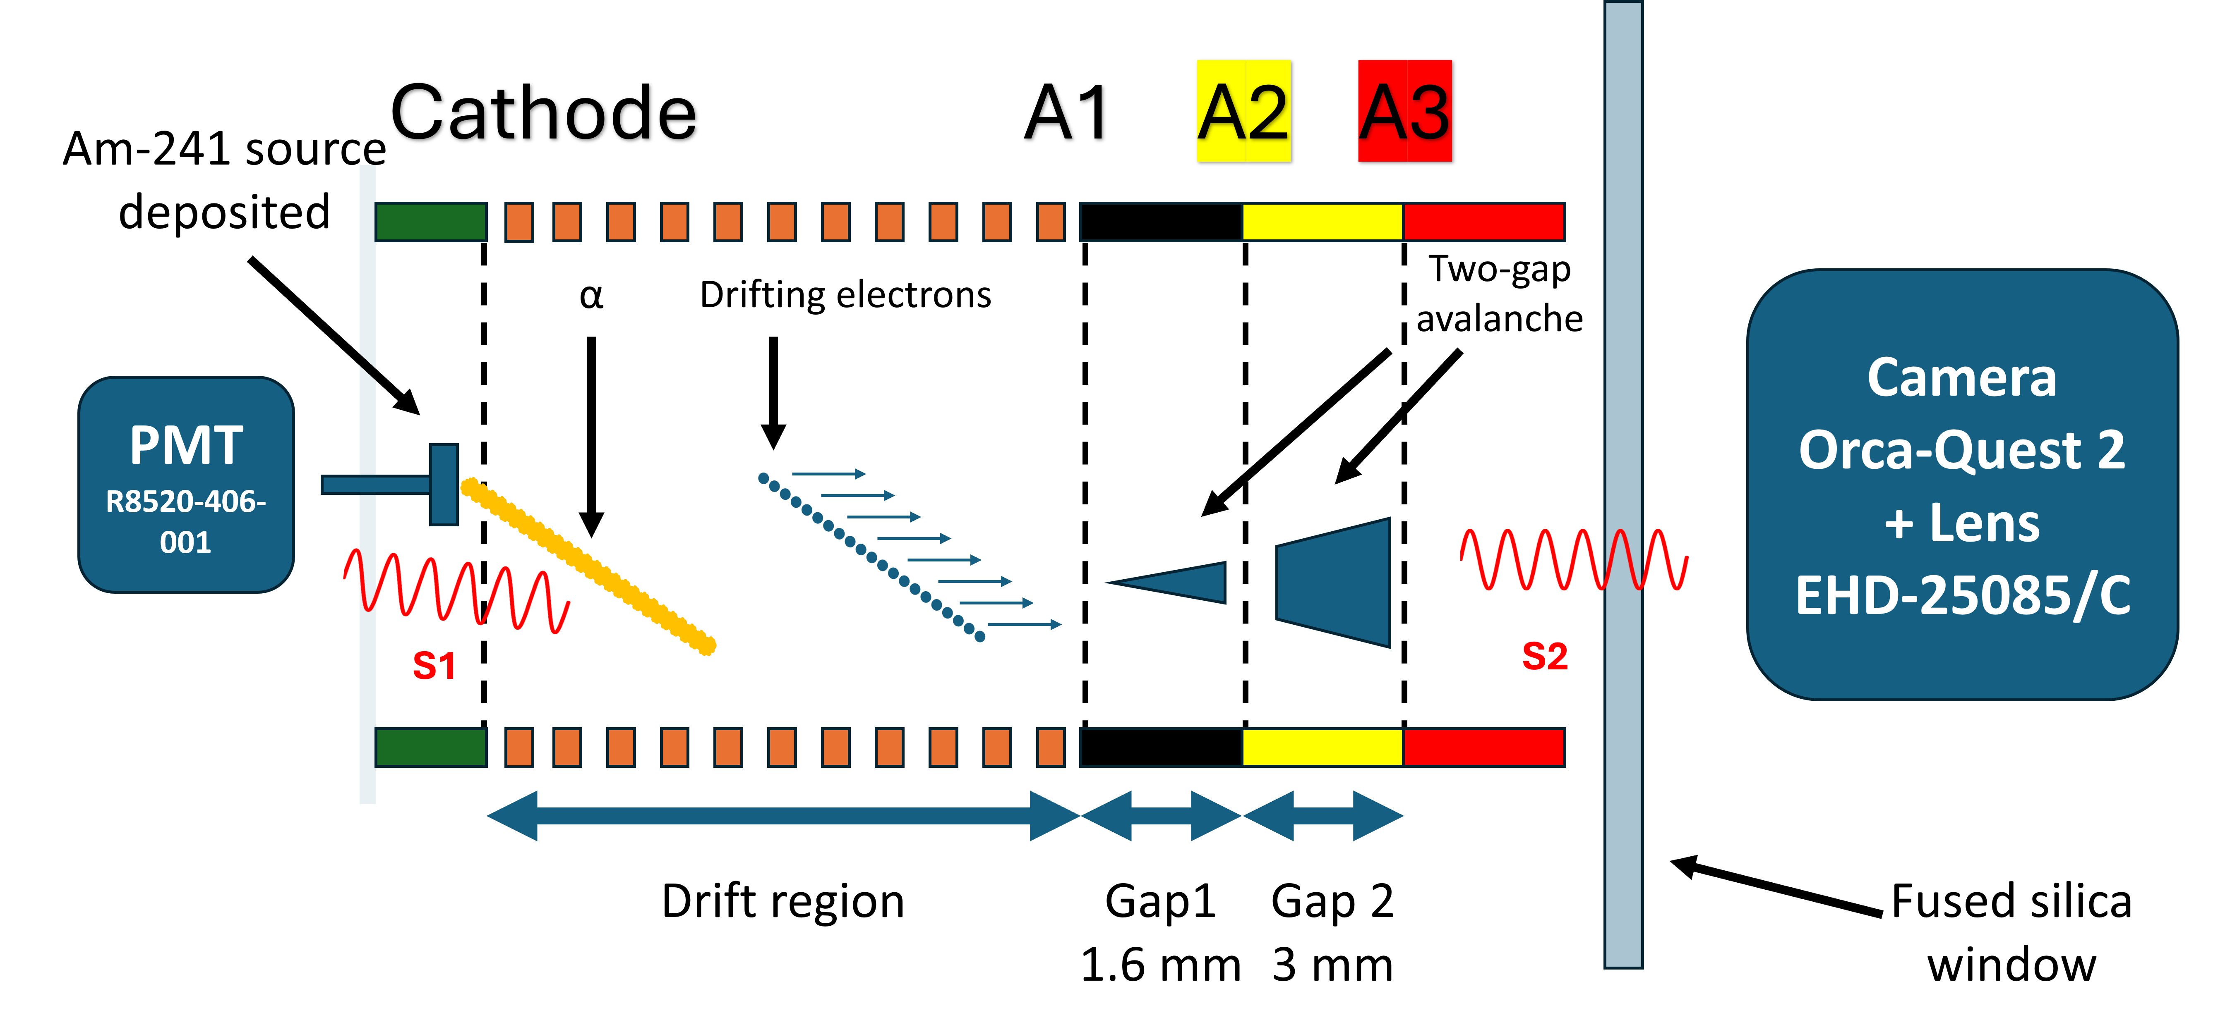
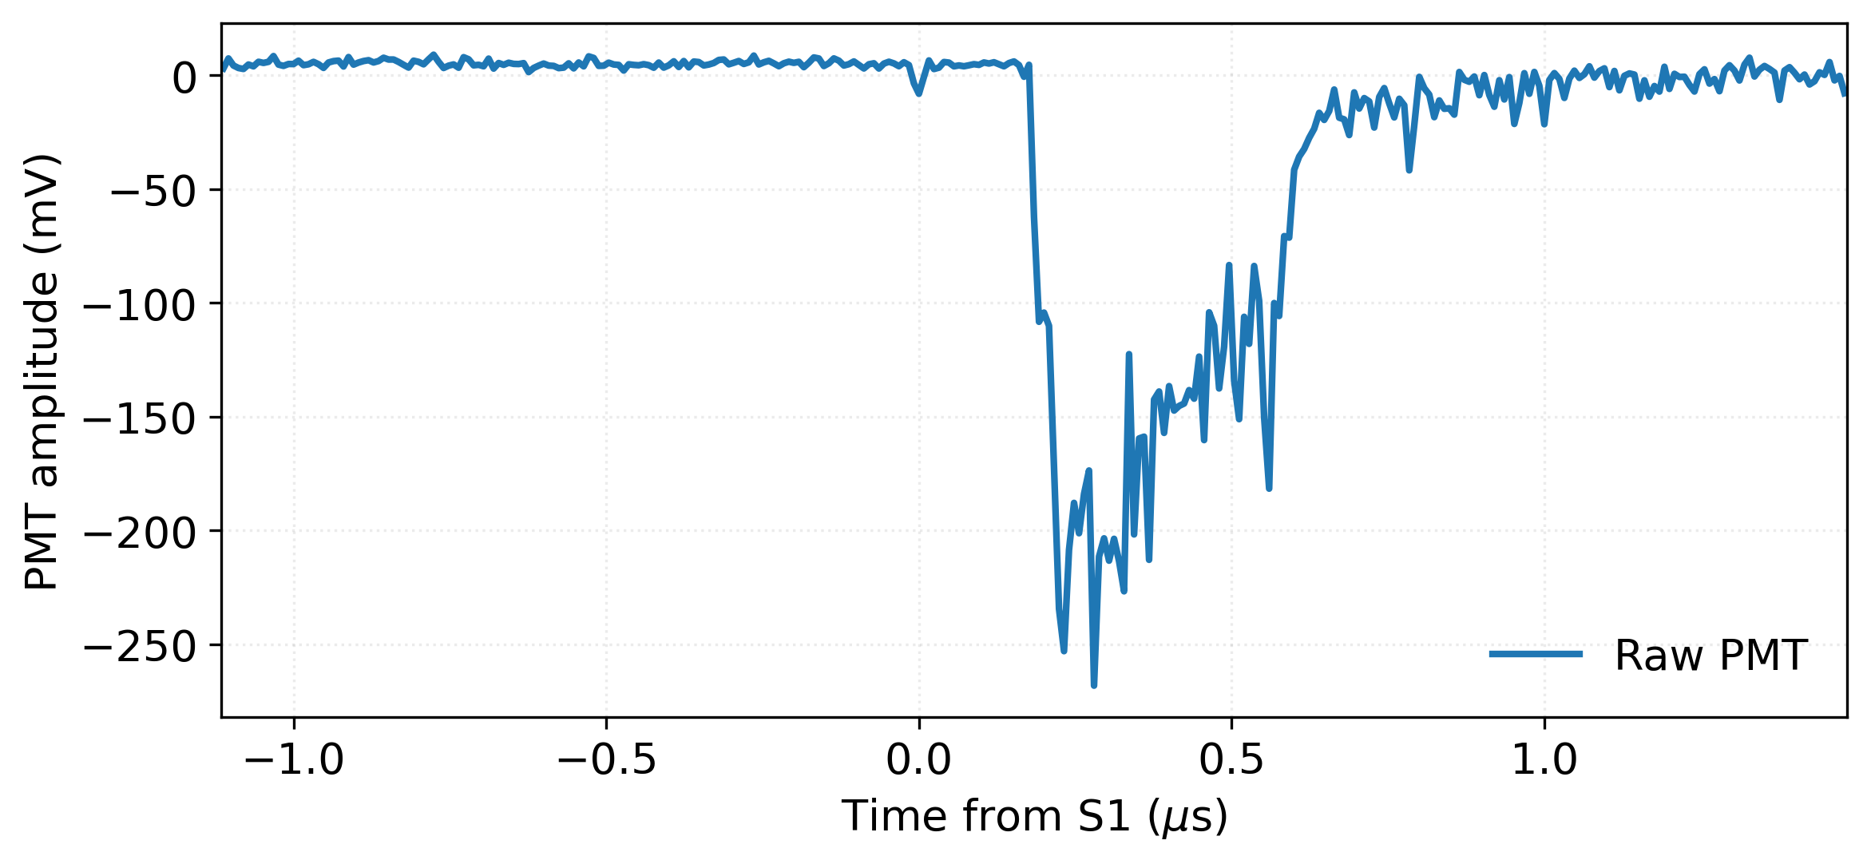
Prototype assembled at Weizmann
Setup views
Baseline gas mixture: Ar:CF₄ 95:5 at 1 bar (constant flow)
Field cage: Stack of copper-clad FR4 (∼ 5 cm max drift length)
4 woven mesh electrodes (500 µm pitch, 50 µm ⌀, 81% T):
- 1 drift cathode, 1 drift anode and 2 amplification anodes
A broadband PMT behind the cathode (sensitive to S1)
Orca-Quest2 camera with ultra-fast lens behind a fused silica viewport
Low activity (30 Bq) Am-241 source placed behind the drift cathode
Example of a PMT signal at moderate amplification
TPC configuration
S1
S2
Ryan Felkai, SARAF&WIS TPC mini-workshop, 19th February 2026

Slide 11
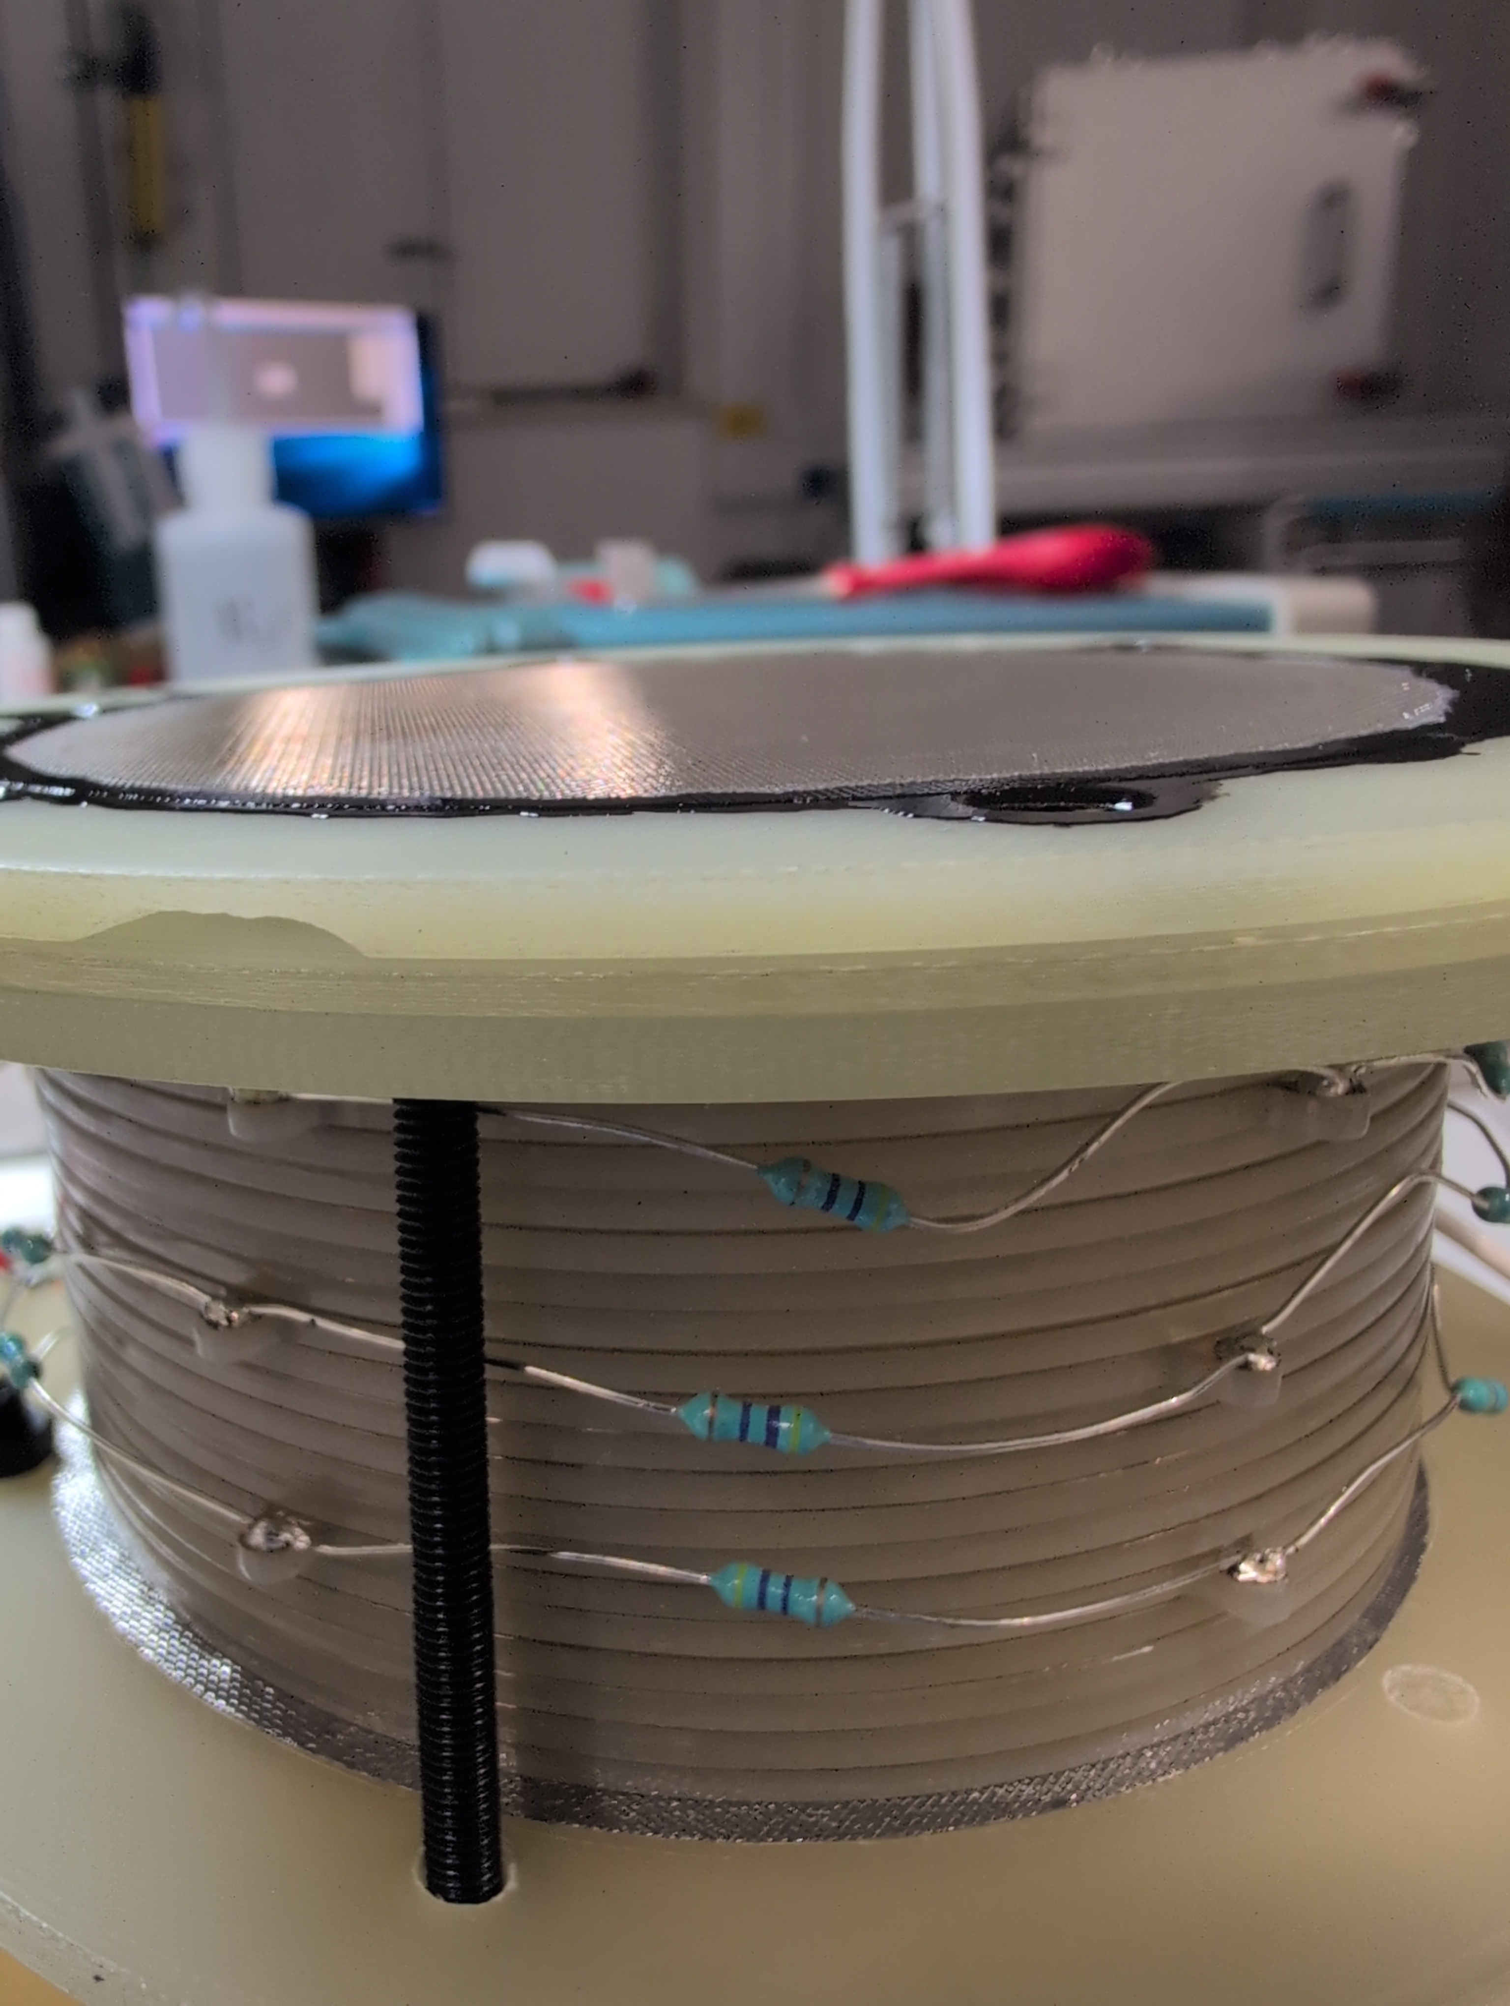
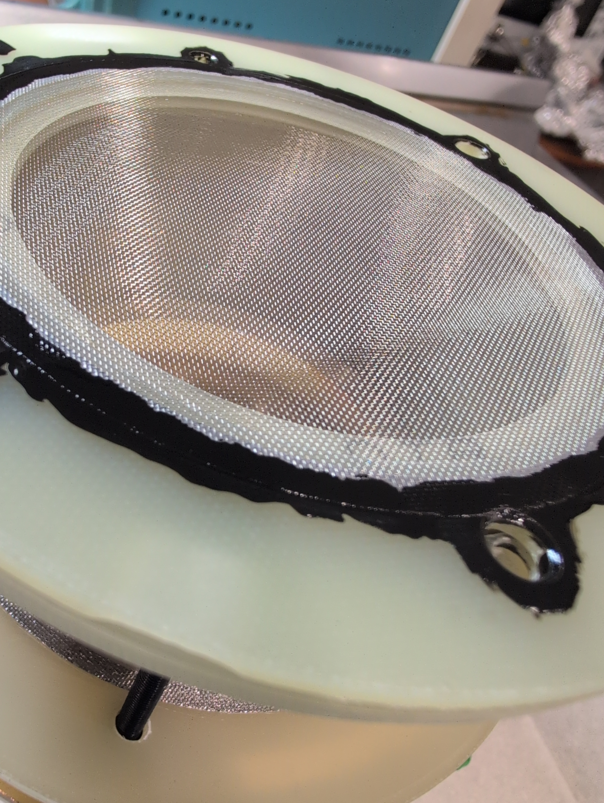
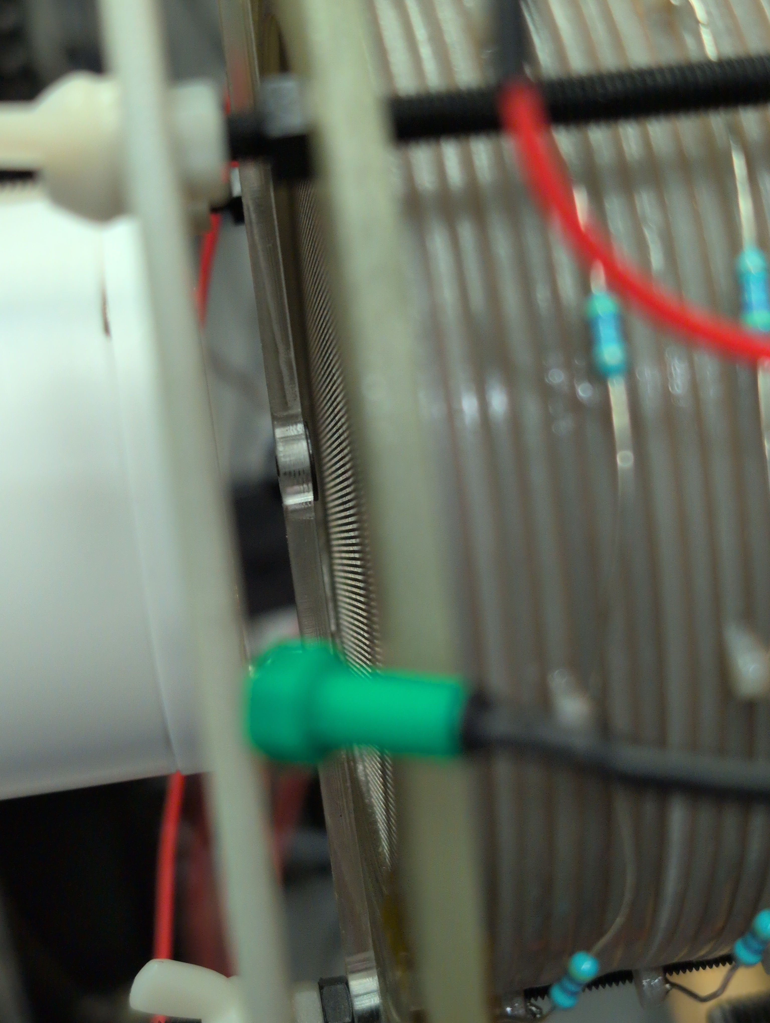
Prototype assembled at Weizmann
Source
Ryan Felkai, SARAF&WIS TPC mini-workshop, 19th February 2026

Slide 12
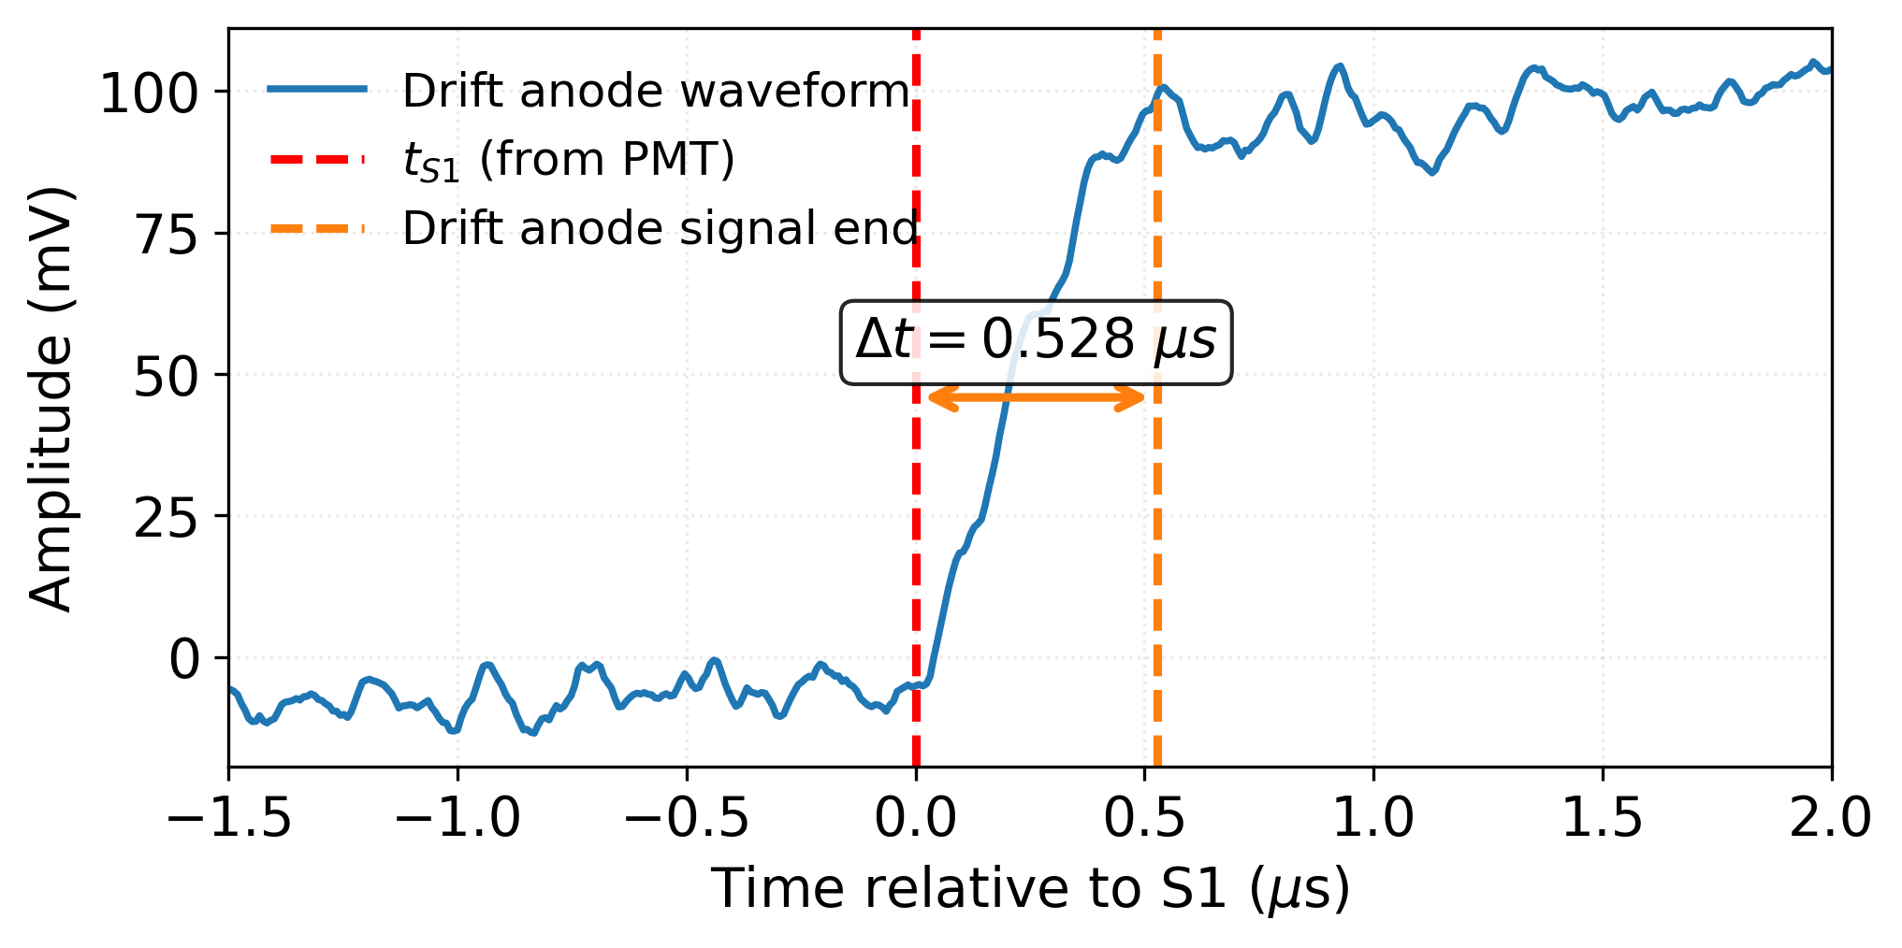
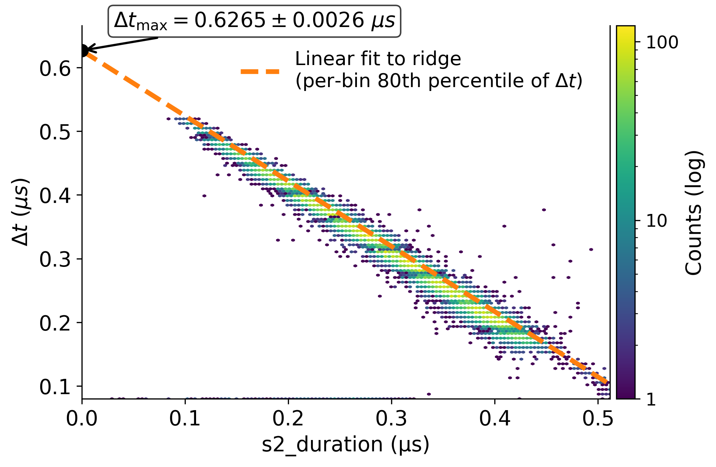
Electron transport in the drift region
Direct measurement from preamp rise time (drift-only)
Two ways to compute the electron drift velocity:
- Charge signal rise time (drift-only) on the drift anode
- Extrapolation of the anti-correlation between S2 delay and S2 duration
These methods take advantage of the alphas being emitted from behind the drift cathode
Explain signal shape
S2 delay wrt S1 (Δt) vs S2 duration (drift field of 200 V/cm)
Knowing the drift velocity is required to convert drift time into distance
Ryan Felkai, SARAF&WIS TPC mini-workshop, 19th February 2026

Slide 13
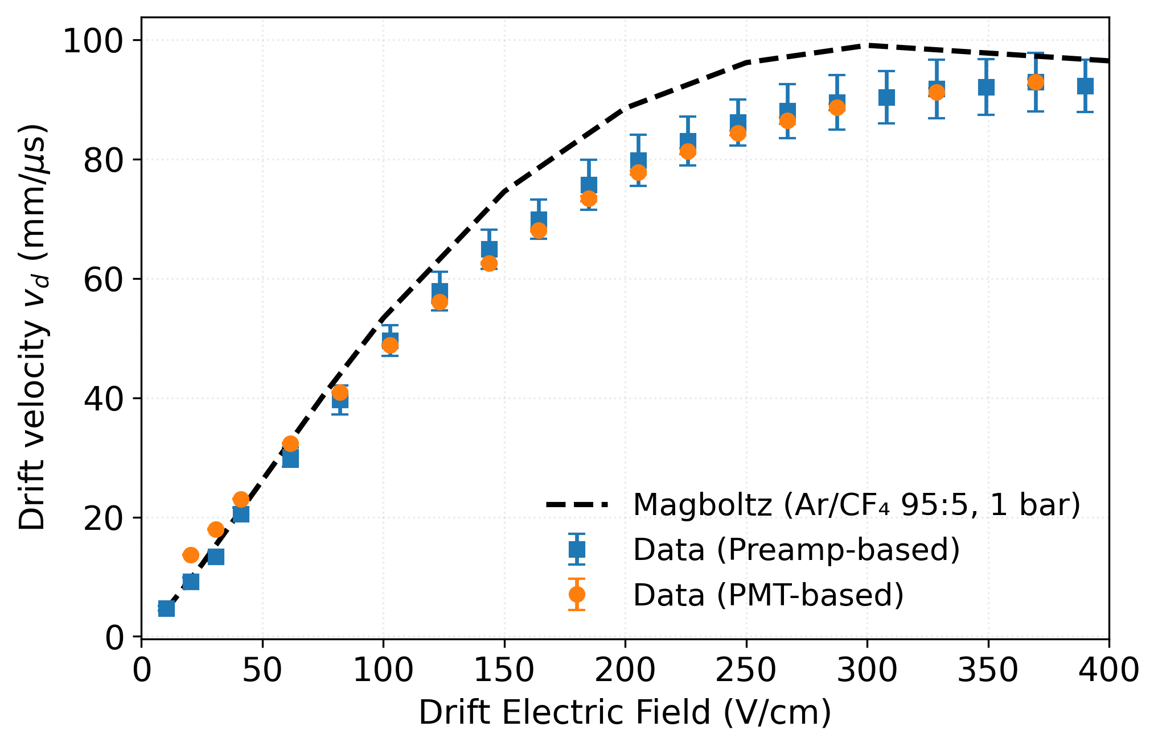
Electron transport in the drift region
Direct measurement from preamp rise time (drift-only)
Two ways to compute the electron drift velocity:
- Charge signal rise time (drift-only) on the drift anode
- Extrapolation of the anti-correlation between S2 delay and S2 duration
These methods take advantage of the alphas being emitted from behind the drift cathode
S2 delay wrt S1 (Δt) vs S2 duration (drift field of 200 V/cm)
Electron drift velocity Vs Drift Field
Working value:
77 mm/µs at 200 V/cm
Ryan Felkai, SARAF&WIS TPC mini-workshop, 19th February 2026

Slide 14
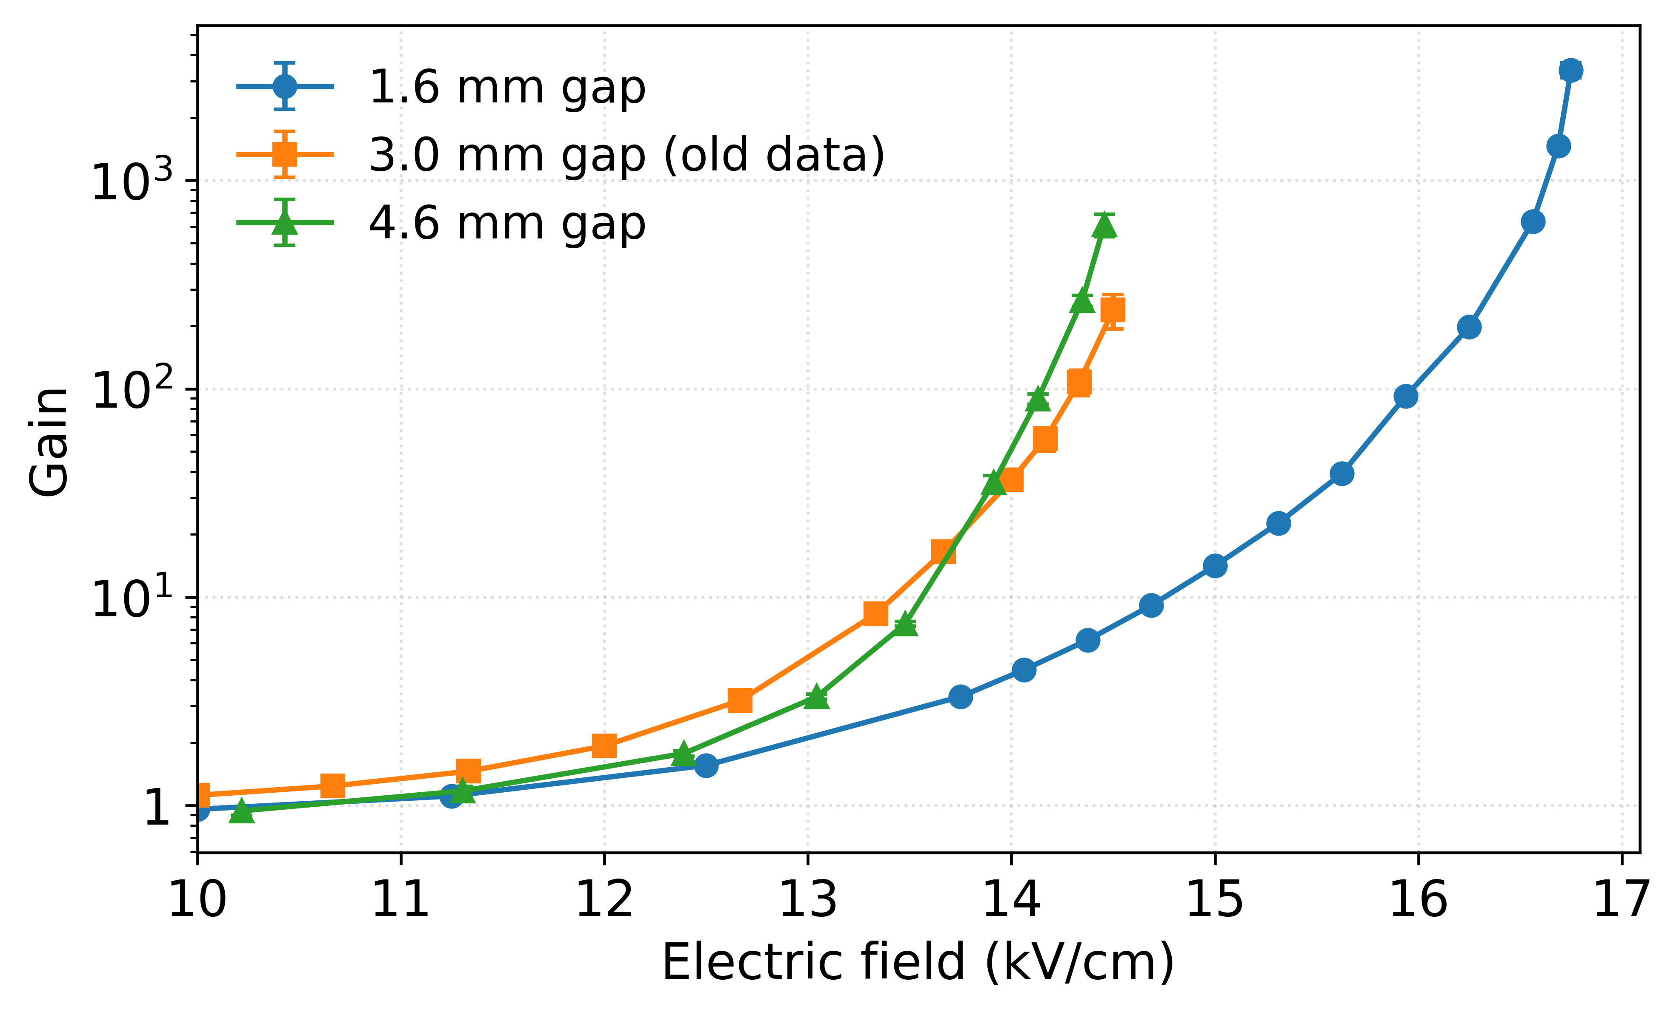
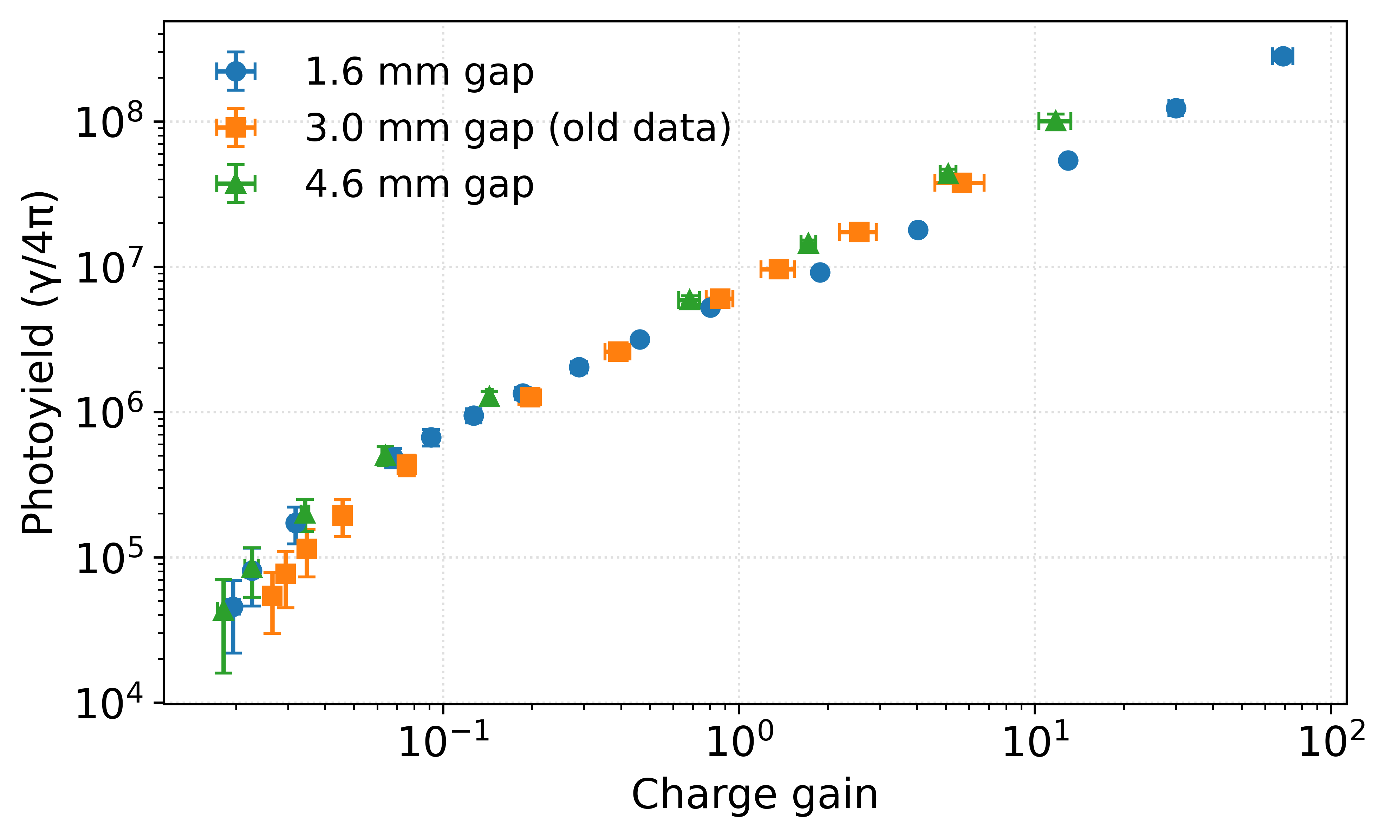
Detector performance
Gain Vs Amplification Field
Charge gain:
Charge sensitive preamplifier connected to the second anode
Drift field at 200 V/cm, gap spacing 1.6 / 3 / 4.6 mm
Collected charges normalized to that obtained in drift-only/collection
Light Yield Vs Gain
Light yield:
Integrate baseline-subtracted PMT waveform
Convert to absolute yield using Ar/CF4 secondary emission spectrum [1], PMT QE and solid angle
[1] F. M. Brunbauer, Applications of gas scintillation properties in optically read out GEM-based detectors, PhD. Thesis, 2018
Ryan Felkai, SARAF&WIS TPC mini-workshop, 19th February 2026

Slide 15
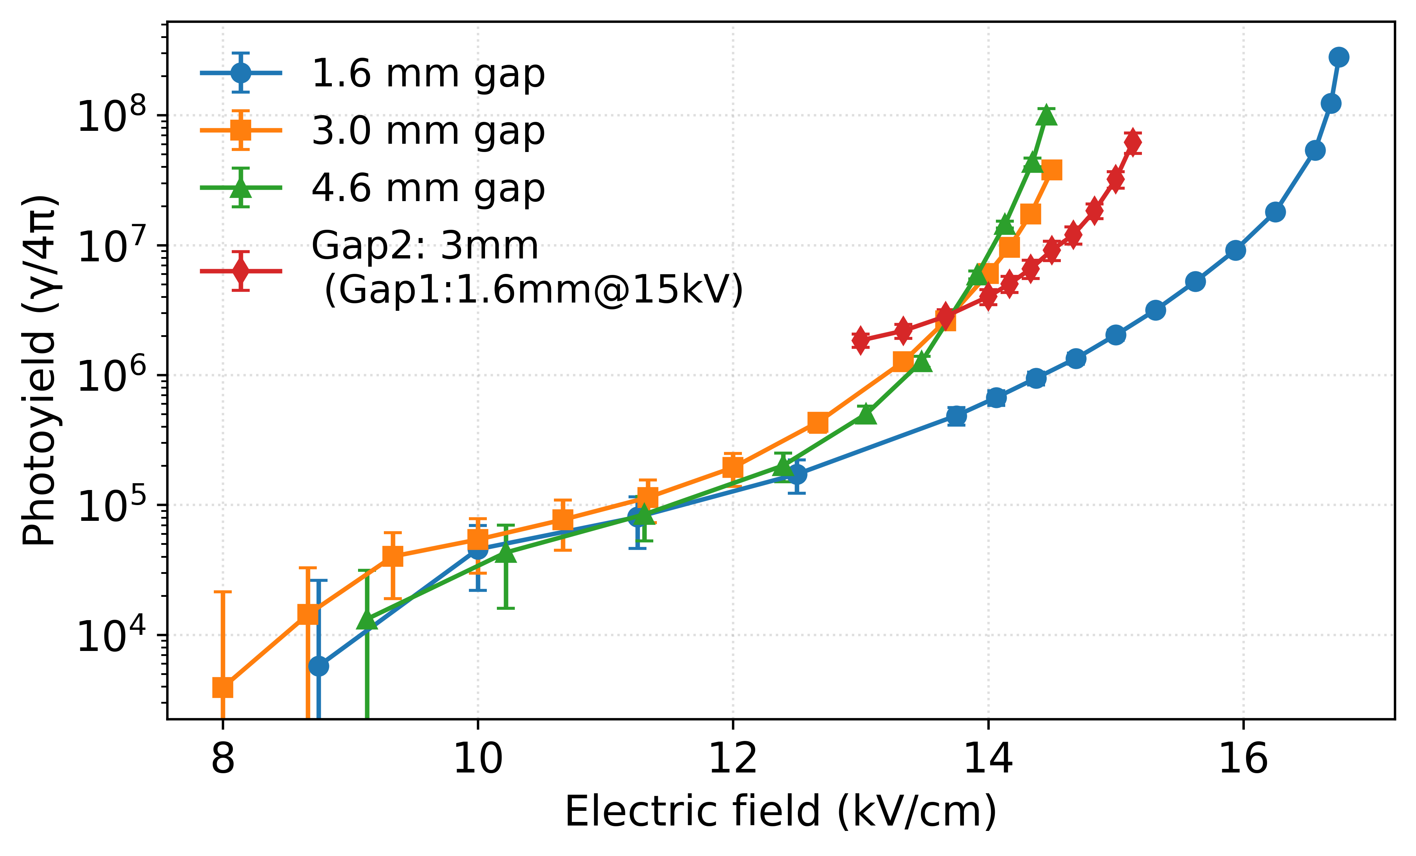
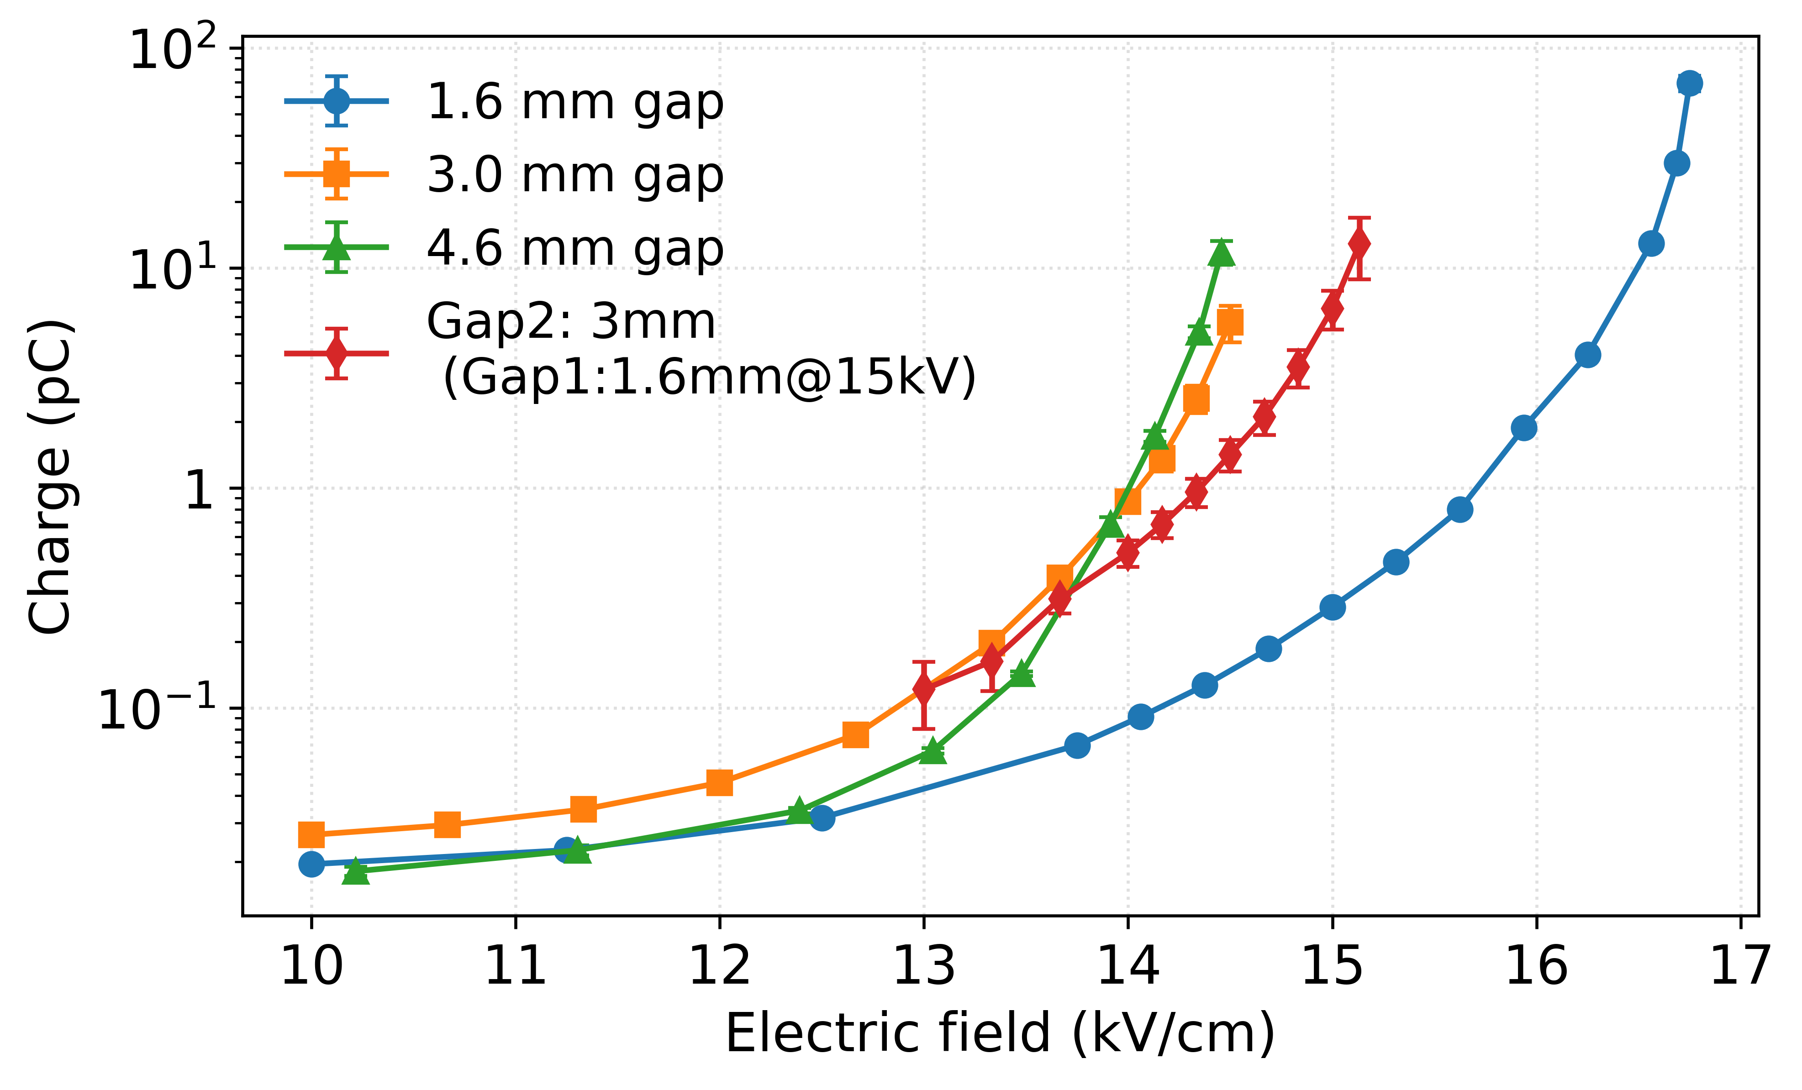
Detector performance: 2-gap operations
Charge
Ryan Felkai, SARAF&WIS TPC mini-workshop, 19th February 2026

Slide 16
3D alpha tracks projection

Slide 17
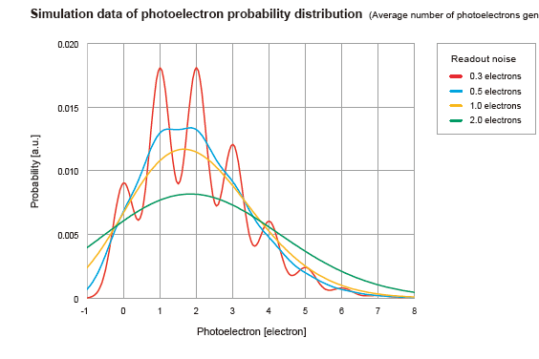
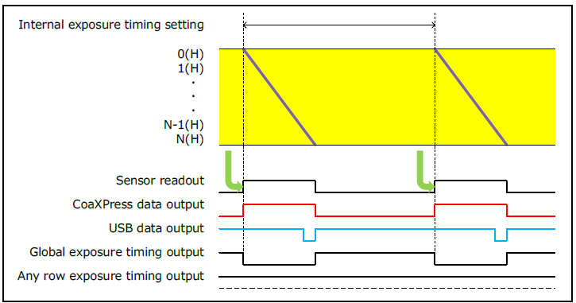
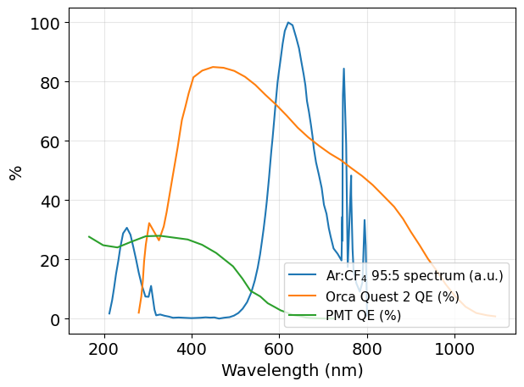
Photon number resolving output
Orca Quest 2
Poisson λ = 2
CMOS camera: 9.4MPixels, 4.6 µm pitch ➔ 18.841 mm × 10.598 mm
Extremely low readout noise (0.4 e⁻ rms in standard, 0.3 e⁻ rms in quiet)
Rolling shutter, readout time 8.3 ms and exp_{min} 7.6 µs ➔ 120 FPS_{max}
QE up to 85% @ 460 nm
Free running mode (with CoaXPress)
From the manufacturer
Quantum Efficiency of sensors + secondary emission spectrum of Ar:CF₄
Ryan Felkai, SARAF&WIS TPC mini-workshop, 19th February 2026

Slide 18
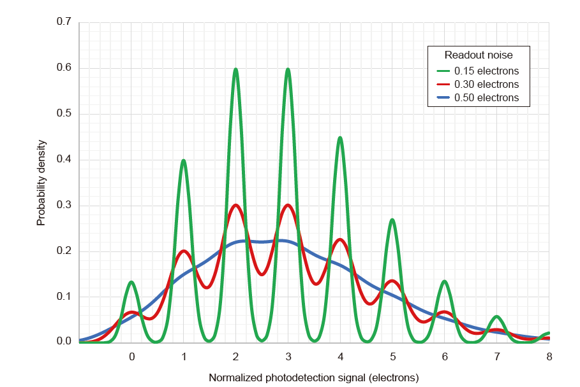
Photon number resolving output
Orca Quest 2
Poisson λ = 3
Poisson λ = 2
CMOS camera: 9.4MPixels, 4.6 µm pitch ➔ 18.841 mm × 10.598 mm
Extremely low readout noise (0.4 e⁻ rms in standard, 0.3 e⁻ rms in quiet)
Rolling shutter, readout time 8.3 ms and exp_{min} 7.6 µs ➔ 120 FPS_{max}
QE up to 85% @ 460 nm
From the manufacturer
Free running mode (with CoaXPress)
From the manufacturer
Quantum Efficiency of sensors + secondary emission spectrum of Ar:CF₄
Ryan Felkai, SARAF&WIS TPC mini-workshop, 19th February 2026

Slide 19
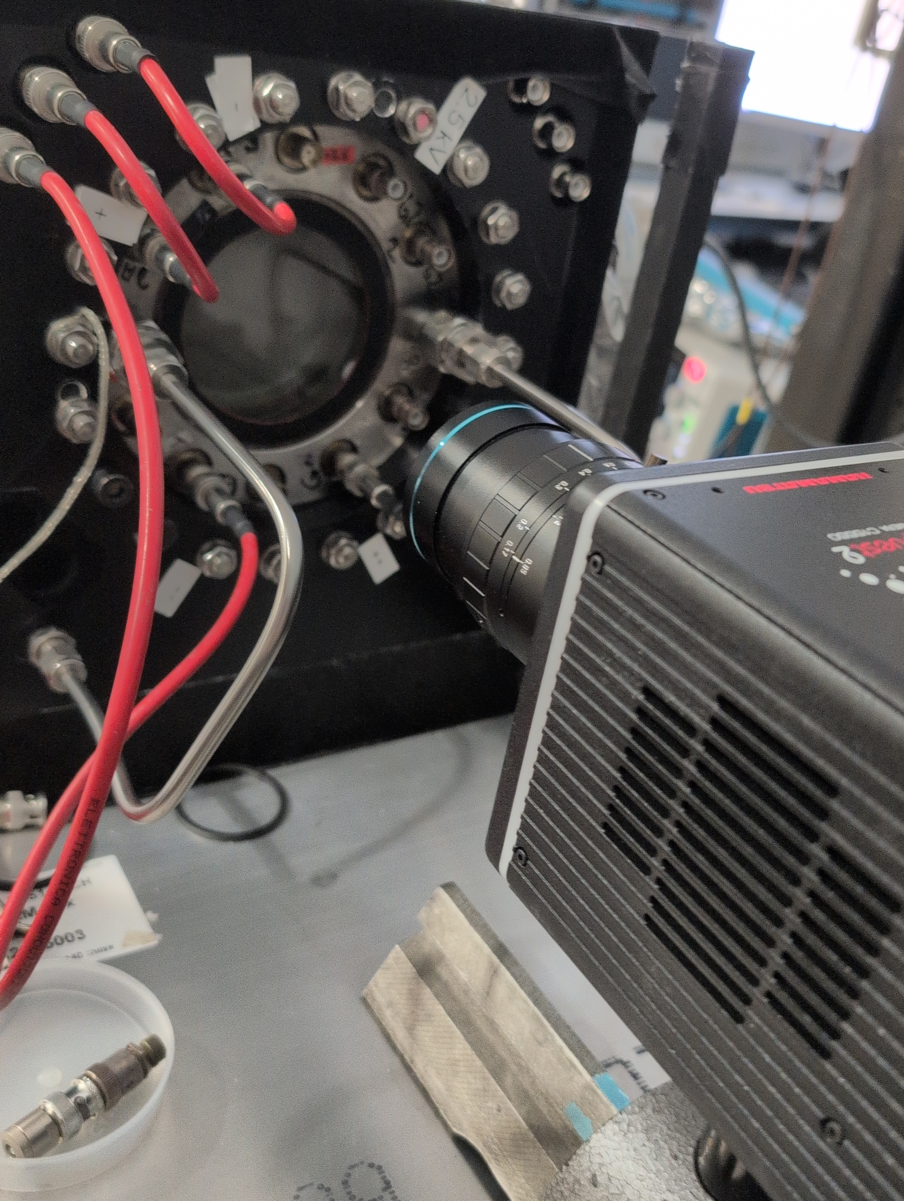
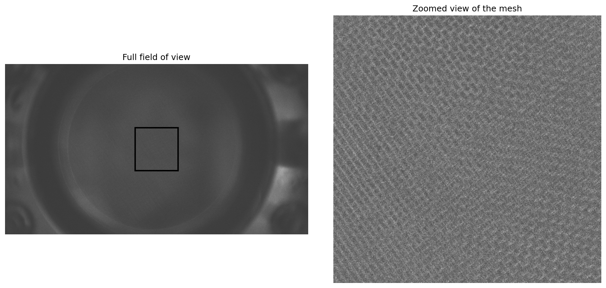
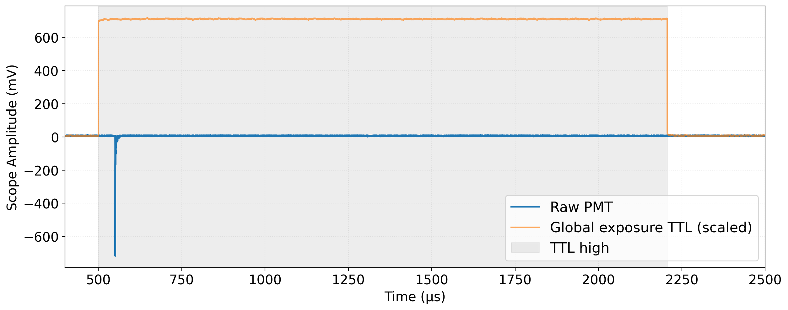
Camera setup and synchronization with the PMT
View of the camera in front of the detector
Global exposure timing output of the camera (TTL) connected to the oscilloscope
Event selection: only one event per time window and within TTL
This is a workaround for the rolling shutter of the camera coupled with USB readout limitations (we are upgrading to CoaXPress)
Image focused on the second and third anodes
Camera signal output in coincidence with PMT-recorded S2
Ryan Felkai, SARAF&WIS TPC mini-workshop, 19th February 2026

Slide 20

Short movie (a tribute to Satyajit Ray)
Ryan Felkai, SARAF&WIS TPC mini-workshop, 19th February 2026

Slide 21
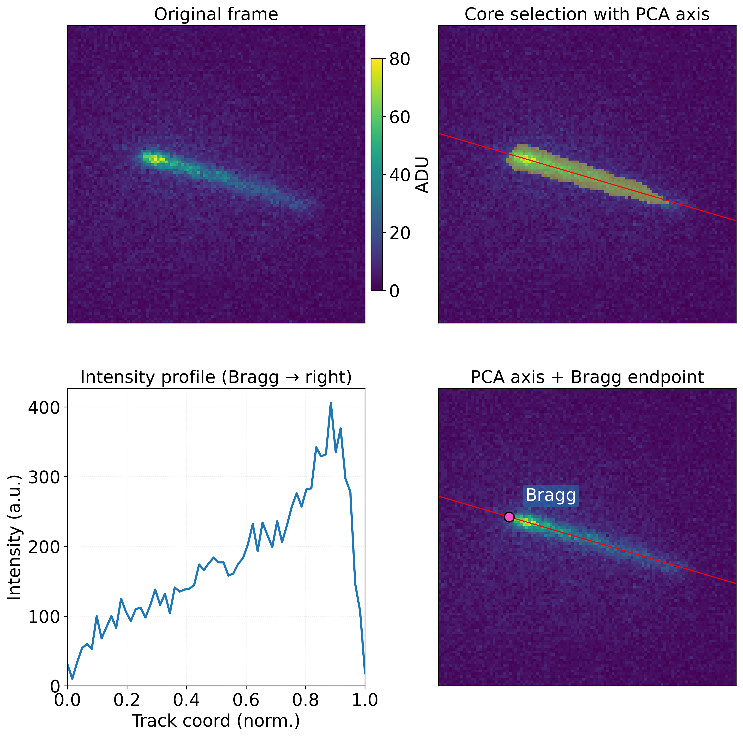
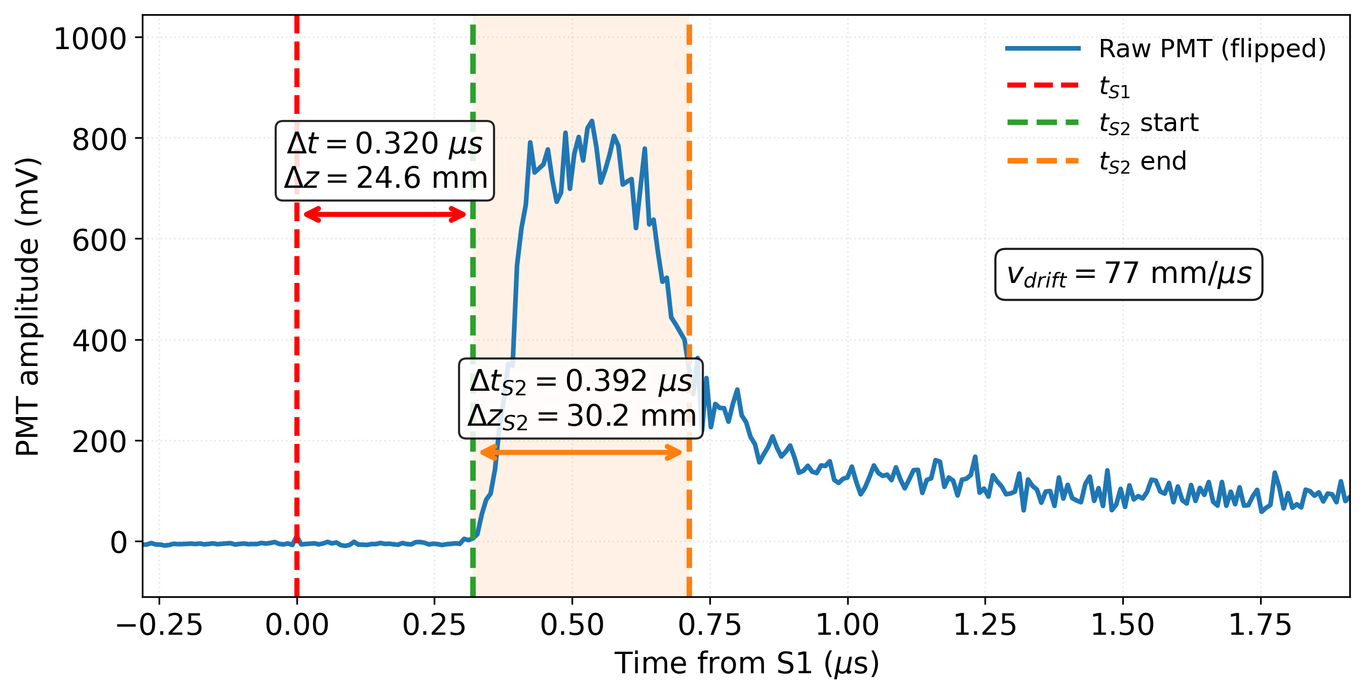
3D Track Projection
PMT timing
Image processing
Images are rebinned 8 x 8 to improve S/N (scale of 0.35 mm/px_{8x8})
Main assumption is a linear mapping between the track profile (camera) and the emission time (PMT)
Ryan Felkai, SARAF&WIS TPC mini-workshop, 19th February 2026

Slide 22
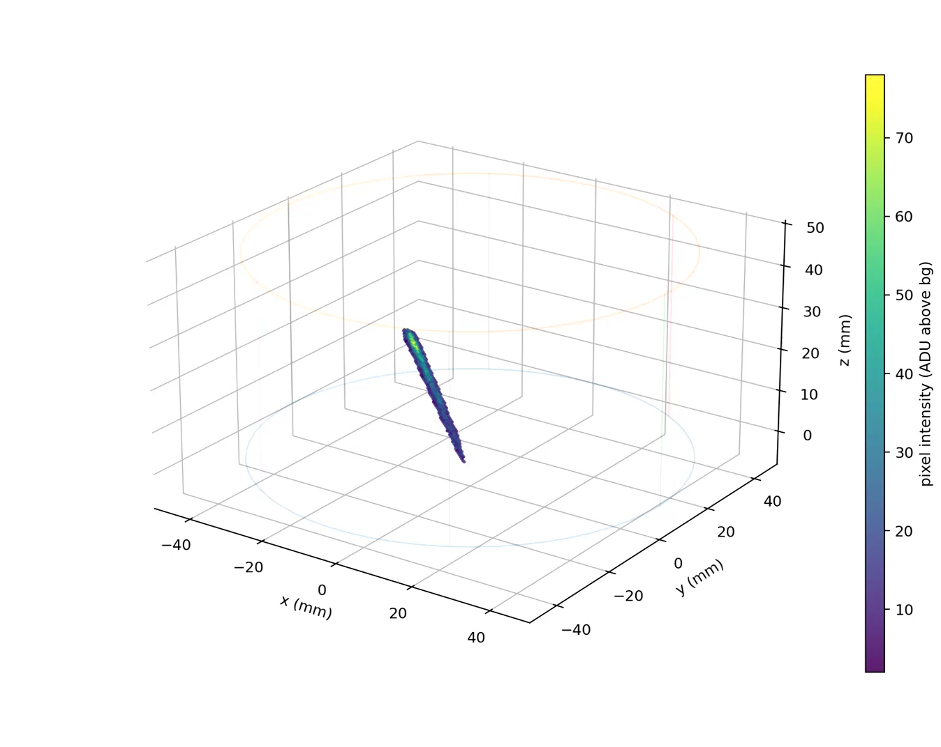
3D Track Projection
3D projection
Short term limitations (can be fixed):
Frame rate is too low (USB) which forces idle time of the camera in free running mode (event loss)
Long term limitations (intrinsic):
2D frame + PMT signal is challenging in multi-track events
Frame rate limit of 120 Hz (hard limit), minimum exposure of 8 ms (lossless) likely too coarse for beamline experiments
Ryan Felkai, SARAF&WIS TPC mini-workshop, 19th February 2026

Slide 23
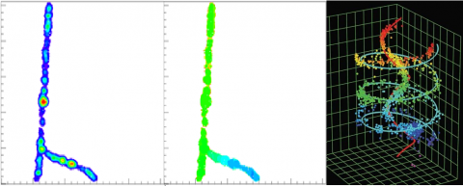
Conclusion and outlook:
From Prototype → Beamline-ready OTPC
1. The OTPC prototype achieved:
Establishing and validating methods of signal acquisition and processing
Performance mapping in Ar:CF4 95:5 at 1 bar
3D track projection with camera+PMT
Understanding hardware limitations and informing the design of the next-generation detector
2. Work in progress:
Test GEM+mesh performance and hexagonal etched meshes with different stacking geometries
Microphysics studies
Demonstrate novel ways of achieving 3D tracking
Compare these novel ways with more classical 3D tracking done by TimePix-based camera and the camera+PMT method described previously
TimePix-based camera
3. Beamline-ready multi-purpose detector:
Commissioning the detector
Performance mapping of different gas mixtures at various pressures
Physics run with a neutron beam provided by a nuclear reactor
Next talks covering these topics!
Source of the image: Medipix collaboration website
Ryan Felkai, SARAF&WIS TPC mini-workshop, 19th February 2026

Slide 24
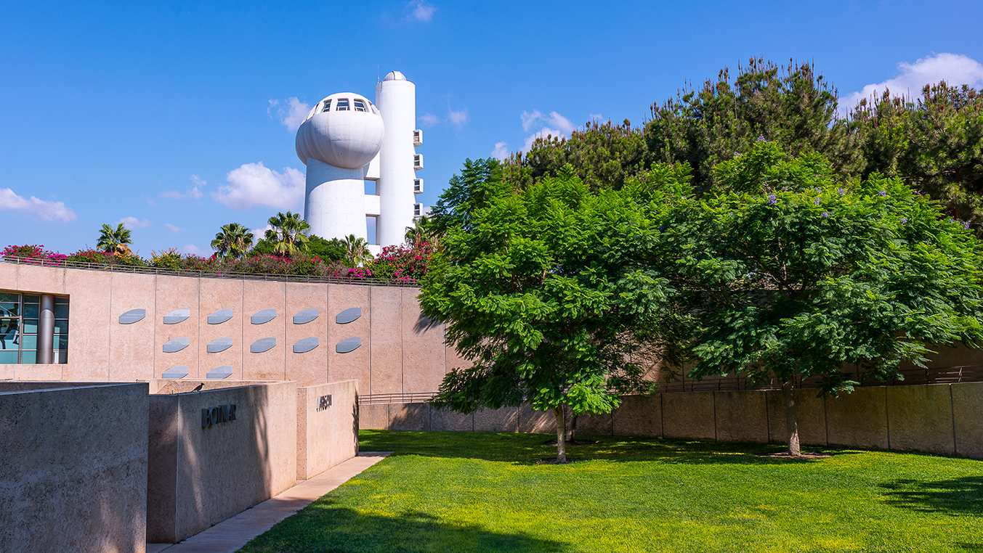

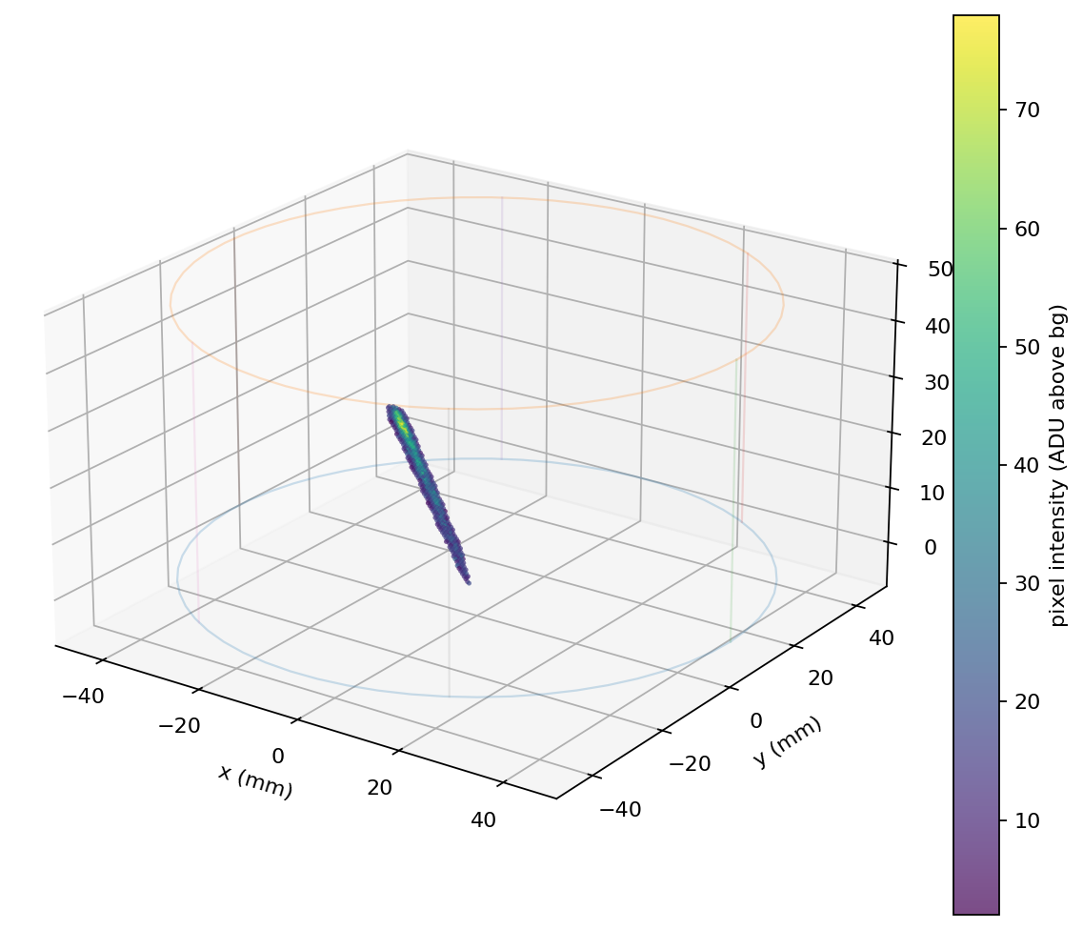
Thank you!

Slide 25
