Slide 1
TPC detector at SARAF
Motivation for TPC detector at SARAF
The proposed detector scheme
Specific cases for the first “easy” experiment

Slide 2
Reactions with the charged particles products
(n,p), (n,a), (n,d), (n,³He),(n,f)
Possible experimental schemes:
Passive activation: irradiation with consequent off-line activity measurement
work for some cases with appropriate reaction products
Solid State Nuclear Track Detectors: irradiation with consequent off-line processing
and track analysis
Charge particle detectors arays: large vacuum chamber, large detector array
Gas detectors: gas detector with thin target in active volume or gas as the target
(active target)
Off –line, “low-tech”
measurements
Advantages– high rate-
close locations
On –line, “high-tech”
Measurements
Far distance locations
TOF beam lines

Slide 3
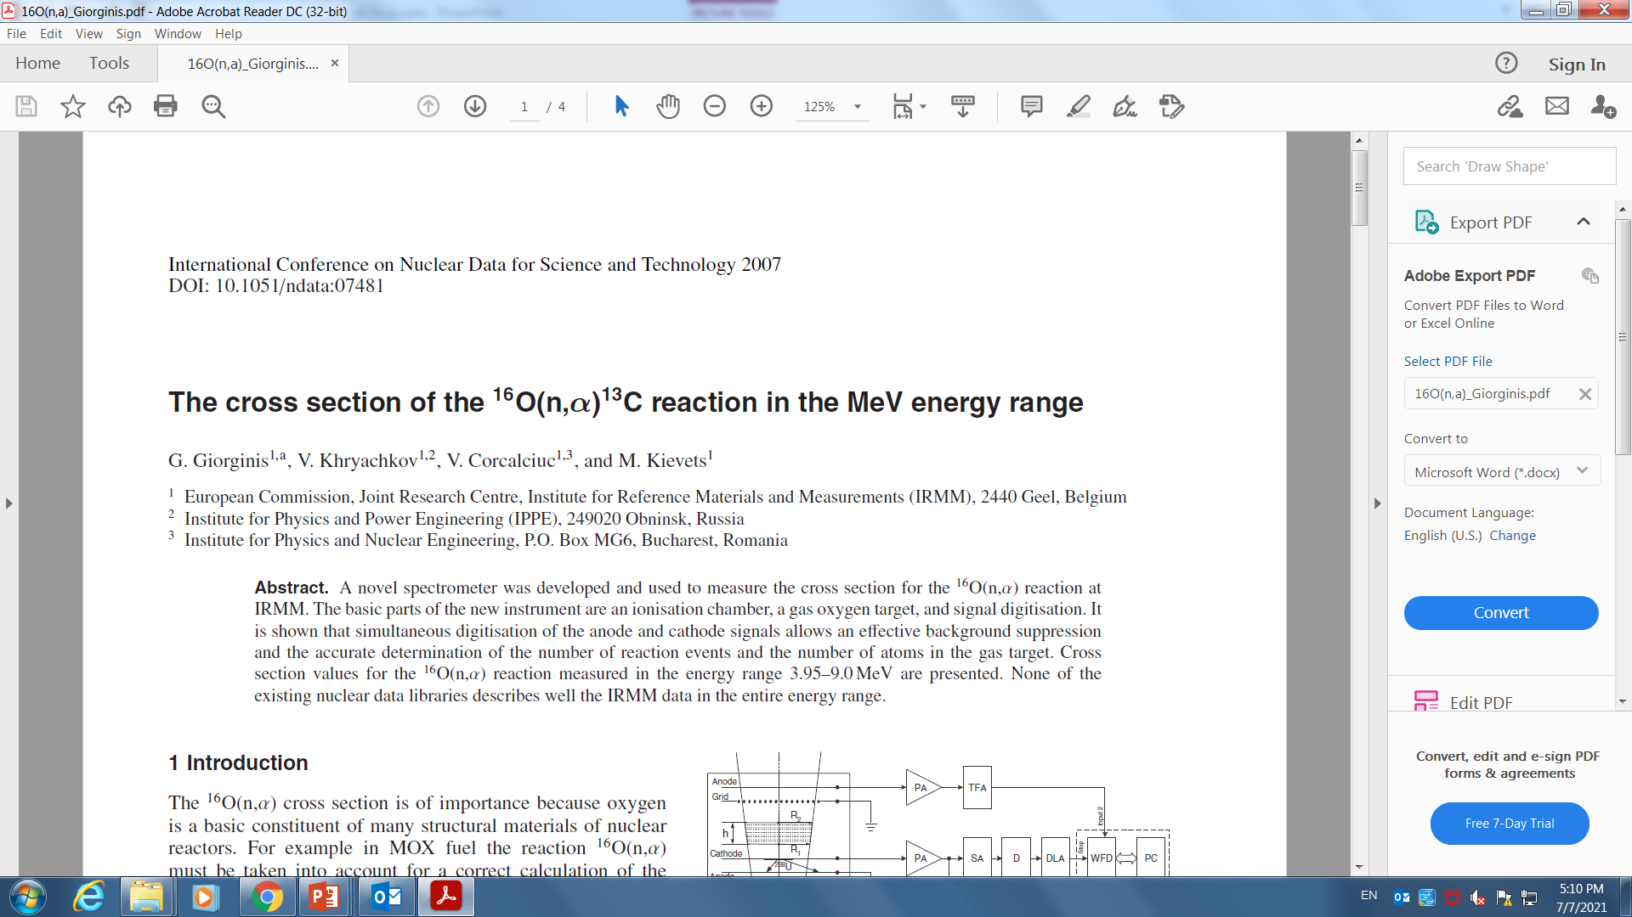
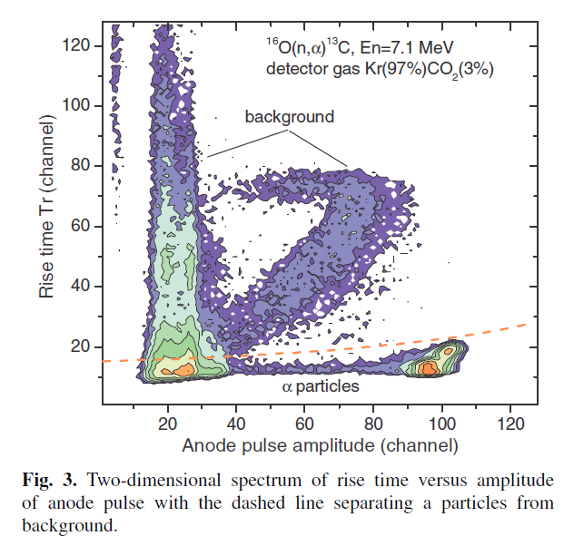
Example: Simple gas detector ¹⁶O(n,α)¹²C
Measurement of ¹²C(α,n)¹⁶O via reverse reaction ¹⁶O(n,α)¹²C (reciprocity)
Ionization chamber with oxygen rich gas (active target)
E_{n} E_{α} E_{el.} _{Recoil}
7.1 2.3-4.7 0-1.5 very good signal to noise
2.5 0-0.25 0-0.6 at astrophysical relevant region
the signal will be buried in the noise
background
including ¹⁶O
from¹⁶O(n,el)
¹⁶O(n,α)
In this very important case, it is evident that
more sophisticated detector is required for the reaction
measurement at E_{n} <3 MeV measurement.

Slide 4
Time Projection Chamber gas detector
oxygen rich gas
oxygen rich gas
amplification gap
anode
readout anode
amplification gap
anode
readout anode
¹²C
¹⁶O
n
n
α
x
drift field
drift field
y
z
The detector readout provide the X-Y projection of the reaction tracks
The time collection provides the Z component
Advantages:
100 % efficiency
Complete 3D reconstruction of events
Relative simplicity and relative cost efficiency
Deep knowledge of gas properties:
drift velocities, survival rate, lateral diffusion, amplification process, fluorescence
amplification system
read out system

Slide 5
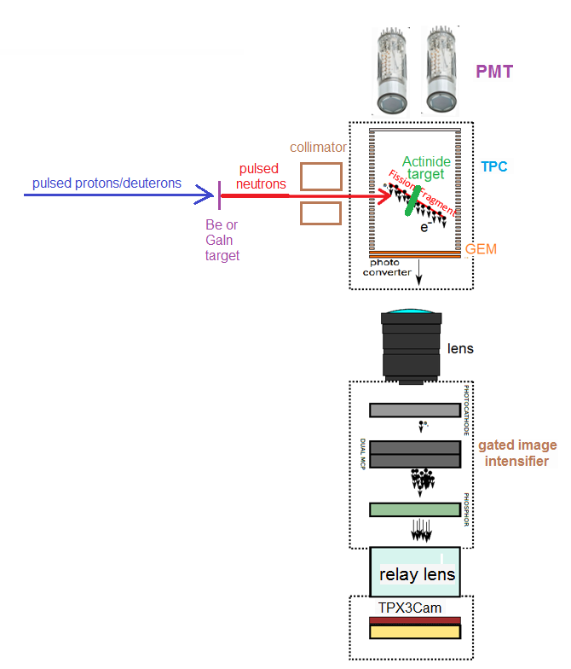
Experimental scheme at SARAF
fast PMTs,
primary light
cathode
production
target
shield/collimator
thin
target
proton
pulse
neutron
pulse
tracks target
drift
field
amplification gap/anode
secondary light
Optical readout system

Slide 6
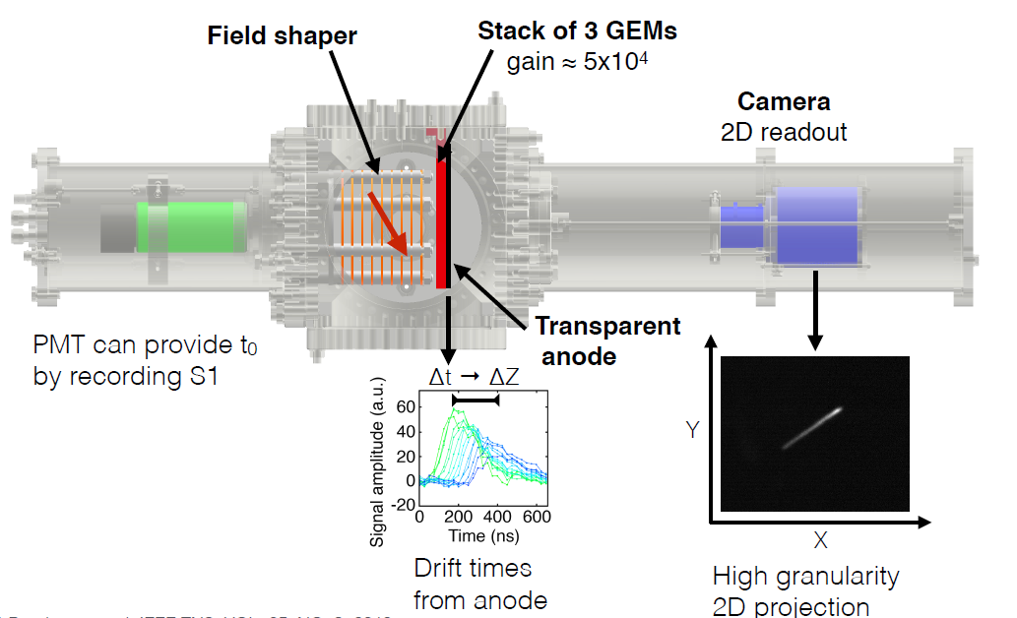
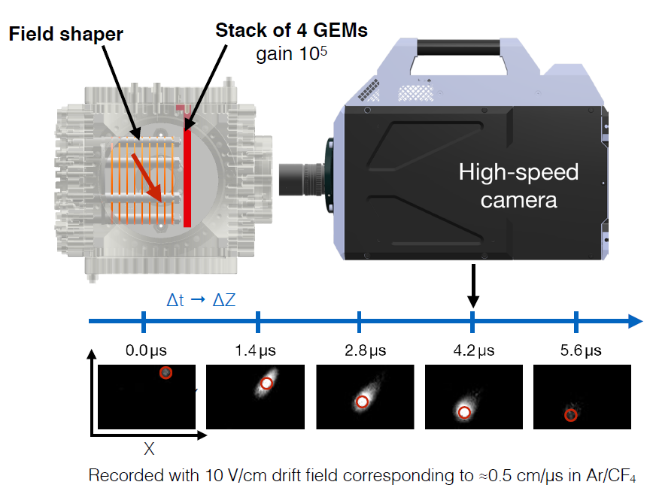
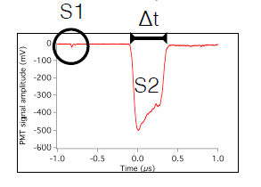
Fast TimePix cameras
Taken from F. Brunbauer presentation

Slide 7
The prospective experiments
Measurements0 | Neutron range | Motivations | Importance | Comment
⁷Be(n,α)α | Astrophysics | ⁷Li underproduction in Big Bang | Very High | Requires a thin radioactive ⁷Be target of high activity. Experimental background due to the target
¹⁷O(n,α)¹⁴C | Astrophysics | Bottleneck for heavy element synthesis in non standard big bang models | High | Possibility to use “active target” mode. Need enriched ¹⁷O gas
¹⁶O(n,α)¹³C | 3-5 MeV | Indirect measurement of ¹³C(α,n)¹⁶O – the main source of neutrons for S-process. Also understanding He production in nuclear fuel (High Priority Request) | Very High | Possibility to use “active target” mode
²⁵Mg(n,a)²²Ne |  | Indirect measurement of ²²Ne(α,n)²⁵Mg - source of stellar neutrons
²⁶Al(n,p)²⁶Mg ²⁶Al(n,α)²⁶Na | Astrophysics | Understanding of abundance of ²⁶Al, an important probe of stellar evolution | High | Need to obtained target with rare ²⁶Al isotope (PSI)
General (n,α) | 0.1-10 MeV | Study of stellar photodisintegration reaction (γ,α) via (n,α) | High
p(n,γ)d | Astrophysics | Big Bang first reaction | Very high | Important for epithermal neutrons
(n,f) | 0.01-10 MeV | Anisotropy in fission, some High Priority Request reactions | High | Require thin actinide targets

Slide 8
“Easy” cases for the first experiments
¹⁰B(n,α)⁷Li reaction
Thin enriched Boron target
¹⁰B(n,α)⁷Li is very well studied reaction up to 3 MeV
The cross-section is very high for low neutron energy: 3840 b for thermal, ~10 b for 10 keV, 2 b for 100 keV
Two final particles α and ⁷Li – unambiguous identification from tracks
Relatively high alpha α/⁷Li energy
The test with boron target will be used for understanding device in the whole operational range
Fission reactions
Thin actinide target
Energy arbitrage: fission products ~ 100 MeV>> elastic recoils energy
Fission cross-section is high > 1 b
Two final particles – unambiguous identification from tracks
It would be very beneficial to perform the first tests at with thermal
neutrons at Soreq research reactor

Slide 9
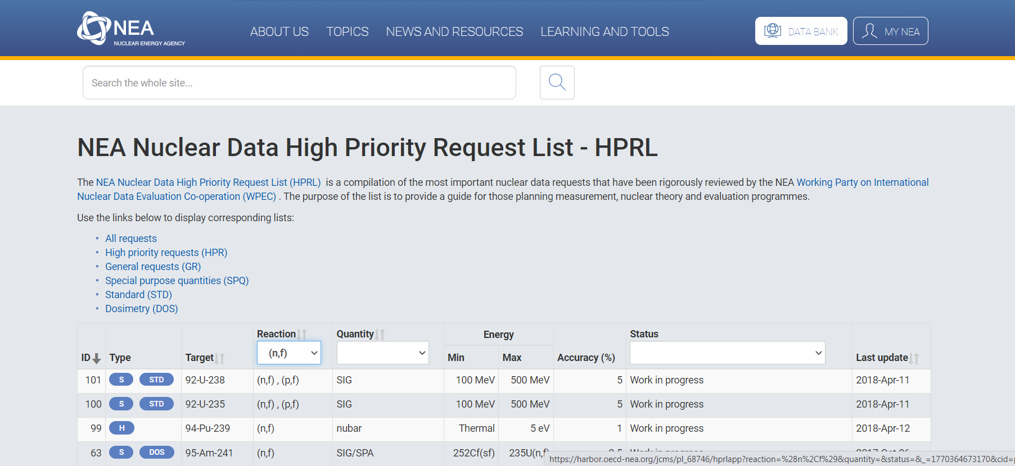
Interest in fission reaction data
Fission discovered in 1938
Is it still any interest in fission ?
Approximately 20 % of HPRL reactions are fission

Slide 10
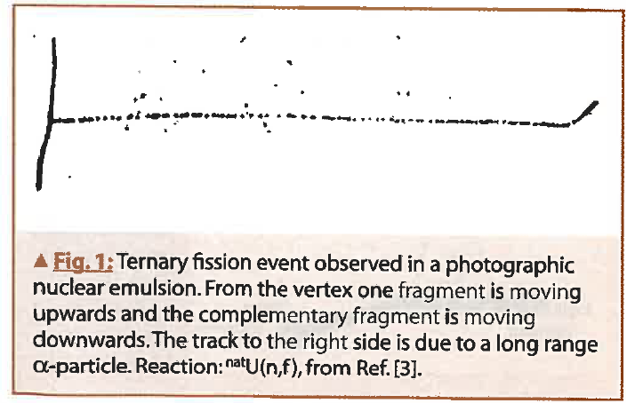
First reports on “exotic” fission events:
long-range alphas in 1947
Long Range Alpha (LRA)
Tsien San-Tsiang et al.,
Phys. Rev.71,382 (1947)
Experiments with photographic emulsion soaked with Uranium salts
After irradiations with neutrons exotic events are visualized
From the track it is concluded that light fragment is LRA
t/b ~ 2 10⁻³
LRA is emitted by ~ 90 deg, collinearity of heave fragment is slightly broken

Slide 11
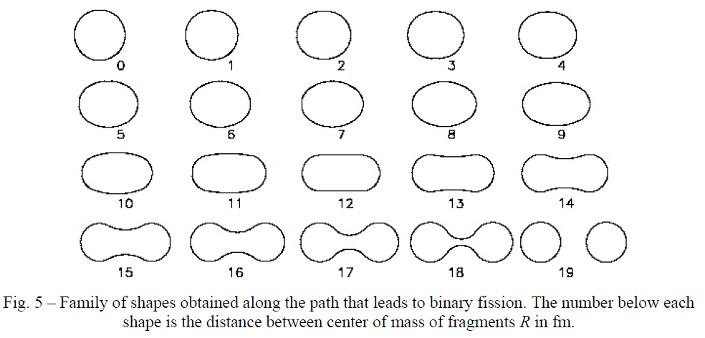
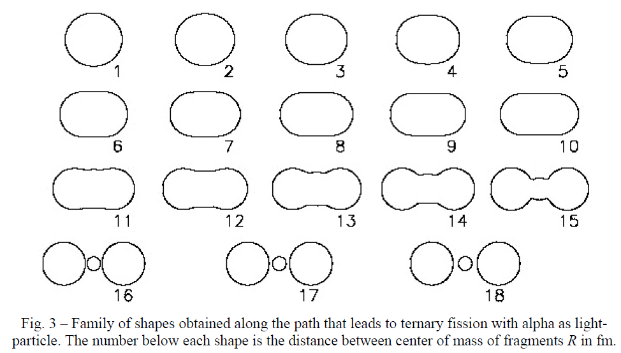
Naive picture
Binary fission
Ternary fission

Slide 12
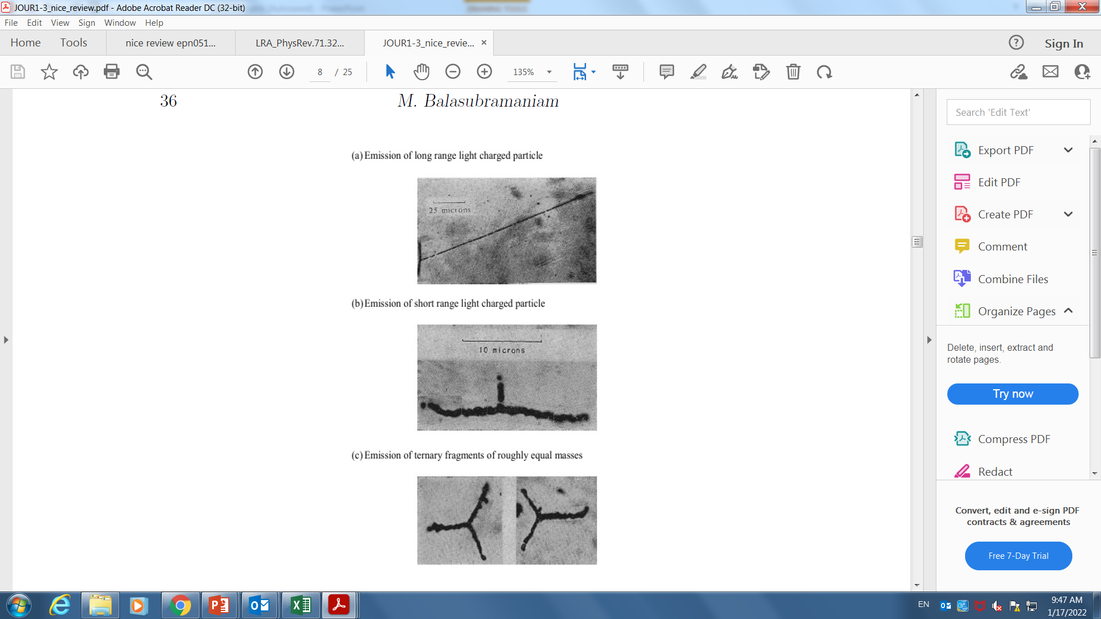
More exotic tracks
Ternary fission
with short range light particle
tripartition
Ternary fission
with roughly equal mass fragments
true ternary fission
Long range alpha
M. L. Muga al , Phys. Rev. 121 270 (1961) and others

Slide 13
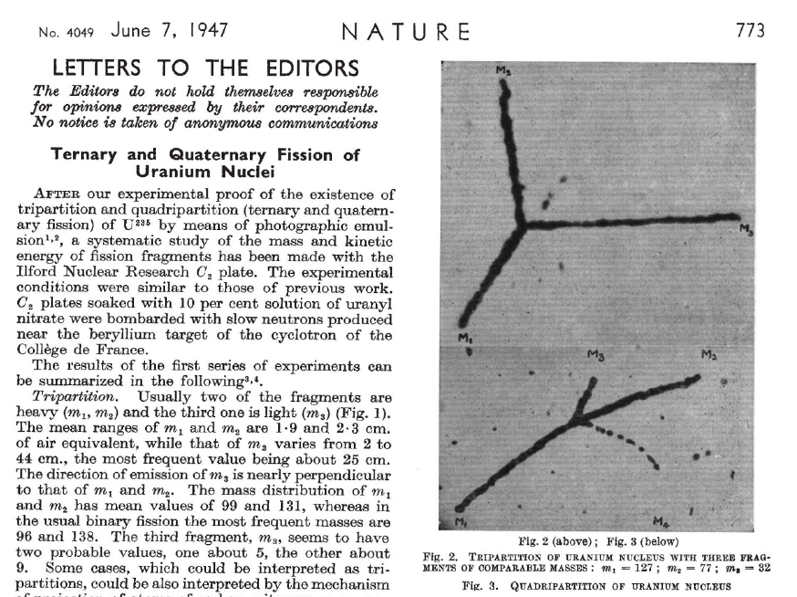
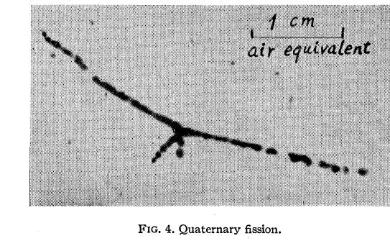
More exotic tracks (quaternary fission)
Tsien San-Tsiang et al, Phys. Rev 1947
Tsien San-Tsiang et al, Nature 1947
Some evidence on quaternary fissions tracks in the pioneering papers from 1947
The ratio of exotic to binary events t/b ~ 3 10⁻³, q/b~ 3 10⁻⁴
In the later publication, much lower ratios t/b <10⁻⁵, q/b< 10⁻⁷

Slide 14
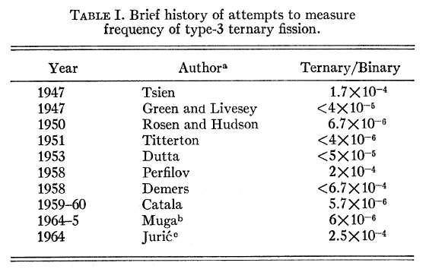
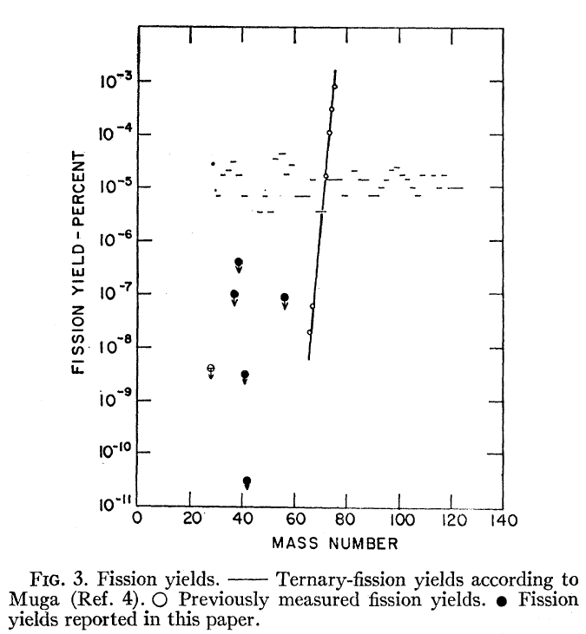
Discrepancy in the literature
Over two decades a few studies were done to obtain ratio of ternary to binary fission
These included experiments with nuclear emulsions , counting method (ionization chambers and solid state detectors)
and radiochemical methods
Reported large discrepancy in results over four orders of magnitude.
Example:
Stonner&Hilman, Phys. Rev 1966 –radiochemical measurements
compared to Muga, Phys. Rev. Lett. 1963 – counting experiment
Muga 1963
Stonner&Hilman 1966
upper limits

Slide 15
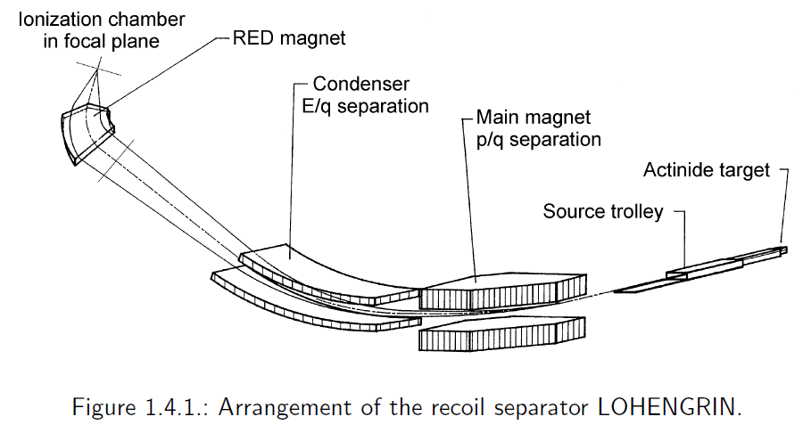
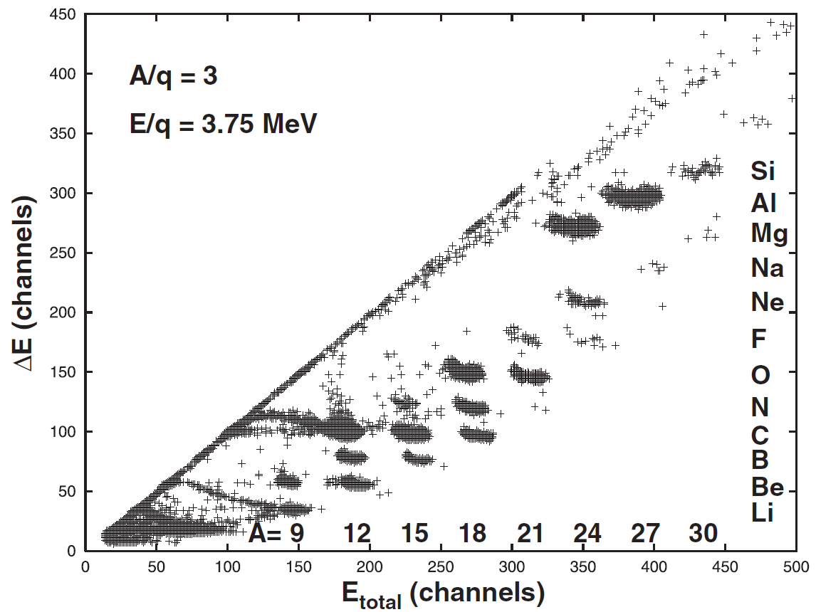
Measurements at ILL reactor (Grenoble)
5 10¹⁴ n/cm²/s
Measure light products from neutron-induced fission
Consider these nuclei as a product of ternary fission

Slide 16
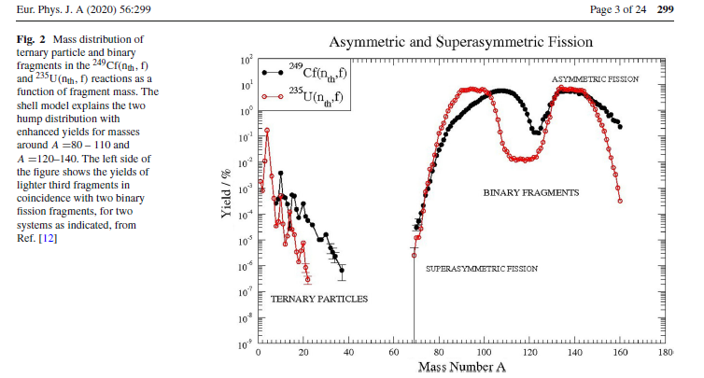
ILL results ternary fission
Von Oertzen &Nasirov

Slide 17
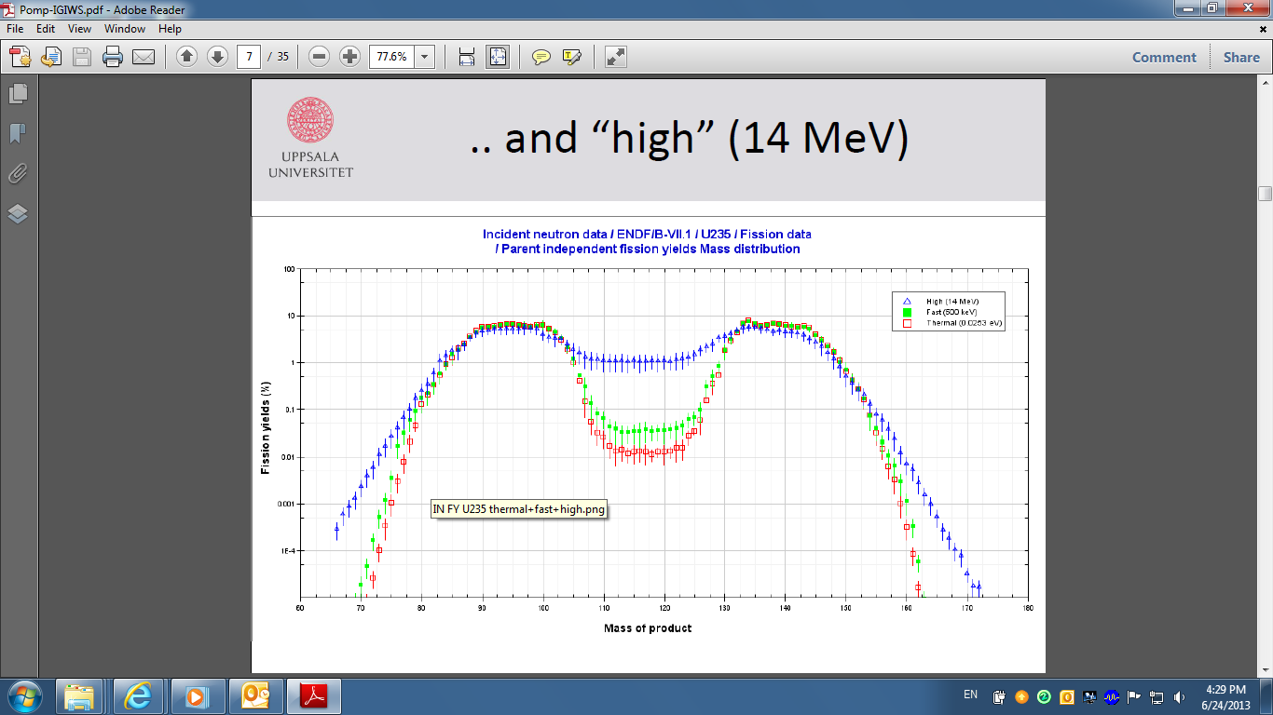
Fission spectrum as a function of neutron energy

Slide 18
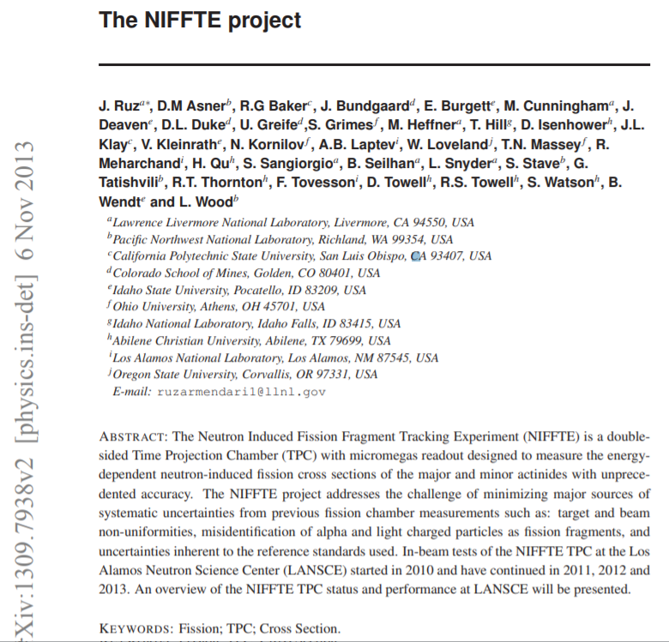
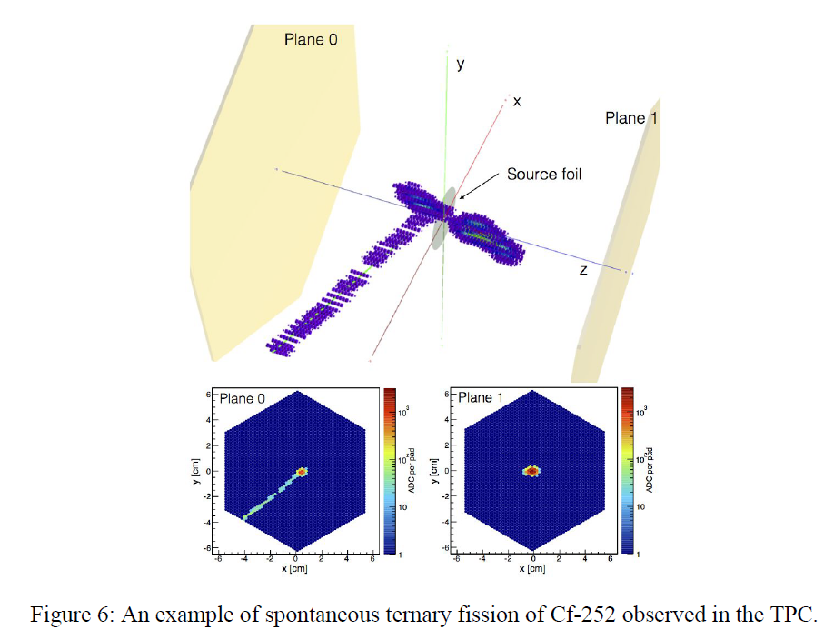
Other people also look into it
Only one image of ternary fission event taken by a modern
detector found in the literature

Slide 19
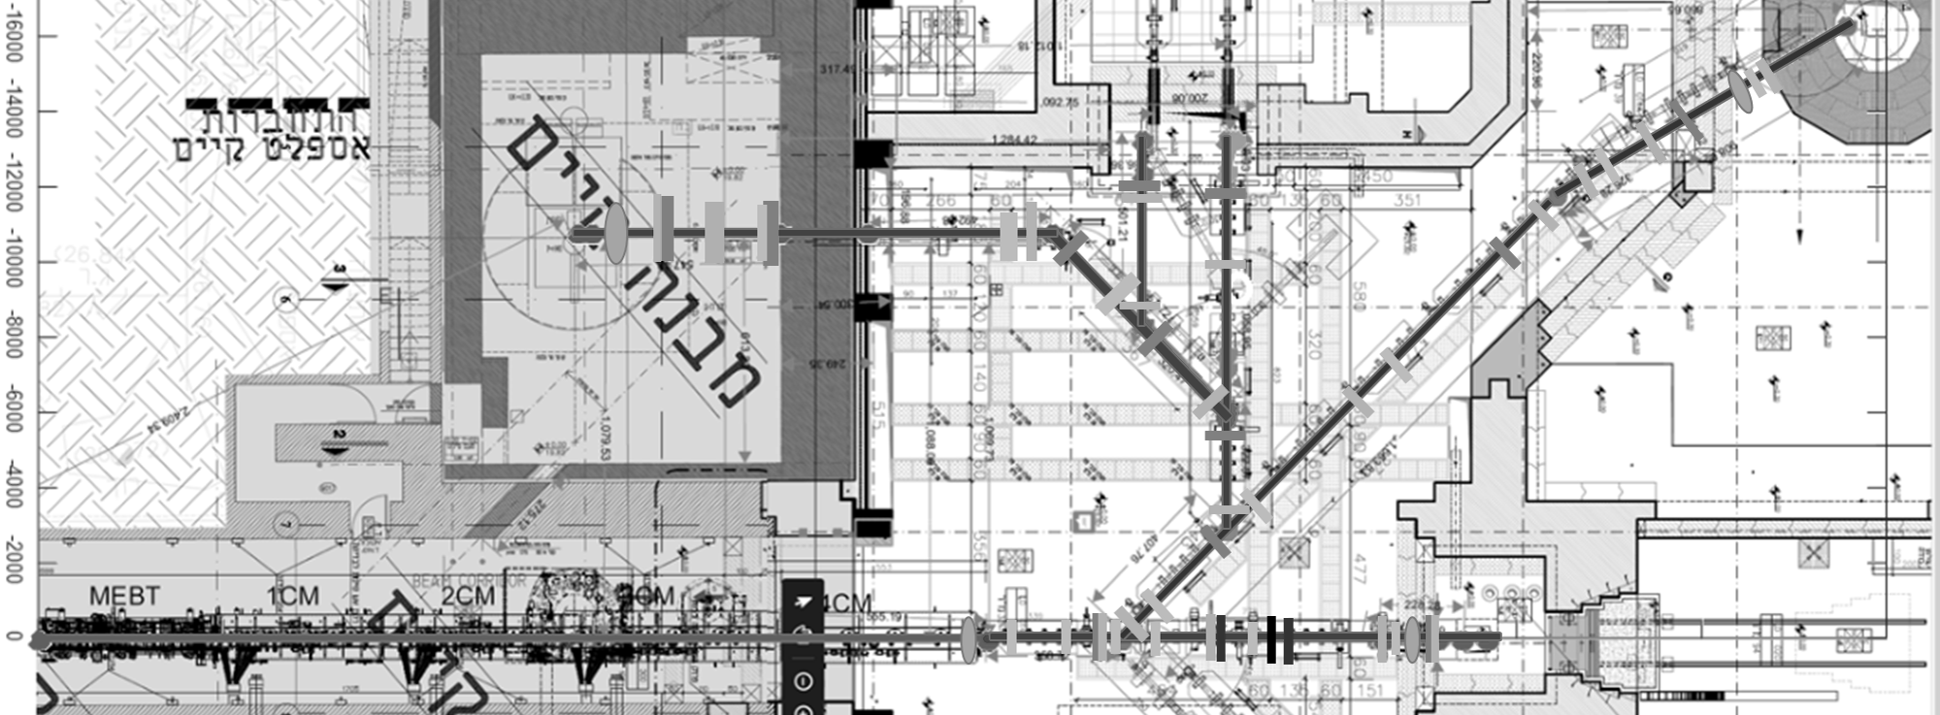
Location for experiment
TOF
GALIT

Slide 20
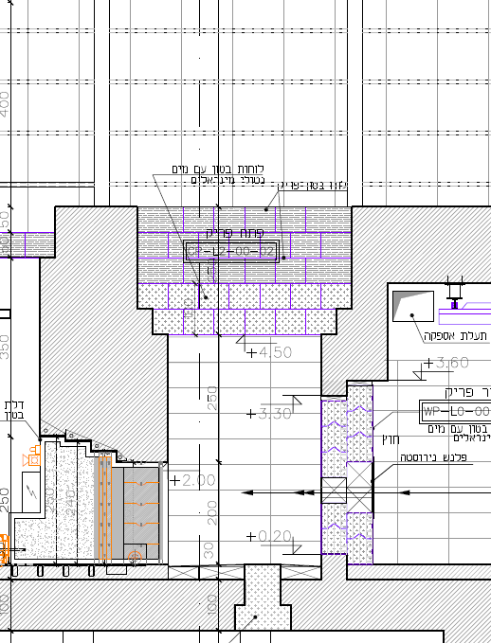
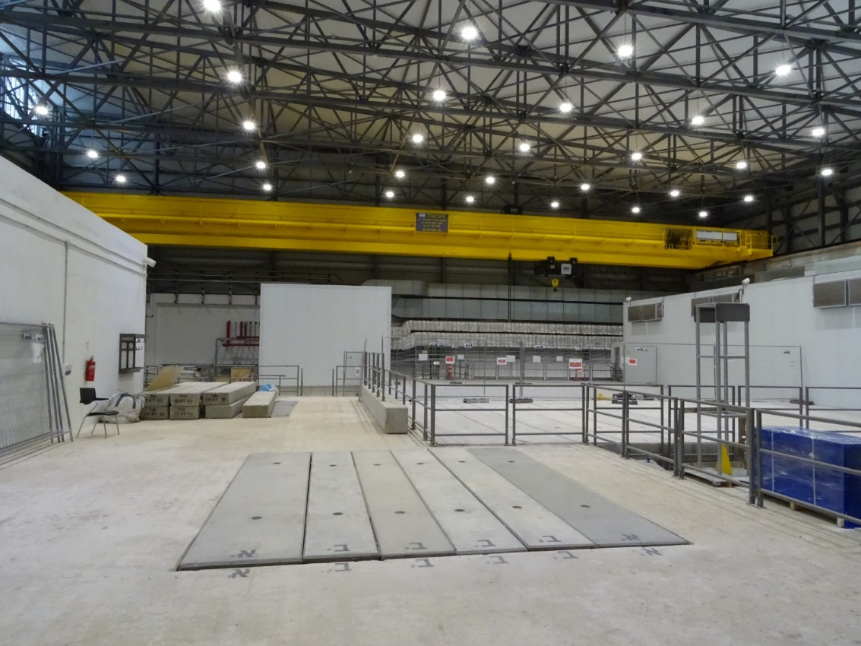
GALIT beam dump: neutron source
Neutrons go to sky – long range many 10s -100 meters
Low neutron scattering on the surrounding:
Good for experiments
Good for radiation safety
No need for neutrons dumps
neutron line
BEAM

Slide 21
Fission experiments at different locations
Assumptions:
high quality fissile target: ~ 300 ug/cm² on thin carbon, 10¹⁸ atoms/cm²
1 barn fission cross-section
SARAF : “nominal” proton beam - 5 mA peak current, 35 MeV
Location | TOF thin target 10 m from the target | TOF thick target 10 m from the target | GALIT BD ~ 6 m from the target | Soreq reactor diffractometer line
Neutron spectrum | White spectrum | Epithermal | White spectrum | Thermal neutrons
Max Duty Cicle | 5 ·10⁻⁴ | 8 ·10⁻⁴ | 1 | Continuous beam
Max flux n/s/cm² | 10⁶ | 10⁴ | 10⁸ | 10⁴
Fissions (Hz) | ~10 | ~0.1 | ~1000 | ~0.1

Slide 22
Summary
TPC detector at SARAF significantly expand the spectrum of prospective measurements
at SARAF (n,p), (n,a), (n,d), n,t), (n,³He), (n,f) reactions
Neutron induced fission reaction – is an “easy” case for the detector commissioning
Exotic fission is the scientific bonus –
It would be very interesting observe ternary events (LRA, tripartition, true ternary)
Even more interesting quaternary event
After first observation one can consider possibility of systematic studies of
exotic fission modes
Possible locations: Soreq reactor – initial test debugging the detector, proof of principle
TOF beam lines – systematic studies, TOF experiments
GALIT – look into exotic fission modes

Slide 23
Spare slides

Slide 24
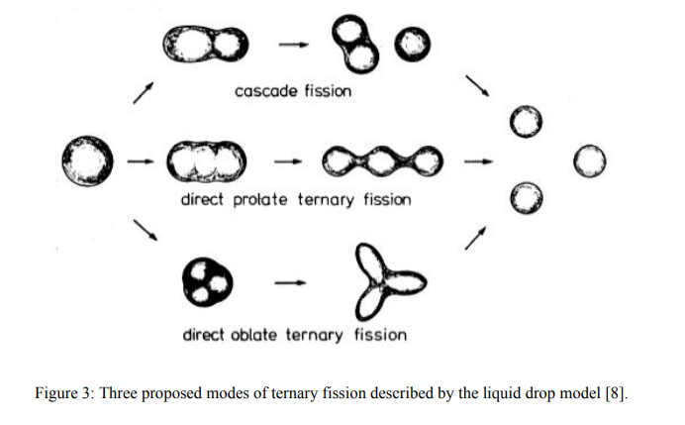
Herbert Diehl and Walter Greiner. Theory of ternary fission in the liquid drop model. Nuclear Physics A229 (1974) 29-46.

Slide 25
Fission experiment
Need to obtain high quality targets:
~ 300 ug/cm^2 on thin carbon
Taking 10¹⁸ atoms/cm² in target
10 n/cm²/burst neutron density in target
100 kHz burst rate (high rate mode)
1 barn fission cross-section
We obtain fission events rate of the order of 10 Hz
We estimate the rate of background to be ~ event/burst 100 kHz
There is a hope that 2-3 orders difference in energy would allows
to suppress the background
The best case would be fissile target (fission at En<<1 MeV), so low
energy neutrons could be used. This is further increase the
difference between signal and background

Slide 26
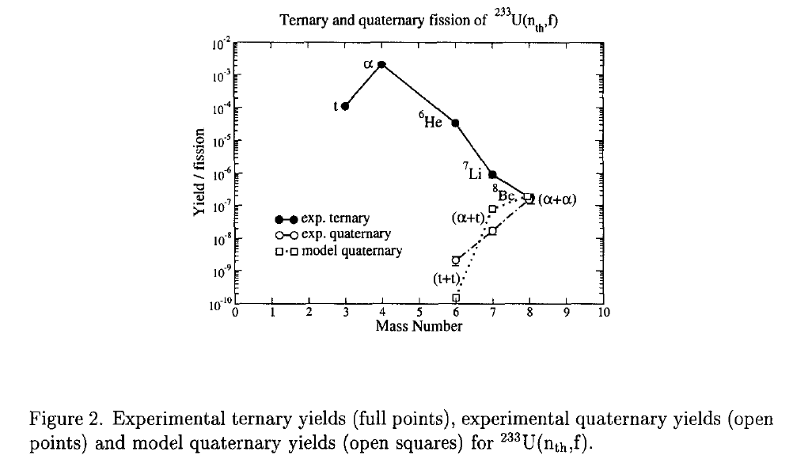
ILL results, quaternary fission
Experiment :
Actinide target
Cold neutrons beam
Two multiwire chambers and PIN diodes array
for multiparticle coincidences
Observed:
Ternary events
Quaternary events involving:
t+t - 10⁻⁹/f
α+t - 10⁻⁸/f
α+α – 10⁻⁷/f
Difficulty to distinguish between simultaneous (or “true”) and sequential
(or “pseudo”) quaternary decays.
R. Hentschel et al., Nucl. Phys. A 571 (1994) 427

Slide 27
Neutron induced charge particle measurements:(n,p), (n,α), (n,f)
Main requirement for a detector:
timing resolution (ns) for TOF use
ability to work at high pulse frequency (200 kHz, potentially 1 MHz)
reasonable energy resolution (< 50 keV)
high detection efficiency for charge particles (>50 %)
low background sensitivity (elastic scattering, (n,p), (n,α) on detector material)
extraction information on reaction kinematic
robustness and relative simplicity
cost effective
versatile
It seems there are two possibilities:
1. gas detector
2. segmented solid state detector array
For these proposal we consider the gas detector option only:
1. expertize of the WI group
2. gas detector seems to be the better option (not discussed here in details why)

Slide 28
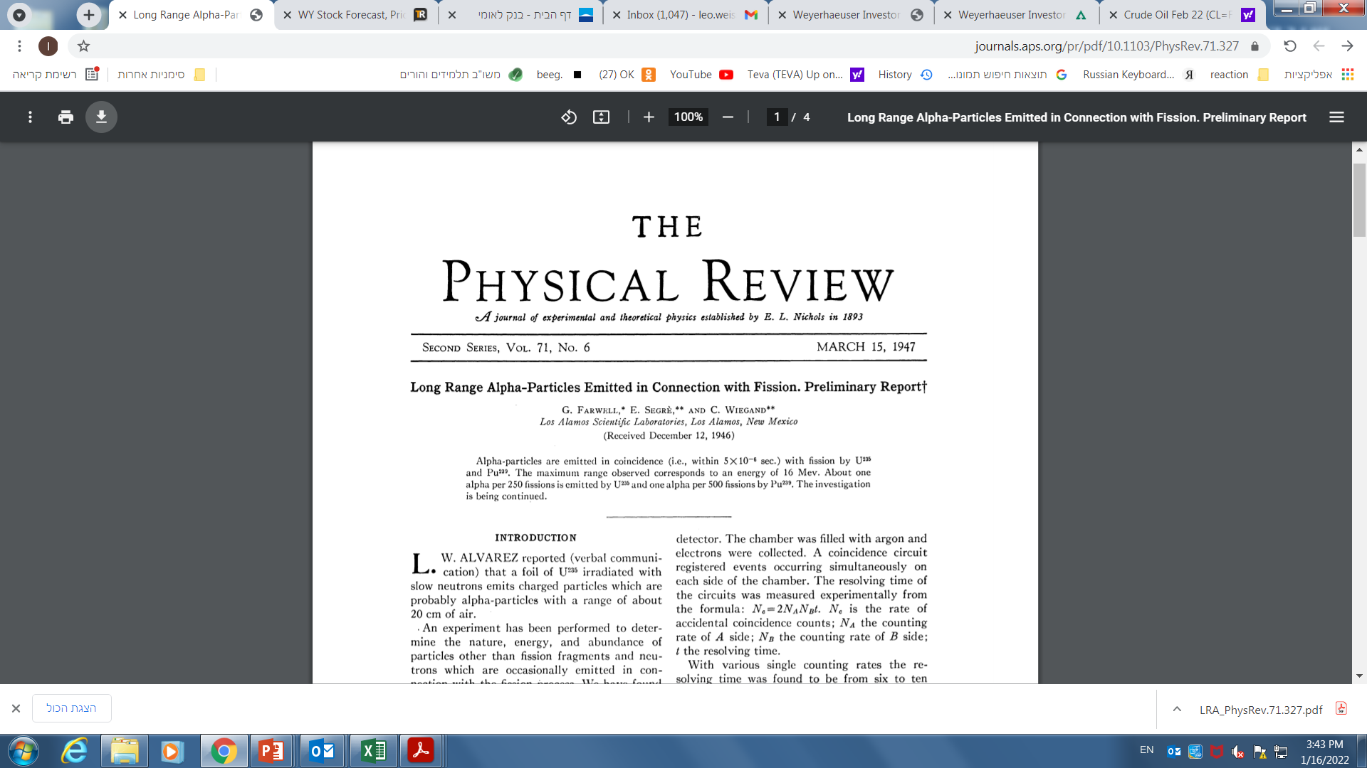
First reports on “exotic” fission events:
long-range alphas in 1947
Experiment with ionizing chamber
~ 16 MeV alphas detected from fissile target
irradiated by neutrons
Alphas from alpha decays chain (4-8 MeV) are blocked by absorbers
One long range alpha (LRA) per 250-500 fissions
(t/b)=2-4 10⁻³
Experiments with photographic emulsion soaked with Uranium salts
After irradiations with neutrons exotic events are visualized
From the track it is concluded that light fragment is LRA
t/b ~ 2 10⁻³
LRA is emitted by ~ 90 deg, collinearity of heave fragment is slightly broken
Tsien San-Tsiang et al., Phys. Rev.71,382 (1947)

Slide 29
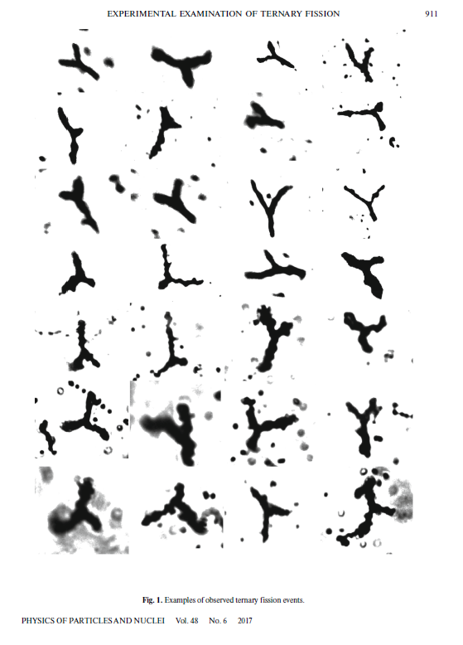
More exotic tracks from photographic emulsion soaked with fissile salt (U, Th)
M. L. Muga al , Phys. Rev. 121 270 (1961)
Some evidence on short range light particle
Some evidence on true ternary fissions (similar masses)

