Slide 1
Overview of SARAF
Israel Mardor
Soreq Nuclear Research Center
Joint SARAF & WIS TPC Mini-Workshop
Weizmann Institute of Science, 19/02/2026

Slide 2
SARAF –
Soreq Applied Research Accelerator Facility
To enlarge the experimental nuclear science infrastructure and promote research in Israel
To develop and produce radioisotopes for
bio-medical applications
To modernize the source of neutrons at Soreq and extend neutron-based research and applications
Notes:
2

Slide 3
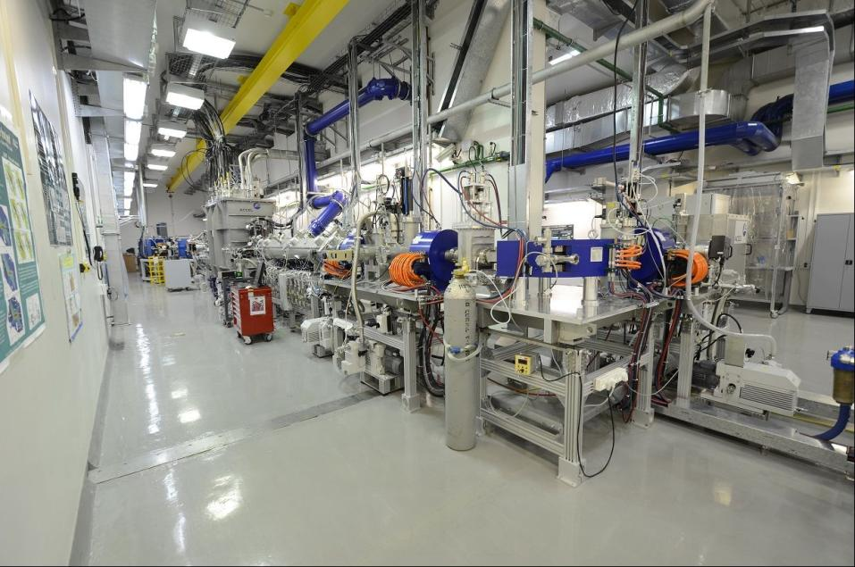
SARAF I 2010 - 2019
Commissioning
A. Nagler, Linac2006
K. Dunkel, PAC 2007
C. Piel, PAC 2007
C. Piel, EPAC 2008
A. Nagler, Linac 2008
J. Rodnizki, EPAC 2008
J. Rodnizki, HB 2008
I. Mardor, PAC 2009
A. Perry, SRF 2009
I. Mardor, SRF 2009
L. Weissman, DIPAC 2009
L. Weissman, Linac 2010
L. Weissman, JINST 2018
 | MeV | mA
p | 4 | 1 CW
p | 2 | 2 CW
d | 5.6 | 1*10%
d | 3 | 1.1 CW
Operation
D. Berkovits, Linac 2012
L. Weissman, RuPAC 2012
A. Kreisel, Linac 2014
L. Weissman, WAO 2014
L. Weissman, JINST 2014
L. Weissman, JINST 2015

Slide 4
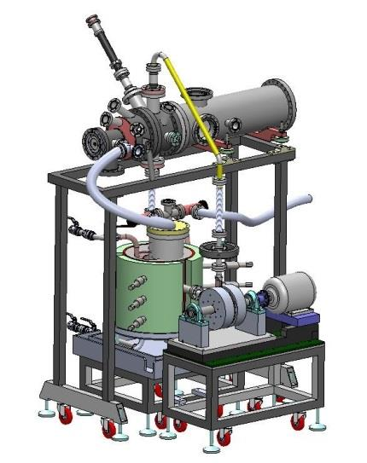
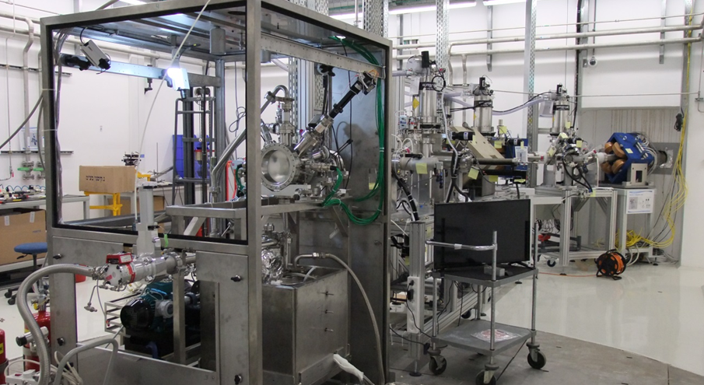
SARAF Phase-I compact neutron source
LiLiT technical reports
S. Halfon et al.:
ARI 69 (2011) 1654
AIP 1525 (2013) 511
RSI 84 (2013) 123507
RSI 85 (2014) 056105
ARI 88 (2014) 238
M. Paul et al.:
PoS (2014) 059
J. RNC (2015)
LiLiT 2.0
The Liquid Lithium jet Target LILIT
10¹⁰ – 10¹² n/sec

Slide 5
SARAF-I nucleosynthesis research program
status | Collaboration HU-SARAF- | Detection technique | Target
M. Tessler et al., PLB 751, 418 (2015) | - | spec | ^{nat}Zr(n,γ)
M. Tessler et al., PRC 105, 035801 (2022) | - | spec | ^{69,71}Ga(n,γ)
R. N. Sahoo et al., PRC 109, 025808 (2024) | - | spec | ^{nat}Ce(n,γ)
S. Pavetich et al., PRC 99, 015801 (2019) | Goethe U Frankfurt –Dresden-Rossendorf-ANU | γ spec + AMS | ²³Na^{35,37}Cl(n,γ)
Under analysis | ANU-ANL | AMS | ⁹²Zr(n,γ)
L. Weissman et al., PRC 96, 015802 (2017) | U. Seville | γ spec | ²⁰⁸Pb(n,γ)²⁰⁹Pb
A. Shor et al., PRC 96, 055805 (2017) | JRC IRMM Geel | α + β + γ spec | ²⁰⁹Bi(n,γ)^{210g}Bi
M. Tessler et al., PRC 104, 015806 (2021) | ANL - Goethe U - U. Bern | γ + β spec + MOT atom trap | ^{78,80,84,86}Kr(n,γ)
M. Tessler et al., PRL 121, 112701 (2018) | ANL - Goethe U | AMS + γ spec | ^{36,38,40}Ar(n,γ)
C. Guerrero et al., PRL 125, 142701 (2020) | U. Seville-PSI-CERN | spec | ¹⁷¹Tm(n,γ)
C. Guerrero et al., PLB 797, 134809 (2019) | U. Seville-PSI-CERN | spec | ¹⁴⁷Pm(n,γ)
Benchmark and higher precision
Noble gases
Michael Paul, Hebrew University of Jerusalem
M. Paul et al.,
EPJA (2019) 55: 44
Radioactive
targets
Notes:
5

Slide 6
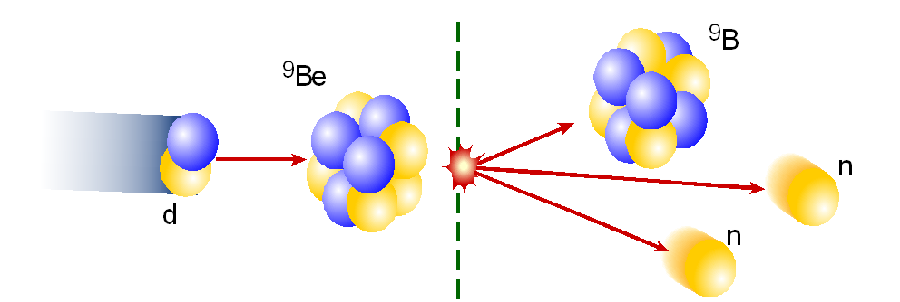
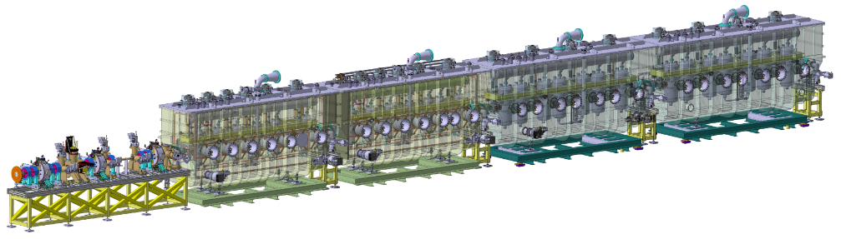

SARAF II – A Superconducting Versatile LINAC
Parameter | Value | Comment
Ion Species | Protons/Deuterons | α, M/q ≤ 2
Energy Range | 1.3(2.6) – 35(40) MeV | p(d), Variable energy
Energy Spread | ~60 keV r.m.s. | At 40 MeV
Current Range | 10 nA – 5 mA | CW (176 MHz)
Pulsed Mode | 0 – 200 kHz | Single 1 nsec pulses → variable macro-pulses
Beam Size | 1 mm – few cm | Transverse plane, 2D Gaussian
Emittance | 0.2 π∙mm∙mrad | Transverse
Maintenance | Hands-On | Very low beam loss
Up to 200 kW beam power
radiation and isotopes
target
2021
2020
2009 - 2019
3) applications
NEW lattice under construction
2) nuclear reaction
1) fast particles
Phase-II design
N. Pichoff et al., IPAC 2019
Phase-I finished operation in October 2019. It was built to test, characterize and prove the novel technologies

Slide 7
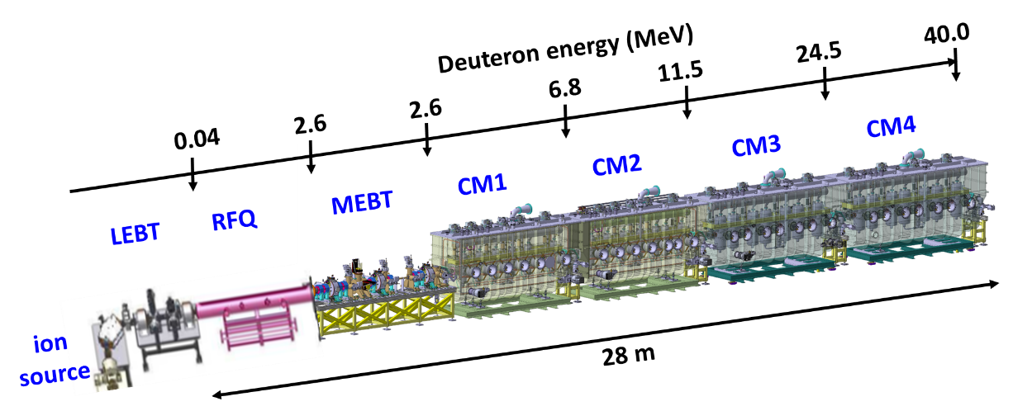
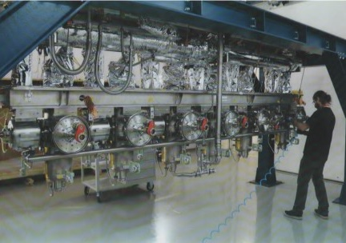

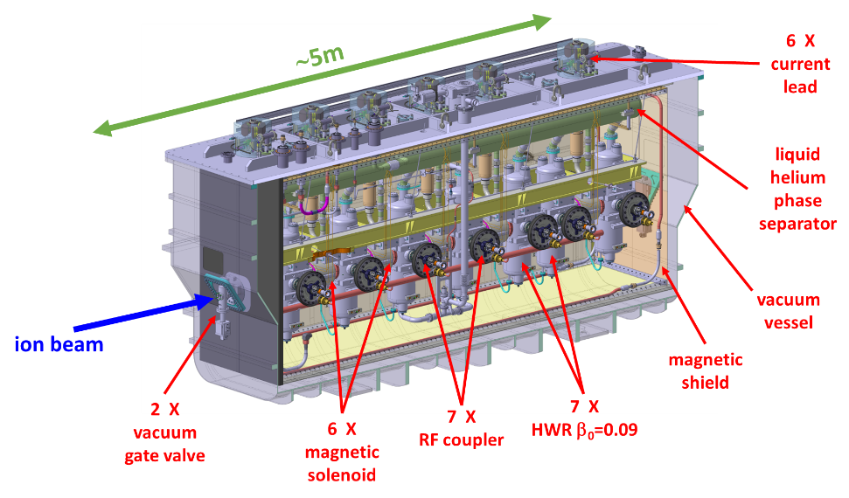
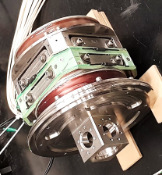
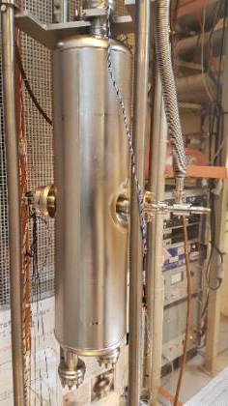
STATUS:
All CM’s are at SARAF
2 installed
2 being assembled
SARAF Phase-II Superconducting RF linac
N. Pichoff et al., IPAC 2018 and IPAC 2019
In operation since 2008
HWR ➔
⬅ Solenoid

Slide 8
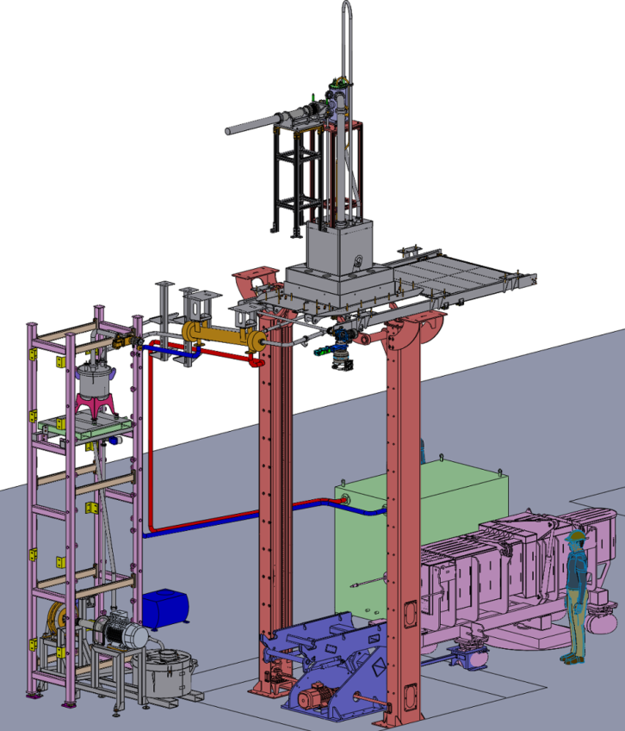
GaLiT
Galium Indium Liquid Target
Target chamber
Beam line
Target room
Ga-Oil heat exchanger
Lifting system
Oil-water heat exchanger
Ga tank
Basement
Ga pipes
Lead shielding for removing the system
Lead wall
EMP
Ga tank for maintains

Slide 9
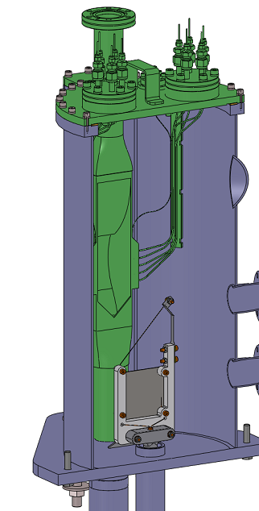
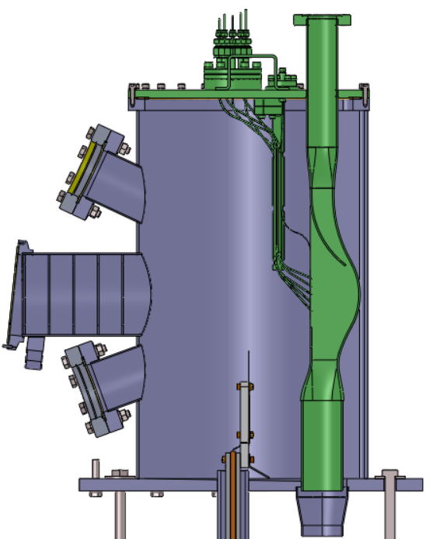
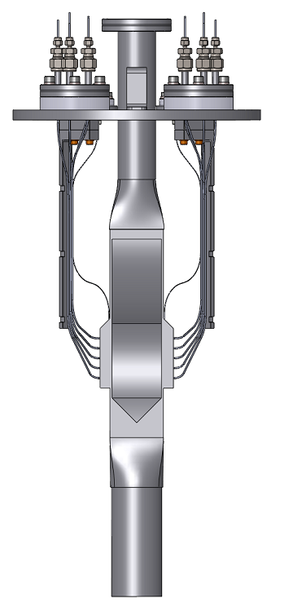
GaLiT chamber and nozzle
Thermocouples
View port
Ga Trap
Nozzle
Fiber optic
Thermocouples
Foil and Wire

Slide 10
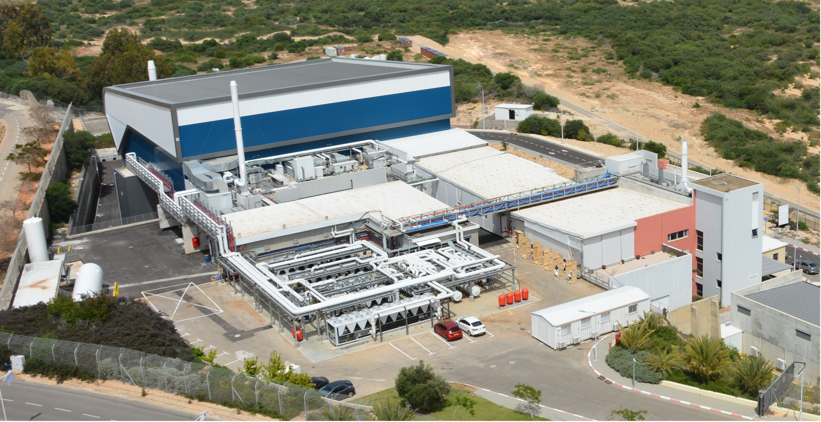
SARAF II – building
SARAF-I
SARAF-II
Nov. 11th, 2019
Notes:
10

Slide 11
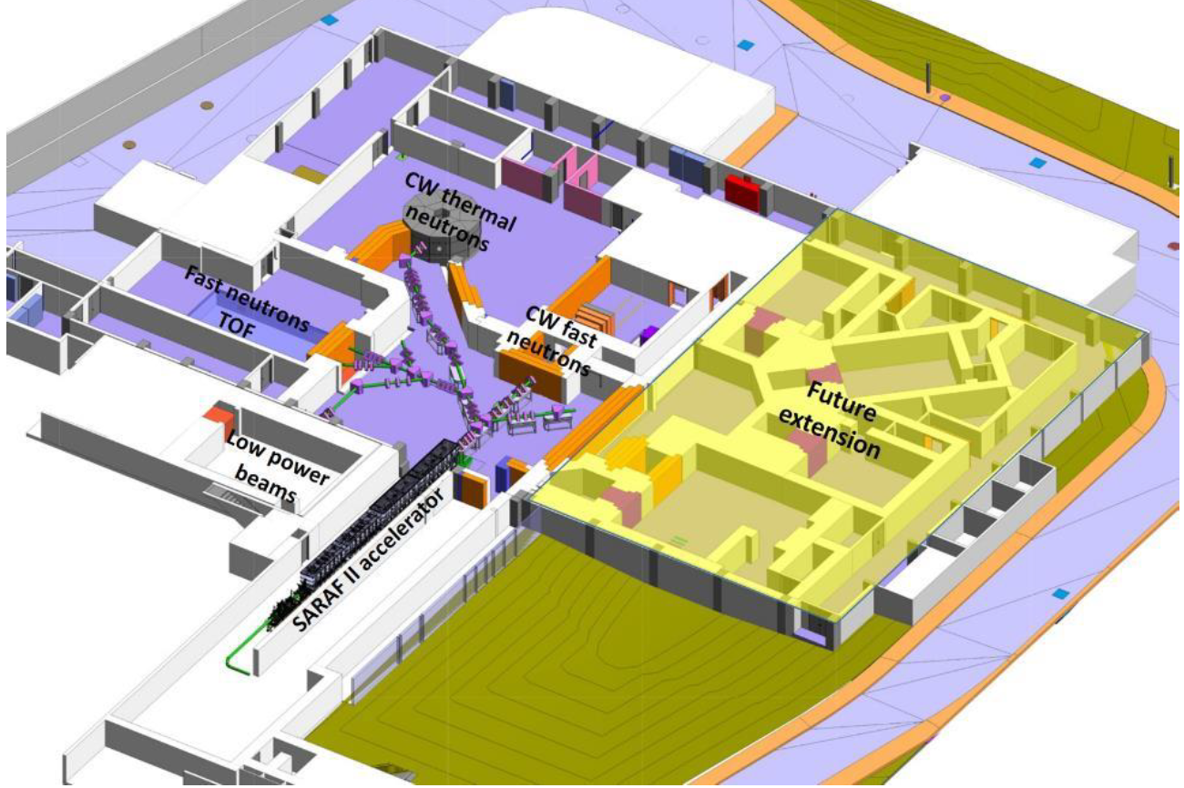
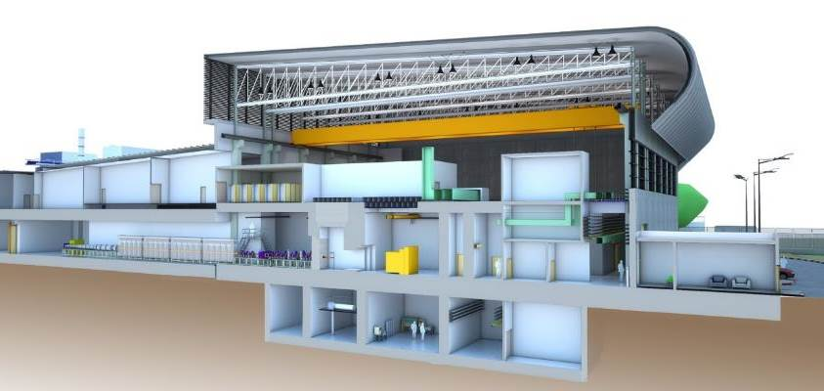
SARAF II – building
SARAF-I
SARAF-II
Nov. 11th, 2019
Notes:
11

Slide 12
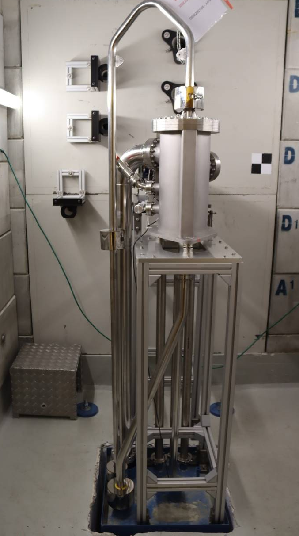
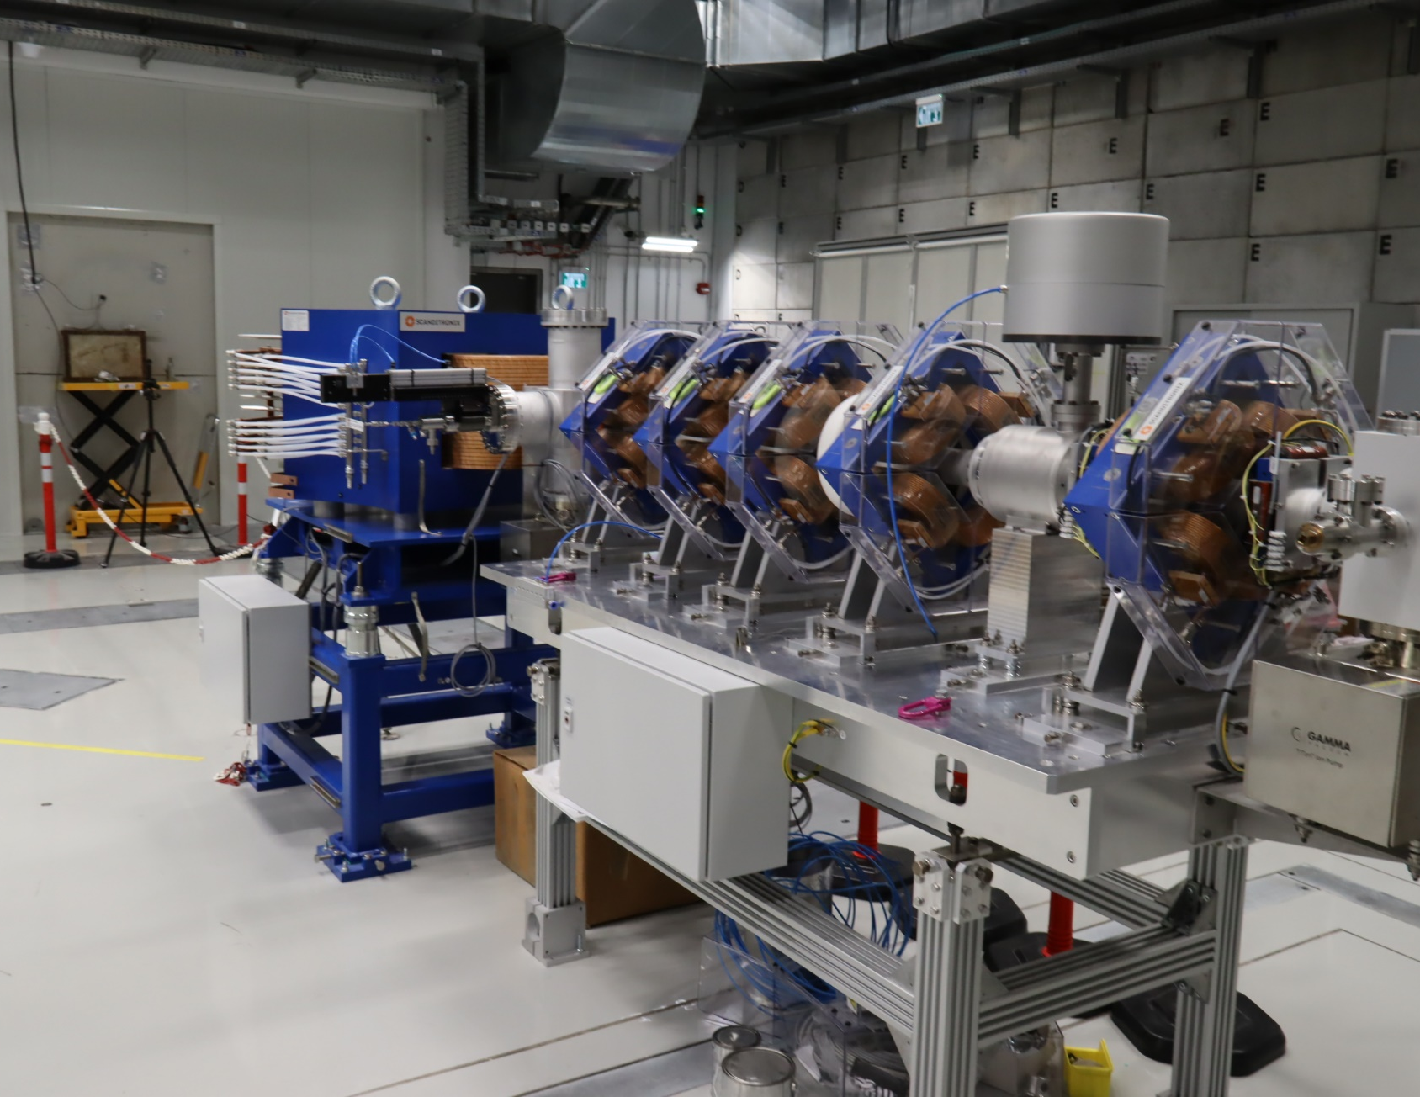
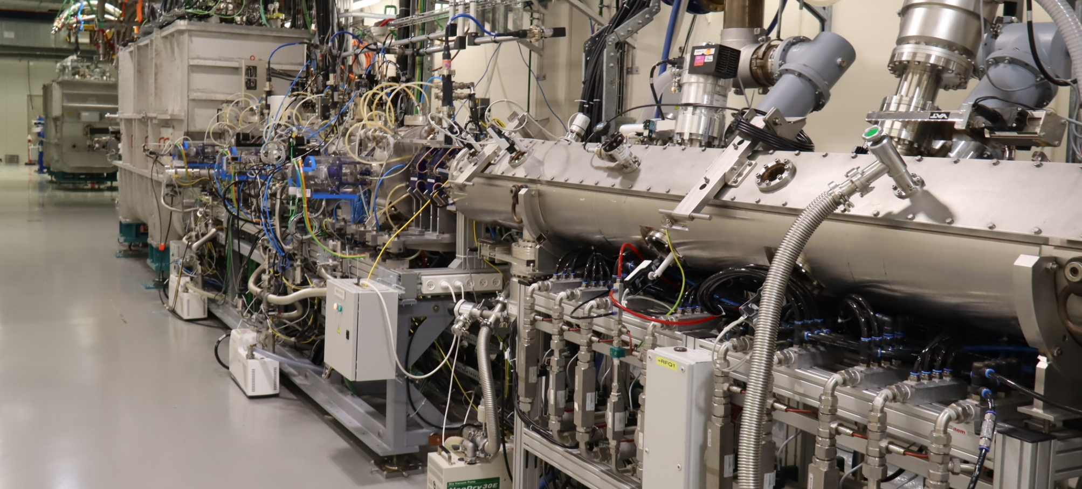
SARAF II – Installations on site
GaLiT
GaIn liquid target
Beam line #1
Accelerator
CM4
CM1
MEBT
RFQ

Slide 13
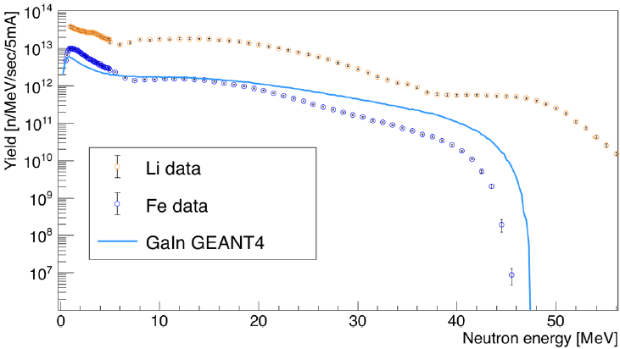
CW Fast Neutrons
Target | Liquid gallium-indium jet
Beam power | 200 kW CW (5 mA ∙ 40 MeV)
Maximum neutron yield | 10¹⁵ n/sec

Slide 14
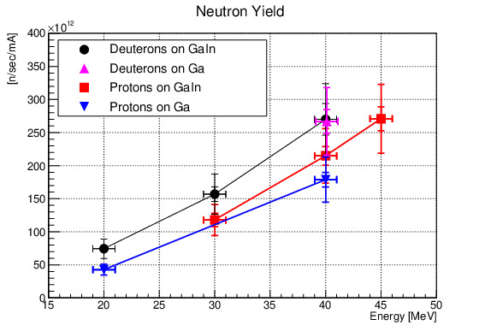
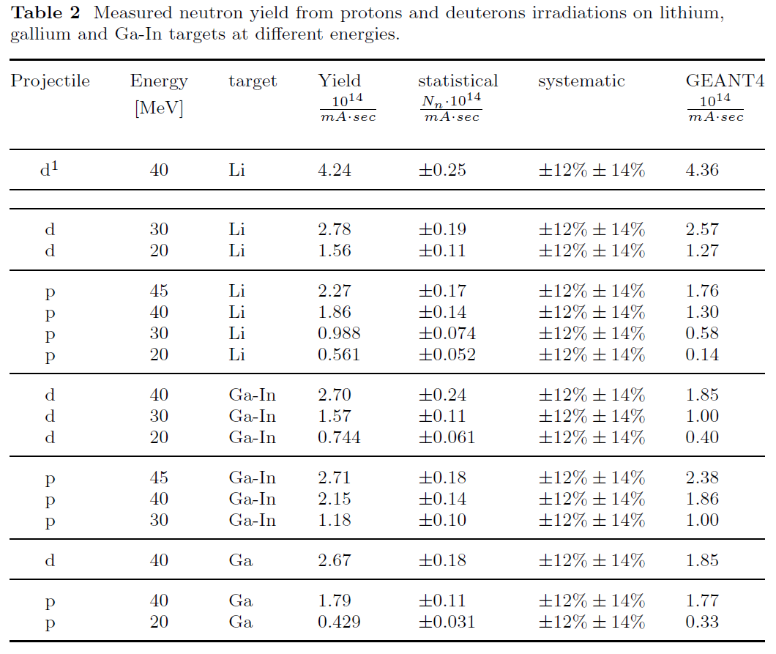
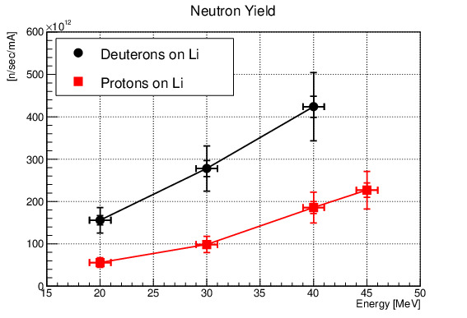
Neutron Yield results
A. Kreisel et al., Eur. Phys. J. A 59, 185 (2023)

Slide 15
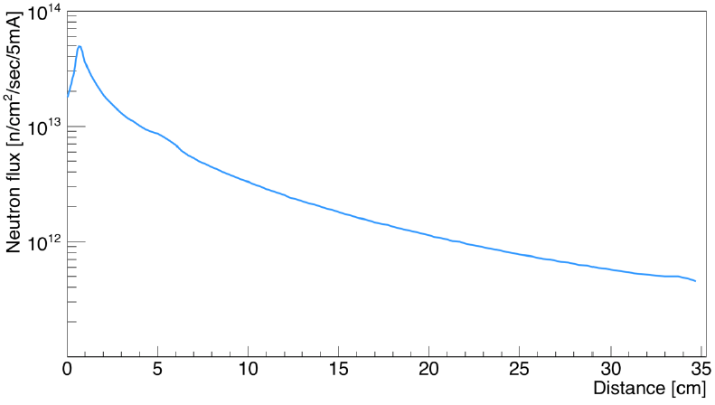
Neutron flux downstream of GaLiT target
FLUKA simulation of n flux from GaIn,
from 40 MeV deuterons at 5 mA
(normalized to measured yield), averaged over a 5×5 cm² area downstream of the target
Power density on GaIn target: ~2 kW/cm² (similar to IFMIF-DONES) on a
2 cm² spot
For highest flux, place sample of interest as close as possible to the neutron source
GaIn target location

Slide 16
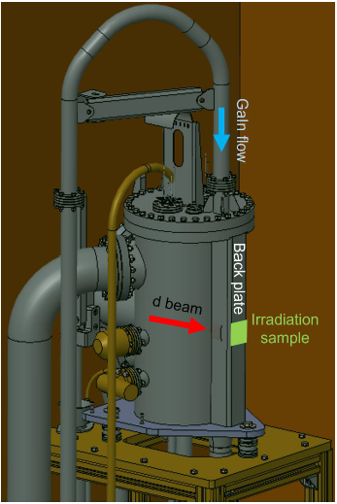
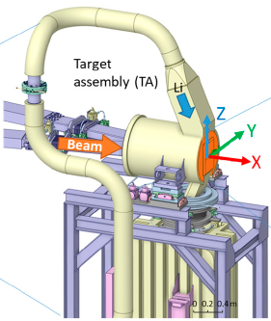
Neutron flux downstream of GaLiT target
Most efficient to place sample on target backplate
Distance from neutron source: ~1-2 cm
Flux at SARAF:
2-3×10¹³ n/cm²/s/5mA
Only ~1 order of magnitude less than IFMIF-DONES, for small samples
SARAF
IFMIF-DONES
Y. Qiu et al., Jour. Nucl. Eng. 3, 385 (2022)

Slide 17
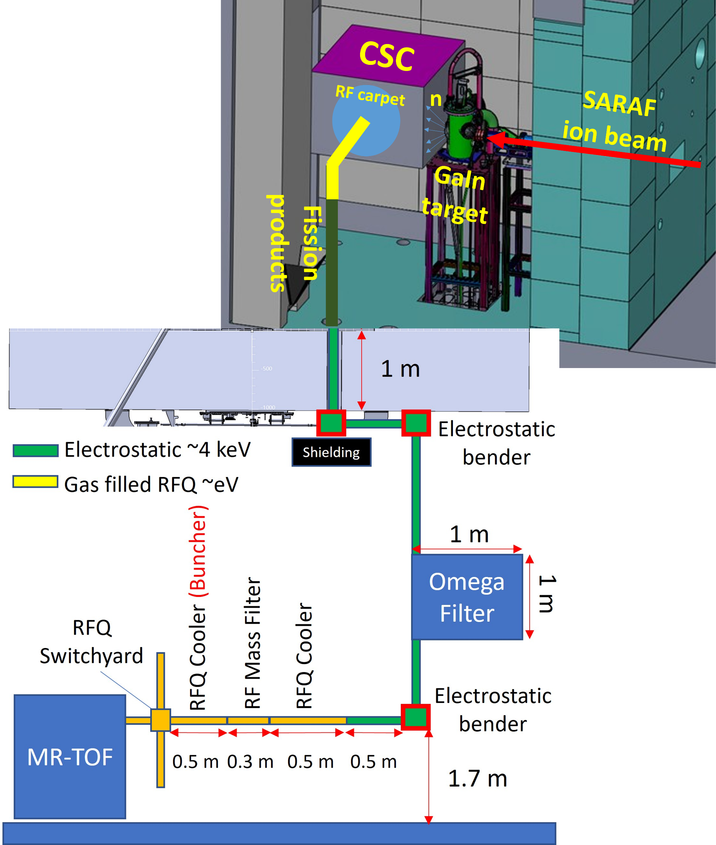
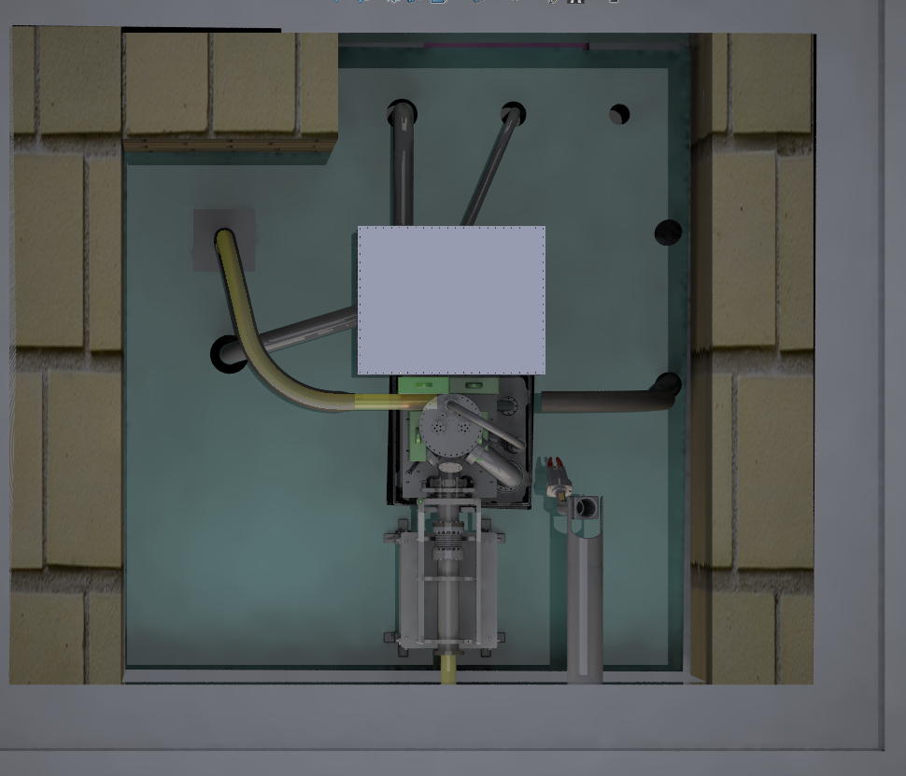
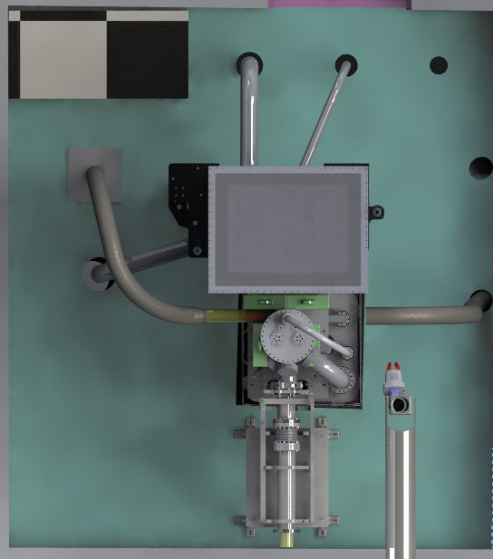
Research plans with CW fast neutrons
Beam dump room top view
Long irradiation pipe
CSC Vacuum
Cryogenic Stopping Cell (CSC)
CSC Beam line
Fast short irradiations (Rabbit)
GaLiT)
BL #1
Manipulator

Slide 18
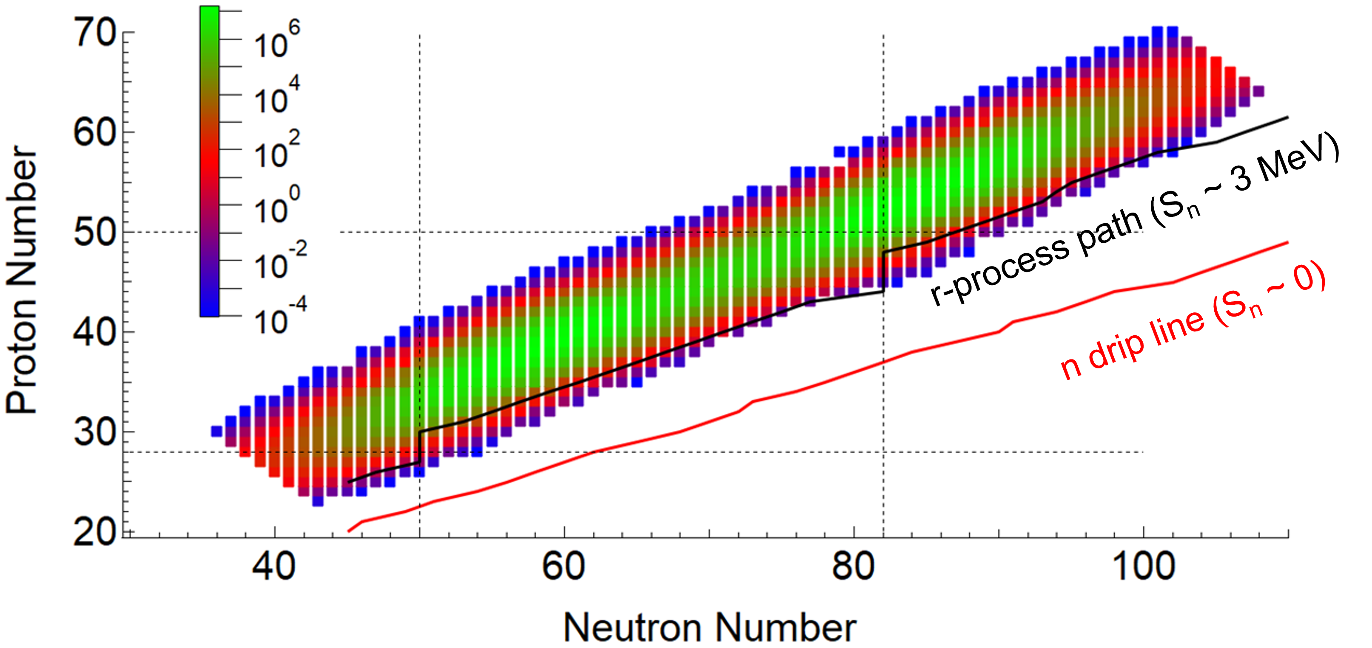
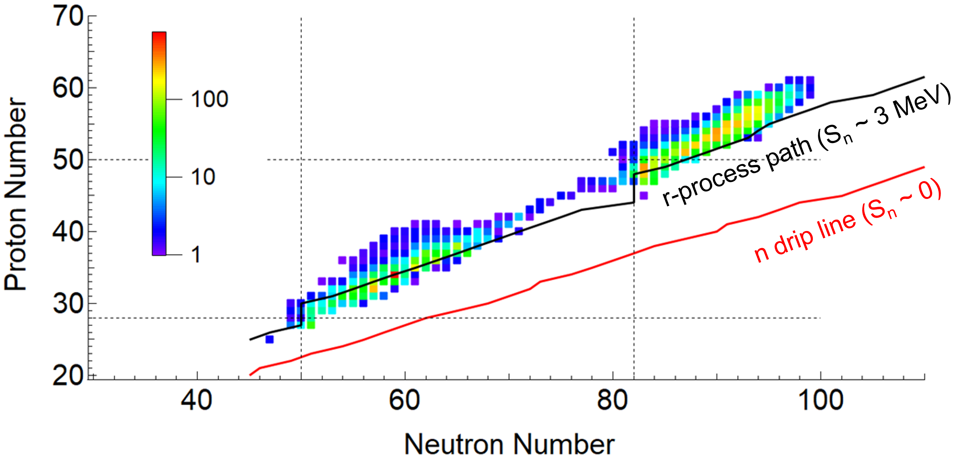
Expected Fission Product Yields
Expected separated fission product rates (FP/sec)
after the MR-TOF-MS
Ratio of SARAF II expected rates to FRIB

Slide 19
Thermal neutron source
Target | Liquid gallium-indium jet
Moderator | Light water
Reflector | Beryllium and polyethylene
Beam power | 200 kW CW (5 mA ∙ 40 MeV)
Thermal camera flux | 4×10⁵ n/cm²/sec at L/D=250
Diffractometer | ~10⁶ n/cm²/sec at exit port
Fast Internal irradiation station | Via pneumatic transfer, ~10¹² n/cm²/sec
Development port | ~10⁶ n/cm²/sec at exit port
Long internal irradiation station | ~10¹² n/cm²/sec

Slide 20
Time of Flight (ToF)
Targets | Solid Li or LiF
Average beam power | Up to 200 W (DC~10⁻³) (5 mA ∙ 40 MeV)
Beam structure | Down to 1 nsec bunches at 200 kHz
Neutron flight path length | 18 m
Epithermal neutrons
Moderator | Polyethylene
Neutron flux | ~10⁴ n/cm²/sec at 10 m from target
Fast neutrons - ‘white’ spectrum
Target thickness | ‘Thick’ target (~25 mm)
Neutron rate from at target | ~10¹² n/sec
Fast neutrons – quasi-mono-energetic
Target thickness | 1.5 mm
Ion beam | Protons up to ~30 MeV
Neutron spectrum | Ion beam energy ± 1 MeV (with low tail)
Neutron flux | ~10¹⁰ n/sec/sr

Slide 21
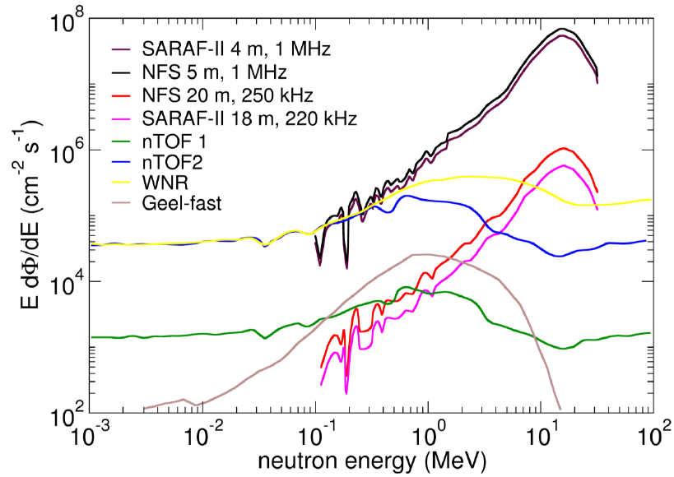
Neutron spectra comparison
SARAF, NFS:
Thick Li targets

Slide 22
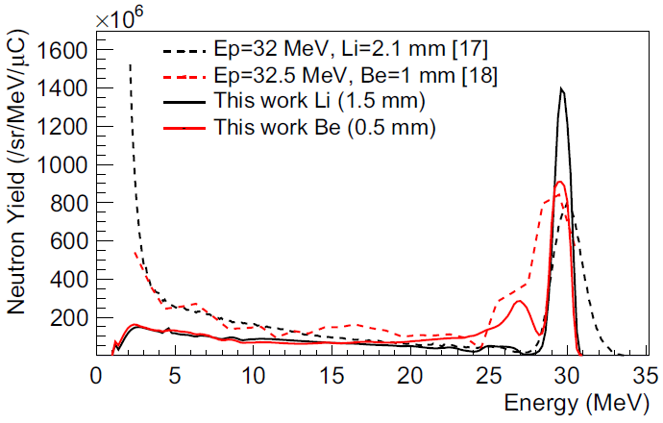
Neutron spectra comparison
Neutron spectra from
thin light targets at
NFS@SPIRAL2,
GANIL, France
NFS:
Neutrons For Science
X. Ledoux et al.,
First beams at neutrons for science
Eur. Phys. Jour. A 57:257 (2021)

Slide 23
ALEX target room
Target | Liquid lithium jet target (LiLiT 2.0)
Target thickness | 1.5 mm (suited for p/d of a few MeV)
Epithermal neutron rate | 10¹⁰ n/sec at 10’s keV
Fast neutron rate | 10¹² n/sec at a few MeV
    Additional future ideas under development for this area:
    A target station for isotope production
    Radiation damage studies via ion beams

Slide 24
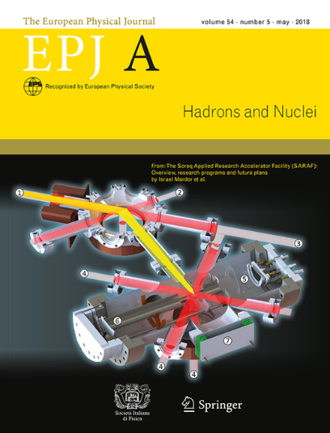
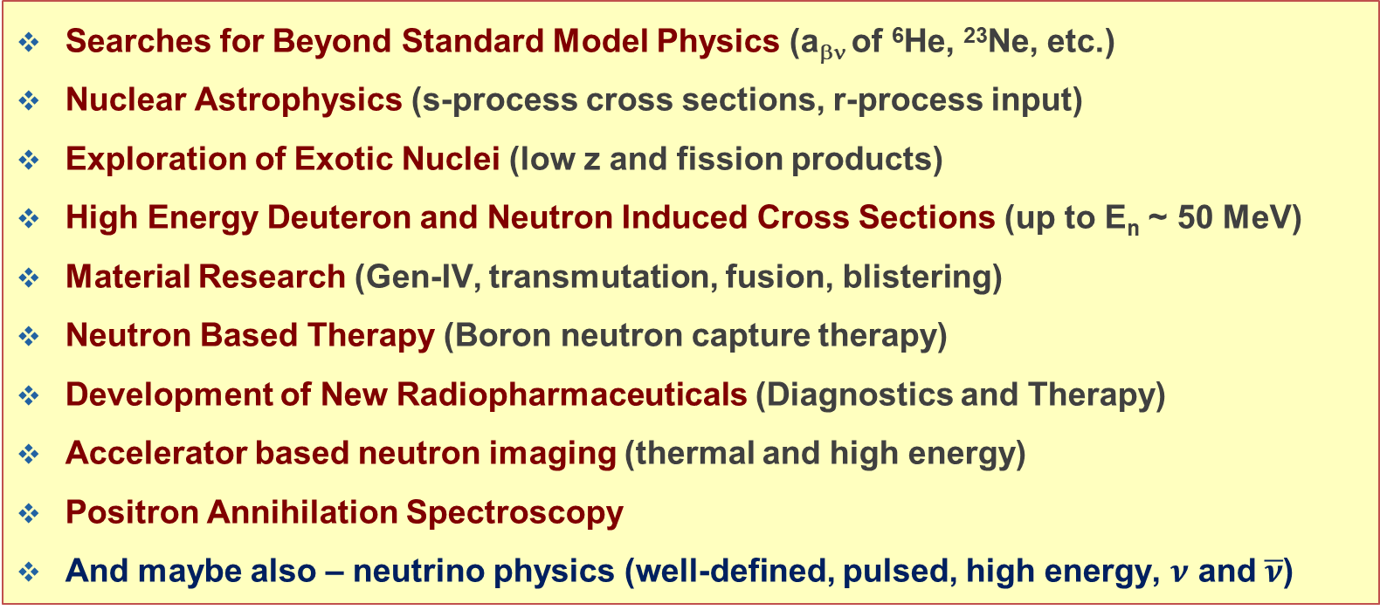
The Science at SARAF (Phases I, II)
Searches for Beyond Standard Model Physics (a_{βν} of ⁶He, ²³Ne, etc.)
Nuclear Astrophysics (s-process cross sections, r-process input)
Exploration of Exotic Nuclei (low z and fission products)
High Energy Deuteron and Neutron Induced Cross Sections (up to E_{n} ~ 50 MeV)
Material Research (Gen-IV, transmutation, fusion, blistering)
Neutron Based Therapy (Boron neutron capture therapy)
Development of New Radiopharmaceuticals (Diagnostics and Therapy)
Accelerator based neutron imaging (thermal and high energy)
Positron Annihilation Spectroscopy
And maybe also – neutrino physics (well-defined, pulsed, high energy, $ν$ and $\overline{ν}$)
I. Mardor et al.,
"Opportunities for high-energy neutron- and deuteron-induced measurements for fusion technology at the Soreq applied research accelerator facility (SARAF)",
Front. Phys. 11:1248191 (2023)
I. Mardor et al.,
"The Soreq Applied Research Accelerator Facility (SARAF) – Overview, Research Programs and Future Plans",
Eur. Phys. Jour. A 54, 98 (2018)

Slide 25
Summary and Outlook
Soreq NRC is constructing SARAF as a versatile facility for the communities of applied and basic research and development
Scientific programs g at SARAF I educated graduate students and generating scientific results that are published and presented in international conferences
The high current of SARAF II, with our high-power irradiation targets, may constitute a world competitive neutron facility at various beam structures and energies
SARAF II accelerator, beam lines 1,2 and two GaLiT targets to be installed in 2026
First thermal neutron images are planned for the end of 2027
Subsequent irradiation stations in the TOF hall are planned by the end of the decade
SARAF is open to new collaborators and contributions. We look forward to research proposals and letters of intent

