Slide 1

An Intense Antihydrogen Beam for Hyperfine Spectroscopy
75th Annual Meeting of the Austrian Physical Society
Victoria Kletzl-Teuffenbach,
on behalf of the ASACUSA collaboration

Slide 2

Where is all the antimatter?
Standard Model predicts same
amount of matter and antimatter
CPT symmetry is consequence of
Lorentz-invariant local quantum field
theory
CPT predicts identical absolute values
for matter and antimatter
AI generated

Slide 3

Where is all the antimatter?
Standard Model predicts same
amount of matter and antimatter
CPT symmetry is consequence of
Lorentz-invariant local quantum field
theory
CPT predicts identical absolute values
for matter and antimatter
AI generated

Slide 4
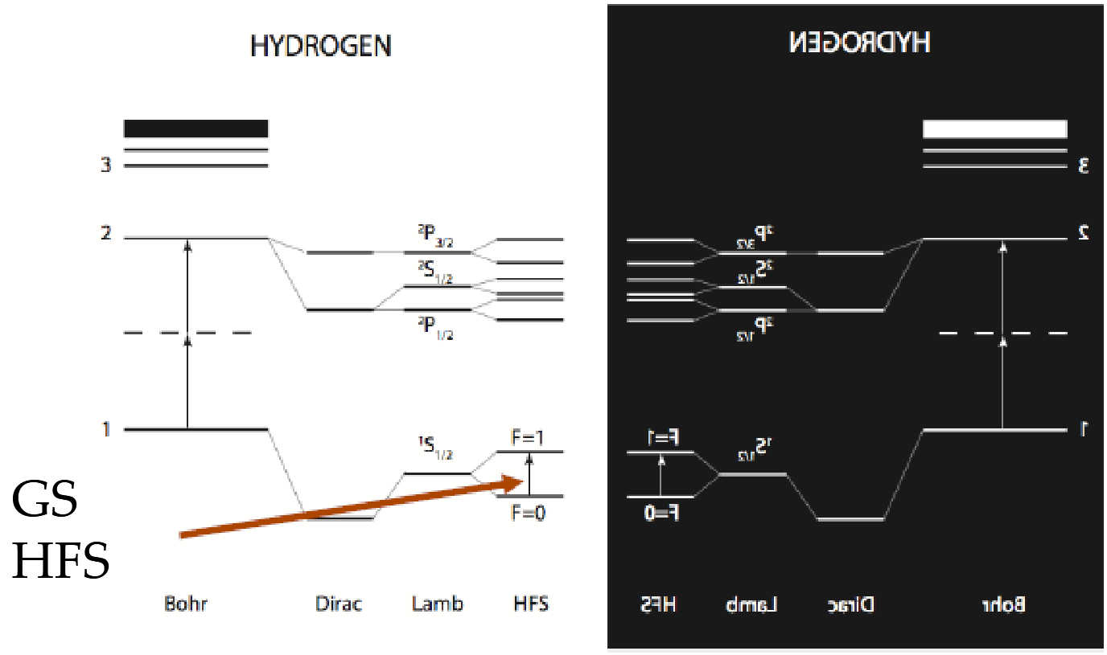
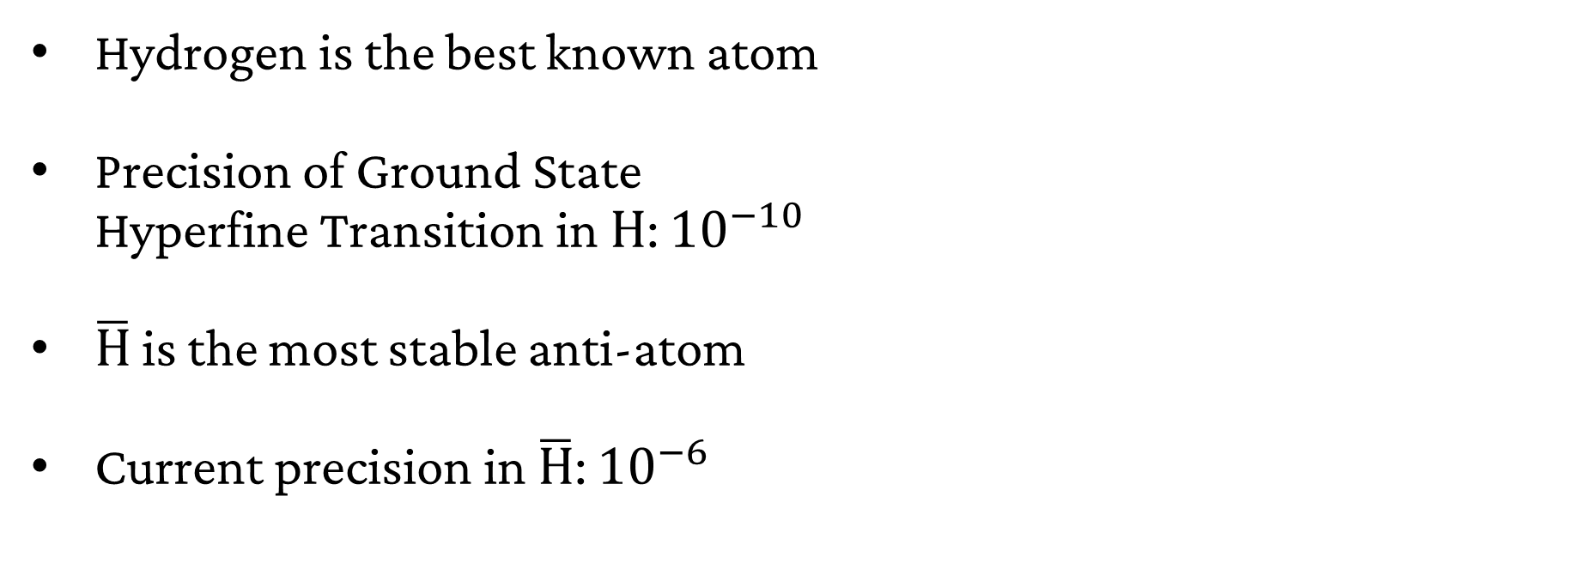
The (anti)-Hydrogen
Hyperfine Structure
Hydrogen is the best known atom
Precision of Ground State
Hyperfine Transition in $\text{H}$: ${10}^{−10}$
$\overline{\text{H}}$ is the most stable anti-atom
Current precision in $\overline{\text{H}}$: ${10}^{−6}$
Akbari, R., et al., Nature 653, 1022–1026 (2026).

Slide 5
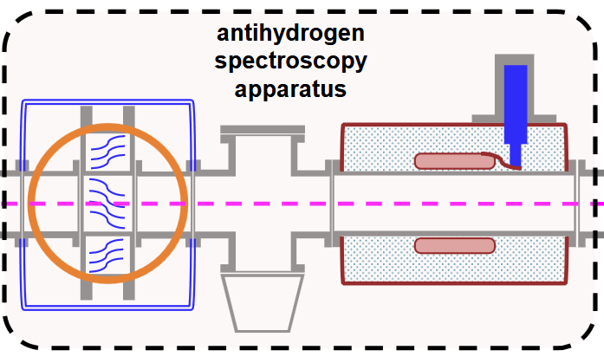

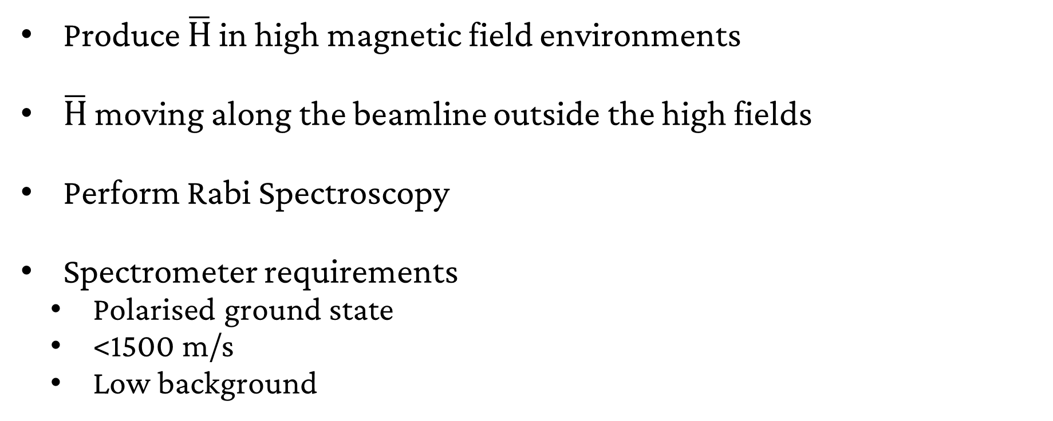
A beam of antimatter
Initial Goal: ${10}^{−6}$
Produce $\overline{\text{H}}$ in high magnetic field environments
$\overline{\text{H}}$ moving along the beamline outside the high fields
Perform Rabi Spectroscopy
Spectrometer requirements
  Polarised ground state
  <1500 m/s
  Low background
F=0
C. Malbrunot et al. NIM Phys. Res. Sect. A 935 (2019)

Slide 6
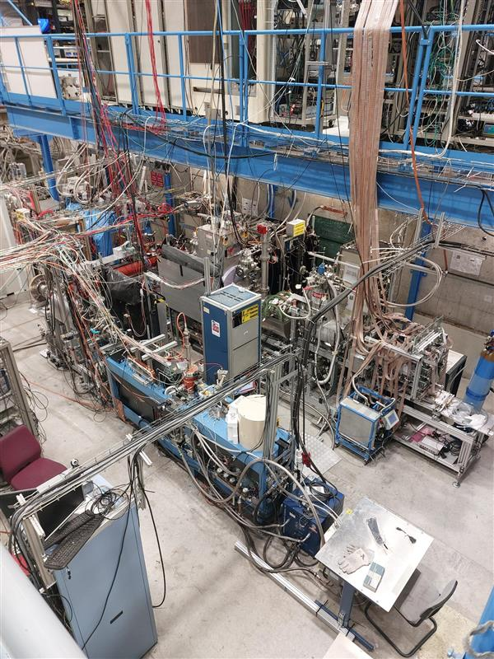
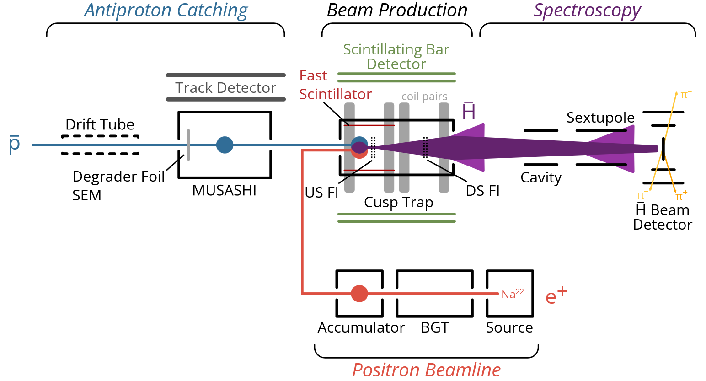




The ASACUSA Experiment
Overview
MUSASHI
Cusp
Trap
$$\overline{\text{p}}$$
Spectroscopy
Line
$${\text{e}}^{\text{+}}$$
$$\overline{H}$$
$\overline{\text{H}}$ Beam
Detector
Positron
Beamline
ASACUSA SPSC Report for 2025, SPSC-SR-377.

Slide 7
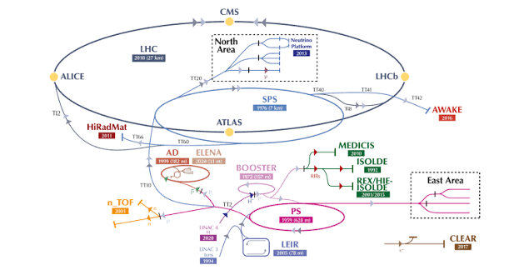
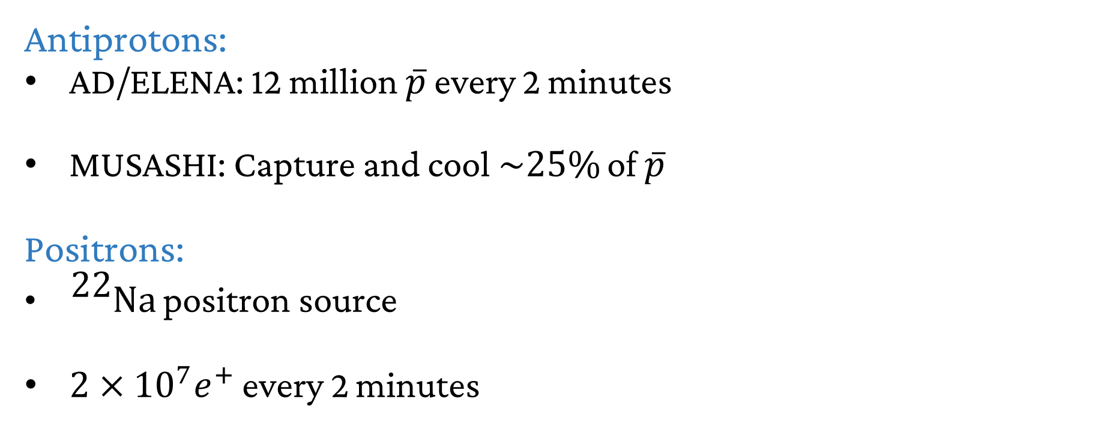
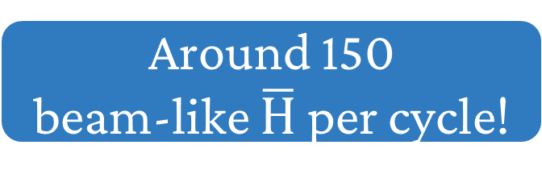
Positron & Antiprotons
Antiprotons:
AD/ELENA: 12 million $\overline{p}$ every 2 minutes
MUSASHI: Capture and cool $\sim 25\%$ of $\overline{p}$
Positrons:
${}_{}^{\text{22}}{\text{Na}}$ positron source
$2×{10}^{7}e^{+}$ every 2 minutes
https://en.wikipedia.org/wiki/Antiproton_Decelerator
Around 150
beam-like $\overline{\text{H}}$ per cycle!

Slide 8
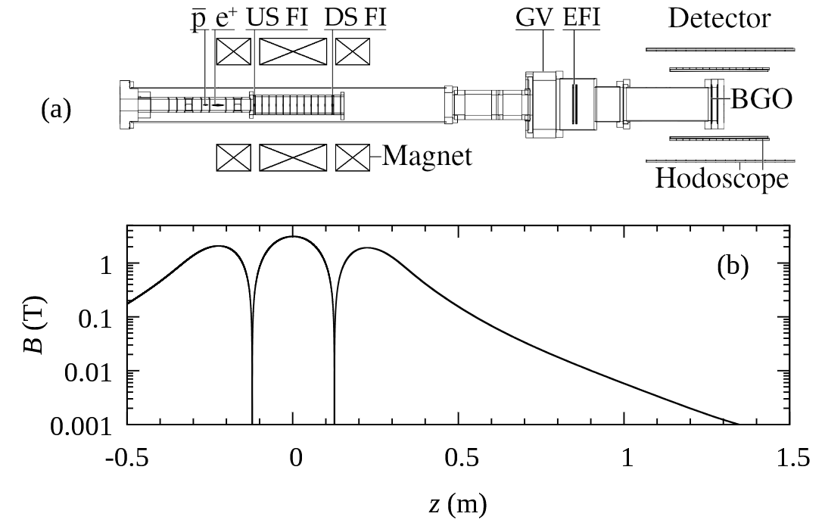
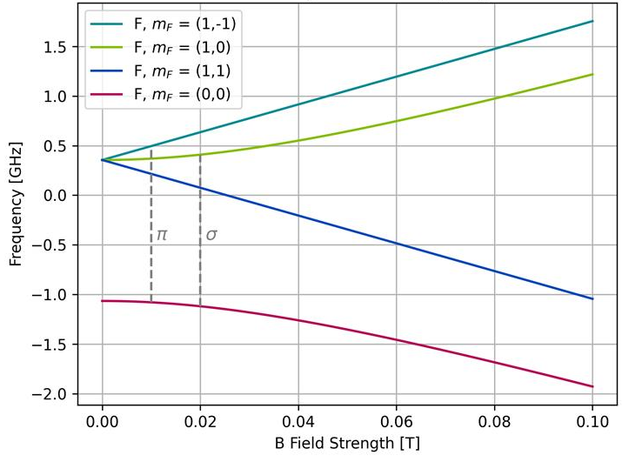

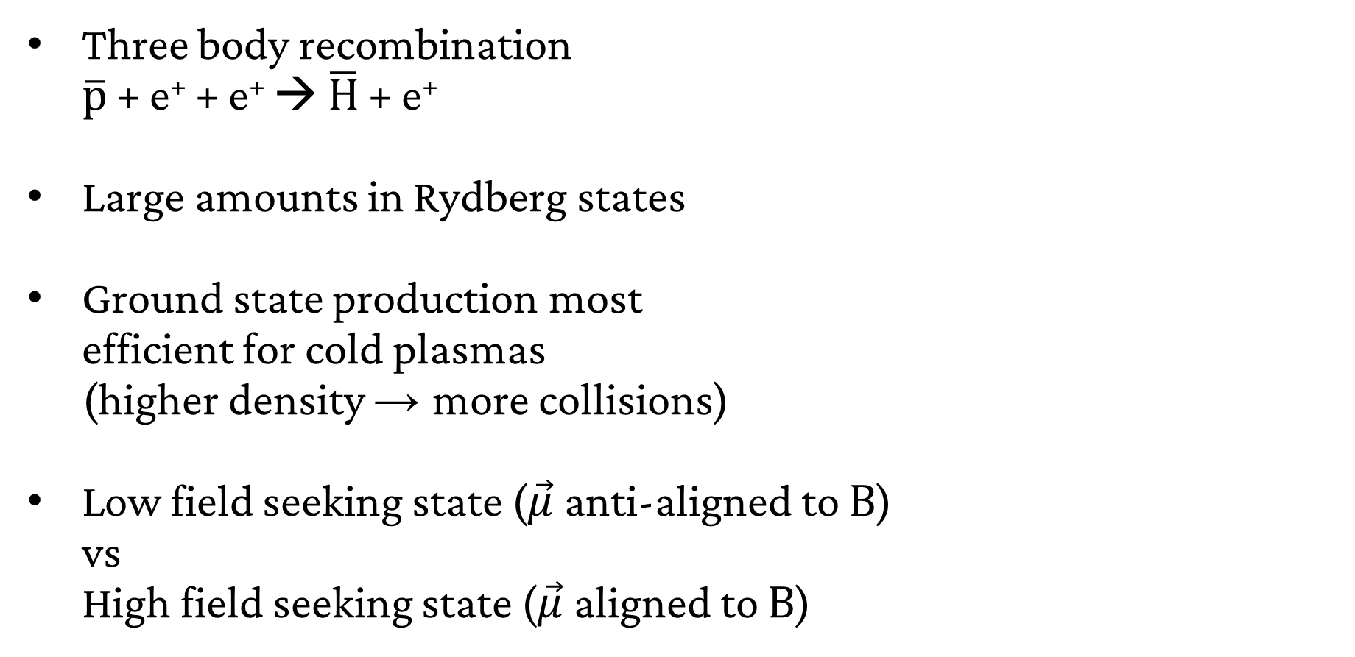
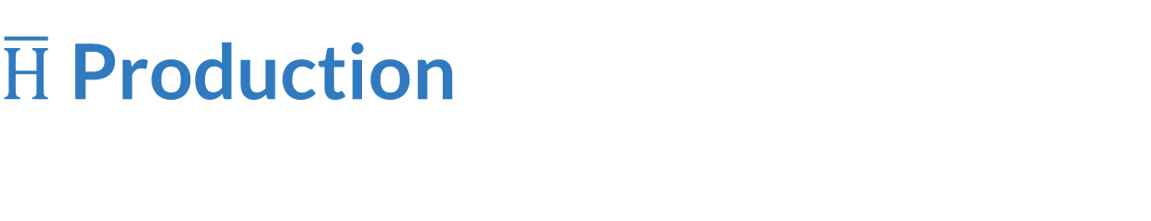



$\overline{\text{H}}$ Production
$$HFS \overline{H}$$
Three body recombination
$\overline{p}$ + e⁺ + e⁺ → $\overline{H}$ + e⁺
Large amounts in Rydberg states
Ground state production most
efficient for cold plasmas
(higher density → more collisions)
Low field seeking state ($\vec{μ}$anti-aligned to $\text{B}$)
vs
High field seeking state ($\vec{μ}$aligned to $\text{B}$)
$$\overline{p}$$
$$LFS \overline{H}$$
e⁺
$$HFS \overline{H}$$
E. D. Hunter et al. Phys. Plasmas 33 (2026)
LFS
HFS

Slide 9
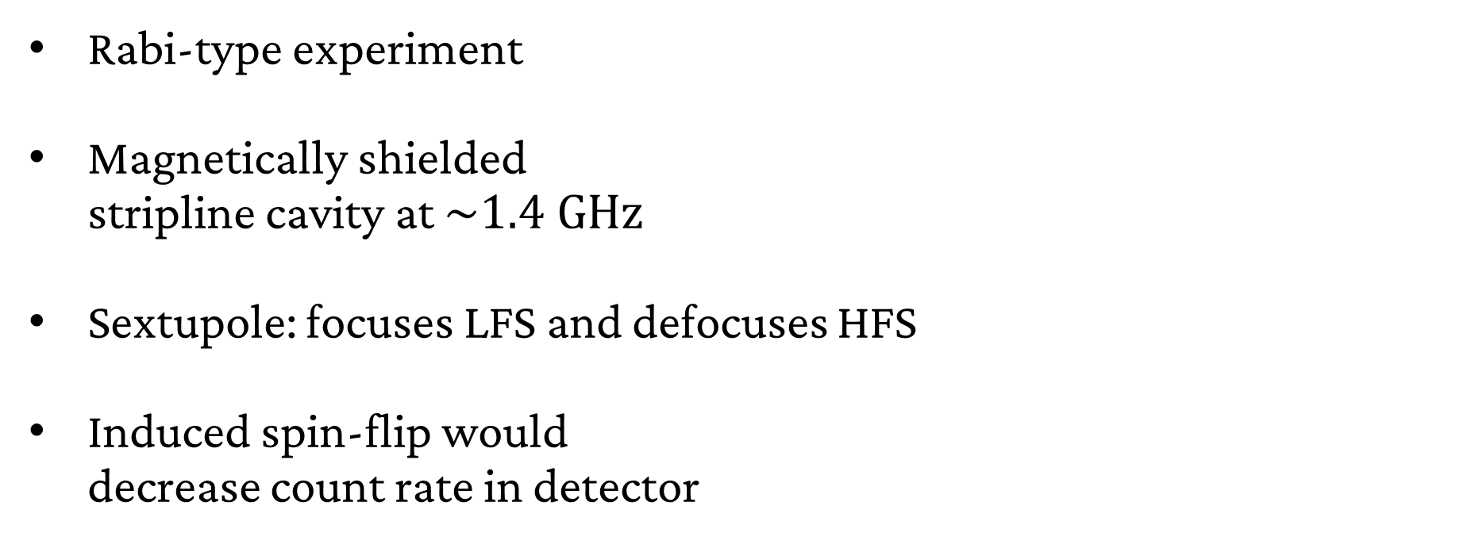
The Spectroscopy Beamline
Rabi-type experiment
Magnetically shielded
stripline cavity at $\sim 1.4 \text{GHz}$
Sextupole: focuses LFS and defocuses HFS
Induced spin-flip would
decrease count rate in detector
ASACUSA SPSC Report for 2025, SPSC-SR-377

Slide 10
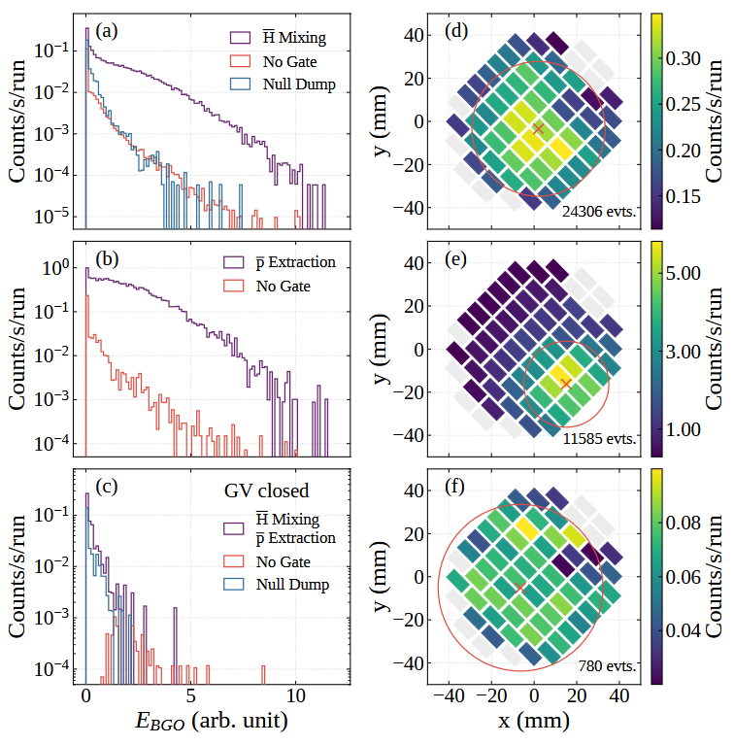
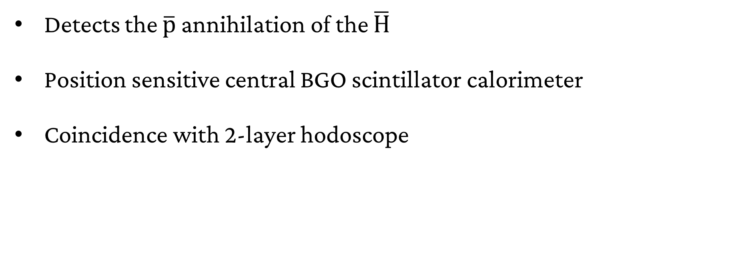

The $\overline{\text{H}}$ Beam - Detector
Detects the $\overline{\text{p}}$ annihilation of the $\overline{\text{H}}$
Position sensitive central BGO scintillator calorimeter
Coincidence with 2-layer hodoscope

Slide 11
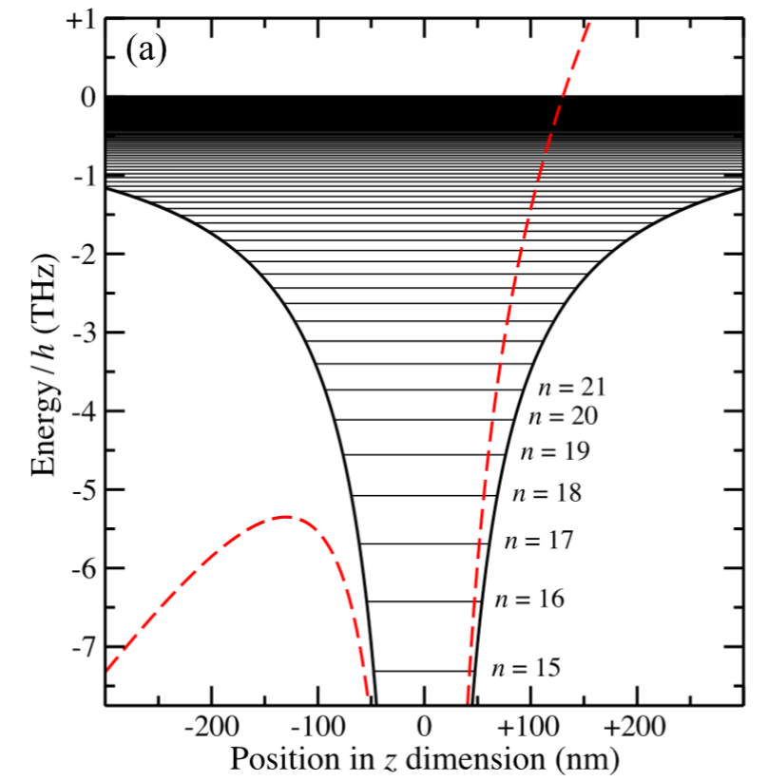
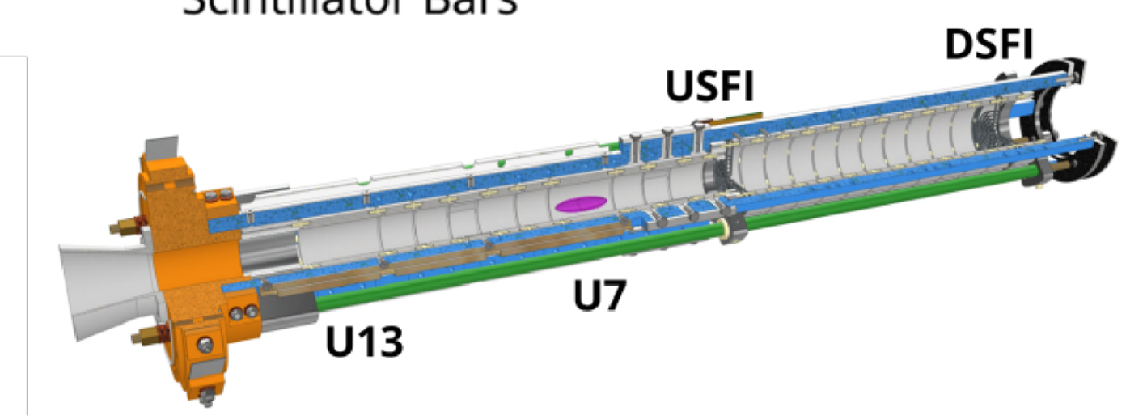


Characterizing the $\overline{\text{H}}$ Beam
Reminder for requirements
  Polarised ground state
  <1500 m/s
  Low background
2h (THz)
$$\overline{H}$$
x2 (nm)
ASACUSA SPSC Report 2025

Slide 12
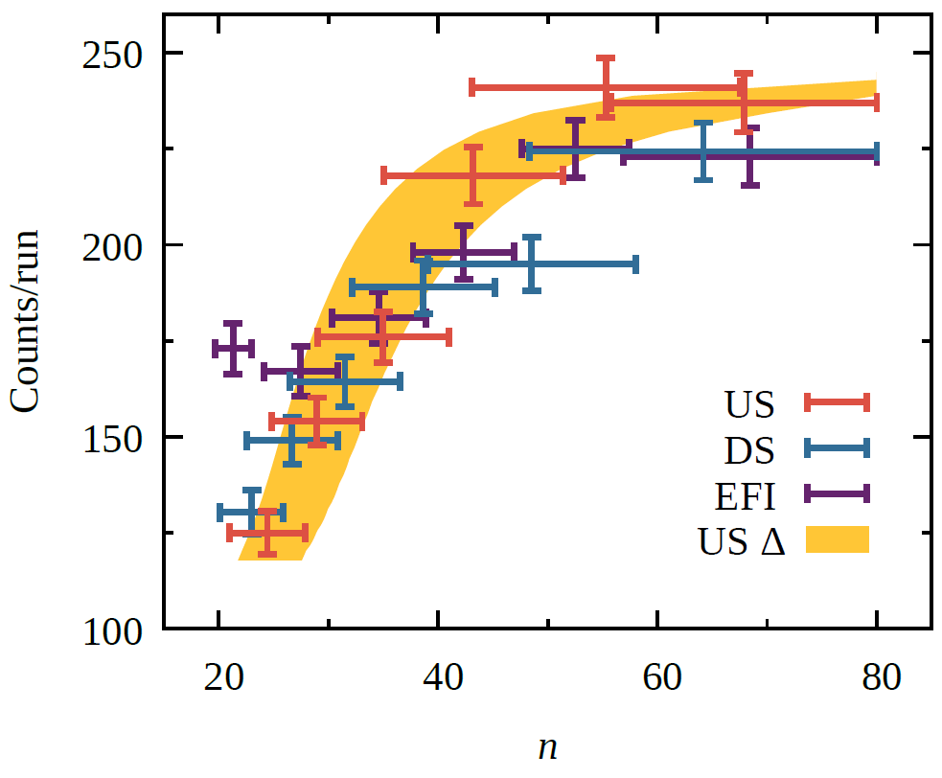
Characterizing the $\overline{\text{H}}$ Beam
E. D. Hunter et al. In Preparation
Reminder for requirements
  Polarised ground state
  <1500 m/s
  Low background
Results
Approximately 66% in n > 20
n < 15 will fluoresce during flight
Estimate > 10% ground state fraction
PRELIMINARY

Slide 13
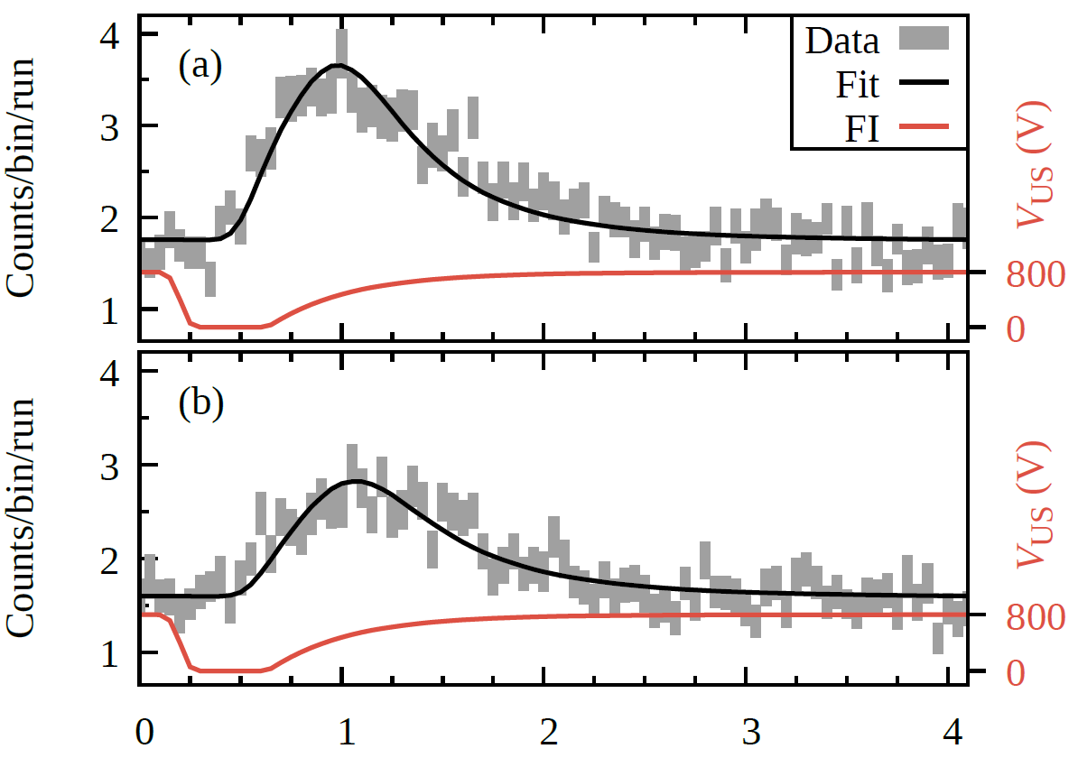

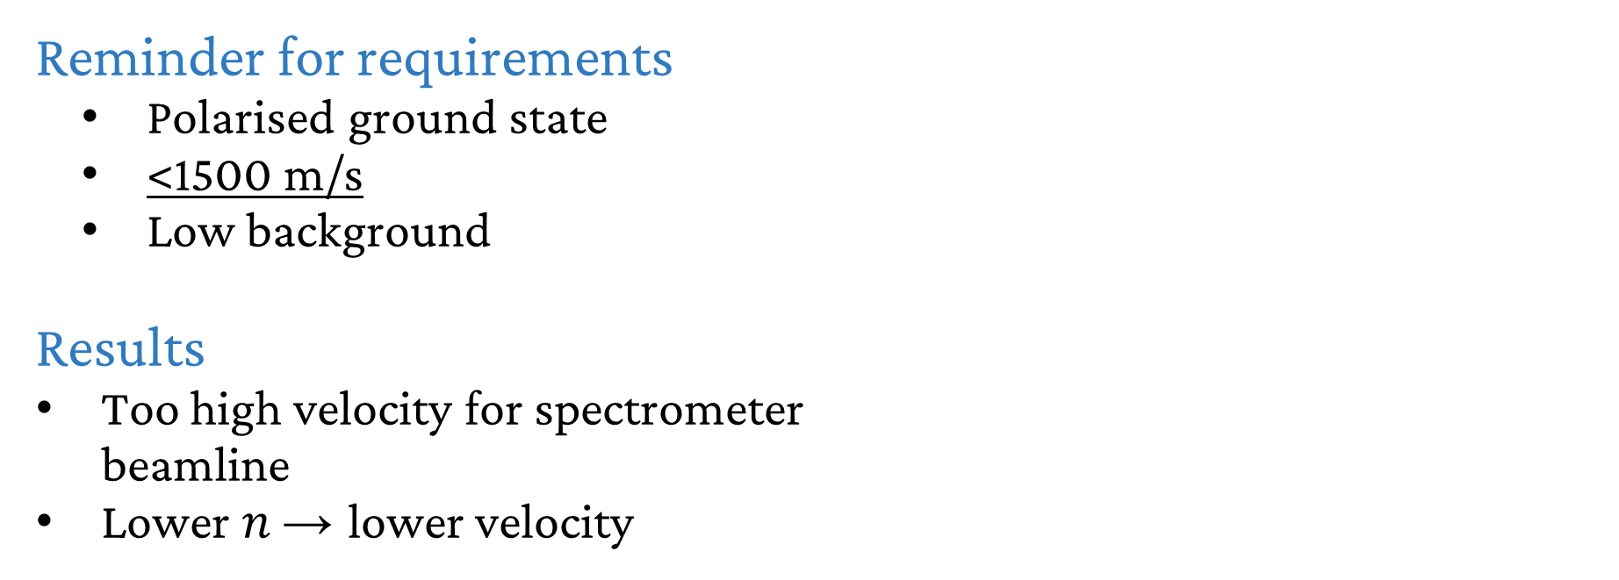
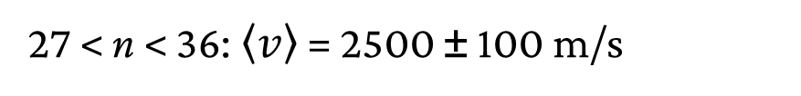
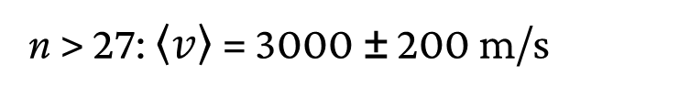
Characterizing the $\overline{\text{H}}$ Beam
E. D. Hunter et al. In Preparation
n > 27: $\left\langle v\right\rangle$ = 3000 ± 200 m/s
Reminder for requirements
  Polarised ground state
  <1500 m/s
  Low background
Results
Too high velocity for spectrometer
beamline
Lower $n$ → lower velocity
PRELIMINARY
27 < n < 36: $\left\langle v\right\rangle$ = 2500 ± 100 m/s

Slide 14
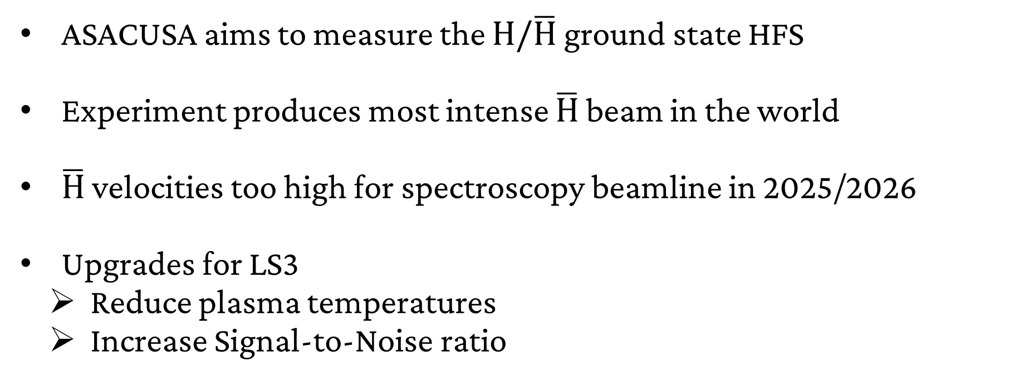
Summary & Outlook
ASACUSA aims to measure the $\text{H}\text{/}\overline{\text{H}}$ ground state HFS
Experiment produces most intense $\overline{\text{H}}$ beam in the world
$\overline{\text{H}}$ velocities too high for spectroscopy beamline in 2025/2026
Upgrades for LS3
  Reduce plasma temperatures
  Increase Signal-to-Noise ratio

Slide 15
Backup

Slide 16
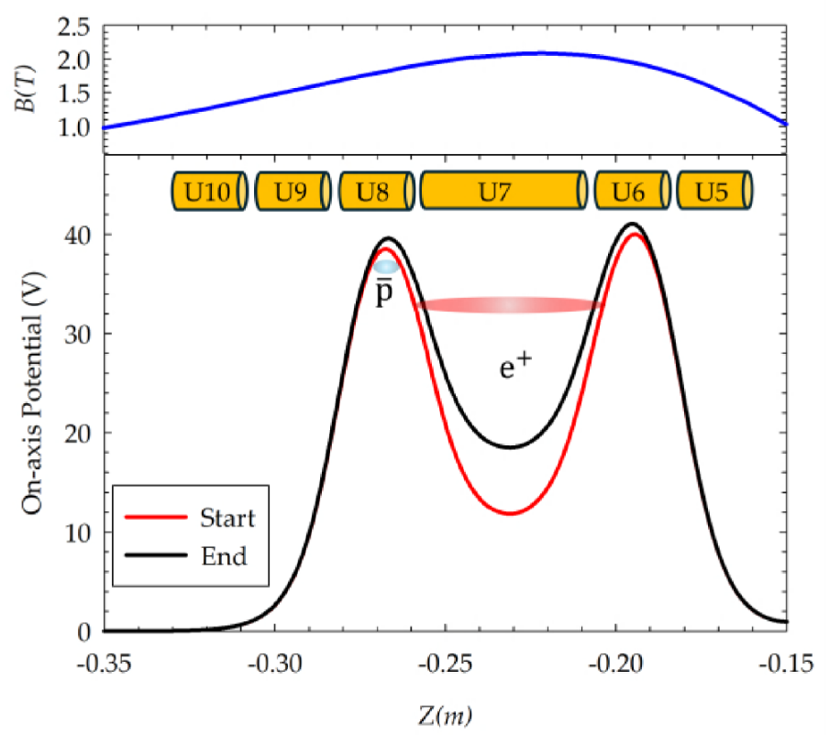

Antihydrogen production
ASACUSA SPSC Report for 2024, SPSC-SR-358
Slow merge mixing over 60s
Production efficiency ~80%
$$\overline{H}$$
Notes:
Used to be direct injection

Slide 17
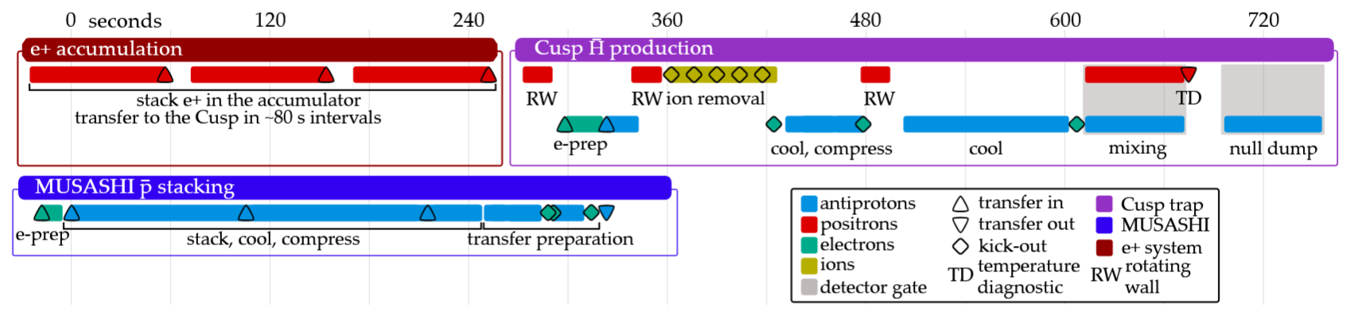
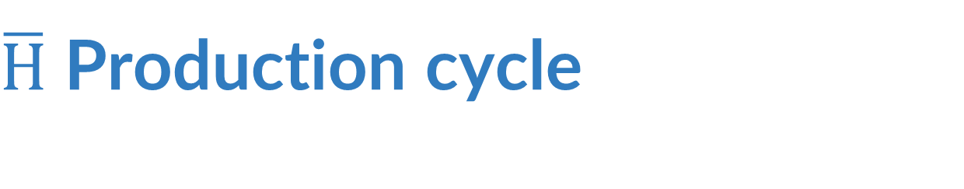
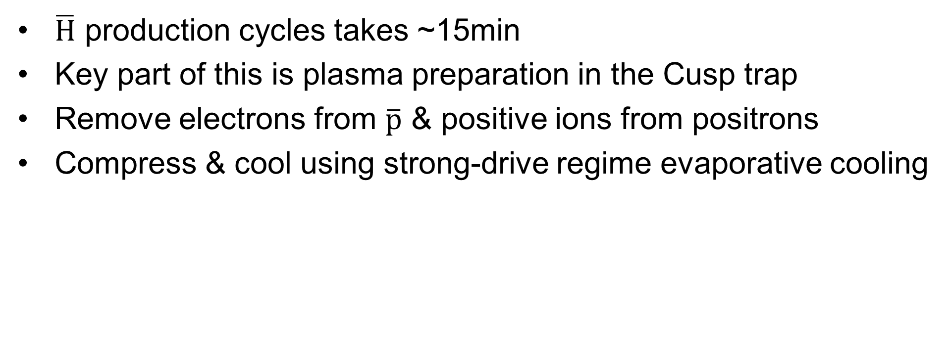
$\overline{H}$ Production cycle
$\overline{H}$ production cycles takes ~15min
Key part of this is plasma preparation in the Cusp trap
Remove electrons from $\overline{p}$ & positive ions from positrons
Compress & cool using strong-drive regime evaporative cooling
ASACUSA SPSC Report for 2024, SPSC-SR-358

Slide 18
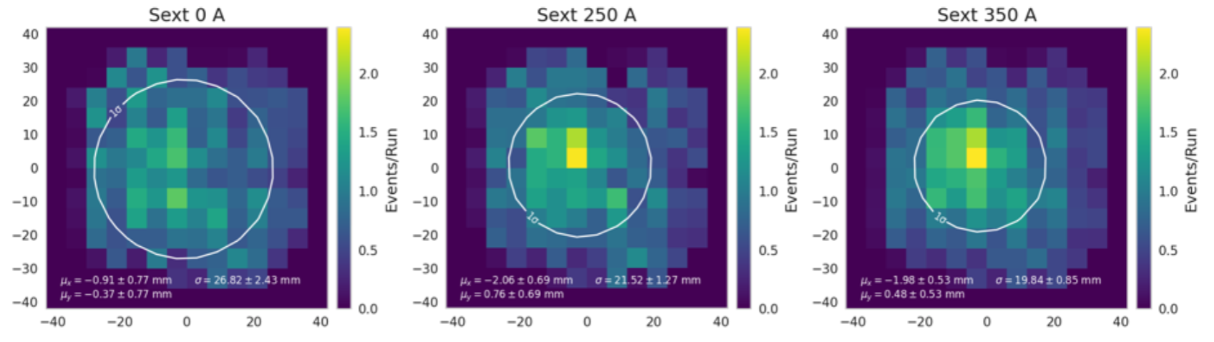
Characterizing the $\overline{\text{H}}$ Beam
ASACUSA SPSC Report for 2025, SPSC-SR-377
Sextupole Off
Reminder for requirements
  Polarised ground state
  <1500 m/s
  Low background
Results
26 ± 7% reduction in beam spot size
No reduction in beam intensity
  High Rydberg contribution
PRELIMINARY
y (mm)
x (mm)
Sextupole On
PRELIMINARY
y (mm)
x (mm)

