Slide 1

GRASIAN: Progress Toward Observing Gravitational Quantum States of Atoms
75th Annual Meeting of the Austrian Physical Society
Victoria Kletzl-Teuffenbach
on behalf of the GRASIAN collaboration

Slide 2






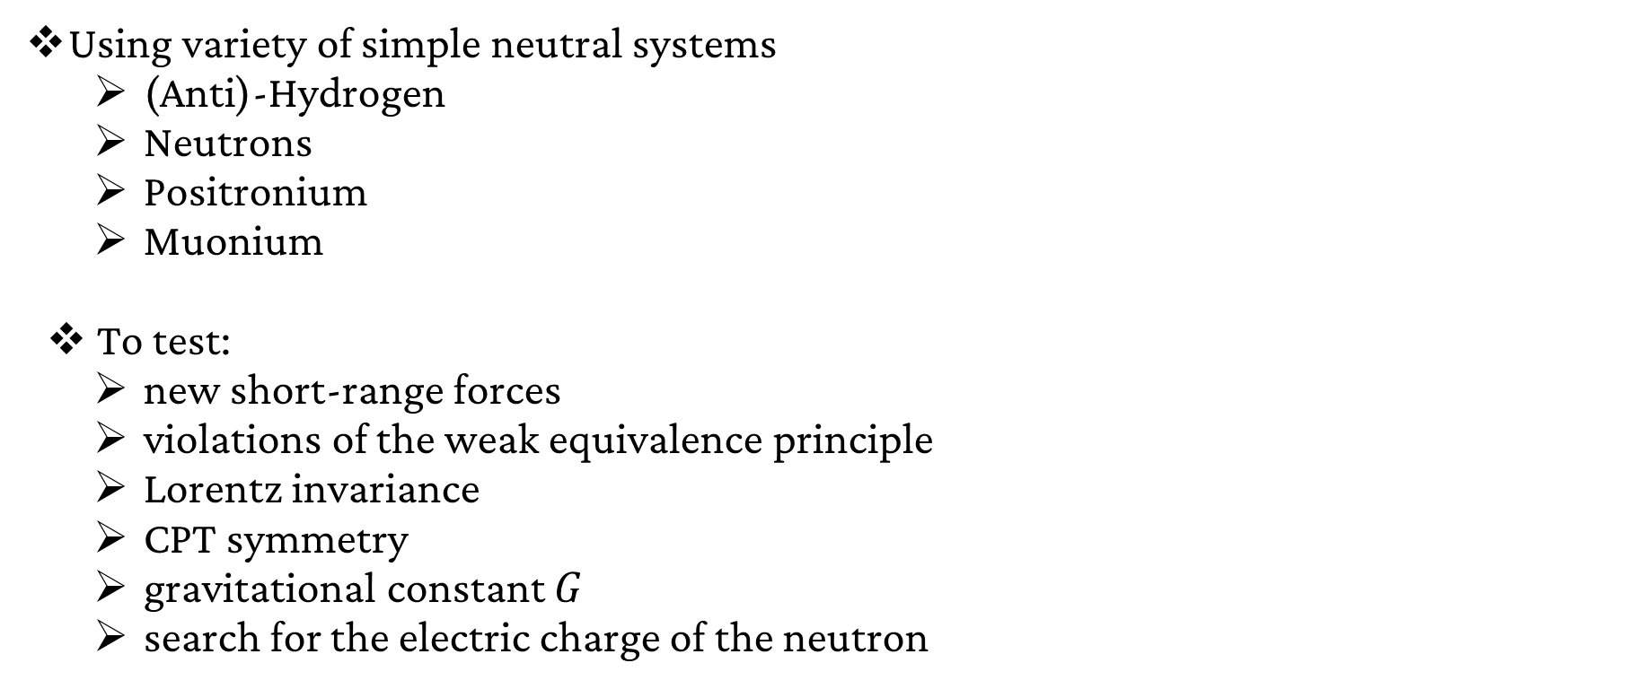
The GRASIAN Collaboration
Using variety of simple neutral systems
  (Anti)-Hydrogen
  Neutrons
  Positronium
  Muonium
To test:
  new short-range forces
  violations of the weak equivalence principle
  Lorentz invariance
  CPT symmetry
  gravitational constant $G$
  search for the electric charge of the neutron

Slide 3
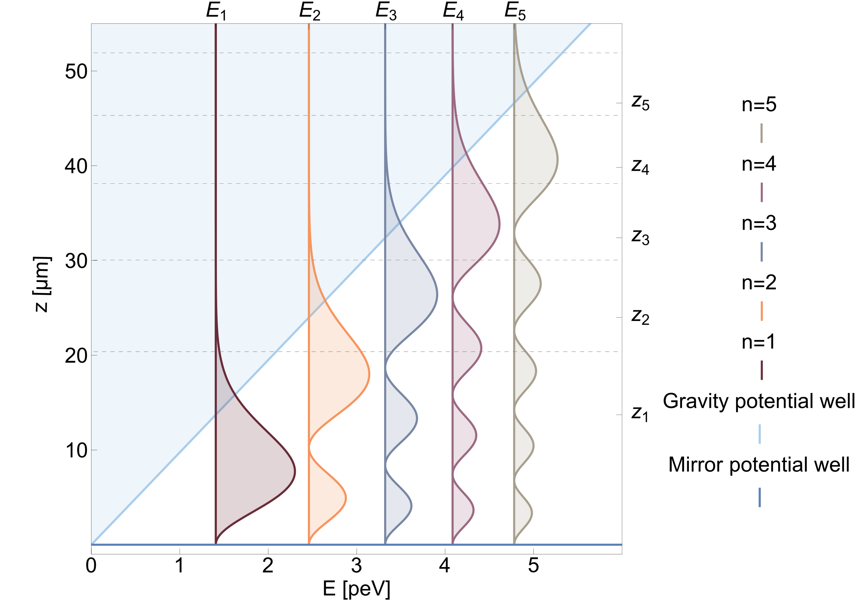
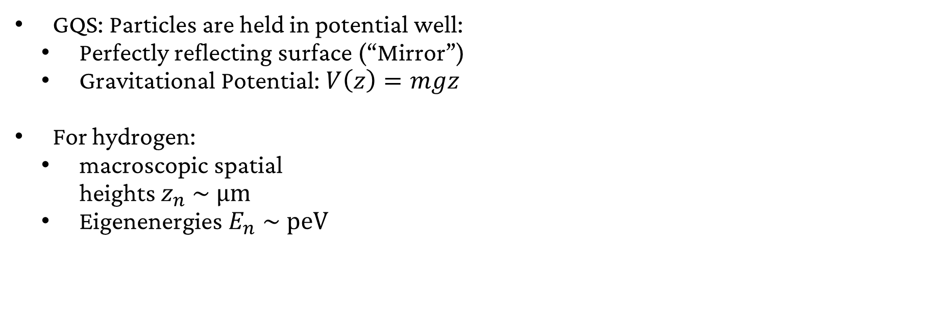
Gravitational Quantum States
GQS: Particles are held in potential well:
  Perfectly reflecting surface (“Mirror”)
  Gravitational Potential: $V\left(z\right)=mgz$
For hydrogen:
  macroscopic spatial
  heights $z_{n} \sim \text{μm}$
  Eigenenergies $E_{n} \sim \text{peV}$
Killian, C. et al. 2023.

Slide 4
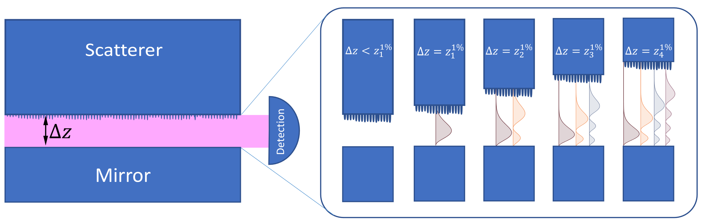
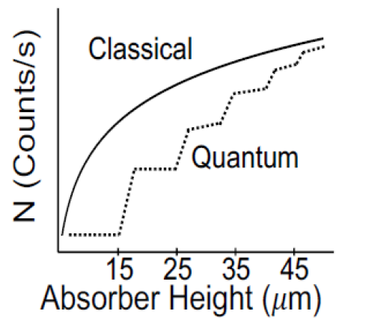
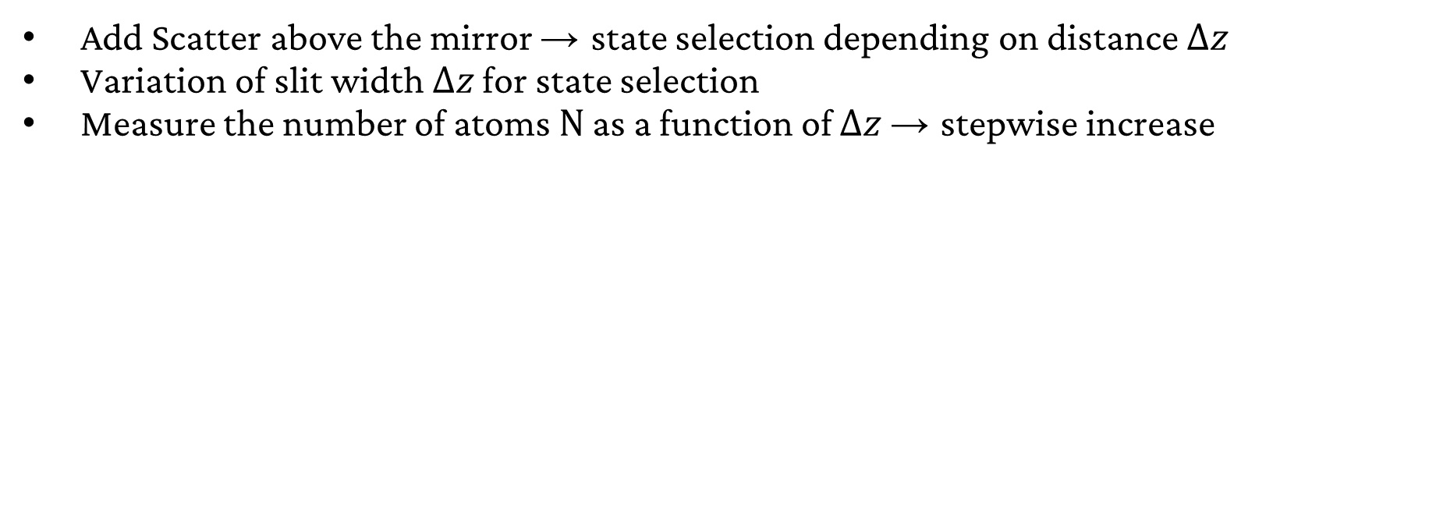
GQS Measurement principle
Add Scatter above the mirror → state selection depending on distance $Δz$
Variation of slit width $Δz$ for state selection
Measure the number of atoms $\text{N}$ as a function of $Δz$ → stepwise increase

Slide 5
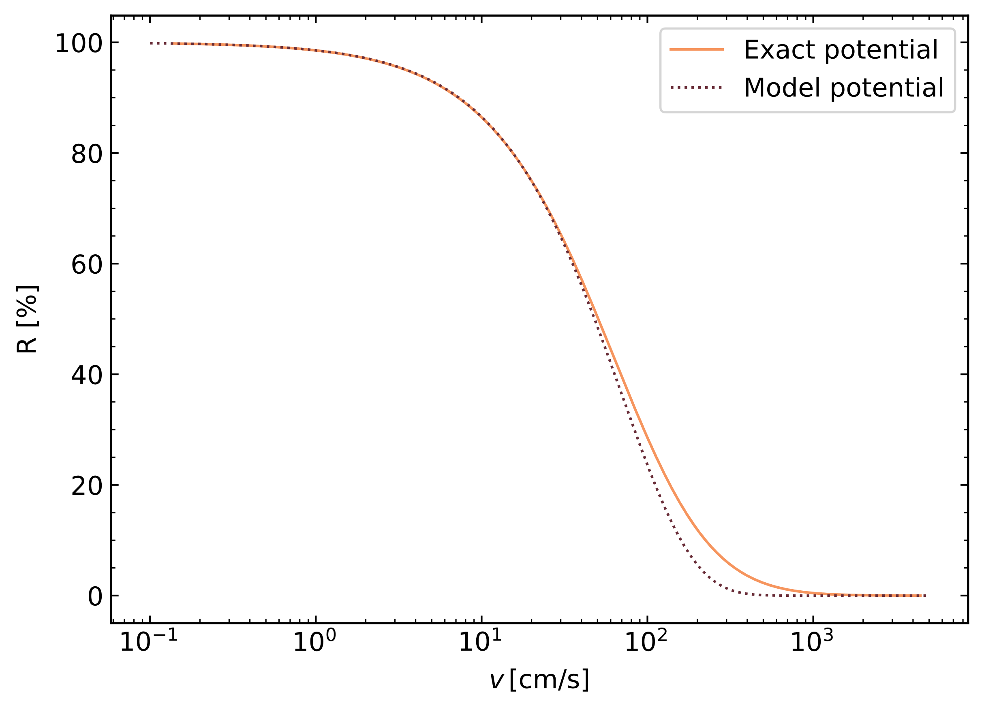
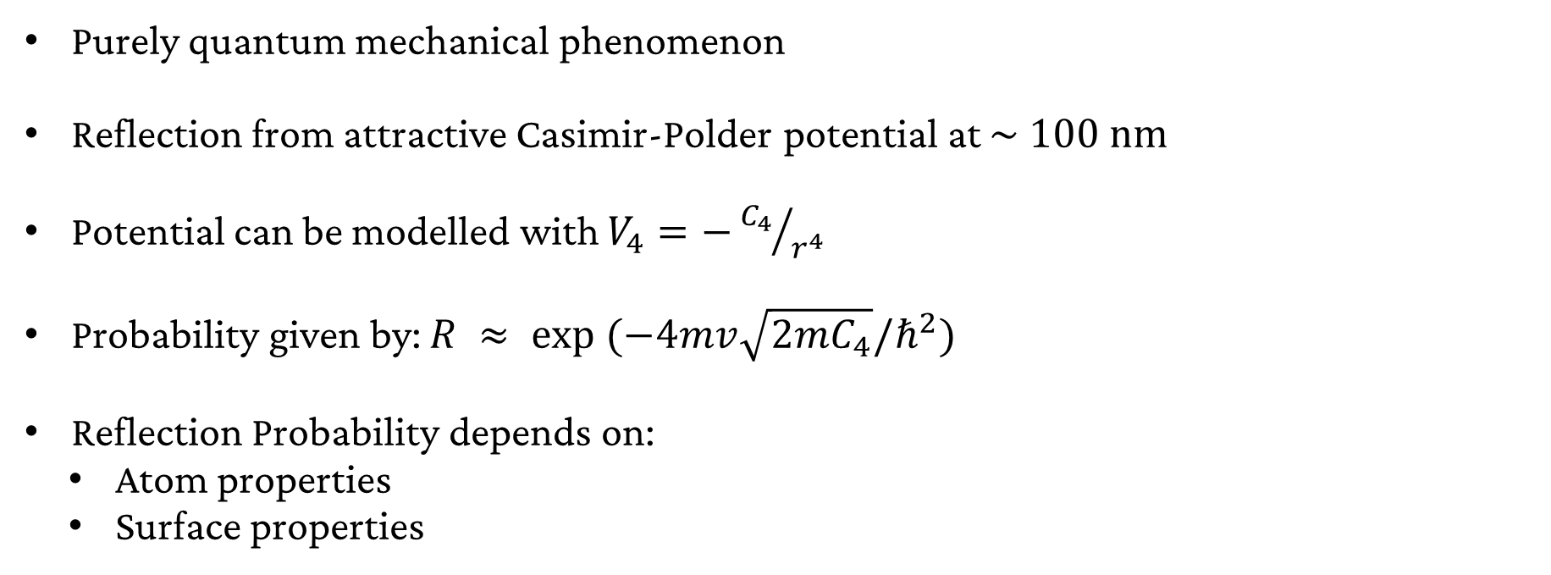
Quantum Reflections
Purely quantum mechanical phenomenon
Reflection from attractive Casimir-Polder potential at $\sim \text{100 }\text{nm}$
Potential can be modelled with $V_{4}=−{C_{4}}/{r^{4}}$
Probability given by: $R ≈ \text{exp} (−4mv\sqrt{2mC_{4}}/ℏ^{2})$
Reflection Probability depends on:
  Atom properties
  Surface properties
Crépin, P.-P. et al. 2023.

Slide 6
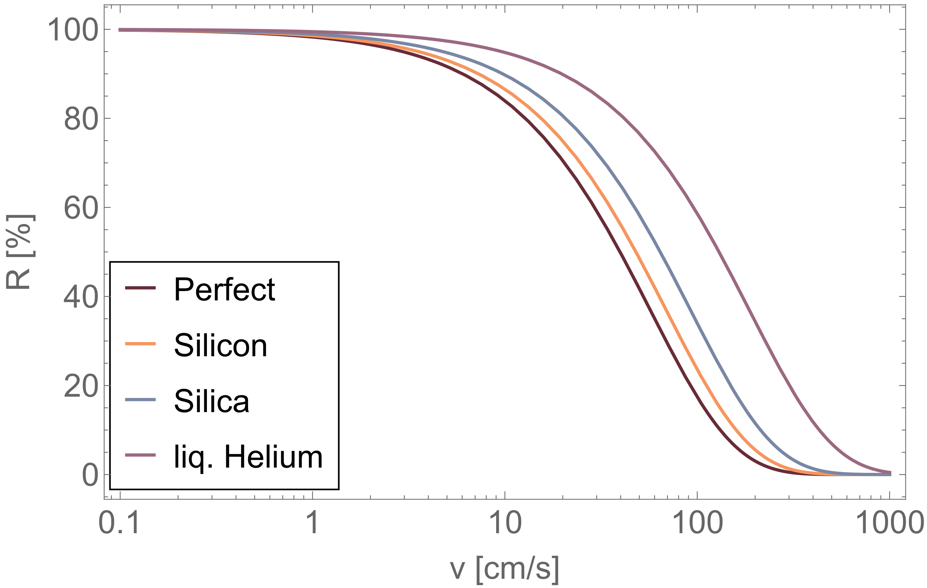
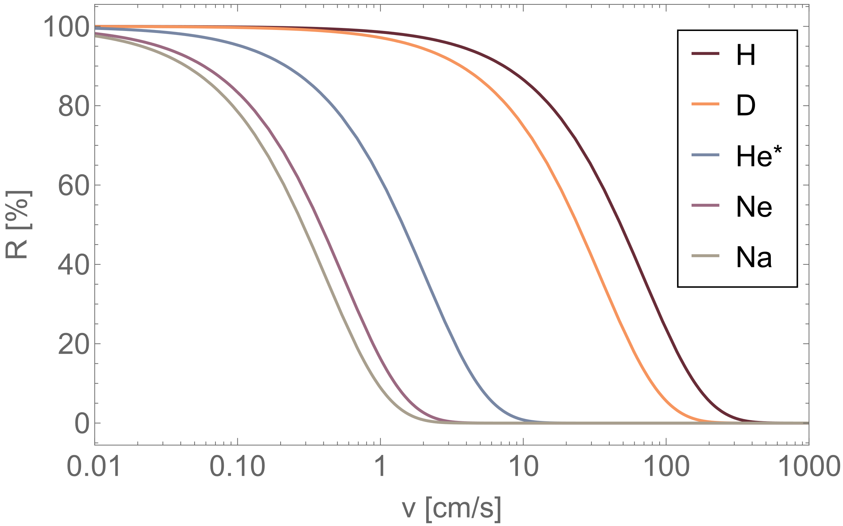
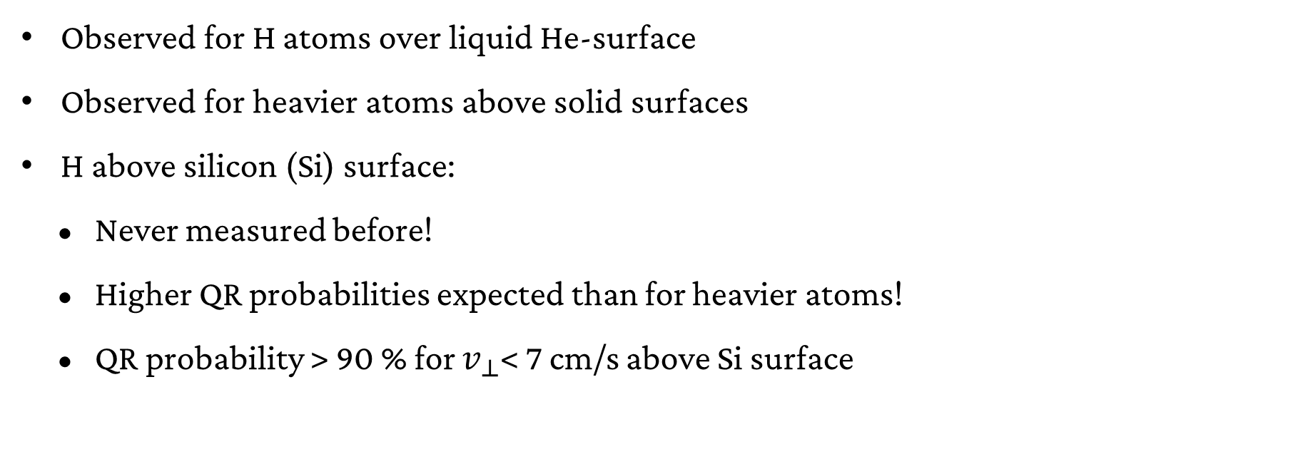
Quantum Reflections
Observed for H atoms over liquid He-surface
Observed for heavier atoms above solid surfaces
H above silicon (Si) surface:
    Never measured before!
    Higher QR probabilities expected than for heavier atoms!
    QR probability > 90 % for $v_{⊥}$< 7 cm/s above Si surface
Quantum reflection probability R (calculated from model potential) as a function of the incident velocity for hydrogen above different surfaces (top) and different atoms above silicon (bottom).

Slide 7
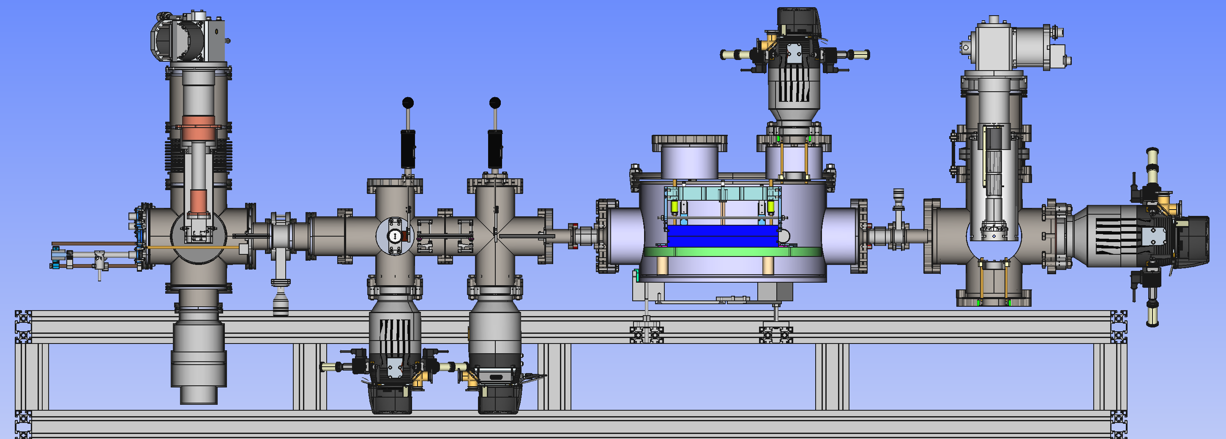
Hydrogen Beam Experimental Setup
Coldhead 1 → 6-30K
Coldhead 2 → 9K
slits
chopper
Hydrogen Plasma
UV Laser Beam
H-beam
MCP
pipe apertures
GQS spectrometer

Slide 8
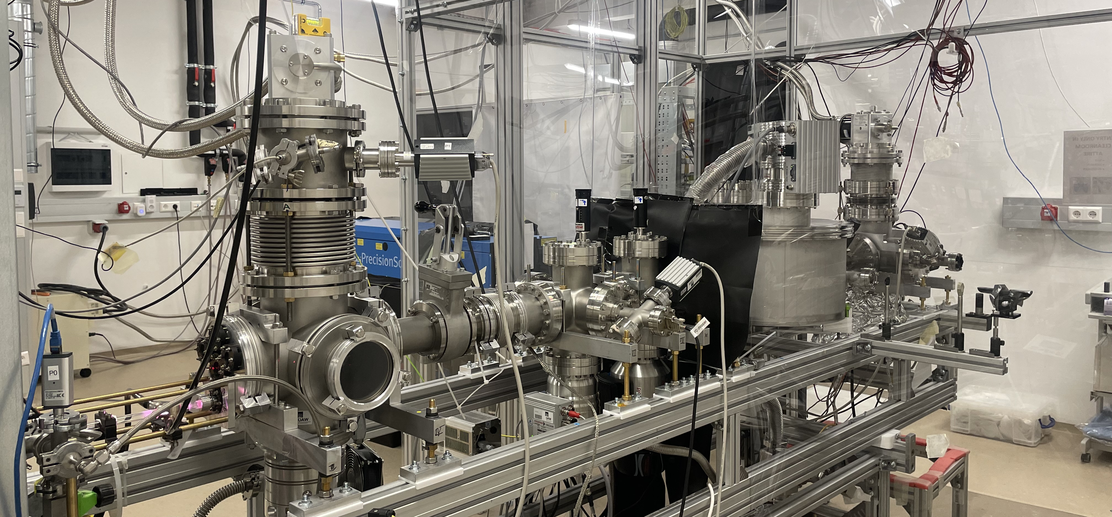
Hydrogen Beam Experimental Setup
Coldhead 1 → 6-30K
Slits (not used)
Coldhead 2 → 9K
chopper
UV Laser Beam
Hydrogen Plasma
MCP
H-beam
GQS chamber
pipe apertures

Slide 9
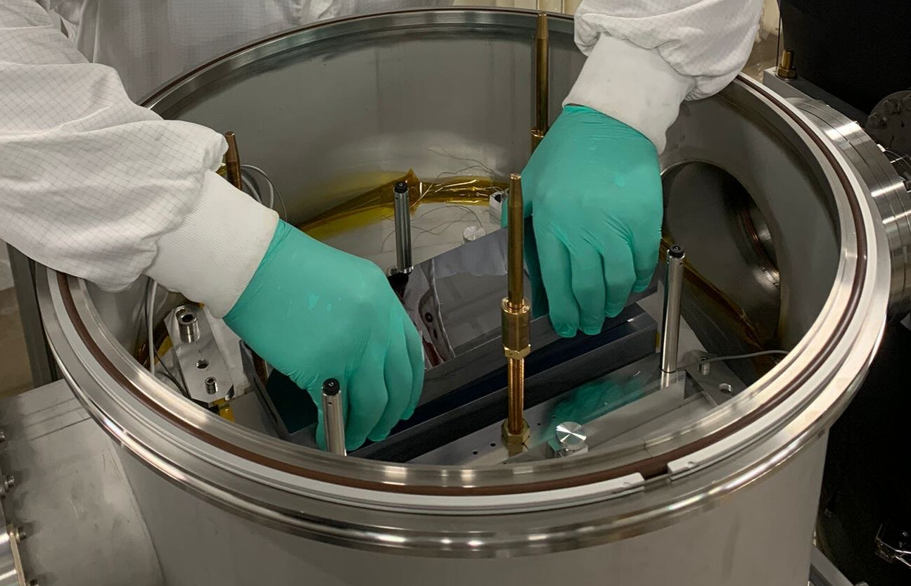
Installation of GQS Spectrometer – July 2025
Silicon Mirror + Absorber separated by 200 µm spacers were inserted
Scatterer
Mirror

Slide 10
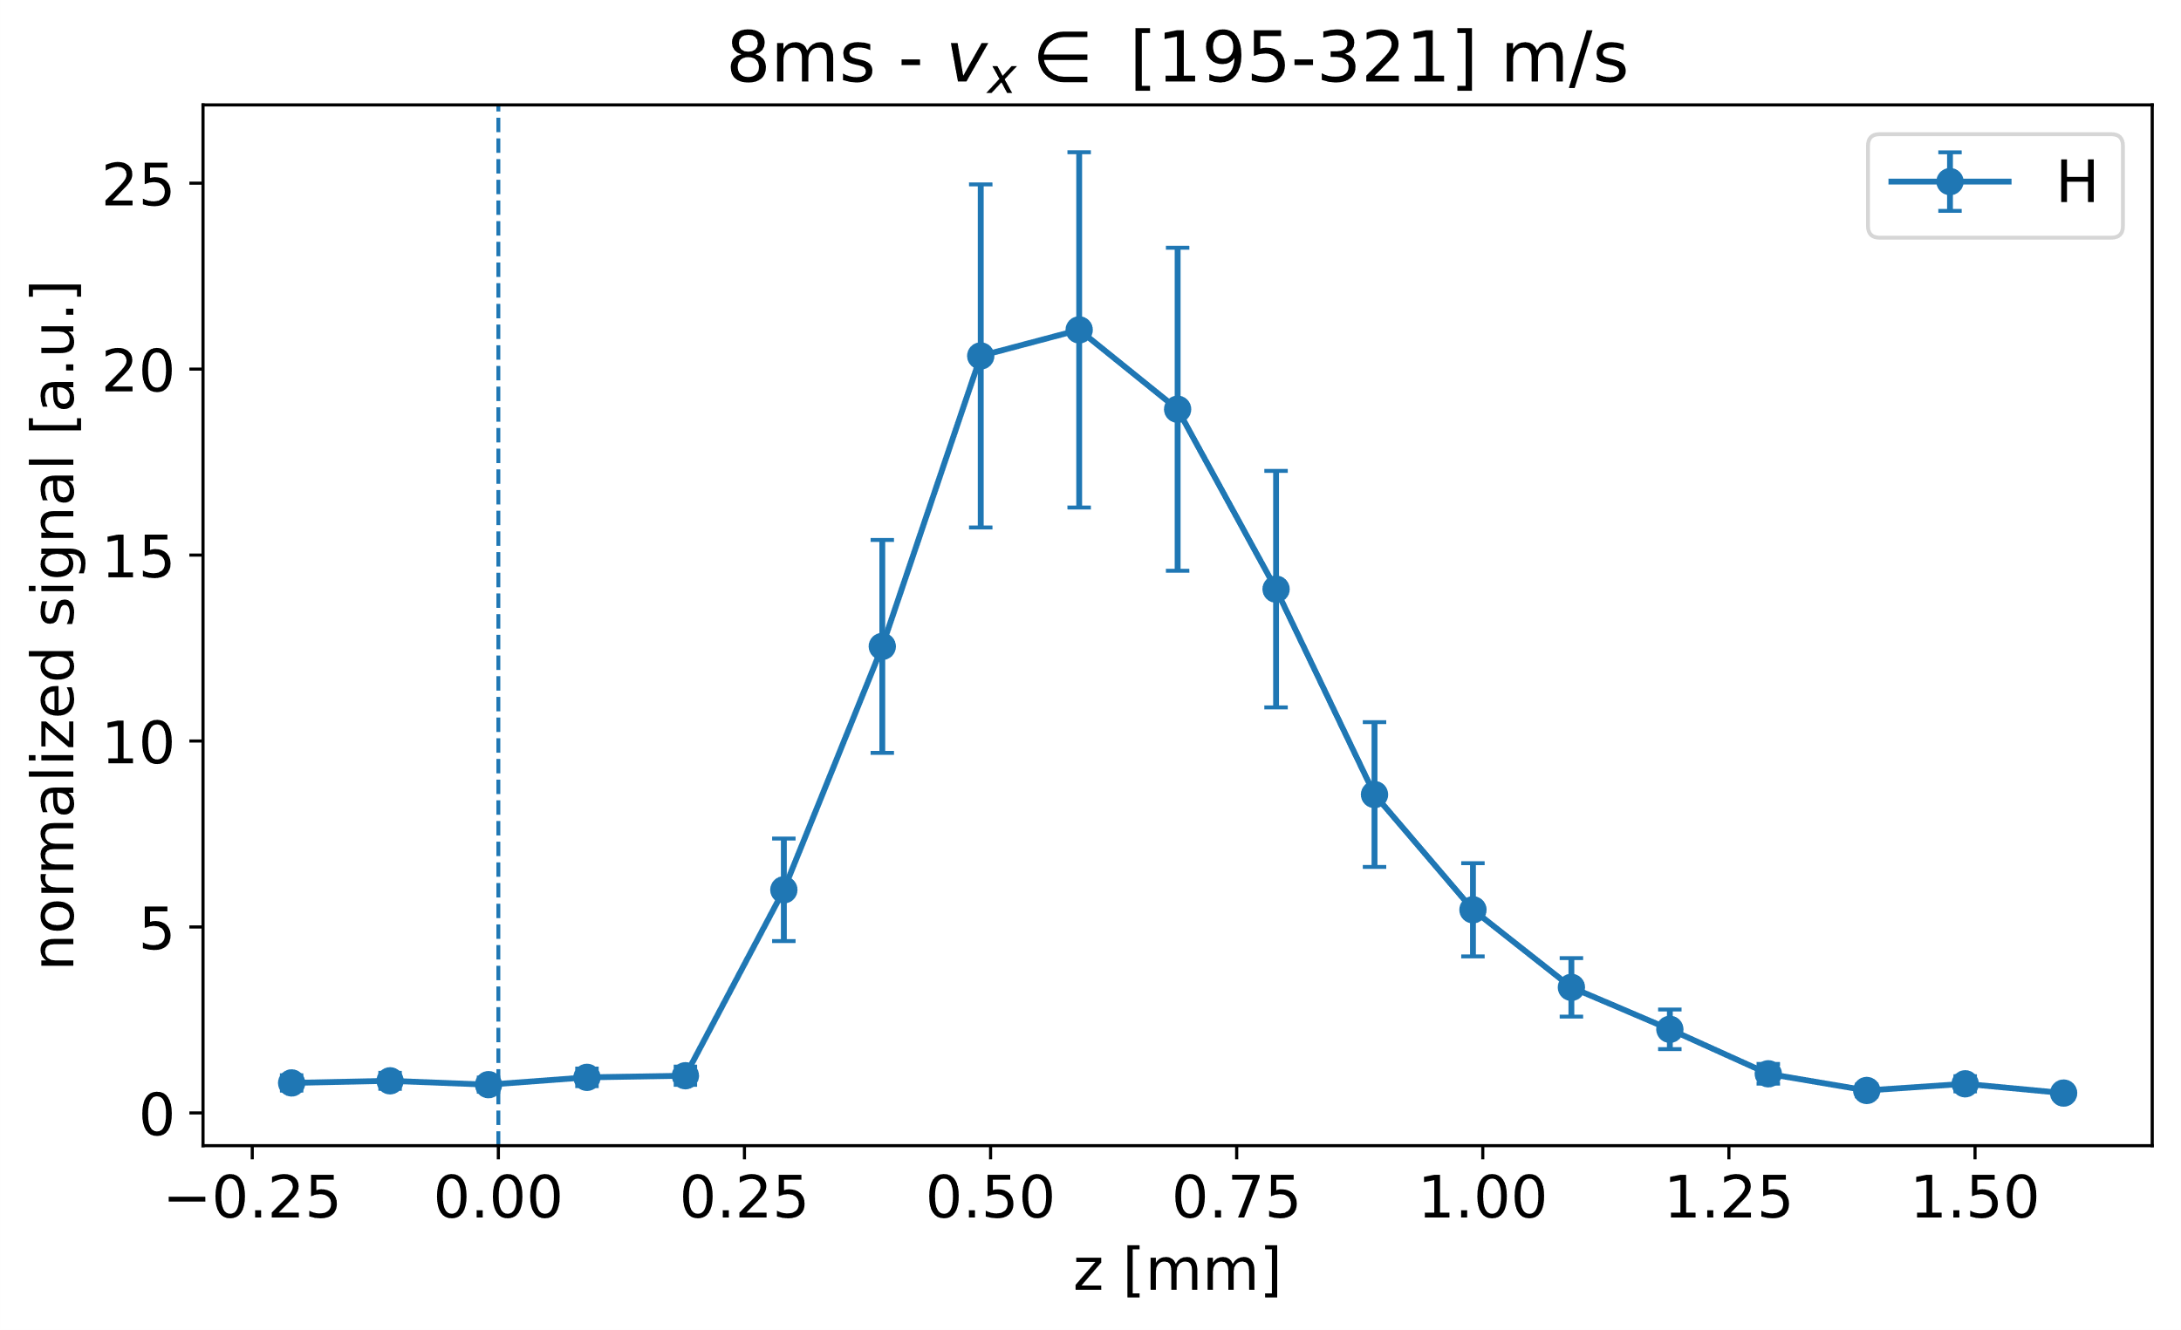
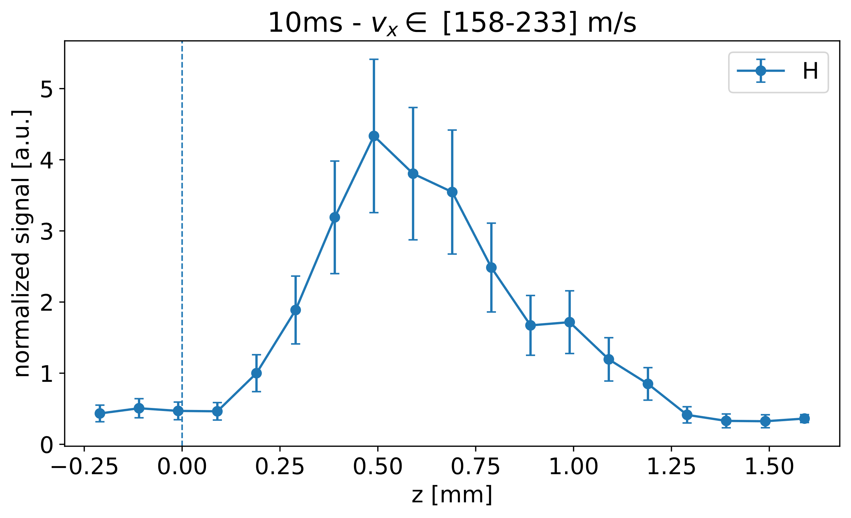
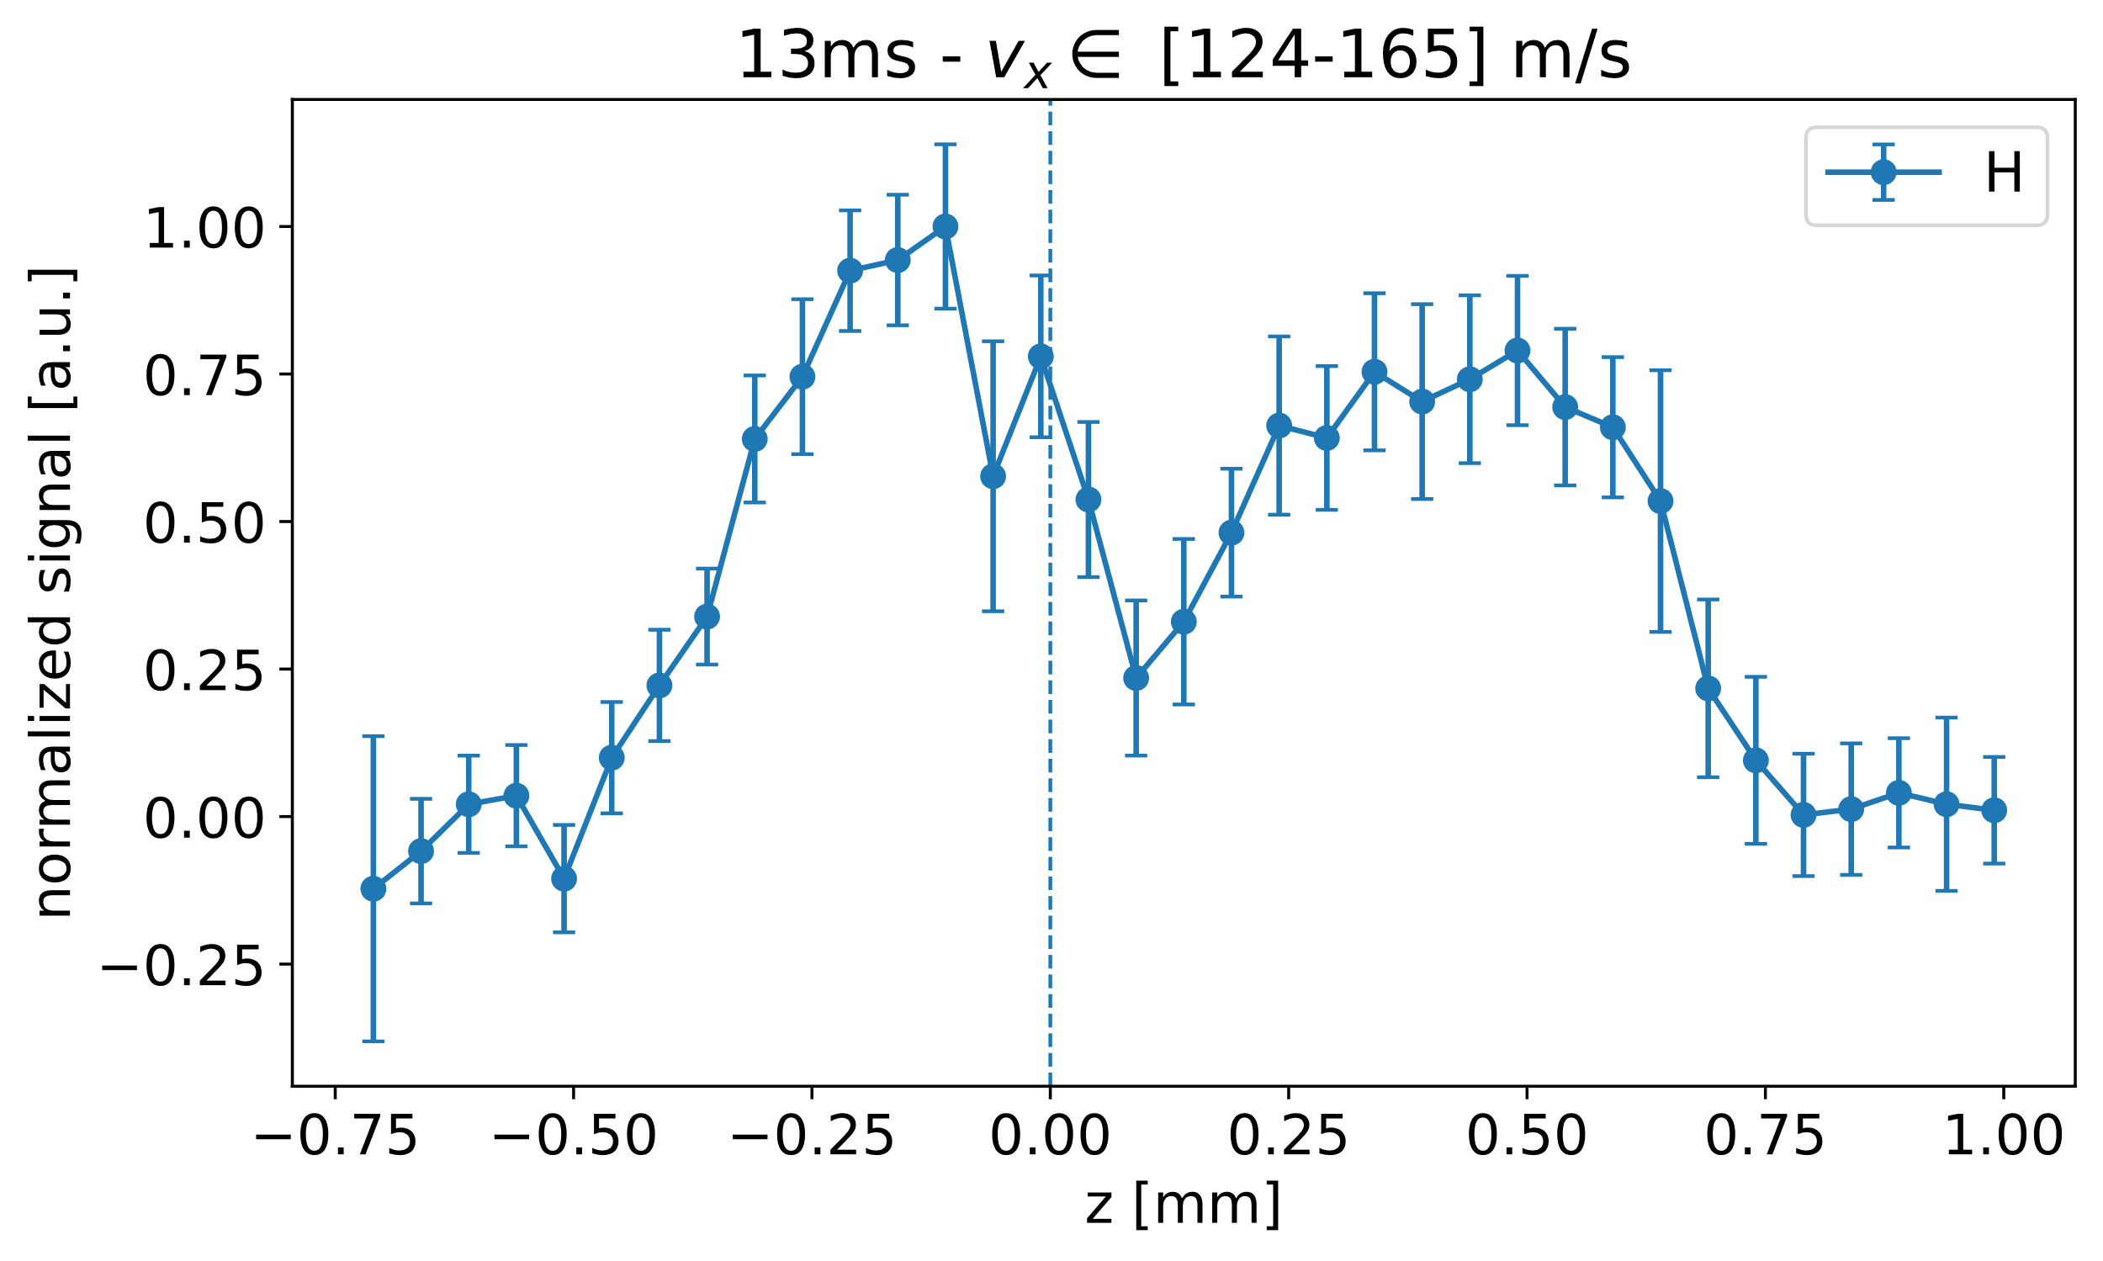
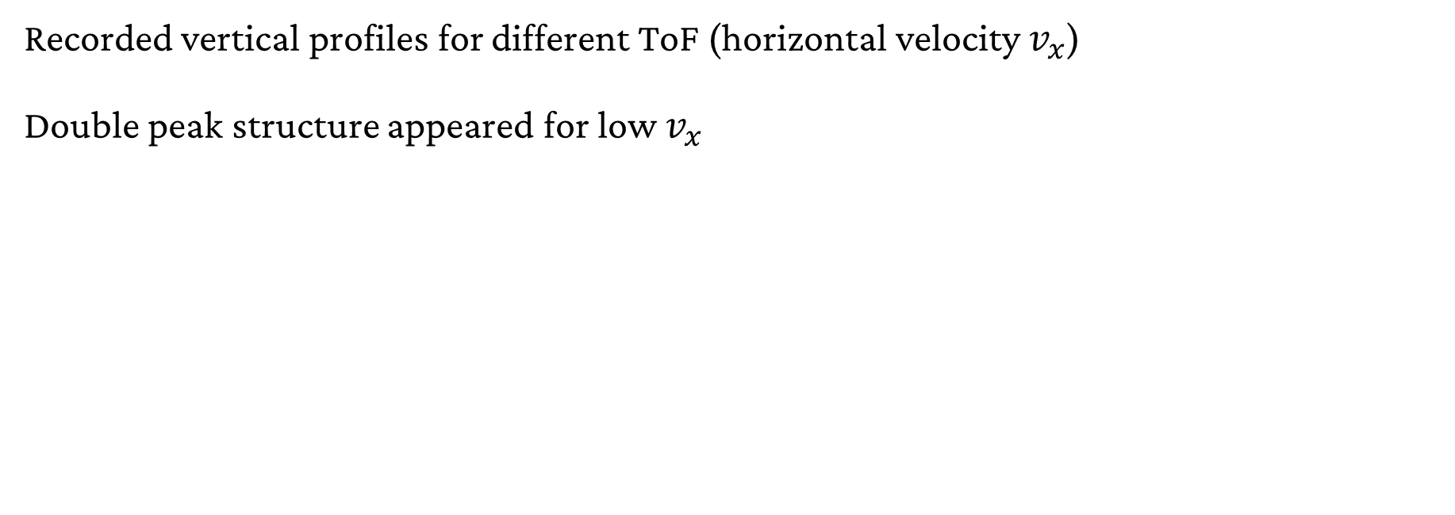
First Measurements with Spectrometer
Recorded vertical profiles for different ToF (horizontal velocity $v_{x}$)
Double peak structure appeared for low $v_{x}$
Preliminary
Preliminary
Preliminary

Slide 11
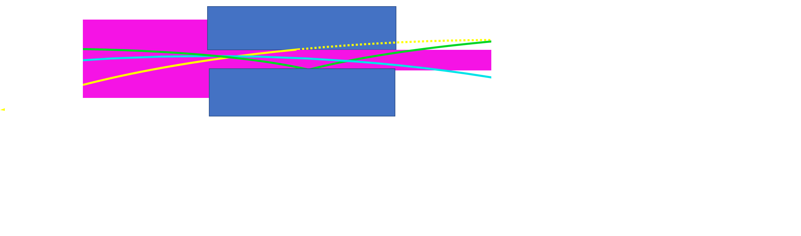
First Observation of QR!
Scatterer
Preliminary
Mirror

Slide 12
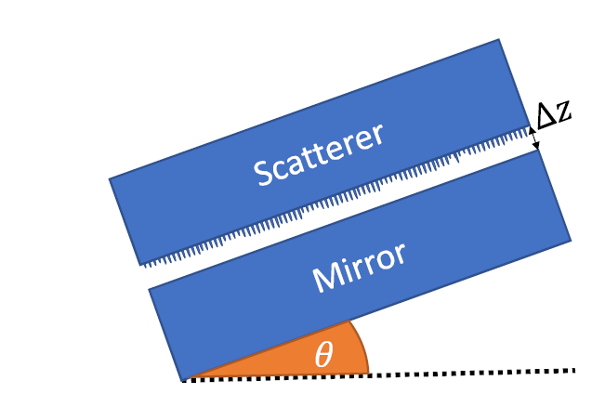
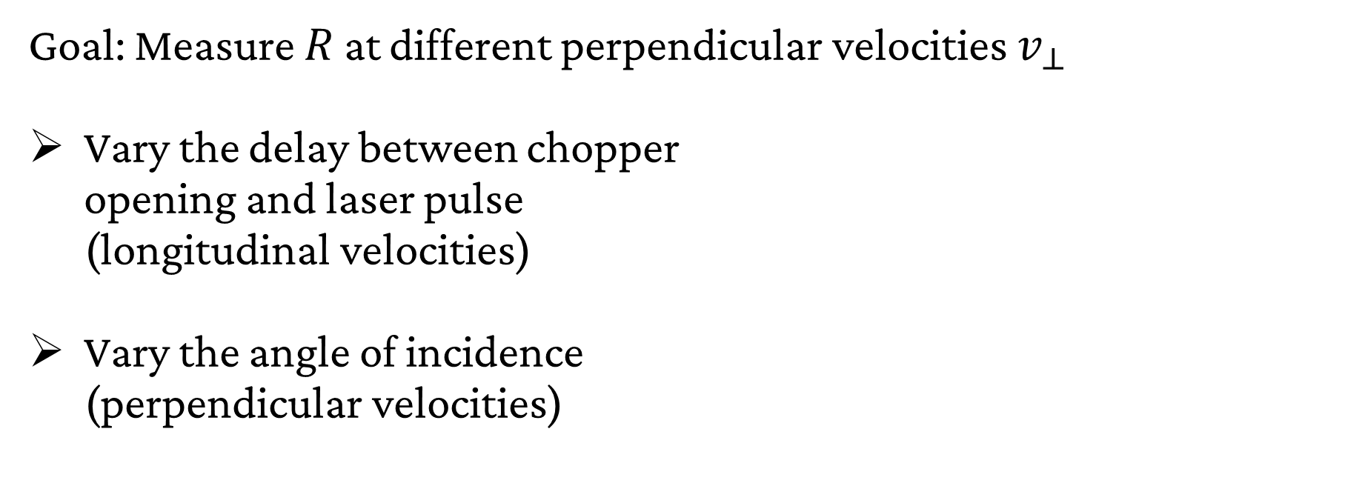

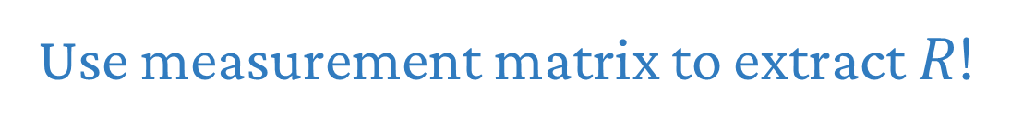
Measurement of the Reflection Coefficient $R$
Goal: Measure $R$ at different perpendicular velocities $v_{⊥}$
Vary the delay between chopper
opening and laser pulse
(longitudinal velocities)
Vary the angle of incidence
(perpendicular velocities)
Use measurement matrix to extract $R$!

Slide 13
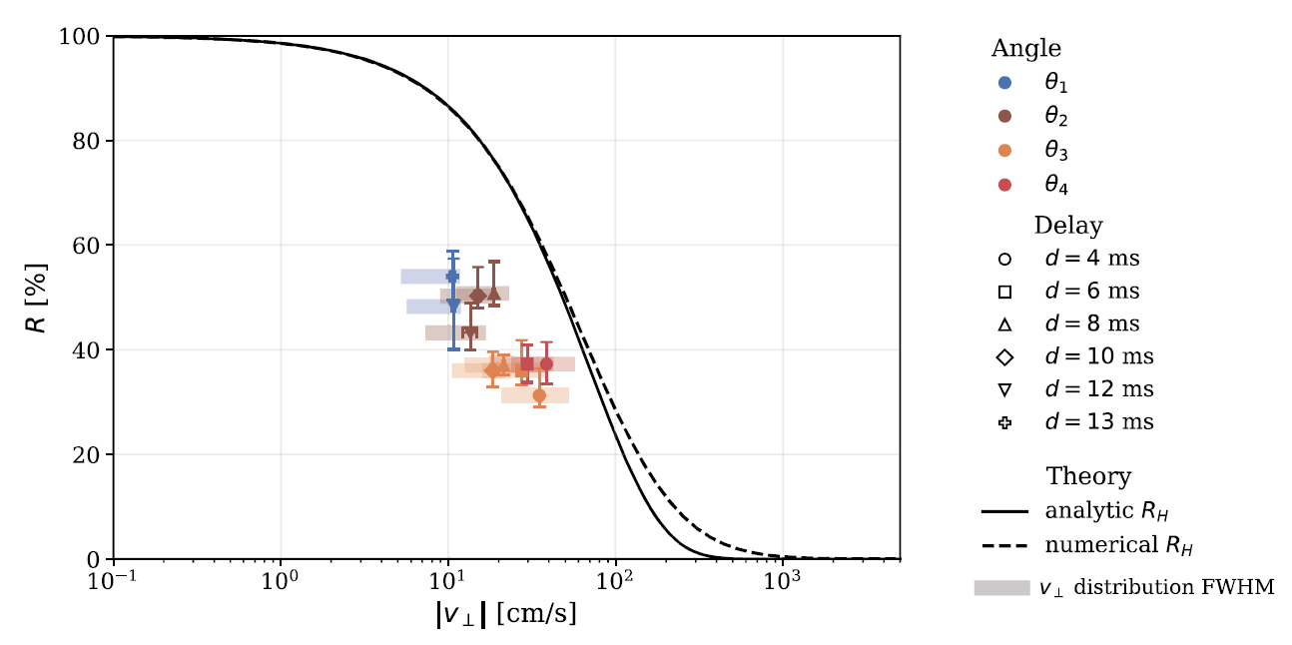
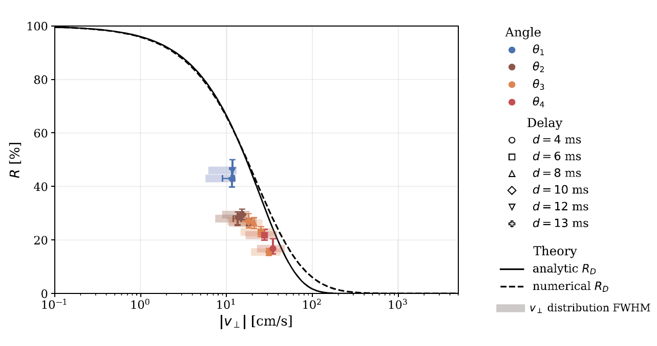

Quantum refection of $\text{H}$ and $\text{D}$
  Hydrogen
  Deuterium
PRELIMINARY
PRELIMINARY

Slide 14
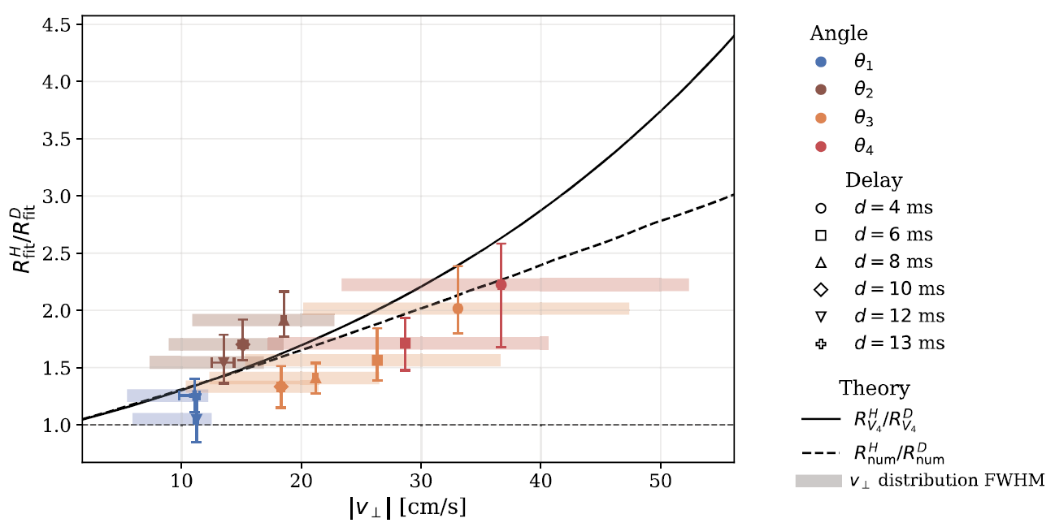

Isotope Shift of $R$
PRELIMINARY

Slide 15
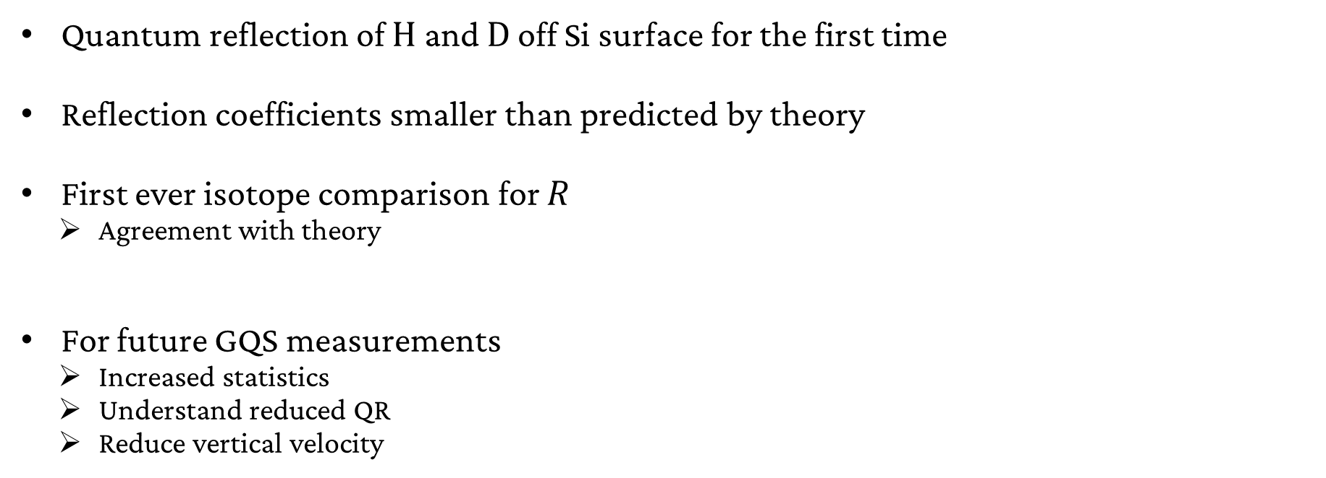
Summary & Outlook
Quantum reflection of $\text{H}$ and $\text{D}$ off Si surface for the first time
Reflection coefficients smaller than predicted by theory
First ever isotope comparison for $R$
  Agreement with theory
For future GQS measurements
  Increased statistics
  Understand reduced QR
  Reduce vertical velocity

Slide 16
Backup

Slide 17
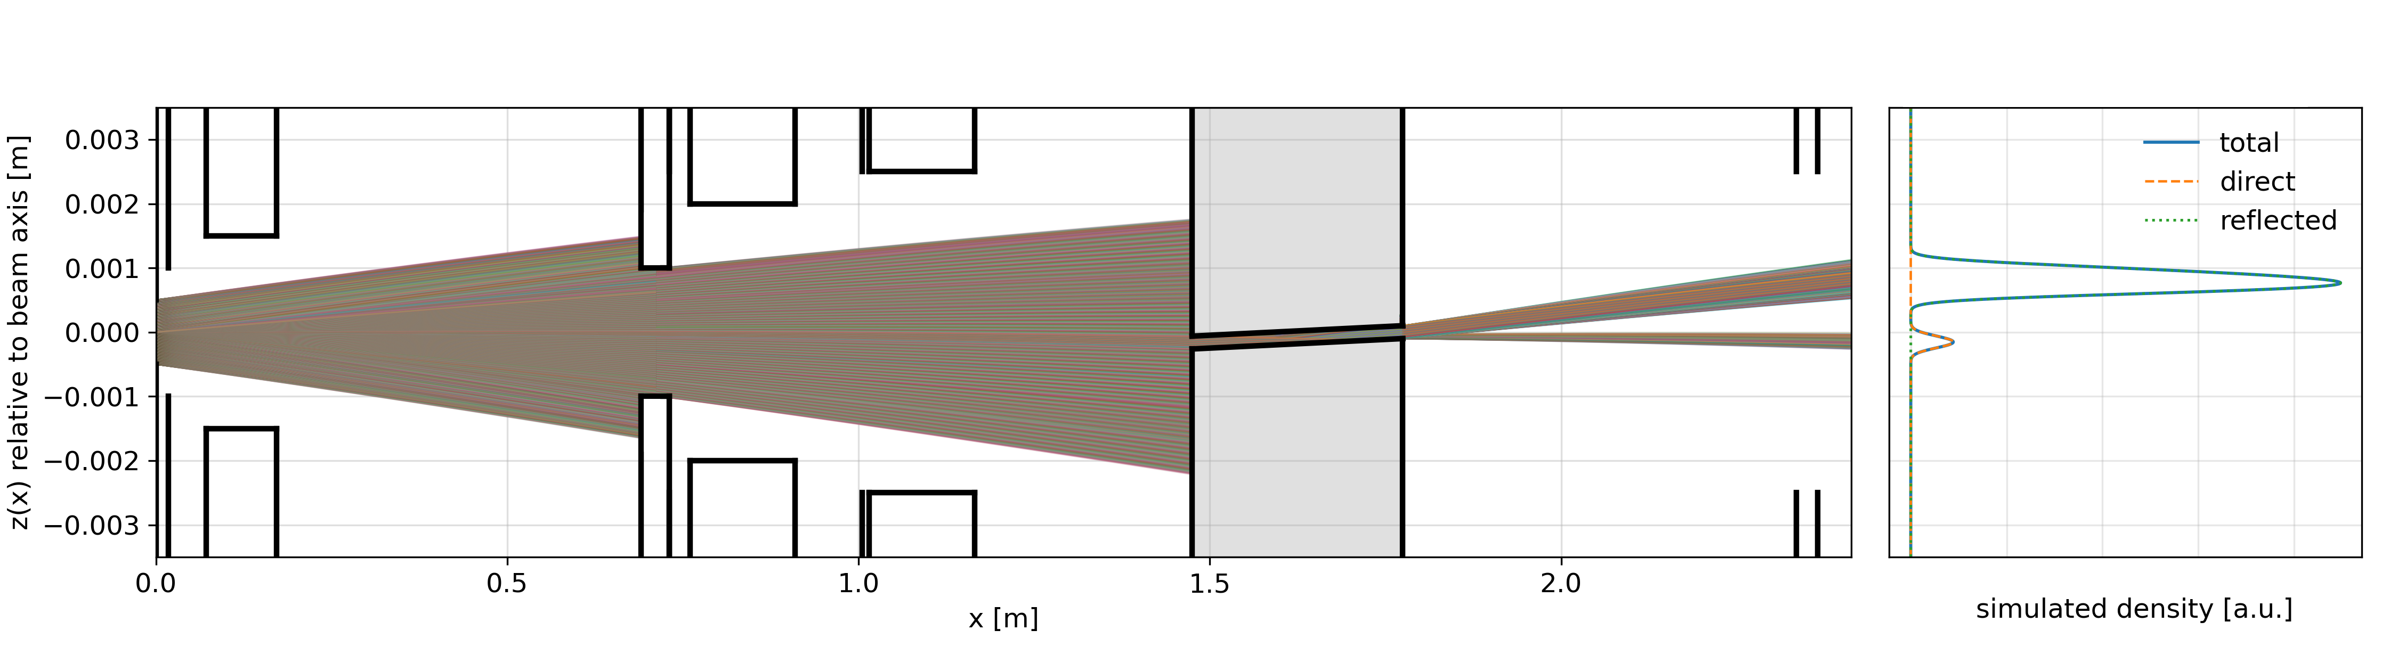
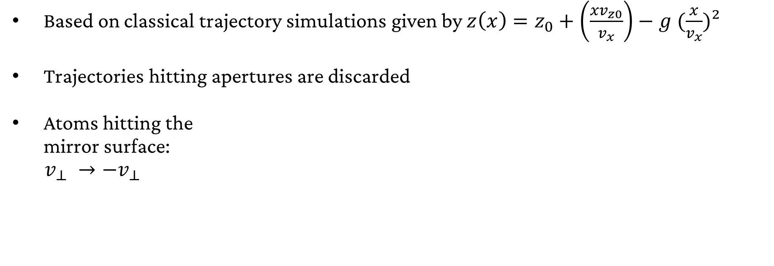
QR Analysis
Based on classical trajectory simulations given by $z\left(x\right)=z_{0}+\left(\frac{xv_{z0}}{v_{x}}\right)−g (\frac{x}{v_{x}})²$
Trajectories hitting apertures are discarded
Atoms hitting the
mirror surface:
$v_{⊥} →−v_{⊥}$
Chopper
Heatshields
CH2
Pipe aperture (PA) 1
Pipe aperture (PA) 3
Pipe aperture (PA) 2
Slit 2
Nozzle + Heatshield
Slit 1
GQS spectrometer

Slide 18
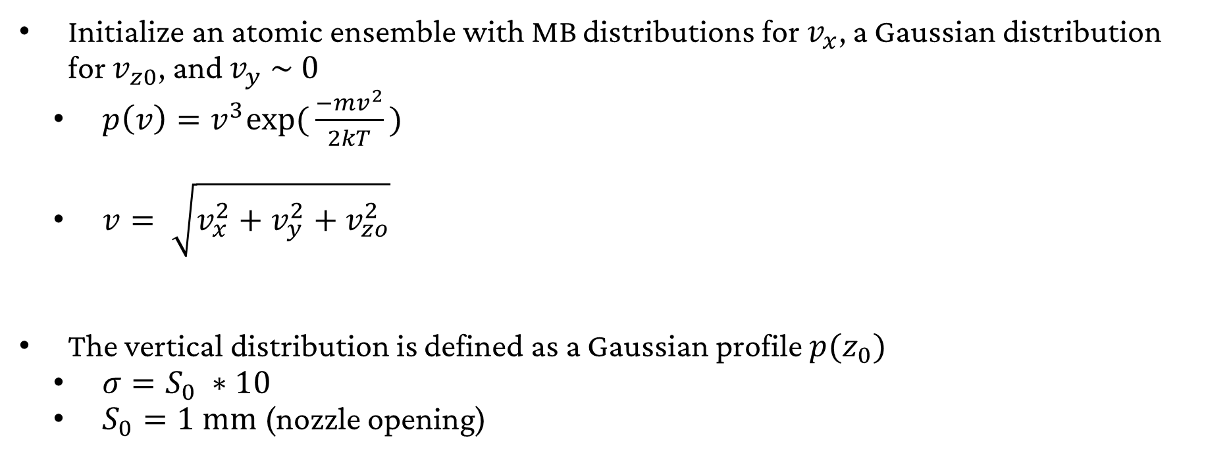
QR Analysis: Initial Beam
Properties
Initialize an atomic ensemble with MB distributions for $v_{x}$, a Gaussian distribution for $v_{z0}$, and $v_{y} \sim 0$
  $p\left(v\right)=v^{3}\text{exp}\text{(}\frac{−mv^{2}}{2kT}\text{)}$
  $v= \sqrt{v_{x}^{2}+v_{y}^{2}+v_{zo}^{2}}$
The vertical distribution is defined as a Gaussian profile $p(z_{0})$
  $σ=S_{0} ∗10$
  $S_{0}=1 \text{mm}$ (nozzle opening)

Slide 19
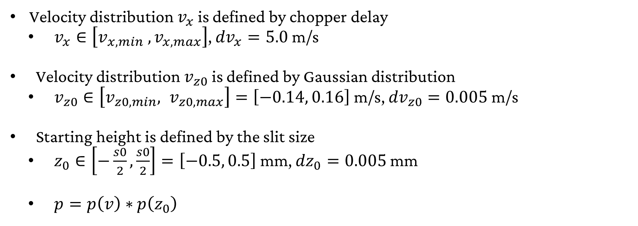
QR Analysis: Trajectories
Velocity distribution $v_{x}$ is defined by chopper delay
  $v_{x}∈\left[v_{x,min} , v_{x,max}\right]$, ${dv}_{x}=5.0$ m/s
Velocity distribution $v_{z0}$ is defined by Gaussian distribution
  $v_{z0}∈\left[v_{z0,min}, v_{z0,max}\right]=\left[−0.14, 0.16\right]$m/s, ${dv}_{z0}=0.005$ m/s
Starting height is defined by the slit size
  $z_{0}∈\left[−\frac{s0}{2},\frac{s0}{2}\right]=\left[−0.5, 0.5\right]$ mm, ${dz}_{0}=0.005$ mm
  $p=p\left(v\right)∗$ $p\left(z_{0}\right)$

Slide 20
QR Analysis: Parameters
VARIED BY
PARAMETER SCAN
Geometrical parameters:
  Vertical offset of chopper from beam axis
  Vertical offset of GQS spectrometer compared to beam axis
  Exact horizontal position of GQS spectrometer along the beamline
  Angles of the different angle settings
  Pivot point of mirror rotation
  Tilts along third (“y”) axis
Other parameters
  Mapping constant
  Laser beam waist
  Vertical velocity spread
Fit parameters
  Scaling of the curves
  QR probability
VARIED BY
PARAMETER SCAN

Slide 21
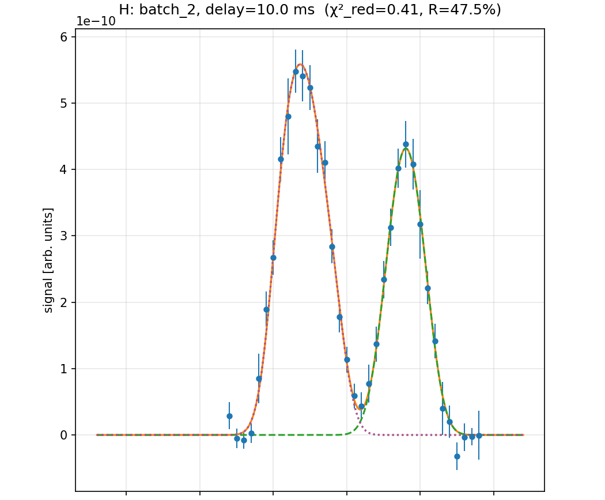
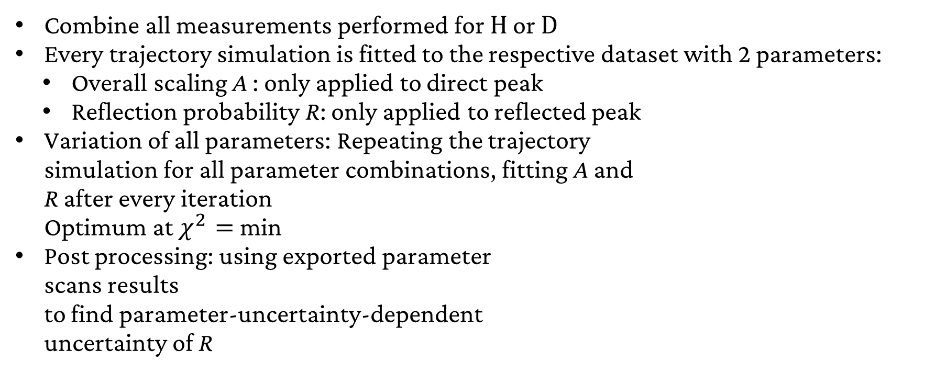
QR Analysis: Global Fit
Combine all measurements performed for $\text{H}$ or $\text{D}$
Every trajectory simulation is fitted to the respective dataset with 2 parameters:
  Overall scaling A : only applied to direct peak
  Reflection probability R: only applied to reflected peak
Variation of all parameters: Repeating the trajectory
simulation for all parameter combinations, fitting A and
R after every iteration
Optimum at $χ^{2}=$min
Post processing: using exported parameter
scans results
to find parameter-uncertainty-dependent
uncertainty of R
Reflected
Peak
Direct Peak

Slide 22
QR Analysis: Parameters
Geometrical parameters:
  Vertical offset of chopper from beam axis
  Vertical offset of GQS spectrometer compared to beam axis
  Exact horizontal position of GQS spectrometer along the beamline
  Angles of the different angle settings
  Pivot point of mirror rotation
  Tilts along third (“y”) axis
Other parameters
  Mapping constant
  Laser beam waist
  Vertical velocity spread
Fit parameters
  Scaling of the curves
  QR probability

