Slide 1






Probing intermediate-mass black hole assembly in star clusters with gravitational waves
Lavinia Paiella
4th year PhD student @ GSSI, she / her
OePG-CMD-Graz2026, GW Mini Colloquia
21st September 2026, Graz University
?
Supervisors:
Prof. Manuel Arca Sedda,
Prof. Gor Oganesyan

Slide 2
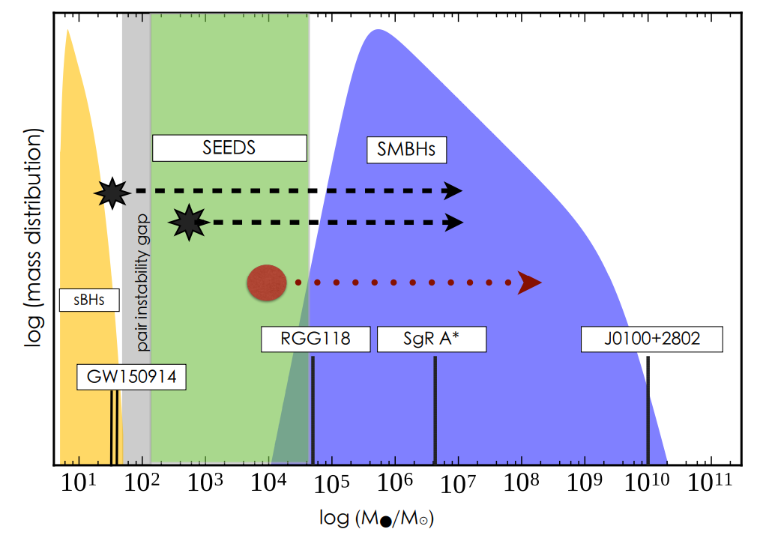

Intermediate-mass black holes: where is everybody?
Barack+ (2019)
Intermediate-Mass Black Hole = IMBH
INTERMEDIATE-MASS
STELLAR-MASS
SUPERMASSIVE
Black Hole = BH
IMBHs may hold key clues into how black holes grow many orders of magnitude in mass over cosmic times.

Slide 3

(Some) IMBH formation channels
Stellar collisions
*
*
Tidal disruptions
?
Gas accretion
?
Migration Traps
Hierarchical mergers
Star Clusters
Direct Collapse
?
Gas accretion
Population-III stars
?
Active Galactic Nuclei
High redshift
Dynamical assembly
*
Typically invoked for supermassive black hole seeds formation

Slide 4
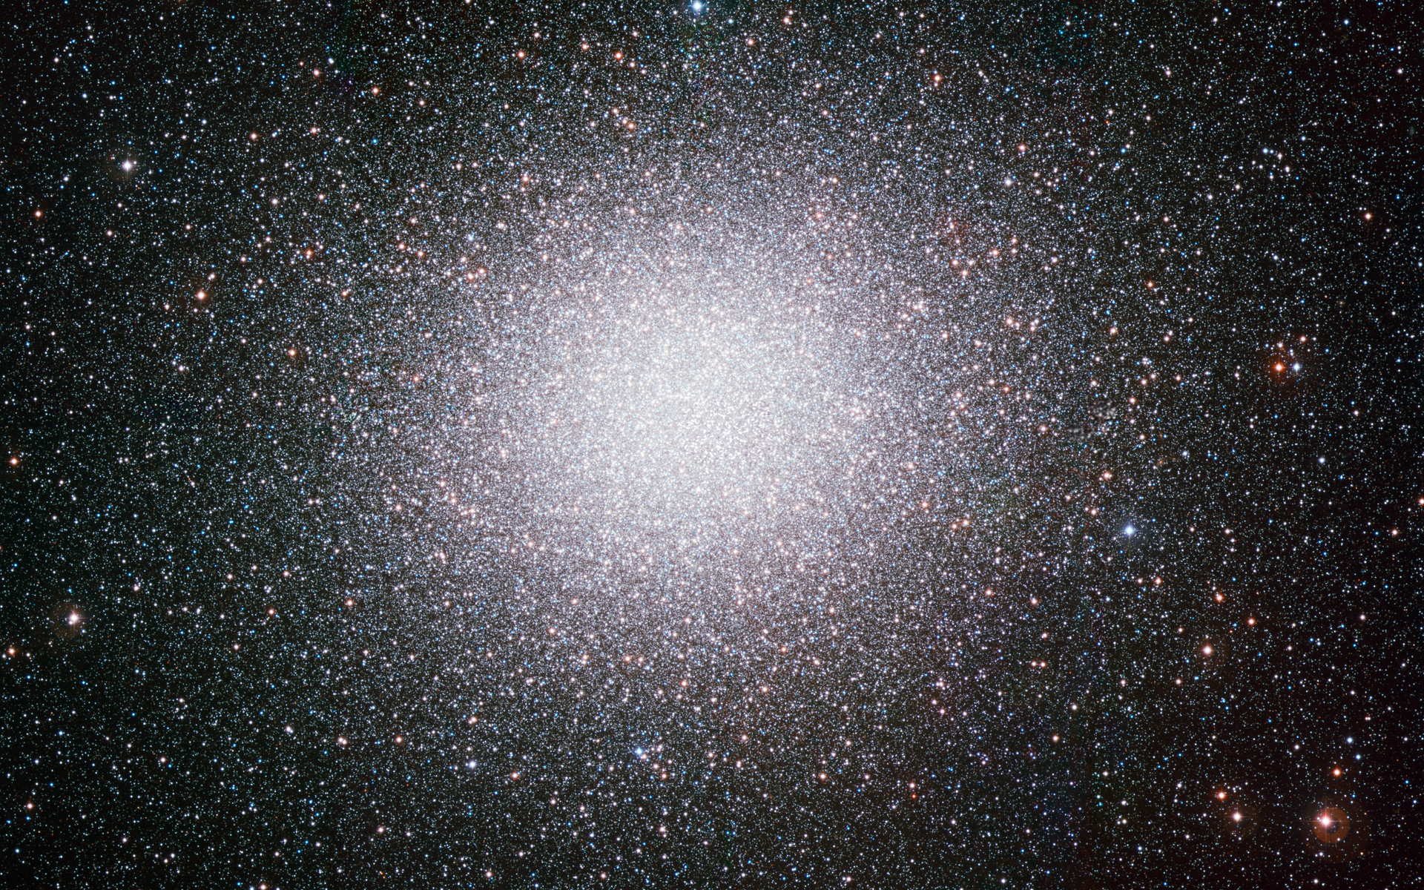


(Some) IMBH formation channels
$ω$-Centauri
Stellar collisions
Tidal disruptions
?
?
Hierarchical mergers
Star Clusters
?
Gas accretion
?
Star clusters are dense collections of stars and BHs
IMBHs can be assembled in star clusters via (repeated) stellar and binary BH mergers

Slide 5
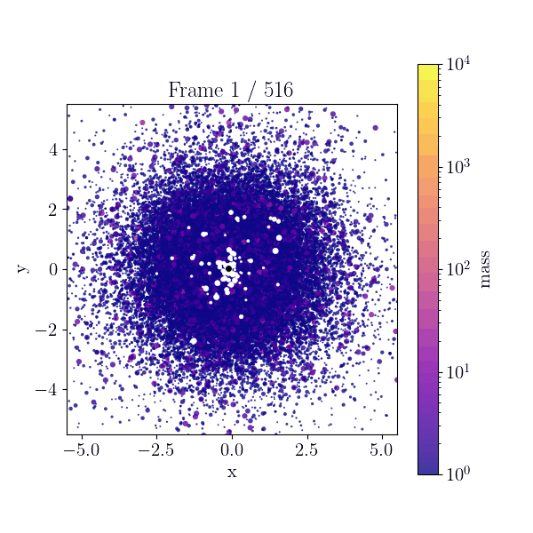
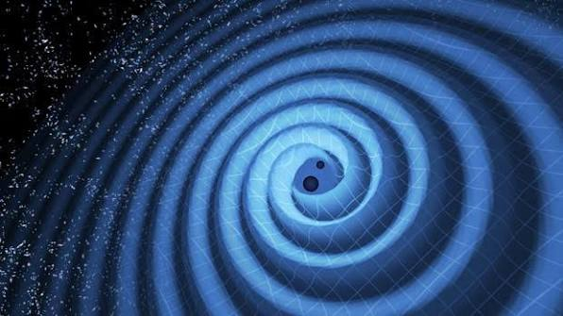
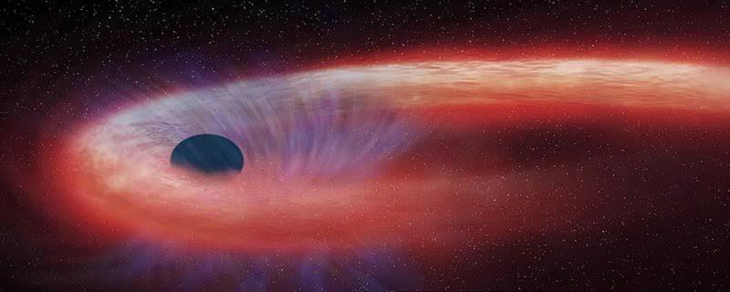
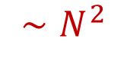
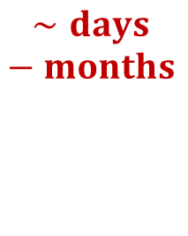
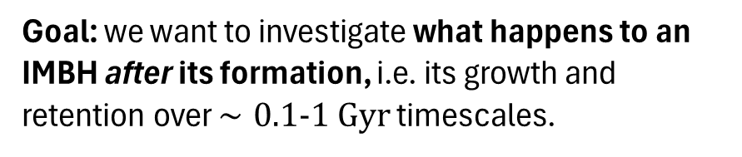
The brute force approach: N-body simulations
$$∼days −months$$
N-body simulations model the single interactions of stars and black holes providing a detailed description of IMBH assembly.
$$∼N^{2}$$
Goal: we want to investigate what happens to an IMBH after its formation, i.e. its growth and retention over $∼0.1-1 Gyr$ timescales.
INA24_C7B15 project, on Leonardo Booster
Pleiadi Call 7 (Cineca), granted 65000 core-hours
Compact Binary Mergers
Tidal Disruption Events

Slide 6







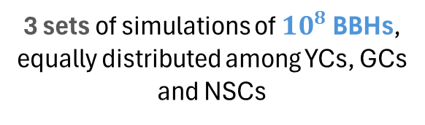

Semi-analytic population synthesis codes: B-POP
Isolated & dynamical:
Fast code for evolving populations of binary black holes in isolated fields and star clusters.
5 $M_{⊙}$
stellar
Arca Sedda, Paiella, Ugolini+ (2026)
[New!] Stellar collisions prescriptions tuned on N-body simulations (DRAGON-II & BI-FROST simulations)
100 $M_{⊙}$
Only dynamical:
intermediate
Arca Sedda & Benacquista (2020), Arca Sedda+ (2023)
$O\left({10}^{6}\right)$ BBHs in $∼$ few hours
Paiella+ (2026)
${10}^{6}$ $M_{⊙}$
3 sets of simulations of ${10}^{8}$ BBHs, equally distributed among YCs, GCs and NSCs
supermassive
Input stellar catalogs from SEVN
[Iorio+ 2022, Spera +2019]

Slide 7
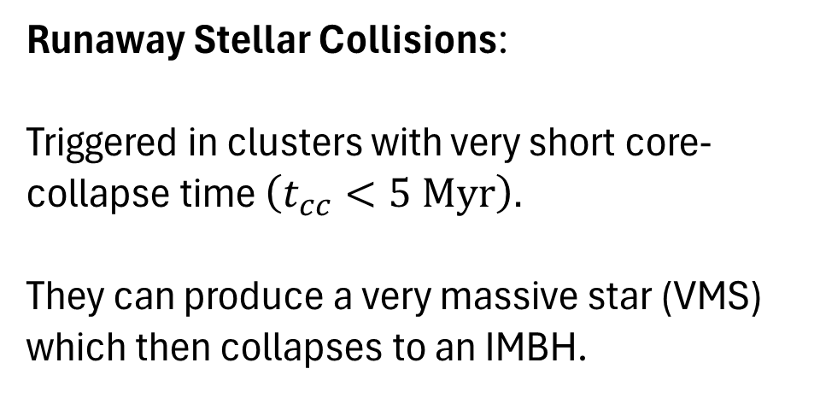

IMBH formation in star clusters: stellar collisions
Runaway Stellar Collisions:
Triggered in clusters with very short core-collapse time $\left(t_{cc}<5 Myr\right).$
They can produce a very massive star (VMS) which then collapses to an IMBH.
[ see e.g. Portegies Zwart & Mc Millan 2002]
Light and dense clusters.
Low metallicities.
«Fast» process ( few Myr ).
$$t≲5 Myr$$

Slide 8
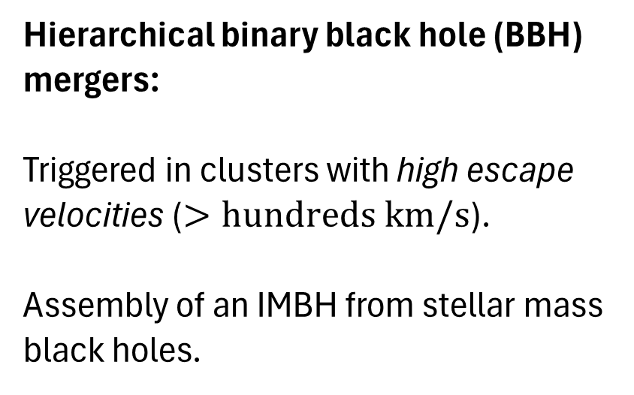


IMBH formation in star clusters: hierarchical mergers
$$v_{esc}∼\sqrt{M_{cl}/R_{cl}}$$
Hierarchical binary black hole (BBH) mergers:
Triggered in clusters with high escape velocities ($>hundreds km/s$).
Assembly of an IMBH from stellar mass black holes.
Very massive clusters.
«Slow» process ( 0.1 – 10 Gyr)
$$t≳5 Myr$$

Slide 9
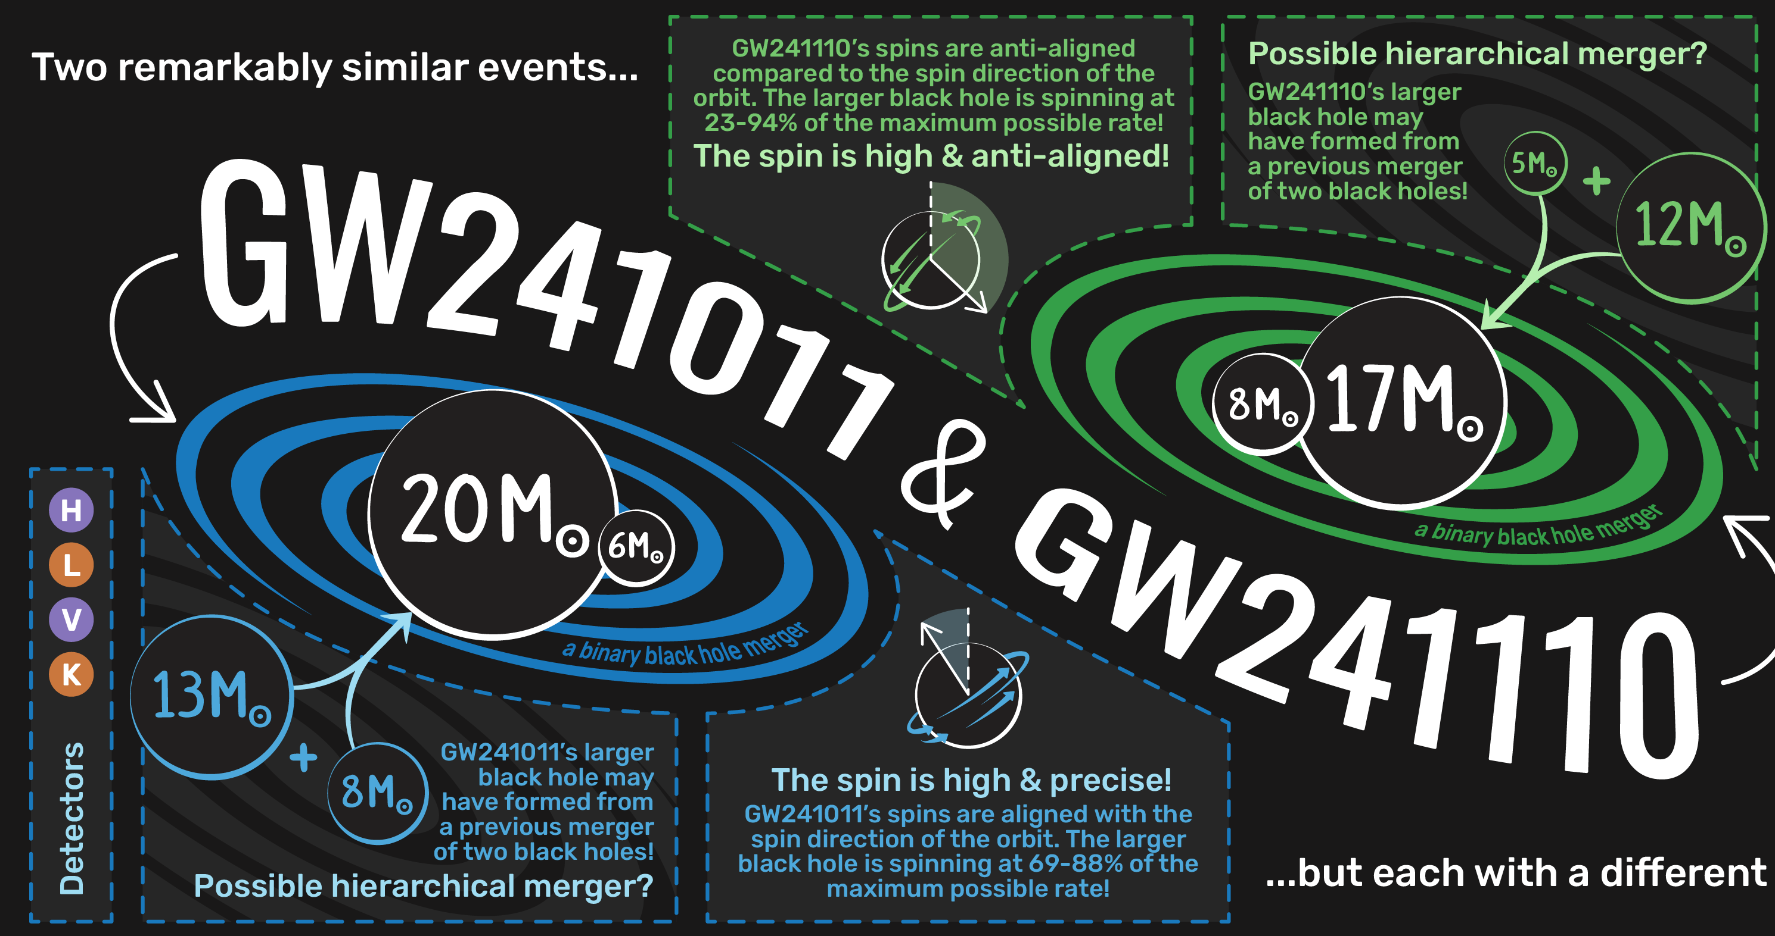
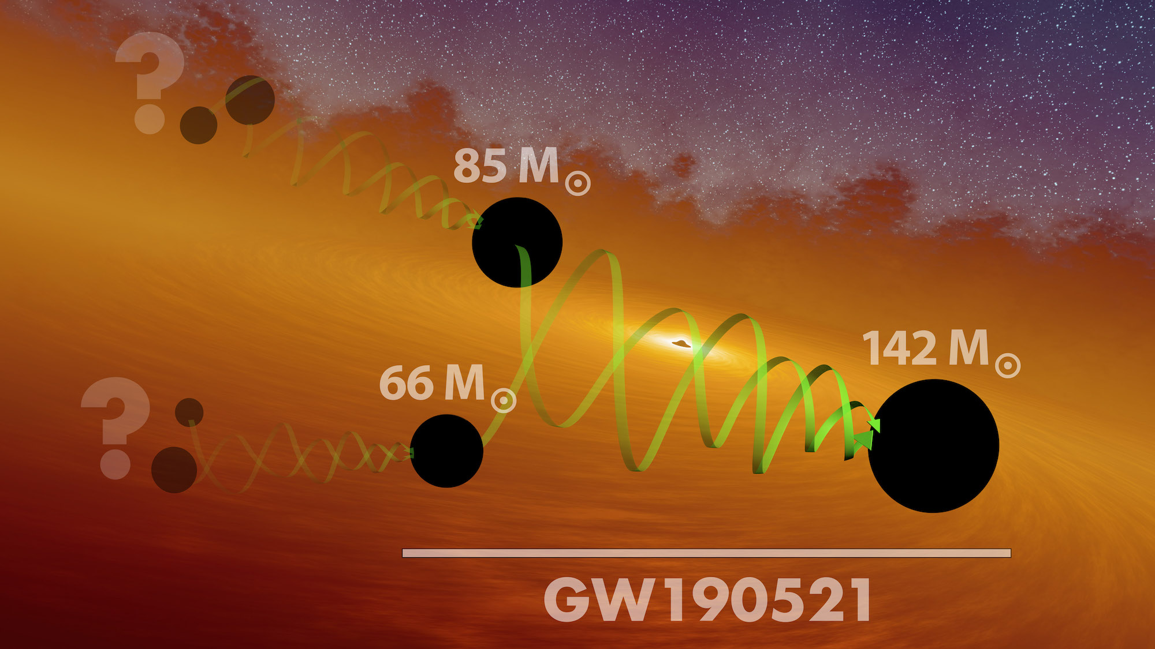
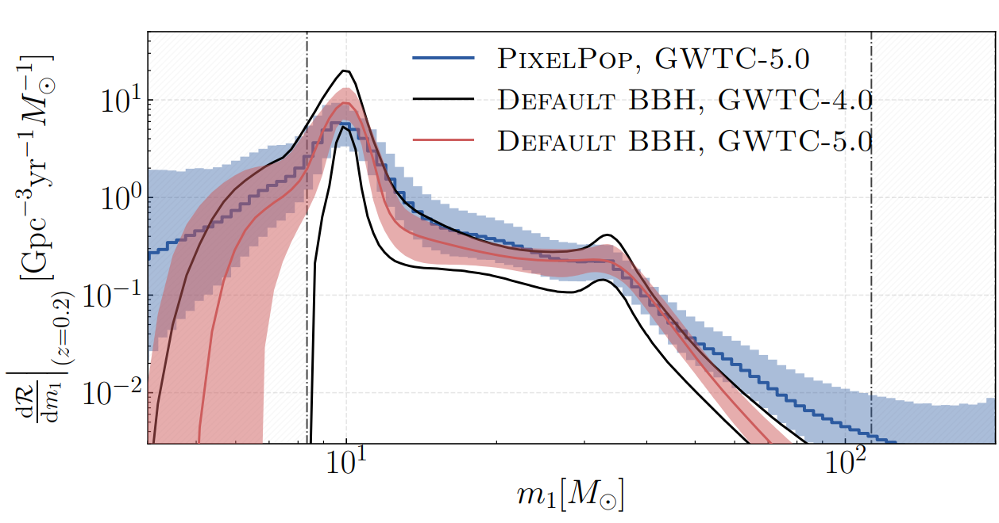
Clues to dynamical binaries and IMBH in current data
GW241011 & GW241110: tilted and spinning
high spins and precession?
GW190521: formation of an IMBH
[Abac+ 2025b]
[Abbott+ 2022]
eccentric?
[see e.g. Romero- Shaw+ 2020, Arca Sedda+ 2021]
[Abac+ 2026]
dynamical binaries?
[see e.g. Antonini+ 2025, Arca Sedda+ 2026]

Slide 10
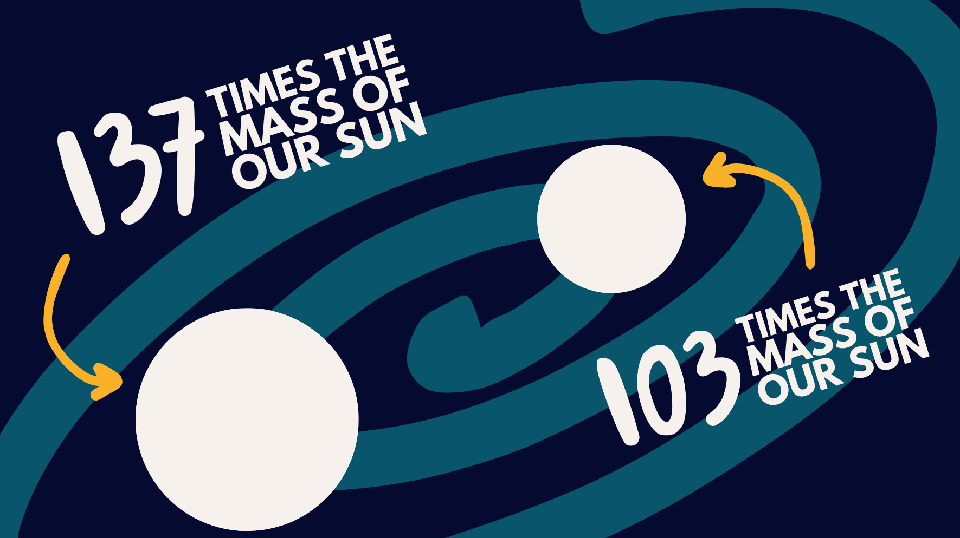
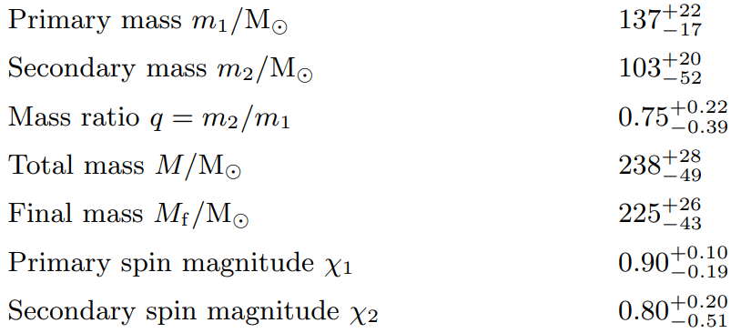
Clues to dynamical binaries and IMBH in current data
[Abac+ 2025b]
[Abbott+ 2022]
[Abac+ 2025a]
[Abac+ 2026]
could it have formed in a star cluster?
GW231123: first IMBH-IMBH merger?

Slide 11
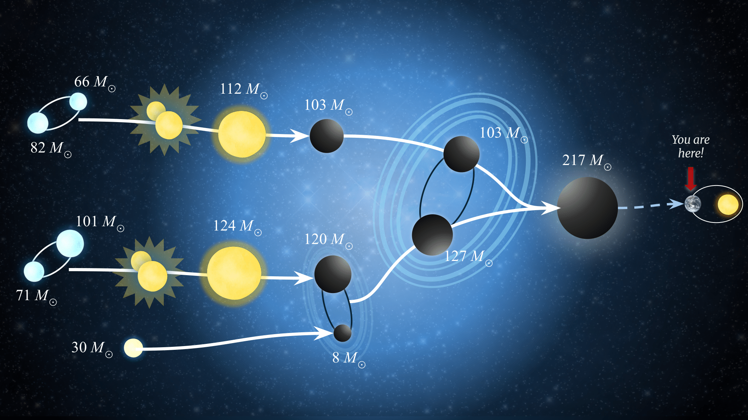

The strange case of GW231123
Gravitational waves (GWs) are extremely valuable probes to IMBH assembly since they carry direct information on the merging objects properties, such as their masses and spins.
dynamical origin?
Stellar mergers and hierarchical binary black hole (BBH) mergers in star clusters can produce BHs in and above the gap.
GW231123: first IMBH-IMBH merger?
GSSI press release
Can we form BHs heavier than 100 solar masses?
Paiella+ (2025)
Can we form them highly spinning?

Slide 12
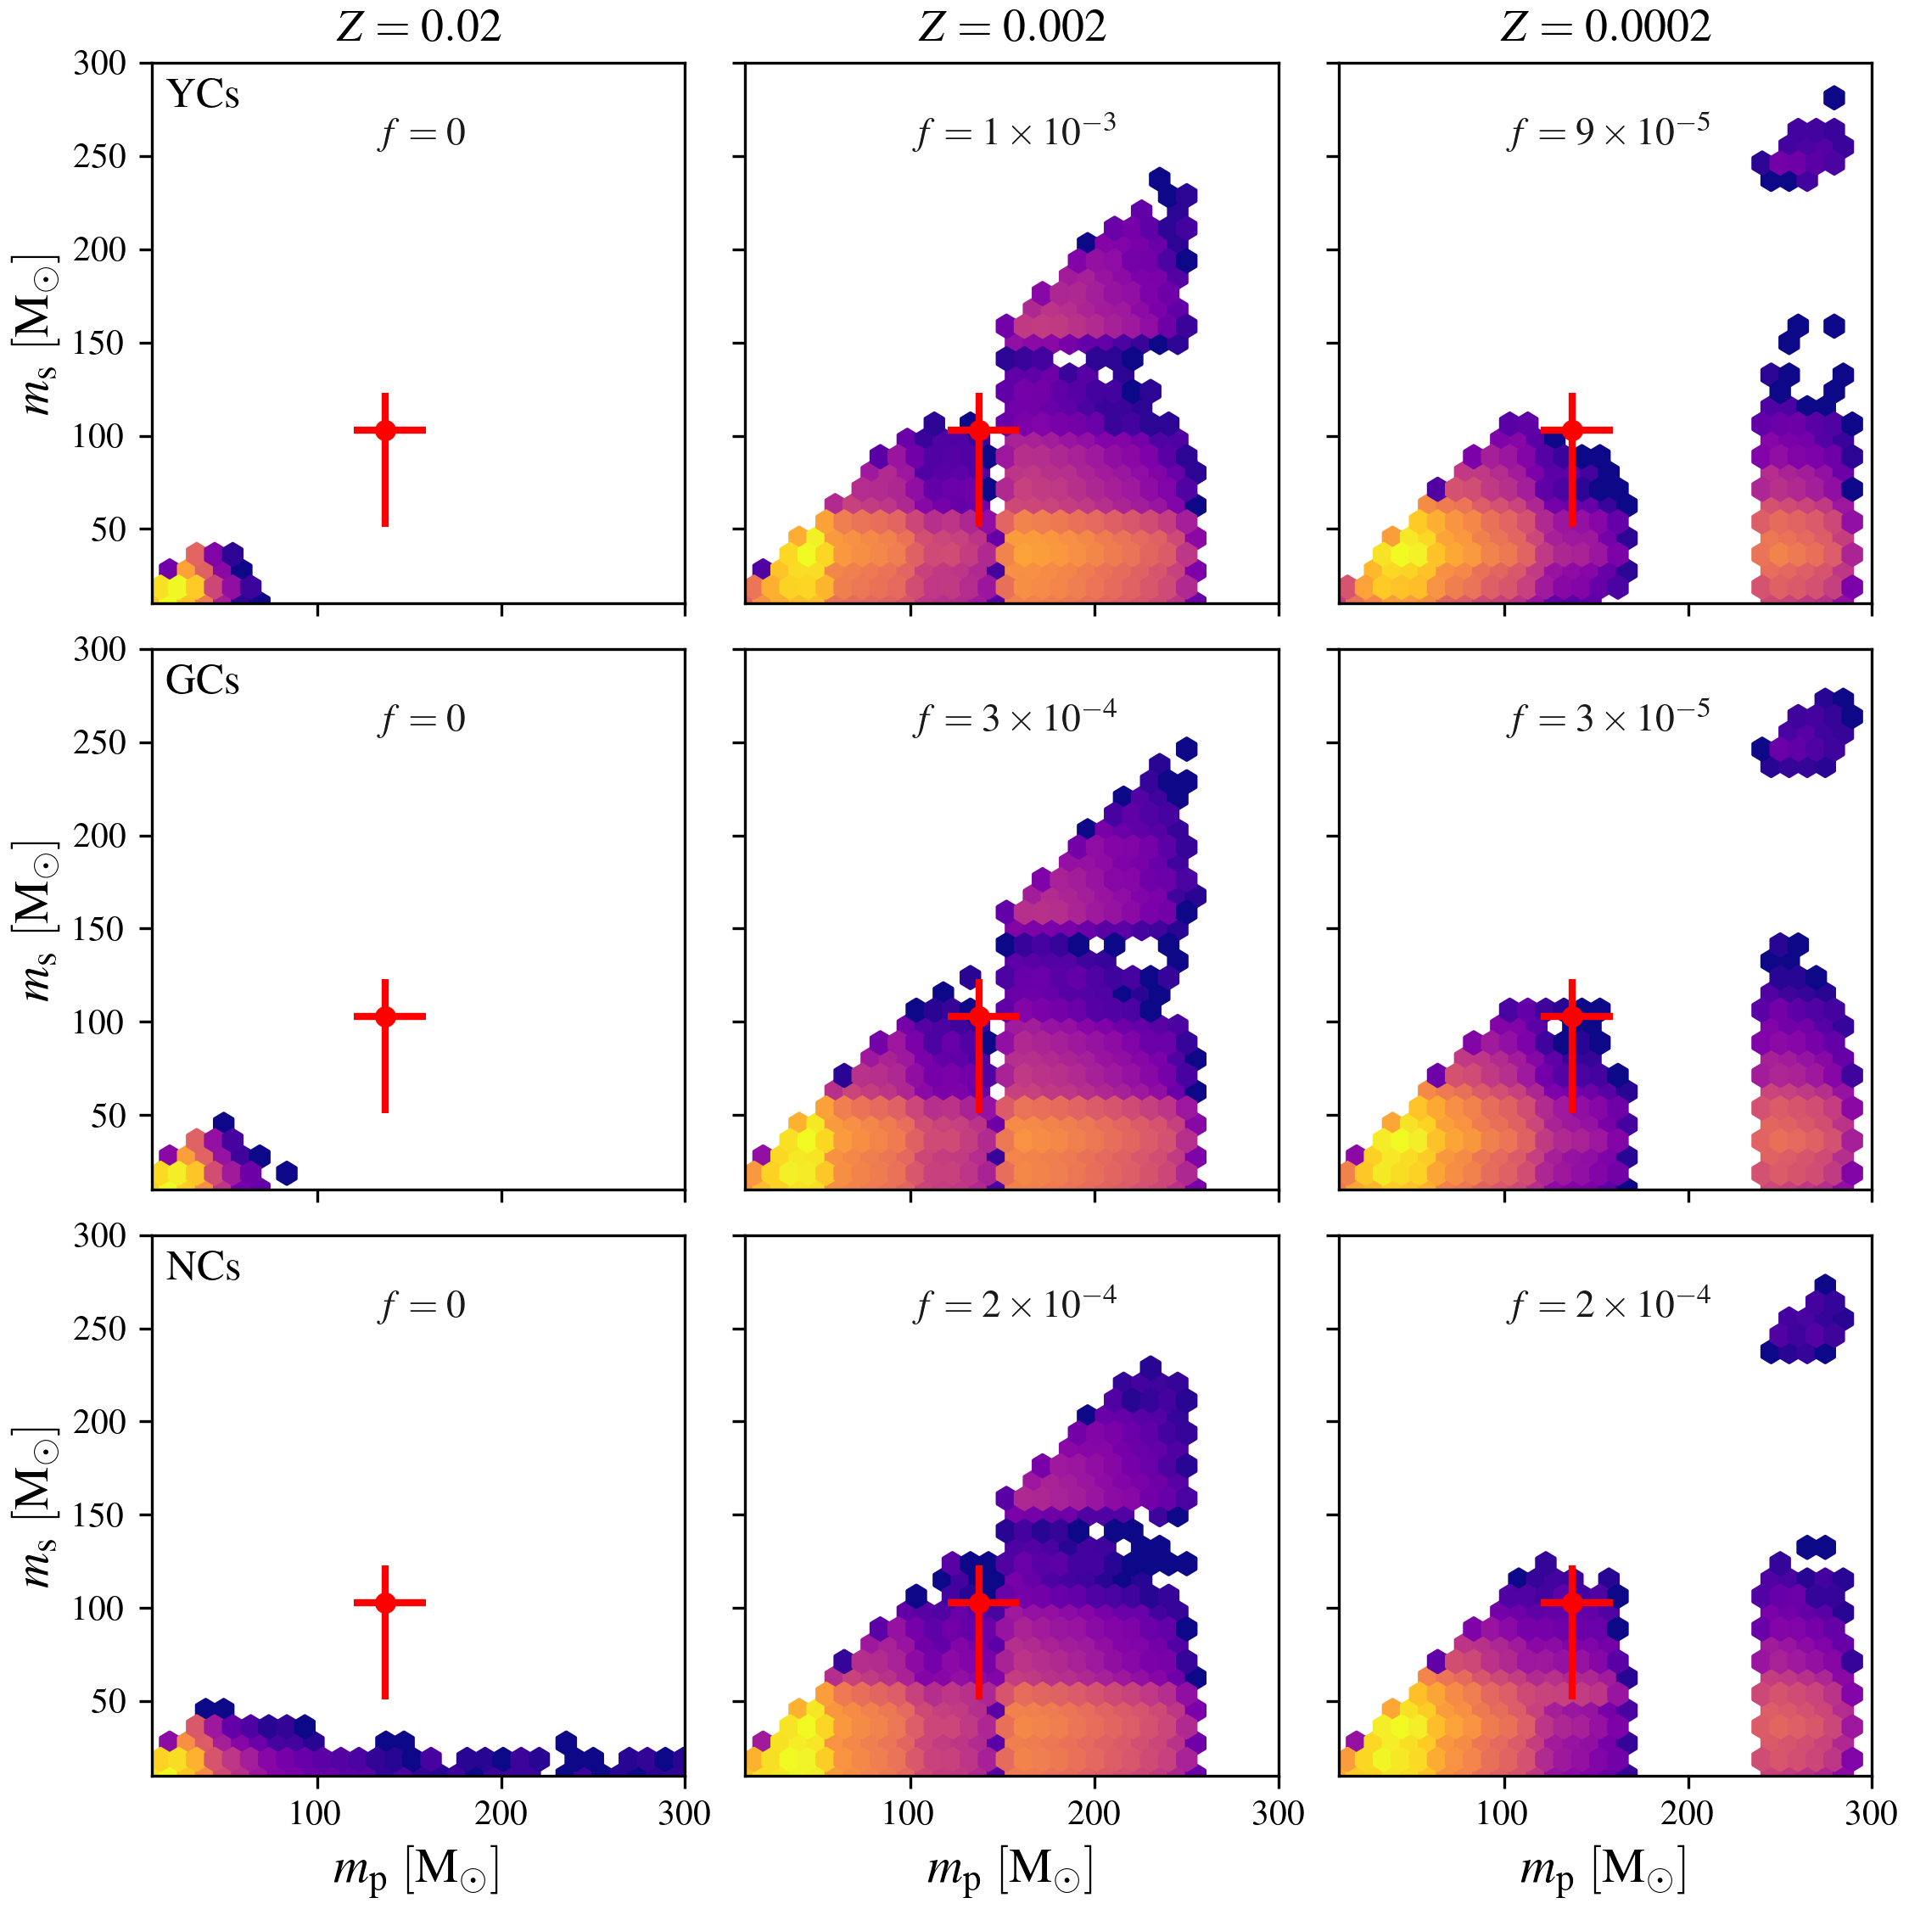
Recovering the masses
decreasing metallicity
Adapted from Paiella+ (2025)
Metallicity affects BH masses and the position of the upper-mass gap.
Low metallicities result in heavier BHs.
High escape velocity environments favor BH retention and support hierarchical chains of BBH mergers.
increasing escape velocity

Slide 13
Recovering the masses
decreasing metallicity
Adapted from Paiella+ (2025)
Metallicity affects BH masses and the position of the upper-mass gap.
Low metallicities result in heavier BHs.
High escape velocity environments favor BH retention and support hierarchical chains of BBH mergers.
increasing escape velocity

Slide 14
Recovering the masses
decreasing metallicity
Adapted from Paiella+ (2025)
Metallicity affects BH masses and the position of the upper-mass gap.
Low metallicities result in heavier BHs.
High escape velocity environments favor BH retention and support hierarchical chains of BBH mergers.
increasing escape velocity

Slide 15
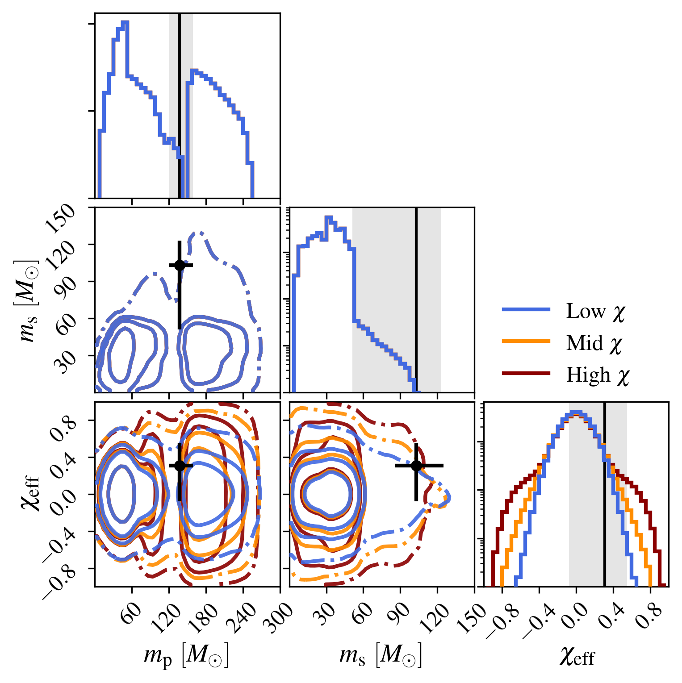
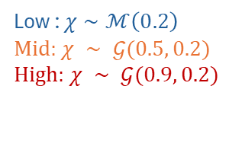
Recovering the spins
Hierarchical BBH merger remnants are expected to have spins $χ ∼ 0.7$ [Berti+ 2007; Hofmann+ 2016].
Stellar merger products spins are largely unconstrained (spin-up: tides, merger dynamics; spin-down: mass loss, magnetic braking).
Fiducial model, all BHs are the same
(«low» spins model):
as suggested by LVK observations performed during the first three observing runs [Abbott+ 2023]
Alternative models, upper-mass gap BHs spin faster («mid» and «high» spins model):
Low : $χ∼ℳ\left(0.2\right)$
Mid: $χ ∼ 𝒢(0.5, 0.2)$
High: $χ ∼ 𝒢(0.9, 0.2)$
What if stellar merger remnants were highly spinning?
Adapted from Paiella+ (2025)

Slide 16
Recovering the spins
Hierarchical BBH merger remnants are expected to have spins $χ ∼ 0.7$ [Berti+ 2007; Hofmann+ 2016].
Stellar merger products spins are largely unconstrained (spin-up: tides, merger dynamics; spin-down: mass loss, magnetic braking).
The occurence of GW231123-like mergers:
generally increases by 2-3 orders of magnitude in mid-high spin scenarios.
from hierarchical chains decreases slightly due to larger post-merger relativistic kicks.
Low : $χ∼ℳ\left(0.2\right)$
Mid: $χ ∼ 𝒢(0.5, 0.2)$
High: $χ ∼ 𝒢(0.9, 0.2)$
Can we improve our estimates on spins of stellar merger remnants?
Adapted from Paiella+ (2025)

Slide 17
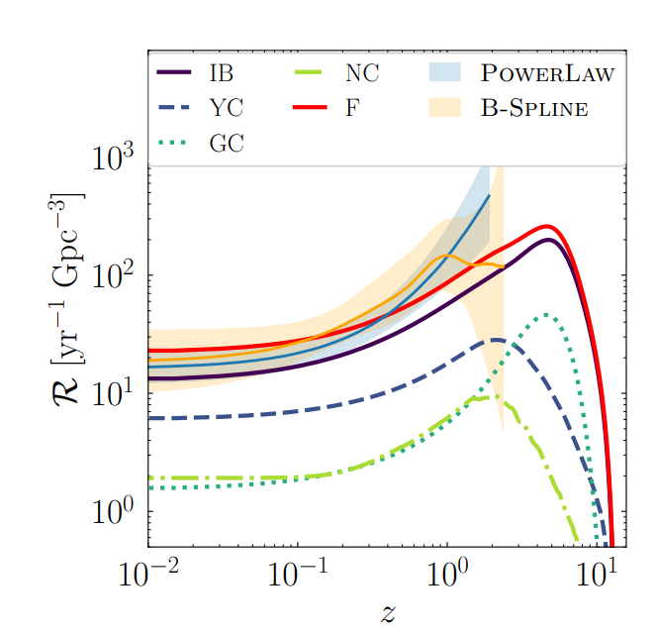
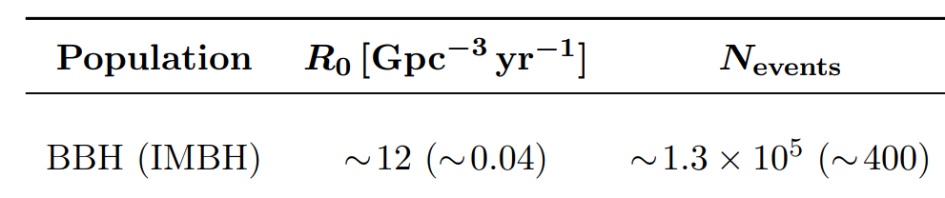
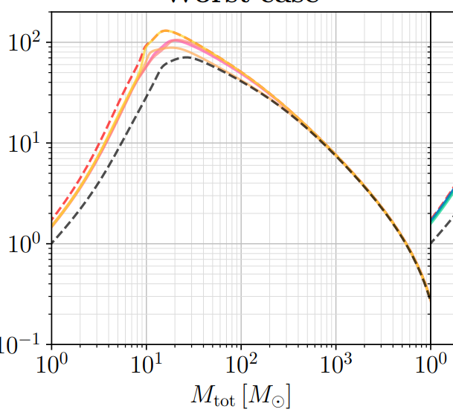

Mock populations of GW sources
We can use our mock populations to: (i) compare IMBH predictions with current GW data (left plot) and (ii) assess the scientific impact of future GW interferometers like the Einstein Telescope (right plot)
!!!
first stars are born
ET may see all GW231123-like mergers in the Universe!
Arca Sedda, Paiella, Ugolini+ (2026)
[Dupletsa , Iacovelli , Korobko, Sequino+, 2026]

Slide 18
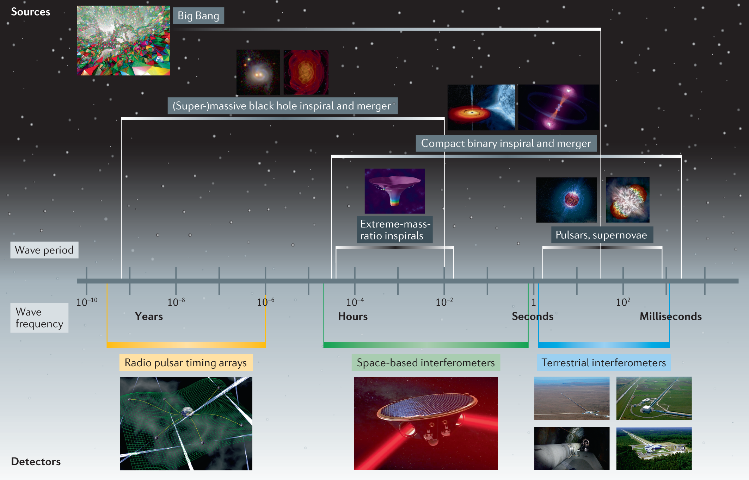



Bailes+ (2021)
$$f_{mer}∼4.4.kHz\left(M_{⊙}/M\right)$$

Slide 19
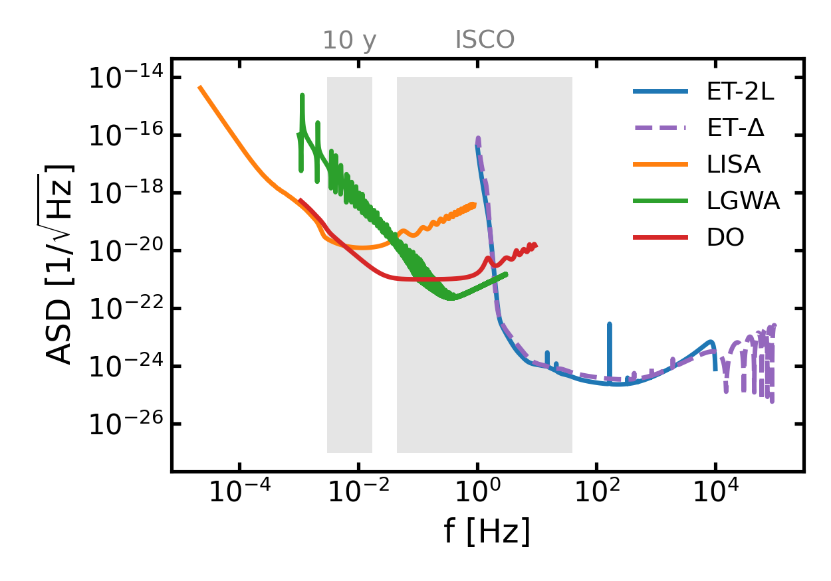

IMBHs and multiband gravitational wave studies
individual star clusters
IMRIs
PRELIMINARY
?
[IMBH + stellar mass BH]
Intermediate mass ratio inspirals (IMRIs) are expected to be promising systems for multiband gravitational wave studies, emitting at frequencies between mHz to Hz.
deci-Hz observatories
How can different detectors act in synergy to study IMBH?
What can they reveal about this population?
Paiella+ (in prep.)
[Dupletsa+ 2022, Dupletsa+ 2024]

Slide 20




Thank you & stay tuned!
lavinia.paiella@gssi.it
lavinia.paiella@github.io
PhD
thesis
Looking for PostDocs

Slide 21
IMBH formation in star clusters: stellar collisions
Runaway Stellar Collisions:
Triggered in clusters with very short core-collapse time $\left(t_{cc}<5 Myr\right).$
They can produce a very massive star (VMS) which then collapses to an IMBH.
[ see e.g. Portegies Zwart & Mc Millan 2002]
Light and dense clusters.
Low metallicities.
«Fast» process ( few Myr ).
$$t≲5 Myr$$

Slide 22
IMBH formation in star clusters: hierarchical mergers
$$v_{esc}∼\sqrt{M_{cl}/R_{cl}}$$
Hierarchical binary black hole (BBH) mergers:
Triggered in clusters with high escape velocities ($>hundreds km/s$).
Assembly of an IMBH from stellar mass black holes.
Very massive clusters.
«Slow» process ( 0.1 – 10 Gyr)
$$t≳5 Myr$$

Slide 23
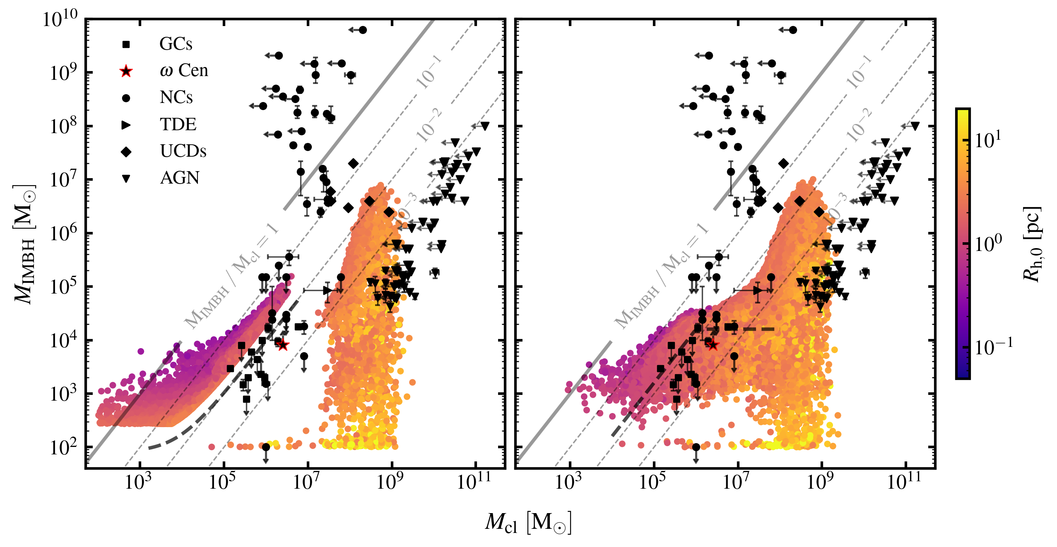
Stellar collisions are needed to recover local candidate observations
Runaway collisions (A)
Mild collisions (B)
Retention is inefficient
Core-collapse time is too long
Paiella+ (2026)
*stellar collisions seeds
*hierarchical mergers
[Lützgendorf et al. 2013b, Kızıltan et al. 2017;Häberle et al. 2024,Lin et al. 2018 ,Graham& Spitler 2009; Neumayer & Walcher 2012; Kormendy & Ho2013,Reines & Volonteri2015; Chilingarian et al. 2018; Nguyen et al. 2018]

Slide 24
Stellar collisions are needed to recover local candidate observations
Runaway collisions (A)
Mild collisions (B)
Better overlap in density-driven model
Paiella+ (2026)
*stellar collisions seeds
*hierarchical mergers
[Lützgendorf et al. 2013b, Kızıltan et al. 2017;Häberle et al. 2024,Lin et al. 2018 ,Graham& Spitler 2009; Neumayer & Walcher 2012; Kormendy & Ho2013,Reines & Volonteri2015; Chilingarian et al. 2018; Nguyen et al. 2018]

Slide 25
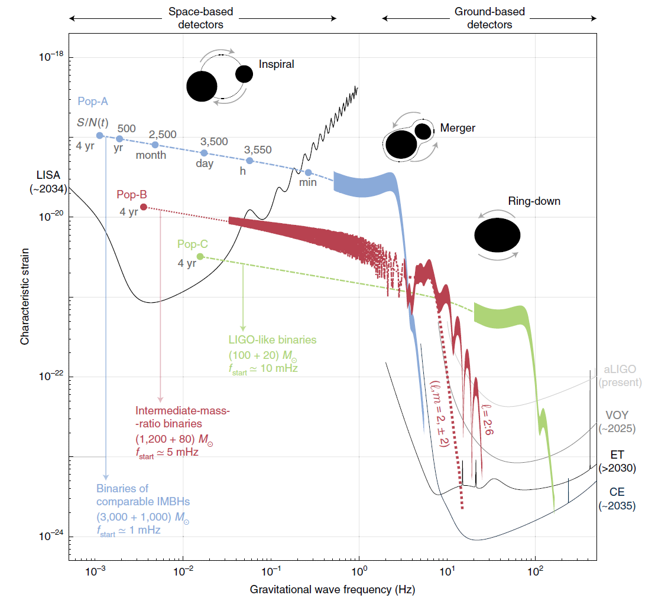
IMBHs and multiband gravitational wave studies: a lot to explore!
[see e.g. Rantala+ 2024, 2025, 2026]
?
Pop-A
interacting
stellar systems
[IMBH + IMBH]
?
?
[see e.g.Arca Sedda & Mastrobuono Battisti 2019, Torniamenti+ 2026]
[see e.g.Khan+2024]
There is a wide variety of channels that could also give rise to binary IMBH mergers. These will contribute to the population of multiband sources accessible by next gen. interferometers!
[Jani, Shoemaker & Cutler 2019]

Slide 26
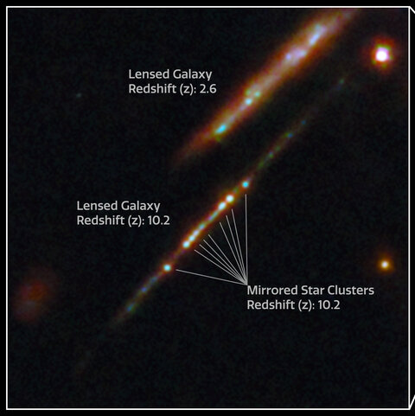
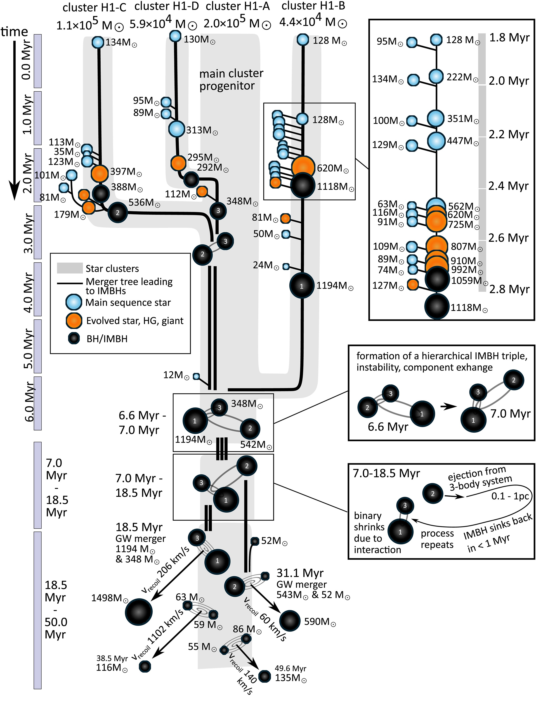
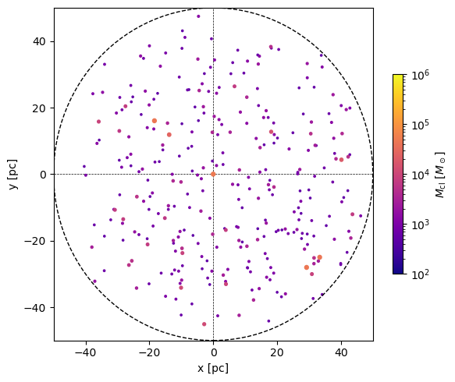
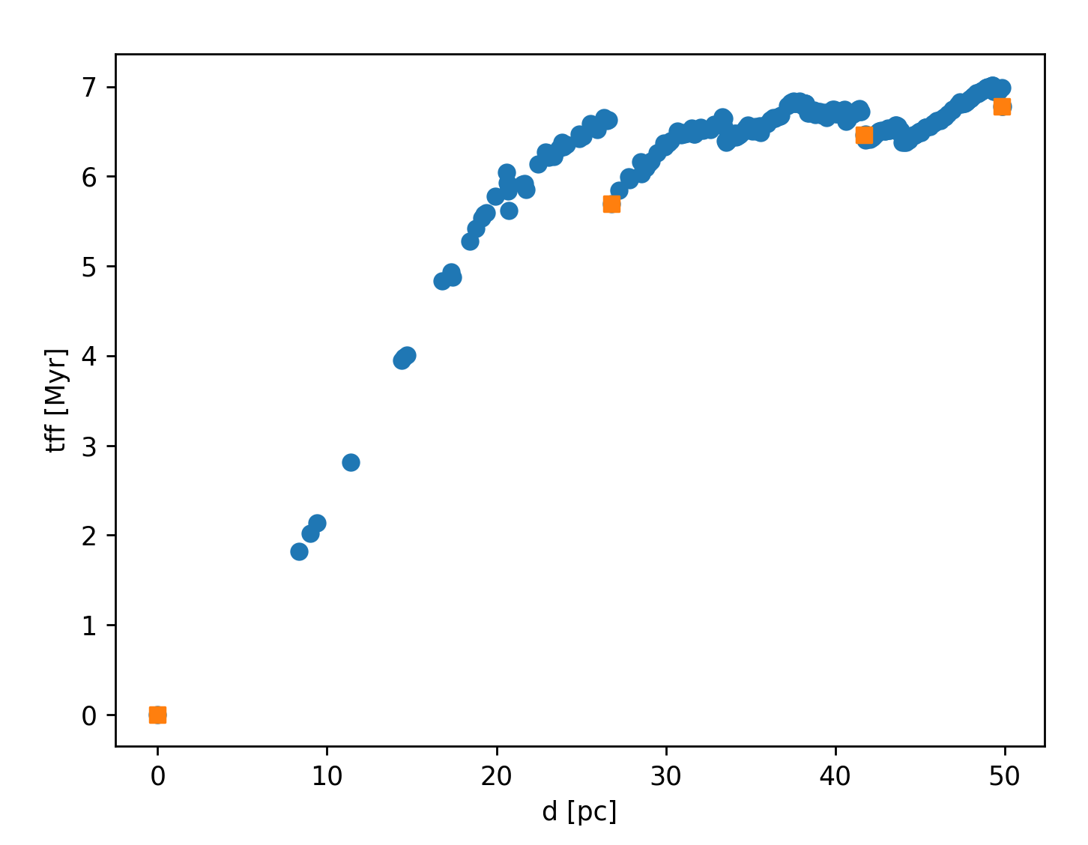
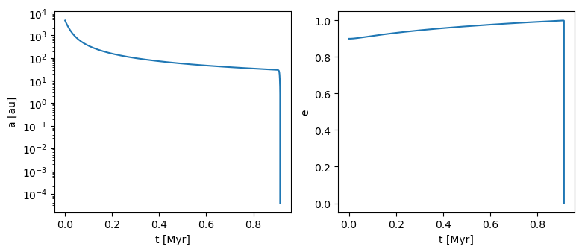
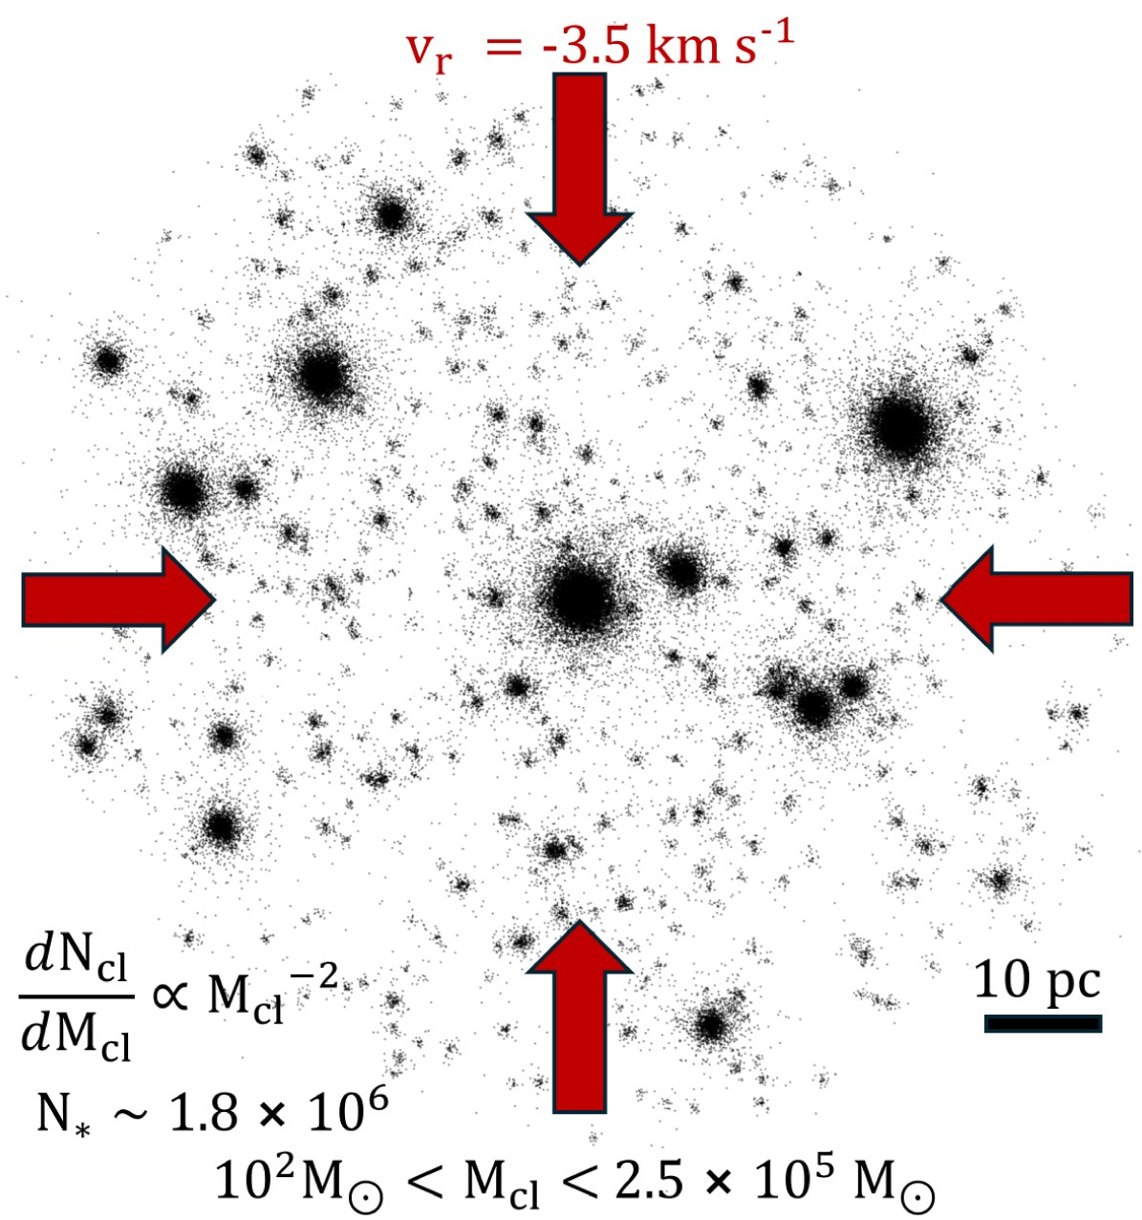
Next steps: Rates of IMBH binaries from star cluster assembly
Cosmic Gems Arc
Credits: JWST
Goal: estimate the rates of IMBH binaries from this channel and detectability in next. generation interferometers
[FROST-CLUSTERS, Rantala+ 2024, 2025, 2026]

Slide 27
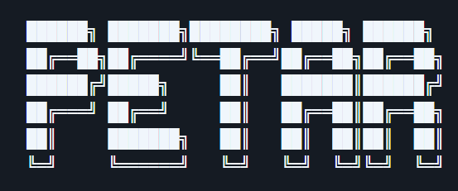


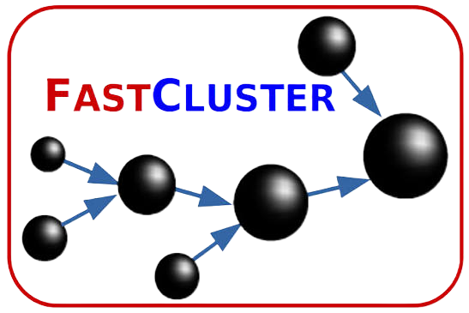
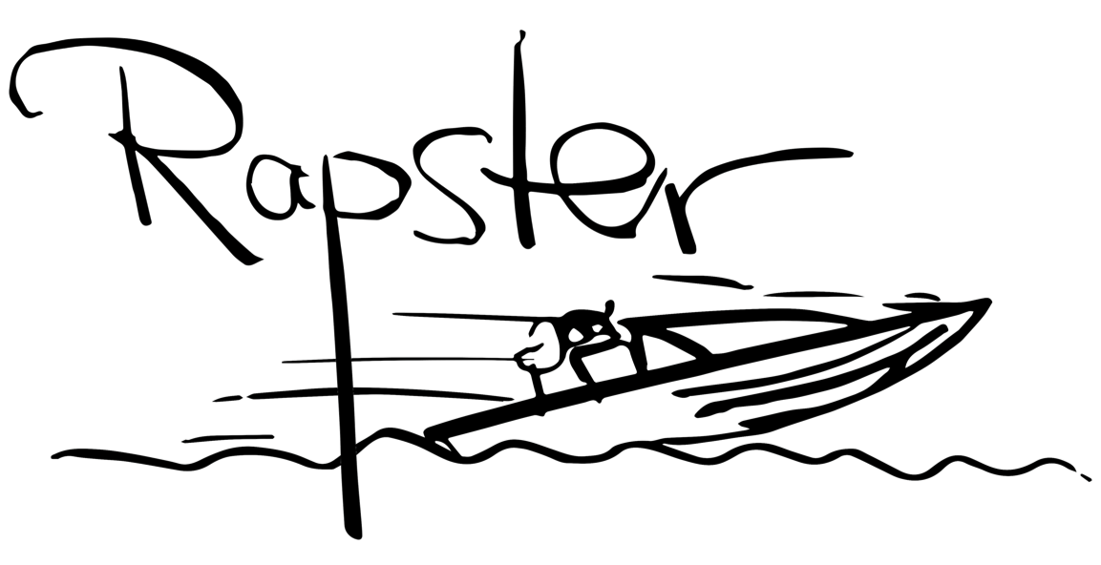

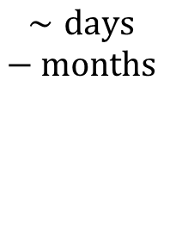
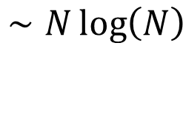
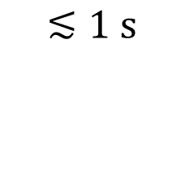
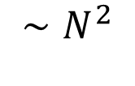
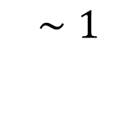
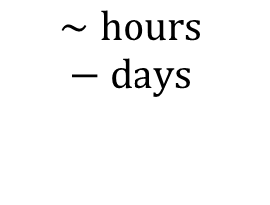
How do we simulate a star cluster?
complexity
$$∼1$$
$$∼N\log\left(N\right)$$
$$∼N^{2}$$
simulation time
$$≲1 s$$
$$∼hours −days$$
$$∼days −months$$
*for one cluster
Semi-analytic
N-body
Analytic prescription for interaction rates, dynamical timescales and cluster properties evolution.
Monte Carlo
Direct integration of the equations of motion.
Cumulative weak encounters treated statistically. Only resolves strong few body encounters.
Kritos+ (2023)
Wang, Spurtzem , Aarseth+ (2015)
Wang+ (2020)
Giersz+ (2013)
Mapelli+ (2022)
Arca Sedda, Paiella, Ugolini+ (2026)
cBHBd
Joshi, Rasio+ (2000), Pattabiram+ (2013)
Pouliasis+ (2026)

Slide 28
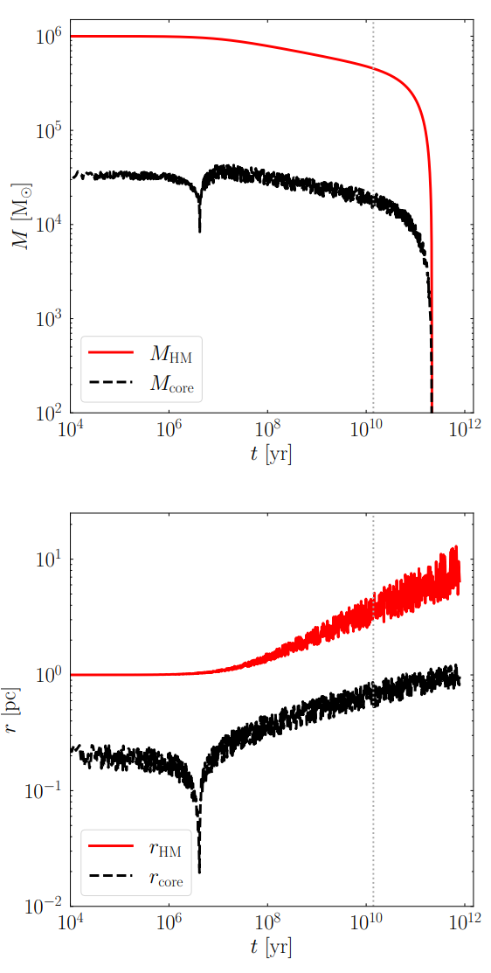




Semi-analytic population synthesis codes: B-POP
Isolated & dynamical:
Cluster evolution tuned on N-body:
5 $M_{⊙}$
stellar
Arca Sedda, Paiella, Ugolini+ (2026)
100 $M_{⊙}$
Only dynamical:
intermediate
[DRAGON II simulations, Arca Sedda+ 2023]
Arca Sedda & Benacquista (2020), Arca Sedda+ (2023)
${10}^{6}$ $M_{⊙}$
Binary black hole evolution based on interaction rates
(3-body, single-binary exchange, hardening rate…)
supermassive
Input stellar catalogs from SEVN
[Iorio+ 2022, Spera +2019]
[see e.g. Lee 1993, Mc Miller & Lauburg 2009, Antonini & Rasio 2016]

