Slide 1




Autoencoder based surrogate model for gravitational waves from BBH mergers
Anastasios Theodoropoulos
CoCoNut Meeting - 08/09/2026
arXiv: 2602.00203

Slide 2
Contents
Introduction
  Gravitational waves are heard not seen
  Binary Black Hole mergers
  Surrogate models
  Autoencoders
Data and model
  Numerical Relativity data
  General Idea
  Synthetic dataset
  Autoencoder Architecture
  Final Architecture
Results
  Training
  Accuracy
  Generated waveforms
  Parameter estimation
  Speed-of-inference
  Higher modes
Conclusions

Slide 3
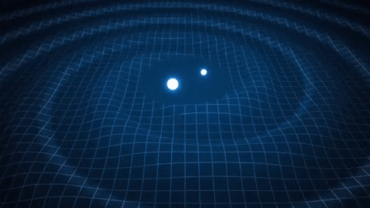
Introduction

Slide 4
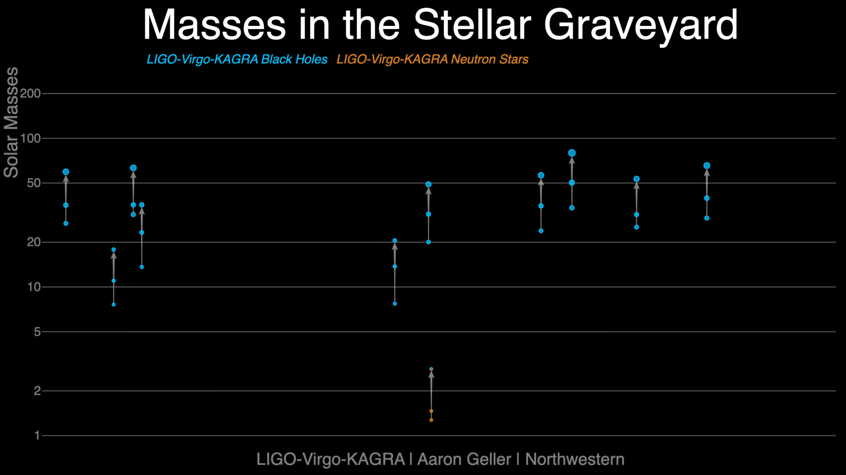
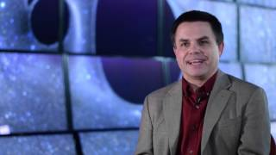
Gravitational waves are heard not seen
Credit: Northwestern University

Slide 5
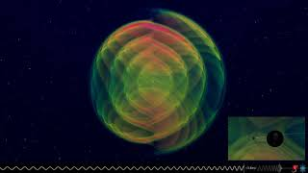
Binary Black Hole mergers

Slide 6
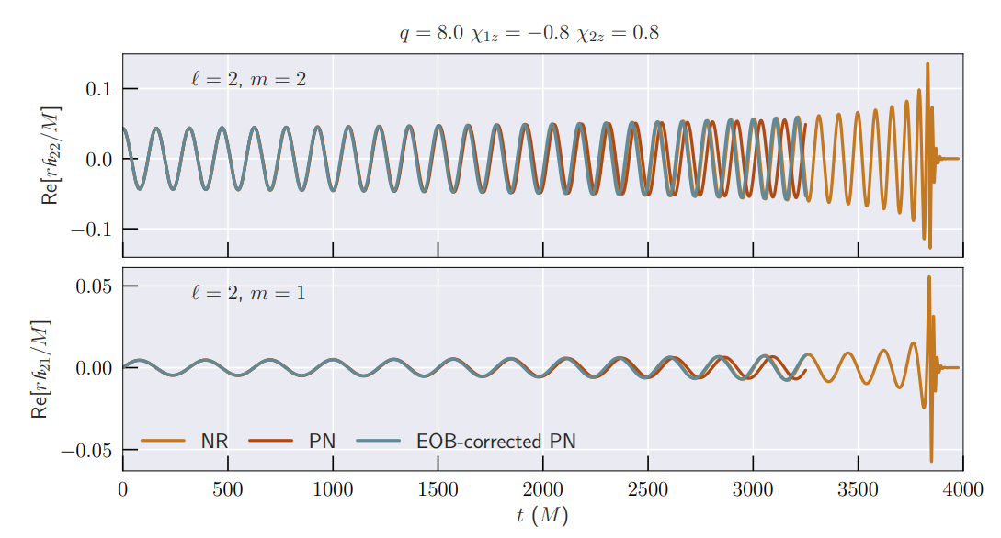
Surrogate models
Post Newtonian:
Newtonian physics with added GR corrections
Accurate during the inspiral
Effective-one-body:
Handles waveforms up to the merger
Phenomenological:
Reduced basis
Interpolation
arXiv:1812.07865

Slide 7
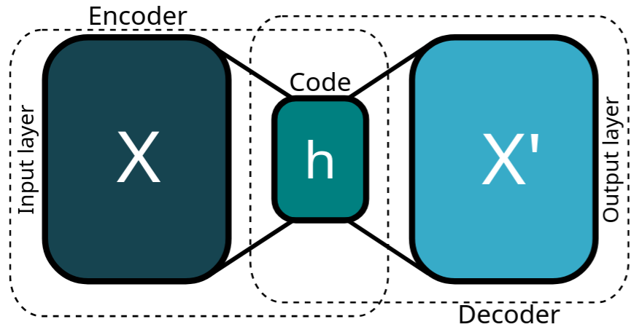
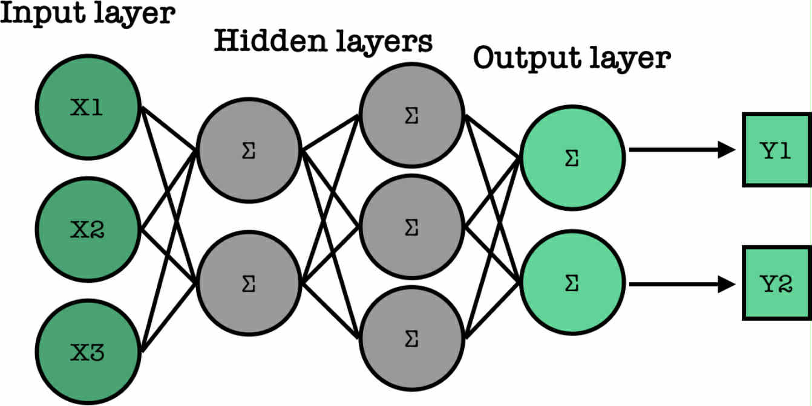
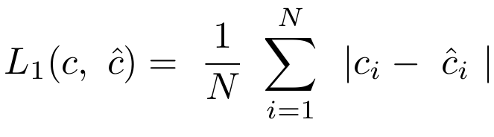
Autoencoders
Autoencoder:
Neural Network Architecture
Unsupervised Learning
Non-linear
Notes:
An Artificial Neural Network is composed of artificial neurons which mimic the behavior of biological neurons.
The algorithm, using the training sample, tunes the transformations so that the output value minimises the loss function.

Slide 8
Autoencoders
Encoder:
Efficiently compresses (encodes) input data down to its essential features.
Latent space:
Features / Representation / Code
Decoder:
It reconstructs (decodes) the original input from this compressed representation (code)

Slide 9
Data and model

Slide 10
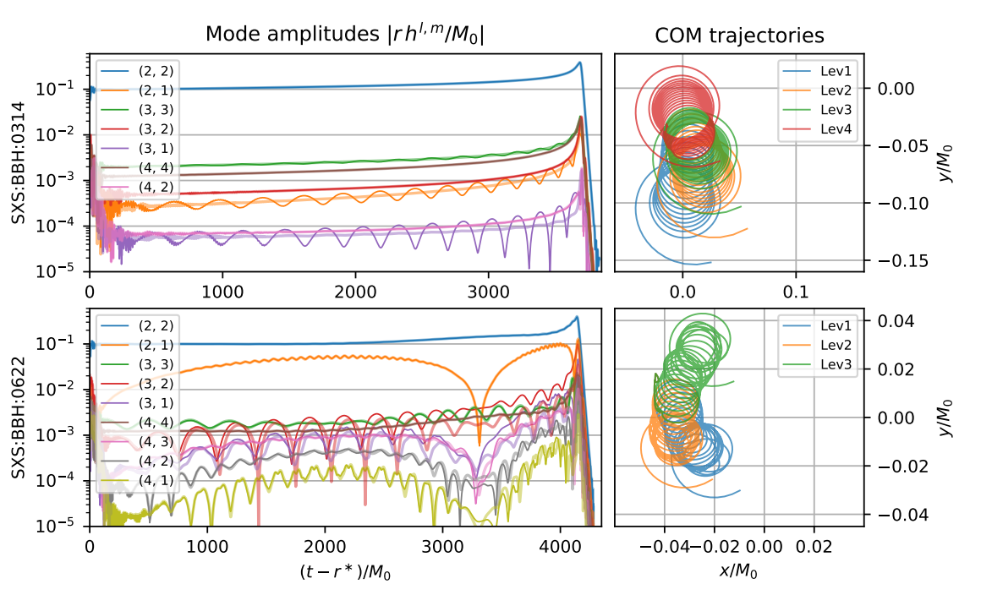
Numerical Relativity data
Our samples:
(2,2) mode
SXS dataset
Filtering:
Duration: d >= 8192 M_{sun}
Minimal precession
Mass ratio ≤ 8
DOI 10.1088/1361-6382/ab34e2
Only 376 samples!

Slide 11
General Idea - 3 stage training
Make a synthetic dataset using a surrogate model
1st stage:
Add networks that can map the initial parameters to the representation we learned
Train the autoencoders on them
3rd stage:
2nd stage:
Fine tune the models using the Numerical Relativity simulations
Train the resulting models on the surrogate model data

Slide 12
Synthetic dataset
Our samples:
(2,2) mode
NRHybSur3dq8
Sampling:
Uniformly
Mass ratio ≤ 8
-0.8 < spins < 0.8
sample rate = 2M⁻¹ ☉
Credit: arXiv:1812.07865

Slide 13
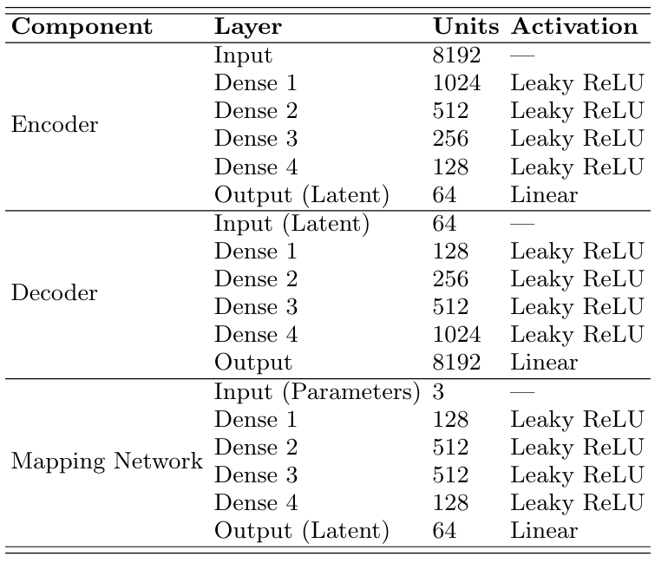
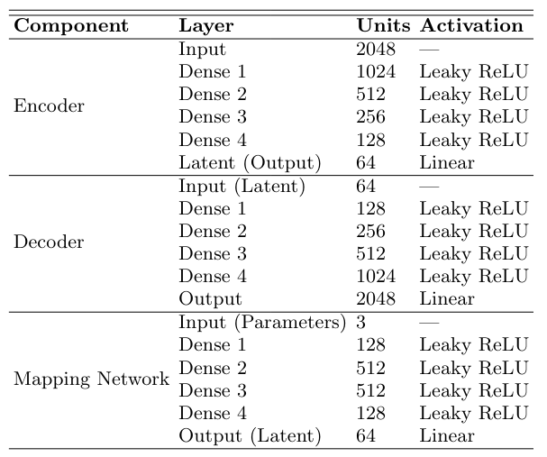
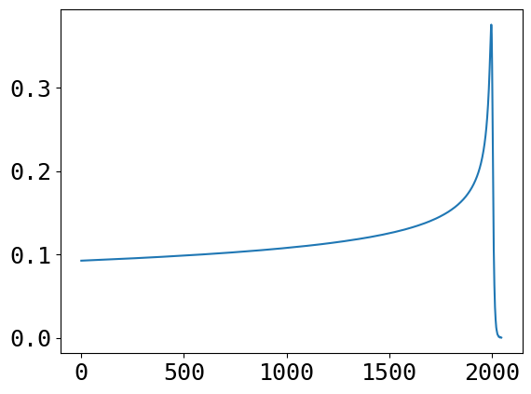
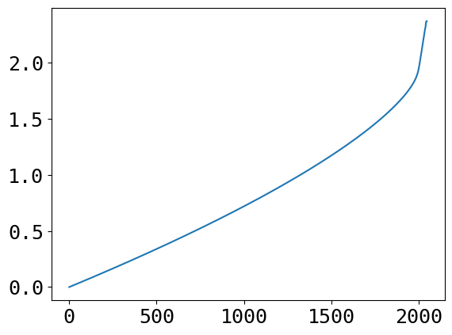
Autoencoder Architecture
Split into components:
Waveforms are split into phase and amplitude
1st step :
We construct an autoencoder for each component and train them separately
Amplitude
Phase
Architecture Components Table

Slide 14
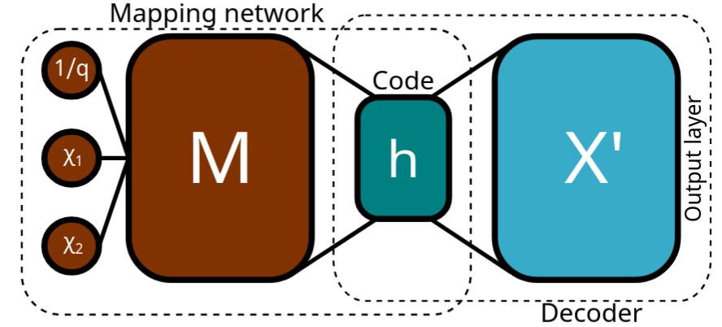
Final Architecture - Adding the mapping network
Mapping network:
After the autoencoders are trained, we keep the decoder and replace the encoder with a mapping network
Second step:
We retrain the full model, with the decoder weights free to change
Fine tuning:
We retrain the full model on the NR waveforms, with a lower starting learning rate

Slide 15
Results

Slide 16
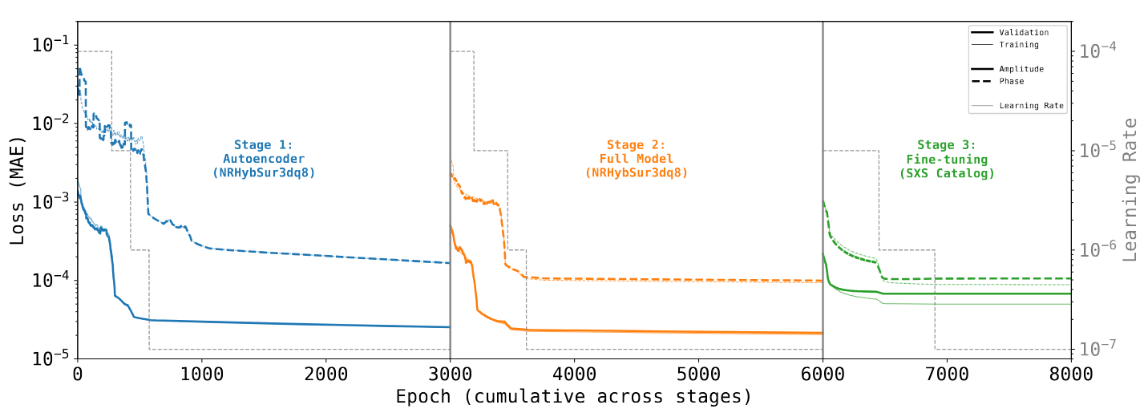
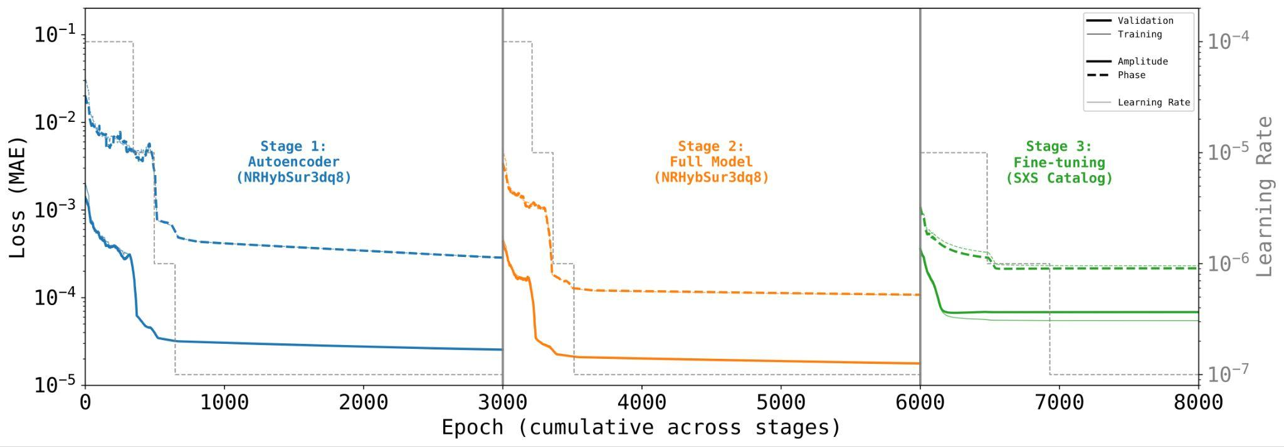
Training

Slide 17
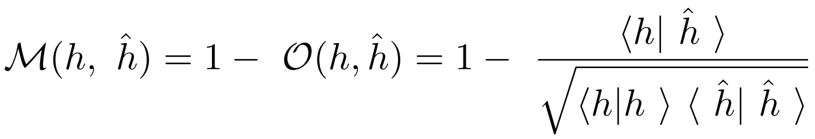
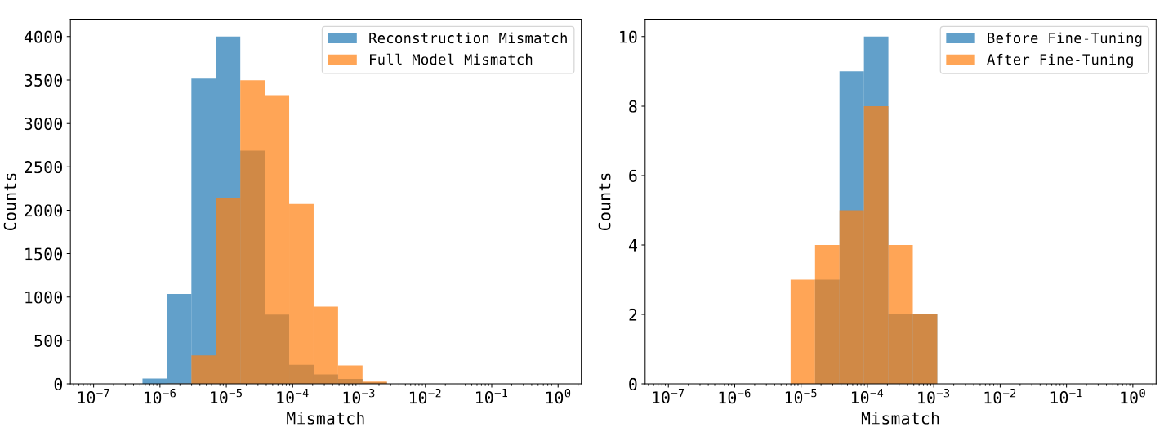
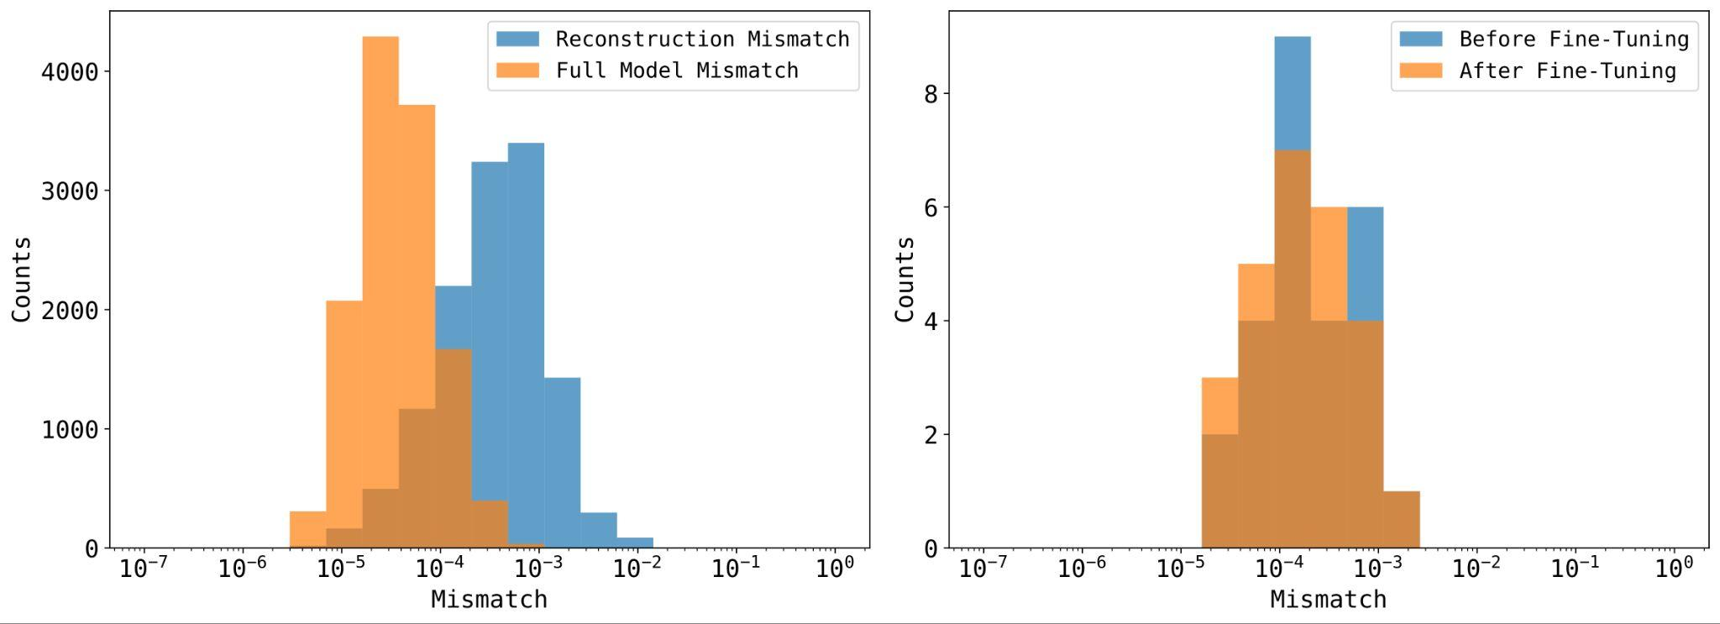
Accuracy

Slide 18
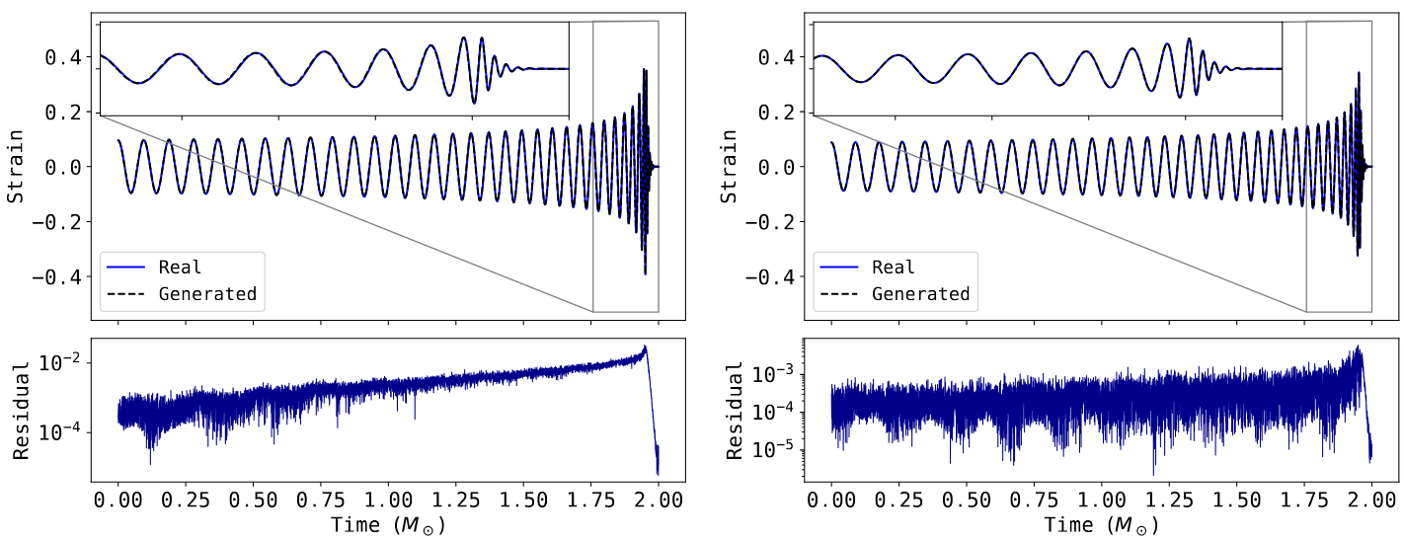
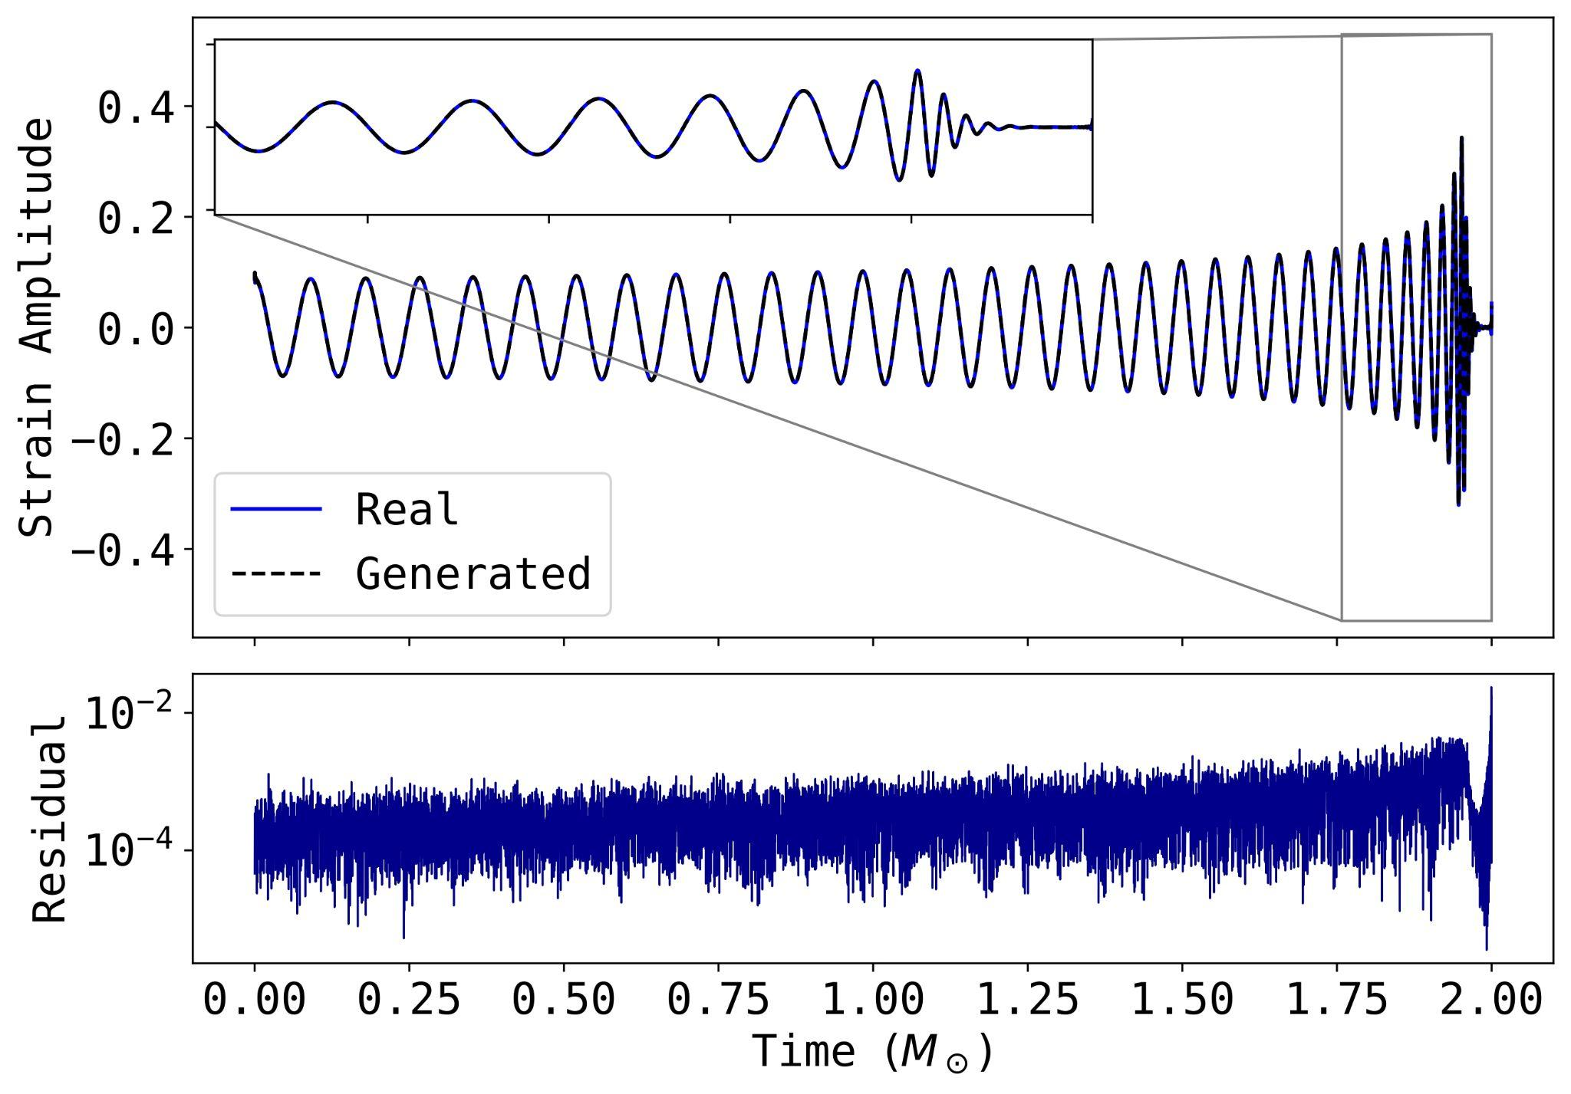
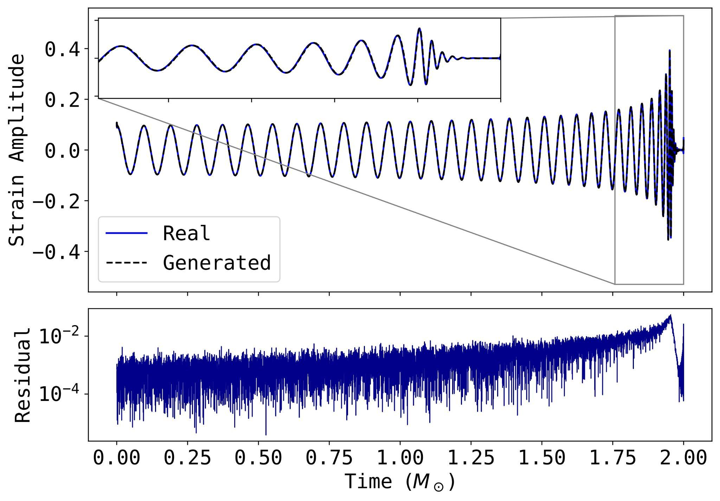
Generated waveforms

Slide 19
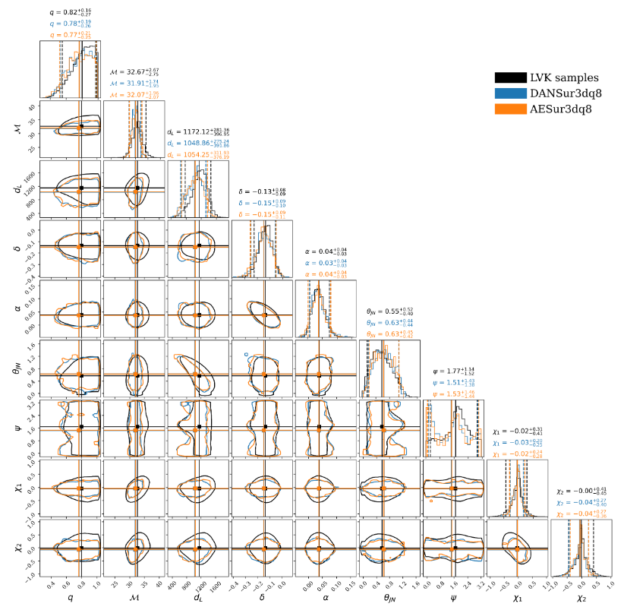
Parameter estimation
Comparison:
When comparing with our previous work: DANSur3dq8 Osvaldo Freitas et al. (2024) and LVK posterior samples. The results are compatible

Slide 20
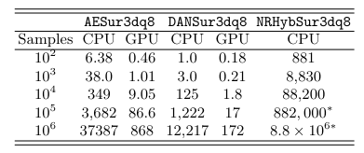
Speed-of-inference (in ms)
Timing:
Model compilation
3 warm-up computations
Average of 10 computations
Comparison:
Faster than the traditional method
Slower than our PCA based model

Slide 21
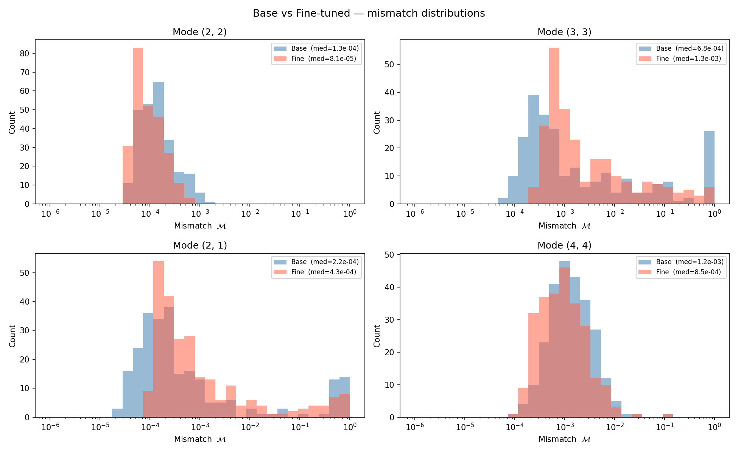
Higher modes - Ongoing work

Slide 22
Conclusions
We construct an autoencoder based surrogate model
We compare the generated waveforms with Numerical Relativity waveforms from the SXS dataset
We perform a bilby parameter estimation, showing the compatibility of our results with the current models
Future tests/extensions include:
  Multi-modal surrogates (Talk from Osvaldo Freitas)
  Precessing spins
  BNS mergers
  Implementation in gw detection pipelines

Slide 23
Thank you for your attention!
This work is supported by the Spanish Agencia Estatal de Investigación (grant PID2024-159689NB-C21) funded by MICIU/AEI/10.13039/501100011033 and by FEDER / EU and from the Universitat de València through the Atracció de Talent fellowship.

