Slide 1
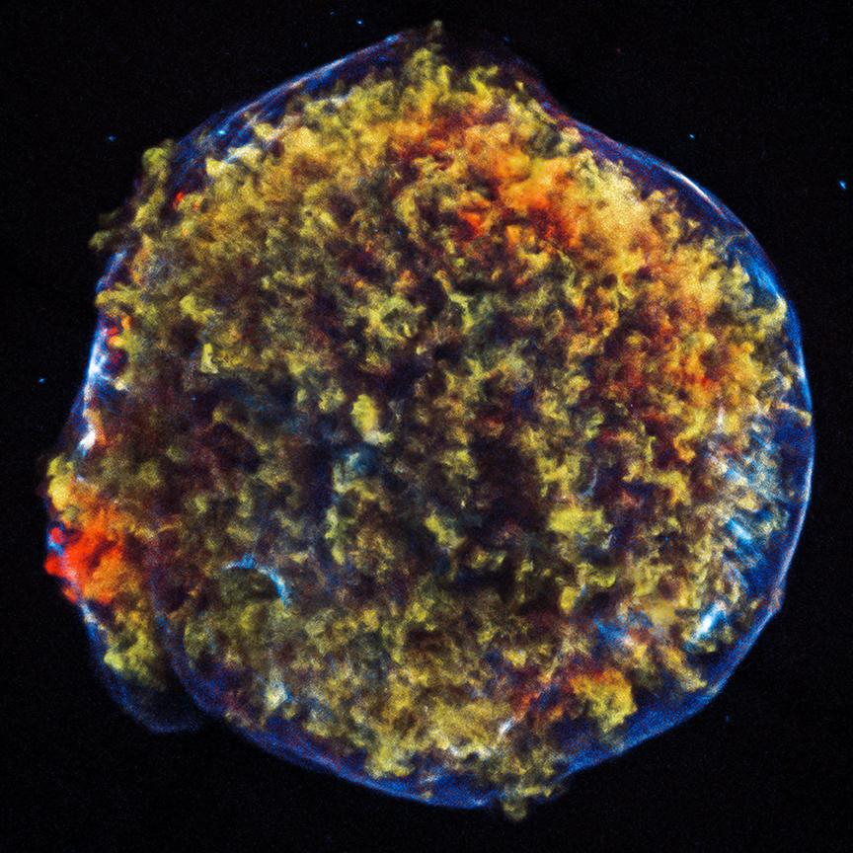


The Role of Magnetic Fields in Core-Collapse Supernova Explosions
Vishnu Varma

Slide 2


Slide 3
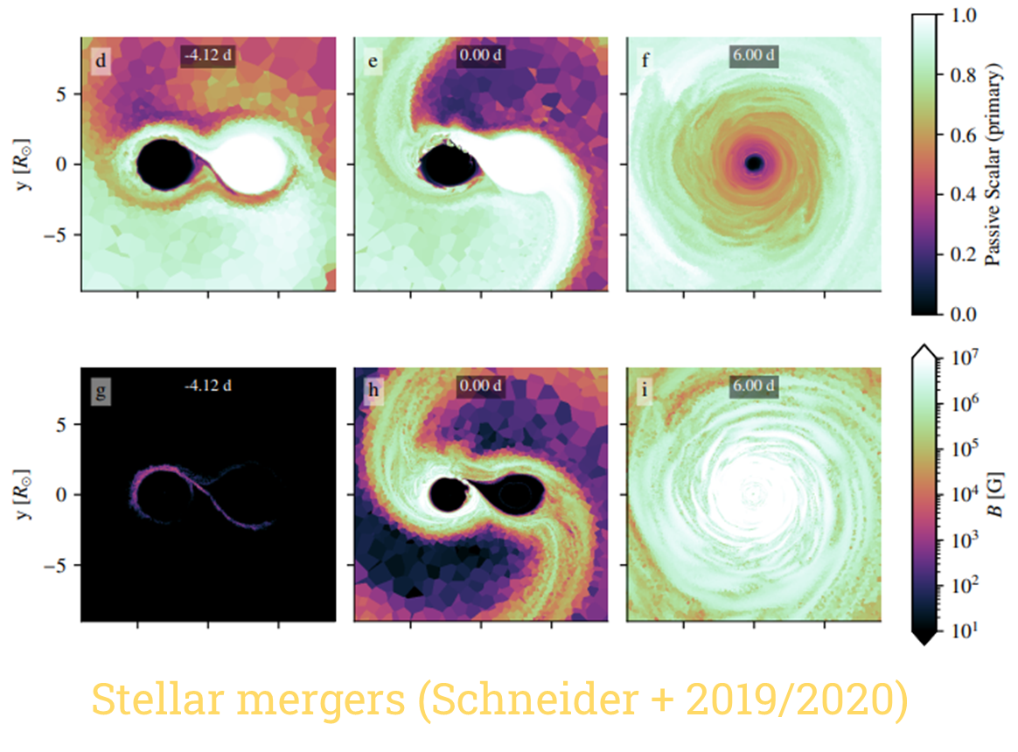

Slide 4
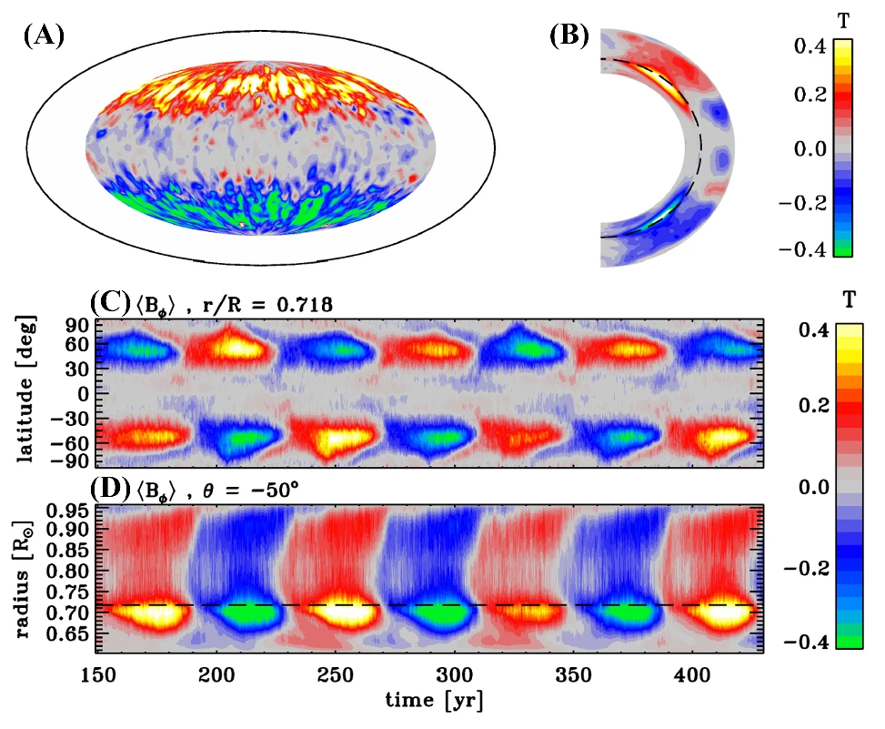
Dynamo mechanism
Most studies are from solar physics
Difficult to extrapolate to stellar interior
1D stellar evolution ignores B-fields in convection zones

Slide 5
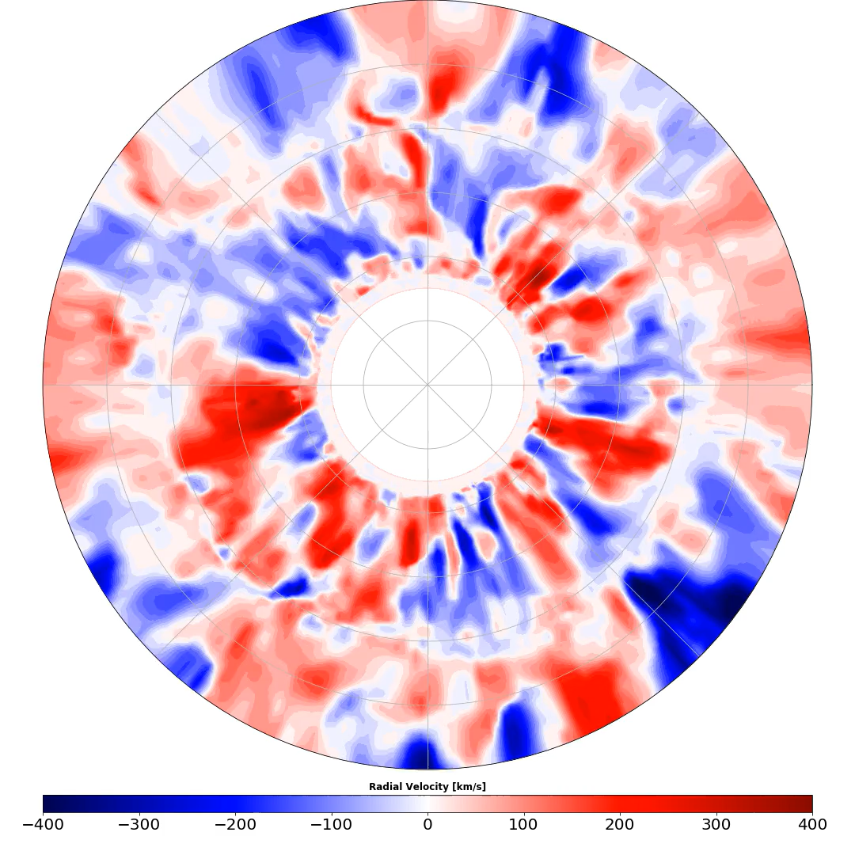
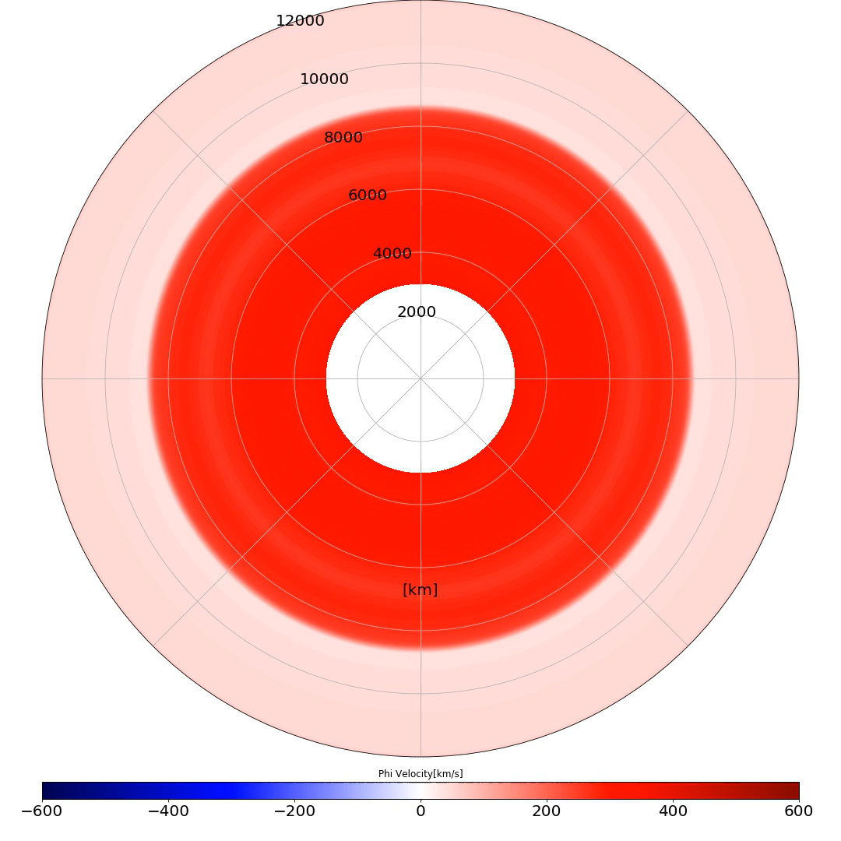
Varma & Mueller 2021
Varma & Mueller 2023

Slide 6
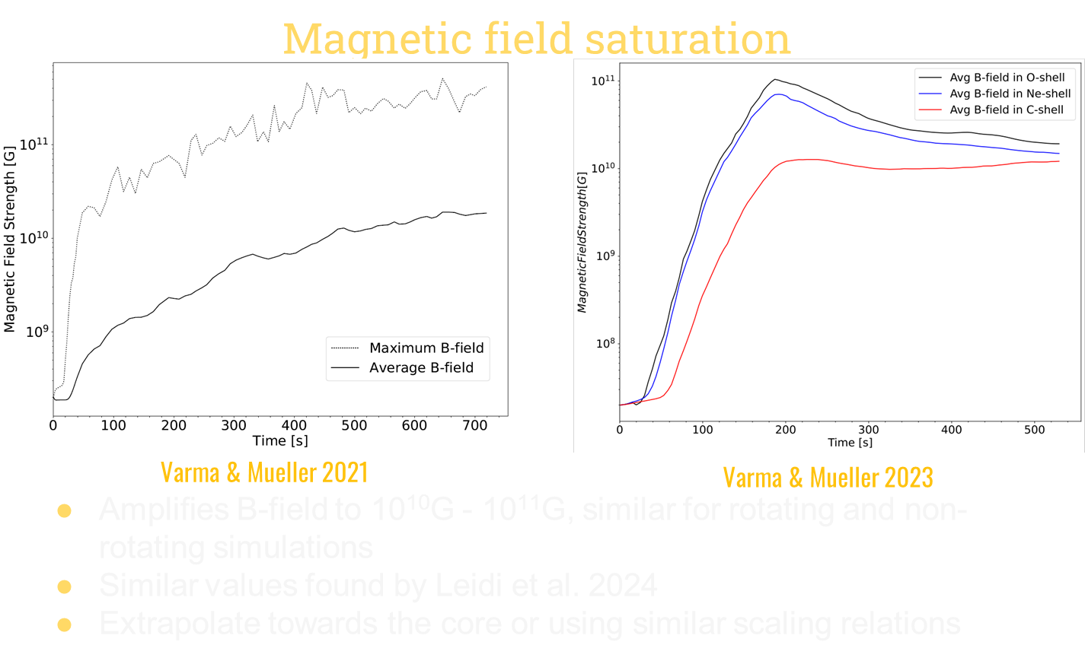
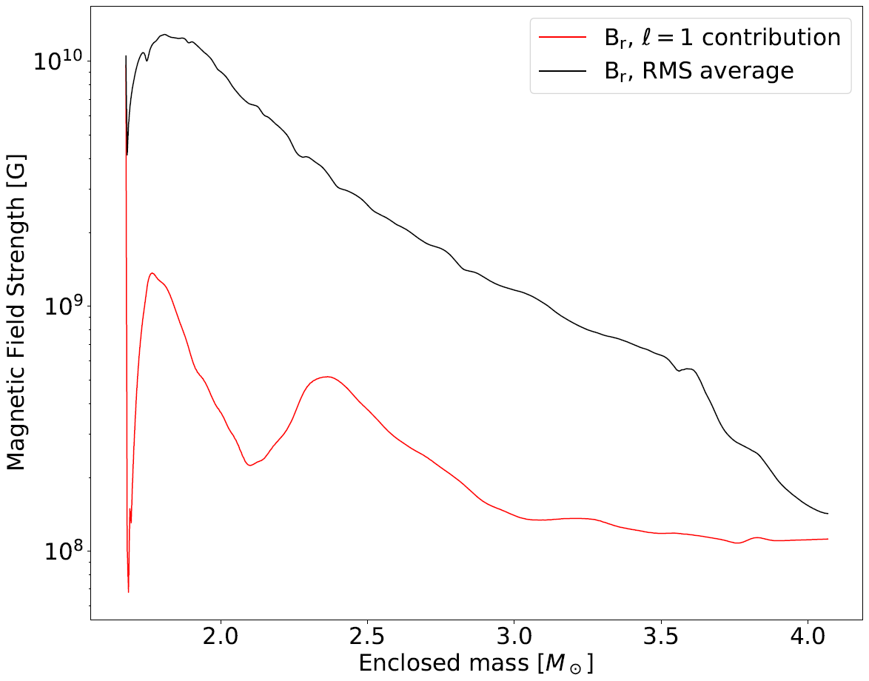
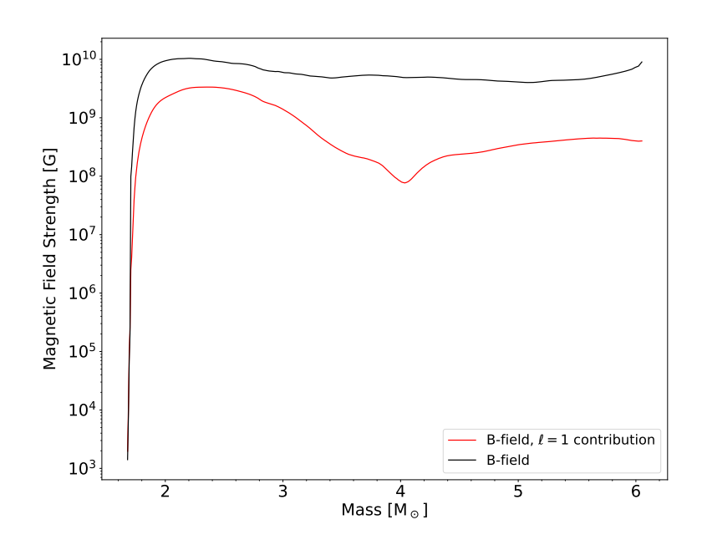

Slide 7

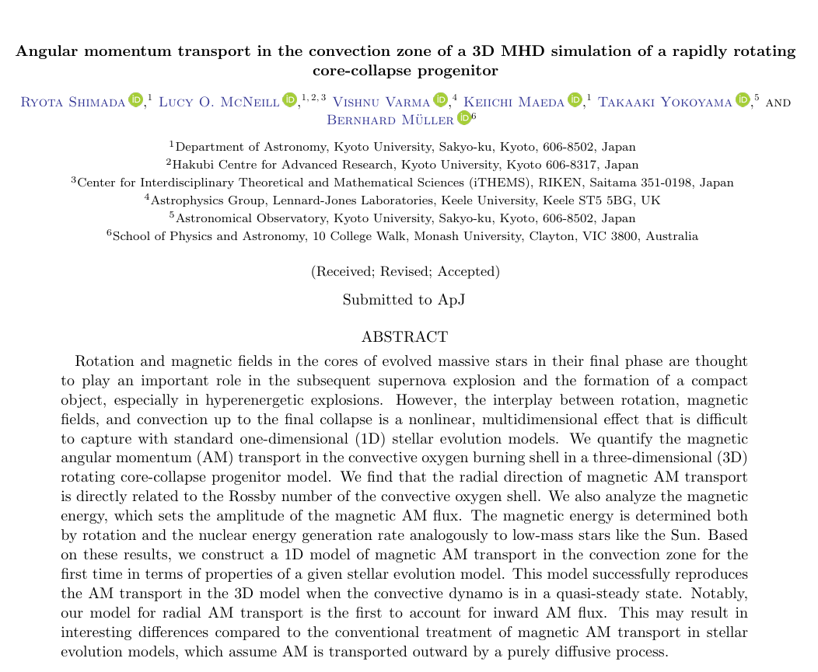
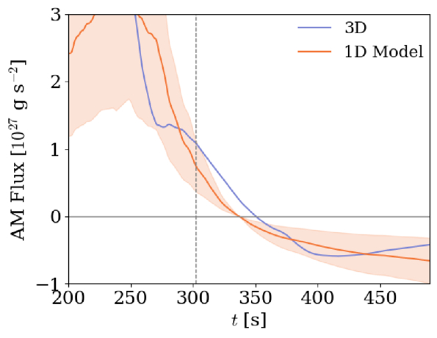
Angular momentum transport from magnetoconvection

Slide 8
Impact of strong magnetic fields

Slide 9
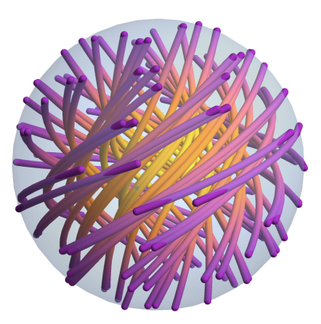
Initial Conditions
17M⊙ merger product
[Schneider et.al. 2019/2020]
Twisted-torus magnetic field geometry
10⁶ G and 10¹² G central field
Strong case is scaled to have magnetic field strengths similar to Varma & Müller 2021 at the O-shell
[Sykes & Mueller 2024]

Slide 10
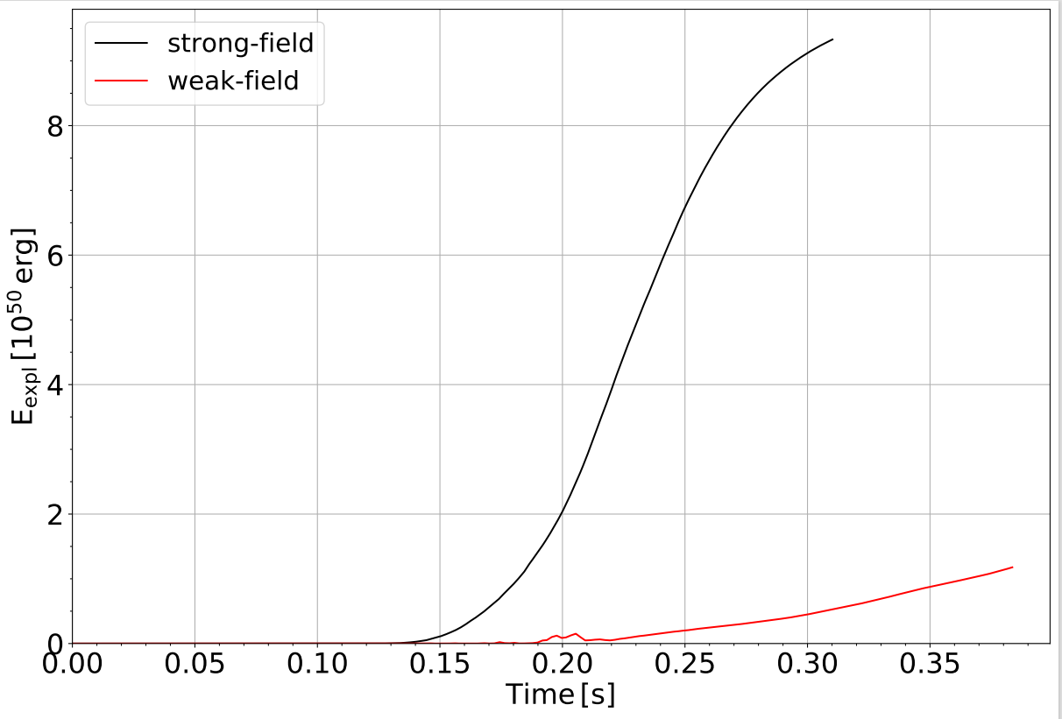
Explosion Energy & Shock revival
Strongly magnetised model grows to ~ 9x10⁵⁰erg
It also explodes more promptly
Even strong magnetic fields only play a subsidiary role
[Varma, Müller & Schneider 2023]

Slide 11
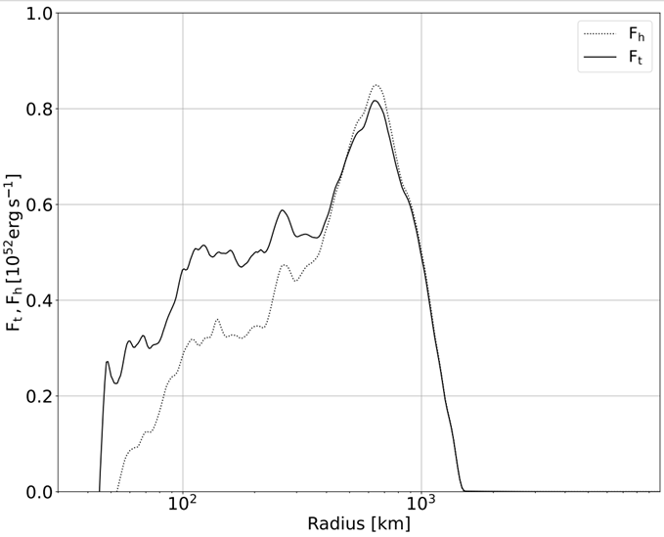
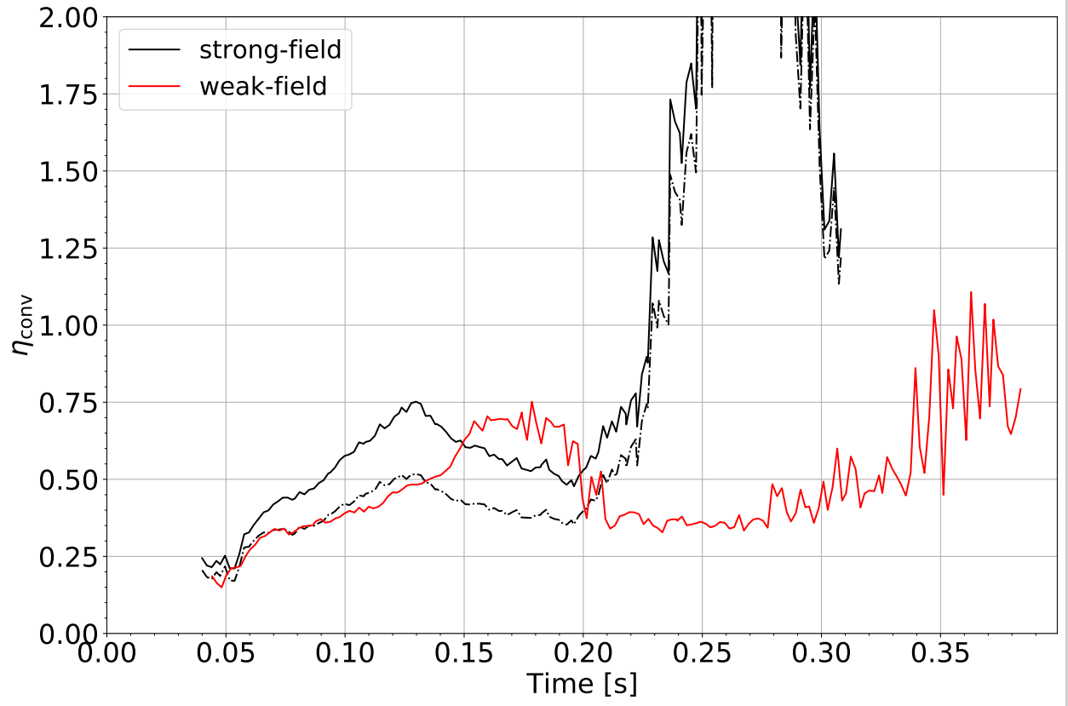
Even strong magnetic fields only play a subsidiary role
Magnetic fields could store extra energy, making it easier to unbind material and release extra energy into neutrino heated material as it expands
Convective efficiency parameter for the conversion of neutrino heating to turbulent kinetic and magnetic energy in the gain region

Slide 12
Are these conclusion robust?

Slide 13
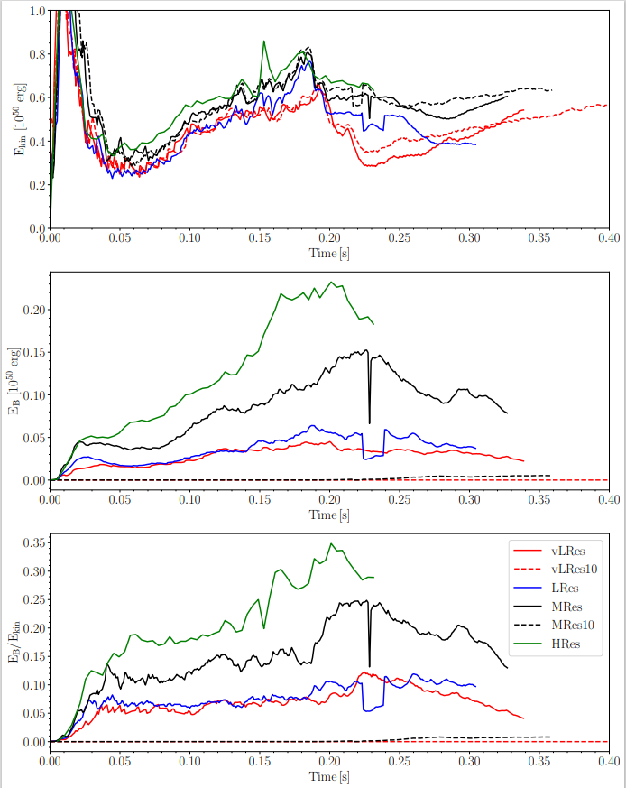
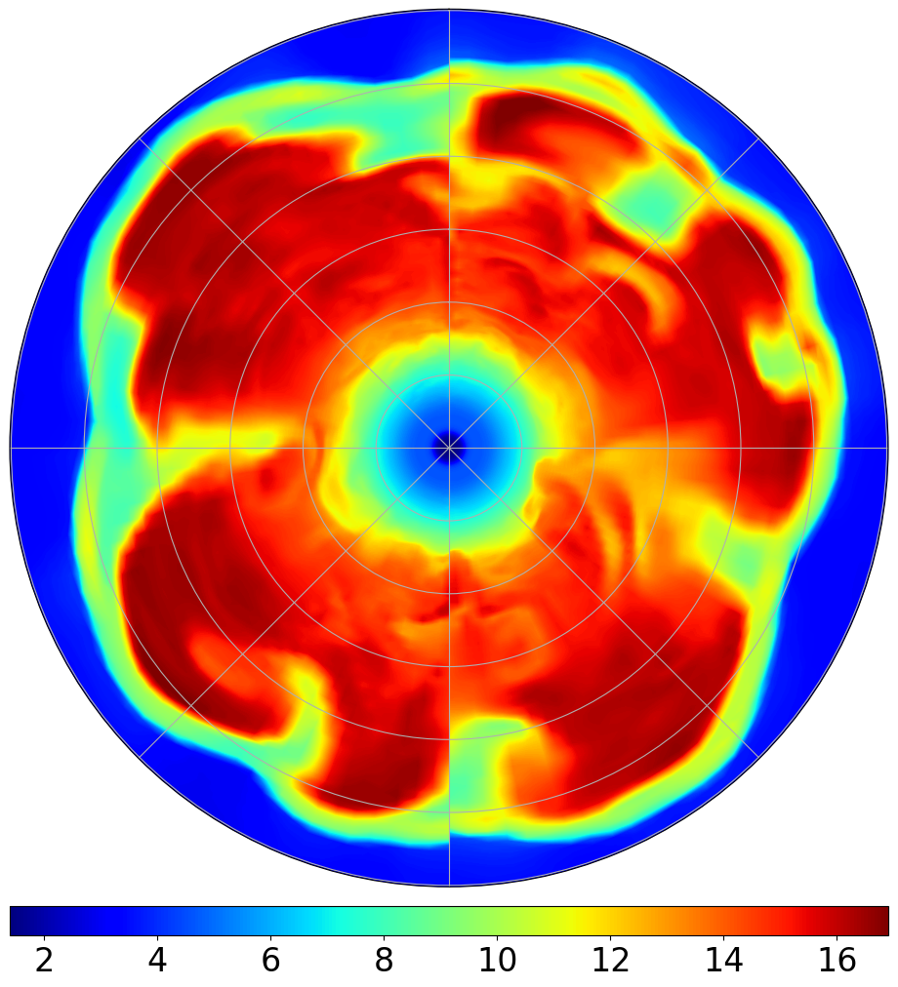
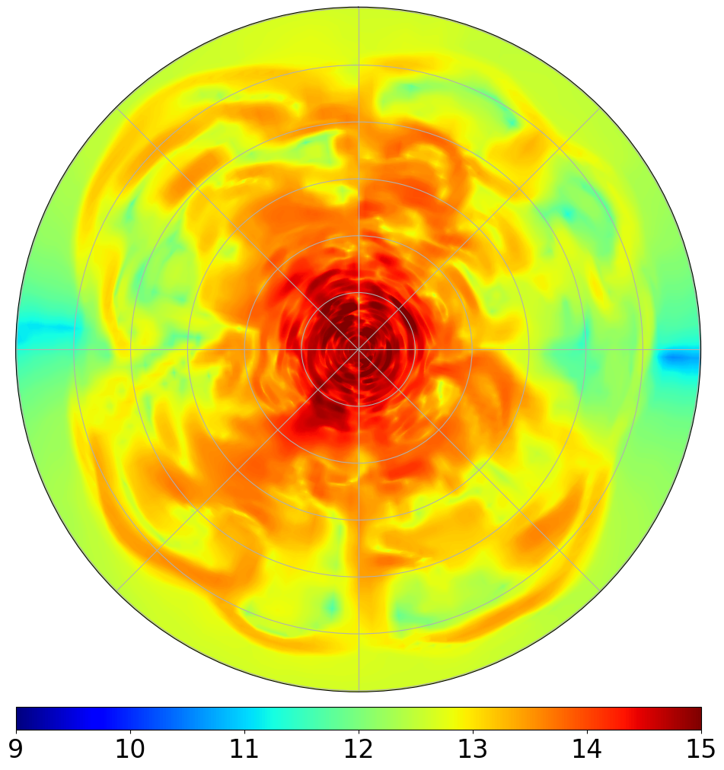
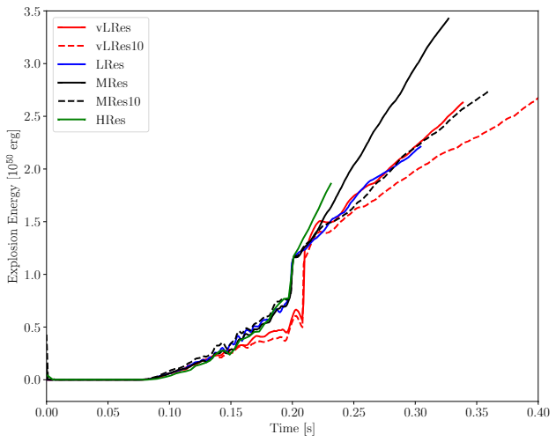
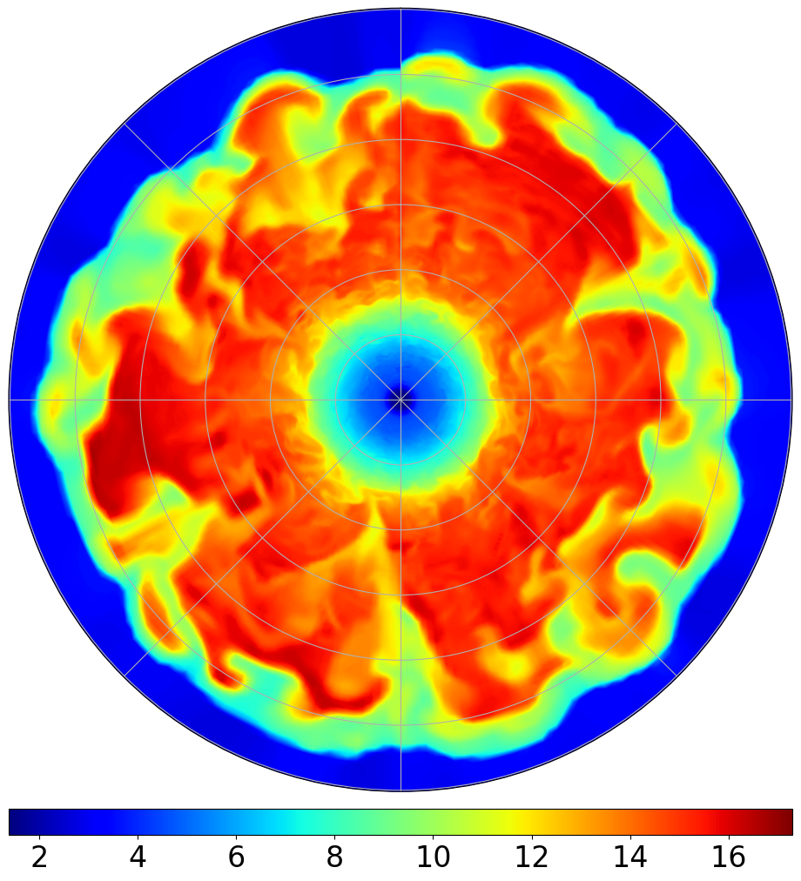
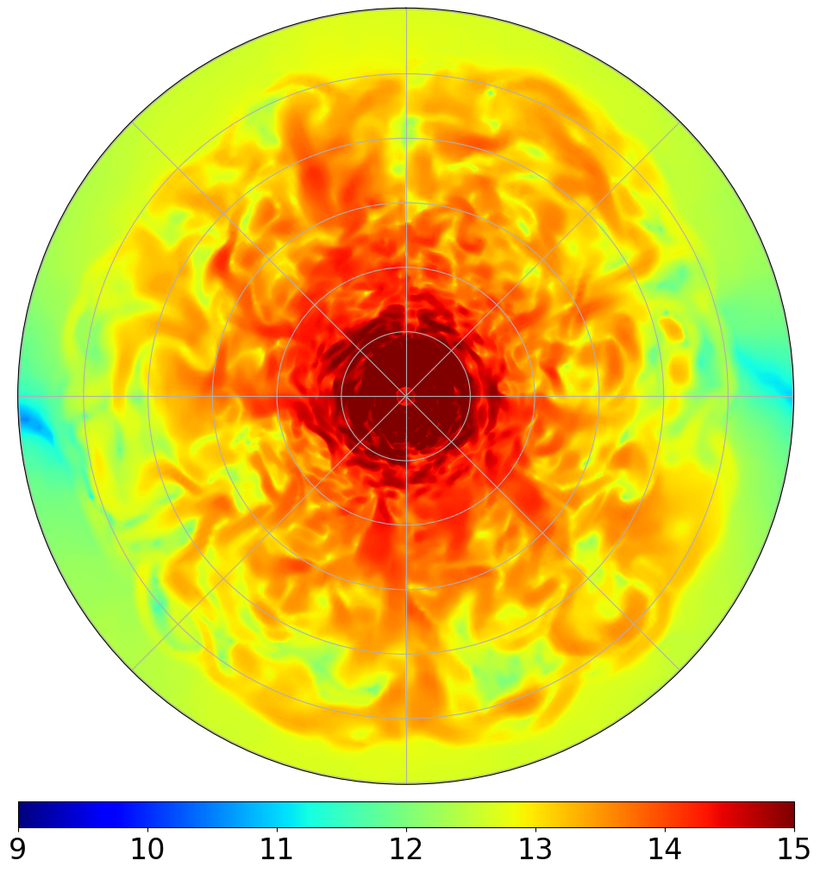
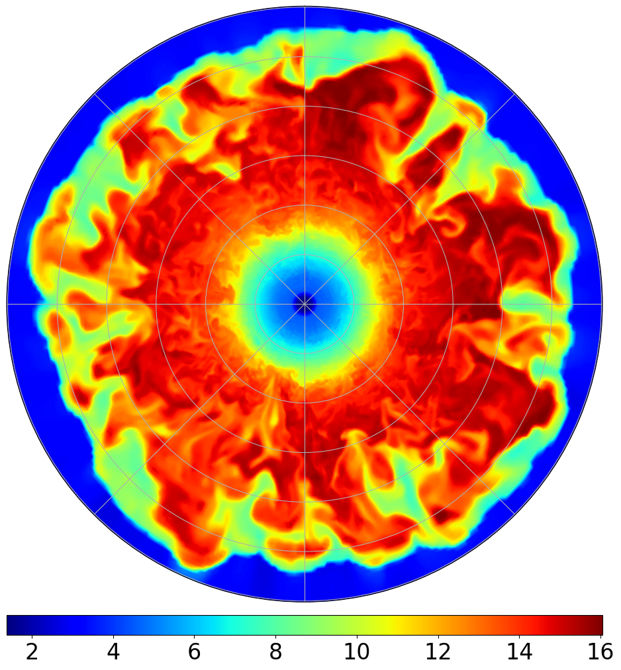
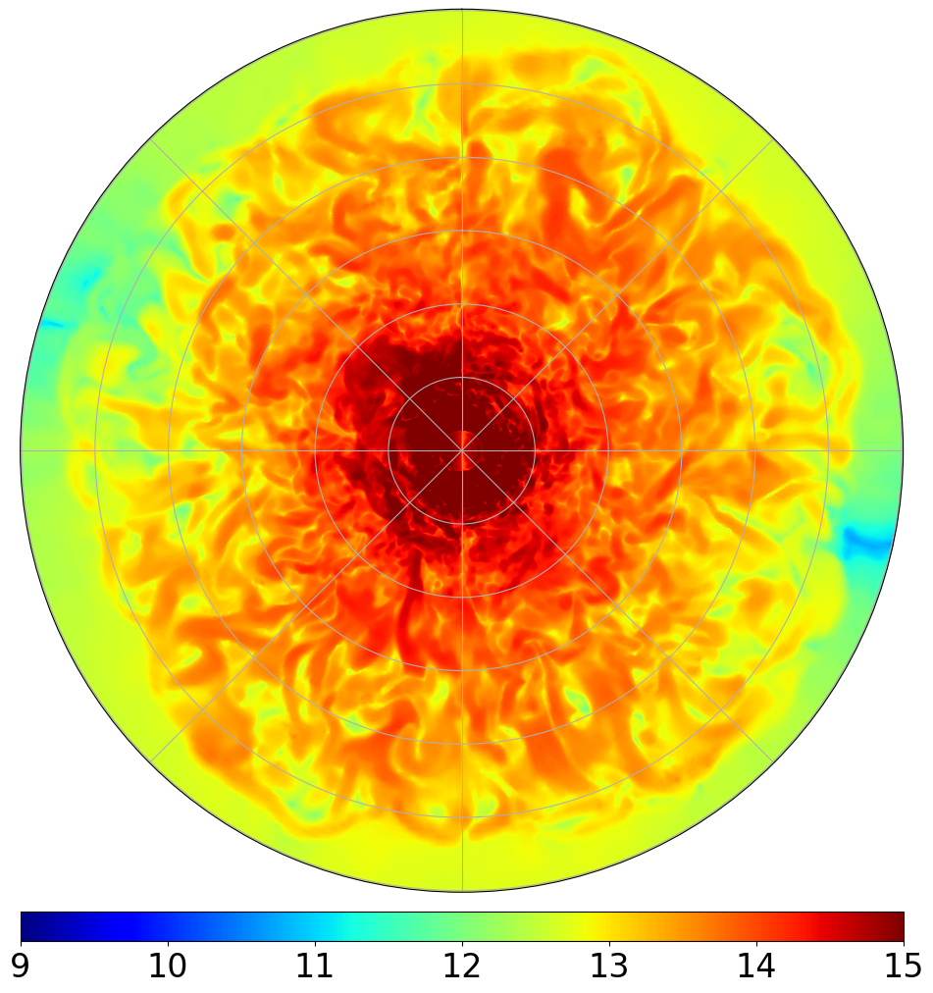

Resolution Study
Compared the impact of resolution and initial field strength (Varma & Müller 2026)
Higher resolution models resolve more small scale turbulent structures
    For hydrodynamic SN, 1.4° angular resolution known to be sufficient
Small-scale dynamo growth rate is resolution-dependent
Explosion energy correlates with initial field strength and numerical resolution
2.8°
1.4°
0.7°

Slide 14
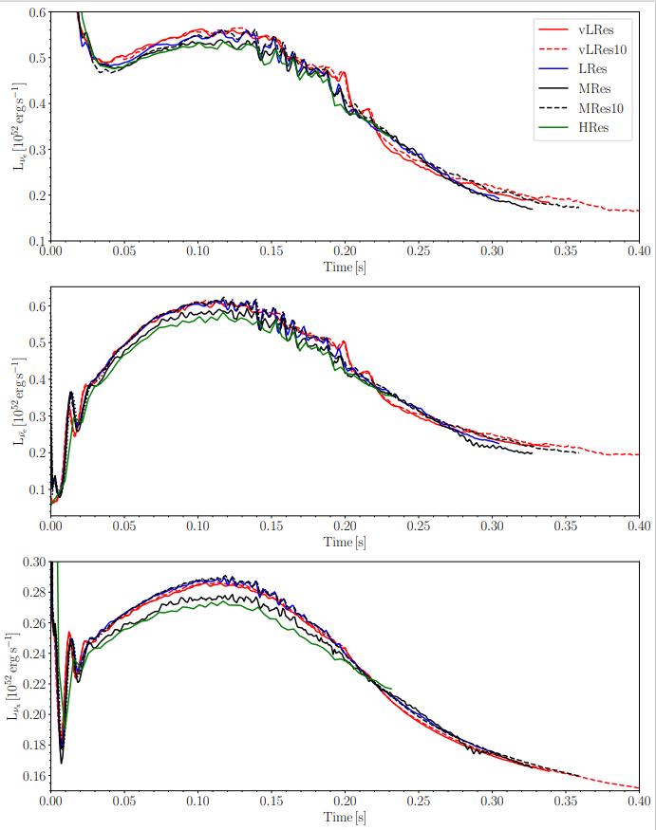
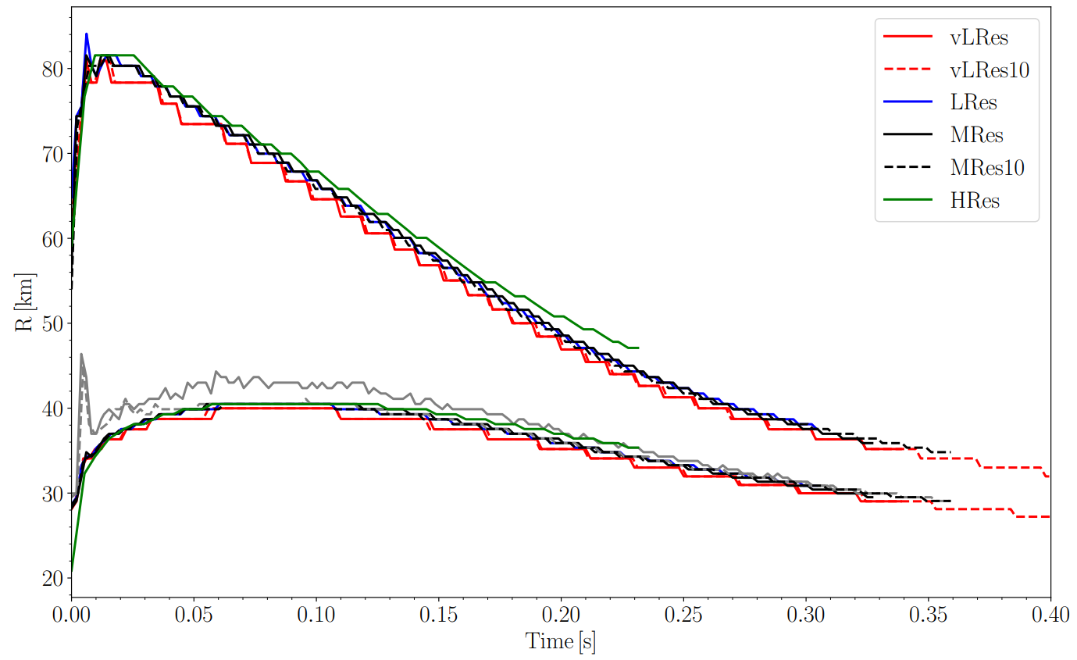
Explosion energy correlates with initial field strength and numerical resolution
Anti-correlation with neutrino luminosity
Strong B-field causes inflated NS

Slide 15
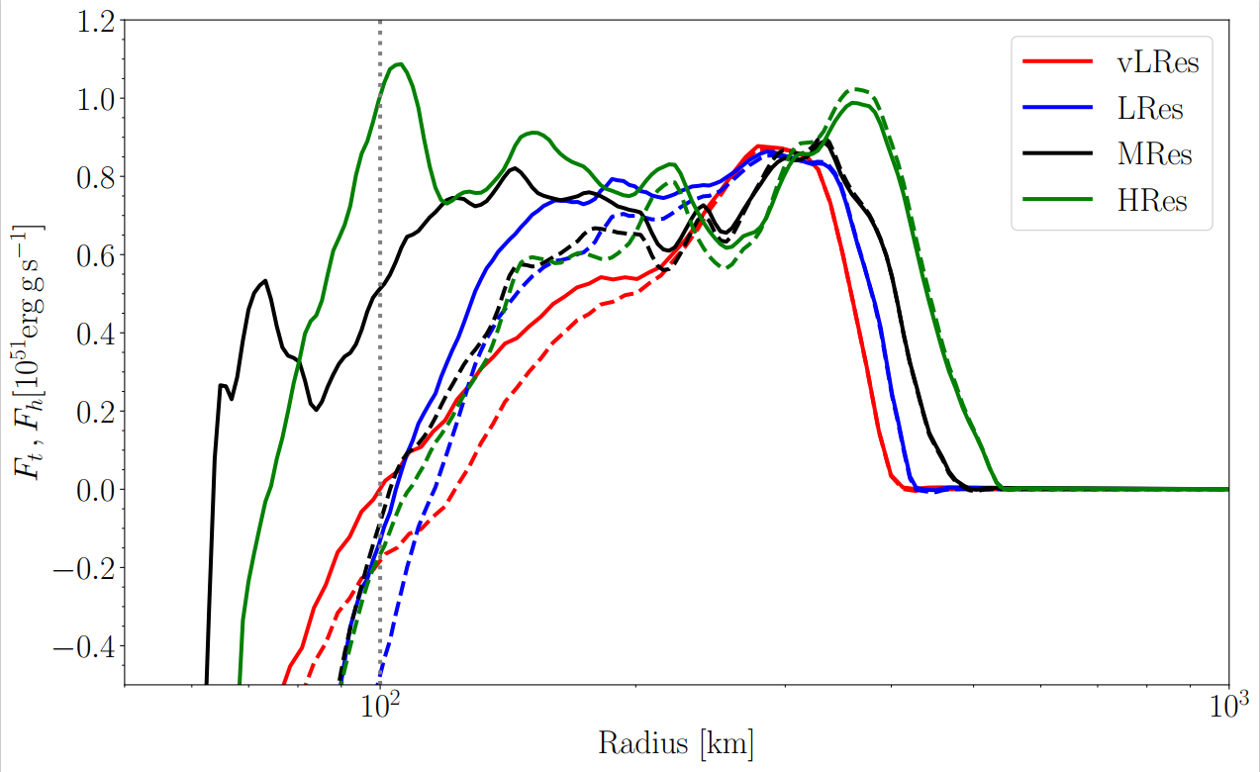
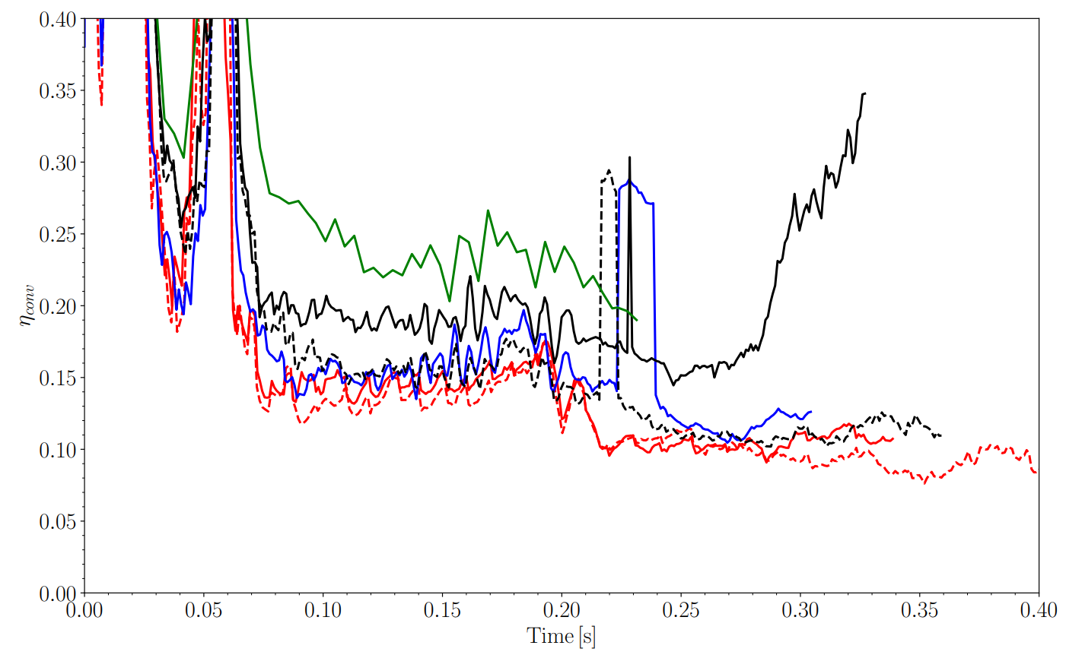
Similar to our previous studies, find that magnetic field play a subsidiary role
Some additional flux from magnetic terms
Presence and strength of magnetic fields lead to more efficient conversion of neutrino heating to turbulent kinetic energy behind the shock

Slide 16
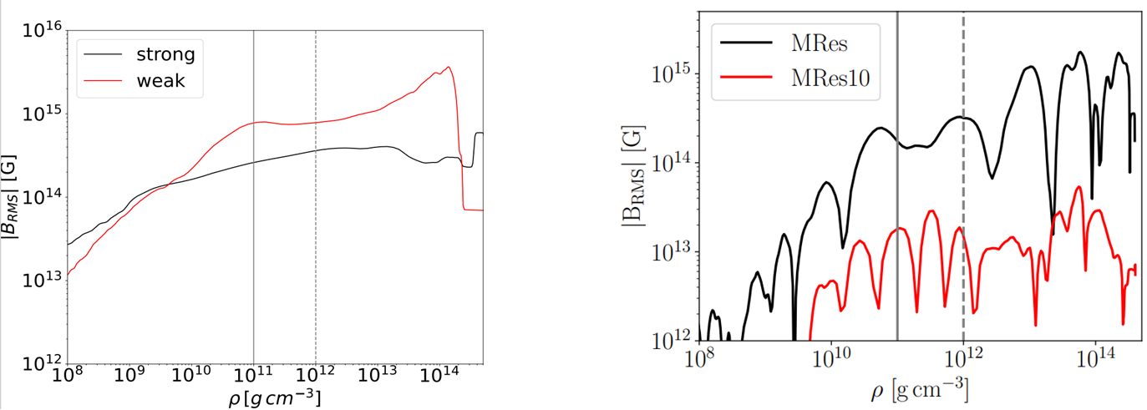
Magnetar/NS Field
Left models (merger product) seemingly loses memory of initial B-field
Some differences may be due to initial magnetic geometry
Differences due to accretion timescale
Initial field strength impacts development of PNS convection

Slide 17
Key Takeaways
Magnetic fields play a subsidiary role in the explosion mechanism
Highest resolution models haven’t saturated
Neutron stars may lose memory of initial field – may depend on initial field geometry
Need much longer time simulations to understand final magnetar state and observables
All of this is likely to be impacted by magnetic Prandtl number

Slide 18
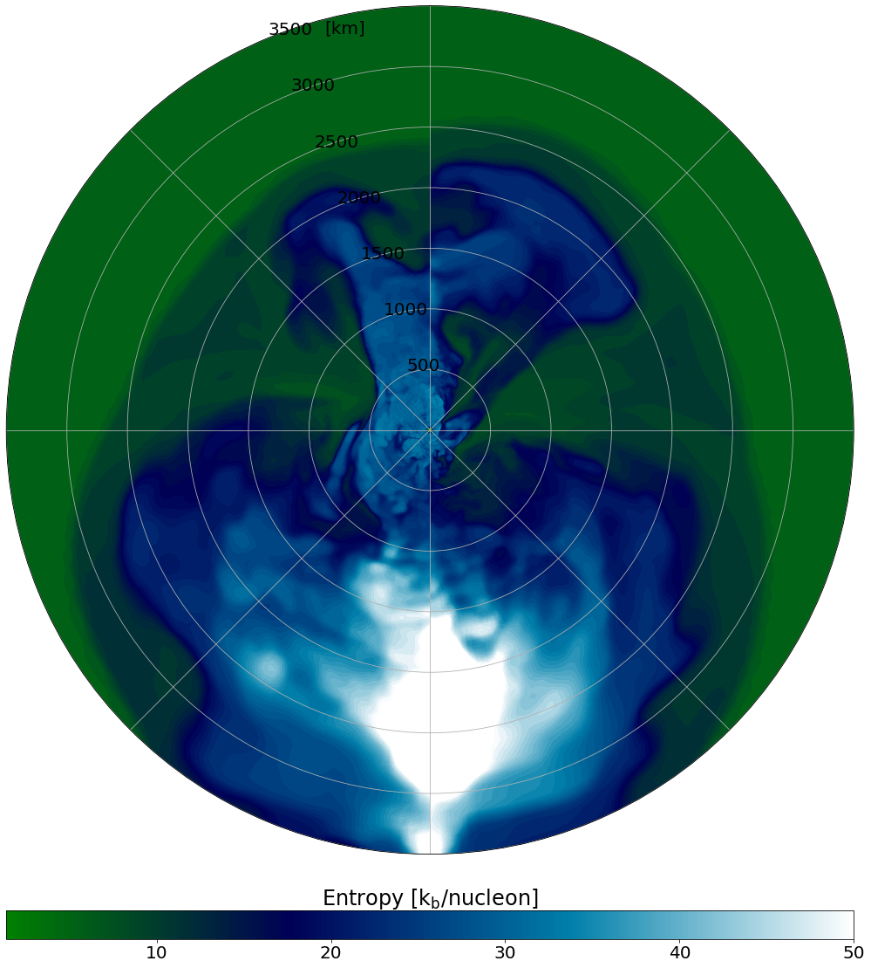
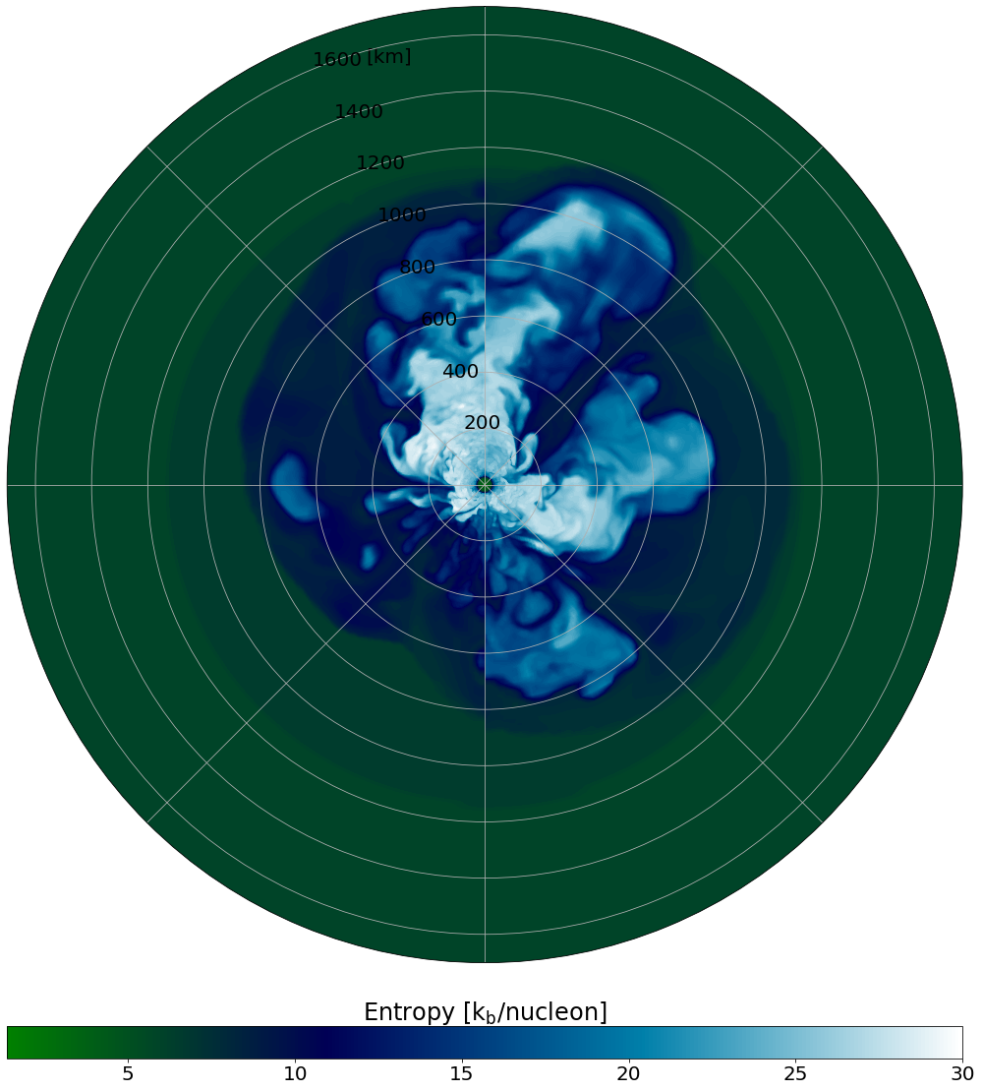
Thank You
Vishnu Varma | v.r.vejayan@keele.ac.uk

Slide 19
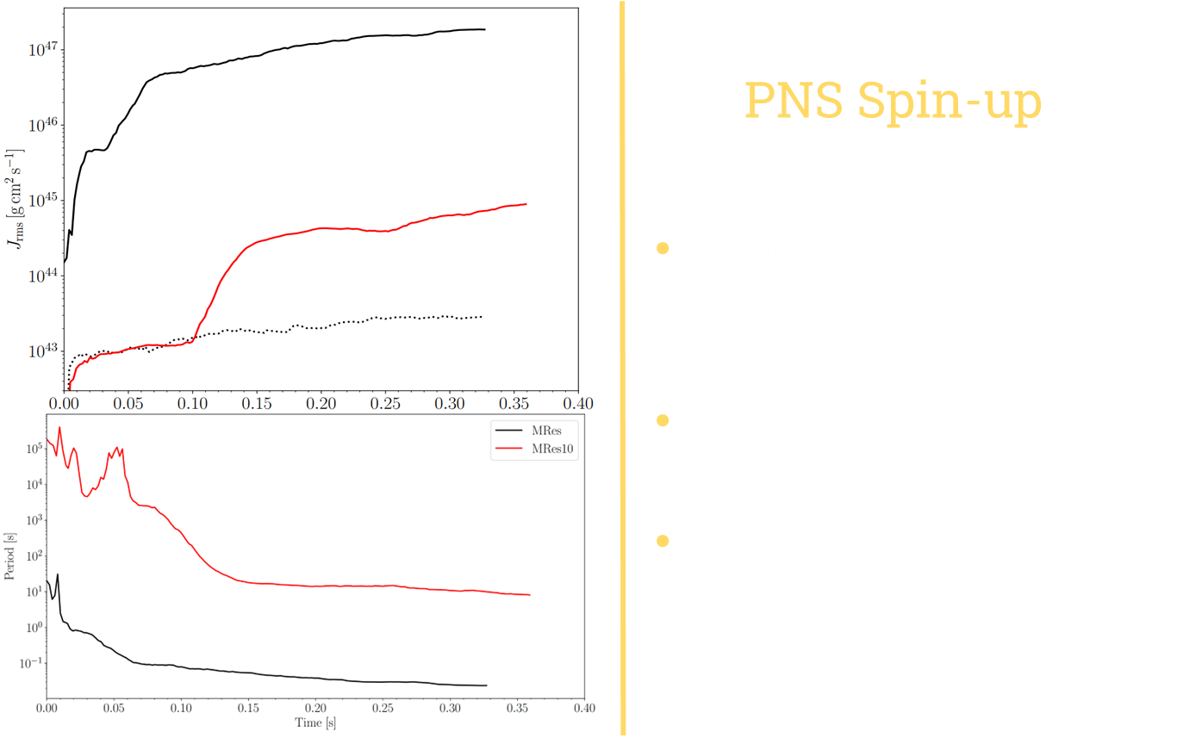

Slide 20
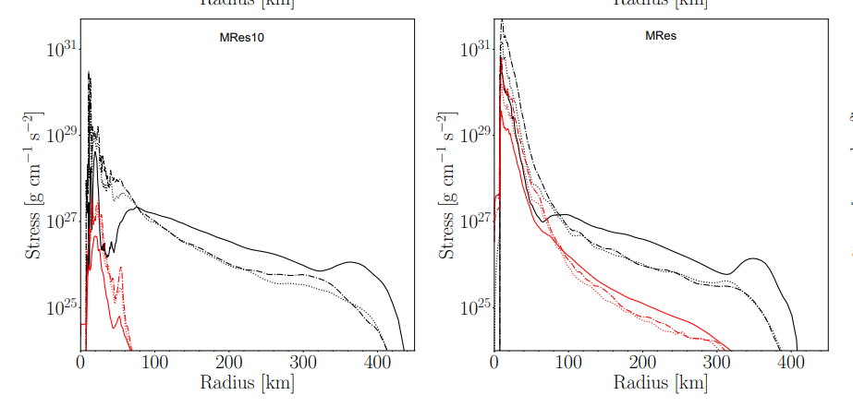
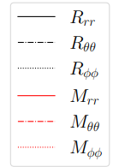
Strong magnetic stresses change have strong feedback
Changes angular momentum transport and PNS convection zone

Slide 21
Difference in Energy Transport
Hydro gain region – convert neutrino heating to turbulent energy
MHD gain region – convert neutrino heating to turbulent energy – some portion converts to magnetic energy
If explosion occurs quickly, magnetic fields act as an energy sink
If explosions occur slightly later, with enough time for fields to grow enough to exert a magnetic pressure/flux, B-fields can help drive the explosion

Slide 22
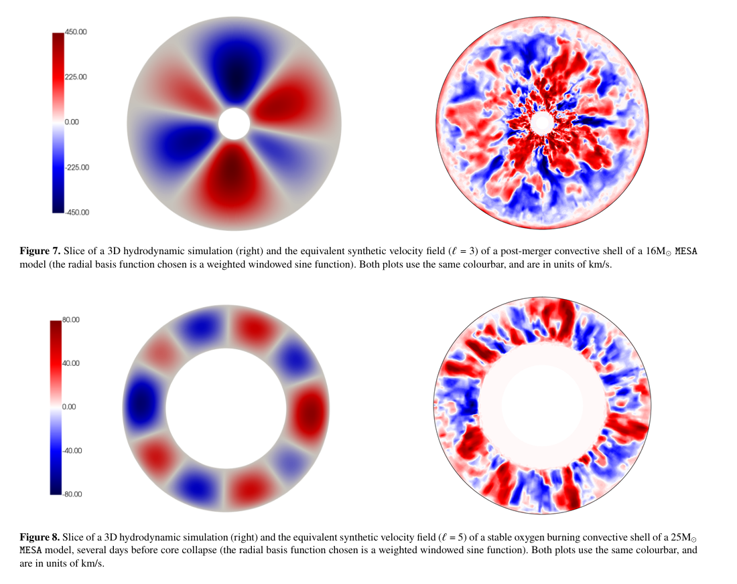
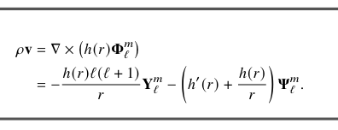
3D Velocity fields from 1D stellar models

