Slide 1







Radiation Effects in Silicon Photonics Micro-Ring Modulators and Waveguides for High-Energy Physics
Daniele Alfiero
Seminar
University of Birmingham
daniele.alfiero@cern.ch
28.05.2026

Slide 2

Outline
Introduction
  Silicon Photonics for high-speed links in particle detectors
  Ring modulators and waveguides
Irradiation campaigns
  X-ray test on ring modulators:
    Electro-optic frequency response
    Localized thermal annealing
  Neutron and X-ray tests on waveguides:
    Radiation-induced attenuation (RIA)
  Heavy ion test on waveguides:
    Optical single-event transients (OSETs)
    TCAD simulations
Conclusions and future work

Slide 3
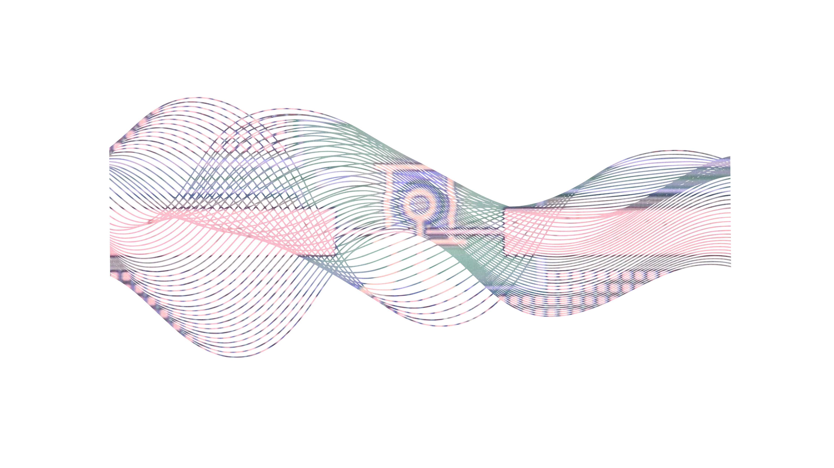
Introduction
Silicon Photonics for High-Energy Physics
3

Slide 4
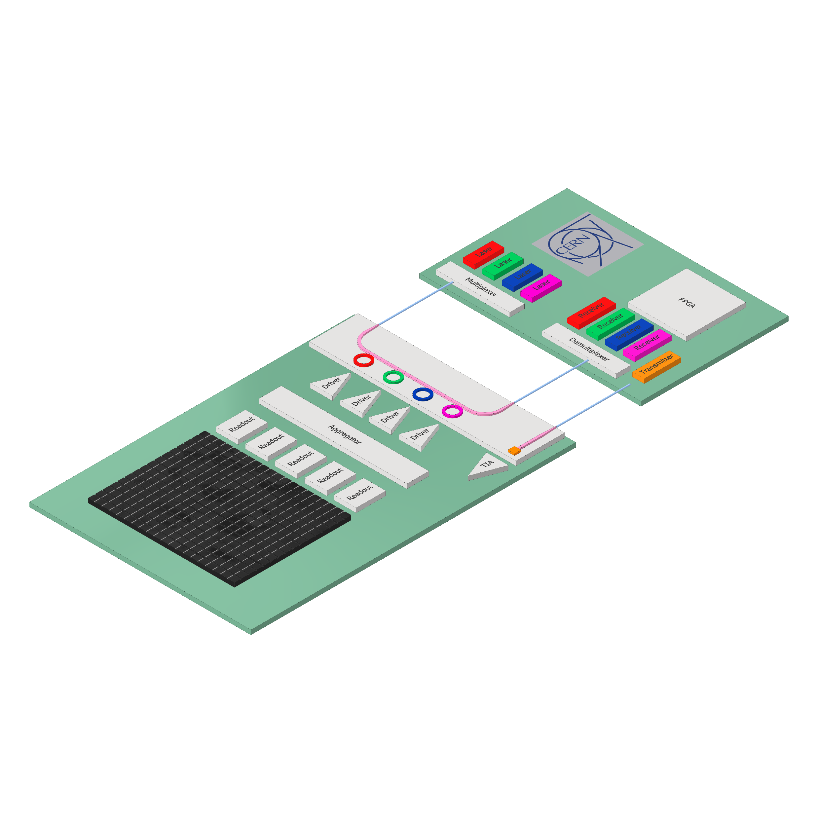
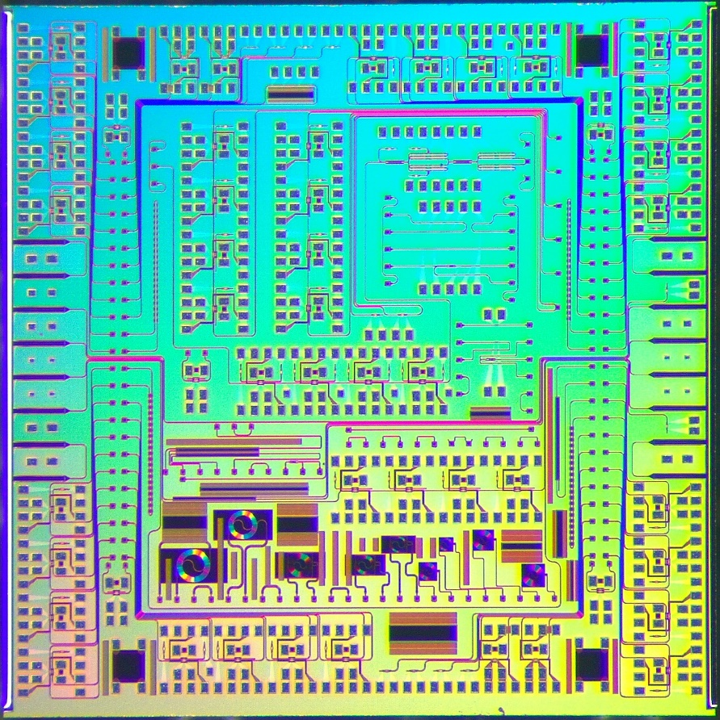


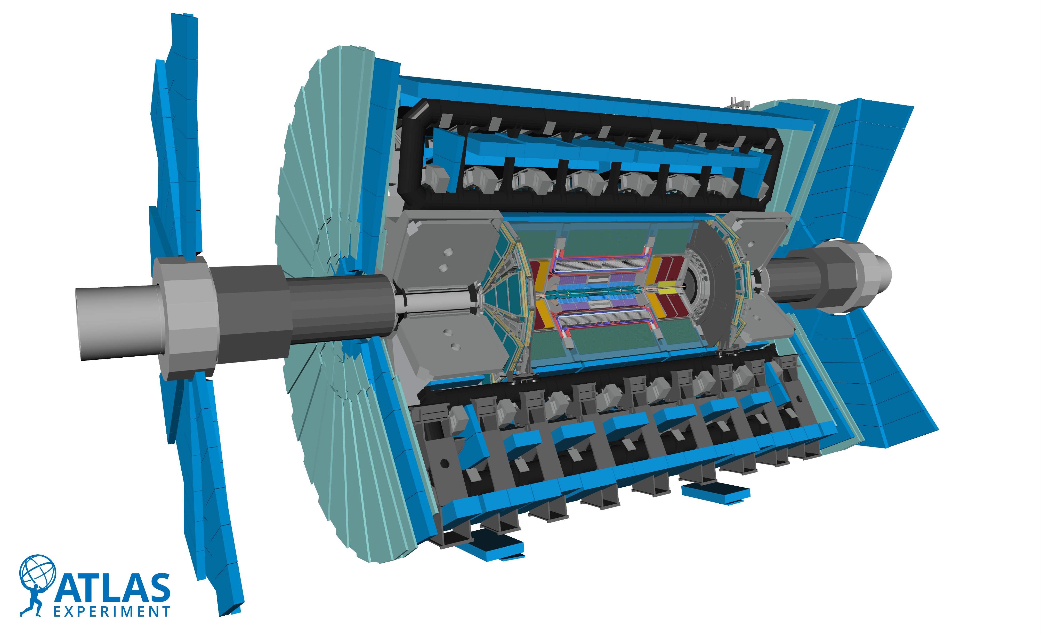



Biereigel
Introduction – Silicon Photonics for High-Energy Physics
Si-PIC
Silicon Photonics
Back-End
>> 100 m Single-mode fibers
High-speed data transmission
PIC
4x25 Gbps
Front-End
Low mass
$\sim$5 Gbps
PD
Low power consumption
Particle sensor
CMOS compatible process flow
Radiation hardness
PIC: Photonic Integrated Circuit
PD: Photodiode

Slide 5





Introduction – Overview of a SiPh-based transceiver
λ₁
Si-PIC
λ₂
Input light
unmodulated light
λ₃
Multiplexer
FAU
λ₄
fiber array unit
Rx
Mirco-Ring Modulators (RM)
Commercial
off-the-shelf
components,
FPGAs, etc.
Waveguides
Rx
Demultiplexer
Rx
modulated light
two of the main photonic components exposed to radiation !
Rx

Slide 6
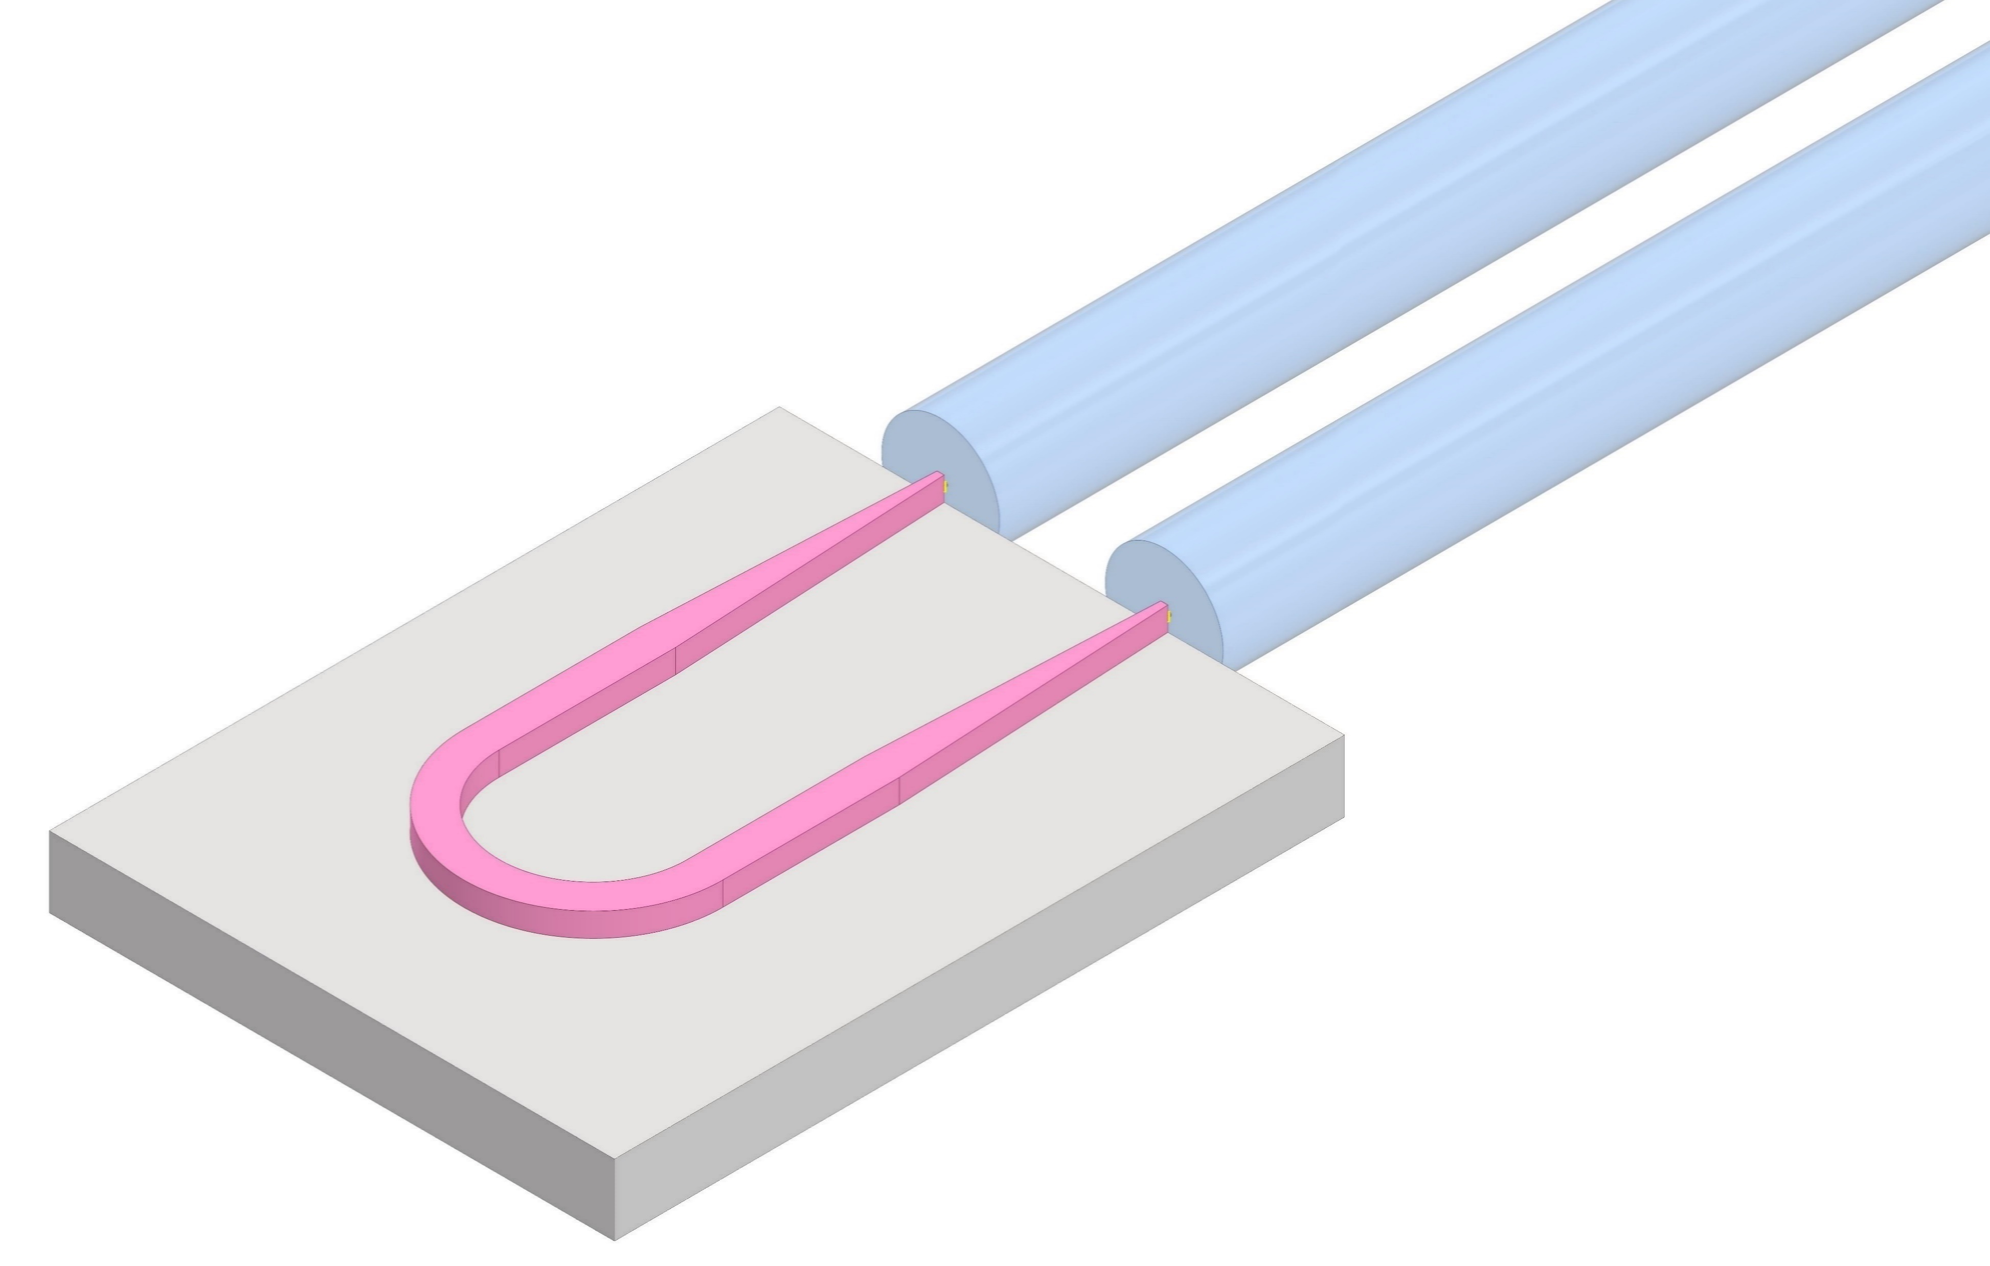
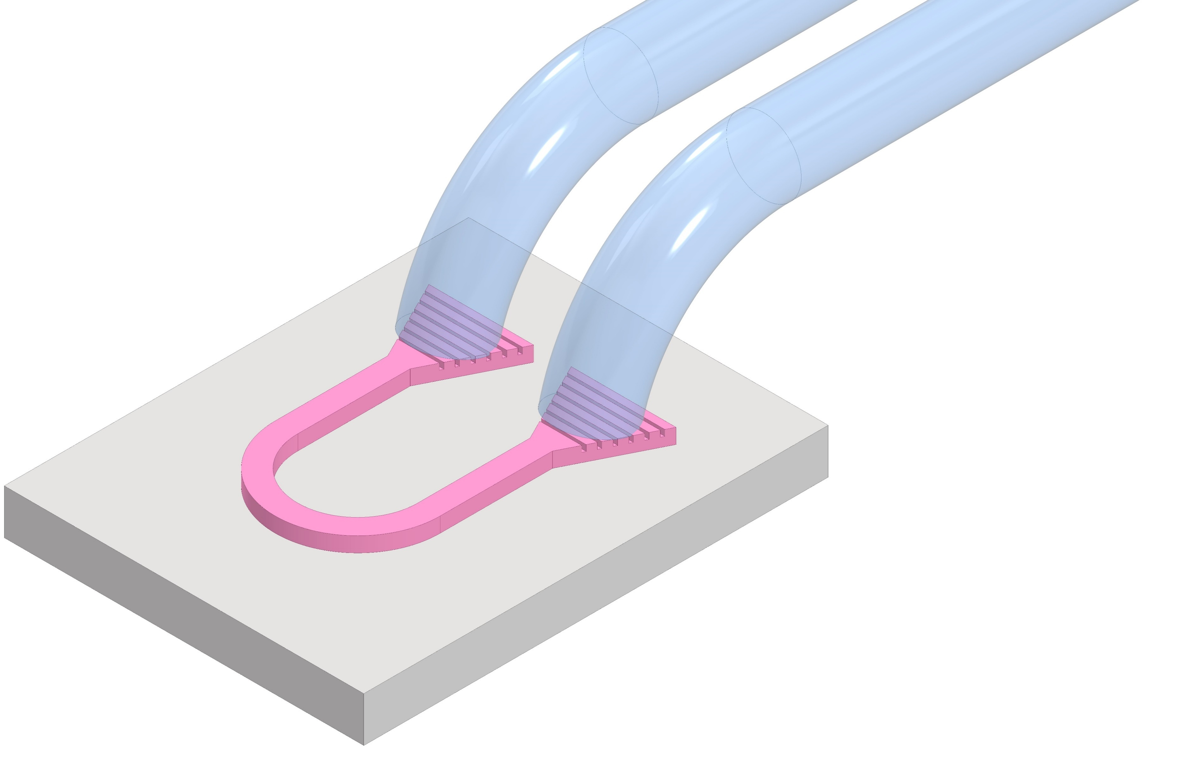
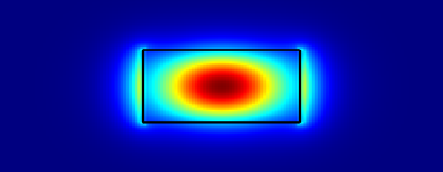
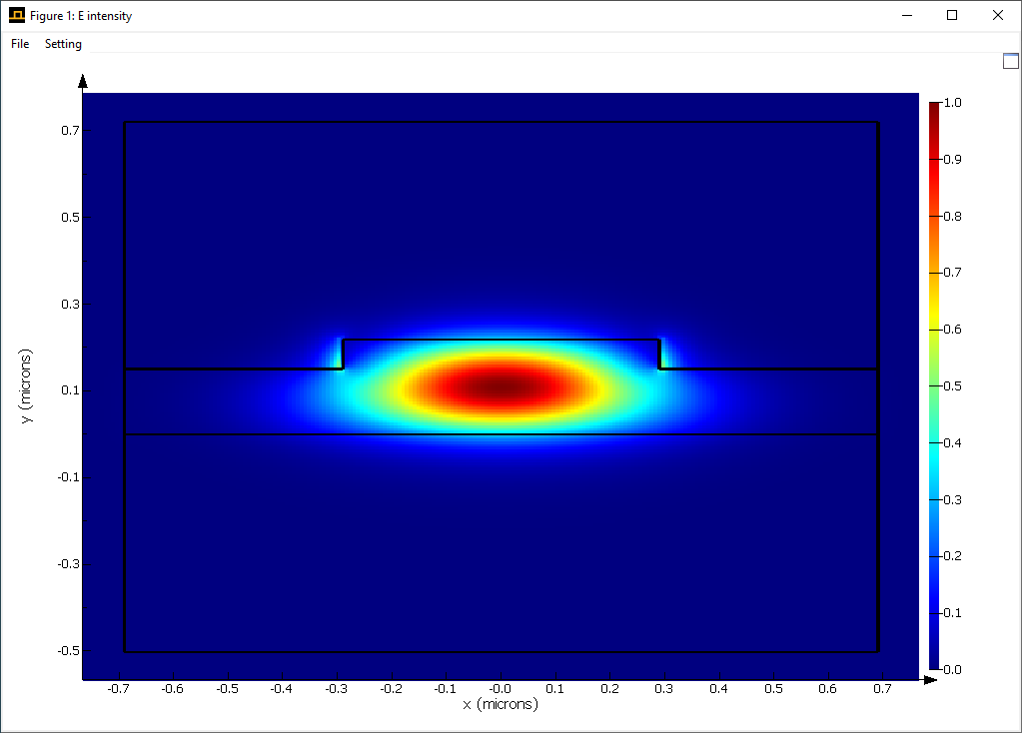

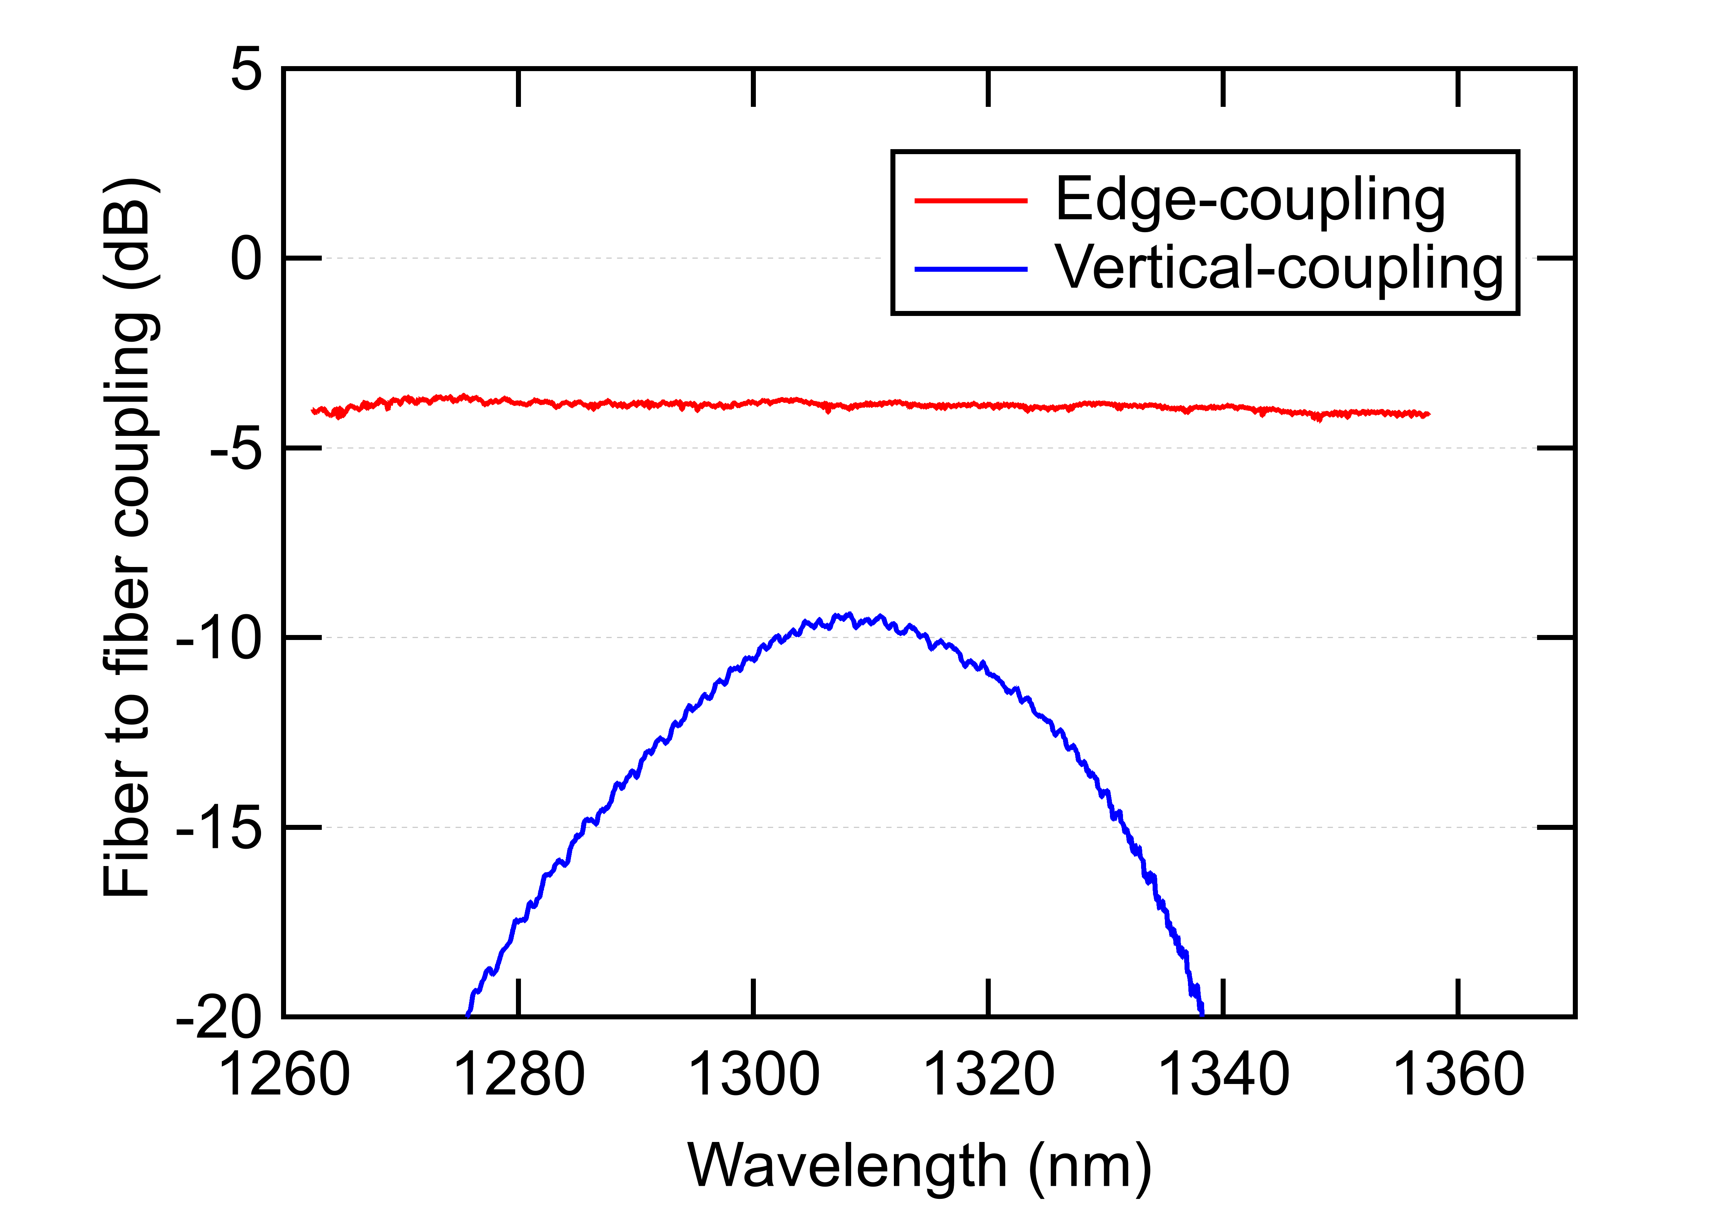
Introduction – Light coupling and waveguides
Edge coupler
Vertical coupler
Angle of incidence
~ 10° off-vertical
Optical fiber
Optical fiber
Waveguides cross-section
(a)
380 nm
strip
SiO₂ substrate
220 nm
Si waveguide
rib
(deep etch)
(b)
 | Edge | Vertical
Insertion Loss | ✓ | ✖
Bandwidth | ✓ | ✖
Packaging Complexity | O | ✓
Wafer Level Probing | O | ✓
|E| [a.u.]
rib
(shallow etch)
(c)
SiO₂
Si

Slide 7
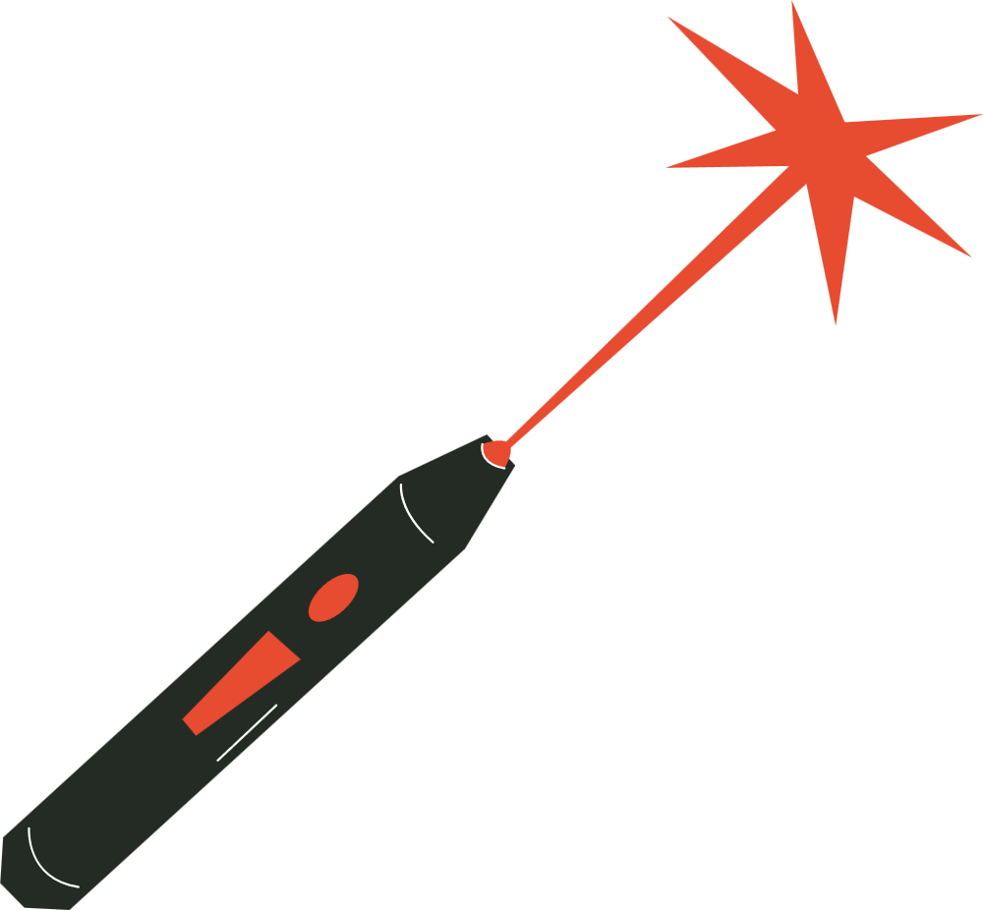
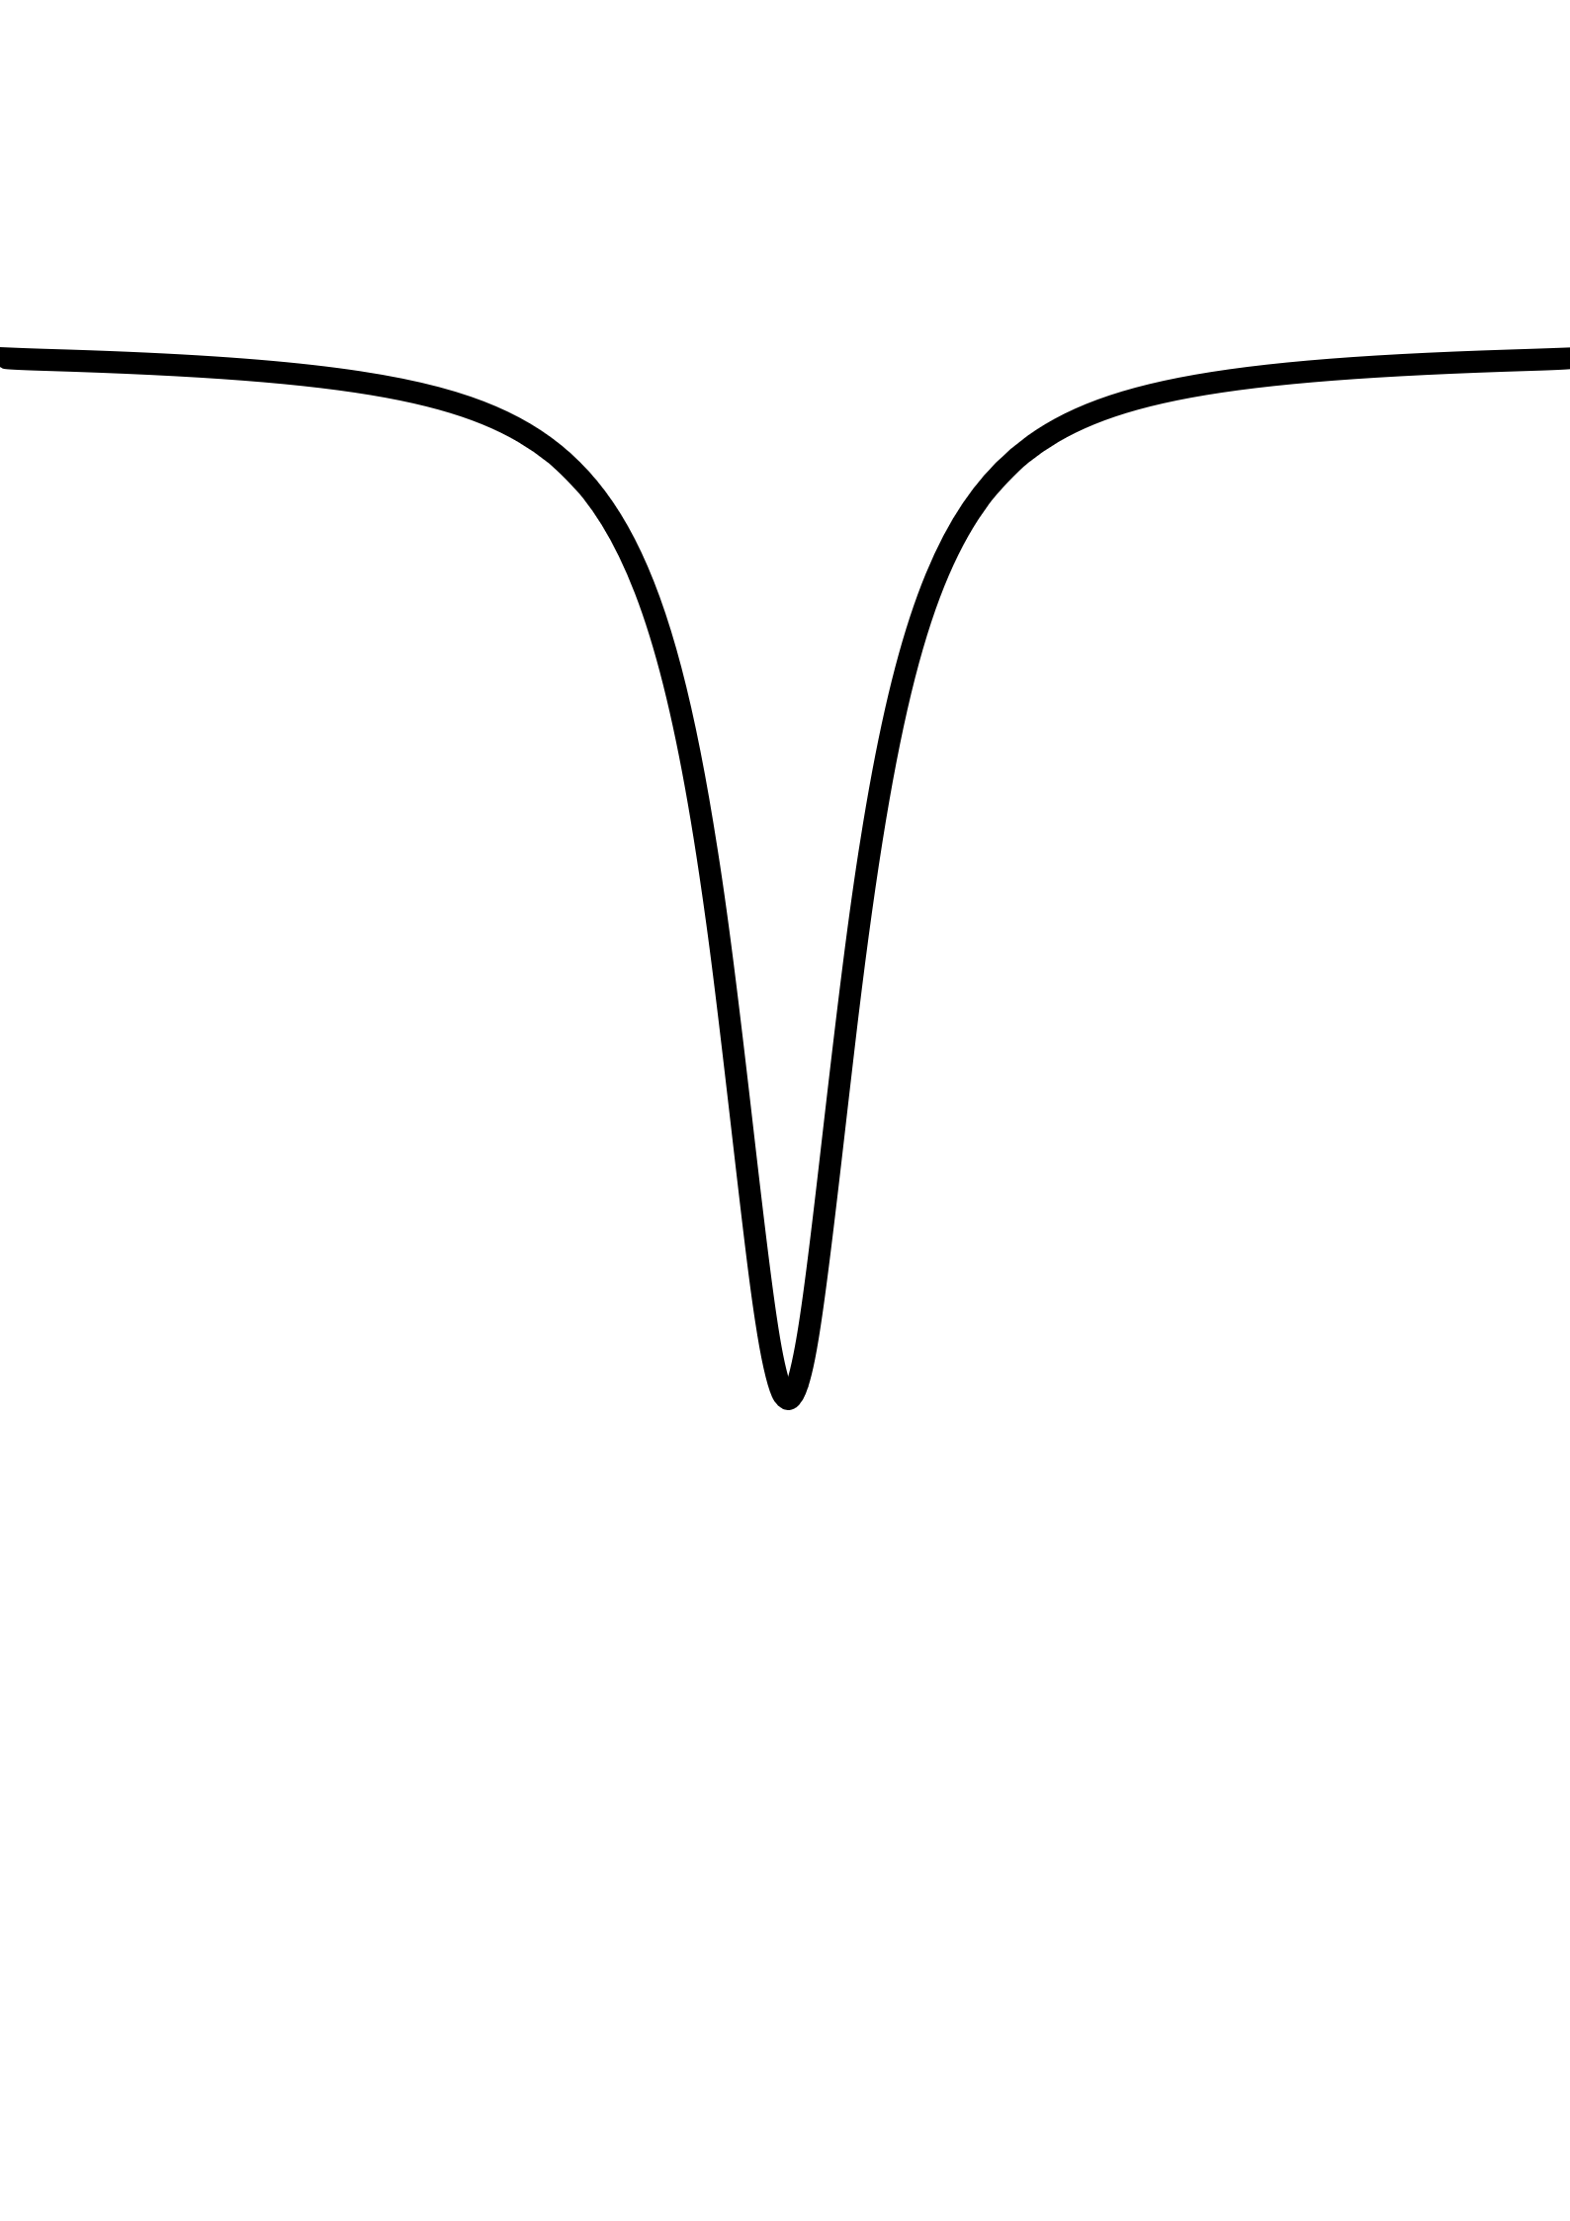




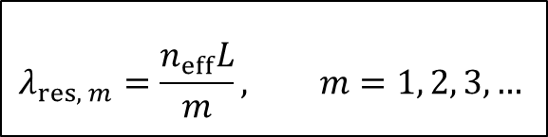
Introduction – Ring Modulators
Working principle:
  Light coupled into the silicon micro-ring
  Destructive interference → resonance
Input light
Si
Output light
5 μm
Optical power
Free Spectral Range
(FSR)
SiO₂
Top view
$$λ_{res, m}=\frac{n_{eff}L}{m}, m=1, 2, 3,…$$
Wavelength
$$λ_{LASER}$$
$$λ_{res, 0}$$
$$λ_{res, 1}$$
$n_{eff}$: effective refractive index
$L$: round trip length

Slide 8
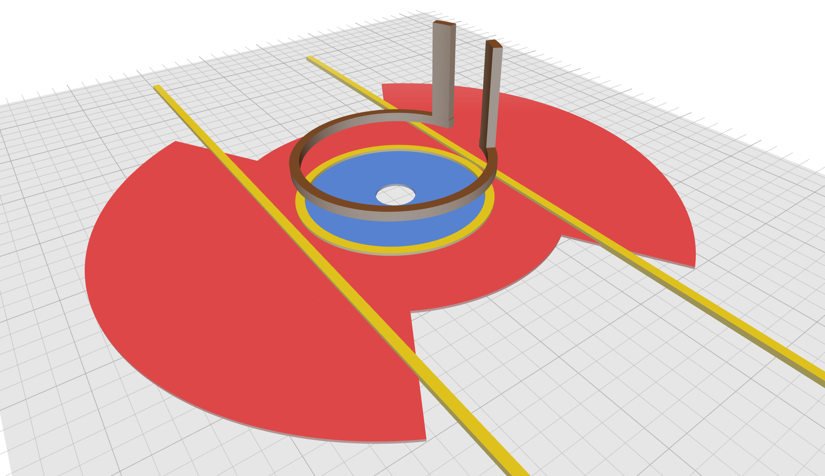
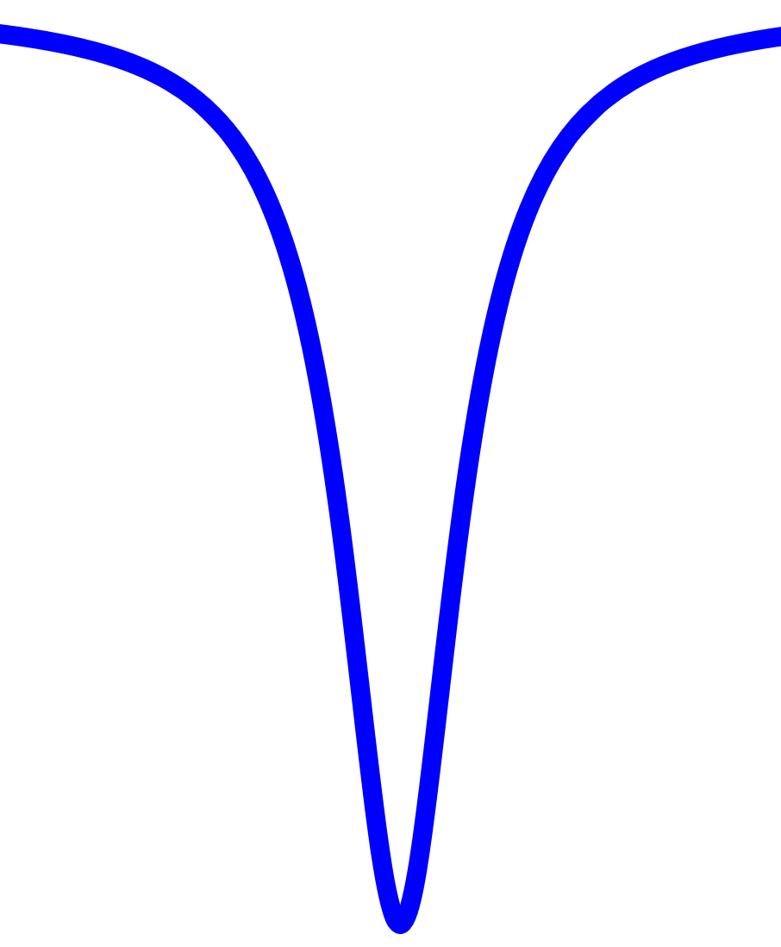
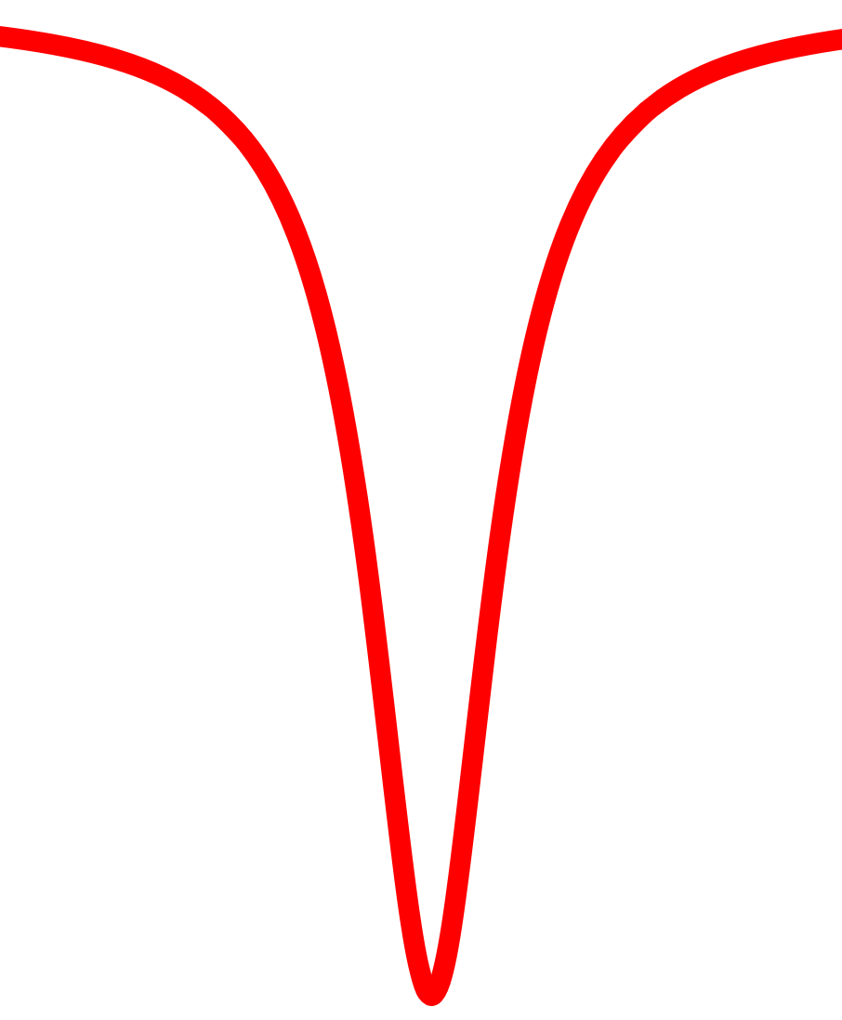
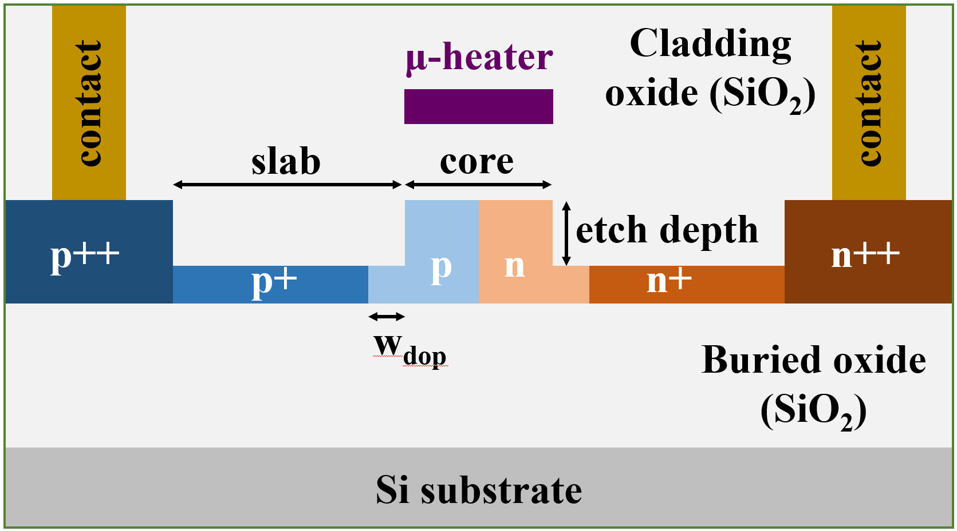
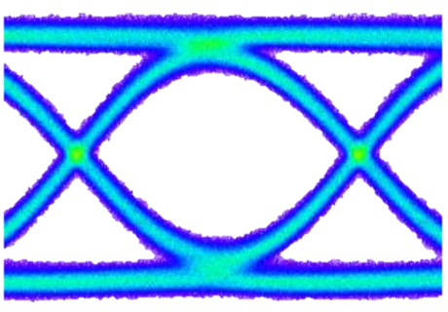
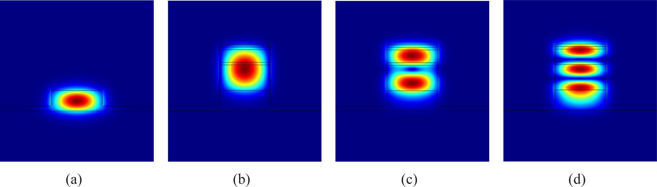
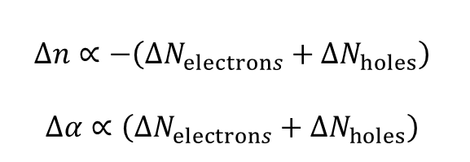

Introduction – Ring Modulators
How do we modulate it?
  Modulation of the resonance peak through the applied voltage
    Injection/depletion of carriers → variation of the effective refractive index
$$∆n∝−\left(∆N_{electrons}+∆N_{holes}\right)$$
$$∆α∝\left(∆N_{electrons}+∆N_{holes}\right)$$
ΔV
V
Optical power
P_{opt}
P₁
X
OMA
P₀
X
V₀
time
V₁
ME
Wavelength
Phase shifter cross-section
$$λ_{LASER}$$
Modulation
Efficiency
OMA: Optical Modulation Amplitude
ME: Modulation Efficiency

Slide 9
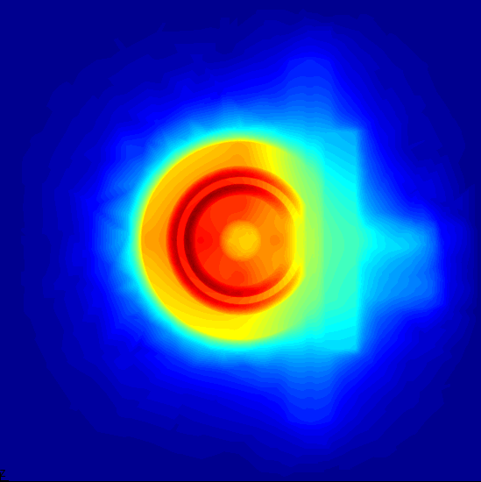
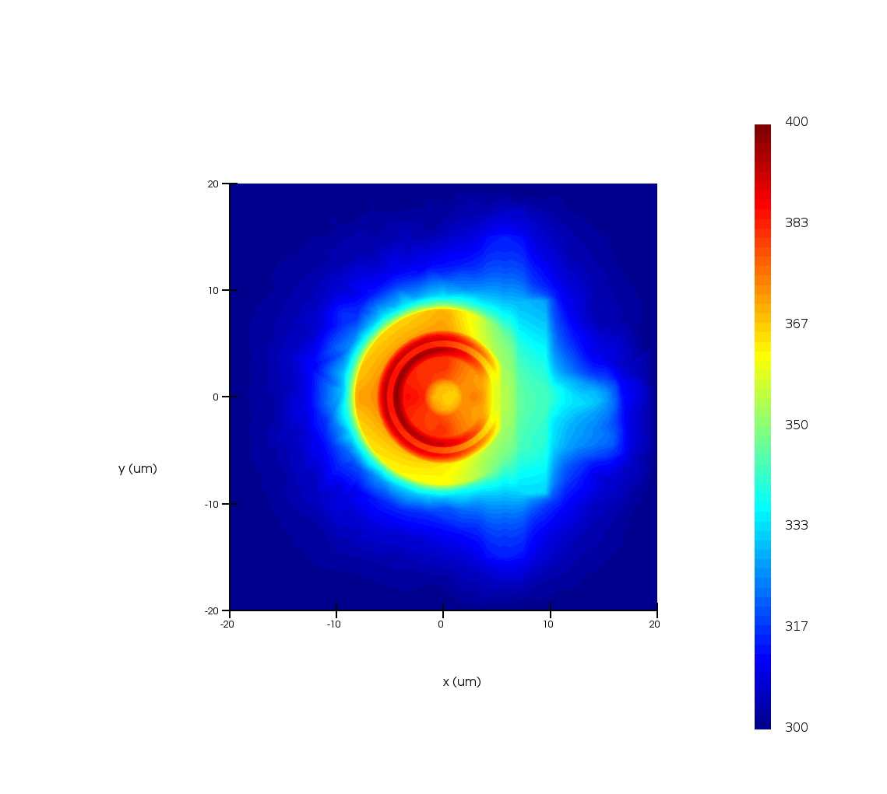
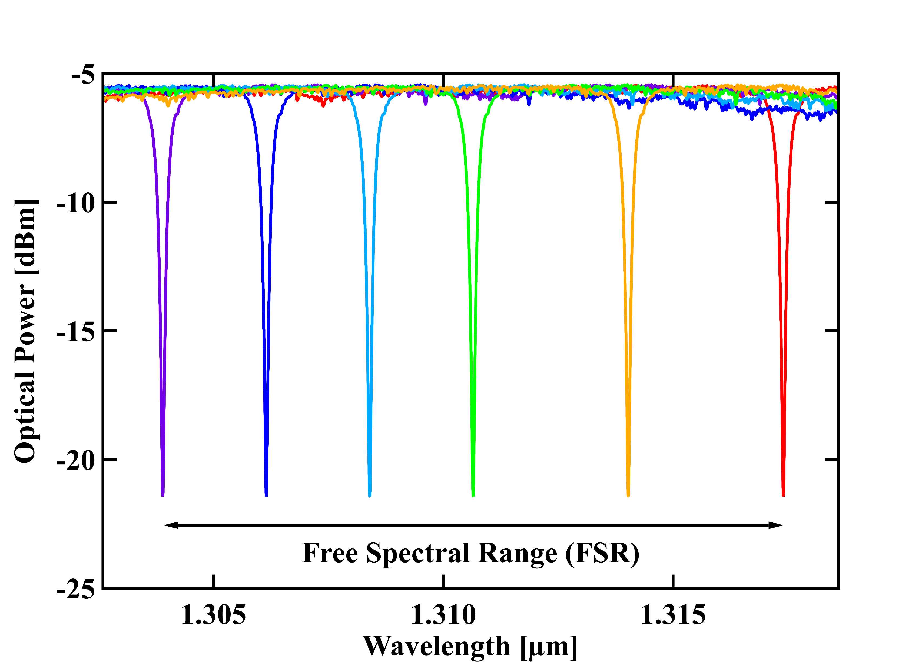
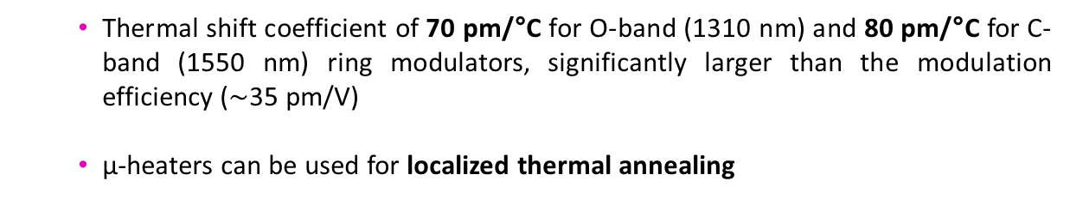
Introduction – Tungsten micro-heaters
  Tungsten µ-heater to shift the resonance wavelength
  Localized heating
  Thermo-optic coefficient of silicon stronger than electrical modulation but slower
SiO₂
400 K
300 K
Si waveguide
µ-heater
µ-heater’s electrical power and temperature
  Thermal shift coefficient of 70 pm/°C for O-band (1310 nm) and 80 pm/°C for C-band (1550 nm) ring modulators, significantly larger than the modulation efficiency ($\sim$35 pm/V)
  µ-heaters can be used for localized thermal annealing

Slide 10

Ring Modulators
X-ray irradiation tests
10

Slide 11
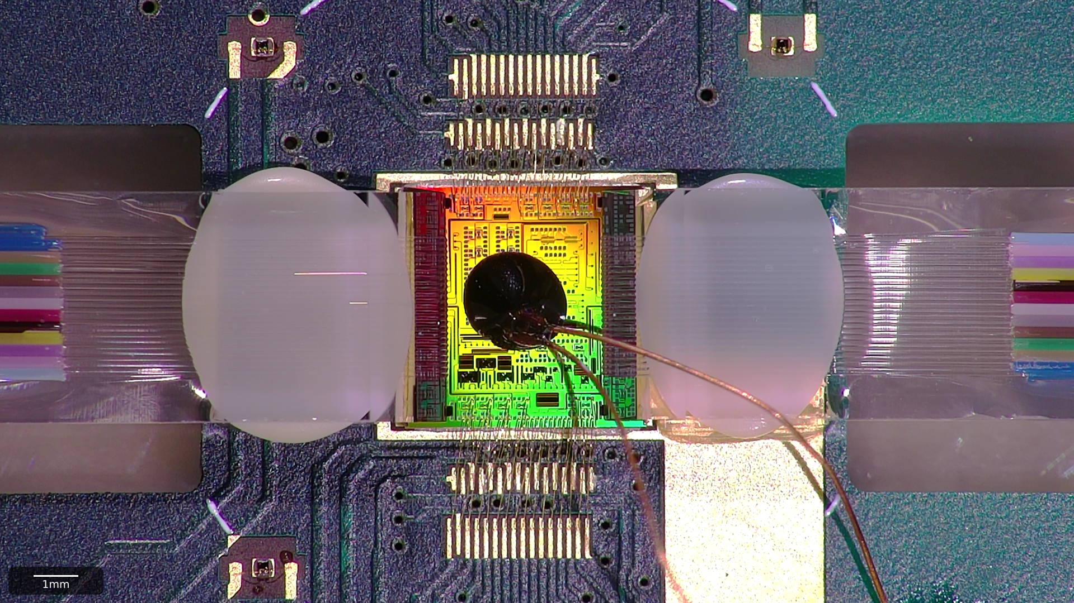
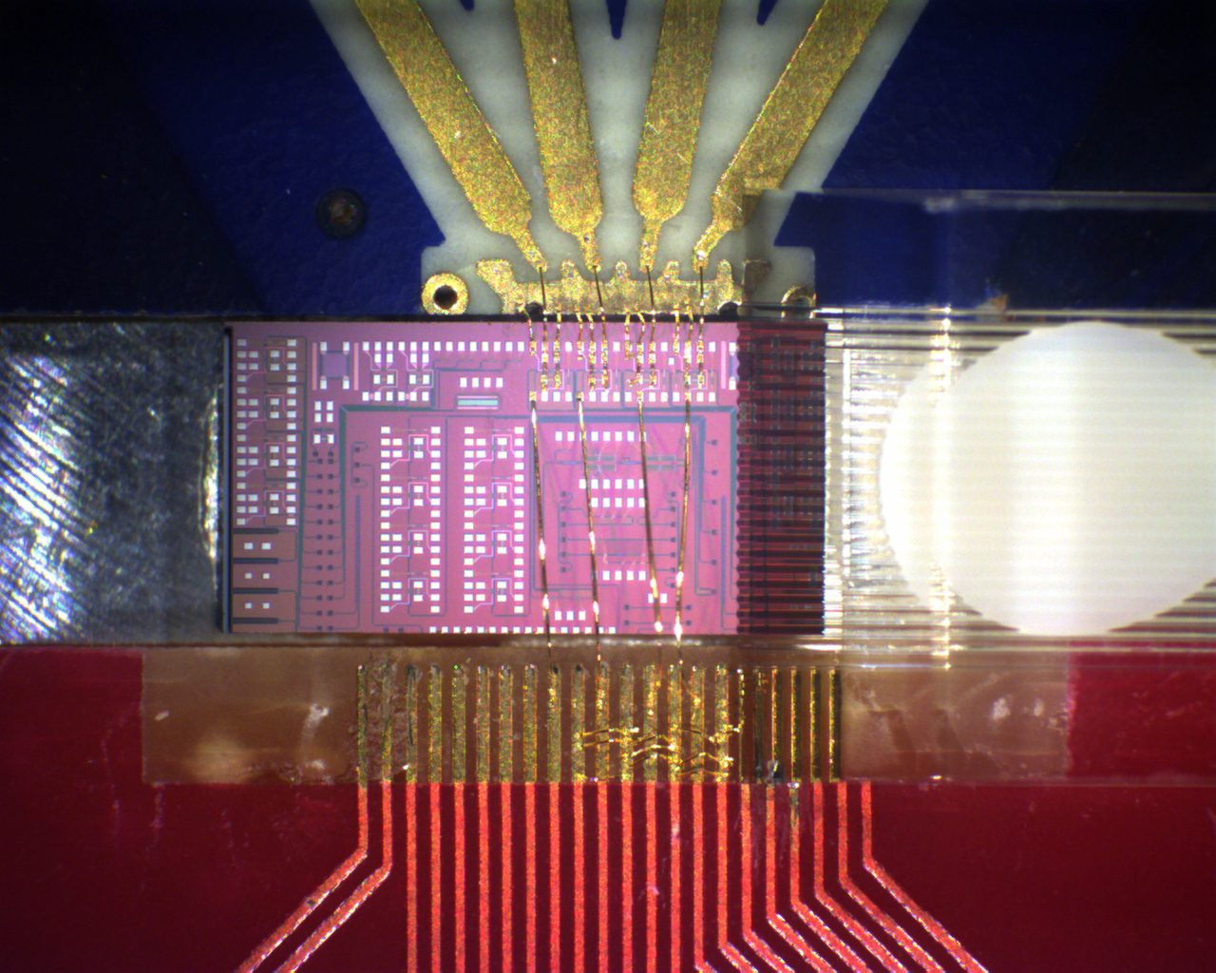
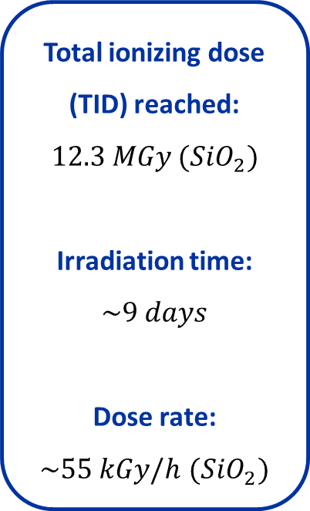
X-ray testing of Ring Modulators – Motivation
Static Test
Dynamic Test
  Characterization of ring modulators and photodiodes under ionizing radiation
  Online acquisition of electrical (I-V) and optical (spectra) device parameters
  Investigation of temperature effects and thermal annealing post-irradiation
  Measurement of electro-optic (EO) frequency response of ring modulators under ionizing radiation
  Analysis across different temperatures and in the 10 MHz - 25 GHz frequency range
  Investigation of thermal annealing during and after irradiation
Total ionizing dose (TID) reached:
$$12.3 MGy ({SiO}_{2})$$
Irradiation time:
$$\sim 9 days$$
Dose rate:
$\sim 55 kGy/h$ $({SiO}_{2})$
5 mm
5 mm
PIC
Optical fiber
array
Temperature
sensor

Slide 12
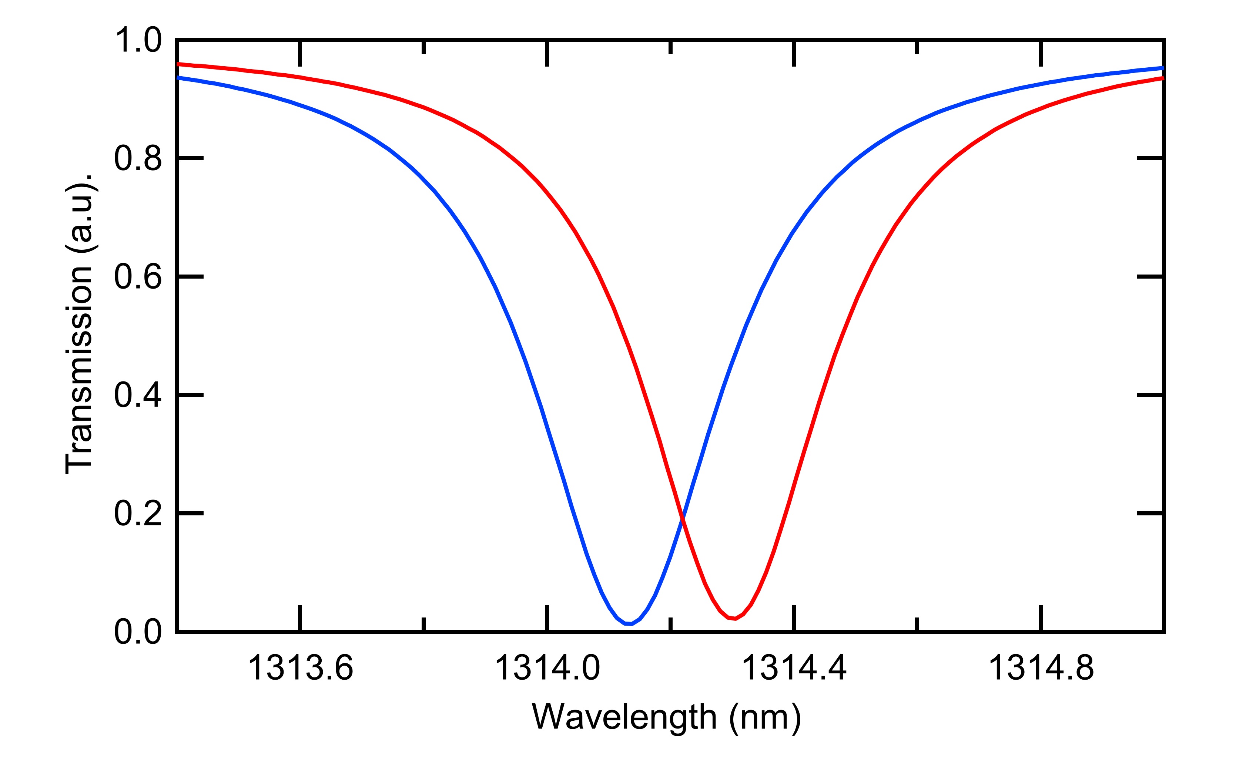
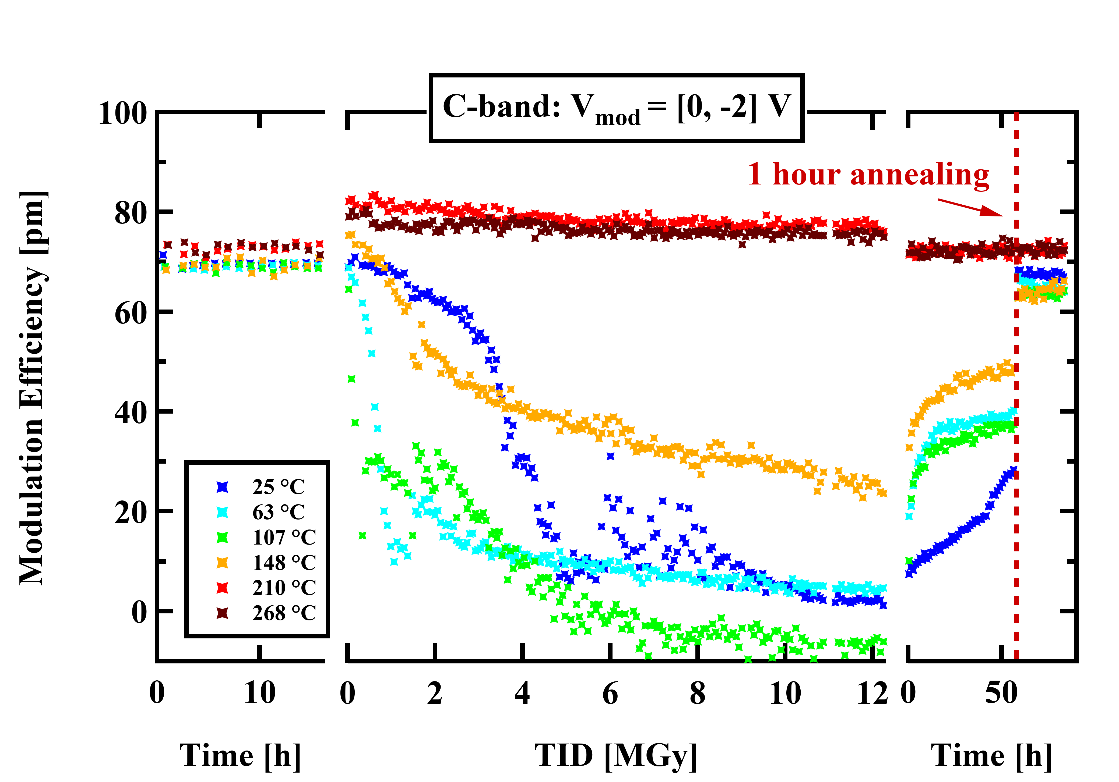
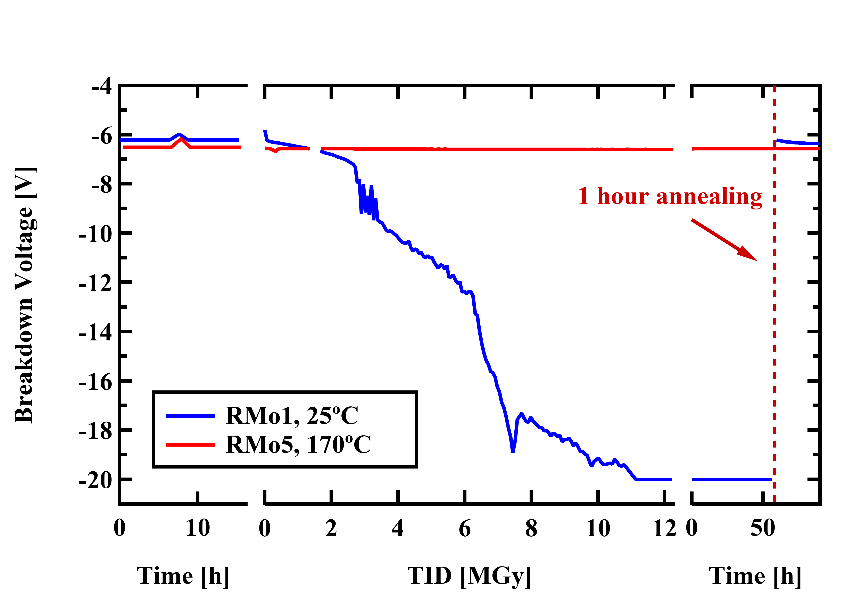
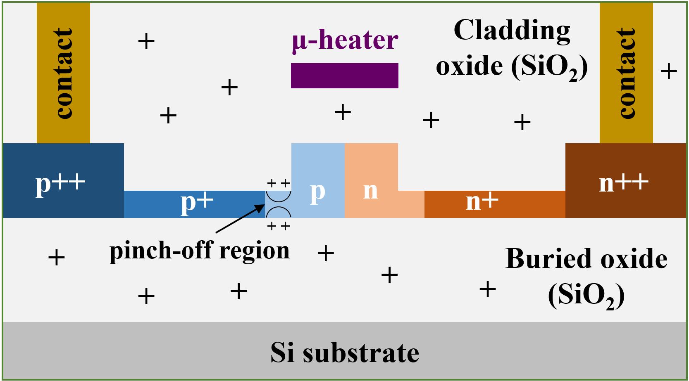
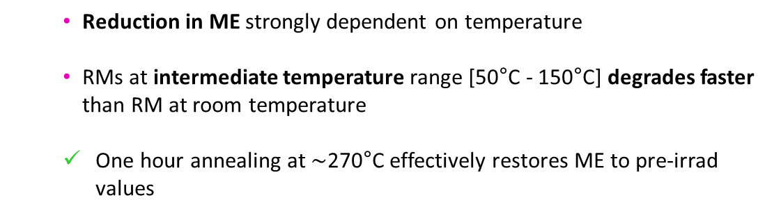
Static X-ray test – Results
pre-irrad
irrad
post-irrad
V₀
V₁
ME
  Reduction in ME strongly dependent on temperature
  RMs at intermediate temperature range [50°C - 150°C] degrades faster than RM at room temperature
  One hour annealing at $\sim$270°C effectively restores ME to pre-irrad values
  Pinch-off of the p-slab caused by positive charge accumulation
  Increase in the breakdown voltage confirms the pinch-off mechanism

Slide 13
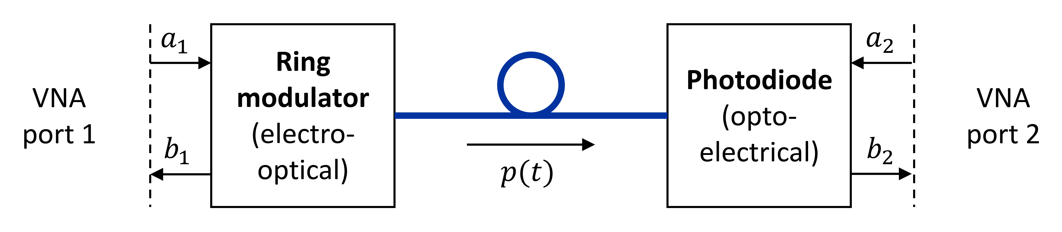
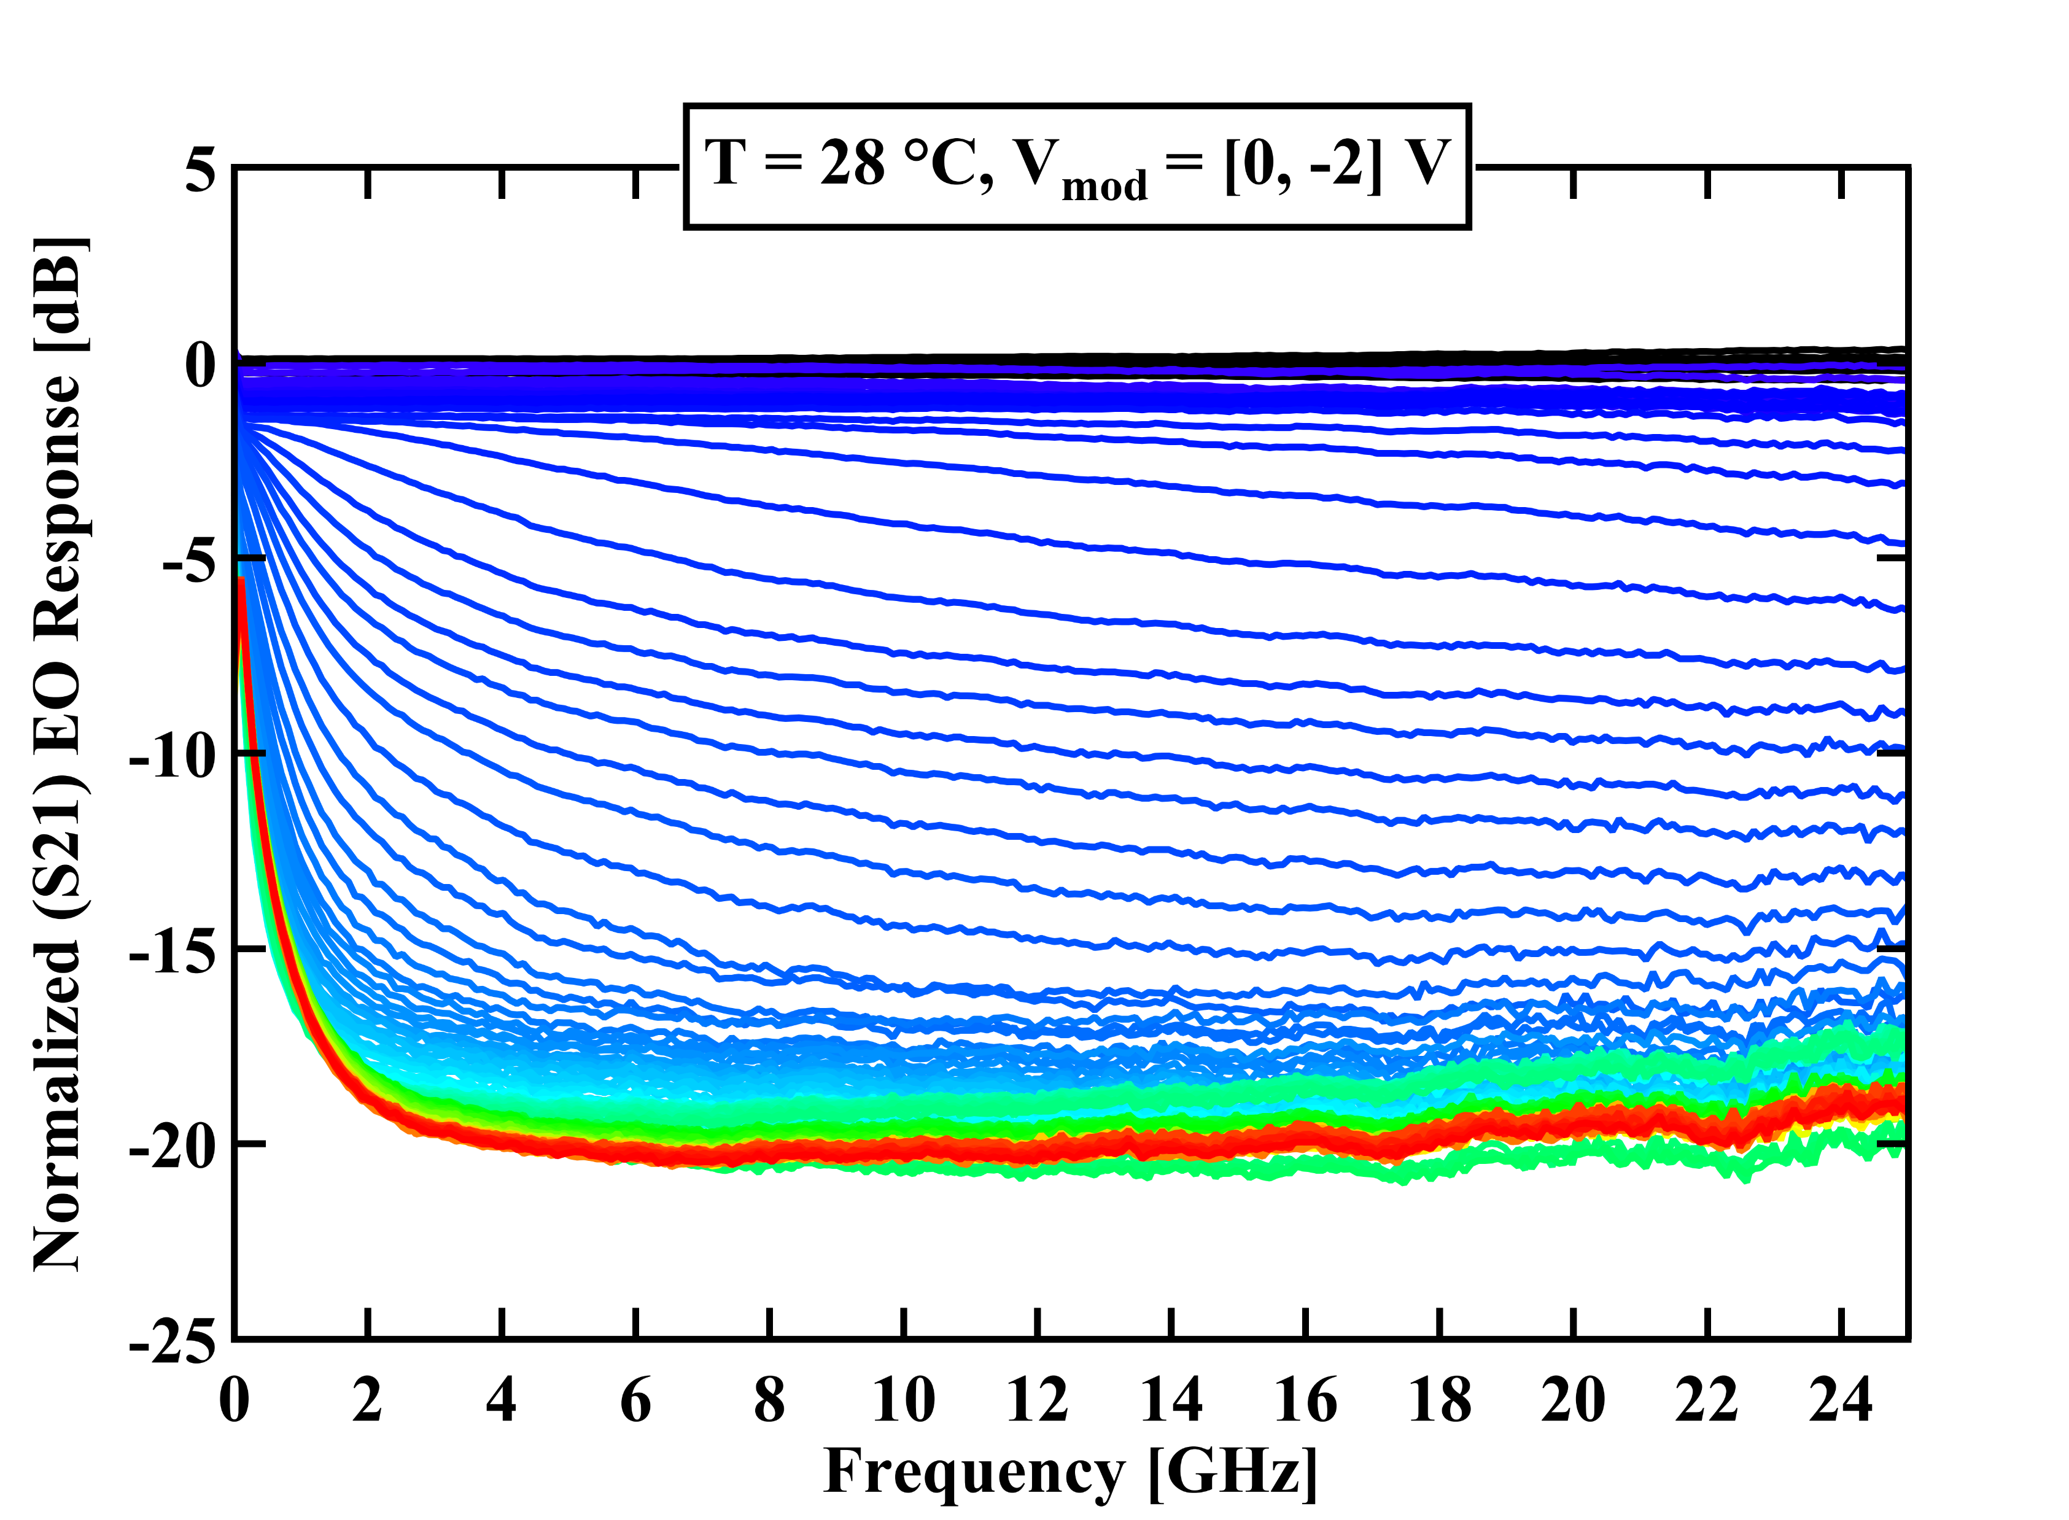
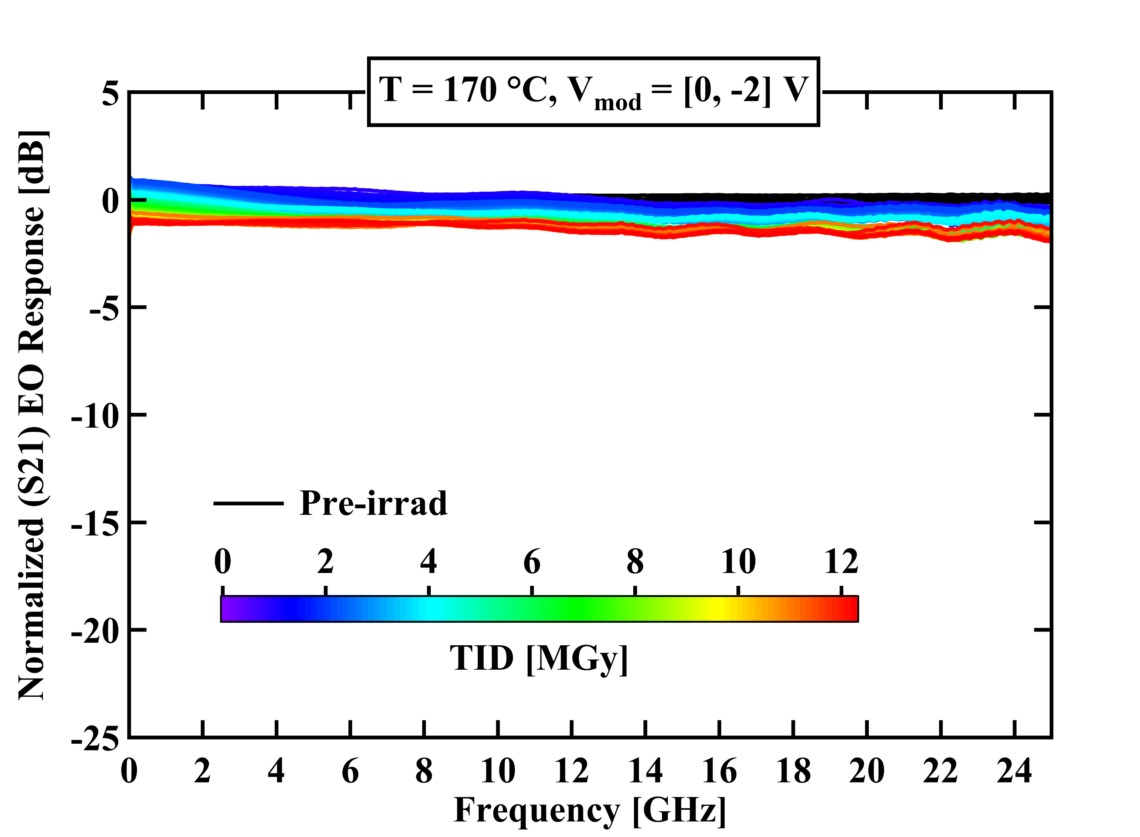
Dynamic X-ray test – EO frequency response (S21)
  EO frequency response (S21) measured online using a VNA (Vector Network Analyzer) and a high-speed photodiode
  TID damage is frequency dependent and saturates around 2 MGy for room temperature device
  RM at 170°C thanks to the µ-heater continuously anneal TID damage

Slide 14
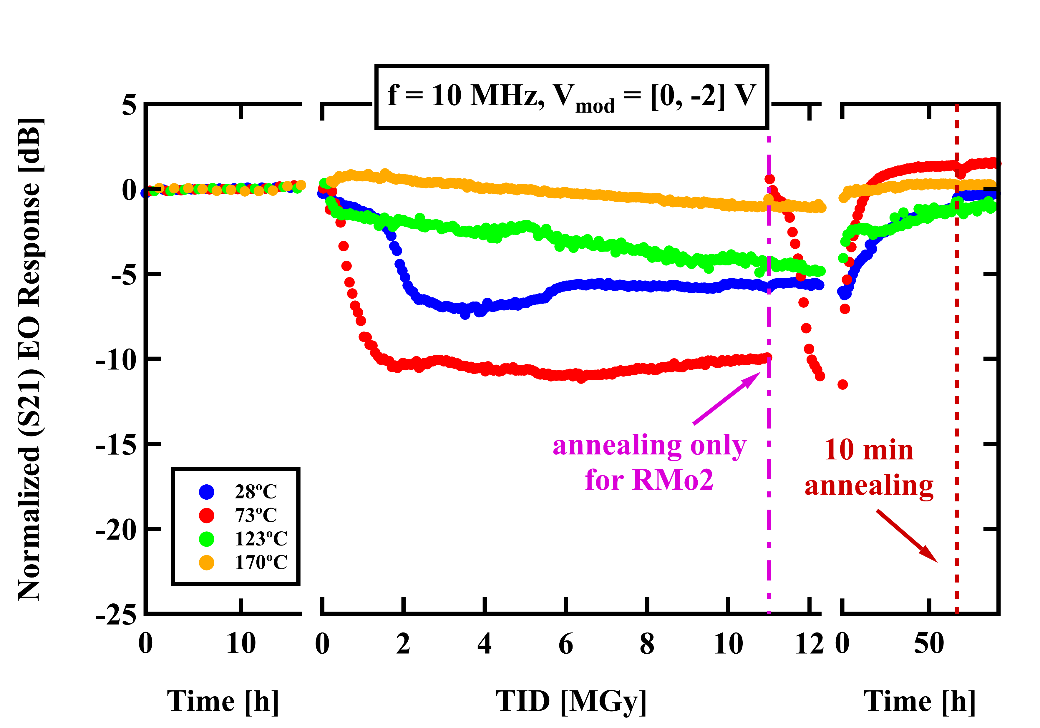
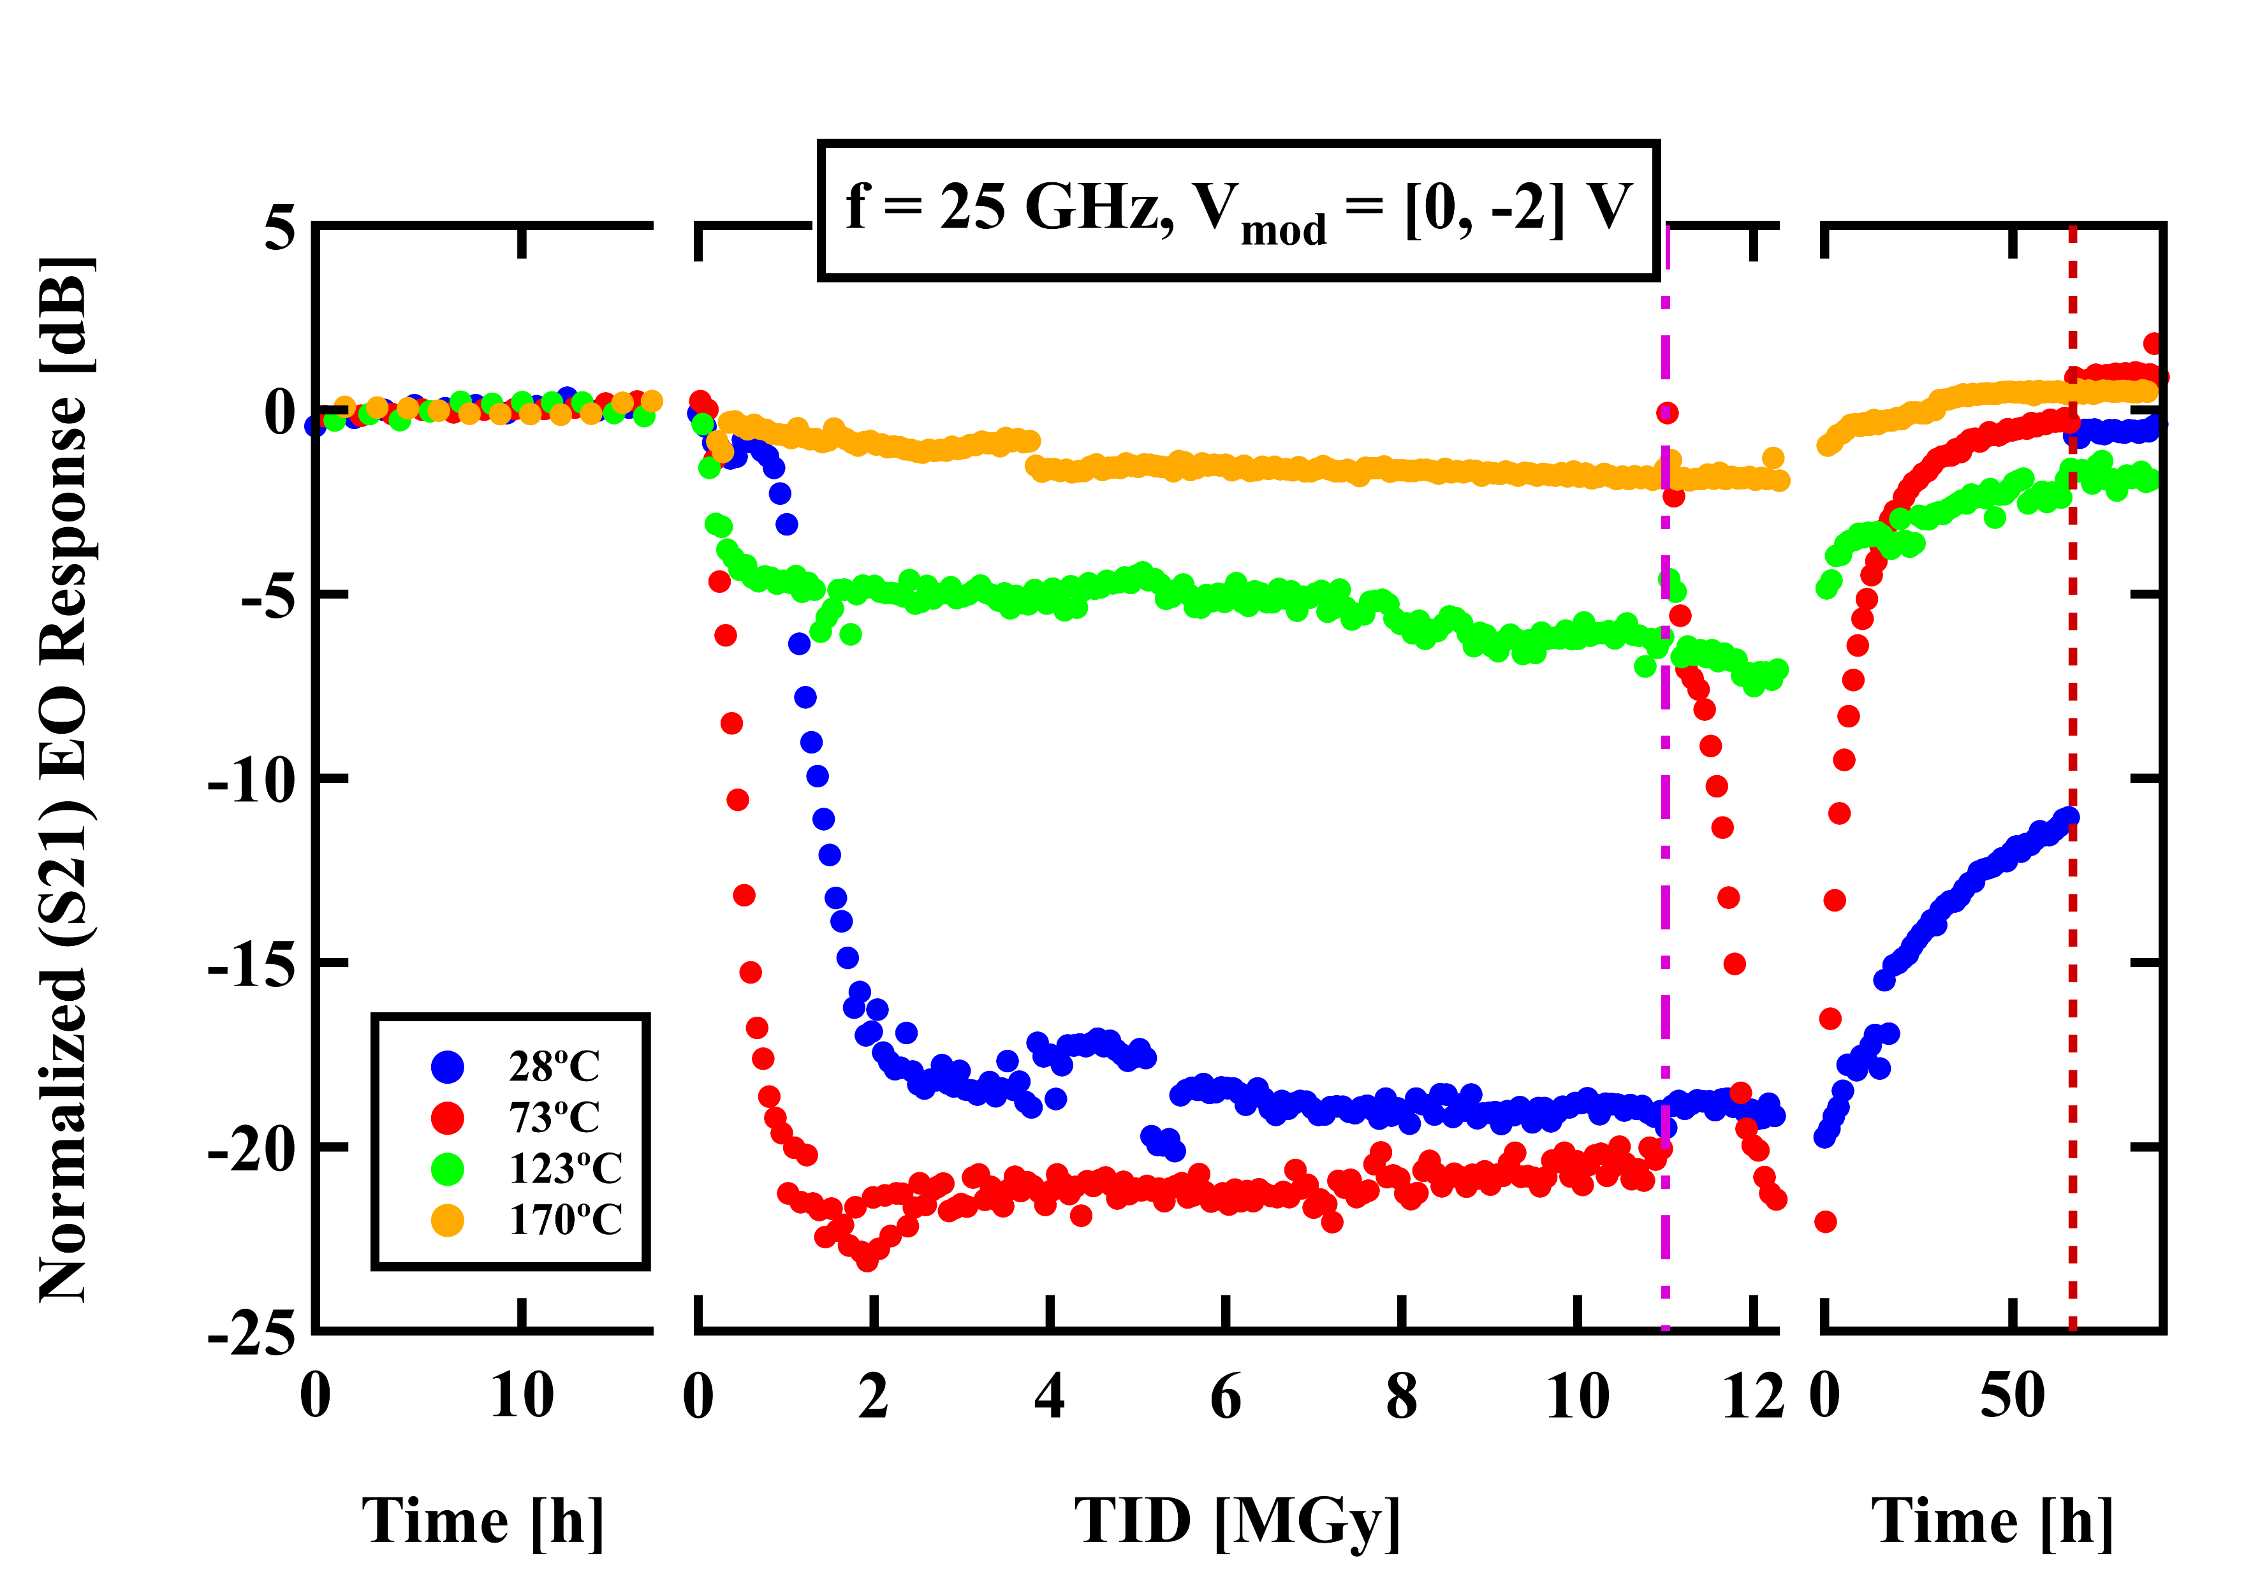
Dynamic X-ray test – S21 at single frequency
pre-irrad
irrad
post-irrad
pre-irrad
irrad
post-irrad
  S21 measurements are consistent with ME results from the static X-ray test:
    Faster degradation observed in the intermediate temperature range compared to room temperature device
    After irradiation, tried shorter annealing than in previous test: 10 minutes at 230°C sufficient to recover the EO frequency response

Slide 15
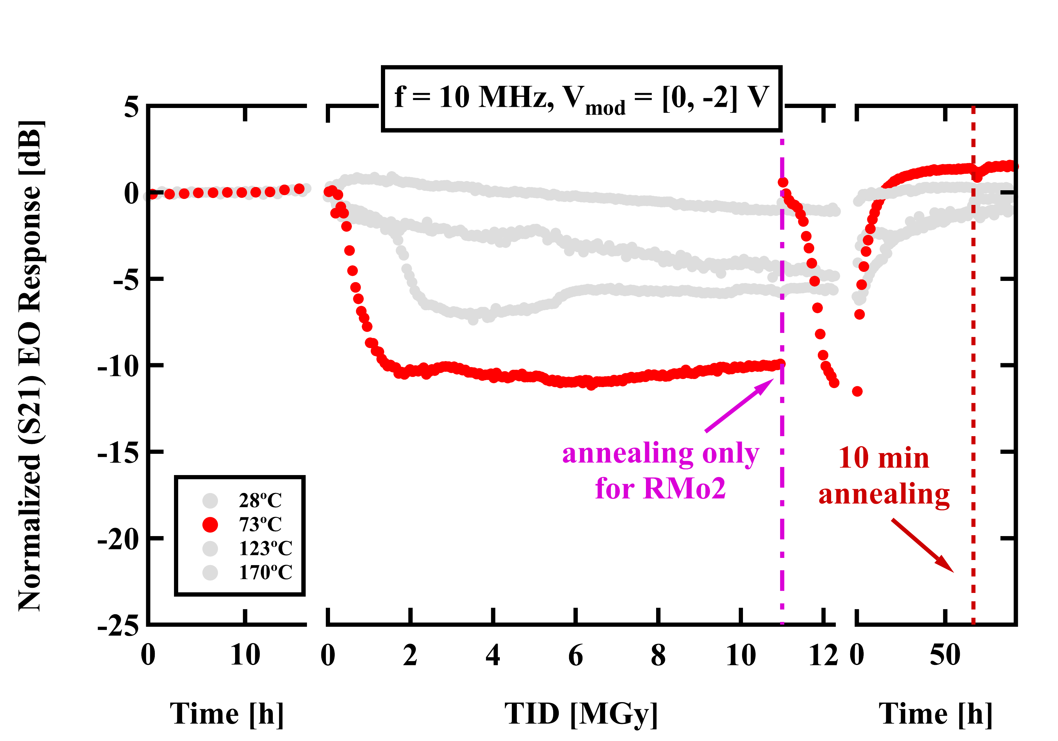
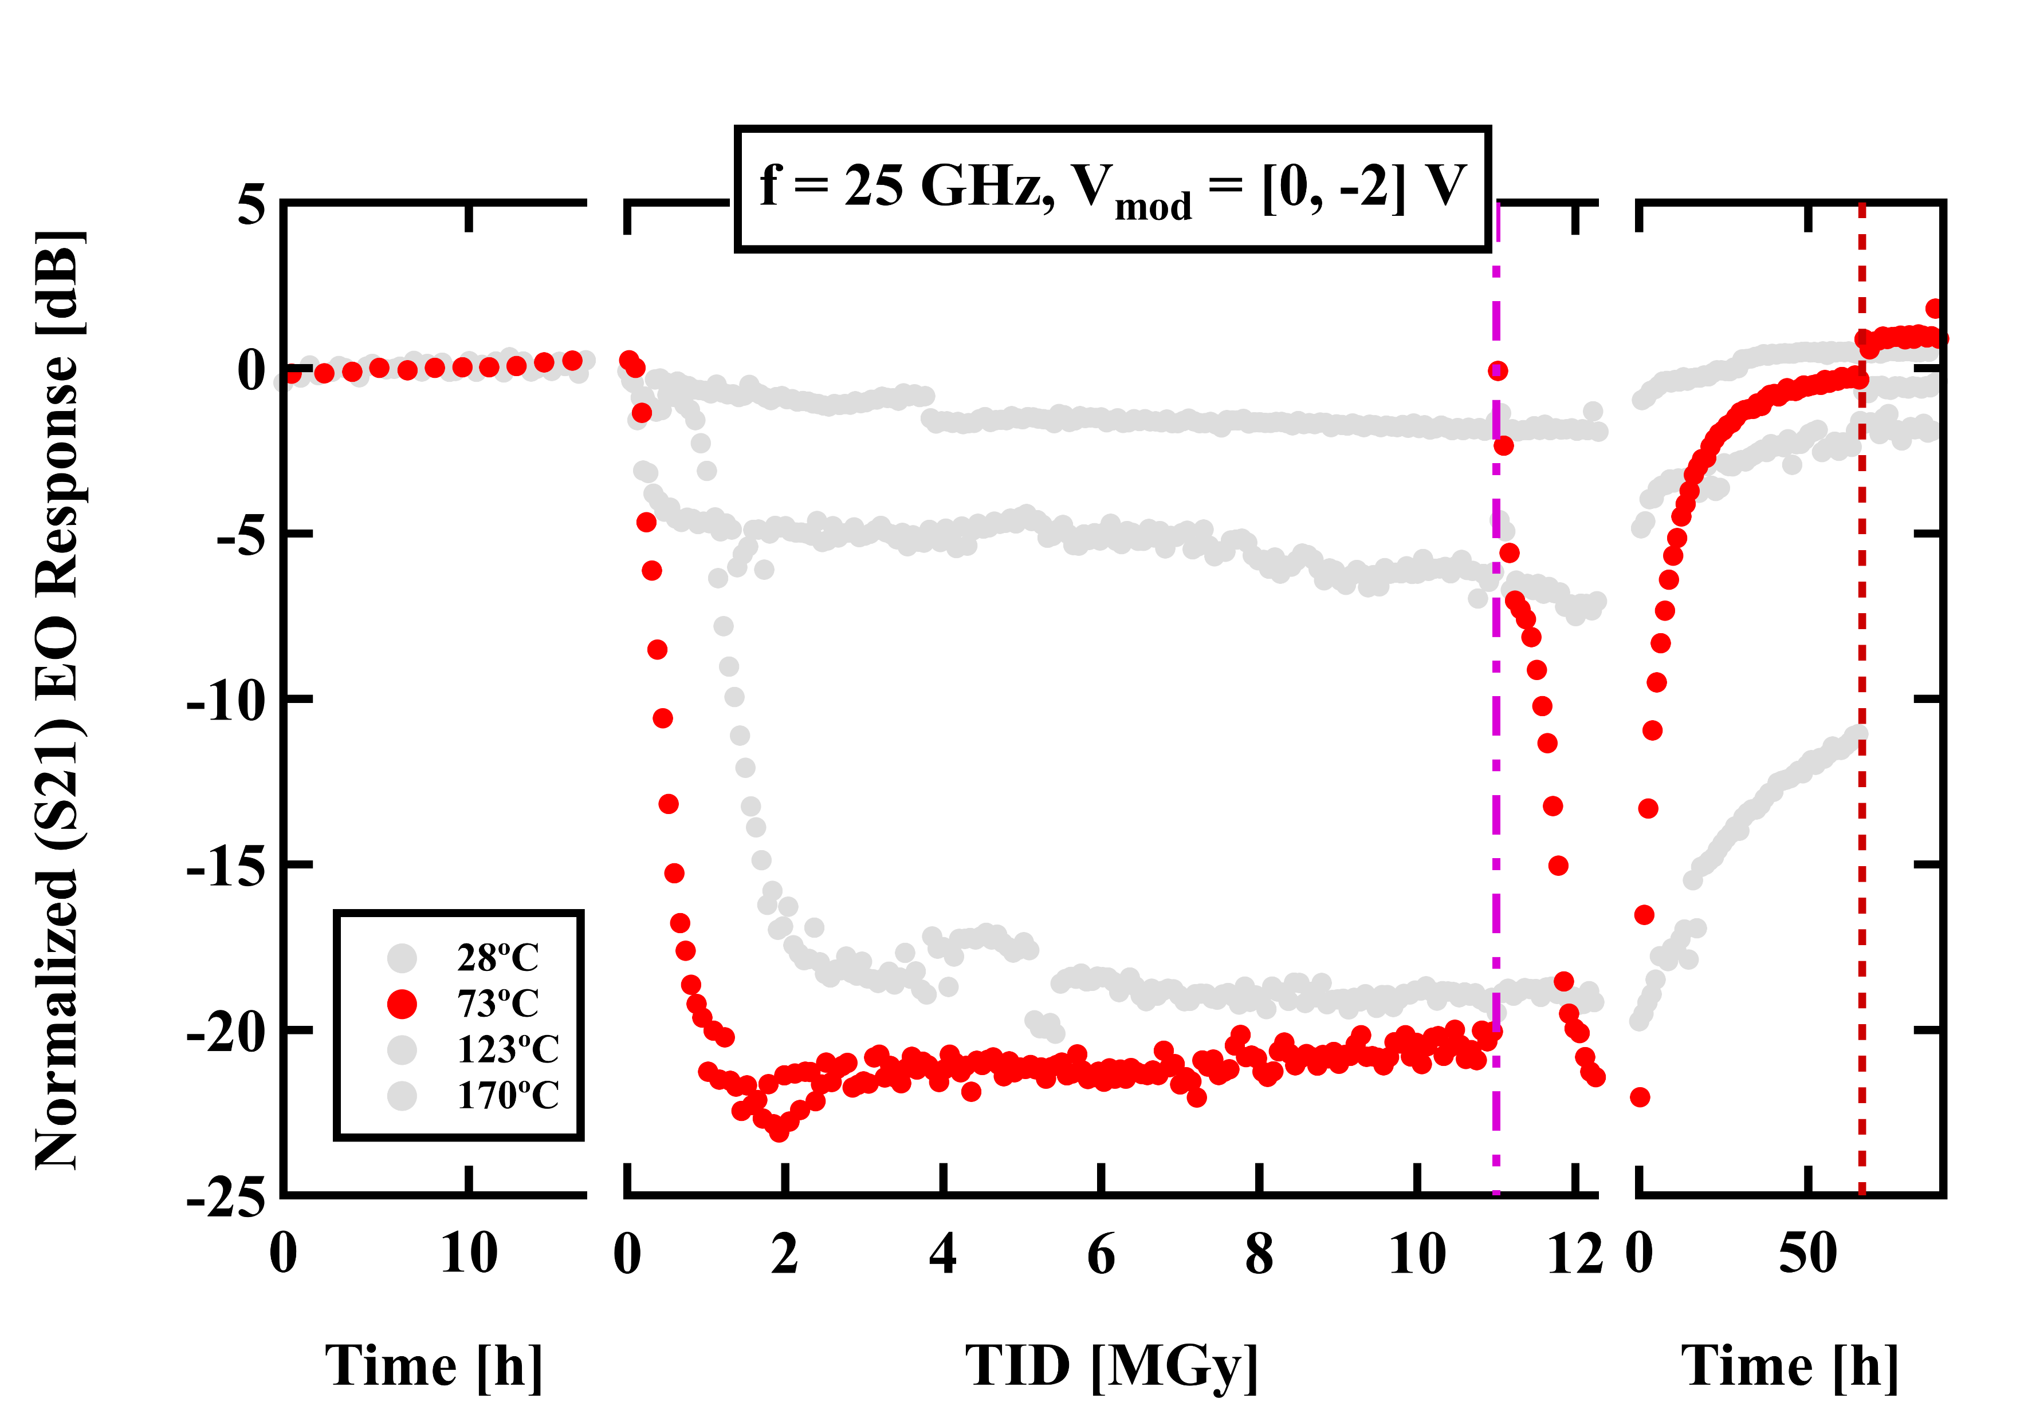
Dynamic X-ray test – RMo2: annealing during irradiation
pre-irrad
irrad
post-irrad
pre-irrad
irrad
post-irrad
  After reaching the TID target of 10 MGy, a thermal annealing step was performed only for RMo2 while keeping irradiating
  RMo2 (only) kept at 230°C for approximately 30 minutes, while measurement loop was continuing for other devices
  After the annealing step, the temperature was lowered back to 73°C

Slide 16
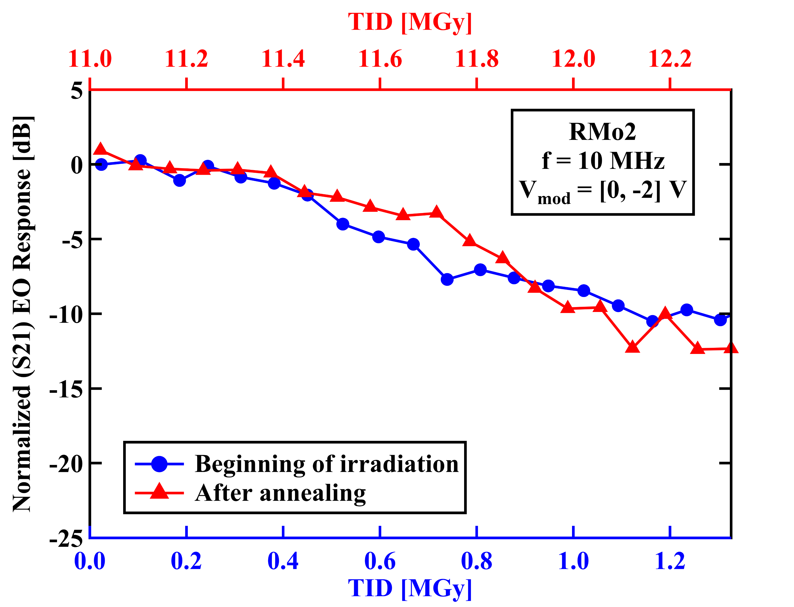
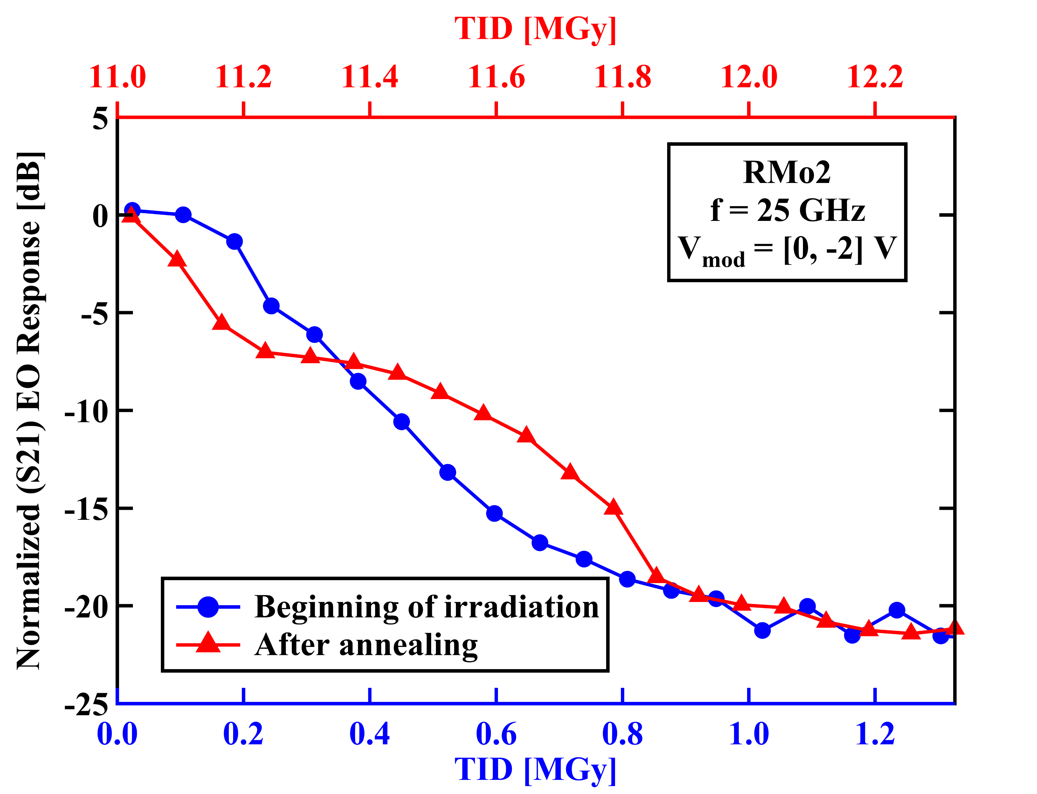
Dynamic X-ray test – RMo2: annealing during irradiation
  TID damage resumes following almost the same degradation trend as observed at the beginning of the irradiation
  After localized thermal annealing, radiation damage does not accumulate with previous one

Slide 17
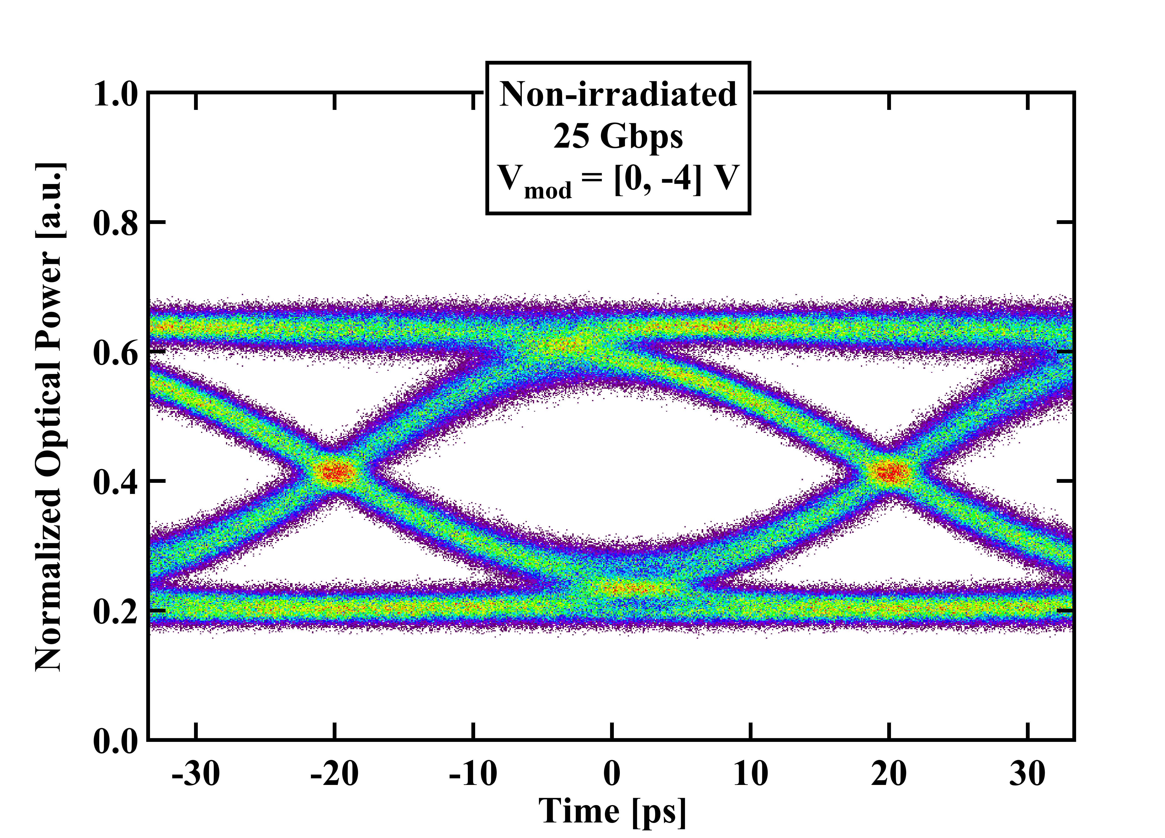
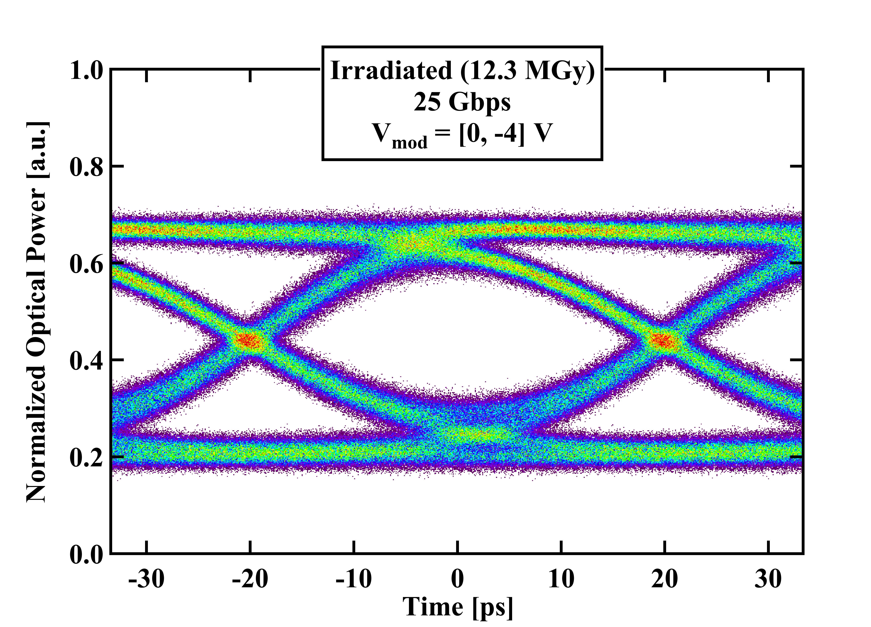
Dynamic X-ray test – Eye diagrams
  Eye diagrams at 25 Gbps were acquired from the irradiated sample and compared with those from non-irradiated devices
  No evidence of degradation after thermal annealing
  Eye diagram parameters do not show differences compared to non-irradiated ring modulators

Slide 18
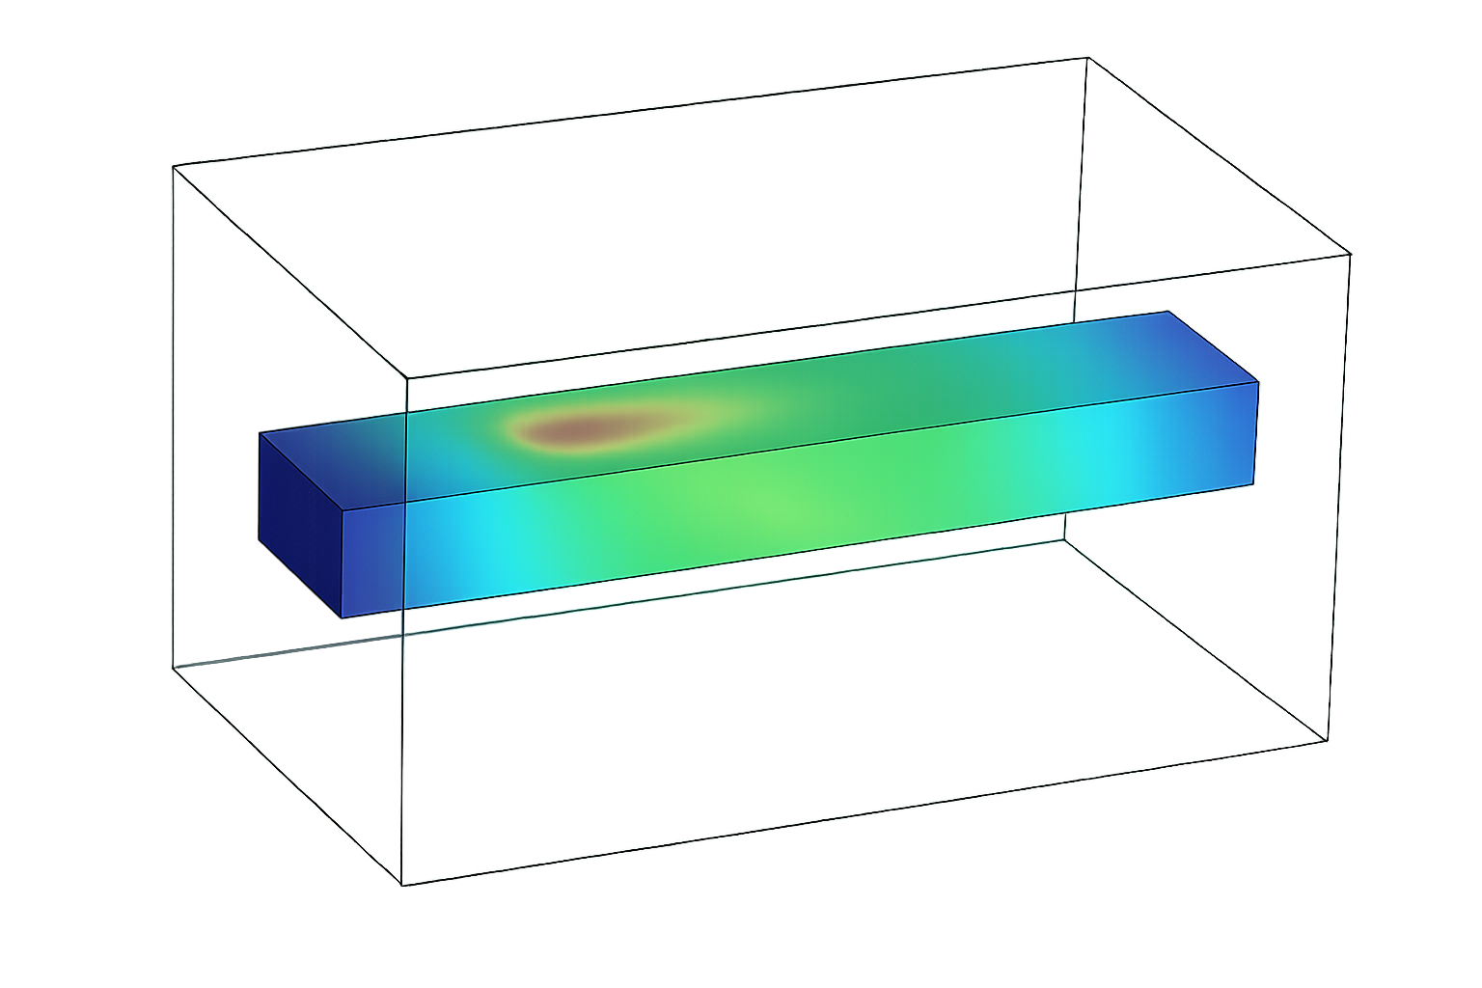
Waveguides
Irradiation campaigns and TCAD simulations
18

Slide 19

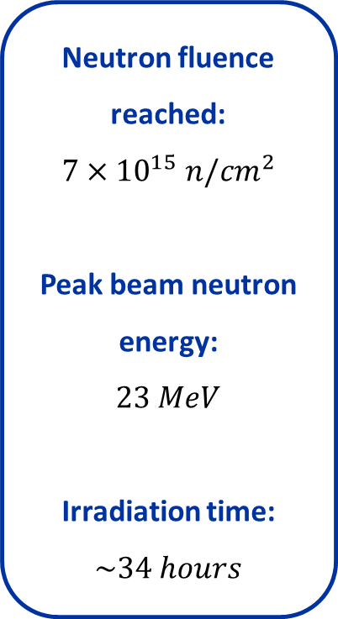
Neutron test – Setup
  Evaluation of radiation-induced attenuation (RIA) in SiPh waveguides
  Measurements of different waveguide types in the two optical bands (O-band at 1310 nm and C-band at 1550 nm)
Neutron fluence reached:
$$7×{10}^{15} n/{cm}^{2}$$
Peak beam neutron energy:
$$23 MeV$$
Irradiation time:
$$\sim 34 hours$$
single mode
optical fibres
optical switch
O- & C-band
P
I
C
1-2
P
I
C
3
optical spectrum
analyzer
neutron beam
polarization controller
superluminescent diode
bunker
walls

Slide 20
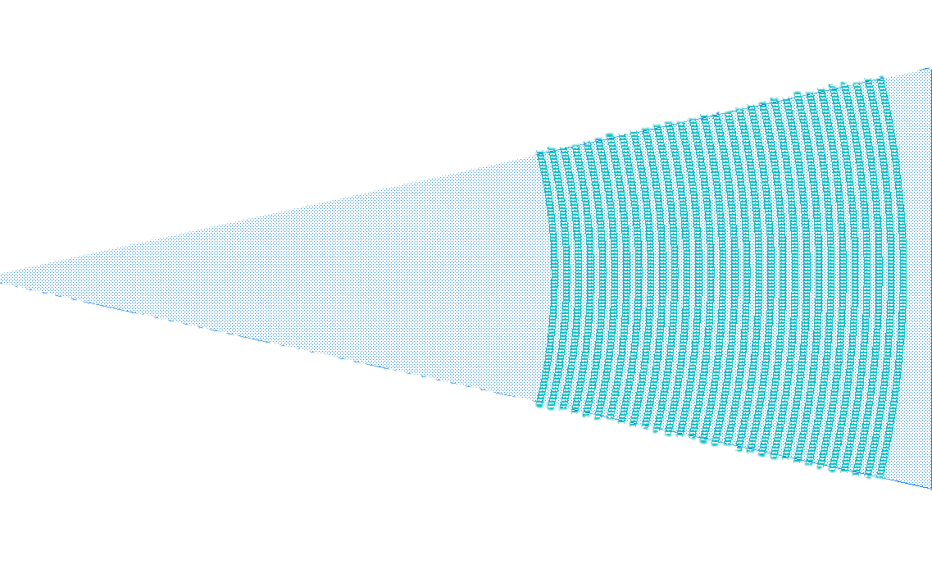
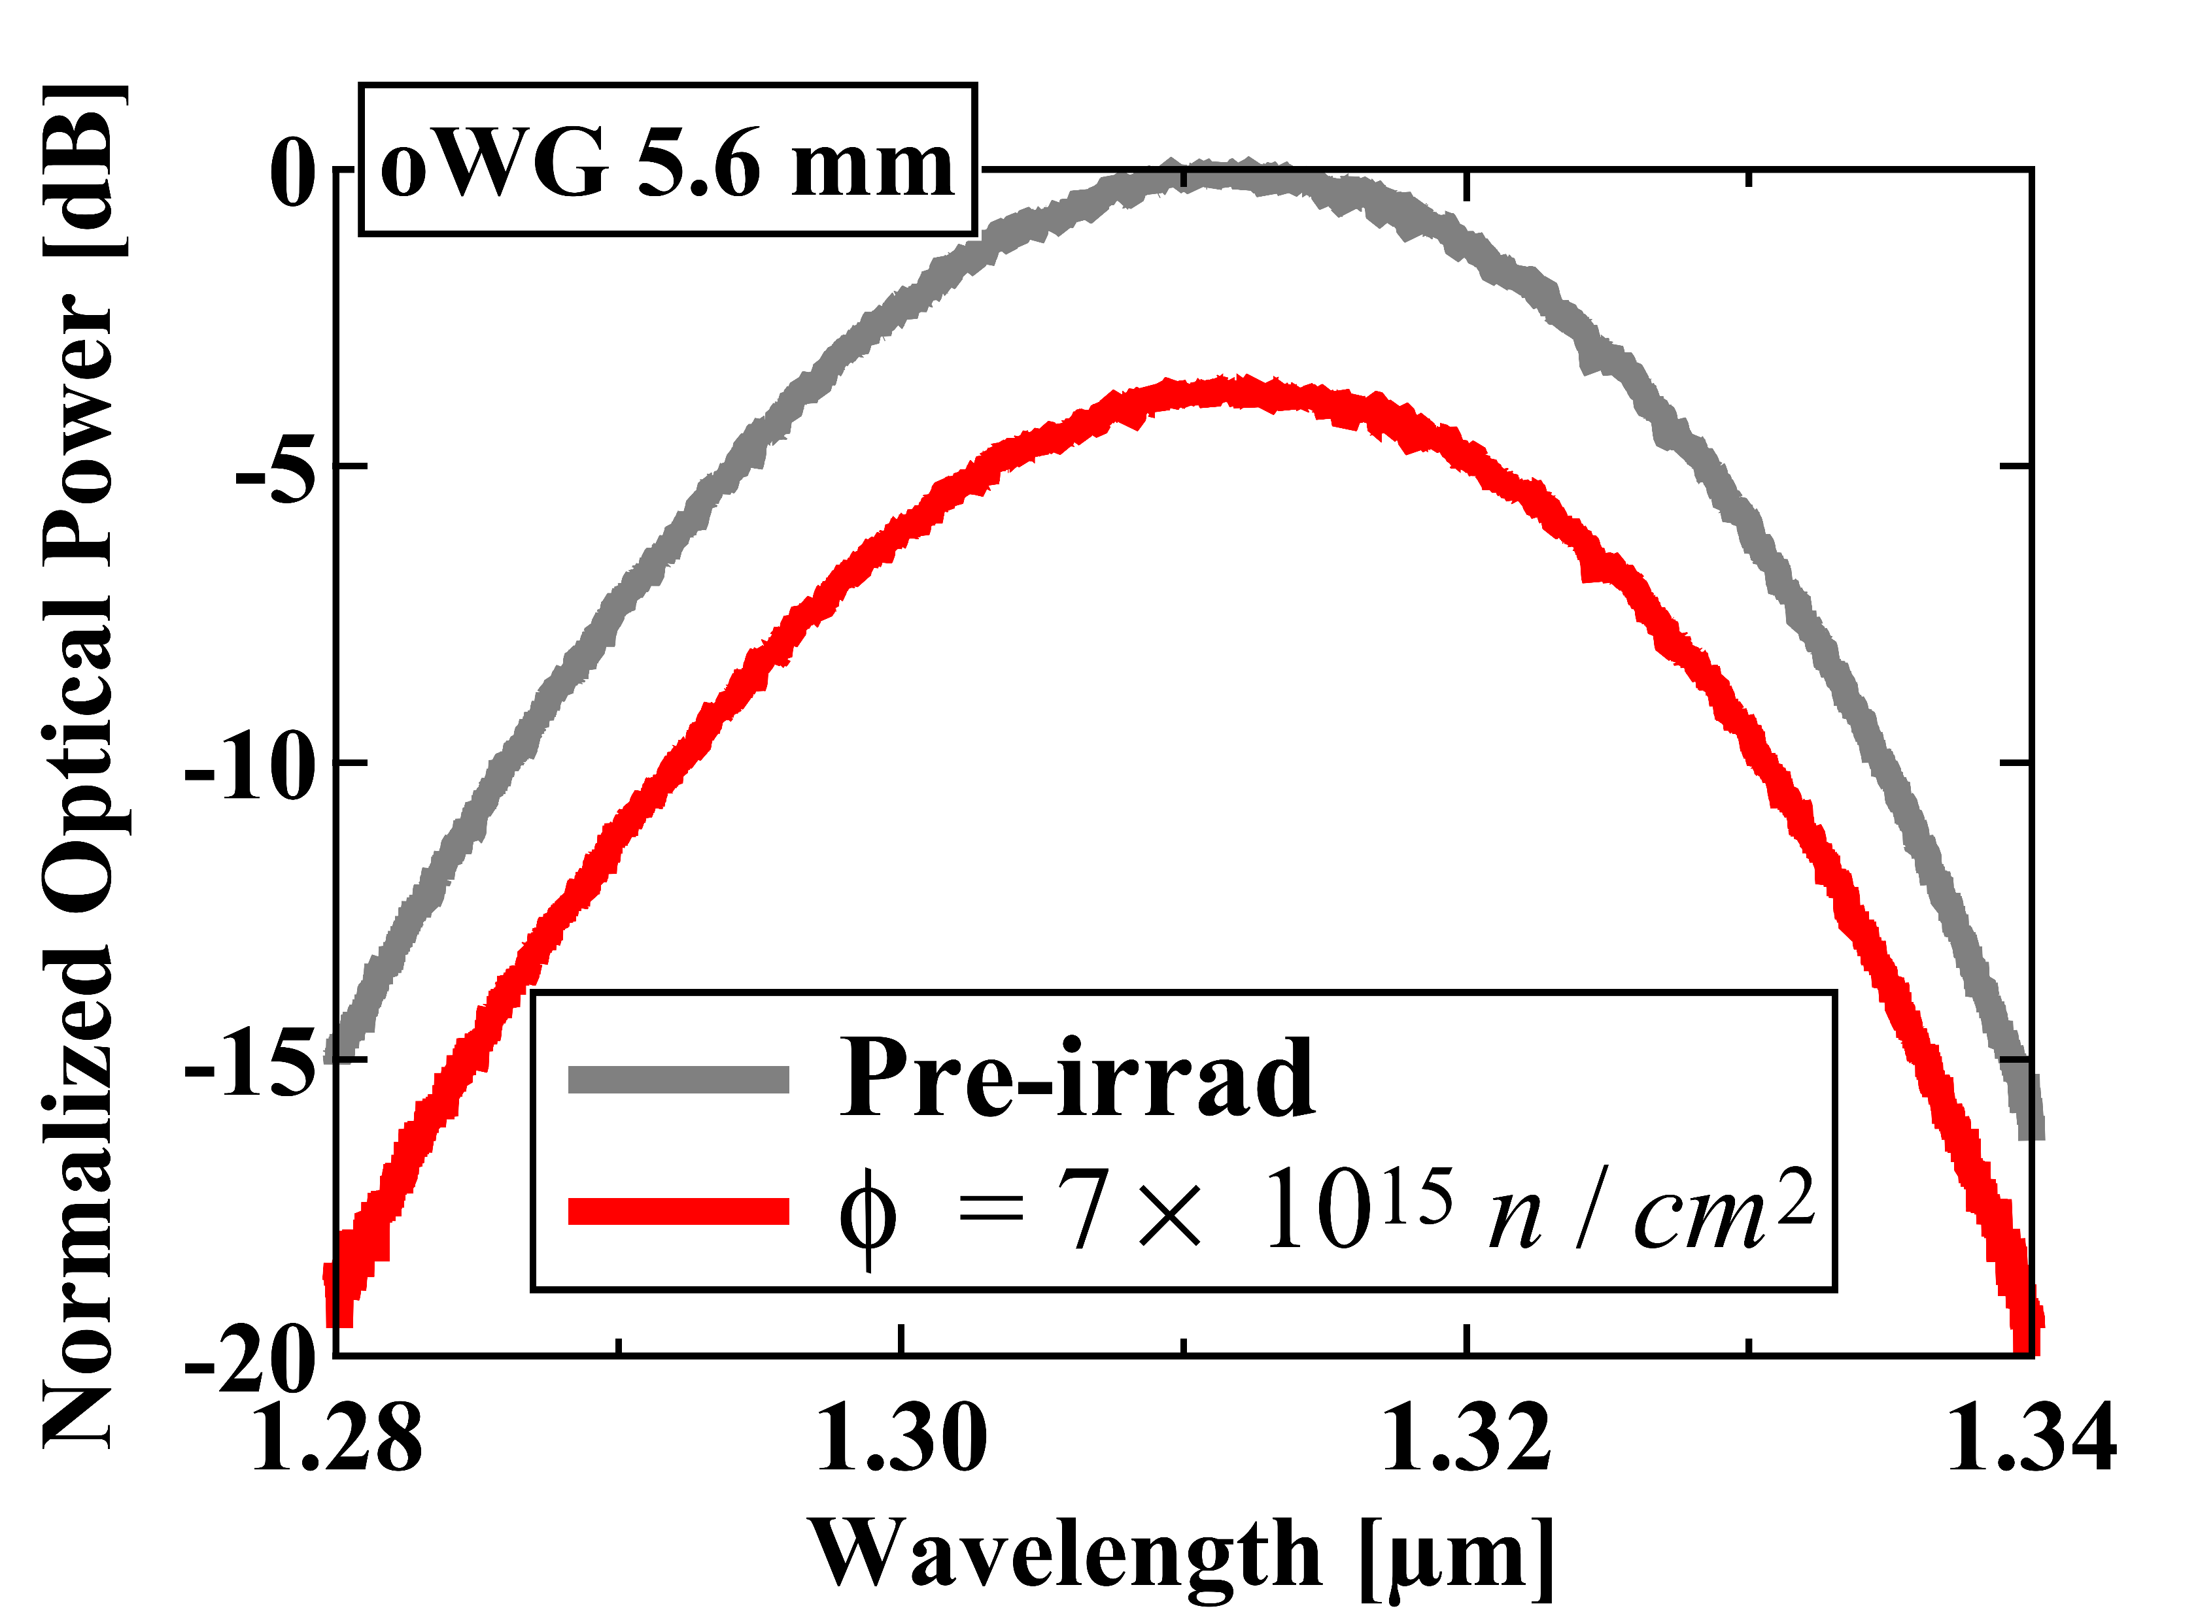
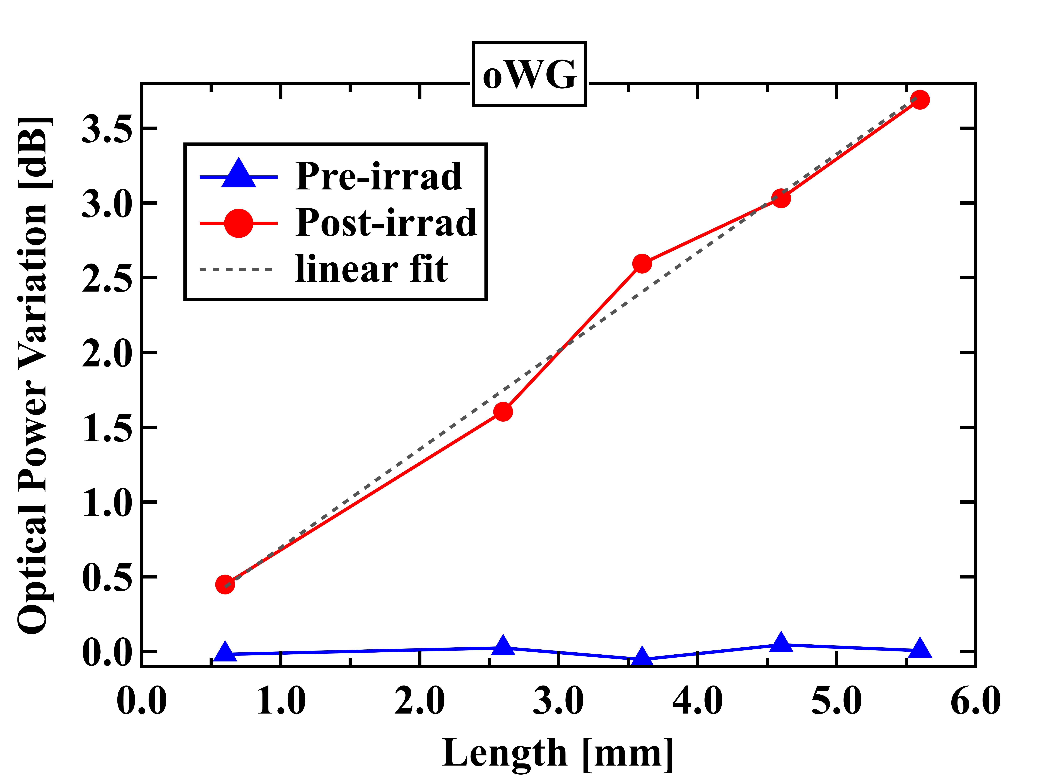


Neutron test – Optical transmission spectra measurements
$$P_{in}(λ)$$
l
$$P_{out}(λ)$$
optical spectrum analyzer
slope = RIA
  Linear fit for the calculation of the RIA (‘cut-back’ method)
  The variation of the slope gives the RIA
  The variation of the y-intercept gives the variation in the grating coupler response (if any)

Slide 21
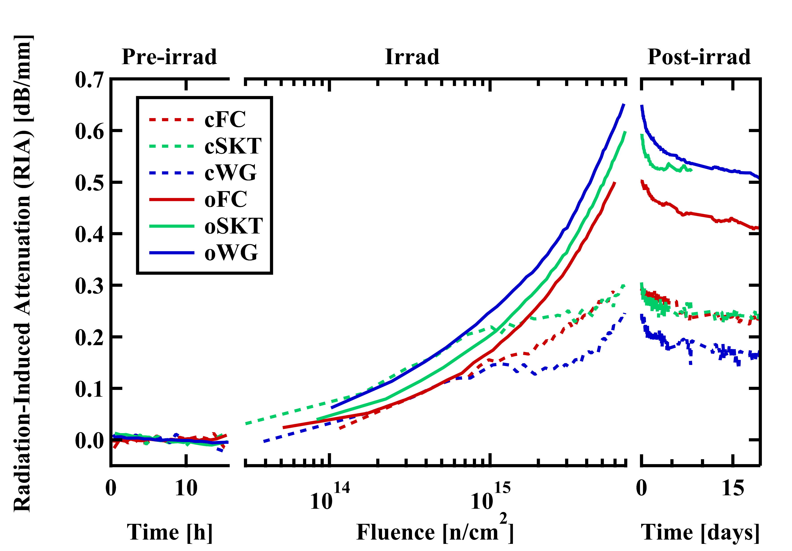
Neutron test – RIA in waveguides
(a)
WG
(b)
SKT
|E| [a.u.]
(c)
FC
  Waveguides in O-band show a higher RIA than their counterpart in the C-band
  Attention must be taken when designing a PIC

Slide 22
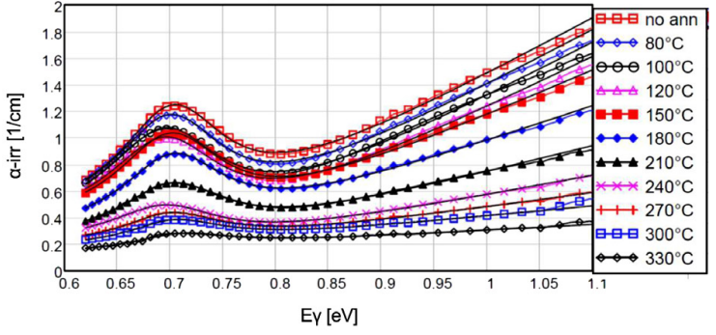
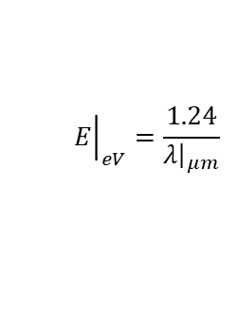
Neutron test – Explaining the results
  Displacement damage (DD)
  Defected-induced energy states reduce the optical absorption length
C. Scharf, F. Feindt, and R. Klanner, “Influence of radiation damage on the absorption of near-infrared light in silicon,” Nuclear Instruments and Methods in Physics Research Section A: Accelerators, Spectrometers, Detectors and Associated Equipment, vol. 968, p. 163955, 2020. [Online]. Available:
https://www.sciencedirect.com/science/article/pii/S0168900220304277
Creation of multiple defect species
Generation of trap states
1550 nm
1310 nm
-
+
Indirectly ionizing radiation
+
-
-
+
+
-
  Both studies show a larger increase in the absorption coefficient at 1310 nm compared to 1550 nm
E. Fretwurst, R. Klanner, J. Schwandt, and A. Vauth, “Study of the v20 state in neutron-irradiated silicon using photon-absorption measurements,” Nuclear Instruments and Methods in Physics Research Section A: Accelerators, Spectrometers, Detectors and Associated Equipment, vol. 1053, p. 168353, 2023. [Online]. Available:
https://www.sciencedirect.com/science/article/pii/S0168900223003431
$${\left.E\right|}_{eV}=\frac{1.24}{{\left.λ\right|}_{μm}}$$

Slide 23

X-ray test – RIA in waveguides
  Same setup as for the neutron test
  X-ray test to decouple the RIA from non-ionizing and ionizing radiation
  RIA saturates, confirming our previous measurements and some results found in literature
+
SiO₂
+
+
+
+
+
+
Si
+
+
+
+
  Hypothesis: the accumulation of positive charges in the SiO₂ and at the Si/SiO₂ interface pushes free carriers in the waveguide (slightly p-doped) toward the center, increasing their overlap with the optical mode and enhancing absorption due to free-carrier absorption
Many thanks to Carlos Solans Sanchez and the ATLAS Tracking Detectors (EP-ATL-TRK) group for providing access to their X-ray facility, and to Kourosh Sarbandi for assistance with the dosimetry!

Slide 24


Heavy ion test – Setup
  Evaluation of optical single-event transients (OSETs) in SiPh waveguides
  First heavy-ion test for OSETs (no tests for OSETs have been reported in the literature)
Max. LET available from the ion cocktail:
$$61.3 MeV∙{cm}^{2}/mg$$
Ion flux:
$$15000 ions/s∙{cm}^{2}$$
Angles of incidence:
$$0°−45°−75°$$
24-ch
fiber-array
unit
LASER
controller
waveguide
7.5 mm
polarization controller
DFB
LASER
1310 nm
reference
receiver
oscilloscope
PIC
This activity has received funding from the European Union's 2020 research and innovation programme under grant agreement No 101008126, corresponding to the RADNEXT project.

Slide 25





Heavy ion test – What is an OSET?
OSET: single-event transient in the optical domain
SiO₂
Si
Ion strike
Si
SiO₂
$$n\left(λ,N_{e},N_{h}\right)=n_{0}\left(λ\right)+{Δn}_{fc}\left(N_{e},N_{h}\right)−i\frac{λ}{4π}{Δα}_{fc}\left(N_{e},N_{h}\right)$$
$$absorption (∆α)∝\left(∆N_{electrons}+∆N_{holes}\right)$$

Slide 26




Heavy ion test – What is an OSET?
Light propagation in the waveguide
Ion strike
Si
Output power
Initial carrier generation from ion strike [100 ps to 1 ns]
OSET
1
4
2
Peak of carrier generation and optical attenuation
3
3
Recombination mechanisms [tens of ns]
1
4
Complete recovery from the transient event [after $\sim$100 ns]
(unit interval for a bit at 25 Gbps is 40 ps)
2
Time

Slide 27




Heavy ion test – Measurements
  For perpendicular strike, OSETs were observed only for the heaviest ion (¹²⁴Xe³⁵⁺, LET of 61.3 MeV·cm²/mg)
  The ratio was approximately of 1 hits/min, with maximum amplitude of transient of $\sim$1.5 %
  Maximum transient amplitude of $\sim$4 % with highest LET and angle of incidence of 75°
  Two-peaks distribution of the transient amplitude because of the L-shaped waveguide

Slide 28

Heavy ion test – TCAD simulations
  Sentaurus TCAD is a powerful tool to combine:
    Electrical simulations → carrier generation, diffusion and recombination from the heavy ion strike (variation in the complex refractive index due to the different number of carriers)
    Electromagnetic simulations → finite-difference time-domain (FDTD) solver to compute the electromagnetic field propagation
emw
FDTD simulations for different time steps
sprocess
snmesh
sdevice
Creation of the 3D strip waveguide structure
Generation of the mesh
Transient simulation of the heavy ion strike event

Slide 29



Heavy ion test – TCAD simulations
  Starting from the LET of 61.3 MeV·cm²/mg we can set a defined number of electron-hole pairs generated per volume within the TCAD simulation (details of the calculations in the backup)
  Amplitude of the transient matches well the measurements
  Good match also for the left-hand side of the transient (initial charge generation)
  The transient amplitude shows a good matching also when the angle of incidence is changed
  Overestimation of the recombination time constant (for now used the pre-defined TCAD values, trying with different recombination parameters)

Slide 30

Heavy ion test – Surface recombination
  By reducing the surface recombination velocity from the default value, we match not only the amplitude of the OSET but also the typical recovery time

Slide 31

Conclusions…
Dynamic X-ray irradiation test on SiPh ring modulators have demonstrated the susceptibility of the electro-optic frequency response to TID damage (pinch-off mechanism of the silicon slab).
Localized thermal annealing using the built-in micro-heaters restores completely the performance. No sign of degradation in the eye diagrams after thermal annealing.
Neutron and X-ray irradiation tests on SiPh waveguides highlighted evidence of radiation-induced attenuation that must considered for future PIC designs.
Heavy ion testing demonstrated non-significant influence of OSETs in the SiPh waveguides transmission. Transient amplitude with LET up to 61.3 MeV·cm²/mg and angle of incidence of 75° remained below 4 %.
TCAD simulations of OSETs events show a good agreement with the measured transient, both in amplitude and recombination time.
…and future work
Write the thesis 🫠

Slide 32

daniele.alfiero@cern.ch
Thank you for your attention!

Slide 33

Backup

Slide 34

Optical datalinks in High-Energy Physics
Optical data link are vital parts of modern High Energy Physics (HEP) experiments
  CERN experiments exploit tens of thousands of custom optical datalinks
All these links utilize conventional discrete components
  Directly modulated lasers and normal-incidence p-i-n photodiodes
  Mature technologies and thoroughly studied characteristics under irradiation
We are reaching the limits what can be done with conventional links: few × 10¹⁵ n/cm²
The placement already restricted by radiation levels during the experiment lifetime
The final runs of High-Luminosity LHC and future accelerators
require even higher levels of radiation tolerance
One quarter cross section of CMS experiment
no-go zone
\\\\
\
Interaction point
Integrated particle fluence in 1 MeV neutron equivalent per cm², for the CMS Phase-2 tracker.
[The Phase-2 Upgrade of the CMS Tracker]

Slide 35





Introduction – Ring Modulators
Input LASER
Optical data out
_{Δλ(V)}
p
n

Slide 36






Introduction – Optical coupling
light
spacer
Angle of incidence
$\sim 10°$off-vertical
Optical fiber
GC periodic cross-section
Si waveguide
Grating coupler
Buried Oxide (BOX)
*https://doi.org/10.1017/CBO9781316084168.006

Slide 37
X-ray
machine
Single Mode
Optical fibers
Optical switch
Optical Power Meter
Optical Power Meter
C-band
Tunable LASER
O-band
Tunable LASER
|
|
O-band
C-band
Polarization controller
Polarization controller
Static
X-ray Test
Setup
Peltier cell
System
PIC
|
|
μheaters
DUTs
DAQ
(electrical switch)
Bias and Idle Sourcemeters
Electrical cables
Heater
Power Supply

Slide 38


Static X-ray Test – Setup
X-ray machine
Polarization controller
Sourcemeters
Power supplies
VNA
O-band laser
+
Optical power meter
Optical
switch

Slide 39


Static X-ray Test – IVs pre-irrad

Slide 40
X-ray
machine
Out «B»
Optical Power Meter
Optical switch
Single Mode
Optical fibres
O-band
Tunable LASER
Out «A»
Polarization controller
O-band
|
Dynamic
X-ray Test
Setup
SystemPIC
Photodetector
μheaters
DUTs
DC Sourcemeter
VNA
(Vector Network Analyzer)
|
|
Bias
tee
Port 2
RF switch
Port 1
Electrical cables
Heater
Power Supply

Slide 41


Dynamic X-ray Test – Setup
X-ray machine
C-band laser
+
Optical power meter
O-band laser
+
Optical power meter
Polarization controllers
Optical switch
Sourcemeters
DAQ
Power supply

Slide 42



Dynamic X-ray test – RM efficiency
$$P_{in}$$
X
_{Input}
_{Laser}
OMA
V₀
V₁
RM efficiency, defined as:
$$η\left(V_{mod}\right)= \frac{OMA}{P_{in}},$$
of the irradiated sample did not change after exposure to 12.3 MGy, following the annealing procedure

Slide 43


Neutron test – Setup
Polarization Controllers
Sheet resistance
Optical switch +
optical powermeters +
optical attenuator
SLED O-band
SLED C-band
TEC
DFB LASER
Sourcemeters
Optical Spectrum Analyser
DAQ
Waveguides
Beam distance: 4.5 cm for sheet resistance - 6.05 cm for cSKT, cWG, oSKT, oWG – 6.65 cm for cFC, oFC, Nonlinearity

Slide 44






Neutron test – Explaining the results
$$q →y−intercept →grating coupler$$
$$y=mx+q$$
$$m →dB/mm$$

Slide 45

Neutron test – oWG annealing
If we plot the increase in linear loss together with the RIA coefficient for the oWG waveguides, the discrepancy between the two measurements becomes evident.
The RIA coefficient, calculated from the increase in linear loss for the 10.4 mm sample, shows a much smaller increase with neutron fluence compared to the other waveguides. This is likely due to a photobleaching effect that induces partial annealing in the waveguide when high optical power is injected. This observation should be emphasized in a potential publication, as it is both important for understanding the behaviour of the device. However, at the same time, this is promising for our application, since it indicates that the calculated RIA coefficient is likely an overestimation.
N.B. For a mistake in the acquisition loop, I forgot to set the attenuation to 25dB in the idle time, that’s why we have this annealing effect. The power into the waveguide during the test was $\sim 14.9 mW$ (calculated from $P_{o}$). Even if this was a mistake, it actually gives us an extra data point which is really useful.

Slide 46

X-ray test – GC variation

Slide 47


Heavy ion test – Setup

Slide 48

Heavy ion test – TCAD simulation
TCAD mesh

Slide 49


Heavy ion test – TCAD simulation

Slide 50






Heavy ion test – TCAD simulation
$N\left(r\right)=N_{0}e^{−r/σ_{ion}}$
$\frac{LET∙ρ_{Si}}{ε_{ehp}}=2πN_{0}σ_{ion}^{2}=\frac{Q_{0}}{h}$
$\frac{LET∙ρ_{Si}}{ε_{ehp}}=3.9455×{10}^{10}ehp/cm$
$h=220 nm → Q_{0}≈868021 ehp$
$→ N_{0}=\frac{Q_{0}}{2πhσ_{ion}^{2}}$
For a defined value of $σ_{ion}^{2}$ we can find the corresponding $N_{0}$:
$σ_{ion}=10 nm → N_{0}≈6.28×{10}^{21} ehp/{cm}^{3}$
$σ_{ion}=20 nm → N_{0}≈1.57×{10}^{21} ehp/{cm}^{3}$
$σ_{ion}=30 nm → N_{0}≈6.98×{10}^{20} ehp/{cm}^{3}$
Selected $σ_{ion}=30 nm$ for all simulations

Slide 51


Heavy ion test – TCAD simulations

Slide 52

Heavy ion test – Recombination mechanisms

