Slide 1
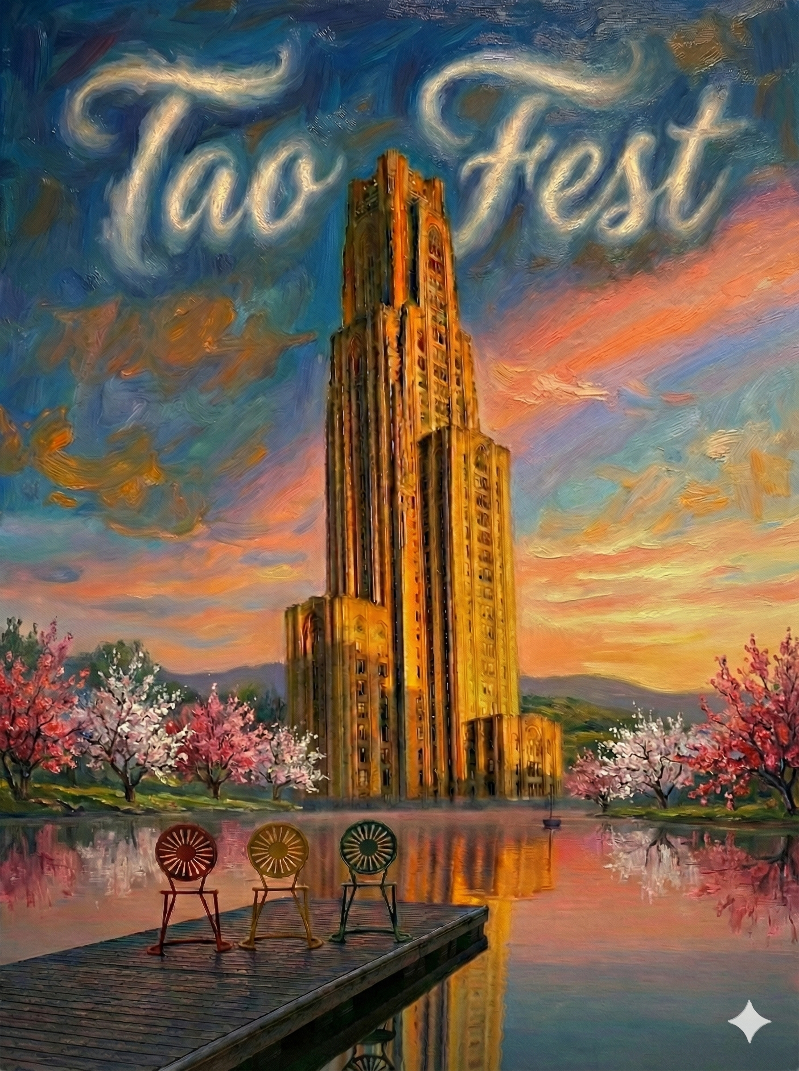

Colored Resonances with Tao
Zhen Liu
TaoFest
5/14/2026
Zhen Liu (UMN)

Slide 2
Colored Resonances at LHC
Zhen Liu Advisor: Tao Han
University of Wisconsin-Madison Physics Department
High Energy Phenomenology Group
Preliminiary Examination
arXiv:1010.4309, with T. Han and I. Lewis
arXiv:11**.****, with T. Han, I. Lewis, and T. Wang
arXiv: 2306.00079 , with T. Han, I. Lewis, H.K. Liu, X. Wang
06/15/2011
Zhen Liu (UW-Madison)

Slide 3

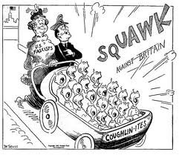
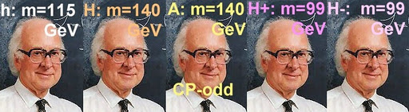
LHC Era?

Slide 4

LHC Era!

Slide 5
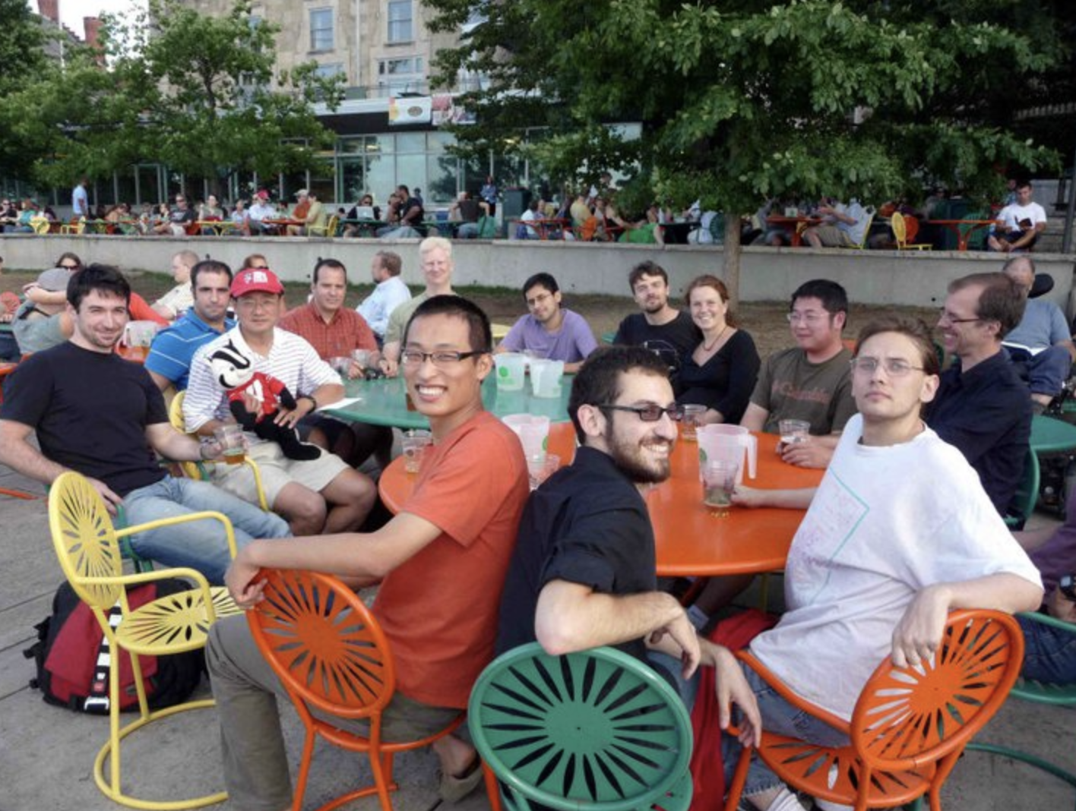
Colored Resonances
Classification

Slide 6
LHC Era
Introduction
Data Driven↔Model Independent Simplest topology and largest rate Simplest topology: resonances Largest rate:
Strong interactions QCD machine
Zhen Liu (UW-Madison)
5 / 35

Slide 7
LHC Era
Introduction
Data Driven↔Model Independent Simplest topology and largest rate Simplest topology: resonances Largest rate:
Strong interactions QCD machine
Zhen Liu (UW-Madison)
5 / 35

Slide 8
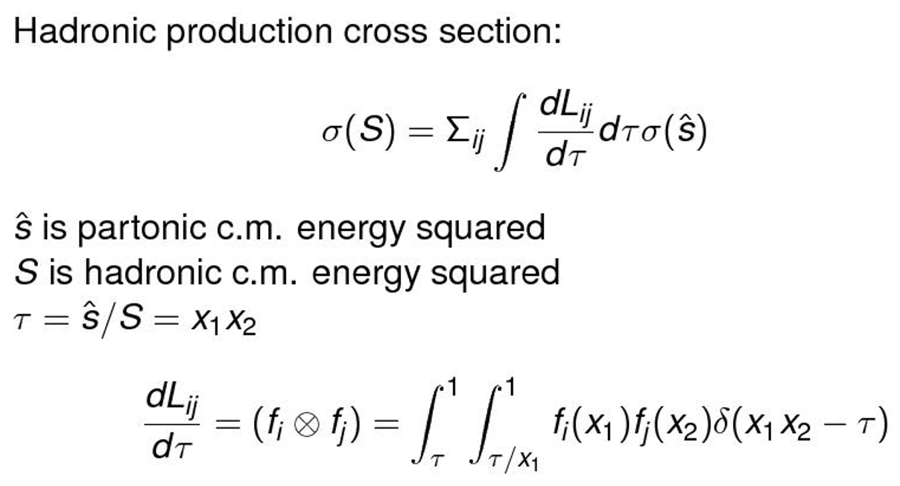
Colored Resonant Production and LHC Bounds
Parton Luminosities
Parton Luminosities
Hadronic production cross section:
i
σ(S) = Σ
ij
^{dLij} d τσ(sˆ)
d τ
sˆ is partonic c.m. energy squared S is hadronic c.m. energy squared τ = sˆ/S = x₁x₂
dL_{ij} d τ
i i
1 1
= (f_{i} ⊗ f_{j} ) =
f_{i} (x₁)f_{j} (x₂)δ(x₁ x₂ − τ)
τ τ/x₁
Zhen Liu (UW-Madison)

Slide 9

Colored Resonant Production and LHC Bounds
Parton Luminosities
Parton Luminosities
2 g u
2 g d
g g u u
2 u d d d
2 u u
2 d d
2 g u
2 g d
g g u u
2 u d d d
2 u u
2 d d
10³
10²
10¹
10⁰
₁₀-1
₁₀-2
10³
10²
10¹
10⁰
₁₀-1
₁₀-2
Parton Luminosity
Parton Luminosity
7 TeV
14 TeV
0.5 1 1.5 2 2.5 3
M (TeV)
1
2
3 4
M (TeV)
5
Zhen Liu (UW-Madison)

Slide 10
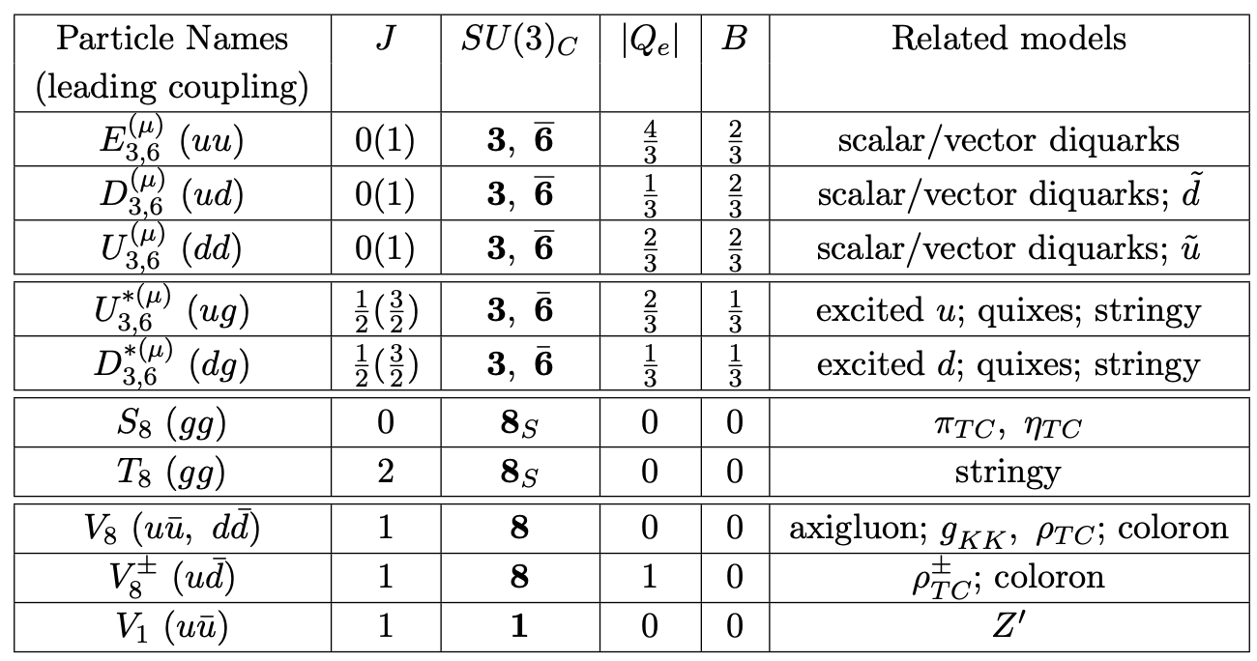
Colored Resonant Production and LHC Bounds
Models
Summary Table
Table: Summary for resonant particle names and their quantum numbers
Zhen Liu (UW-Madison)

Slide 11
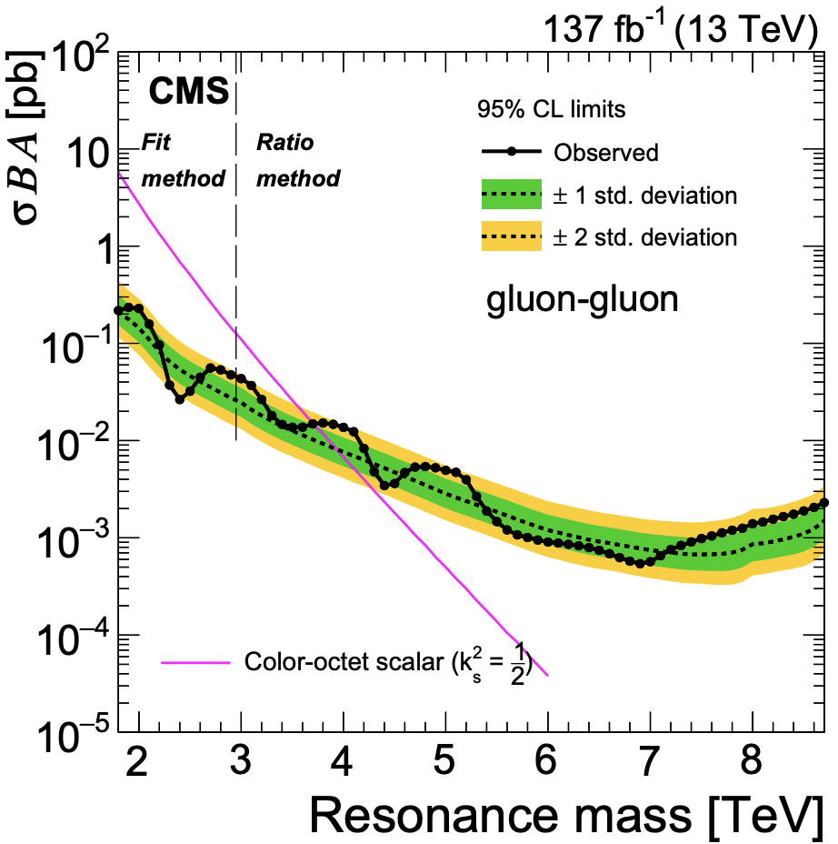
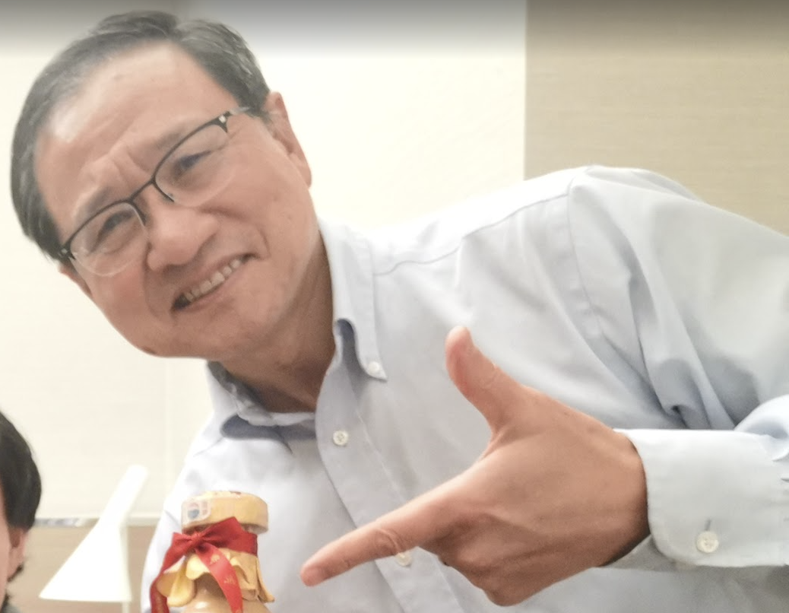
Colored Resonant Production and LHC Bounds
Bounds
bounds figures
4
3
2
4
3
2
7 TeV
Vector Octet
1
1
κ²xBR
g²xBR
CMS (2.9 pb⁻¹)
0.5
7 TeV
Octet Scalar
0.5
+ −
ud,ud→V₈ ,V₈
gg→S
uu→V ⁰
8
0
⁸ -1
dd→V₈
CMS (2.9 pb )
qq→V ⁰ (Sum)
8
0.1 .
0.5
1
1.5 2
M (TeV)
2.5
0.1.
0.5
1
1.5 2
M (TeV)
2.5
Zhen Liu (UW-Madison)

Slide 12

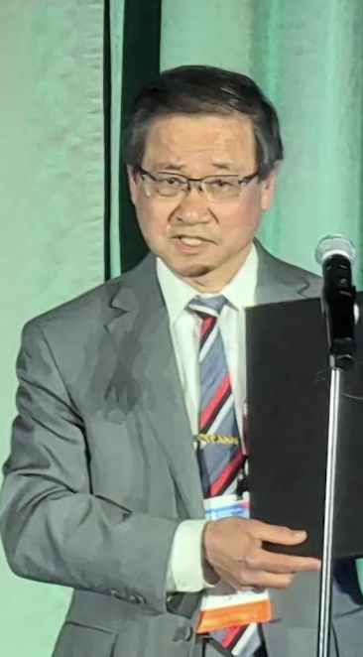
Dijet Distribution
Dijet Resonances Diagnosis
Zhen Liu (UW-Madison)

Slide 13
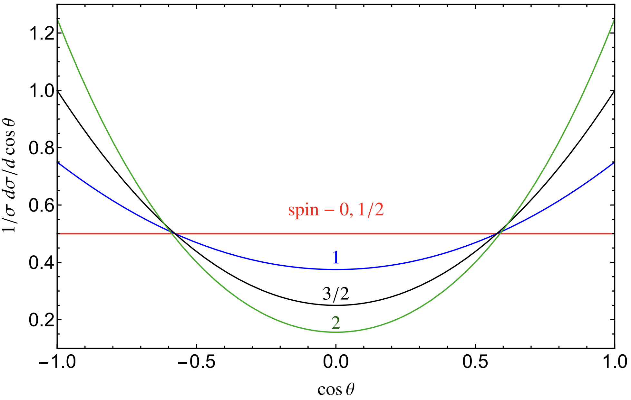
Dijet Angular Distribution
Dijet Distribution
Helicity Amplitudes
dΣ
dcosΘ Σ
1.0
0.8
0.6
0.4
0.2
- 1.0
- 0.5
0.5
1.0
cosΘ
Zhen Liu (UW-Madison)

Slide 14
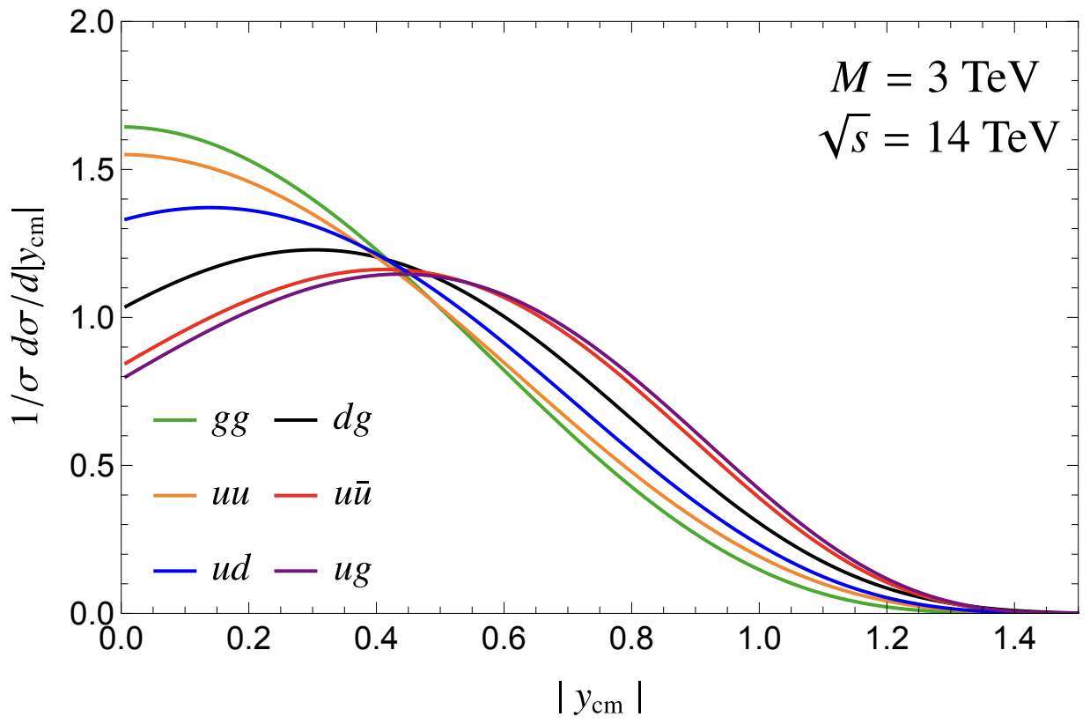
Dijet Rapidity Distribution
Dijet Distribution
See also many nice works by Chivukula, Simmon, and collaborators, 1302.1069, 1406.2003, 1412.3094, 1507.06676, 1710.04661…
Events generating: FeynRules→UFO files→MadGraph5 The rapidity distribution of the whole system.
y = ¹ ln( ^{x1} )
2 x₂
7000
6000
qq qg gg qq~
5000
4000
3000
2000
1000
0₀
0.5
1
1.5
2
2.5
3
Zhen Liu (UW-Madison)

Slide 15
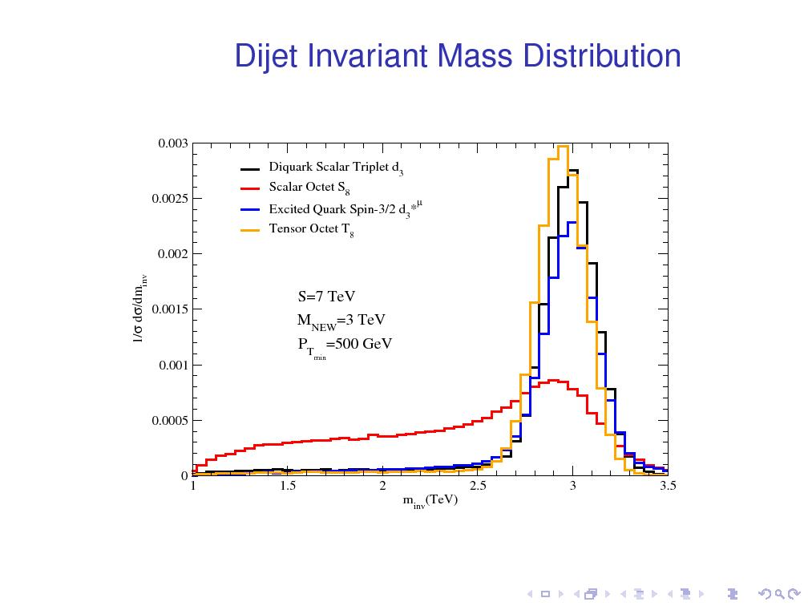
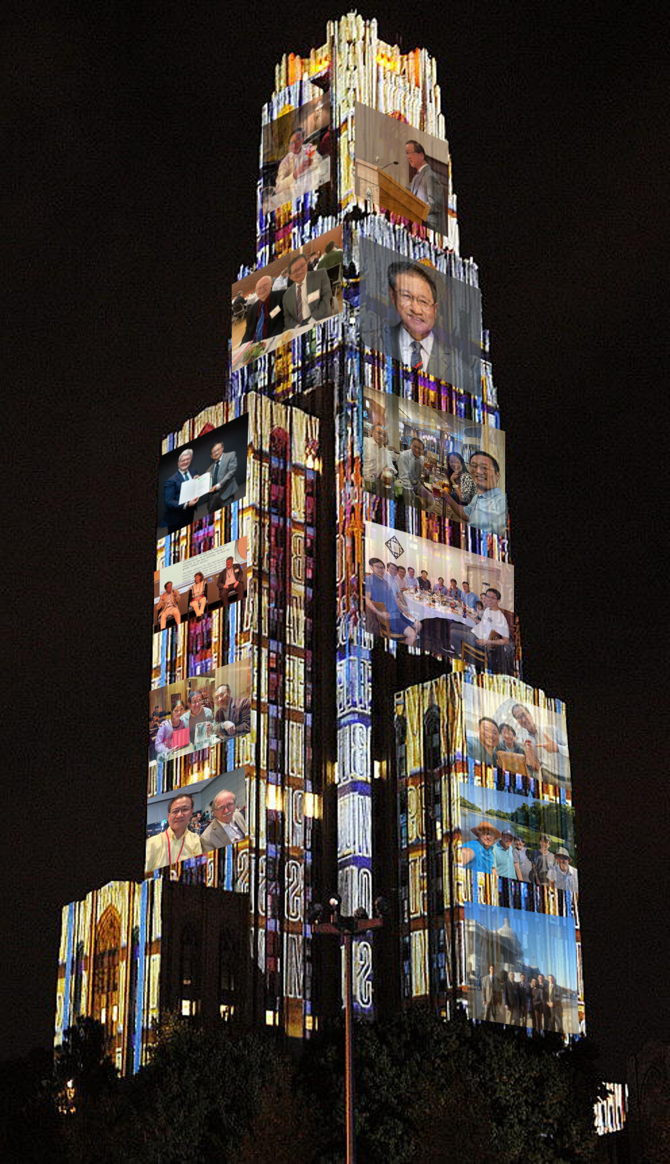

Slide 16
Color Flow
Color Flow and Hadronic Antenna
Zhen Liu (UW-Madison)

Slide 17


Color Flow
Heuristic View
Color Flow
1
3
1
3
_{Z}′
2 4
2
V₈
4
Black lines are for Feynman diagrams Colored lines indicate the color flow
Zhen Liu (UW-Madison)

Slide 18
Color Flow
Jason Gallicchio and Matthew D. Schwartz, arxiv:1001.5027
Color Flow
pi
hi 0
mpi
−3
−2
−1
0
1
2
3 −3
−2
−1
0
1
2
3
Figure: Accumulated pT after showering a particular partonic phase space point 3 million times.
Zhen Liu (UW-Madison)

Slide 19
Color Flow
John Ellis, Valery A. Khoze and W. James Stirling, arxiv:hep-th/9608486
Color Flow
g g → g g
0.20
β
q g → g q
0.15
|M₃|² / |M₂|²
jet 1 (p₃)
0.10
jet 3 (k)
q q → Z' → q' q'
beam axis
0.05
q q → q' q'
q g → q g
jet 2 (p₄)
0.00
0 20 40 60 80 100 120 140 160 180
β (degrees)
Zhen Liu (UW-Madison)

Slide 20







Color Flow
Color Flow
Sextet v.s. Triplet
1
3 1
3
−
2
4 2
Q₃
4
1
3 1
3
+
2
4 2
Q₆
4
Zhen Liu (UW-Madison)

Slide 21
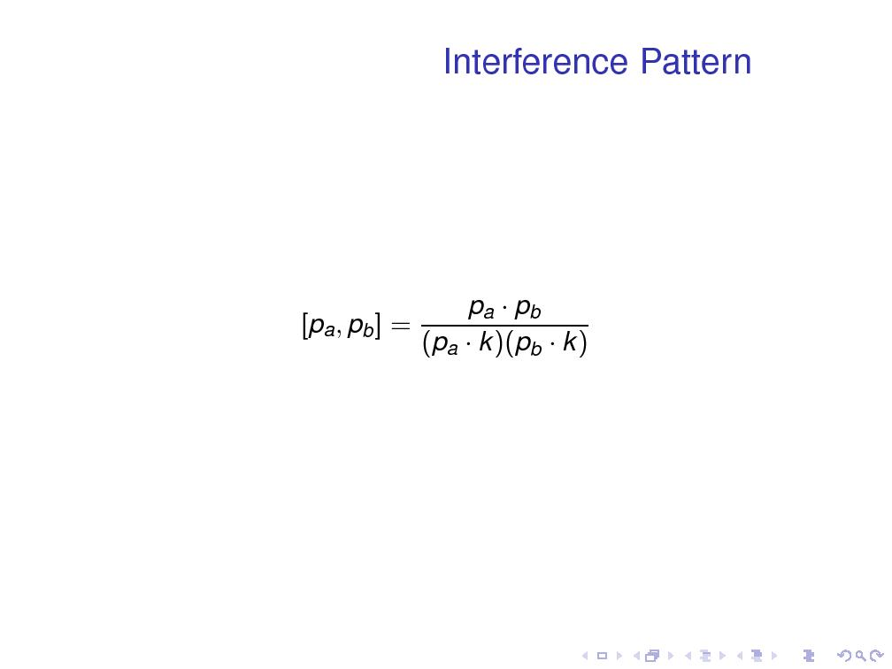
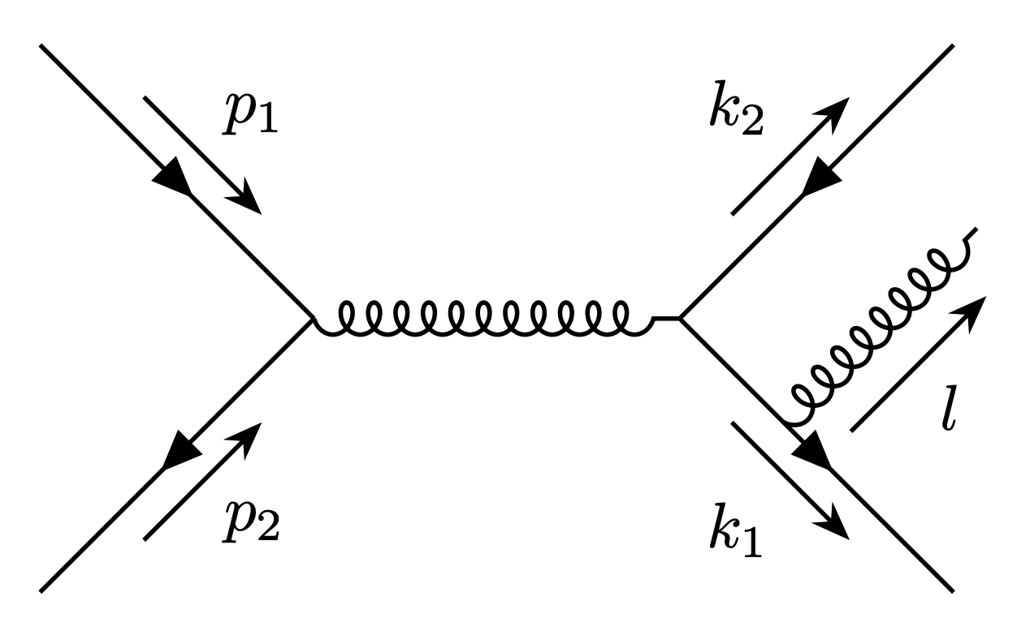
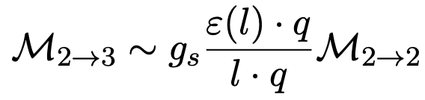
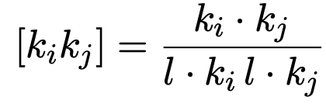
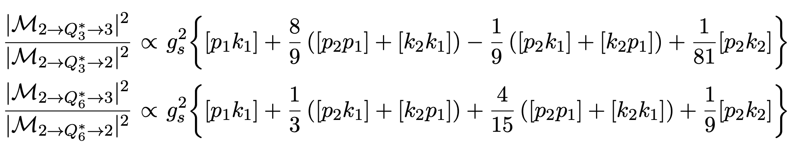

Slide 22
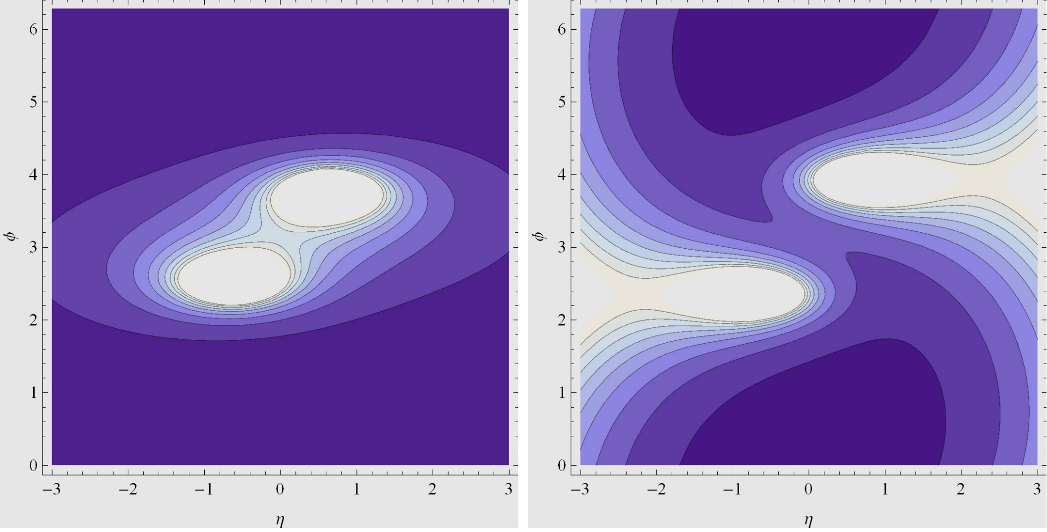

Slide 23
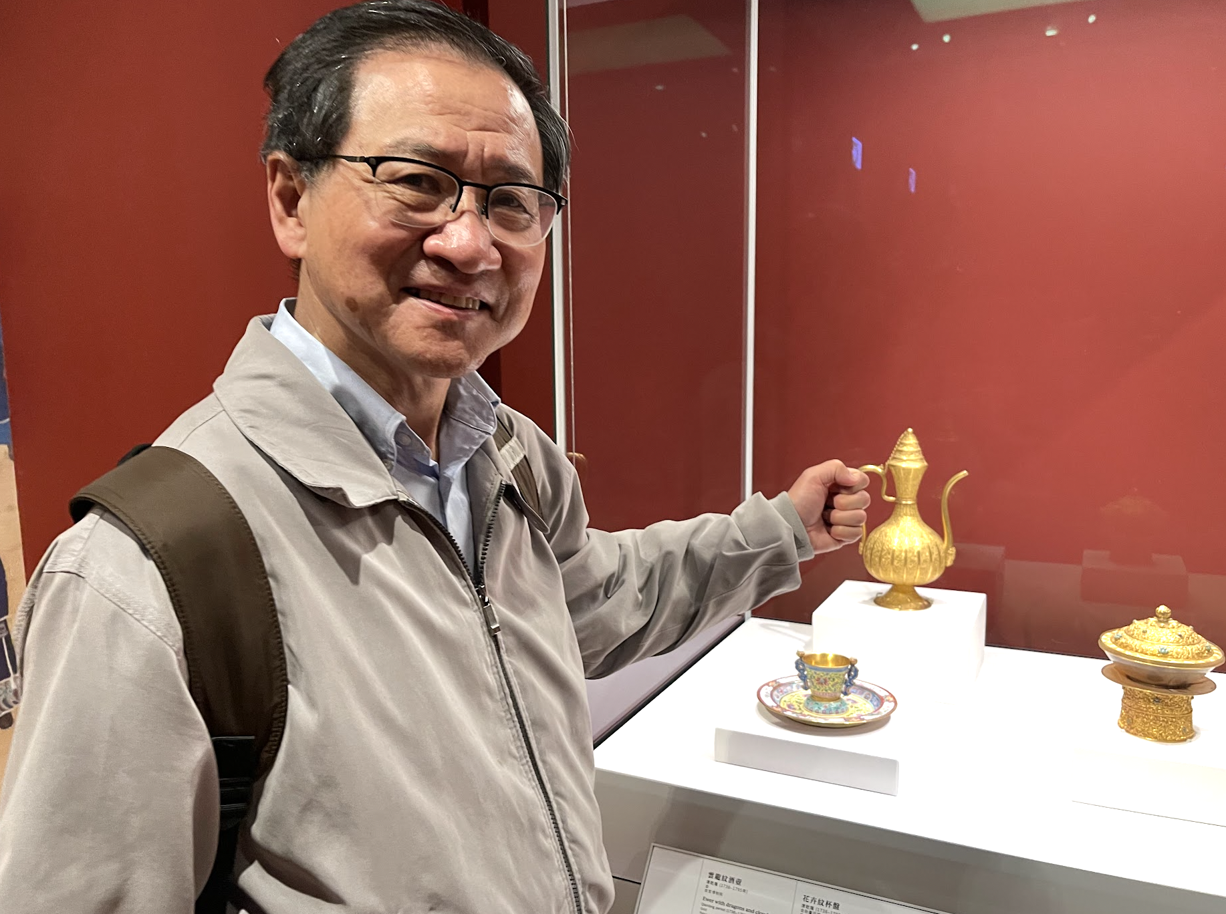
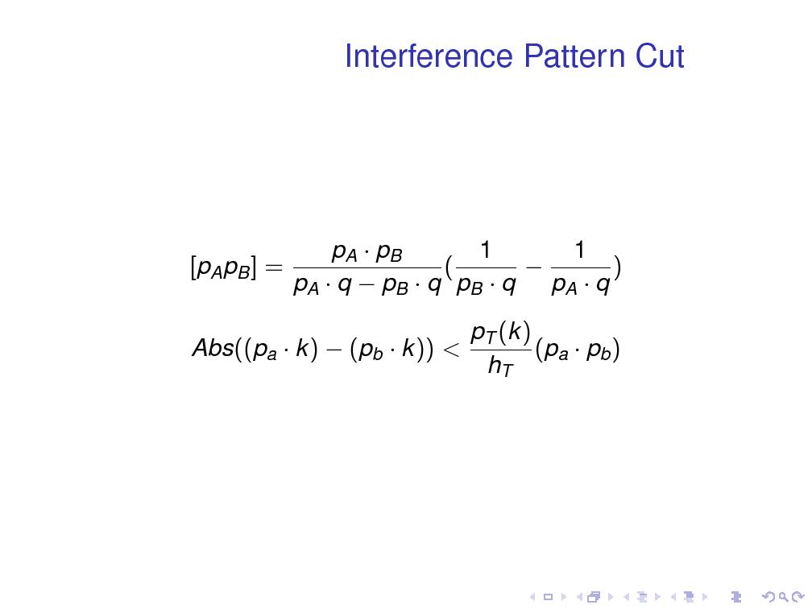
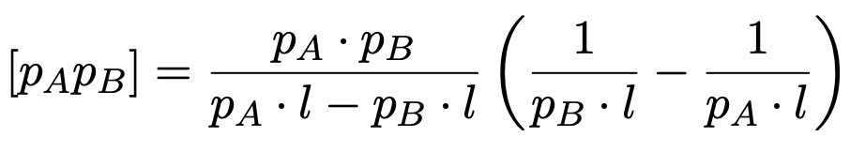
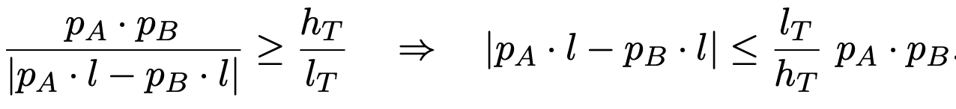
artistry!

Slide 24
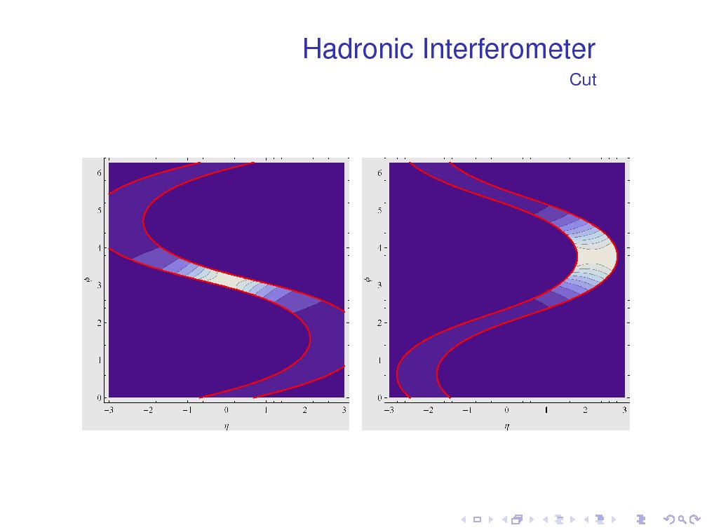
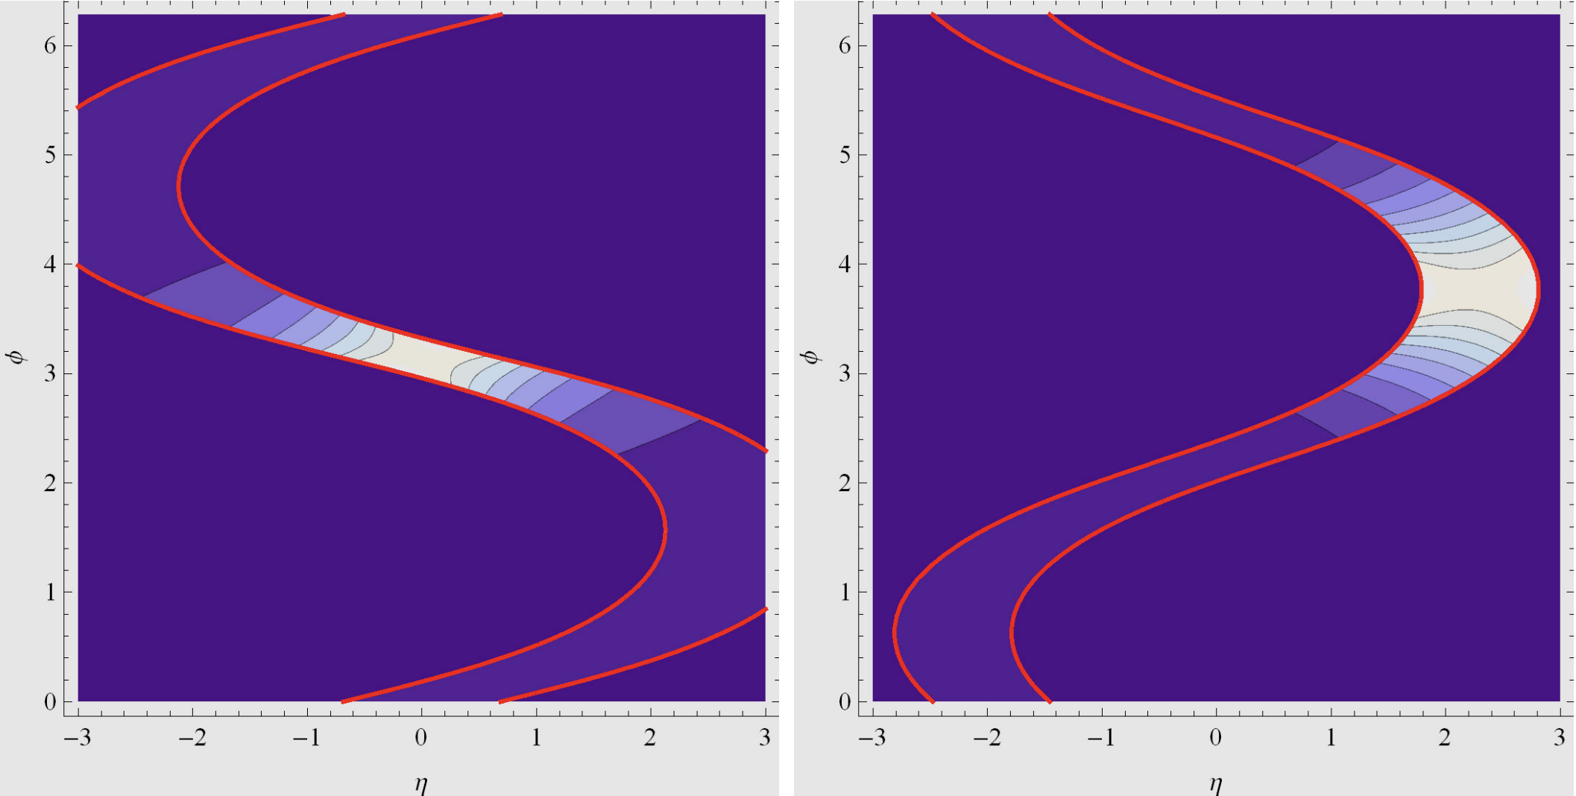

Slide 25
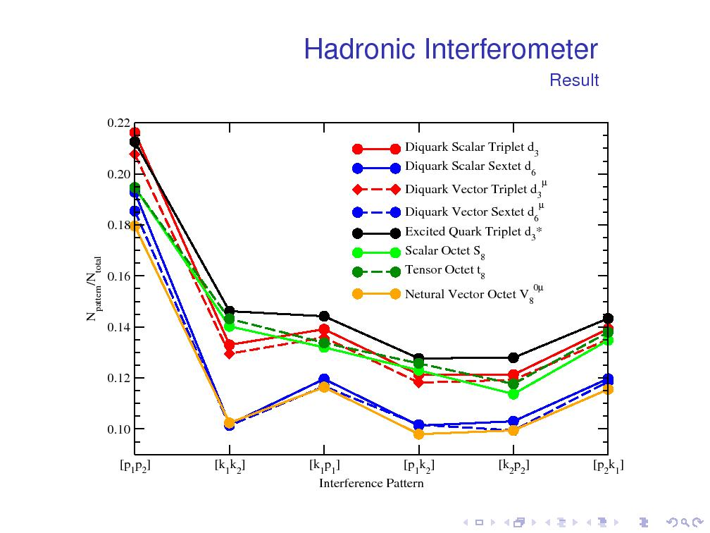
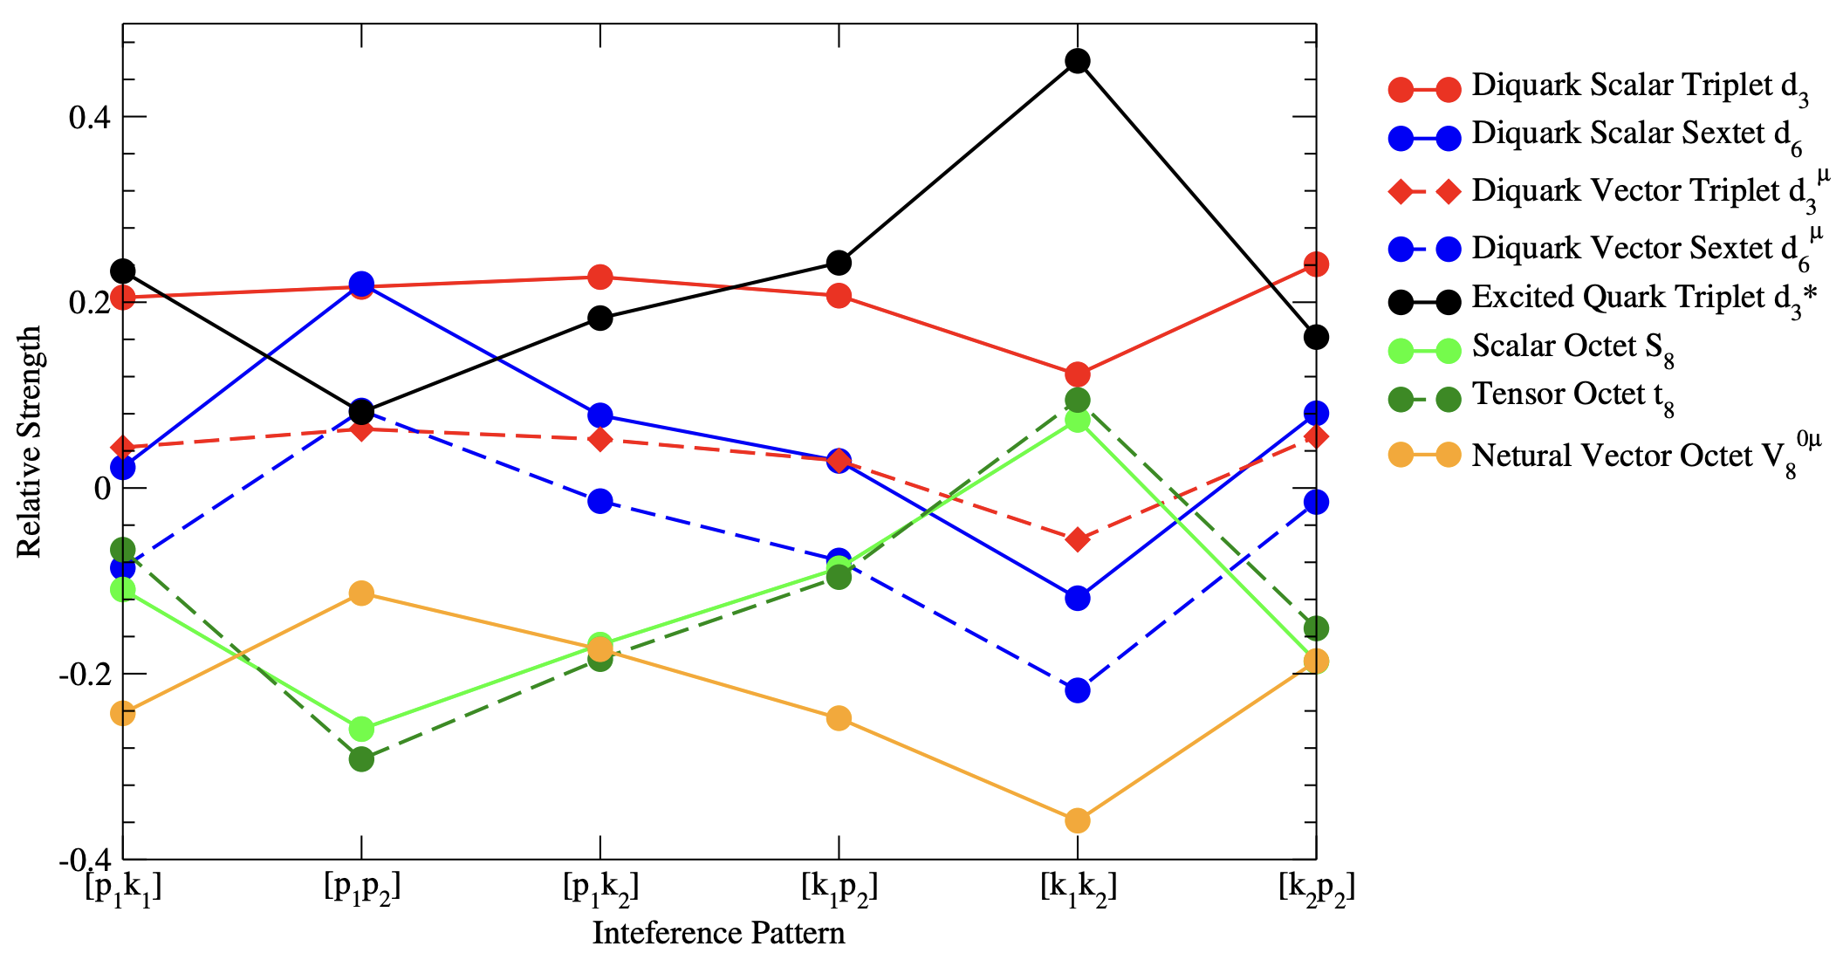

Slide 26
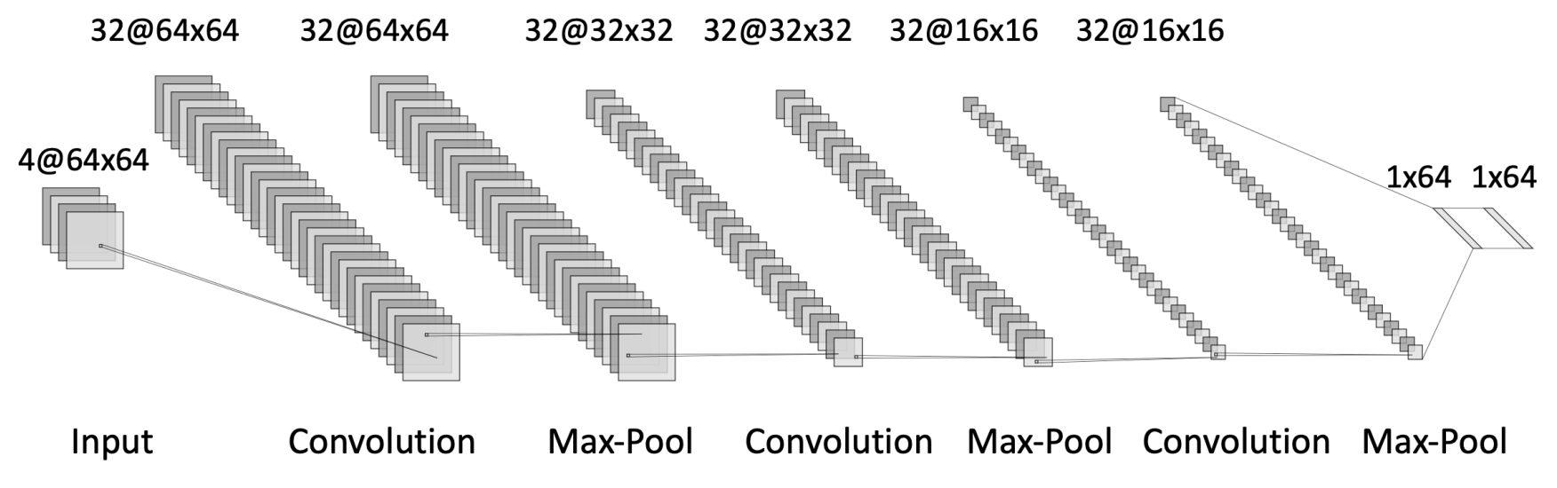
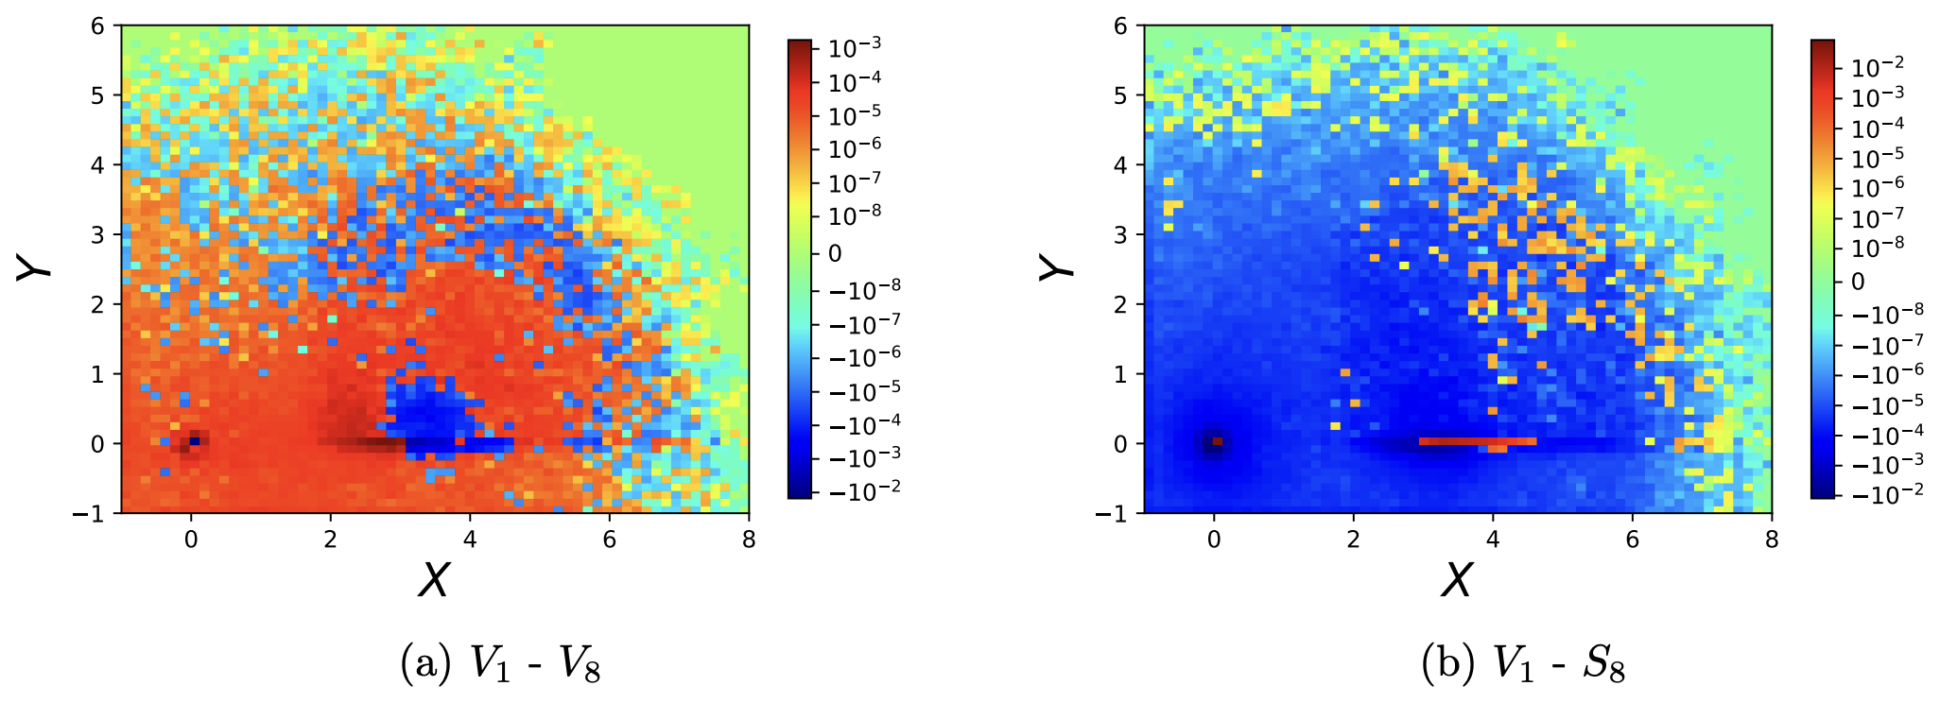
New Era

Slide 27
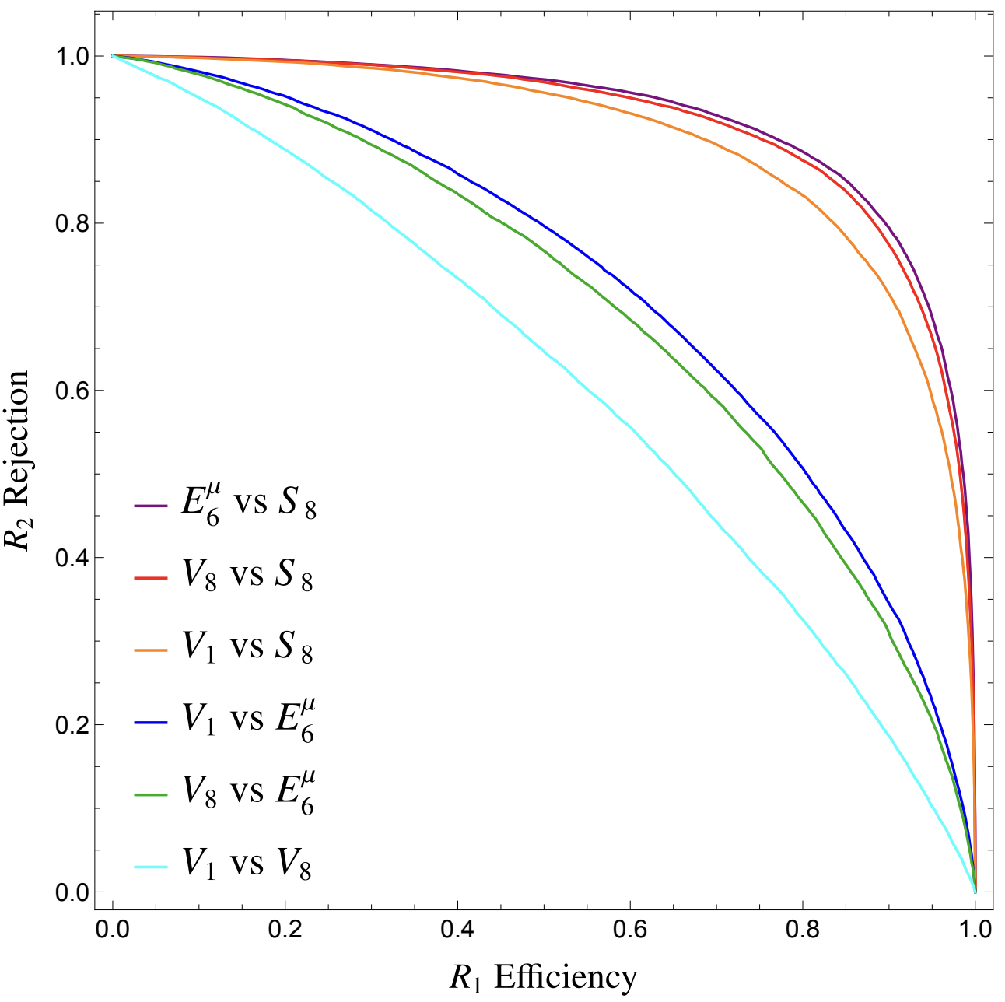
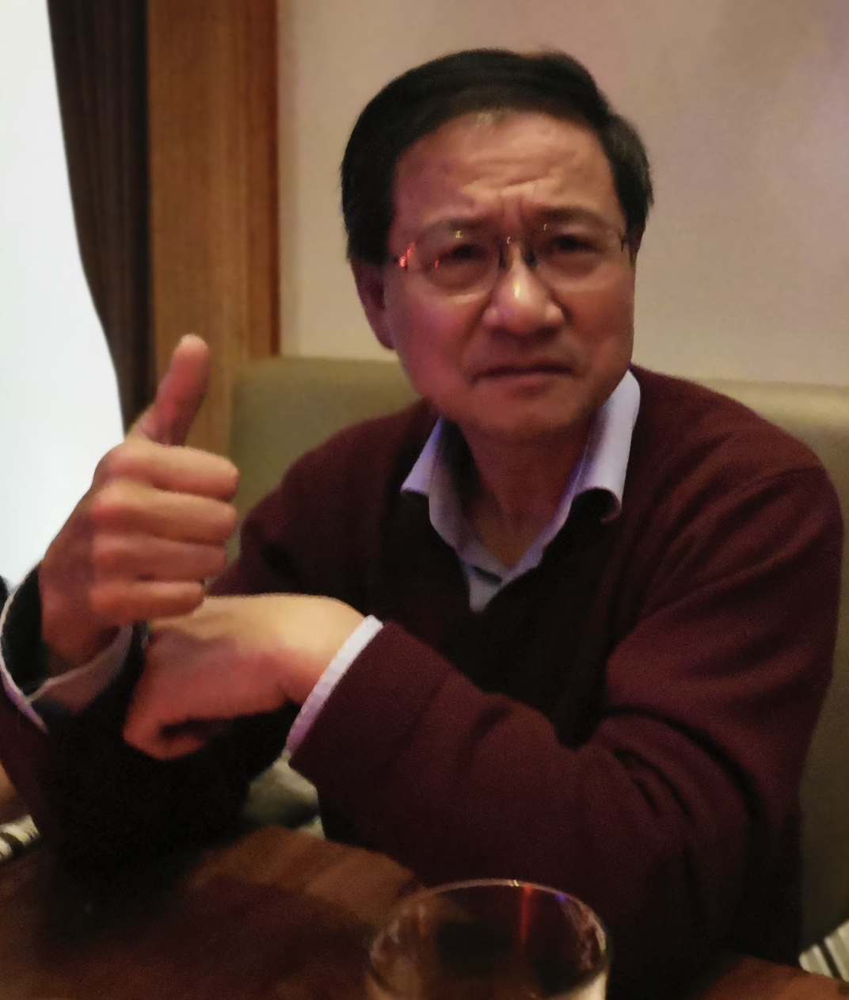
New Era

Slide 28

Summary
We performed a data-driven study for color resonances at the LHC
We classified possible color resonances at LHC
Bounds are put according to early LHC data
Extract mass, spin information of possible colored resonances.
Explored on how to get color structure of different resonances.

Slide 29
SUMMARY
Summary
We performed a data-driven study for color resonances at the LHC We classified possible color resonances at LHC
Bounds are put according to early LHC data Work in progress:
Dijet distributions
How to extract color information NLO sextet fermion calculation
Zhen Liu (UW-Madison)

Slide 30
Sextet Fermion NLO
Sextet Fermion NLO Calcuation
Zhen Liu (UW-Madison)

Slide 31
Parton Luminosities
Sextet Fermion NLO
2 g u
2 g d
g g u u
2 u d d d
2 u u
2 d d
2 g u
2 g d
g g u u
2 u d d d
2 u u
2 d d
10³
10²
10¹
10⁰
₁₀-1
₁₀-2
10³
10²
10¹
10⁰
₁₀-1
₁₀-2
Parton Luminosity
Parton Luminosity
7 TeV
14 TeV
0.5 1 1.5 2 2.5 3
M (TeV)
1
2
3 4
M (TeV)
5
Zhen Liu (UW-Madison)

Slide 32




Sextet Fermion NLO
Sextet Fermion NLO
Dimensional regulation d = 4 − 2ǫ
M¯S scheme
UV divergences are canceled by renormalization
Zhen Liu (UW-Madison)

Slide 33
Sextet Fermion NLO
Sextet Fermion NLO
Soft divergences are canceled by real gluon emission
Collinear divergences are canceled by PDF universal counter terms
Zhen Liu (UW-Madison)

Slide 34


LHC Era?
Zhen

Slide 35
Colored Resonant Production and LHC Bounds
Bounds
Acceptance
10⁴
ATLAS
Our Fit
10⁴
CMS
Our Fit
q₃*
q₃*
10
3
10
3
3.1 pb⁻¹
7 TeV
σx BR x A (pb)
2.9 pb⁻¹
7 TeV
σx A (pb)
10²
10
10²
10
1
1
95% CL Upper Limit Quark-Gluon
95% CL Upper Limit
₁₀-1
₁₀-1
Gluon-Gluon Quark-Gluon
Quark-Quark
Axigluon
-2
1000 1500 2000 ¹⁰ 500 1000 1500 2000 2500
M (GeV)
¹⁰⁻² 500
M (GeV)
Zhen Liu (UW-Madison)

Slide 36
Colored Resonant Production and LHC Bounds
Bounds
bounds figures
4
3
2
4
3
2
7 TeV
Sextet Vector
CMS (2.9 pb⁻¹)
dg→d*
ug→u*
6
6
1
μ
1
λ²xBR
dd→U₆
λ²xBR
7 TeV
Sextet Fermion
0.5
0.5
ud→D^{μ}
6
μ
ATLAS (3.1 pb⁻¹) CMS (2.9 pb )
uu→E₆
-1
0.1.
0.5
1
1.5
M (TeV)
2
2.5
0.1.
0.5
1
1.5 2
M (TeV)
2.5
Zhen Liu (UW-Madison)

Slide 37
Methodology
Data Driven: Model Independent
Simplest topology and largest rate
Simplest topology: resonances
Largest rate:
Strong interactions
QCD machine

Slide 38
QCD Machine: PDF

Slide 39
