Slide 1
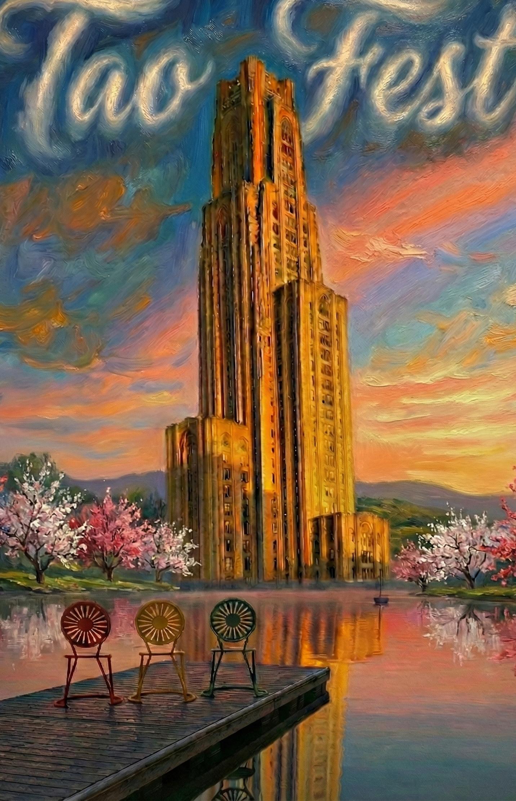
A SYMPOSIUM IN HONOR OF TAO HAN
The Madison–Pitt Legacy
From Theoretical Beauty to Collider Discovery
MAY 14–15, 2026
University of Pittsburgh
Note the terrace chairs →

Slide 2
Tao Han
PhD, UW–Madison · 1990
Bridging theory and experiment in the Golden Era of Phenomenology
Phenomenologist · Mentor · Builder of communities
TaoFest · Madison–Pitt Legacy
2 / 15

Slide 3
WITH US TODAY
UW Phenolanders & Alumni
Here to celebrate Tao’s amazing career — and its lasting impact on particle physics and on mentoring the next pheno generations.
UW–MADISON
UW PHENO ALUMNI & FORMER UW FACULTY
Lisa Everett
Neil Christensen · Illinois State University
Hooman Davoudiasl · Brookhaven National Laboratory
Francis Halzen
Kaoru Hagiwara · KEK
Ian Lewis · University of Kansas
Dan Hooper
Zhen Liu · University of Minnesota
Tilman Plehn · Heidelberg University
Xerxes Tata · University of Hawai‘i at Mānoa
Liantao Wang · University of Chicago
Dieter Zeppenfeld · KIT, Karlsruhe
TaoFest · Madison–Pitt Legacy
3 / 15

Slide 4
Tao’s PhD Years at UW–Madison
The Spirit of Chamberlin Hall
During this time, the Madison “Pheno” group was exceptionally cohesive. These individuals were either fellow students or postdocs with whom Tao co-authored several foundational collider papers.
THE PHD-ERA CIRCLE
Collaborator | Madison Role | Scientific Synergy
James Ohnemus | PhD student | NLO heavy-quark & triple-gauge-boson production
Kingman Cheung | PhD student | Strong WW scattering & Higgs collider signatures
Howard Baer | PhD student | Early top quark physics
Scott Willenbrock | Postdoc | Structure-function approach to VBF discovery
Kaoru Hagiwara | Postdoc | Higgs signals & electroweak-precision isolation
TaoFest · Madison–Pitt Legacy
4 / 15

Slide 5
Tao’s PhD-Era Publications
Three foundational papers that defined his trajectory — the collider phenomenology papers set the stage for the LHC No-Lose Theorem that followed.
1989
Some New Aspects of R-Parity-Violating SUSY
Barger, Giudice & Han · Phys. Rev. D40, 2987
Systematic phenomenology of R-parity violation — a framework that shaped SUSY collider analyses for decades.
1990
Strong W⁺W⁺ Scattering Signals at pp Supercollider
Barger, Cheung, Han & Phillips · Phys. Rev. D42, 3052
Established the collider signature of strong electroweak symmetry breaking — the no-Higgs leg of the No-Lose argument.
1991
Intermediate Mass Higgs Boson Physics at Hadron Colliders
Barger, Bhattacharya, Han & Kniehl · Phys. Rev. D43, 779
Mapped the search for the standard-model Higgs in the elusive intermediate-mass window via H → W*W* → leptons + missing energy.
TaoFest · Madison–Pitt Legacy
5 / 15

Slide 6
A LANDMARK
The 1994–95 No-Lose Theorem
“The LHC will discover the mechanism of
electroweak symmetry breaking.”
Guaranteed Discovery of the Higgs or New Physics at multi-TeV energies
AUTHORSHIP
RESULT
IMPACT
Bagger et al., 1994/95
A guarantee, not a hope
The mandate to build
The landmark study, with Tao Han playing a leading role.
Proved the LHC would either find the Higgs or the strong WW dynamics.
Provided the strategic case that justified construction of the LHC.
TaoFest · Madison–Pitt Legacy
6 / 15

Slide 7
Tao’s Higgs Search Toolkit
Three signature contributions that defined the LHC Higgs-search playbook — applied and refined throughout his Madison return, which contributed to the Higgs discovery by ATLAS and CMS.
1991
Cluster Transverse Mass
A new variable for reconstructing Higgs decays with missing energy — a foundational technique for isolating signals from massive backgrounds.
1991
Forward-Jet Tagging & Central-Jet Vetoing
Initiated the strategy that became the standard for Higgs discovery via Vector Boson Fusion.
1992
Structure-Function Approach to EWSB
Pioneering NLO framework for vector-boson scattering — figures from this work appear in the iconic Collider Physics textbook.
TaoFest · Madison–Pitt Legacy
7 / 15

Slide 8
LEGACY
PhD Alumni — The Madison Generation
From a single advisor, a generation of leaders dispersed across continents.
Alumnus | PhD Year | Current Position
Danny Marfatia | 2001 | Professor, University of Hawaii
Piyabut Burikham | 2005 | Professor, Chulalongkorn University
Kai Wang | 2008 | Professor, Zhejiang University
Tong Li | 2008 | Associate Professor, Nankai University
Ian Lewis | 2011 | Professor, University of Kansas
SELECTED WORK WITH MADISON POSTDOCS: Phenomenology of the Little Higgs Model (Han, Logan, McElrath & L.-T. Wang, 2003) · Phys. Rev. D67, 095004.
TaoFest · Madison–Pitt Legacy
8 / 15

Slide 9
LOOKING FORWARD
The Muon Quartet
Founding paper: Barger, Berger, Gunion & Han, s-channel Higgs Boson Production at a Muon-Muon Collider, Phys. Rev. Lett. 75, 1462 (1995).
Tao’s vision for the next frontier — co-founder of the team defining the physics potential of a multi-TeV muon collider.
Han
Barger
Berger
Gunion
Tao harmonizing theory with the next multi-TeV frontier. A top priority for P5 and the NAS.
SELECTED PAPER
FOLLOW-ON COMMUNITY VISION
Han, Liu, L.-T. Wang & X. Wang, WIMPs at High-Energy Muon Colliders, Phys. Rev. D103 (2021).
Al Ali, Arkani-Hamed, et al., The Muon Smasher’s Guide, Rep. Prog. Phys. 85 (2022).
TaoFest · Madison–Pitt Legacy
9 / 15

Slide 10
NEUTRINO PHYSICS
The Search for Heavy Majorana Neutrinos
Tao’s foundational contributions to lepton-number violation at hadron colliders — defining the search strategy and the community reference for a generation of LHC analyses.
2006
Signatures for Majorana Neutrinos at Hadron Colliders
Han & Zhang · Phys. Rev. Lett. 97, 171804
Introduced the same-sign dilepton + jets channel as the landmark LHC signature for heavy Majorana neutrinos via the Type-I Seesaw mechanism.
2008
Neutrino Masses and the CERN LHC: Testing Type II Seesaw
Fileviez Perez, Han, Huang, Li & Wang · Phys. Rev. D78, 015018
Extended the programme to the Type-II Seesaw — doubly-charged Higgs triplets and multi-lepton signatures at the LHC.
2009
The Search for Heavy Majorana Neutrinos
Atre, Han, Pascoli & Zhang · JHEP 0905:030
The definitive community review of heavy neutral lepton searches — a 1,000+ citation reference that shaped the LHC experimental programme.
TaoFest · Madison–Pitt Legacy
10 / 15

Slide 11
RECOGNITION
2025 APS Mentoring Award
Meenakshi Narain Award · Division of Particles and Fields
“
Outstanding mentoring, sustained and caring early-career advising, and a quarter century cultivating the welcoming and supportive Phenomenology symposium.
— American Physical Society, Division of Particles and Fields
Four decades · Two universities · A global community of students.
TaoFest · Madison–Pitt Legacy
11 / 15

Slide 12
ALSO RECENT
Honors
A career’s breadth of recognition.
2024
2025
Alexander von Humboldt
Distinguished Alumni
Research Award
Award
Federal Republic of Germany
UW–Madison Department of Physics
TaoFest · Madison–Pitt Legacy
12 / 15

Slide 13
SERVICE TO PARTICLE PHYSICS
Building the Community
Sustained leadership in the American Physical Society and the U.S. particle physics planning process.
2019–2022
APS Division of Particles and Fields
Vice-Chair (2019) · Chair-Elect (2020) · Chair (2021) · Past-Chair (2022)
Led the largest division of the American Physical Society through the COVID era — stewarding the field’s strategic priorities.
2020
APS April Meeting
Chair
Organized the APS Division’s flagship annual gathering.
2020–2022
Snowmass 2021 — Particle Physics Community Planning Exercise
Chair-line and Steering Committee
Helped guide the once-per-decade community process that sets U.S. particle-physics priorities for the coming decade.
1998–present
Phenomenology Symposium Series
Founding & continuing organizer · UW–Madison and University of Pittsburgh
Built and sustained the field’s premier annual gathering for collider phenomenology — a quarter-century legacy of community-building cited in the 2025 APS Mentoring Award.
TaoFest · Madison–Pitt Legacy
13 / 15

Slide 14
UNIVERSITY OF PITTSBURGH · 2011–PRESENT
PITT PACC
Headquarters of Discovery
Since 2011, at Pitt, Tao has led us in new paths of phenomenology research that will be exciting topics of other speakers at this meeting.
TaoFest · Madison–Pitt Legacy
14 / 15

Slide 15
With gratitude
For the theorems and the phenomenology.
For the meetings you built and the students you raised.
For the warmth, the rigor, and the example.
And above all, your friendship.
Here’s to the next chapter.
TaoFest · Madison–Pitt Legacy

