Slide 1


INVESTIGATION OF SUPER-EDDINGTON DISKS AROUND TIDAL DISRUPTION EVENTS
DOMONKOS SZABÓ
ELTE, Astronomy Msc, 4th Semester
Observatory assistant, HUN-REN CSFK, Konkoly-Thege Miklós Astronomical Institute
Supervisors:
GÁBOR KOVÁCS
Junior research fellow, HUN-REN CSFK, Konkoly-Thege Miklós Astronomical Institute,
ZSÓFIA KOVÁCS-STERMECZKY
Junior research fellow, HUN-REN CSFK, Konkoly-Thege Miklós Astronomical Institute

Slide 2
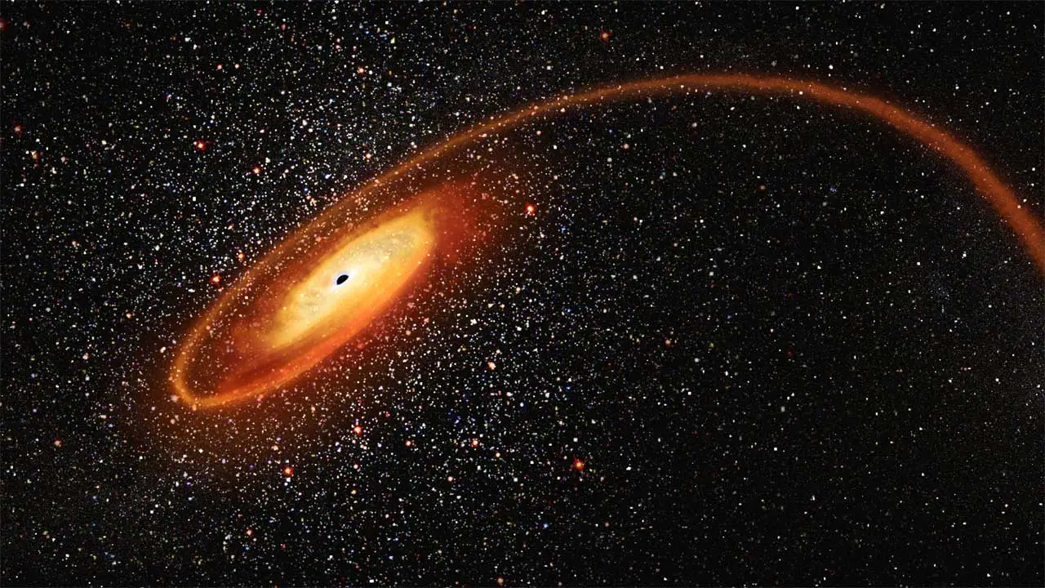
What is a TDE?
Tidal disruption events (TDE)
Black hole: disrupts a star
Super-Eddington accretion disk
Super-Eddington wind
Great intensity
Detect black holes
Measure black hole’s mass
https://vajiramandravi.com/upsc-daily-current-affairs/prelims-pointers/tde/

Slide 3
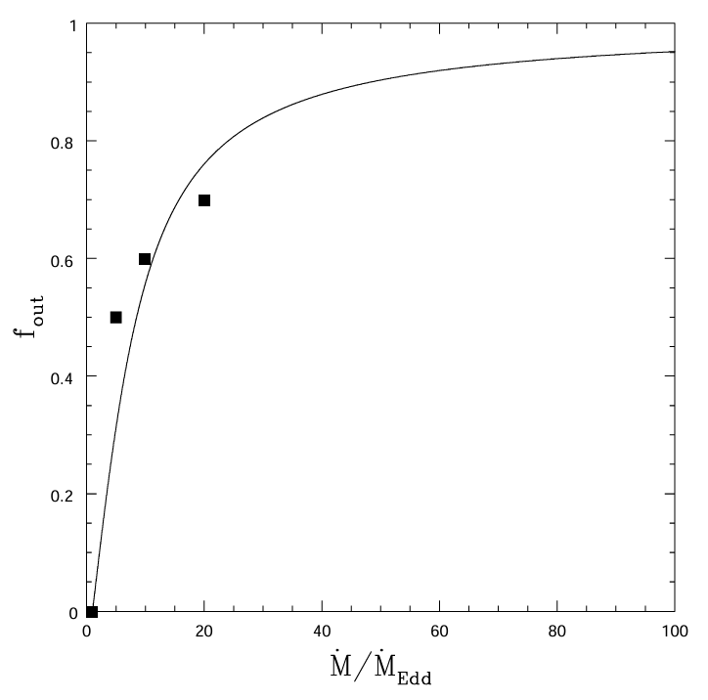


Scientific background
TiDE: light curve simulation
$f_{out}$ parameter:
Lodato & Rossi (2011), Dotan & Shaviv (2011)
Kovács-Stermeczky & Vinkó (2023)
$$\frac{2}{π}\operatorname{arctg}\left[\frac{1}{7,5}\left(\frac{{\dot{M}}_{fb}}{{\dot{M}}_{Edd}}−1\right)\right]$$
https://doi.org/10.1111/j.1365-2966.2010.17448.x

Slide 4
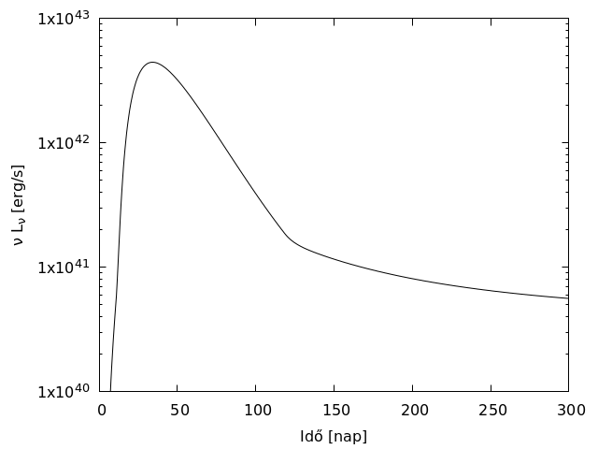
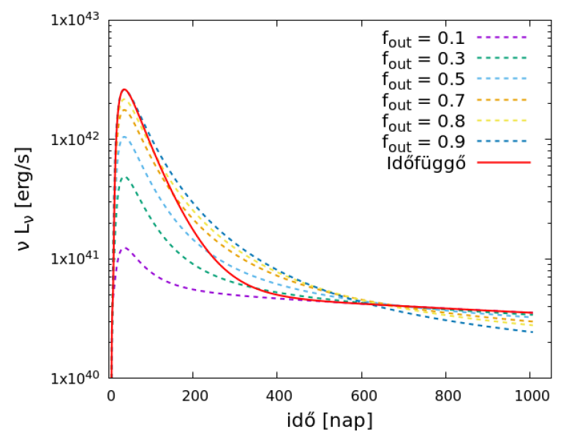
Scientific background
time-dependent
time [day]
time [day]
Szabó, 2024

Slide 5

Goal of my work
Implementation of the Dotan slim disk model
Define $f_{\text{out}}$ parameter more accurately
Own numerical solver in C
Implementation of the Shakura & Sunyaev thin disk model
Analogue problem
Validating my code

Slide 6
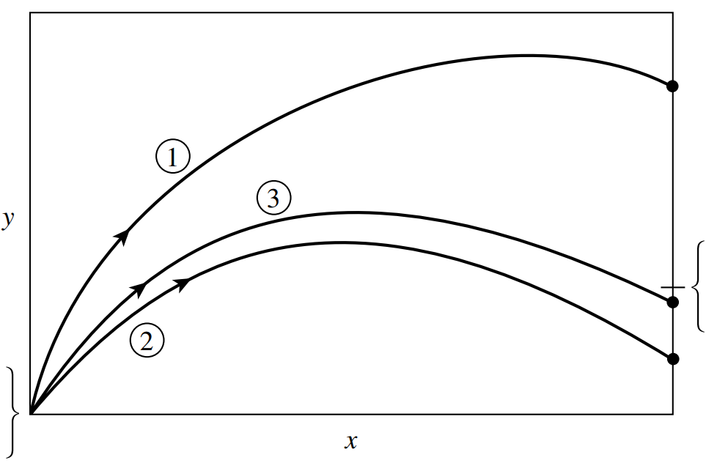
Shooting method
Outer boundary value
Inner boundary value

Slide 7
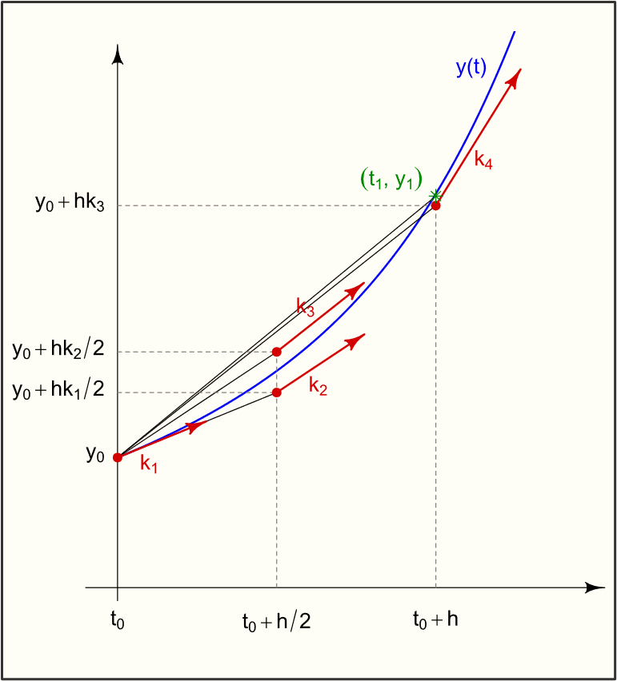





Fourth order Runge-Kutta method
$$\frac{dy}{dx}=f(x,y)$$
$$k_{1}=hf(x_{n},y_{n})$$
$$k_{2}=hf(x_{n}+\frac{1}{2}h,y_{n}+\frac{1}{2}k_{1})$$
$$k_{3}=hf(x_{n}+\frac{1}{2}h,y_{n}+\frac{1}{2}k_{2})$$
$$k_{4}=hf(x_{n}+h,y_{n}+k_{3})$$
$y_{n+1}=y_{n}+\frac{1}{6}k_{1}$ $+\frac{1}{3}k_{2}+\frac{1}{3}k_{3}+\frac{1}{6}k_{4}+O(h^{5})$
https://en.wikipedia.org/wiki/Runge%E2%80%93Kutta_methods

Slide 8
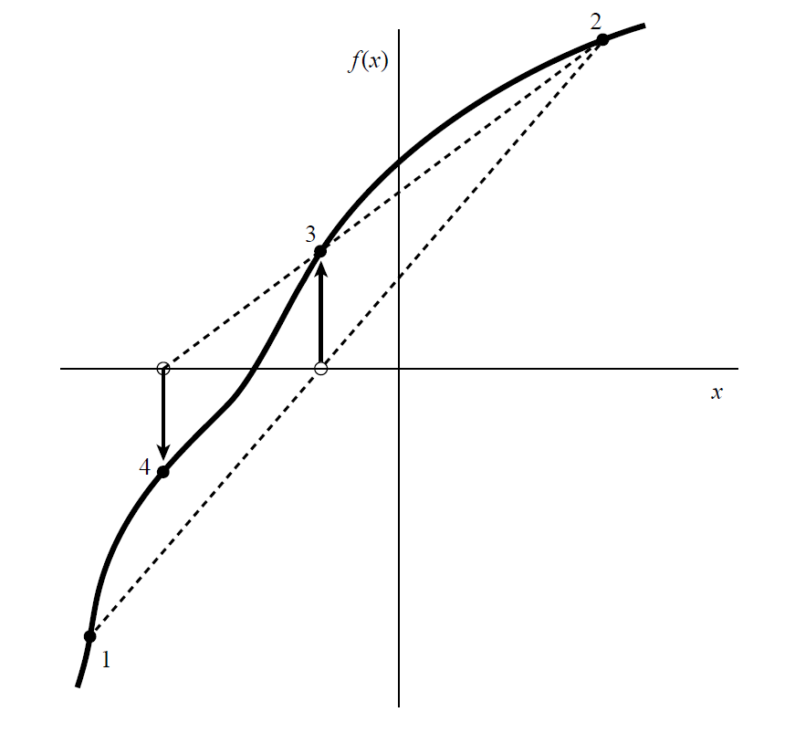
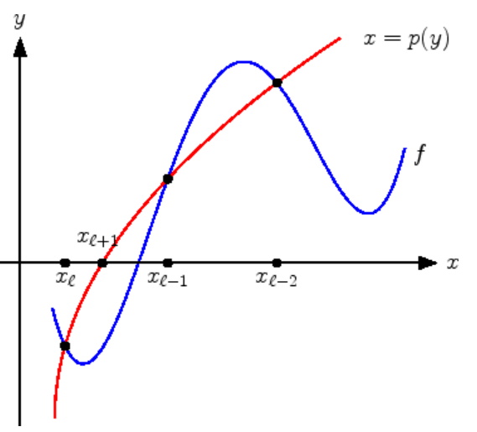
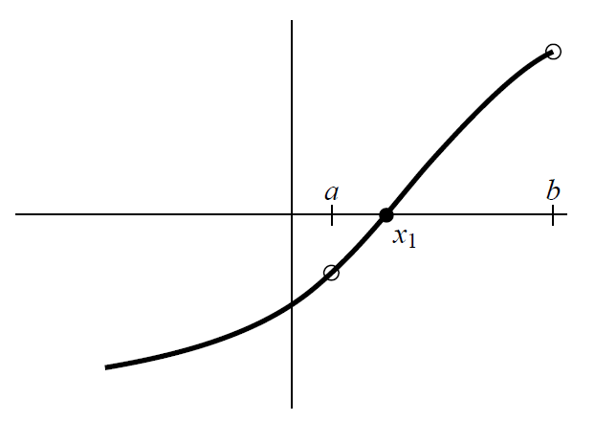
Brent’s method
Secant method
Inverse quadratic interpolation
Bisection method
Hybrid method
Superlinear convergence
No numerical derivative

Slide 9
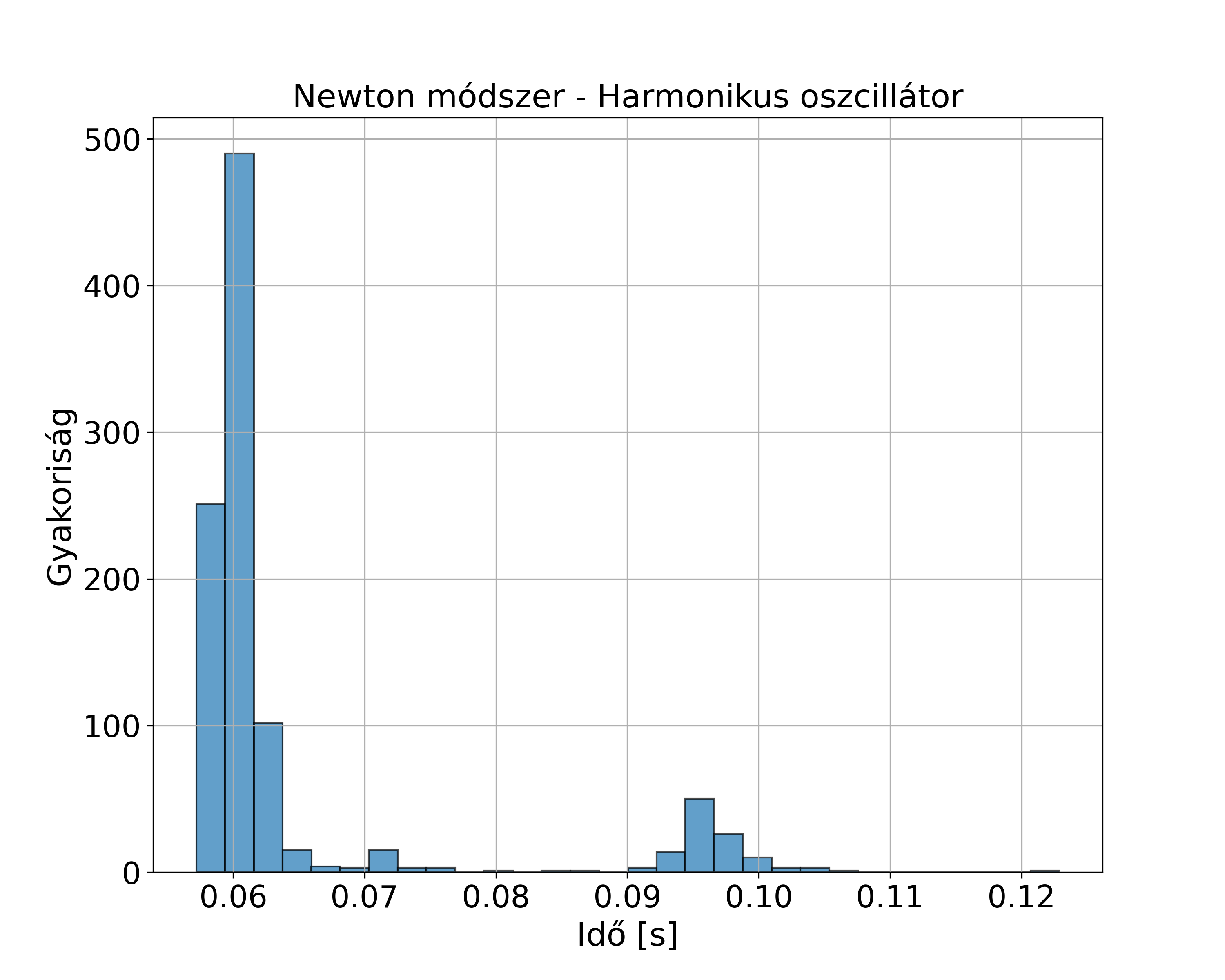
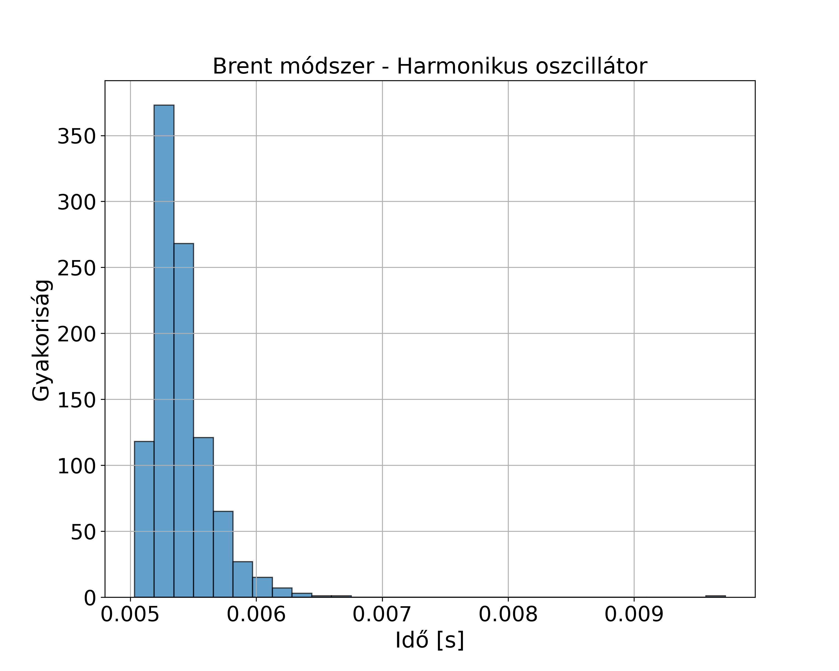


Brent’s method
Newton’s method – Harmonic oscillator
Brent’s method – Harmonic oscillator
frequency
frequency
time [s]
time [s]
1000 iterations
Brent: 0.005[s], Newton: 0.06[s]
$$\ddot{x}=−\frac{D}{m}x$$
$$x(t)=A∙\cos{(ωt)}+B∙\sin{(ωt)}$$
$$v(t)=−A∙ω∙\cos{(ωt)}+B∙ω∙\sin{(ωt)}$$

Slide 10
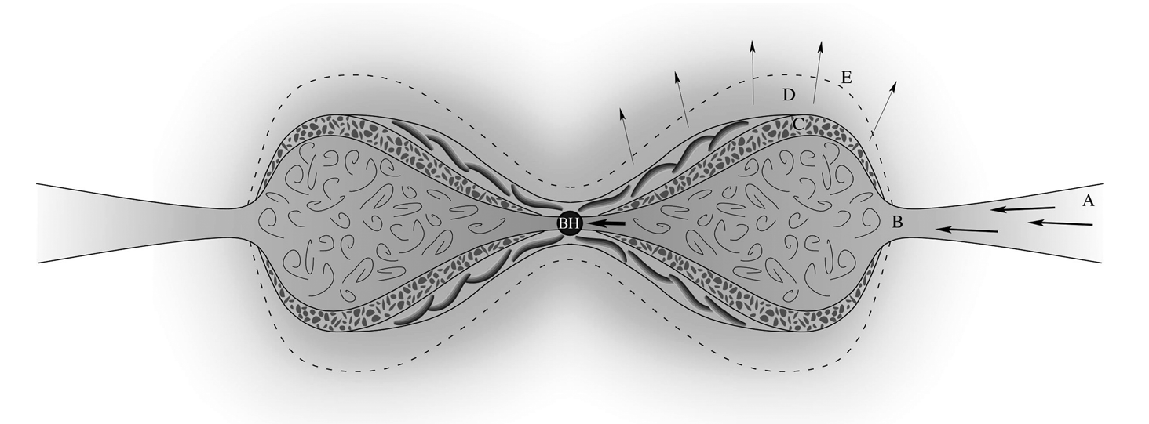
Dotan & Shaviv slim disk model
super-Eddington wind
porous layer
photosphere
Shakura-Sunyaev disk
convective zone

Slide 11

Dotan & Shaviv slim disk model
Half-analytical model, can be solved numerically
Horizontally:
Outer boundary value: Shakura & Sunyaev disk solution
Inner boundary value : sonic point $2−3R_{g}$
Vertically:
Outer boundary value : Flux of photosphere
Nested univariate boundary value problem

Slide 12

Shakura & Sunyaev thin disk model
Can be solved analytically
Horizontally:
Inner boundary value : $τ_{rφ}=0$ $3R_{g}$
Vertically:
Outer boundary value : Flux of photosphere
Separated univariate boundary value problem

Slide 13










Shakura & Sunyaev thin disk model
Keplerian angular speed
Black hole mass
Vertical structure
Horizontal structure
Angular momentum transfer
Gravitational constant
$$ω=\sqrt{\frac{GM}{R^{3}}}$$
Hydrostatic equilibrium
$$Σ\frac{dωR^{2}}{dt}=−Σv_{r}\frac{dωR^{2}}{dR}=\frac{1}{R}\frac{d}{dR}\left(τ_{rφ}R^{2}\right)$$
$$\frac{1}{ρ}\frac{dP}{dz}=−\frac{GM}{R^{3}}z.$$
Density
Shear stress
Surface density
Radial velocity
Vertical energy transport
Half-thickness of the disk
$$τ_{rφ}=2\int_{0}^{z_{0}}{w_{rφ}}=−αΣv_{s}^{2}$$
Speed of sound
$$Σ=2\int_{0}^{z_{0}}{ρdz}$$
$$\frac{1}{ρ}\frac{dq}{dz}=\frac{3}{4π}\frac{GM}{R^{3}}\frac{\dot{M}}{Σ}\left[1−{\left(\frac{R_{0}}{R}\right)}^{1/2}\right]$$
Radiative flux
Alpha parameter
$$F=\frac{1}{2}τ_{rφ}R\frac{dω}{dR}=\frac{3}{8π}\dot{M}\frac{GM}{R^{3}}\left[1−{\left(\frac{R_{0}}{R}\right)}^{1/2}\right]$$
Radiative energy density
Radiative transfer
Flux
Equation of state
Accretion rate
$$\frac{c}{3σρ}\frac{dε_{r}}{dz}=−q\left(z\right)$$
$$ε=\frac{3}{2}ρ\frac{kT}{m_{p}}+bT^{4}∼ρ\frac{v_{s}^{2}}{2}$$
$$\dot{M}=2πΣv_{r}R=\text{const}\text{.}$$
Energy density

Slide 14





Horizontal integration
Initial value problem:
$R_{0}=3R_{g}=6GM/c^{2}$
$\dot{M}=3×{10}^{−9}\frac{M_{⊙}}{\text{yr}}$
$τ_{rφ}=0$
$$Σ\frac{dωR^{2}}{dt}=−Σv_{r}\frac{dωR^{2}}{dR}=\frac{1}{R}\frac{d}{dR}\left(τ_{rφ}R^{2}\right)$$
$$τ_{rφ}=2\int_{0}^{z_{0}}{w_{rφ}}=−αΣv_{s}^{2}$$
$$\dot{M}=2πΣv_{r}R=\text{const}\text{.}$$
$$F=\frac{1}{2}τ_{rφ}R\frac{dω}{dR}=\frac{3}{8π}\dot{M}\frac{GM}{R^{3}}\left[1−{\left(\frac{R_{0}}{R}\right)}^{1/2}\right]$$
Fourth order Runge-Kutta method

Slide 15
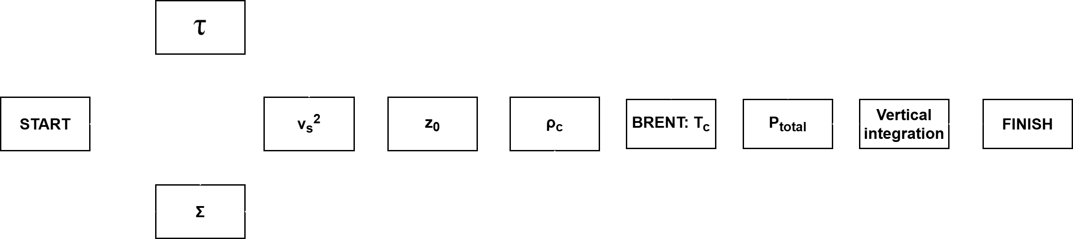
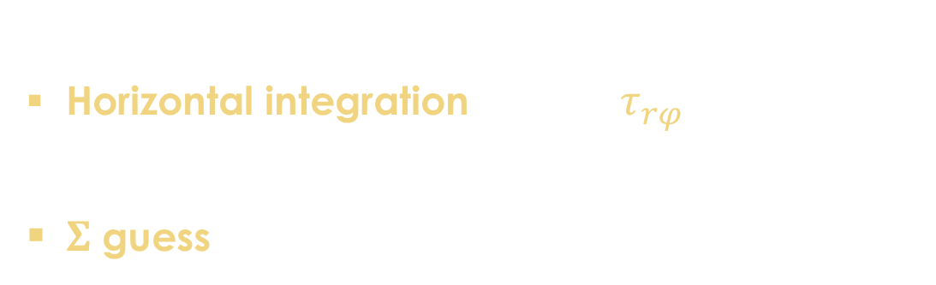


Calculation of initial state
Horizontal integration $τ_{rφ}$
$Σ$ guess
$$T_{c}=\frac{v_{s}^{2}m_{p}}{6k}−\frac{bT_{c}^{4}m_{p}}{3ρk}$$
Brent’s method:
$f\left(T_{c}\right)=0$
$\left[T_{\text{left}}={10}^{2}\text{K},T_{\text{right}}={10}^{10}\text{K}\right]$

Slide 16





Vertical integration
Boundary value problem shooting method
$\left[Σ_{\text{left}}=0.01 \text{kg}/{\text{m}}^{2},Σ_{\text{right}}=2 \text{kg}/{\text{m}}^{2}\right]$
$T_{\text{c}}$ $P_{\text{c}}$ $ρ_{\text{c}}$
$F$ $T_{\text{s}}$
Brent:$f=T_{\text{final}}−T_{\text{s}}=0$
$$\frac{dP}{dz}=−\frac{GM}{R^{3}}zρ$$
$$\frac{dq}{dz}=\frac{3}{4π}\frac{GM}{R^{3}}\frac{\dot{M}}{Σ}\left[1−{\left(\frac{R_{0}}{R}\right)}^{1/2}\right]ρ$$
$$\frac{dε_{r}}{dz}=−q\left(z\right)\frac{3σρ\left(z\right)}{c}$$
$$P_{\text{g}}=P_{\text{total}}−\frac{ε_{\text{r}}}{3}, ρ=P_{\text{g}}\frac{m_{\text{p}}μb^{1/4}}{kε_{\text{r}}}$$

Slide 17
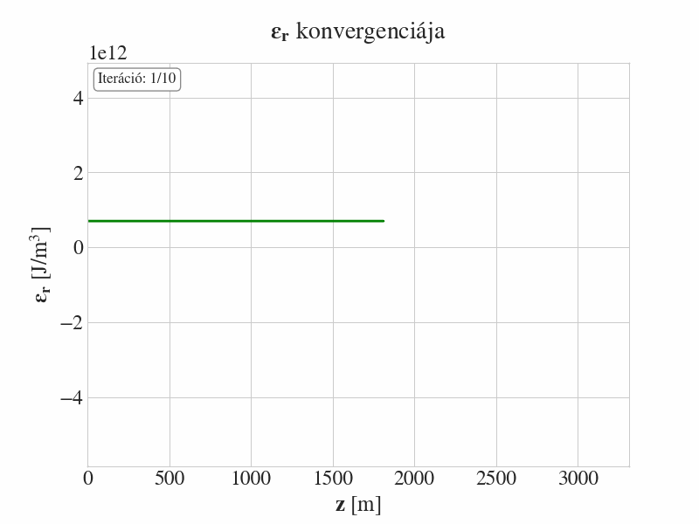


Results: Shakura & Sunyaev solution
Convergence of $ε_{\text{r}}$
$τ_{rφ}=−4.356642×{10}^{15}N\backslash m^{2}$
$R=5R_{g}$
$P_{\text{radiation}}≫P_{\text{gas}}$
$σ_{T}≫σ_{ff}=0,04 kg/{\text{m}}^{2}$
Iteration

Slide 18
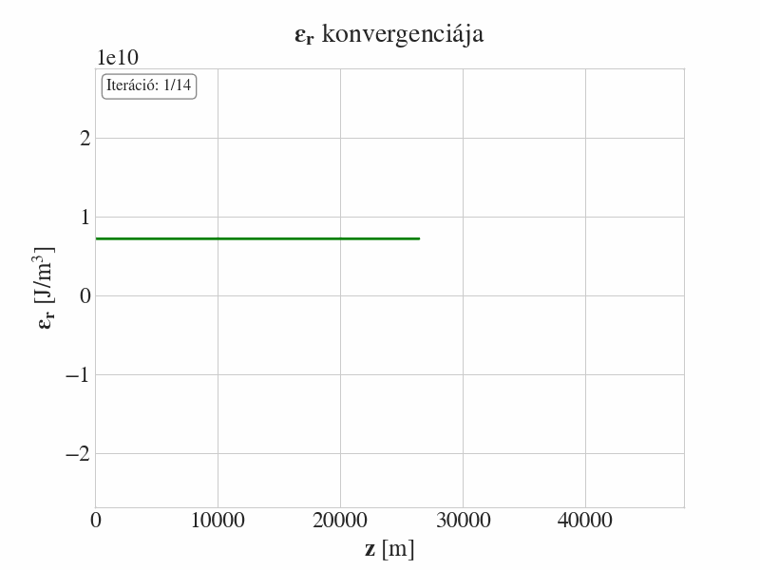

Results: Shakura & Sunyaev solution
Convergence of $ε_{\text{r}}$
$τ_{rφ}=−4.356642×{10}^{14}N\backslash m^{2}$
$R=50R_{g}$
$P_{\text{gas}}≫P_{\text{radiation}}$
$σ_{T}≫σ_{ff}=0,04 kg/{\text{m}}^{2}$
Iteration

Slide 19
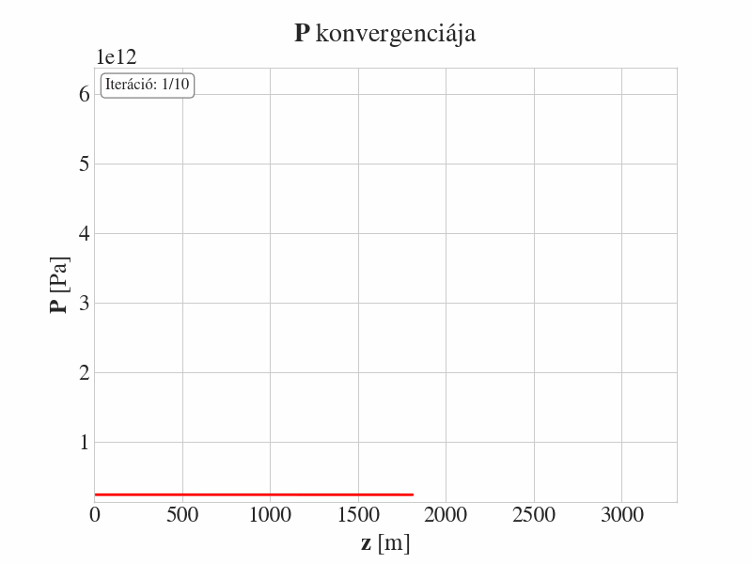

Results: Shakura & Sunyaev solution
Convergence of $P$
$τ_{rφ}=−4.356642×{10}^{15}N\backslash m^{2}$
$R=5R_{g}$
$P_{\text{radiation}}≫P_{\text{gas}}$
$σ_{T}≫σ_{ff}=0,04 kg/{\text{m}}^{2}$
Iteration

Slide 20
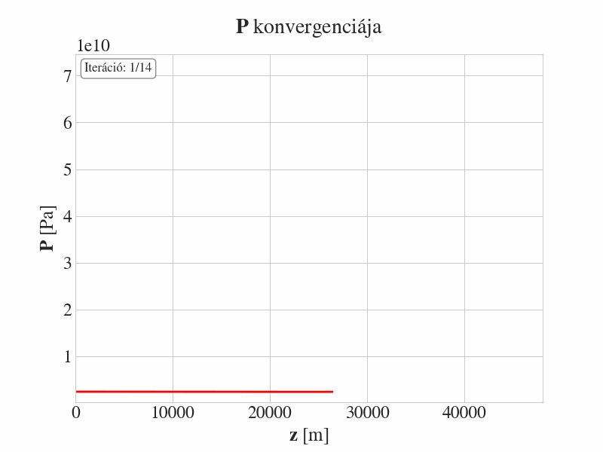
Results: Shakura & Sunyaev solution
Convergence of $P$
$τ_{rφ}=−4.356642×{10}^{14}N\backslash m^{2}$
$R=50R_{g}$
$P_{\text{gas}}≫P_{\text{radiation}}$
$σ_{T}≫σ_{ff}=0,04 kg/{\text{m}}^{2}$
Iteration

Slide 21
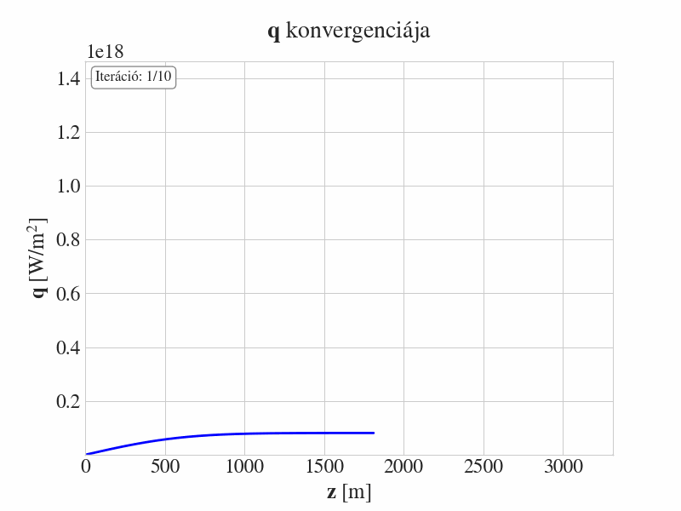

Results: Shakura & Sunyaev solution
Convergence of $q$
$τ_{rφ}=−4.356642×{10}^{15}N\backslash m^{2}$
$R=5R_{g}$
$P_{\text{radiation}}≫P_{\text{gas}}$
$σ_{T}≫σ_{ff}=0,04 kg/{\text{m}}^{2}$
Iteration

Slide 22
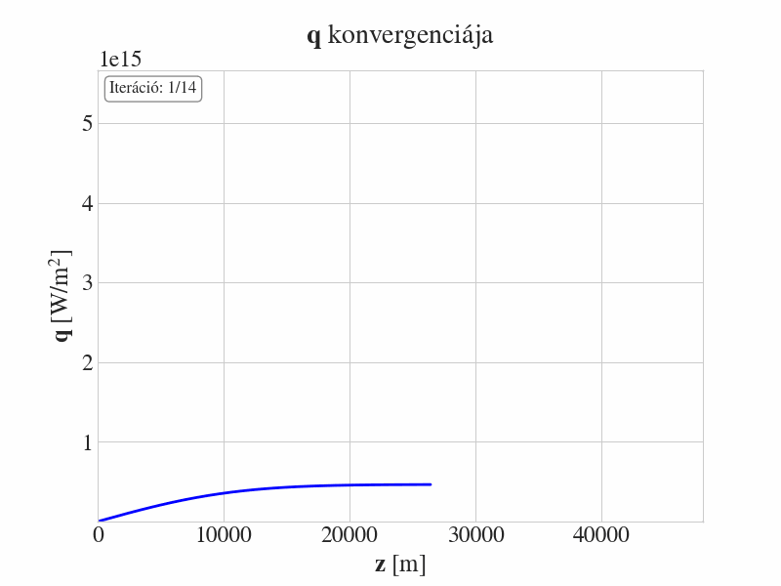
Results: Shakura & Sunyaev solution
Convergence of $q$
$τ_{rφ}=−4.356642×{10}^{14}N\backslash m^{2}$
$R=50R_{g}$
$P_{\text{gas}}≫P_{\text{radiation}}$
$σ_{T}≫σ_{ff}=0,04 kg/{\text{m}}^{2}$
Iteration

Slide 23
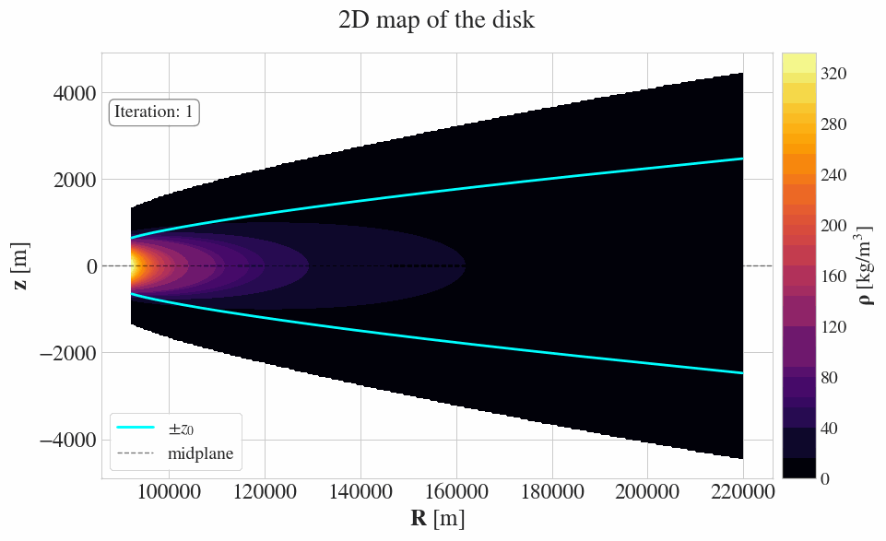

Results: Shakura & Sunyaev solution
Boundary value problem
$R_{\text{start}}=10R_{g}$

Slide 24
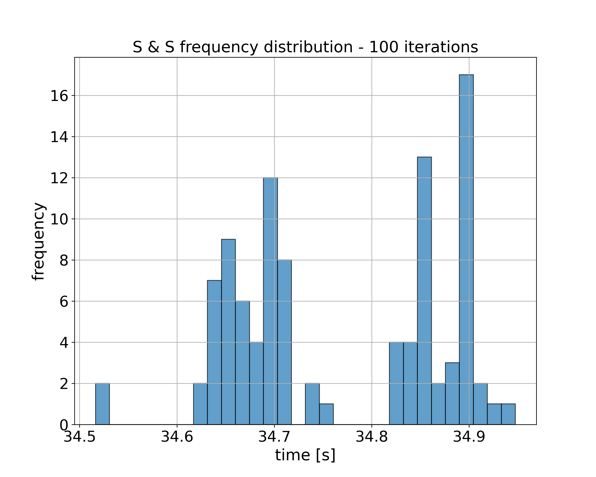

Results: Shakura & Sunyaev solution
$R_{\text{start}}=5R_{g}$
Median: $34.72138\left[s\right]$

Slide 25


Future steps
1
2
3
4
Shakura-Sunyaev disk
Dotan disk solution
$f_{out}$ investigation
Own C algorithm

Slide 26
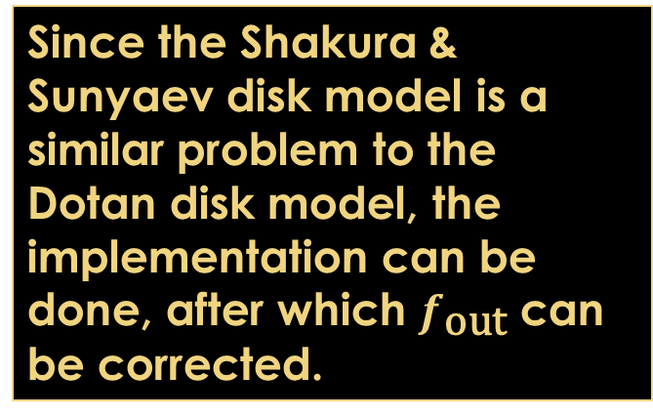
Summary
TDEs
Dotan disk model:
Super-Eddington disk
Super-Eddington wind
Nested initial boundary value problem
Since the Shakura & Sunyaev disk model is a similar problem to the Dotan disk model, the implementation can be done, after which $f_{\text{out}}$ can be corrected.
Shakura & Sunyaev disk model
Horizontal structure
Vertical structure
Brent’s method
Own C implementation

