Slide 1
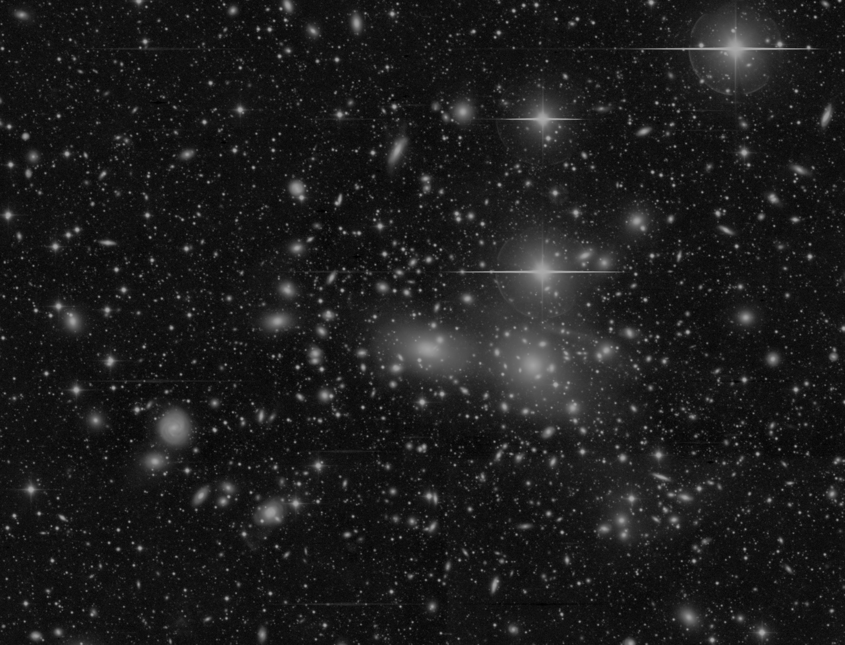


Type Ia Supernovae in the Coma Cluster
Ágoston Horti-Dávid
Supervisor: József Vinkó
NKFIH-OTKA K142534

Slide 2
Background of the project
The Coma Cluster is one of the largest galaxy clusters in the local universe
There are thousands of galaxies and a relatively large number of potential supernovae
A perfect cosmic laboratory for SNe
Goal: Search for Type Ia supernovae and measure the precise distance to the Coma Cluster
Scolnic et al., 2025: Similar work to ours, so we can compare results

Slide 3
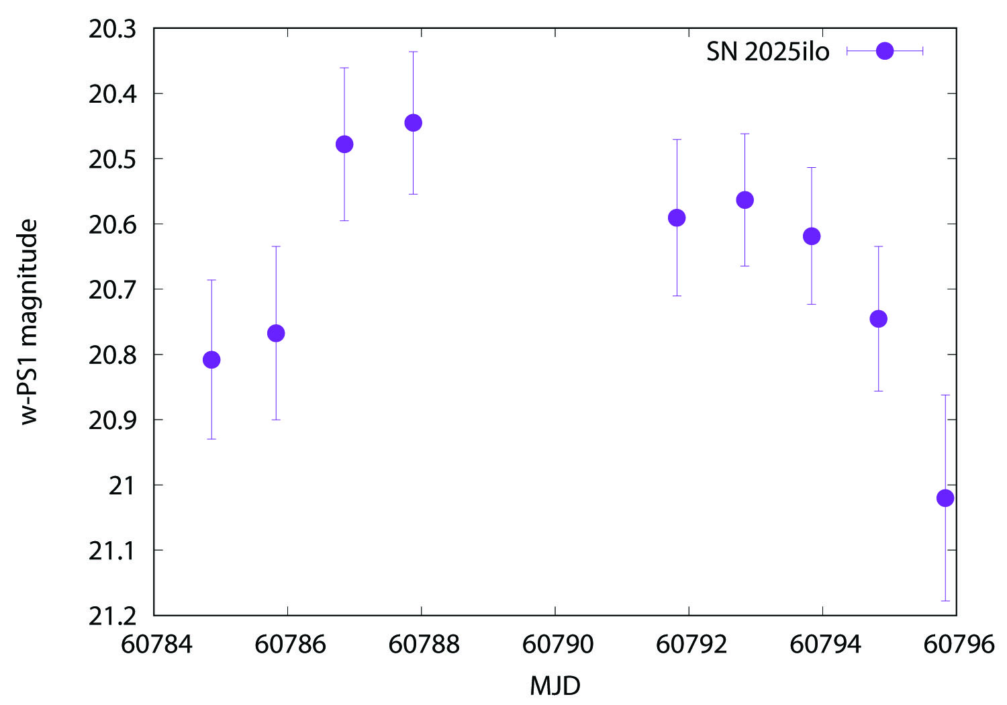
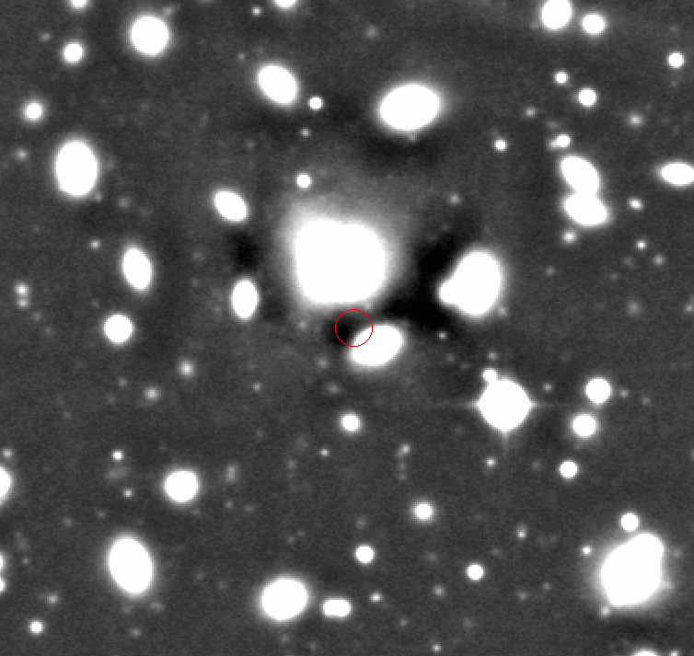
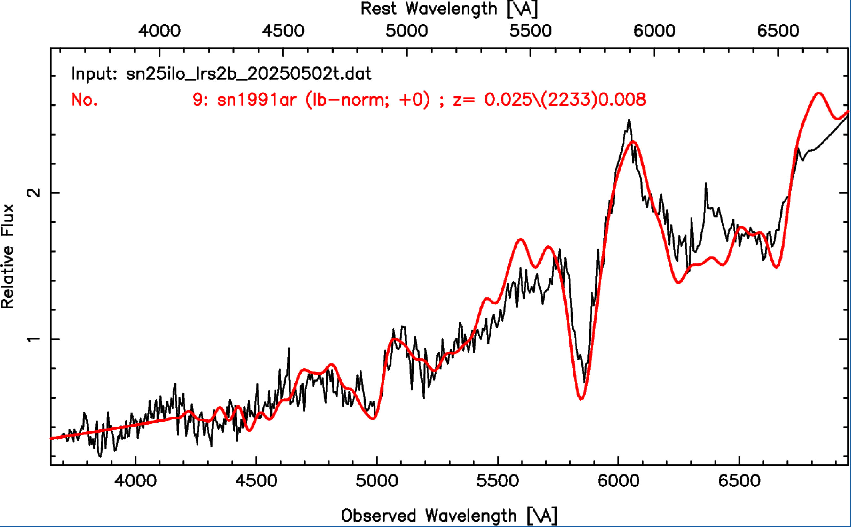
SN search
We used the Schmidt telescope for search new supernovae in the Coma Cluster
Krisztián Sárneczky regularly took a sequence of images of the Coma Cluster
1 discovered SN so far
April 26, 2025 discovery of SN2025ilo, Type Ib suprenova, 20.59 ± 0.12 mag in PS1-w band
Spectral classification made with the Hobby-Eberly Telescope

Slide 4
Photometric data
The Schmidt telescope have only one photometric filter, the Pan-STARRS w (400-800 nm)
We need more bandpasses to make the Type Ia SN light curve fit and measure the distance of the SN
With the RC80 robotic telescope we made multi colour photometry with 6 filters (Johnson B V SDSS g r i z) for the discovered supernovae in the Coma Cluster at the last 2 years
Combined our own photometric data with the ZTF and the ATLAS data base to achieve higher precision for the distance measurement
The Schmidt data reach the highest single point photometric precision (long integration, wide filter transmission)

Slide 5
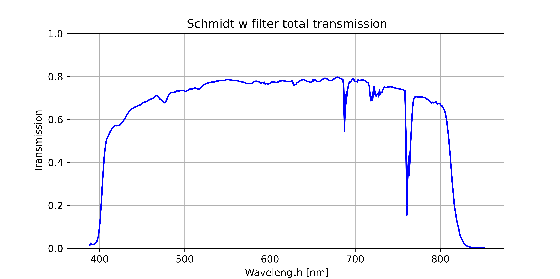
SALT3 light curve fitting
For the distance measurement we used the SNCosmo package and the SALT3 model
We defined a new bandpass in the SNCosmo package, which was represented the Schmidt telescope photometric system
Combine the PS1-w filter transmission, the atmospheric transmission and the STA1600LN CCD QE curve

Slide 6
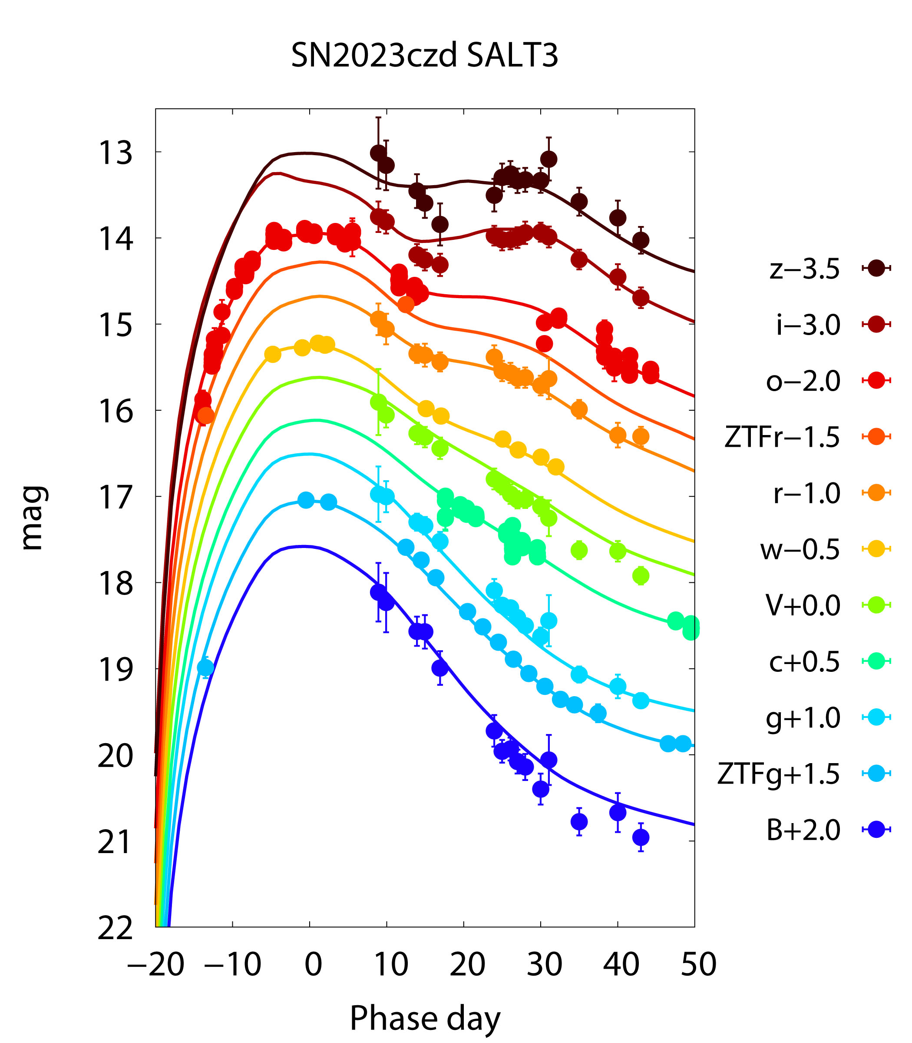
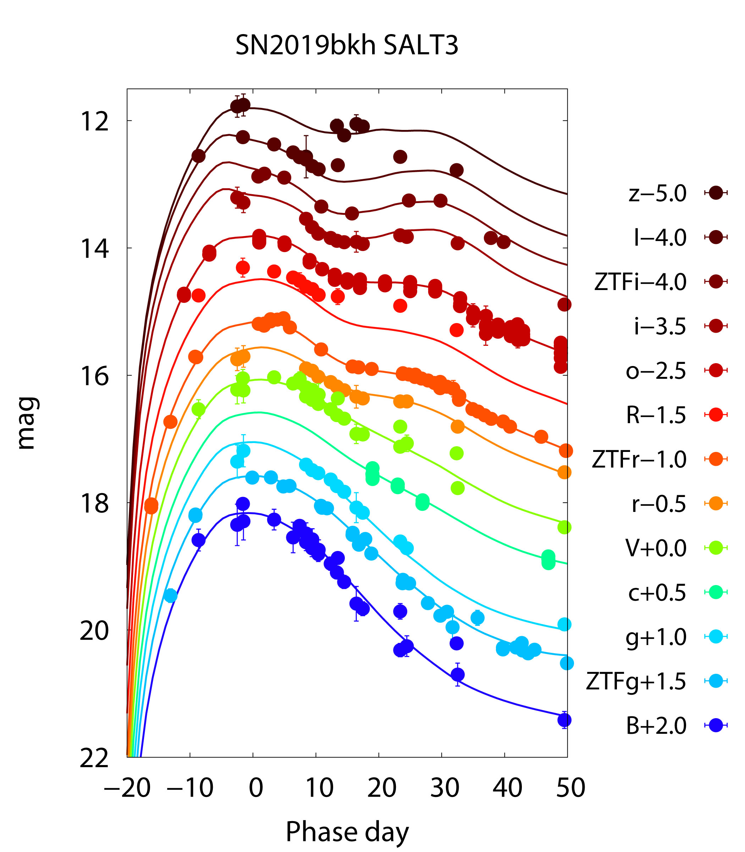
SALT3 light curve fitting
The Coma Cluster 13 type Ia supernovae have high-quality photometric data for SALT3 light curve fit from the last 15 years
3 of them observed by the RC80 and the Schmidt telescope
The others observed by the ATLAS, ZTF and YSE survey
3 older SNe light curves were used from the Pantheon+ database

Slide 7
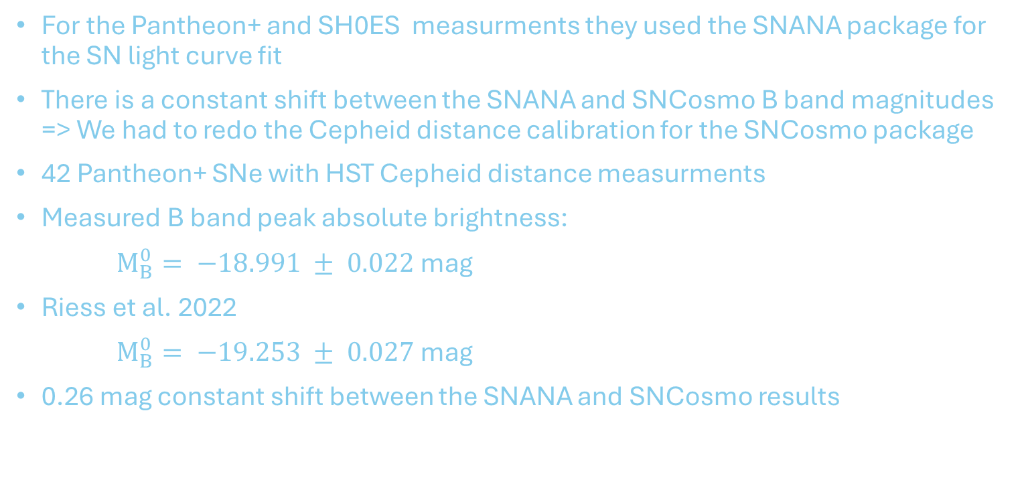
Type Ia SN absolute brightness
For the Pantheon+ and SH0ES measurments they used the SNANA package for the SN light curve fit
There is a constant shift between the SNANA and SNCosmo B band magnitudes => We had to redo the Cepheid distance calibration for the SNCosmo package
42 Pantheon+ SNe with HST Cepheid distance measurments
Measured B band peak absolute brightness:
$M_{B}^{0}= −18.991 ± 0.022$ mag
Riess et al. 2022
$M_{B}^{0}= −19.253 ± 0.027$ mag
0.26 mag constant shift between the SNANA and SNCosmo results

Slide 8
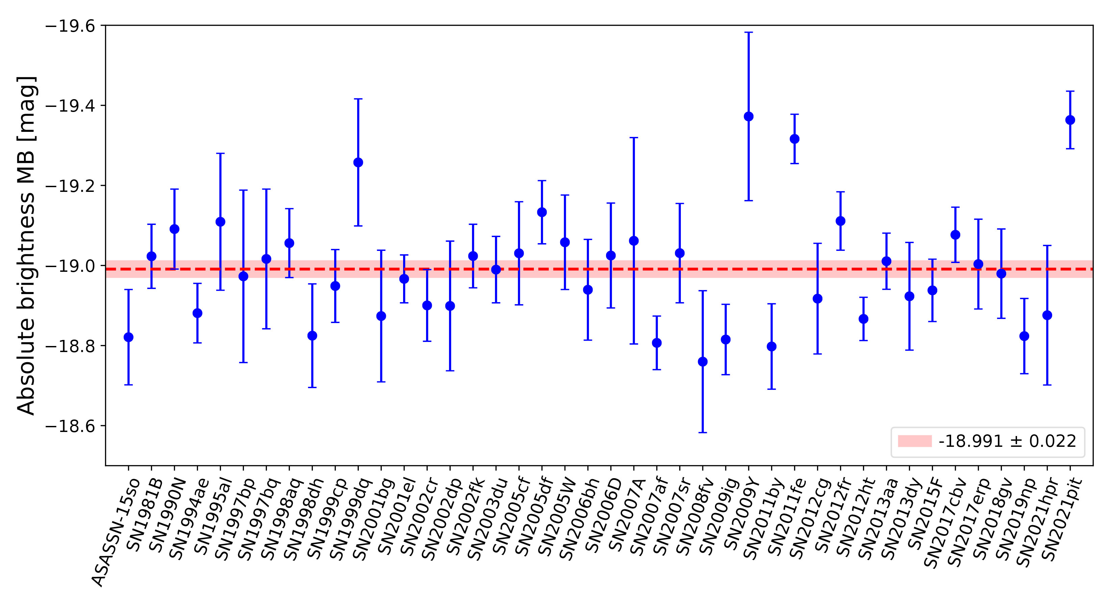
Type Ia SN absolute brightness

Slide 9
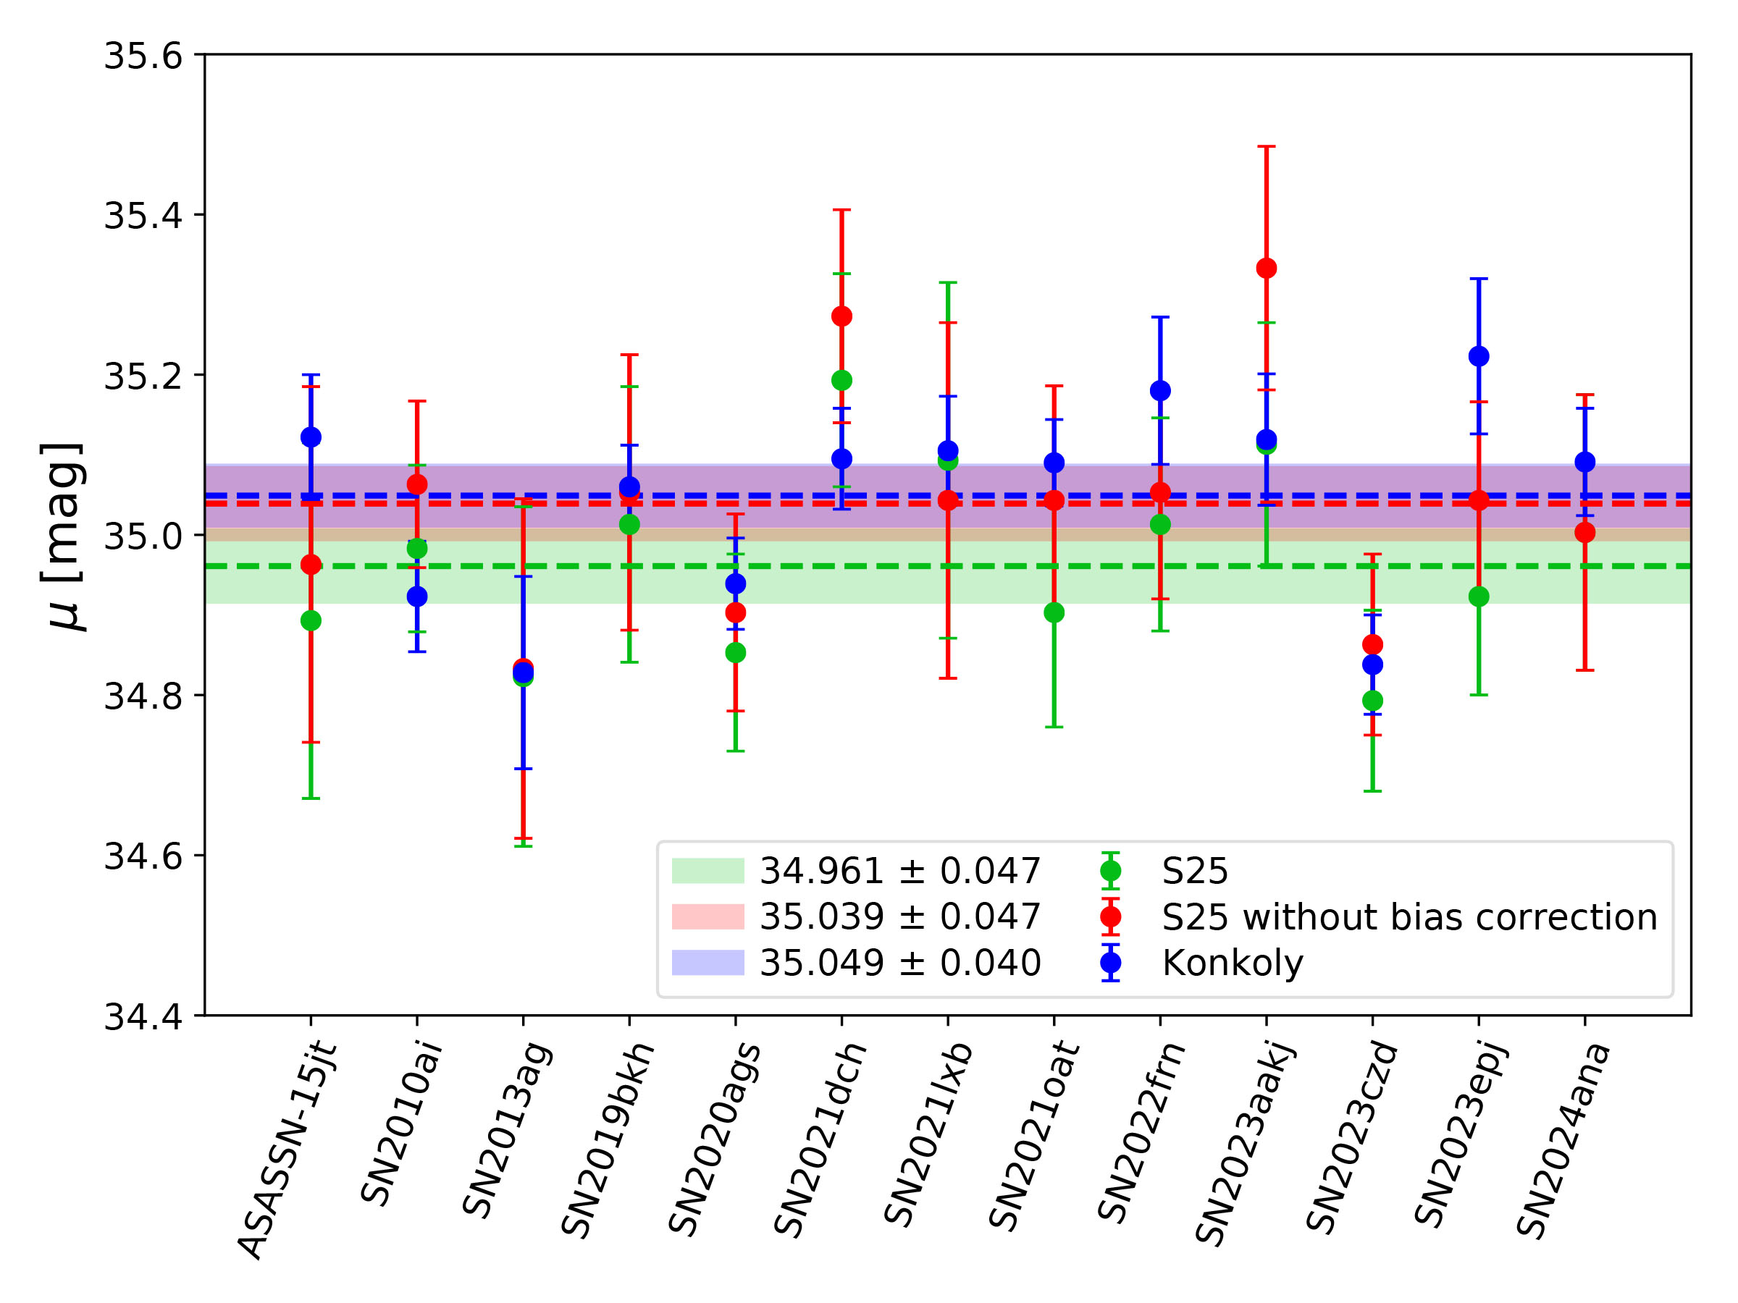
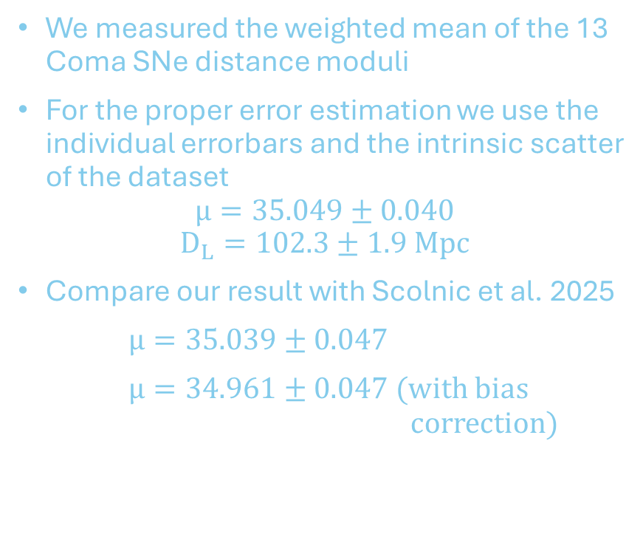
Luminosity distance of the Coma Cluster
We measured the weighted mean of the 13 Coma SNe distance moduli
For the proper error estimation we use the individual errorbars and the intrinsic scatter of the dataset
$$µ=35.049±0.040$$
$$D_{L}=102.3±1.9 Mpc$$
Compare our result with Scolnic et al. 2025
$µ=35.039±0.047$
$µ=34.961±0.047$ (with bias correction)

Slide 10
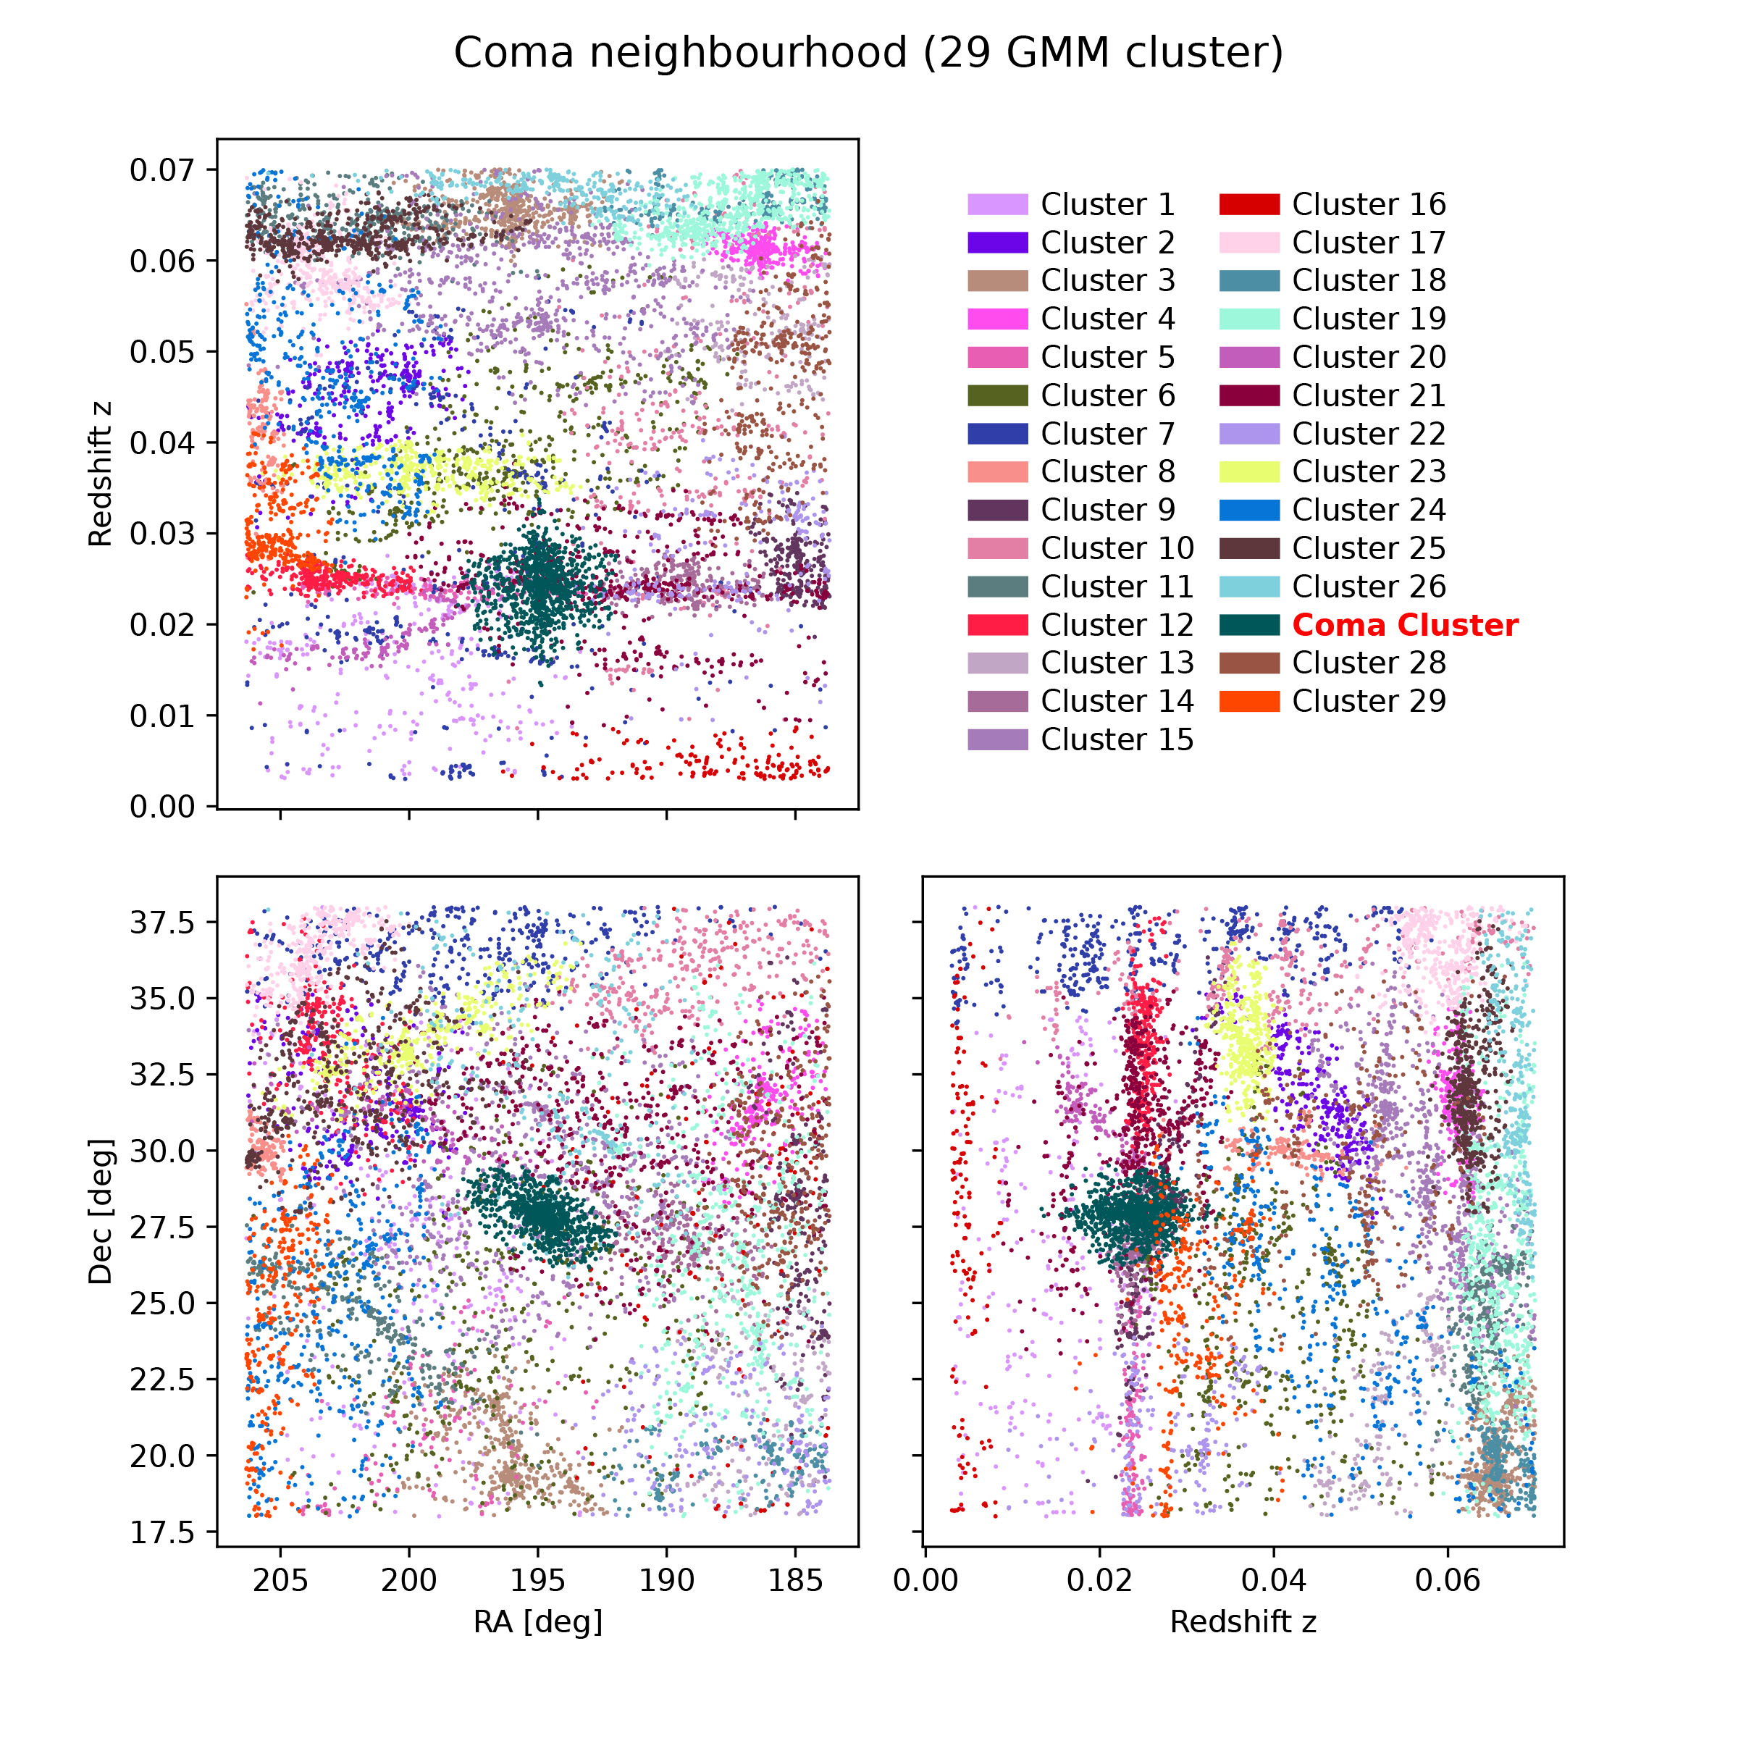
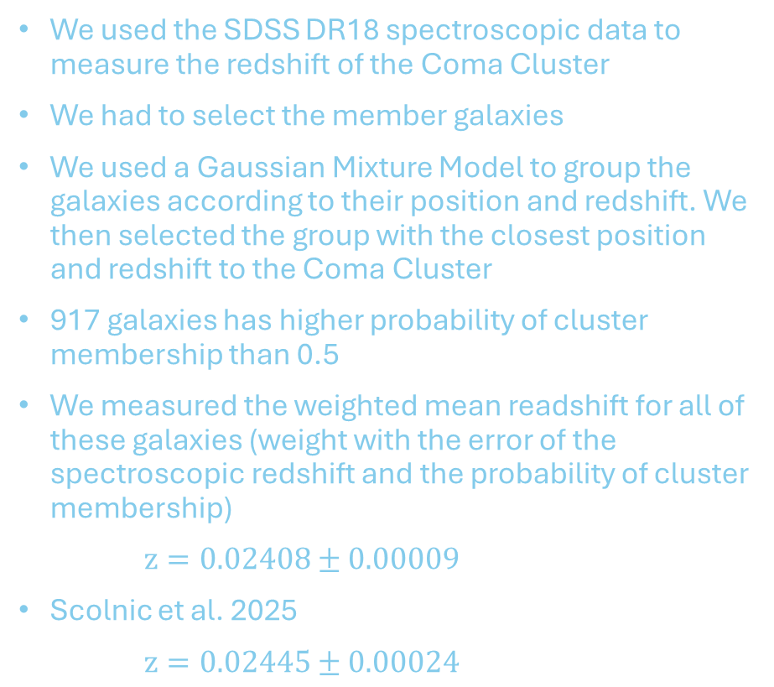
Redshift of the Coma Cluster
We used the SDSS DR18 spectroscopic data to measure the redshift of the Coma Cluster
We had to select the member galaxies
We used a Gaussian Mixture Model to group the galaxies according to their position and redshift. We then selected the group with the closest position and redshift to the Coma Cluster
917 galaxies has higher probability of cluster membership than 0.5
We measured the weighted mean readshift for all of these galaxies (weight with the error of the spectroscopic redshift and the probability of cluster membership)
$z=0.02408±0.00009$
Scolnic et al. 2025
$z=0.02445±0.00024$

Slide 11
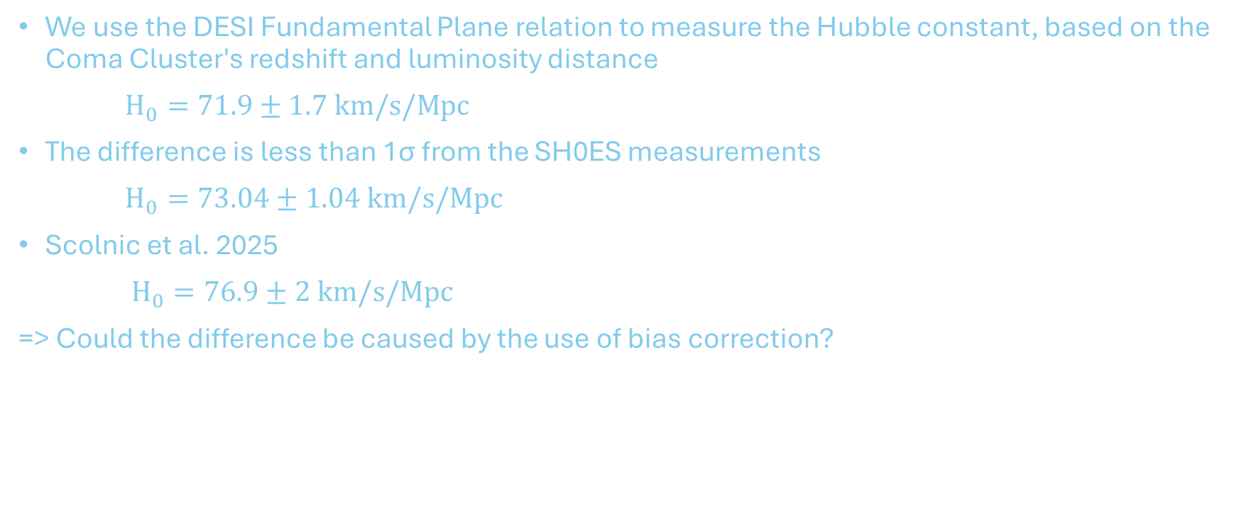
Hubble Constant
We use the DESI Fundamental Plane relation to measure the Hubble constant, based on the Coma Cluster's redshift and luminosity distance
$H_{0}=71.9±1.7 km/s/Mpc$
The difference is less than 1σ from the SH0ES measurements
$H_{0}=73.04±1.04 km/s/Mpc$
Scolnic et al. 2025
$H_{0}=76.9±2 km/s/Mpc$
=> Could the difference be caused by the use of bias correction?

Slide 12
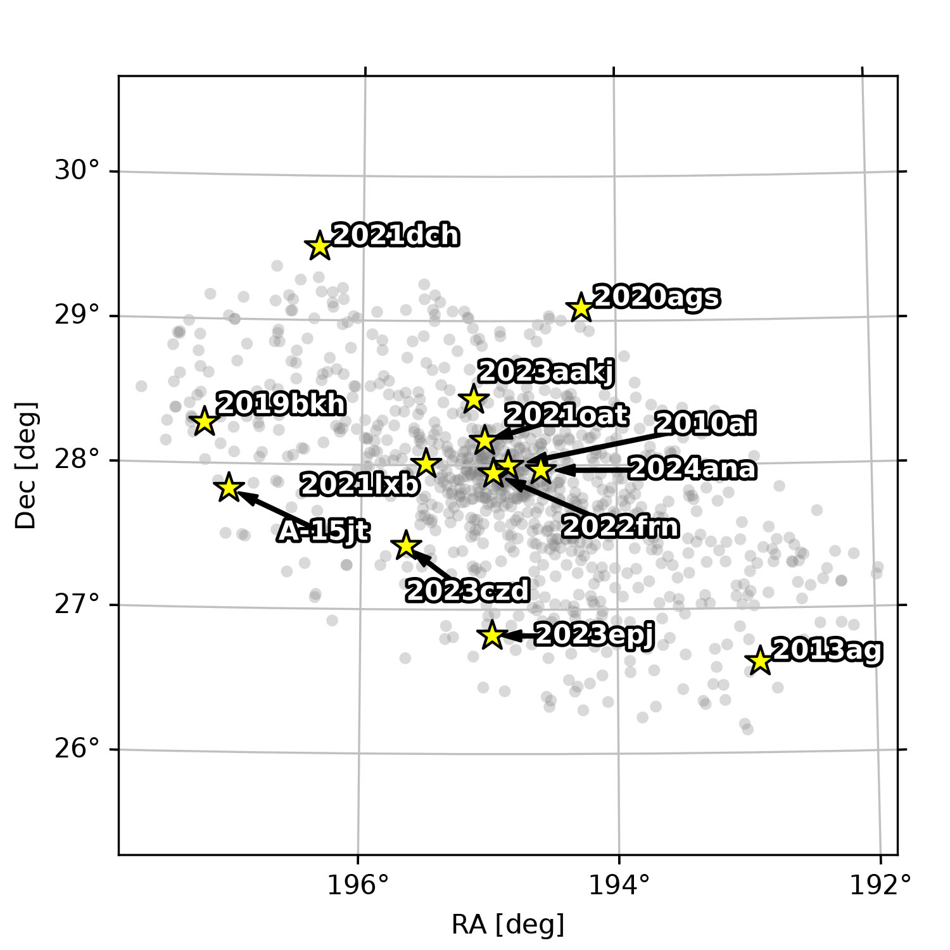
Summary
SN search in the Coma Cluster with the Schmidt telescope
Discovery of SN2025ilo
Photometric follow up with the RC80 robotic telescope
SALT3 light curve fitting in the combined data (Schmidt, RC80, ZTF, ATLAS, YSE)
Calculate redshift from SDSS DR18, select cluster member galaxies with GMM model
D_{L} = 102.3 ± 1.9 Mpc
z_{CMB} = 0.02408 ± 0.00009
H₀ = 71.9 ± 1.7 km/s/Mpc
Scolnic et al. 2025: H₀ = 76.9 ± 2 km/s/Mpc (Bias correction?)

