Slide 1



Complex radio jet in a distant blazar across two orders of magnitude in size: multi-frequency VLBI imaging of J1429+5406 at z~3
${\text{Koller} \text{D}\text{á}\text{vid}}^{ 1}$, ${\text{Frey} \text{S}\text{á}\text{ndor}}^{ 2}$, Cristiana Spingola $^{1}$MSc final year
$^{2}$Supervisor
ELTE
Notes:
Good morning, everyone my name is Dávid Koller, and I am currently a final-year astronomy master's student. My supervisor is Sándor Frey.
And lately we have been working on the analysis of a complex…
(My studies are based at ELTE.)

Slide 2
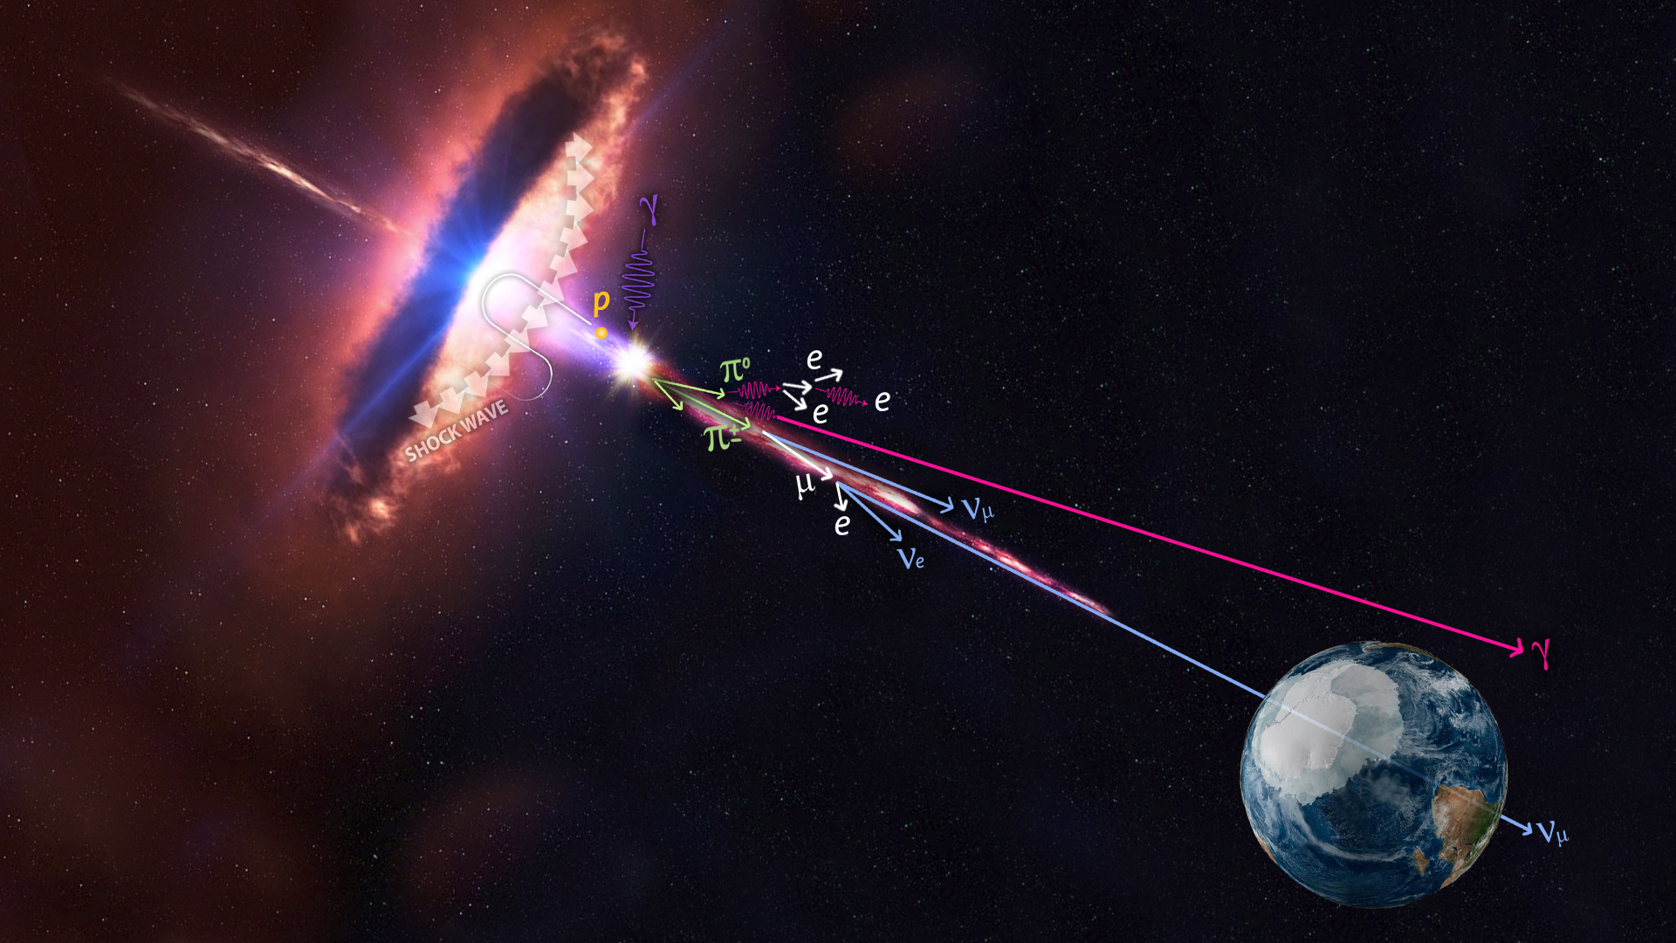
Blazars
Quasars with jets, viewed at an angle smaller than ∼10°
Superluminal motion and high brightness temperature
They are classified into two categories: BL Lac and FSRQ
Notes:
Firstly, let's look at what blazars are.
This figure is my favorite obviously not unrealistic illustration of blazars, which clearly shows us that we consider quasars to be blazars if we can see them from an angle of less than 10 degrees.
In addition, blazars are also characterised by superluminal motion and high brightness temperature.
They are categorized into two main types: BL Lac objects and flat-spectrum radio quasars (FSRQs). FSRQs exhibit strong and broad optical emission lines, whereas BL Lac objects have weak optical lines.

Slide 3

EVN and VLBA
EVN:
Eurasia and South Africa
Telescopes with diameters between 14 and 100 meters
Phase-reference calibration source → L- and C-band data
VLBA:
System of 10 telescopes
Identical antennas, 25 m diameter
Data location → Astrogeo
Notes:
The two main instruments that i worked with during my research are the EVN and VLBA.
The EVN network is spread over several continents. From here I used observations at the 1.7 GHz and 5 GHz frequency. Since J14 blazar was previously used as a phase reference calibration source in another measurement.
The VLBA network is a system of ten identical telescopes. Some of the VLBA data are uploaded to the astrogeo website, which is the source for the rest of the processed data except the measurements from 2024. These more recent observations, which I have been working on since this october, were part of Cristiana Spingola’s project.

Slide 4
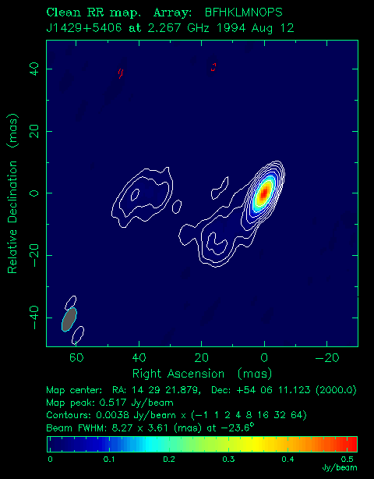
Brightness distribution modeling
Observations at six frequencies (0.4, 1.7, 2.3, 5, 8.4, 15 GHz) between 1994 and 2024
Fitting Gaussian components
Based on the determined core-jet distance (R) and position angles (𝜃), polar coordinates
𝜃
R
Notes:
After creating the clean maps, I modeled the brightness distribution; the investigated frequency bands are visible on the slide.
During the modeling, I fitted circular Gaussian components to the visibility data.
Based on this, the core-jet distances and position angles could be determined.
So this is the core jet distance, and this is the position angle measured from north to east.

Slide 5
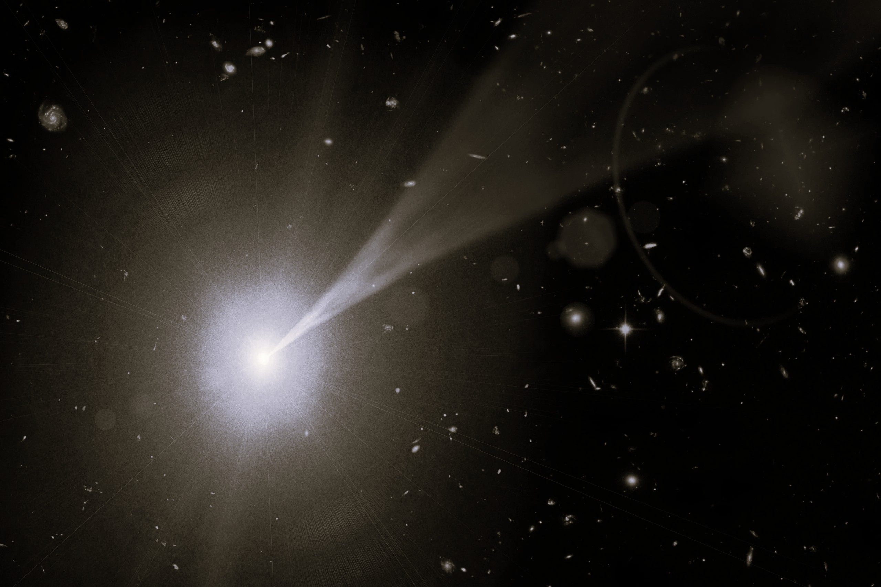
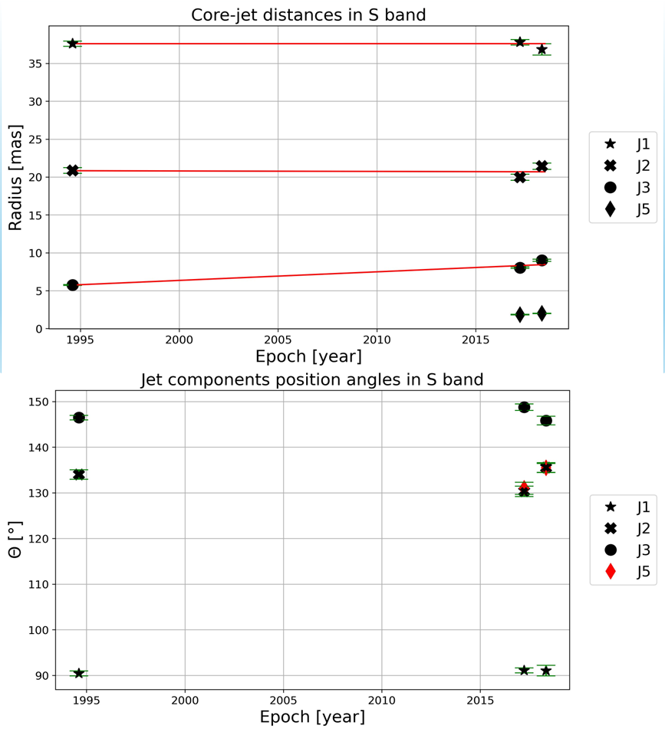
Proper motion at 2.3 GHz
Apparent proper motions:
J1: Not detected
J2: Not detected
J3: 𝜇₃ = (0.11 ± 0.02) mas/yr
Difference in position angle between J1 and J3 ~60 degrees
→ Interaction with interstellar gas
→ Change in the black hole’s spin axis
Notes:
Now lets look at what we have found previously.
At 2.3 GHz for the j1 and j2 components, no proper motion was detected. For the j3 component, however, proper motion was observed, but it can be fitted with smaller error at 8 GHz, thus making it the most reliable.
Additionally, we found, a bending of nearly 60 degrees in the jet. To explain the bending we assumed that this could be due to the interaction of the jet with interstellar gas or a change in the spin axis of the black hole.

Slide 6
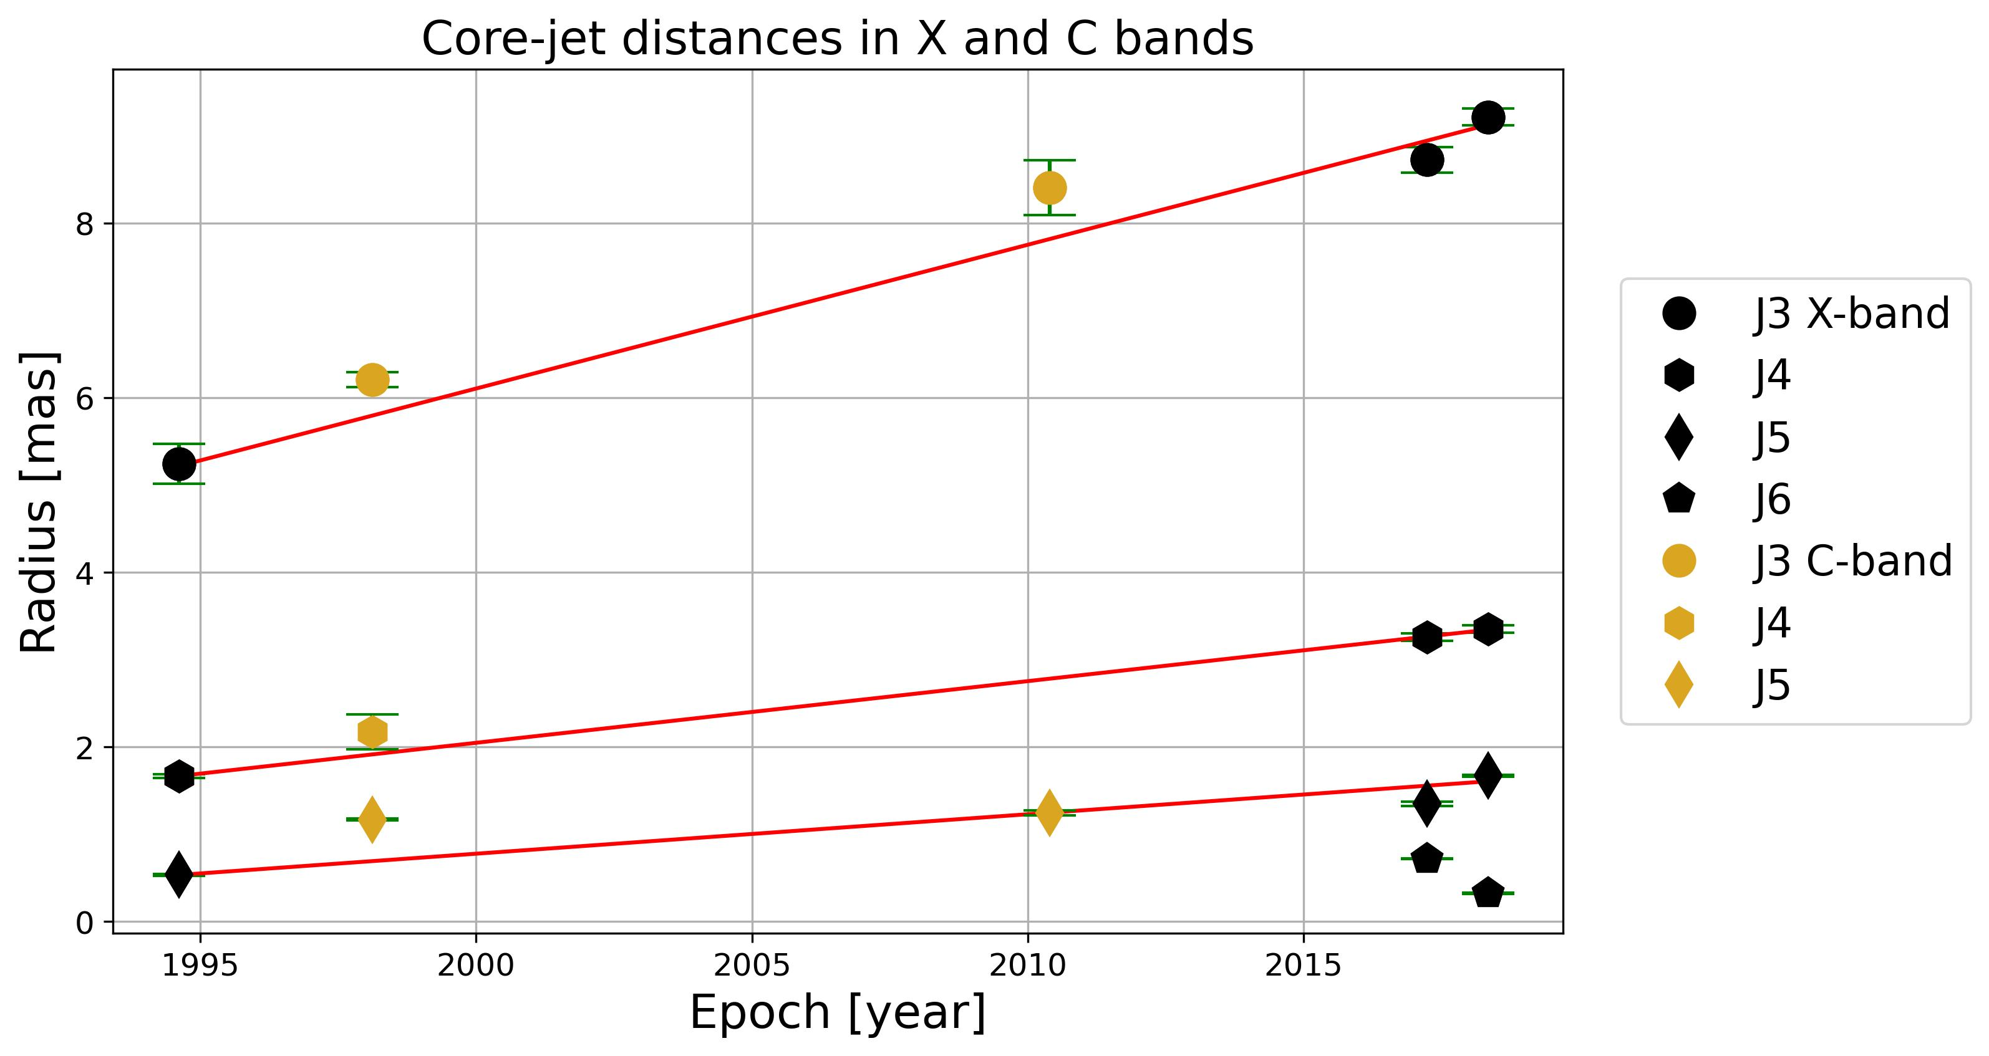
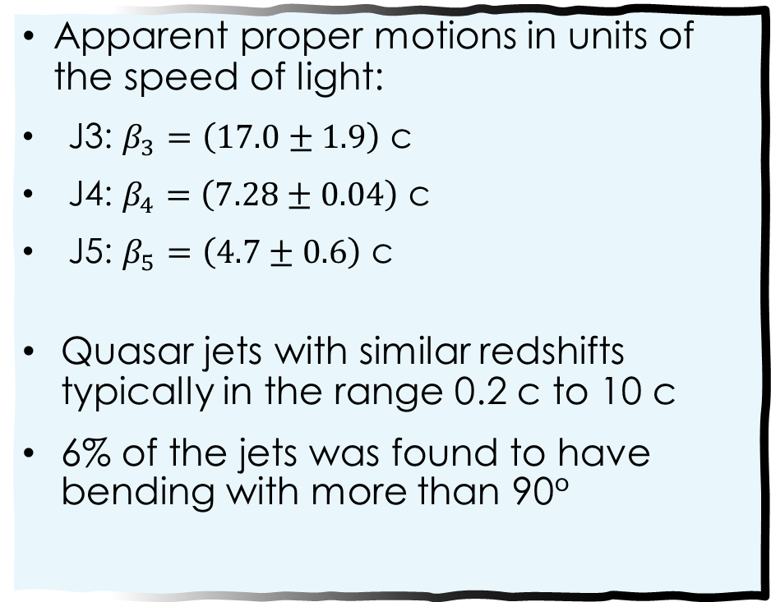
Proper motion at 8 GHz
Apparent proper motions in units of the speed of light:
J3: $β_{3}=\left(17.0±1.9\right)$ c
J4: $β_{4}=\left(7.28±0.04\right)$ c
J5: $β_{5}=\left(4.7±0.6\right)$ c
Quasar jets with similar redshifts typically in the range 0.2 c to 10 c
6% of the jets was found to have bending with more than 90°
(Guo et al; 2025)
Notes:
Based on the 8 GHz frequency data, three apparent proper motion could already be detected. These are shown on the slide converted to speed-of-light values. A study from 2025 suggests that the proper motions of jet components in sources with similar redshifts tipically range between 0.2c and 10c. Furthermore significant jet bendings are not uncommon at z ≥ 3. In the same study with a large sample, a significant fraction (6%) of the jets was found to have bending with more than 90◦

Slide 7
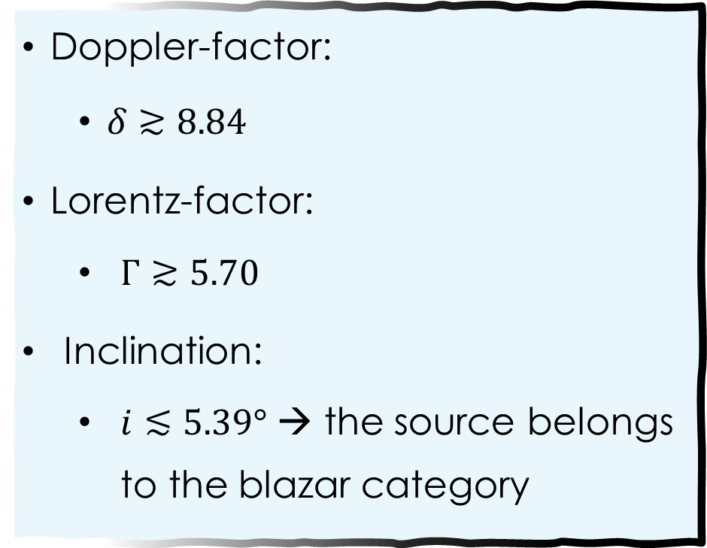
Inner Jet parameters
Doppler-factor:
$δ≳8.84$
Lorentz-factor:
$Γ≳5.70$
Inclination:
$i≲5.39°$ → the source belongs to the blazar category
Notes:
Among the three available epochs, only in one case was the core size larger than the minimum resolvable size of the interferometer. So I only provided lower and upper limits for the derived parameters.

Slide 8
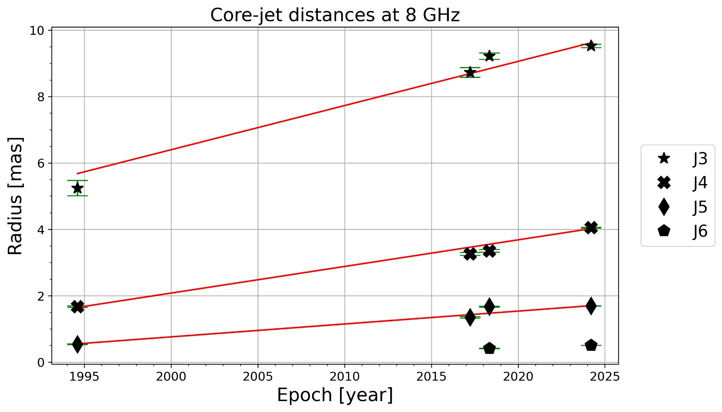
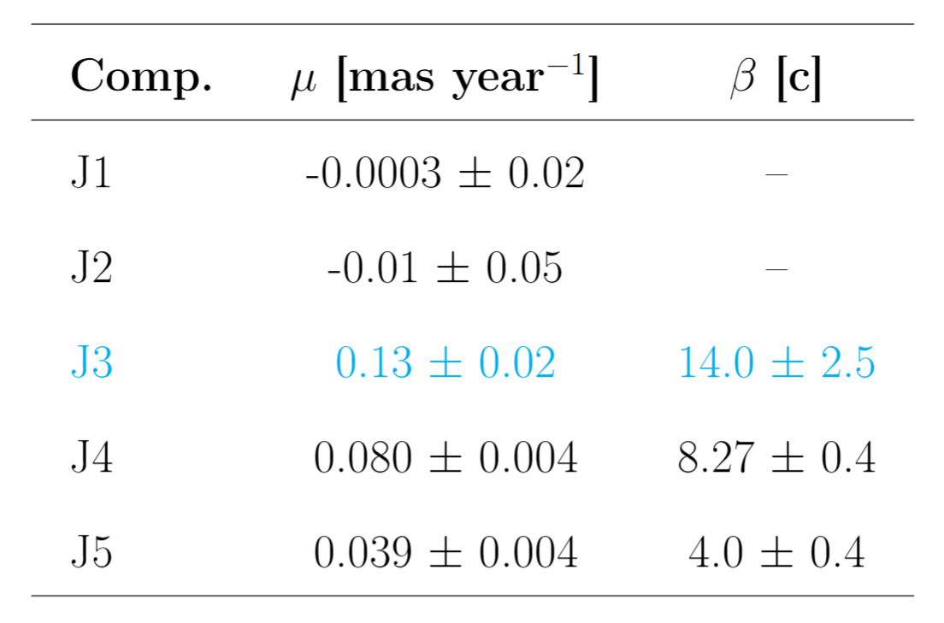
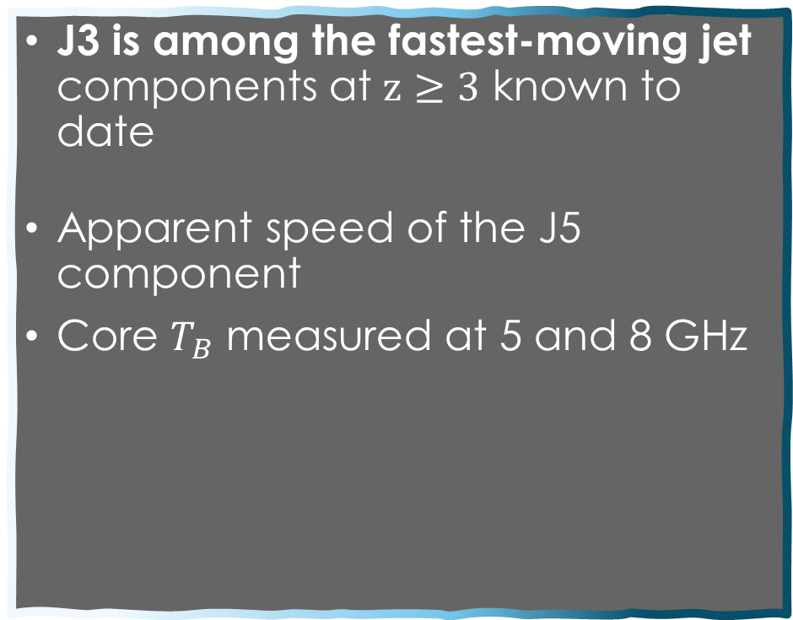
New results
J3 is among the fastest-moving jet components at $z≥3$ known to date
Apparent speed of the J5 component
Core $T_{B}$ measured at 5 and 8 GHz
Notes:
But recently with a new epoch i was able to refine these results. The new proper motions are shown on the slide converted to speed-of-light values. J3 component is among the fastest-moving….
For further calculations, I used the J5 component as the basis. Because it is the closest to the unresolved inner jet region, (to the core).

Slide 9
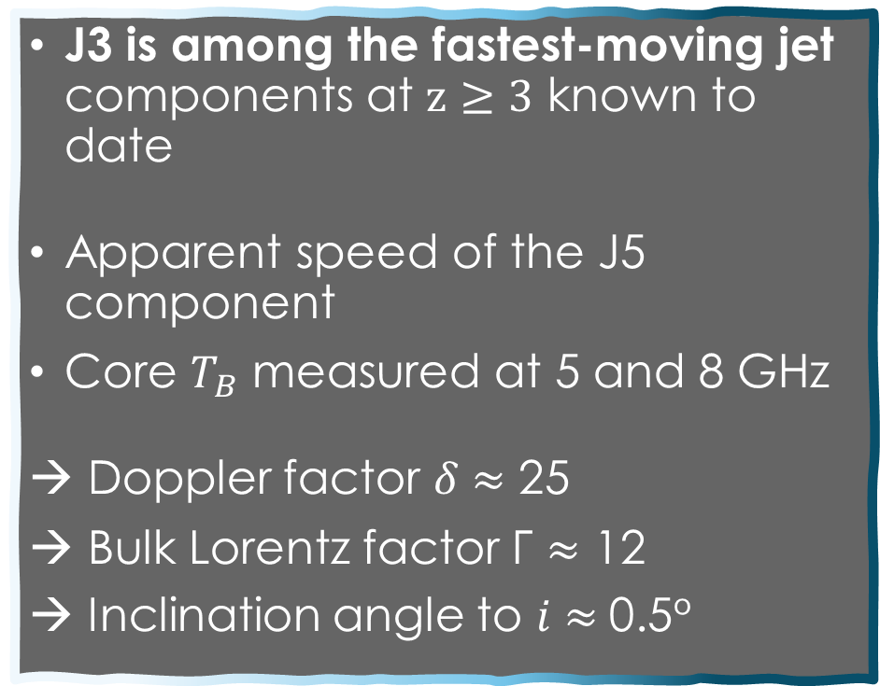
New results
J3 is among the fastest-moving jet components at $z≥3$ known to date
Apparent speed of the J5 component
Core $T_{B}$ measured at 5 and 8 GHz
→ Doppler factor 𝛿 $≈$ 25
→ Bulk Lorentz factor Γ $≈$ 12
→ Inclination angle to 𝑖 $≈$0.5°
Notes:
Based on this, the median values of the doppler factor, Lorentz factor and inclination are around 25, 12, 0.5 degree respectively. The new findings, based on three decades of observations, are consistent with our previous constraints on the physical parameters of the jet, derived from the first ~25 years of VLBI data.
These values suggest that there is no fundamental difference between jet physics at low and high redshifts, since the Lorentz factor is consistent with typical values found in low-redshift blazars

Slide 10
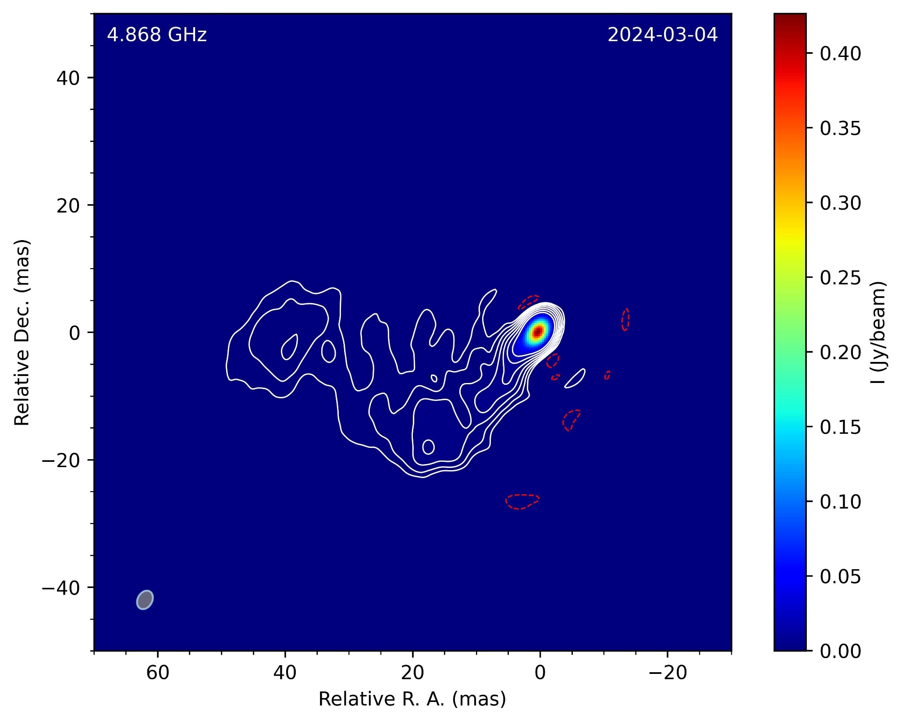
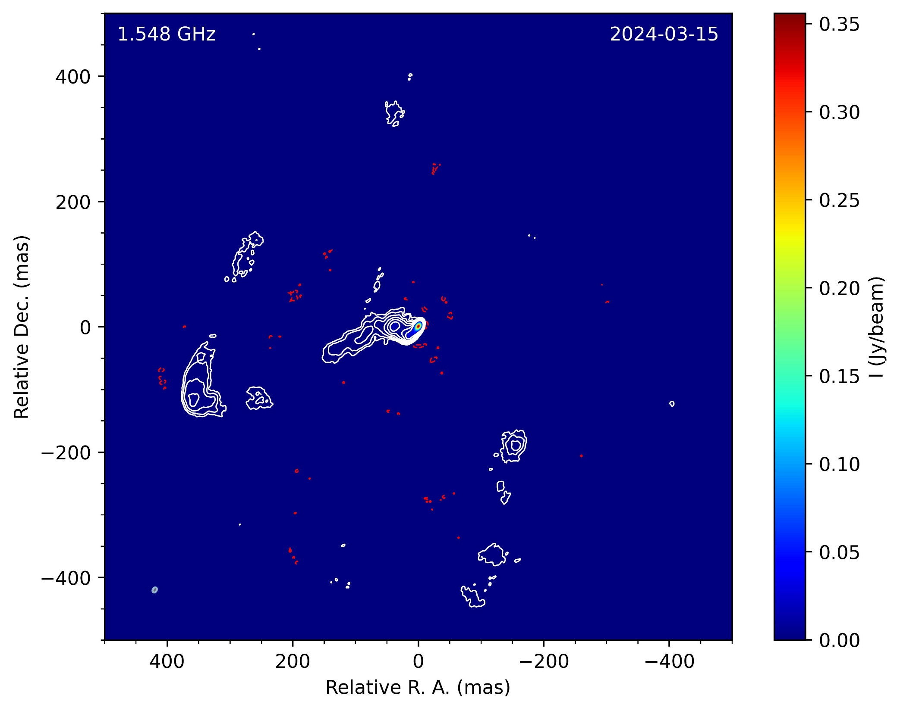
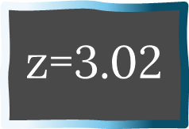
J1429+5406
$$\text{z}\text{=3.02}$$
Very Long Baseline Array (VLBA), project BS333
Very Long Baseline Array (VLBA), project BS333
J5, J6
J4
J1
J2
J3
80 pc
800 pc
Notes:
The image clearly shows a multi-component jet and a compact bright core region. Here are the identified components from our previous article. At high frequencies the outermost component is located nearly 40 mas from the core. Based on the distance of the object, this corresponds to about 315 pc. And this is what we have known about this source previously.
But… the recent high sensitivity measurements show an extended radio structure around the core, reaching up to ~400 mas which is rarely, if ever, seen in a high-redshift blazar. And this extended structure becomes more prominent at lower frequencies.

Slide 11
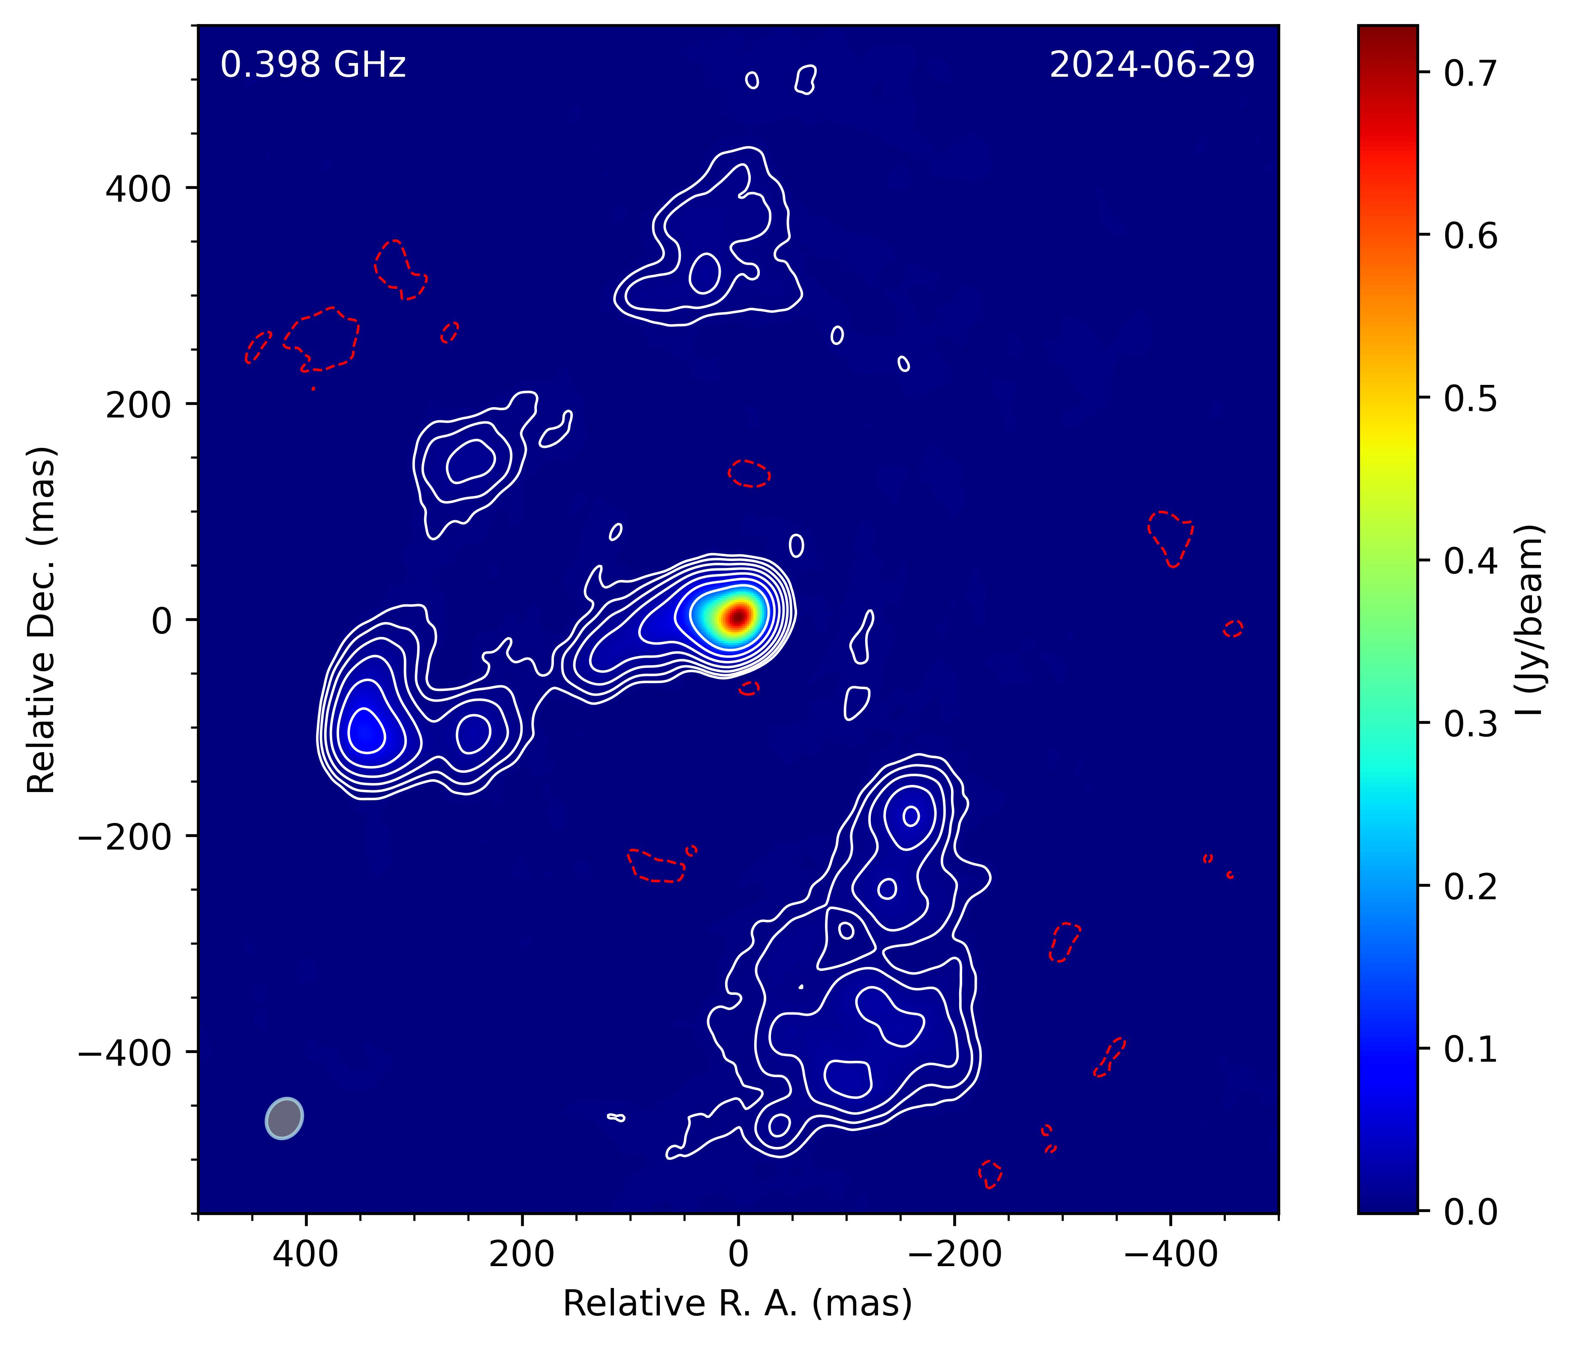
Notes:
The clean map created at 0.4GHz is shown here. The previously known inner 40 mas stucture is unresolved here.

Slide 12

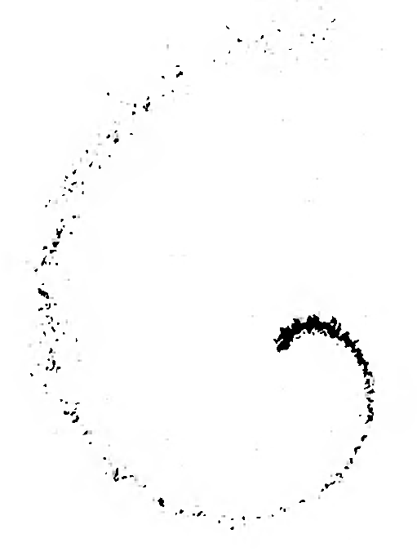
Jet precession
Ann, C., Gower, et al. (1982)
Notes:
Here are the observations and a theoretical model for a precessing jet from 1982 assuming 0 degree inclination, 20 degree opening angle and high proper motions.
Based on the similarity between them the structure may indicate a precessing jet.
I have been modelling this precession lately, to constrain its geometry.

Slide 13
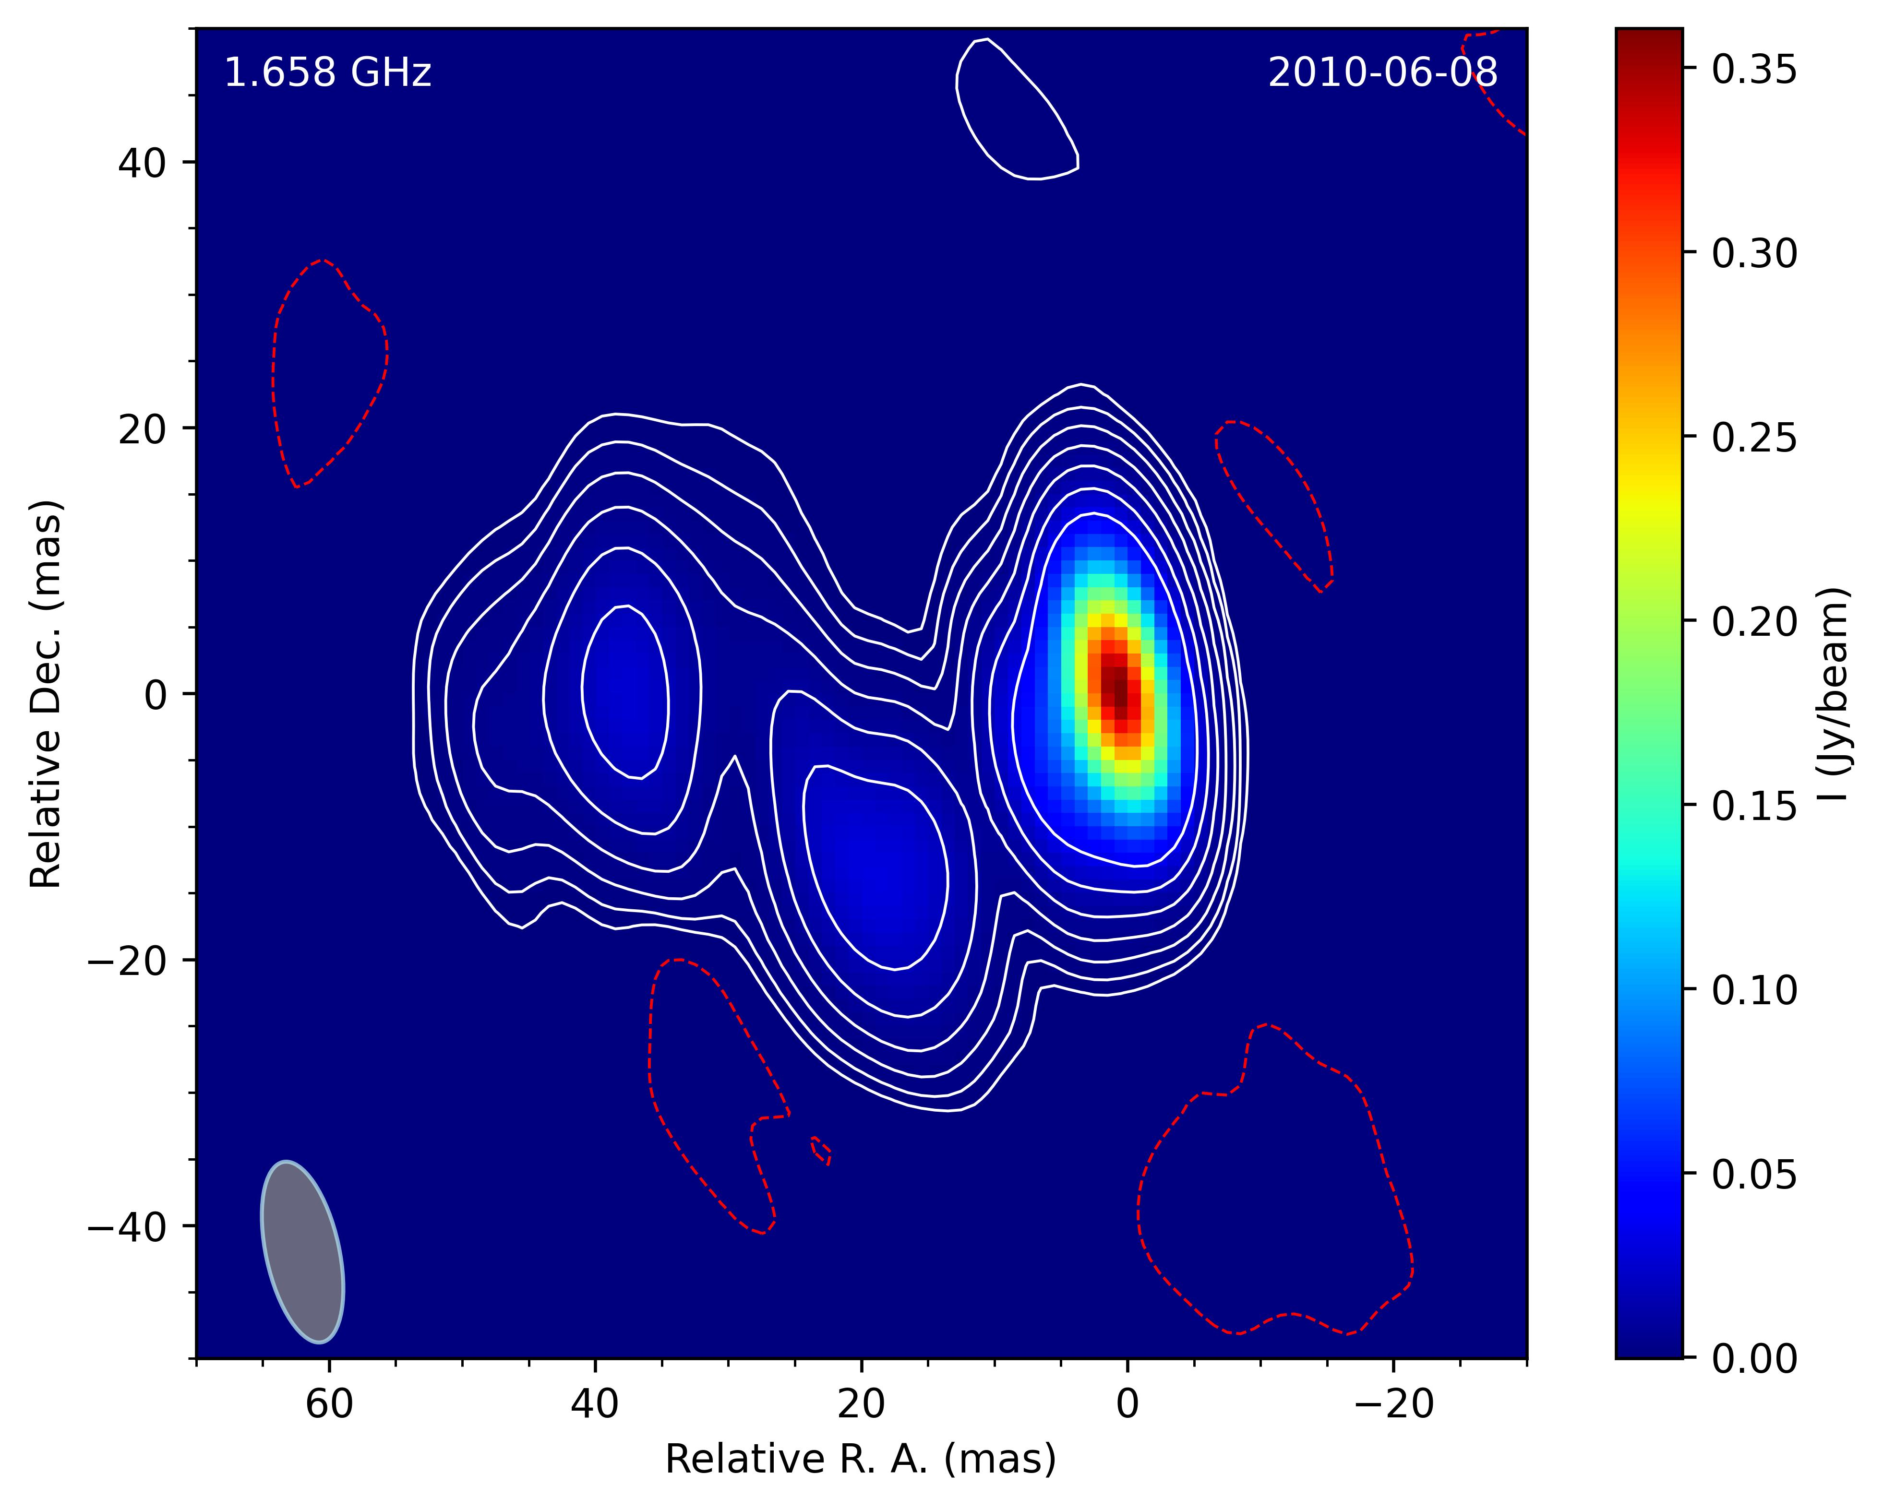
„Outside the box”
Notes:
Nevertheless, what we saw here indicates a ‘blind spot’ inherent in the current standard data‑processing methods.
This figure shows the reduction of the 2010 L‑band observation using the standard procedures.
It is evident that, compared to the structure we previously analyzed, there is no sign of any additional extended emission. Just noise patches.

Slide 14
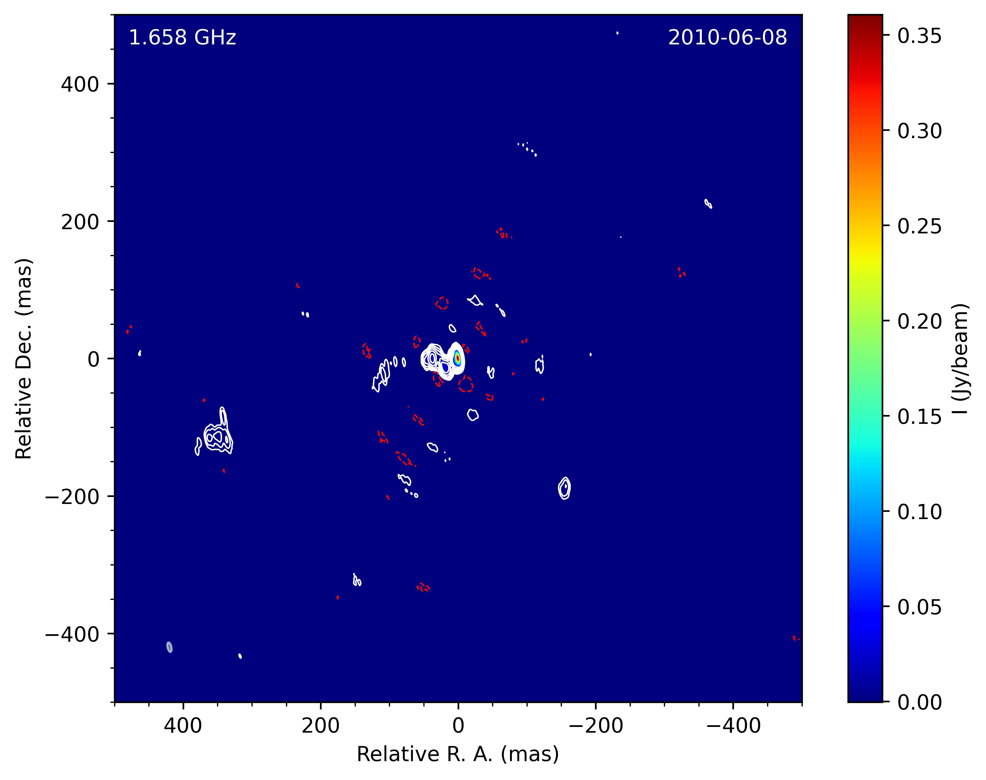

„Outside the box”
Notes:
However, with our new knowledge in hand, a mapping performed under the assumption of a 400‑mas‑scale structure reveals a very different picture. Here you can see the traces of the extended structure, which—naturally—match precisely what appears in the later, more sensitive map.
All of this suggests that interesting features may still be hidden in the resolution gap between smaller telescope systems (like VLA) and large interferometers (like EVN and VLBA). Therefore, when processing VLBI data, it may be worthwhile to examine the available field of view beyond the narrow 50–100 mas scales.

