Slide 1
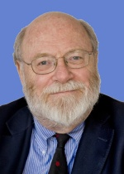
Constituents, Currents, Colour … and Cashmore
Cashmore @ 70
Oxford
30 June 2015
John Dainton
University of Liverpool, UK

Slide 2
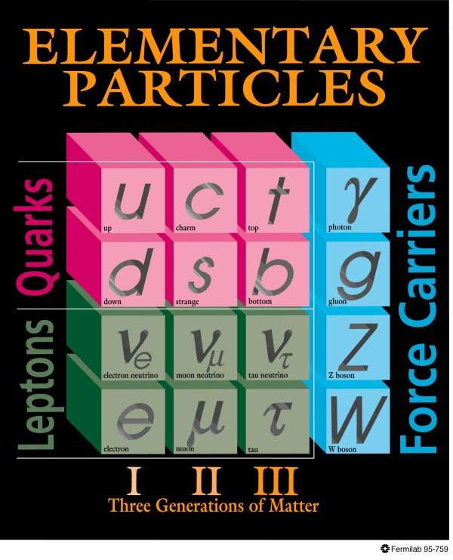
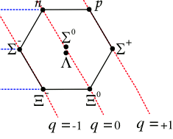
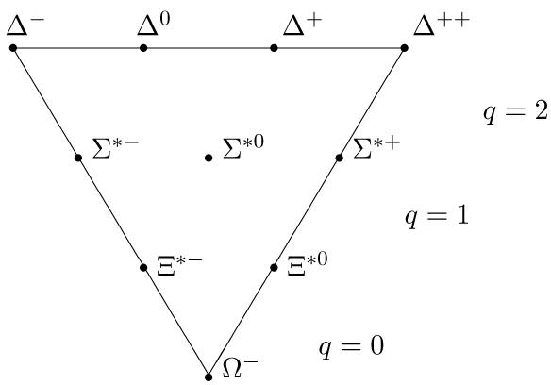
Constituents @ Oxford 1970
Cashmore @ 70
Oxford
30 June 2015
mass ? GeV
Dalitz
“Three quarks for Muster Mark!”
James Joyce “Finnegans Wake”
“The Eightfold Way”
SU(3)_{F}
M Gell Mann, G Zweig
mass ? GeV
• 3 quarks for a proton
uud → 938 MeV = ?
and resonances ?
down
• sub-femtoscopic matter
= Dirac fermions (uds +eν/μν)?
• strong, EM, weak: Fermi+unitarity = W?
Perkins “B” 1969

Slide 3
Constituents @ Oxford 1970
Cashmore @ 70
Oxford
30 June 2015
“… This allows one to set a lower limit M_{q} > 5 GeV on the quark mass.”
“(The quark) model is non-relativistic. The quarks supposed extremely massive, and bound in a deep potential well W by the superstrong forces, so as to yield the physical masses M_{q} = 2M_{u/d} + M_{d/u} – W. … So the quarks are in non-relativistic motion.”
Donald H Perkins
Lectures on “Particle Physics” Final Honour Schools
Distributed notes: Nuclear Physics B Oct-Dec 1968
and “Introduction to High Energy Physics” (Addison Wesley 1972)
pp. 248 and 249
Oxford 1970: setting the stage for the quark era

Slide 4
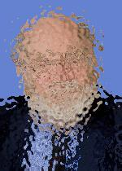
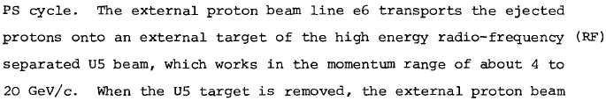

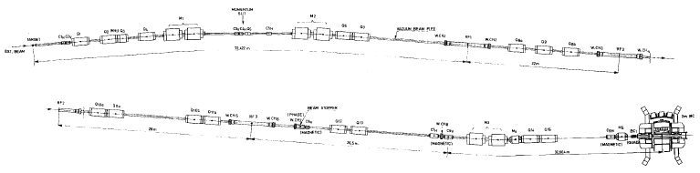


Constituents:
Cashmore’s Shadow
Cashmore @ 70
Oxford
30 June 2015
• 1969 strange resonances in Oxford
-“Cashmore would have …”^{Bowler} and he had!
K⁺ 3.72γ = 37 m @ 5 GeV!
… and the experiment still worked
… and the shadow became reality

Slide 5
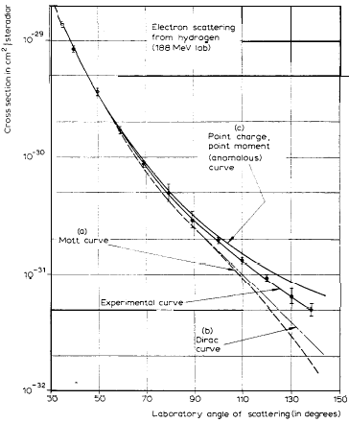
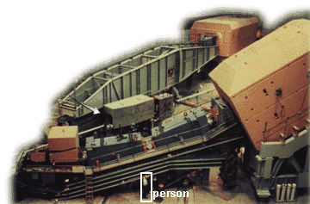
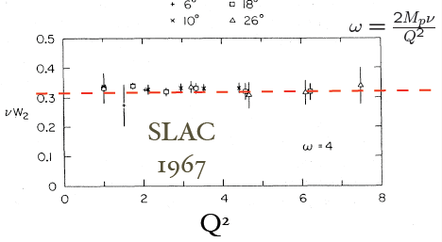
Constituents
Cashmore @ 70
Oxford
30 June 2015
● SLAC end station:
- 1959 nucleus size
nucleon size
- 1967 quarks
dσ /dΩ
(cm²ster⁻¹)
Hofstädter
Friedman Kendall Taylor
Proposal:
“A general survey of the basic
cross sections which will be
useful for future proposals”
1
x
=
F₂
e
p
γ
1
x
=
q
Q² (GeV²)

Slide 6
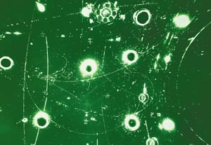
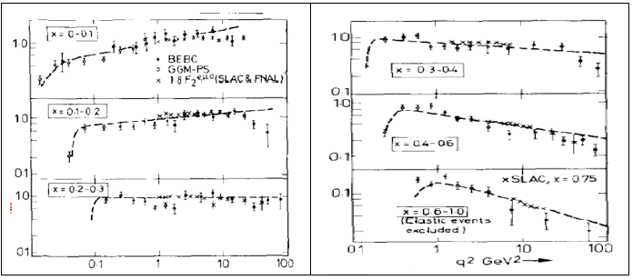
Constituents
Cashmore @ 70
Oxford
30 June 2015
μ
μ
ν
● CERN + Fermilab
- fixed target
- sub-fm (Q² ≤ 20 GeV)
- 1972 weak NC
1977 QCD
ν
●
fixed
target
CERN (Perkins et al.)
Fermilab
e
ν
●
●
F₂
+
●
●
μ
μ
●
+
●

Slide 7
Constituents and Currents
Cashmore @ 70
Oxford
30 June 2015
• the Standard Model landscape
lepton
γ Z W
electroweak
quark
Higgs
g
VB Mass 0 80 91 GeV
chromodynamics
γ Z W
lepton mass 0.1 0.5 5 GeV
EW+colour
• matter = Dirac fermions
force = colour, charge, gauge bosons

Slide 8
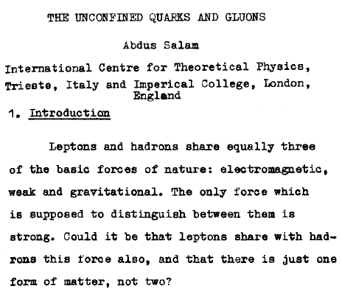
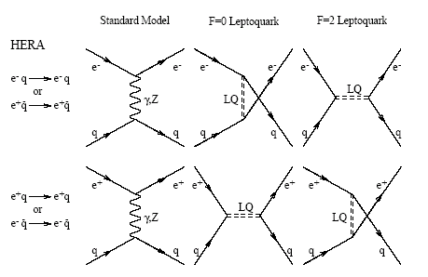
Why Leptons and Quarks ?
Cashmore @ 70
Oxford
30 June 2015
● how are leptons and quarks related ? (1976)
Q
|Re + new physics|² ?
F=0,2
F=0,2
ICHEP76 Tbilisi
● precision SM template for new physics

Slide 9
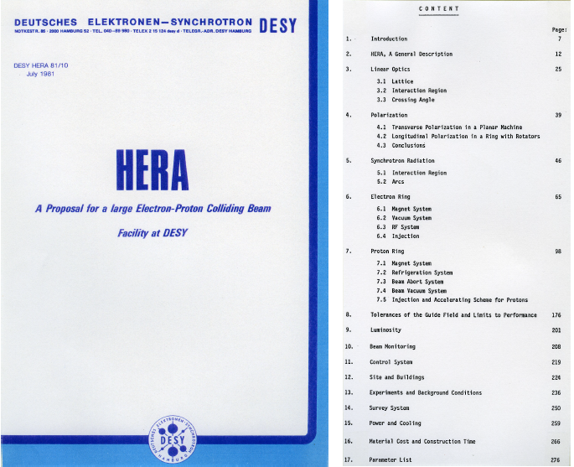
Why Leptons and Quarks ?
Cashmore @ 70
Oxford
30 June 2015

Slide 10
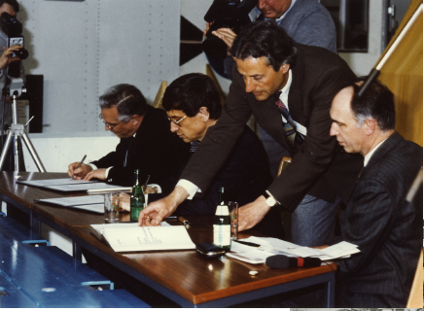
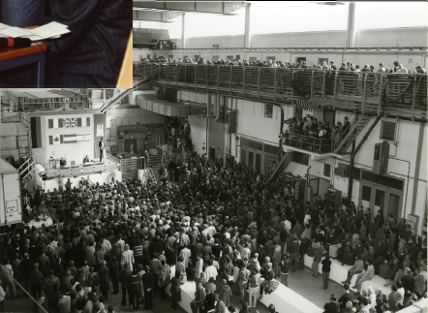
Why Leptons and Quarks ?
Cashmore @ 70
Oxford
30 June 2015
JBD?

Slide 11
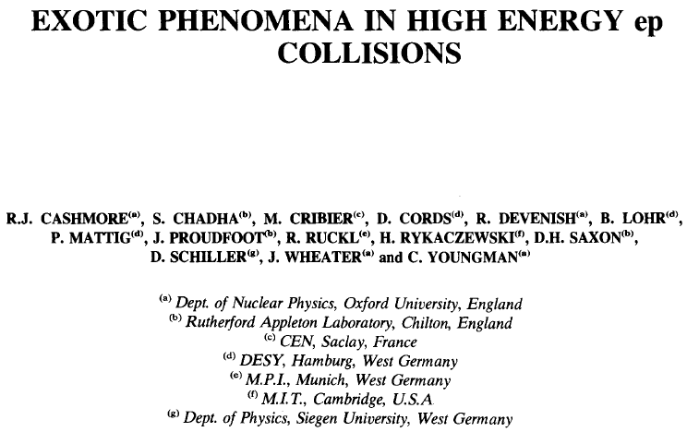
Why Leptons ↔ Quarks ?
Cashmore @ 70
Oxford
30 June 2015
Physics Reports 22 (1985) pp 275-386

Slide 12
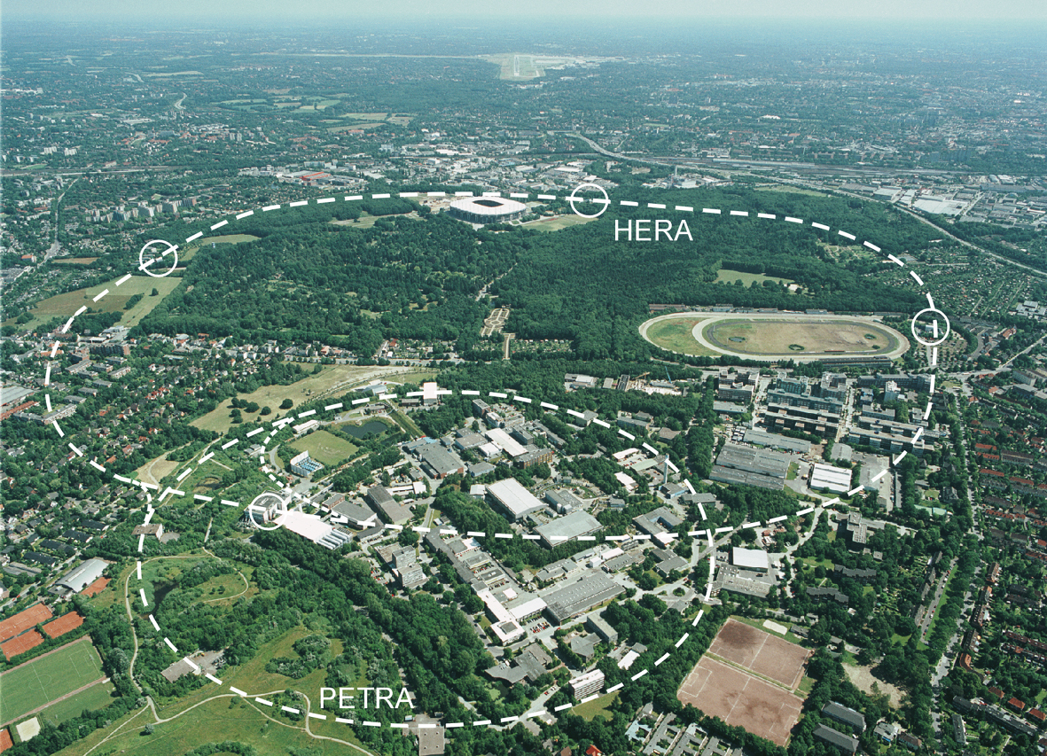

A precision Fermiscale ep Collider HERA @ DESY
Cashmore @ 70
Oxford
30 June 2015
• challenge: different particle species ep in collision
27.6 GeV electrons + 920 GeV protons
uud +sea
ep cm energy 314 GeV
lepton
Hermes
HERA
DESY
Hamburg
electrons
H1
ZEUS
HERA
+
protons
1992-2007
RIP

Slide 13
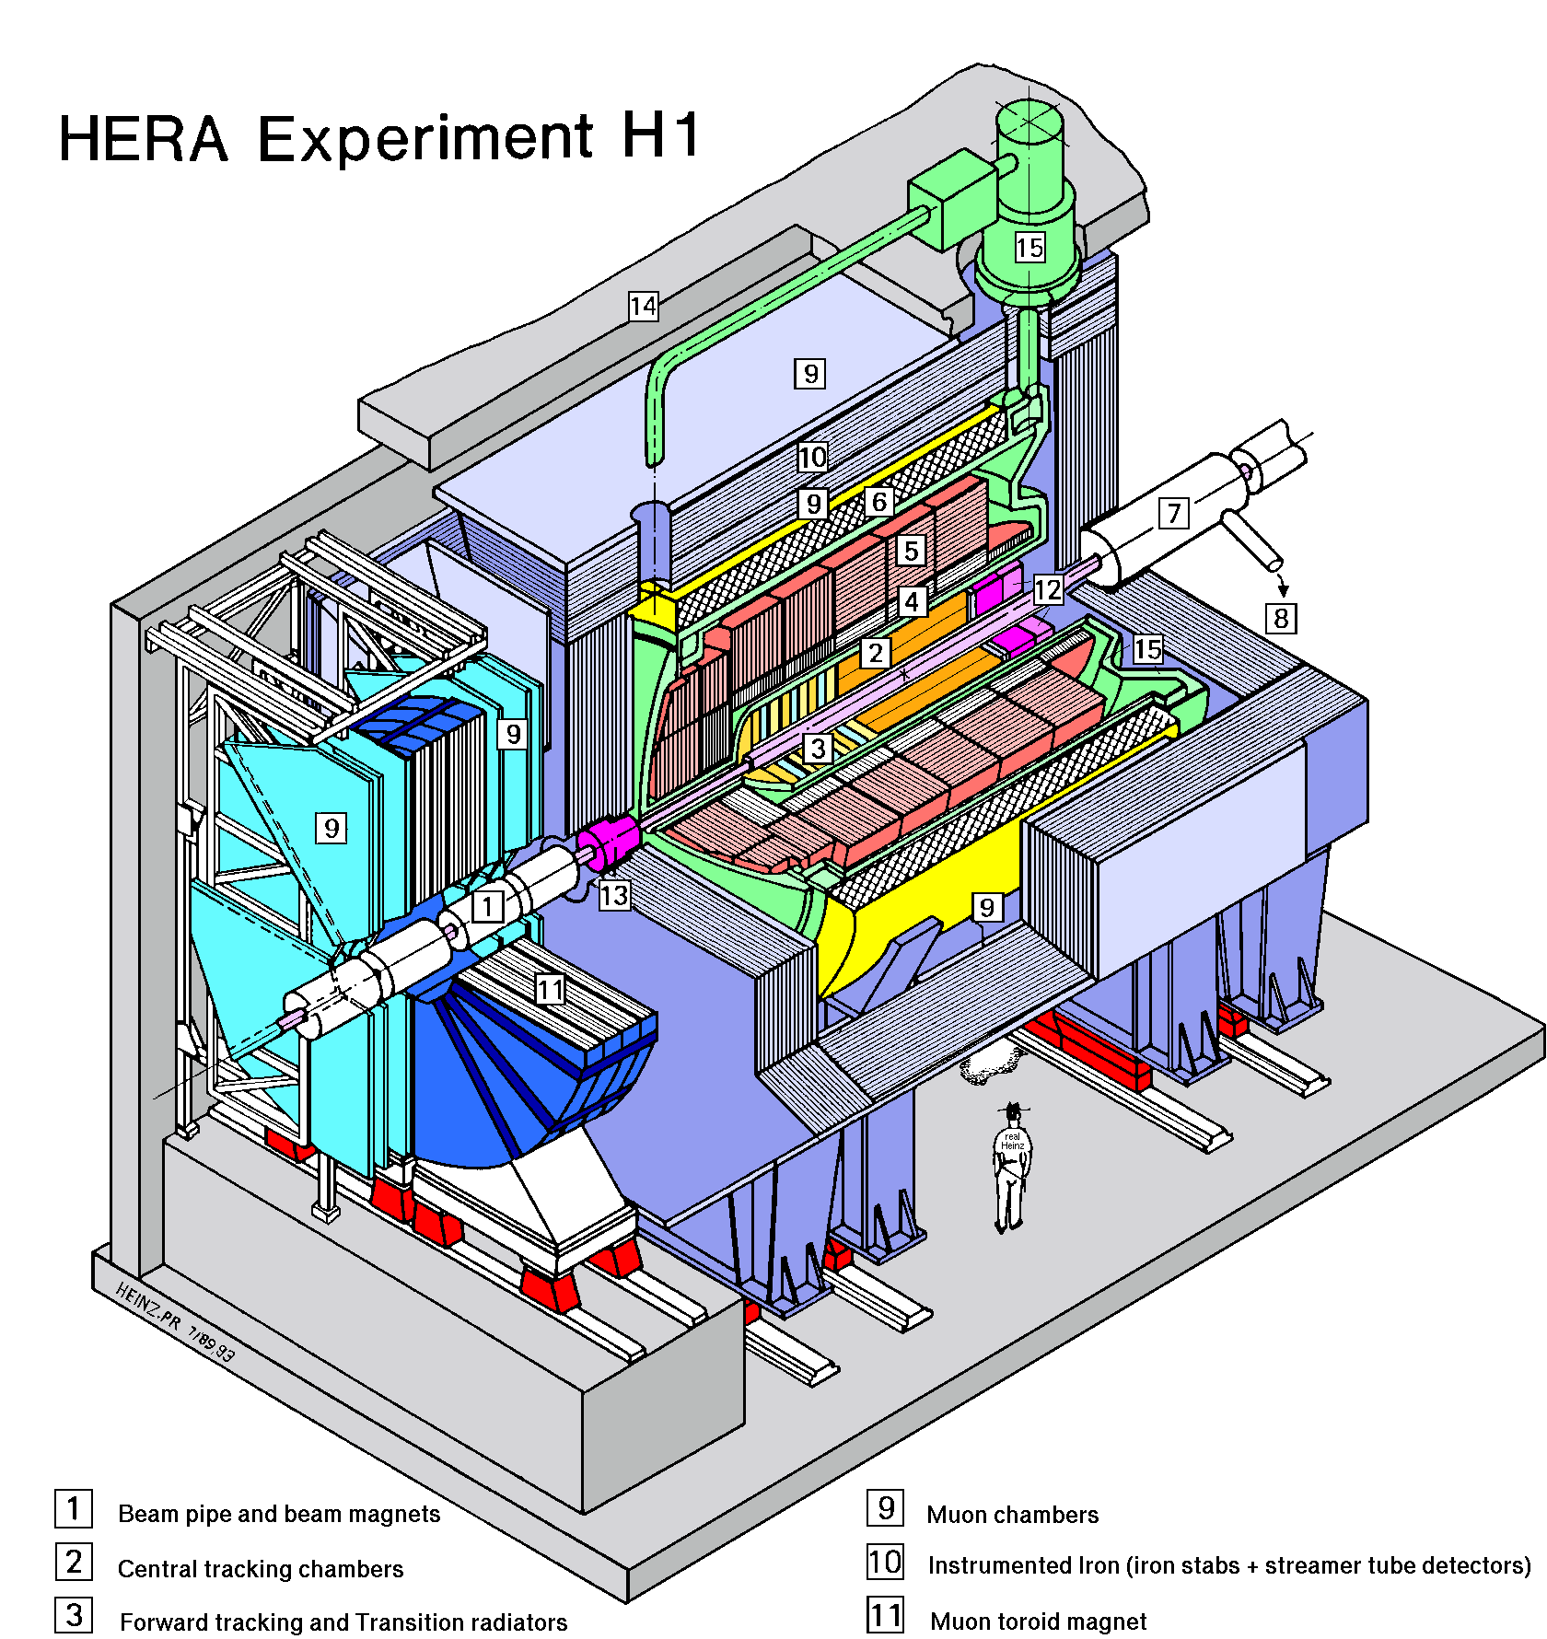
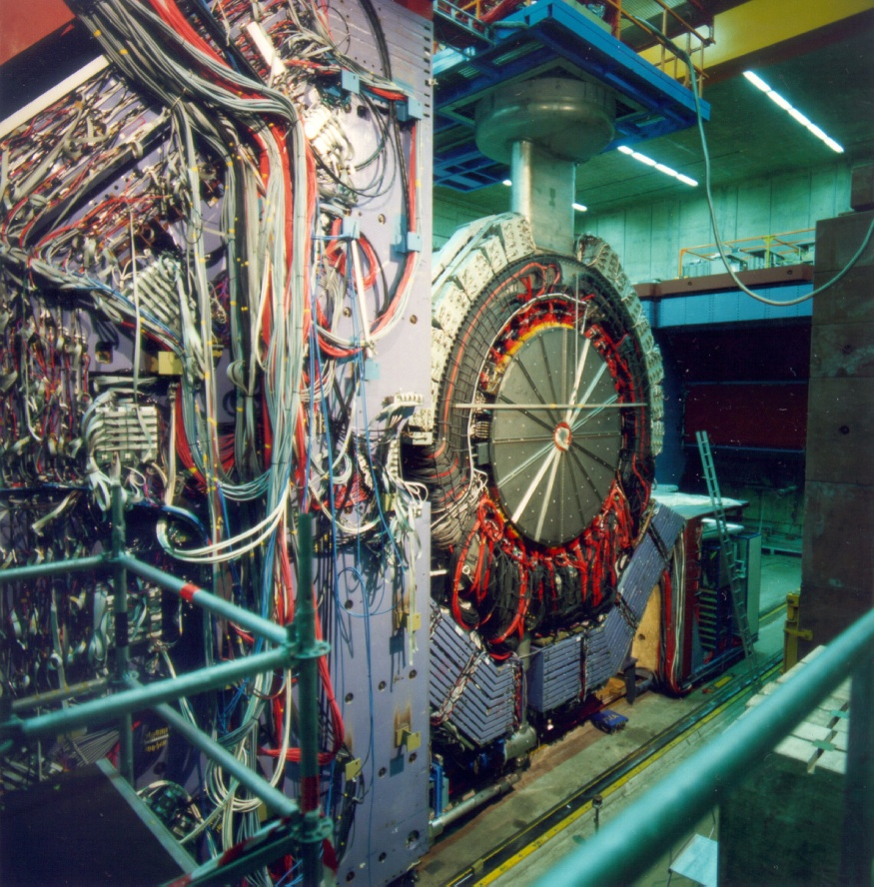
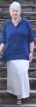
A Precision Fermiscale Experiment @ HERA
Cashmore @ 70
Oxford
30 June 2015
protons
920 GeV
electrons
27.6 GeV
electrons
27.6 GeV
• asymmetric e and p
• many bunch Δt_{ep} = 75 ns
• p_{T} scale ~ 300 GeV (Fermi)

Slide 14
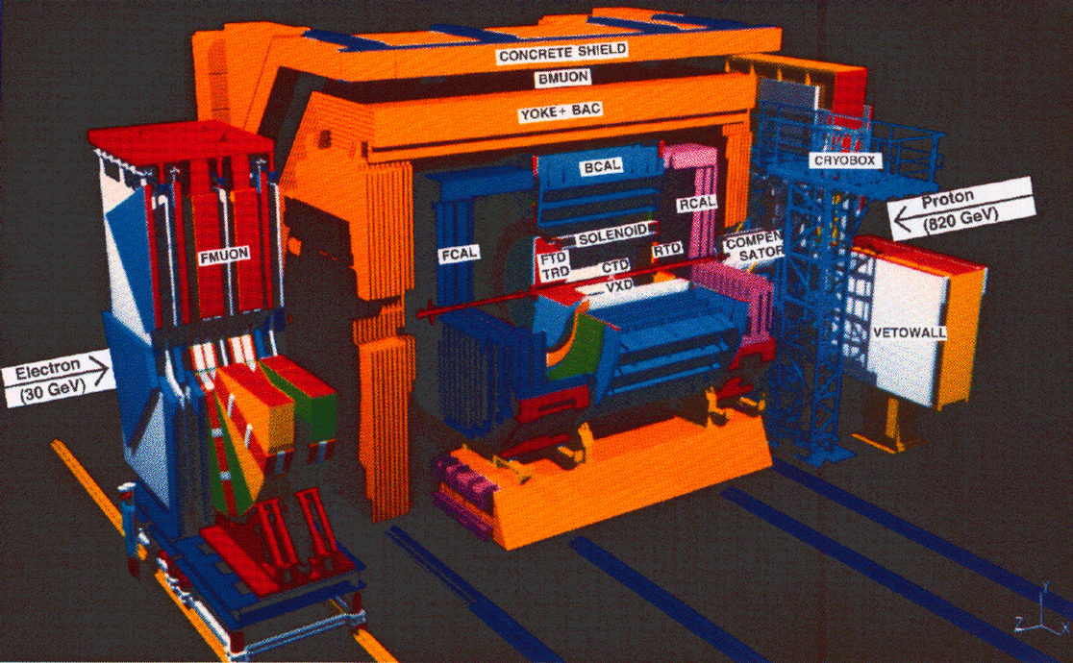
Another Precision Fermiscale Experiment @ HERA !
Cashmore @ 70
Oxford
30 June 2015
Oxford Zeus

Slide 15
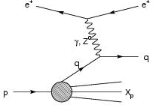
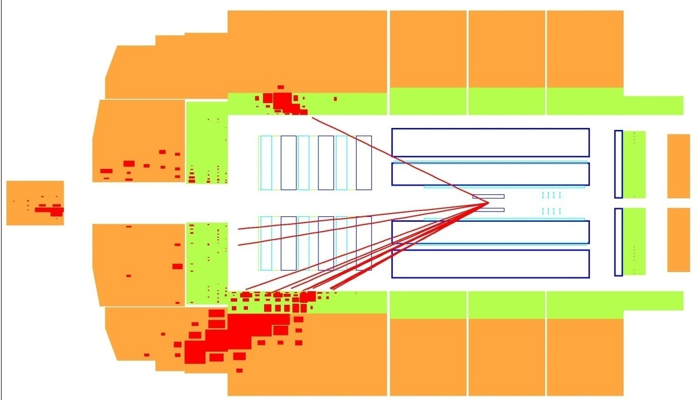
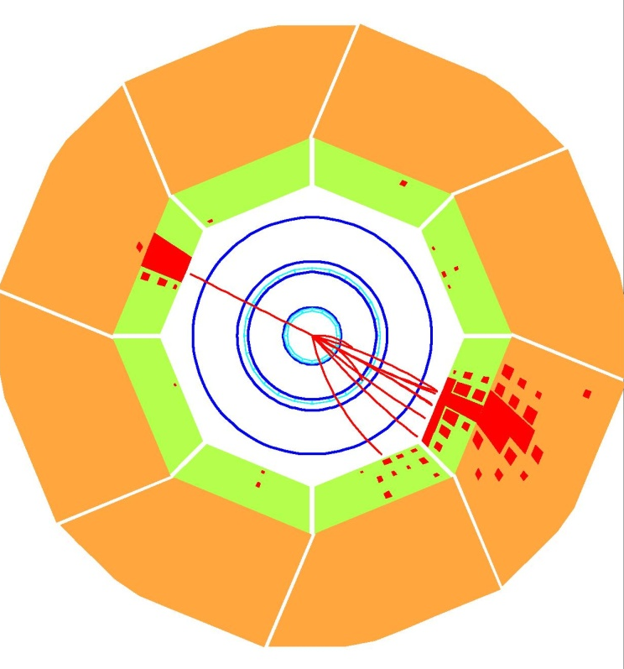
Constituents with Currents
Cashmore @ 70
Oxford
30 June 2015
• >1992: Rutherford scattering at the Fermi scale
e
e
+ … ?
γ
Z⁰
q
q
F₂
F_{L}
electron
electron
← → stored high energy beams
electron
proton
jet
quark
jet=quark

Slide 16
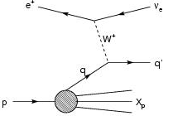
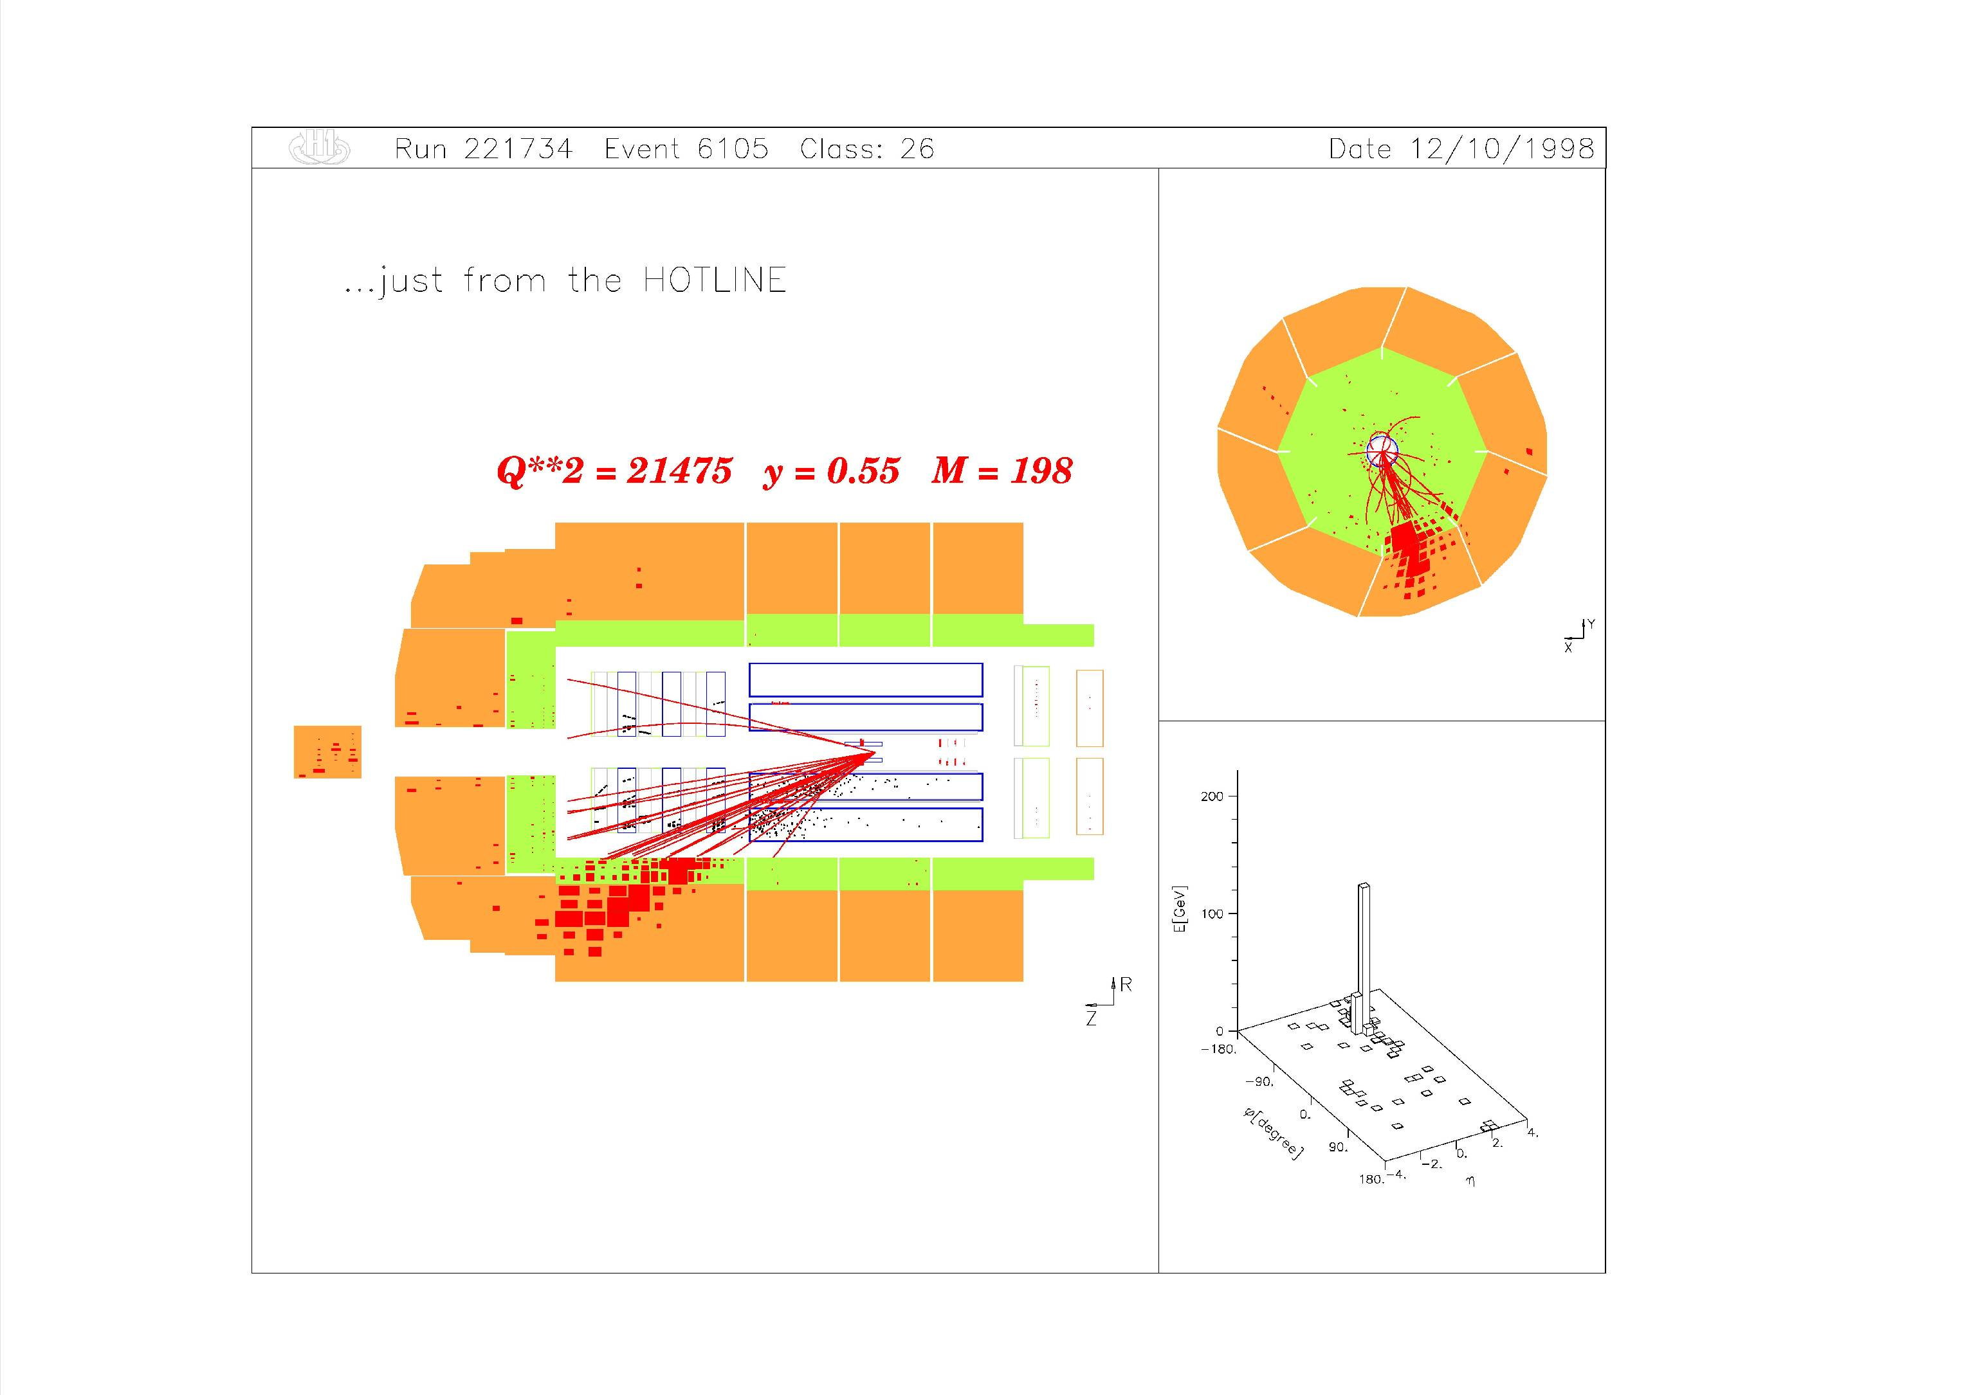
Constituents with Currents
Cashmore @ 70
Oxford
30 June 2015
• >1992: inside Fermi’s β-interaction
e
●
ν
q
q
ν
+ … ?
e
xF₃
W±
≤ am
q
q
quark
jet
jet=quark

Slide 17
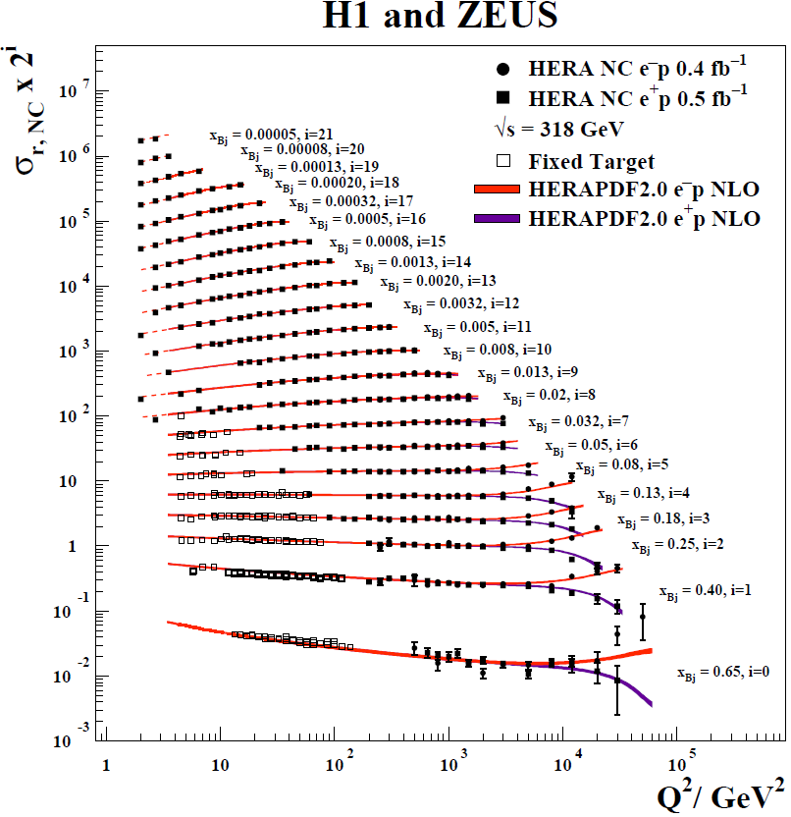
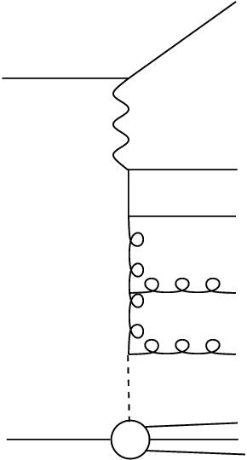
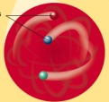
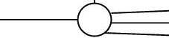
Constituents with Currents
Cashmore @ 70
Oxford
30 June 2015
e
e
Q²
x_{Bj}
+
e
e
γ
Z⁰
q
q
+
colour
driven
γ
Z⁰
+
γ
Z⁰
+
valence
driven
probe 70 fm 20 am 7 am 2 am

Slide 18
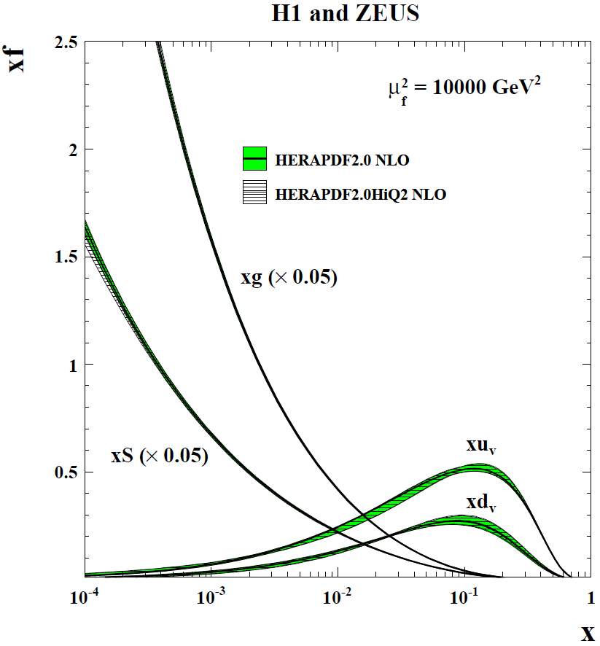
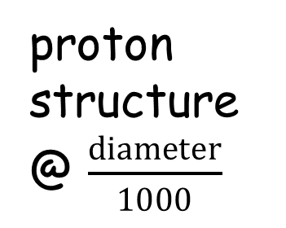
Constituents with Currents
Cashmore @ 70
Oxford
30 June 2015
e
e
NLO μ² = 10000 GeV²
probe @ 2 am (Fermi)
Q²
e
e
x_{Bj}
γ
Z⁰
+
q_{v}
q
+
γ
Z⁰
colour
driven
+
γ
Z⁰
+
proton structure @ $\frac{diameter}{1000}$
valence
driven
fraction of proton momentum

Slide 19
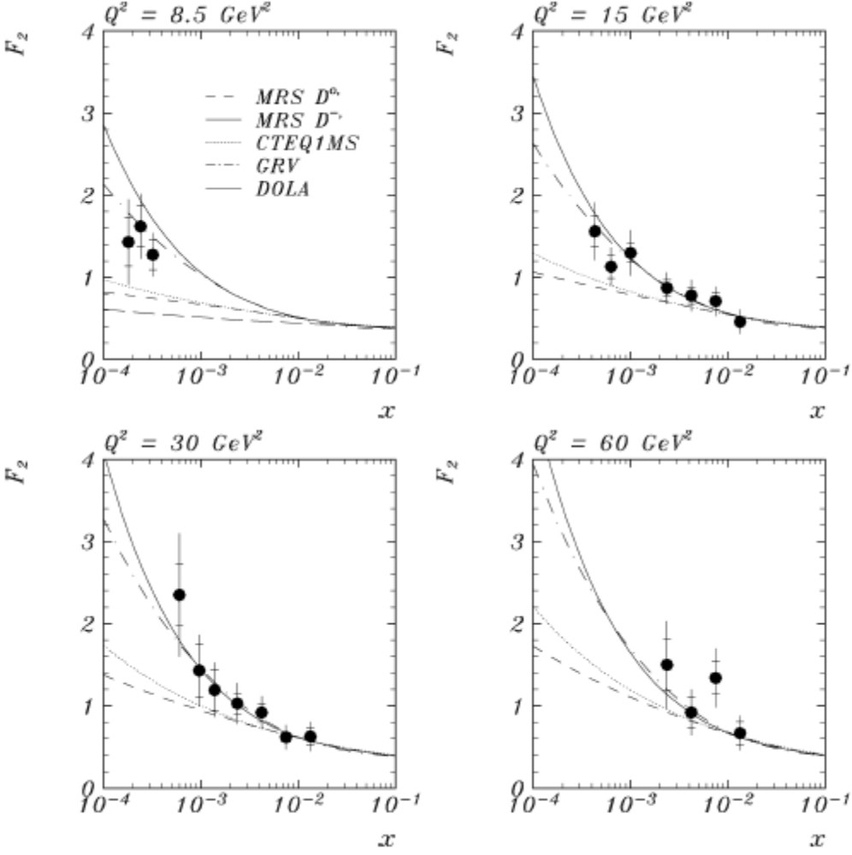
Colour and Constituents
Cashmore @ 70
Oxford
30 June 2015
● 1993: rise to low x
of proton structure
function F₂
- the gauge field
theory QCD is
proton structure
F₂
Q²
+
+
+
+
x_{Bj}
● discovery: we are chromodynamic energy

Slide 20
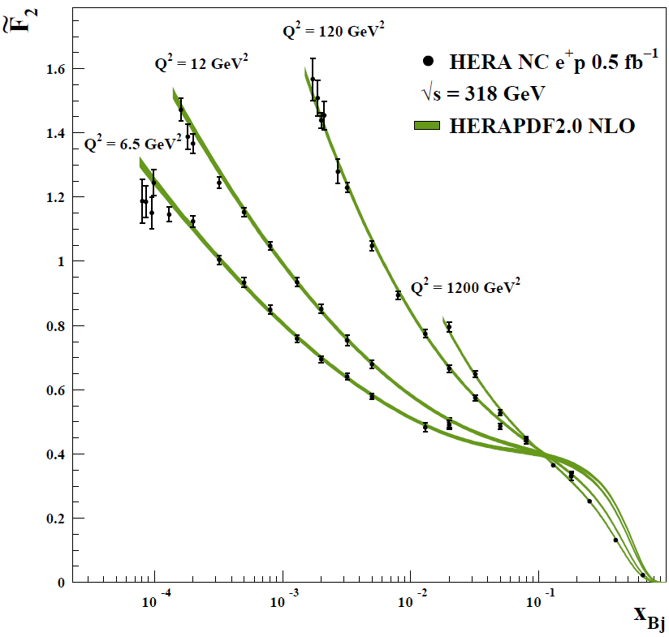
Colour Conundrum
Cashmore @ 70
Oxford
30 June 2015
● 2015: rise to low x
of proton structure
function F₂
- the gauge field
theory QCD is
proton structure
Q²
+
+
+
x_{Bj}
● discovery: but we don’t understand how: $\ln{\frac{1}{x}}$ ?

Slide 21
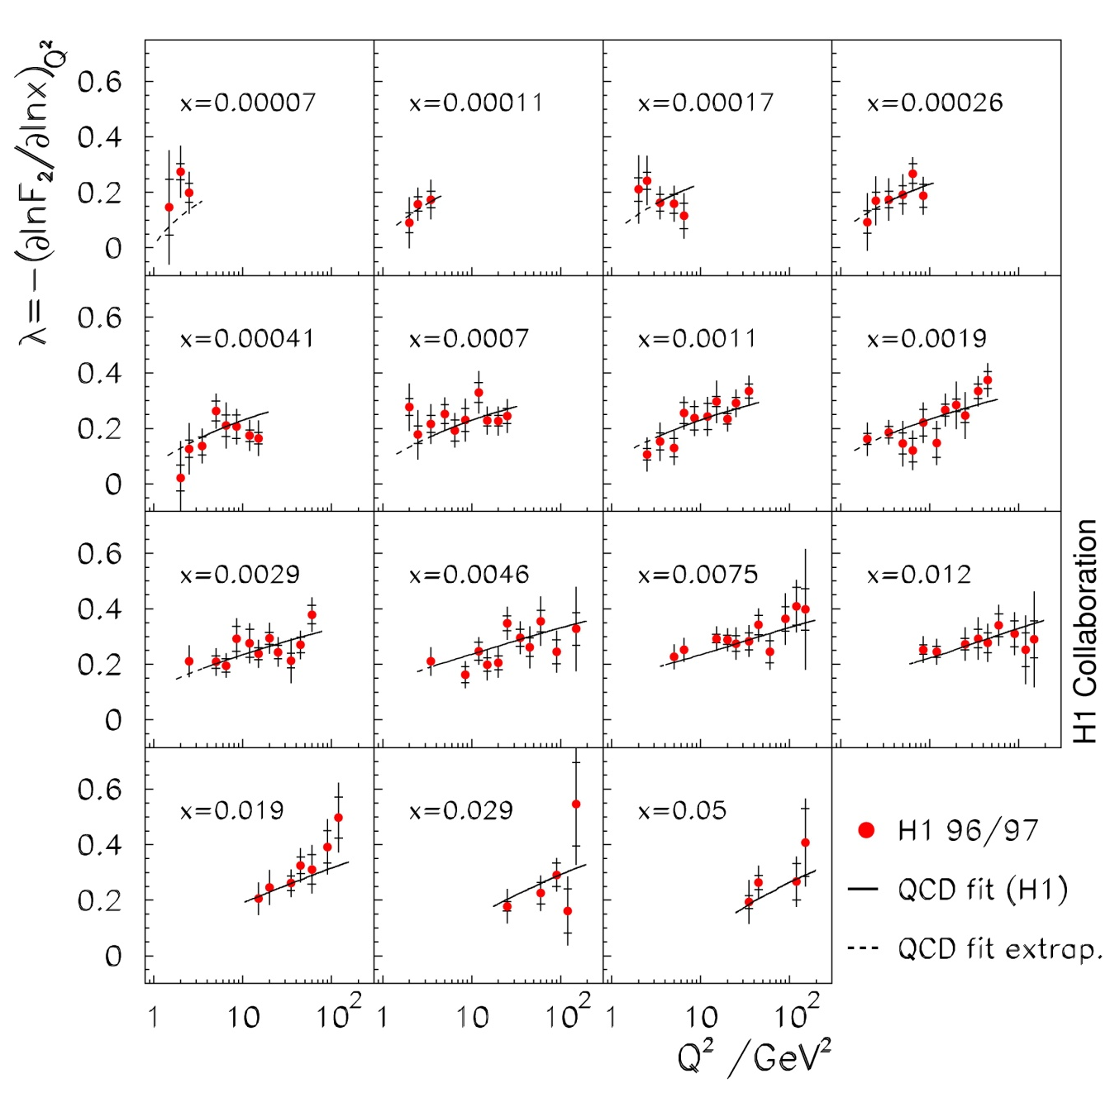
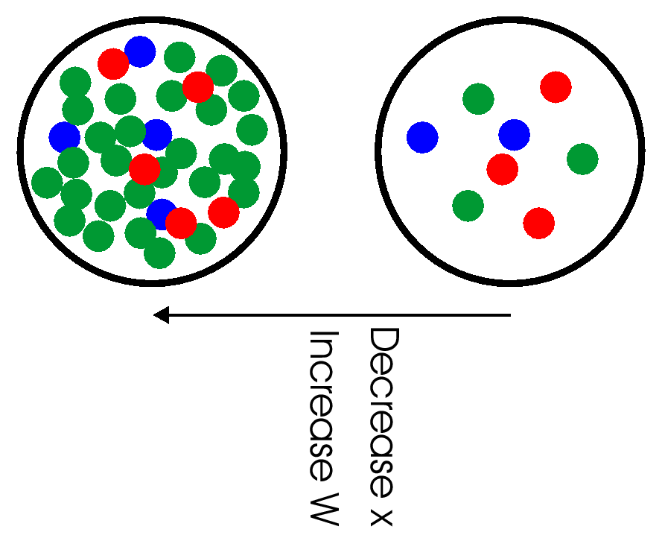
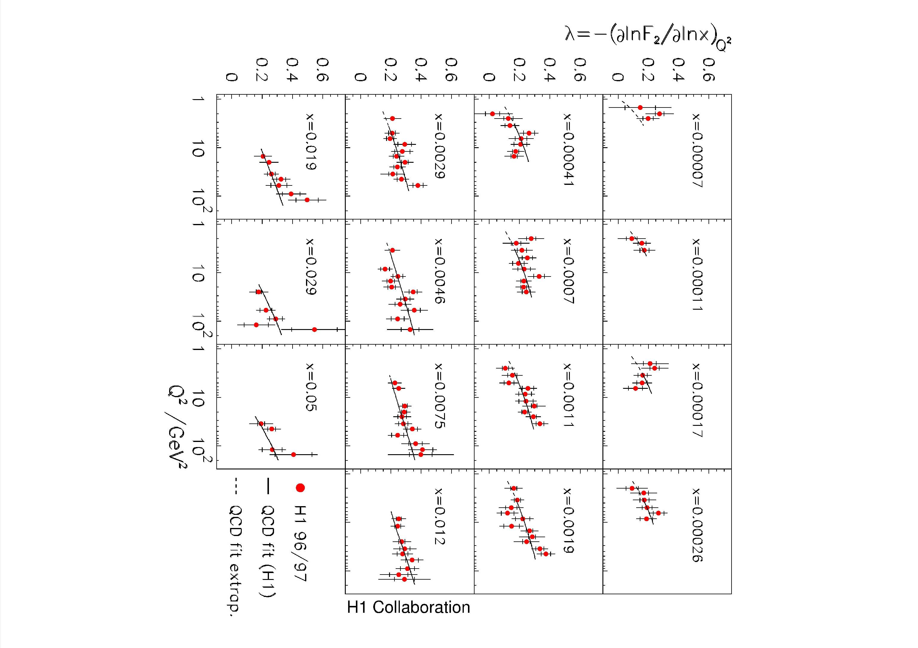
Colour Conundrum
Cashmore @ 70
Oxford
30 June 2015
● F₂ @ low x
- saturation in
F₂ ∝x ^{-λ} ?
?
lower x
higher x
smaller
larger ?
● experiment →
observation in
measurements?
more!
● unitarity in colour field?

Slide 22
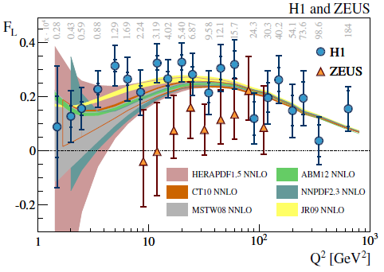
Colour Conundrum
Cashmore @ 70
Oxford
30 June 2015
• colour field structure of hadron F_{L} ?
longitudinal
virtual boson
γ Z
H1 and Zeus must sort this out?
+
EW+colour
γ Z
● Dirac fermions in colour ?

Slide 23
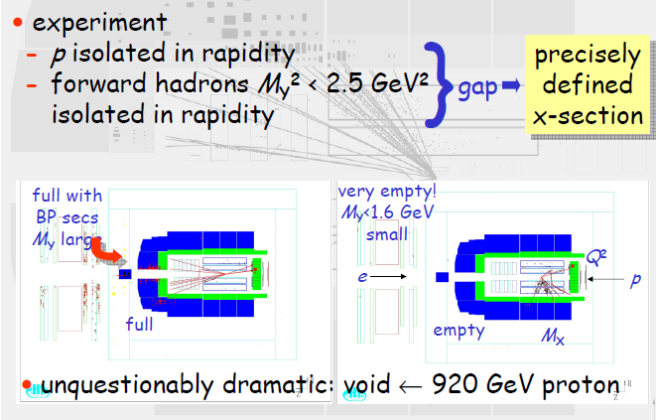
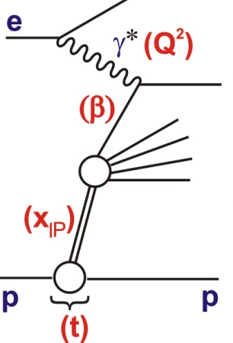
Colour Interaction Dynamics
Cashmore @ 70
Oxford
30 June 2015
ep→epXY with Q⁻¹ < 50 am
- probe hadronic interaction

Slide 24
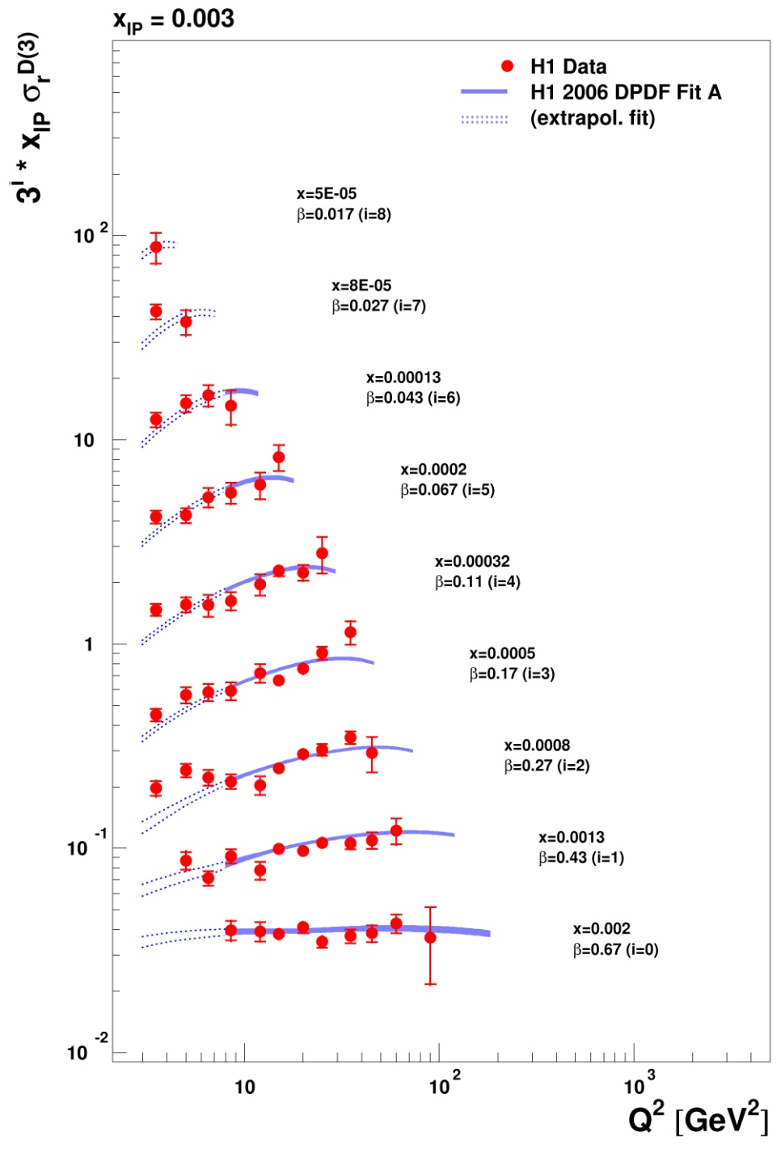
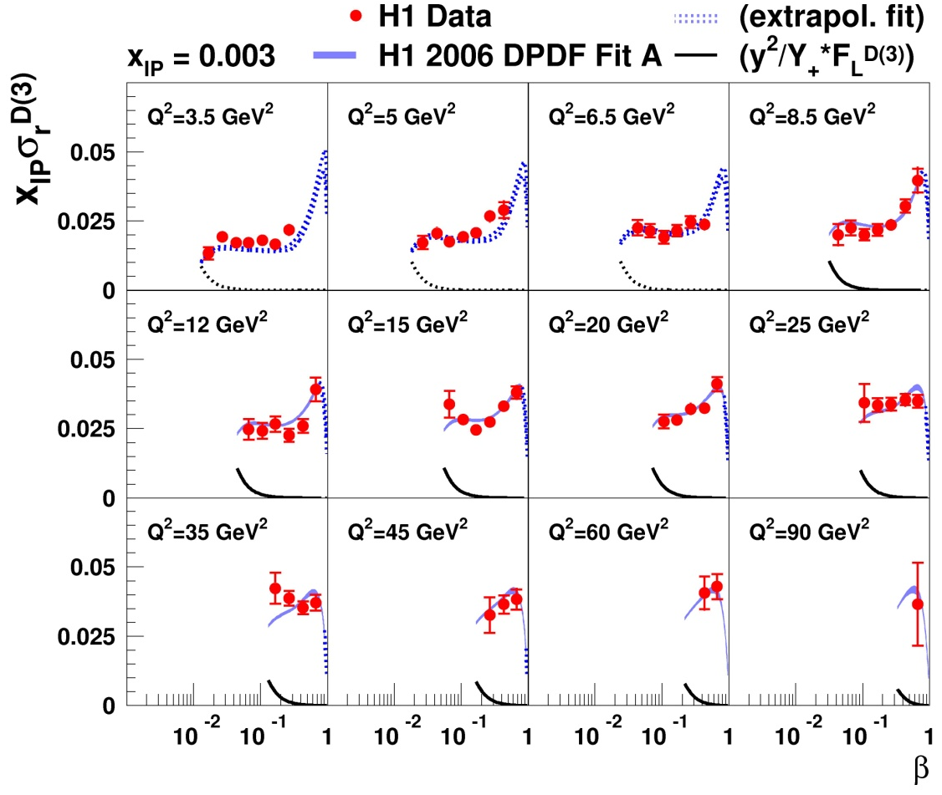
Cashmore @ 70
Oxford
30 June 2015
Colour Interaction Dynamics
_{D}
● x-section x σ_{r} ~ F₂ (β,Q²,x )
- scaling violations →
flavour singlet q_{S} QCD evol^{n}
- β dep^{c} ~ g→qq
_{I}
_{P}
_{I}
_{P}
_

Slide 25
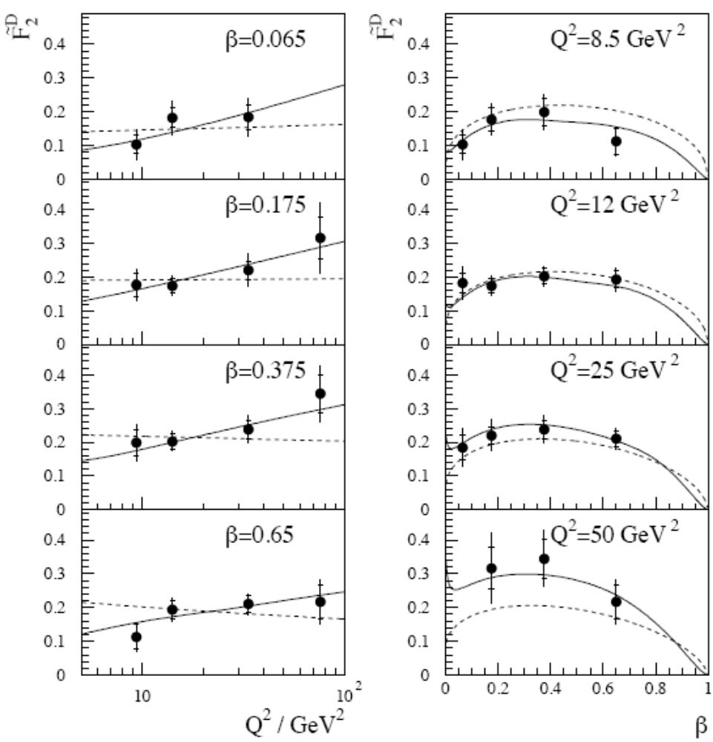
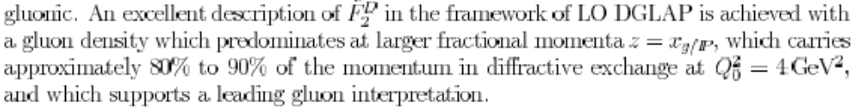
Cashmore @ 70
Oxford
30 June 2015
Colour Interaction Dynamics
_{D}
● H1 F₂ 1996 (Brussels)
- scaling violations →
flavour singlet q_{S} QCD evol^{n}
- β dep^{c} ~ g→qq
_

Slide 26
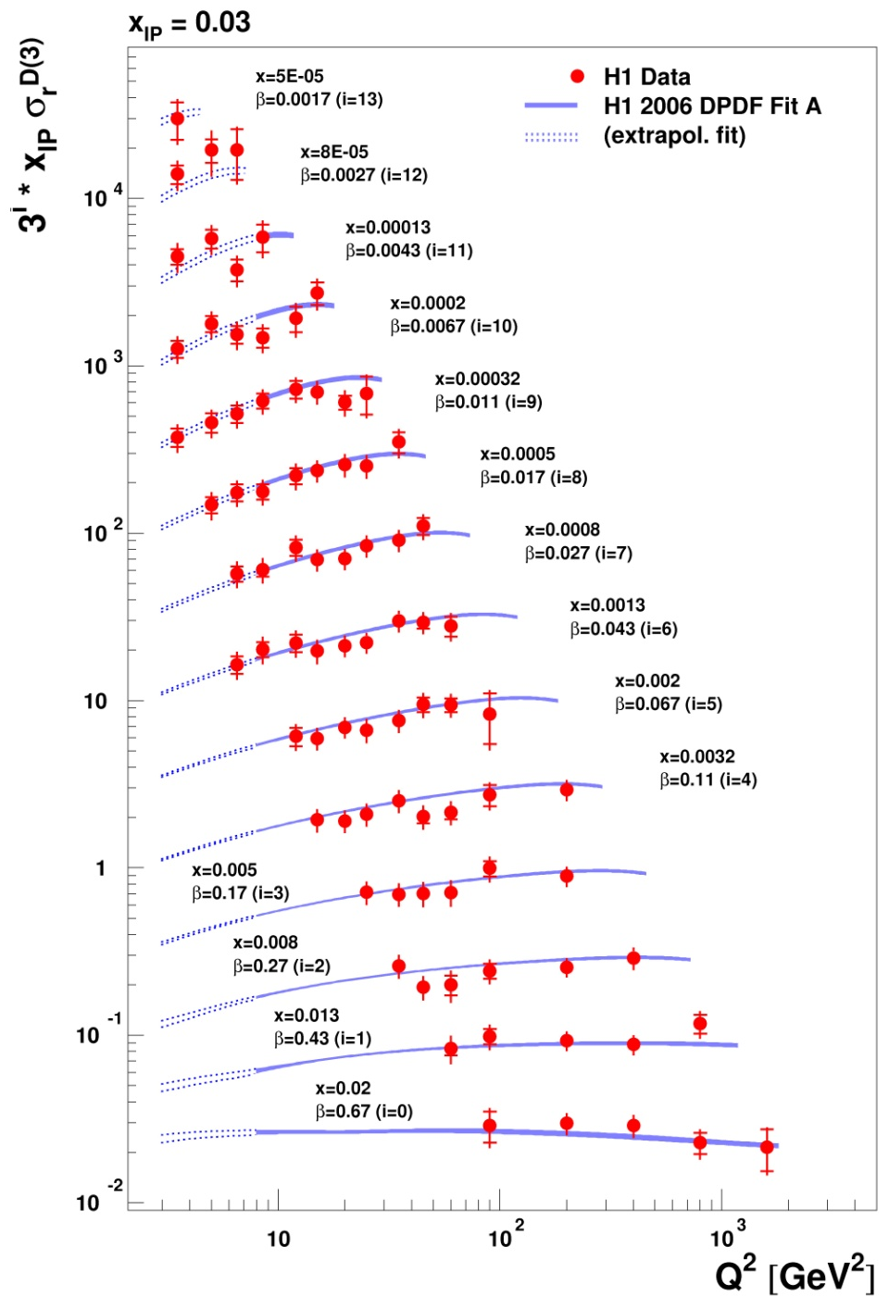
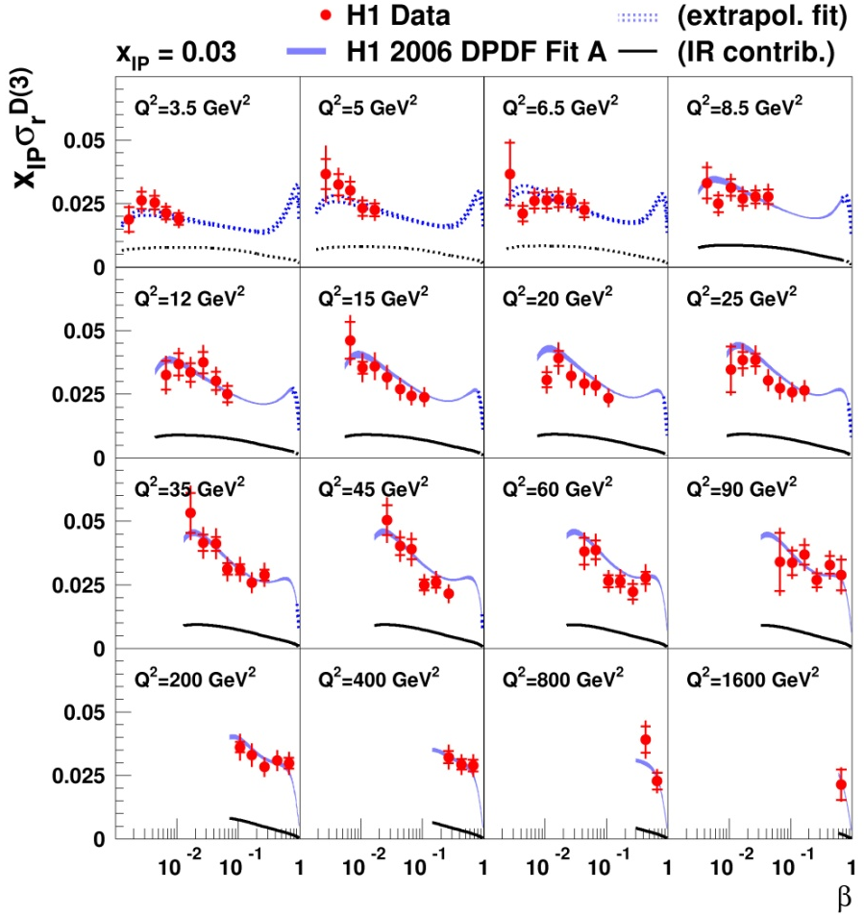
Cashmore @ 70
Oxford
30 June 2015
Colour Interaction Dynamics
● x-section x .σ_{r} @ larger x
- scaling violations →
flavour singlet q_{S} evol^{n}
- β dep^{c} ~ 1_{g→qq}
_{I}
_{I}
_{P}
_{P}
c
_
+ q_{meson}
Ruspa

Slide 27
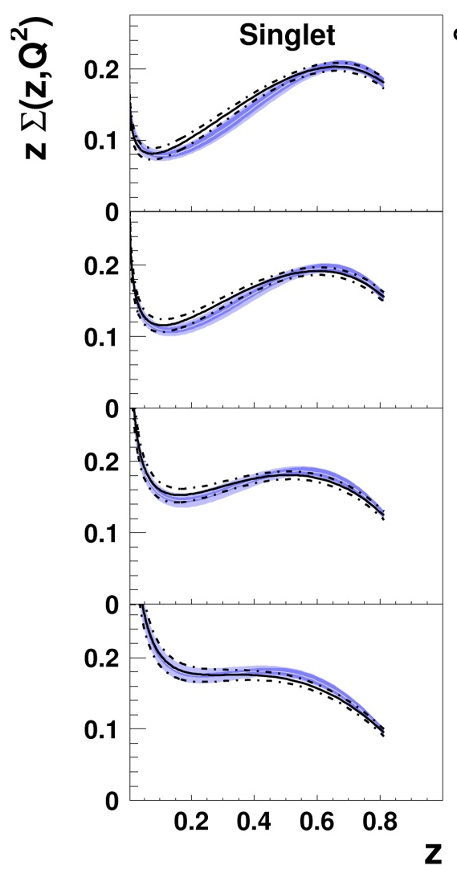


Cashmore @ 70
Oxford
30 June 2015
Colour Interaction Dynamics
● the colour dynamics of the nucleon interaction
- NLO → 1^{c} colour singlet q interaction
_
g +
g→gg+
g→ggg
+…
g→qq
+ g→qqg
+ …
_
_{I}
_{P}
QCD field at work … with itself!
cf photon structure
_
“hard” (~70%) g with g→gg and g→qq splitting

Slide 28
Cashmore @ 70
Oxford
30 June 2015
Inelastic QCDiffraction
● inelastic (dissociative) quark diffraction
→ 1^{c} singlet q interaction ?
- space-like photon “delivers asymptotically free
quark” to short distance diffractive interaction
e
e
e
e
_
γ
_
γ
q
q
→
1^{c}
1^{c}
+…
“∞ momentum” ↔“dipole”
q_{s}
q_{s}
q_{s}
q_{s}
● colour singlet 1^{c} quark dynamics in QCD

Slide 29
Cashmore @ 70
Oxford
30 June 2015
Elastic Quark Scattering
● elastic quark diffraction = scattering
→ 1^{c} singlet q interaction
- space-like photon “delivers asymptotically free
quark ” to short distance elastic interaction
e
e
_
γ
M_{VM}
Q
q
q
q'
distance scale q
1^{c} J^{P}=1⁻
q
1^{c}
+…
1^{c}
+…
q_{s}
q_{s}
q
q'
1^{c} I=½
● exclusive VM electroproduction:
unique control of distance scale withQ and M_{VM}

Slide 30
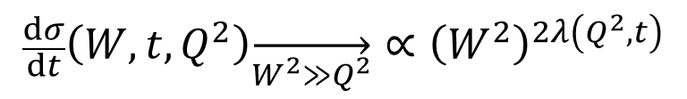







Cashmore @ 70
Oxford
30 June 2015
Elastic Quark Scattering
● kinematics and size Δ of elastic q scattering
total $γ^{∗}p$cross-section
$$∝Im\left[T_{γ^{∗}p→γ^{∗}p}\left(Q^{2},t=0\right)\right]$$
elastic and dissociative
vector-meson electropruction
q
Q²
Q²
Q²
q
M
virtualityv
q
1^{c} J^{P}=1⁻
virtuality
v → Δ
q
1^{c}
$\left|t\right|$small
1^{c}
t =0
q_{s}
q_{s}
q_{s}
q_{s}
$−\frac{M^{2}+Q^{2}−t}{2}\left(1−\sqrt{1+4\frac{Q^{2}t}{{\left(M^{2}+Q^{2}−t\right)}^{2}}}∙\sqrt{1−4\frac{m_{q}^{2}}{M^{2}}}\right)$
$≳v^{2}−m_{q}^{2}≳$
$−\frac{M^{2}+Q^{2}−t}{2}\left(1+\sqrt{1+4\frac{Q^{2}t}{{\left(M^{2}+Q^{2}−t\right)}^{2}}}∙\sqrt{1−4\frac{m_{q}^{2}}{M^{2}}}\right)$
$${−m}_{q}^{2}{−Q}^{2}>v^{2}>{−m}_{q}^{2}{−Q}^{2}$$
$$quark mass m_{q}$$
${v^{2}\sim −\left(\frac{ℏ}{∆}\right)}^{2}$
$$F_{2}\sim x_{Bj}^{−λ\left(Q^{2}\right)}→size\left(Q^{2}\right)∝\frac{ℏ}{v}$$
$$\frac{dσ}{dt}\left(W,t,Q^{2}\right)\overset{→}{W^{2}≫Q^{2}}∝{\left(W^{2}\right)}^{2λ\left(Q^{2},t\right)}$$

Slide 31




Cashmore @ 70
Oxford
30 June 2015
Elastic Quark Scattering
● kinematics and size Δ
of elastic q scattering
- total $γ^{∗}p$cross-section
$$∝Im\left[T_{γ^{∗}p→γ^{∗}p}\left(Q^{2},t=0\right)\right]$$
∝F₂($Q^{2}$,x) @ low x
$$F_{2}\sim x_{Bj}^{−λ\left(Q^{2}\right)}→size\left(Q^{2}\right)=∆\left(Q^{2}\right)∝\frac{ℏ}{v}$$
Q²
q
Q²
0.02 ≤ Δ ≤ 1 fm
virtualityv
q
1^{c}
t =0
q_{s}
q_{s}
$λ\left(∆\right)\sim 0.14±0.01−\frac{0.15}{2.303}\ln{\frac{∆ fm}{0.2}}$

Slide 32





Cashmore @ 70
Oxford
30 June 2015
Elastic Quark Scattering
● kinematics and size Δ of elastic q scattering
- elastic and dissociative VM electroproduction
- consistency with
Q²
q
M
virtualityv
q
1^{c} J^{P}=1⁻
1^{c}
$\left|t\right|$small
q_{s}
q_{s}
$$\frac{dσ}{dt}\left(W,t,Q^{2}\right)∝{\left(W^{2}\right)}^{2λ\left(Q^{2},t\right)}$$
$λ\left(∆\right)\sim 0.14±0.01−\frac{0.15}{2.303}\ln{\frac{∆ fm}{0.2}}$
1^{c} colour singlet QCD qq→qq for q =u,d,s,c,b

Slide 33



Cashmore @ 70
Oxford
30 June 2015
GSW Current
● 1993: hint of weak unitarity = GSW unification ?
- from ep→νX
to νp→eX
- IVB in CC
- EW probe
_
e⁺
_
H1
ν
G_{weak}
W
- structure of
Fermi constant G_{weak}

Slide 34

Cashmore @ 70
Oxford
30 June 2015
GSW Current
• now: resolved structure in GSW SU(2)_{L} ⊗ U(1)
0.2 TeV·am
Q
Δx ~
ep→eX
• Rutherford
scattering
eq → eq
¹
_
_{Q}4
e
e
ep→νX
γ
Z⁰
q
q
eq → νq (CC β)
ν
e
●
q
q
0.2 GeV·fm
M_{W}
~2 am
ν
e
²
M_{W}
W±
≤2 am
q
q
probe 20 am 7 am 2 am

Slide 35




Rotating Spin
Cashmore @ 70
Oxford
30 June 2015
• stored e radiates
e → e_{T}
transversely polarised e
Sokolov-Ternov
synchrotron radiation
• “spin-rotator”
- subtle and precise
precession
- “Siberian snake”
insertion device
e_{T} → e_{RL} → e_{T} at IR
HERA
HERA
IR
Barber, Steffen (DESY)

Slide 36

Cashmore @ 70
Oxford
30 June 2015
GSW Current
±
e
ν
• quarks = L(R) Dirac (anti-)fermions
L(R) (anti-)leptons
LR
W±
q
q

Slide 37

Cashmore @ 70
Oxford
30 June 2015
GSW Current
• polarisation asymmetry: e±→ NC parity violation
±
e
LR
e
γ
Z⁰
q
q
probe 20 am 7 am 2 am

Slide 38

Cashmore @ 70
Oxford
30 June 2015
Anti-matter GSW Current
• in ep interaction chirality probes anti-matter in p
±
e
LR
e
γ
Z⁰
q
q

Slide 39

Cashmore @ 70
Oxford
30 June 2015
Current Quark Couplings
• V and A current quark couplings:
e polarisation and γ*Z interference
• space-like (HERA) and time-like (LEP+Tevatron)

Slide 40



Cashmore @ 70
Oxford
30 June 2015
GSW Bosons
• Fermi scale complete: EW unification
lepton
γ Z W
electroweak
45 years coming: GSW a triumph of humanity
SppS brings intermediate vector bosons
LEP brings time-like Standard Model precision
HERA brings space-like (“Rutherford” NC CC)
LHC brings the last piece … at last … !
… Dirac fermions @ am have scalar coupling
quark
g
chromodynamics
γ Z W
EW+colour

Slide 41


New Constituents and Currents ?
e
e
e
e
• beyond Dirac quark “contact” ?
γ
Z⁰
q
q
q
q
to date incomplete – flagship of electron “attoscope”
probe 7 am 2 am
7 am 2 am

Slide 42

Cashmore @ 70
Oxford
30 June 2015
New Constituents
and Currents ?
•new eq physics – “LQ”
e
e±
γ Z
q
e
e
+
LQ
experiment #1
1992-1996 37 pb⁻¹
q
e
q …
2
+
LQ
q
•SM template ↔ experiment !
q

Slide 43

Cashmore @ 70
Oxford
30 June 2015
New Constituents
and Currents ?
•new eq physics - leptoquarks
e
e±
γ Z
q
e
e
+
LQ
experiment #2
1999-2000 81 pb⁻¹
q
e
q …
2
+
LQ
q
•SM template ↔ experiment !
q

Slide 44

Cashmore @ 70
Oxford
30 June 2015
New Constituents
and Currents ?
e
● new eq physics – 1992-2007
e±
γ Z
q
NC
CC
e
e ν
+
LQ
q
e
q …
2
+
LQ
0.1 0.2 0.4 x
q
discovery: SM @ Fermi scale !
≤ 200 GeV

Slide 45


Cashmore @ 70
Oxford
30 June 2015
New Constituents
and Currents ?
● LQ ?
- SM consistency → Dirac fermion + gauge coupling
e
e±
γ Z
q
e
e
+
LQ
q
e
q …
2
+
LQ
q

Slide 46
Electron-Quark Physics: the HERA Era
Cashmore @ 70
Oxford
30 June 2015
● HERA - leptons and quarks together @ 314 GeV
tells us that we are field energy
measures the quantum structure of hadron force
identifies colour-singlet colour physics
questions quarks as Dirac QCD fermions ?
says quarks are Dirac GSW SM fermions > 2 am
electron and positron are gauge fermions > 2 am
defines SM+QCD template(s) @ the Fermi scale
sets new e±q physics threshold
coupling λ ≥ M_{eq} ≥ GeV
0.01
200
1
314

Slide 47

Cashmore @ 70
Oxford
30 June 2015
… and after the constituents, the currents, the colour, … now the Cashmore
Happy 70th Birthday Roger and many many more happy returns … to physics too … for we will always need your wisdom and judgement

