Slide 1

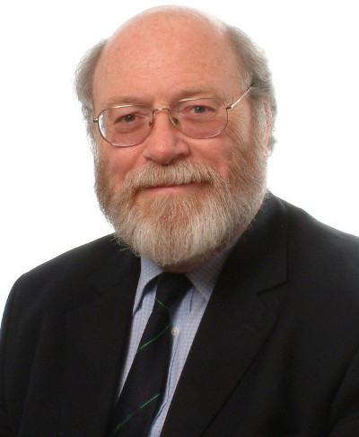
Roger’s Affair with ALICE
David Evans
The University of Birmingham
Cashmorefest
30th June 2015 St. Jonh’s College, Oxford

Slide 2
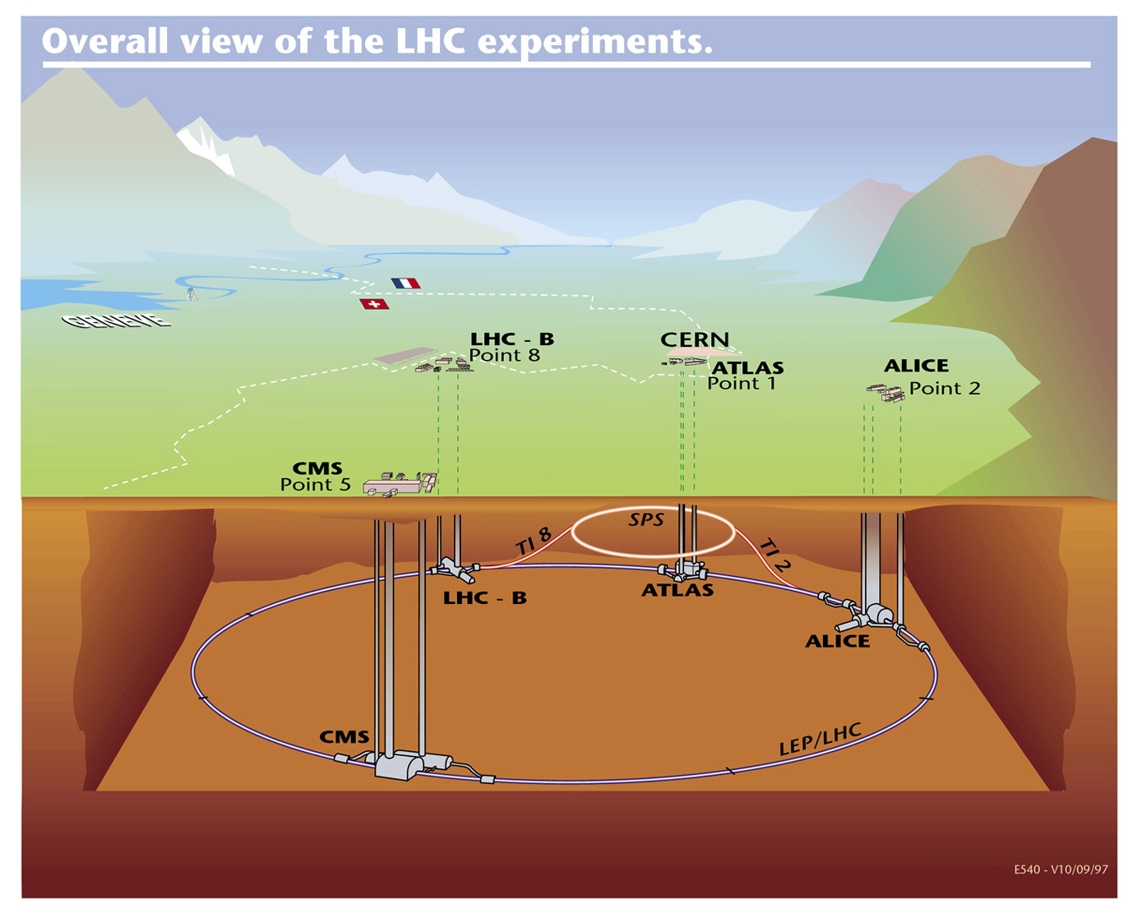
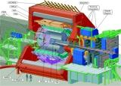

Four Main Detectors
ALICE, ATLAS, CMS & LHCb

Slide 3
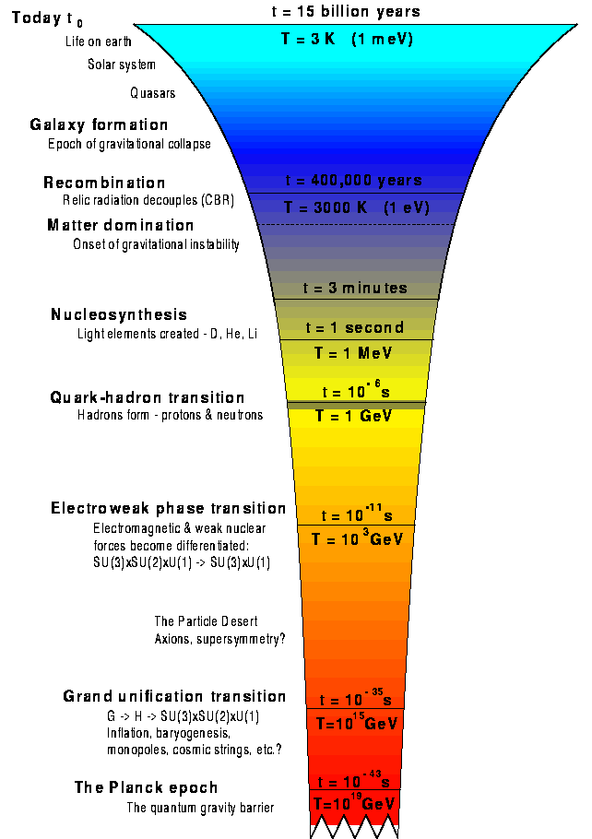
Aims of ALICE
We collide lead ions (& p-p, p-Pb) to study QCD at extreme energy densities over large volumes and long time-scales.
Study the QCD phase transition from hadronic matter to a deconfined state of quarks and gluons - The Quark-Gluon Plasma.
Study the physics of the Quark-Gluon Plasma (QCD under extreme conditions).
Gain insight in to the role of chiral symmetry in the generation of mass in hadrons (accounts for ~ 99% of mass of nuclear matter).
and the nature of quark confinement.

Slide 4
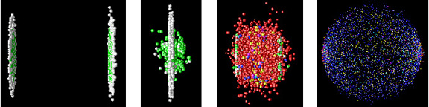
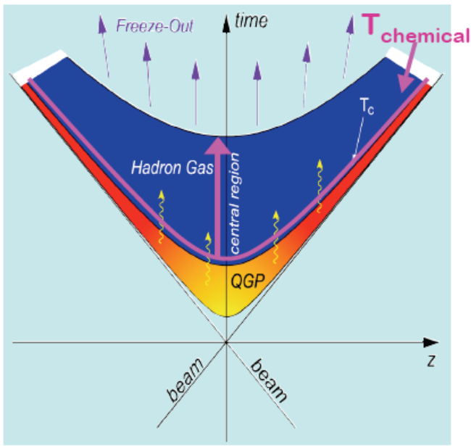
Heavy Ion Collisions
Create QGP by colliding ultra-relativistic heavy ions
pre-equilibration ⇒ QGP ⇒ hadronisation ⇒ freeze out
Colliders: AGS, SPS, RHIC, LHC
√S_{NN} (GeV) = 5.4 19 200 2760 (5130)

Slide 5
UK and ALICE
Our task: to design, build, commission, and maintain the ALICE Trigger System.
  And do physics of course
  Gives us a high profile within collaboration
UK (Birmingham) approved to join ALICE in 1999 when PPARC signed the ALICE MoU.
Since then, some voices in PPARC (and then STFC) have had second thoughts …… and third, fourth and fifth thoughts about staying in ALICE.

Slide 6


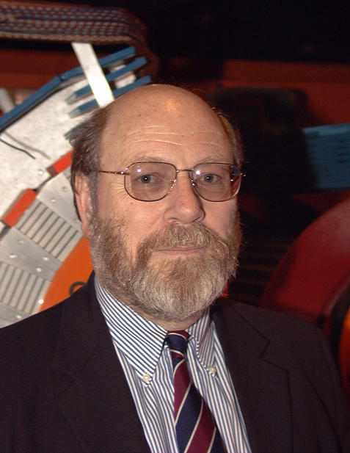
The Cashmore Effect
Roger was Director of Research and Deputy Director General at CERN between 1999 and 2004.
He realised the damage a UK withdrawal would cause and the importance of keeping a UK finger in this pie.
So he worked to convince PPARC to continue to support ALICE.
Don’t be silly

Slide 7
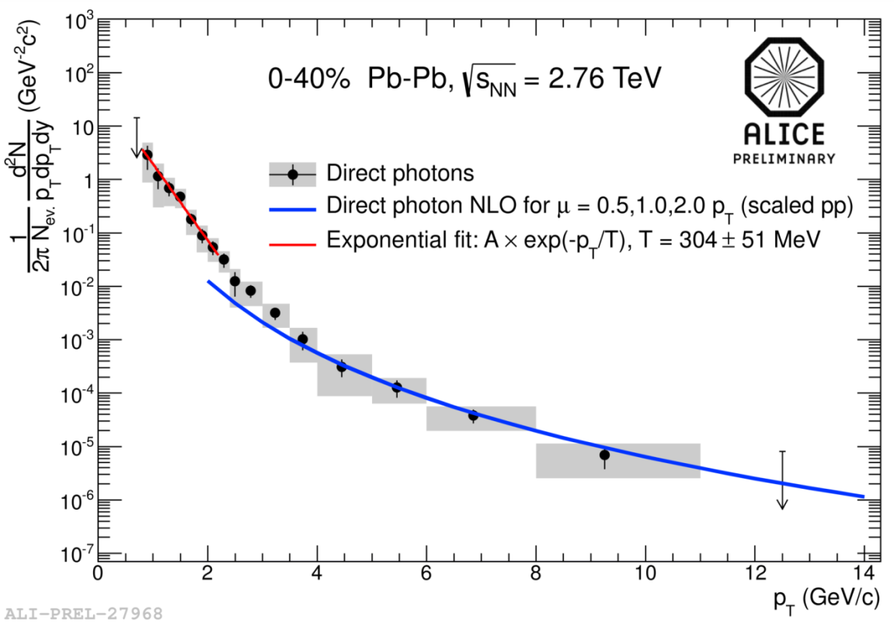
Still here and some Highlights of Run 1 include
We have measured many of the global features
  Phase transition temperature - Agrees with theory T_{c} ~ 164 MeV
  Energy density - Over 10x critical energy density, ε > 15 GeV/fm³ (> 3X RHIC)
  size & lifetime of system ~ 5000 fm³, τ ~ 10-11 fm/c
  Highest temperature ever measured (from low p_{T} photon spectrum)
Started to measure dynamical features
  Very strong radial flow,
  β ≈ 0.66
  Strong elliptical flow – ideal liquid
  Strong suppression of jets and high p_{T} particles
  First hint of quark mass dependence on energy loss

Slide 8
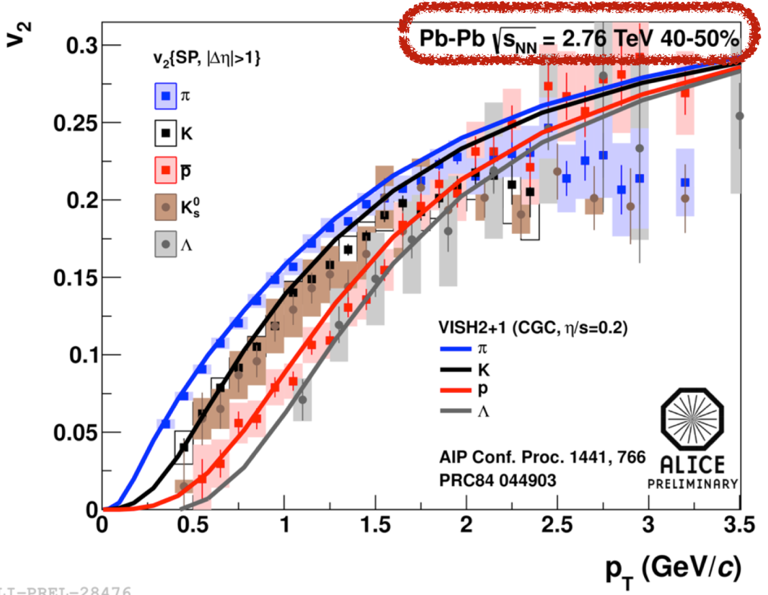
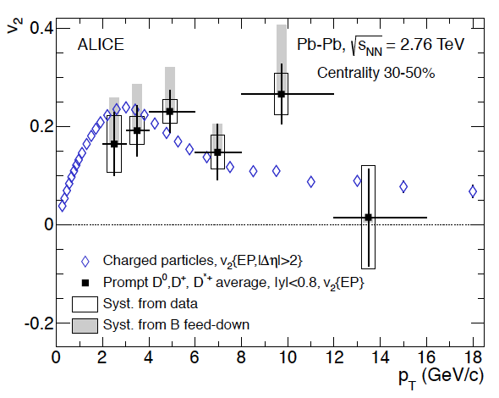
Flow – Ideal Liquid
V₂ = elliptic flow
Collective effects of data fit hydro-dynamical models
→ Most ideal liquid ever created
Evidence for flow from D-mesons suggests collective effects from charm.
→ More data needed (Run 2)

Slide 9
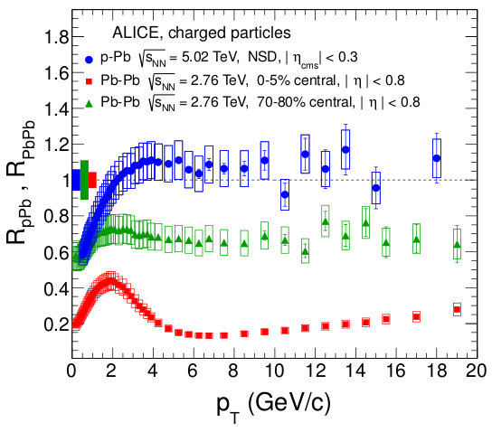
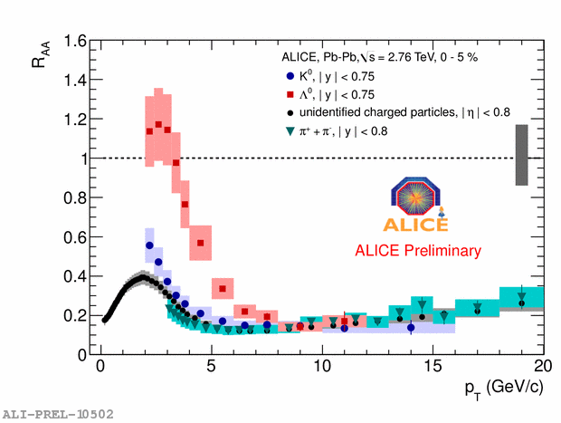
Jet & High p_{T} Suppression
High p_{T} particles supressed by factor 7 in central Pb-Pb w.r.t. weighted p-p data
p_{T} reach high enough to see minimum & then rise (seen for the first time by ALICE).
No such suppression seen in p-Pb
Strangeness suppressed by equal amount as lightest flavours (unlike predicted mass dependence)
Strange

Slide 10
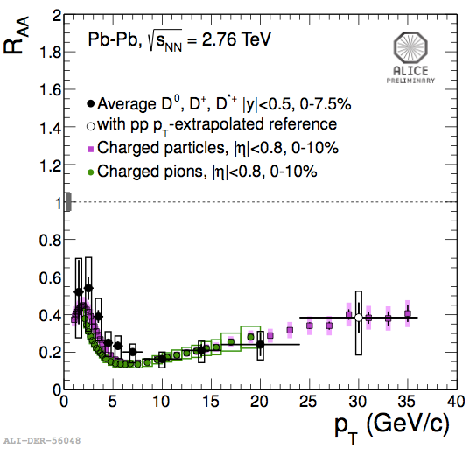
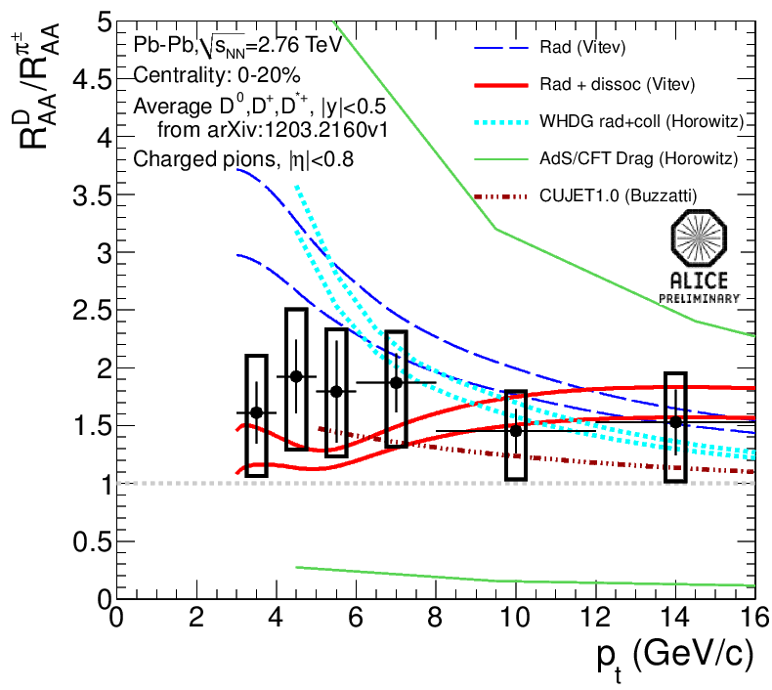
Jet & High p_{T} Suppression
Charm high p_{T} suppression similar to lighter flavours
Hint of flavour dependence
  More stats required (RUN 2)
  And B physics from Run 3

Slide 11
ALICE and the Future
Many more results, of course.
  Indeed, after the 4 Higgs discovery papers the next three highest cited LHC physics papers come from ALICE.
Plan to take 10x data in Run 2
Major upgrade for run 3 (new ITS, Trigger etc) – rare probes and b-physics.
ALICE has an exciting future and the UK are playing a leading role in that.
Thank you Roger

