Slide 1
“CashmoreFest”
Roger’s first 70 years
Norman McCubbin
(retired member of) Particle Physics Department
Rutherford Appleton Laboratory, STFC

Slide 2
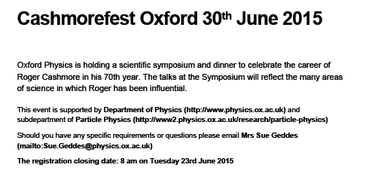
Congratulations Roger
I’m honoured and very pleased to have been asked to “open the batting”, so to speak. (See off new ball; the “stroke players” come later..)
I will skim lightly over Roger’s “first 70 years”, and aim to complement the later talks, which will cover several areas in more detail.
To begin at the beginning:
  dob: 22-Aug-1944
  so, with the normal rules of arithmetic...
71st
2

Slide 3
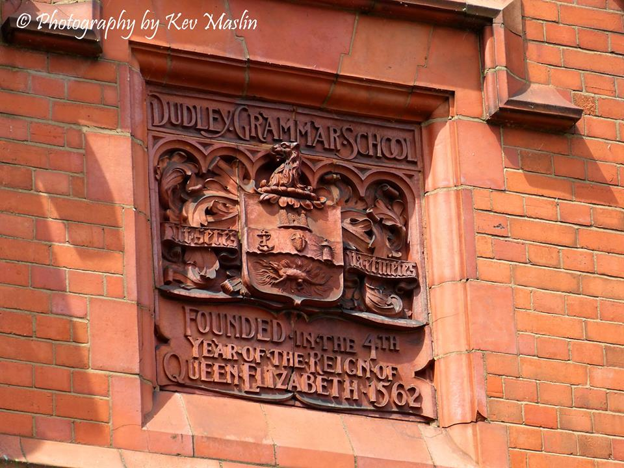
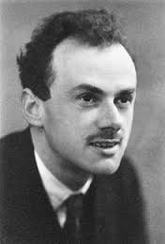
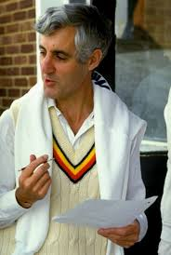
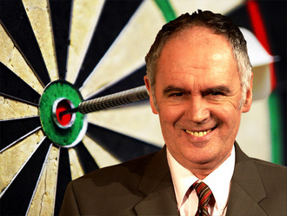
Early years
Attended Dudley Grammar School.
Founded 1562, merged with other schools in 1975.
Then to St John’s, Cambridge.
The college of:
3

Slide 4
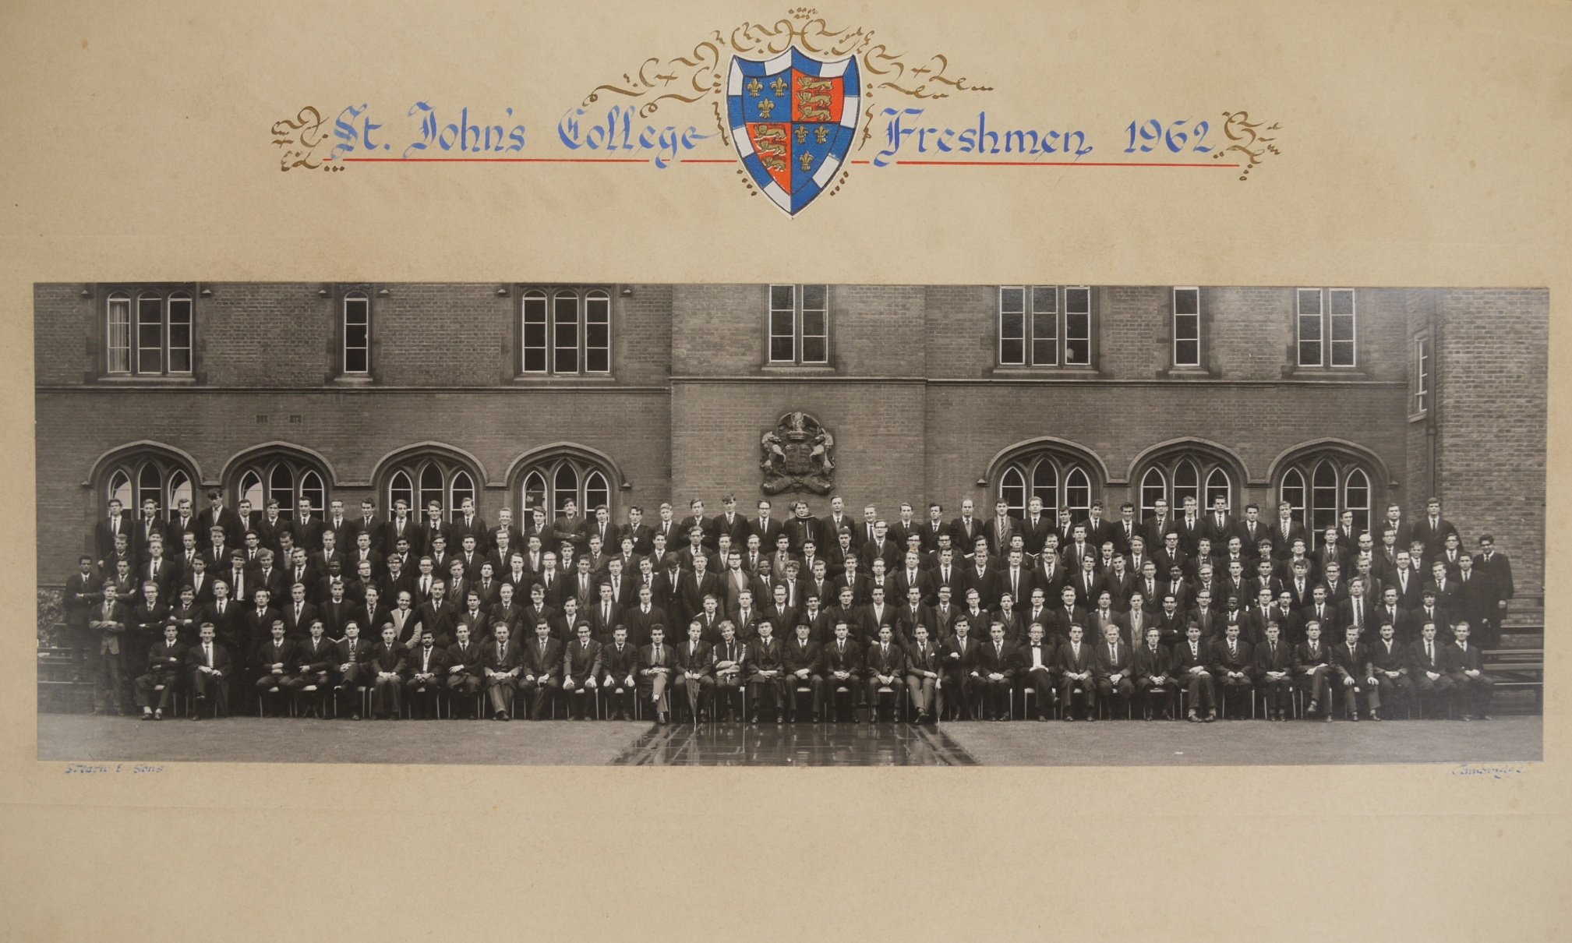
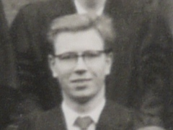
Cambridge 1962-65
Warm welcome to many friends and colleagues of long-standing. (I am endeavouring to avoid the word ‘old’ today, lest it be misunderstood. ☺)
A particular welcome to George, and all members of the Kalmus family.
Many messages received from those who can’t make it today: Roger Cashmore, Frank Close, Derek Colley, Ian Corbett, Don Davis, Sandy Donnachie, Heather Murphy, Steve Myers, Terry Sloan, Peter Smith, Mike Tyndel, Alan Watson, ….
Reproduced with the permission of the Master and Fellows of St John’s College, Cambridge
4

Slide 5
Oxford – 1965-69
Roger came to Oxford in 1965 for his DPhil on πp scattering (Saclay Bubble Chamber at RHEL) supervised by Mike Bowler, newly arrived from Bristol, as was Don Perkins.
Fellow graduate students included Gareth Hughes and Chris Jones. Ian Corbett and Chris Damerell were a few years ahead...
Chris Jones recalls Roger as “..a tad better than all of us, having completed whatever that supplementary maths thing is at Cambridge...” (Pt III)
Roger shared an office with Ollie Waldron, of bitten-ear fame.
5

Slide 6

Mesons and Baryons, SLAC and CERN (1)
Roger joined David Leith’s group at SLAC in 1969, and quickly became a highly valued member of that group.
And he and Annie were married during this time.
Work at SLAC:
  bubble chamber data: extensive partial-wave analysis of π-nucleon interactions, nucleon resonances etc;
  large-aperture spectrometer and wire chambers: extensive study of π/K/p proton interactions, K*’s,.. (Start of the LASS programme.)
  collaboration with Tony Hey and Peter Litchfield: “SU(6)_{W} decays of Baryon Resonances” (>150 citations)
6

Slide 7
Mesons and Baryons, SLAC and CERN (2)
David Leith summarised Roger’s contribution: “Roger played an important role in the analysis of the data... Roger’s skill in data analysis, and his interest in using the full angular information to wring the last drops of information from the data, were very important to the success.”
Roger returned to Oxford in 1974, and, together with Mike Bowler, Jim Loken and Graham Thompson, joined the ACCMOR collaboration, using the CERN SPS. Oxford group played a big part in the analysis of the multi-pion final states.
As is well known, during the 70’s the particle physics “landscape” changed dramatically, and Roger led the Oxford group to PETRA+TASSO... (See Brian’s talk.)
Ian Brock remembers his DPhil viva…
7

Slide 8
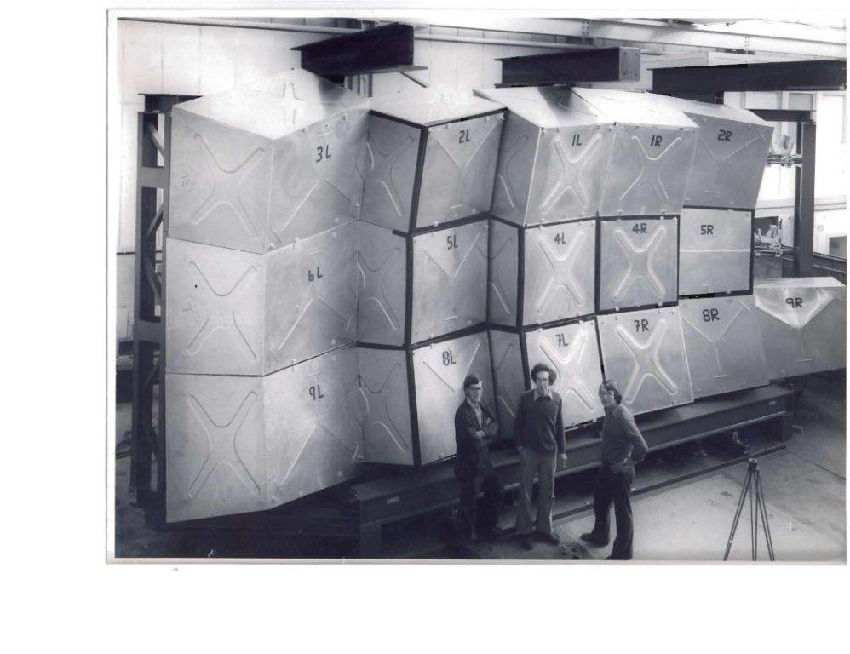
Meeting Roger....
I first met Roger around this time (late 70’s), and since I showed an early picture of him....
Hair
Flat tummy!
cigarette
8

Slide 9
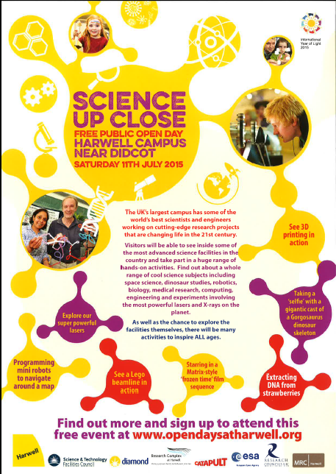
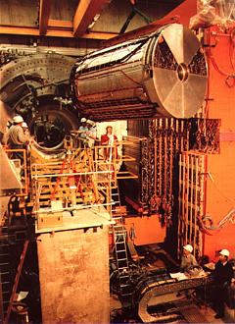
HERA: the ZEUS CTD
John will say more on HERA, ZEUS etc. I would just like to say:
  Roger was very insistent that UK should take responsibility for ALL aspects of ZEUS Central Tracking Detector (CTD).
  CTD had a first-level trigger operational in 1992. (ATLAS and CMS have now caught on to fast track triggers, and theirs should be operational ~2022 ☺)
  During the construction of the CTD I learned that VAT was, like particle physics, a subject of seemingly infinite depth.
  If you want to see the CTD again...
9

Slide 10
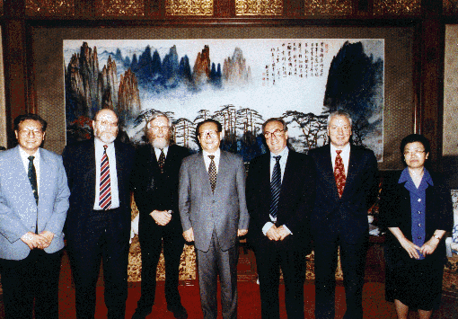
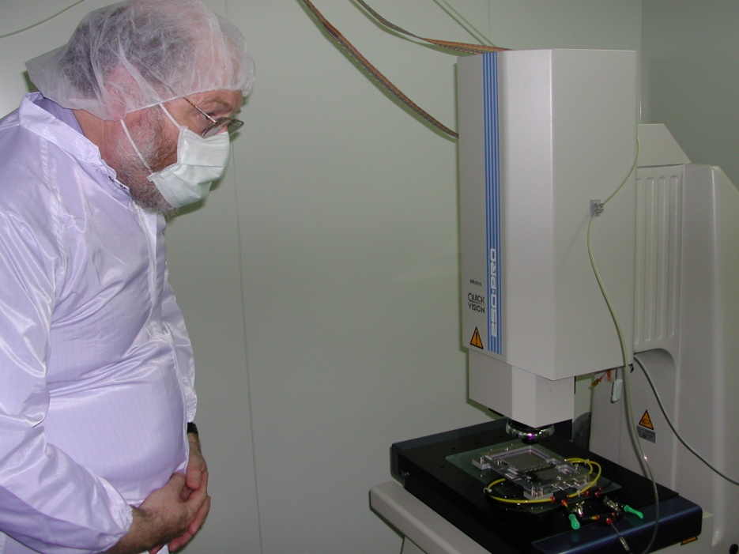
CERN Directorate (1999-2003)
Roger was appointed to the CERN Directorate in 1999. (Director for Collider Programmes and, latterly, also Deputy DG.)
Challenges included timing of LEP closure, overseeing the construction of the experiments, LHC costs and resources (RRB),..
You also get to do lots of visits:
10

Slide 11
CERN Directorate (1999-2003)
Peter Jenni has sent the following:
Dear Roger,
Warm (and sunny) greetings and congratulations from Erice, Professor Zichichi’s famous international school of subnuclear physics.
It is great now to remember the very intense years when you, as CERN Research Director, guided the LHC experiments, and ATLAS in particular, through those tough years of construction, with the overcosts and schedule delays that are inherent in projects of this complexity. Naturally our respective roles led at times to some “healthy exchanges” of views. But it was always for the good of the project, and that is what I remember most. And the beautiful physics results now show how worthwhile our collective efforts were, and your own contribution was highly significant.
As ATLAS spokesperson of that time, I want to thank you for all you did to keep the project on track, and for helping us to get the famous “costs to completion” covered.
Personally, I wish you most cordially all the best, and enjoy the physics to come from LHC!
Peter Jenni
Former spokesperson, ATLAS Collaboration
11

Slide 12
Inter alia...
Director Summer School for UK Experimentalists in mid-1980’s, and encouraged their exposure to real RQFT. This exposure continues to this day.
Chair Particle Physics Committee early 1990s: oversaw production of the report “Particle Physics 2000” (used copy in good condition available from AbeBooks for ~£100!).
The “first edition” of this document was “officially recalled” by SERC Chairman - ask Roger ☺.
Honours and Prizes include:
  IoP CV Boys Prize (1983); Von Humboldt Research Award (1995); FRS (1998); CMG (2004);...
12

Slide 13
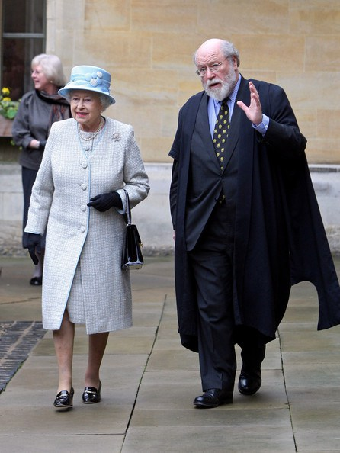
More recently...
Principal of BNC (2002-2011): Richard Cooper will talk this evening about Roger’s contributions to BNC. I note:
Nuclear matters:
  Chair MoD Nuclear Research Advisory Council (2005- )
  Chair UKAEA (2010- )
  Chair Royal Society Nuclear non-proliferation WG (2010- )
13

Slide 14
To the future...
Roger: it has been both highly instructive and a great pleasure to have known you as friend and colleague, and to have shared various particle physics adventures with you during your first 70 years.
May you continue to enlighten us for many years to come...
Acknowledgements: I would like to thank warmly Ian Brock, Chris Damerell, Peter Jenni, Chris Jones, and David Leith for help in preparing this talk. Responsibility for inaccuracies etc is mine.)
14

