Slide 1
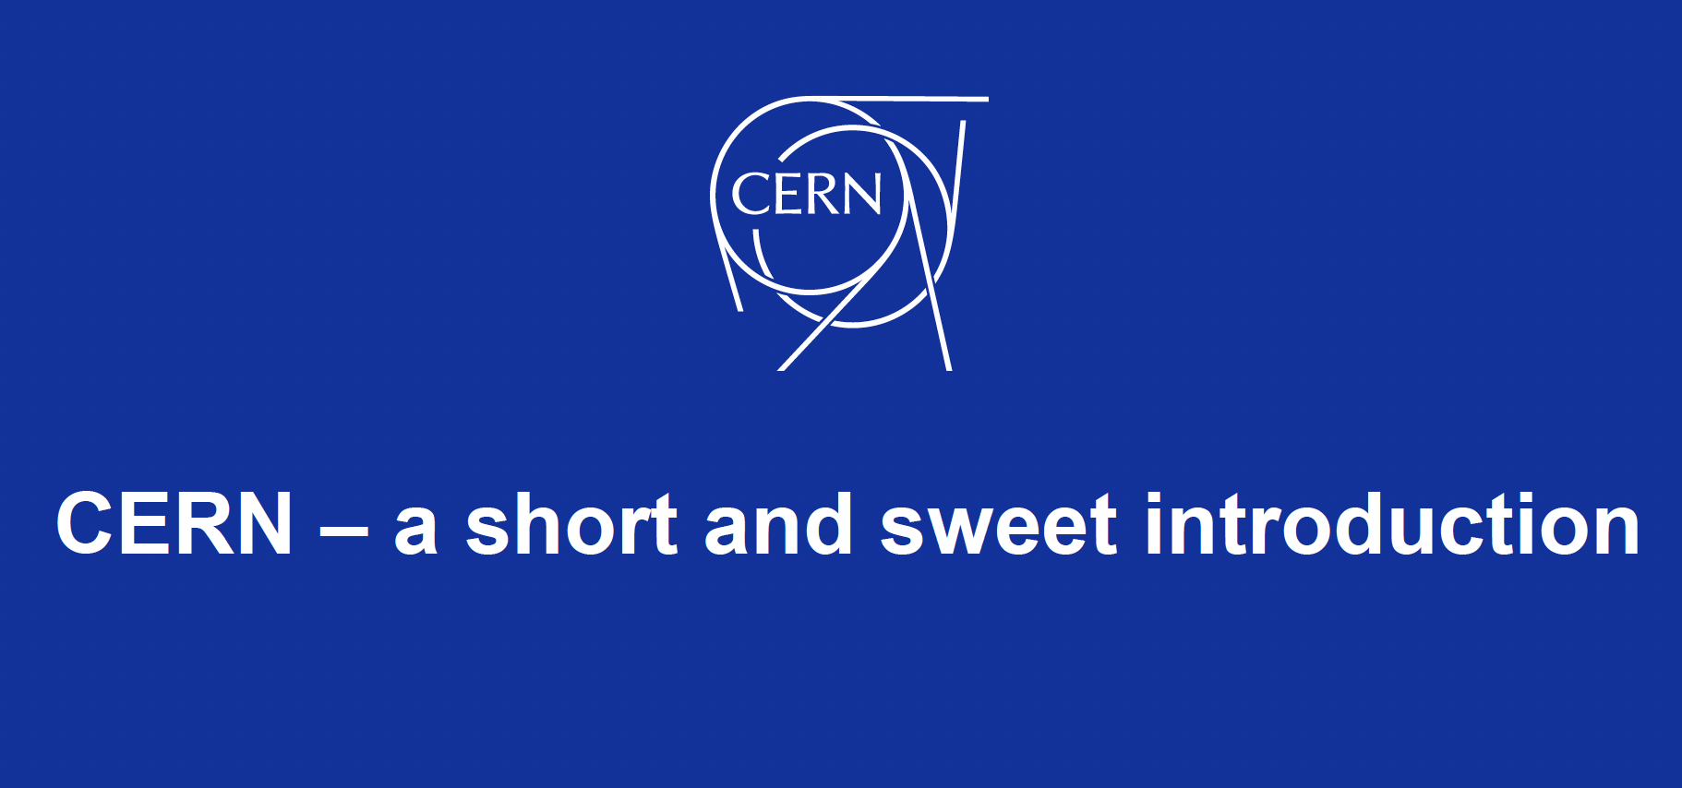


Slide 2
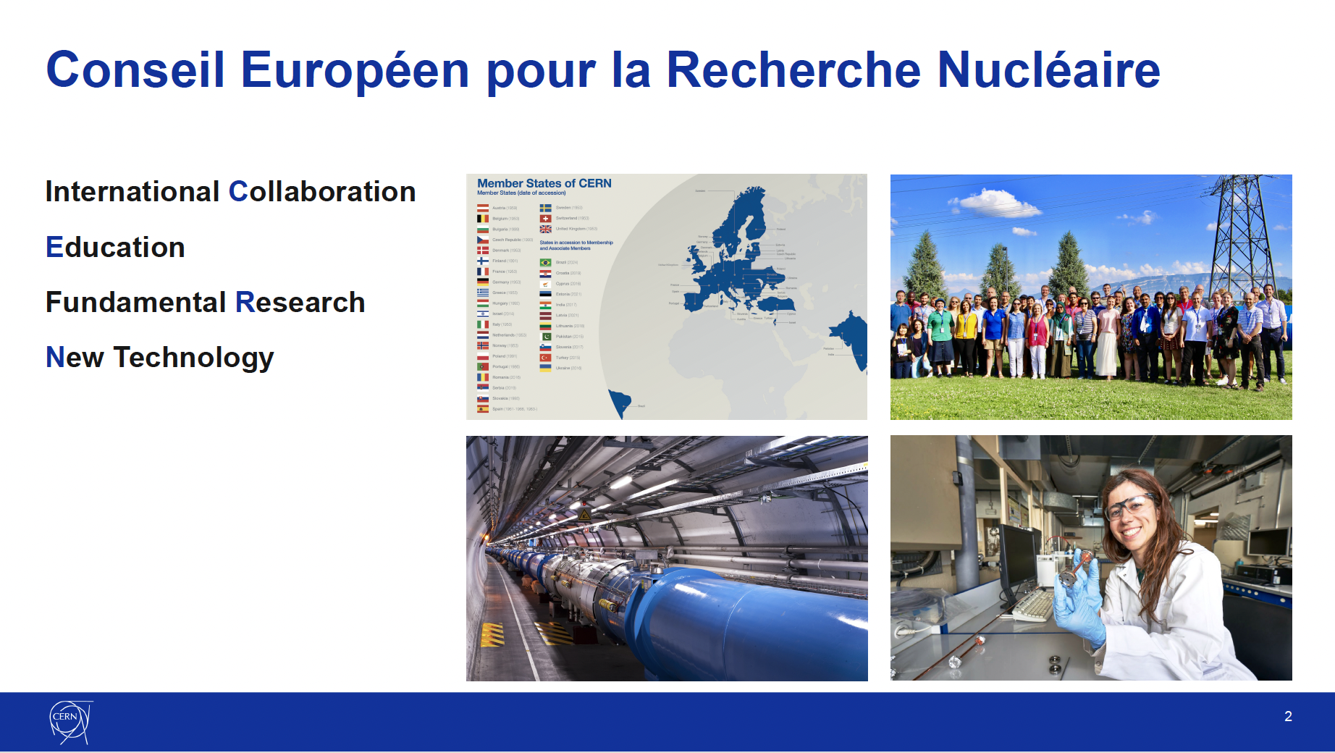
CERN

Slide 3
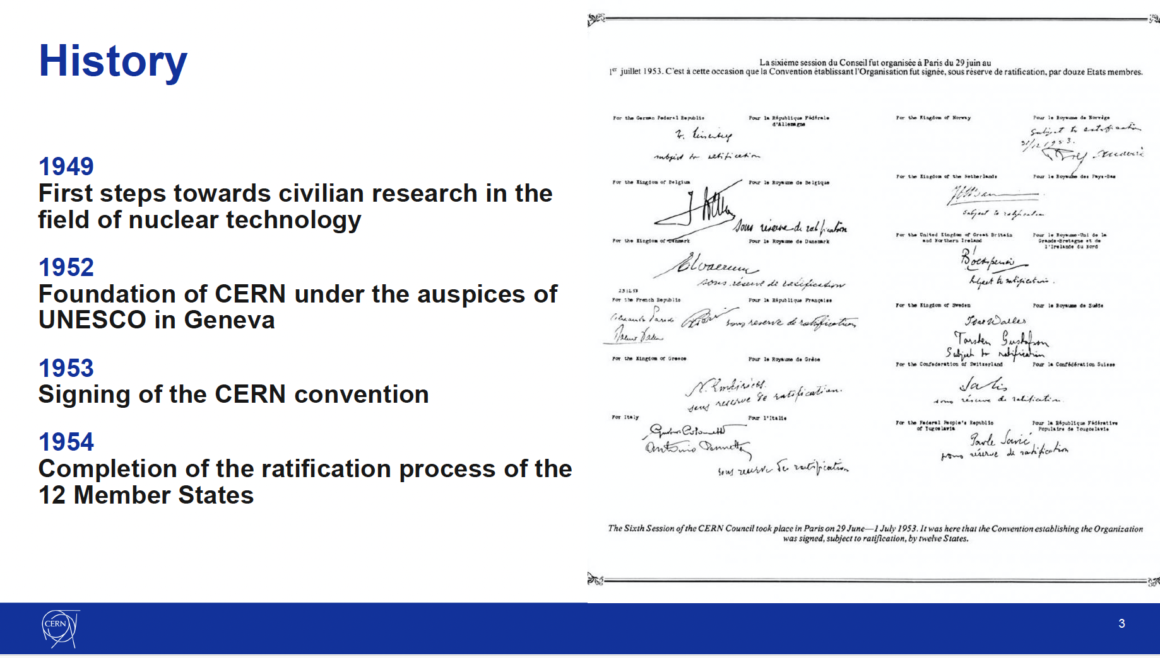
History

Slide 4
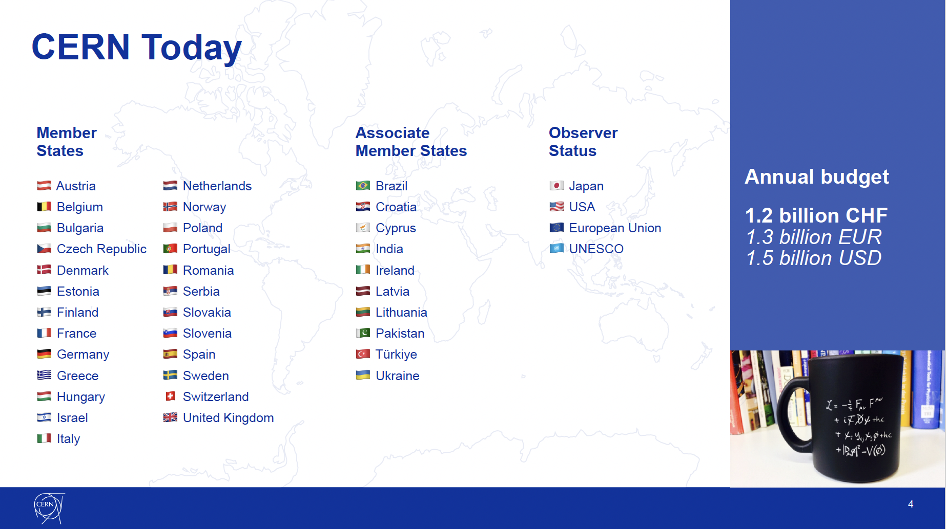
Today

Slide 5
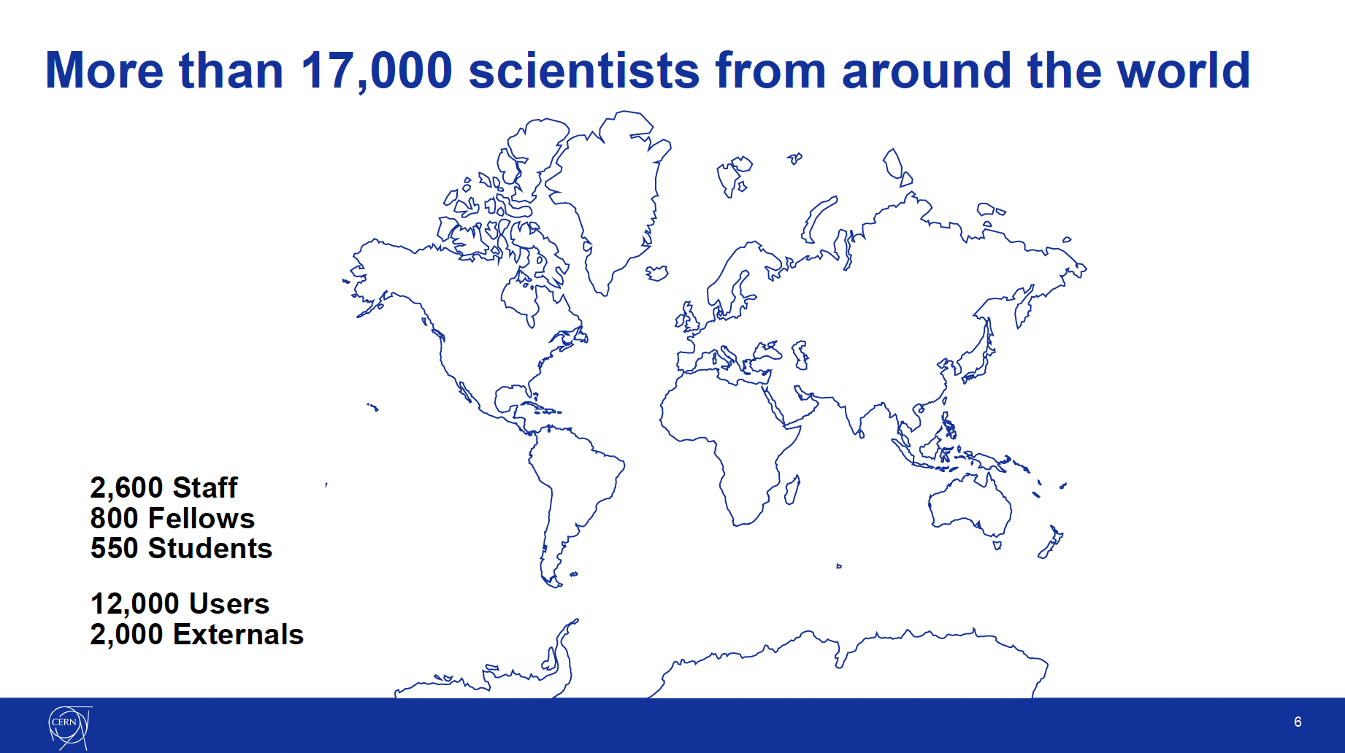

Slide 6
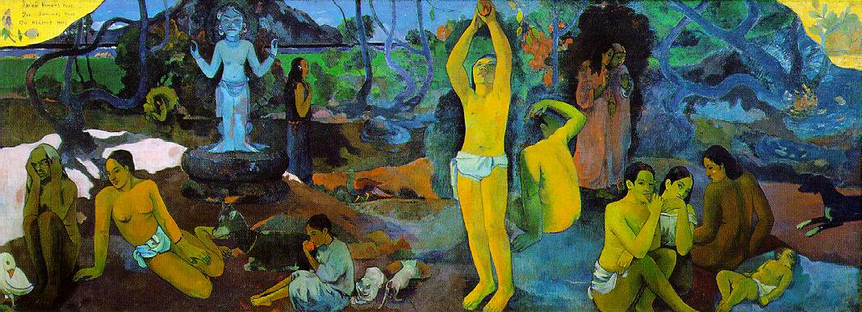
Gauguin’s questions
What is the future of the Universe?
What is the Universe build from?
What were early
phases after Big Bang?
Where are we going ?
Who are we ?
Where do we come from?
Notes:
Čovjeka su odvajkada mučila teška pitanja, a ovdje ih je jezikom umjetnosti predocio francuski postimpresionisticki slikar Eugene Henri Paul Gauguin
Od kuda dolazimo (s desna)? Tko smo mi? Kuda idemo?
7 June 1848 – 8 May 1903 francuski postimpresionizam
U kozmoloskom jeziku ta pitanja su: Od kuda dolazimo…= Koje su bile rane faze Big Banga (Velikog praska) "On the right (Where do we come from?), we see the baby, and three young women - those who are closest to that eternal mystery. In the center, Gauguin meditates on what we are. Here are two women, talking about destiny (or so he described them), a man looking puzzled and half-aggressive, and in the middle, a youth plucking the fruit of experience. This has nothing to do, I feel sure, with the Garden of Eden; it is humanity's innocent and natural desire to live and to search for more life. A child eats the fruit, overlooked by the remote presence of an idol - emblem of our need for the spiritual. There are women (one mysteriously curled up into a shell), and there are animals with whom we share the world: a goat, a cat, and kittens. In the final section (Where are we going?), a beautiful young woman broods (to be in deep thought;meditate), and an old woman prepares to die. Her pallor and gray hair tell us so, but the message is underscored by the presence of a strange white bird. I once described it as "a mutated puffin," and I do not think I can do better. It is Gauguin's symbol of the afterlife, of the unknown (just as the dog, on the far right, is his symbol of himself).

Slide 7
Thank you!

