Slide 1


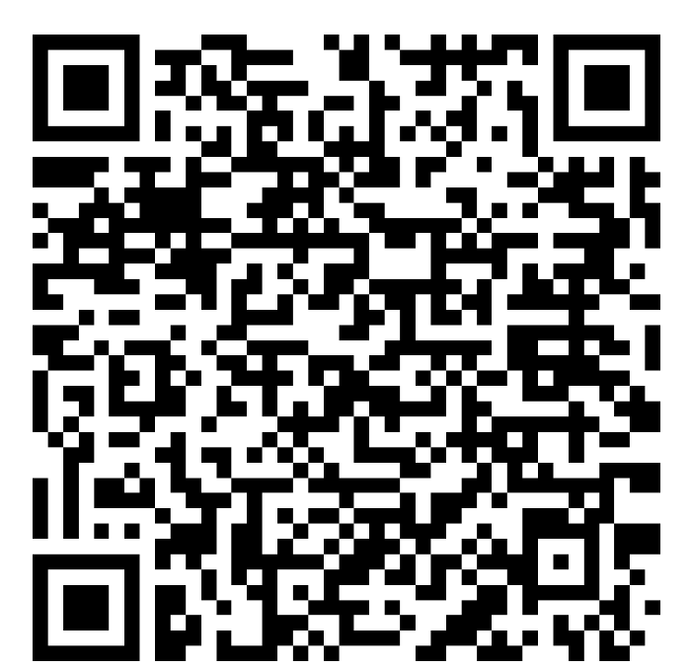
PSD14 Conference Papers
The PSD14 conference papers will be published in a dedicated Research Topic that is co-listed in
Frontiers in Detector Science and Technology
and Frontiers in Physics
Editorial Team:
Paul Sellin: p.sellin@surrey.ac.uk
Richard Bates: richard.bates@glasgow.ac.uk
Michela Esposito: michela.esposito@ucl.ac.uk
Link to the PSD14 Research Topic:
https://www.frontiersin.org/research-topics/84951/advances-in-position-sensitive-detectors-insights-from-psd14-conference
Deadline for paper submission: 1st December 2026
QR code for PSD14
Research Topic

Slide 2
Paper Styles
Frontiers is a fully open-access and online journal
A range of different paper styles are offered. The most relevant styles for PSD14 are probably the following:
Original Research Paper – a full-length research paper featuring unpublished data
Techniques and Methods Paper – a significant new method, protocol, or technique. This can include results, either completed or anticipated
Review Paper – either full length, or a briefer mini Review.
Brief Research Report – useful for presenting results in a brief format. Maximum 4000 words and 4 figures/tables

Slide 3
Publication Charges
Frontiers uses a publication fee, or Author Publication Charge (APC)
The cost of the APC varies, depending on which journal you wish to use, and the style of your paper:
The APC for Frontiers in Detector Science and Technology is slightly lower than the APC for Frontiers in Physics
The shorter paper styles have a lower APC
Overall, the APC ranges from CHF 1750 – CHF 2695 (£1575 - £2425)
Options for fee support:
1. Some Universities have fee discount agreements with Frontiers (including CERN)
2. The conference has a limited number of 50% fee waivers
Please use the Online Form on the conference website to request a 50% fee waiver – application deadline is 1st October

Slide 4
Further Information
All the information about the PSD14 Conference Papers is available on the Conference Website.
There is a FAQ which has more detailed information about
paper styles and publication fees.
You are also welcome to speak with the Frontiers Journal team,
who have a table in the poster area
Key Dates:
Applications for 50% fee waivers: 1st October
Submission deadline for papers: 1st December
We look forward to receiving your papers!

