Slide 1



Welcome to PSD14
International Conference on Position Sensitive Detectors
Tue 1 September 2026
Dr Seth Zenz, QMUL, Local Organising Committee Chair
Thanks to our sponsors!

Slide 2
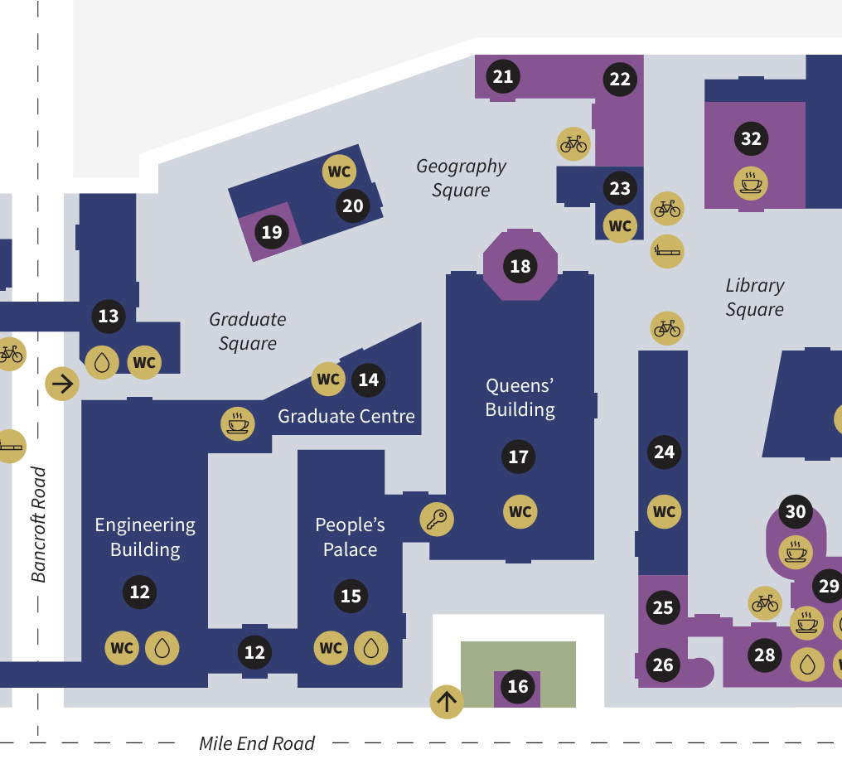
Where are we?
Graduate Center (14)
  Foyer: Posters 1-12, 20-23, exhibitors, catering tables
  Peston Lecture Theatre: all talks
Engineering Foyer (12)
  Access across the courtyard
  Posters 13-19, 24-40 (and beyond)
Octagon (18)
  Conference Dinner
Cafes
  Graduate Centre (14), Ground (30), see full campus map for all locations
All step-free access
  Octagon steps have a lift if required
Emergency Assembly Point: Library Square
Court-
yard
N.B. Poster numbers are not the indico contribution number – ask a LOC member

Slide 3
Catering
We will serve coffee at the breaks and sandwiches for lunch each day
  Traditional Meat, Fish, Halal, Vegetarian, Vegan
Your dietary requirements should be covered if we had them already before the conference
  These should have been double-checked at registration
  If you need to double check or have any requirements we don’t know about, please let me know!
Conference Dinner – Wednesday 2 September
  One primary menu: sit where you like if you don’t have dietary requirements
  Those with dietary requirements will need to sit in specific places – ask the staff when you arrive
Our kitchens may handle nuts etc and we cannot guarantee that there is no cross-contamination
  This applies to all catering and other places to eat at Queen Mary
  If you have questions or concerns please speak to me or another LOC member

Slide 4
Poster and Exhibition Sessions
Each poster has a defined location…
  Please ask a LOC member for your poster number and location
  N.B. the number is not the same as the Indico contribution number
  We use one side of each board to maximise space for conversation
… but not a defined time!
  Please be ready to talk about your poster throughout the scheduled sessions: Wed 1-2, 4-6; Thu 9:45-11
There will be judges and prizes! See https://indico.global/event/16792/page/6166-poster-sessions-and-prizes
Remember to visit our sponsors!

Slide 5
Talks
All talks are plenaries and are in this room
All talks are 15+5: 15 minutes speaking, 5 minutes for questions
Please upload your slides to indico at least 1 hour before the start of the session
Overview/introduction talks
  PSD traditionally has overview talks for detector usage in each field
  We have these on some topics but not others
  Remember we are from many fields, and think about the context your audience has!

Slide 6
Proceedings
Frontiers in Detector Science and Frontiers in Physics
Dedicated talk on Wednesday PM by Lead Editor Paul Sellin
Detailed information on Indico: https://indico.global/event/16792/page/5679-publication-of-proceedings
Deadline 1 December 2026

Slide 7
Code of Conduct
Attendees will be expected to adhere to the Institute of Physics Code of Conduct as it pertains to conference attendance: https://www.iop.org/code-conduct
  See Section 5, "Treating all with Dignity and respect"
Concerns about Code of Conduct violations should be communicated to the LOC Chair, Seth Zenz, s.zenz@qmul.ac.uk

Slide 8
Further Questions?
Please see the indico page sidebar
  Many topics covered, including a new and growing FAQ
Do you need a receipt/invoice/letter? Email me!
WiFi
  Eduroam if your institution supports it
  QM-Visitor works too – just click “Get Connected” when it pops up
If you are still unsure, please ask me or another LOC member

