Slide 1




Embedding Position Sensitivity in the Detector with ANNA: an Analog Neural Network ASIC
M.Amadori, M.Ronchi, G.Borghi, M.Carminati and C.Fiorini
Politecnico di Milano and INFN, Milano, Italy
PSD14: The 14th International Conference on Position Sensitive Detectors
London (UK), 03-09-26

Slide 2
Outline
Motivation: edge-processing in large detection systems (Total-Body PET)
Neural networks for event reconstruction in monolithic scintillators
The ANNA ASIC: V1 and V2
Experimental measurements
Future application for LGADs readout
Conclusions

Slide 3
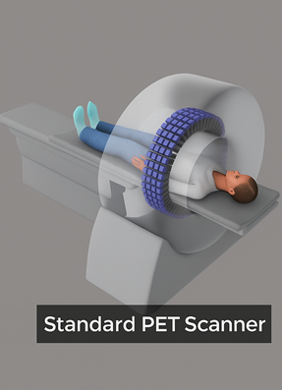

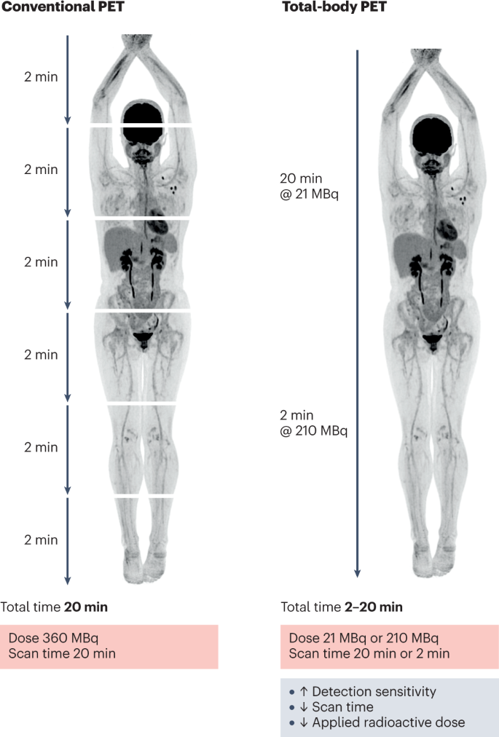
Motivation: edge-processing in large detection systems (TB PET)
Trend towards Total Body PET systems
(Katal S. et al. - Advantages and Applications of Total-Body PET Scanning. Diagnostics, 2022)
Advantages
Full-body coverage
Higher sensitivity
Faster scans
Lower radiation dose
Disadvantages
High number of channels
Complex system implementation
High power
Total time
20min
Total time
2-20min
Low-power, edge-processing of detector signals required
(also for other applications with large number of detector modules)

Slide 4
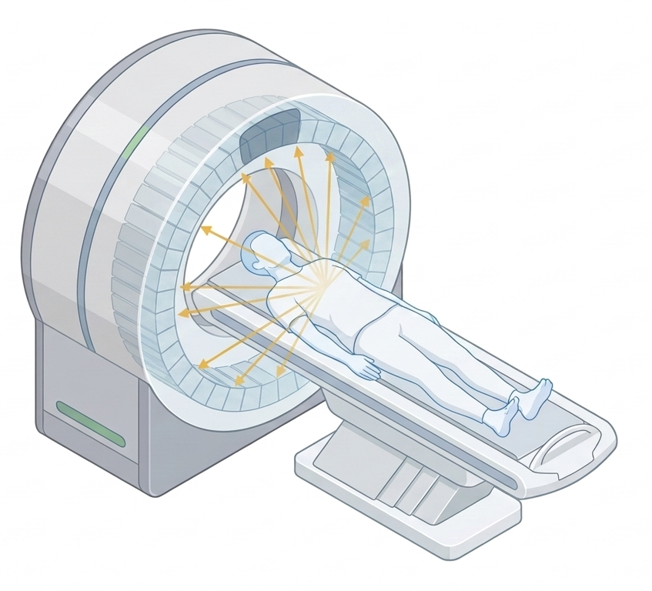
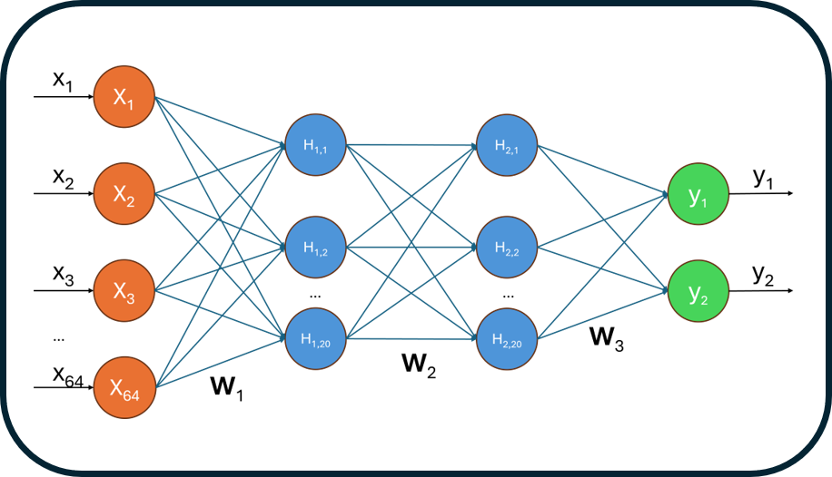
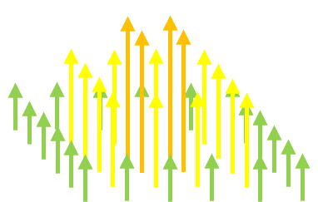
Monolithic Scintillator Detector and Neural Network Reconstruction
X
Y
Scintillator
crystal
Photodetectors
+ front-end
Position Reconstruction
Algorithm (Neural Network)
Monolithic Scintillator: simplifies the scintillator structure (vs. pixelated), facilitate DOI, at cost of possible pile-up
SiPMs Readout: now quite standard vs. PMTs as more compact and insensitive to magnetic fields
Neural Network Algorithm: better and faster estimation of γ-ray interaction in the crystal, vs. Anger and other methods

Slide 5
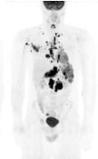
Traditional Digital Processing vs Analog Processing (ANNA)
64 ADCs
Analog Neural Network ASIC (ANNA)
FPGA
Computer
Image Reconstruction Algorithm
Image Reconstruction Algorithm
Traditional Processing
X
x 64
digital
signals
Y
Computer
Image Reconstruction Algorithm
2 ADCs
X
Image Reconstruction Algorithm
Analog Processing
Y
Only 2
analog
signals

Slide 6
Traditional Digital Processing vs Analog Processing (ANNA)
Analog operations performed directly on analog signals coming from photodetectors
No need for ADC and FPGA for embedded processing
Interaction coordinates (X,Y) directly at the output of the ASIC
Compatibility with Front-end ASIC for SiPMs current processing (Amplitude, Timing)
Same approach possible also for other segmented solid-state detectors
Analog approach (as memristors) to in-memory computing (vs. digital)
Analog Neural Network ASIC (ANNA)
Computer
Image Reconstruction Algorithm
2 ADCs
X
Image Reconstruction Algorithm
Analog Processing
Y
Only 2
analog
signals

Slide 7
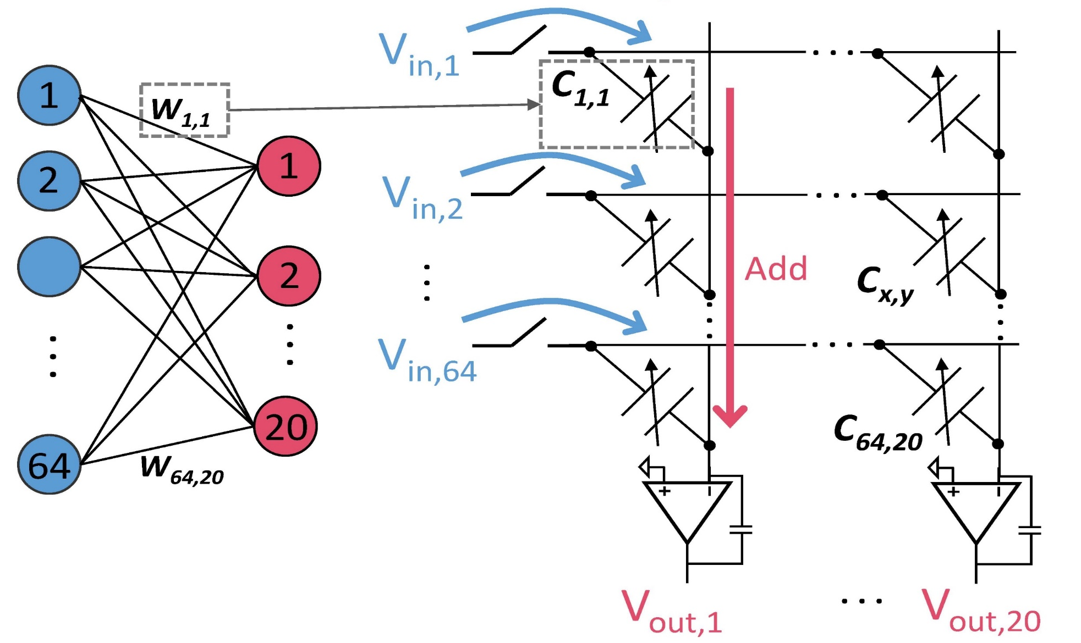
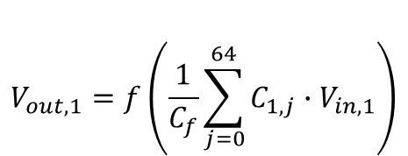


ANNA: Analog Multiply and Accumulate (MAC) principle
$${Multiplication: Q1,1=C}_{1,1}∙{Vin,}_{1}$$
Features:
Capacitive cross-bar array
Charge sum by an integrator
Activation function implemented in the integrator
$$V_{out,1}=f\left(\frac{1}{C_{f}}\sum_{j=0}^{64}{C_{1,j}∙V_{in,1}}\right)$$
C_{f}
$$f:activation function$$

Slide 8
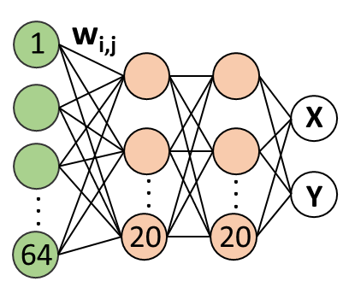
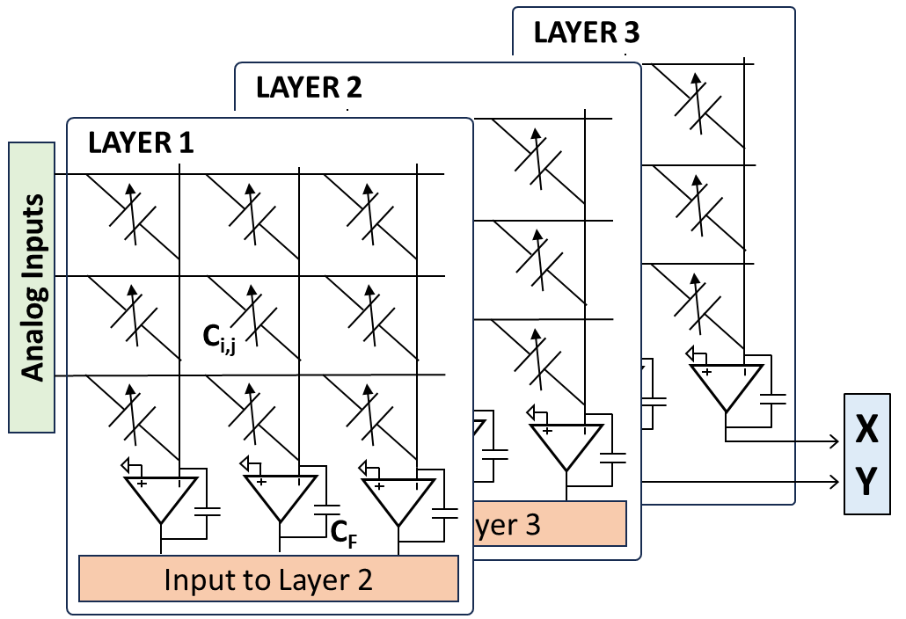
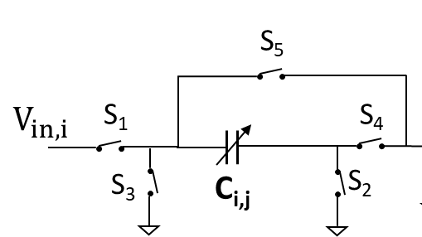
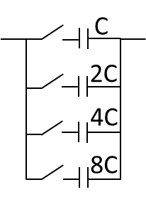
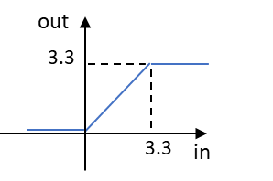
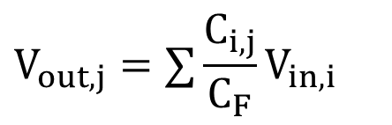
ANNA (Analog Neural Network ASIC): V1 version (proof-of-concept)
Cell i,j
4 bits weight
(+ 1 bit sign)
Switches: allows to circulate the charge in two directions (positive and negative weights)
Activation function: clipped ReLU implemented by the op-amp bias limits
Quantization-Aware Training
$$V_{out,j}=∑{\frac{C_{i,j}}{C_{F}}V}_{in,i}$$
MAC:
weight

Slide 9

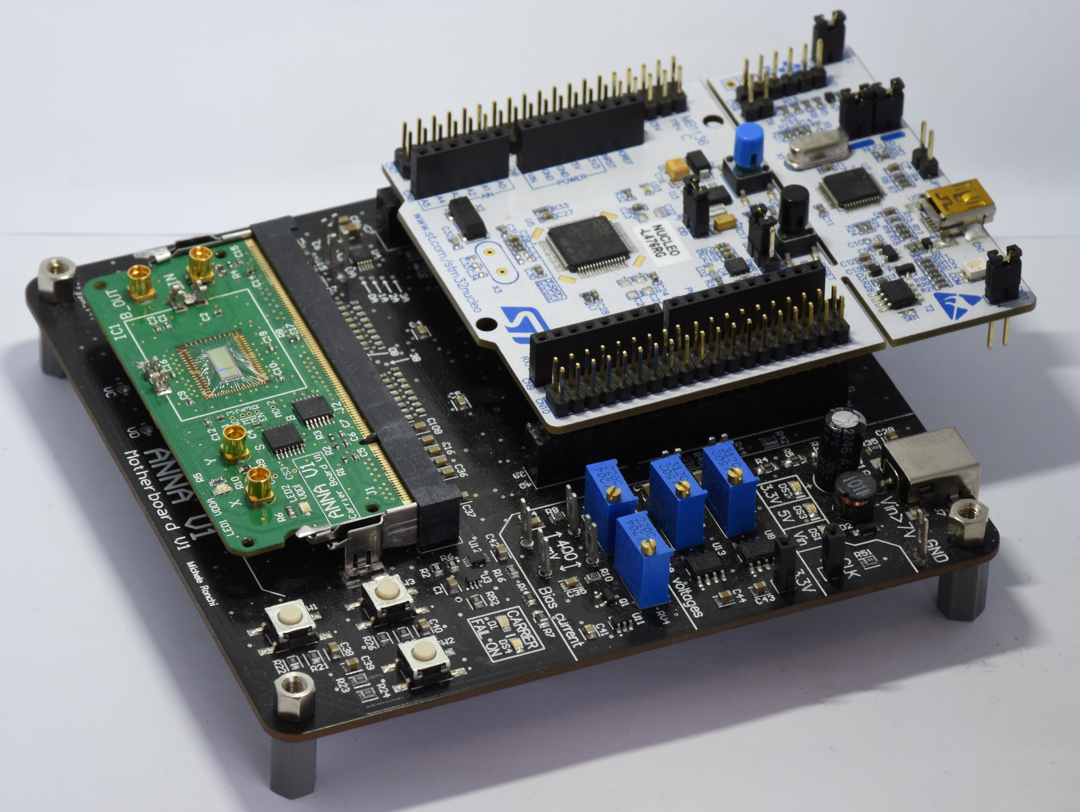
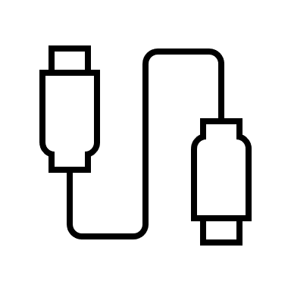
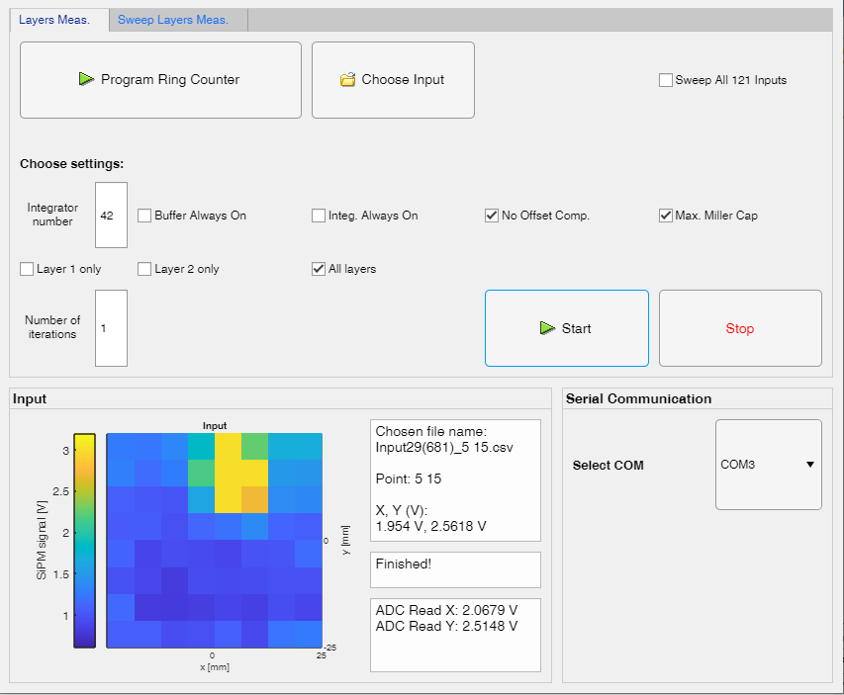
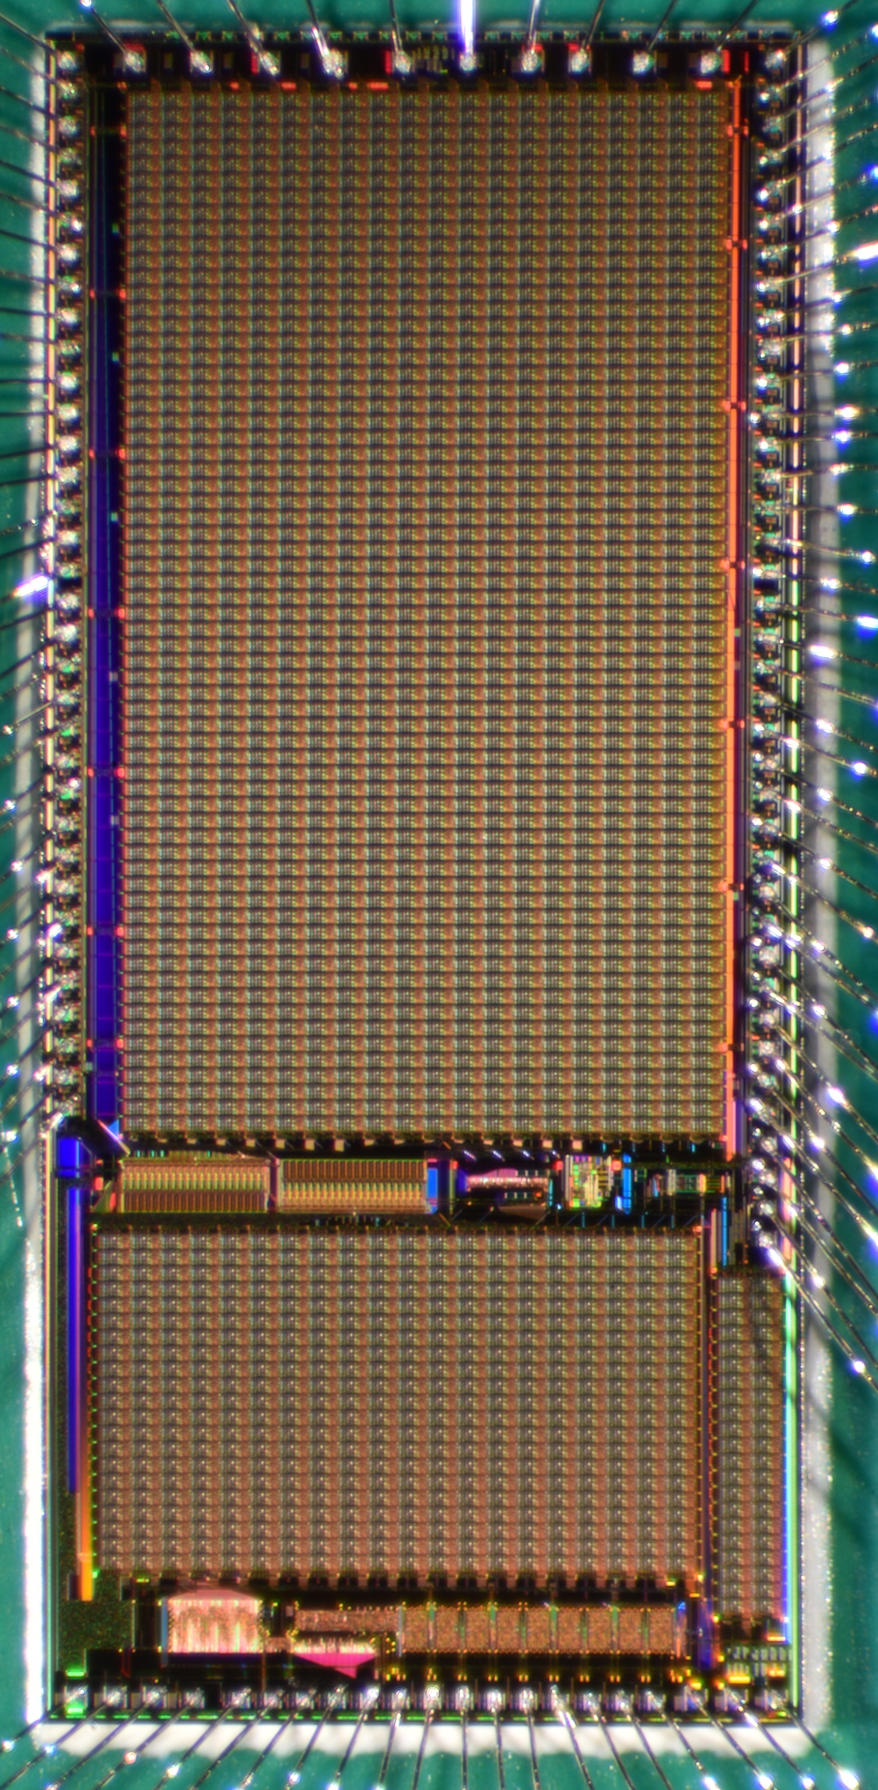
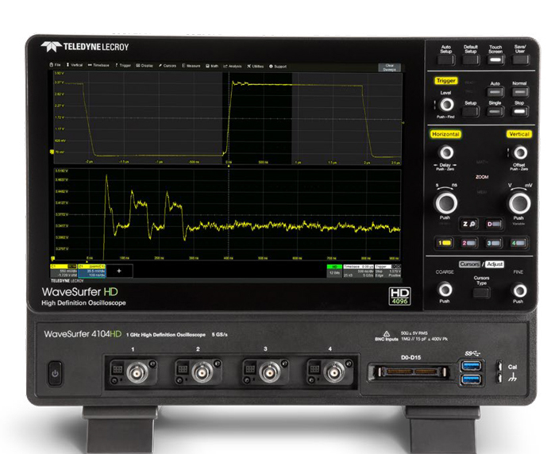
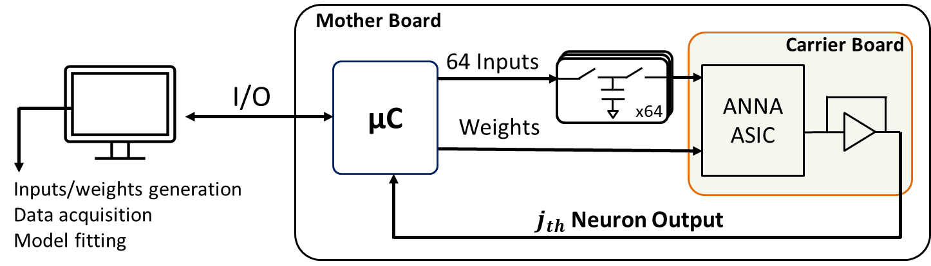
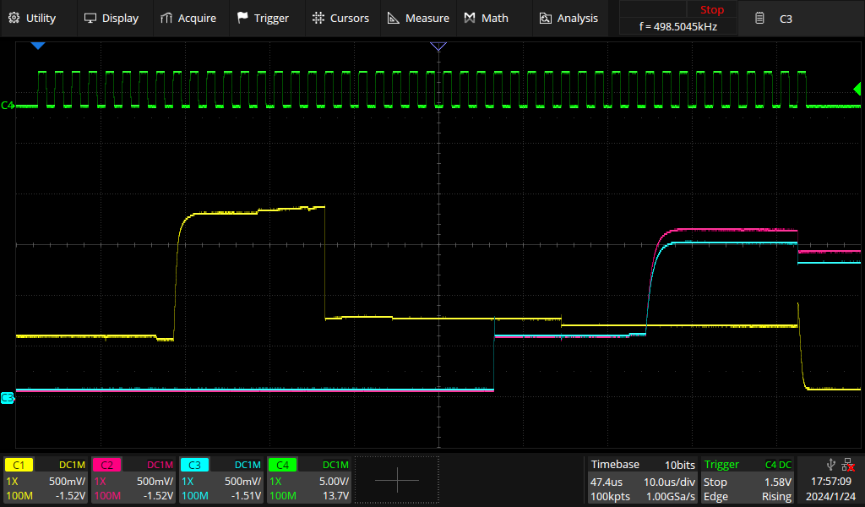
Characterization of ASIC V1 (CMOS 0.35 µm, 24 mm²)
Microcontroller Board
Carrier Board
Layer 1
Inner nodes
Graphic interface:
ASIC programming
Inputs delivery
Data acquisition
Integrators
X
Layer 2
Y
Mother Board
3
Digital (SPI)

Slide 10
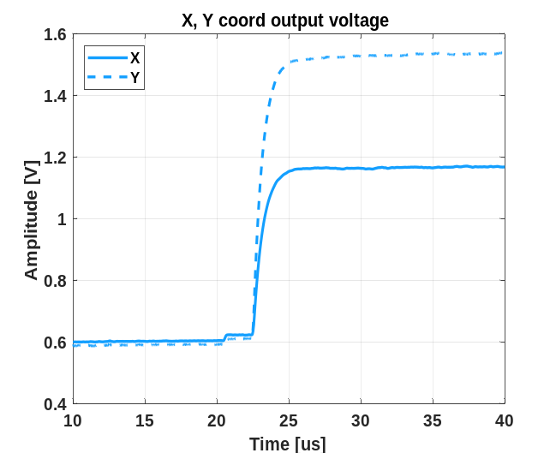
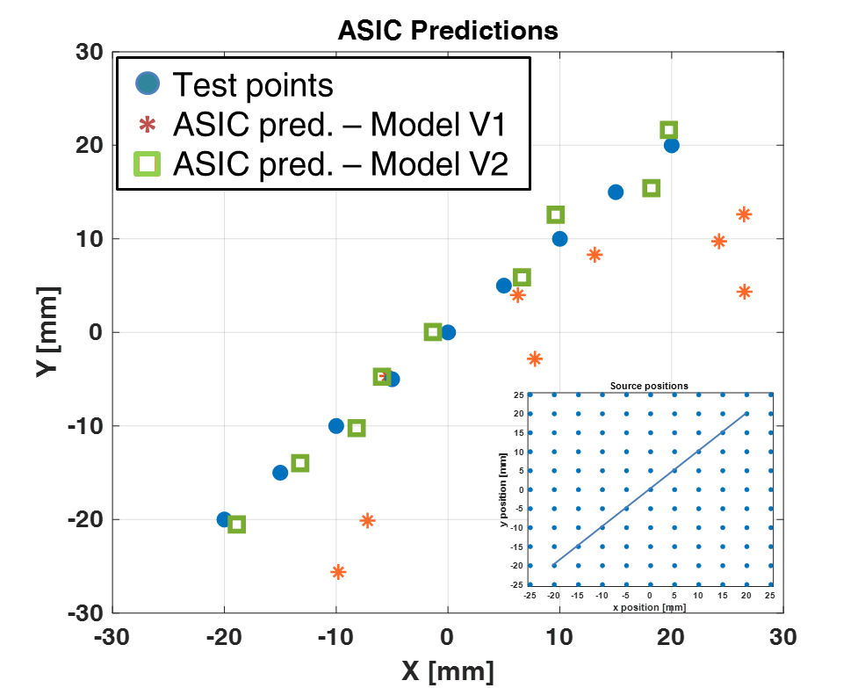
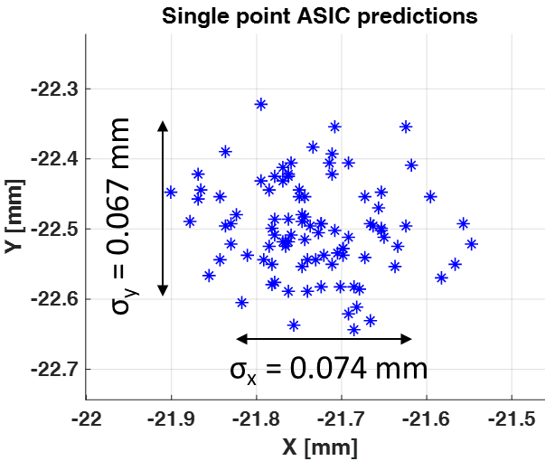
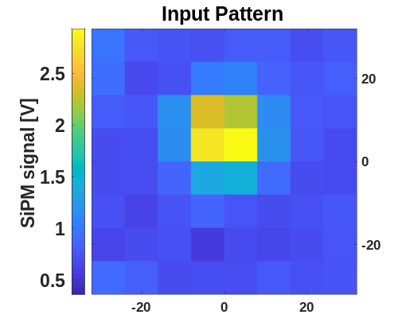
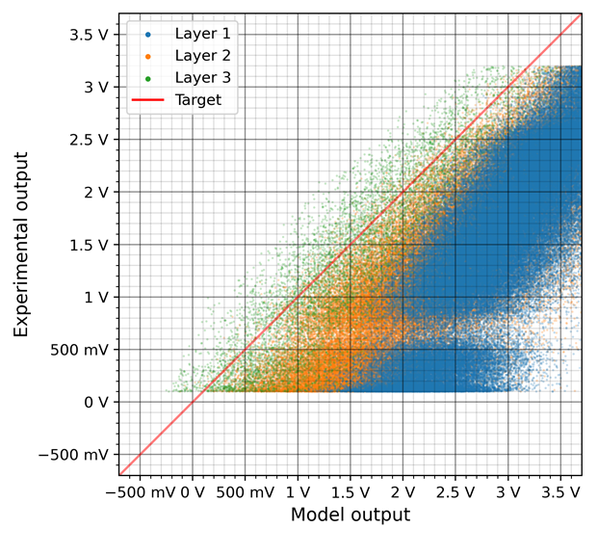
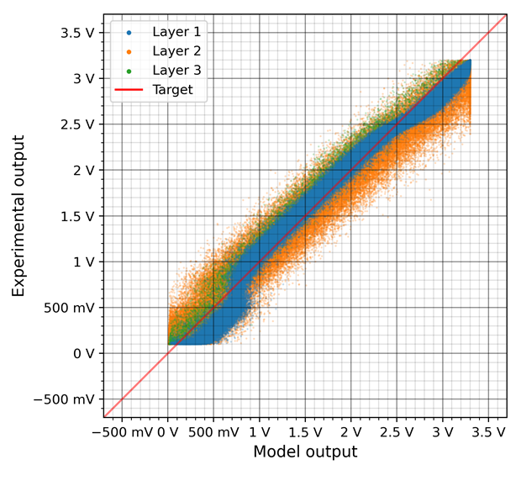
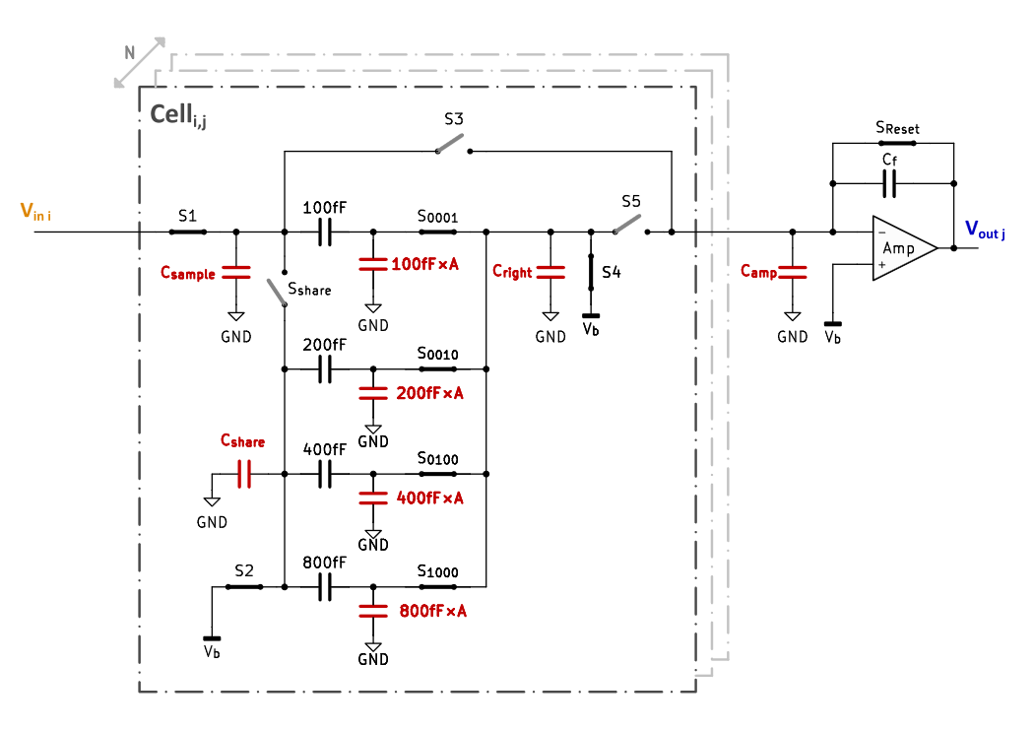
ANNA V1 Performance Characterization
Grid of 121 simulated points (ANTS2) provided as ASIC voltage inputs
8x8 SiPMs signal [V]
X
y [mm]
Y
x [mm]
Original, simplest model
Hardware-aware model
Hardware-aware model, used during training, takes into account parasitics, offsets and charge injections, measured during stand-alone test of the ASIC

Slide 11
ANNA V2
New improved architecture (including recursive network)
Parasitics: more repeatable and easier to characterize, access to raw analog outputs of each layer
Complexity: simplified neuron design, fewer steps needed for MAC operations
 | ANNA V1 | ANNA V2
Process node | 350 nm | 110 nm
Supply voltage | 3.3 V | 1.2 V
Area | 23.5 mm² | 9.5 mm²
Neural network config | Fixed | Programmable
Neural network | 64 inputs, 2 outputs 64 x 20 x 20 x 2 (3 weighted layers) | 69 inputs, 32 outputs 69 x 32 x 32 x 32 x 32 x 32 (5 weighted layers)
Parameters (weights and biases) | 1762 (5 bits – 31 analog levels) | 6496 (6 bits – 63 analog levels)
Inference execution time | 4.5 µs | < 1.5 µs
Throughput | 0.77 GOP/s | > 10 GOP/s
Efficiency | 0.05 TOPs/W | > 5 TOPs/W

Slide 12
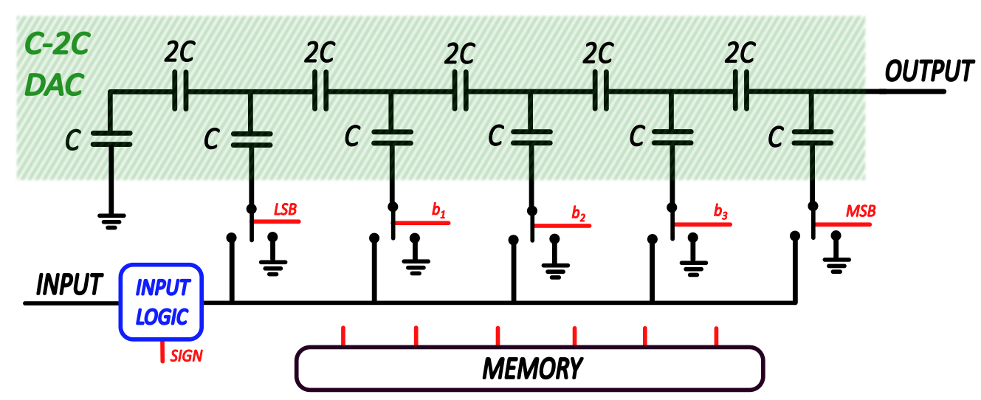
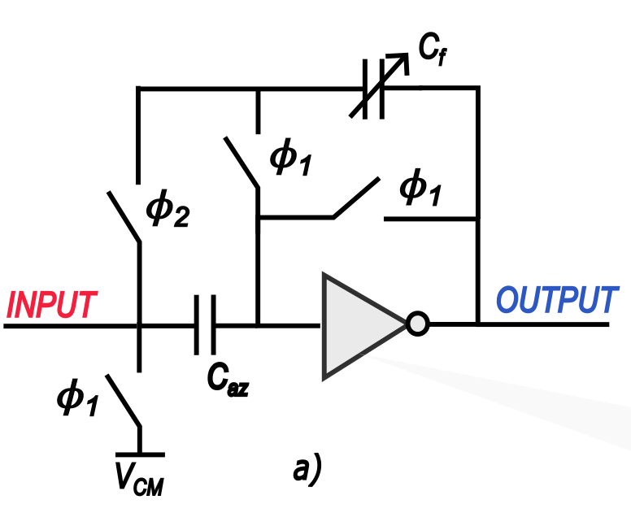
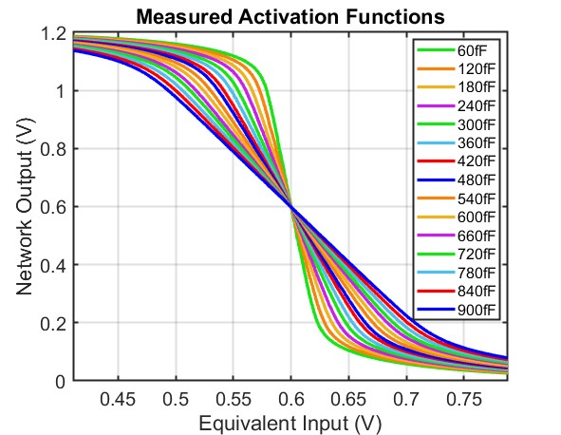
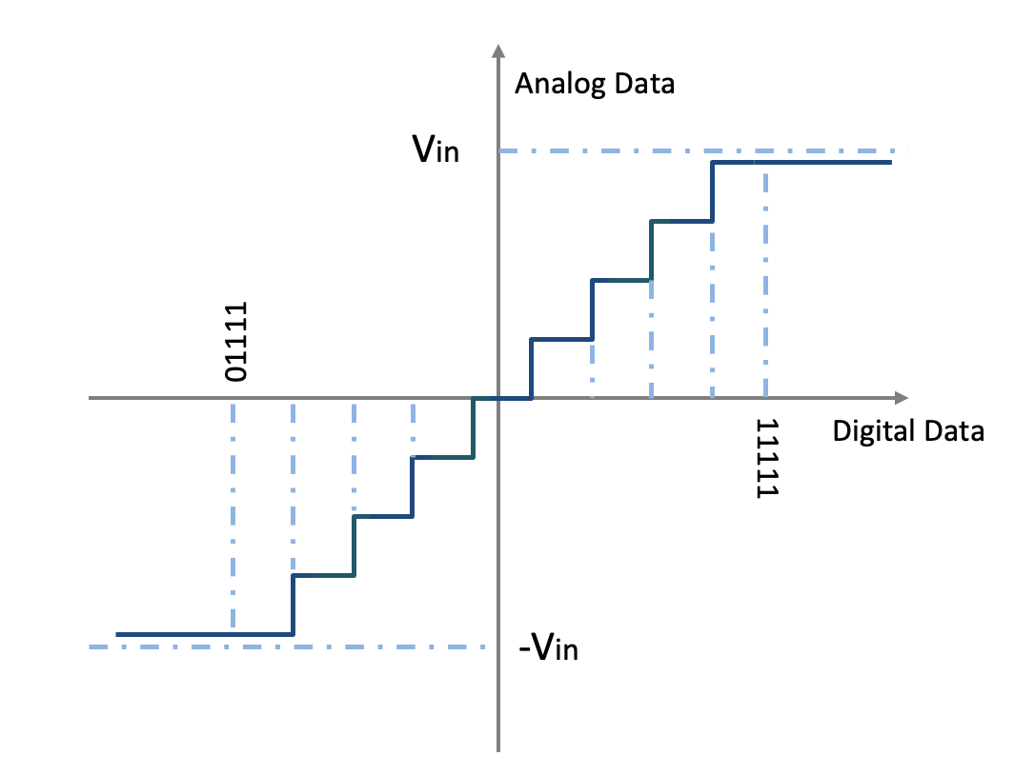

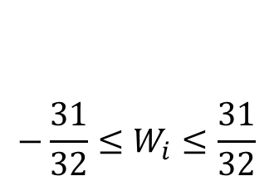
ASIC V2 design: new neuron schematic
New Multiplying Element (C-2C DAC)
New Integrator (inverter-based)
$$−\frac{31}{32}≤W_{i}≤\frac{31}{32}$$
Tanh-like activation function
Variable feedback capactitor (15 values)
6-bit weights precision
Programmable power consumption
Output capacitance always 2C
More compact layout
Charge injection reduction by design
Power reduction due to C reduction (30fF)

Slide 13
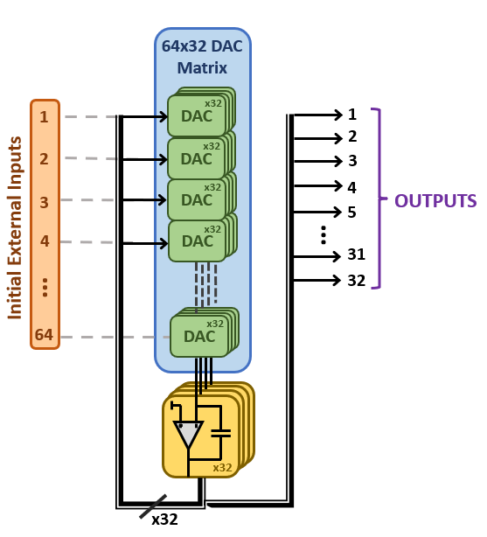
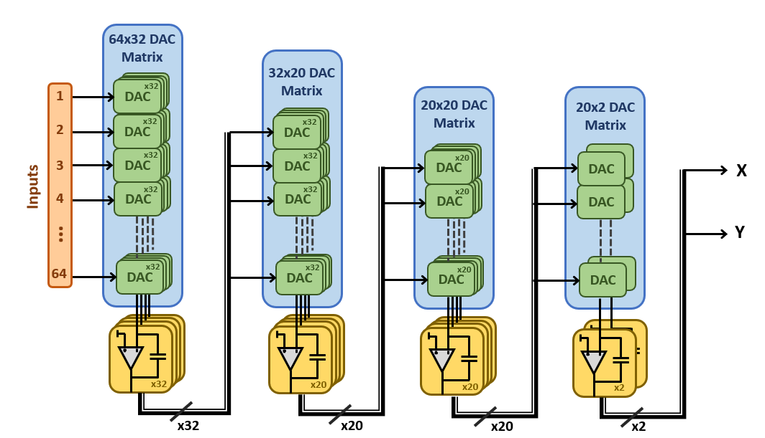

ASIC V2 architecture: recursive network
Standard network (as in V1)
Recursive network
32 outputs are feed back to the inputs
Weights (stored in SRAM) are iteratively updated each layer
High Area occupation
No Flexibility
Simple Design
Low Area
High Flexibility
Difficult Design

Slide 14
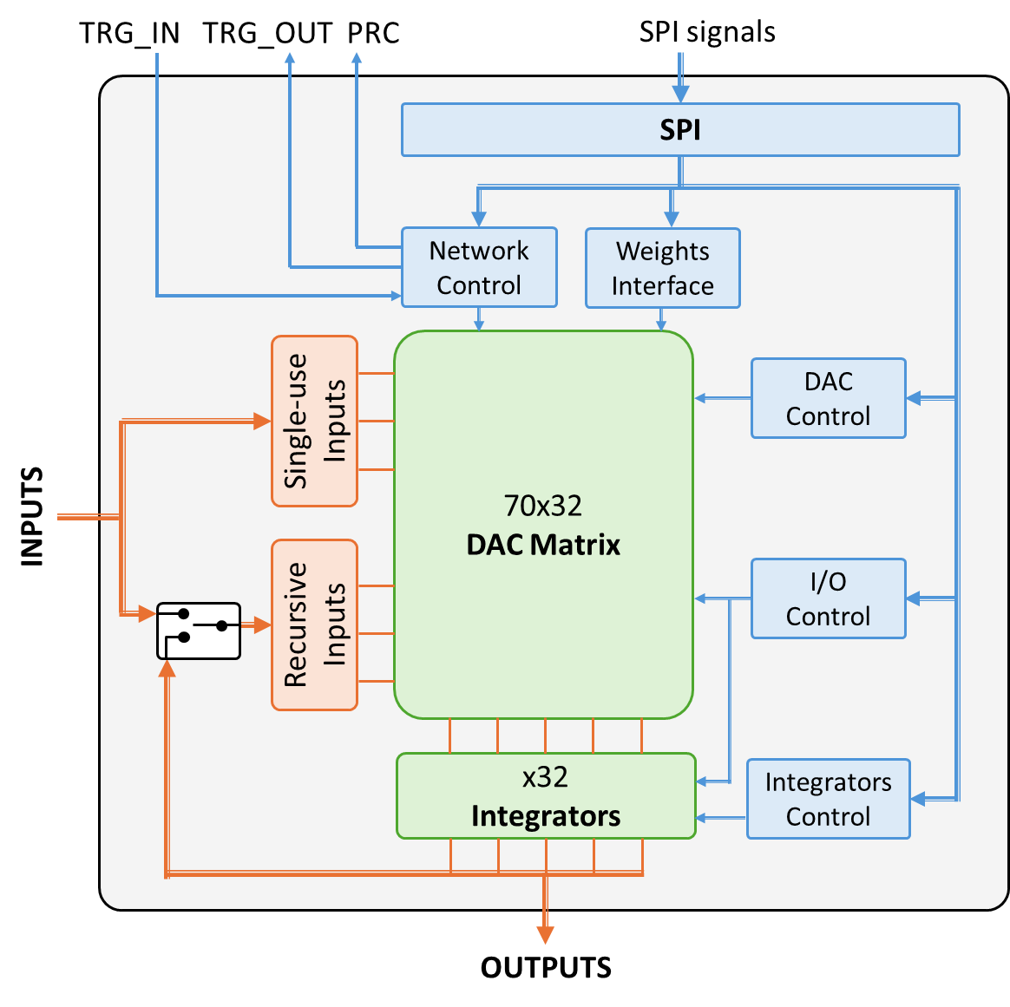
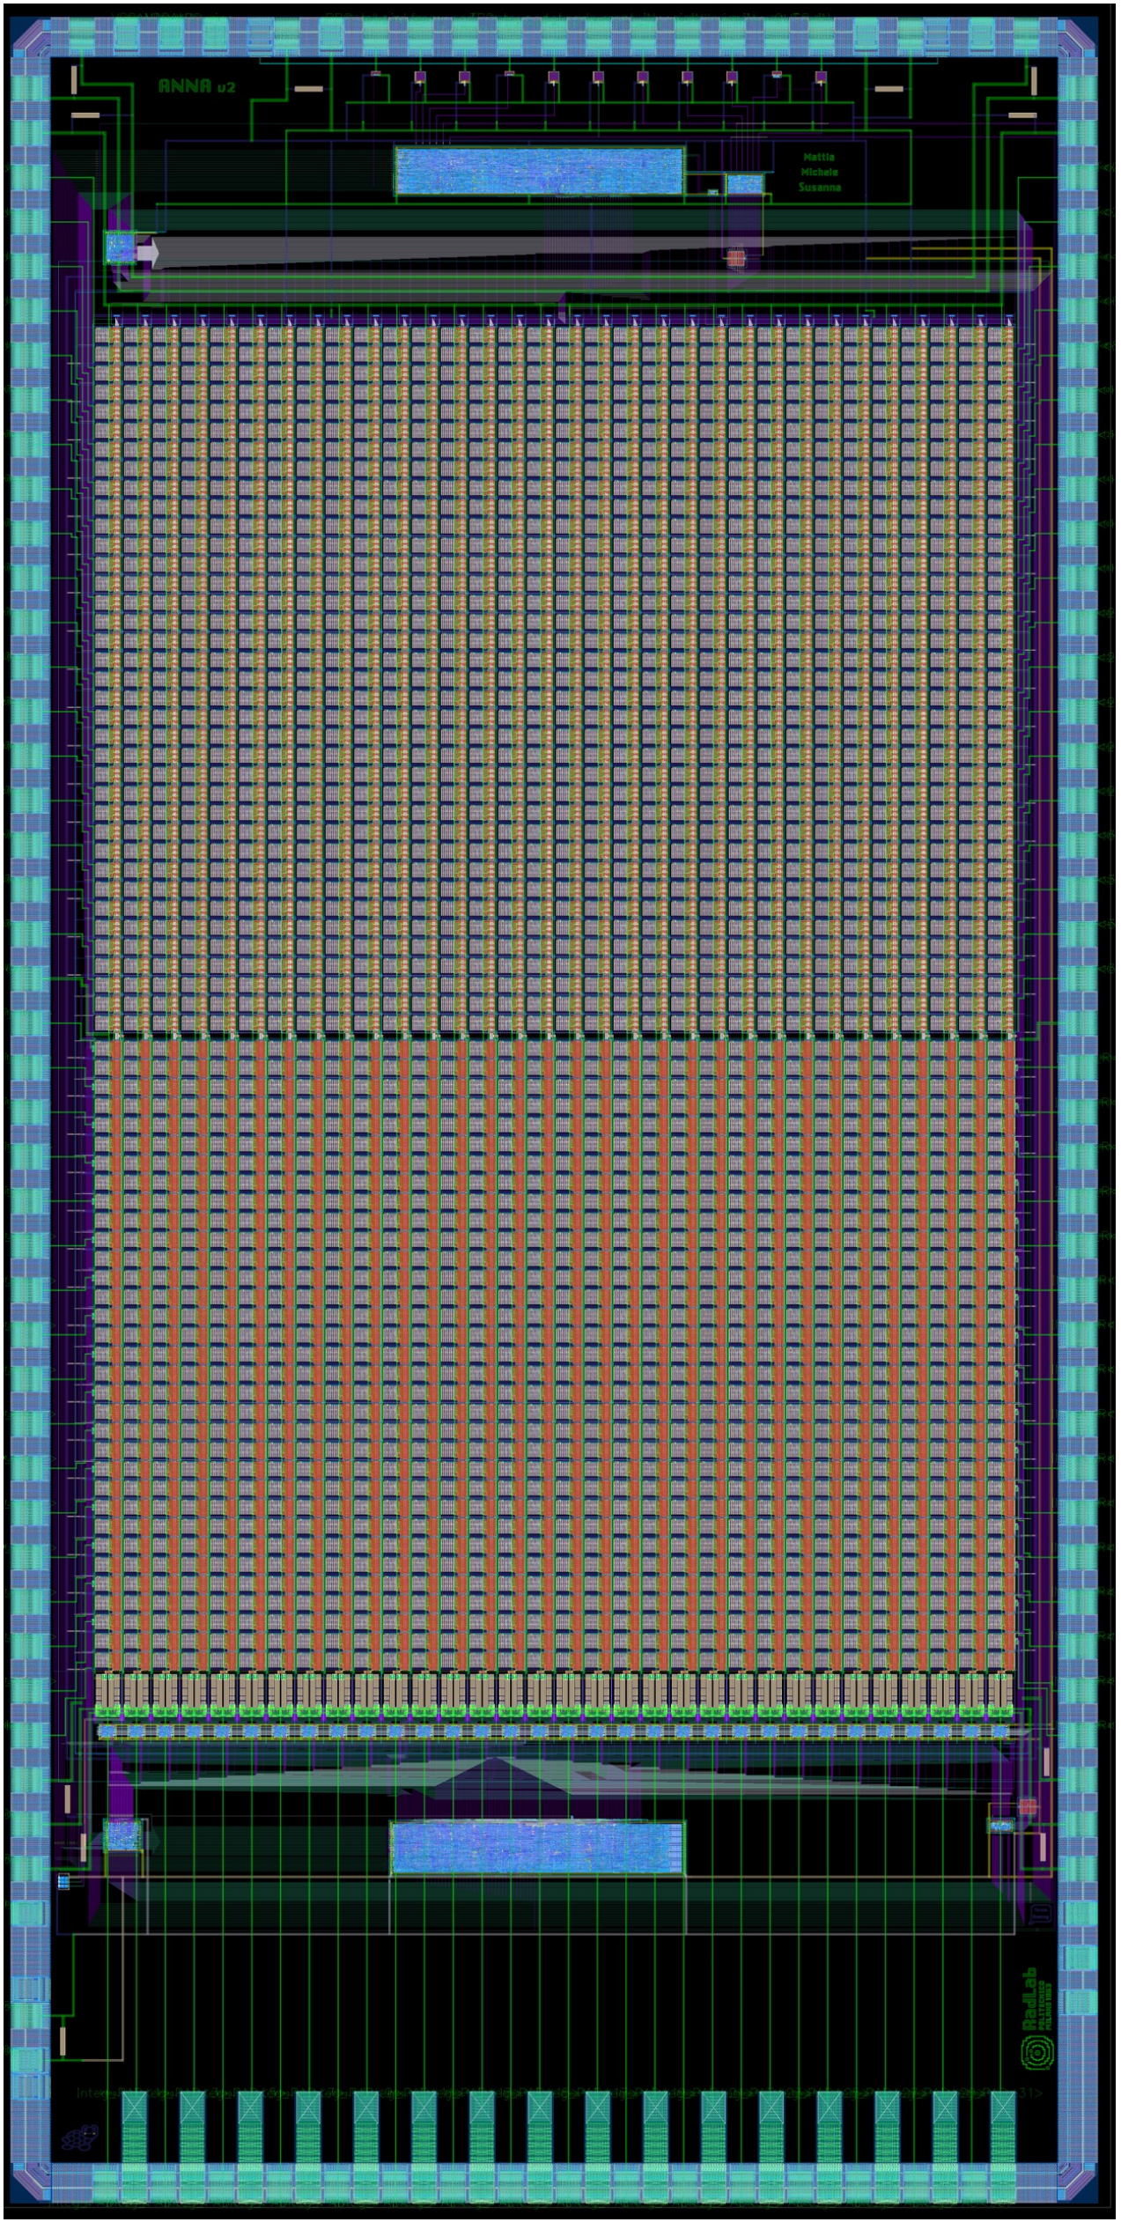
ANNA V2 – Architecture and Layout
ANNA V2
Single reusable layer
Fully programmable neural network (layers and neurons) and parameters (weight, biases, activation functions)
Configurable power consumption and power cycling
Programmable layer duration and synchronization
Trigger based input processing and options to improve throughput
Non
Recursive
35 inputs
35 inputs
Recursive
32 outputs

Slide 15
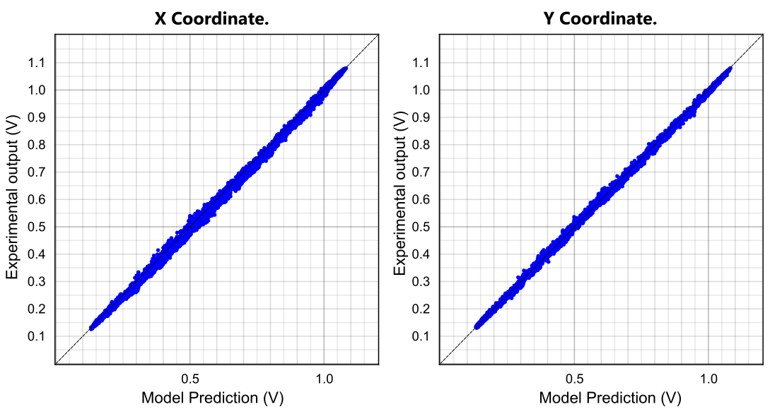
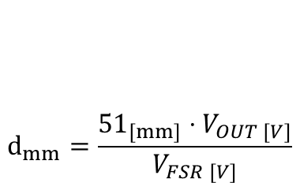
64x20x20x2 Network - Results
Grid of gamma-ray events emulated with ANTS3
$$d_{mm}=\frac{{51}_{[mm]}⋅V_{OUT [V]}}{V_{FSR [V]}}$$
Scintillator
Simulated events on a 51mm x 51mm LYSO scintillator
10mm
Linear mapping between mm and Voltages
51mm
Model vs ASIC Results
51mm
Mean Absolute Error (MAE)
Tensorflow Model | ~ 0.9 mm
ANNA | ~ 1.1 mm

Slide 16
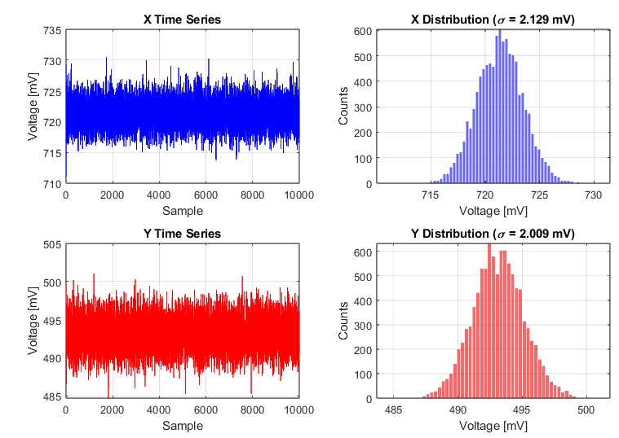
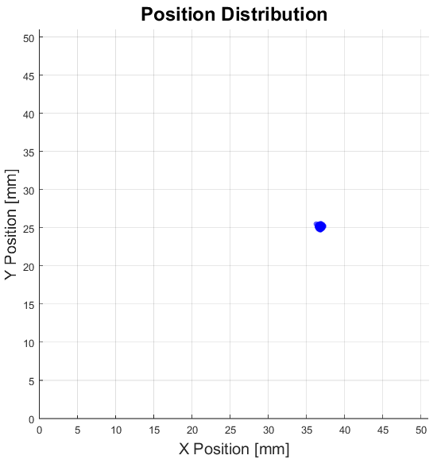
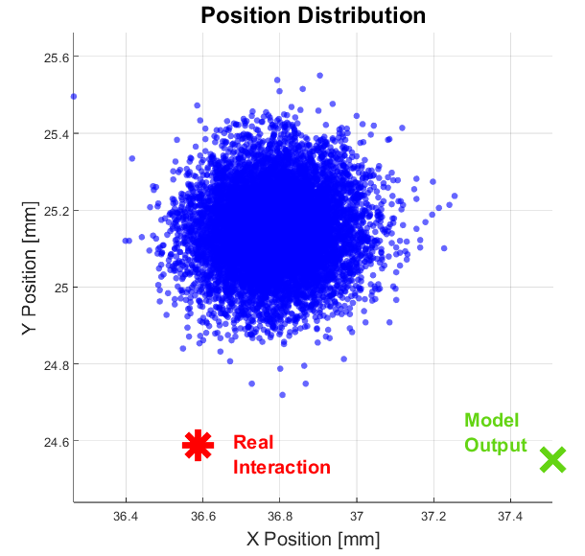
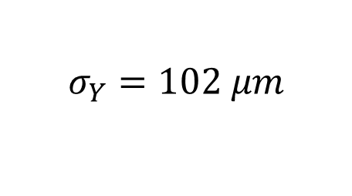
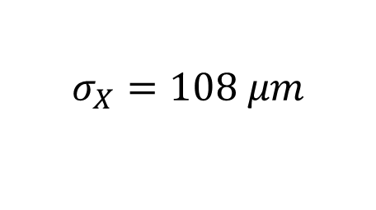
64x20x20x2 Network – Noise Analysis
Total SiPM Area
Noise of 10000 events
51mm
Cf = 120fF for every layer
51mm
Spatial Precision of
$$σ_{X}=108 μm$$
$$σ_{Y}=102 μm$$

Slide 17
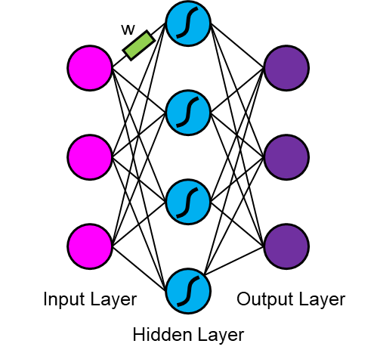
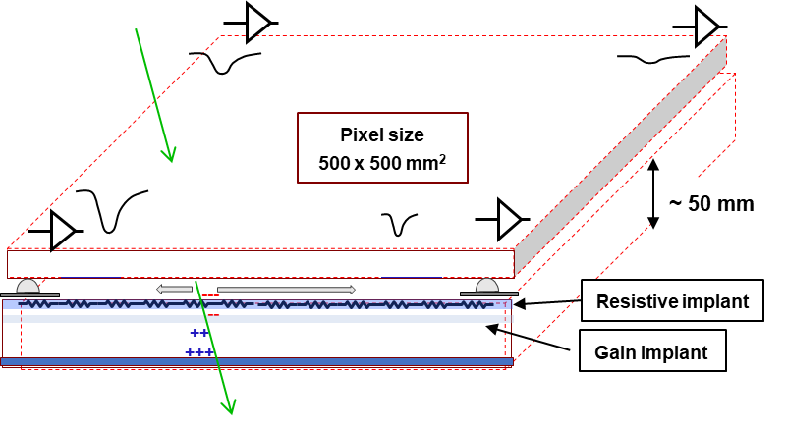
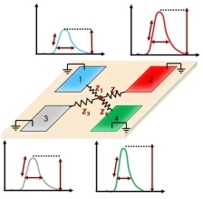
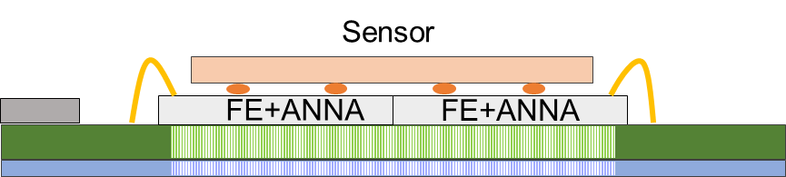
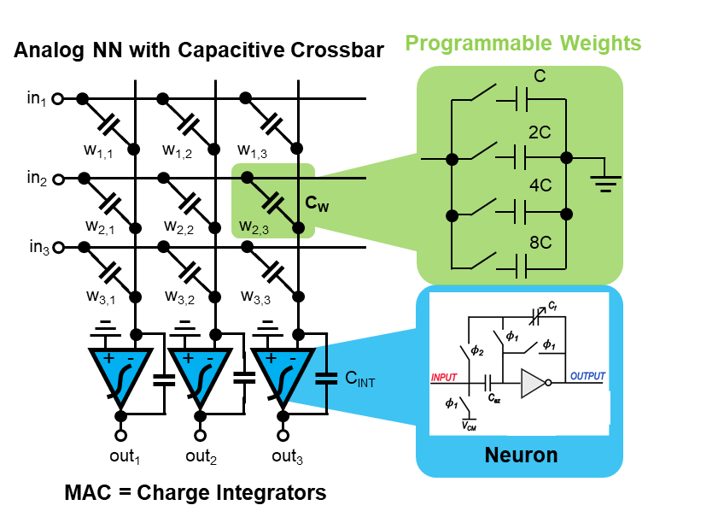
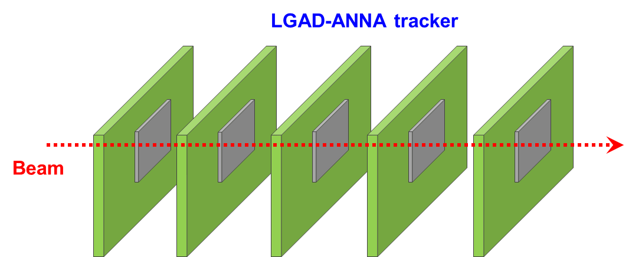
Future Developments – LGADs signals processing with ANNA processing
Resistive LGADs (DC-RSD) exploits charge sharing to achieve excellent spatial resolution, much smaller than the pixel size, reducing number of readout channels, power and material budget (N.Cartiglia, NIMA, 2022)
Neural networks (NNs) allows a fast and energy-efficient reconstruction of events in DC-RSD
1
2
3
ANNA implements the NN directly on-chip
We aim to develop a demonstrator for a new, low-power 4D tracker based on LGADs with embedded reconstruction of the event features (position, timing) by ANNA
Activity in collaboration with INFN-TO/FI, UNI-TO, UNI-Pe

Slide 18
Conclusions and future work
ANNA brings neural-network processing directly into the analog detector readout chain, avoiding prior signal digitalization.
The new ANNA V2 architecture combines high programmability, compact implementation and ultra-low-power analog computation.
Experimental results demonstrate accurate position reconstruction, not too far from the TensorFlow model.
This approach enables true edge processing in large-scale detector systems, reducing data throughput and system-level complexity.
Beyond monolithic scintillators, ANNA opens the way to “intelligent detectors” with embedded reconstruction, including future low-power LGAD trackers.
Next steps:
Construction (ongoing) and test of PETRARCA: a PET detector with embedded, ANNA-based position recontruction
Development of a proof-of-concept prototype of resistive LGAD detector with ANNA processing

Slide 19
Relevant Publications
S. Di Giacomo, et al., "Implementing an Integrated Neural Network for Real-Time Position Reconstruction in Emission Tomography with Monolithic Scintillators“, IEEE TRANSACTIONS ON RADIATION AND PLASMA MEDICAL SCIENCES, VOL. 8, NO. 5, MAY 2024.
S. Di Giacomo, et al., «Experimental Validation of ANNA: Analog Neural Network ASIC for Event Positioning in Monolithic Scintillation Detectors», IEEE Transactions on Radiation and Plasma Medical Sciences, 2025.
M.Amadori, et al., «A Compact Neuron Implementation for a Capacitive Analog Neural Network for In-Sensor Processing», 2024 31st IEEE International Conference on Electronics, Circuits and Systems (ICECS).
M. Ronchi, et al., «Design, Implementation and Analysis of an Integrated Switched Capacitor Analog Neuron for Edge Computing AI Accelerators», IEEE Transactions on Circuits and Systems I: Regular Papers, 2025.
Acknowledgements
This work was supported by the IANNET project (Italian MUR) and by the ANNA project (Italian INFN)

Slide 20

The RADLAB team
Thank you for your attention!

Slide 21
Backup

Slide 22




Analog Neuron Operation
Charge-redistribution approach
Charge only C with V_{in} to minimize energy consumption $\left(E=CV^{2}\right)$
Charge is redistributed among all capacitors closing S_{s}
Only the capacitors corresponding to the desired weight are connected to the integrator, while the others are disconnected by means of their respective switch.
$$V_{out,j}=\frac{V_{in,i}}{15}\frac{C_{ij}}{C_{F}}$$
The output is
Step 1
Step 2
Step 3
Positive weight
Negative weight

Slide 23


ANNA V2 – Multiply and accumulate
The multiplication phase is implemented through a 2-2C architecture, providing a weighted charge to the integrator.
Compared to the previous implementation:
Faster (less switching steps)
Much more compact (less capacitors: above 4 bits the C-2C is more area-efficient than binary weighted)
More accurate (consistent parasitics, constant output impedance)

Slide 24


ANNA V2 – new architecture
Two computation regions:
Full matrix (69+bias)×32: first layer
Recursive region ((32+bias)×32): subsequent layers
The recursive region is isolated from inputs during operation
Weights are iteratively updated each layer
All weights are stored in SRAMs in the ASIC

Slide 25

Detector simulations and ANNA test
Detector simulation
LYSO
Detector simulated in ANTS: LYSO scintillator 51 × 51 × 10 mm³ coupled to an 8 × 8 SiPM array.
Generated a training dataset (27000 events) and test dataset (4500 events).
Labeled datasets: the input data are the SiPM signals and the associated labels are the coordinates of the interaction point in the crystal.
Chosen neural network topology: 64 × 20 × 20 × 2.
Model of the network trained and tested in Tensorflow.
51 mm
8x8
SiPMs
51 mm
10 mm
TRAINING PHASE
TEST PHASE
Training
dataset
Test dataset:
real (x,y)
ANTS simulation
Untrained model in TENSORFLOW
ANTS simulation
Trained model in TENSORFLOW
Expected (x,y)
Weightsf
Real network implemented by ANNA
Measured (x,y)

Slide 26


Results: Edge Detection
Convolutional Filter
Edge detection:
Image provided on the analog domain, 3x3 patches
Analog edge filter on the ASIC
Analog output sampled
0
-7
0
1
.
-7
28
-7
W =
32
0
-7
0
Input Image
Output Image
ANNA

Slide 27

ANNA V2 Summary
Comparison of Neural Accelerators
Computation Speed [GOP/s]
ANNA V2
Power Consumption [W]

