Slide 1

Positive ion-initiated secondary avalanches study with intensified camera
Victoria Uttaree Bashu
Department of Nuclear Physics and Accelerator Applications
The Australian National University (ANU)
ARC Centre of Excellence for Dark Matter and Particle Physics

Slide 2
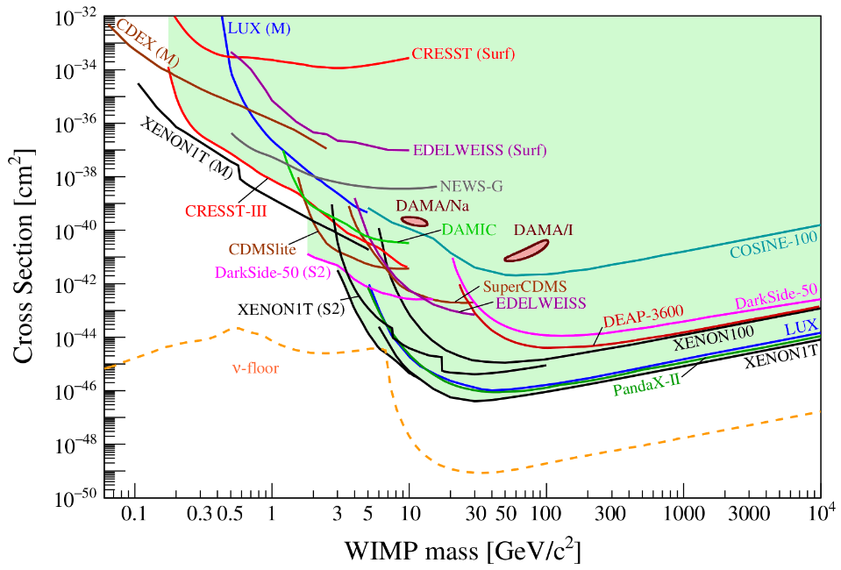
Motivation: Dark Matter (WIMPs)
Neutrino floor
  Mimics dark matter signal
  Solar neutrino
Shape:
  Left side -> detector threshold
  Right side -> dark matter density
Spin Independent model of Dark Matter
  Current standard
arXiv:2104.07634
|
PSD14: International Conference on Position Sensitive Detectors
  Victoria Uttaree Bashu
Positive ion-initiated secondary avalanches study with intensified camera
ANU Nuclear Physics and Accelerator Applications ​
​
01/09/2026
Notes:
Dark matter exists (astronomical proves)
WIMP as good candidate. Why?
Explain the diagram.
End on how the white parts of the chart can be accessed by Migdal effect as it depends on the recoil of an electron instead of a nucleus
Order of 10 GeV
Make two slides
Migdal makes us make the energy threshold to be lower
Make arrows about the low mass XENON graph

Slide 3
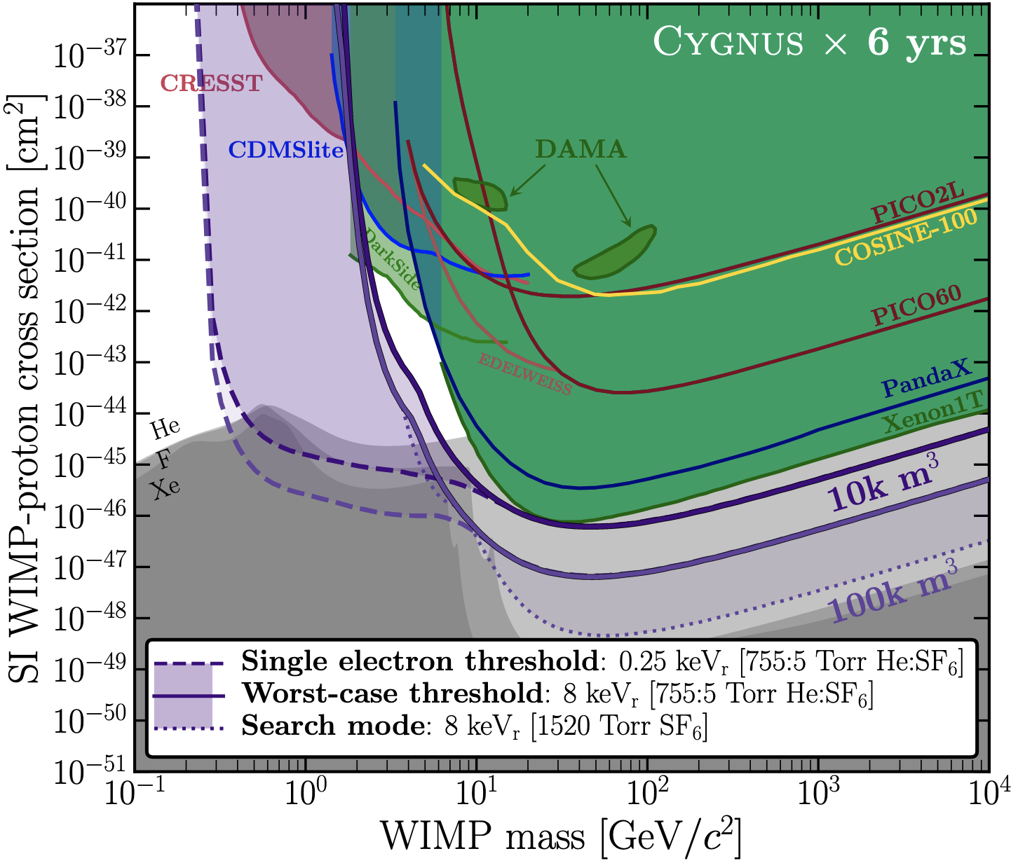
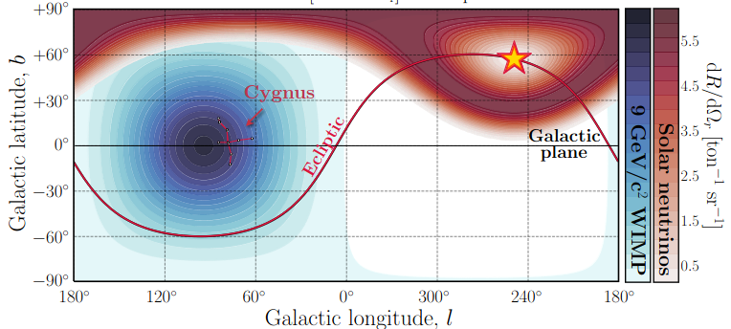
Directional Detection with TPCs
Directionality distinguishes solar neutrinos from dark matter wind
arXiv:2008.12587
|
PSD14: International Conference on Position Sensitive Detectors
  Victoria Uttaree Bashu
Positive ion-initiated secondary avalanches study with intensified camera
ANU Nuclear Physics and Accelerator Applications ​
​
01/09/2026
Notes:
Dark matter exists (astronomical proves)
WIMP as good candidate. Why?
Explain the diagram.
End on how the white parts of the chart can be accessed by Migdal effect as it depends on the recoil of an electron instead of a nucleus
Order of 10 GeV
Make two slides
Migdal makes us make the energy threshold to be lower
Make arrows about the low mass XENON graph

Slide 4
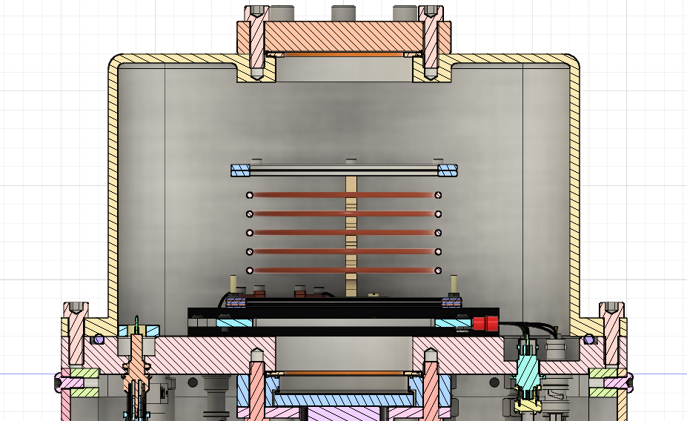
Gas Time Projection Chamber (TPC)
Electron
Particle
Gain stage
GEMs
E Field
|
PSD14: International Conference on Position Sensitive Detectors
  Victoria Uttaree Bashu
Positive ion-initiated secondary avalanches study with intensified camera
ANU Nuclear Physics and Accelerator Applications ​
​
01/09/2026
Notes:
Dark matter exists (astronomical proves)
WIMP as good candidate. Why?
Explain the diagram.
End on how the white parts of the chart can be accessed by Migdal effect as it depends on the recoil of an electron instead of a nucleus
Order of 10 GeV
Make two slides
Migdal makes us make the energy threshold to be lower
Make arrows about the low mass XENON graph

Slide 5
Ion Induced Secondary Avalanche
Electron
Electron Avalanche ~ns
Positive ion initiated Avalanche ~µs
Ion
|V1|<|V2|
V1
GEM 1
Electron avalanche
Electron and ions drifting
V2
GEM 2
Time
|
PSD14: International Conference on Position Sensitive Detectors
  Victoria Uttaree Bashu
Positive ion-initiated secondary avalanches study with intensified camera
ANU Nuclear Physics and Accelerator Applications ​
​
01/09/2026
Notes:
Directional detection: 3d reconstruction
Add the graph on Lindsey's presentation and say the 10 , 50 event thing.
Migdal effect is possible with small scale detector , Jay
Nutrinos, solar nutrinos, Ciaran

Slide 6
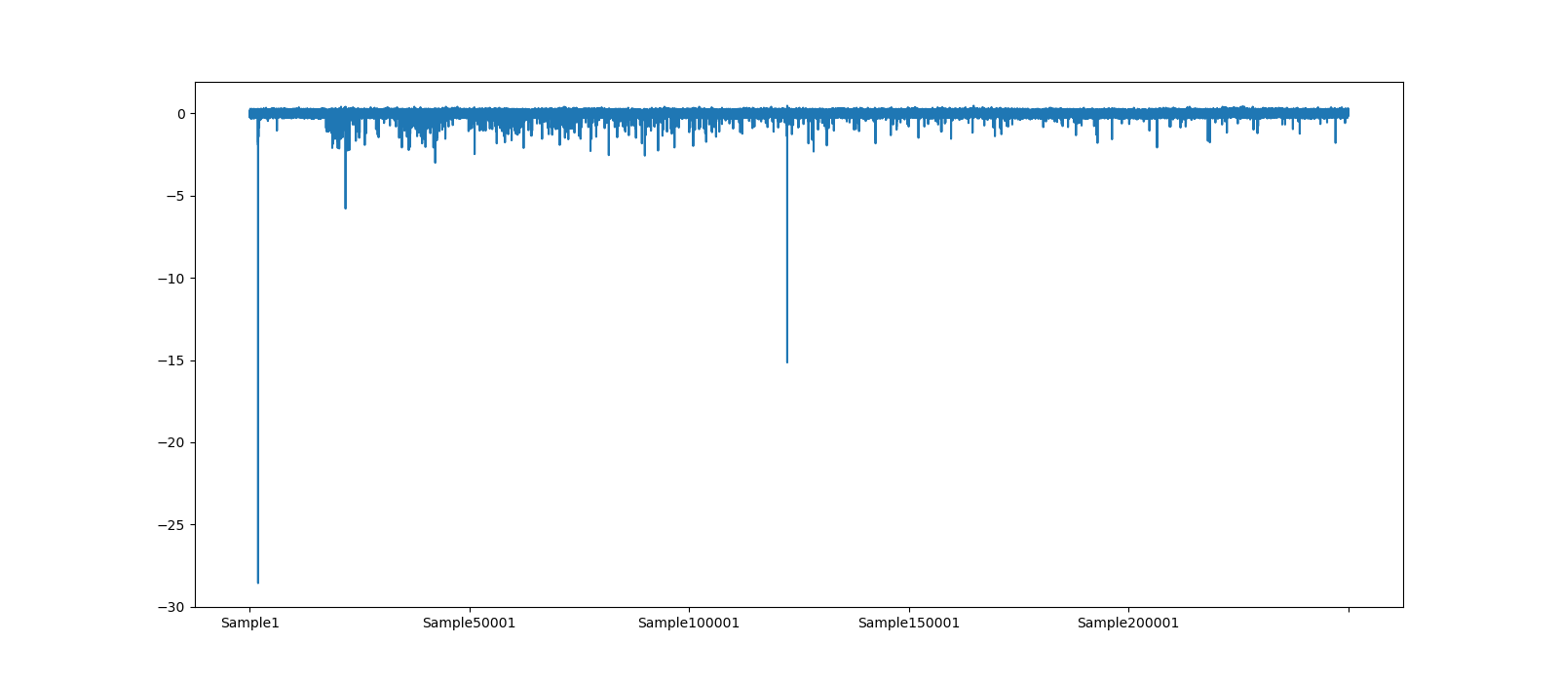
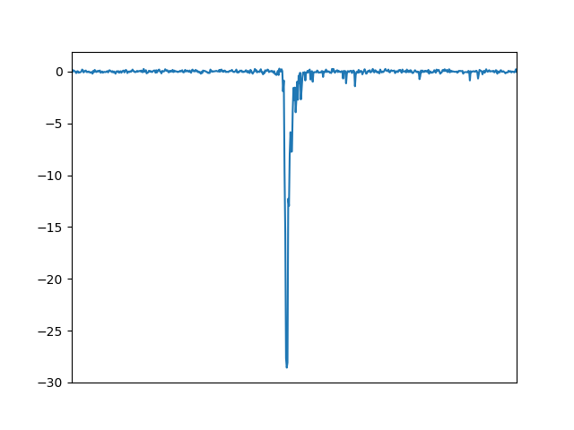
PMT waveform of ion induced avalanche
Bottom PMT 30 µs long trace with electron avalanche and possible Ion induced avalanche signal
Bunched signals, amplitude slowly decreasing
mV
Initial 250ns trace
Intensified camera can see the different parts of the light
|
PSD14: International Conference on Position Sensitive Detectors
  Victoria Uttaree Bashu
Positive ion-initiated secondary avalanches study with intensified camera
ANU Nuclear Physics and Accelerator Applications ​
​
01/09/2026
Notes:
Dark matter exists (astronomical proves)
WIMP as good candidate. Why?
Explain the diagram.
End on how the white parts of the chart can be accessed by Migdal effect as it depends on the recoil of an electron instead of a nucleus
Order of 10 GeV
Make two slides
Migdal makes us make the energy threshold to be lower
Make arrows about the low mass XENON graph

Slide 7
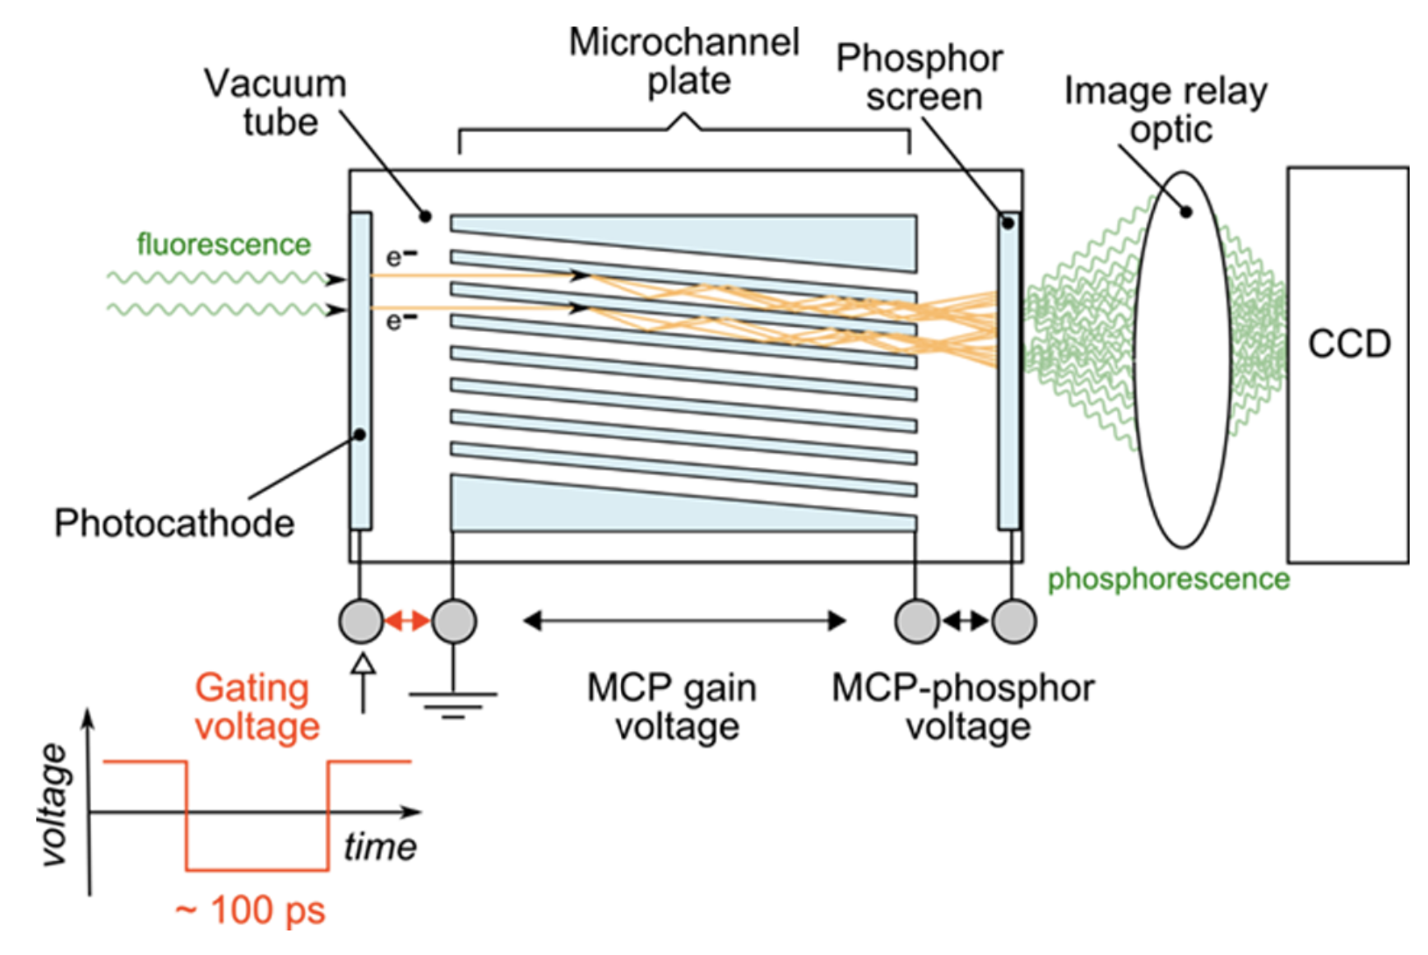
Intensified Camera in gas-TPC
Sensor noise
Dark photo electron
Image Credit: H. Sparks, F. G¨orlitz, D. J. Kelly, et al. Characterisation of new gated optical image intensifiers for fluorescence lifetime imaging. Review of Scientific Instruments, 88(1), 2017.
|
PSD14: International Conference on Position Sensitive Detectors
  Victoria Uttaree Bashu
Positive ion-initiated secondary avalanches study with intensified camera
ANU Nuclear Physics and Accelerator Applications ​
​
01/09/2026
Notes:
Dark matter exists (astronomical proves)
WIMP as good candidate. Why?
Explain the diagram.
End on how the white parts of the chart can be accessed by Migdal effect as it depends on the recoil of an electron instead of a nucleus
Order of 10 GeV
Make two slides
Migdal makes us make the energy threshold to be lower
Make arrows about the low mass XENON graph

Slide 8
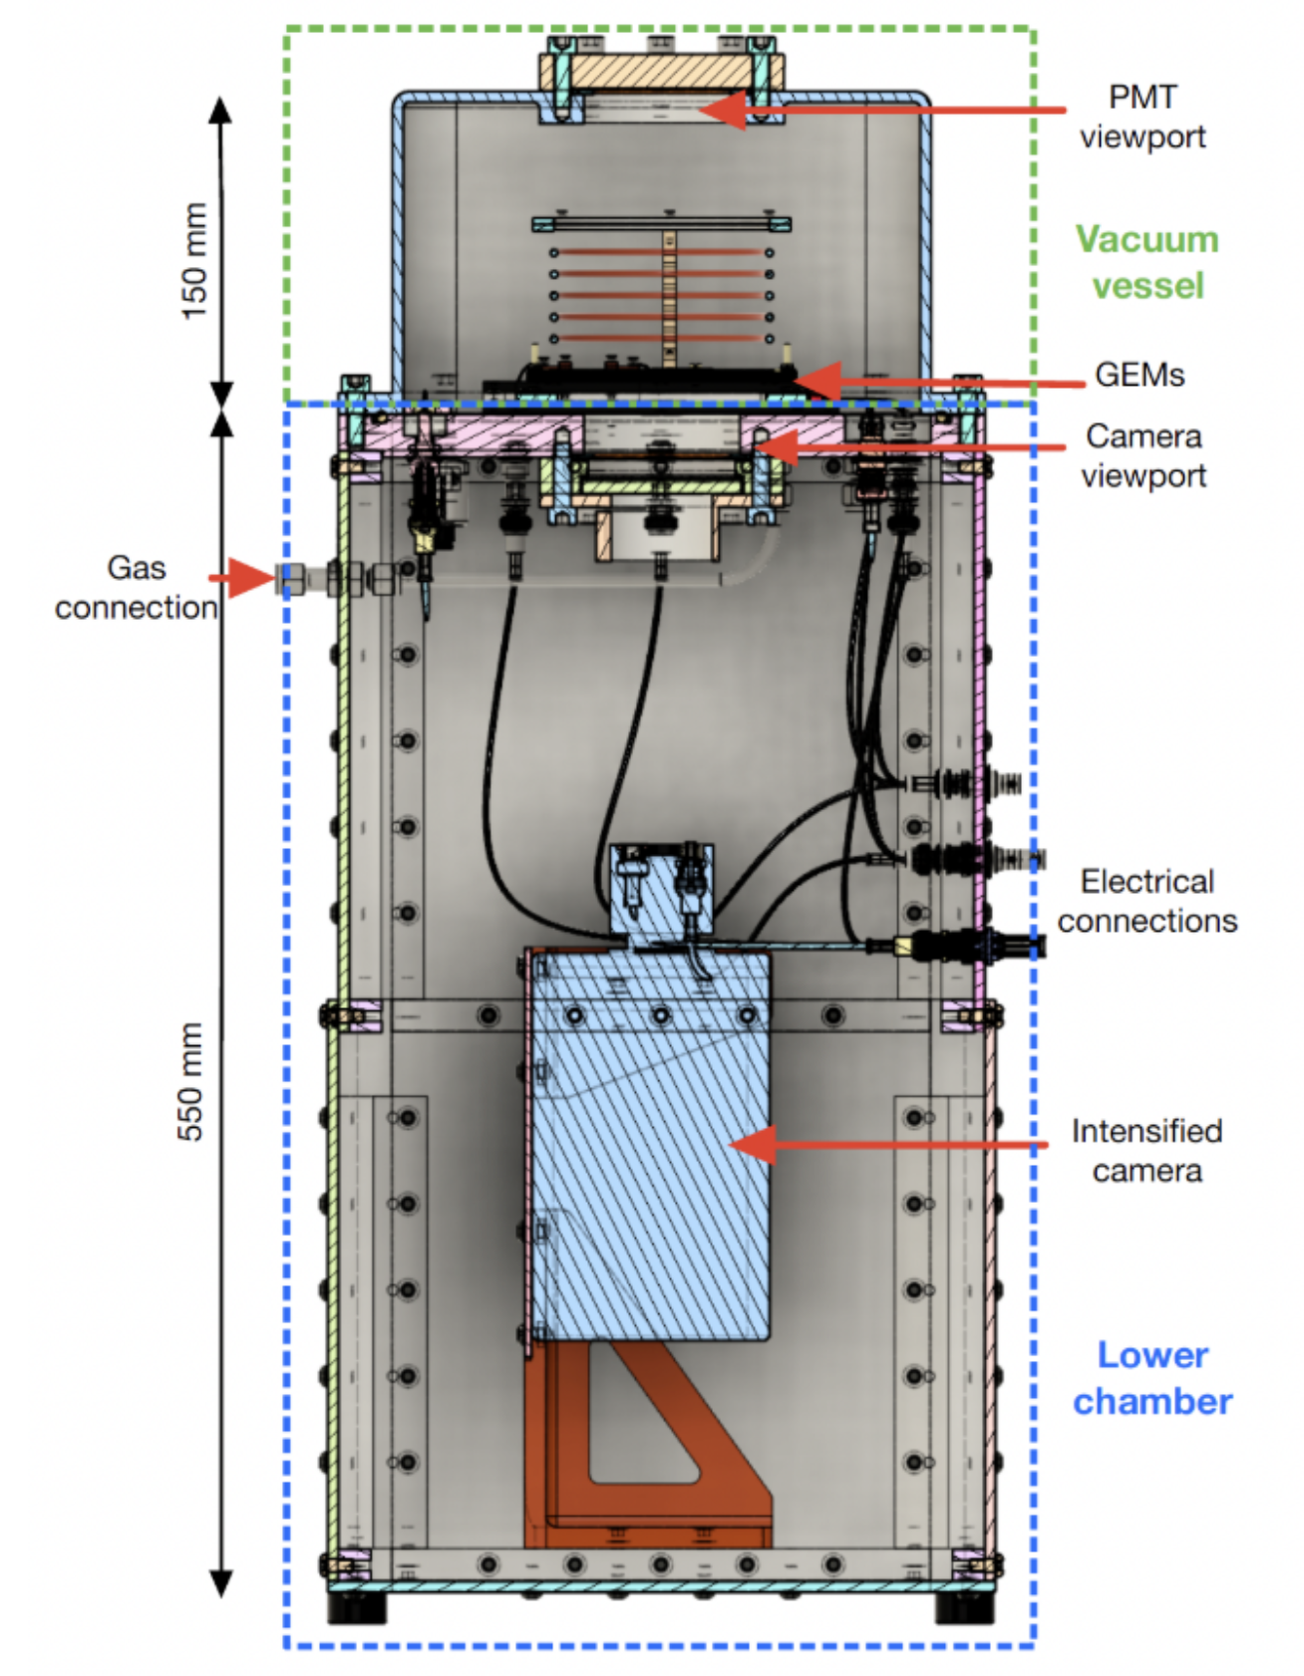
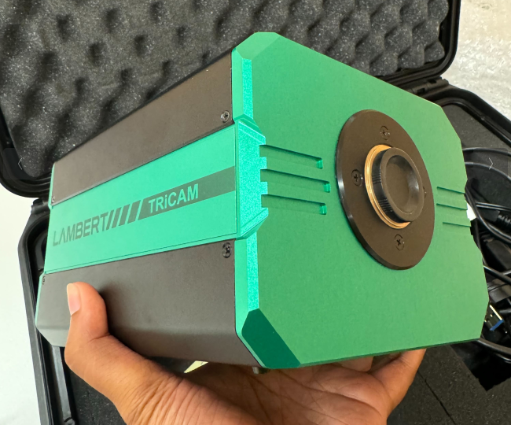
Intensified Camera in gas-TPC
PMT
PMT
|
PSD14: International Conference on Position Sensitive Detectors
  Victoria Uttaree Bashu
Positive ion-initiated secondary avalanches study with intensified camera
ANU Nuclear Physics and Accelerator Applications ​
​
01/09/2026
Notes:
Dark matter exists (astronomical proves)
WIMP as good candidate. Why?
Explain the diagram.
End on how the white parts of the chart can be accessed by Migdal effect as it depends on the recoil of an electron instead of a nucleus
Order of 10 GeV
Make two slides
Migdal makes us make the energy threshold to be lower
Make arrows about the low mass XENON graph

Slide 9
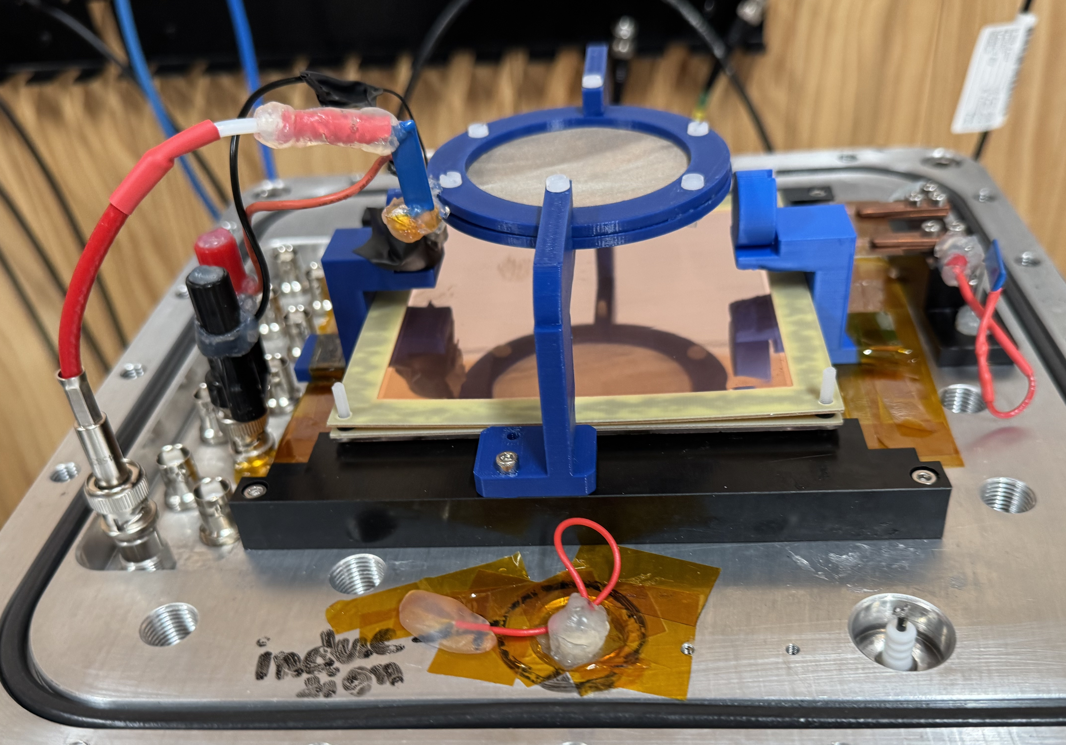
Experimental setup
40Torr CF4
3cm drift length
Photodiode trigger (digitiser and camera)
241Am (5.5MeV alpha) collimated source
2 thin GEMs
Top and bottom PMT
Intensifier camera
|
PSD14: International Conference on Position Sensitive Detectors
  Victoria Uttaree Bashu
Positive ion-initiated secondary avalanches study with intensified camera
ANU Nuclear Physics and Accelerator Applications ​
​
01/09/2026
Notes:
Dark matter exists (astronomical proves)
WIMP as good candidate. Why?
Explain the diagram.
End on how the white parts of the chart can be accessed by Migdal effect as it depends on the recoil of an electron instead of a nucleus
Order of 10 GeV
Make two slides
Migdal makes us make the energy threshold to be lower
Make arrows about the low mass XENON graph

Slide 10
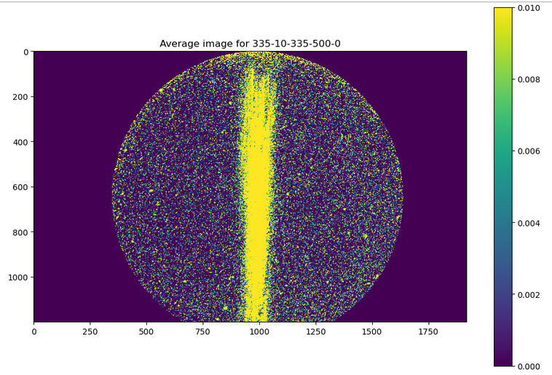
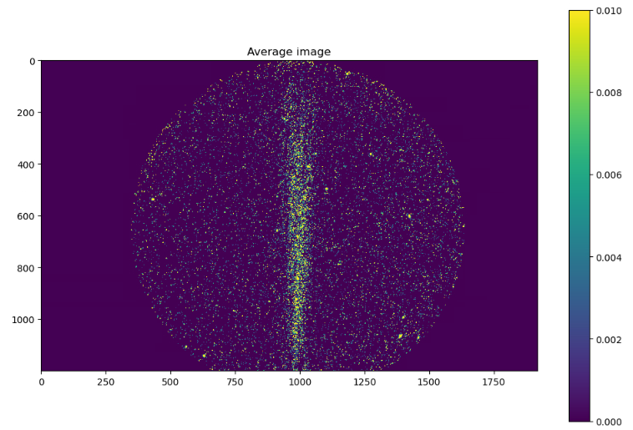
Average image light comparison
Average image with light from both electron and ion induced avalanche
Average image with light from only ion induced avalanche
500µs gating
150-250µs gating
|
PSD14: International Conference on Position Sensitive Detectors
  Victoria Uttaree Bashu
Positive ion-initiated secondary avalanches study with intensified camera
ANU Nuclear Physics and Accelerator Applications ​
​
01/09/2026
Notes:
Dark matter exists (astronomical proves)
WIMP as good candidate. Why?
Explain the diagram.
End on how the white parts of the chart can be accessed by Migdal effect as it depends on the recoil of an electron instead of a nucleus
Order of 10 GeV
Make two slides
Migdal makes us make the energy threshold to be lower
Make arrows about the low mass XENON graph

Slide 11
Variation in GEM voltage for study
GEM1
GEM2
STUDY1:
High Top GEM study
Top GEM: 350-340V
Bottom GEM: 330-320V
Transfer field: 100V/cm
STUDY2:
High Bottom GEM study
Top GEM: 330-320V
Bottom GEM: 350-340V
Transfer field: 100V/cm
STUDY3:
Varying Transfer Field
Top GEM: 335V
Bottom GEM: 335V
Transfer field: 50-150V/cm
GEM1 + GEM2= 670V
Transfer field in between
50-150 V/cm
|
PSD14: International Conference on Position Sensitive Detectors
  Victoria Uttaree Bashu
Positive ion-initiated secondary avalanches study with intensified camera
ANU Nuclear Physics and Accelerator Applications ​
​
01/09/2026
Notes:
Dark matter exists (astronomical proves)
WIMP as good candidate. Why?
Explain the diagram.
End on how the white parts of the chart can be accessed by Migdal effect as it depends on the recoil of an electron instead of a nucleus
Order of 10 GeV
Make two slides
Migdal makes us make the energy threshold to be lower
Make arrows about the low mass XENON graph

Slide 12
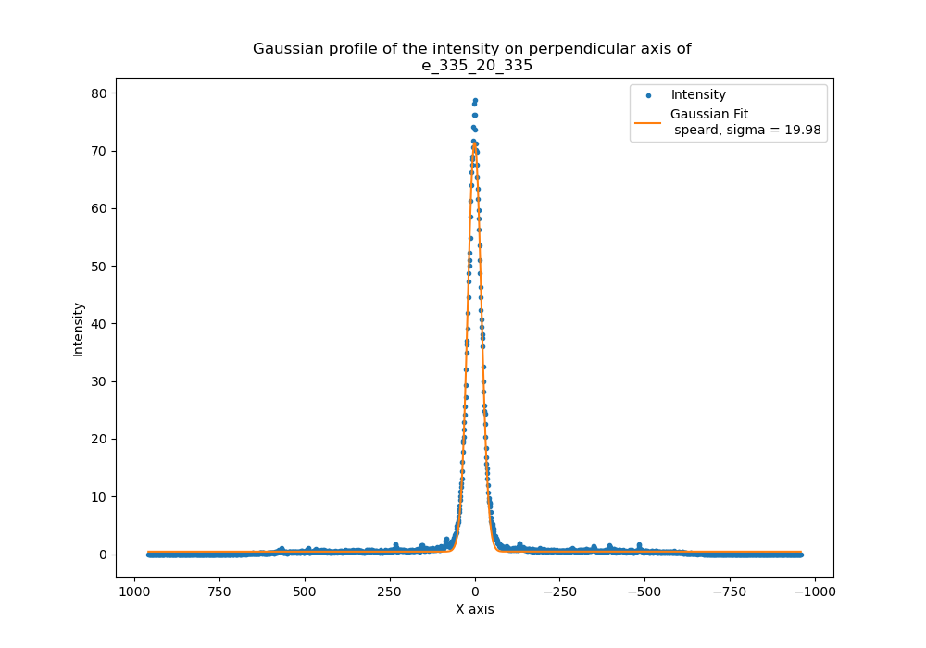
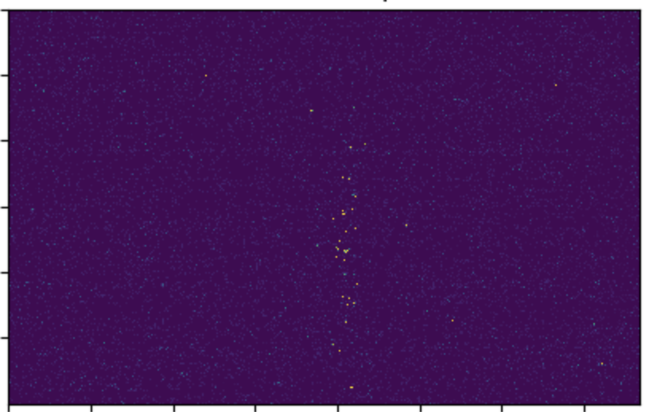
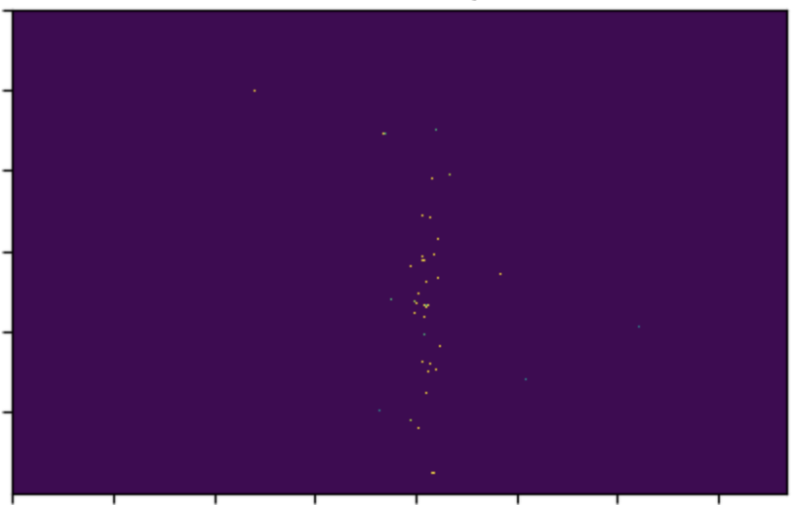
Data Analysis
TB size data, compression done for efficient access
Dark frame
Event by event PCA in the ROI
Track spread by projecting the intensities on the second principle axis of the track
Intensity from PMT and Charge readout
Dark photo electron correction
  Dark Frame correction
  Before
  After
|
PSD14: International Conference on Position Sensitive Detectors
  Victoria Uttaree Bashu
Positive ion-initiated secondary avalanches study with intensified camera
ANU Nuclear Physics and Accelerator Applications ​
​
01/09/2026
Notes:
Dark matter exists (astronomical proves)
WIMP as good candidate. Why?
Explain the diagram.
End on how the white parts of the chart can be accessed by Migdal effect as it depends on the recoil of an electron instead of a nucleus
Order of 10 GeV
Make two slides
Migdal makes us make the energy threshold to be lower
Make arrows about the low mass XENON graph

Slide 13
Data Analysis
TB size data, compression done for efficient access
Dark frame
Event by event PCA in the ROI
Track spread by projecting the intensities on the second principle axis of the track
Intensity from PMT and Charge readout
Dark photo electron correction
  Dark Frame correction
  Before
  After
|
PSD14: International Conference on Position Sensitive Detectors
  Victoria Uttaree Bashu
Positive ion-initiated secondary avalanches study with intensified camera
ANU Nuclear Physics and Accelerator Applications ​
​
01/09/2026
Notes:
Dark matter exists (astronomical proves)
WIMP as good candidate. Why?
Explain the diagram.
End on how the white parts of the chart can be accessed by Migdal effect as it depends on the recoil of an electron instead of a nucleus
Order of 10 GeV
Make two slides
Migdal makes us make the energy threshold to be lower
Make arrows about the low mass XENON graph

Slide 14
Data Analysis
TB size data, compression done for efficient access
Dark frame
Event by event PCA in the ROI
Track spread by projecting the intensities on the second principle axis of the track
Intensity from PMT and Charge readout
Dark photo electron correction
|
PSD14: International Conference on Position Sensitive Detectors
  Victoria Uttaree Bashu
Positive ion-initiated secondary avalanches study with intensified camera
ANU Nuclear Physics and Accelerator Applications ​
​
01/09/2026
Notes:
Dark matter exists (astronomical proves)
WIMP as good candidate. Why?
Explain the diagram.
End on how the white parts of the chart can be accessed by Migdal effect as it depends on the recoil of an electron instead of a nucleus
Order of 10 GeV
Make two slides
Migdal makes us make the energy threshold to be lower
Make arrows about the low mass XENON graph

Slide 15
Data Analysis
TB size data, compression done for efficient access
Dark frame
Event by event PCA in the ROI
Track spread by projecting the intensities on the second principle axis of the track
Intensity from PMT and Charge readout
Dark photo electron correction
|
PSD14: International Conference on Position Sensitive Detectors
  Victoria Uttaree Bashu
Positive ion-initiated secondary avalanches study with intensified camera
ANU Nuclear Physics and Accelerator Applications ​
​
01/09/2026
Notes:
Dark matter exists (astronomical proves)
WIMP as good candidate. Why?
Explain the diagram.
End on how the white parts of the chart can be accessed by Migdal effect as it depends on the recoil of an electron instead of a nucleus
Order of 10 GeV
Make two slides
Migdal makes us make the energy threshold to be lower
Make arrows about the low mass XENON graph

Slide 16
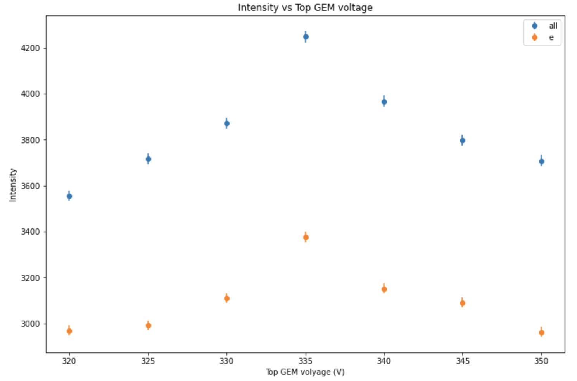
Intensity from different part of avalanche
Intensity change with GEM voltage
all = electron + ion avalanche light
e = electron avalanche light
ibf = ion avalanche light
GEM1+GEM2=670V
|
PSD14: International Conference on Position Sensitive Detectors
  Victoria Uttaree Bashu
Positive ion-initiated secondary avalanches study with intensified camera
ANU Nuclear Physics and Accelerator Applications ​
​
01/09/2026
Notes:
Dark matter exists (astronomical proves)
WIMP as good candidate. Why?
Explain the diagram.
End on how the white parts of the chart can be accessed by Migdal effect as it depends on the recoil of an electron instead of a nucleus
Order of 10 GeV
Make two slides
Migdal makes us make the energy threshold to be lower
Make arrows about the low mass XENON graph

Slide 17
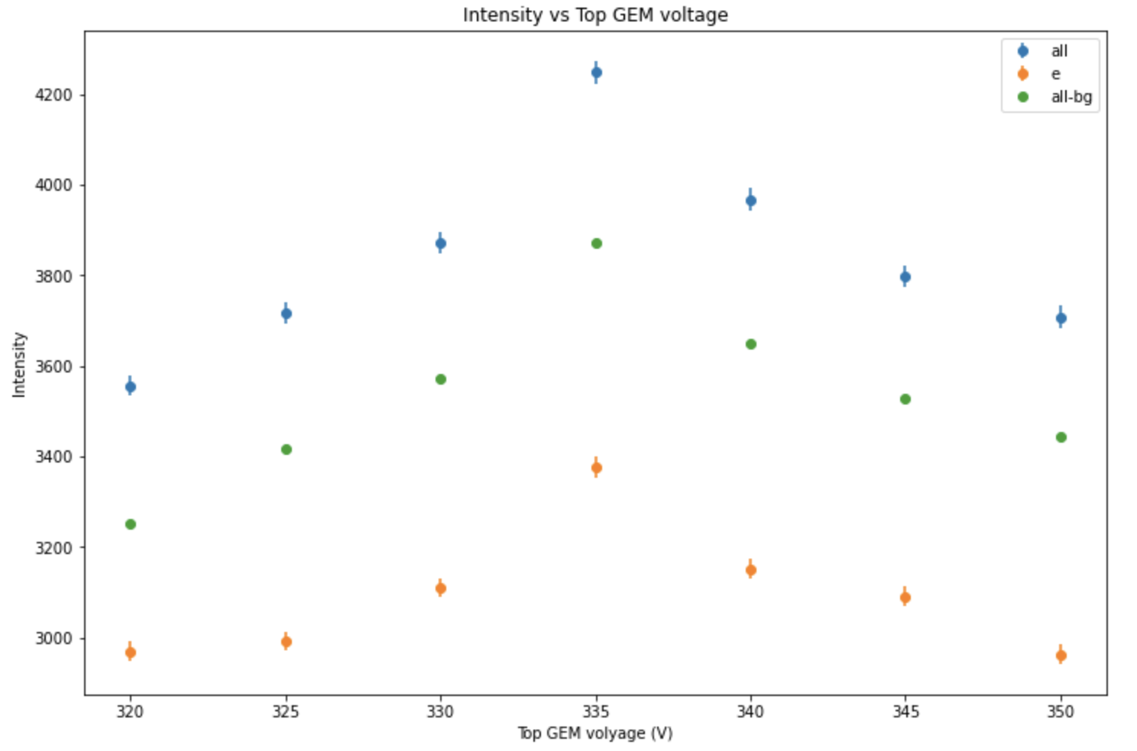
Intensity from different part of avalanche
Intensity change with GEM voltage
all = electron + ion avalanche light
e = electron avalanche light
ibf = ion avalanche light
GEM1+GEM2=670V
|
PSD14: International Conference on Position Sensitive Detectors
  Victoria Uttaree Bashu
Positive ion-initiated secondary avalanches study with intensified camera
ANU Nuclear Physics and Accelerator Applications ​
​
01/09/2026
Notes:
Dark matter exists (astronomical proves)
WIMP as good candidate. Why?
Explain the diagram.
End on how the white parts of the chart can be accessed by Migdal effect as it depends on the recoil of an electron instead of a nucleus
Order of 10 GeV
Make two slides
Migdal makes us make the energy threshold to be lower
Make arrows about the low mass XENON graph

Slide 18
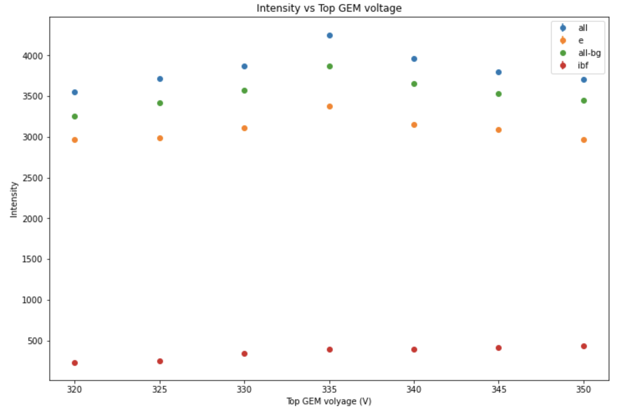
Intensity from different part of avalanche
Intensity change with GEM voltage
all = electron + ion avalanche light
e = electron avalanche light
ibf = ion avalanche light
GEM1+GEM2=670V
|
PSD14: International Conference on Position Sensitive Detectors
  Victoria Uttaree Bashu
Positive ion-initiated secondary avalanches study with intensified camera
ANU Nuclear Physics and Accelerator Applications ​
​
01/09/2026
Notes:
Dark matter exists (astronomical proves)
WIMP as good candidate. Why?
Explain the diagram.
End on how the white parts of the chart can be accessed by Migdal effect as it depends on the recoil of an electron instead of a nucleus
Order of 10 GeV
Make two slides
Migdal makes us make the energy threshold to be lower
Make arrows about the low mass XENON graph

Slide 19
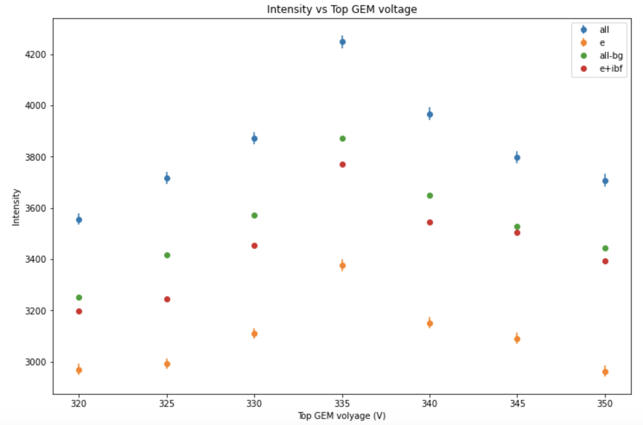
Intensity from different part of avalanche
Intensity change with GEM voltage
all = electron + ion avalanche light
e = electron avalanche light
ibf = ion avalanche light
GEM1+GEM2=670V
|
PSD14: International Conference on Position Sensitive Detectors
  Victoria Uttaree Bashu
Positive ion-initiated secondary avalanches study with intensified camera
ANU Nuclear Physics and Accelerator Applications ​
​
01/09/2026
Notes:
Dark matter exists (astronomical proves)
WIMP as good candidate. Why?
Explain the diagram.
End on how the white parts of the chart can be accessed by Migdal effect as it depends on the recoil of an electron instead of a nucleus
Order of 10 GeV
Make two slides
Migdal makes us make the energy threshold to be lower
Make arrows about the low mass XENON graph

Slide 20
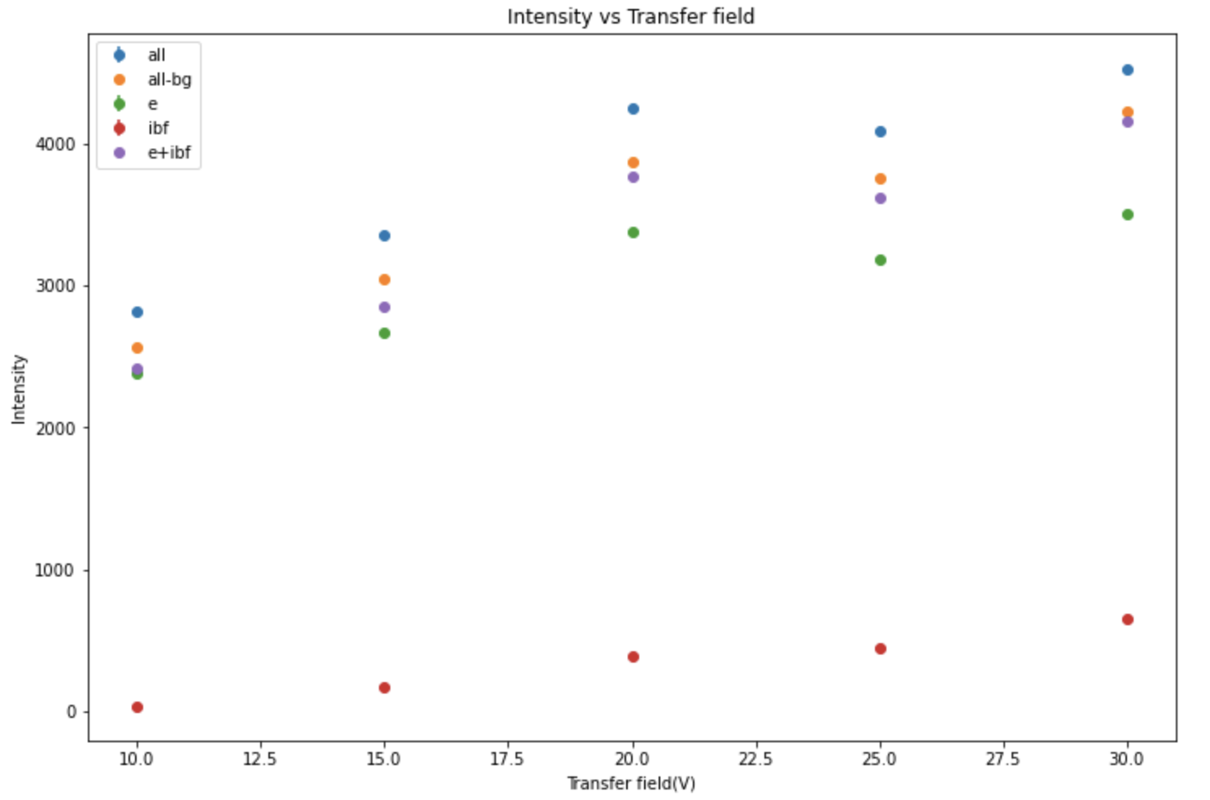
Intensity from different part of avalanche
Intensity change with Transfer field
all = electron + ion avalanche light
e = electron avalanche light
ibf = ion avalanche light
GEM1 and GEM2 both 335V
|
PSD14: International Conference on Position Sensitive Detectors
  Victoria Uttaree Bashu
Positive ion-initiated secondary avalanches study with intensified camera
ANU Nuclear Physics and Accelerator Applications ​
​
01/09/2026
Notes:
Dark matter exists (astronomical proves)
WIMP as good candidate. Why?
Explain the diagram.
End on how the white parts of the chart can be accessed by Migdal effect as it depends on the recoil of an electron instead of a nucleus
Order of 10 GeV
Make two slides
Migdal makes us make the energy threshold to be lower
Make arrows about the low mass XENON graph

Slide 21
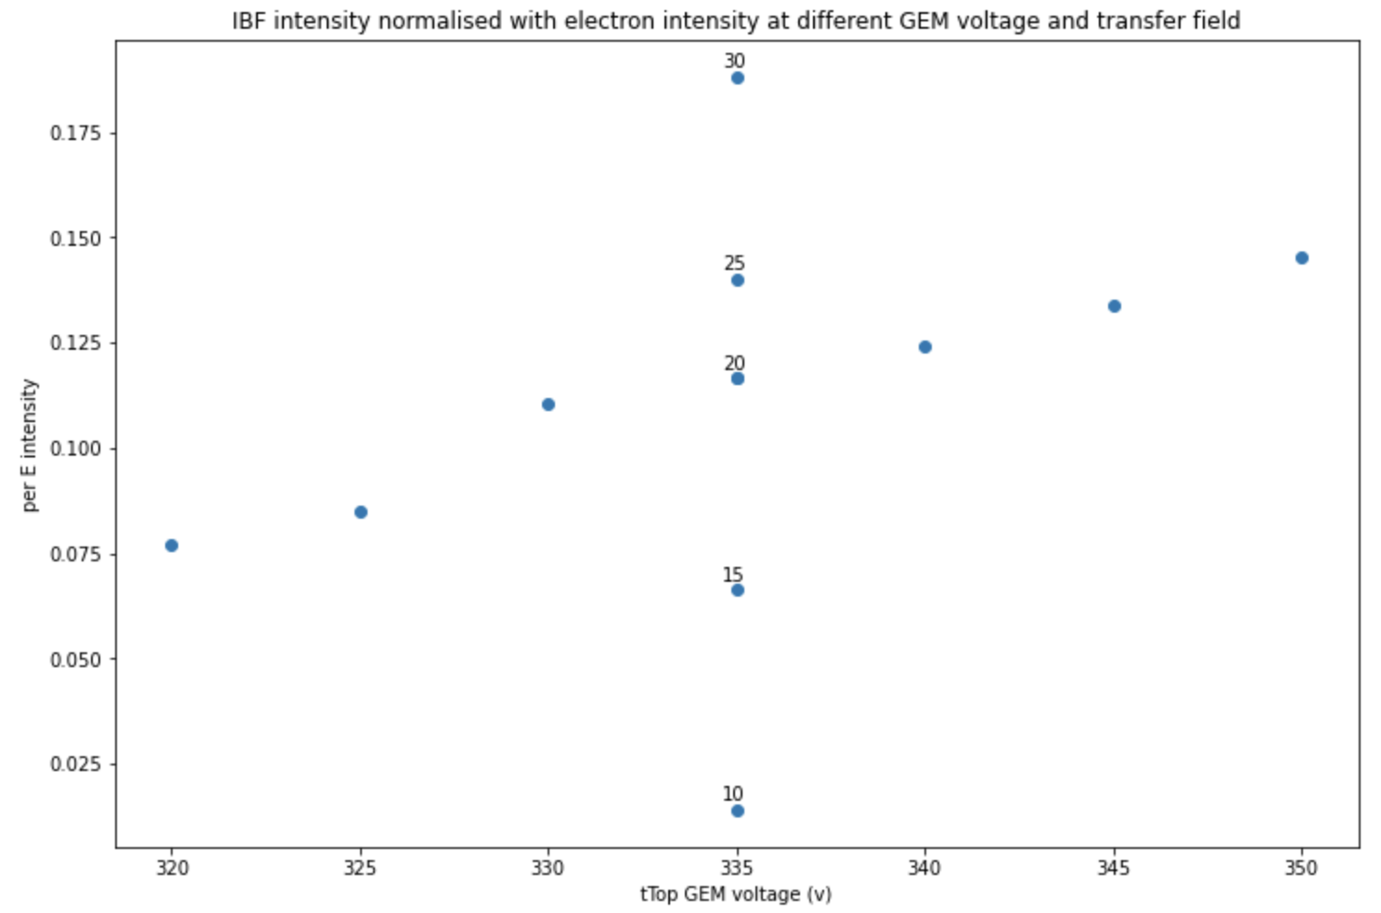
Ion avalanche intensity per electron intensity
Ion induced avalanche light intensity gets high with higher top GEM voltage and with higher transfer field
~18% extra light with ion induced avalanche
|
PSD14: International Conference on Position Sensitive Detectors
  Victoria Uttaree Bashu
Positive ion-initiated secondary avalanches study with intensified camera
ANU Nuclear Physics and Accelerator Applications ​
​
01/09/2026
Notes:
Dark matter exists (astronomical proves)
WIMP as good candidate. Why?
Explain the diagram.
End on how the white parts of the chart can be accessed by Migdal effect as it depends on the recoil of an electron instead of a nucleus
Order of 10 GeV
Make two slides
Migdal makes us make the energy threshold to be lower
Make arrows about the low mass XENON graph

Slide 22
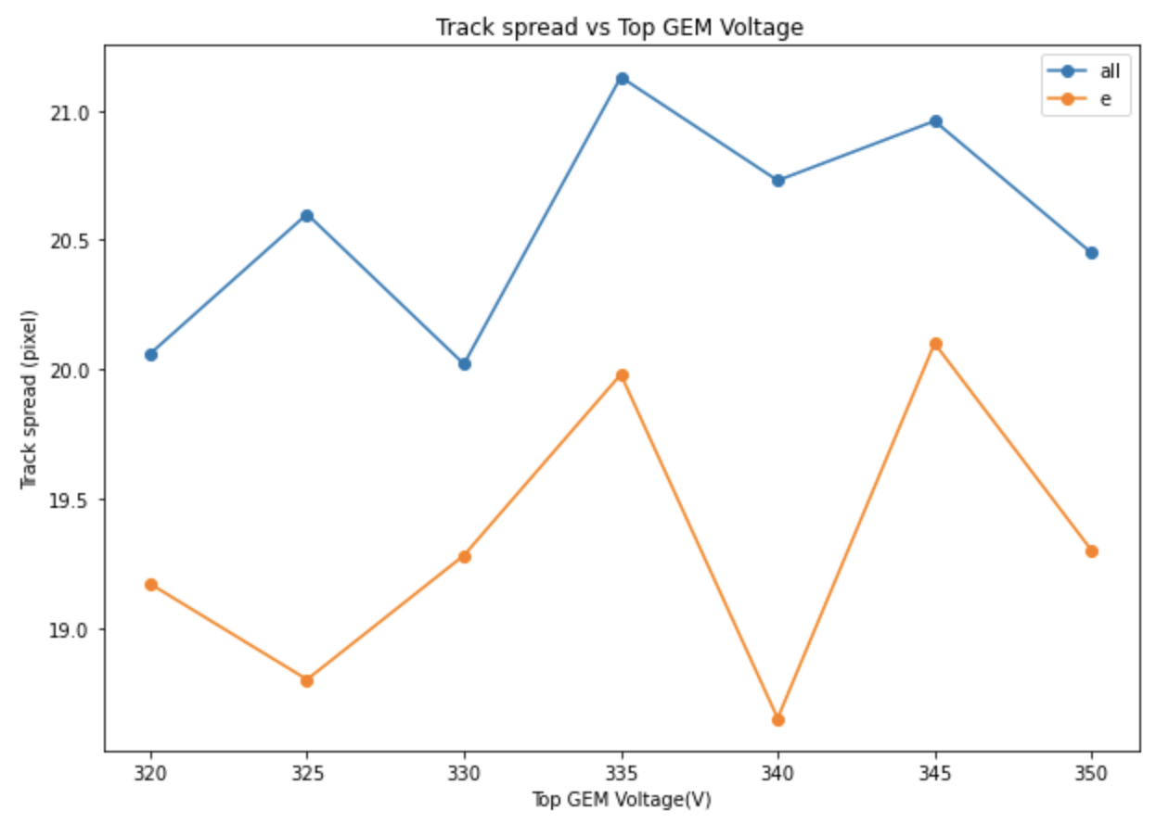
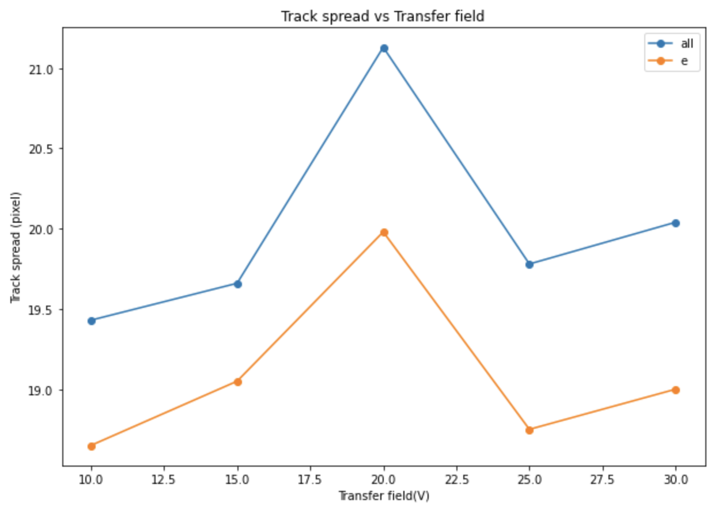
Track spread with and without IBF
|
PSD14: International Conference on Position Sensitive Detectors
  Victoria Uttaree Bashu
Positive ion-initiated secondary avalanches study with intensified camera
ANU Nuclear Physics and Accelerator Applications ​
​
01/09/2026
Notes:
Dark matter exists (astronomical proves)
WIMP as good candidate. Why?
Explain the diagram.
End on how the white parts of the chart can be accessed by Migdal effect as it depends on the recoil of an electron instead of a nucleus
Order of 10 GeV
Make two slides
Migdal makes us make the energy threshold to be lower
Make arrows about the low mass XENON graph

Slide 23
Future work
Advanced clustering
Quantitative measure of light gain vs diffusion loss
Top and bottom PMT comparison
Garfield simulation for comparison
|
PSD14: International Conference on Position Sensitive Detectors
  Victoria Uttaree Bashu
Positive ion-initiated secondary avalanches study with intensified camera
ANU Nuclear Physics and Accelerator Applications ​
​
01/09/2026
Notes:
Dark matter exists (astronomical proves)
WIMP as good candidate. Why?
Explain the diagram.
End on how the white parts of the chart can be accessed by Migdal effect as it depends on the recoil of an electron instead of a nucleus
Order of 10 GeV
Make two slides
Migdal makes us make the energy threshold to be lower
Make arrows about the low mass XENON graph

Slide 24
THANK YOU
QUESTIONS?

Slide 25
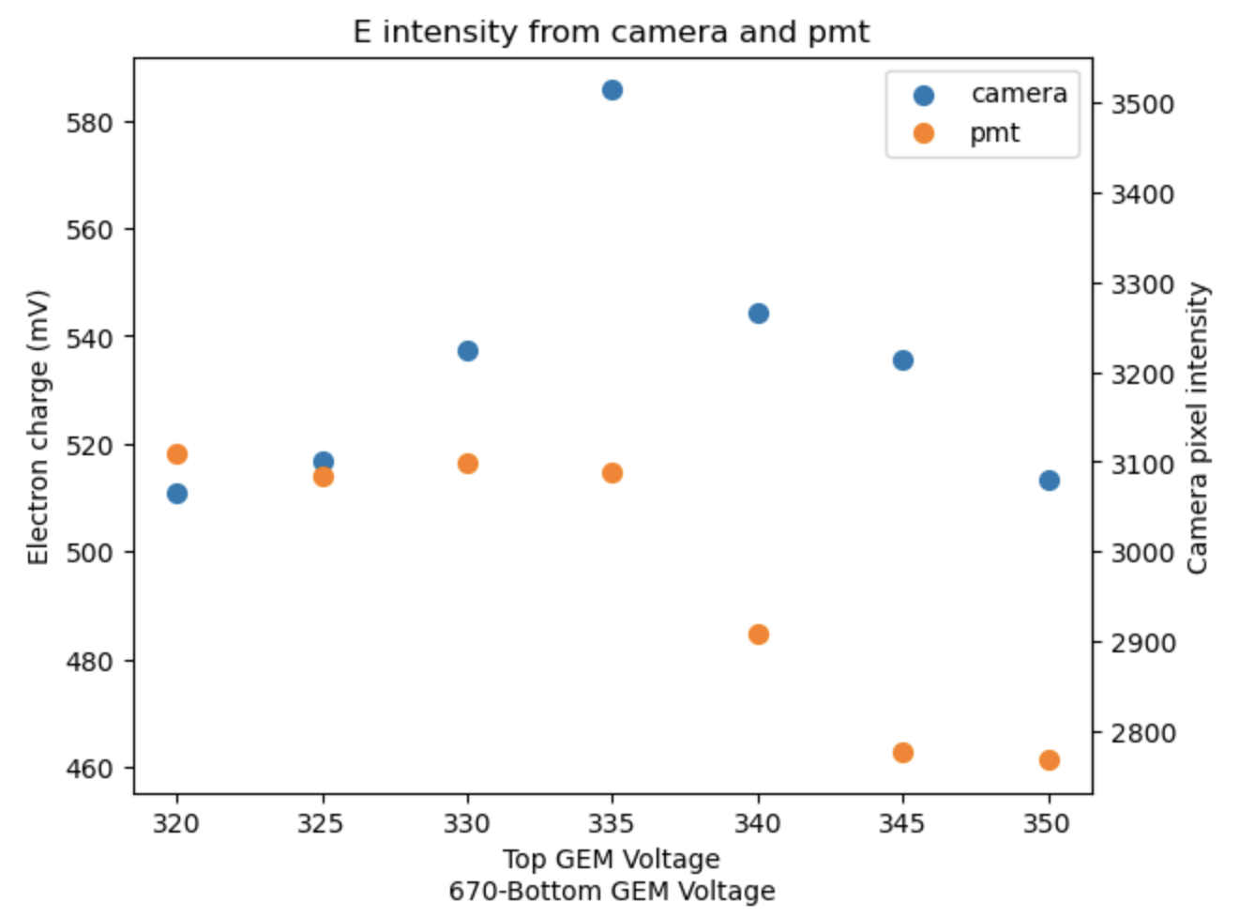
PMT and Camera Intensity
PMT is missing some light depending on the track position in the detector due to the angle of the PMT through the viewing window
|
PSD14: International Conference on Position Sensitive Detectors
  Victoria Uttaree Bashu
Positive ion-initiated secondary avalanches study with intensified camera
ANU Nuclear Physics and Accelerator Applications ​
​
01/09/2026
Notes:
Dark matter exists (astronomical proves)
WIMP as good candidate. Why?
Explain the diagram.
End on how the white parts of the chart can be accessed by Migdal effect as it depends on the recoil of an electron instead of a nucleus
Order of 10 GeV
Make two slides
Migdal makes us make the energy threshold to be lower
Make arrows about the low mass XENON graph

