Slide 1


Development of high efficiency and high resolution thick-GEM detectors for muography application
PSD14: International Conference on Position Sensitive Detectors, 2026
03/09/2026
Saikat Ghosh, Shubhabrata Dutta, Promita Roy, Subhendu Das, Supratik Mukhopadhyay, Nayana Majumdar
Saha Institute of Nuclear Physics
A CI of Homi Bhabha National Institute

Slide 2
Outline of the talk
Motivation.
Detector requirement.
Manufacturing.
Conditioning.
Characterization.
Detection efficiency measurement.
Measurement of position resolution.
Effect of detector properties on imaging .
Conclusion.

Slide 3
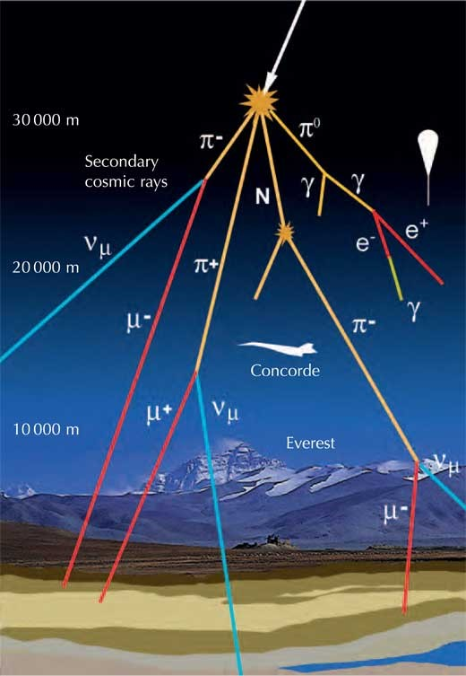
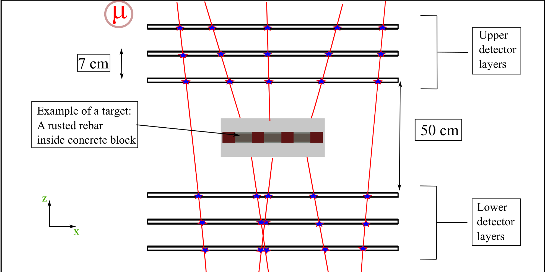
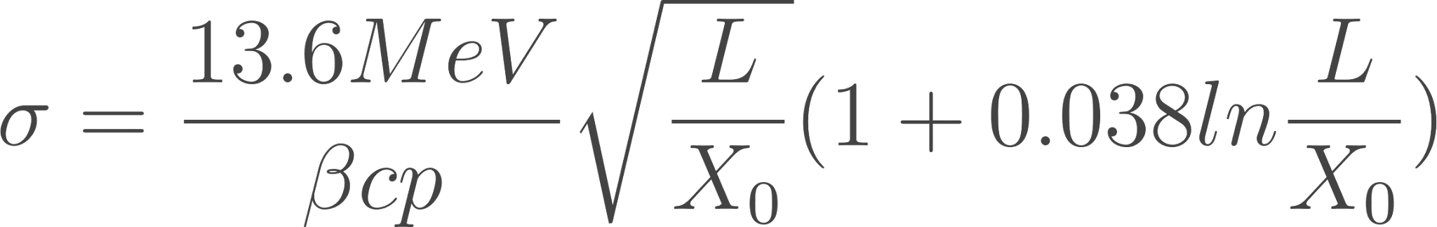
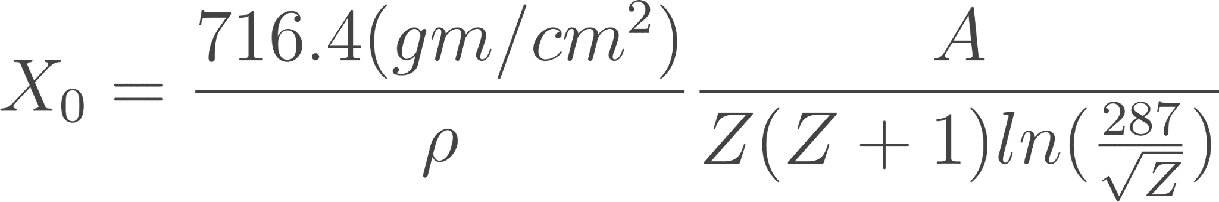
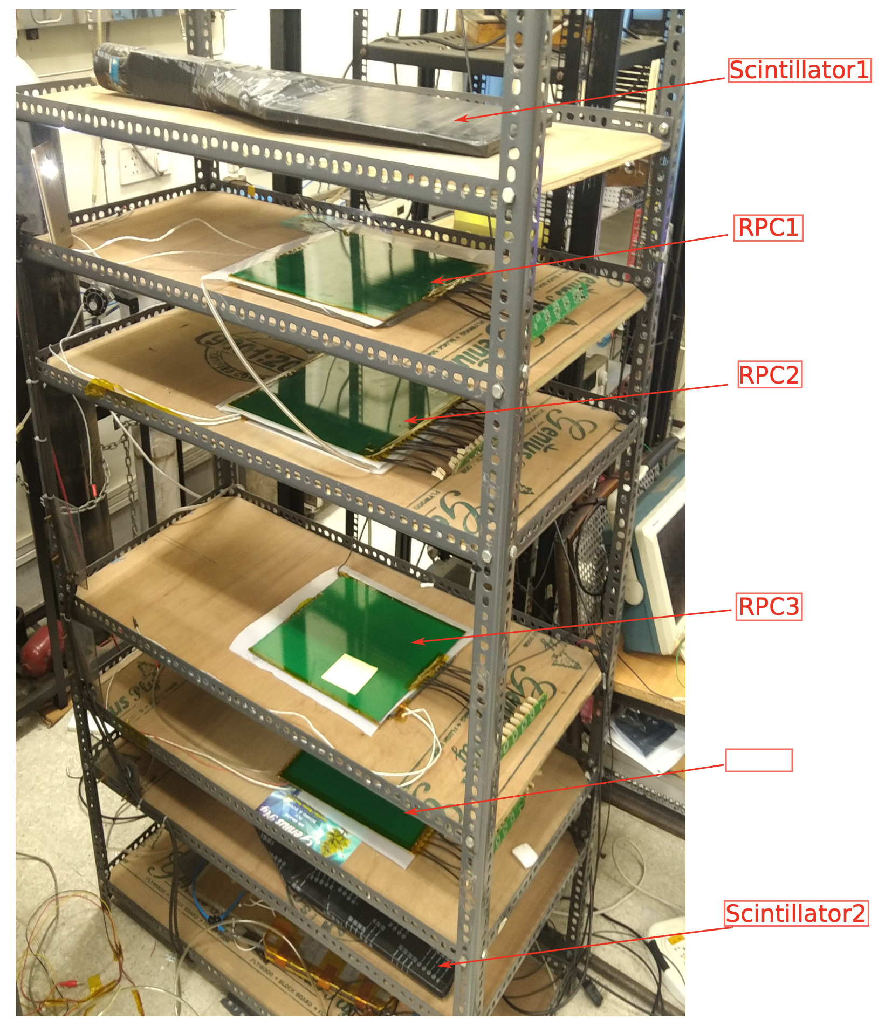
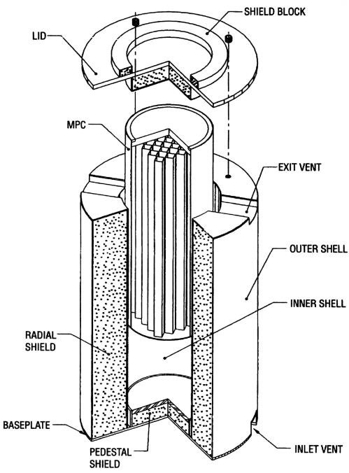
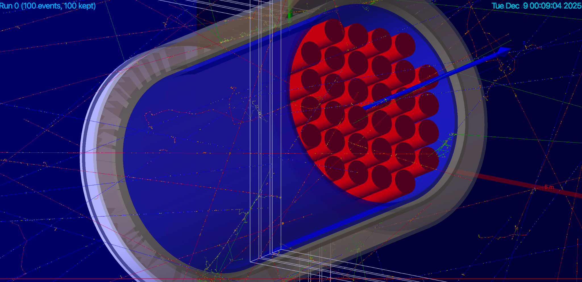
Motivation
Cosmic muons passing through the matter causes EM interaction such as mcs, ionisation, atomic excitation, Bremsstrahlung.
Minimum ionizing particle (1-10 GeV) Can travel long distance within matter without losing much of its energy.
Tracks before and after interaction can be interrogated using particle detectors.
Muon absorption tomography.
  Depends on matter density
  Path travelled inside the material
Muon scattering tomography.
  Mainly multiple coulomb scattering.
  Scattering angle follows Gaussian distribution.
  𝝈 depends on thickness of the material and radiation length.
  Depends on Z and ⍴ of the material.

Slide 4
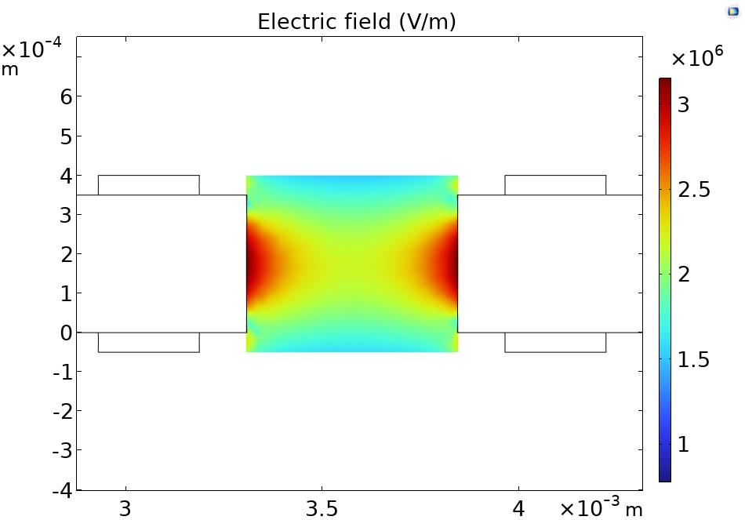
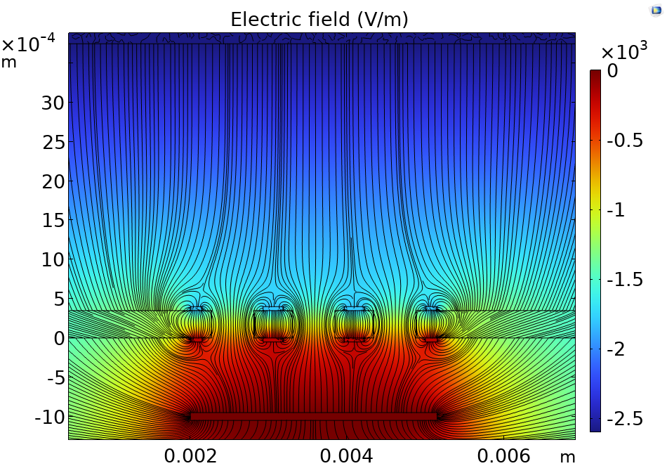
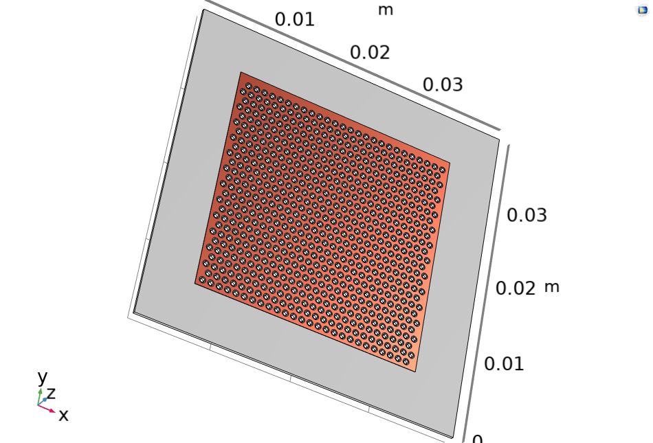
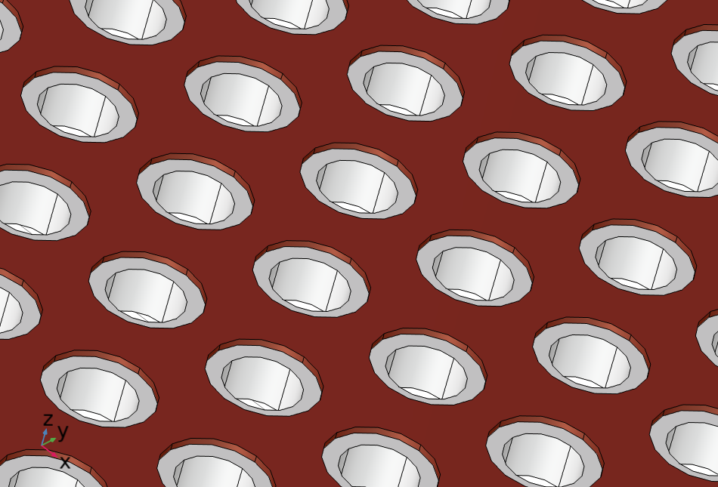
Detector requirements
Detector | Spatial Resolution | Production cost | Electronics cost | Operation
Scintillator Bars | 1–10 mm | Low | High | Robust, easy
Scintillator Fibres | 10–100 μm | High | High | Industrial; avoid bending
MWPC | 0.1–1 mm | Medium | Medium | Complex; T/P dependent
MPGD | 10–100 μm | High | Medium | Complex; T/P dependent
RPC/MRPC | 0.1–1 mm | Low | Low | Easy; T/P dependent
Silicon Microstrips | 1–100 μm | High | High | Robust, radiation hard
Robust large area detector with good position resolution and low manufacturing cost is required.
Thick-GEM detectors
A robust gaseous detector derived from GEM technology. 5-10 fold enlarged version.
Uses a thick insulating plate with mechanically drilled holes and copper electrodes on both sides.
Why THGEM
High gain (10⁴–10⁵) with good stability.
Mechanically strong and cost-effective for large areas.
Good spatial resolution and muon detection efficiency.
Suitable for harsh High and long-term experimental conditions.

Slide 5
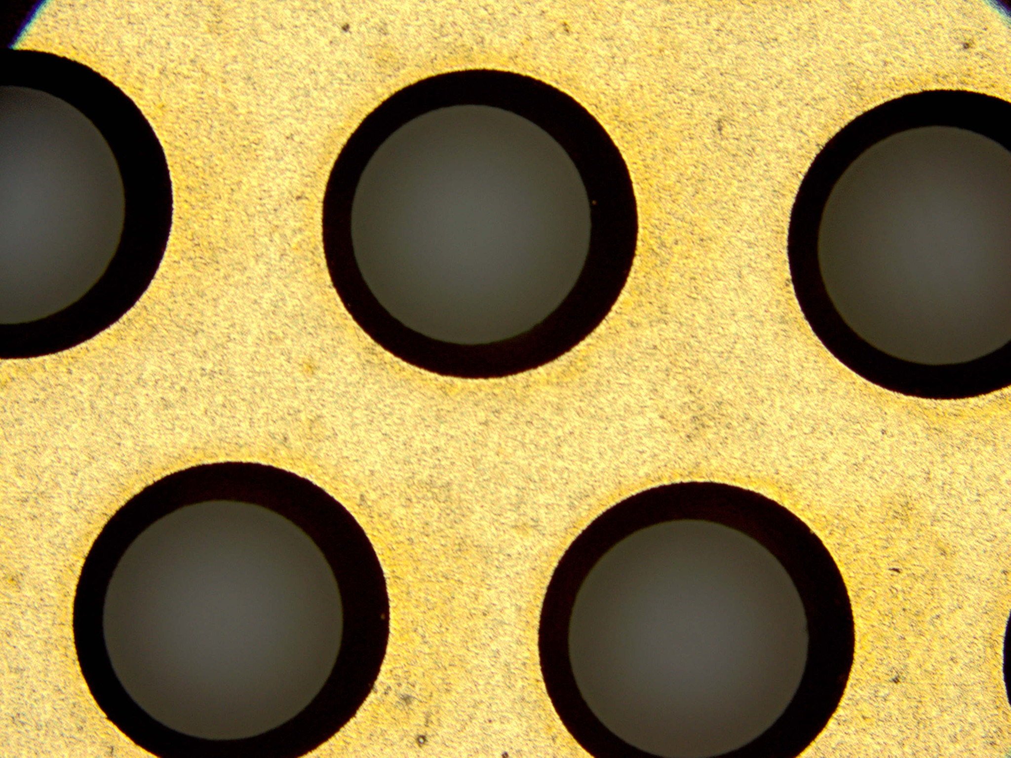
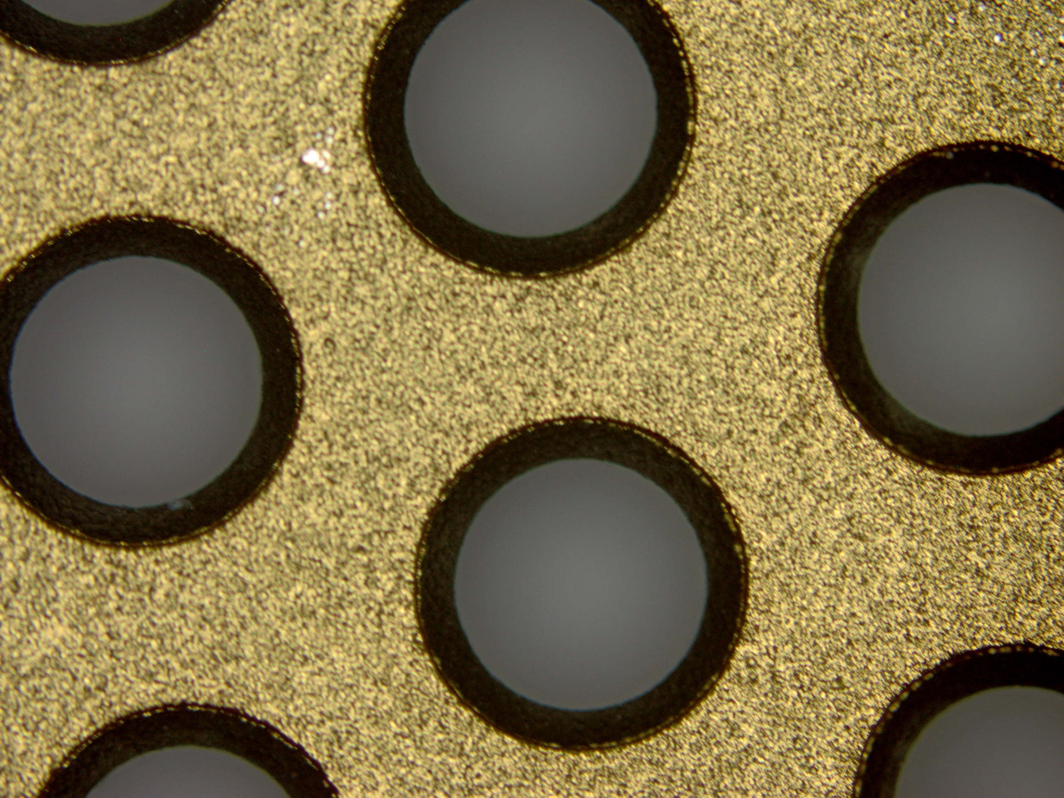
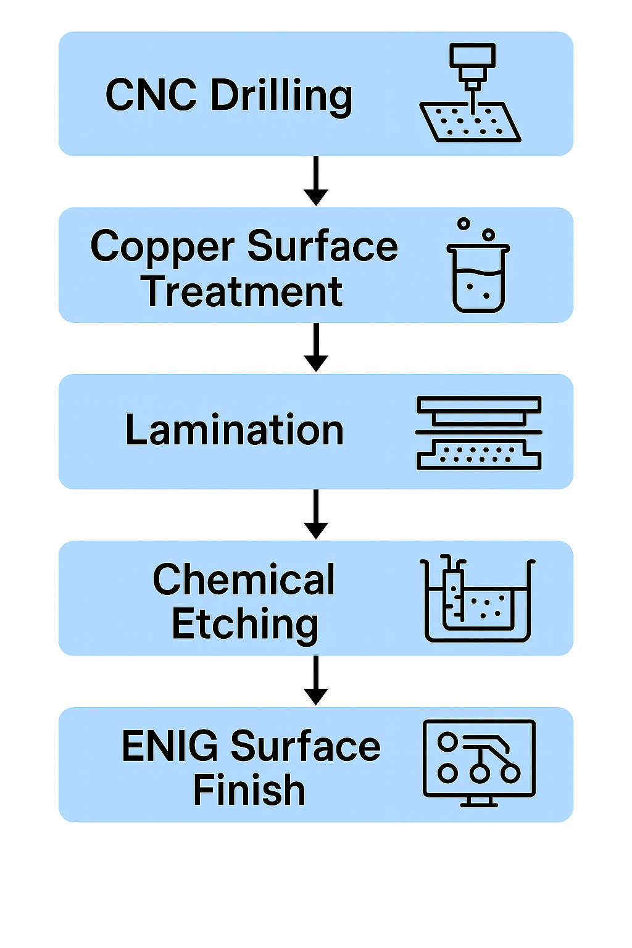
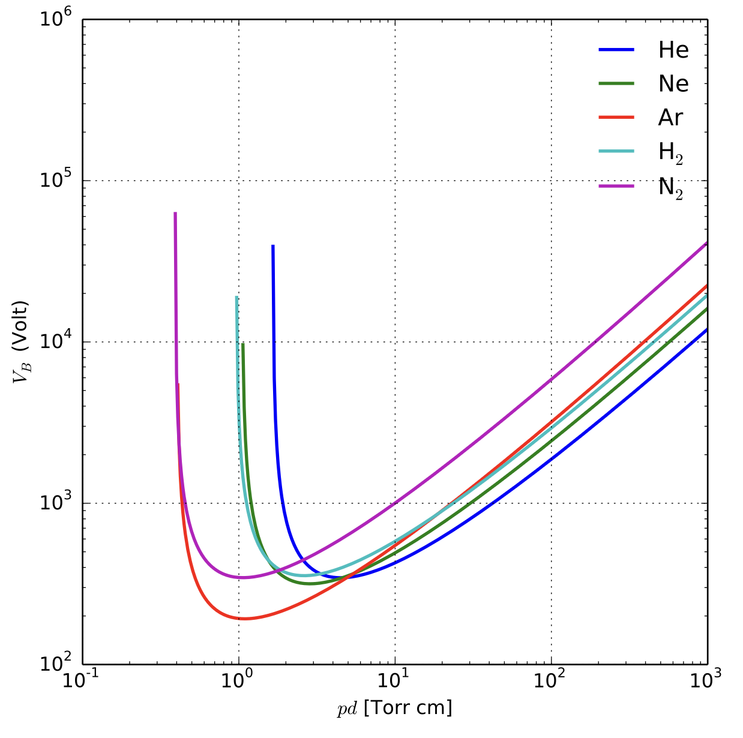
Manufacturing
Manual etching process
Chemical spray etching
Copper surface treatment with sulphuric acid creates rough edges on the copper rim.
This makes the detectors to generate spark at very low voltage.
Thickness | Maximum High voltage reached in N₂ | Paschen limit for 50 micron Rim
270𝜇m | 1800 V | 2200 V
400𝜇m | 1950 V | 2600 V

Slide 6
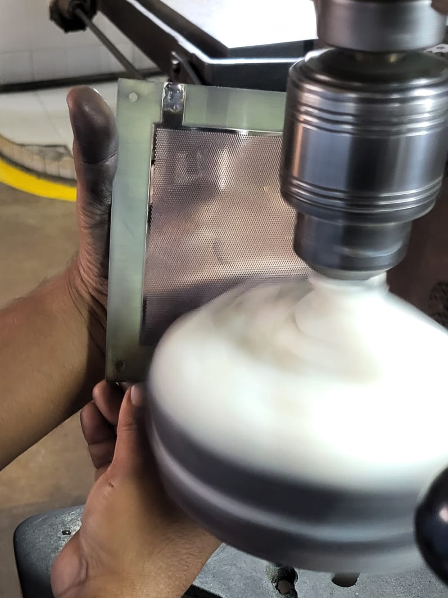
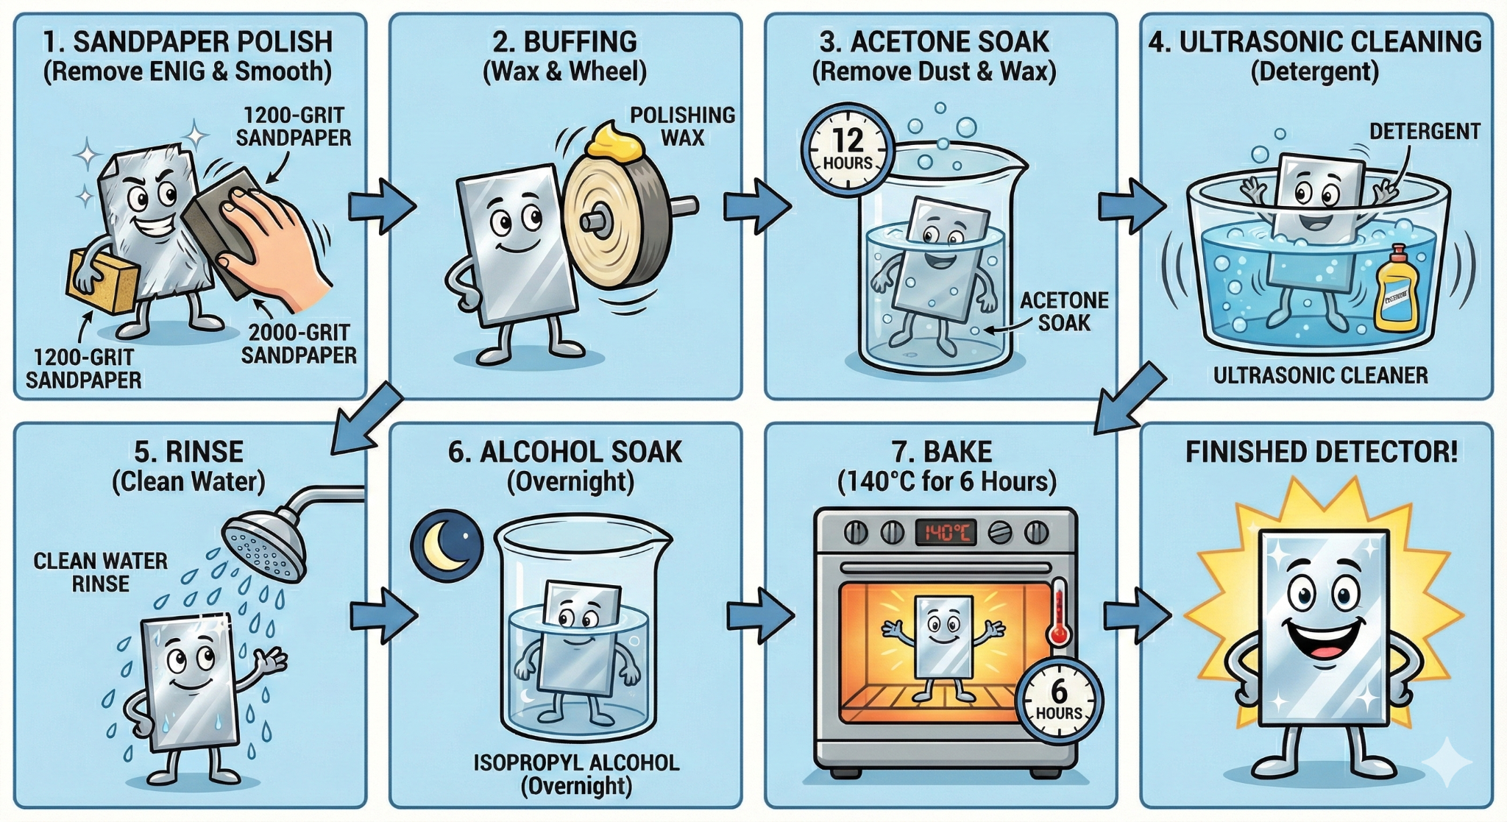
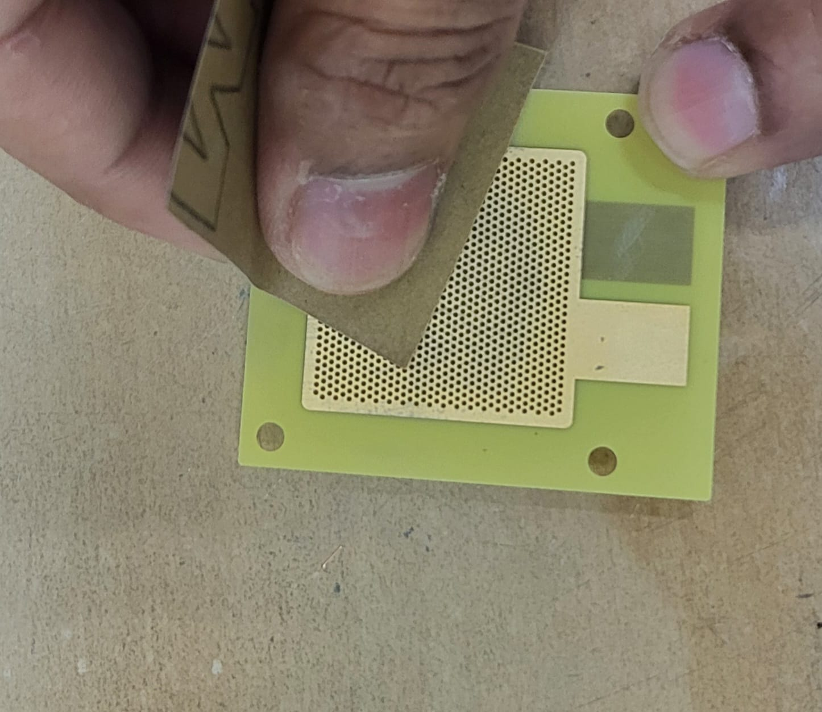
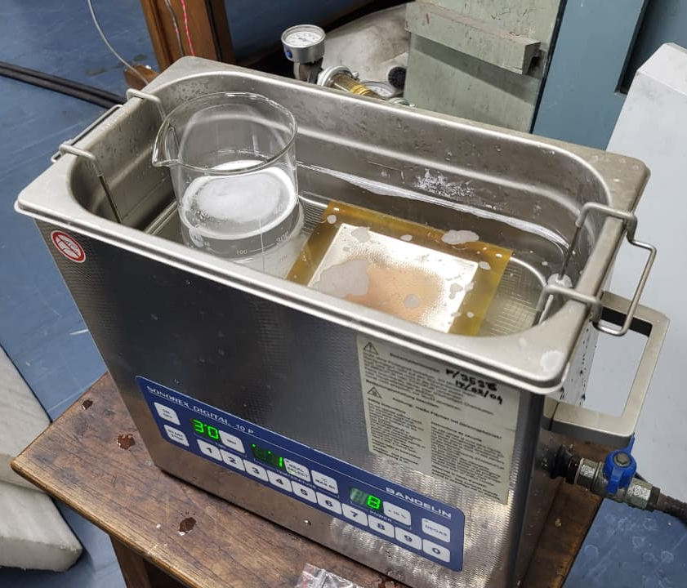
Surface treatments

Slide 7
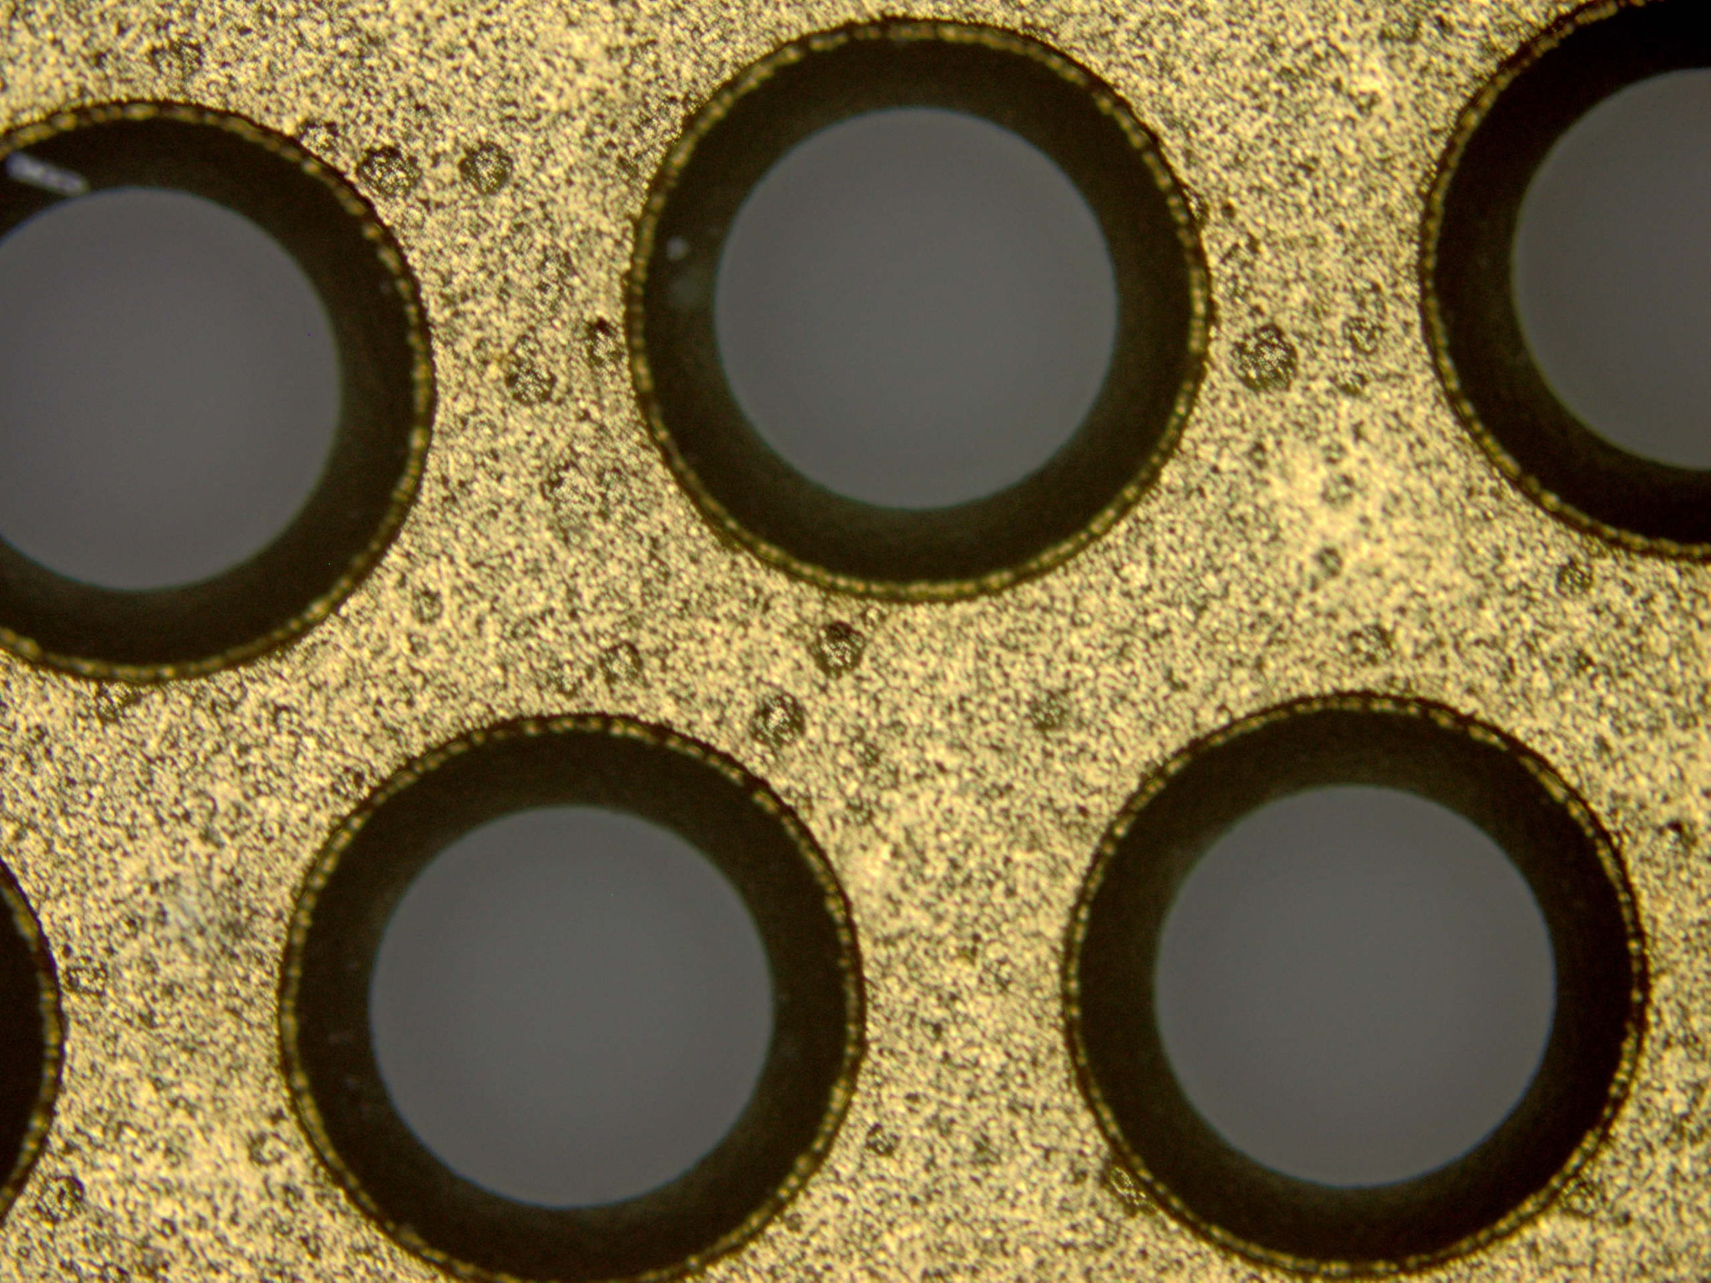
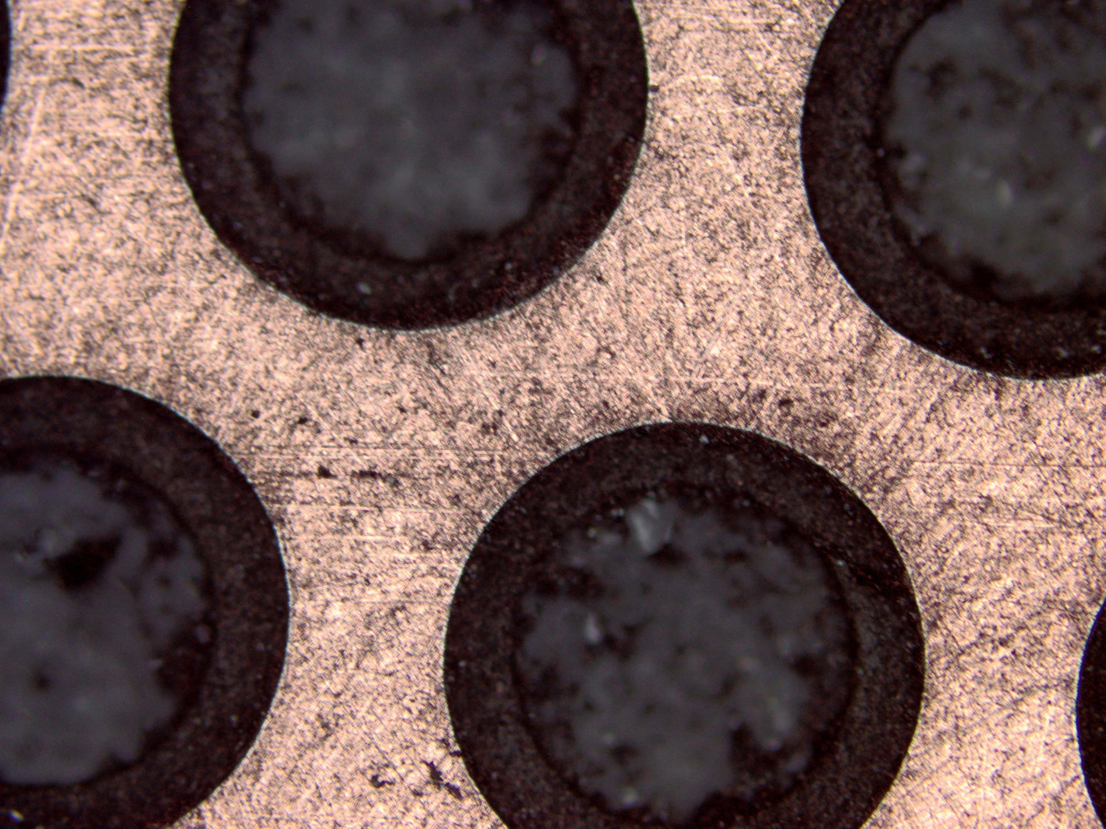
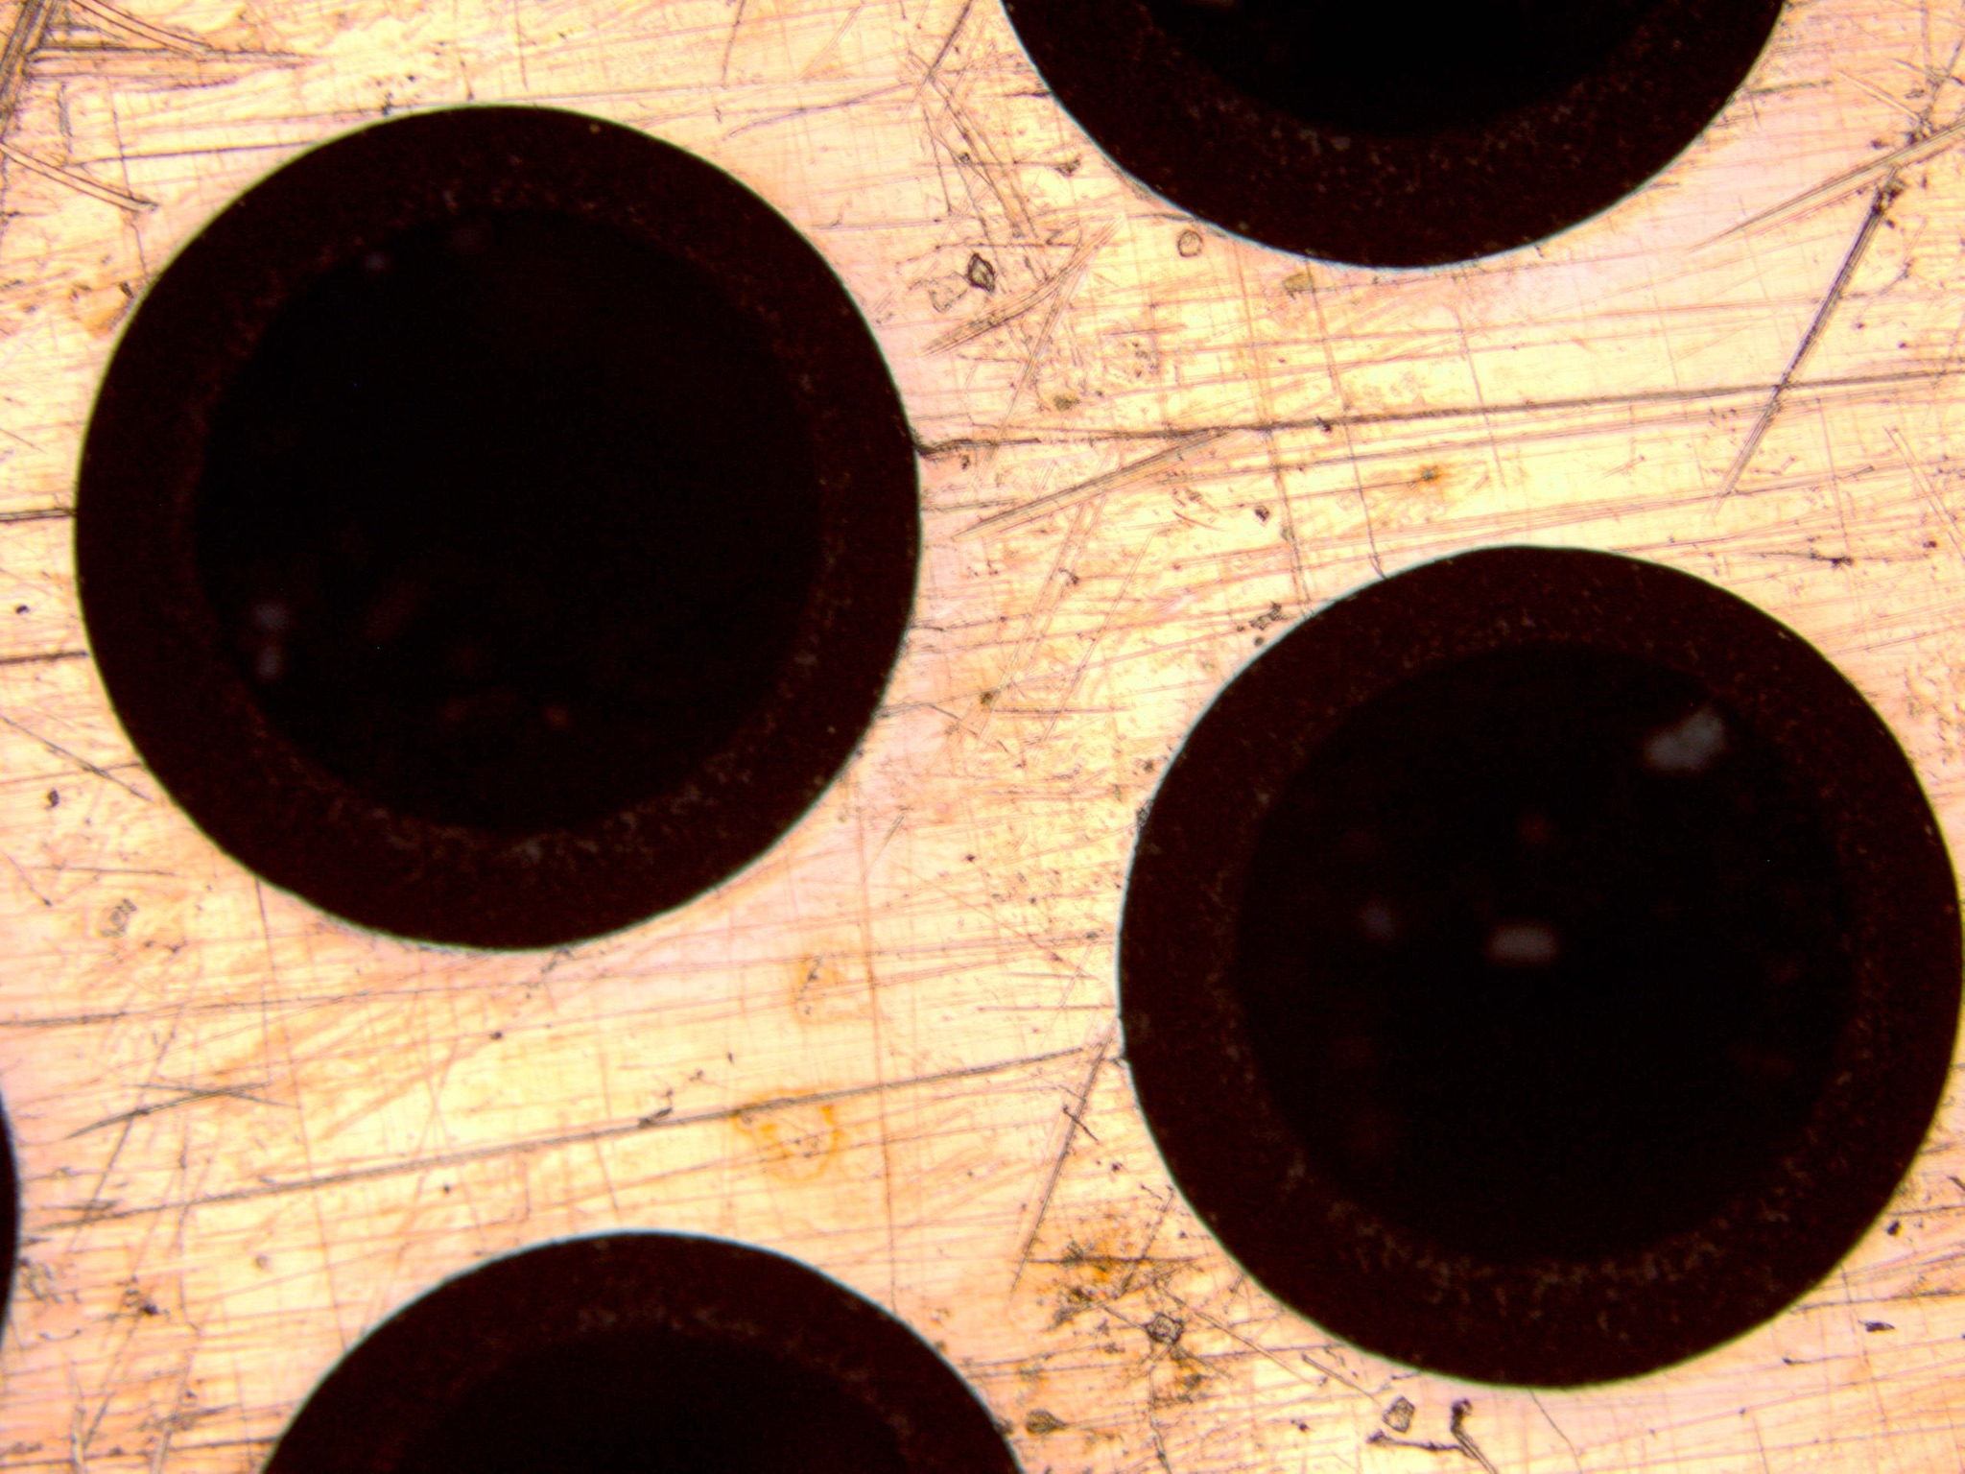
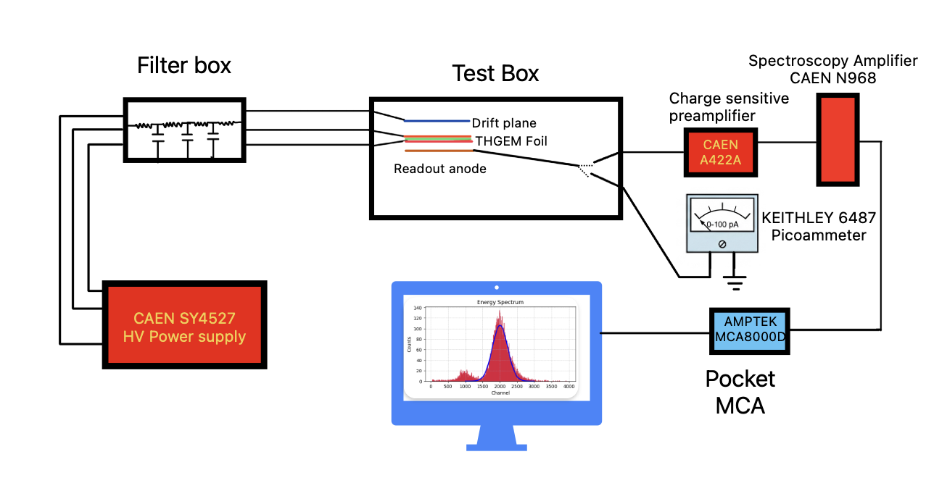
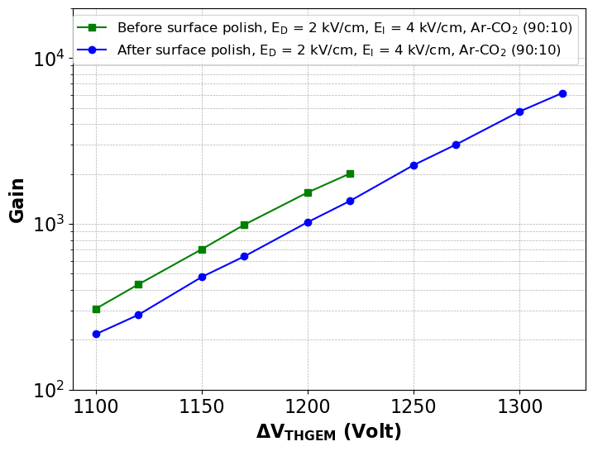
Results
 | Before surface treatment | After surface treatment
High voltage limit in N₂ | (i) 1600 V (ii) 1900 V | (i) 2700 V (ii) 2500 V
Working voltage range in Ar-CO₂ (90:10) | (i) No working region observed. (ii) 1100-1220V | (i) 1400-1550 V (ii) 1100-1350 V
Maximum gain achieved | (i) — (ii) 2000 | (i) 5500 (ii) 7500
After sandpaper polishing
After buffing
Manufacturer | Hole diameter | Pitch | Rim width | Thickness | Material
electronkolkata.in | 500 𝜇m | 1000 𝜇m | 100 𝜇m | 355𝜇m | FR4, IS410
micropack.in | 400𝜇m | 800𝜇m | 50𝜇m | 269𝜇m | FR4 ITEQ IT-180A

Slide 8
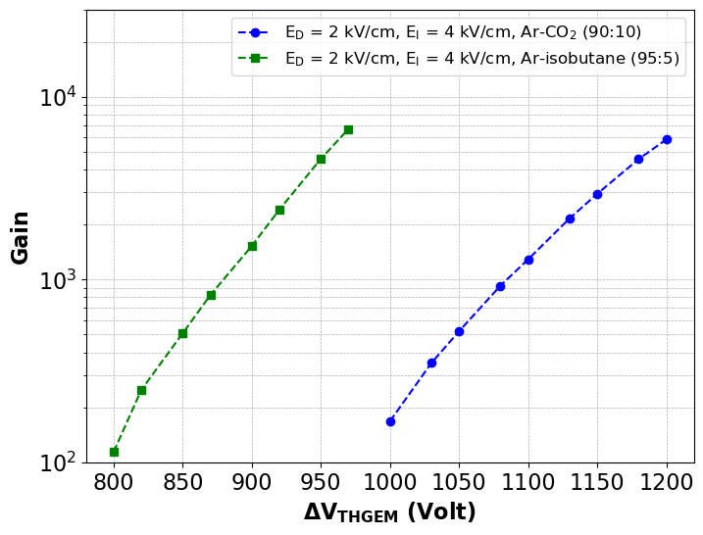
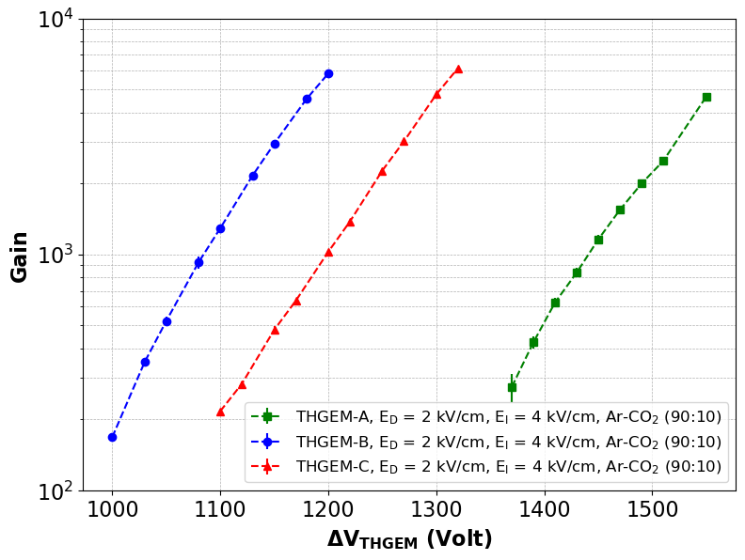
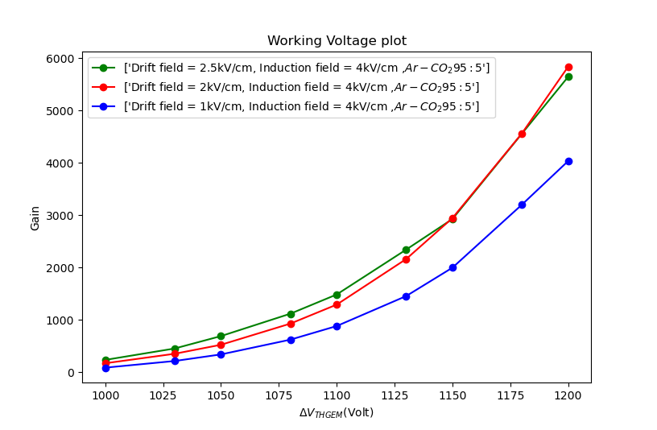
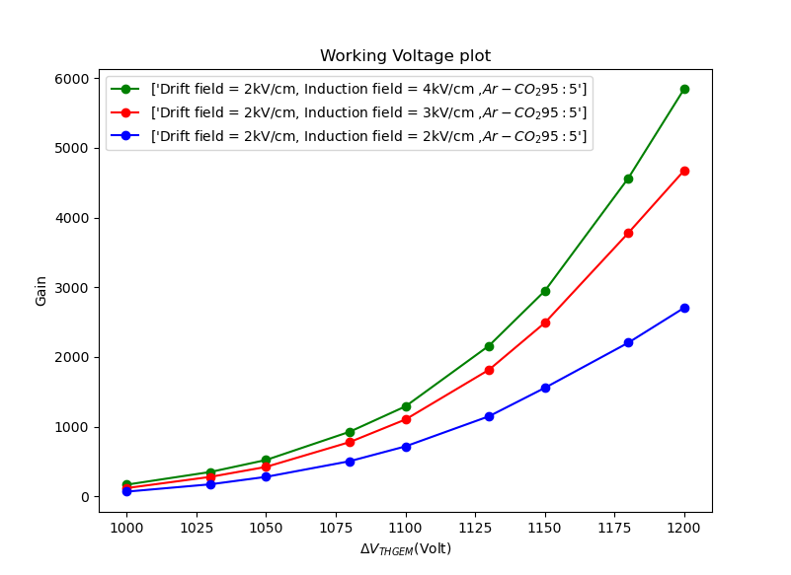
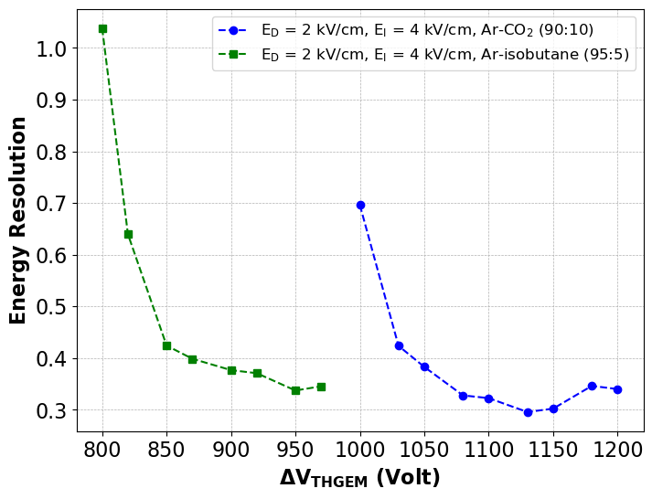
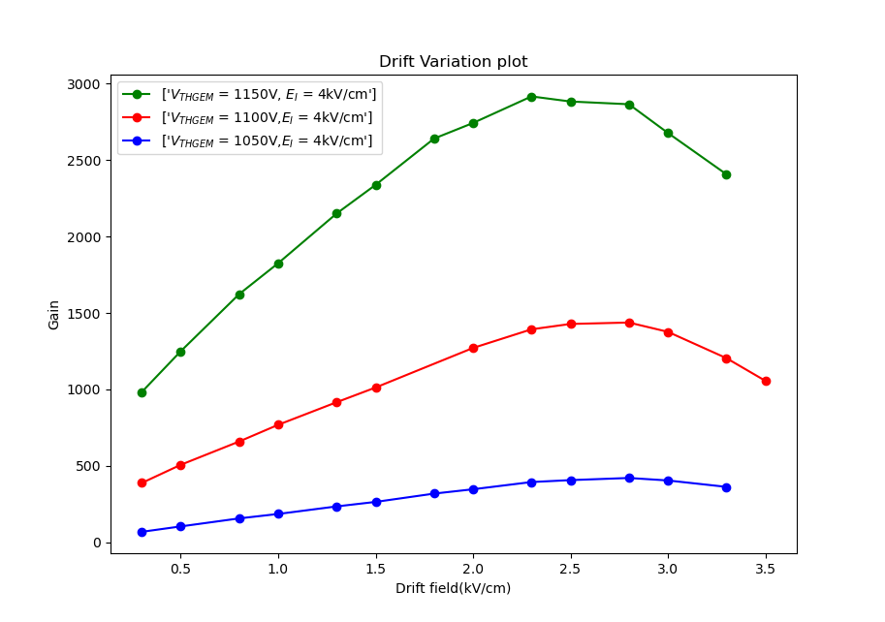
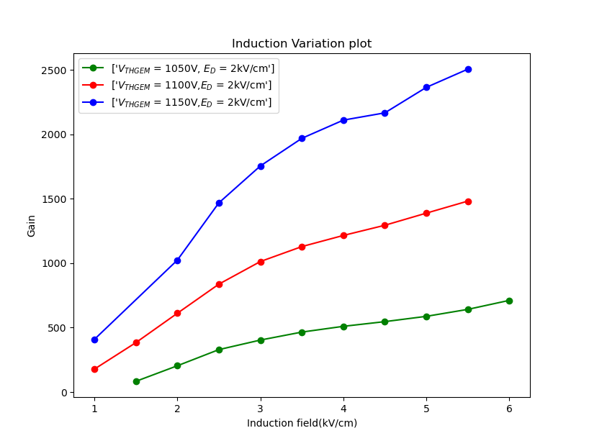
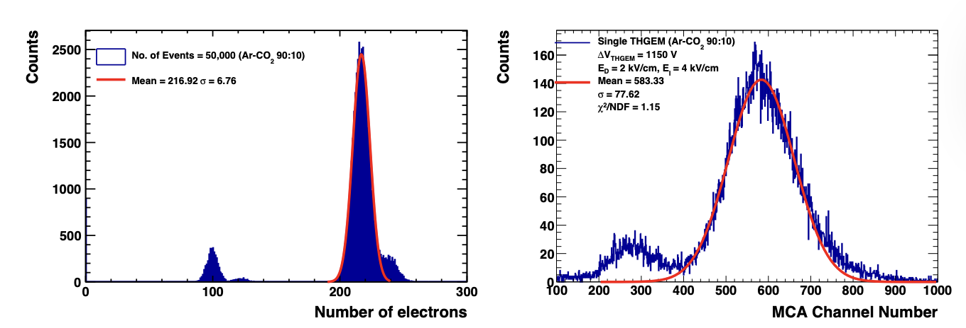
Characterization
Variation of gain with two different gas mixtures
Variation of gain with working voltage in three different THGEMs
Variation of gain with working voltage for different drift fields.
Variation of gain with working voltage for different induction fields.
Variation of gain with changing the induction field at different THGEM voltages
Variation of energy resolution with THGEM voltages
Variation of gain with changing the drift field at different THGEM voltages

Slide 9
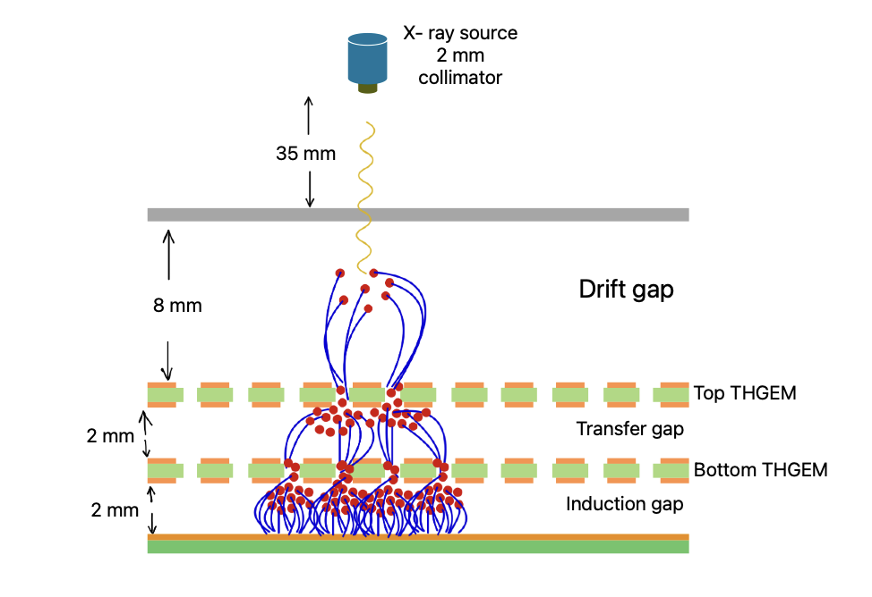
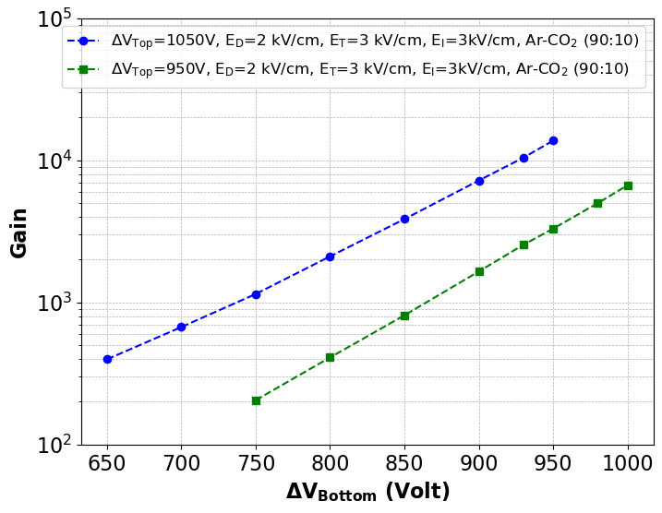
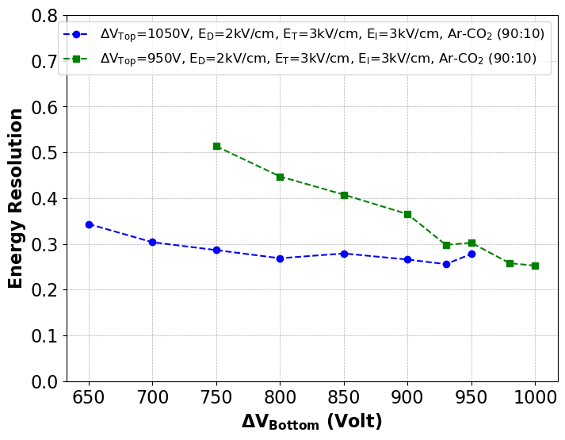
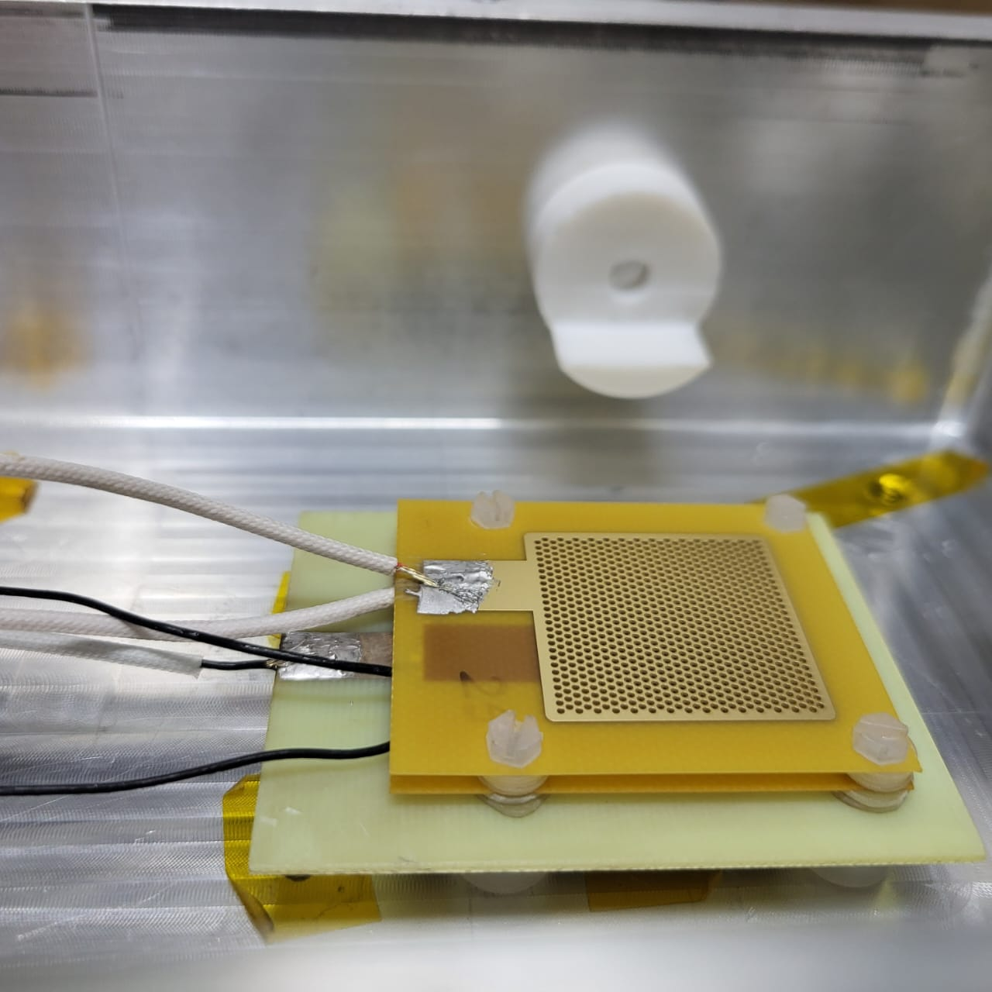
Double stage gain
Sufficient gain without any discharge is the ideal operating condition.
Large voltage difference for single THGEM configuration causes breakdown.
Signal distribution in neighbouring strips may improve position resolution.
Variation of gain with Bottom THGEM voltage for to fixed Top THGEM voltages

Slide 10
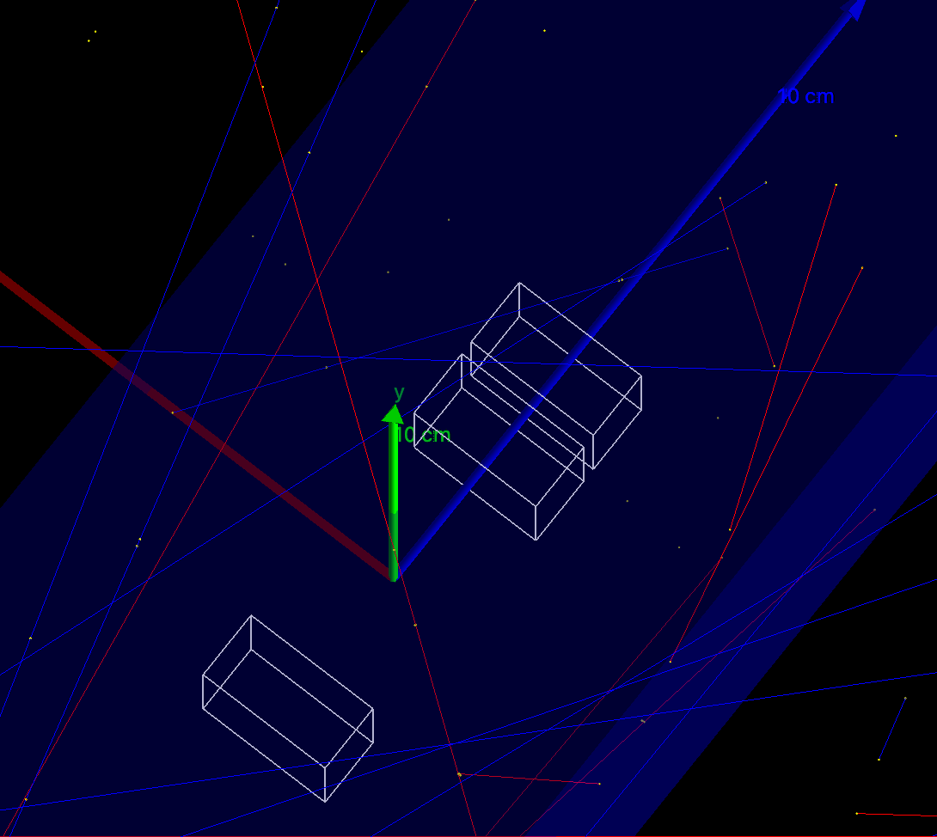
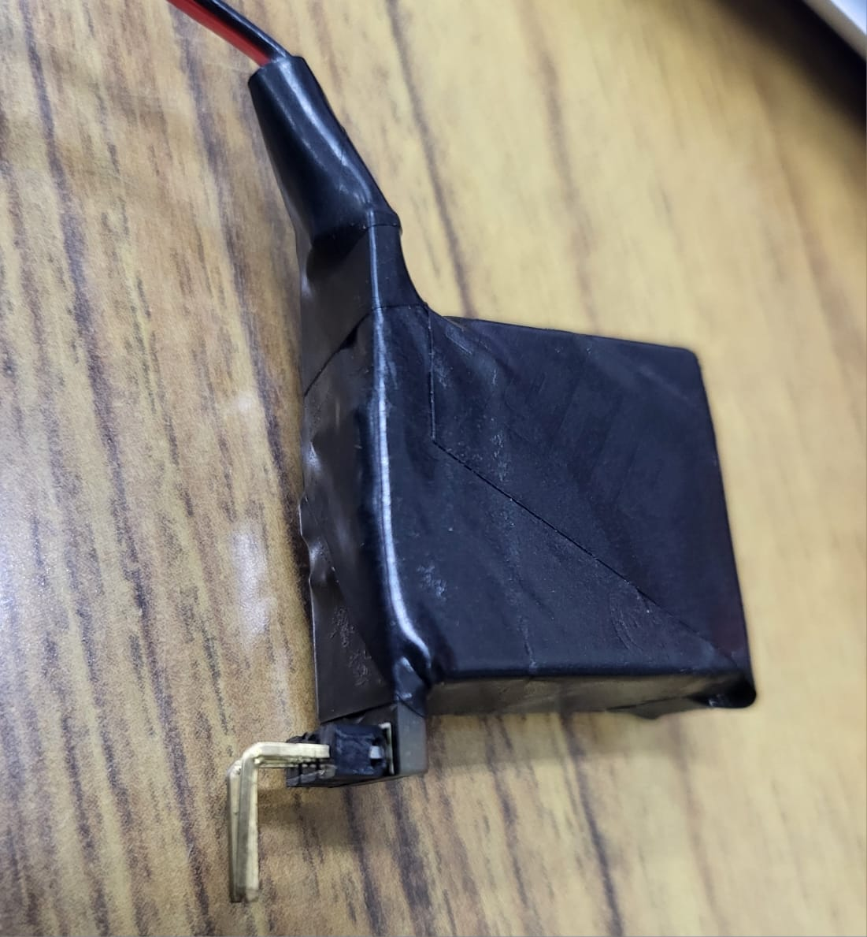
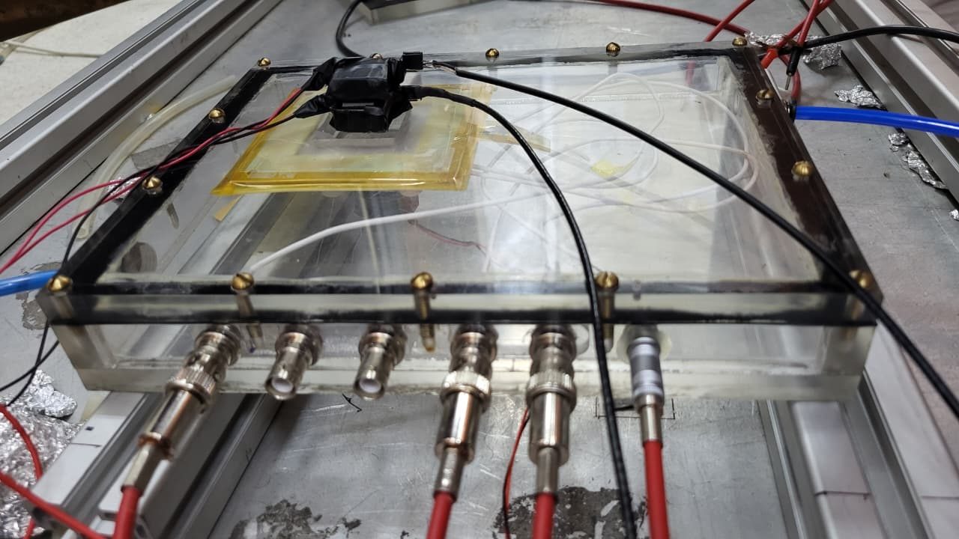
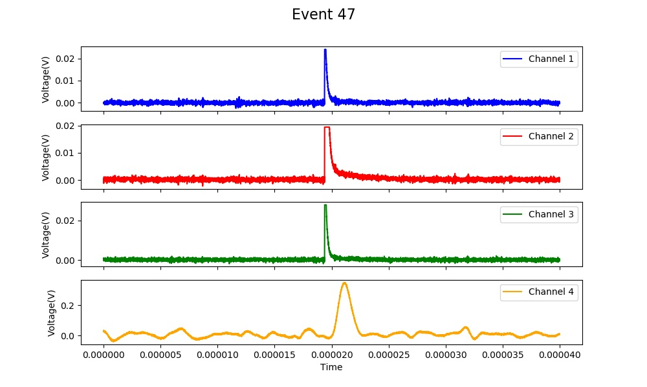
Muon detection efficiency measurement
Scintillator-SiPM based muon coincidence setup has been built.
Oscilloscope logic trigger has been used to find the actual muon events.
Each of these spectrum has been saved and further analysed to find the occurrence of detector hits.
The test detector signal arises on the spectrum with a delay of 0.8 µs.

Slide 11
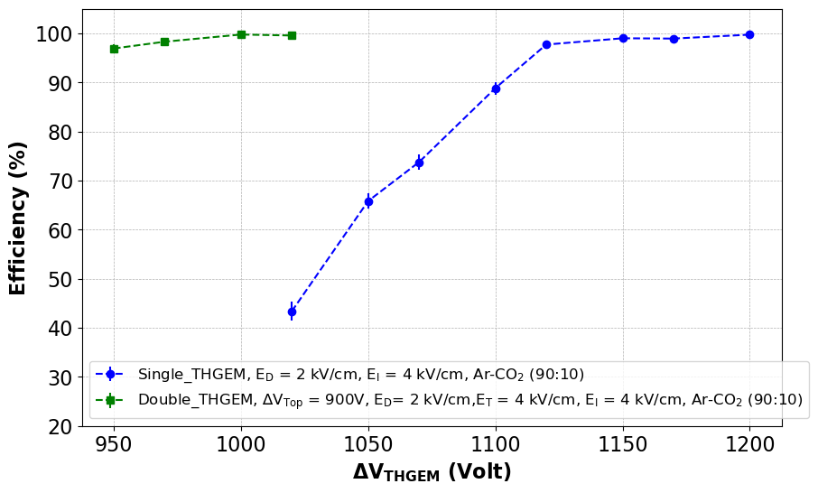
Efficiency
There are electrical noises and spark on the Thick-GEM detector which generates oscilloscope triggers.
Have to be extremely careful while choosing the true events.
A threshold cut of 50 mV in THGEM signal has been used to select an event as detected muon event.
Each data point does not comprises of same number of total events.
600-1200 events has been taken for efficiency calculation.
1 µs trigger window has been selected.

Slide 12
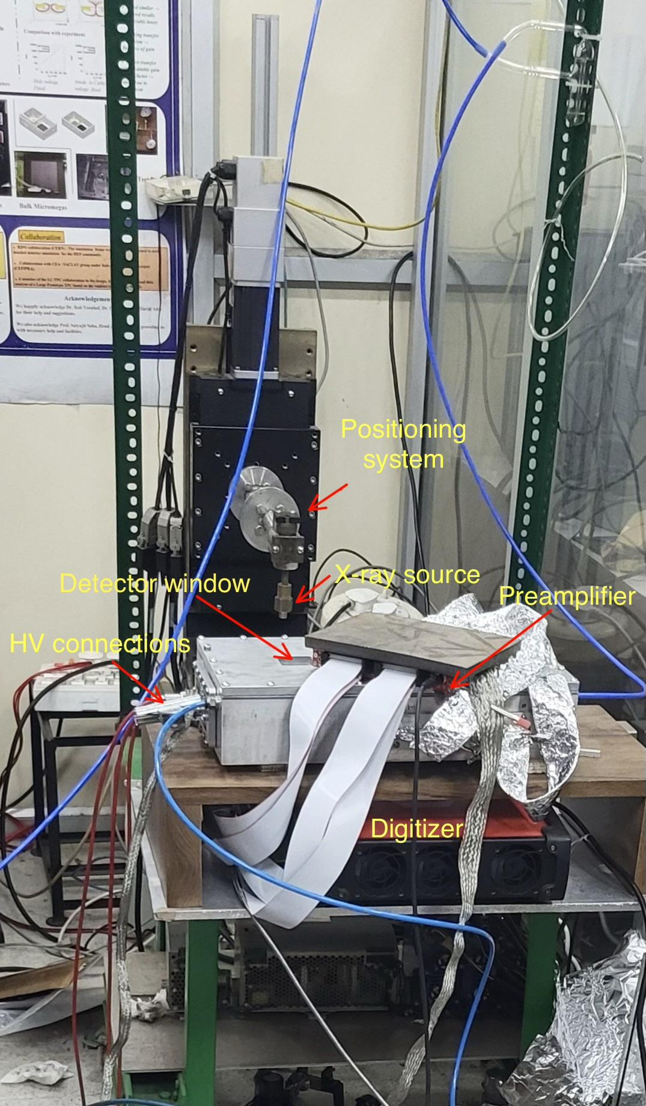
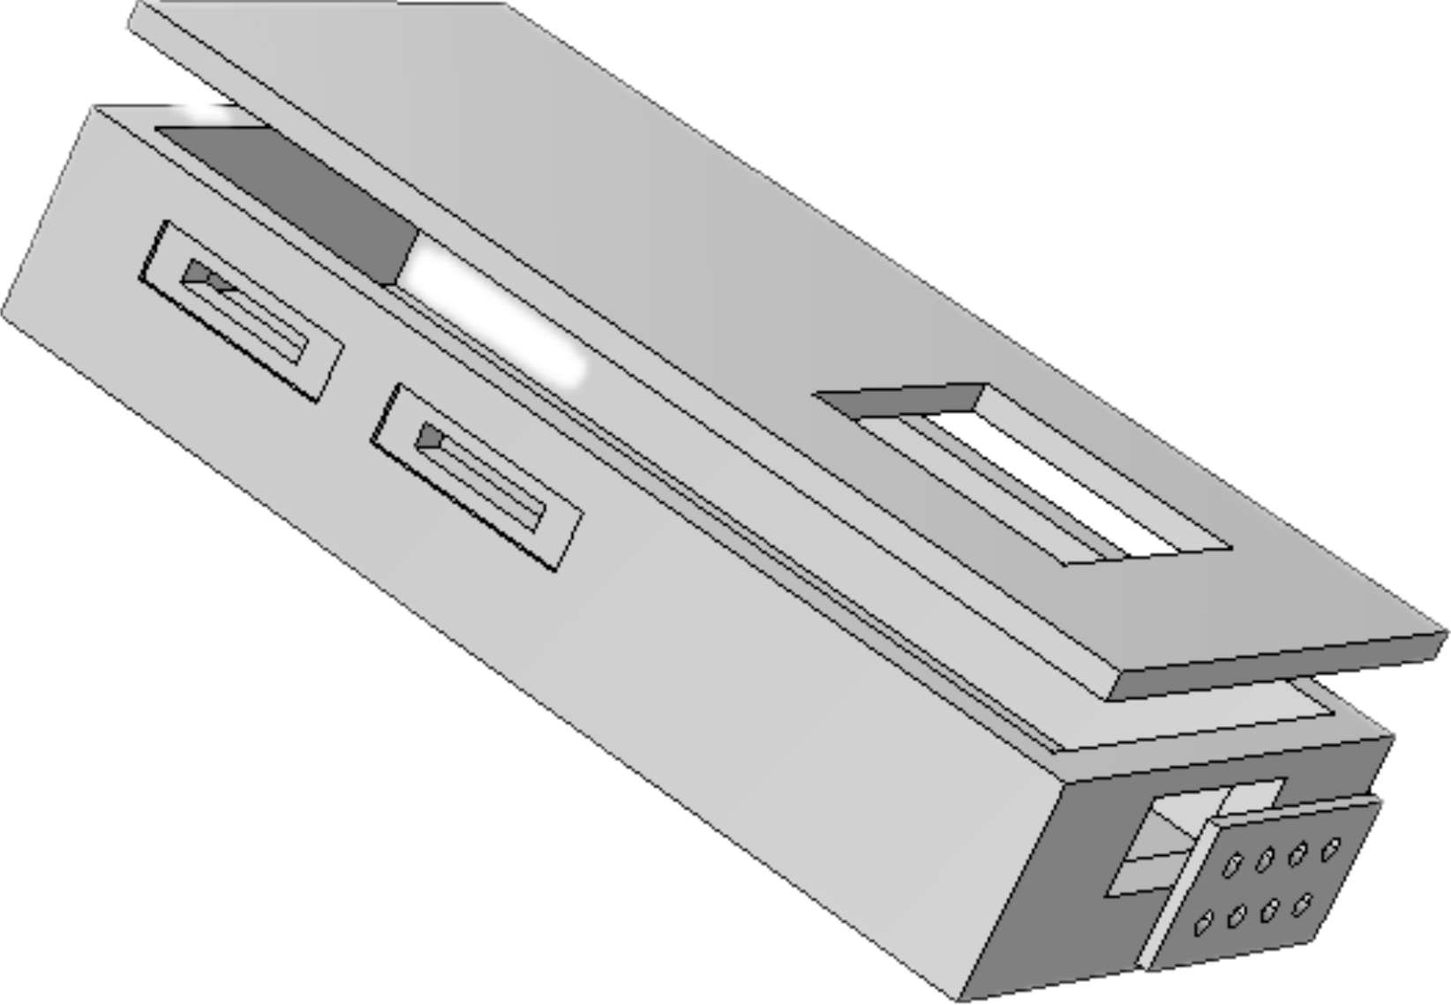
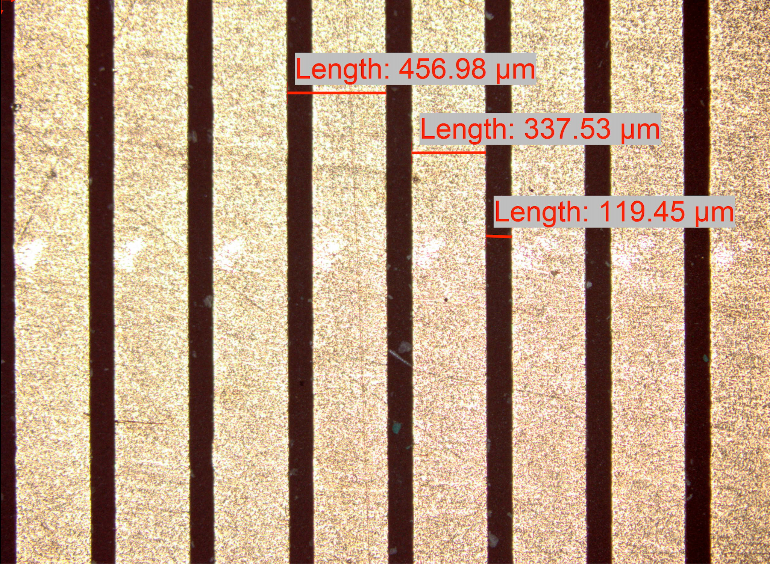
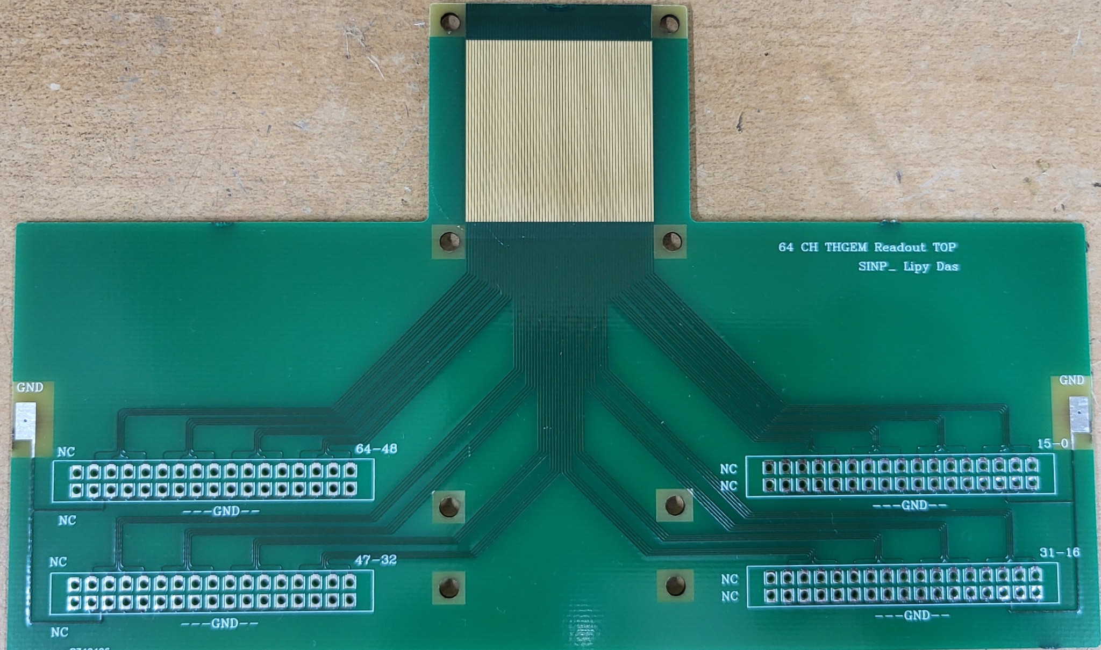
Position Resolution Measurement study
Imaging of different structures with muons require precise reconstruction of its track, thus hit position should be determined accurately.
Knowledge of the position resolution of the detector is important as how much we can trust the detector hits.
The method involves moving an x-ray source precisely and how much the detector hits moves accordingly.
A multi-strip readout board with multi-channel data acquisition system is required for this purpose.
Strip pitch is 450 µm and strip width is 350 µm.

Slide 13
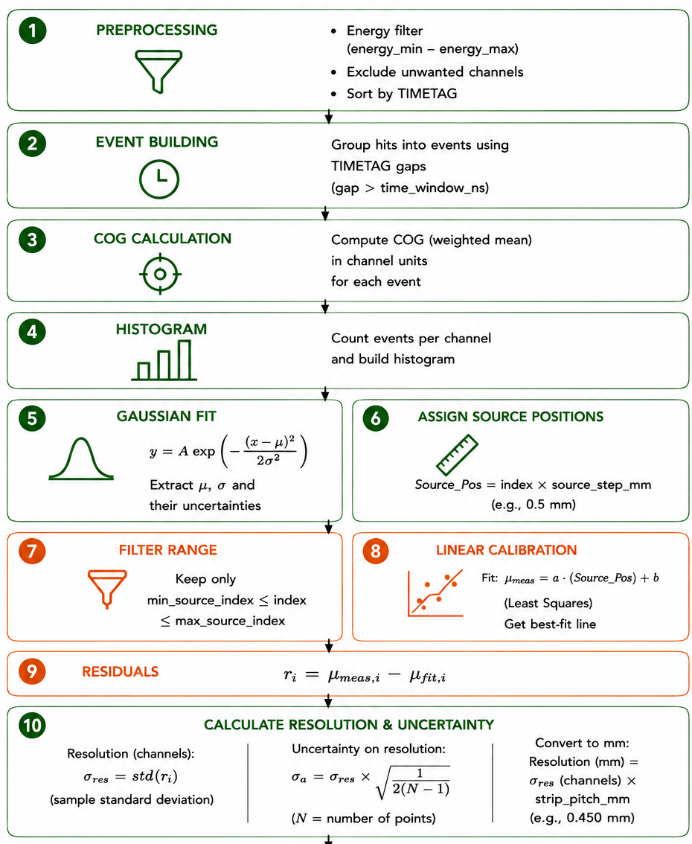
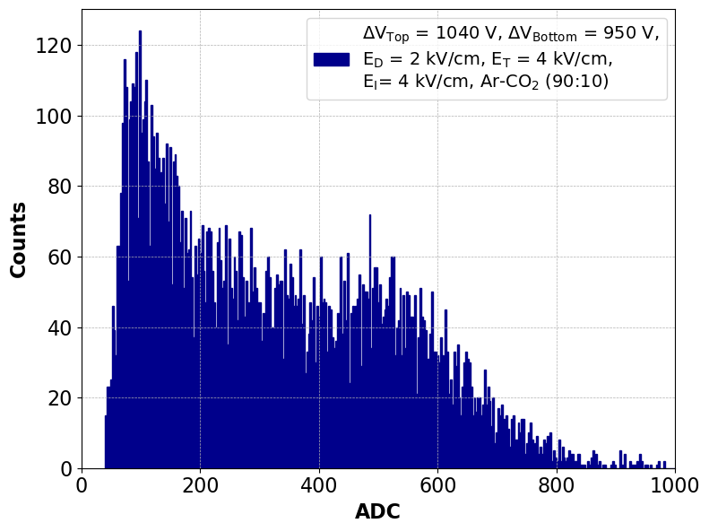
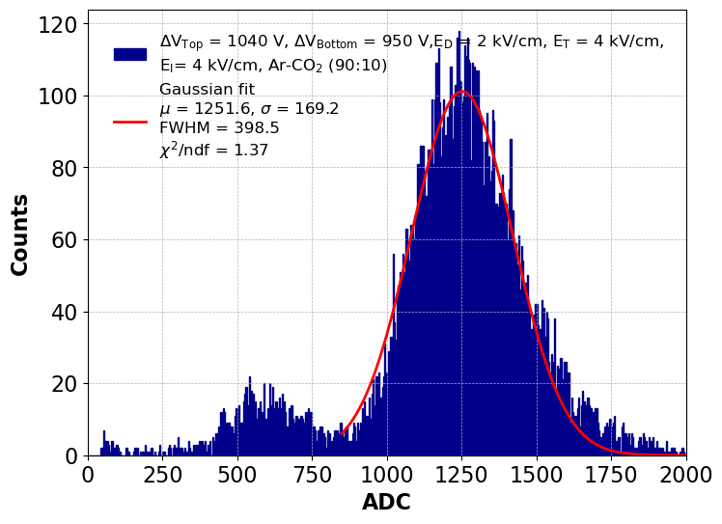
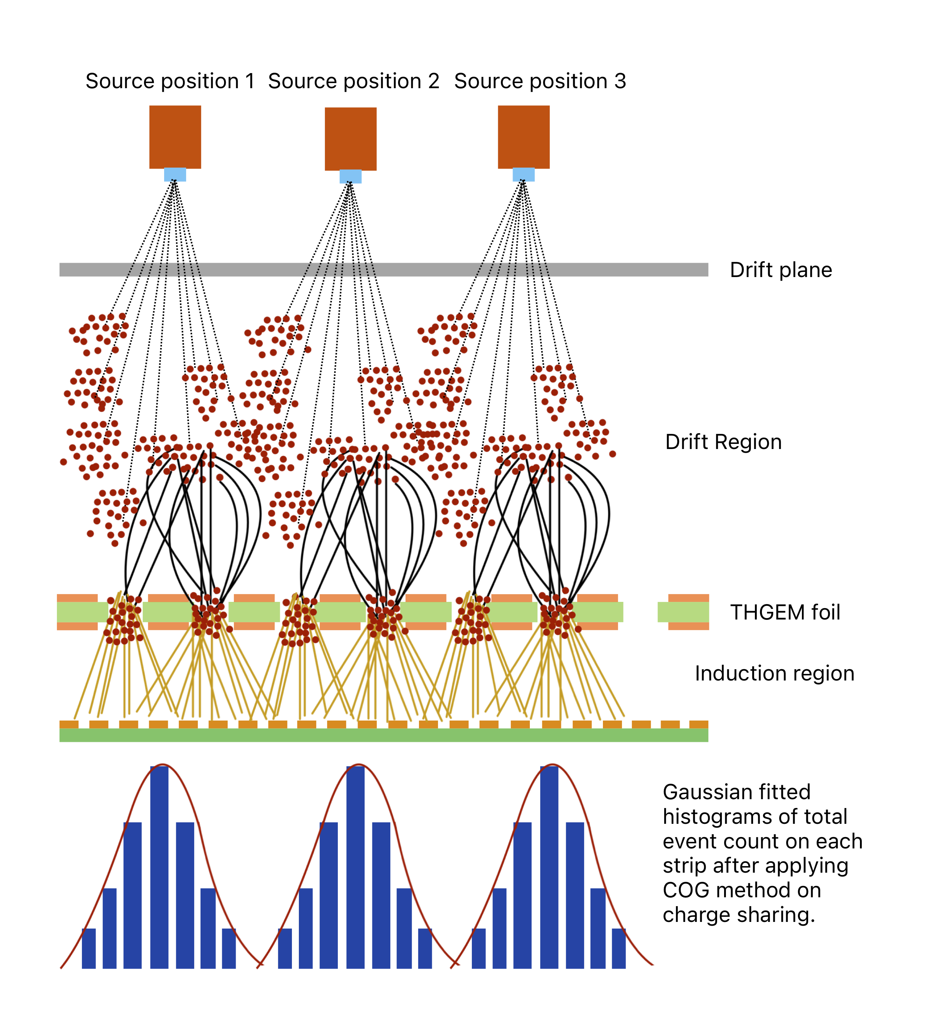
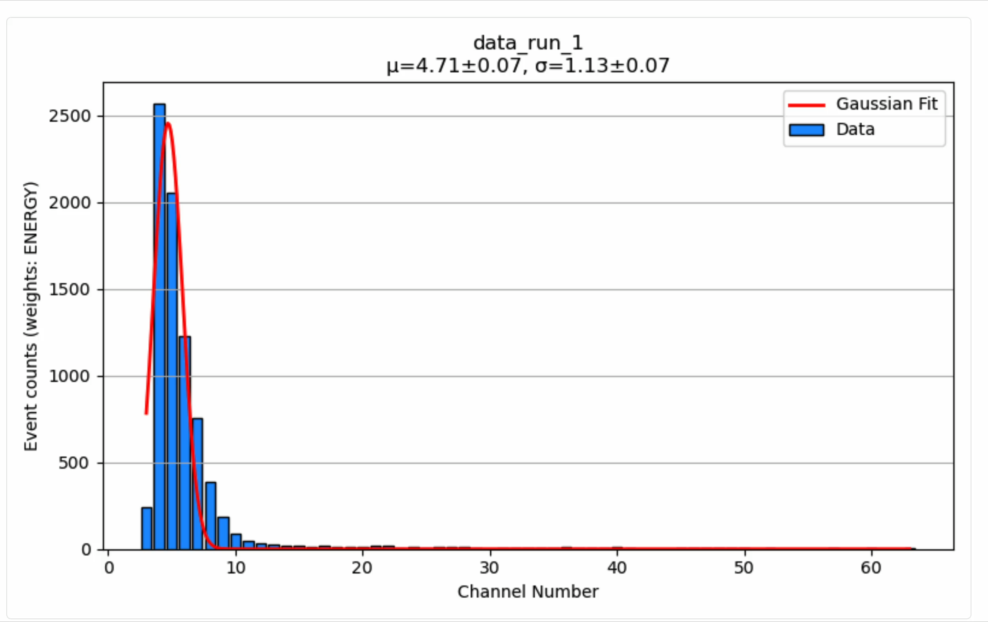
Data acquisition and event reconstruction

Slide 14


Position resolution calculation
The source with 2 mm collimator has been moved 0.5 mm at each step with accuracy 0.5 µm.
Position of the source has been determined from the fitted gaussian.
Residual is the difference between the actual movement of the source and the reconstruced source movement.
σ of the residual distribution is the position resolution.

Slide 15


Variation of position resolution
Multiplicity increses with increasing gain.
At the same gain multiplicity is high for double stage configuration than single stage.
Also at the same gain the multiplicity is higher for Ar-isobutane mixture than Ar-CO2 mixture.
Same also applies for the Position resolution.

Slide 16




Resolution variation
Less multiplicity in Ar-CO2 mixture can be explained from the Magboltz calculations.
The transverse diffusion coefficient is less and Drift velocity is high for Ar-CO2 mixture.
At lower drift-field values, the position resolution is relatively poor because of
Lower effective detector gain
Lower electron drift velocity, and
Larger transverse diffusion in the drift region.

Slide 17





2-D Readout
A 2-D readout has been designed and fabricated with local PCB manufacturing industries.
Strip pitch is 0.9 mm and width is 0.35 mm in X-plane and 0.75 mm in Y-plane.
The middle Polymide layer has been ethched chemically with Ethylene diamine and KOH solution to expose the bottom copper layer for electrons to become transperent.

Slide 18



2-D image
Fe⁵⁵ source with 2 mm collimator has been placed.
Event reconstruction has been done within a specific time window applied.
COG applied to find the actual event location in both X and Y plane.

Slide 19





Effect of detector properties on Muon imaging
iron - class A
rust - class B
AUC=P(xA​>xB​) + 0.5* ​P(xA​=xA​)
Spatial Resolution (um) | AUC | t-score | p-value
50 | 0.9250578704 | 17.18754771 | 2.17E-45
200 | 0.9072145062 | 15.51356976 | 1.33E-39
500 | 0.831404321 | 10.60061004 | 2.31E-22
Rust-Iron discrimination
Resolution (um) | AUC Separation | t-score | p-value
50 | 0.9819018454 | 30.98462577 | 5.11E-66
200 | 0.9696518133 | 28.9706047 | 1.73E-62
500 | 0.9195191937 | 21.49349624 | 3.86E-47
𝜇𝐴, 𝑠𝐴, 𝑛𝐴 denote the mean, standard deviation, and pixel count of the reference distribution (iron)
𝜇𝐵, 𝑠𝐵, 𝑛𝐵 represent those of the test distribution (rust)
Iron-Concrete discrimination

Slide 20
Conclusion and future outlook
Locally fabricated THGEMs demonstrated stable operation and high gain, reaching >6 × 10³ (single) and ~3.3 × 10⁴ (double) in Ar-based gas mixtures.
Achieved >95% muon detection efficiency, with a peak efficiency of 99.5%, confirming suitability for charged-particle tracking.
Excellent position resolution was achieved using COG reconstruction.
Detector performance showed dependence on gas composition and drift field, with Ar–CO₂ providing superior resolution in the low-gain regime.
Muography simulations demonstrate that improved spatial resolution enhances material discrimination and increases the fraction of image-suitable muon events.
Future: Scale up THGEM fabrication, develop larger readouts, and integrate multiple tracking planes toward a full-scale muography system.

Slide 21
Acknowledgement
Prof. Nayana Majumdar, Prof. Suprartik Mukhopadhyay.
Dr. Sridhar Tripathy, Dr. Promita Roy, Dr. Subhendu Das, Dr. Pralay Kumar Das, Mr. Shubhbarata Dutta.
Nilanjan Biswas , Lipy Das, Sudipta Barman for their tireless effort in helping designing the experiment.
I like to express my gratitude towards SINP, HBNI and DAE for providing necessary funding and equipment throughout the work.

Slide 22
Thank you!

