Slide 1


PICMIC*: An Ultra Precise 4D Detection Concept
* PICosecond subMICron detection concept
IP2I-Lyon : I.Laktineh, E. Bechetoille, H. Abreu, H. Mathez, Ch. Combaret, G. Garillot, X. Chen, K. Sabra, L. Balleyguier, G. Noel, G. Grenier, L. Mirabito
IPHC : Ch. Hu, C. Colledani, H. Pham, I. Vallin, G. Bertolone, G.Claus, M. Specht
IJCLab: J. Maalmi, D. Breton, D. Charlet, A. Back
OMEGA: S. Callier, C. de la Taille
SDU: L. Zhang
Nakai University: Y. Zhao
IHEP: J. Ye, Q. Sen, L. Chen
IMP: A. Serghei, L. Leveque, L. David
INL: J-L. Leclercq, P. Pittet, C. Chevalier, P. Kleimann, B. Rea, N. Terrier
ILM: A. Ayari
XIOPM: P. Chen, X. Zhng
I. Laktineh, PSD14 conference, QM University, London 2026

Slide 2
Outline
Introduction
PICMIC concept
Time measurement
Position measurement
First prototype with MCP and results
Time and position improvements
From MCP to NCP

Slide 3
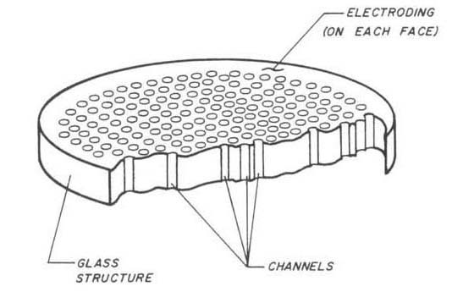
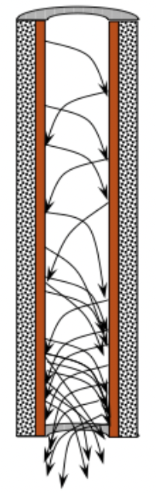
Micro Channel Plate (MCP)
MCP is considered as the best timing device
with a few picoseconds of time resolution.
MCP has an excellent intrinsic spatial resolution since the avalanche produced by the incoming particle is constrained to one of the glass tube whose diameter can be as small as 3 µm
MCP are often used for their timing ( reaching few to tens ps) while their
spatial resolution is not appropriately exploited.
Few µm diameter

Slide 4
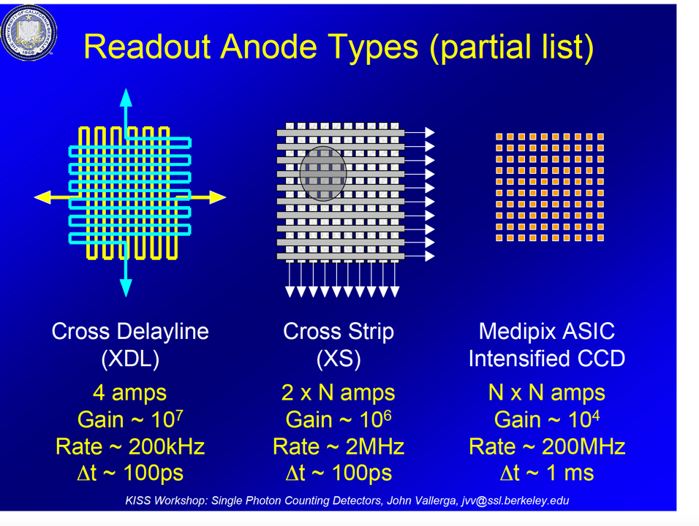
Courtesy J.Vallegra
Few mm
100 µm

Slide 5
Courtesy J.Vallegra
Few mm
100 µm
Timpix4: 193 ps lsb

Slide 6

  MCP intrinsic spatial resolution is not well exploited as its temporal one
  We propose the following scheme :
  A transparent grid placed downstream the MCPs and read out by sensors with excellent time resolution. Followed by:
  A detection matrix with micrometric pixels to measure with great precision the position of the avalanche while requiring limited number of electronics channels.
Patented concept:
PCT/EP2020/050058
MCP
Concept description
T₃
T₂
Metallic Grid
Delay plane concept
T₄
T₁
The grid can be the metallic anode of the MCP
Time + position
T₅
T₆
Woven strips→
3d interconnected
pixels concept
Pixels
X,Y
Position+ time
Use (x,y) to subtract the time propagation on the grid and then improve on time measurement : T_{abs} = $\frac{\sum_{0}^{N}{T_{i}−T_{i−propag}}}{N}$

Slide 7
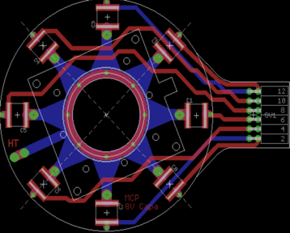
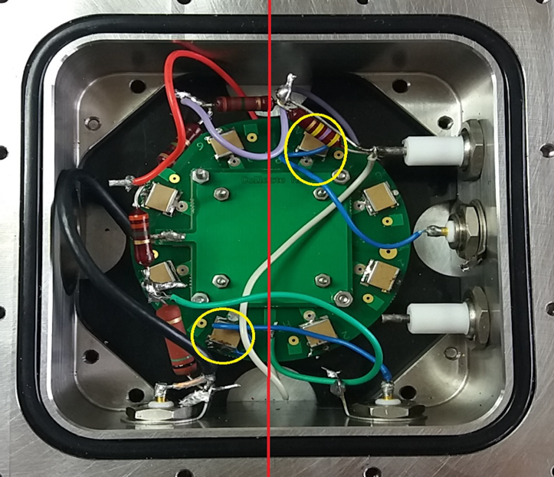
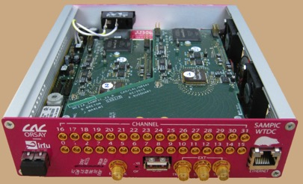
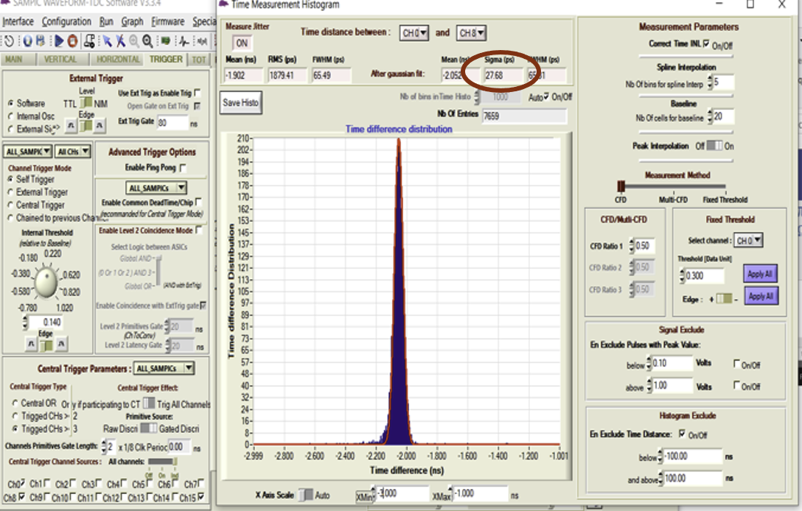
Time measurement
First setup with two MCP of 2.5 cm diameter to validate the delay plane principle
Delay-plane readout
SAMPIC: a waveform digitizer (3ps)
σ_{Τi-Tj}=30 ps → σ_{T} = 8 ps

Slide 8
Position measurement
PCT/EP2018/053561
To reach few microns resolution with a limited number of electronic channels, a new concept was developed and successfully tested (Tricot)
Connect the pixels in woven strips in three or more orientations
Two neighboring pixels are connected to two different strips of different orientations
Each strip is connected to one electronic channel
Share the charge among a few ones
Crossing the fired strip to determine the position
Ambiguity is eliminated thanks to the 3D interconnection
NXN → 3N : Reduction of electronic channels, power consumption and occupancy

Slide 9
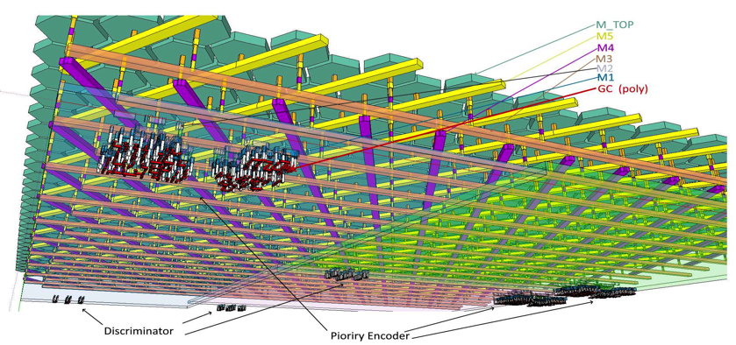
Pixel sensor & electronics
Pixels of a few microns are needed to exploit the spatial resolution
Only wafer-based technique can offer such a structure
TJ 180 nm, 6 metallic layer wafer
Current conveyer preamplifier
Priority encoder
Parameters | Value
Design Flow | Cadence DoT flow
Technology | TJ CIS 180nm
Power supplies | 1.8V
Power density | >172mW/cm² (only analog static current)
Die dimension | ~7.5x7.5 mm² (6.5x7.5mm²)
Anode dimension | ~22µ²(5µm hexagonal pitch)
Readout pixel dimension | 50µmx140µm
Readout matrix | 128x54 cells (only 2556 active)
Input clock | 40MHz
Read-out port | 13-bit parallel
I/O Pad | CMOS
Slow control | I2C
Max data rate (1Mhz hit rate) | 390Mbps
The 2556 RO cells allow reading out the
2 216 000 pixels of 5 µm pitch

Slide 10
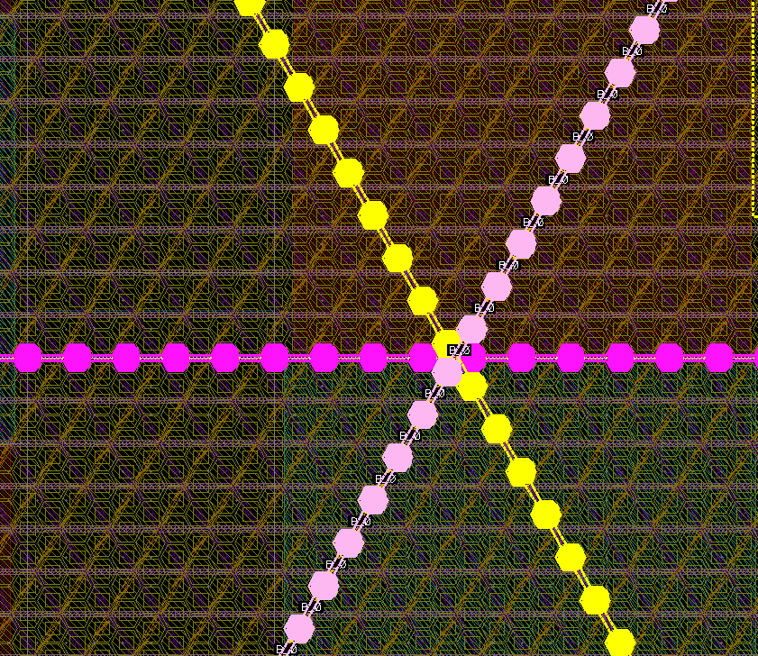
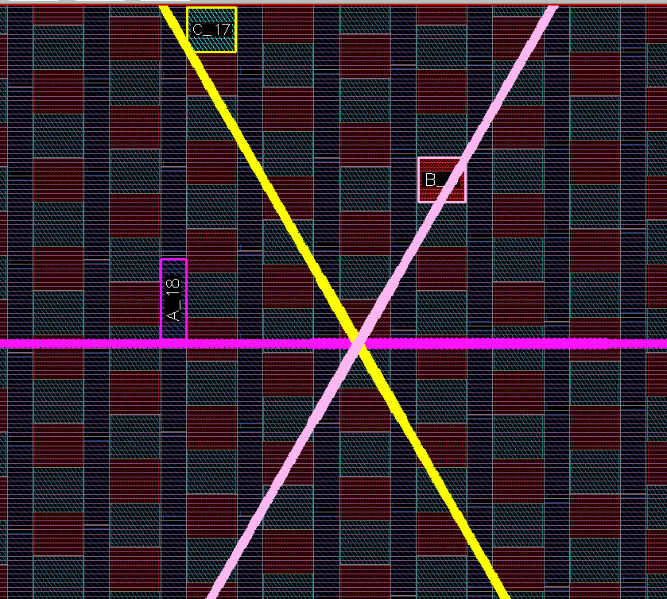
The signal is transmitted from the fired pixels to their associated readout cells
86.6
43.3
75
ReadOut cells ‘fired’
Crossing the lines associated to the fired channels provides the position

Slide 11
Front End lock
VDD
Out_EN
Internal
VDD
VDD
Out_EN
ENA_CM
D2
PWR
D1
I_gain<0:1>
VDD
ENA_CC
TOCHECK
ENA_D1P
VBP
Vref_P
Pulsing
ENA_CM
ENA_CM
ENA_D2P
Vin
Ith1 (S3)
Current
Comparator
Current
Mirror
To DFF
S1
VBN
S2
Iadj
MUX
Idet
(Idet < 0)
ENA_CM1
Vref_N
VBNadj
GND
S3
Ith2 (S1,S2)
ENA_CM
I_adj<0:2>
GND
GND
Current conveyer preamplifier
Dynamic range:
> 10 fC
Column lines
ENA_IP
Vref_P
Vref_N
VBN
VBP
ENA_D2P
Vin
ENA_D1P
ENA_CM1
VBNadj
GND
VDD
Dac_P
1-200µA
8 bits
E
VDac_BP
Cible 700mV
8 bits
ENA_IPb
ENA_IN
VDD
Dac_N
1-200µA
8 bits
Pad
ENA_INb
F
Pad
A
GND
B
C
D
Dac_CM
3-7µA
8 bits
Pad
Pad
Dac_Iadj
0-5µA
8 bits
DAC system

Slide 12
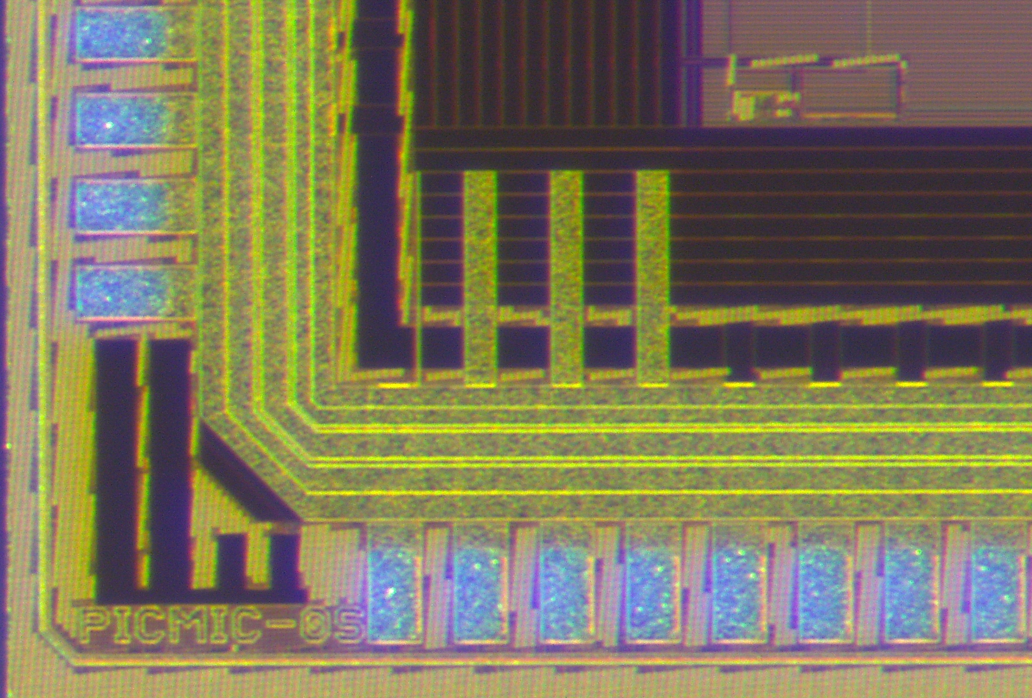
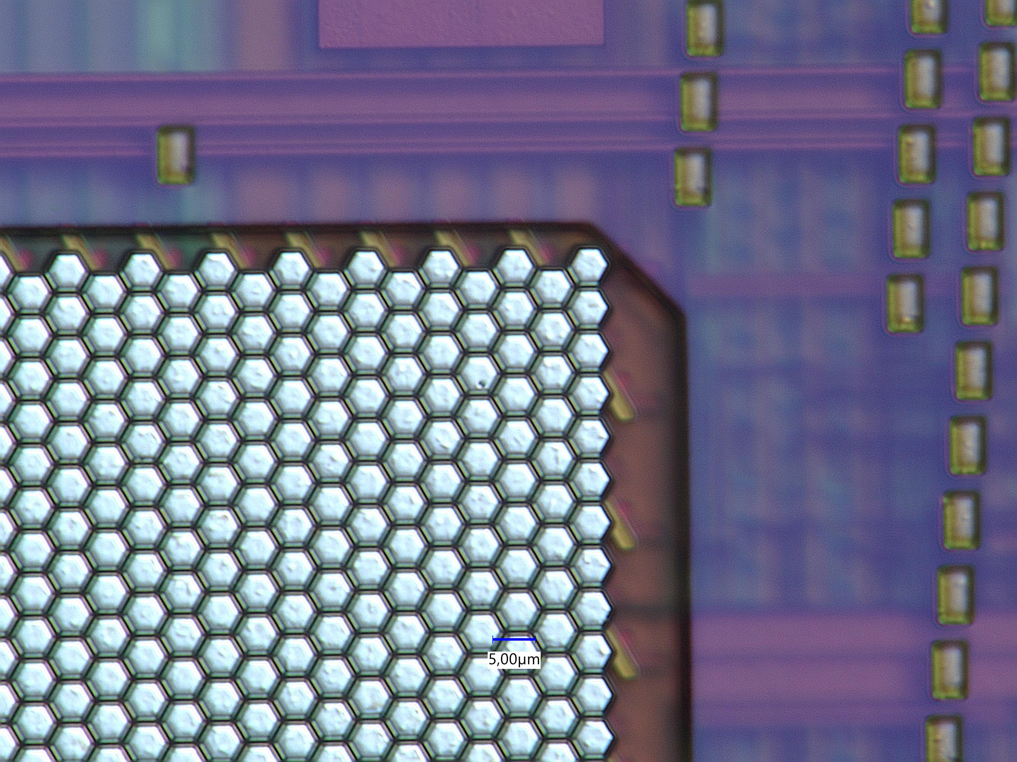
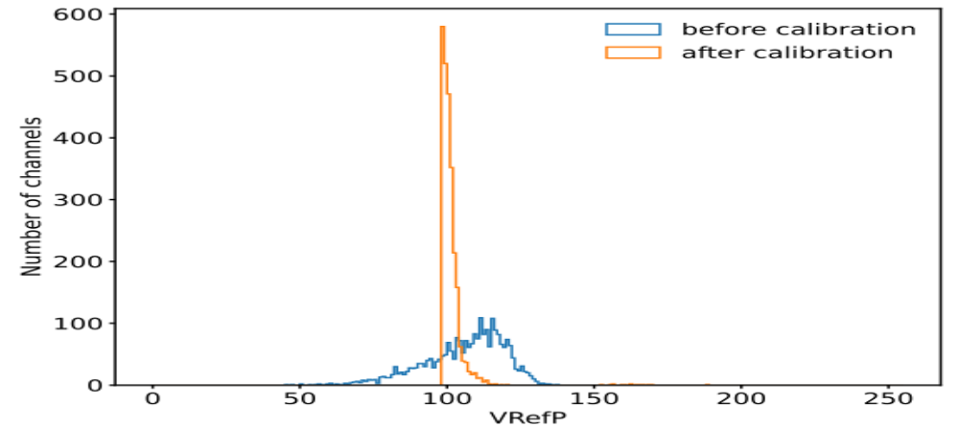
The chip was submitted in November 2021and received on July 2022
TowerJazz 180 nm
A calibration system was developed to reduce the S-Curve dispersion of the 2556 channels. 3-bit local DAC is used to reduce the dispersion.

Slide 13

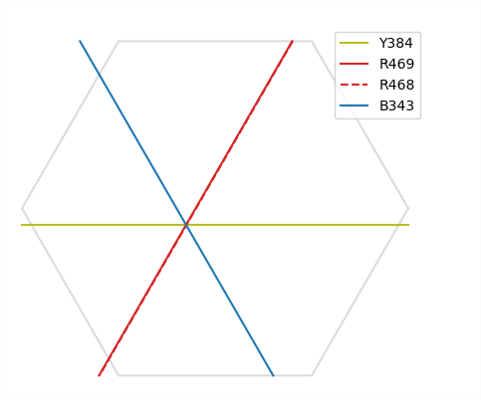
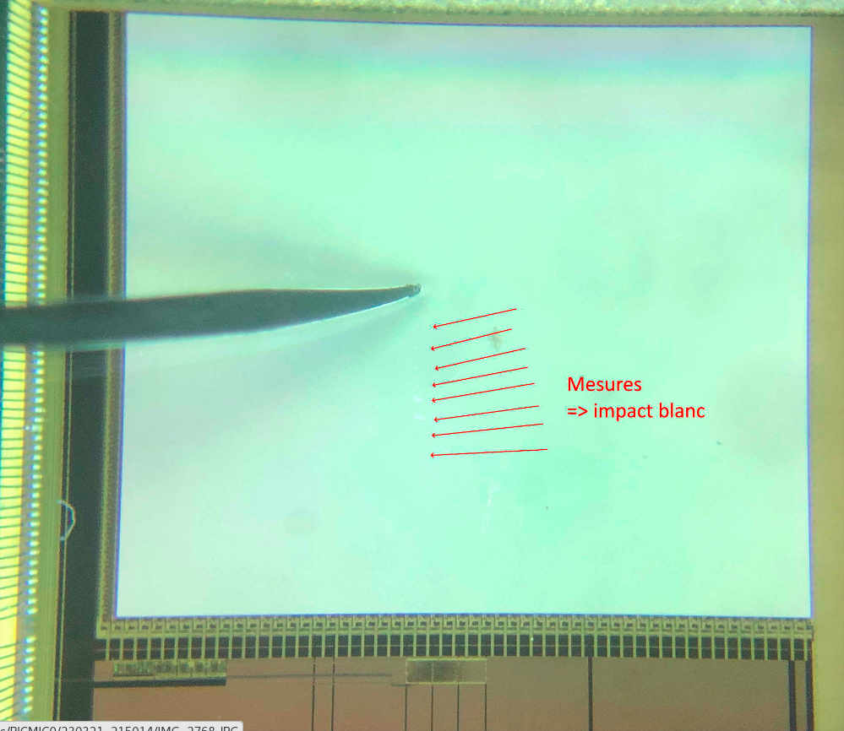
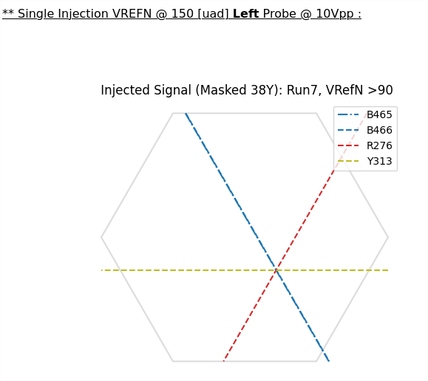
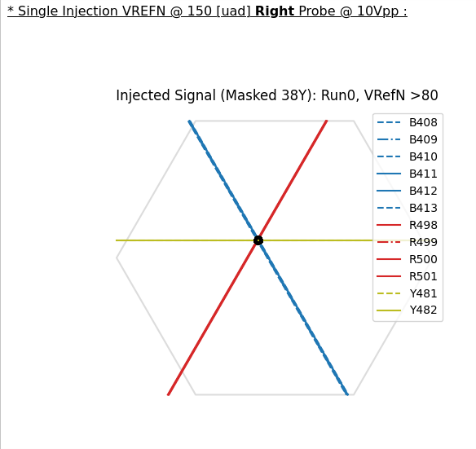
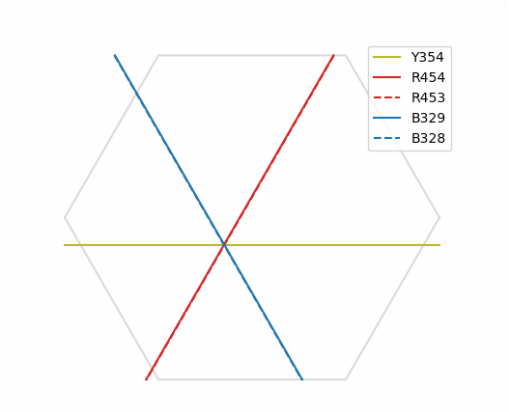
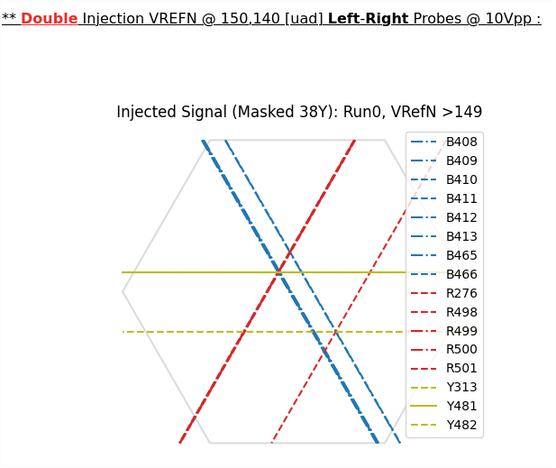
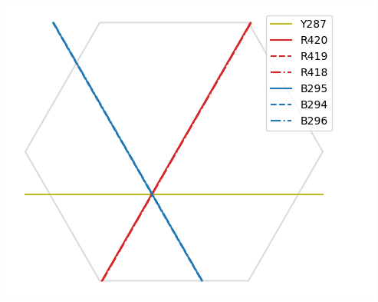
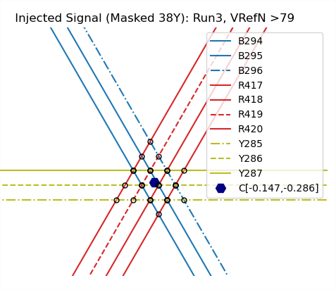
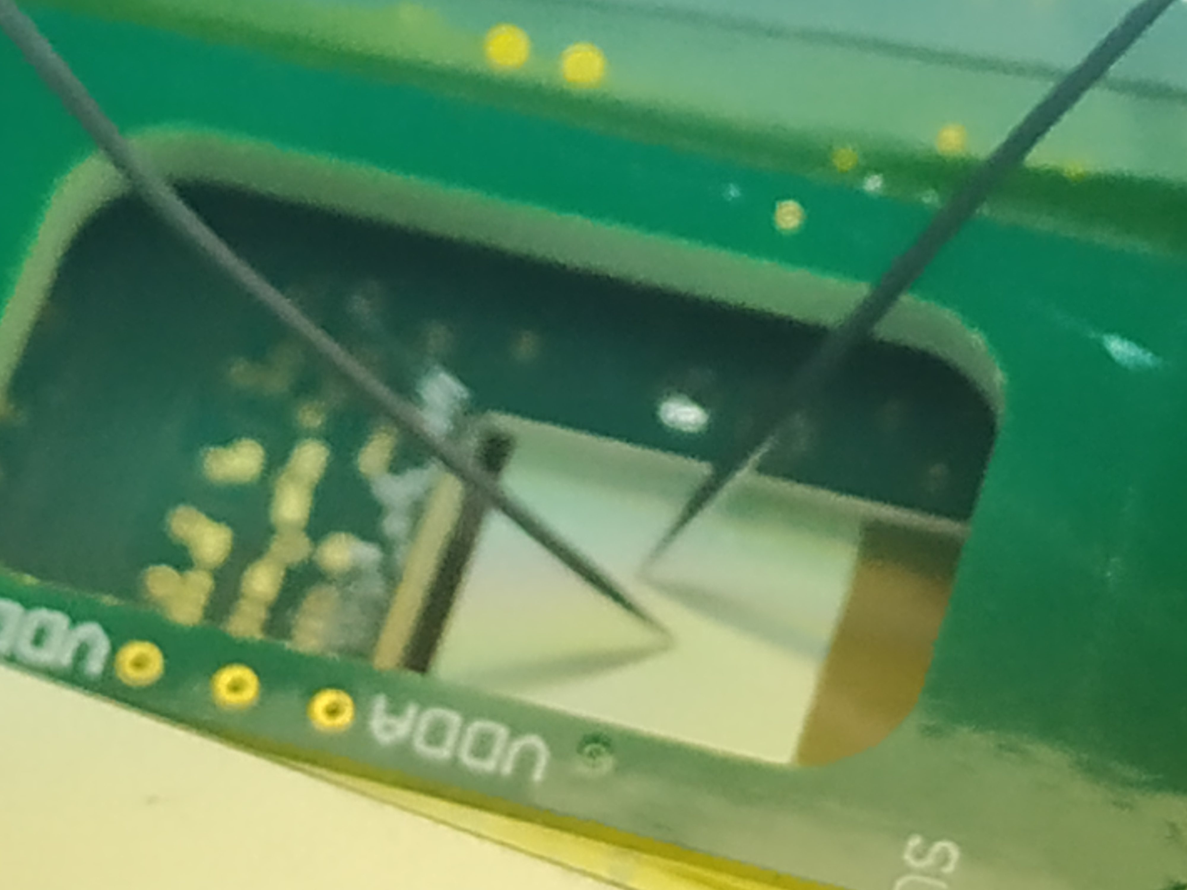
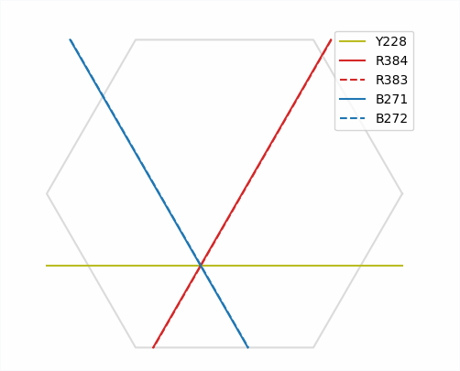
Tests with direct injection using probes
Two probes injection
left-probe
right-probe
both-probes
Probe scan from bottom - top
Clustering and
centroid estimation
13

Slide 14
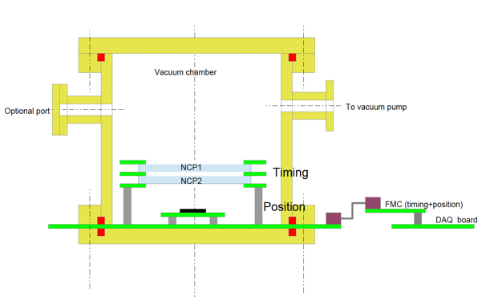
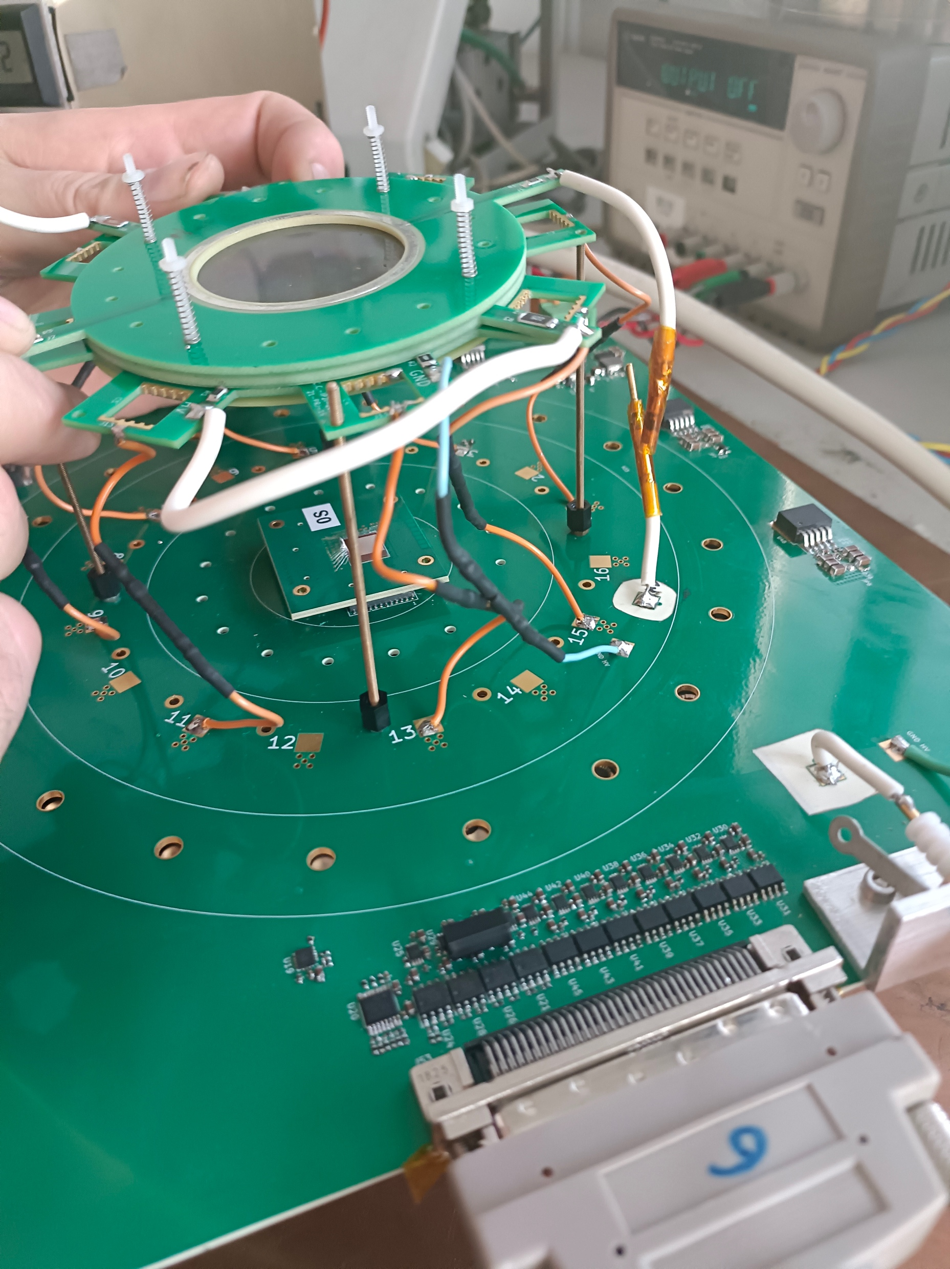
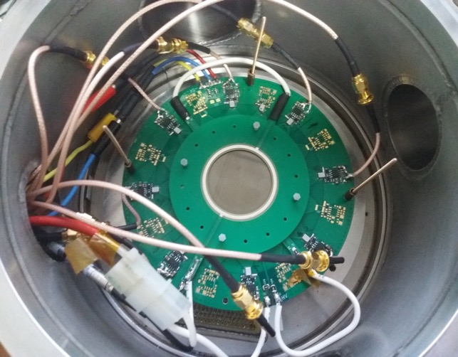
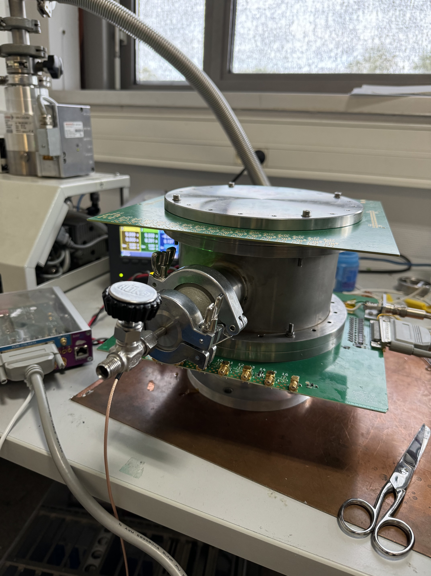
The first PICMIC demonstrator
The first prototype including:
Two 5-cm diameter MCP (Hamamatsu, Photonis, CBMA)
A board hosting 16 timing sensors (only 8 were cabled)
A mezzanine hosting the pixel sensors
A Master board
All are placed within a vacuum system ( <10e-5 mB)
A DAQ board allowing the synchronization between the time
and the position measurement (40 MHz clock).

Slide 15
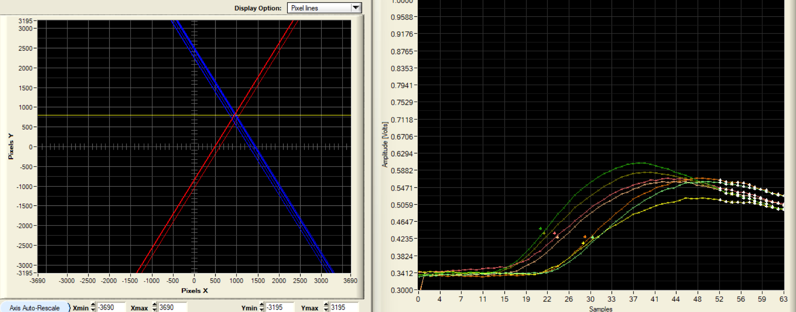
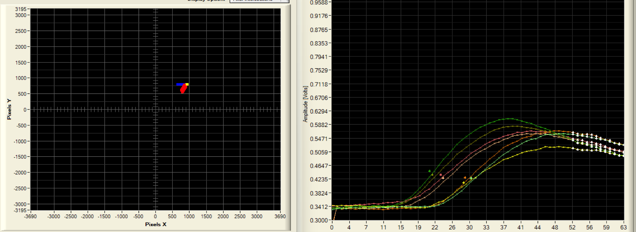
The whole system was tested by using collimated α and γ sources

Slide 16
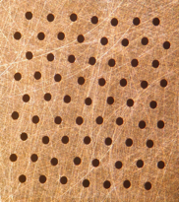
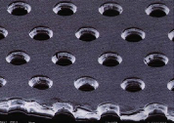
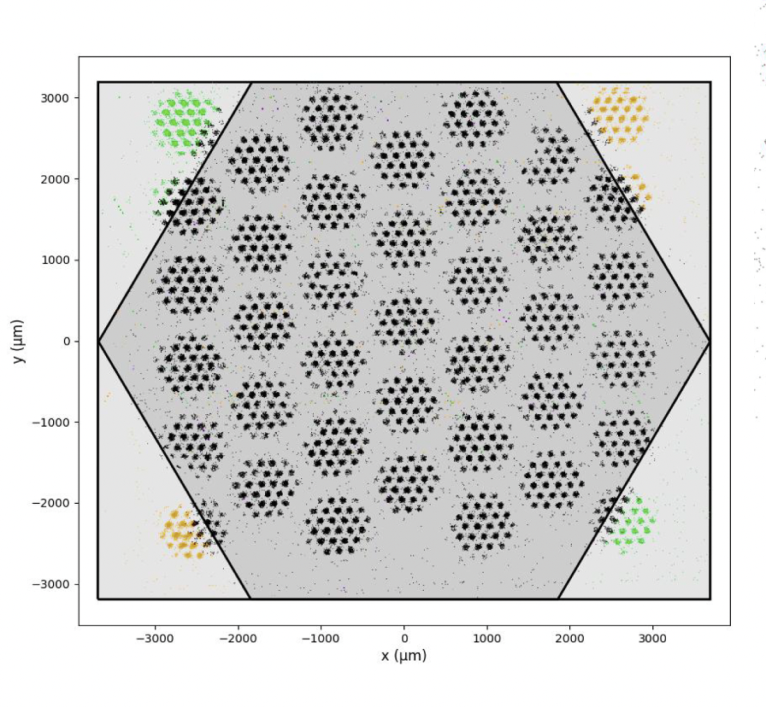
Spatial resolution
α source seen through a holes of 0.3 mm diameter and 0.8 mm pitch placed on a GEM foil with 50µm diameter and 140µm pitch

Slide 17
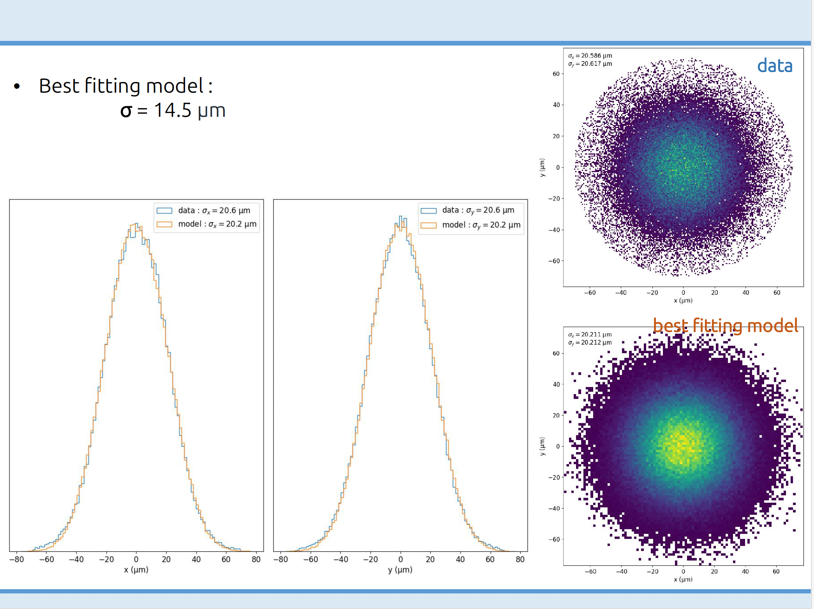
Spatial resolution
To estimate the spatial resolution, we developed a simulation tool to describe the alpha trajectories and their impact on the MCP. We then convolute the impact with a 2D gaussian distribution. The best data-simulation fit provides the spatial resolution of our detector
Best fit→ σ_{x} , σ_{y} of 14.5 µm

Slide 19
15 ps
15 ps

Slide 20
Next step

Slide 21
Can we use PICMIC for tracking
Charged particle
Radiator
Photocathode
electrons
Time
Position
Radiator should fulfil two constraints:
Enough Cerenkov photons are produced
Small budget material
MgF2 crystal of 3 mm thickness was coated with DLC
@ CERN and will soon be tested on the PICMIC setup
Cherenkov rings construction using Hough Transform

Slide 22
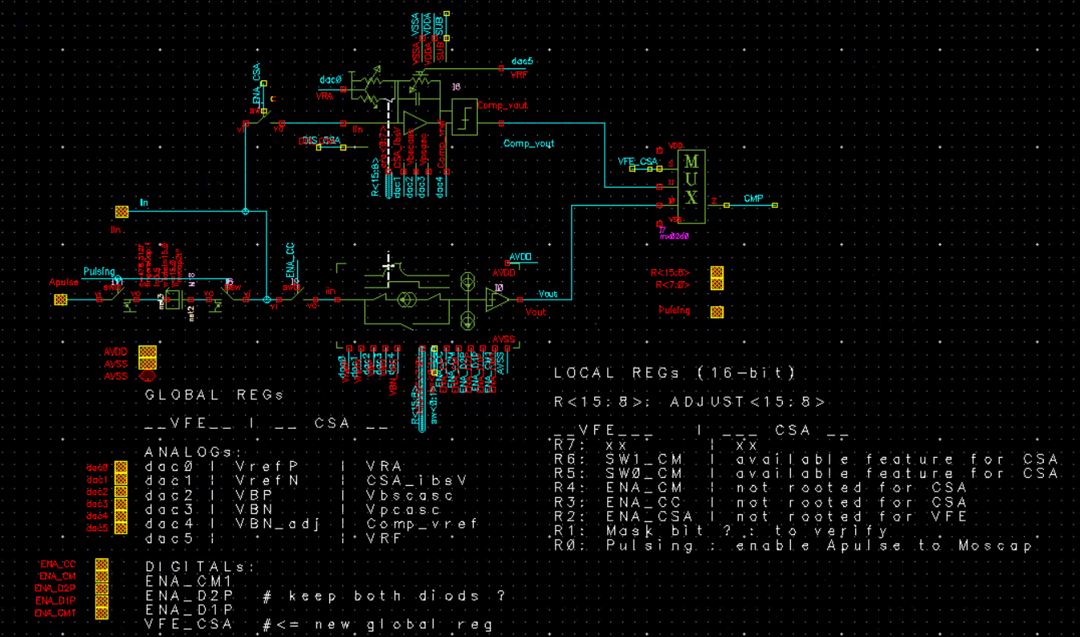
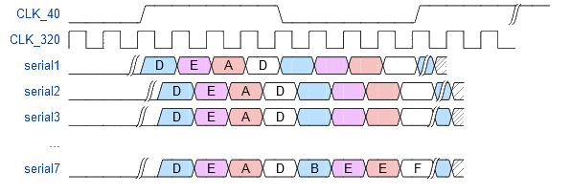
Next step: Spatial Measurement
The PICMIC0 chip was the first attempt to demonstrate the concept. We need to improve on several features:
Better calibration possibilities (8 bits DAC) to get better uniformity
Higher acquisition rate (1 Mhz → 10-30 MHz)
By reading out each column separately
By increasing the surface of the sensor by a factor of 4 (1.2 cm x 1.4 cm)
Adding a charge preamplifier to avoid current smearing problems for long tracks.
Few channels outputs are directly accessible to test external TDC

Slide 23
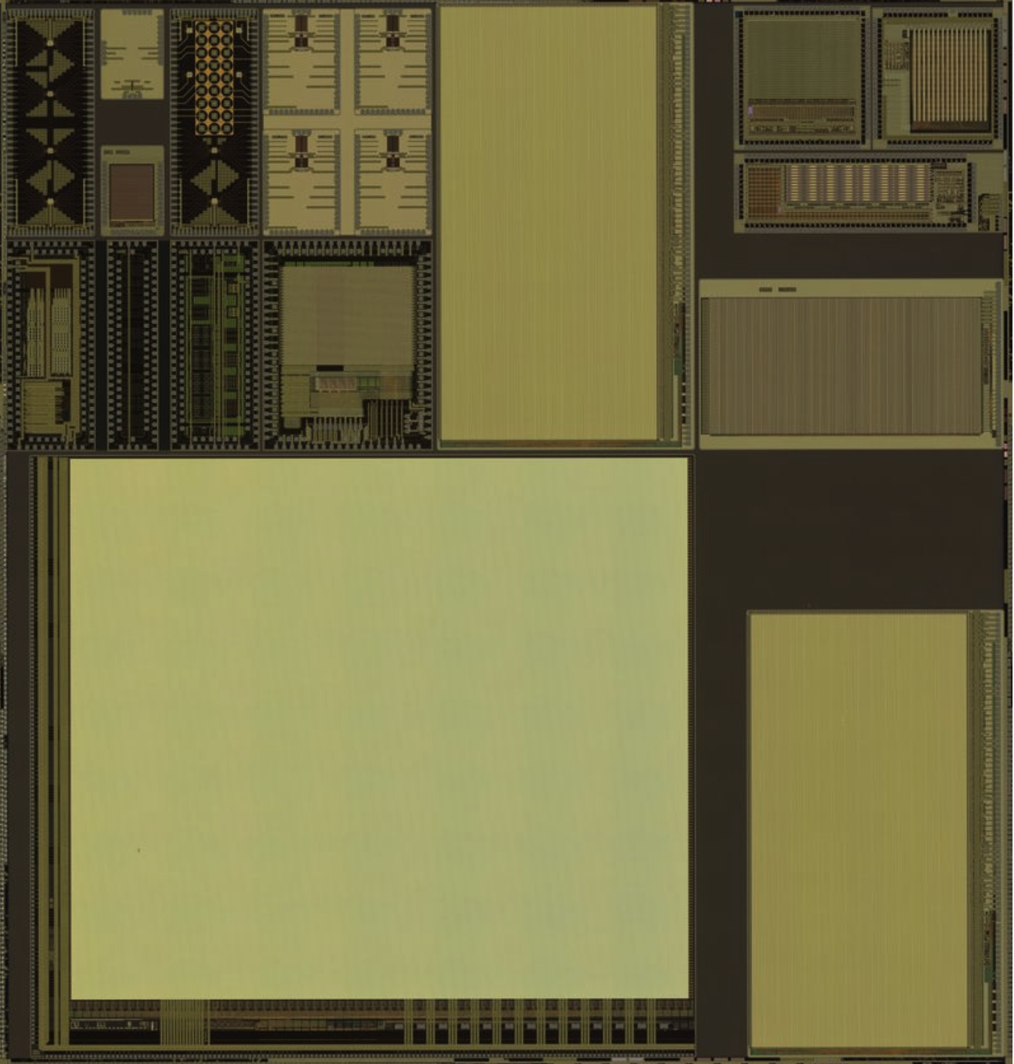
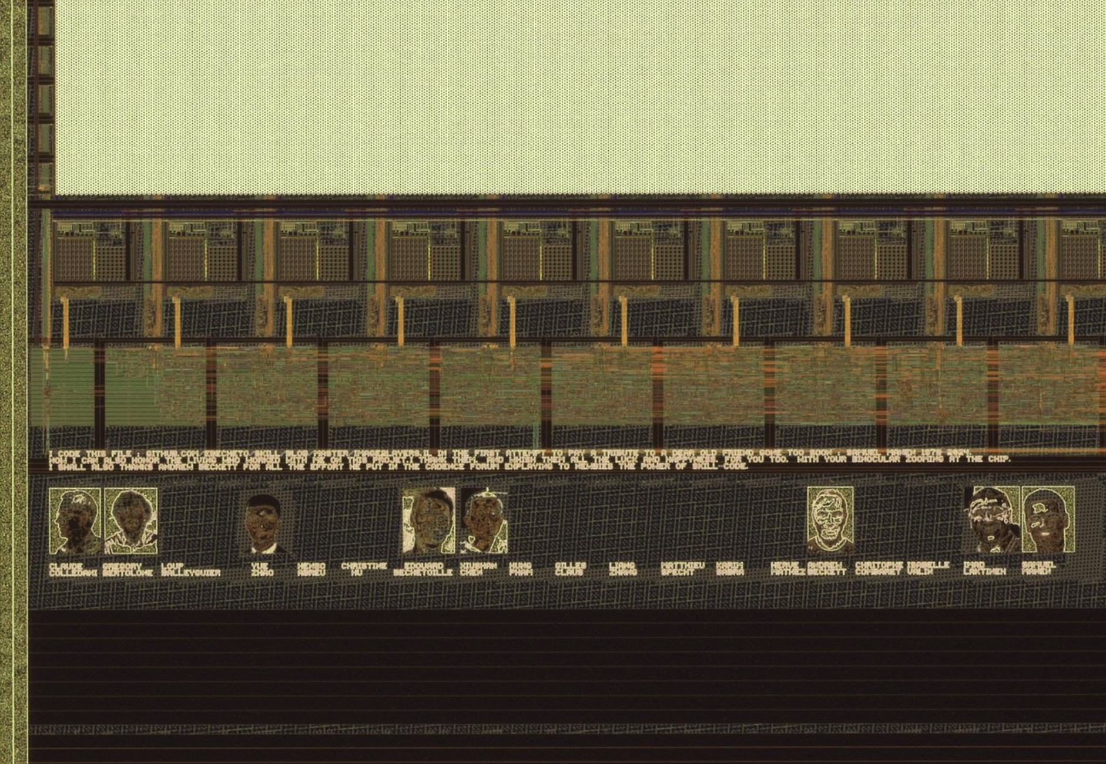
PICMIC1

Slide 24
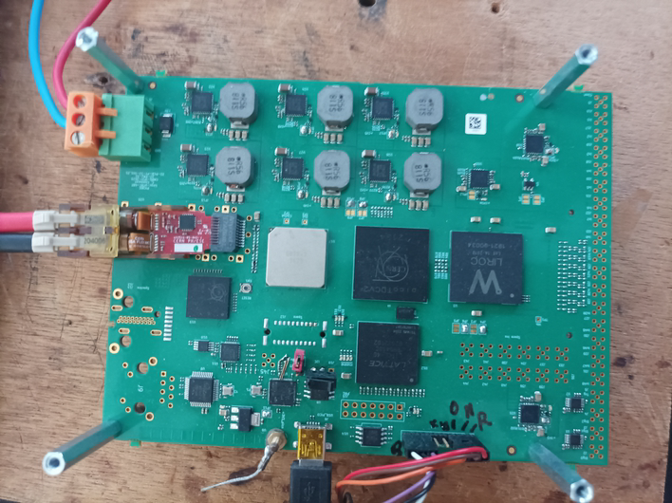
Next step: Time Measurement
SAMPIC is an excellent toot but has a dead time of about 1.25 µs.
Another timing measurement having a TDC with negligible dead time is needed to use PICMIC in higher rate modes.
A board integrating a low-jitter timing preamplifier and discriminator (LIROC-OMEGA) as well as a precise TDC (picoTDC-CERN) was conceived.
The board will use the GBTX developed by the CERN to communicate with
the DAQ system.
VTRx
GBTX
PicoTDC
Liroc
GBT
SCA
FPGA
The board is ready: 10 ps is obtained measured with charge injection of 1 pC

Slide 25
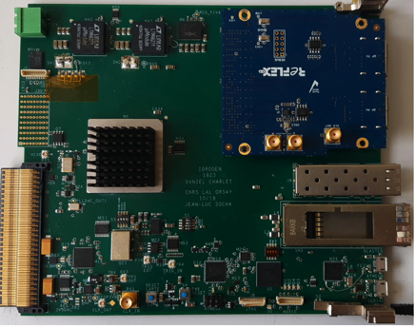
Next step: Acquisition
IDROGEN board that was developed within the DAQGEN of the IN2P3 will be used.
To be able to exploit the IDROGEN board we need:
develop appropriate interface/mezzanine boards between the IDROGEN and the timing and position boards.
develop an appropriate firmware to synchronize the data
This work is now in an advanced stage. First tests with the board is foreseen before end of 2026

Slide 26
Going beyond the MCP→ NCP

Slide 27
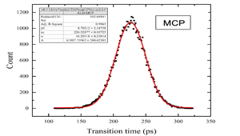
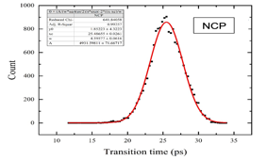
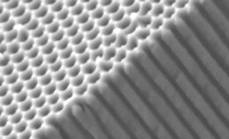
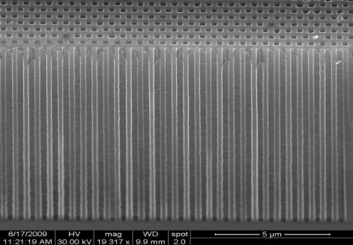

NCP
A new kind of MCP that we call NanoChanel Plate (NCP) is being developed.
It aims at producing structures with nanoholes that could be coated with emissive and resistive materials.
→ At least ten ttimes better spatial and temporal resolution
Three technologies are followed:
Anodized Aluminium Oxide AAO (with IMP→ ANR NanoPolyPad)
Silicon electrochemical etching (with INL →ANR NCP)
Femto-laser digging (with LHC→ ANE LAMP?)
SiNCP
AAO
Femto-laser

Slide 28
Summary
The PICMIC concept proposed to to simultaneously exploit the time and position intrinsic resolutions of MCP is validated
Time resolution of 15 ps has been achieved
Spatial resolution of 15 µm has been achieved
New version of PICMIC will allow to exploit the intrinsic resolutions of MCP.
the system can be used as timing tracker as well as a precise 4D camera.
A new generation of MCP called NCP with the aim to reach
1 ps and sub-micrometer resolutions are being developed

Slide 29
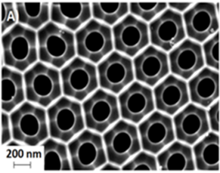
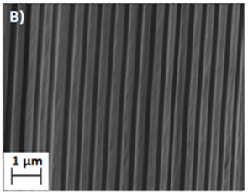
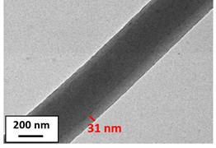
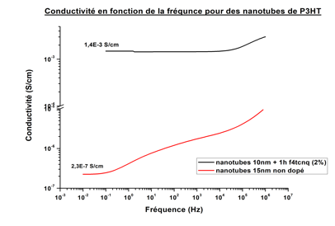
NCP-AAO
TEM
Coating
Conductivity
We are developing a new coating using ALD techniques to reach higher SEY

Slide 30
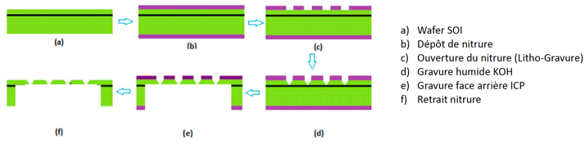
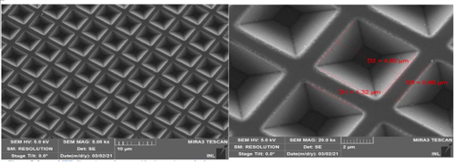
PICMIC for photodetection
We are developing a highly granular reflective photocathode. Photocathode is made of holes with conic shape.
Exploit the high spatial resolution the MCP offers
Increase the quantum efficiency
The structure is produced on a silicon wafer will be coated with different kinds of photocathode materials (DLC,B₄C) and then cast on MCP to test PICMIC as a photodetector concept.
1 cm² area

Slide 31
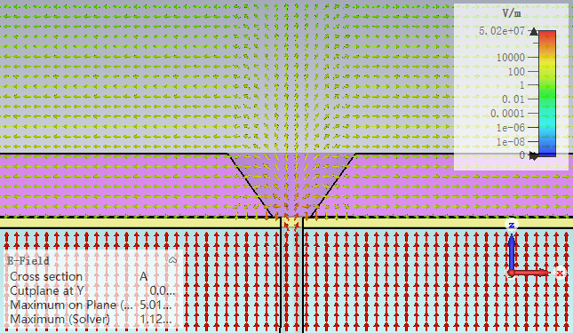

PICMIC for photodetection
Glass plate
Cathode
50 µm
100 V
2 µm
Si
2100 V
100 µm
Anode
Simulation with CST

Slide 32








Injections Studies
(1/2)
PICMIC allows external signal injection trough the (PAD):
- R424[R68,C28],R425[R103,C35] and R426[R6,C15].
- * it also allows to excite whole columns in the channel matrix (no shown in above layouts).
Voltage injection through external 1pF, then scan of the threshold of Current Comparator.
Below the current threshold, the falling edge sensitive does not trig.
The signal is recorded on falling edge, so above a certain value of iRefN added to threshold current, the comparator does not trig anymore-→ chapeau!
Efficiency [%]
VRefN [udac]
iComp
iComp
iComp
iRefN
‘1’
VPULSE
Dout
ith+iin
iRefN
ith+iin
iRefN
ith+iin
1pF
Vout
1
Vout
1
Vout
1
0
No edges
0
0
fall edge
No edges
Dout
Dout
Dout
1
32
1
1
0
0
0

Slide 33


CSA Architecture from previous design
DC output voltage must be
as low as possible (e- collection)
V (R_{a})
V (R_{f})
≈ R_{a}
≈ R_{f}
V _{DD}
C _{f}
-A
Vout
Idet
C_{d}
GND
-A
R_{a} and R_{f} are made of 2 PMOS transistor polarized in triode region
V(R_{a}) and V(R_{f}) could be use to modify the DC output voltage (e⁻ or h⁺ collection)
$V_{DC_Out}=V_{DC_In}\left(1+\frac{R_{f}}{R_{a}}\right)$ - ${\frac{R_{f}}{R_{a}}V}_{DD}$

Slide 34
Input signal characteristics
Estimated from Picmic_0
Input current : 2 µA to 20 µA
Charge collection time : (1 ns )
Input charge : (10⁵ e⁻ to 10⁶ e⁻) (16 fC to 160 fC)
Simulation with (8 fC to 80 fC) (factor 2)
Counting rate : 10 Mevt/s minimum value)
Detector capacitance
C_{d} = (7,66 fF/50 µm) * 15 mm = 2,2 pF (CSA simulations with 5 pF) (C_{d-max} = 5 pF)
2 pF < Cd < 5 pF, C_{d-sim} = 3 pF
ENC < 0,4 fC (2500 e-)
CSA output signal :
Rise time ≈ (10 ns)
Decay time ≈ (100 ns)
Output Voltage : qq 100 mV
Feedback network :
C_{f} ≈ (20 fF)
R_{f} ≈ R_{a} (200 kΩ) made with PMOS and could be modified to adjust DC level output

Slide 35

CSA Sim Results
Feedback network :
Cf ≈ 20 fF
R_{f} and R_{a} = 200 kΩ
C_{d} = 3 pF
Q_{in} = 42 fC
Vdc_Out = 0,715 V
Vdc_In = 1,26 V
CSA bias current (input Transistor) : 15 µA
Output voltage = 310 mV
(42 fC/20 fF = 2 V !) due to amplifier GBW
Peaking Time = 11 ns
Decay Time = 100 ns
RfCf = 4 ns, Tcoll = 2 ns
10 Mevt/s

Slide 36
DAQ system : PICMIC V0 vs PICMIC V1
Both ASICs employ a frame-based mechanism to periodically transmit the addresses of stimuli pixels, but with different readout column modes. The stimulated pixels record information in their in-pixel logic and send it out in the next frame.
PICMIC V0
PICMIC V1
N columns
N columns
Pixel column
Pixel column
Pixel column
Pixel column
Pixel
Priority encoder
Pixel column
Pixel column
Pixel
Priority encoder
Pixel
Pixel
End of col
End of col
Priority encoder
Pixel address encoder
Multiplexer
Frame controller
Multiplexer
Frame controller
Parallel Output in Double Data Rate Mode
Frame markers
Pixel adresse
Frame markers
Pixel adresse
To FPGA
To FPGA
Notes:
The DAQ system of PICMIC0 operates in three steps:
Step 1: The frame controller module periodically sends control signals to all pixels to prepare them for readout.
Step 2: The priority encoder module reads out the stimulated pixels column by column, based on a column-dependent priority scheme.
Step 3: The encoder module generates and transmits the addresses of the stimulated pixels.
Steps 2 and 3 are repeated until all stimulated pixels have been read out.
The DAQ system of PICMIC1 operates differently, thanks to the use of an end-of-column module to control the readout of each column. Like PICMIC0, the frame controller module periodically sends control signals to all pixels. Then, each end-of-column module reads out the stimulated pixels and sends them out through a multiplexer. The data is sent out in DDR mode, which transmits data on both clock edges in order to reduce the required number of pins by half.

Slide 37





Slide 38

  To fully exploit MCP we propose the following scheme:
  A transparent grid placed downstream the MCPs and read out by sensors with excellent time resolution. Followed by:
  A detection matrix with micrometric pixels to measure with great precision the position of the avalanche while requiring limited number of electronics channels.
Patented concept:
PCT/EP2020/050058
Concept description
The avalanche crosses a transparent grid connected on its periphery to a few
timing sensors
The avalanche is then collected by pixels
1- Measure X,Y, from the fired woven strips by crossing them geometrically
2- Measure T_i (from time sensors)
3-Substract time propagation
using speed propagation and X-Y)
4- average on the (T_i-T_i(propag))
T_{abs} = $\frac{\sum_{0}^{N}{T_{i}−T_{i−propag}}}{N}$
MCP
T₃
T₂
Metallic Grid
T₄
T₁
Time + position
T₅
T₆
Pixels
Position+ time
X,Y

Slide 39

PICMIC: Proof of Concept
Metallic grid is replaced by the 100% transparent MCP grid (metallic anode)

Slide 40

First step: Delay plane concept ?

Slide 41


Second step :
Setup with timing sensors+1 large pad (collect) for the position
Collect: Negative signal
Grid: positive signals

Slide 42
Time Measurement
8-point PCB for the time measurement.
PCB to be in contact with the grid
SAMPIC: TDC ASIC allowing to reach 3 ps time resolution

Slide 43

ΔT (ps)
Time difference between two channels

Slide 44


Time measurement → position measurement
Waiting to have the pixel matrix to measure the position, two algorithms using the difference of time of arrival among the different channels were developed to obtain the position of the hitting particle.

Slide 45
Where is it useful?
  High Energy Physics,
    Cerenkov detectors, trackers, etc.. For FCChh /SPPC
  Nuclear Physics
    Mass Spectrometry (ToF)
  Accelerator
    Beam monitoring, Streak Camera
  Free Electron laser
    Analysis of the structures of materials, in particular biological objects (XFEL, LCLS2, Shine)
  Spectrophotometry : FLIM fluorescence lifetime microscopy, Raman spectroscopy, Time-resolved near IR spectroscopy
  Medical equipment : PET Scan, CT-Scan, In-Vitro Assay, Gamma Cameras
  Biotechnology : Flow cytometry, confocal laser microscopy, DNA sequencers, Mass spectrometry
  Environmental measurement : Dust counters, LIDAR (ToF 3D imaging)

Slide 48
The signal is transmitted from the fired pixels to their associated readout cells
86.6
43.3
75
ReadOut cells ‘fired’

Slide 49

Cross-talk was carefully studied and showed less than 10%.

Slide 50
Front End lock
VDD
Out_EN
Internal
VDD
VDD
Out_EN
ENA_CM
D2
PWR
D1
I_gain<0:1>
VDD
ENA_CC
TOCHECK
ENA_D1P
VBP
Vref_P
Pulsing
ENA_CM
ENA_CM
ENA_D2P
Vin
Ith1 (S3)
Current
Comparator
Current
Mirror
To DFF
S1
VBN
S2
Iadj
MUX
Idet
(Idet < 0)
ENA_CM1
Vref_N
VBNadj
GND
S3
Ith2 (S1,S2)
ENA_CM
I_adj<0:2>
GND
GND
Column lines
ENA_IP
Vref_P
Vref_N
VBN
VBP
ENA_D2P
Vin
ENA_D1P
ENA_CM1
VBNadj
GND
VDD
Dac_P
1-200µA
8 bits
E
VDac_BP
Cible 700mV
8 bits
ENA_IPb
ENA_IN
VDD
Dac_N
1-200µA
8 bits
Pad
ENA_INb
F
Pad
A
GND
B
C
D
Dac_CM
3-7µA
8 bits
Pad
Pad
Dac_Iadj
0-5µA
8 bits
This work is a fruit of excellent collaboration between SDU and IP2I-Lyon

Slide 51


Pedestal threshold calibrations
Freeze a set of DAC(Global) values driven by :
- small dispersion between s-Curves
- bigger number of sCurves in a given
space of phase vs VRefN(quite sensitive)
Then, additional scan in local values are performed:
- iadj<3bits>, sw<2bits>, EN_CM, EN_CC.
To determine value @50% inflection point.
To select the closest sCurves@50% in VRefN

Slide 52


Pedestal threshold calibrations
Freeze a set of DAC(Global) values driven by :
- small dispersion between s-Curves
- bigger number of sCurves in a given
space of phase vs VRefN(quite sensitive)
Then, additional scan in local values are performed:
- iadj<3bits>, sw<2bits>, EN_CM, EN_CC.
To determine value @50% inflection point.
To select the closest sCurves@50% in VRefN
full matched sCurves(VRefN)

Slide 53




DAQ to read both time (SAMPIC) and PIXEL sensor
40 MHz clock is generated and distributed to the two devices (time, pixels)
Data are collected by both sorted out with the same counter

Slide 54

Digital test bench
Results are as expected

Slide 55






The whole system was tested by using alpha and gamma sources
1 mm holes
2 mm holes

Slide 56


0.5 mm holes

Slide 57

GEM foil+ cooper plate with 3holes of 1 mm diameter eachwith

Slide 58

PICMIC will be soon tested with a channeltron producing single electrons of energy up to 30 keV in a MEB to have independent time and resolution measurement

Slide 59


AAO NCP
Nano Channel alumina structure made by electrolyse was invented twenty years ago: H. Masuda, K. Fukuda, Science 268, 1466 (1995)
L/d = 200-300, L is the plate thickness and d the tube diameter
In principle we should have better timing than that of the MCP
(less dispersion (TTS))
Nanopores are obtained with simple electrolysis process.

Slide 60

Femto-Laser NCP
The concept is to produce micro/nano-pore using the Femto-Laser techniques
Bessel beam allows digging deep in transparent material producing regular pores
By using lead-glass plates and obtaining high density of pores, one can not only produce NCP but also reduce the tedious chemical process used in MCP fabrication

Slide 61




0.4 µm diameter and 2.5 µm pitch

Slide 63


Slide 64


Slide 66


Slide 69
Can we use PICMIC for Cherenkov?
We are studying the performance of PICMIC to be used in a Cerenkov detector when associated to a photocathode and a radiator.
Using Hough Transform we are able to determine the contour of a Cerenkov ring of a few mm.
P. Roger

