Slide 1
The Mu3e Detector
Richard Plackett on behalf of the Mu3e Collaboration
1st - 4th September 20206
PSD 14
Queen Mary University of London

Slide 2
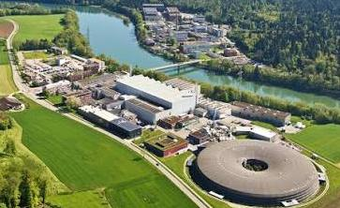

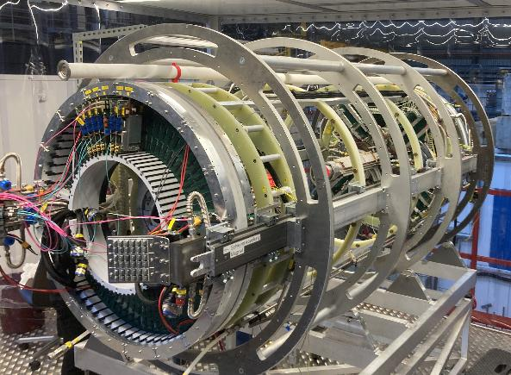
The Mu3e Project
The Mu3e Experiment is looking for the decay of a Muon to Three Electrons which is a Charged Lepton Favour Violating decay
Detector currently under construction on the PiE5 beamline at the Paul Scherer Institute (PSI)
80 people from 12 institutes
Switzerland: PSI, U. Zurich, U. Geneva, ETH
Germany: Heidlberg, Mainz, KIT
UK: Bristol, Liverpool, Oxford, UCL
A high rate, high precision, ultra low-mass detector

Slide 3
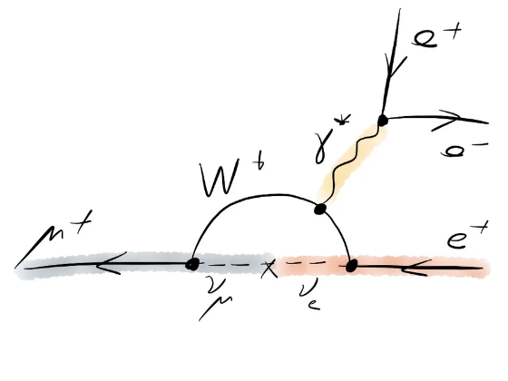
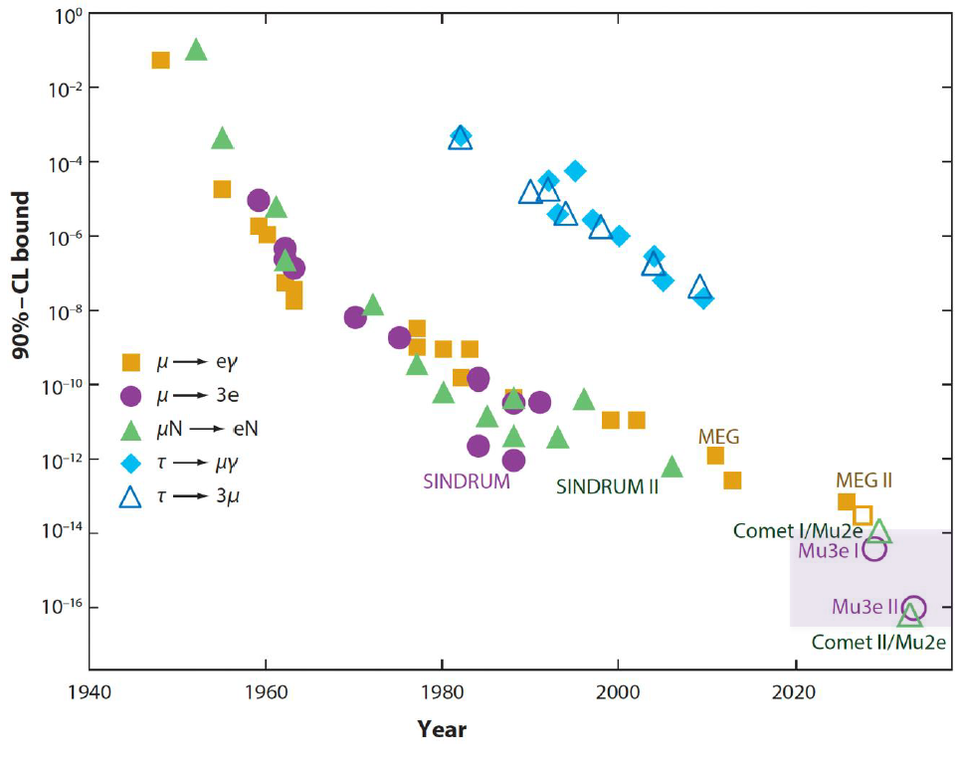
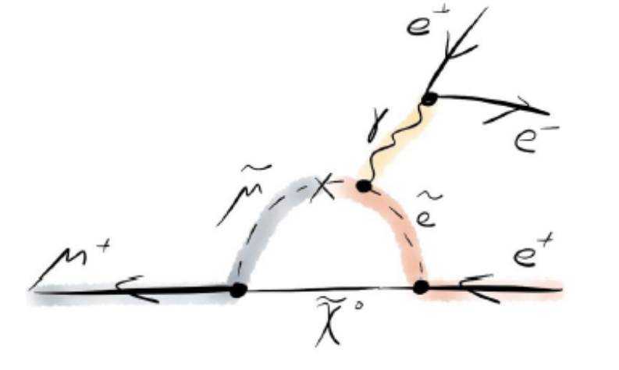
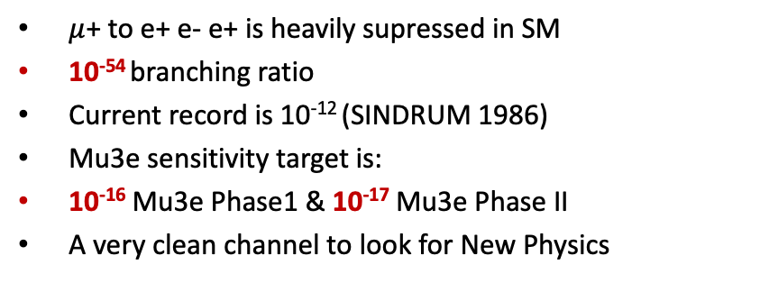
Physics Motivation
$μ$+ to e+ e- e+ is heavily supressed in SM
10⁻⁵⁴ branching ratio
Current record is 10⁻¹² (SINDRUM 1986)
Mu3e sensitivity target is:
10⁻¹⁶ Mu3e Phase1 & 10⁻¹⁷ Mu3e Phase II
A very clean channel to look for New Physics
New Physics

Slide 4
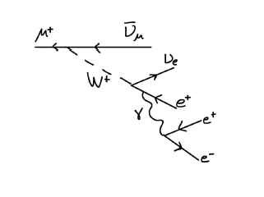
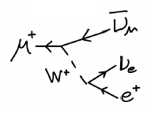
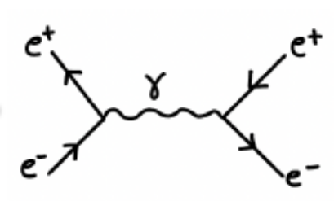
Backgrounds
When ‘signal’ is at 10⁻⁵⁴ then ‘background’ is what we will actually measure
Radiative Muon Decay
µ -> 3e + 2ν Br ~10⁻⁵
Accidental Background
Michel Decay & Bahbah Scattering Br ~0.99
&
Momentum Resolution
Precise Vertexing and Timing
Outer Pixel System
µ -> 3e Max e- momentum ½ Muon Mass ~ 53 Mev/c
Low mass, low multiple scattering, monolithic pixels
Vertex System
Low mass, low multiple scattering, monolithic pixels
25 um resolution
Scintillator Timing Systems
Scintillating Fibres 250ps
Scintillating Tiles 80 ps
High time precision on tracks

Slide 5
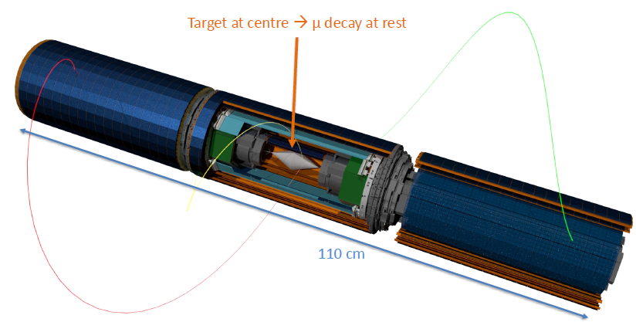
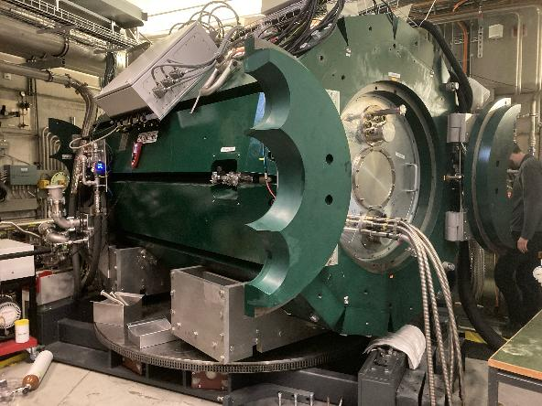
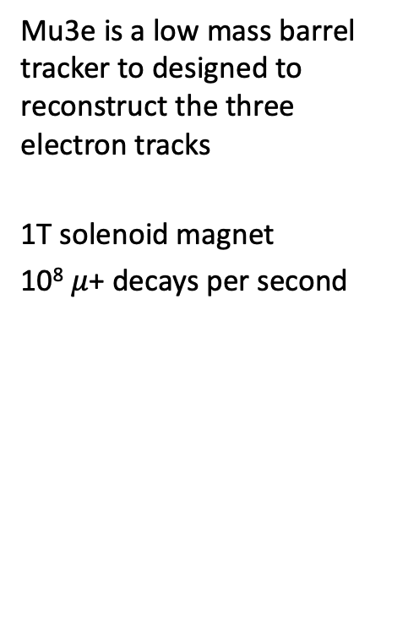
Detector Design
Mu3e is a low mass barrel tracker to designed to reconstruct the three electron tracks
1T solenoid magnet
10⁸ $μ$+ decays per second

Slide 6
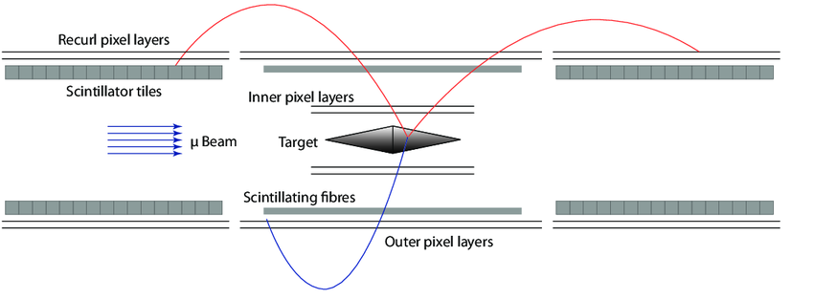
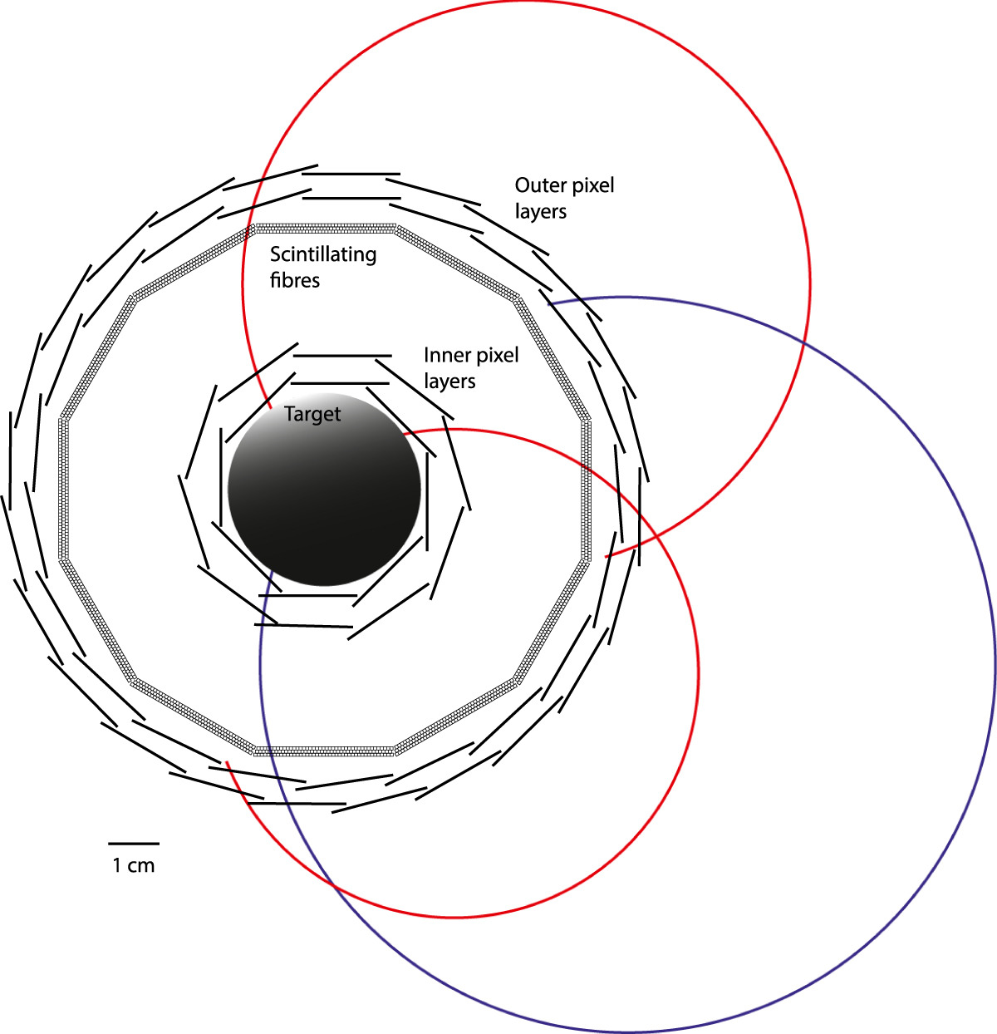
Detector Design
Positive muons come to rest on the mylar target and decay 10⁸ Hz (spreading out the muon decay positions)
Vertex pixel detector system reconstructions the decay point
Scintillating Fiber and Scintillating Tiles systems provide ~100 ps track timing
Outer Pixel stations (and the magnet) provide a momentum measurement
Pixel systems are multiple scattering dominated

Slide 7
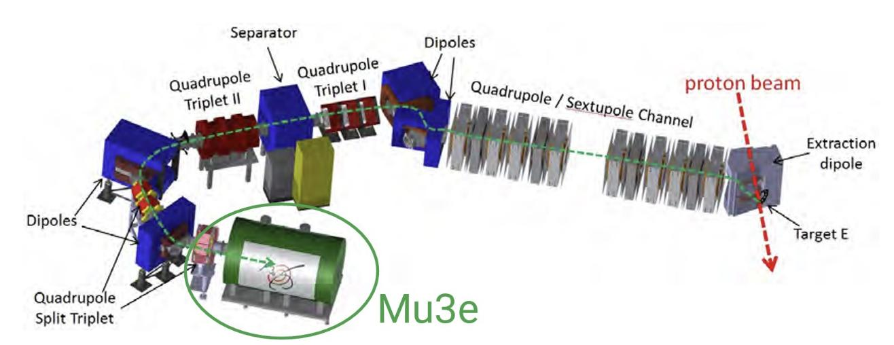

$π$E5 Beamline
The πE5 beam line is a low energy (10-120 MeV/c) pion and muon beam line part of the High Intensity Proton Accelerator Complex at PSI
Mu3e shares the beamline with other Experiments
MEG / MEG II: Currently running MEGII uses πE5 for high-intensity muon beams to search for rare muon decays (μ → eγ).
Mu3e: Shares the high intensity muon beam to look for the lepton-flavour violating decay μ → 3e.
PIONEER: Next-generation experiment planned to utilize πE5's high-intensity pion stopping capabilities to measure rare pion branching ratios and test lepton flavour universality

Slide 8
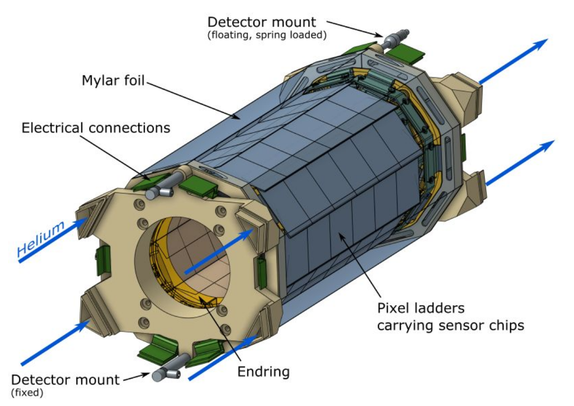
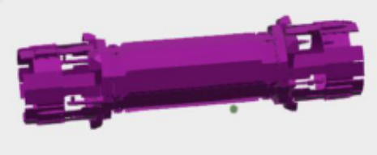
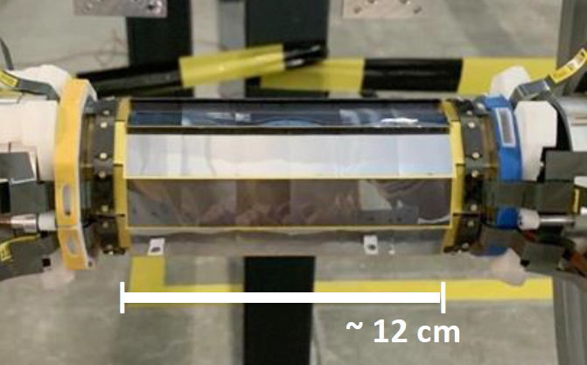
Vertex Sub-Detector
Vertex
Required for vertex separation of accidental backgrounds
108 Mupix11 sensors
6 chip ladders as sub-unit
2 layers – eight and ten ladders for L1 and L2
23um resolution
0.1% Xo radiation length
Gaseous helium cooling

Slide 9
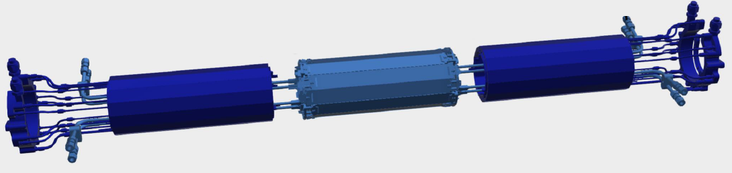

SciFi Sub-Detector
SciFi
Timing System required for ‘Accidental Background’ discrimination
SciFi is mounted in the central station between Vertex and Outer Pixels
Scintillating fibres (Kuraray SCSF-78) giving 250 ps timing resolution
12 ribbons arranged in 6 modules
Double ended readout by 128 channel SIPM array (Hamamatsu S13552) coupled to custom MuTrig timing ASIC.
1MHz per channel readout
0.2% Xo radiation length in acceptance
Silicon oil liquid cooling of SIPMs for low dark noise

Slide 10
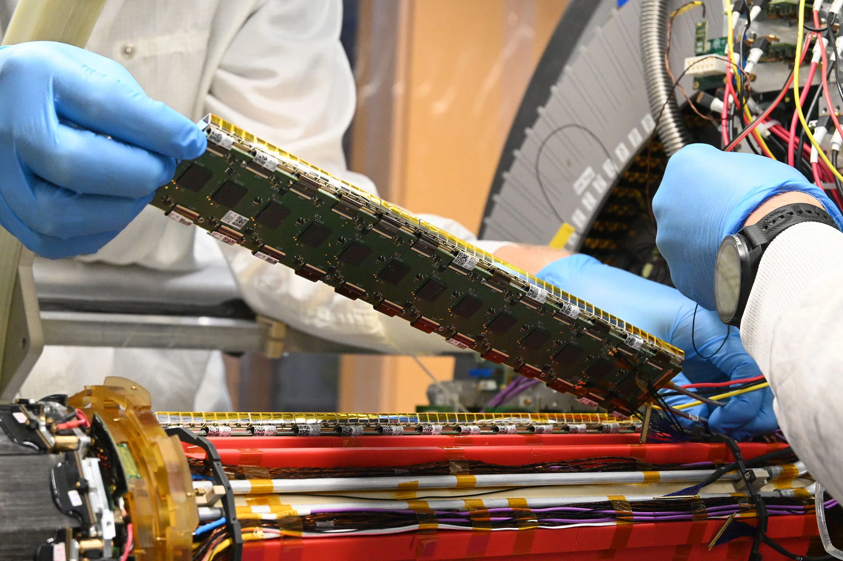
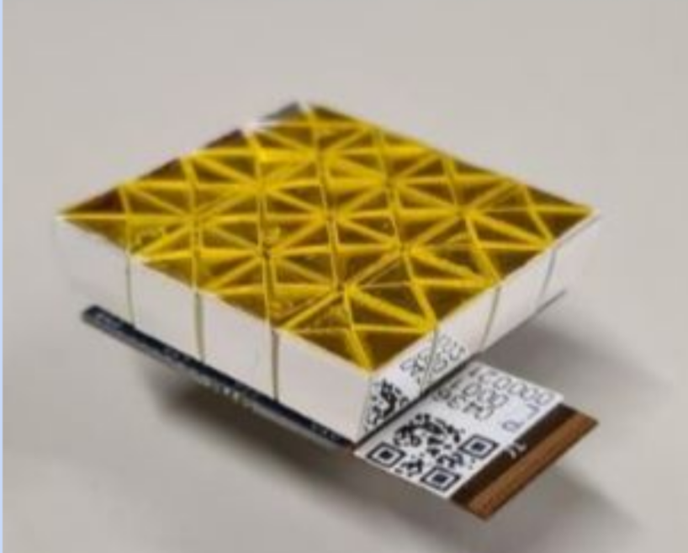
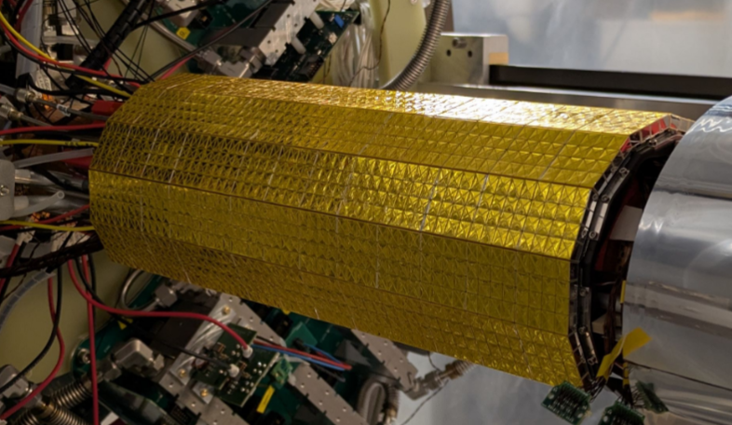
SciTile Sub-Detector
SciTile
SciTile
Timing System required for ‘Accidental Background’ discrimination
Scintillating Tile detectors Mounted in Recurl stations around the beampipe
~80 ps Timing resolution
Array of 5mm square tiles of plastic scintillator each individually wrapped and read by an single channel SIPM (Hamamatsu S13360-3050VE)
~2900 tiles/station ~5800 tile/SiPM channels for the two stations
Also uses the MuTrig readout ASIC

Slide 11
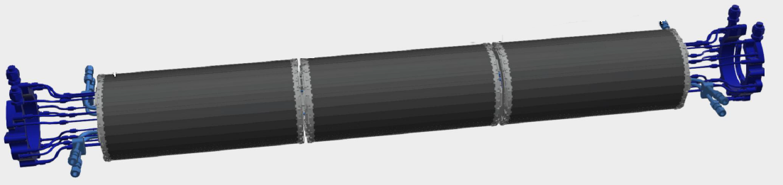
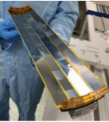
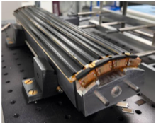
Outer Pixel Sub-Detector
Needed for Radiative Muon Decay Background
Reconstruct electron momentum to exclude neutrino production
Needed for momentum resolution: 𝜎 (𝑝) ~200 keV/c
Mupix11 pixel sensors, 25 µm carbon fibre supports
~ 1m² silicon, 2736 MuPix11
2 layers in three outer stations
Helium cooling of each station ~900W

Slide 12
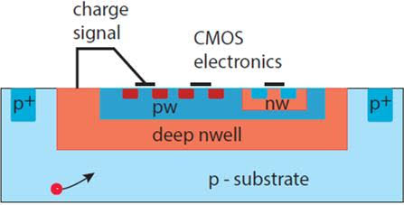
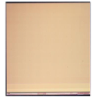
Mupix11
High-Voltage Monolithic Active Pixel Sensor (HV-MAPS) using commercial high-voltage CMOS technology. Bosch/TSI
Performance: Over 99% hit detection efficiency with time resolution ~25 ns
80 µm square pixels 2cm by 2cm array
256 by 250 pixels
Designed to be thinned to 50–70 µm to reduce multiple scattering. Backside stress compensation by plasma etching.
Continuous, trigger-less data readout, at high rate.
Three 1.25Gb data links per chip (Vetex)
Single multiplexed 1.25Gb link (Outer Pixels)
250mW/cm² -> 1W per chip
High speed digital pixel structures are physically outside the analogue pixel matric to allow lower thresholds.
Bosch 180nm process ended leaving us with a limited number of wafers and a worrying total yield requirement of ~35-40%
Analogue Pixel Matrix
Digital Pixel Matrix
Periphery

Slide 13
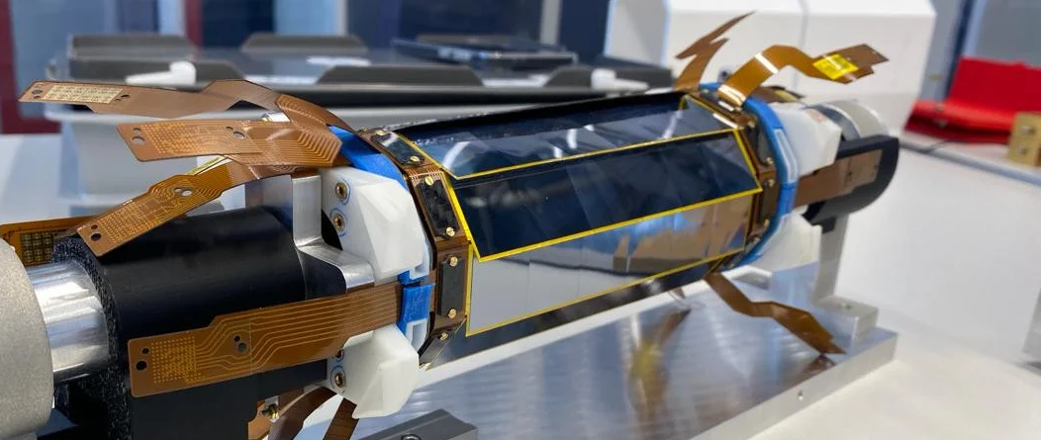
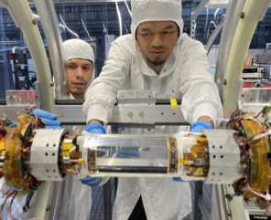
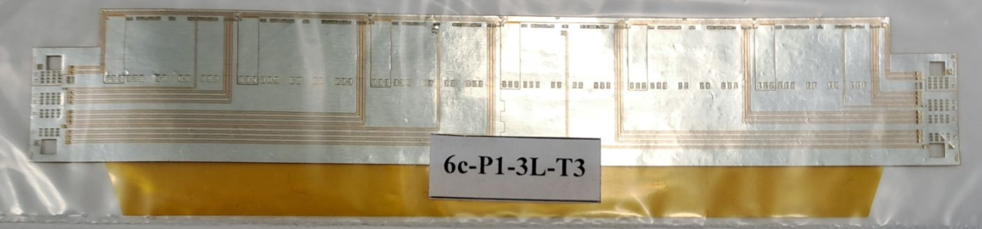
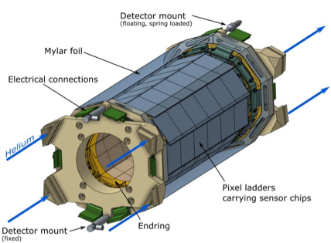
Vertex Detector Construction
Vertex Detector assembly at Heidelberg & PSI
0.1% Xo per layer
50 µm / 70 µm silicon
75 µm two-layer Al Kapton flex
Jig based chip placement with vacuum tools
spTAB bonding between chip and flex
Ladders glued together into half cylinder modules
Flaps between ladders connected to enclose helium cooling flow volumes

Slide 14
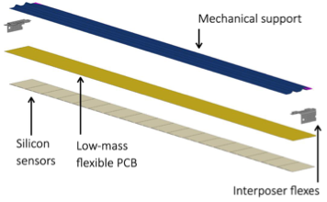

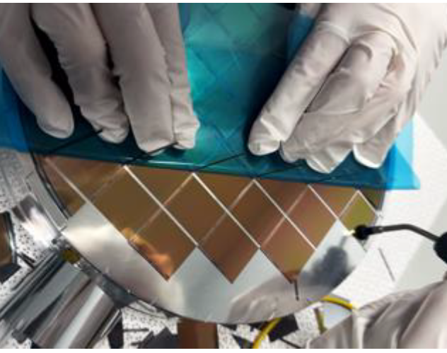
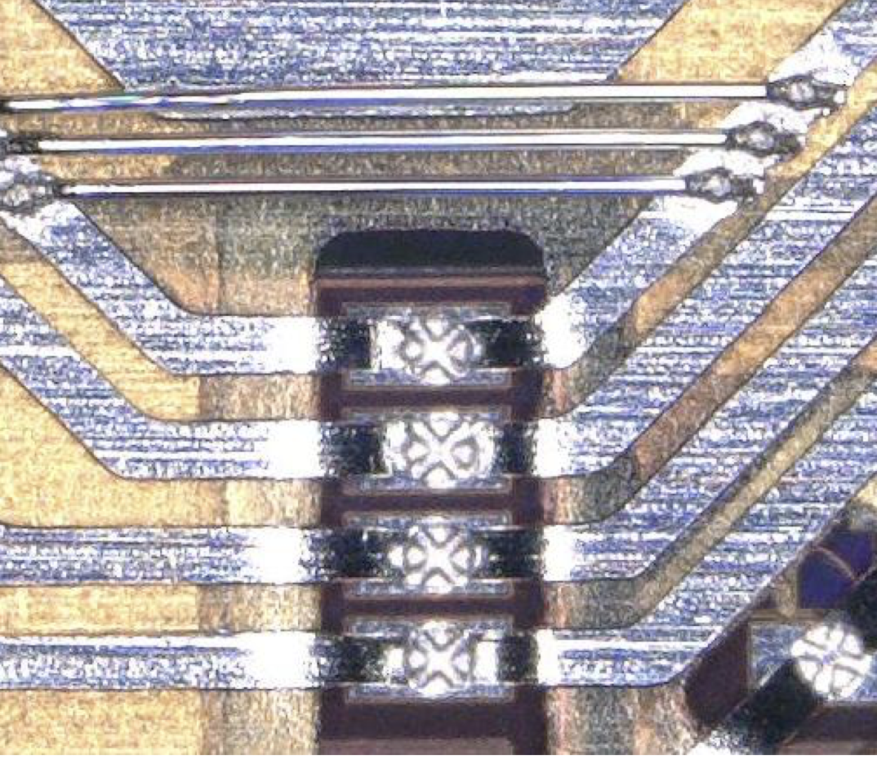
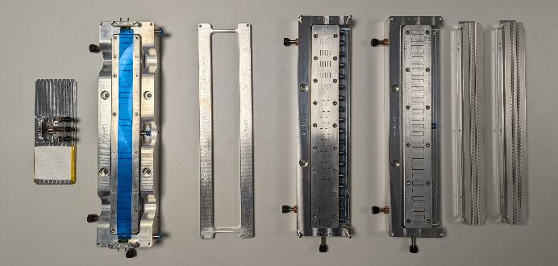
Outer Pixel Construction
Mupix11 ASIC testing and Ladder Assembly at Oxford
Tape removal and QC testing of 4500 70 um Mupix11 ASICs
Robotic assembly of 17 and 18 chip ladders with 10µm precision (20 µm gap between chip)
SpTAB bonding to Al/kapton flex
Gluing to 25um carbon fibre support structures
Ladder electrical QC testing

Slide 15
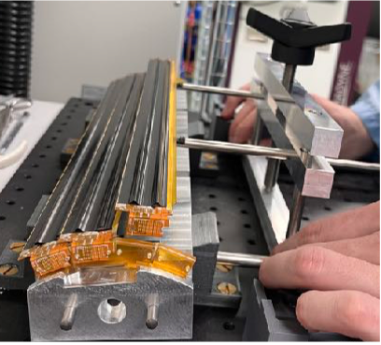
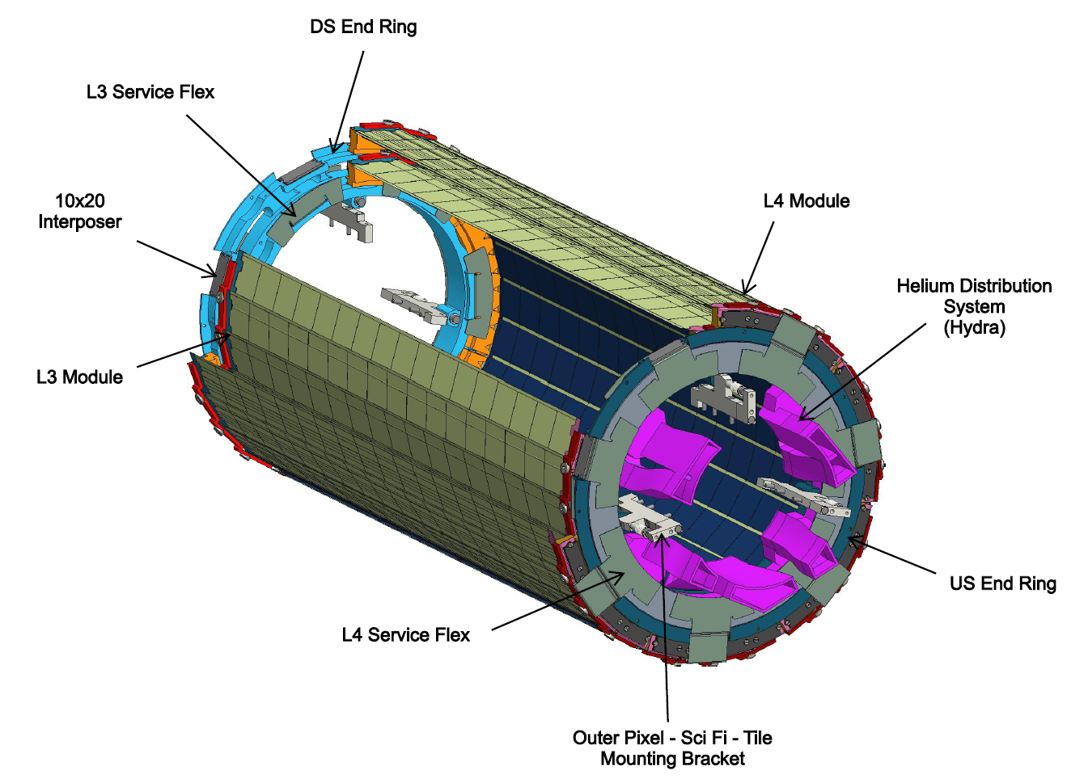
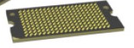
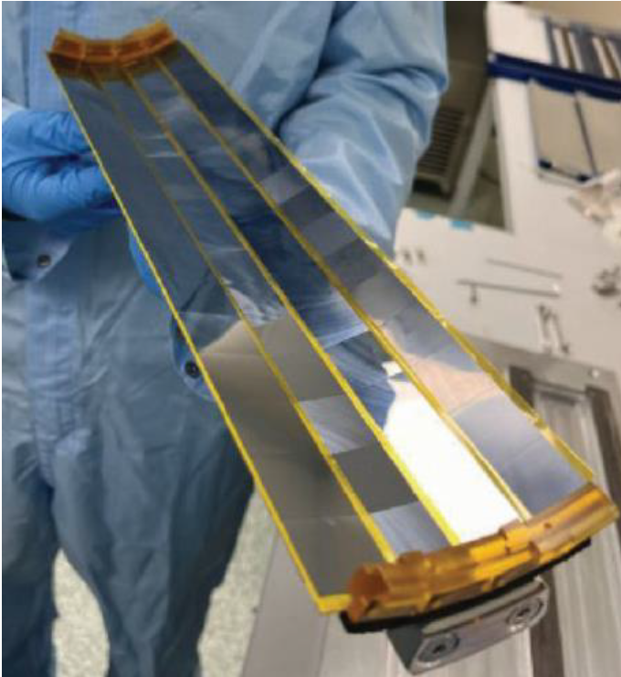
Outer Pixel Construction
Module Assembly at Liverpool
Four ladders tested and assembled into a module
Ladders are clamped so can be removed for rework
Dedicated specialist tooling to handle fragile ladders
Modules also include PIE end pieces, interposers and Service flex parts
Modules fit into end rings and connect with interposers

Slide 16
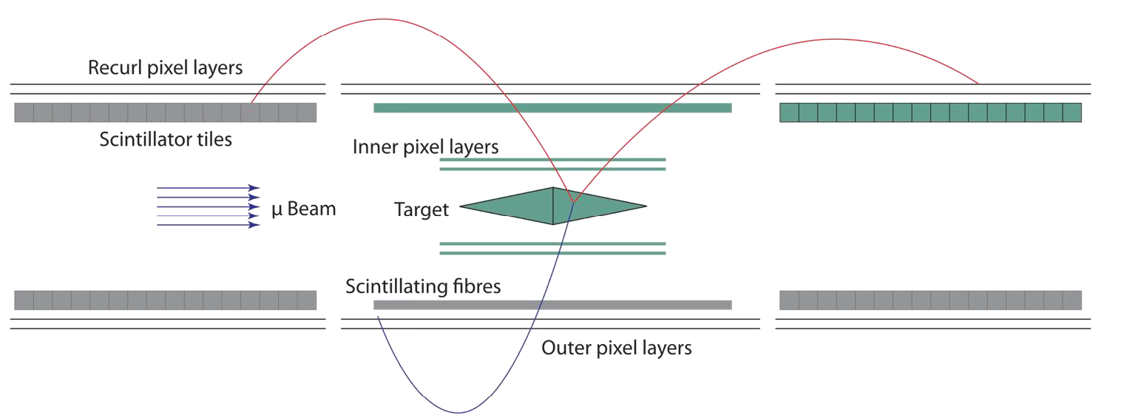
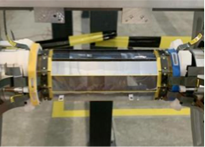
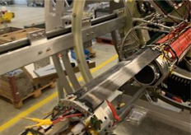
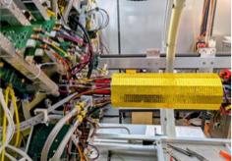
2025 Operation
3 weeks operation with a minimal commissioning setup
3/14 Downstream SciTile modules
Vertex V1 detector
1/6 SciFi modules

Slide 17
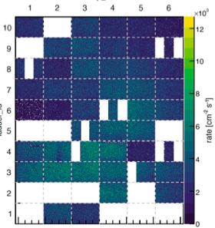
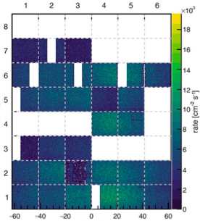
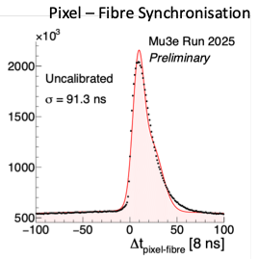
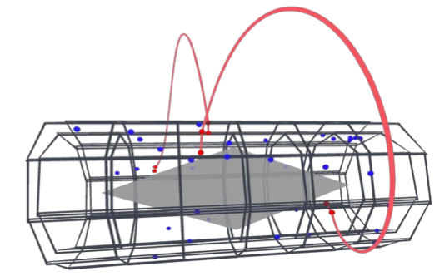
2025 Results
Three Weeks Beamtime in 2025
First operation of Vertex sub-detector
Curved Electron tracks reconstructed
Sub-Detector timing integration successful
Many Vertex channels missing due to mechanical and bonding issues
Helium cooling system successfully operated at 2g/s

Slide 18
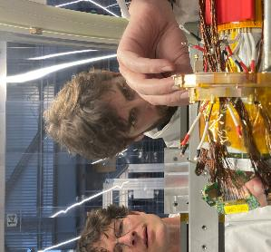
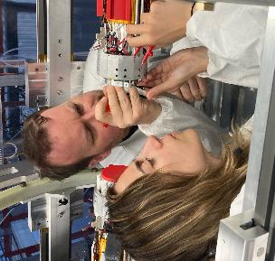
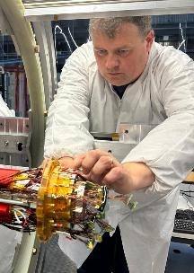
2026 Status
Eight weeks planned running with:
Rebuilt Vertex V2
Full SciFi detector <- First full detector operation
Downstream SciTile detector <- First full detector operation
Layer3 Outer Pixel Central Detector <- First Operation
Full helium cooling system <- First Operation
Full Filter Farm trigger system <- First Operation
First Integration of full systems
Starting in October!!

Slide 19





2026 Status
Services: Installed April-May 2026
Vertex V2: Installed June-July 2026
SciFi: Installed July 2026
SciTile DS: Installed Aug 2026
Outer Pixel L3: Installing now

Slide 20

2027 and Beyond
2013 - 2024
2025
2026
2027
2028 - 2029
2030 ->
First Commissioning
Vertex V1
SciFi
Sci Tile
Initial Operation
Vertex V2
Full Sci Fi
½ Sci Tile
Outer Pixel L3
Phase 0 Running
Vertex V3
Full SciFi
Full SciTile
Outer Central
Full Phase 1 Running
Shutdown Beamline HIMB upgrade
R&D and Preparation

Slide 21
Summary
Mu3e has firmly left the R&D phase and is now under construction.
The pixel detectors have been designed for: ultra-low mass, high resolution, gaseous cooling and are based on the Mupix11 chip.
Interesting techniques are used in the pixel detector construction including theMupix11, Al/Kapton spTAB bonded flexes and the 25um composite supports
Three weeks commissioning beam time in 2025 is being followed by eight weeks starting in October this year.
We have a chance of a first physics measurement this year, depending on commissioning, but realistically we expect our first result in 2027 with a more complete detector.
HIMB accelerator upgrade lets us reach our final Phase I sensitivity in 2030

Slide 22

Thank you
Switzerland: PSI, ETH, University of Zurich, University of Geneva
Germany: Heidlberg Physics Institute, Heidlberg Kirchoff Institute, Karlsruhe Institute of Technology, University of Mainz
United Kingdon: University of Bristol, University of Oxford, University of Liverpool, University College London

Slide 23
Backup

