Slide 1

Assembly of hybrid detector modules for advanced medical imaging
Aswathi Koorikkat
UKRI-Science and Technology Facilities Council (STFC), Rutherford Appleton Laboratory (RAL), Didcot, UK
PSD14: International Conference on Position Sensitive Detectors
Notes:
Please note all ‘white’ slides use an accessible white background colour rather than pure white.
In exceptional circumstances (such as screen glare) you may update the background colour to R234 G234 B234 which is our approved accessible grey.
A background colour update can be made to the master pages via background styles / format background. This will allow you to update the background colour values.

Slide 2
Agenda
      1 STFC and MH3D an overview
      Brief description of both organizations and what they do
      2 Motivation – Targeted Alpha Therapy and Theranostics
      Real-life impact of the project and commercial application of the assembled modules
      3 Module assembly technique
      Overview of how HEXITEC modules are assembled from wafer to a full working module
      4 Future plans
Notes:
To replace with a photo of your own: Right click on centre of image select ‘Change picture’ click ‘from file…’ and choose your image.

Slide 3
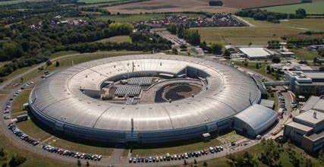
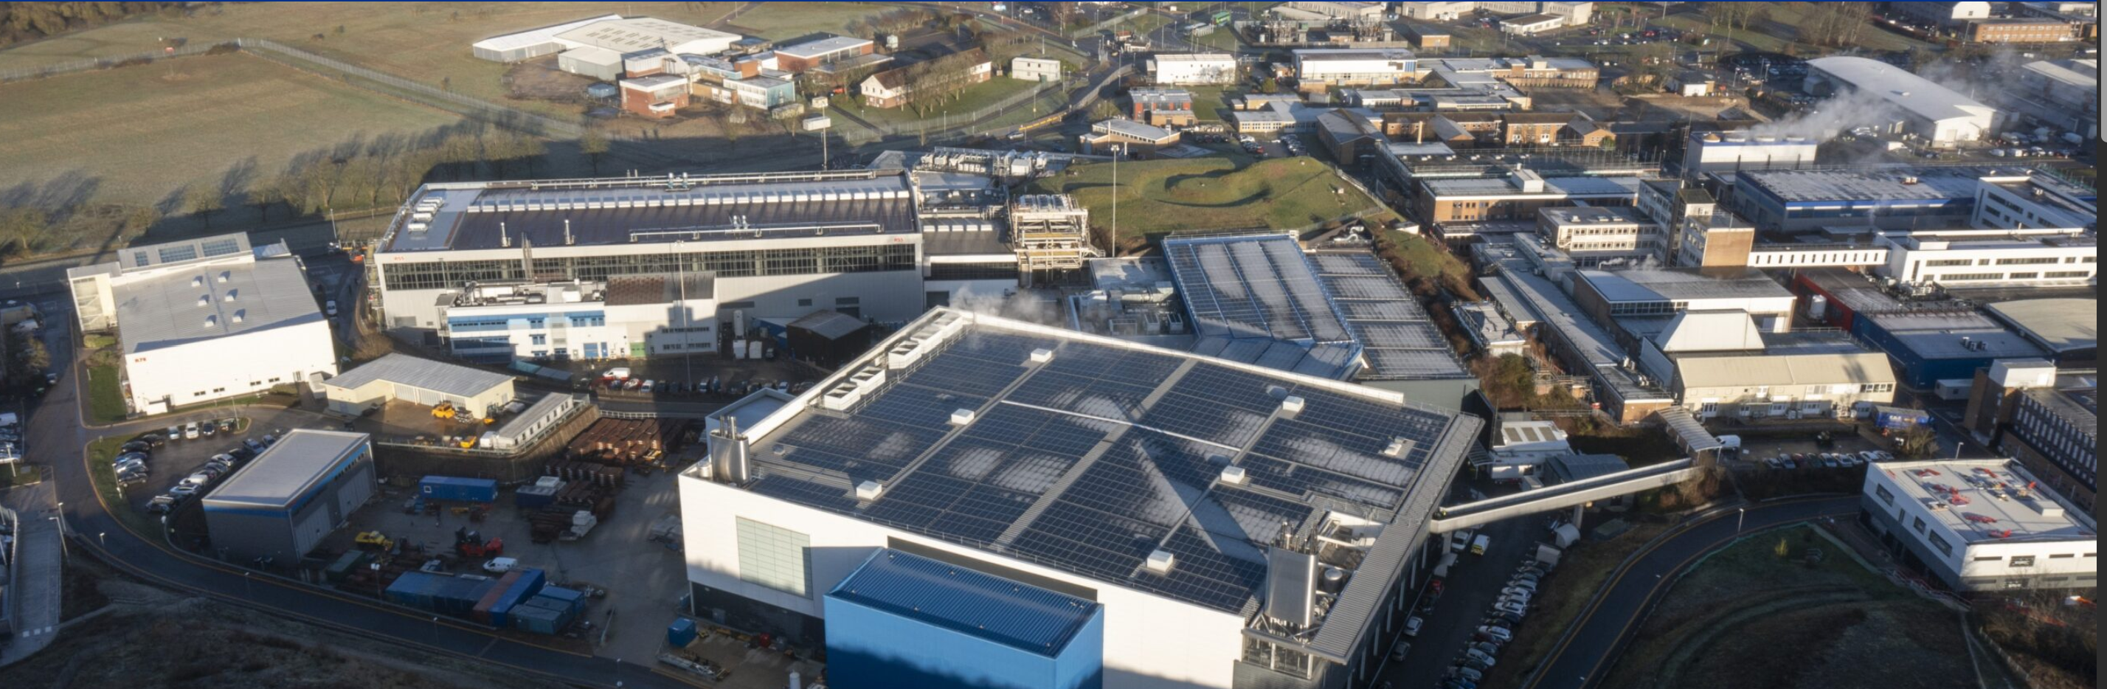
Who are we?
Science and Technology Facilities Council (STFC) is a multi-disciplinary science organization. We support fundamental research in astronomy, physics, computational science, space science and operates world-leading, large-scale facilities across a range of physical and life sciences.
STFC-RAL long-standing experience with building and integration of pixel radiation detectors used for experiments at synchrotrons and with other high-energy X-ray radiation sources
Diamond Light Source
ISIS Neutron and Muon source

Slide 4
STFC Interconnect capabilities
We are involved in different impactful projects including ATLAS ITk upgrade, Kirana (high speed camera, 7M frames per second), LPD for European XFEL etc
Building large pitch (~500µm) and small pitch (~55µm)radiation detectors
Indium bump bonding for fine pitched devices for quantum computing applications in collaboration with NQCC.
Solder reflow in formic acid environment for applications like ATLAS ITk pixel modules

Slide 5


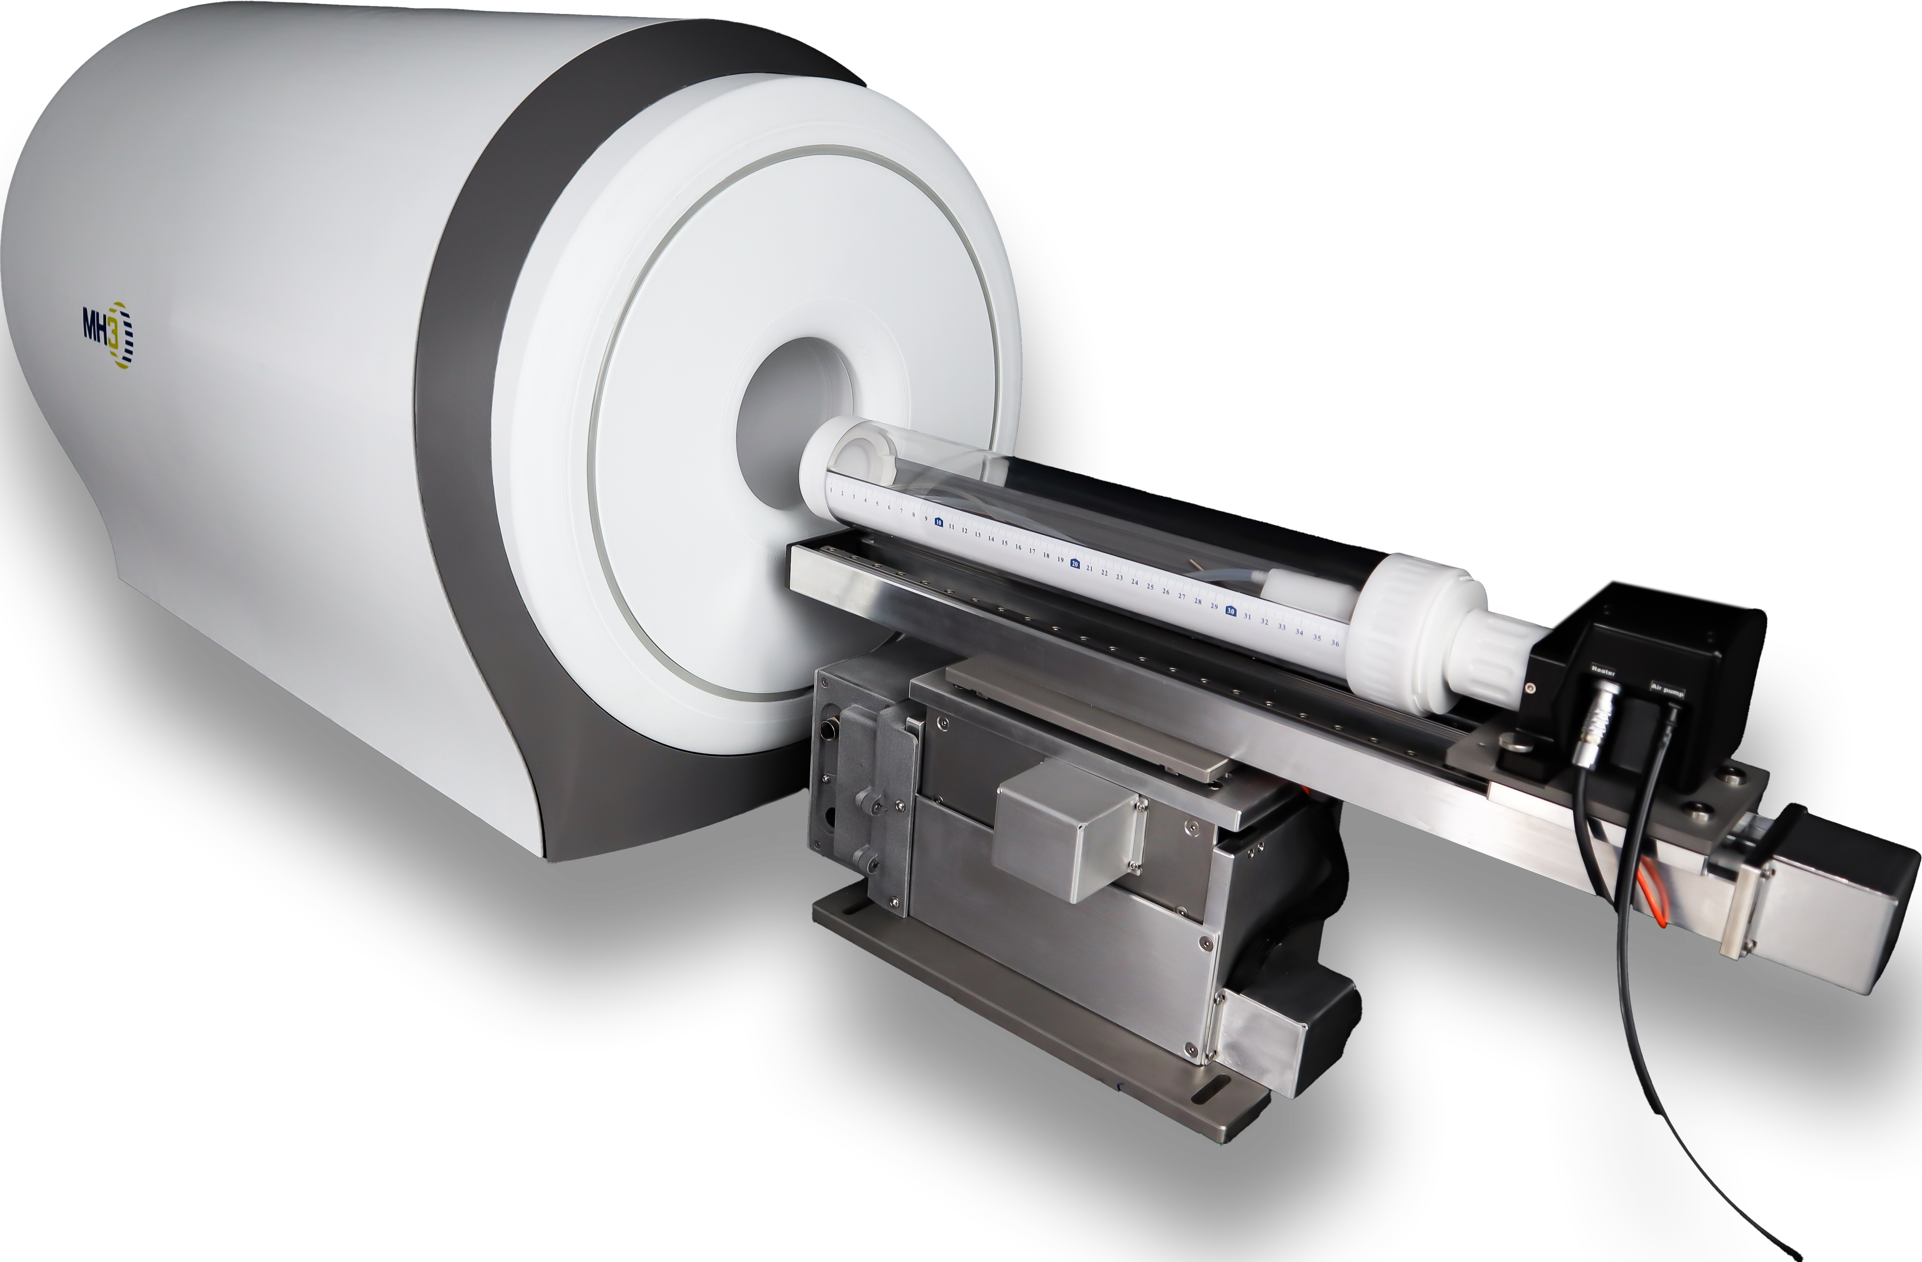
MH3D an Overview
  Start-up founded in 2023, spin-off of university of Michigan and university of Illinois
  Currently developing next generation SPECT (Single Photon Emission Computed Tomography) imaging systems for early detection and monitoring of cancer, cardiovascular, and neurogenerative diseases.
  Aims to deliver sub - 1 mm resolution Alpha-SPECTTM Mini
  Scanners for preclinical research (mice and rats)

Slide 6
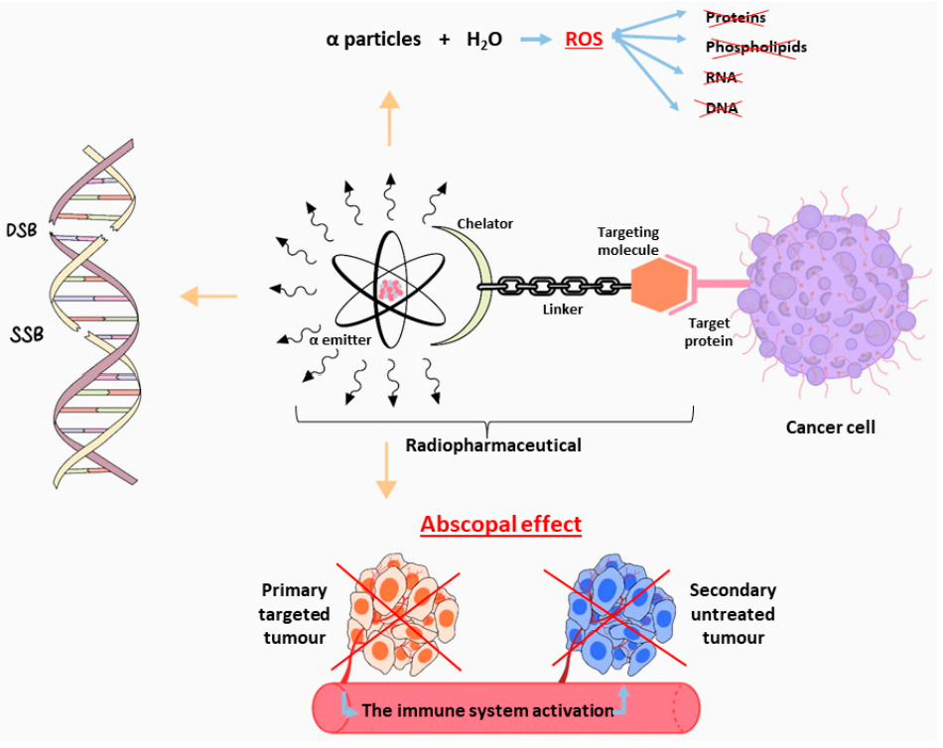
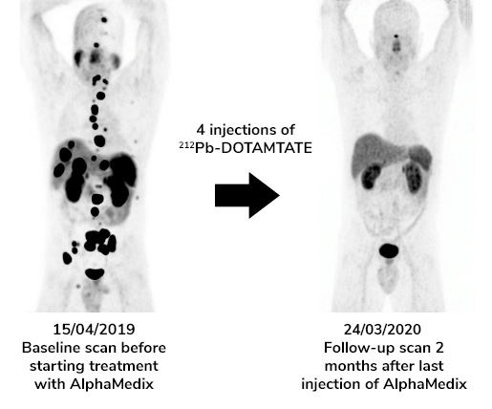
Targeted Alpha Therapy
Targeted Alpha Therapy uses α particles to selectively destroy tumour cells while preserving adjacent healthy tissues
α particles travel short distances less than 0.1mm.
Radionuclides like ²²⁵Ac and ²¹²Pb are used
TAT can target primary targeted tumour as well as the secondary untreated tumour due to abscopal effect.
Jalloul, Wael, et al. "Targeted alpha therapy: all we need to know about 225Ac’s physical characteristics and production as a potential theranostic radionuclide." Pharmaceuticals 16.12 (2023): 1679.

Slide 7
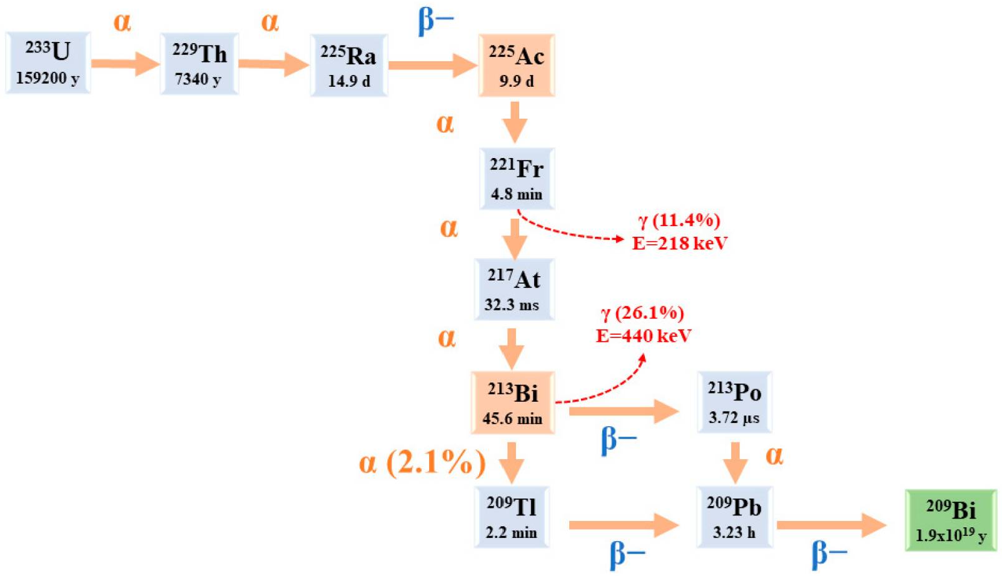
Theranostics
Combination of targeted diagnostic imaging with radioactive therapy
The radioactive tracers emit gamma rays then captured by the gamma camera to construct a 3D image.
Radionuclides used for SPECT have longer half lives and the α emitters have complex decay schemes producing daughter isotopes.
Jalloul, Wael, et al. "Targeted alpha therapy: all we need to know about 225Ac’s physical characteristics and production as a potential theranostic radionuclide." Pharmaceuticals 16.12 (2023): 1679.

Slide 8
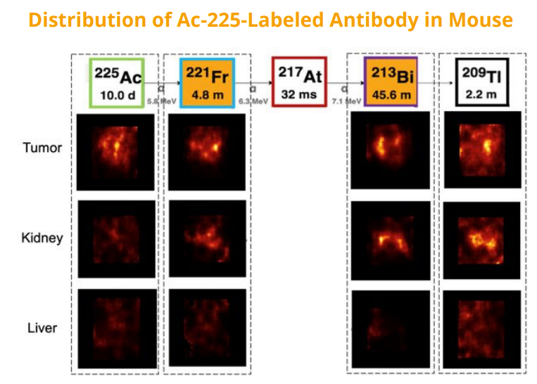
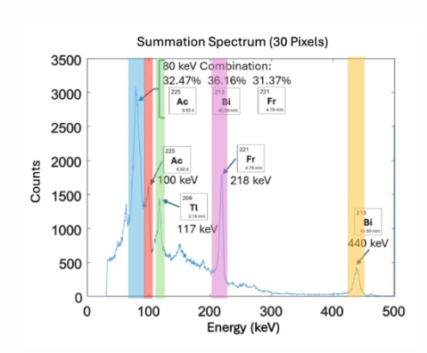
The clinicians need to know not just "where," but "which” isotope in the decay chain to accurately calculate the dose delivered to the cancer and healthy tissues, like the kidney and liver.
https://scintica.com

Slide 9

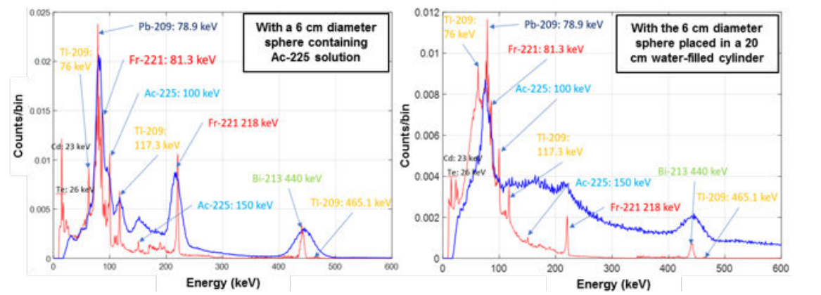
HEXITEC
HEXITEC ASIC developed by STFC in 2007-2009. It’s an 80x80 pixel array, on a 250 µm pitch. Pitch of 500µm MH3D i.e, 40x40 array.
Delivers excellent energy and spatial resolution capabilities
HEXITEC can distinguish closely-spaced emission peaks from different radioisotopes. Ideal for SPECT imaging.
Comparison between the alpha SPECT Mini and a conventional Siemens SPECT system
Zannoni, Elena Maria, et al. "The alpha-SPECT-mini: a small-animal SPECT system based on hyperspectral compound-eye gamma cameras." IEEE transactions on radiation and plasma medical sciences 9.8 (2025): 1107-1117.

Slide 10
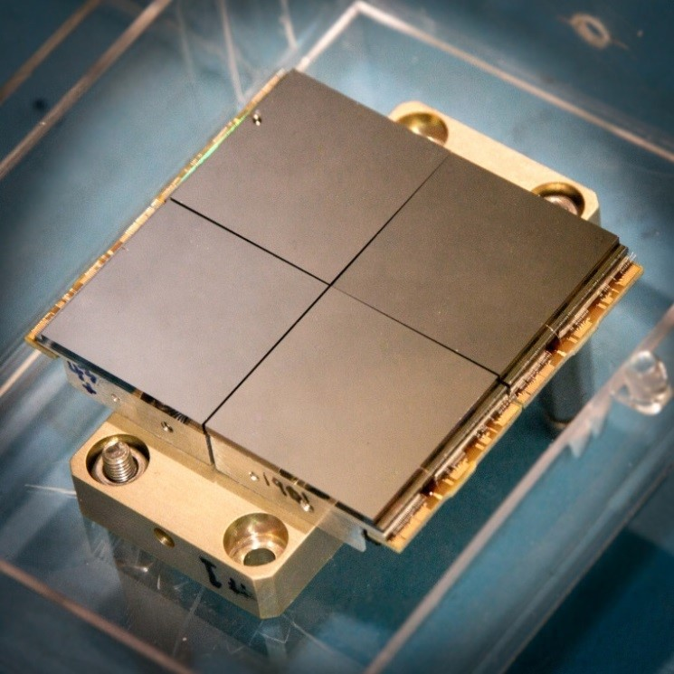
Assembly of a full module
A full module consists of an HEXITEC ASIC(Application Specific Integrated Chip) flip-chip bonded to a compound high-Z semiconductor. In this case CZT (Cadmium Zinc Telluride)sensor.
CZT can stop high energy photons and operates at room temperature.
Depending on the application, the full modules are arrayed to a panel
HV bias wire
40 mm
40 mm
FC-bonded interconnects
sensor
ASIC
wire bonds
Module block
Assembly block for detector modules
PCB
w/ connector
Panel assembly

Slide 11
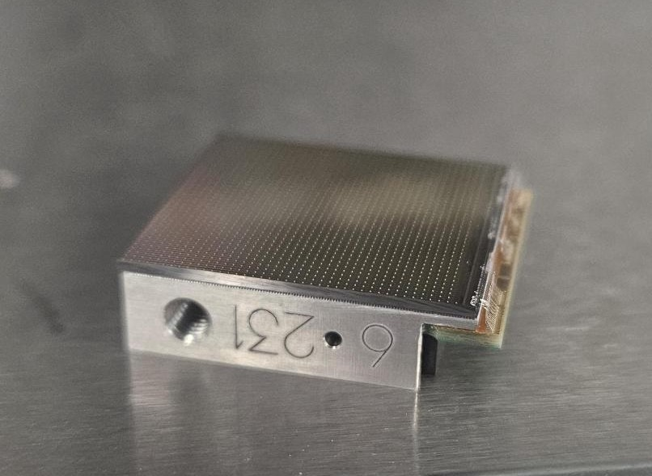
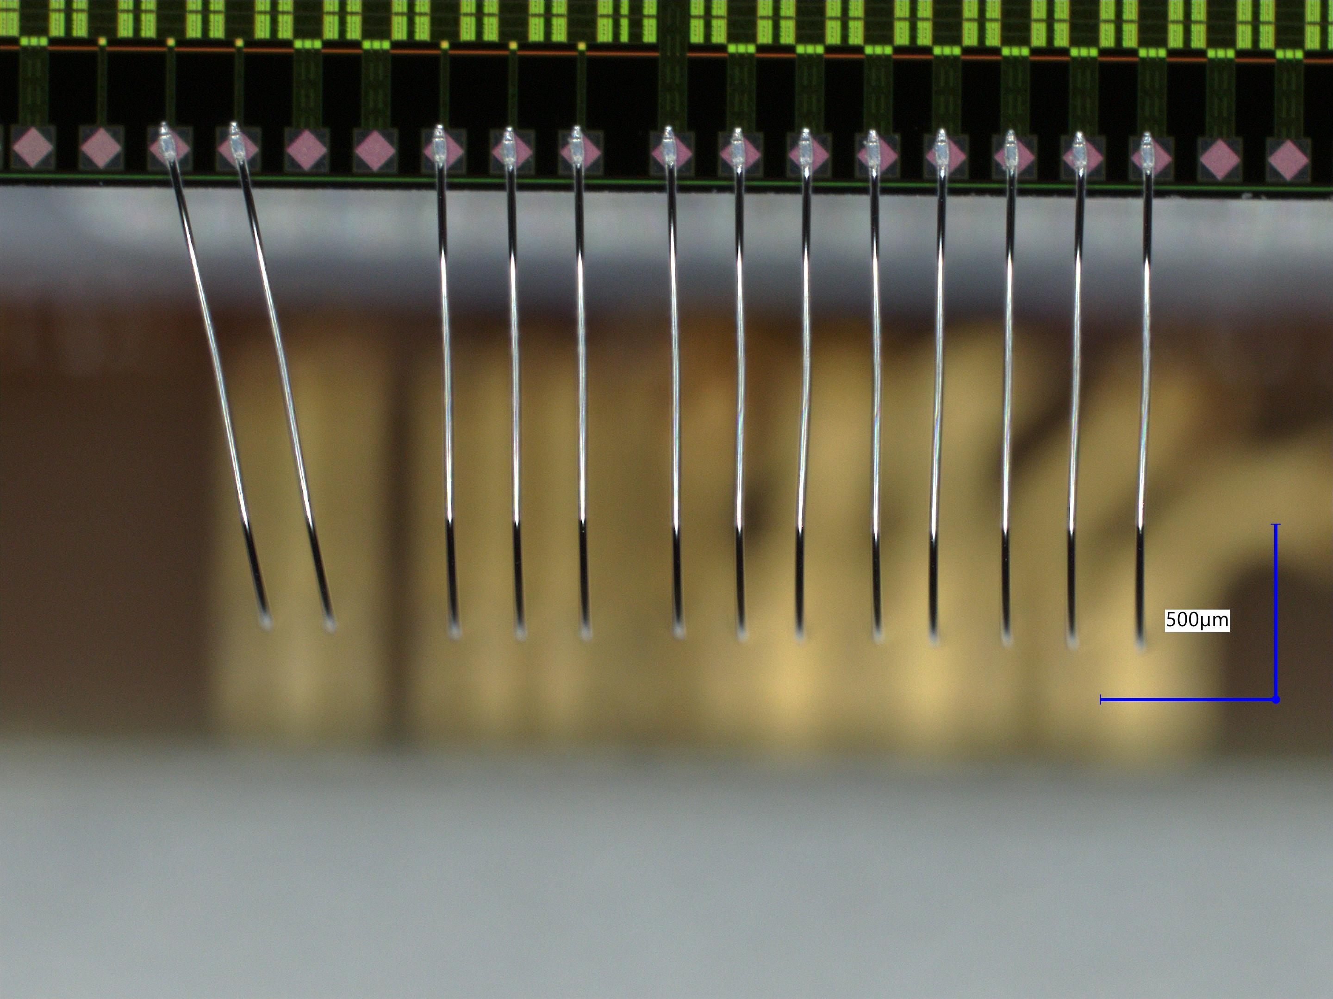
Key Assembly steps for HEXITEC
1. ASIC studding – Starts with ASICS on a wafer. Gold studs formed on ASIC pads to provide electrical contact point & mechanical standoff
    Average triple studs of height ~40µm
    2. A door-step PCB is attached to an Al block. The studded ASIC is mounted onto the block
    3. The ASIC is wire bonded to the PCB. Before putting the CZT on the ASIC,
    they are Vcal (Voltage calibration) test. This will determine if the ASIC is dead or alive.
SEM image of gold studs
ASIC
PCB
Wire bonds

Slide 12
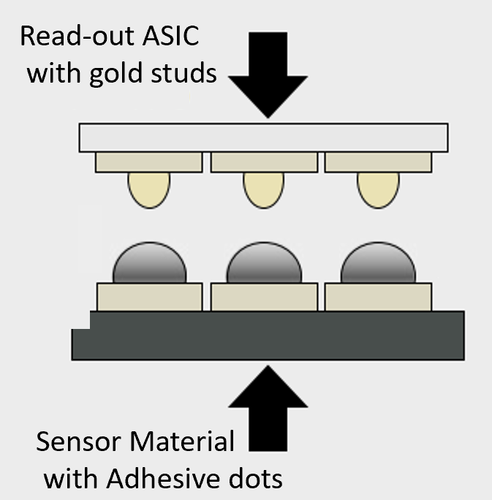

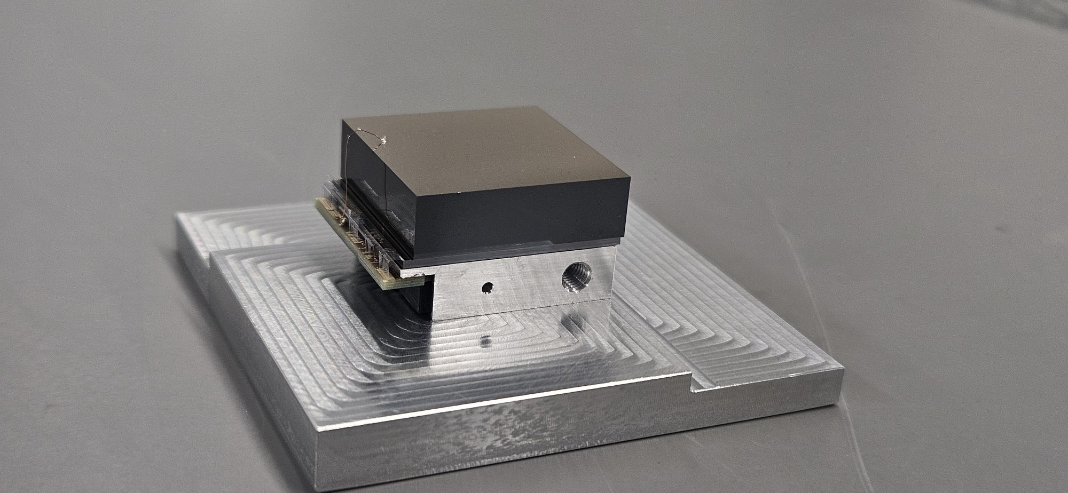
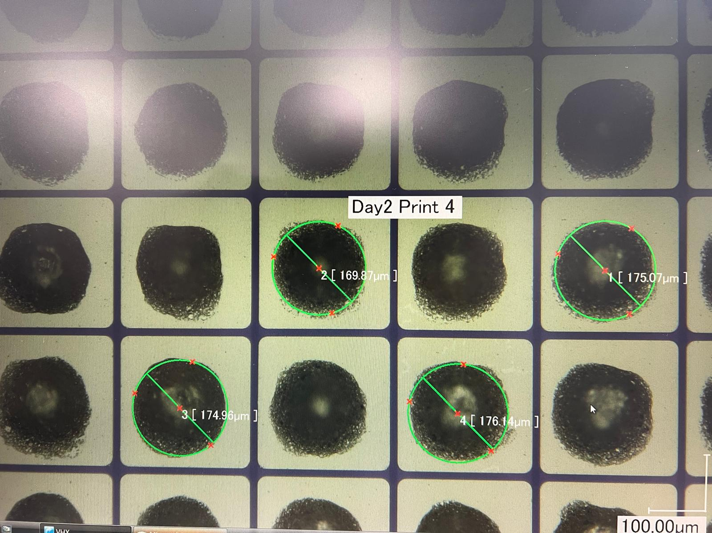
3. Stencil Printing – Thixotropic conductive epoxy is deposited on the CZT sensor pads using a precision stencil print
4. Flip chip bonding - The studs on the ASIC are aligned and bonded to the
epoxy dots on the sensor, through controlled pressure and temperature.
5. A CZT is connected with a bias wire
Fully assembled module
CZT with epoxy dots. On average
~160µm in diameter and ~40µm in height

Slide 13
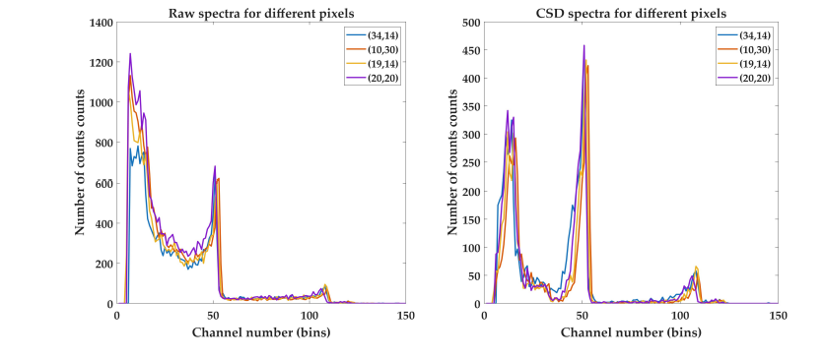
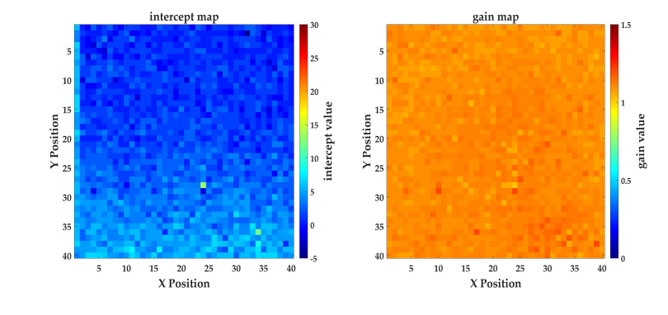
The assembled modules are tested with Americium-241 and Cobalt-57 radiation sources
The tested full modules have a spectroscopic energy resolution of ~3-4 keV full width half maximum(FWHM) measured at 60keV in low gain and a bond yield of 99%.

Slide 14
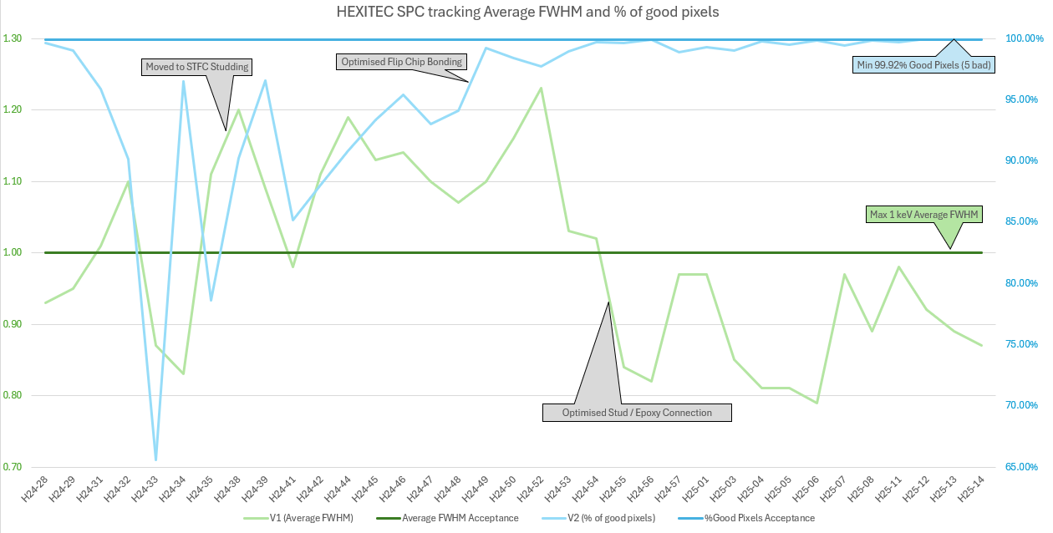
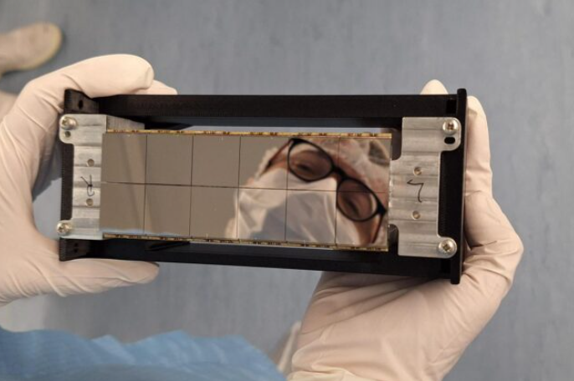
After testing, the full modules are assembled on to a panel
Currently STFC is able to produce 100+ full modules every month with a yield of 95%.
Example of a panel on the HEXITEC 2x6

Slide 15
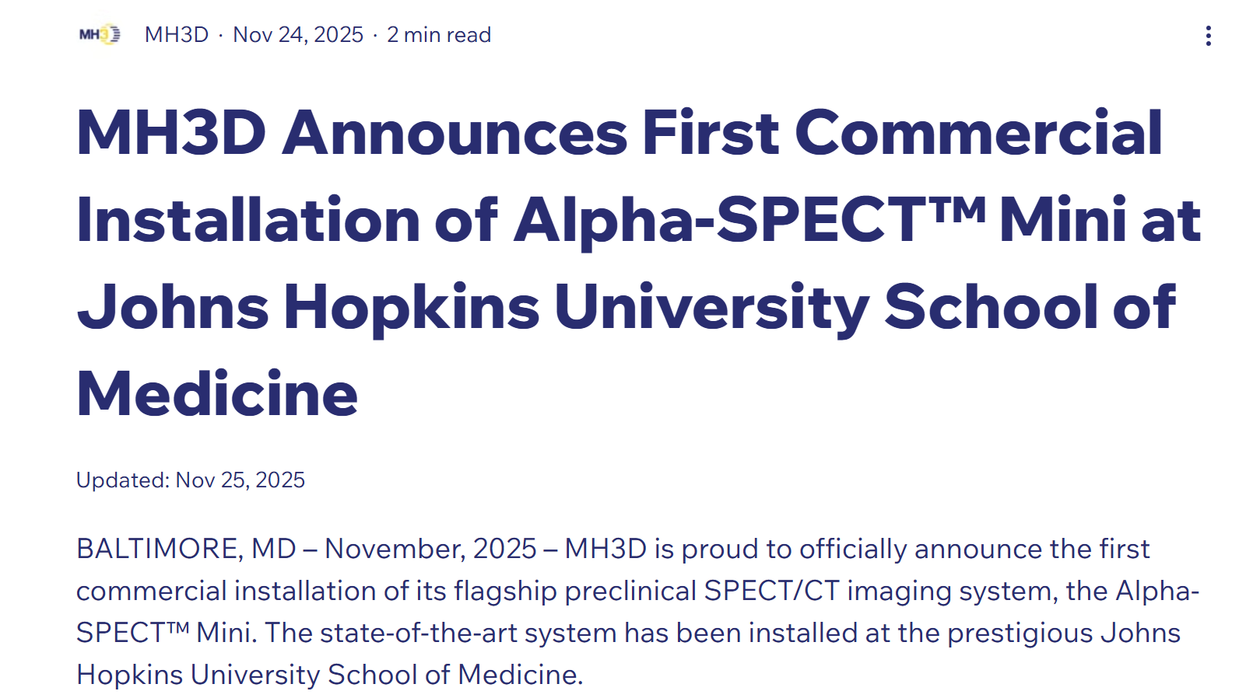

Outcomes
Further read News | MH3D Inc.

Slide 16
MH3D – forecast and future plans
Alpha SPECT MINI for small animals (mice) are mainly targeting radionuclide development companies
Requires hundreds of HEXITEC modules per mini scanner
Next step is to Move on to brain scanner – 200+ HEXITEC modules
Full SPECT scanner (Humans)
For STFC, the production will move to a high throughput line by the end of 2026

Slide 17

Questions?
Notes:
To edit the background image, select ‘Format’ from the PowerPoint menu and ‘Slide Background’ from the drop-down menu. Within the new list of options that appears on the right of the screen, select the ‘File’ button under ‘Insert picture from’ and select your image from your file browser.

