Slide 1
Systematic Study of Proton- and Neutron-Induced Radiation Damage in 4H-SiC PN Diodes
Sebastian Onder, Peter Fischer, Stefan Gundacker, Matthias Knopf, Daniel Radmanovac, Simon Waid, and Thomas Bergauer
PSD14
04.09.2026

Slide 2
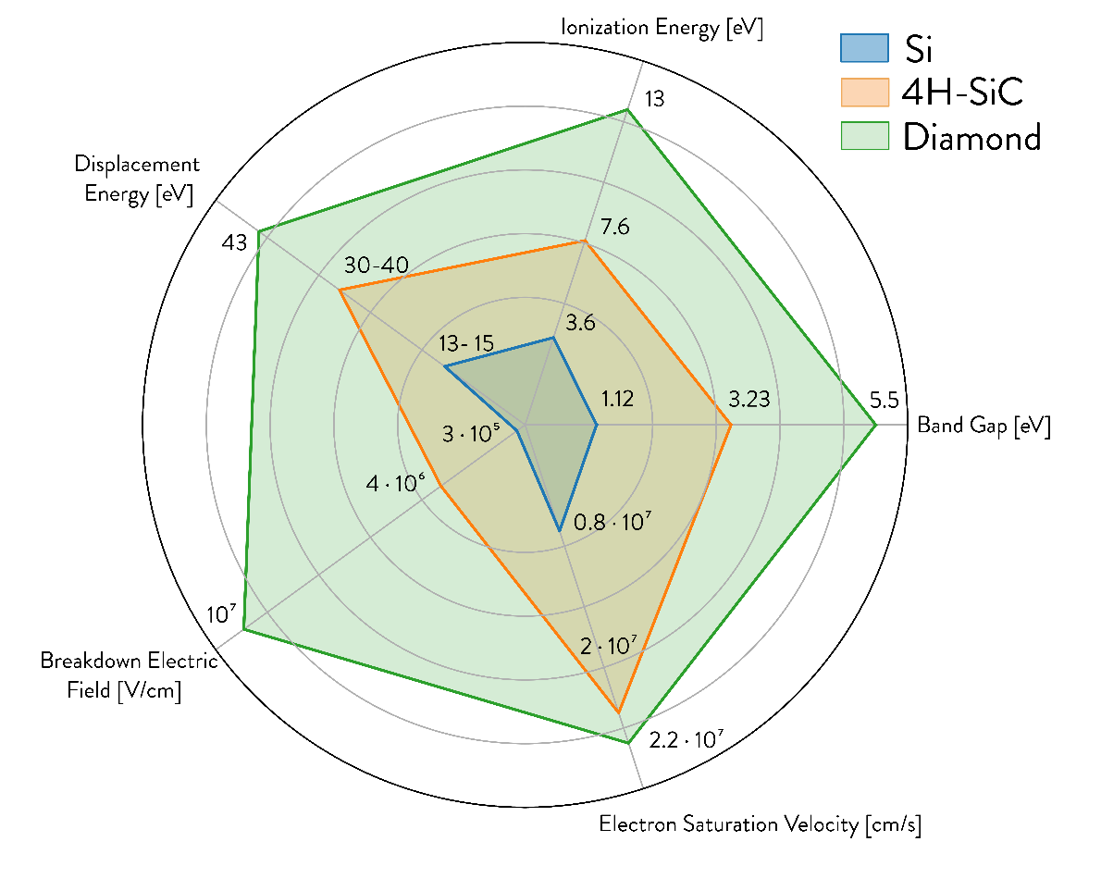
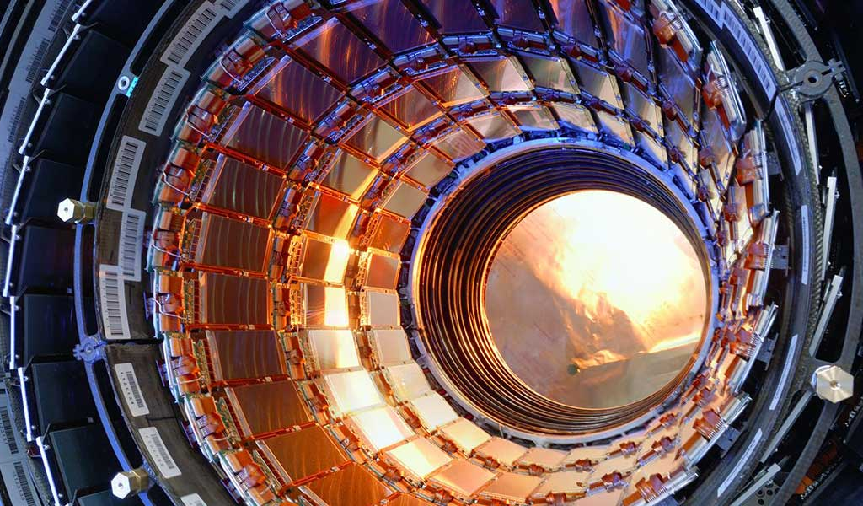
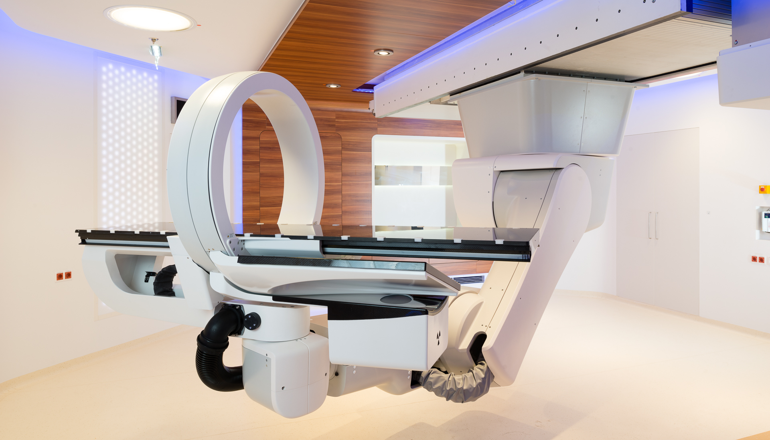
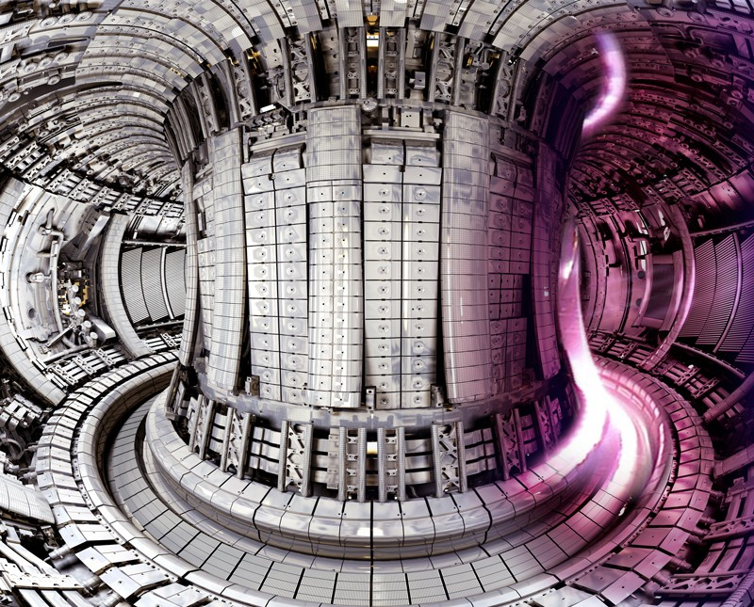
4H-SiC for Radiation Detection
Attractive for power electronics & automotive industry
⇒ Increased availability and lower costs
Wide bandgap (Si: 1.12eV, 4H-SiC: 3.26eV)
  low leakage current & thermal noise at room temperature and after irradiation ⇒ no cooling
  insensitive to visible light, thermal robustness (up to 300°C)
Low doped & high quality material <100µm thick
(Si: ~300µm) + higher ε_{i} ⇒ less signal yield
High Energy Physics
No cooling, SiC LGADs
Proton/Ion therapy
Beam monitoring, dosimetry
Upcoming: Fusion Diagnostics
Munoz et. al., „Characterization of 4H-SiC p-n Junction Detectors for Alpha
Particle Detection in Plasma Diagnostics“, Talk at 3rd DRD3 Week, 2025
Symbolic image. Taken from: https://www.nature.com/articles/d41586-021-00408-1

Slide 3
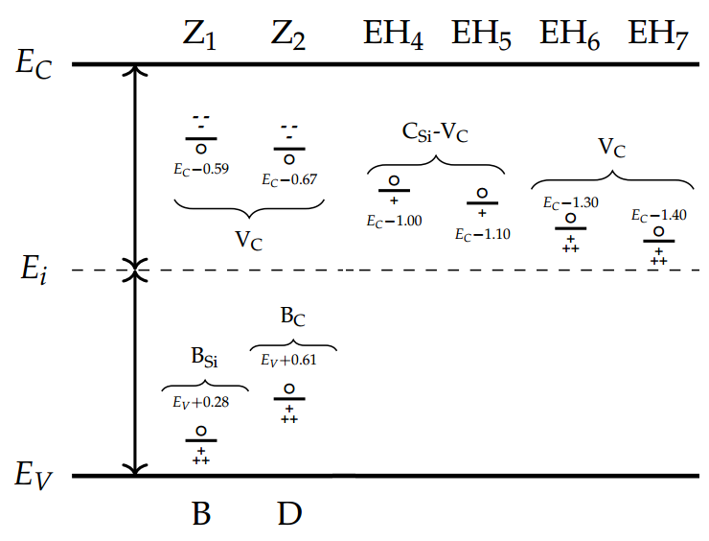
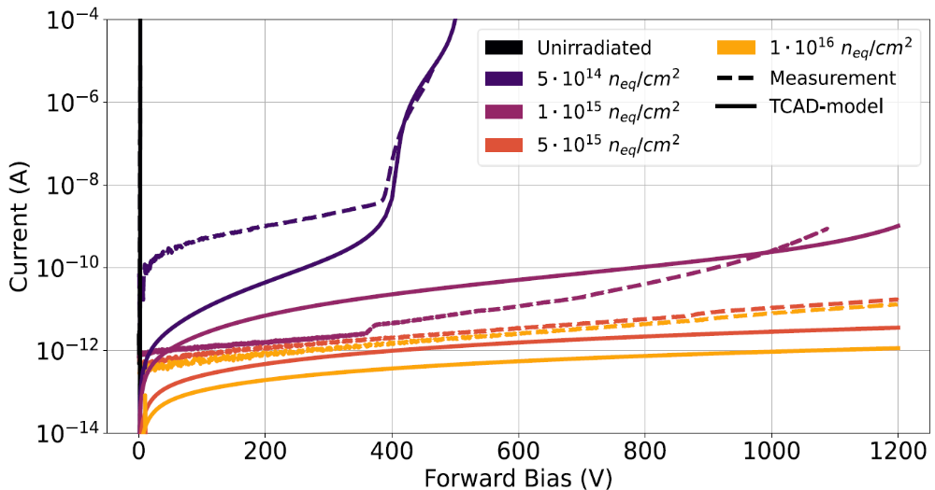
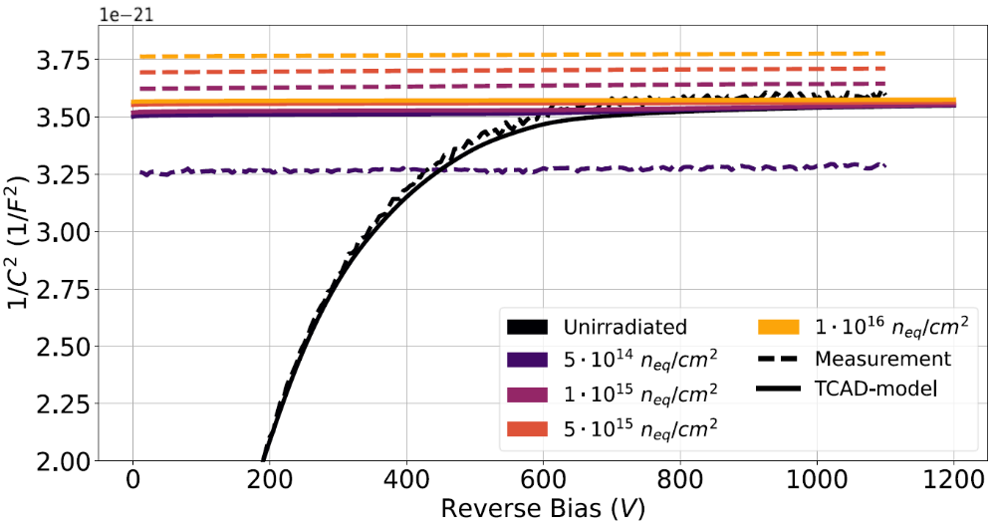
Radiation Damage in 4H-SiC
Radiation damage in 4H-SiC is dominated by deep level traps (Z_{1/2}, EH_{4/5}, EH_{6/7}):
  Negligible increase in leakage current
  Voltage-independent, flatlining capacitance
  Loss of rectification
TCAD radiation damage model:
  Preliminary Vienna model for neutron irradiation yields
  qualitative results
  Based on small fluence range and single devices per fluence
  ⇒ larger study with more fluences and more samples
Common defect energy
levels in 4H-SiC
P. Gaggl, et. al. (2024). TCAD modeling of radiation-induced defects in 4H-SiC
diodes. NIM A, 170015. https://doi.org/10.1016/j.nima.2024.170015
I-V
C-V

Slide 4
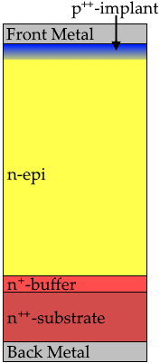

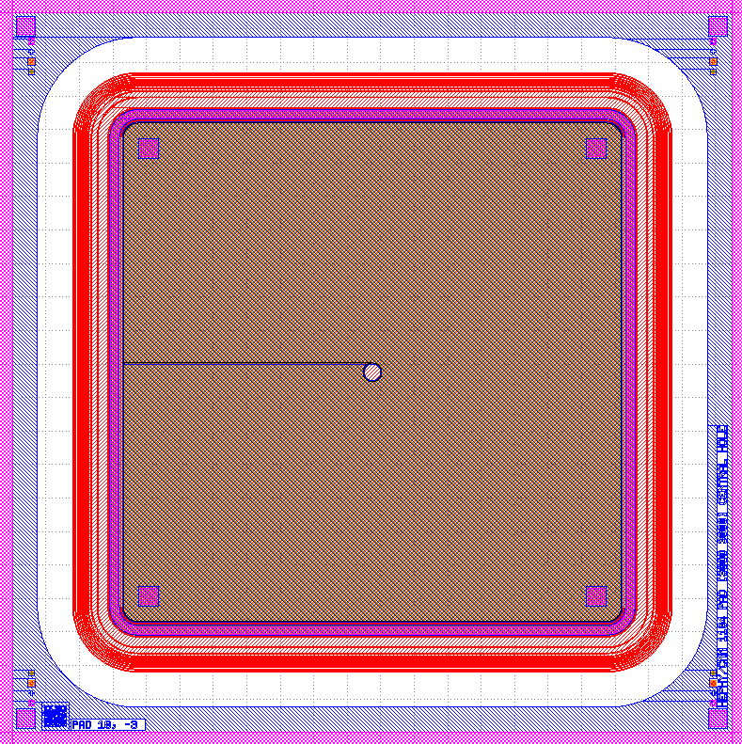
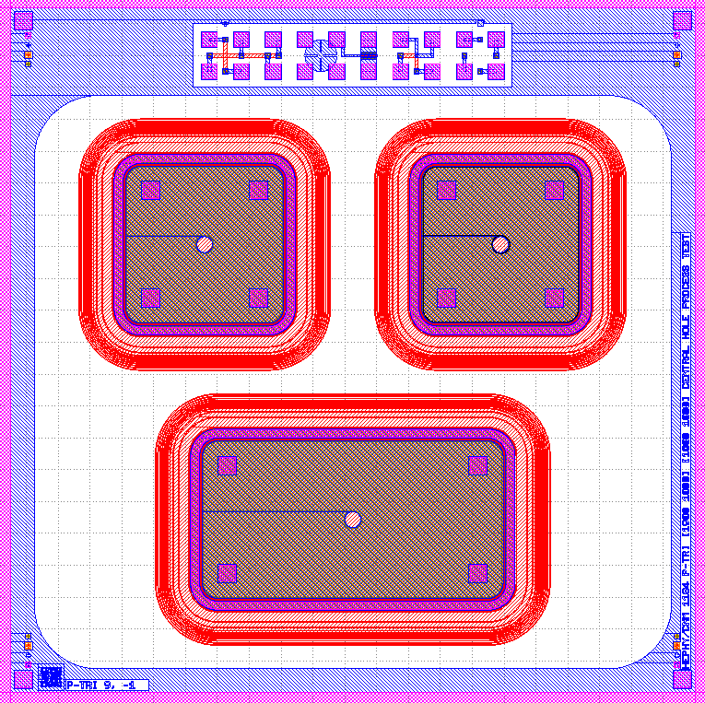
Irradiation Campaign
181 total PN diodes included in study:
  2 epitaxial thicknesses: 50µm and 100µm
  3 device areas: 3x3mm², 1x2mm², 1x1mm²
  Average doping of 3-5e14cm⁻³ (depending on epi thickness) ⇒ 100um only partially depleted
4-6 diodes per particle, epi thickness and fluence
24 GeV protons (CERN IRRAD): 8 fluences,
5e12 - 5e15 p/cm²
Neutrons (JSI): 11 fluences, 1e13 - 1e18 n_{eq,Si}/cm²
Characterization techniques:
  I-V and C-V
  UV-laser-based CCE measurements
3mm
50um/
100um
3-5e14/cm⁻³
1mm
~350um
1e18/cm⁻³
2mm

Slide 5
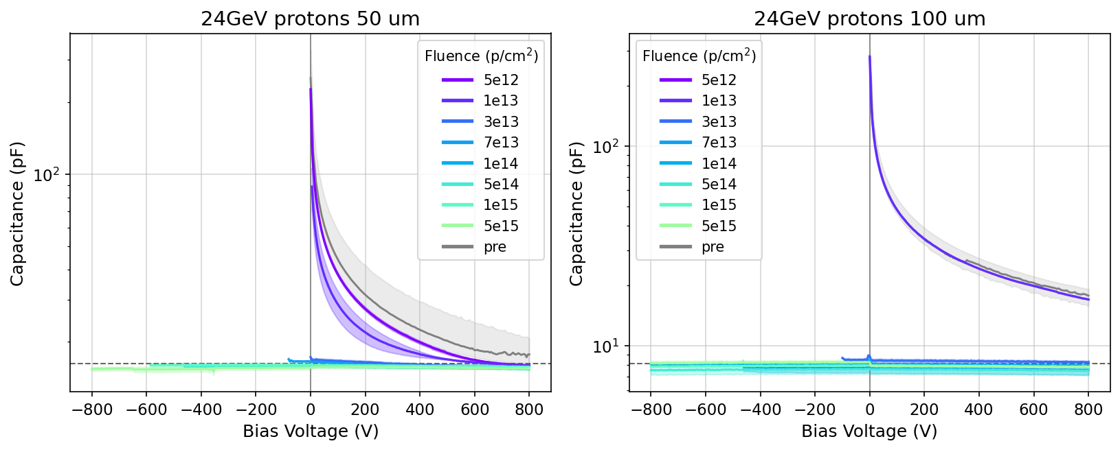
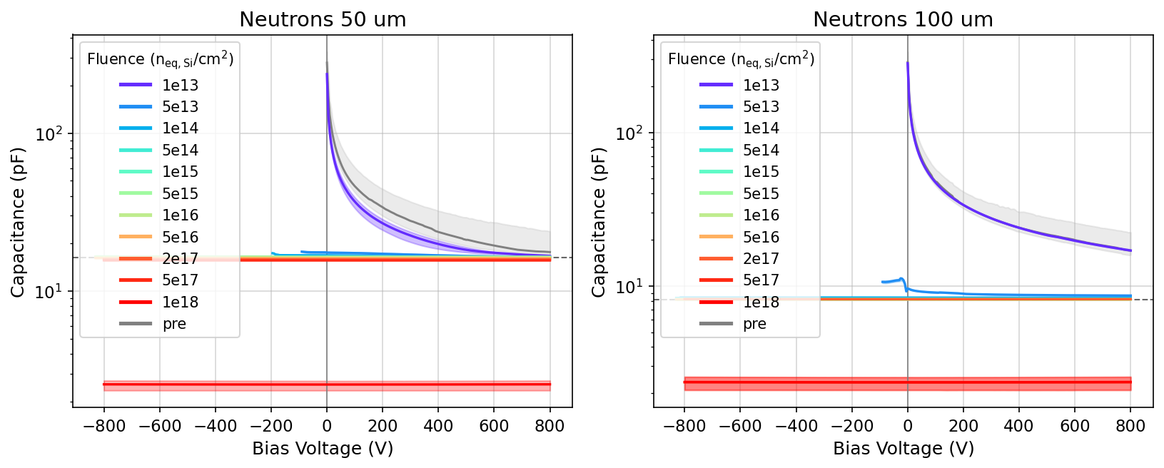
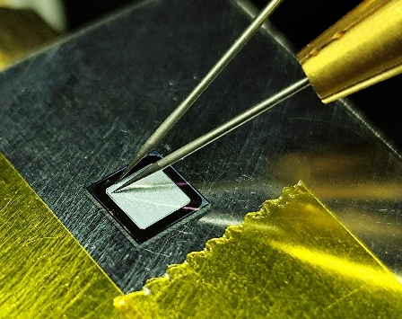
CV Characteristics
Bias-independent capacitance
after 3e13 p/cm² resp.
5e13 n_{eq,Si}/cm²
forward
reverse
f=100kHz, V_{AC}=250mV
Chuck (HV)
Probe needles (GND)
I-V/C-V probe station

Slide 6
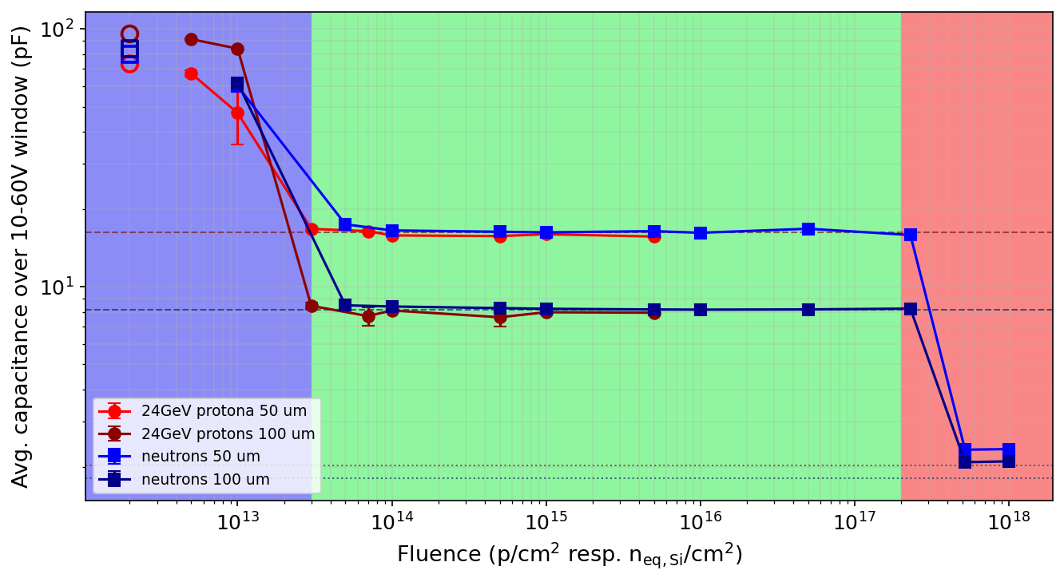
Capacitance vs. Fluence
unirrad
Epitaxial layer compensated and becomes semi-insulating
50um/
100um
Substrate compensated
Removal of active donors
~350um
Geometric capacitances
of epi thickness
Geometric capacitances of
epi + substrate

Slide 7
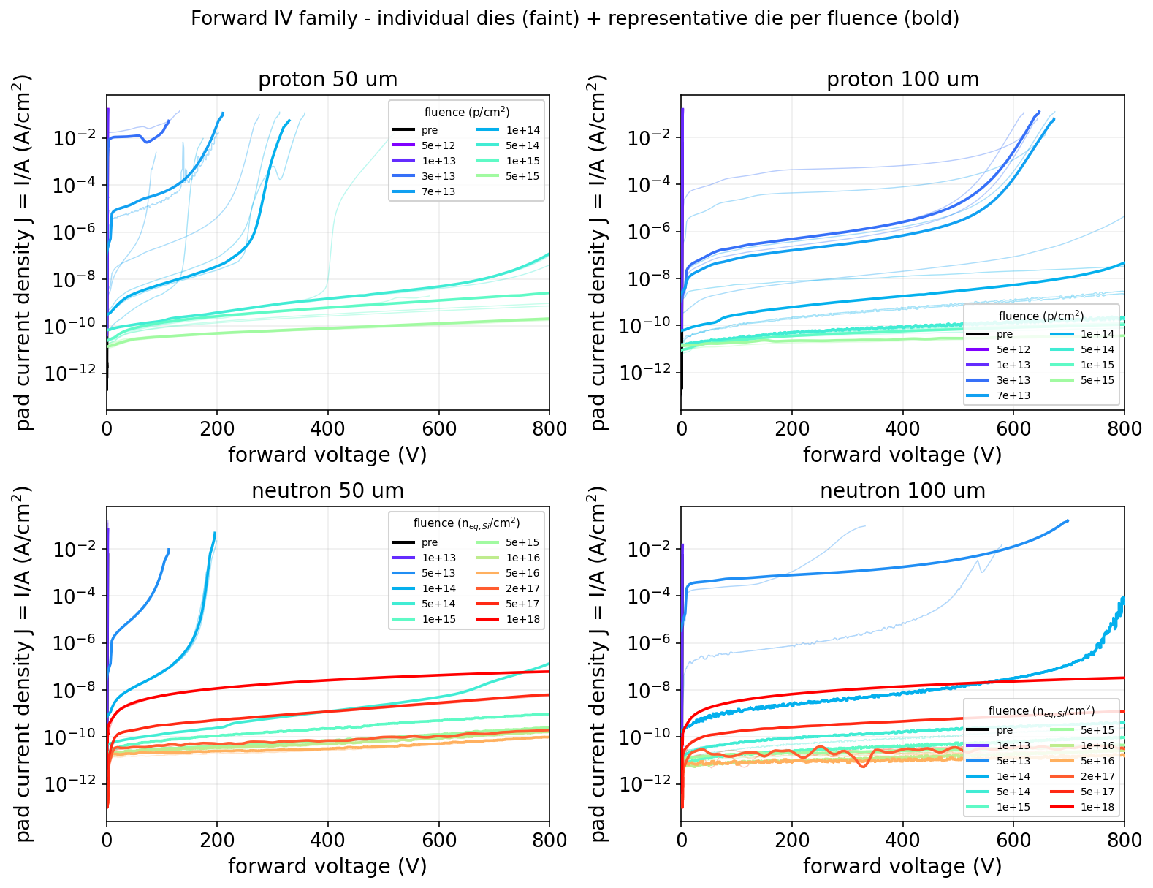
Forward IV Characteristics
Up to 1e13/cm²:
  Characteristic turn-on voltage
  of ~2.7V
  Ideality factor jumps from ~1.2
  to ~2 (see backup)
Up to ~5e14/cm²:
  Forward current reduction
  Turn-on voltage gradually shifted
  to higher voltage (on-resistance
  increase due to compensation)
From ~5e14/cm²:
  Forward current becomes
  similar to reverse current
  Total loss of rectification
Loss of
rectification

Slide 8
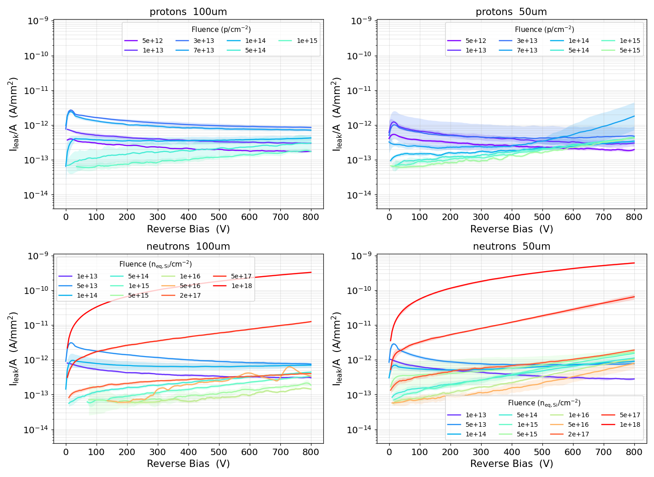
Reverse IV Characteristics
<1e14/cm²: transient-dominated, likely slow detrapping (τ ~ 40s)
1e14/cm² to 5e16/cm²: current grows with V, but decreases with fluence
→ field-driven generation/emmission and compensation compete
From 2e17/cm²: generation-dominated, increase to nA currents
behaviour is analogous in 100µm
(see back up)

Slide 9
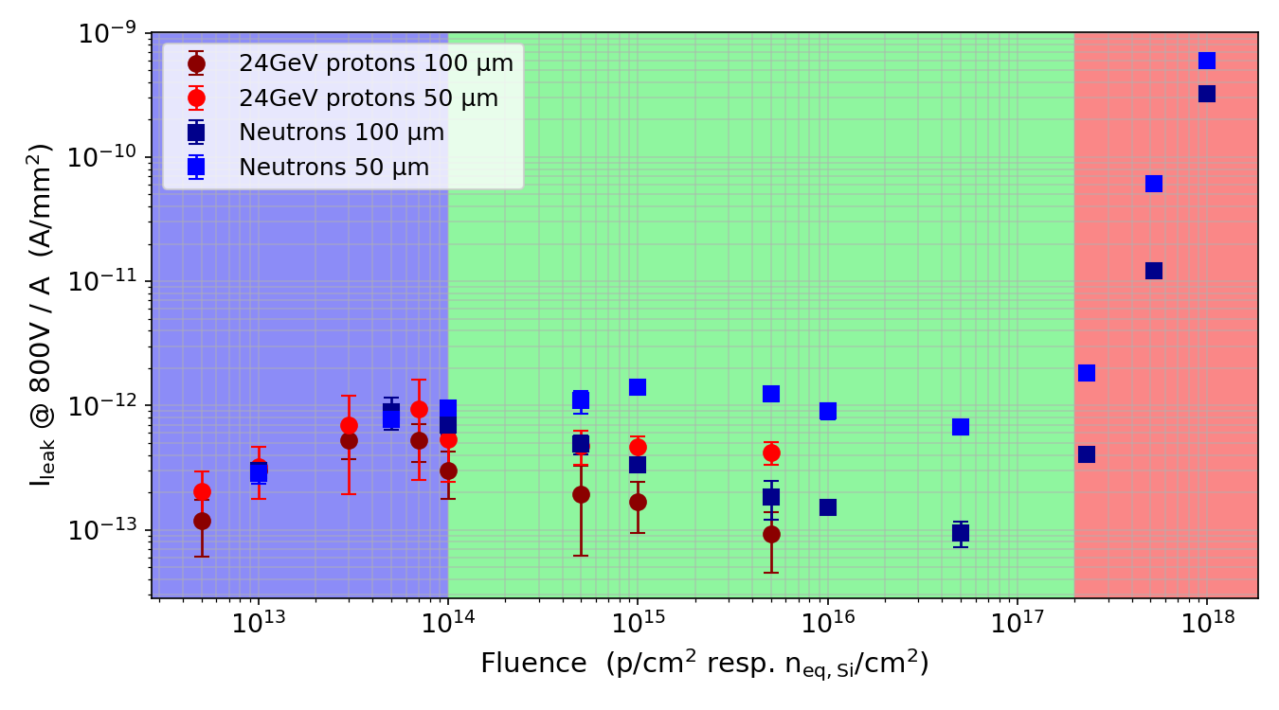
Reverse IV vs. Fluence
Leakage stays below 10pA/mm², followed by sharp increase >2e17n_{eq,Si}/cm² to nA/mm²
Not compatible with established damage model in Si (ΔI = αΦV)
Field-driven emmission/generation vs. compensation
(mechanism to be investigated)
transient-
dominated
generation-
dominated
Protons exhibit less current

Slide 10
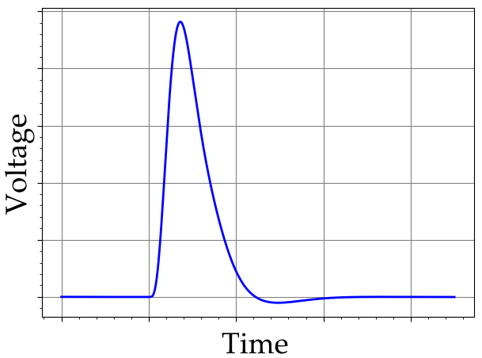
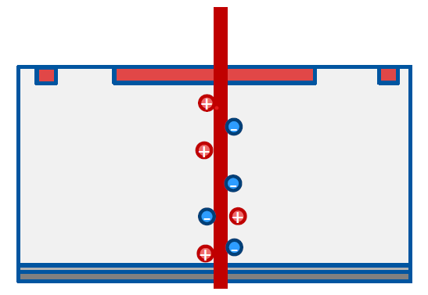
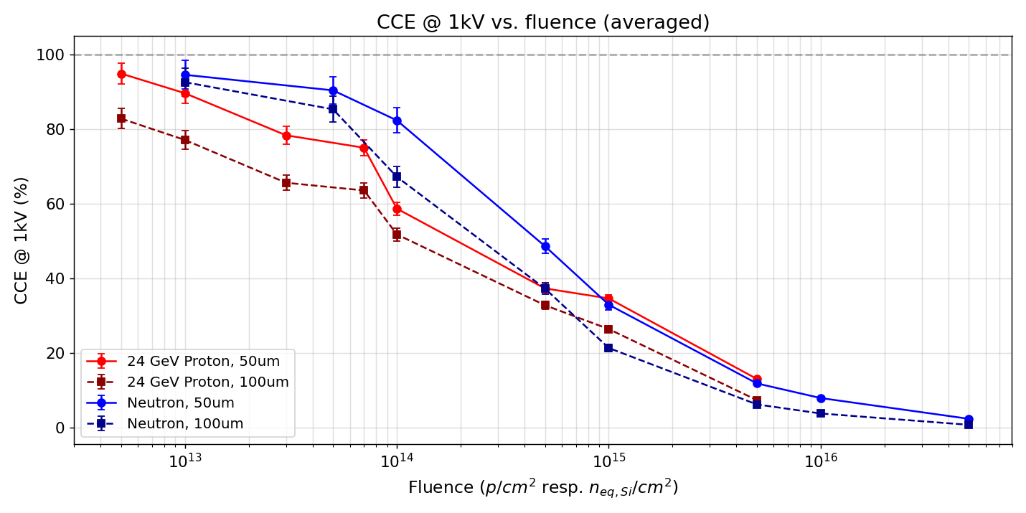

CCE vs. Fluence
UV laser 375nm
(237µm absorption length)
Cividec Cx-l
$$CCE=\frac{Q_{collected}}{Q_{deposited}}$$
CCE determined relative to unirradiated device @1kV
Lower CCE in 100um samples → likely an artifact
of partial depletion
Slightly stronger decline of CCE from 24GeV protons
(other way around in Si)
CSA
$$V_{ampl} ∝Q_{collected}$$
CCE measurement principle using a UV laser and
charge sensitive amplifier (CSA)

Slide 11
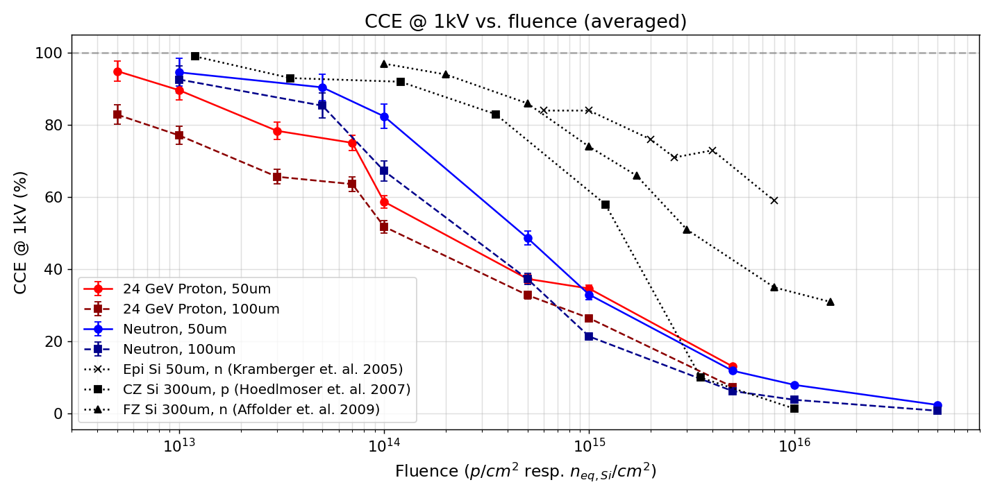
CCE: 4H-SiC vs. Si
4H-SiC falls below 50% by approx. one order of magnitude earlier than Si
⇒ In terms of charge collection, 4H-SiC PN diodes are not radiation harder than Si
50%

Slide 12
Summary
Large irradiation study on 4H-SiC PN-diodes: 181 diodes, 24 GeV protons & reactor neutrons, 2 epi thicknesses, fluences over >4 orders of magnitude
CV / doping: donor removal up to ~1e13; device then becomes semi-insulating (geometric capacitance)
Forward IV: turn-on shifts to higher voltage ⇒ progressive loss of rectification
Reverse IV: leakage stays remarkably low (<10 pA/mm²) up to 2e17; not described by the Si damage model (ΔI = αΦV)
CCE: drops below 50% roughly one order of magnitude earlier than Si
⇒ In terms of charge collection, 4H-SiC PN diodes are not radiation harder than silicon
  Bad news for HEP applications: MIP detection becomes very challenging ⇒ SiC LGADs
  Ion therapy and fusion: higher energy deposition of particles compensates for lower CCE i.e. low leakage and thermal robustness still offer significant advantages
Outlook: dataset feeds refinement of the Vienna TCAD damage model; hardness-factor / NIEL analysis follows (e.g. protons degrade CCE slightly faster); temperature dependent studies in the next step

Slide 13




Thank you!
This work was supported by the Austrian research promotion agency FFG, project number 883652.
Production and development of the 4H-SiC samples was supported by the Spanish State Research Agency (AEI) and the European
Regional Development Fund (ERDF), ref. RTC-2017-6369-3.
The production of the planar 6''-SiC samples has been supported in part by the RD50 collaboration (RD50-SiC-LGAD common project)
This project has received funding from the European Union’s Horizon Europe Research and Innovation programme under Grant Agreement No 101057511 (EURO-LABS)."
Special thanks to colleagues from CTU and FZU Prague for organizing the irradiation at CERN IRRAD and letting us participate with the devices irradiated as part of this study.

Slide 14
Back Up

Slide 15
Devices Under Test
181 total diodes included in study
  PN diodes
  3 areas: 3x3mm², 1x2mm², 1x1mm²
Irradiated using
  24 GeV protons (CERN IRRAD)
  Neutrons (JSI)
Fluence (p/cm² resp. n_{eq,Si}/cm²) | 5e12 | 1e13 | 3e13 | 5e13 | 7e13 | 1e14 | 5e14 | 1e15 | 5e15 | 1e16 | 5e16 | 2e17 | 5e17 | 1e18
24GeV Protons 50µm | 5 | 5 | 5 | - | 5 | 5 | 5 | 5 | 5 | - | - | - | - | -
24GeV Protons 100µm | 5 | 5 | 5 | - | 5 | 5 | 5 | 5 | 5 | - | - | - | - | -
Neutrons 50µm | 5 | 4 | - | 5 | - | 4 | 5 | 5 | 5 | 5 | 5 | 5 | 5 | 5
Neutrons 100µm | 6 | 4 | - | 6 | - | 4 | 6 | 4 | 6 | 4 | 6 | 5 | 5 | 5

Slide 16
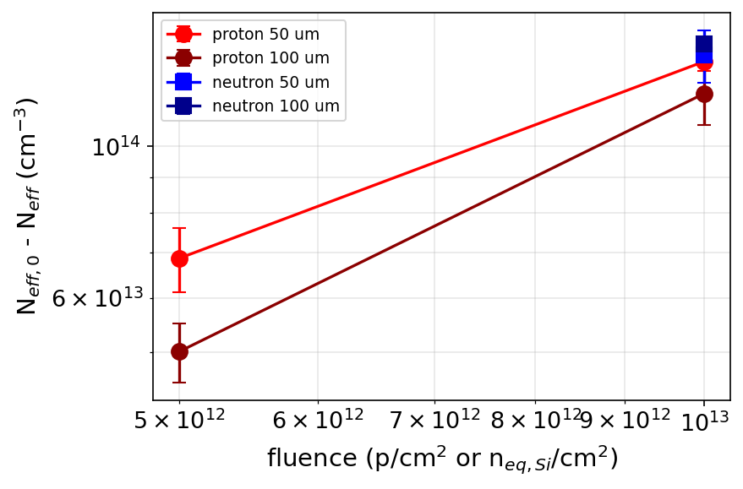
Donor Removal
CV curves flatten out after 3e13p/cm² resp. 5e13n_{eq,Si}/cm²
⇒ Decrease of effective doping concentration only visible up to 1e13/cm²
 | g (cm⁻¹) | Avg. N_{eff,0} (10¹⁴cm⁻³)
Protons 50µm | 13.4 ± 0.7 | 2.91 ± 0.15
Protons 100µm | 11.9 ± 1.9 | 5.00 ± 0.05
Neutrons 50µm | 13.6 ± 0.9 | 3.53 ± 0.11
Neutrons 100µm | 14.1 ± 0.7 | 3.78 ± 0.05

Slide 17
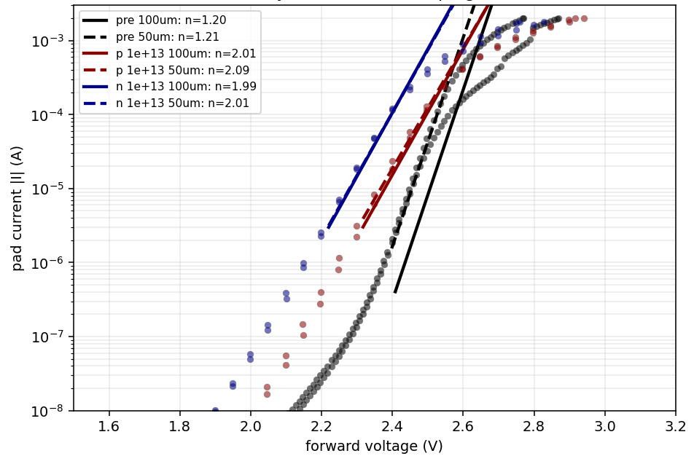
Forward IV - Ideality Factor
Ideality factor jumps from ~1.1-1.2 to ~2 within one fluence step
Ideality factor n | Pristine | 5E12 (p/cm² resp. n_{eq,Si}/cm²) | 1E13 (p/cm² resp. n_{eq,Si}/cm²)
Proton 50 µm | 1.19 ± 0.06 | 2.00 ± 0.03 | 2.10 ± 0.04
Proton 100 µm | 1.17 ± 0.01 | 1.93 ± 0.01 | 2.01 ± 0.04
Neutron 50 µm | 1.11 ± 0.11 | – | 2.01 ± 0.01
Neutron 100 µm | 1.13 ± 0.17 | – | 1.99 ± 0.04

Slide 18
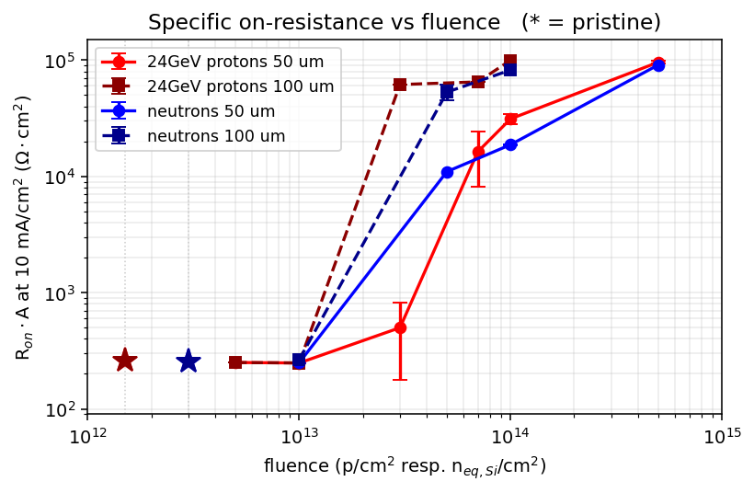
On-Resistance vs. Fluence
As the turn-on voltage grows beyond 1e13/cm² the on-resistance explodes
⇒ diodes become increasingly semi-insulating

Slide 19
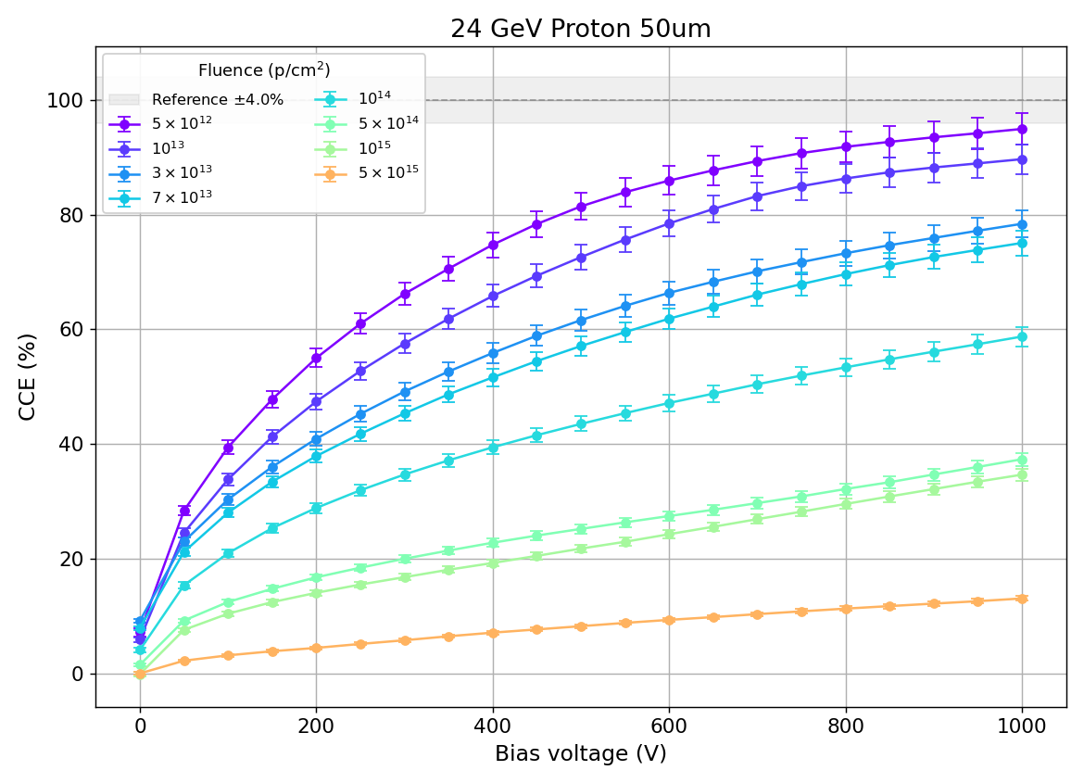
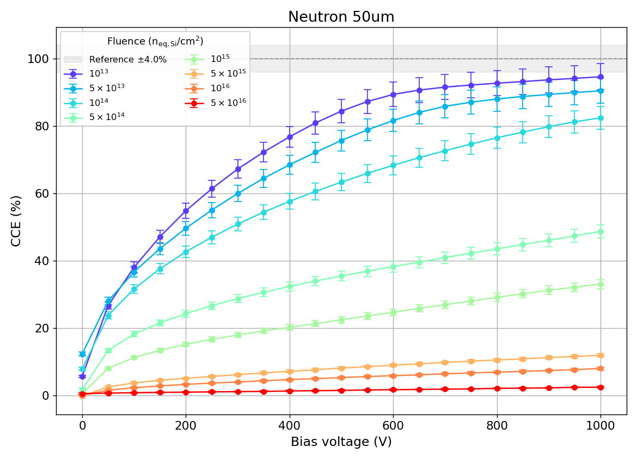
CCE vs. Fluence
$$CCE=\frac{Q_{collected}}{Q_{deposited}}$$
375nm laser (absorption length of ~237µm)
Charge information via Cividec Cx-L charge sensitive
amplifier
CCE determined relative to unirradiated device
UV laser
CSA
$$V_{ampl} ∝Q_{collected}$$
CCE measurement principle using a UV laser and
charge sensitive amplifier (CSA)

Slide 20
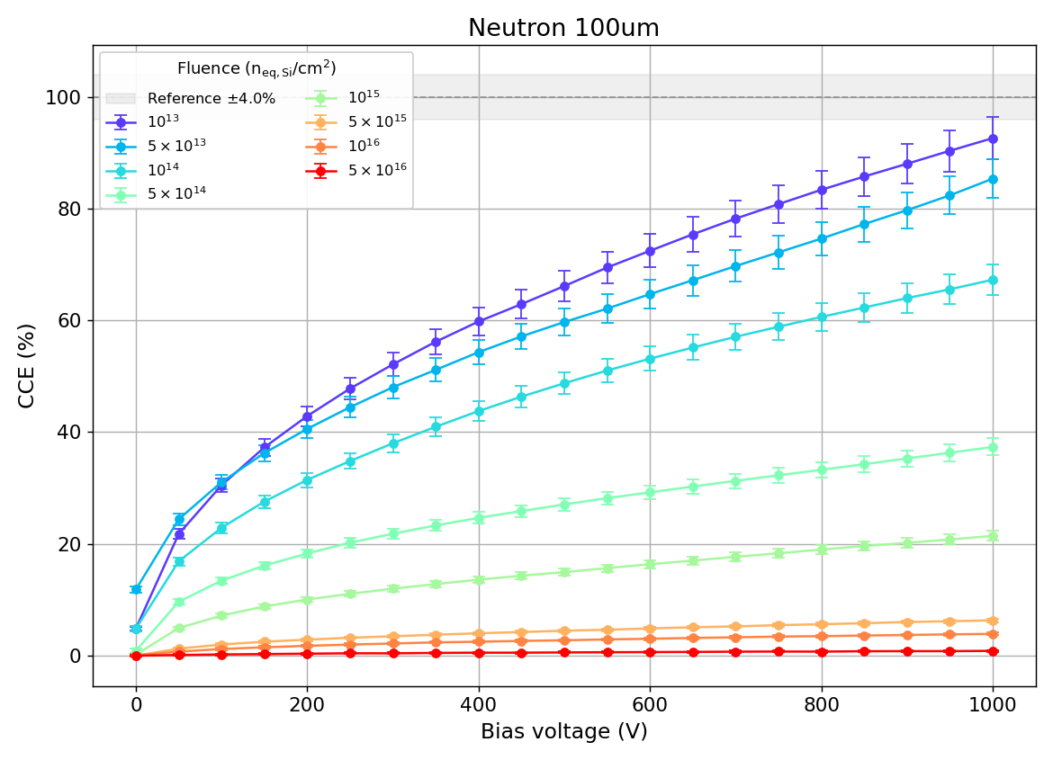
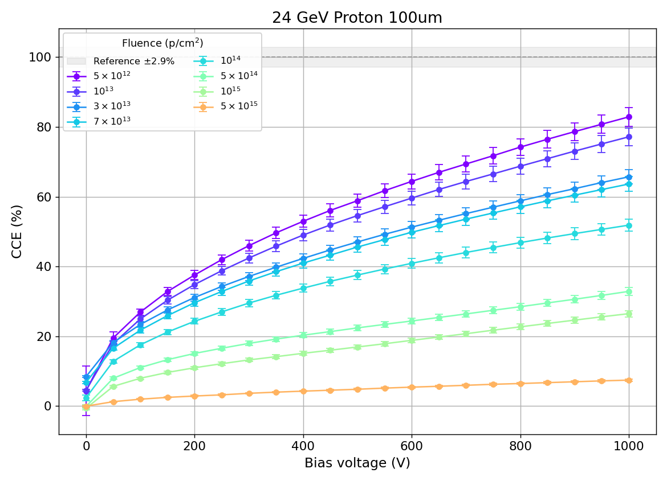
CCE at a Glance

Slide 21
Reverse IV at a Glance

Slide 22
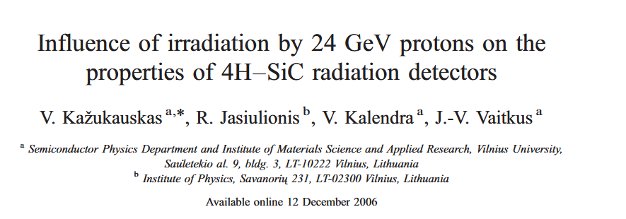
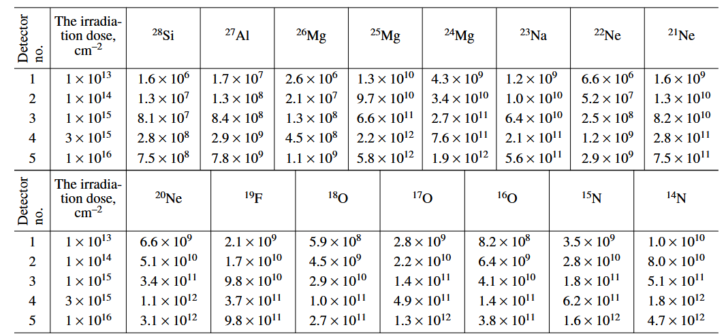
Damage by 24GeV Protons
Irradiation can change atomic composition of 4H-SiC
Neutrons:
  Main process: neutron capture
  Mainly turns Si and C into other Si and C isotopes
24GeV protons:
  Creates a large array of spallation products,
  see https://doi.org/10.1134/S1063782607030190
  Creates a concentration of
  ~1e13 to ~1e16/cm³ of stable isotopes
  across the probed dose range
  (1e13 to 1e16 p/cm²)
  Among the stable isotopes are e.g. N, Al, O, Na
  Radiation damage from protons potentially
  more complex than from neutrons

Slide 23
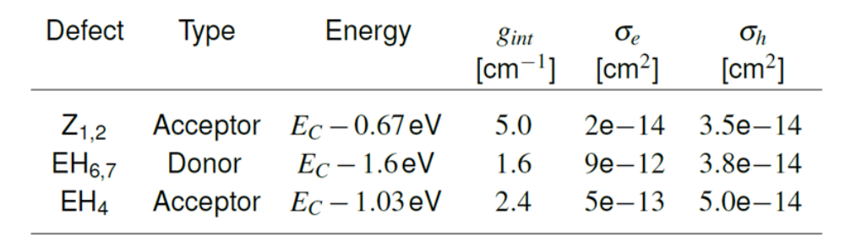
Radiation Damage Model
Radiation damage model (preliminary) via radiation induced traps for simulation in TCAD
Material and defect parameters deviate across literature:
  Initial guesses from literature
  Optimized by fitting simulation results to measurement
Qualitative agreement
I-V
C-V
(most significant trap levels)
P. Gaggl, et. al. (2024). TCAD modeling of radiation-induced defects in 4H-SiC diodes. NIM A, 170015. https://doi.org/10.1016/j.nima.2024.170015
J. Burin, et.al. (2024). TCAD Simulations of Radiation Damage in 4H-SiC. Austrochip 2024. https://doi.org/10.1109/Austrochip62761.2024.10716221.
Sebastian Onder Vienna Conference on Instrumentation 2025

Slide 24
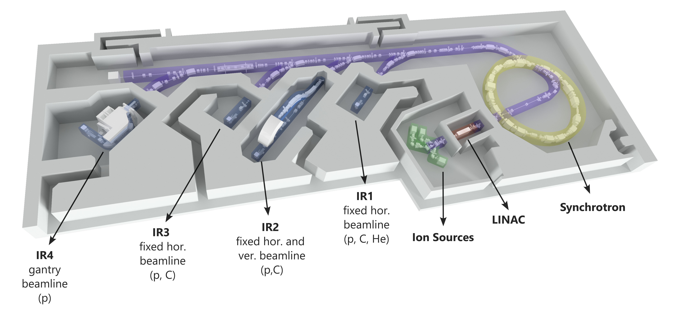

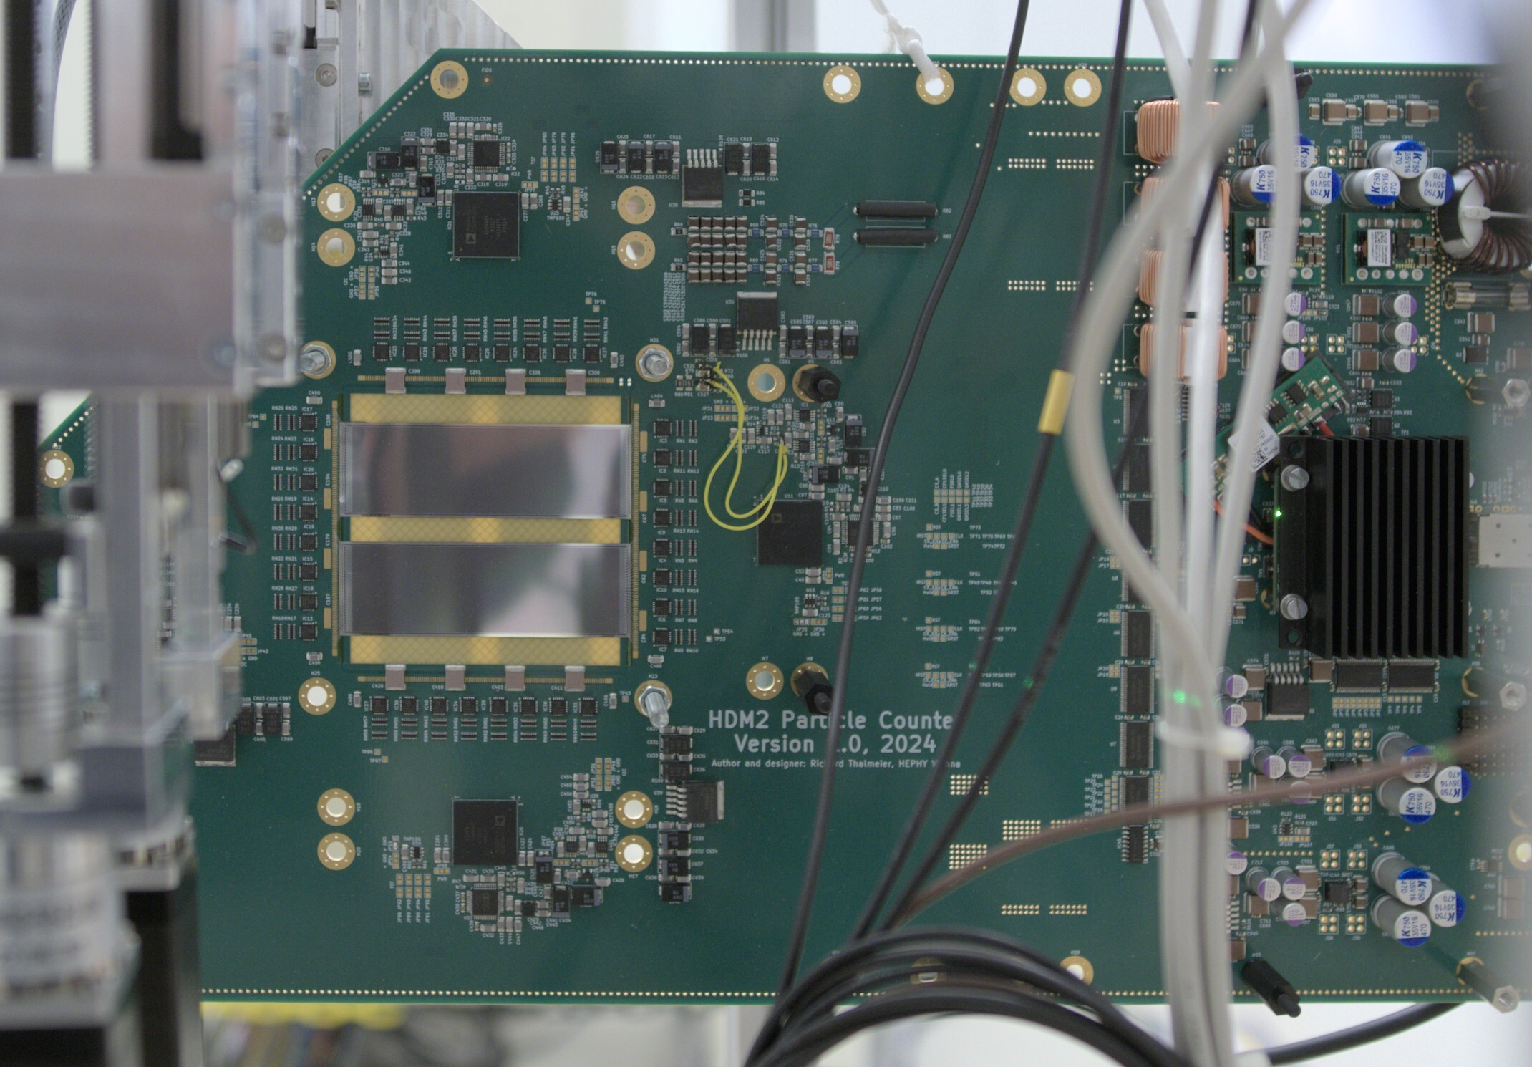
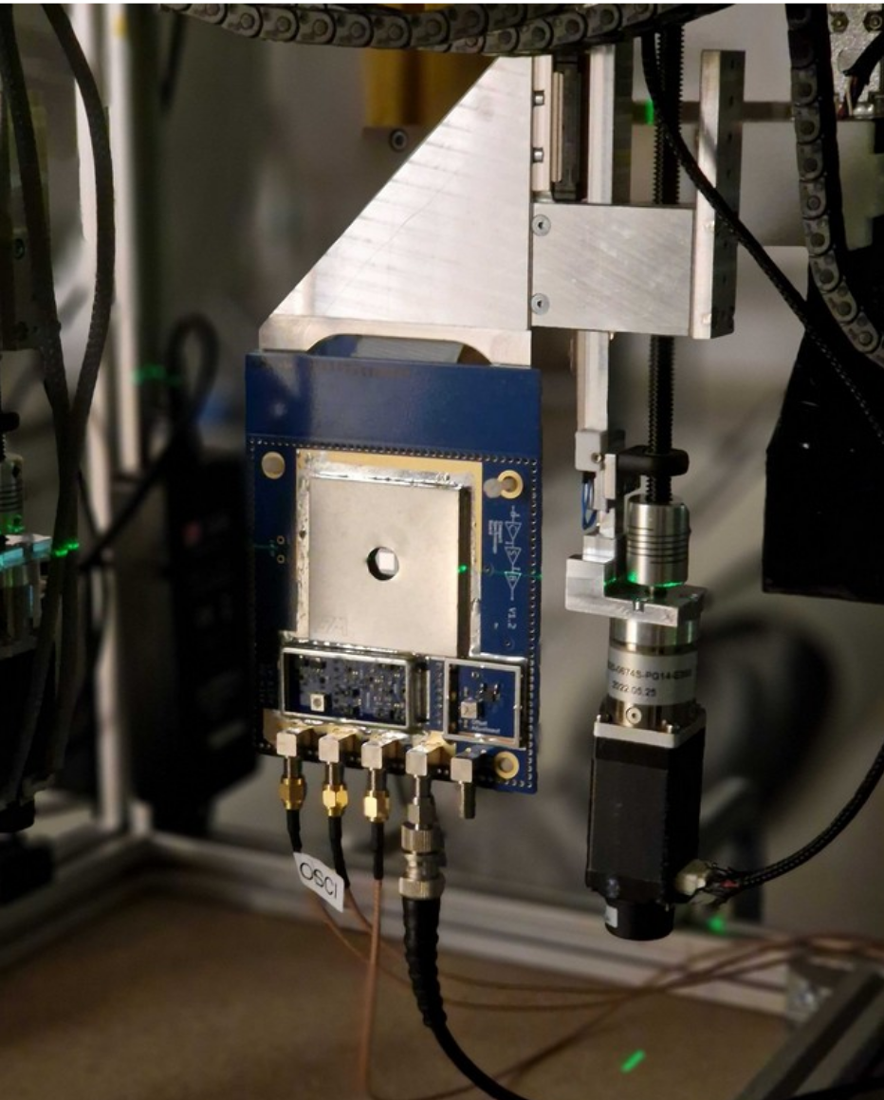
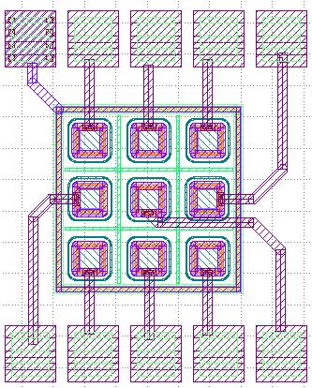
Medical Applications: Beam Monitor & Dosimetry
Collaboration Partner: ion beam radiotherapy center MedAustron
Low leakage currents, after irradiation and at room-temperature
⇒ DC readout
Insensitive to visible light, better tissue equivalence
Beam monitoring for clinical therapy beams (p⁺ and ¹²C)
Microdosimetry: single particle dose deposition on length scale of cells (<10µm) ⇒ thin sensors
UHDR beam monitor prototype (planar SiC sensor)
New SiC-based beam monitor for a wide dynamic beam
intensity range and FLASH-like beams in the future
Soon: SiC Microdosimeter
(50µm x 50µm pitch, 10µm epi)

Slide 25
CCE vs. Fluence
Lower CCE in 100um samples → likely an artifact of partial depletion
Slightly stronger decline of CCE from 24GeV protons (other way around in Si)

