Slide 1


Title Slide
Insights into CCD Trap Defects
from in-orbit trap pumping on the Euclid VIS instrument.
PSD14 Conference
Toby Wallage, David Hall, Jesper Skottfelt
Centre for Electronic Imaging, The Open University
September 2026

Slide 2
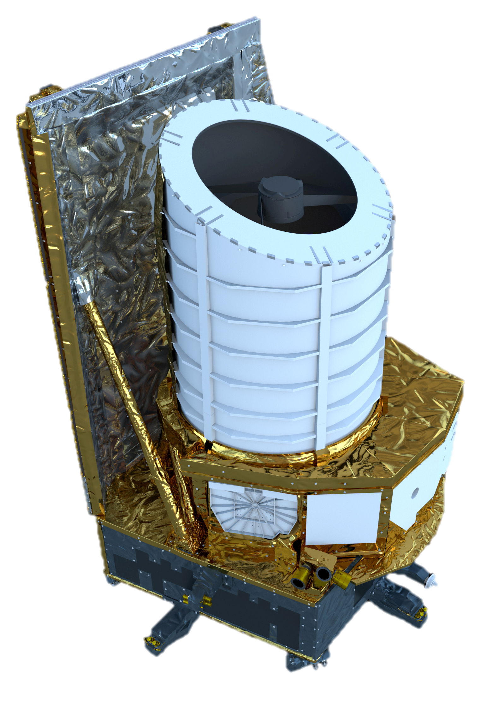
Euclid Space Telescope
Euclid Space Telescope
Model of Euclid
(Credit: ESA)
Euclid is an ESA space mission to ‘map the Dark Universe’.
The Visible Instrument (VIS) on board consists of 36 CCD273-84 ‘s from e2v.
It launched in July 2023 to orbit at L2
VIS will measure the shapes of galaxies, and distortions due to weak gravitational lensing.
Radiation damage creates trap defects that also affect the shape measurements
VIS Focal Plane array before launch.
(Credit: Cropper et al 2024)
Notes:
Detector looking at is Euclid Space telescope and in particular the Visible instrument on board
Science goal to Study Dark matter, by building a map of the distribution of mass in the universe by measuring the shapes of distant galaxies to detect weak gravitational lensing.
Located L2 where it joins other space telescopes like Gaia and James Webb.
Images shows example of strong lensing (an einstein ring) where a distant galaxy is behind the dense core of a nearby galaxy. Gravity bends the light rays from the distant galaxy, magnifying it and distorting it.
Most distant galaxies aren’t perfectly aligned behind foreground galaxies, however the light rays from them can still be distorted and magnified very slightly by gravity on their path to reach us. This is weak gravitational lensing.

Slide 3
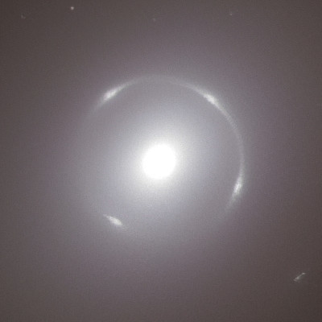
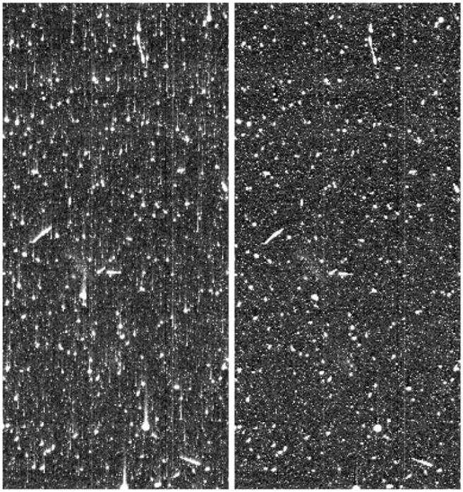
Euclid Space Telescope
Example of strong lensing discovered by Euclid in nearby Galaxy NGC 6505
(Credit: O’Riordan et al. 2025)
Euclid Space Telescope
Euclid is an ESA space mission to ‘map the Dark Universe’.
The Visible Instrument (VIS) on board consists of 36 CCD273-84 ‘s from e2v.
It launched in July 2023 to orbit at L2
VIS will measure the shapes of galaxies, and distortions due to weak gravitational lensing.
Radiation damage creates trap defects that also affect the shape measurements
Before Correction
After Correction
Charge smearing in HST images before and after correction.
(Credit: Massey et al. 2010)
Notes:
Detector looking at is Euclid Space telescope and in particular the Visible instrument on board
Science goal to Study Dark matter, by building a map of the distribution of mass in the universe by measuring the shapes of distant galaxies to detect weak gravitational lensing.
Located L2 where it joins other space telescopes like Gaia and James Webb.
Images shows example of strong lensing (an einstein ring) where a distant galaxy is behind the dense core of a nearby galaxy. Gravity bends the light rays from the distant galaxy, magnifying it and distorting it.
Most distant galaxies aren’t perfectly aligned behind foreground galaxies, however the light rays from them can still be distorted and magnified very slightly by gravity on their path to reach us. This is weak gravitational lensing.

Slide 4
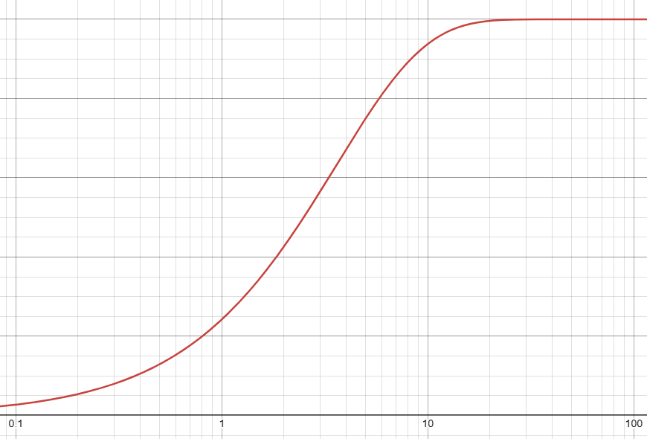



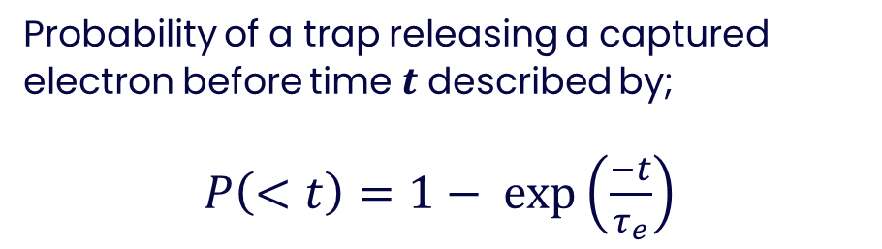
Trap Defects
Behaviour of trap defects described by Shockley-Read-Hall (SRH) theory.
Characteristic emission time constant $τ_{e}$ that depends on temperature and energy level of defect.
Before Correction
After Correction
Charge smearing in HST images before and after correction.
(Credit: Massey et al. 2010)
Probability of a trap releasing a captured electron before time $t$ described by;
$P\left(<t\right)=1− exp\left(\frac{−t}{τ_{e}}\right)$
$$P\left(<t\right)$$
$$t$$
Notes:
Behaviour of electron capture and release of trap defects described by Shockley-Read-Hall theory.
Traps can be described by a characteristic emission time constant, Tau, which itself depends on the energy level of the defect within the band gap and temperature (aswell as some other properties of the silicon).

Slide 5
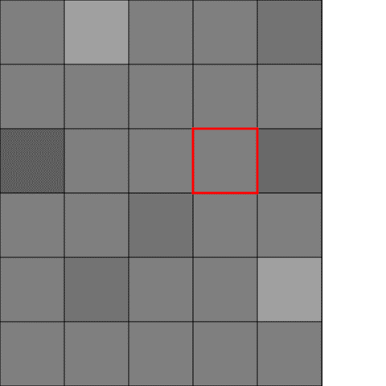
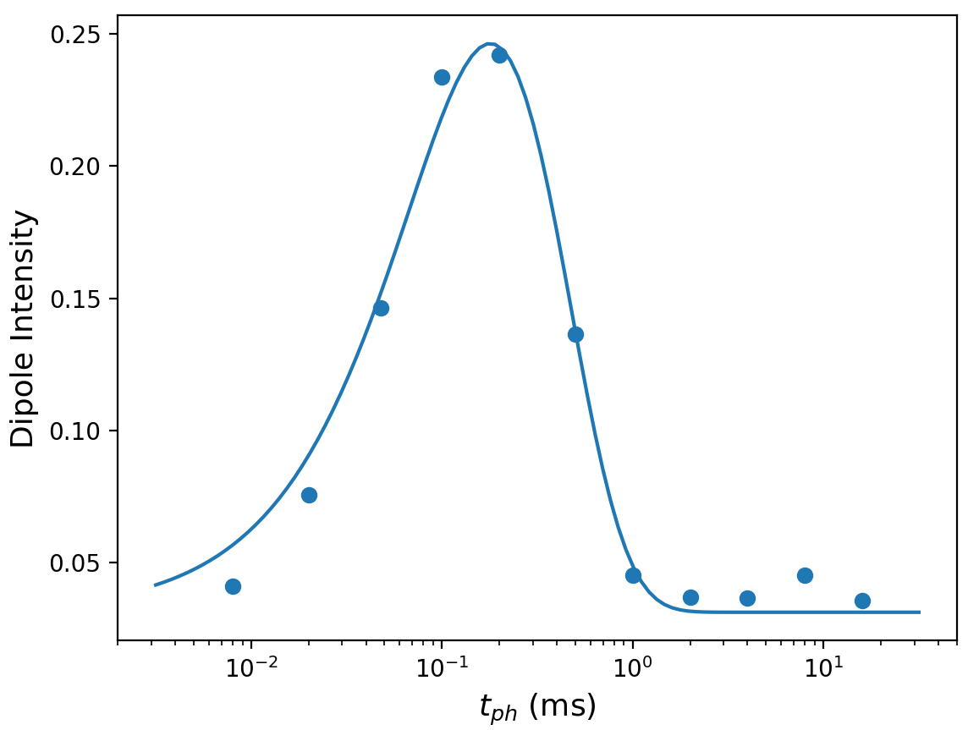
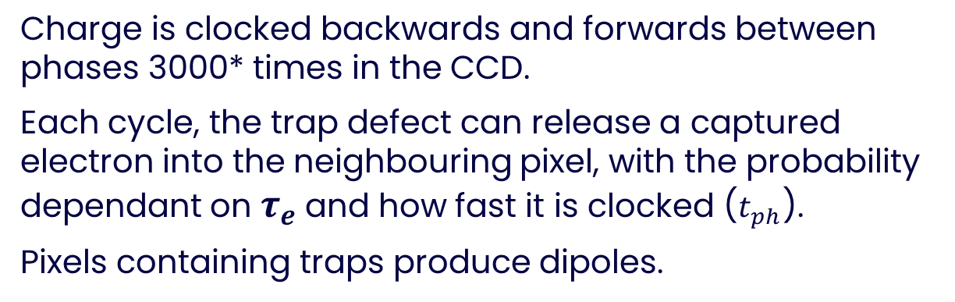
Trap Pumping
Charge is clocked backwards and forwards between phases 3000* times in the CCD.
Each cycle, the trap defect can release a captured electron into the neighbouring pixel, with the probability dependant on $τ_{e}$ and how fast it is clocked ($t_{ph}$).
Pixels containing traps produce dipoles.
Fitted Function
Dipole Intensity
Euclid Preliminary
Illustration of dipoles appearing during trap pumping by clock charge back and forth.
Example of a fitted dipole curve from Euclid data.
Notes:
The CCD is initially filled with charge,
This is then clocked backwards and forwards between the sub pixel phases a few thousand times with a period defined by the T PH value.
Each cycle, if the trap releases a captured during a specific time frame, it will end up in the neighbouring pixel.
After a few thousand cycles this accumulates into a dipole in pixels containing a defect. As indicated by the red square indicating a pixel containing a trap.
The intensity of this dipole depends on the emission time constant of the trap and how fast the charge was clocked back and forwards.

Slide 6


Trap Pumping
Each unique trap detected has a dipole curve which get fitted with this equation to find $τ_{e}$
$$I=N P_{c}\left(\exp\left(−\frac{t_{ph}}{τ_{e}}\right) −\exp\left(−\frac{2t_{ph}}{τ_{e}}\right)\right)$$
Fitted Function
Dipole Intensity
Euclid Preliminary
Illustration of dipoles appearing during trap pumping by clock charge back and forth.
Example of a fitted dipole curve from Euclid data.
Notes:
The intensity of this dipole depends on the emission time constant of the trap and how fast the charge was clocked back and forwards.
By repeating this several different clocking speeds, this T Ph value,
A dipole curve can be produced from the dipole intensities plotted against the clocking speeds.
This is fitted with this equation to extract the emission time constants of the defect.

Slide 7
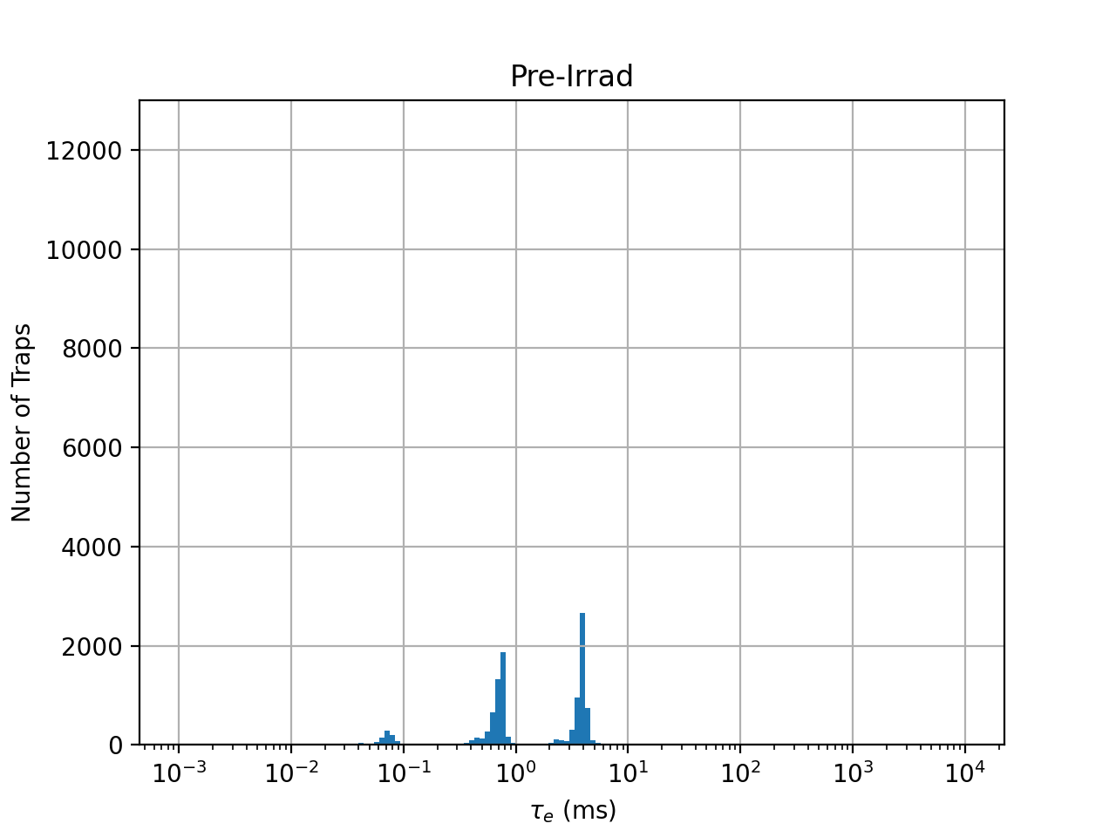
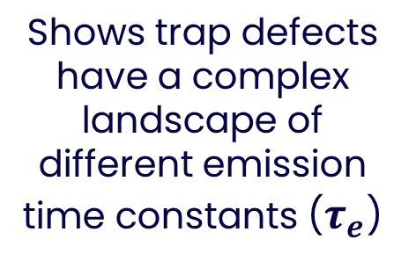
Pre-Launch Lab Testing
Note that the detector was kept cold throughout until near the end.
Shows trap defects have a complex landscape of different emission time constants ($τ_{e}$)
Trap defects ‘species’ from pre-irradiation intrinsic to CCD from manufacturing.
After irradiation, a new prominent peak appears along with a broad continuum of emission time constants.
Matches that expected for divacancy defect.
Notes:
Write down how to go from curve to distribution hists
Also data is cold

Slide 8
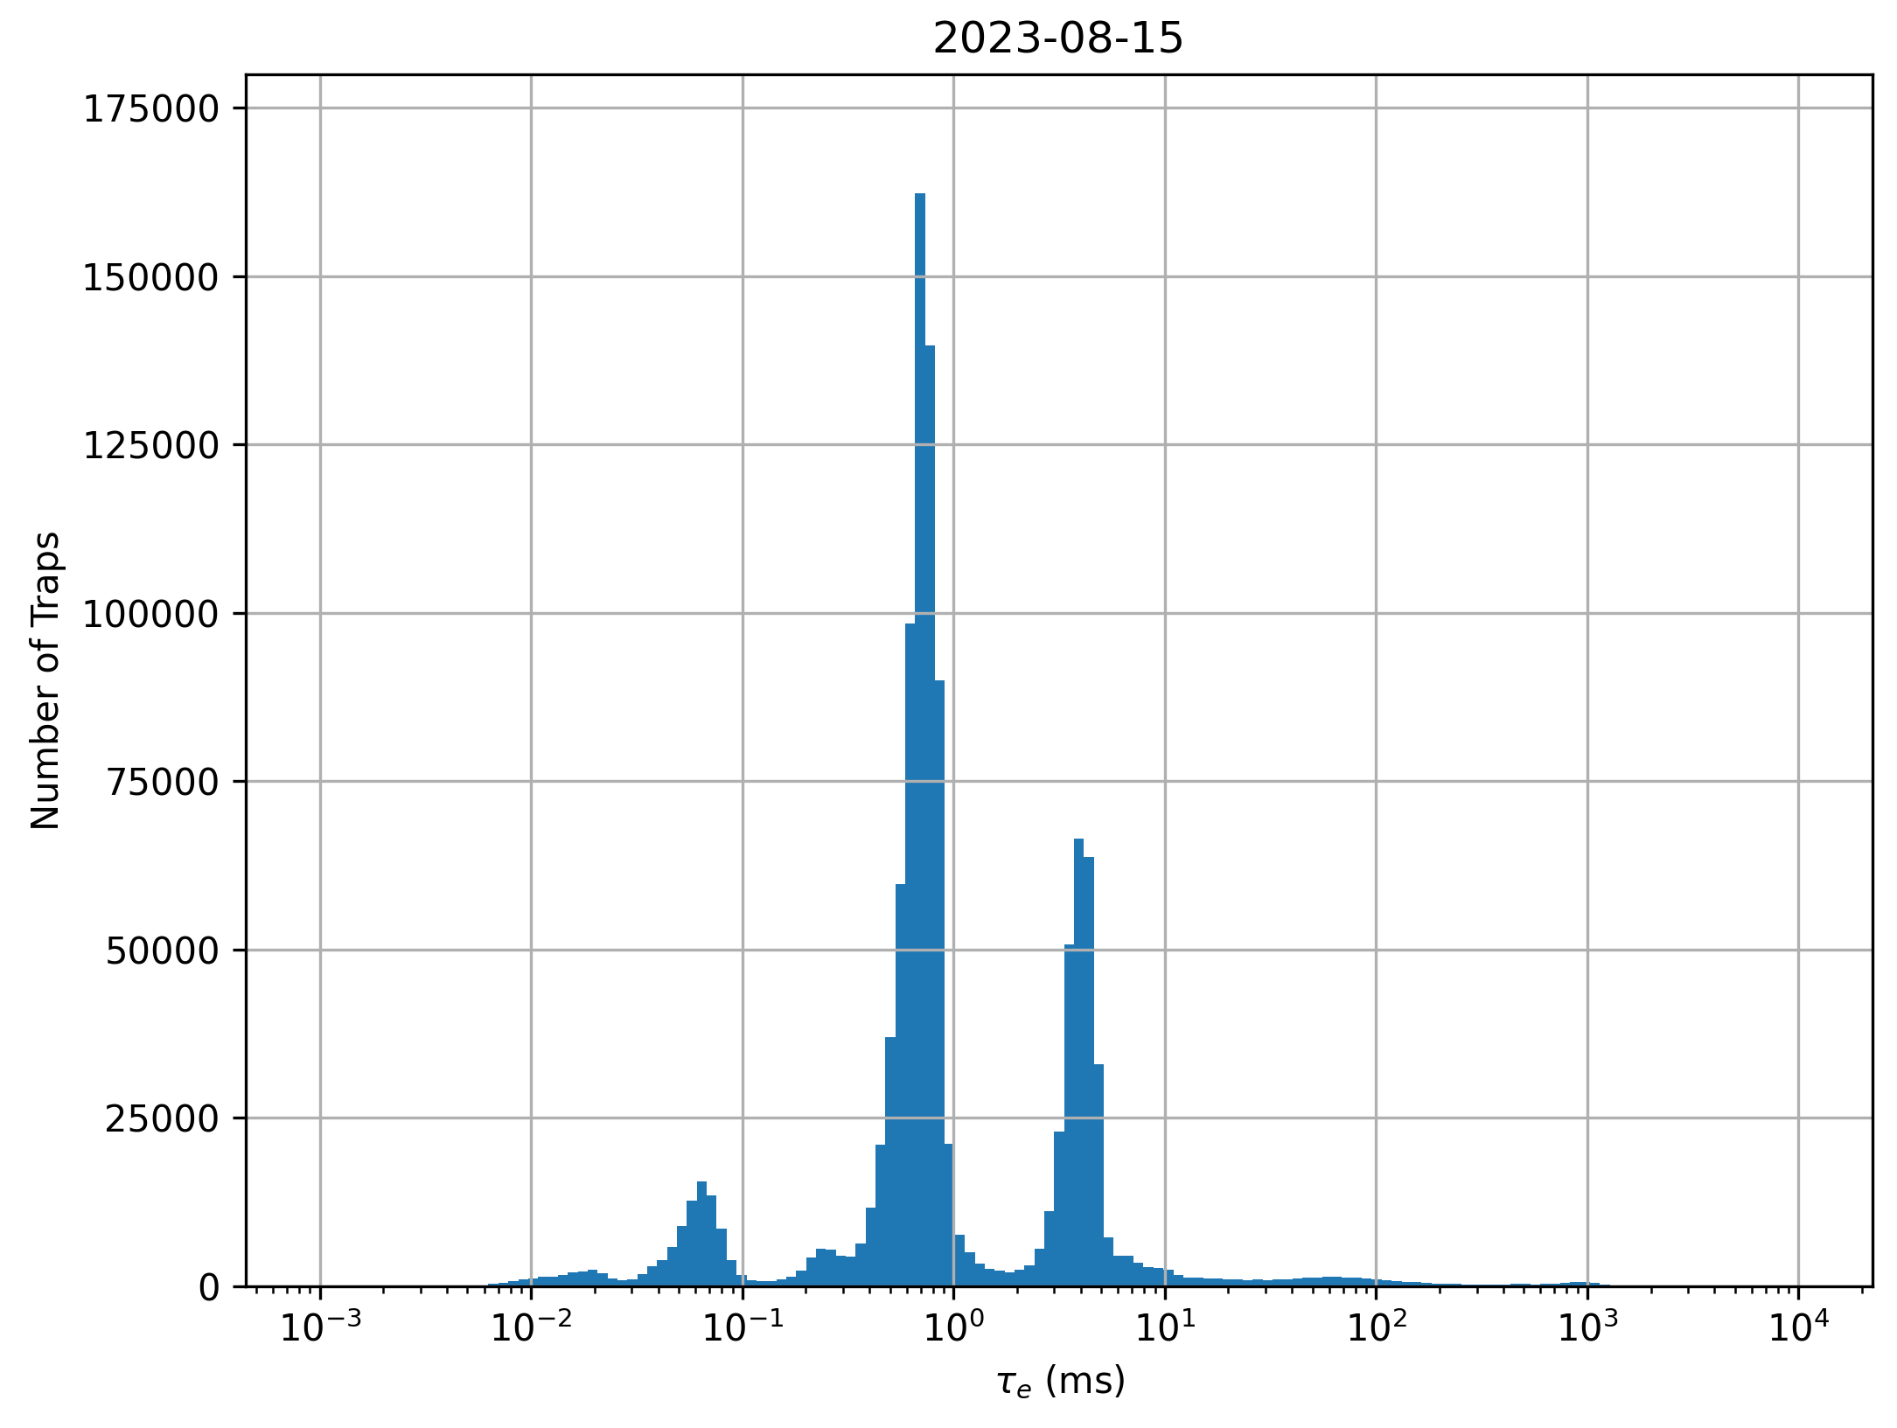
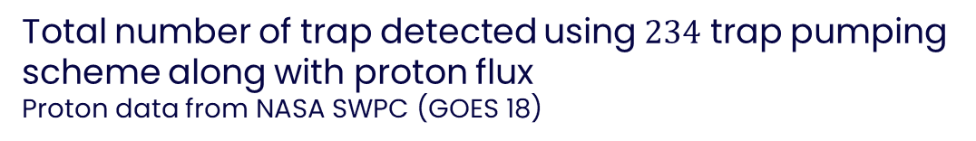
Solar Proton showers correspond to spikes in proton count and jumps in number of traps.
In-orbit Trap Pumping
Euclid Preliminary
Euclid Preliminary
Time in Orbit (days)
Total number of trap detected using $234$ trap pumping scheme along with proton flux
Proton data from NASA SWPC (GOES 18)
Animation of trap defect landscape evolving in orbit.
Notes:
The massive spike in proton flux corresponds to a massive solar flare and coronal mass ejection that occurred in January this Year.

Slide 9
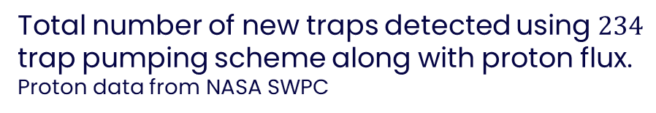
In-orbit Trap Pumping
Euclid Preliminary
Euclid Preliminary
Total number of new traps detected using $234$ trap pumping scheme along with proton flux. Proton data from NASA SWPC
Trap landscape from beginning of mission overlaid on top of latest data.

Slide 10
Difference Between Solar & GCR Traps
Seems to be two different sources of traps.
Sharp Jumps → Solar Energetic Particles
Steady Increase → GCRs?
Is there a difference in the trap defects created by these sources?
Euclid Preliminary
Notes:
Increase in number of new traps over time shows jumps due to solar events and a steady increase in-between presumable from galactic cosmic rays (from outside the solar system)
Can use trap pumping data to test for if there is a difference between trap defects created during these different sources
Grey regions shows the period of data considered for this, with the first data point corresponding to solar event traps and subsequent new traps being steady increase traps

Slide 11
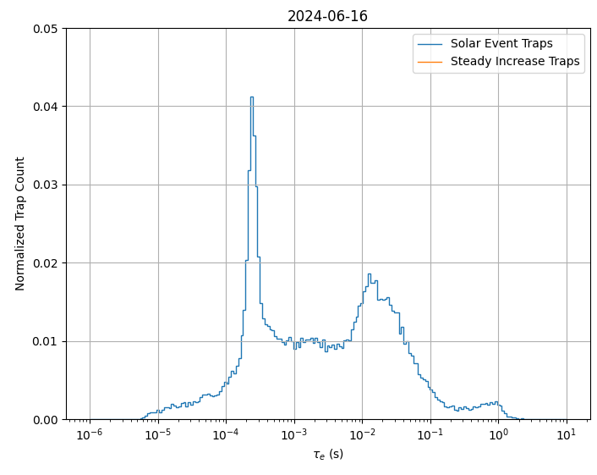
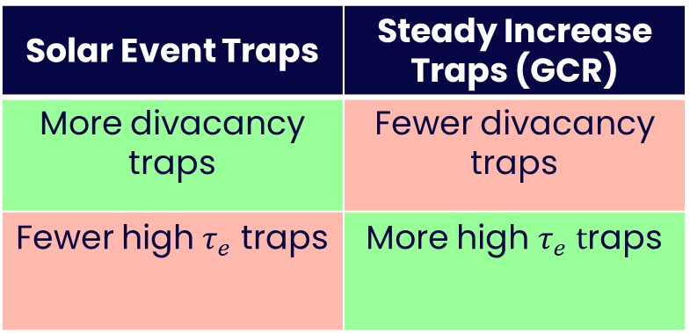
Difference Between Solar & GCR Traps
Comparing distribution of Emission time constants over time.
Euclid Preliminary
Solar Event Traps | Steady Increase Traps (GCR)
More divacancy traps | Fewer divacancy traps
Fewer high $τ_{e}$ traps | More high $τ_{e}$ $t$raps
Notes:
Comparing the distributions of emission time constants for these two subsets does seem to indicate a small difference.
No peaks due to intrinsic defects like previous histogram I showed, these are only traps created by radiation damage with di-vacancy peak etc.

Slide 12
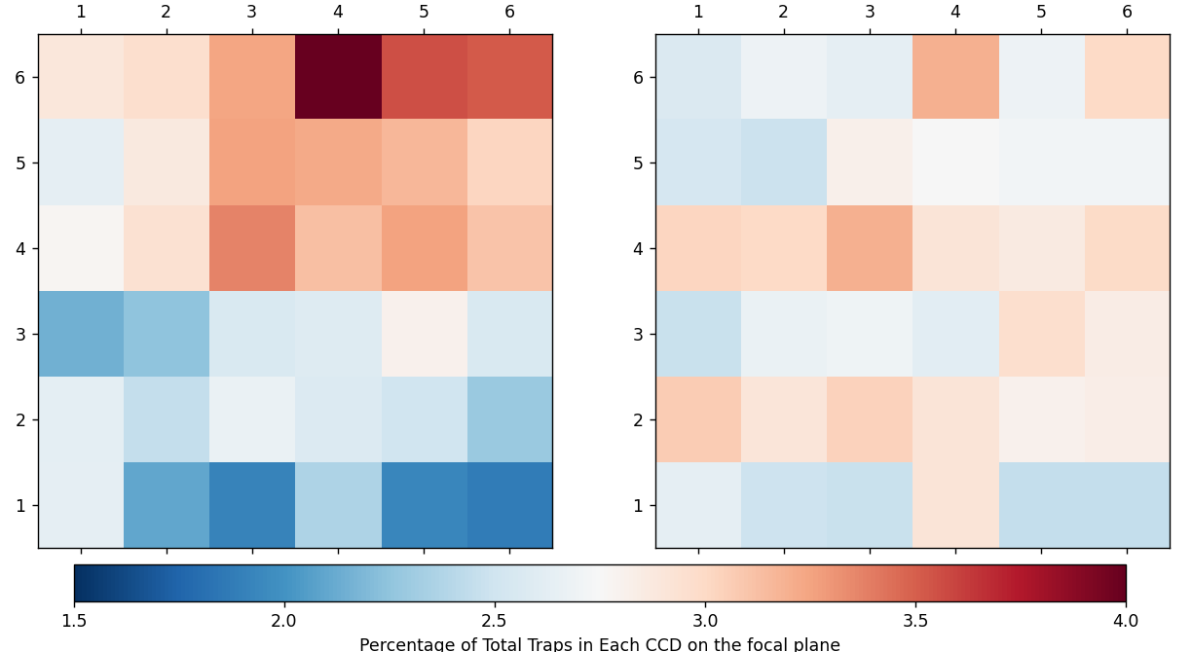
Difference Between Solar & GCR Traps
Solar Event Traps
GCR Traps
VIS Focal Plane array before launch. Credit: Cropper et al 2024
Distribution across 6x6 Focal plane array.
Solar events traps closely match the signal seen during a proton shower.
The steady increase traps are more uniformly distributed.
Euclid Preliminary
Notes:
Can also look at the distribution of these subsets across focal plane
The solar events traps mostly match that expected from the shield on Euclid
Whereas the GCR/steady increase traps are much more uniformly distributed basically confirming they are due to galactic cosmic rays which are much higher energies and will just punch through any shielding.

Slide 13
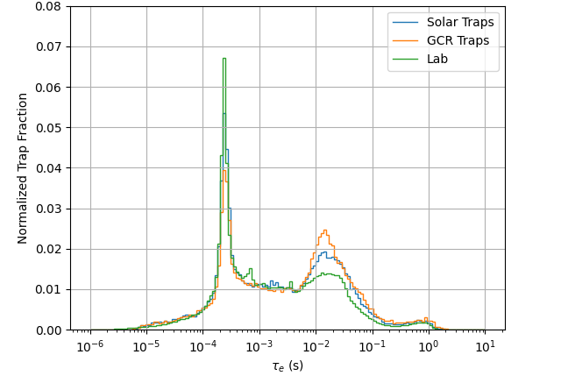
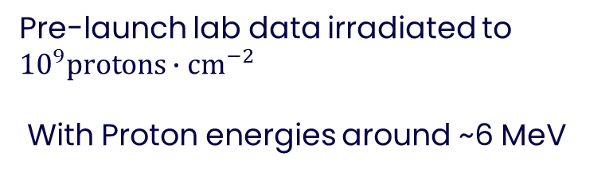
Comparison to Lab Data
Pre-launch lab data irradiated to ${10}^{9}\text{protons}∙{\text{cm}}^{−2}$
With Proton energies around ~6 MeV
Euclid Preliminary
Could difference be due to;
Rate of Defect creation
Or
Energy of particles creating the defects?
(Or something else entirely?)
Notes:
Compared to lab data, similar pattern seems to emerge.
Like a more exxagerated version of the Solar event traps.
Two ideas currently that could explain this.
The rate of defect creation, lab data is end of life dose over a few minutes, solar is over a few days, GCR is over a month or two
Maybe they are creating single vacancies two slowly for them to form into di-vacancies, leading to smaller di-vacancy peak?
Energy of the particles that are creating defects; lab data is around 6 MeV protons, solar event range about 10-50 MeV, and GCRs likely over 200 MeV
GCRs will also create more secondary radiation that may have it’s own effects.

Slide 14
Individual Trap Defects
Euclid Preliminary
Initial Dipole Curve
Latter Dipole Curve
Days Since First Detected
Trap randomly changes behaviour
Notes:
Serendipitously found this trap why looking through data.
Seems to be oscillating between two stable emission time constant.

Slide 15
Individual Trap Defects
Euclid Preliminary
Days Since First Detected
Seems to be oscillating randomly between two distinct emission time constants.
Notes:
Serendipitously found this trap why looking through data.
Seems to be oscillating between two stable emission time constant.

Slide 16
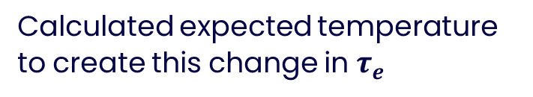
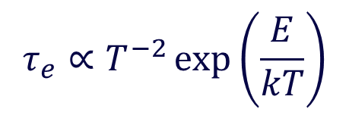
Individual Trap Defects
Is this oscillating due to temperature or something else?
$$τ_{e}∝T^{−2}\exp\left(\frac{E}{kT}\right)$$
Calculated expected temperature to create this change in $τ_{e}$
Euclid Preliminary
Notes:
Doesn’t appear to be caused by temperature
This is further supported by this pattern not appearing in any other traps I’ve looked at so far, which it is assumed would also be affected by these kinds of temperature changes.

Slide 17
Individual Trap Defects
Euclid Preliminary
Initially unstable emission time constant but reaches stable value. Seems to also randomly switch between two values.
Trap randomly jumps to new stable emission time constants a few times.
Euclid Preliminary

Slide 18
Slide Title 30
Thank you

Slide 19
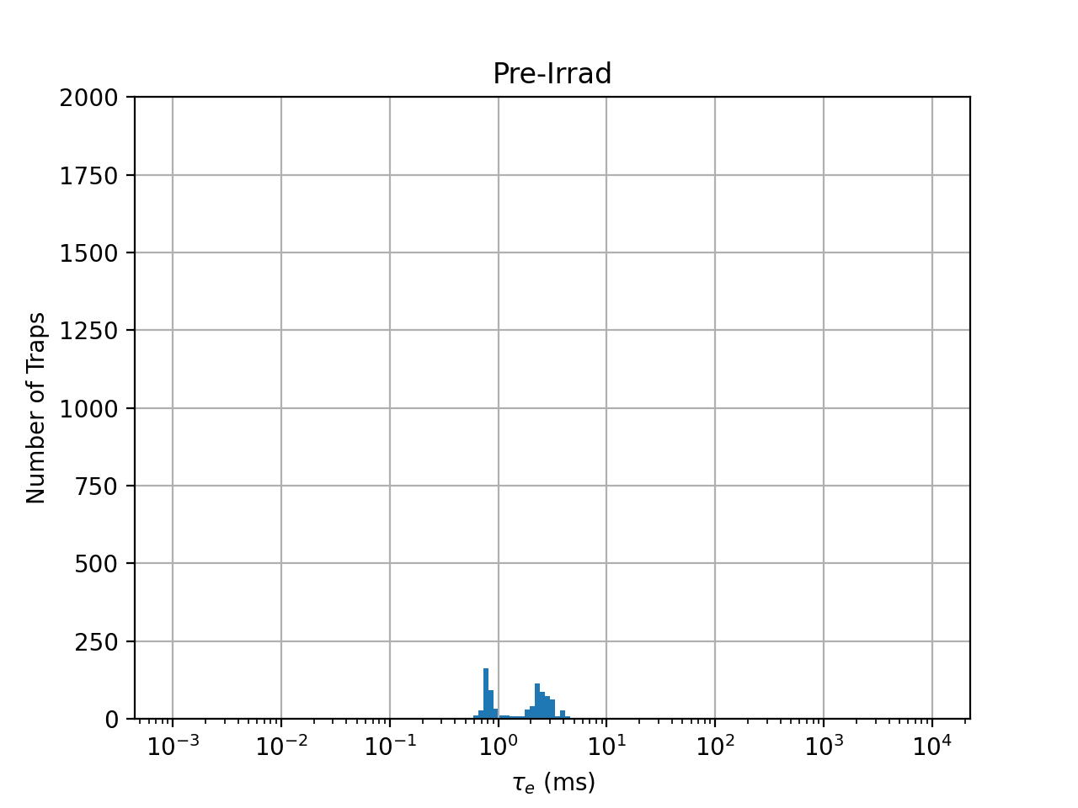

Appendix Slides
Pre-Launch Lab Testing
Monitoring how a small subset of $τ_{e}$ value evolve over time
Not quite as simple as radiation induced traps annealing into stable divacancy trap defects.
Notes:
Todo - Move appendix

Slide 20
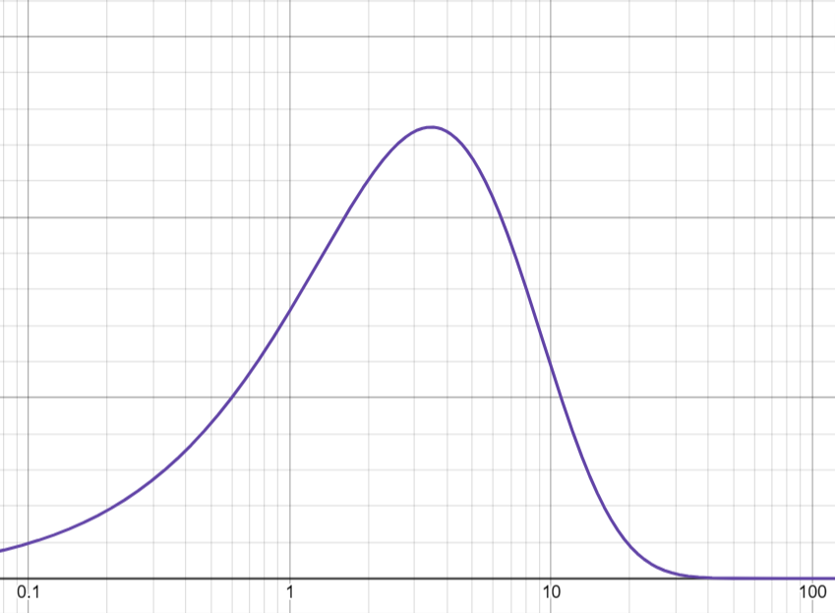
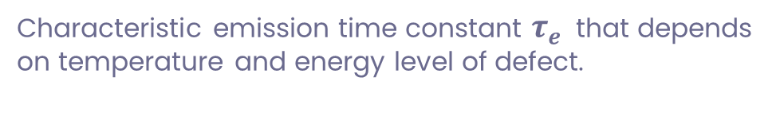


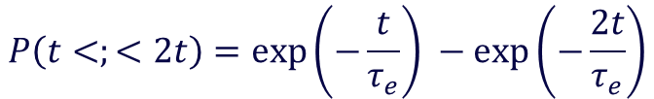

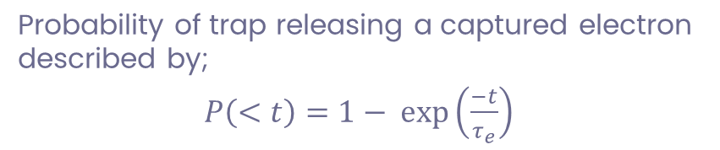

Appendix Slides
Trap Defects
Characteristic emission time constant $τ_{e}$ that depends on temperature and energy level of defect.
$$P\left(<t\right)$$
Probability of trap releasing a captured electron described by;
$P\left(<t\right)=1− exp\left(\frac{−t}{τ_{e}}\right)$
$$t$$
Probability for trap to release captured electron within a specific time window is described by;
$$P\left(t<;<2t\right)=\exp\left(−\frac{t}{τ_{e}}\right) −\exp\left(−\frac{2t}{τ_{e}}\right)$$
$$P\left(t<;<2t\right)$$
$$t$$

Slide 21
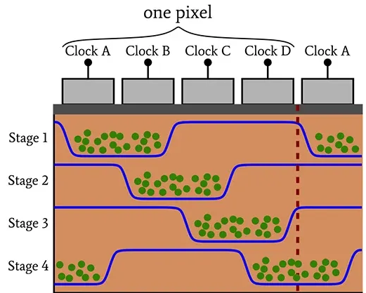


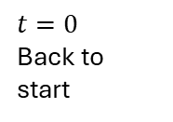


Appendix Slides
Trap Pumping
Phases within Pixel
4` | 1 | 2 | 3 | 4 | 1` | 2`
Charge packet
$$t=0$$
Neighbouring pixel charge packet
$$t=t_{ph}$$
$$t={2t}_{ph}$$
$$t={3t}_{ph}$$
$$t=0$$
Back to start
Illustration of CCD electrodes and electron wells
(credit allpcb.com)

Slide 22
Appendix Slides
Trap Pumping
Phases within Pixel
4` | 1 | 2 | 3 | 4 | 1` | 2`
Charge packet
Trapped electron
$$t=0$$
$$t=t_{ph}$$
$$t={2t}_{ph}$$
$$t={3t}_{ph}$$
$$t=0$$
Back to start

Slide 23
Appendix Slides
Trap Pumping
Phases within Pixel
4` | 1 | 2 | 3 | 4 | 1` | 2`
Charge packet
Trapped electron
Electron released into same charge packet
No Pumping Occurs
$$t=0$$
$$t=t_{ph}$$
Electron Released into neighbouring pixel
Pumping Occurs
$$t={2t}_{ph}$$
$$t={3t}_{ph}$$
$$t=0$$
Back to start

Slide 24
Appendix Slides
Trap Pumping
Phases within Pixel
4` | 1 | 2 | 3 | 4 | 1` | 2`
Charge packet
Trapped electron
Electron released into same charge packet
No Pumping Occurs
$$t=0$$
$$t=t_{ph}$$
Electron Released into neighbouring pixel
Pumping Occurs
$$t={2t}_{ph}$$
$$t={3t}_{ph}$$
Depending on location of trap. Pumping can also occur on return.
$$t=0$$
Back to start

Slide 25
Appendix Slides
Trap Pumping
Phases within Pixel
4` | 1 | 2 | 3 | 4 | 1` | 2`
Charge packet
Trapped electron
Electron released into same charge packet
No Pumping Occurs
$$t=0$$
$$t=t_{ph}$$
Electron Released into neighbouring pixel
Pumping Occurs
$$t={2t}_{ph}$$
$$t={3t}_{ph}$$
Depending on location of trap. Pumping can also occur on return.
$$t=0$$
Back to start

