Slide 1


Run 3 experience with the ALICE ITS2: operation, performance and lessons learned
Jian Liu (University of Liverpool)
on behalf of the ALICE Collaboration
The 14th International Conference on Position Sensitive Detectors
1-4 September 2026, Queen Mary University of London, London, UK

Slide 2
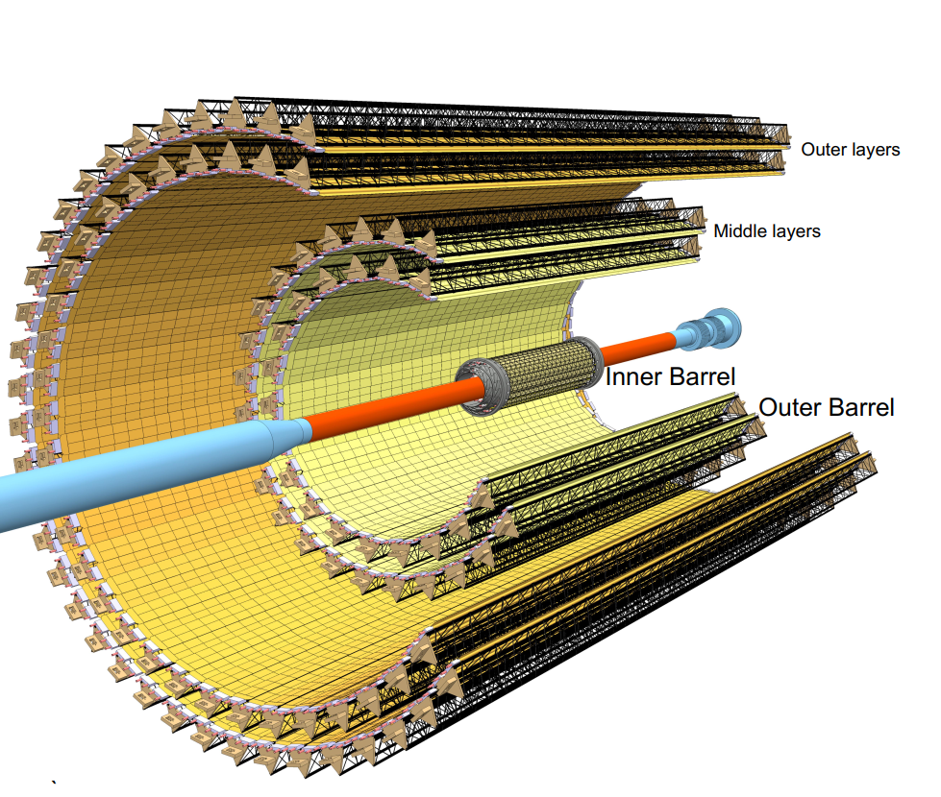
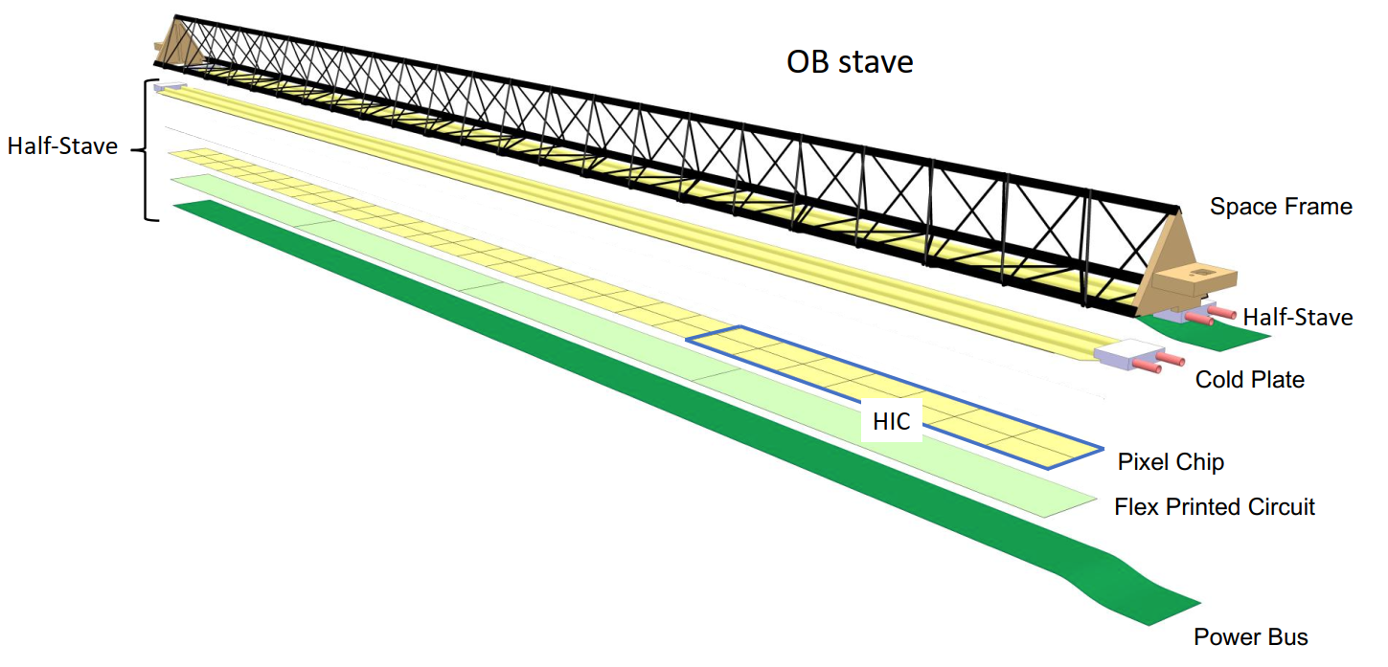
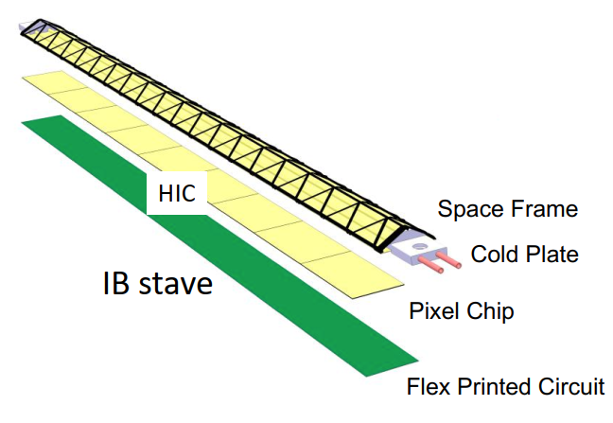
Inner Tracking System upgrade (ITS2)
Major upgrades completed for ALICE during LHC Long Shutdown 2 (2019 - 2021)
Motivation and goal
  High-precision measurements of rare probes at low p_{T}
  Continuous readout of all Pb–Pb interactions at rates up to 50 kHz
  Pb-Pb integrated luminosity > 10 nb⁻¹ in Run 3 and Run 4
  Improved vertex reconstruction and tracking capabilities
ITS2 at a glance
  Seven layers of Monolithic Active Pixel Sensors (MAPS): ~10 m² and 12.5 billion pixels
  23 mm innermost radius and 0.36% (X_0) per Inner Barrel layer
  Get closer to IP: 39 mm → 23 mm
  Reduce material budget:
    1.14% X₀ → 0.36% X₀ per layer (inner layers)
  Reduce pixel size: 50 x 425 µm² → 29 x 27 µm²
  Increase number of track points: 6 → 7 layers
ALICE upgrades during the LHC Long Shutdown 2, JINST 19 P05062
Technical Design Report for the Upgrade of the ALICE Inner Tracking System, J. Phys. G: Nucl. Part. Phys. 41 087002

Slide 3
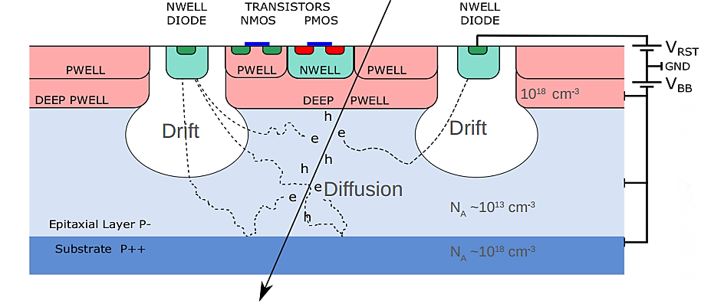
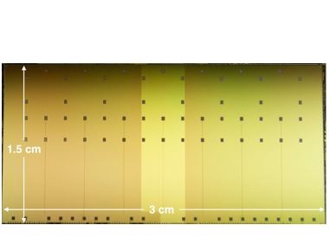
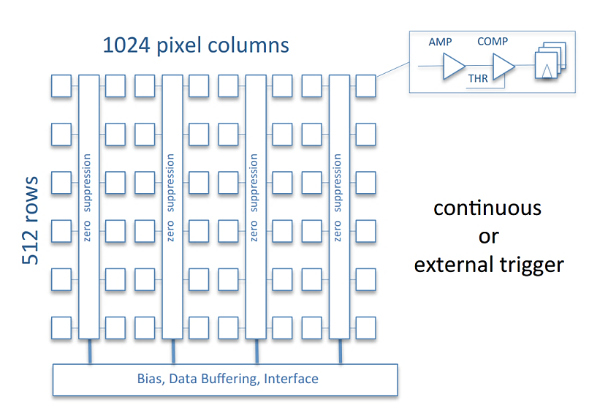
ALPIDE: ALICE PIxel DEtector
ALPIDE technology features:
TowerJazz 180 nm CiS Process
Deep p-well implementation available → full CMOS
High resistivity (>1 kΩ·cm), 25 μm thick, p-type epi-layer
Possibility to apply reverse-substrate bias
Smaller charge collection diode
→ lower capacitance → higher S/N
Substrate can be thinned down
Sensor specification:
Pixel pitch: ~27 μm x 29 μm → spatial resolution: ~5 µm
Priority Encoder Readout
Power consumption: 47.5 mW/cm² (IB) and 35 mW/cm² (OB)
Integration time: < 10 µs
Fake-hit rate: << 10⁻⁶ /pixel/event
Readout bandwidth up to 1.2 Gbit/s (IB) and 400 Mbit/s (OB)
Continuous or triggered readout
IB: 50 ∝m thick
OB: 100 ∝m thick

Slide 4
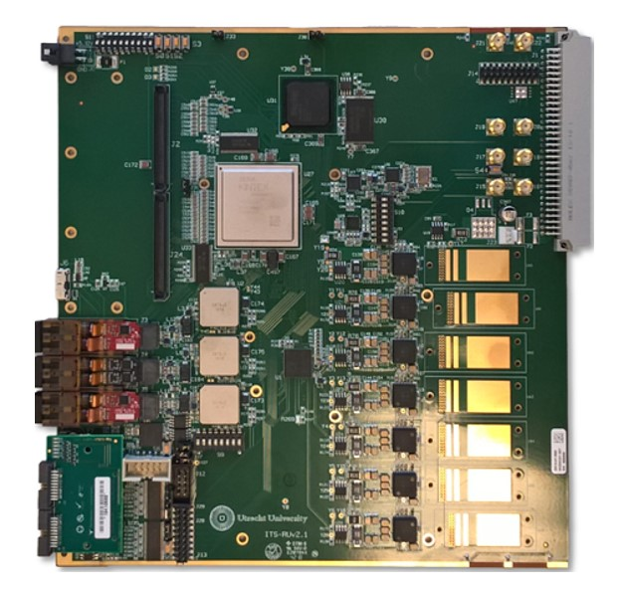
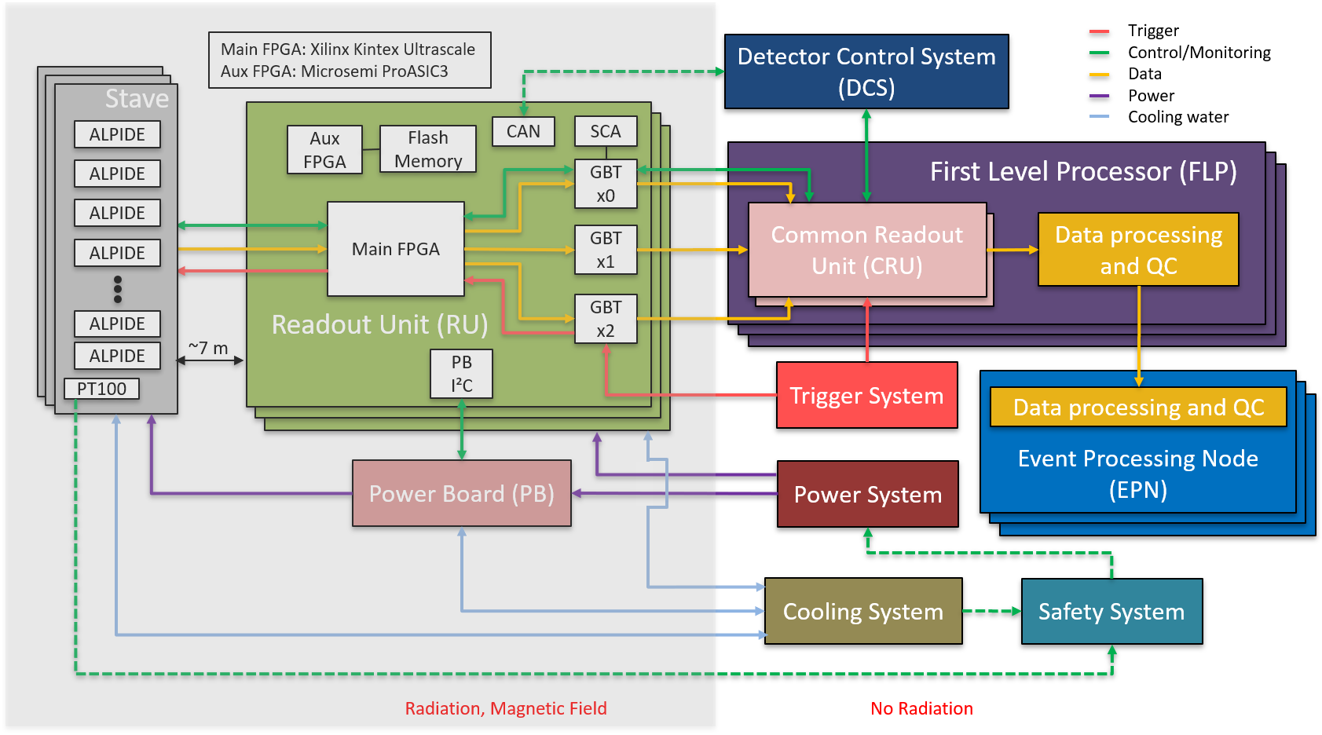
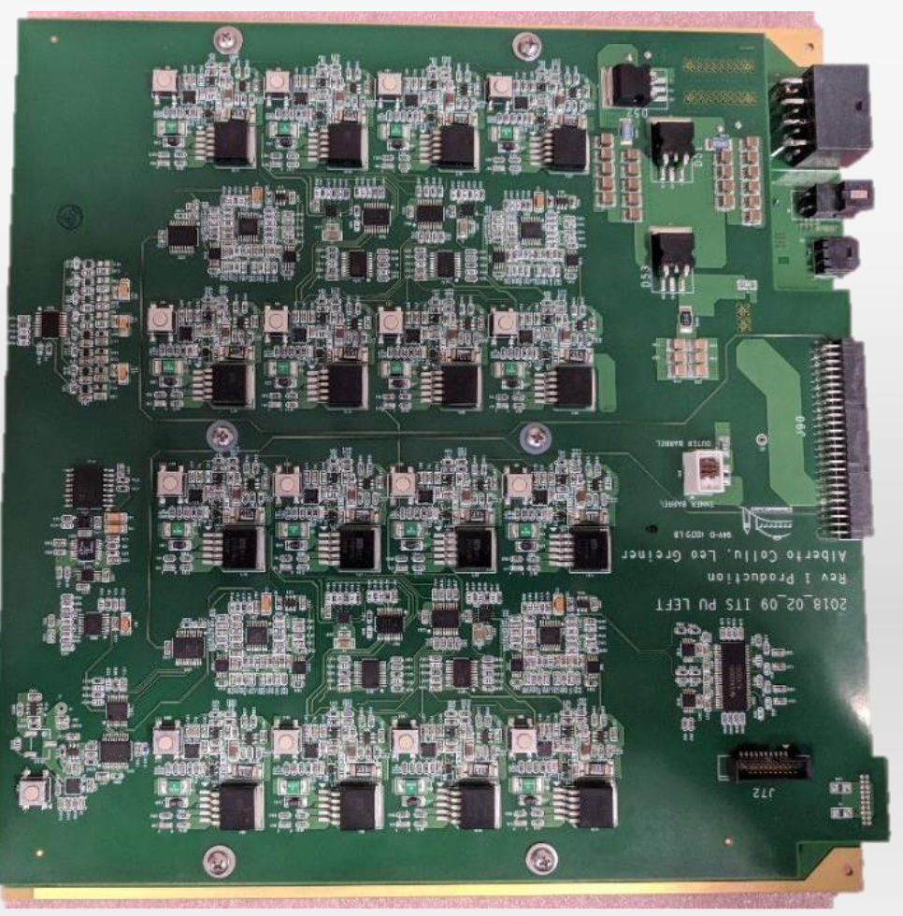
﻿ITS2 system architecture
Readout Unit (RU)
Power Board (PB)
Electrical links and power cables (~7 m) connect the detector to the RU
FPGA in the radiation environment controls the detector, packages the data, performs electrical-to-optical conversion via the Versatile Link, and manages powering

Slide 5
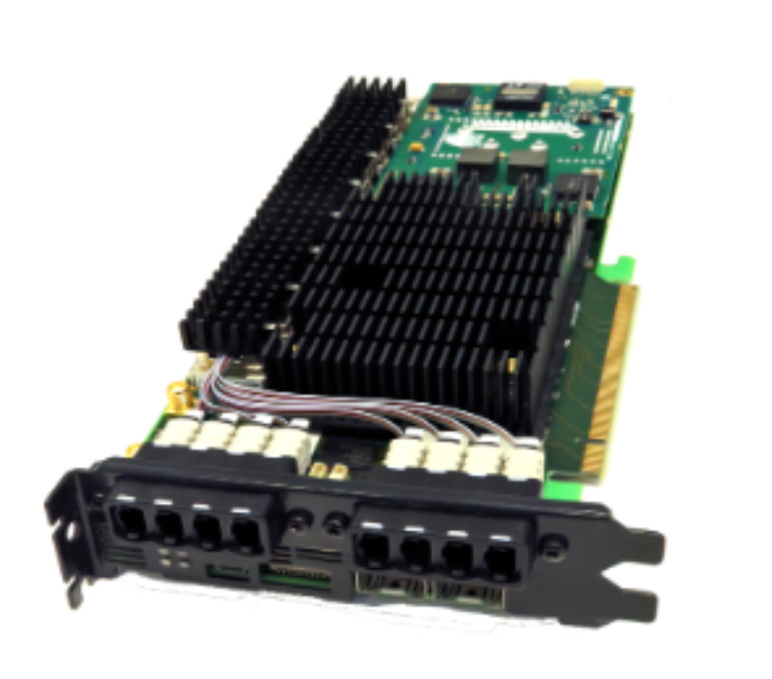
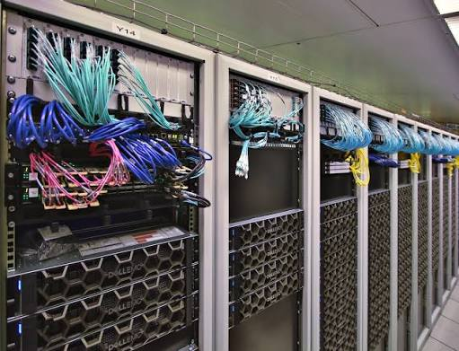
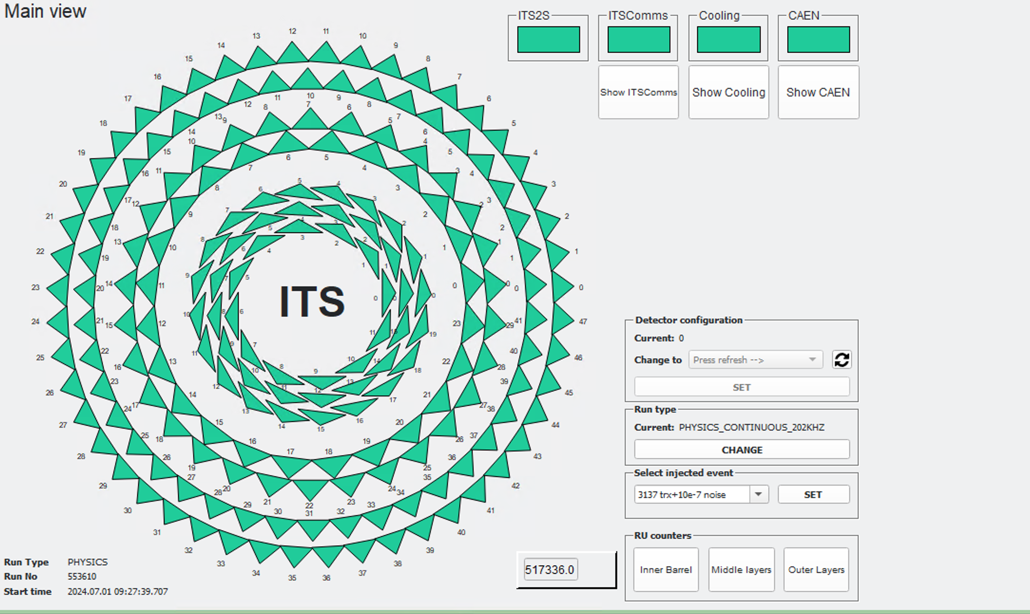
﻿ITS2 system architecture
First Level Processors (FLPs)
Common Readout Unit (CRU)
Main DCS UI
Connects to 22 CRUs hosted on 13 FLPs for raw data processing
Detector Control System (DCS) communicates with the detector via CRU and RU

Slide 6
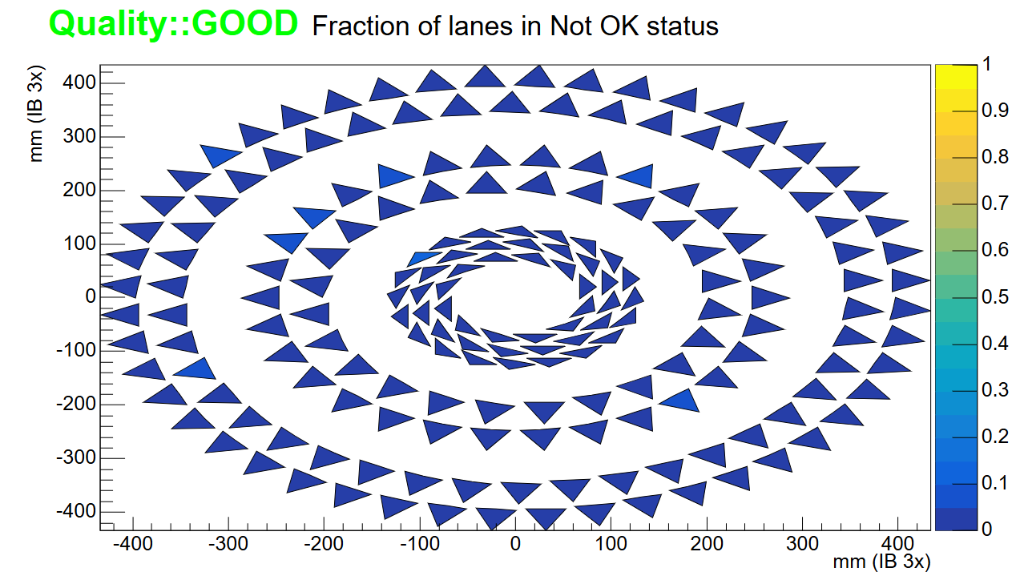
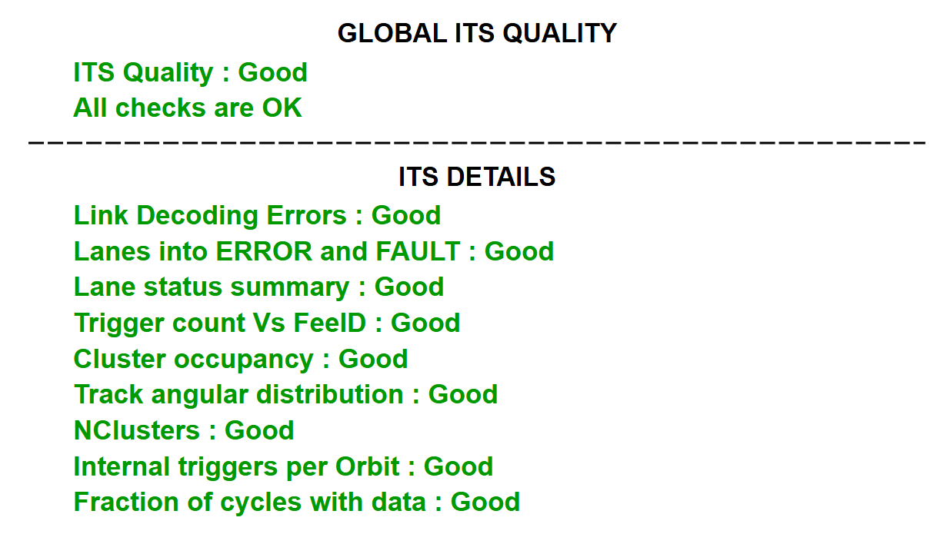
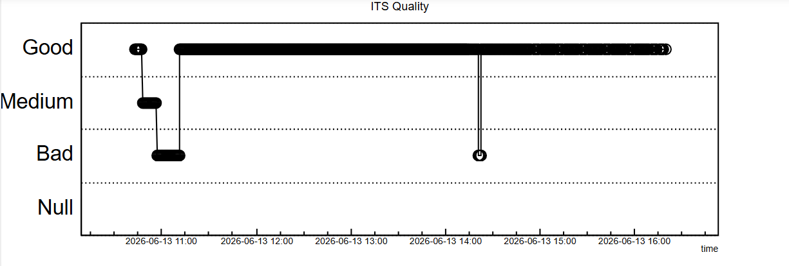
﻿ITS2 system architecture
Example QC plots
Synchronous/asynchronous event reconstruction and detector calibrations on EPNs
Dedicated QC tasks to monitor data quality in data taking and calibration scans
See Svetlana Kushpil’s poster: "Inner Tracking System 2 (ITS2) - Data Quality Control and Calibration"

Slide 7
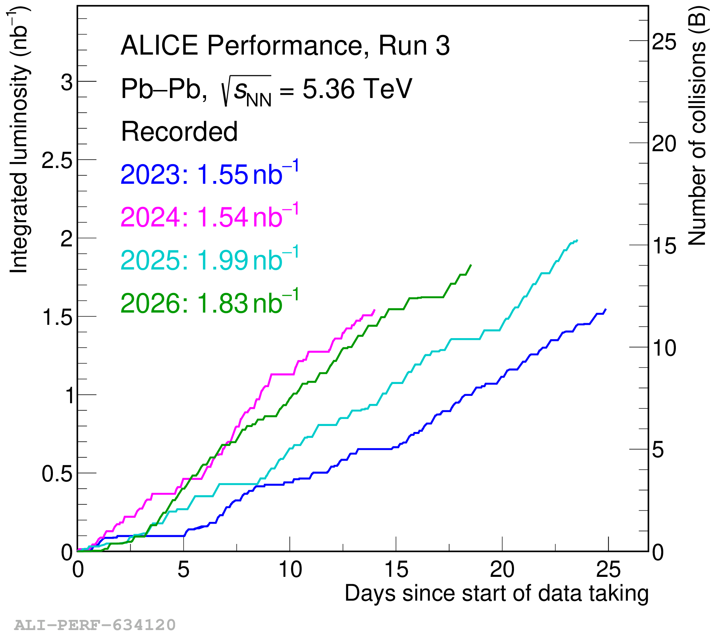
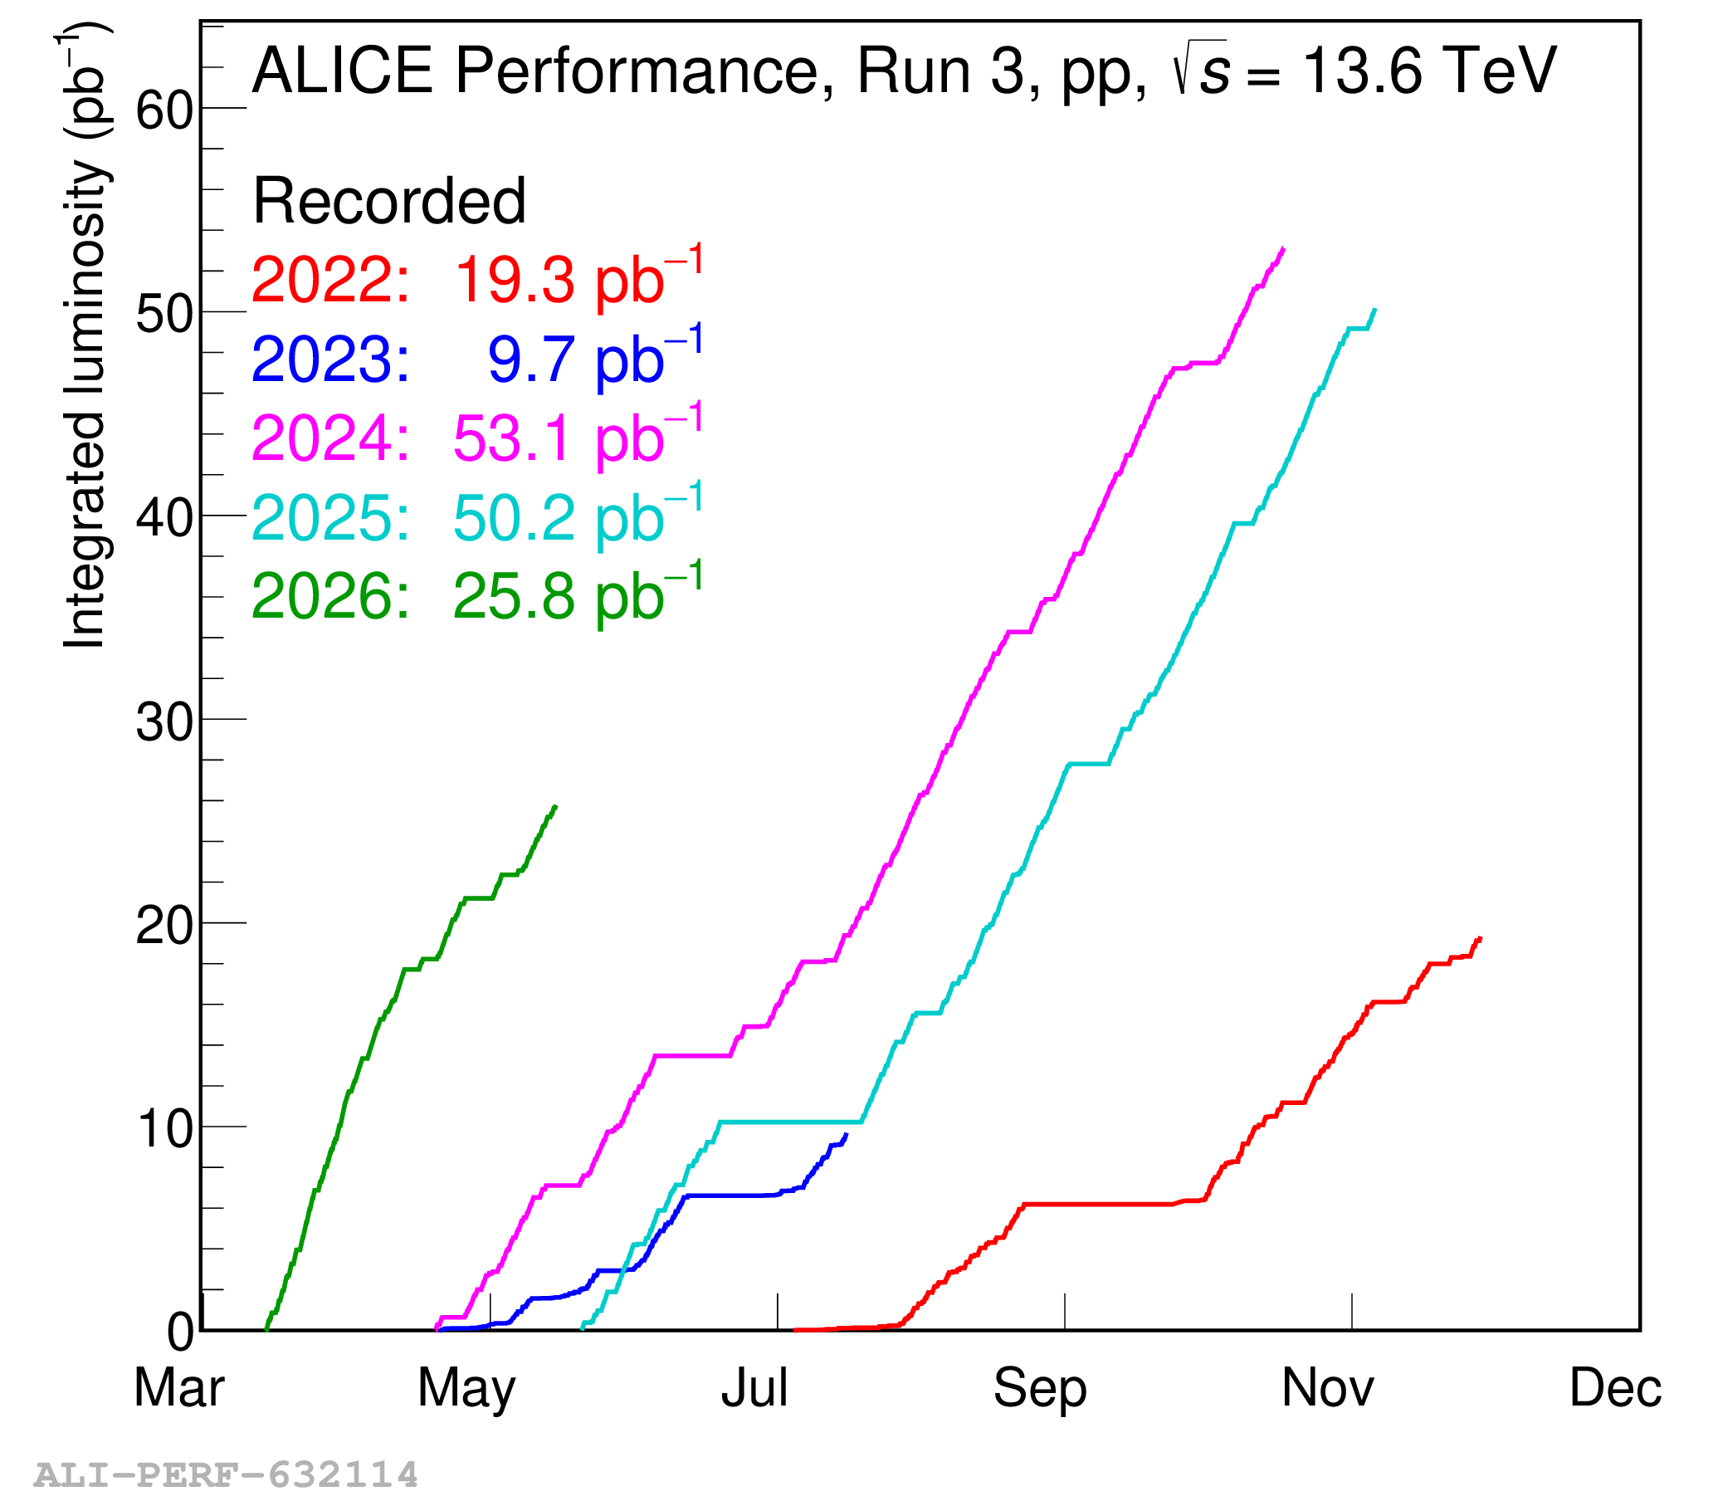
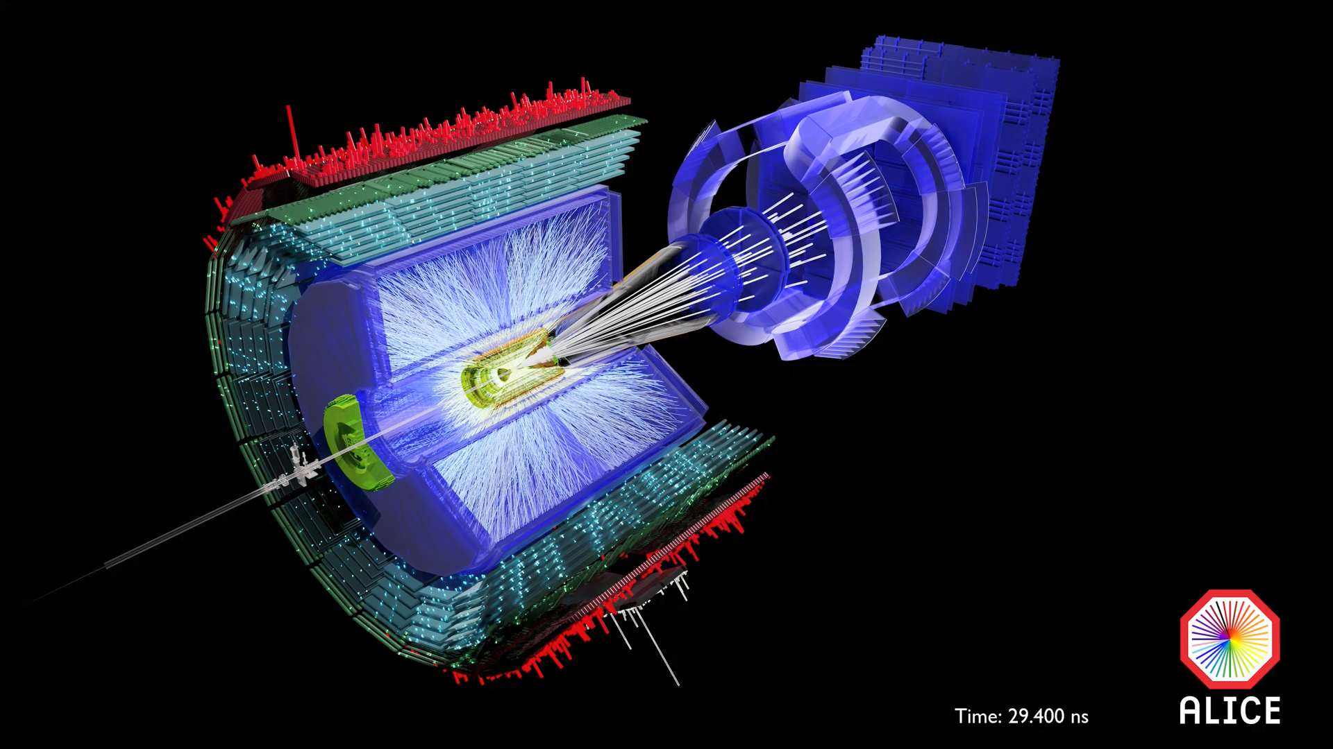
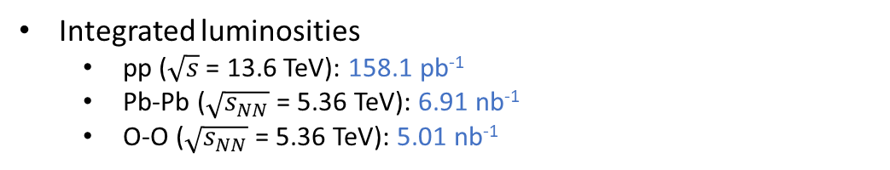
ALICE and ITS2 in Run 3
﻿Integrated luminosities
  pp ($\sqrt{s}$= 13.6 TeV): 158.1 pb⁻¹
  Pb-Pb ($\sqrt{s_{NN}}$= 5.36 TeV): 6.91 nb⁻¹
  O-O ($\sqrt{s_{NN}}$= 5.36 TeV): 5.01 nb⁻¹
Standard interaction rates
  pp: up to 750 kHz
  Pb-Pb: up to 50 kHz
﻿99.6% of pixels active across the detector
  94 chips broken/excluded, 970 k dead pixels and 500 k noisy pixels
  Thresholds and noisy pixels remain stable over time
Sporadic data corruption events do not affect the overall performance
  Dominated by SEU induced issues
  Mitigations implemented in the RU firmware and DCS

Slide 8
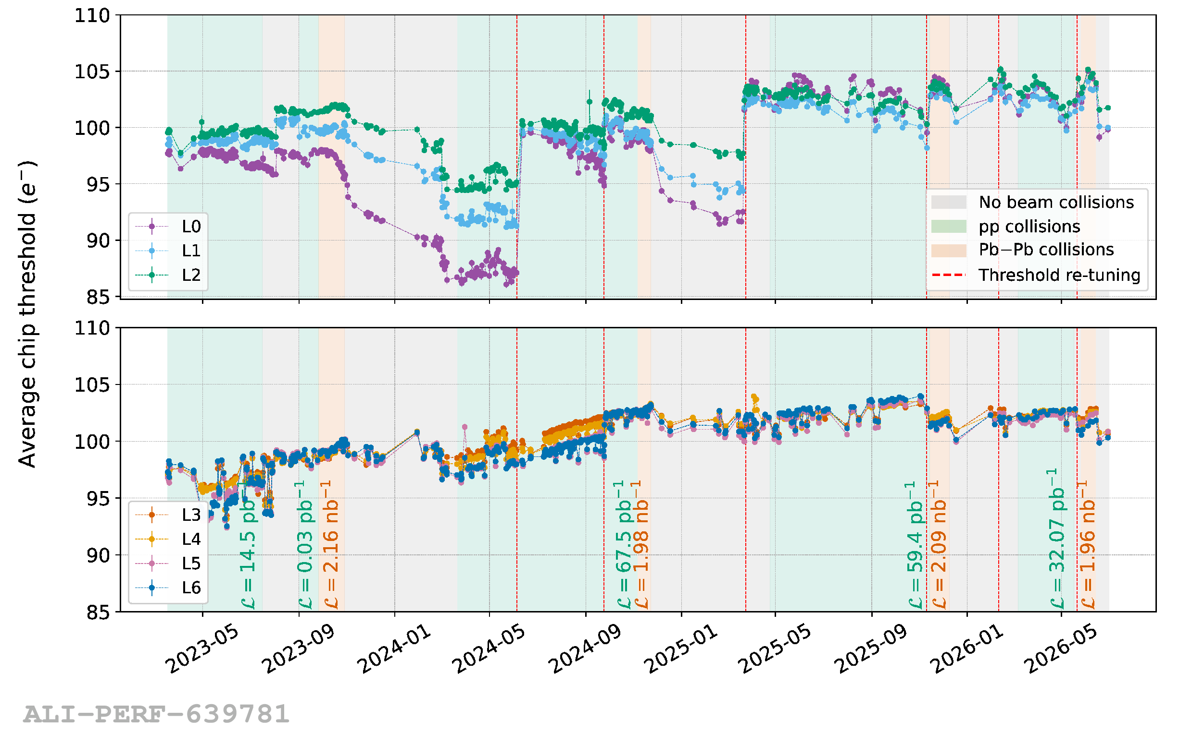
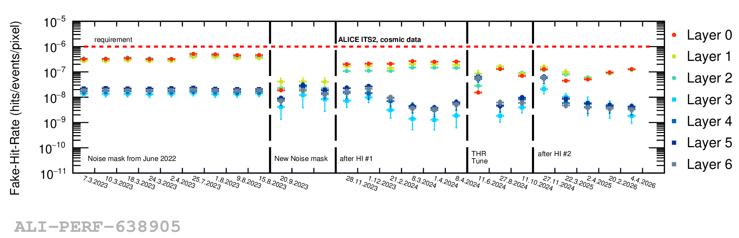
Calibration
﻿Main ITS2 calibrations
  Threshold tuning
  Noisy pixel masking
﻿Threshold & noise re-calibration: ~1/year
Fast threshold scan (﻿~1% pixels) at each beam dump
Full threshold scan (100% pixels): ~1/year
Pixel threshold
Uniform response across the detector achieved (100 e⁻ target)
Threshold stability has been consistently maintained across 24 k chips
  Minor fluctuations due to supply voltage optimizations ​
Noisy pixel
Possibility to run with static masks already proven during surface commissioning
Fraction of masked pixels: 0.004%​
Stable noisy pixel map → occasionally noise calibration is sufficient​

Slide 9
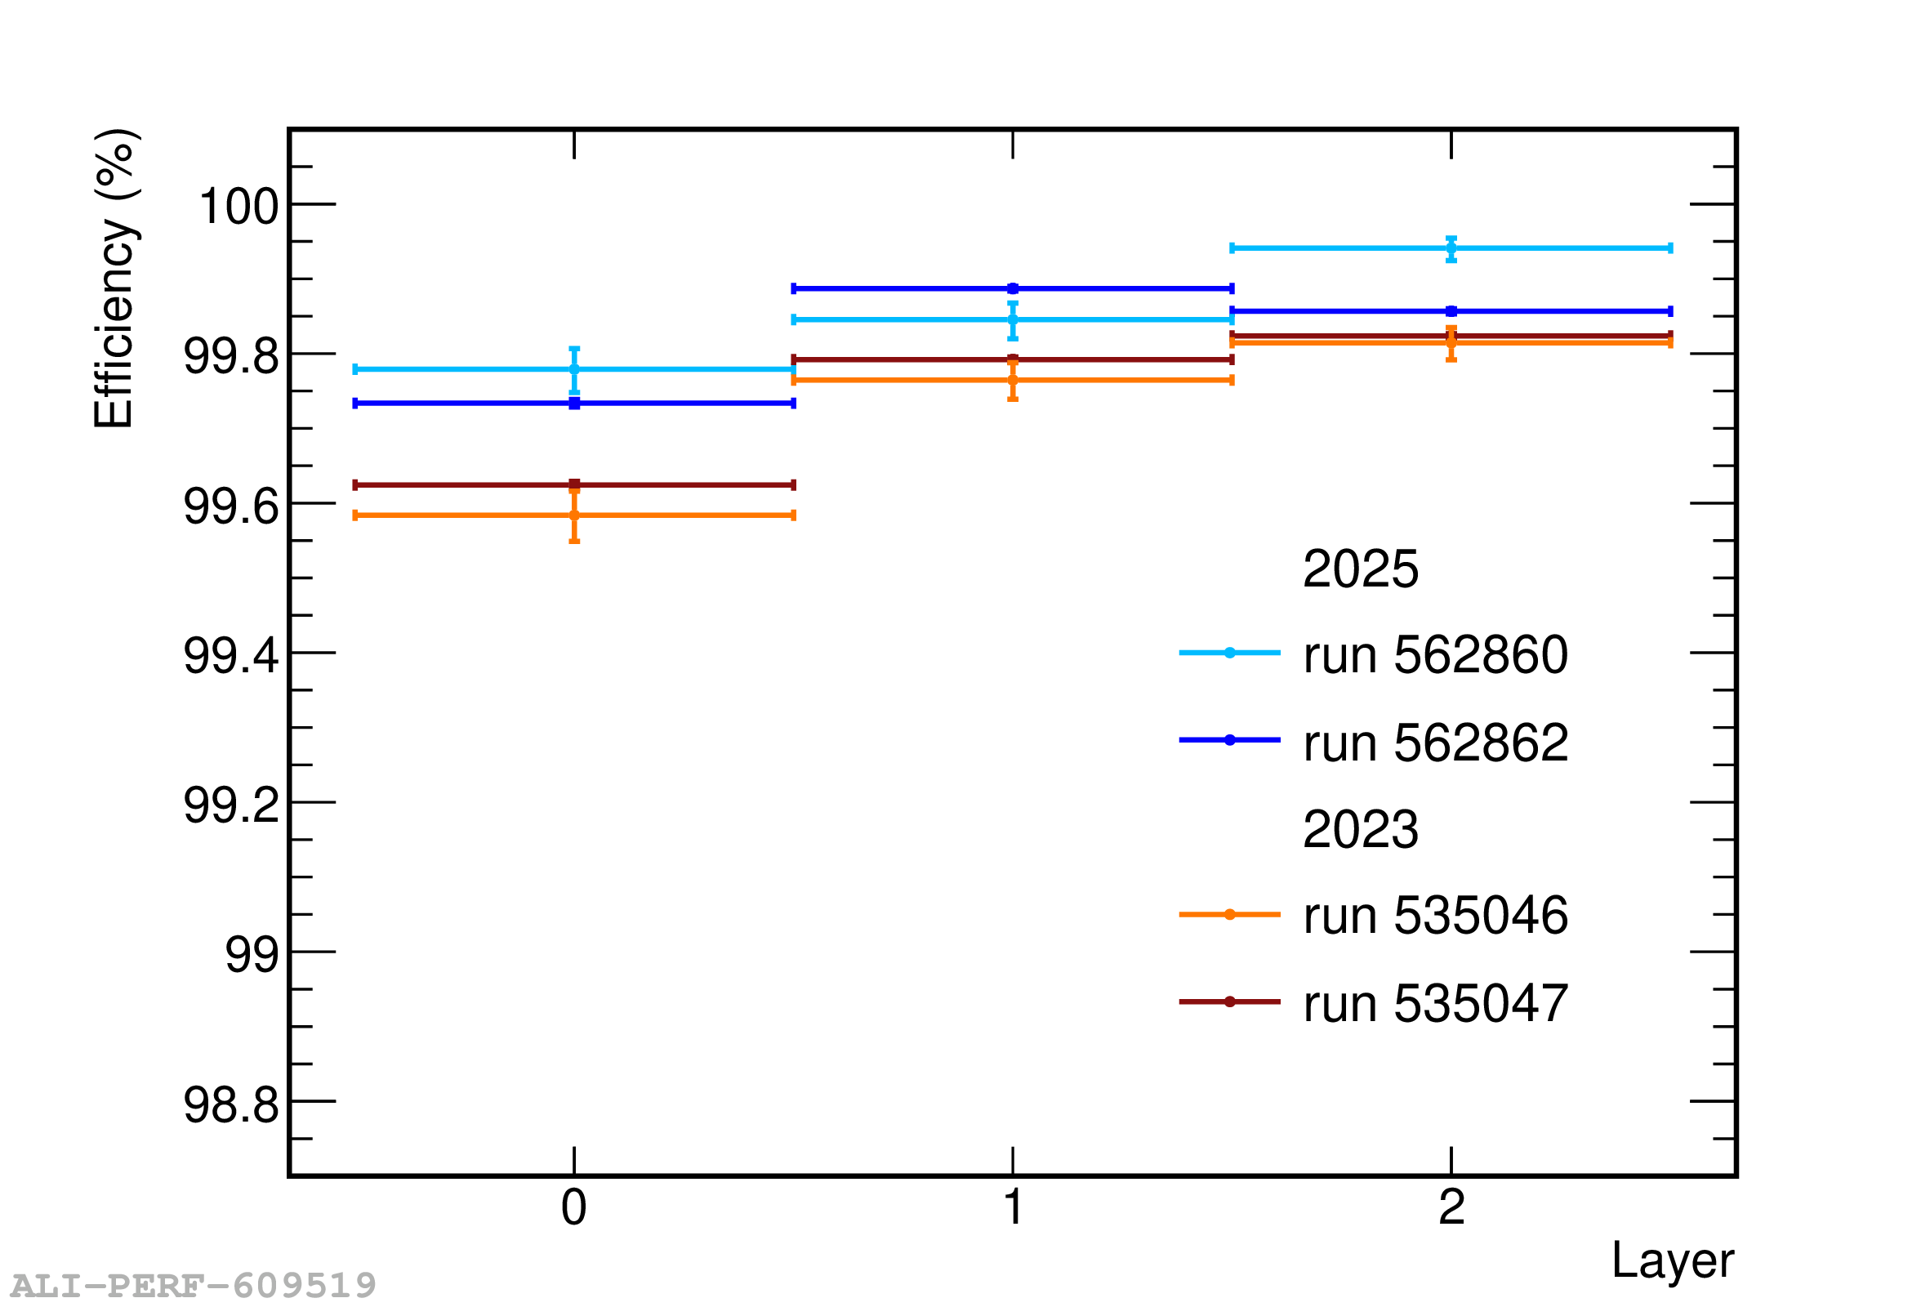
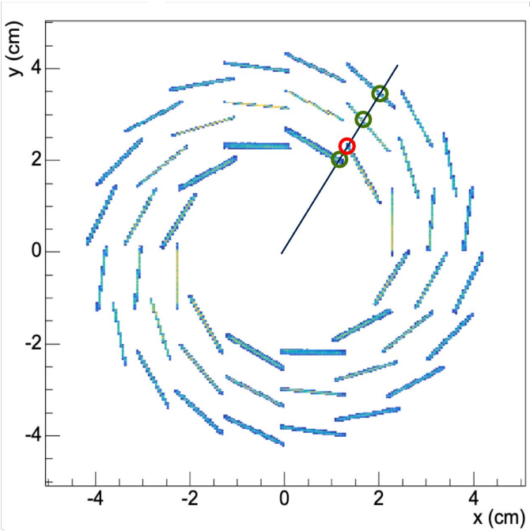
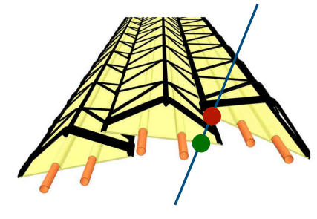
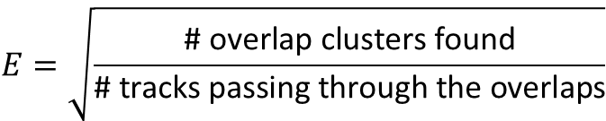
Detection efficiency
$$E=\sqrt{\frac{\text{\# overlap clusters found}}{\text{\# tracks passing through the ove}\text{r}\text{laps}}}$$
Reconstructed tracks in ITS2 do not have missing hits in the central layers
Estimate the ITS2 detection efficiency using the stave overlaps
Efficiency above 99% in all IB layers

Slide 10
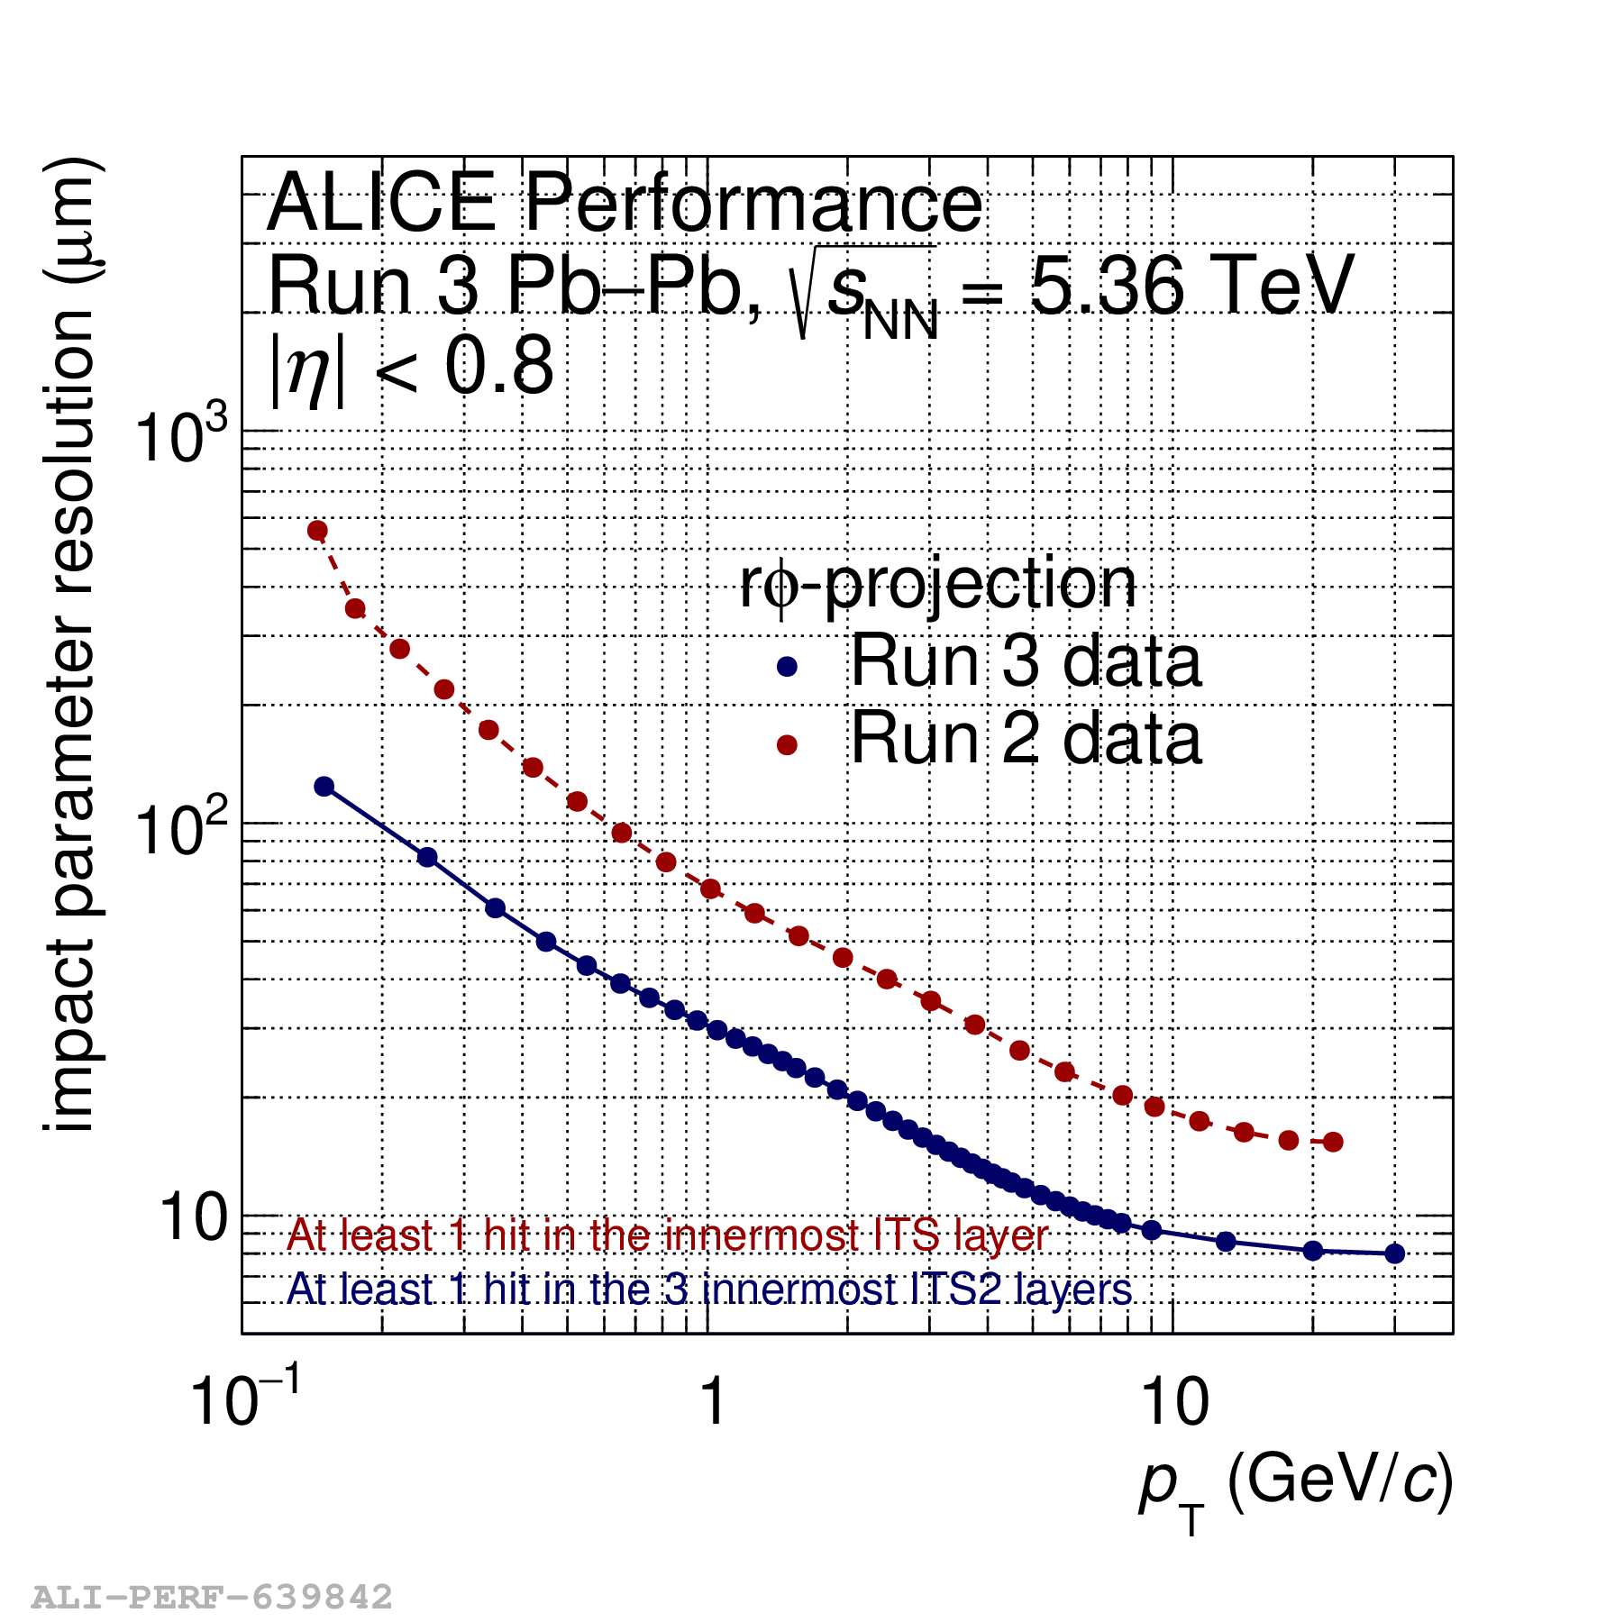
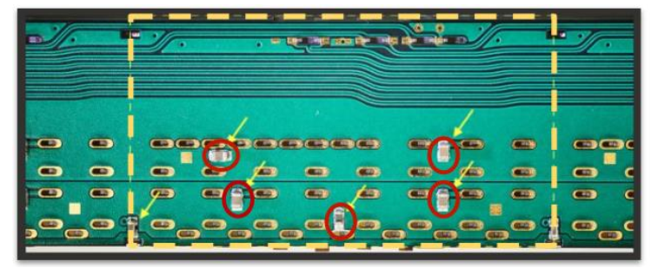
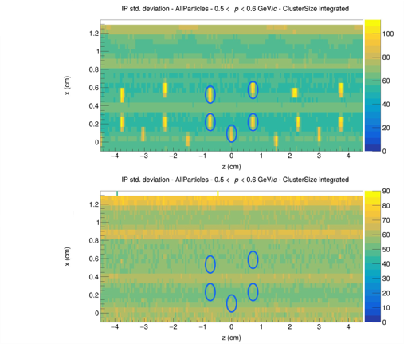
Impact parameter resolution​
Run 3 Pb–Pb data show an approximately 2.2x improvement at p_{T} = 1 GeV/c compared with Run 2
The impact parameter resolution is sensitive to every detail of the detector implementation
Local variations associated with the stave structure are visible in data
Local impact parameter resolution on Layer 0
σ(IP) (μm)

Slide 11
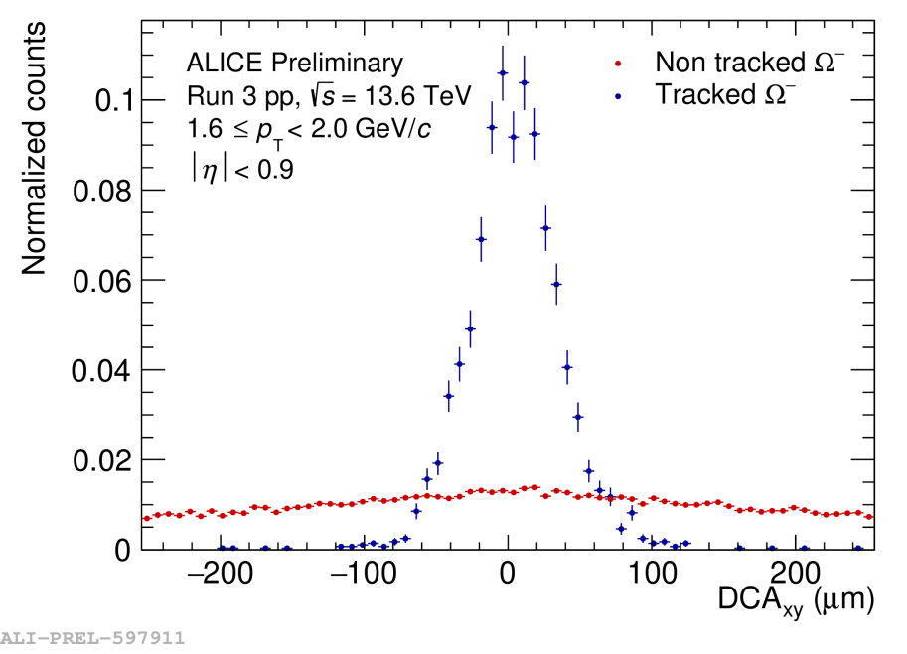
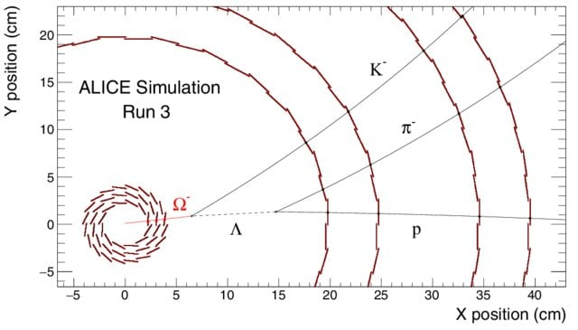
Detection of weakly decaying particles
﻿The three innermost layers lie within 4 cm of the interaction point
﻿Direct tracking of charged weakly decaying particles before their decay via strangeness tracking
  New possibilities of studies: non-prompt cascades, hypernuclei, exotic bound states
Impact parameter resolution of tracked Ω⁻ baryons: more than a factor of ten improvement!

Slide 12
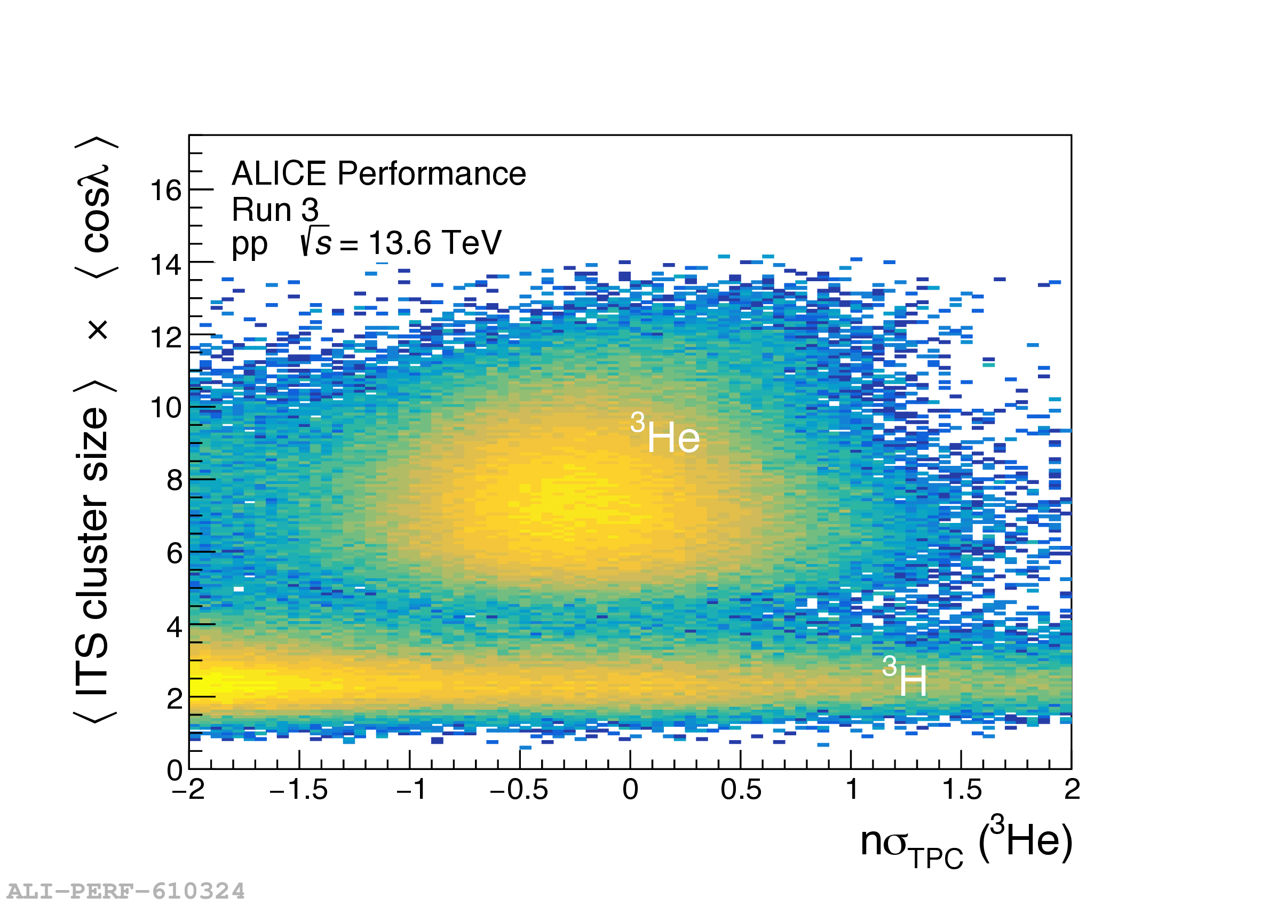
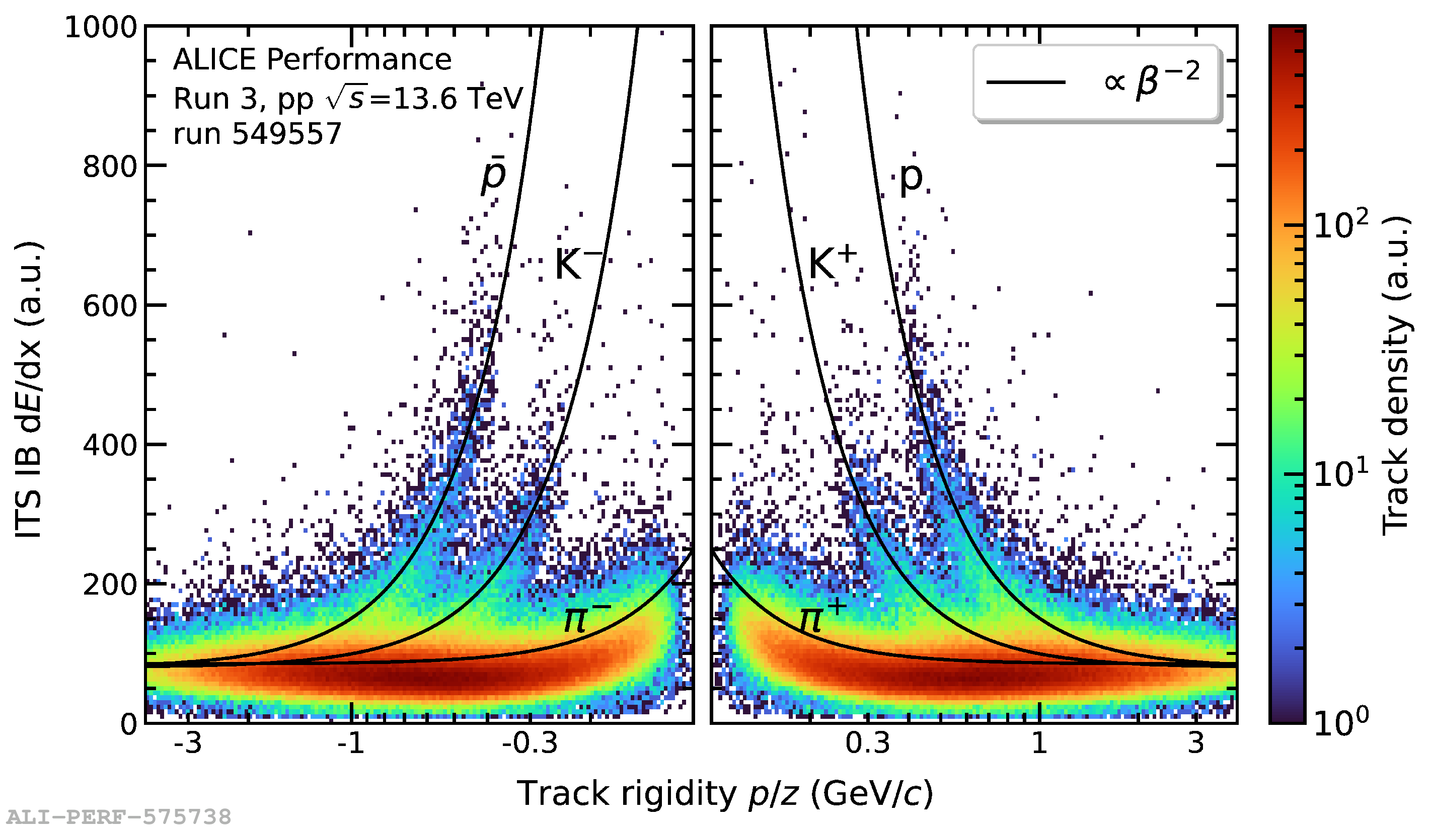
Particle identification
1. Cluster size — spatial information
Available in standard operation
Cluster size reflects track inclination and energy loss → identification of highly ionising nuclei
2. Time-over-Threshold (ToT) — temporal information
Demonstrated in dedicated low-rate runs with special IB configuration
﻿Front-end tuned for charge-proportional analogue pulse length → oversampling ALPIDE response → ToT provides a proxy for dE/dx
Example
  ³He is selected using the TPC
  ITS cluster size can be used to suppress the ³H background
Proof of concept for dE/dx PID with thin (~25 μm) binary-readout MAPS

Slide 13
Lessons learned – high-speed link and powering
Insufficient local voltage stabilisation makes the high-speed link sensitive to supply voltage perturbations
  Exceptionally large events can perturb the supply, shifting the link phase and occasionally causing loss of synchronisation
Additional transmission issues due to radiation-induced corruption
Protocol does not facilitate re-alignment of the data stream after upsets → need to stop triggers
Last power regulation stage 7 m away from the detector → change in operation mode, like stopping triggers, lead to changes in detector power consumption → need to adjust voltages before resetting → complex resynchronization
➔ Involved recovery sequence implemented in DCS
Exceptionally
large event
Supply voltage perturbation
Introduces phase shift on the link
Link/data stream
loses alignment
Insufficient local voltage stabilisation
Gradual trigger-rate ramp-up
avoiding large instantaneous phase shifts
Detector load and
supply voltage change
Adjust voltage
Reset
Resynchronise
Stop
triggers
Final regulation stage
~7 m from detector
Radiation-induced
upset
Data corruption
Transmission upset
RECOVERY SEQUENCE (~10 s)
Automatic recovery in DCS
Simplified view of high-speed link upsets, recovery and mitigation

Slide 14
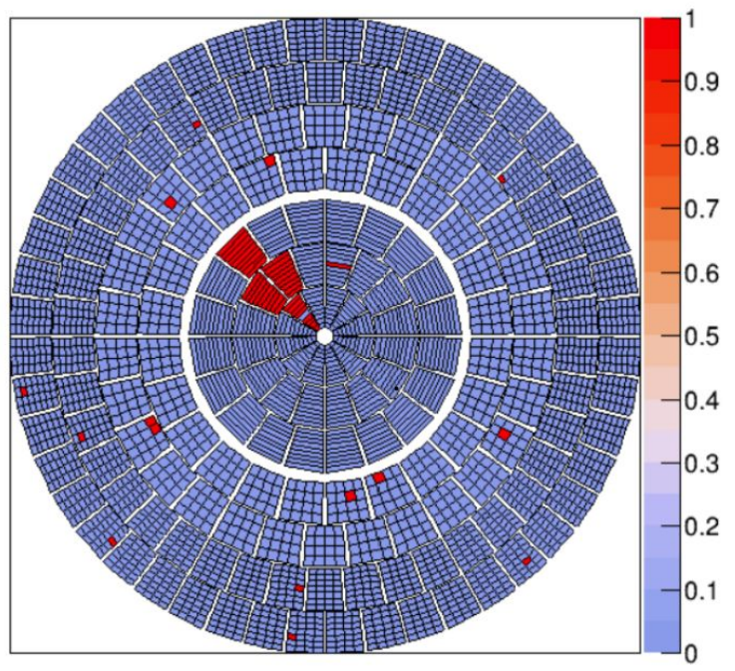
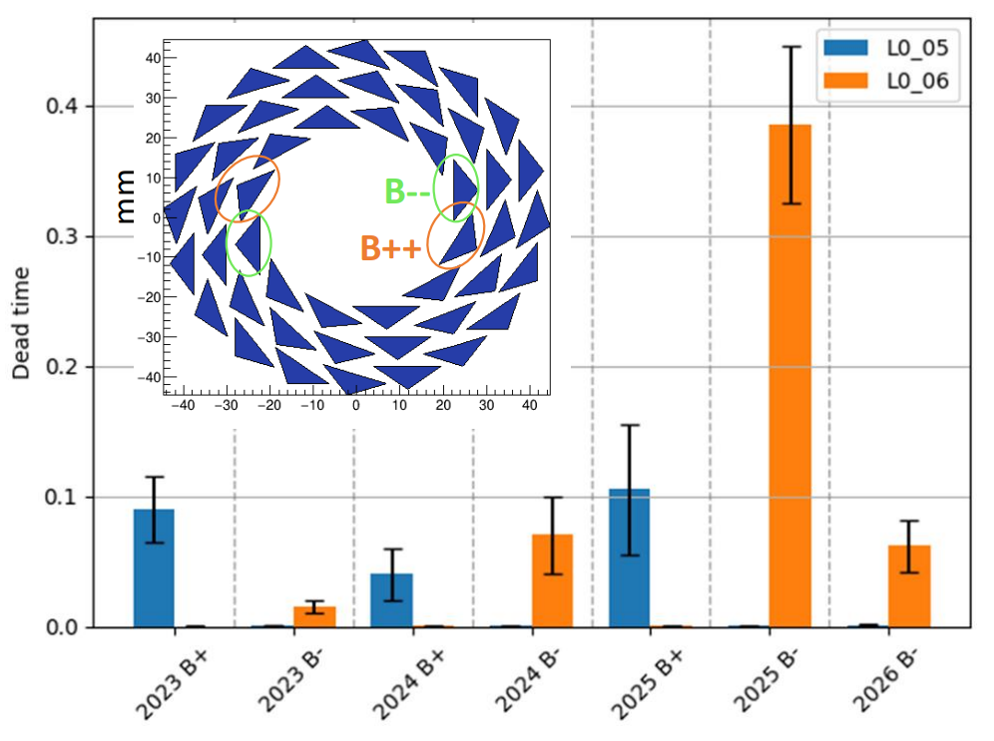
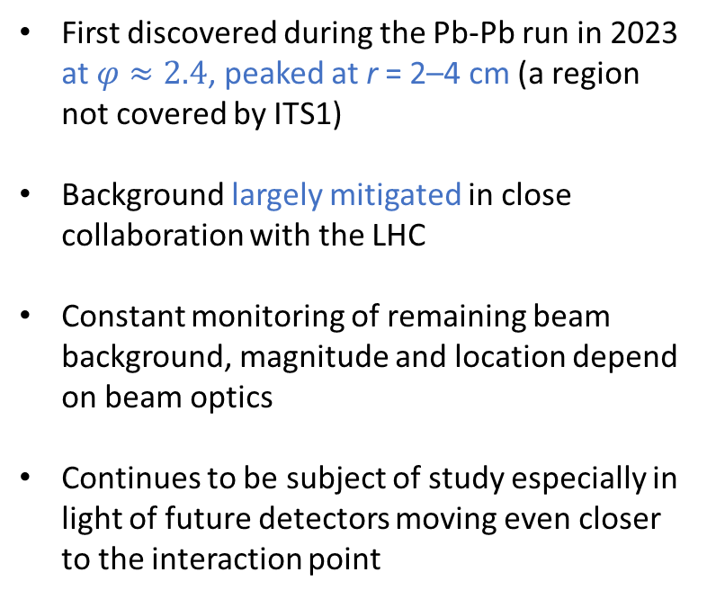
Lessons learned – beam background
First discovered during the Pb-Pb run in 2023 at $φ≈2.4$, peaked at r = 2–4 cm (a region not covered by ITS1)
Background largely mitigated in close collaboration with the LHC
Constant monitoring of remaining beam background, magnitude and location depend on beam optics
Continues to be subject of study especially in light of future detectors moving even closer to the interaction point
L0_05
L0_06
Inefficiency map in Pb-Pb
(before mitigation and at low interaction rate in 2023)
Stave inefficiency time after the mitigation in 2023
Example hit-map in Pb –Pb collisions
~1.5 cm (single chip)
IB stave: ~27 cm

Slide 15
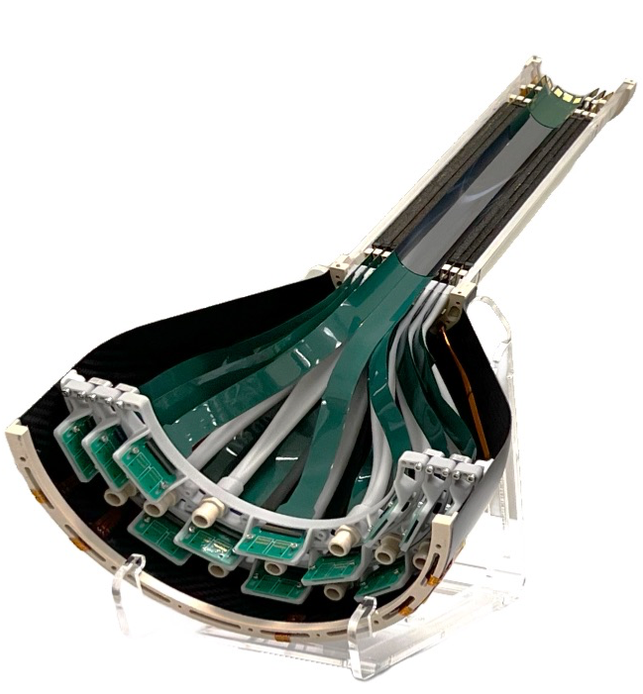
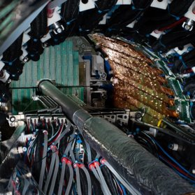
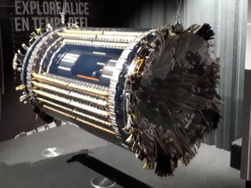
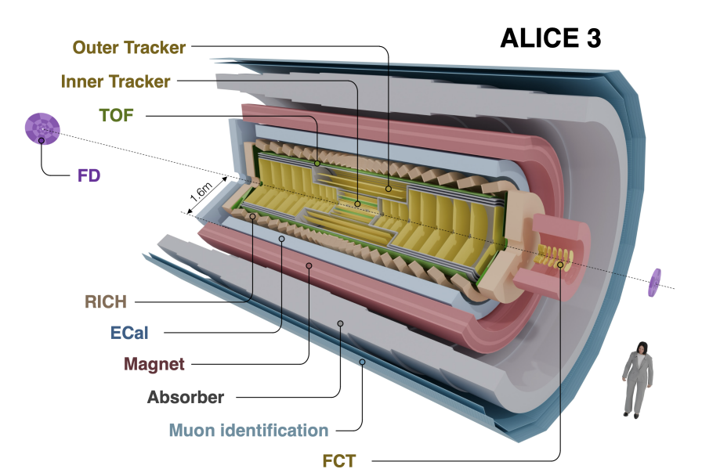
Summary
ITS2, the first MAPS-based detector at the LHC and the largest built for high-energy physics, was installed in ALICE during LS2
  Successful operation throughout Run 3, with stable and efficient data taking since the first day of operation
  Significantly improved tracking capabilities, impact parameter resolution of 30 μm at p_{T} = 1 GeV/c
  ﻿Proof of concept for highly ionising particle identification using cluster size in standard operation as well as dE/dx via time-over-threshold information in special runs
Operational lessons learned from Run 3 are being leveraged to guide the ITS3 and ALICE 3 upgrades
ITS3
See Umberto Savino’s talk Wednesday morning: "Design and Performance of Fast Analog Pixel Test Structures for the ALICE ITS3 Upgrade"
See Kshitij Agarwal’s talk Thursday morning: "ALICE 3 Inner Tracker: Design and Developments"
ITS1
ITS2
See Alessandro Sturniolo’s poster Thursday morning: "Testing of Analogue Pixel Test Structures for the ALICE 3 Inner Tracker"

Slide 16
Backup

Slide 17
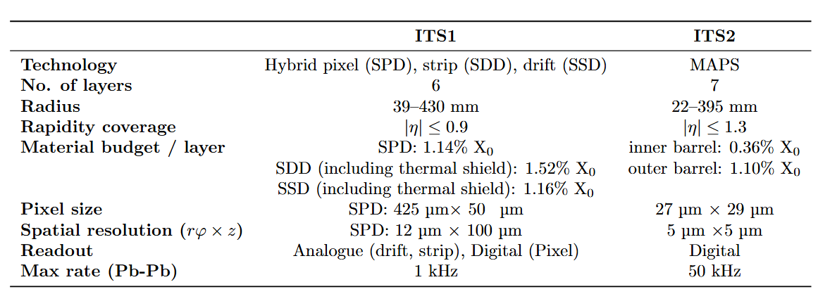
ITS1 vs ITS2
SPD: Silicon Pixel Detector
SDD: Silicon Drift Detector
SSD: Silicon Strip Detector

Slide 18
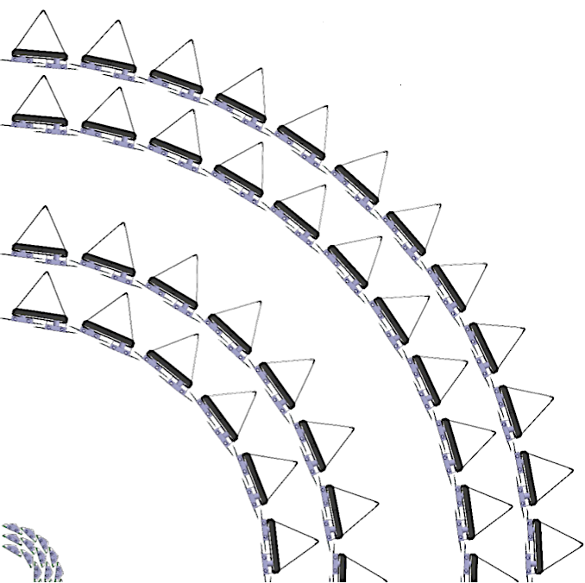
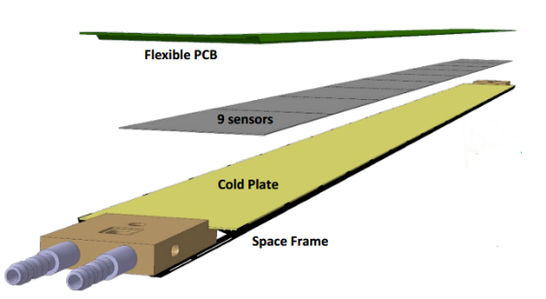
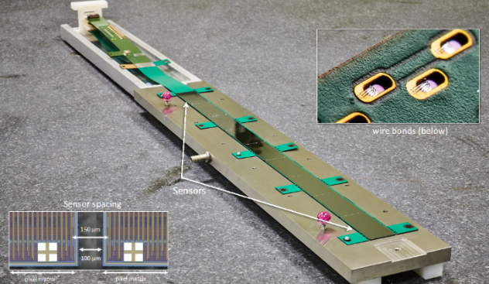
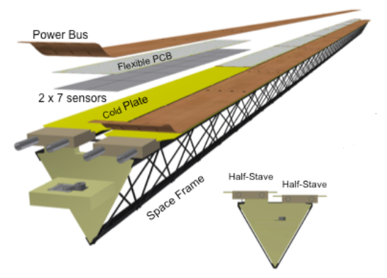
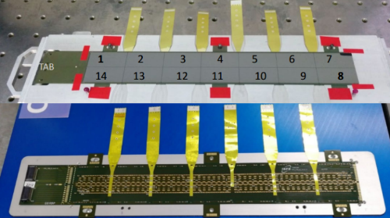
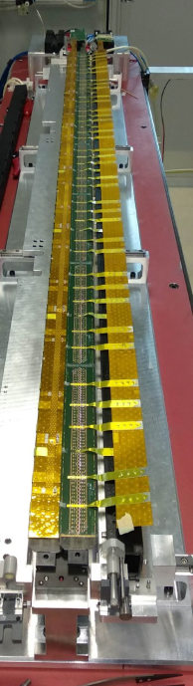
ITS2 Barrels
48
6
42
5
30
4
27 cm
24
3
IB HIC
IB stave
20
2
OL
16
1
12
0
Stave
Layer
IB
Staves Layer
OB
Inner Barrel (IB):
Hybrid Integrated Circuit (HIC): 9 sensors glued onto Al Flexible Printed Circuit (FPC)
Wirebonds electrically connect FPC to chips
Stave: a HIC glued onto cold plate and space frame
Each sensor is read out individually
ML
OB Stave
OB HIC
Outer Barrel (OB):
OB HIC:
  7x2 sensors (2 rows) glued onto Cu FPC
  Power delivered via 6 Al cross-cables soldered to the FPC
  Data and control are transferred through 1 master chip per row
OB stave:
  4x2 HICs (for ML) or 7x2 HICs (for OL) glued onto cold plate and space frame
OL stave

Slide 19
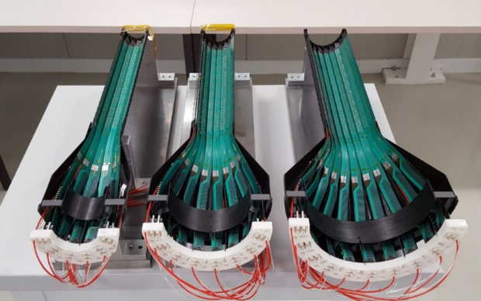
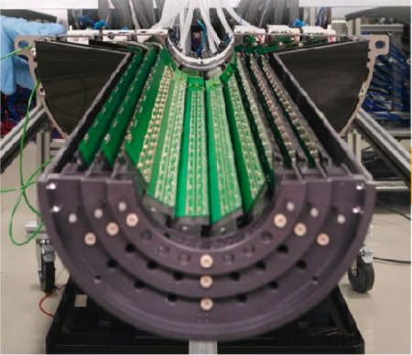
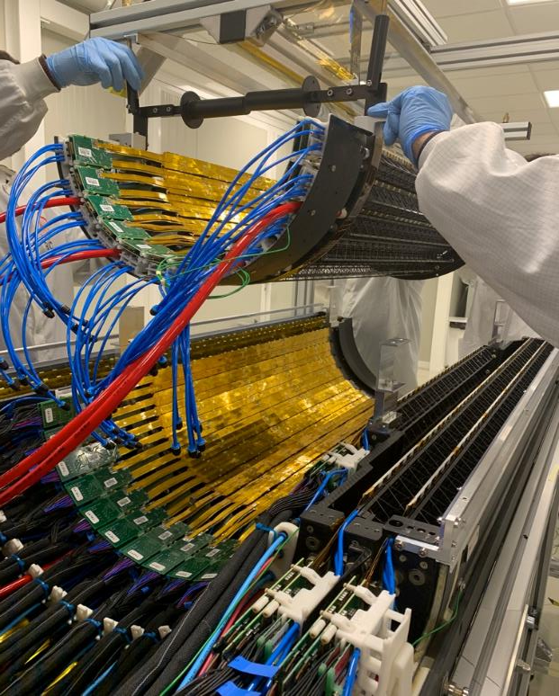
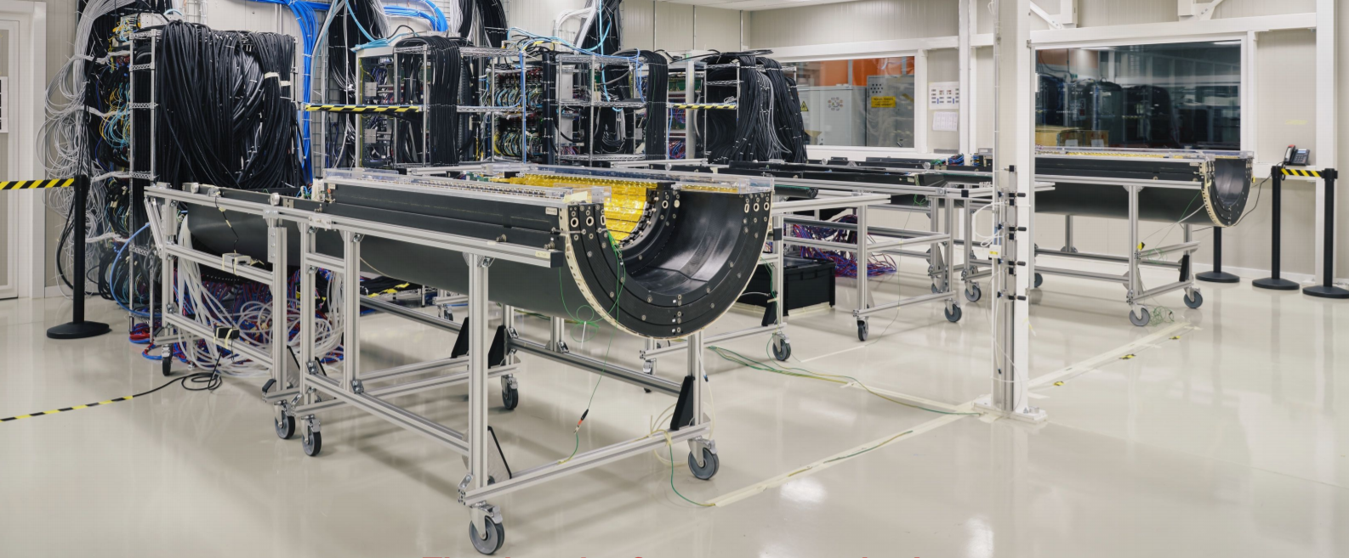
Layer and Barrel Assembly
Inner Barrel assembly
Outer Barrel assembly
Inner half-layers
Middle half-layer3
Inner half-barrel
Services
Middle half-layer4
Outer half-layer5
Outer half-layer6
IB-Bottom
OB-Bottom
OB-Top
IB-Top
On-surface commissioning lab
Detector fully assembled in Dec. 2019

Slide 20





Installation
MFT
OB L3
OB-Bottom being loaded to mini-frame
OB-Bottom being positioned
IB-Bottom
Beam pipe
OB installation completed – mid March 2021
IB installation completed – mid May 2021
IB being installed
IB installed

Slide 21


DCS and safety system
DCS
  User interface (UI) developed in WINCC OA SCADA
  Logics implemented as a Finite State Machine (FSM)
  Detector operation and monitoring
    Control the detector itself and its infrastructure, like RU/PB and cooling system
    Monitoring > 100 k data points with data archiving
    Automatic in-run recovery maximizes detector acceptance and data-taking efficiency
ITS2S
  Independent safety system
  Interlocks CAEN power channels based on stave temperatures and cooling plant loop status
FSM
Main UI
RU counters monitoring

Slide 22


Time-dependent acceptance maps
Various factors can lead to the loss of ITS2 high-speed links during data taking (refer to slide #13)
The DCS in-run recovery process typically requires approximately 10 s to restore them
These inefficiencies are reflected in the cluster and track distributions
A dedicated online calibration workflow has been implemented to monitor inefficient chips → enabling the generation of time-dependent acceptance maps → reproducible in Monte Carlo simulation

Slide 23


Tracking
Excellent performance in both pp and Pb-Pb runs with the current updated detector alignment
  Good angular distribution of tracks
  Time-dependent ﻿acceptance maps accurately describe acceptance loss in MC simulations
No specific cut on p_{t} is applied
No specific cut on p_{t} is applied

Slide 24

Online/Offline (O²)
Targeting to record large minimum-bias sample
All collisions stored for main detectors with continuous readout in combination with triggered detectors
Extreme online data compression (~3.4 TB/s → ~0.1 TB/s) → GPUs to speed up online (and offline) processing
First level processors (FLP)
  Readout of detectors (3 TB/s) and raw data processing
  200 nodes in total
Event processing nodes (EPN)
  Synchronous/asynchronous event reconstruction
  280 nodes each with 8 GPUs (extending to 350 nodes)

Slide 25


Calibration
IB
OB
Uniform response across the detector achieved (100 e⁻ target)
OB masking: pixels with 10⁻⁶ hits/event​
IB masking: 10⁻² hits/event → almost no masking → prioritization of efficiency over data rate reduction​
​
100 e⁻
Noisy pixels

Slide 26

ALPIDE continuous readout mode

Slide 27

High-speed link phase offset
ALPIDE high-speed link phase offset measurement

Slide 28



Beam background: dominant source and mitigation
Main source was identified in 2023
²⁰⁷Pb⁸²⁺ produced in IR7 collimation
Their displaced trajectory led them to strike the bottom jaw of B1 tertiary collimator in IR2
The resulting particle shower crossed ITS2 at shallow angles
Mitigation
A dedicated orbit adjustment (modifying vertical dispersion - “on_disp” knob) moved the secondary-ion trajectory away from the tertiary collimator
The dominant background contribution was largely suppressed; only the first ~10% of the 2023 data were affected
Smaller residual background remains under monitoring
Before mitigation: ²⁰⁷Pb⁸²⁺ ions hit the tertiary collimator
After mitigation: ions miss the collimator

Slide 29






ITS3
Replacing the 3 innermost layers with new ultra-light, truly cylindrical layers
Reduced material budget (from 0.36% to 0.09% X₀ per layer) with a very homogenous material distribution by removing water cooling, circuit boards and mechanical support
Closer to the interaction point (from 23 to 19 mm)
ITS3
ITS2 Inner Barrel
Improved vertexing performance and reduced backgrounds for heavy-flavour signals and for low-mass dielectrons
ITS2
ITS3

